Slide 1

National Park Service
U.S. Department of the Interior
Air Resources Division
Source Apportionment Modeling to Support Regional Haze Rule Planning in the Western U.S.
Michael Barna, National Park Service, Air Resources Division, Fort Collins, CO
Ralph Morris, Ramboll, Novato, CA
Tom Moore, Regional Air Quality Council, Denver, CO
Gail Tonnesen, U.S. Environmental Protection Agency, Region 8, Denver, CO
Kevin Briggs, Colorado Department of Public Health and Environment, Denver, CO
CMAS Conference 2023
Chapel Hill, NC
October 16-18, 2023
E X P E R I E N C E Y O U R A M E R I C A

Slide 2
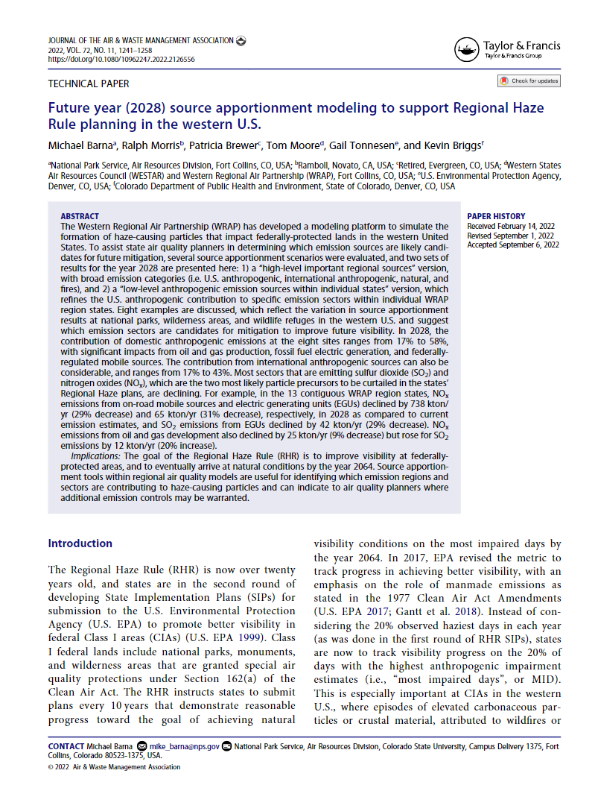
Introduction
Western Regional Air Partnership (WRAP) used CAMx source apportionment modeling to support the 2nd round of Regional Haze Rule (RHR) State Implementation Plans (SIPs)
2nd round of RHR SIPs vs. the 1st round:
  ‘Impaired’ v. ‘worst’ (to minimize the role of fires)
  Isolate the impact of US anthropogenic SO2 and NOx
  Account for international contributions
  Some changes in the emission source mix
    Significant reductions in SO2 and NOx
    Coal fired EGU emissions decreasing
    Oil and gas emissions increasing
Barna et al., 2022, JAWMA, DOI: 10.1080/10962247.2022.2126556

Slide 3
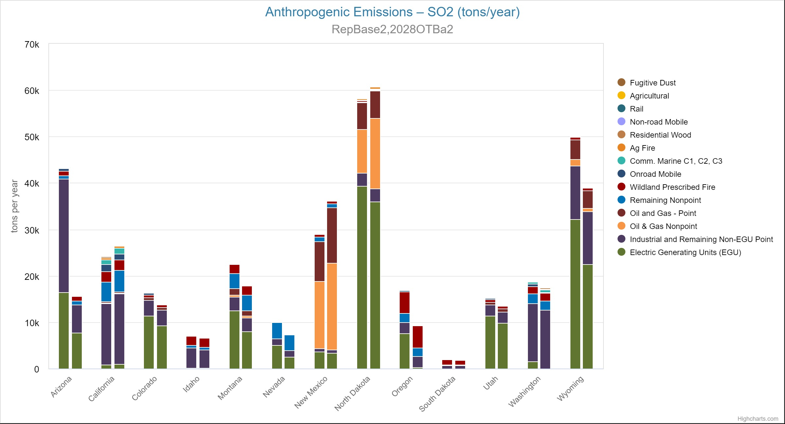
SO2 emissions: ‘current’ (2014-2018) v. future (2028)
Reductions, but not as much as NOx
  Current: 316k tons SO2
  2028: 268k tons SO2
EGU SO2 continues to decline

Slide 4
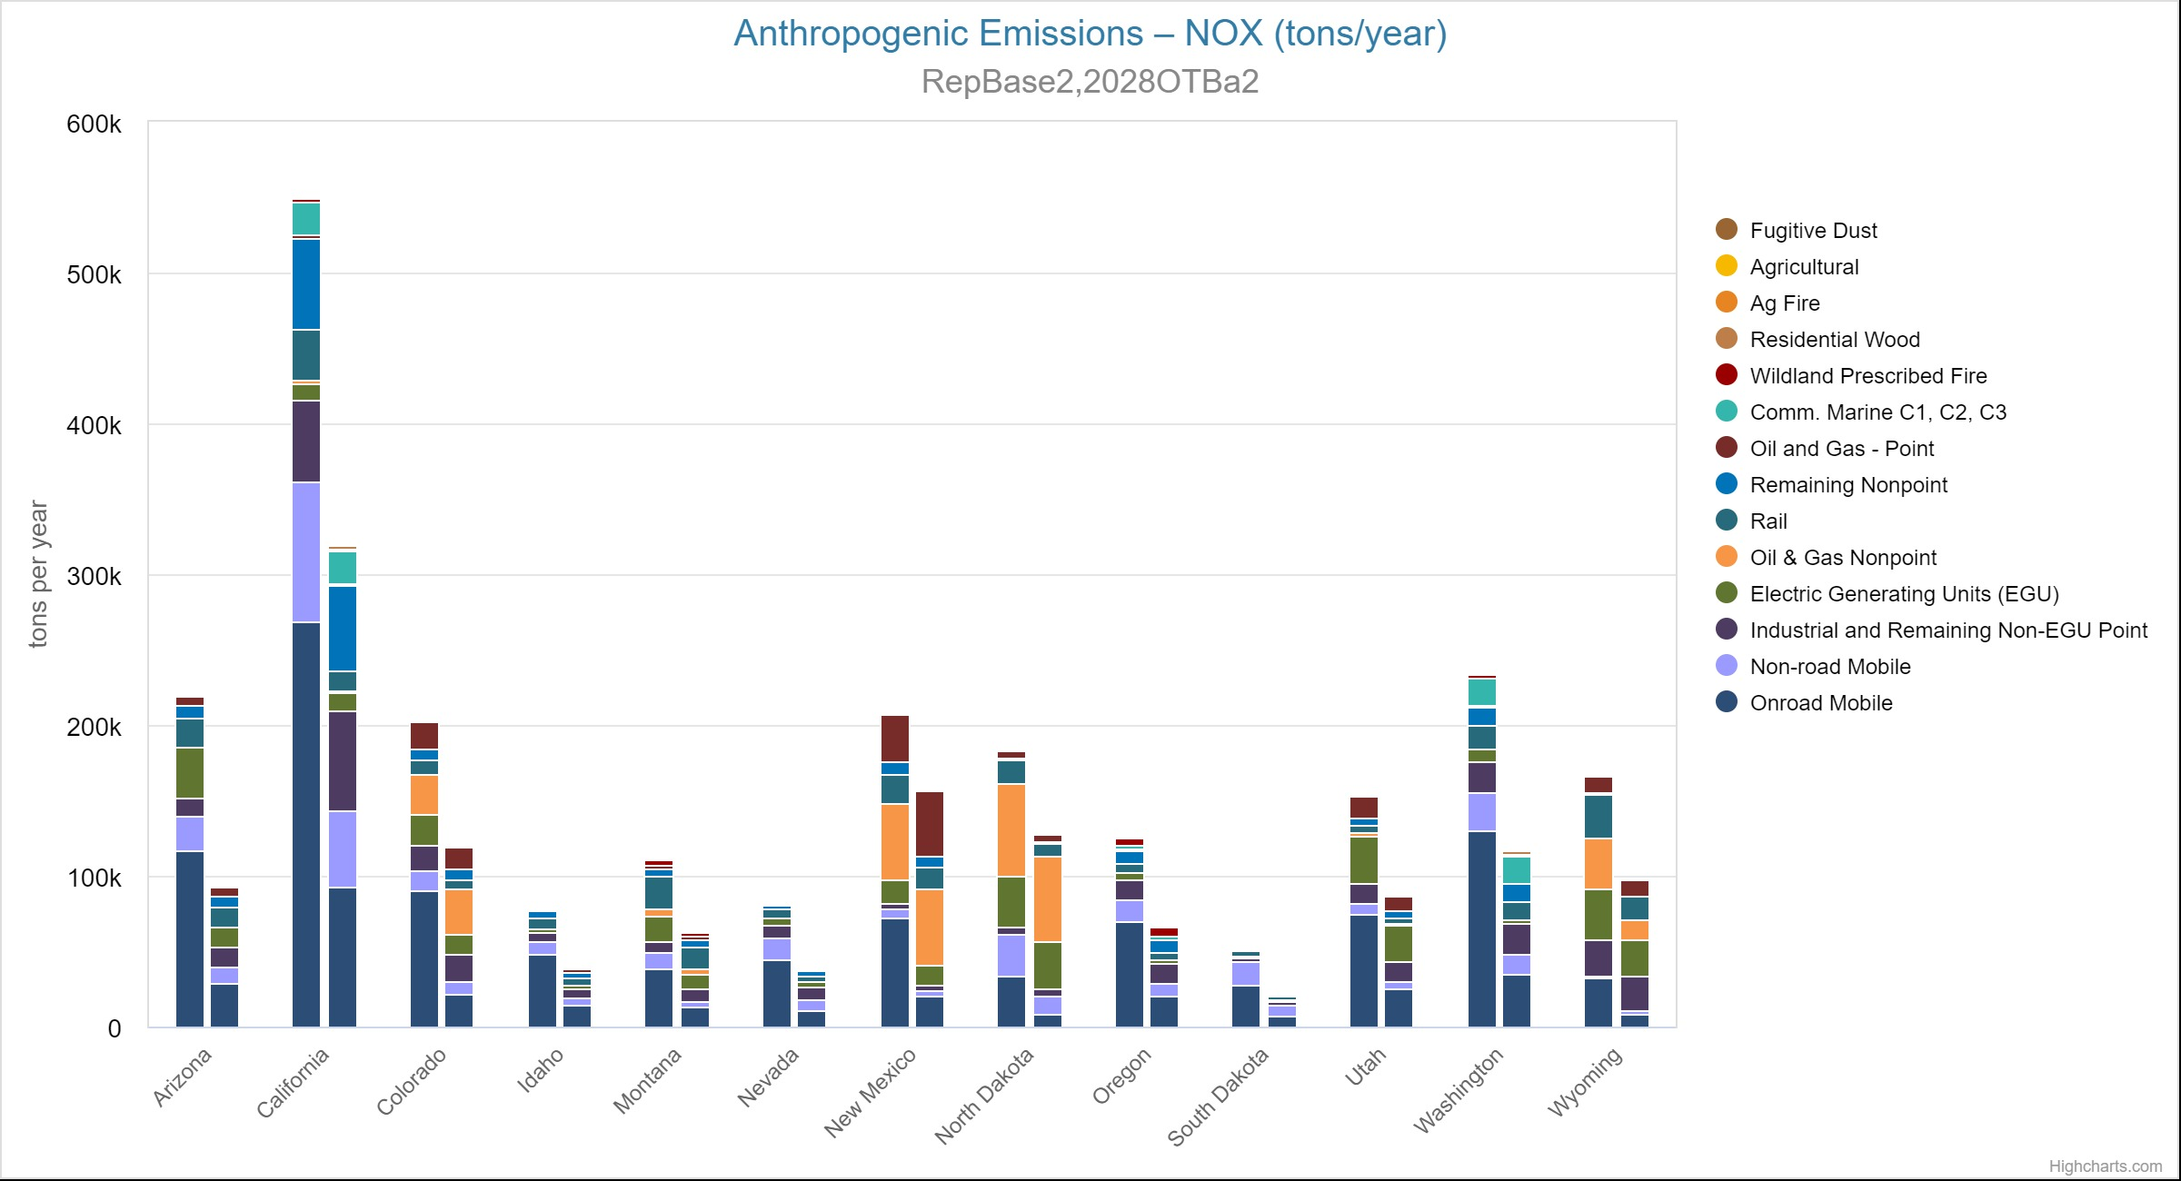
NOx emissions: ‘current’ (2014-2018) v. future (2028)
Significant reduction
  Current: 2.4M tons NOx
  2028: 1.4M tons NOx
Most sectors are going down, especially onroad mobile
Oil & gas contribution can be significant

Slide 5
Steps in developing a CAMx source apportionment
Decide on the ‘current year’
  Is it representative with regard to meteorology and air quality?
  WRAP considered 2014, 2015, 2016; chose 2014 as ‘most typical’
Evaluate the performance of this 2014 base case
  Is the model’s skill adequate?
Smooth out the year-to-year emissions variability
  Average emissions for 2014-2018
  This ‘representative baseline’ is our estimate of current year visibility
Project the emissions to the future year of 2028
  Emissions will change between the representative baseline and 2028
  How does visibility respond to these (typically lower) future emissions?

Slide 6
Source apportionment with CAMx PSAT
Regional air quality models like CAMx can ‘tag’ emissions and follow their evolution as they are transported and transformed in the atmosphere
  PSAT: ‘particulate source apportionment technology’
Emissions can be tagged with respect to
  Region (e.g., an individual state)
  Sector (e.g., mobile or oil & gas)
The result is an hourly estimate of which emissions are responsible for downwind pollutant impacts for each grid cell
  Specifically, look at particulate sulfate and nitrate concentrations
The aim is to identify which emissions could be reduced to improve visibility at western Class I areas

Slide 7
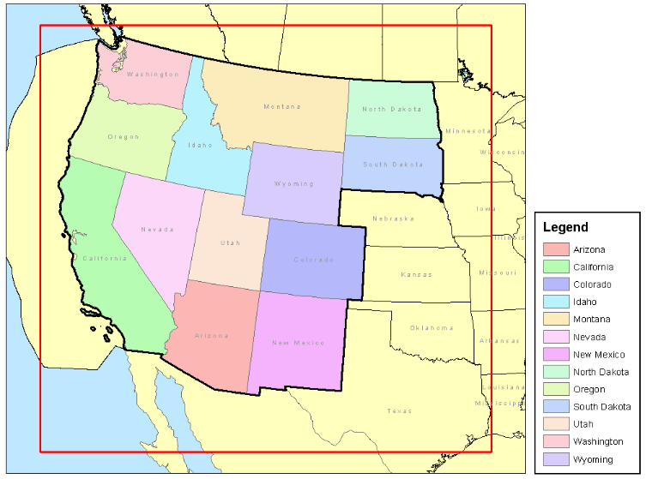
‘High level’ and ‘low level’ source apportionment runs
High level
  look at broad categories of emissions
    US anthropogenic
    International
    Natural
    Wildfire
Low level
  refine the US anthropogenic category to examine SO2 and NOx emissions by sector and state
    EGU point
    Non-EGU point
    O&G
    Mobile
    Other anthropogenic
    Fires

Slide 8
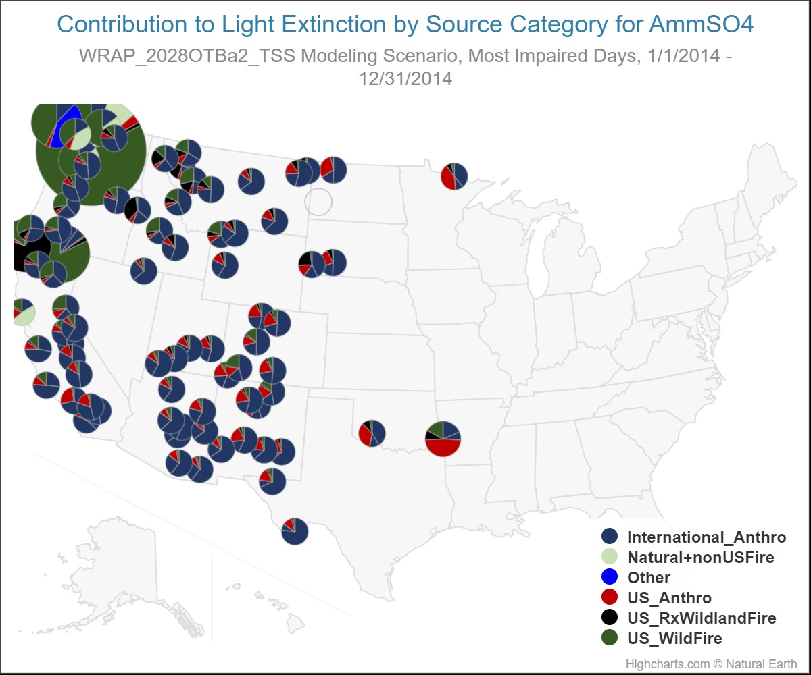
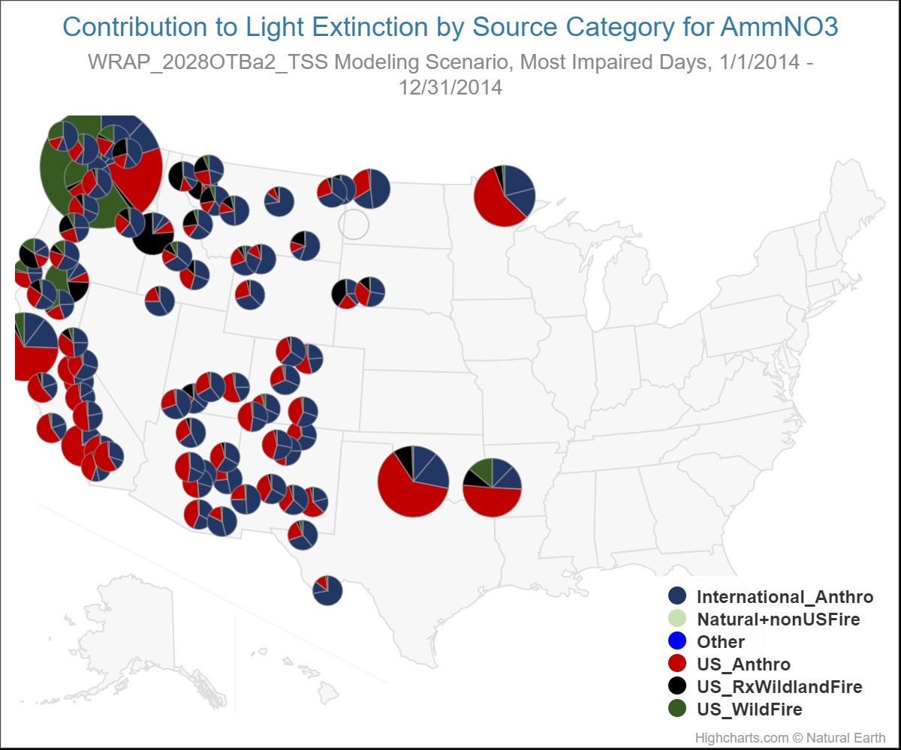
High level source apportionment
Sulfate
Nitrate

Slide 9
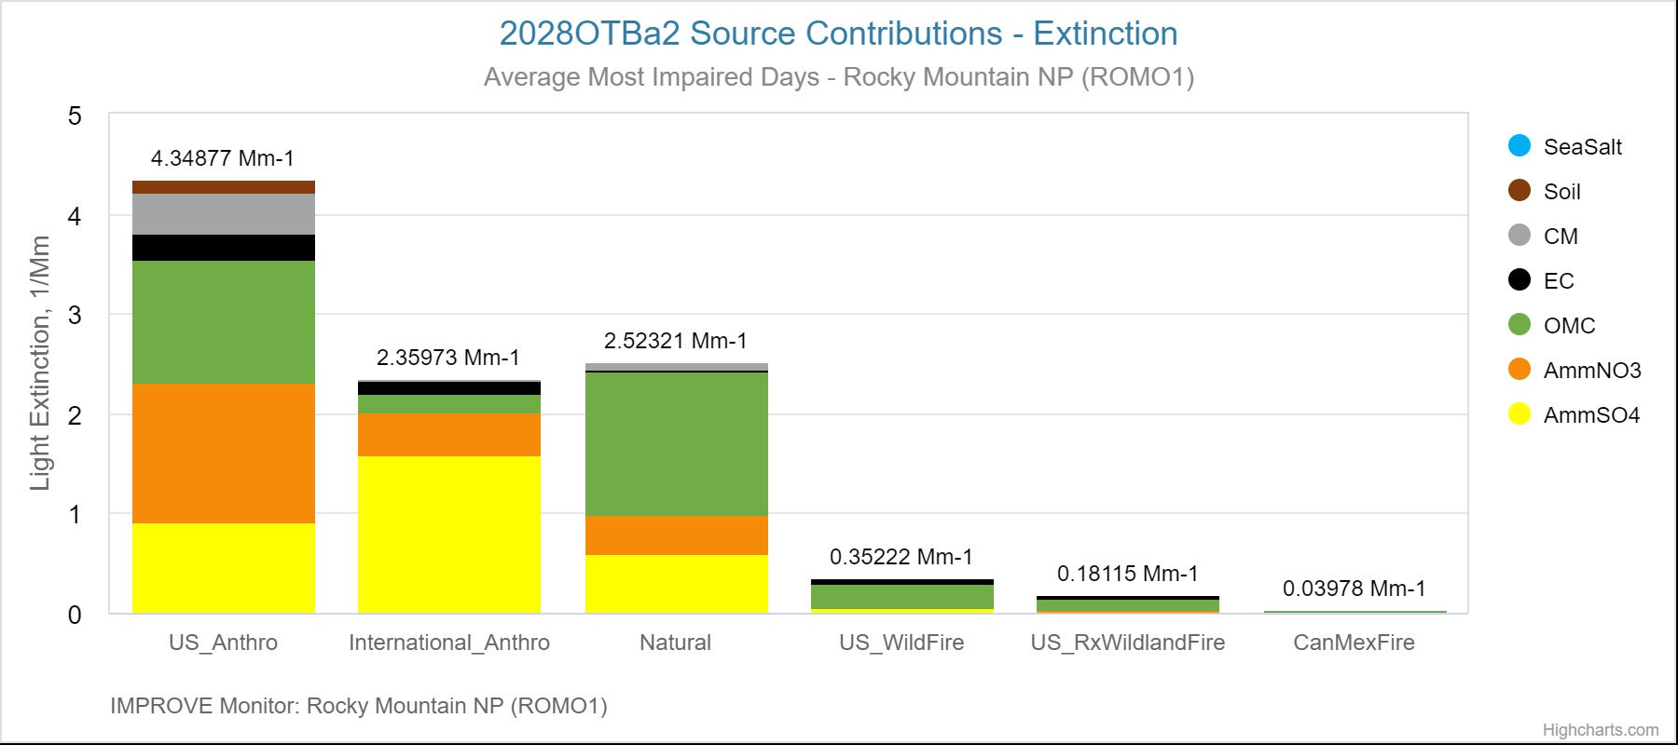
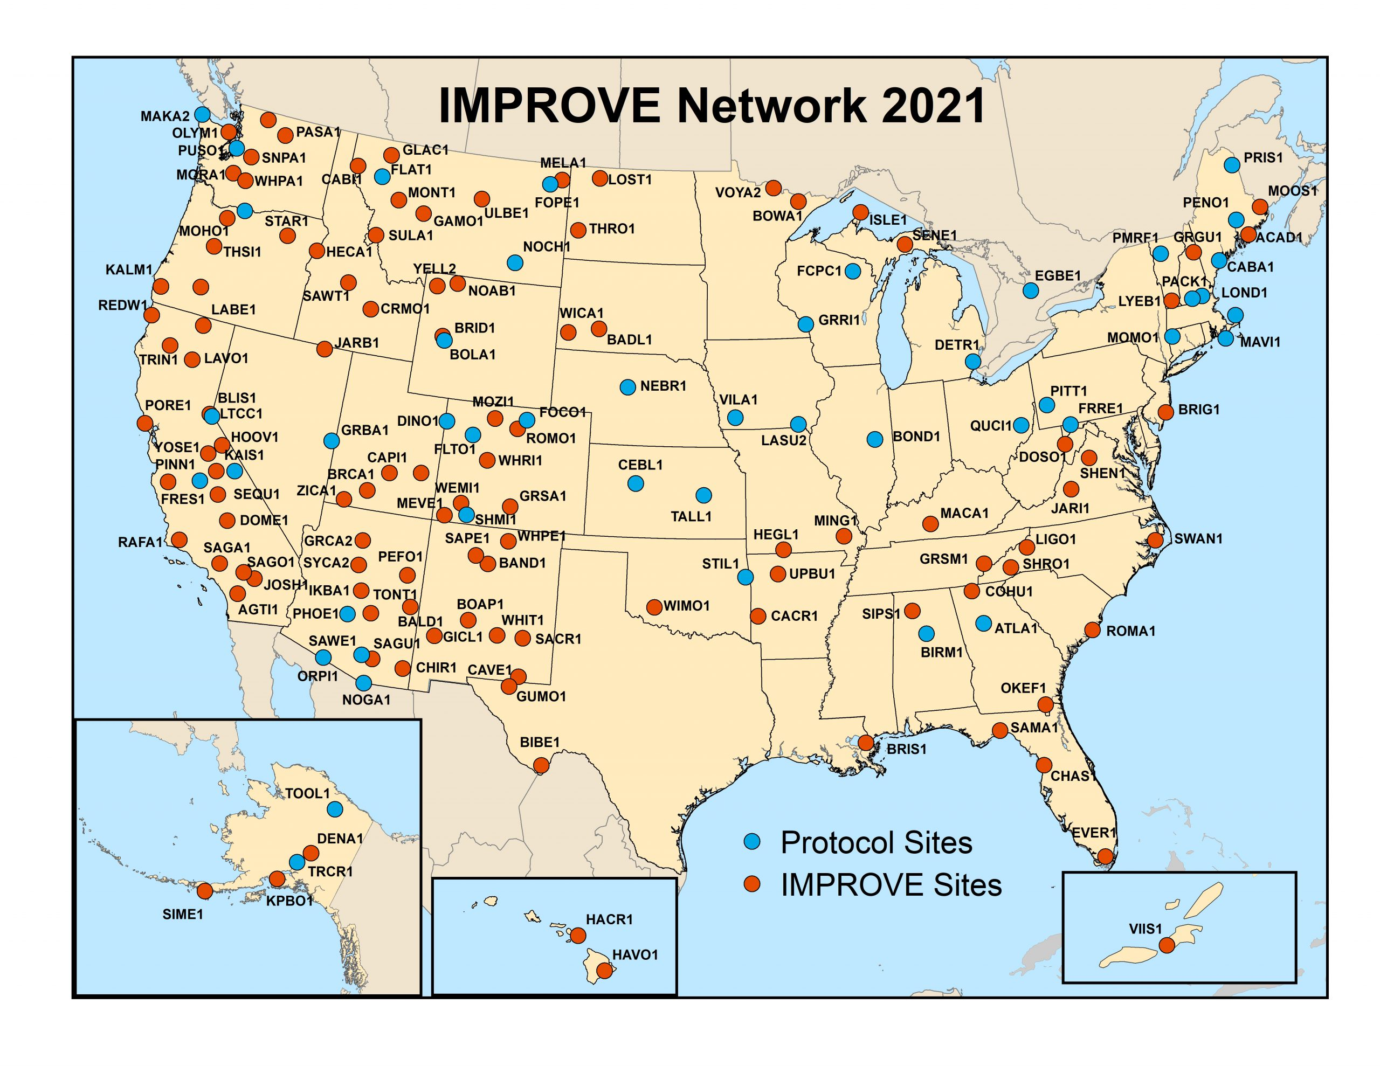
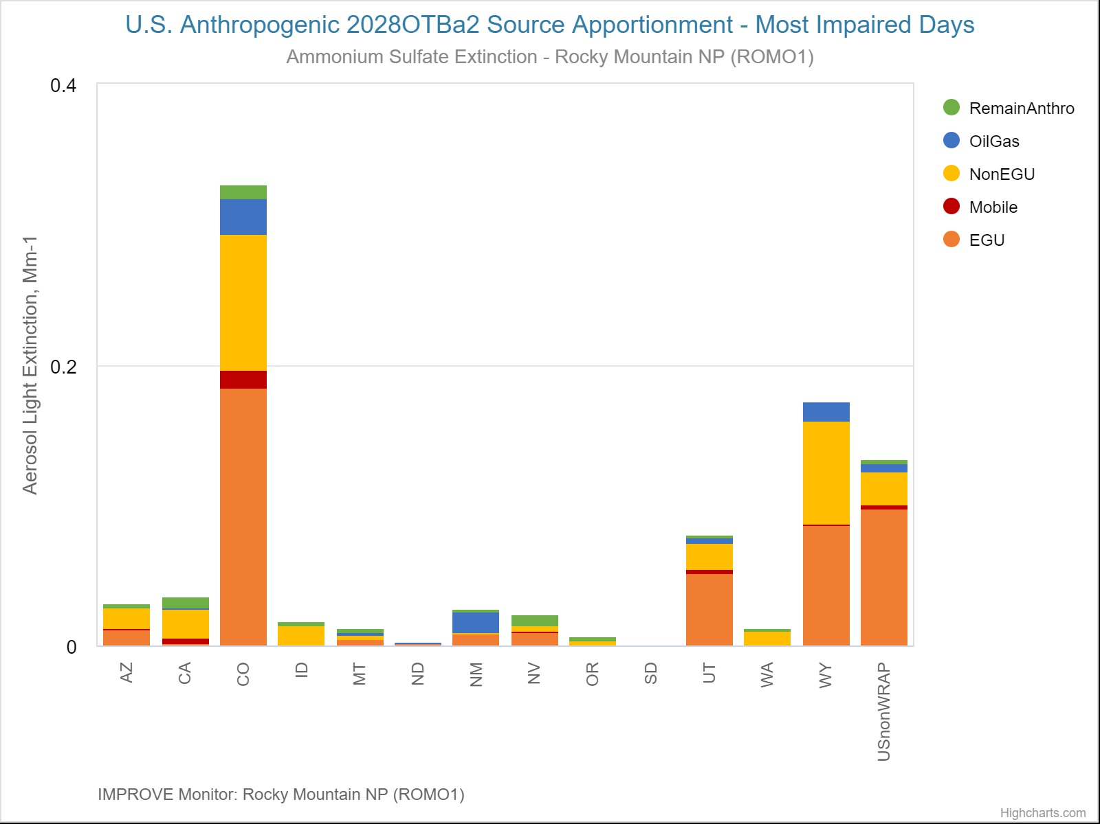
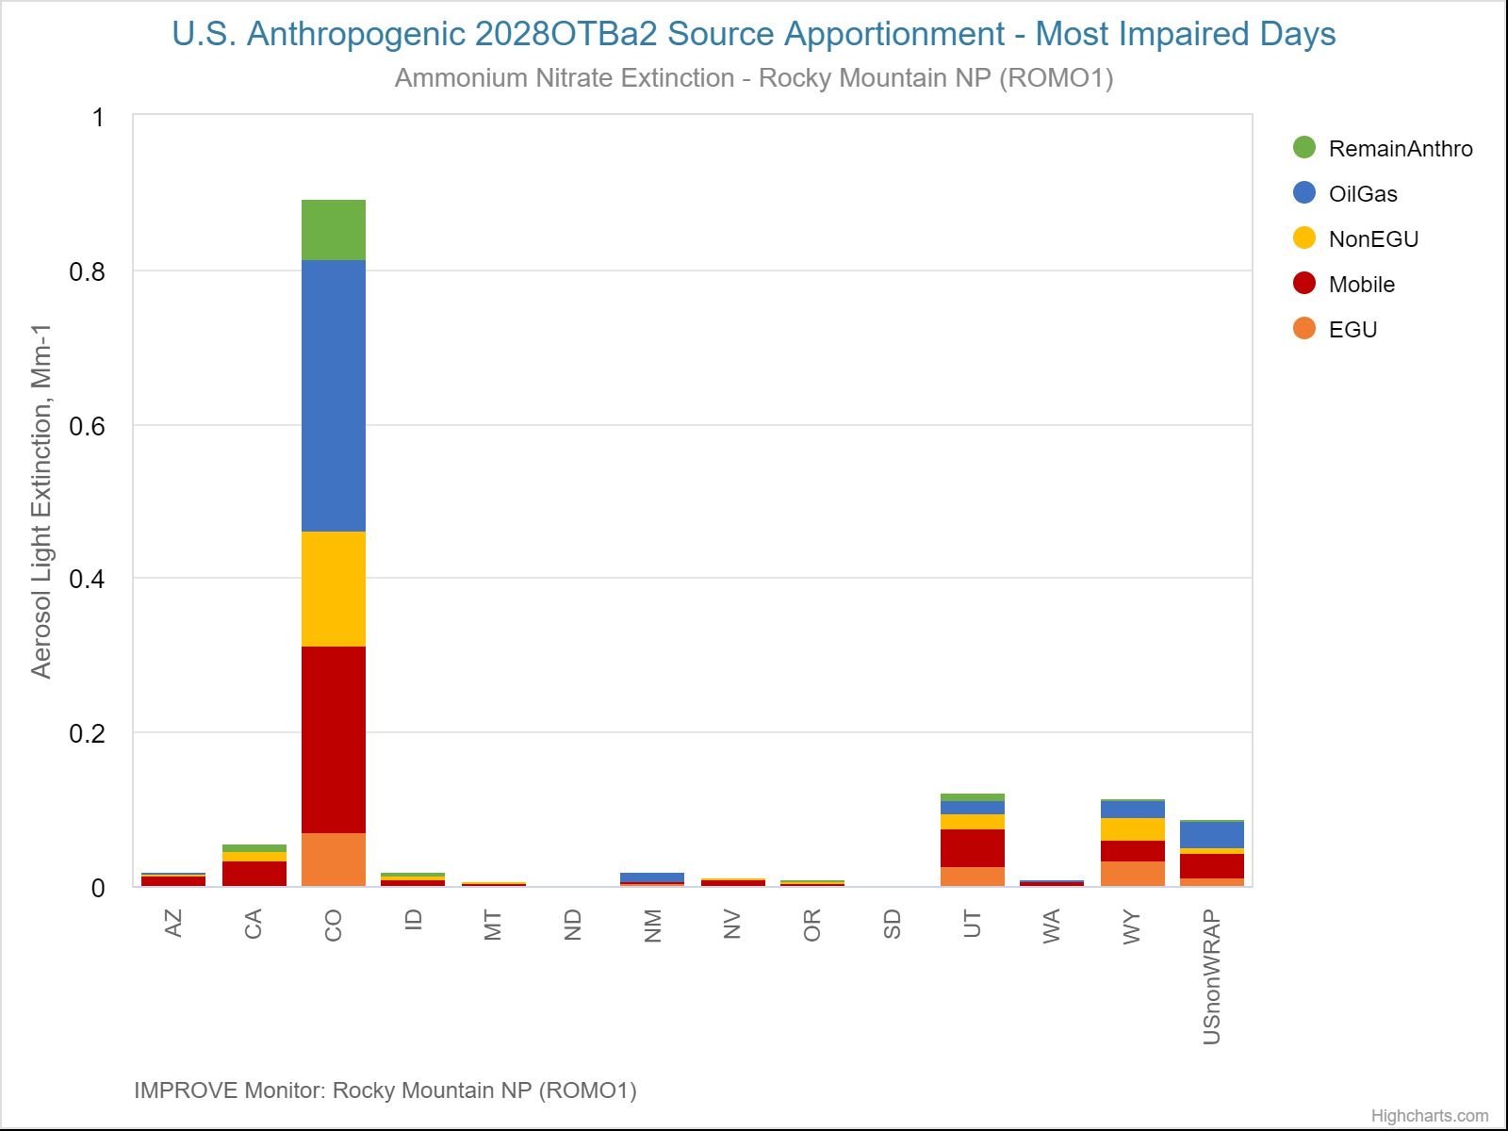
Rocky Mountain
NP
US Anthro:
US Anthro Sulfate Extinction (Mm-1)
US Anthro Nitrate Extinction (Mm-1)

Slide 10
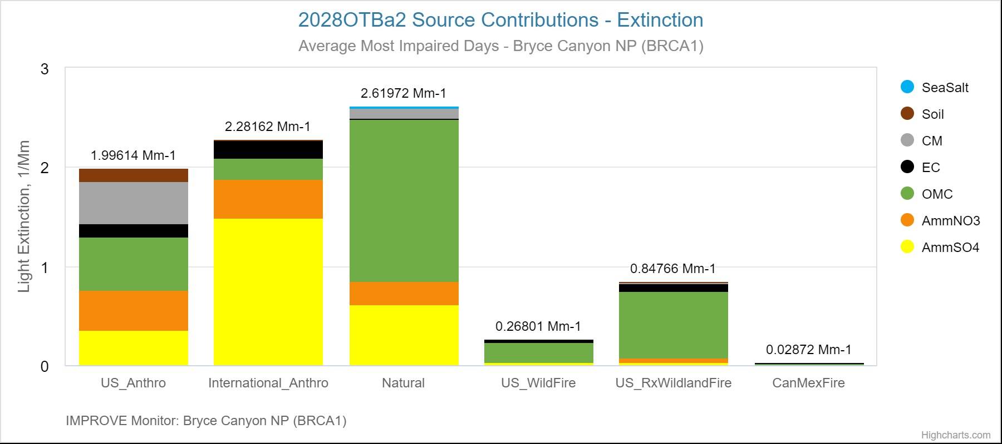
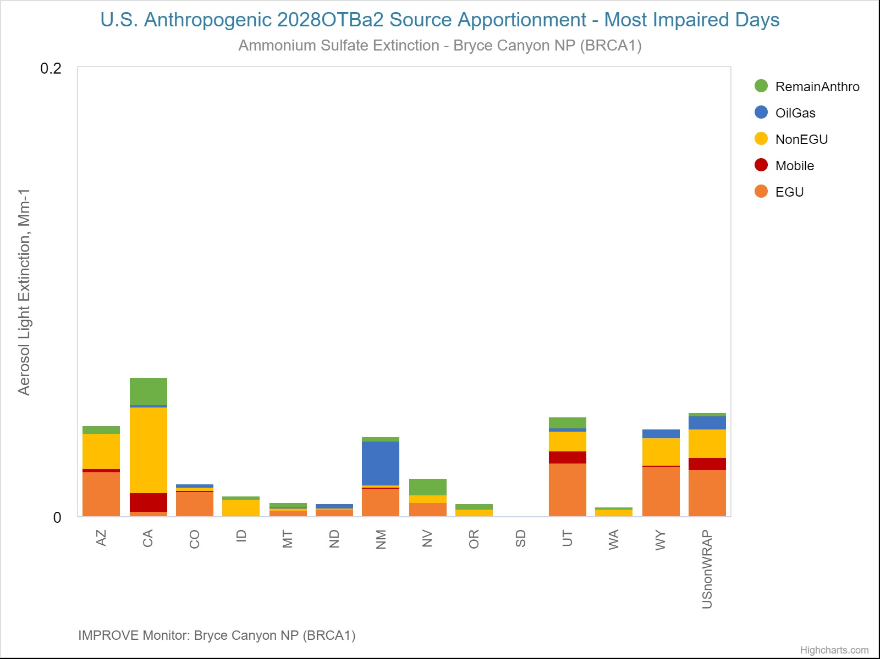
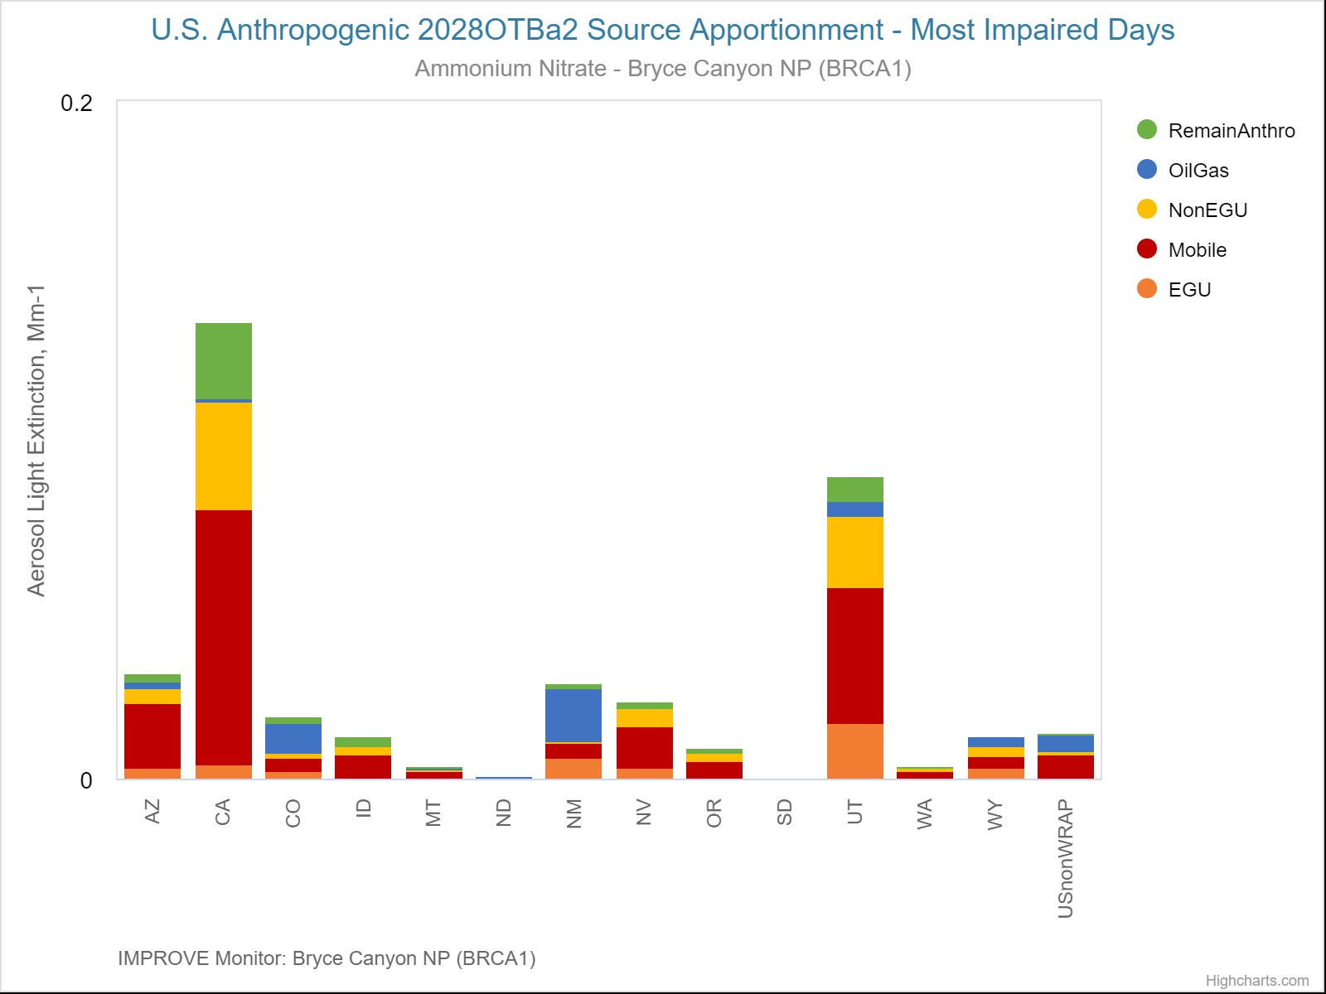
Bryce
Canyon
NP
US Anthro:
US Anthro Sulfate Extinction (Mm-1)
US Anthro Nitrate Extinction (Mm-1)

Slide 11
Area of influence/weighted emission potential (AOI/WEP)
Two ingredients to start with
  Back trajectories
  Emission inventories
Area of influence (AOI) – which upwind areas are impacting each CIA
Weighted emission potential (WEP) – overlay emissions inventory
A different tool that doesn’t rely on the air quality model, but more qualitative in nature
  Result is a ranked list of emission sources that are estimated to impact each CIA
+

Slide 12
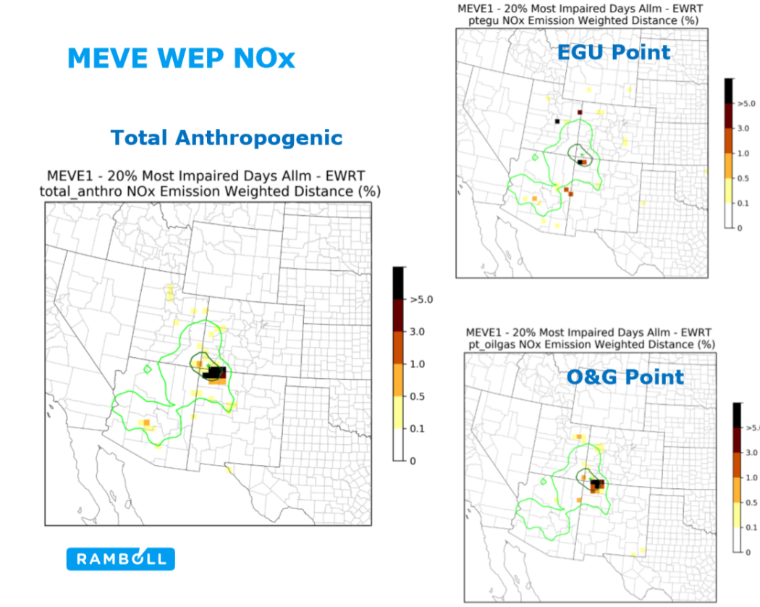
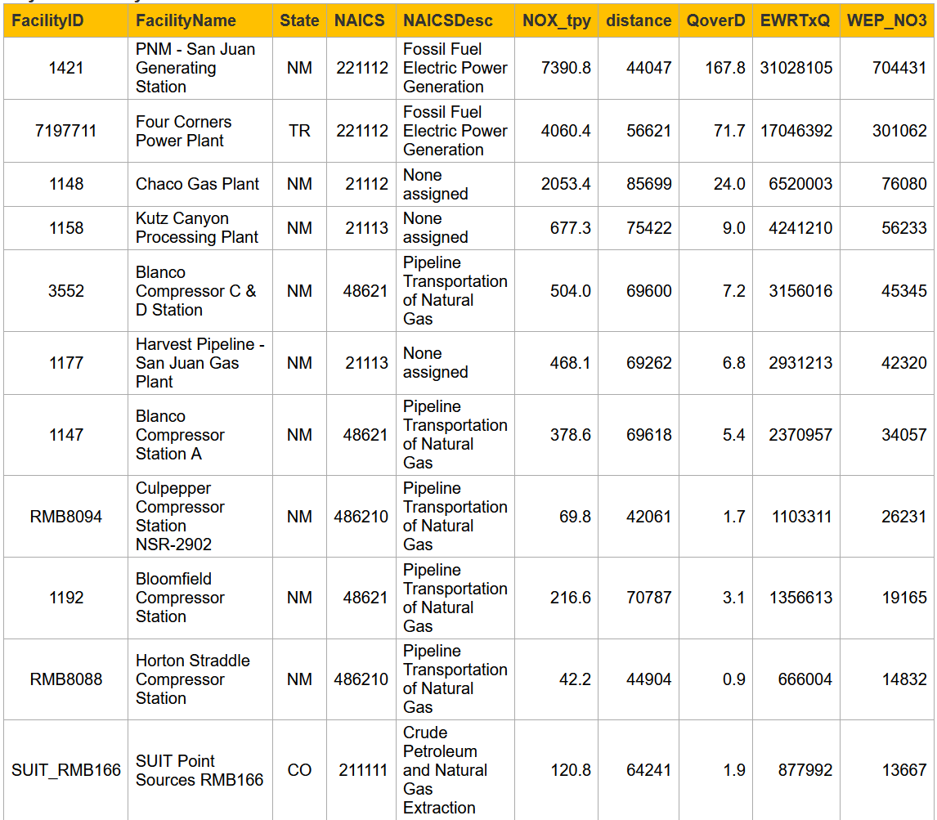
Can further refine AOI / WEP by emission sector

Slide 13
Summary
For the 2nd round of RHR SIPS, focus on sulfate and nitrate contributions on 20% most impaired days
Continued big reductions are forecast for both NOx and SO2 emissions (42% and 15%, respectively) from 2014-2018 to 2028
Significant amount of variability in the source apportionment
Sometimes the US Anthropogenic contribution is not the largest
How useful are these source apportionment results anyway? May want to add other techniques (e.g., WEP/AOI)

