Slide 1
Graphics Processing Unit Assisted Computation for a Gas-Phase Chemical Solver in CMAQ
Khanh Do^{1,2,4}, Jose Rodriguez Borbon¹, George Delic³, Bryan Wong¹,
Yang Zhang⁴, and Cesunica Ivey^{1,2,5}
22nd CMAS Conference, Chapel Hill, NC, October 16th, 2023
¹Department of Chemical and Environmental Engineering, University of California, Riverside, CA
²Center for Environmental Research and Technology, Riverside, CA
³Hiperism Consulting, LLC, Chapel Hill, NC
⁴Department of Civil and Environmental Engineering, Northeastern University, Boston, MA
⁵Now at Department of Civil and Environmental Engineering, University of California, Berkeley

Slide 2
Motivation
3D air quality models are computationally intensive
Solve for chemistry and transport
Simulate entire CONUS domain < 12-km is computationally expensive
All air quality models are being executed on CPUs
Limited number of cores per CPU
Intel consumer product: 24 cores (i9 13900k)
Intel server: 60 cores (Xeon Platinum 8490H)

Slide 3
Rectilinear Grid Model
hadv
zadv
hdiff
sciproc
vdiff
cldproc
phot
driver
chem
pa_irr
aero
ros3
pa_output
All science processes are executed sequentially for every grid cell in the domain
The number of MPI threads corresponds to those grid cells being computed

Slide 4
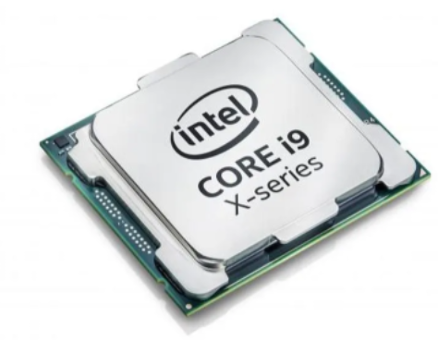
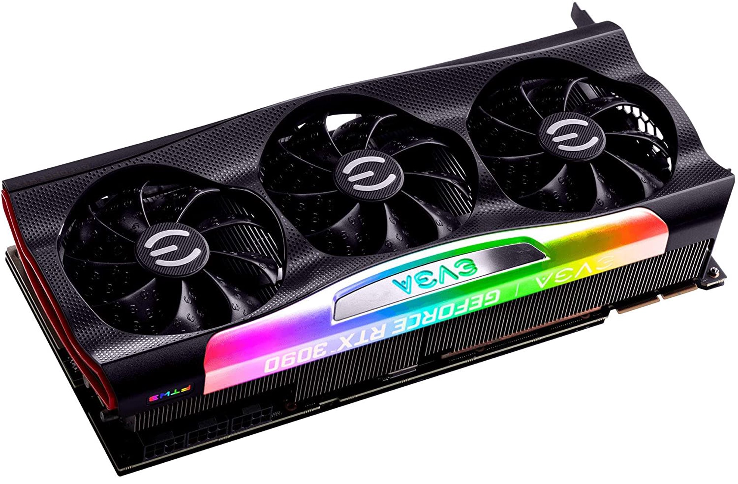
Why GPU?
Central processing unit (CPU)
Very fast, smart, and low latency
Very few cores, parallelization limitation
Graphics processing unit (GPU)
Thousands of cores
Speed up of massive independent workload
GPU is used to accelerate CMAQ
Parallelize and vectorize independent loops for numerical intensive subroutines
Increase efficiency and reduce simulation time
Intel Core i9 CPU
NVIDIA RTX 3090

Slide 5
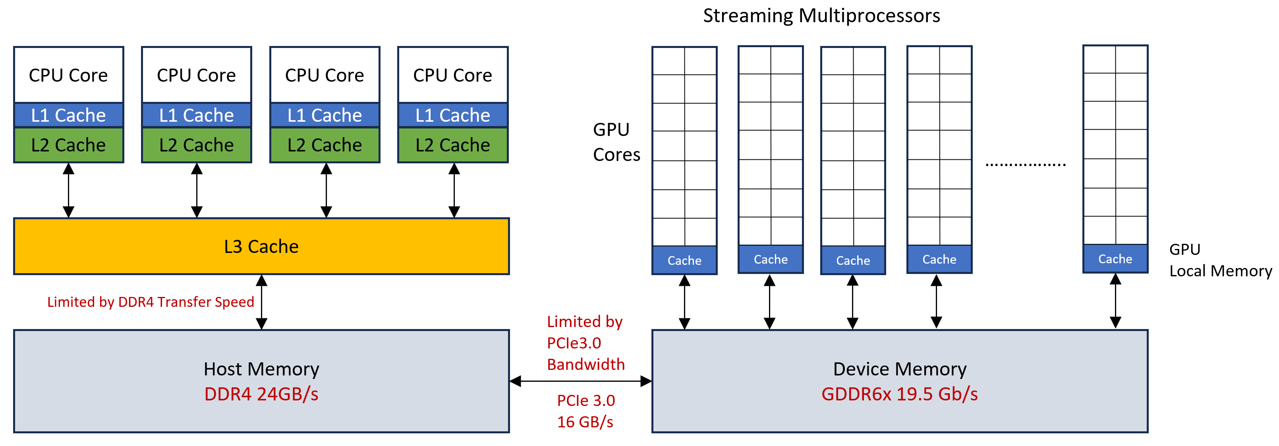
Heterogeneous Computing
GPU program
Step 1: send a copy of the data from the CPU host to the GPU device
Step 2: launch a CUDA kernel (.cuf) for instruction to compute on the GPU
Step 3: send the GPU-computed data (results) from the GPU device to the CPU host
Each step adds to the overall computing time of the system
Scheme of a computer with a GPU

Slide 6
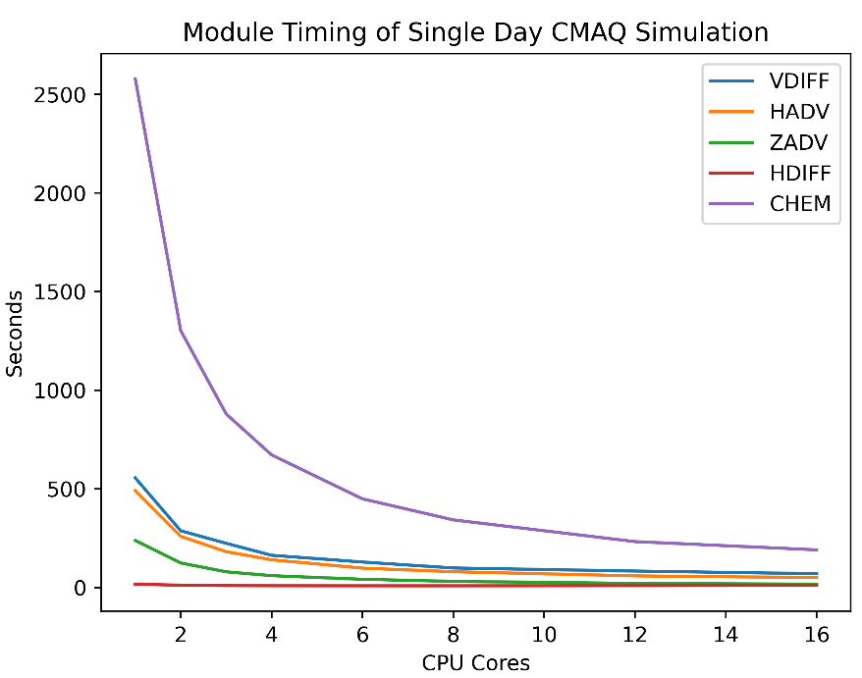
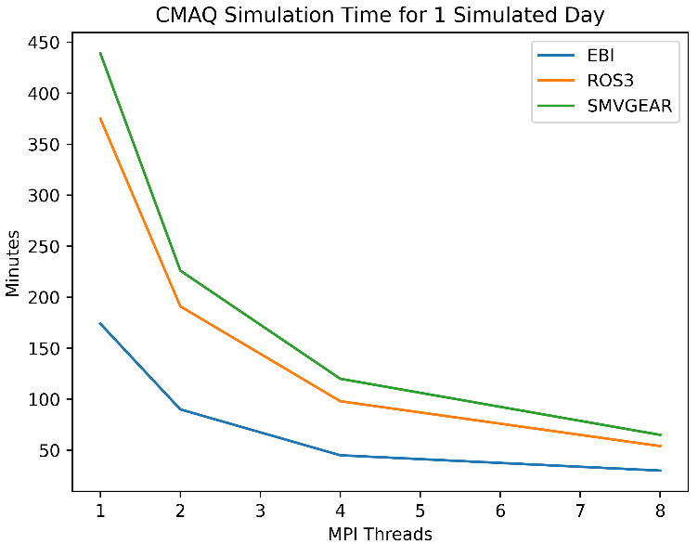
Development Process
Determine the slowest process in CMAQ
Create GPU-friendly data structures and algorithms
Design compilation compatibility with the CUDA
Perform code independent analysis
The slowest module among the five modules
Target ROS3 solver for gas-phase mechanism
Port subroutines of ROS3 solver into the GPU
Optimize CUDA program

Slide 7
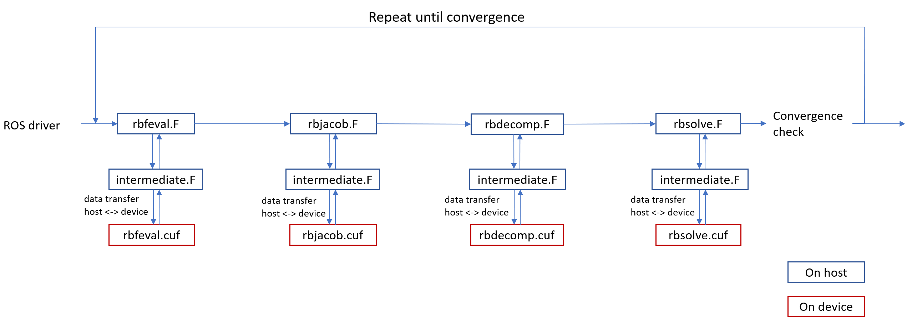
Flow Diagram of CMAQ-CUDAv1.0
The blue blocks are executed using the CPU (host), and the red blocks are executed using GPU (device)
GPU computing time (kernel) much faster than the CPU time
The overall simulation time is still slower than the original CMAQ

Slide 8
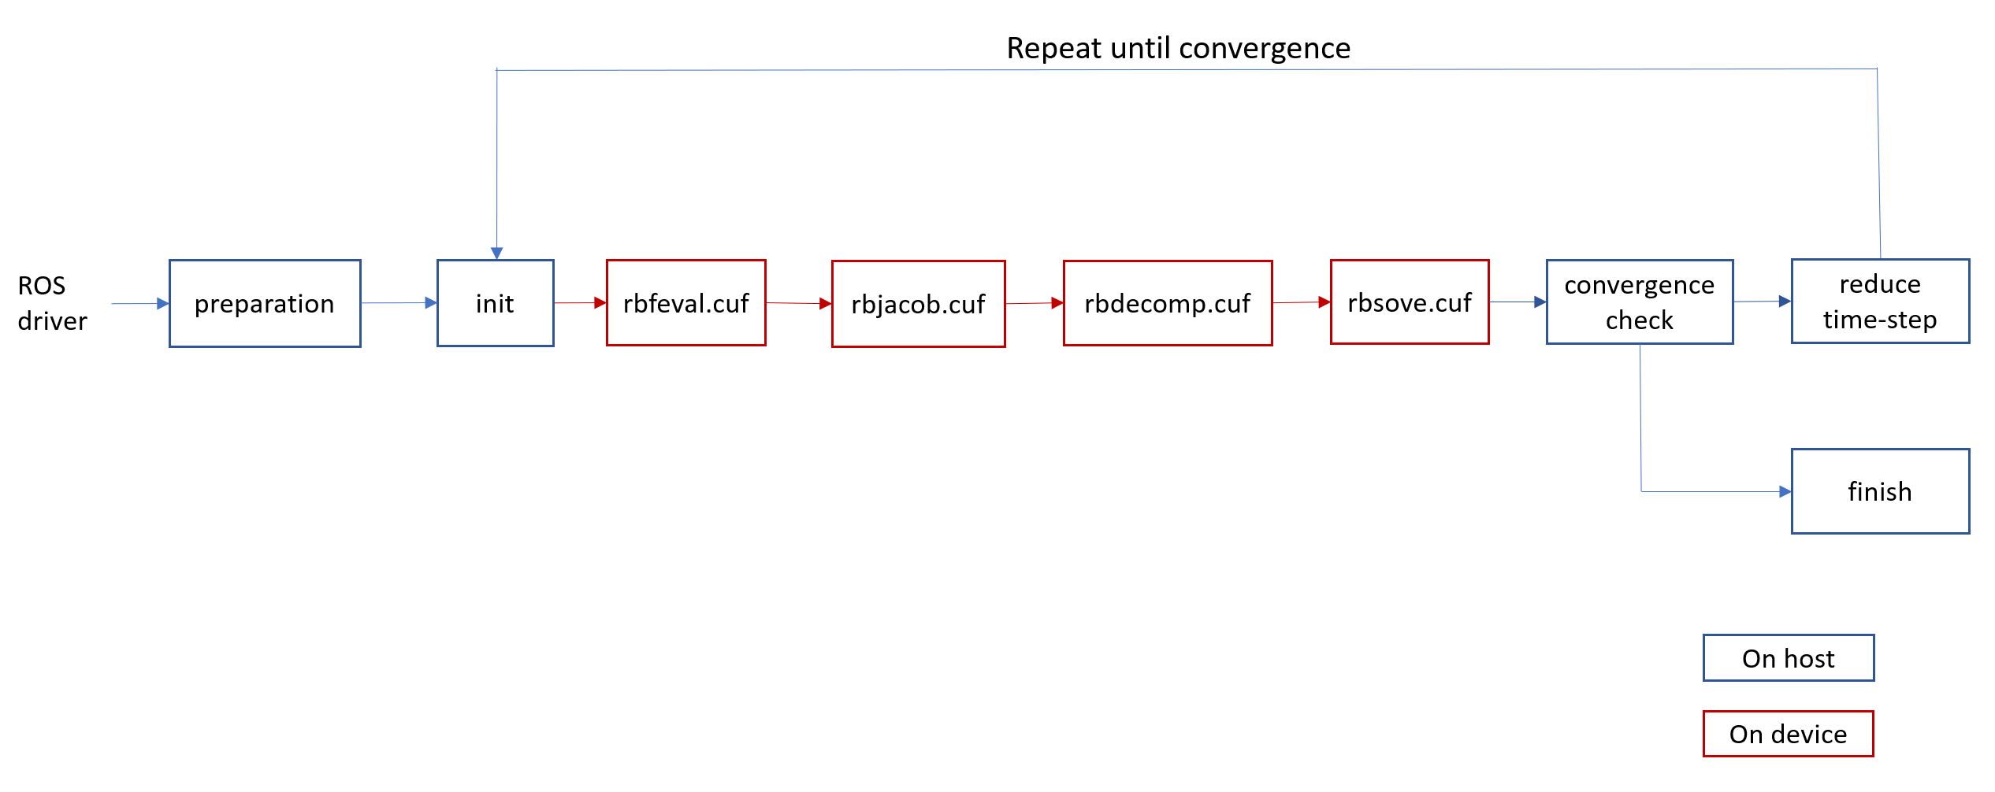
CMAQ-CUDAv2.0
Minimize data transfer and optimize parallel computing
Vectorize & combine 4 subroutines ported on GPU to enhance transfer
The blue blocks are executed using the CPU (host), and the red blocks are executed using GPU (device)

Slide 9
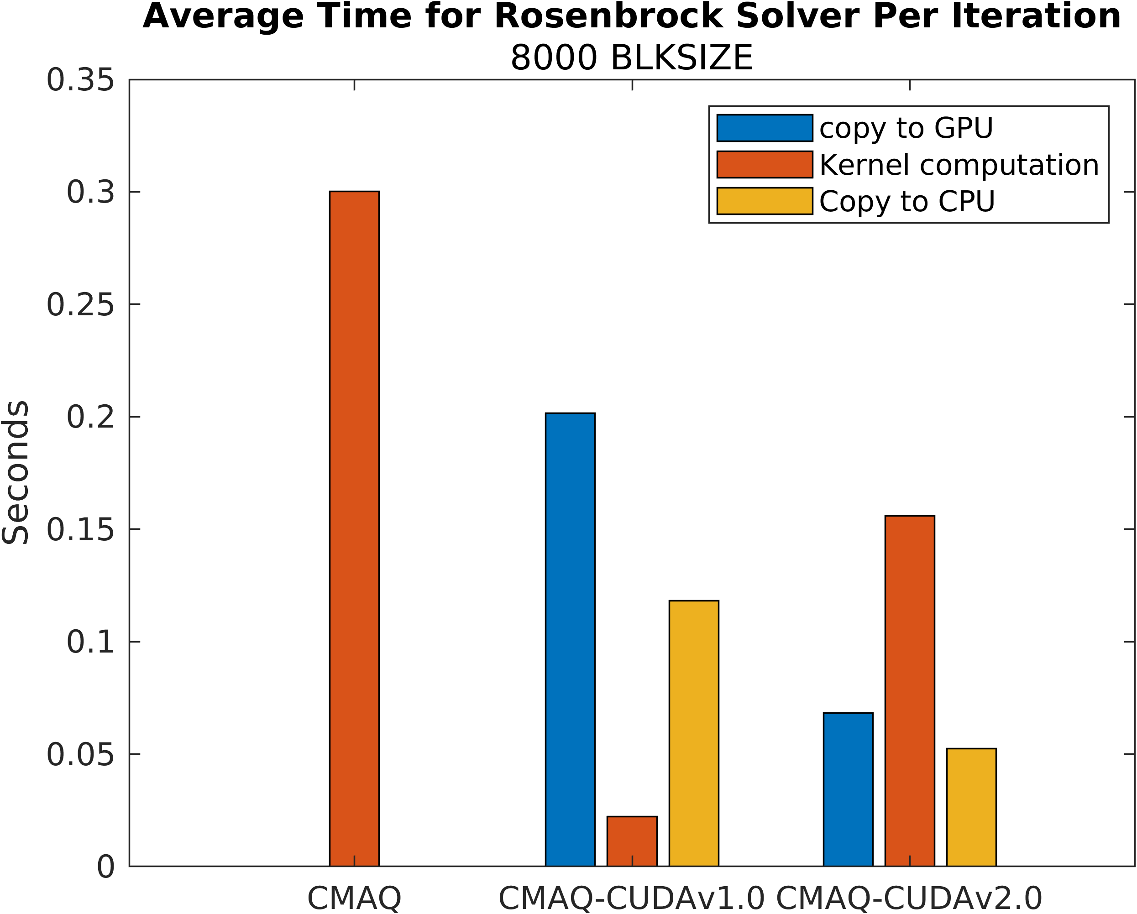
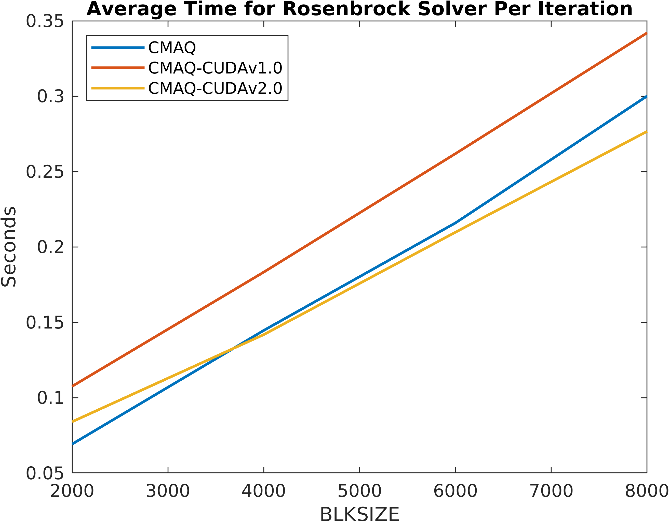
Performance of CMAQ-CUDA
CMAQ-CUDAv2.0
Reduce significantly the data transferring
Increase kernel time due to more arithmetic operations, series operations
Perform better with larger computing block size (BLKSIZE)

Slide 10
Simulation Errors (Spatial)
O₃
NO₂
Two versions of CMAQ produce very similar concentrations across all the species
Domain mean biases are small
Maximum differences are ~0.8% for NO, ~5% for O₃, and ~0% for SO₂

Slide 11
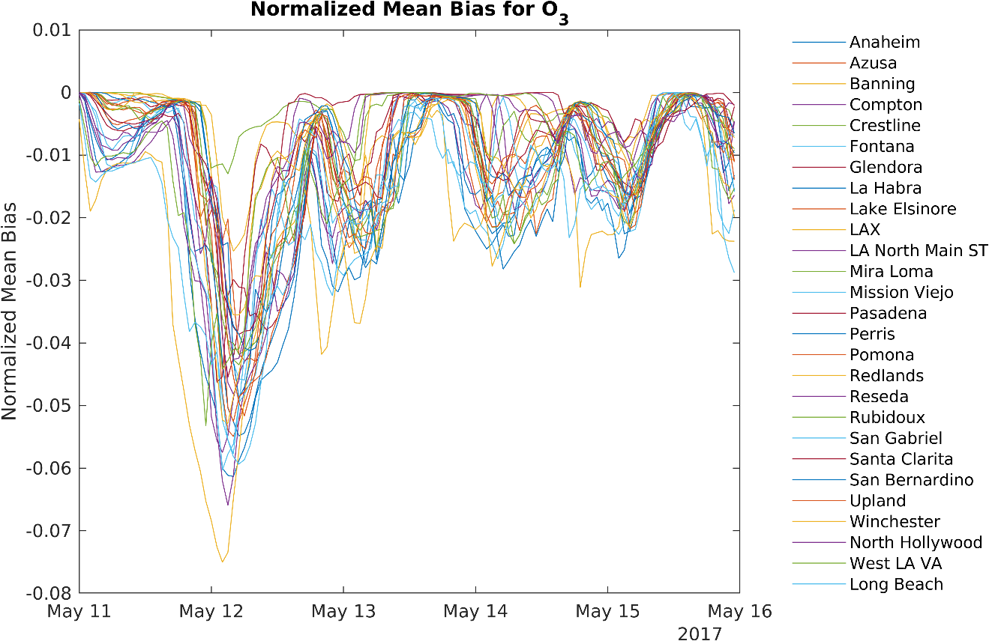
Simulation Errors (Temporal)
Normalized Mean Bias for O₃ of 27 sites in Southern CA
Errors do not accumulate and grow
Largest NMB for O₃ is < 3% across all sites

Slide 12
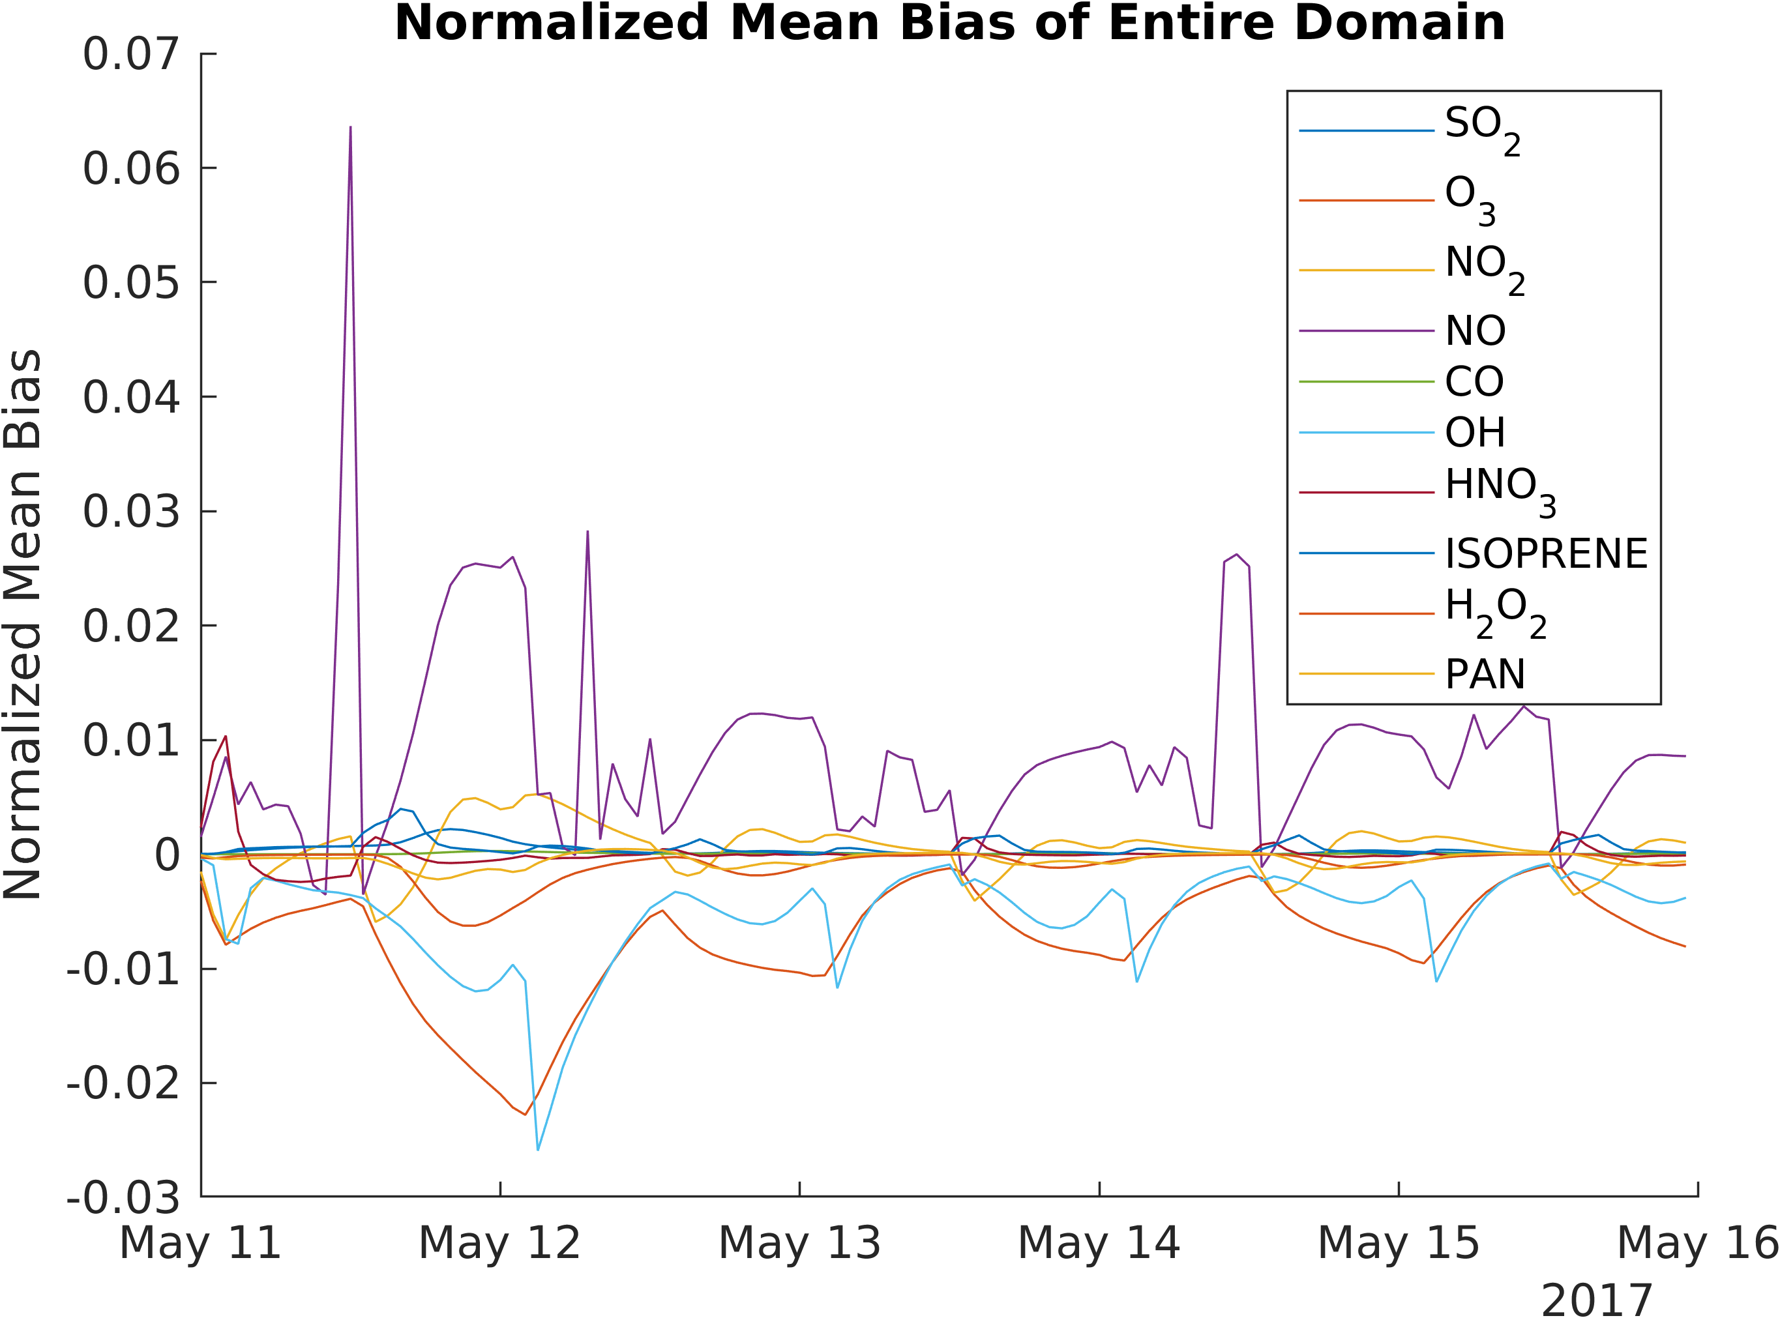
Simulation Errors
Domain NMB errors do not accumulate over prolonged simulation periods for all species
Largest domain NMB errors is < 1% across all species

Slide 13
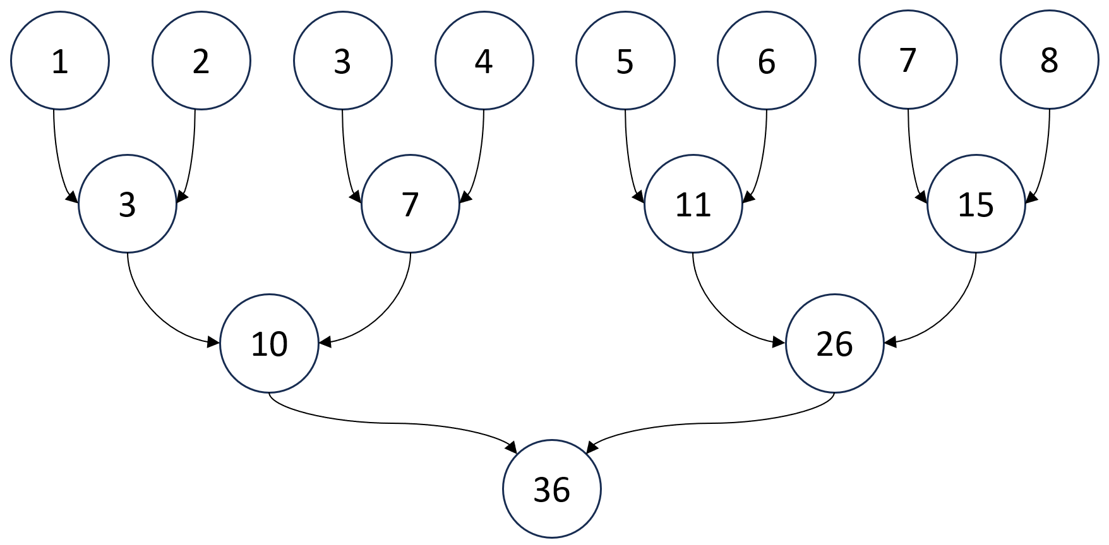
Error Analysis
Technical factors
Human errors
Port a large number of codes to the GPU
Vectorize dependence loops
Architecture differences
Extremely small values (e.g., time step, concentrations) magnify the errors
The ROS3 for CMAQ-CUDA is highly parallel to maximize loop vectorization
Vector operation on GPU is different than CPU
Reduction algorithm for GPU computing

Slide 14
Conclusions
GPU computing gains popularity with the CUDA library
Computer hardware improves
Lift the communication bottleneck between the host and the device
Faster GPU clock speed
GPU computing remains the model’s integrity
CMAS team develops a GPU version of CMAQ
ODE solver can be generalized for other AQMs
Quality control, maintenance, and support
Heterogeneous computing offers a promising future of the grid models

Slide 15
Acknowledgments
NSF CDS&E (#2053560)
Duncan Quevedo for developing CMAQ-CUDAv3.0
Prithviraj Yuvaraj for supporting CMAQ-CUDA

Slide 16
Motivation
Scientists have been working to improve the performance of 3D air quality models
Algorithm optimization
MPICH, OpenMP
Improvements the chemistry solvers; still maintain the integrity
Sparse Matrix Vectorized Gear (SVMGear) - slowest but most accurate
Rosenbrock (ROS3) – based on GEAR method and faster than SMVGear
Euler Backward Iteration (EBI) – fastest but least accurate
Hardware optimization
Faster CPUs and more MPI processes and OpenMP threads
Porting intensive codes on GPU
Machine learning
Background/
Objective
Methods
Results
CMAQ-CUDAv1.0
Results
CMAQ-CUDAv2.0
Future Work

Slide 17
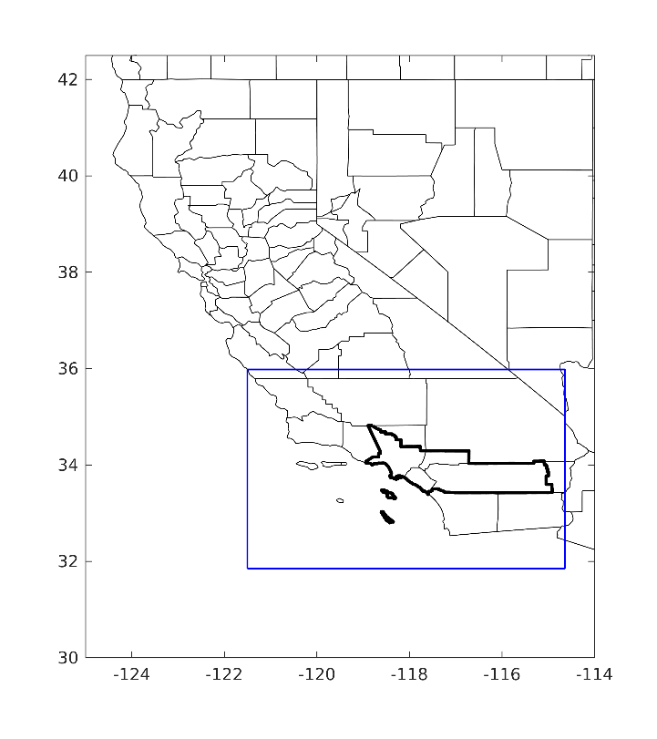
Methods
We target ROS3 solver for gas-phase mechanism
Handle well stiff ODEs
Highly vectorizable independent loops
Porting subroutines of ROS3 solver onto the GPU
Partial derivative, Jacobian matrix, LU decomposition, back substitution
Model configuration
SAPRC-07 mechanism
4x4 km resolution
156x102x11 grids
Southern California
Figure 6. The third and inner-most domain (blue boundary) with 4 km horizontal grid spacing covered the entire SCAQMD region (thick black lines).
Background/
Objective
Methods
Results
CMAQ-CUDAv1.0
Results
CMAQ-CUDAv2.0
Future Work

Slide 18
Results and Discussion
The actual GPU computing time (kernel) is much faster than CPU with the same number of arithmetic operations
The overall simulation time still slower than original CMAQ
Suffered from the cost of data transfer between the host and device
The gain from the kernel was offset by the data communication cost
Table 1. Computing time for RBFEVAL, RBJACOB, RBCECOMP, and RBSOLVE subroutines for CMAQ and CMAQ-CUDAv1.0. The time was measured in seconds and was the average of a CMAQ timestep for 2,100 and 10,000 BLKSIZE. CTD (copy to device) is the time for transferring data from host to device. CTH (copy to host) is the time for copying the results from the device to the host. KER (kernel) is the GPU computing time in milliseconds.
ROS3 | RBFEVAL (ms) |  |  | RBJACOB (ms) |  |  | RBDECOMP (ms) |  |  | RBSOLVE (ms)
 | CTD | KER | CTH | CTD | KER | CTH | CTD | KER | CTH | CTD | KER | CTH
Version 1.0 2,100 BLKS | 3.8 | 2.5 | 0.39 | 12 | 14 | 13 | 11 | 11 | 9.8 | 9.9 | 1.6 | 11
CMAQ 2,100 BLKS | 0 | 4.0 | 0 | 0 | 12 | 0 | 0 | 38 | 0 | 0 | 4.1 | 0
Version 1.0 10,000 BLKS | 24 | 1.9 | 1.7 | 50 | 7.6 | 58 | 53 | 13 | 45 | 46 | 1.7 | 53
CMAQ 10,000 BLKS | 0 | 23 | 0 | 0 | 56 | 0 | 0 | 190 | 0 | 0 | 21 | 0
Background/
Objective
Methods
Results
CMAQ-CUDAv1.0
Results
CMAQ-CUDAv2.0
Future Work

Slide 19
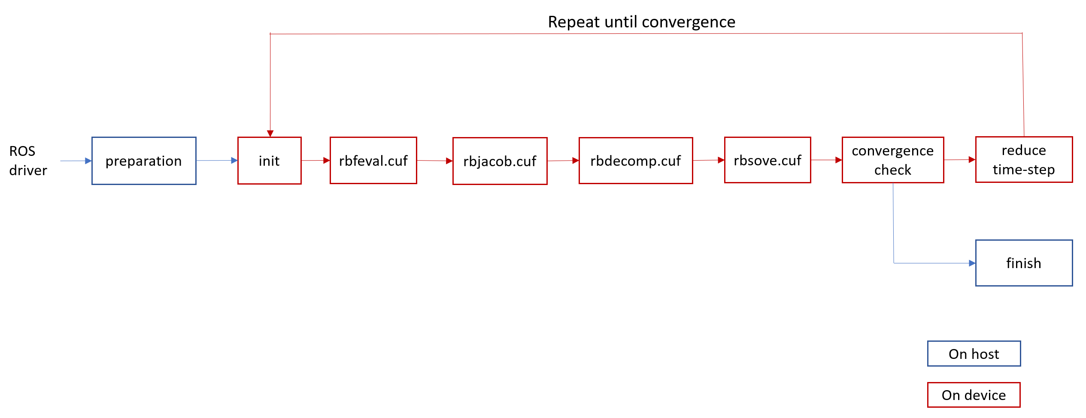
Future Work
CMAQ-CUDAv3.0 will significantly reduce data transfer between host and device
We will implement multi-GPU method

Slide 20
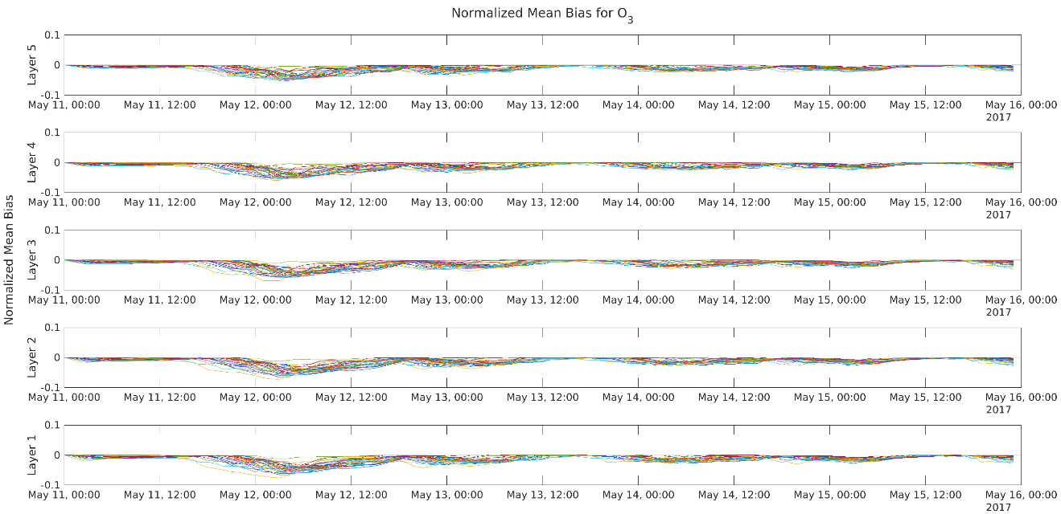
Simulation Errors
Time series of O₃ normalized mean bias for 27 locations over Southern California for vertical layers
NMB errors do not accumulate over prolonged simulation periods for all layers
Enhancement over the simulation duration spanning all layers

Slide 21
Optional aqueous chemistry with kinetic mass transfer and Rosenbrock solver: AQCHEM-KMT
GAS-PHASE CHEMISTRY Chapter 8 from CMAQ Documentation: Gear type solvers are the most accurate
https://www.cmascenter.org/cmaq/documentation/4.4/CHEM_SOLVER_NOTES.txt

