Slide 1
Black carbon aging process simulation in the WRF-CMAQ coupled model
Yuzhi Jin¹，Jiandong Wang¹，David C. Wong², and Chao Liu¹
¹ School of Atmospheric Physics, Nanjing University of Information Science and Technology, China.
² Office of Research and Development, U.S. Environmental Protection Agency.
The views expressed in this presentation are those of the authors and do not necessarily reflect the views or policies of the U.S. EPA.

Slide 2
Introduction
BC Aging Module Development
Case Description
New Model Evaluation
New Model Results Analysis

Slide 3
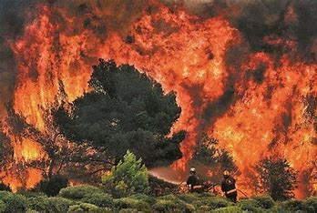
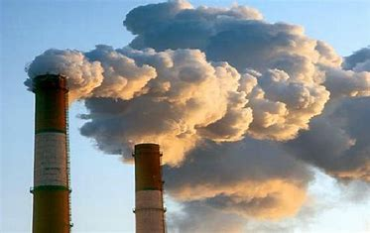
Introduction：Black Carbon
Black Carbon (BC) : Produced from the incomplete combustion of carbonaceous fuels.
BC
Strong light absorption
Regional air pollution
Global radiative forcing
Direct radiative forcing
Indirect radiative forcing
Atmospheric stability
Secondary particulate matter

Slide 4
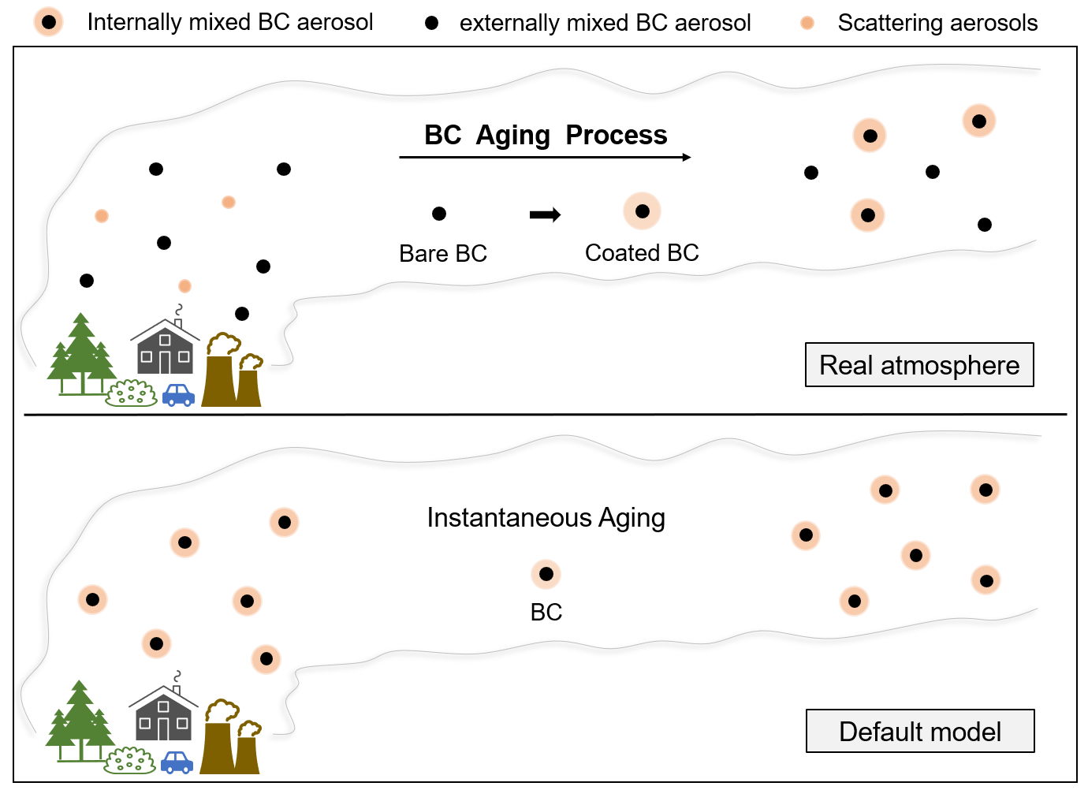
Introduction：BC Aging Process
Mixing states
Optical properties
Potential impact
Cloud condensation nuclei (CCN)
Ice nuclei (IN) concentration
Dry and wet deposition ……

Slide 5
BC Aging Module Development：New Species
Default Model
New Model
BC
Bare BC
Coated BC
 | Mode | Mode | Mixing state | Hygroscopicity
 | Aitken | Accumulation
Bare BC | “ABECI” | “ABECJ” | External mixing | hydrophobic
Coated BC | “ACECI” | “ACECJ” | Internal mixing | hydrophilic

Slide 6
BC Aging Module Development：Aging Schemes
1. Set an e-folding conversion lifetime；
2. Focus on the change in the properties during the BC aging process and their physical processes；
Set the aging process related to specific atmospheric components;
Hydrophilicity change as an aging indicator;
3. Subdivide black carbon aerosols into finer units.
A two-dimensional size-BC proportion interval；
Particle-resolved models.

Slide 7
BC Aging Module Development：Aging Schemes
1. Set an e-folding conversion lifetime；
2. Focus on the change in the properties during the BC aging process and their physical processes；
Set the aging process related to specific atmospheric components;
Hydrophilicity change as an aging indicator;
3. Subdivide black carbon aerosols into finer units.
A two-dimensional size-BC proportion interval；
Particle-resolved models.
Scheme1: 1.15 days.
（Cooke et al., 1999,2002; Chung and Seinfeld, 2002 ; Huang et al., 2013 ）
Scheme2: OH radicals concentration.
（Liu et al., 2011; Huang et al., 2013）
$k=β\left[OH\right]+α$
Where β is 4.6×10⁻¹² cm³ molecule⁻¹ s⁻¹，𝛼 is 5.8×10⁻⁷ s⁻¹.
OH aging scheme

Slide 8
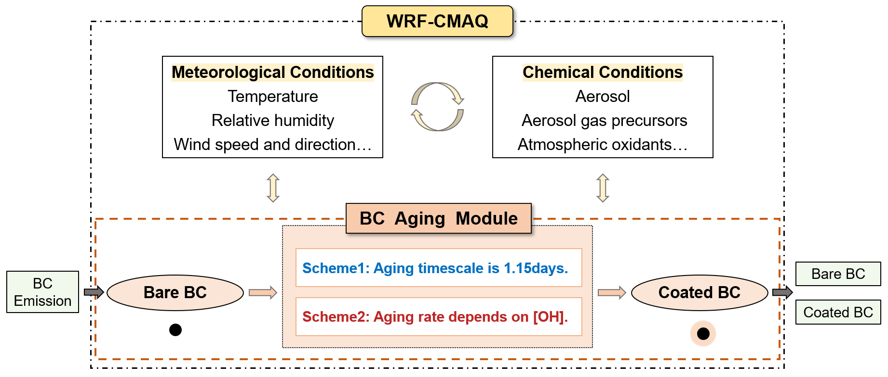
BC Aging Module Development：New Model

Slide 9
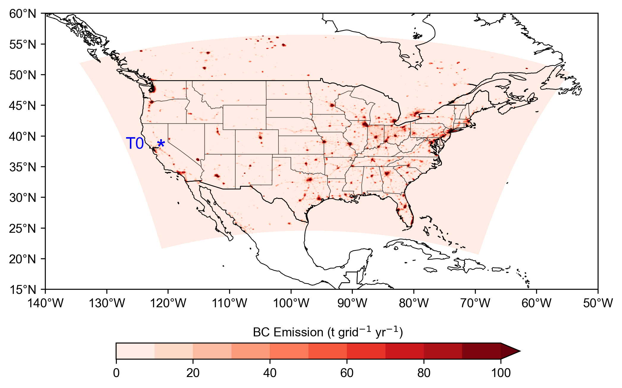
Case Description：Model Setup
Two-way coupled WRF4.4.1-CMAQ5.4
Location: United States
Time: June 2010
Resolution: 12km, 35 vertical layers
Chemical Mechanism: “CB6r5-AERO7”
Assimilation Datasets: FNL, NAM, NARR
Physics processes | Schemes | References
Microphysical Process | Morrison 2–moment Scheme | Morrison et al., 2009
Planetary Boundary Layer(PBL) Physics Process | Asymmetric Convection Model 2 Scheme(ACM2) | Pleim, 2007
Cumulus Parameterization Process | Kain–Fritsch Scheme | Kain, 2004
Shortwave Radiation Process | RRTMG Shortwave Scheme | Iacono et al., 2008
Longwave Radiation Process | RRTMG Longwave Scheme | Iacono et al., 2008
Land Surface Physics Process | Pleim–Xiu Land Surface Model | Pleim and Gilliam, 2009
Surface Layer Physics Process | Pleim–Xiu Scheme | Pleim, 2006

Slide 10
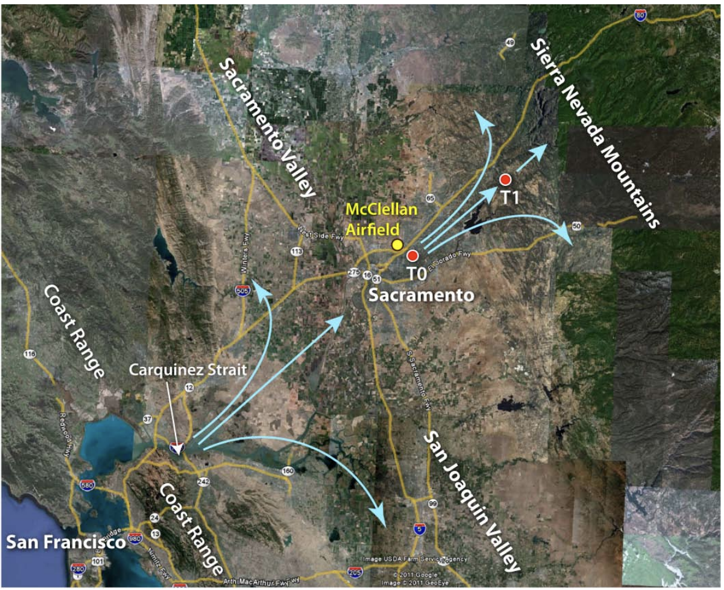
Case Description：Observational data
Carbonaceous Aerosols and Radiative Effects Study (CARES）
Data type | Data | Data description | Instrument/Technique
Meteorology | T | Temperature | Vaisala WXT-510
Meteorology | RH | Relative Humidity | Vaisala WXT-511
Meteorology | P | Pressure | Vaisala WXT-512
Meteorology | WS | Wind speed | Vaisala WXT-513
Meteorology | WD | Wind direction | Vaisala WXT-514
Gas concentration | O₃ | O₃ concentration | UV absorption
Gas concentration | SO₂ | SO₂ concentration | Thermo Model 43i
Gas concentration | NO | NO concentration | Chemiluminescence
Gas concentration | NO₂ | NO₂ concentration | Photolytic conversion CU GMAX-DOAS
BC | M_{BC} | BC mass concentration | Sunset OC/EC
Optics properties | b_{abs} | Absorption coefficient | PSAP
（Zaveri et al., 2012）

Slide 11
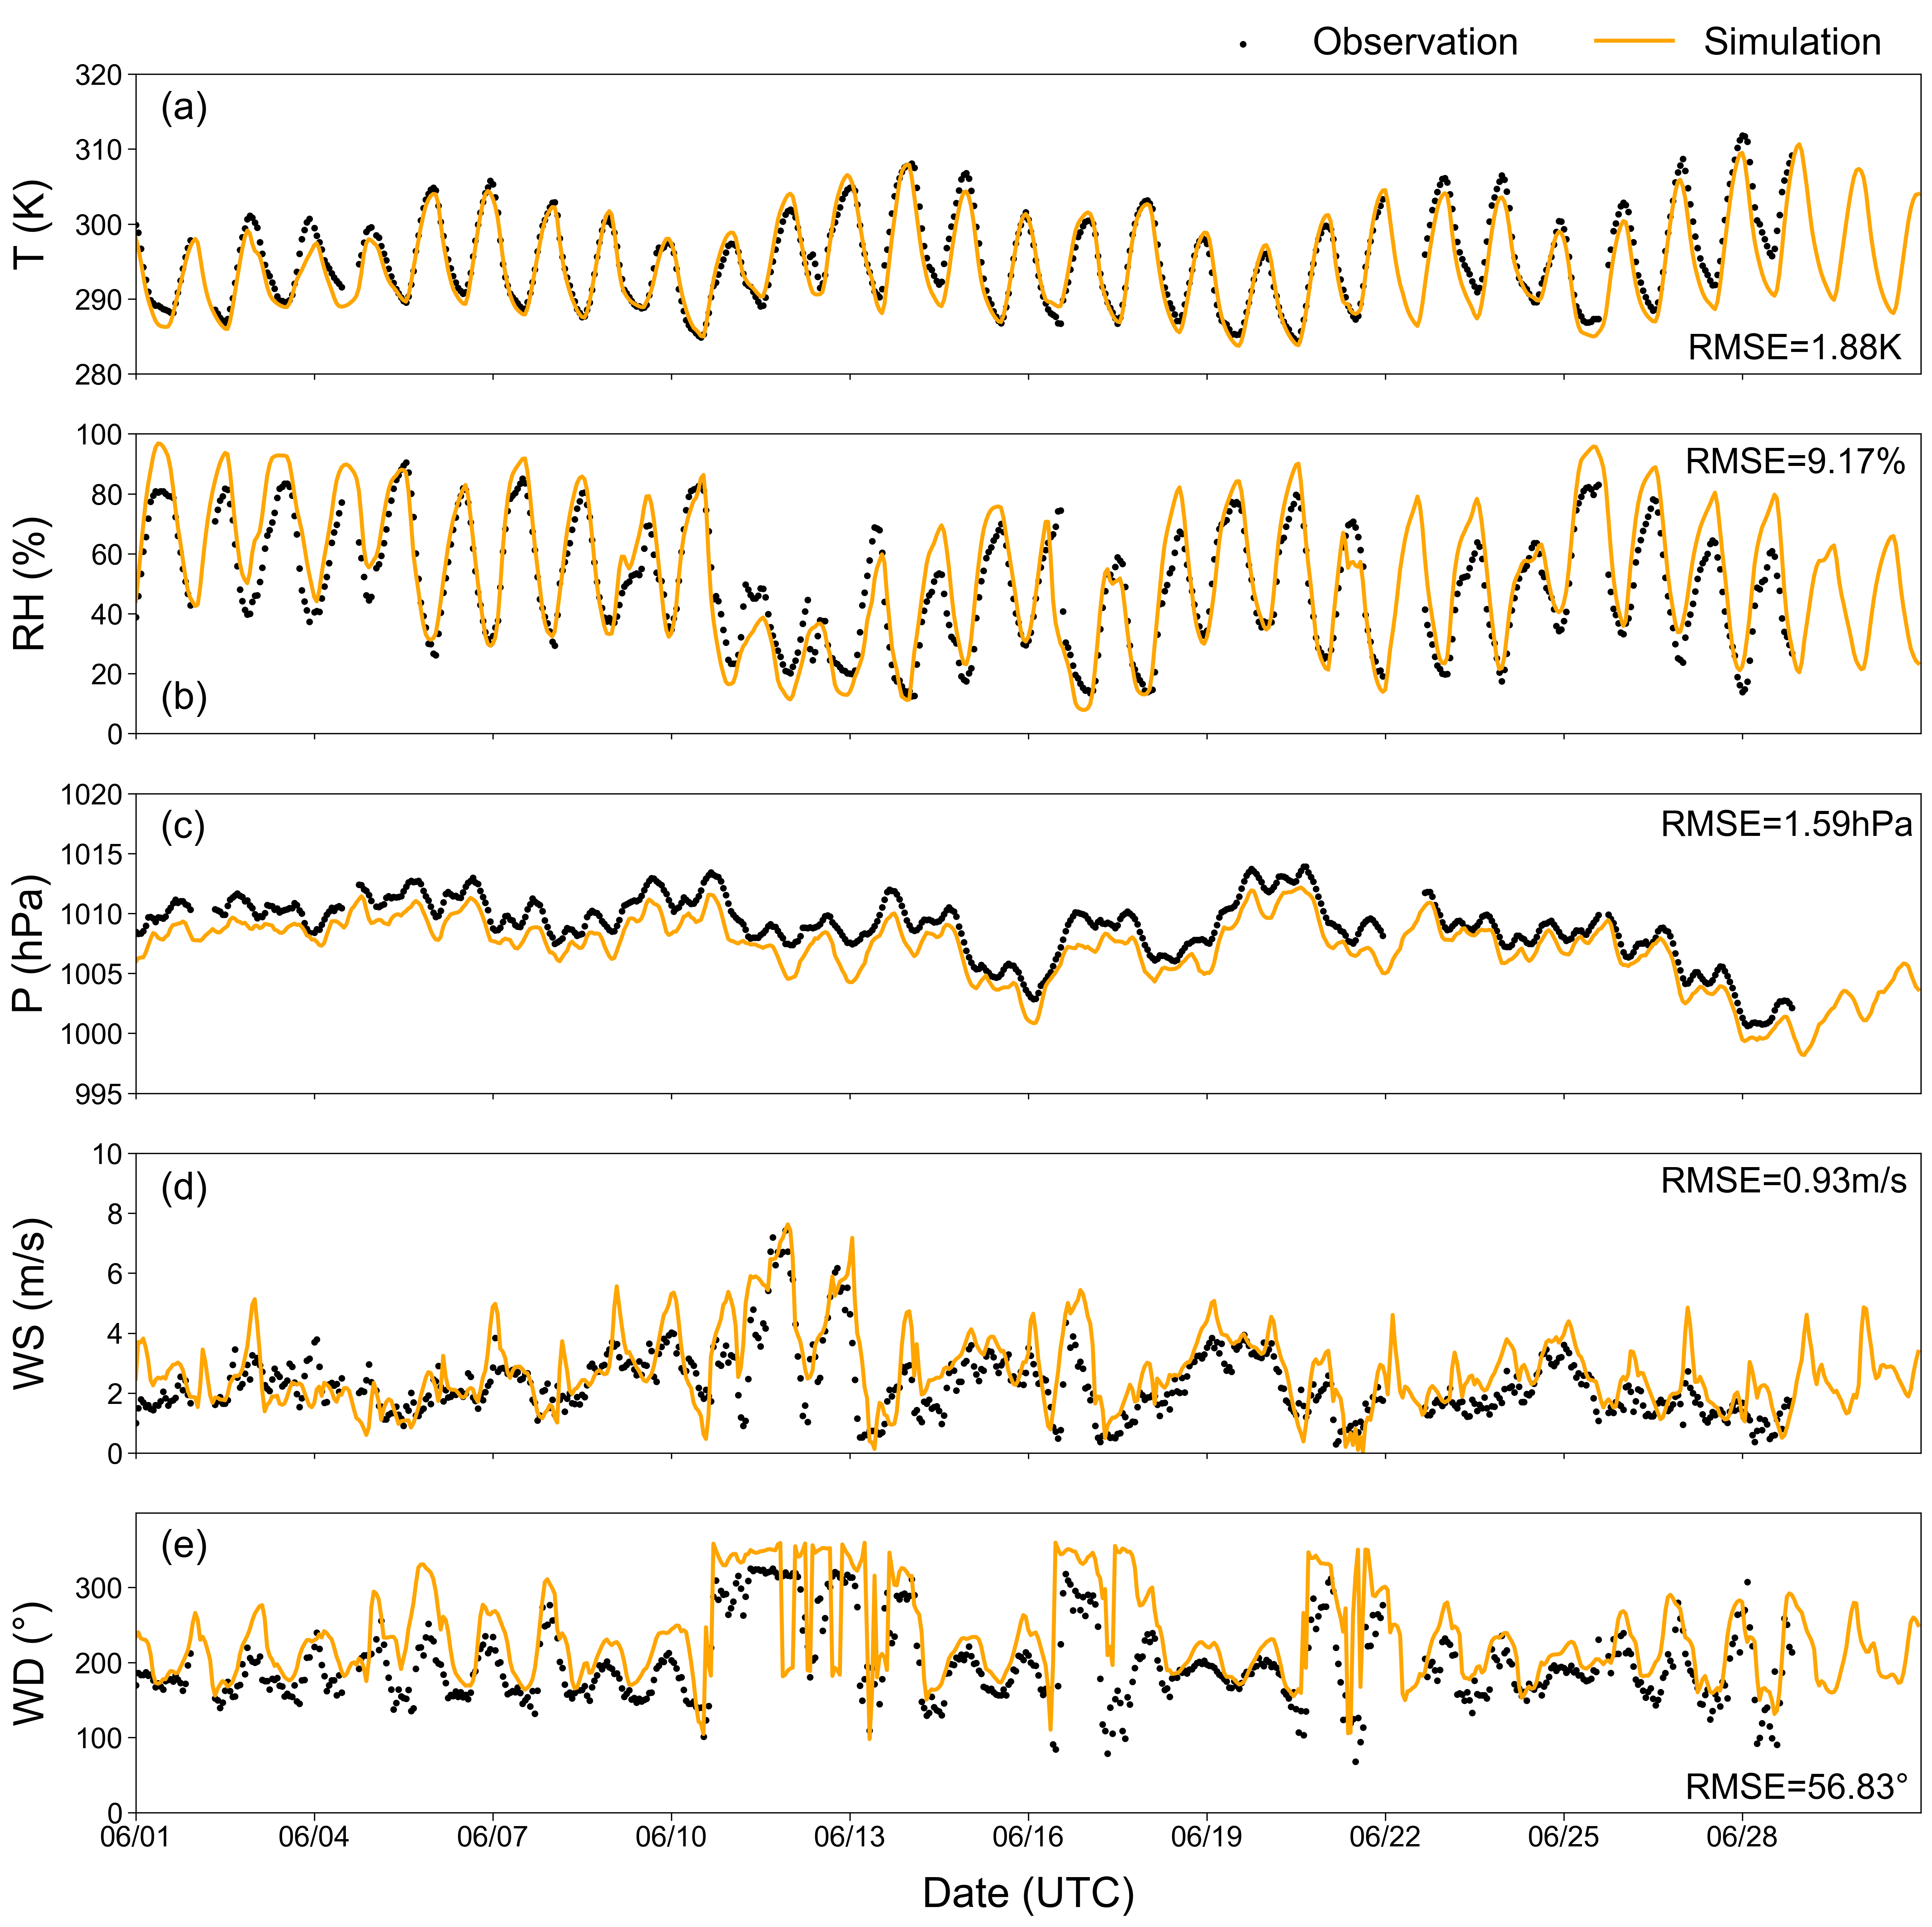
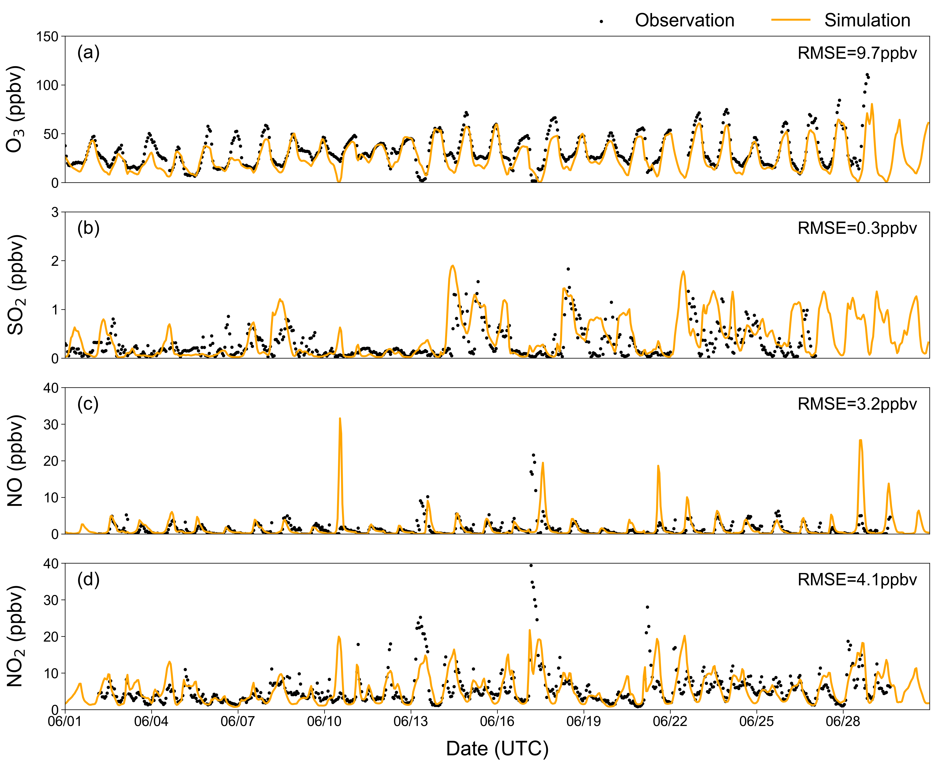
Based Model Evaluation

Slide 12
New Model Results Analysis：Aging-related Variables
Aging rate ($k$)
Aging timescale (τ)
$k$= 1.00644×10⁻⁵ s⁻¹ τ = 1.15 days (27.6h)
Scheme1
𝒌 (s⁻¹)
τ (h)
Scheme2

Slide 13
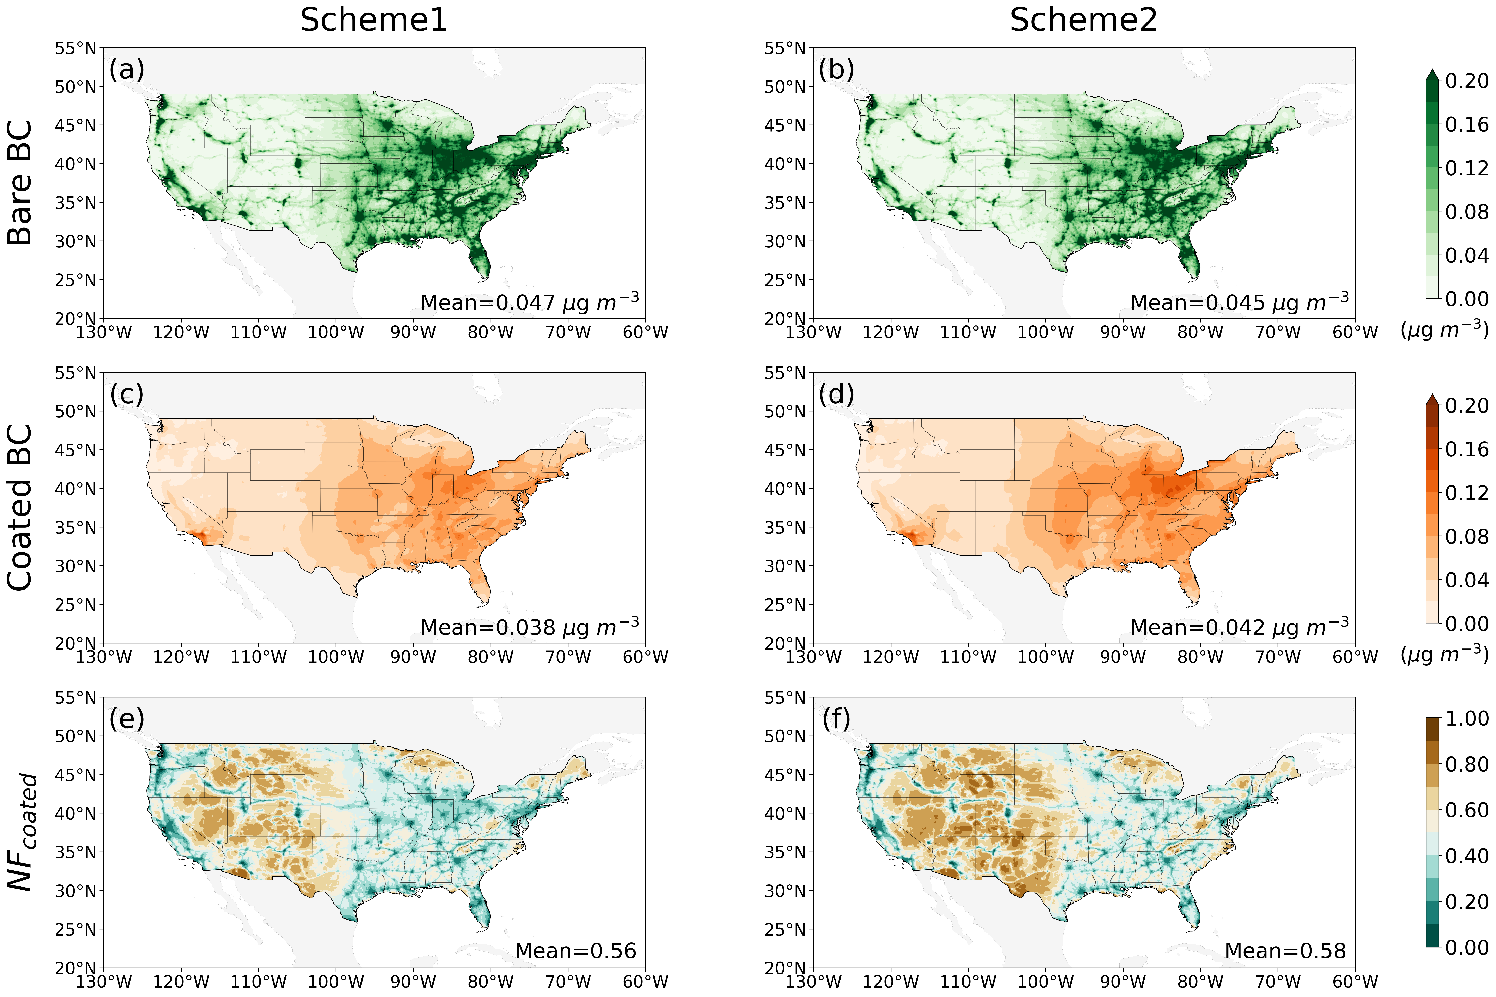
New Model Results Analysis：BC mixing state
The number fraction of Coated BC (${NF}_{Coated})$
${NF}_{coated}$ = $\frac{N_{CoatedBC}}{N_{BareBC}+N_{CoatedBC}}$
Bare BC dominates near the emission sources, while Coated BC dominates in areas further away from the sources.

Slide 14
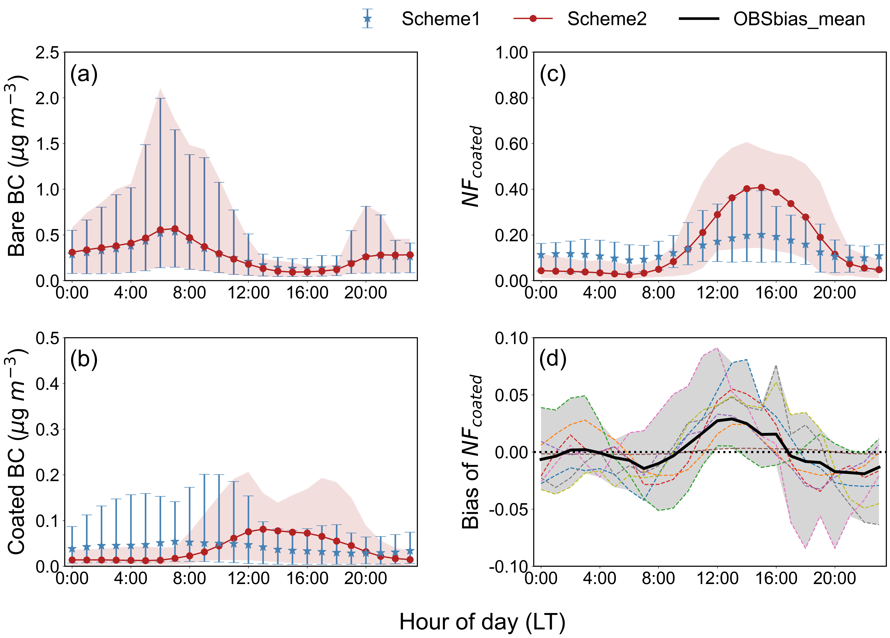
New Model Results Analysis：BC mixing state (cont’d)
The number fraction of coated BC shows a distinct increase during the local time period of 8:00-20:00.

Slide 15
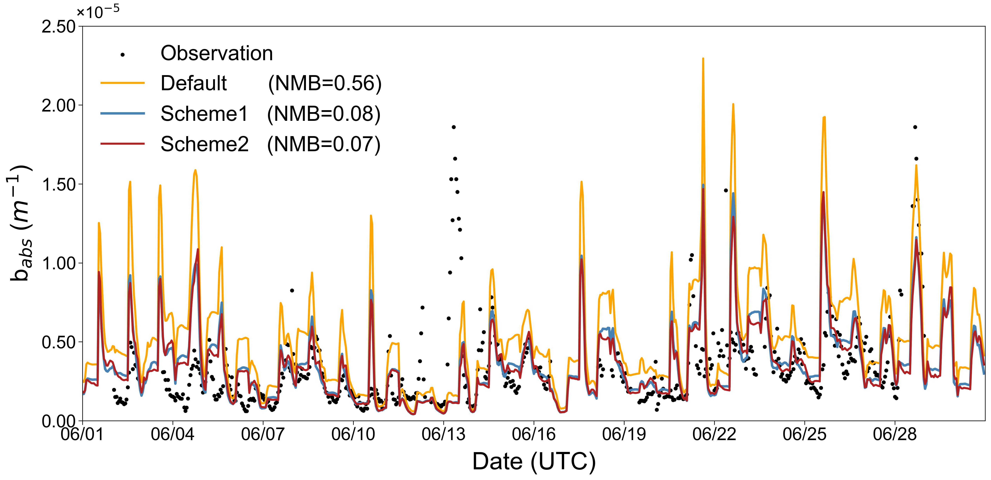
New Model Results Analysis：Optical properties
Absorption coefficient ($b_{abs}$) (532nm)

Slide 16
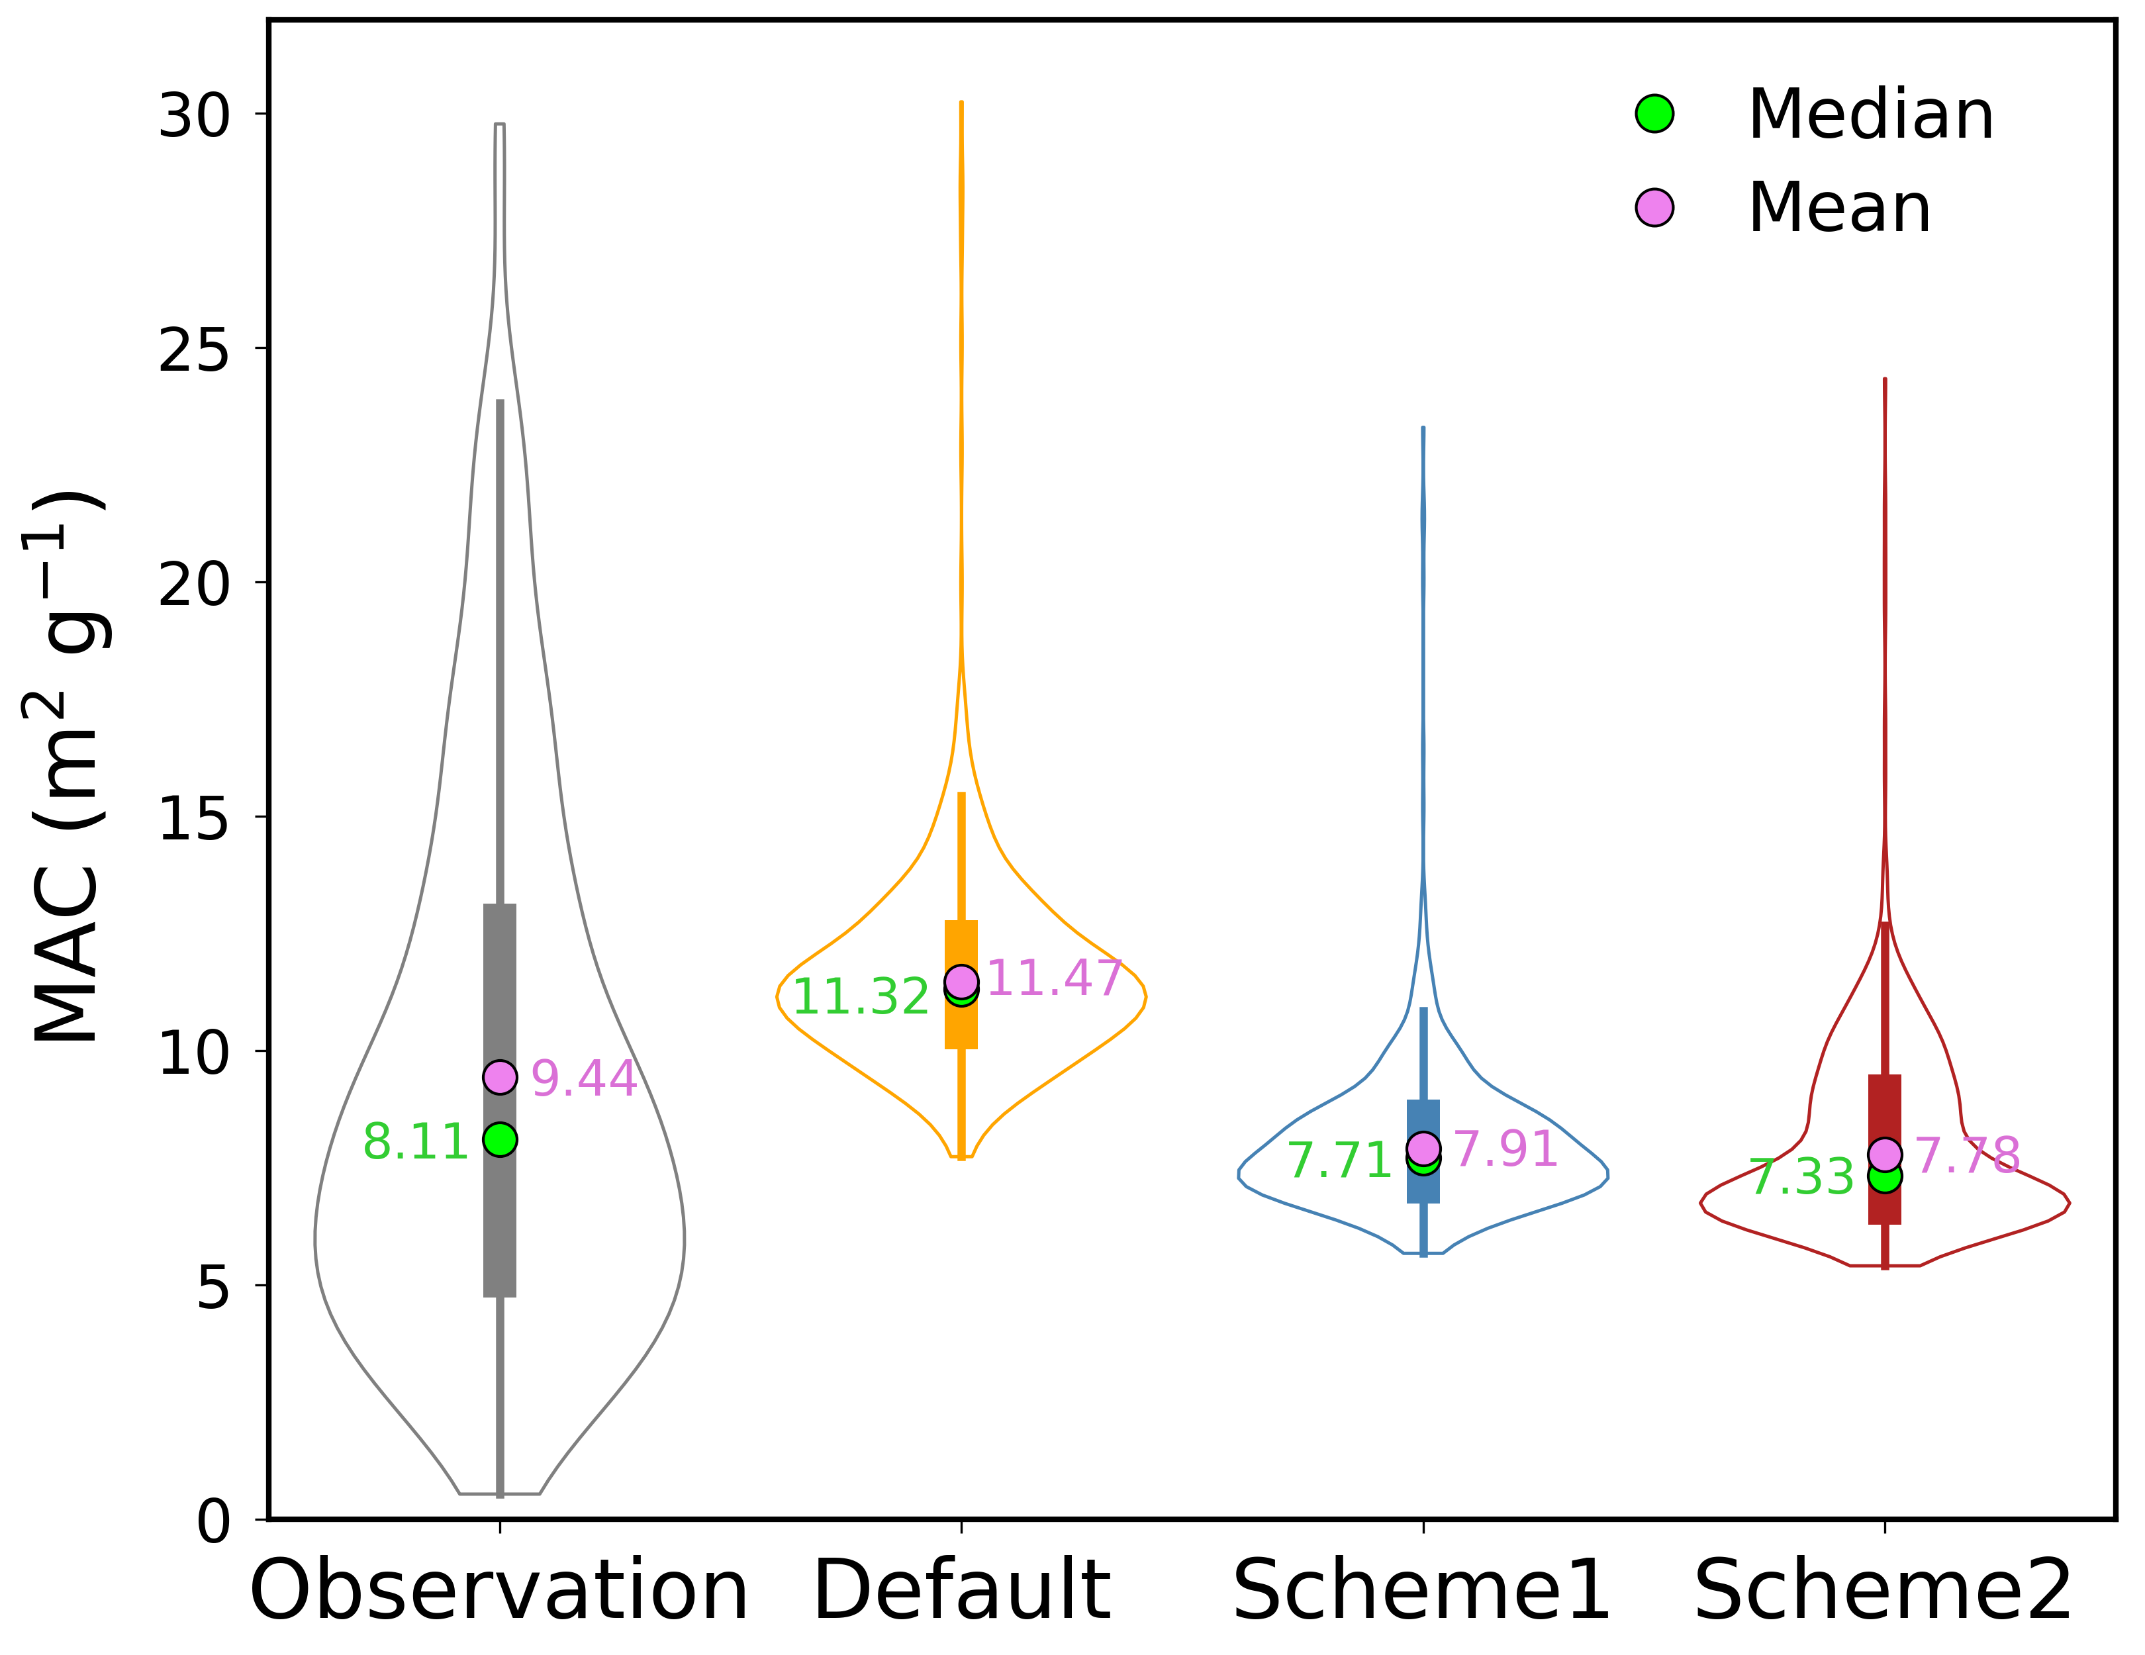
New Model Results Analysis：Optical properties (cont’d)
BC mass absorption cross-section (MAC) (532nm)
$$MAC=\frac{b_{abs}}{M_{BC} }$$
Absorption coefficient
BC mass concentration
Considering BC aging process can reduce the MAC values.

Slide 17
New Model Results Analysis：Optical properties (cont’d)
“Grid-Point Equivalent Particles” (GPEP)
The Diameter of Particles (Dp)
The Diameter of BC Core (Dc)

Slide 18
New Model Results Analysis：Conclusions
The new model, which takes into account the BC aging process, exhibits good performance in terms of aging-related variables, BC mixing state, and optical properties.
The scheme2 better reflects the spatiotemporal distribution of aging-related variables.
We will explore more suitable BC aging schemes in the future.

Slide 19
THANKS Email: jin@nuist.edu.cn

