Slide 1


Quantifying the effects of vegetative in-canopy photolysis and turbulence processes on U.S. air quality
Chi-Tsan Wang, Patrick Campbell, Siqi Ma, Irena Ivanova, Paul Makar, Daniel Tong,
Bok H. Baek, Center of Spatial Information Science and System
Research support by NOAA/In-Canopy Processes project & NOAA/Emission Inventories satellite project

Slide 2
Outline
Research Background
Objectives
Methods
Results
Conclusions

Slide 3
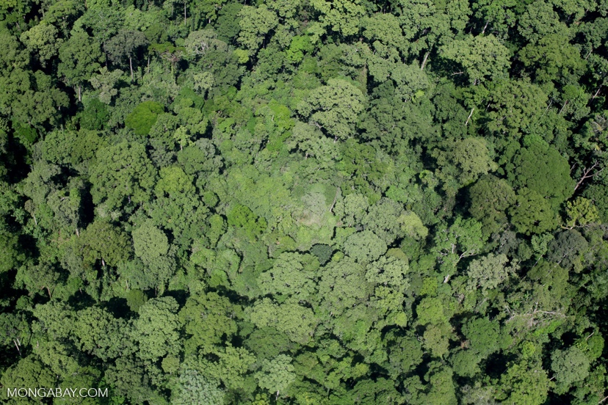
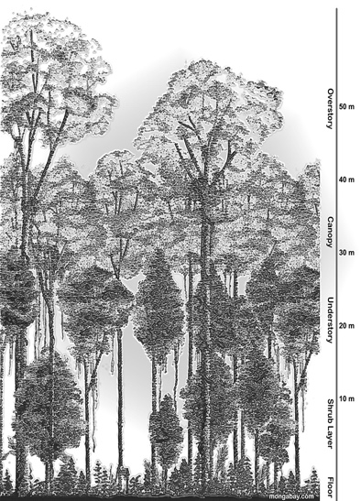
Research background
https://rainforests.mongabay.com/0303.htm
https://rainforests.mongabay.com/0202.htm
Atmosphere-biosphere interactions have important effects on air quality.
Historically, chemical transport models (CTMs) have been well developed to account for simulating the bulk effects (e.g., biogenic emissions, dry deposition, etc.) of the overlaying and vegetative canopy top processes.
However, most CTMs continue to rely on the approximate, but useful “big-leaf” model for the air-canopy interface, with little to no representation of the underlying in-canopy processes, especially at the "leaf-scale".
Systematic ozone overpredictions in CTMs are linked to distinct vertical gradients of ozone measured within dense forest canopies of the U.S. (Makar et al., 2017)
In-Canopy processes : Winds, dry deposition, photolysis, eddy diffusion

Slide 4
Objectives
Develop and employ explicit, but simplified parameterizations for the effects of in-canopy photolysis attenuation and modulated vertical turbulence/eddy diffusivity
Implement these canopy effects in variant of the George Mason University (GMU) air quality modeling system.
Investigate and quantify the canopy chemical and transport impacts on systematic ozone overpredictions in areas of contiguous canopies.

Slide 5
Methods: CTM model configuration
CTM model | CMAQv5.3.1 with Canopy (https://github.com/GMU-SESS-AQ/CMAQ/tree/5.3.1_gmu-dev-canopy)
Model Domain/Res. | CONUS @ 12x12 km horizontal with 35 vertical layers (~ 40 m 1st layer thickness)
Simulation period | August 2019
Meteorology | NOAA Global Forecast System Version 16 (Interpolated 13 km --> 12 km horizontal and 127L --> 35 L vertical)
Emissions | NEI 2019
Wildfire emission | NEI 2019 wildfire data
Basic Canopy Effects | Photolysis Attenuation and reduced vertical turbulence
Chemical mechanism | CB6r3 with Aero7
Simulation cases | Canopy effect turn on (canopy case) and off (base case)
Notes:
NO Horizonal wind speed reduced? Or this already considered in CMAQ? Summarize two tables. 5.3.1.
Put the simulation period, simulation scenario.
Mothed :

Slide 6
Methods: Canopy configuration
Input variables added for canopy criteria and correction
Canopy variables | Descriptions | Criteria
FCH | Forest canopy Height | > 10 m
FRT | Forest Fraction | > 0.5 (50%)
POPU | Population density (10km²) | < 10000 people
LAI | Leaf Area Index | > 0.1
CLU | Clumping index | EXP(-0.5*LAI*CLU) > 0.45 and FCH < 18 m
Data and thresholds adapted from on Makar et al. (2017)

Slide 7
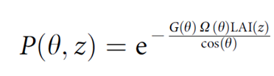
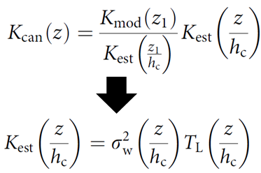
Methods: Canopy Parameterizations in CMAQ
Photolysis Attenuation
Eddy Diffusivity
Probability of beam penetration (i.e., fractional light penetration; Nilson, 1971; Monsi and Saeki, 1953) depends on LAI, leaf projection (G), clumping index (Ω), and solar zenith angle (θ).
Modified turbulent diffusivity based on the Raupach (1989) near field theory for turbulence within the forest canopy. K is scaled to 1st model layer and depends on variance in Eulerian vertical velocity (σ²_{w}) and turbulent length scale (T_{L}).
Parameterizations based on Makar et al. (2017), but not exact methodology.
Work here is based on original model vertical structure, with simplified integrated canopy effects.

Slide 8
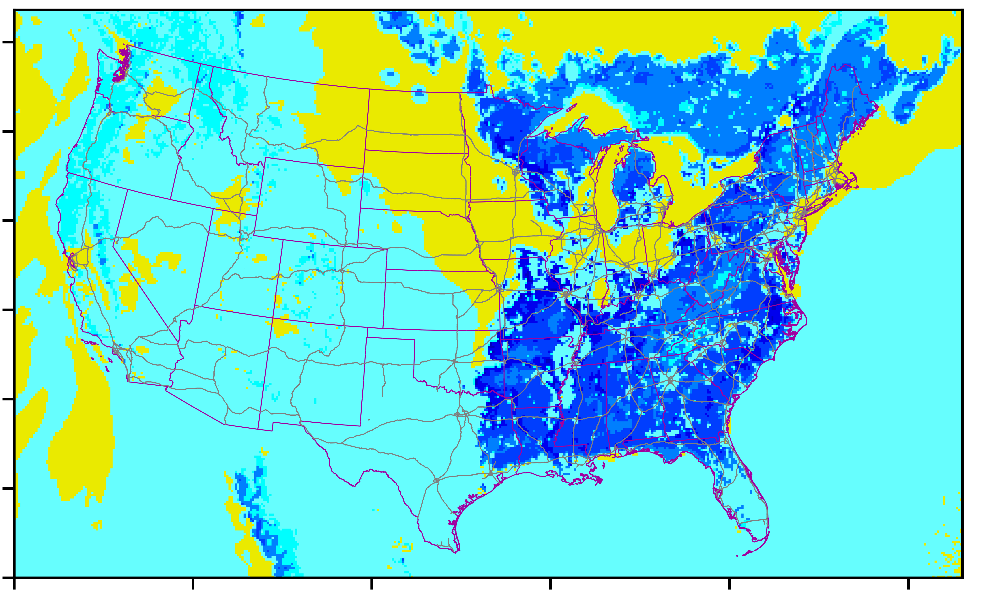
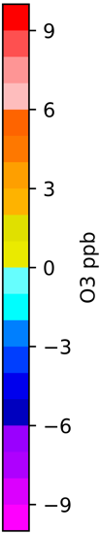
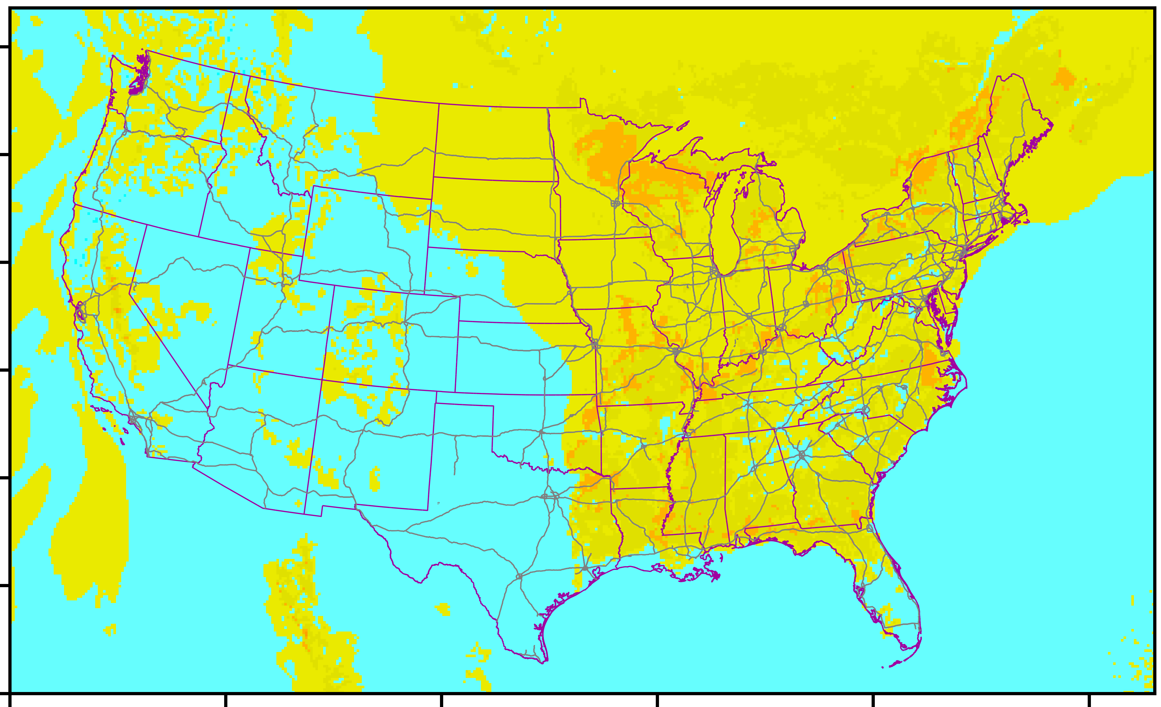
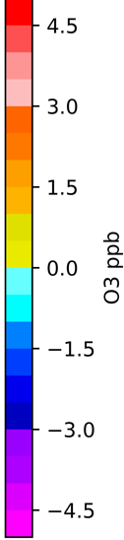
Results: Ozone difference spatial plot
Model result :Average Ozone difference (Canopy - no Canopy)
August 2019
Surface
2nd layer
1. Ozone decrease in the morning, evening and night on surface layer, this decrease happened in the eastern area.
2. The second layer ozone increase.
Notes:
Result, subtitle 2019 same time period.
2019 ozone.

Slide 9
Results: Ozone time series plot with PA result
PA result timeseries for average August 2019 over eastern CONUS in regions of contiguous canopies for
Canopy (Left) and Canopy-Base (Right)
Eastern US Sep.2019 monthly average by hour Ozone PA
Eastern US monthly average by hour Delta Ozone conc and process rate
Solid color : canopy

Slide 10
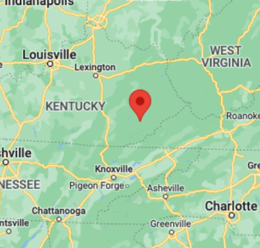
Case Study: PA result timeseries on August 03, 2019 in eastern forest in KY (37.167, -83.268), surface layer
Results: Ozone time series plot with PA result
Ozone hourly concentration with all and delta processes for
Canopy (left) and Canopy-Base (Right)
Process rate (ppb /hr)
Process rate (ppb /hr)
Reduced photolysis
Late Vertical diffusion

Slide 11
Results: NOx time series plot with PA result
Surface NO_{X} hourly “delta” concentration and processes for Canopy - Base,
NO (left) and NO₂ (Right)
Increasing chemical formation (NO-> NO2)
Reduction of vertical transport
Delta process (Canopy - Base)
Delta process (Canopy - Base)
Increasing chemical loss (NO-> NO2)
Increasing vertical transport
Summary of canopy effects in 1st model layer for Ozone and NOx:
Canopy reduce the transport effect for Ozone and NOx
Most of the NO become NO₂ (NO + (O₃, HO₂, RO₂) -> NO₂) at the surface and transport to upper layer.

Slide 12
Model Evaluation for Eastern US and Forest fraction > 50% AQS grid cell locations
O₃
0
2
4
6
8
10
14
16
18
20
22
LT
Sepcies | Model SCE | MB (ppb) | NMB (%)
O₃ | Base | +2.47 | +4.15%
 | Canopy | +1.05 | +1.7%
NO₂ | Base | -0.56 | -1.8%
 | Canopy | -0.46 | -1.5%

Slide 13
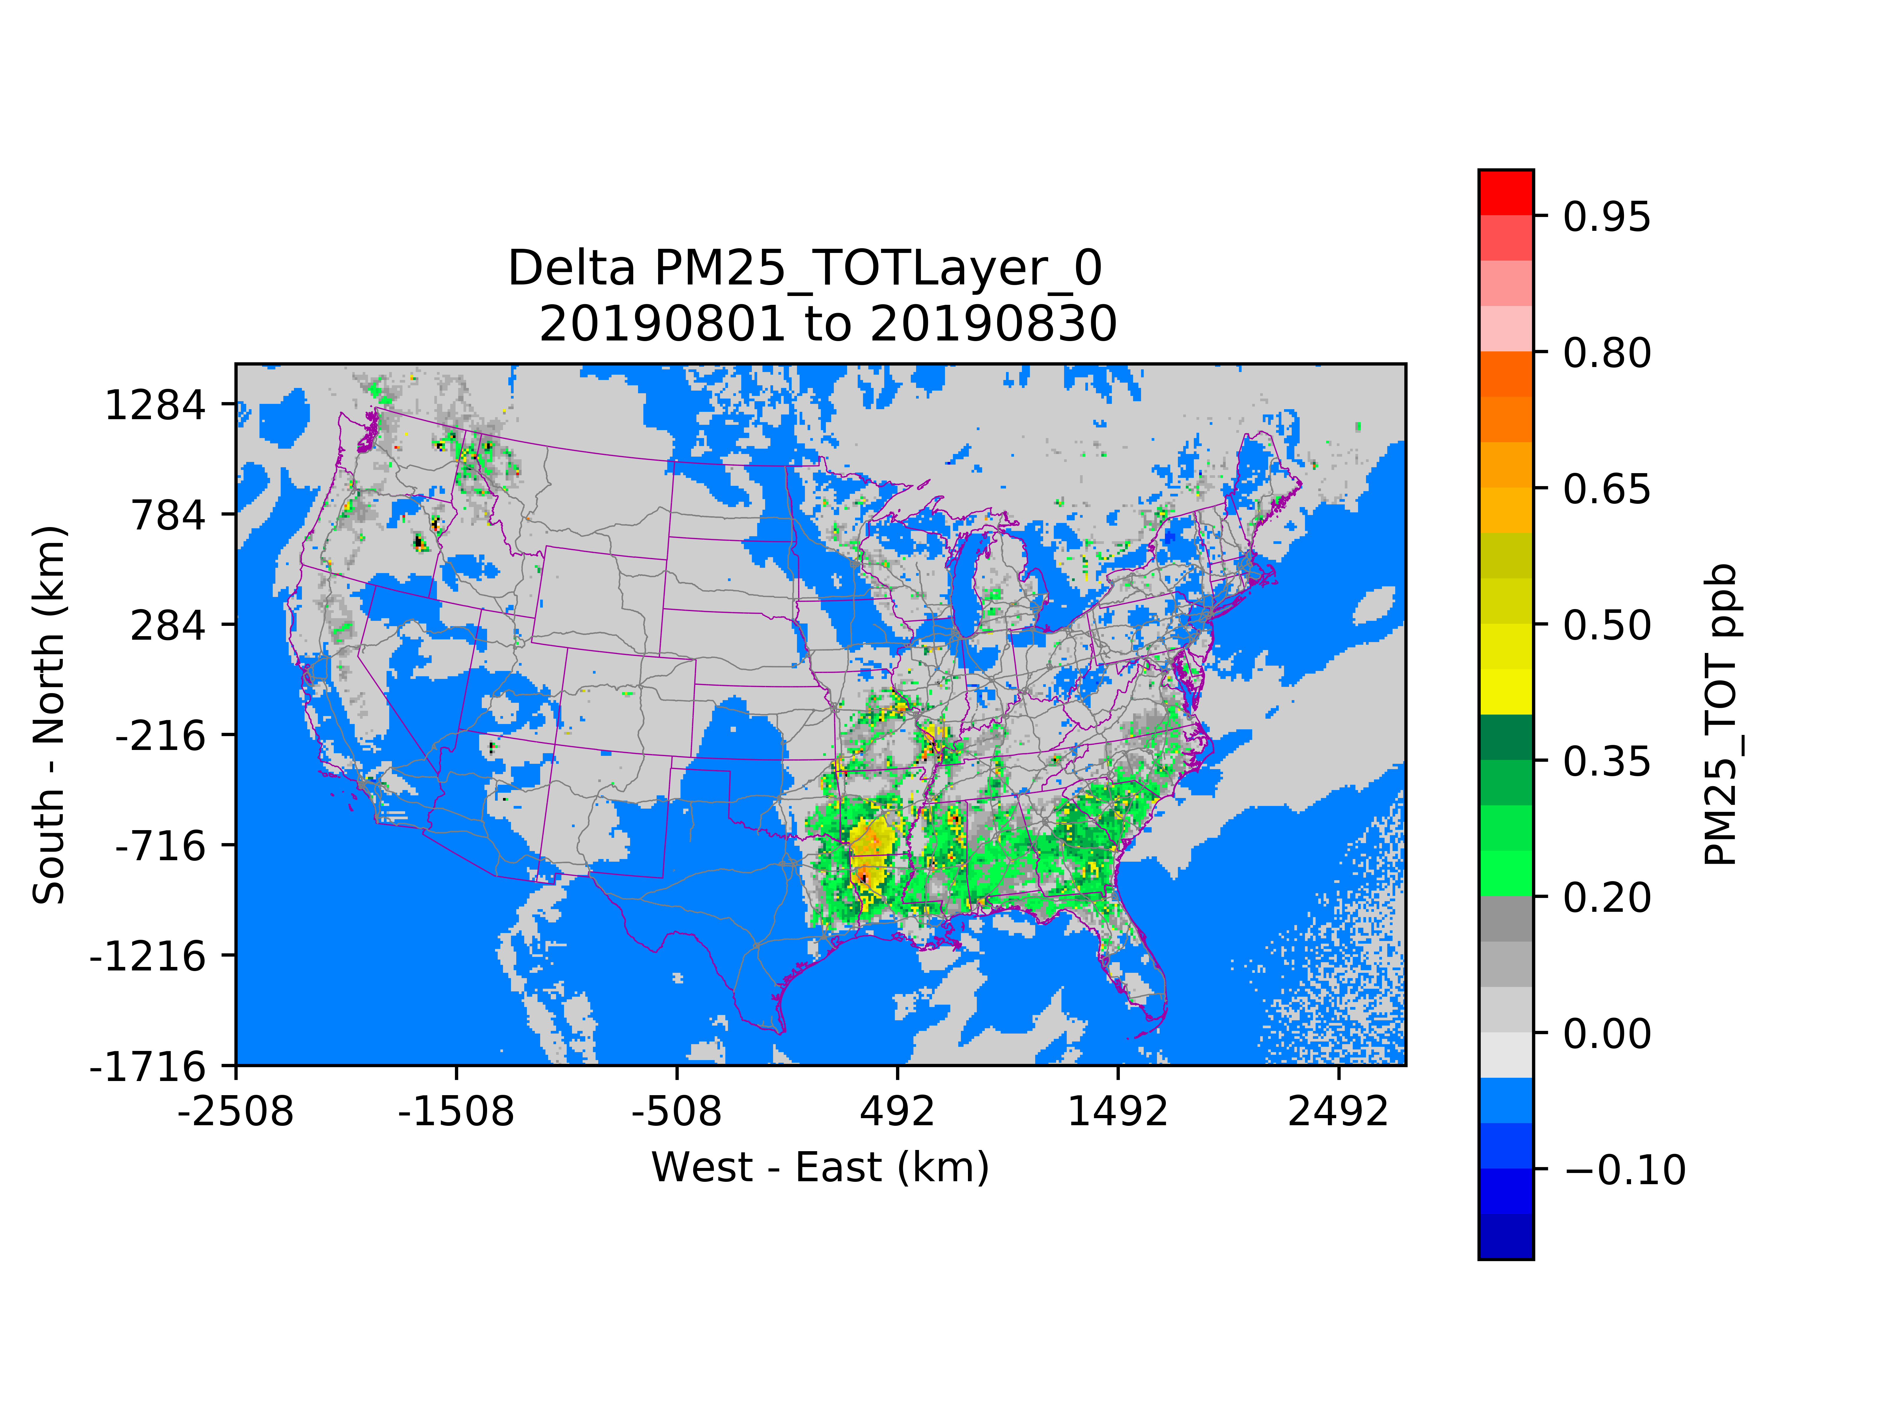
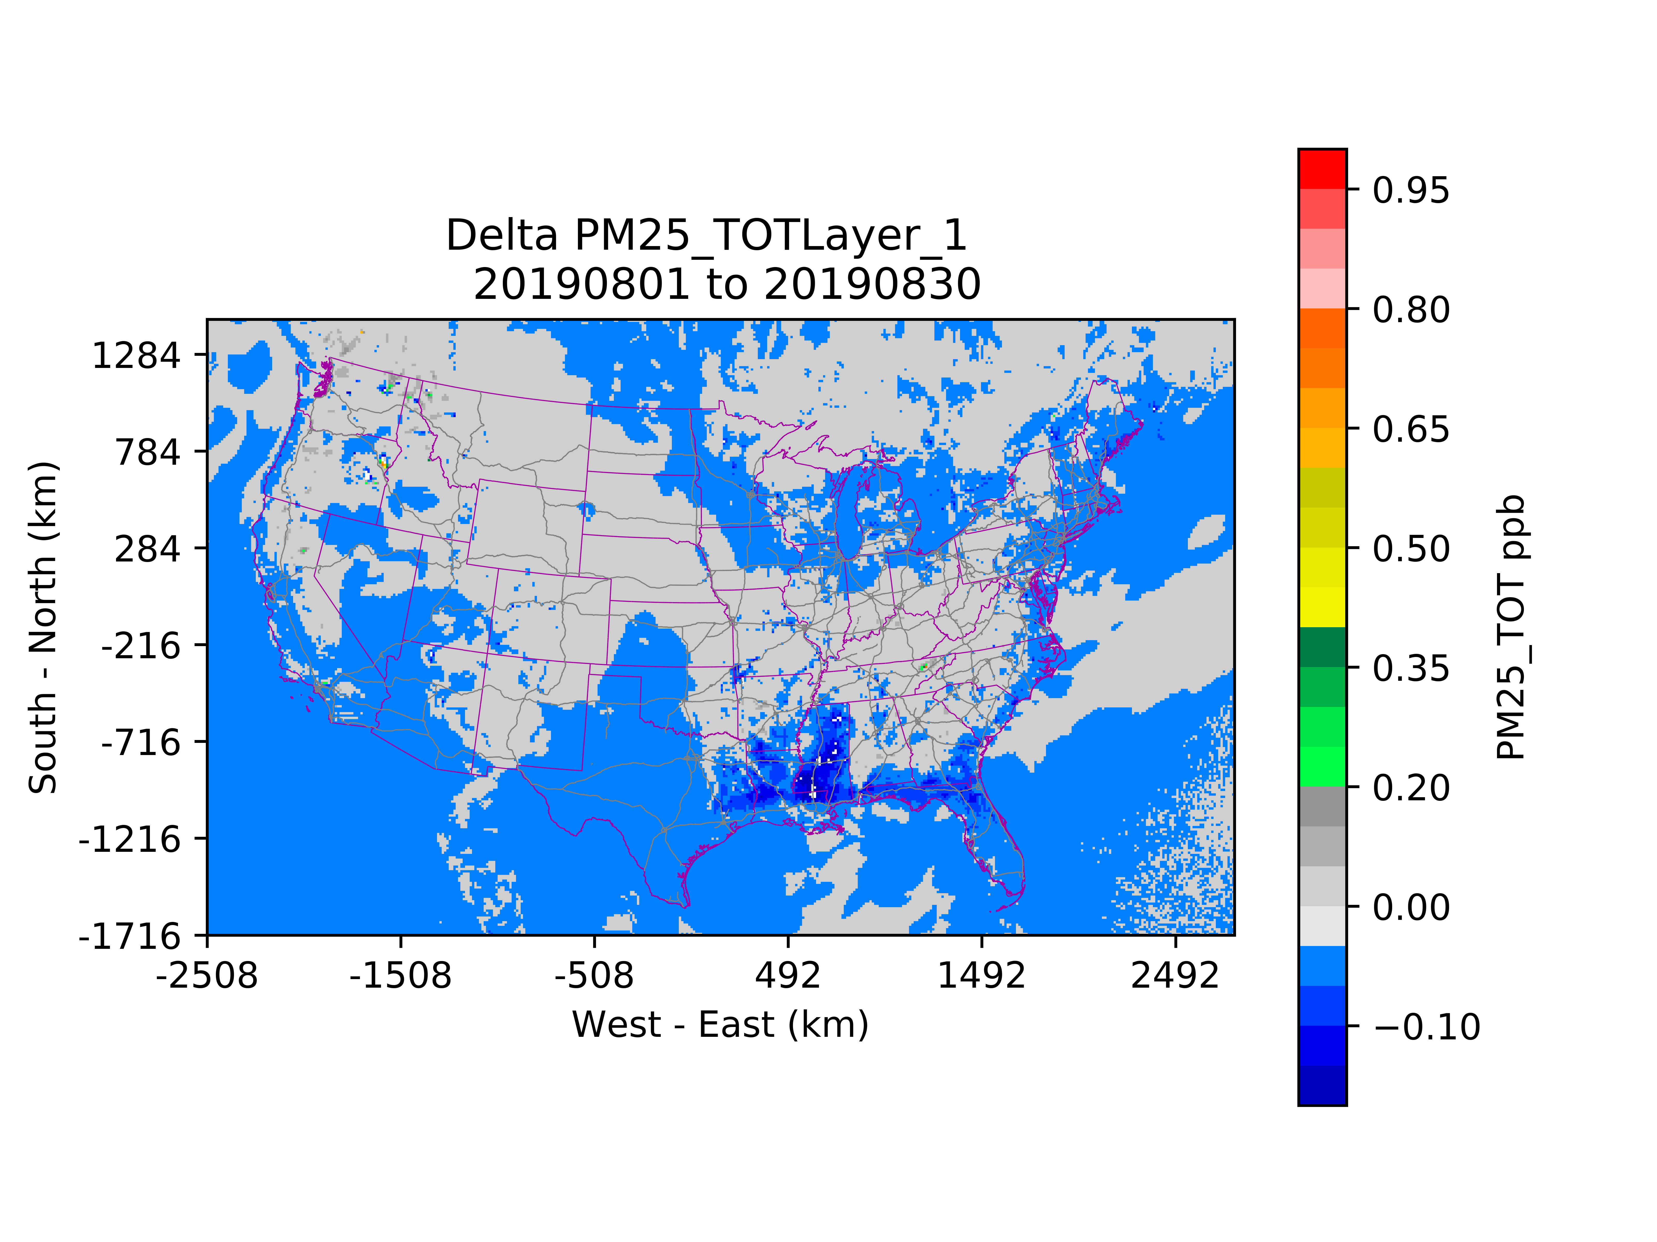
Results: PM25_TOT difference spatial plot
Model result :Average PM25 difference (Canopy - no Canopy)
August 2019
Surface
2nd layer

Slide 14
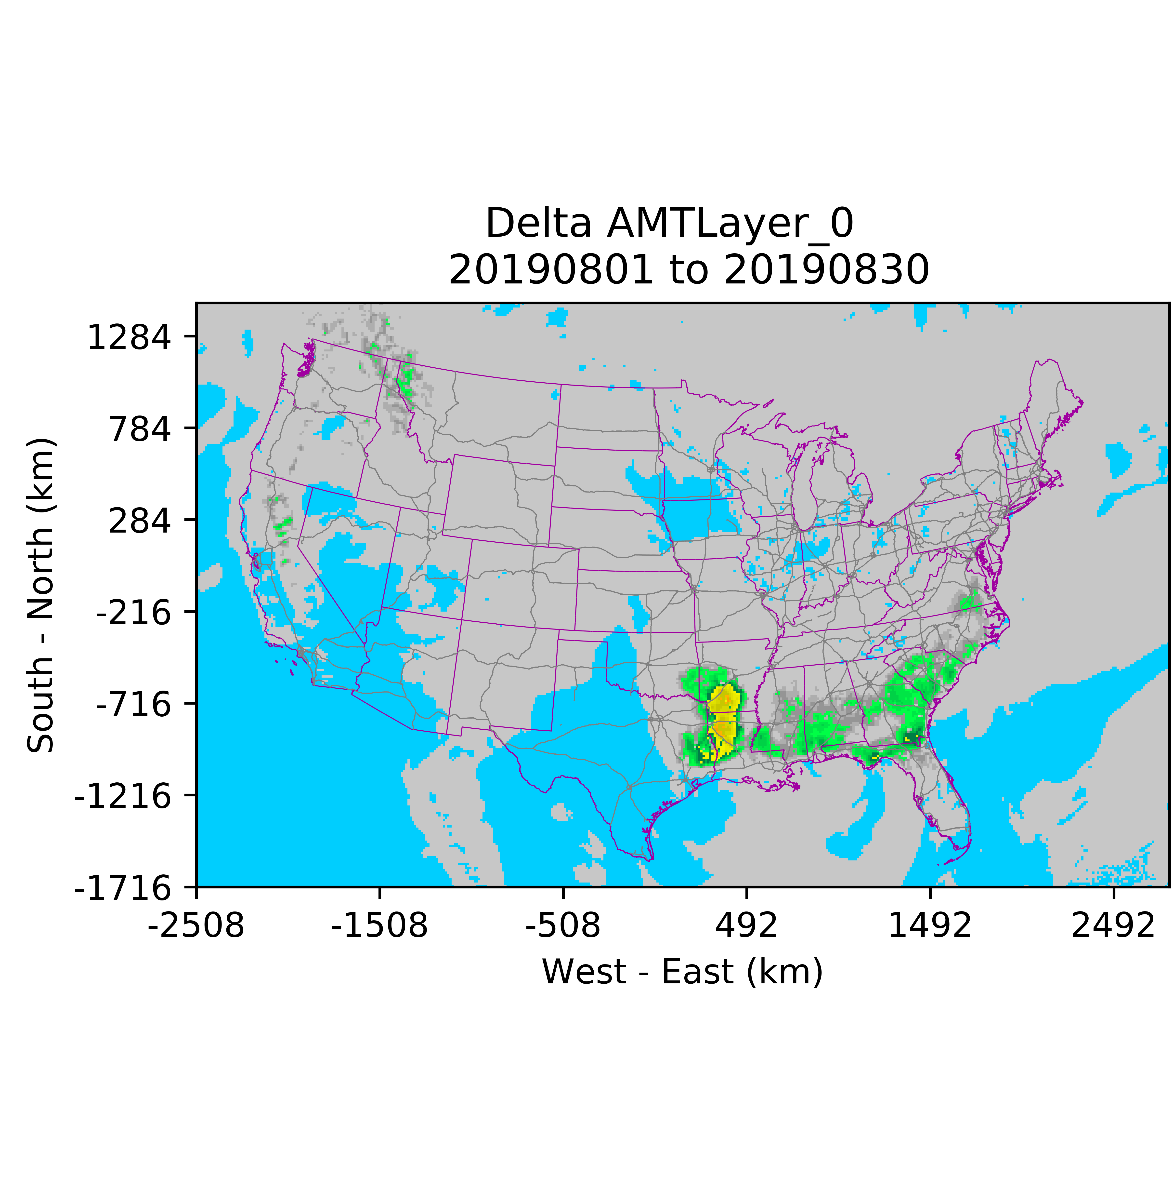
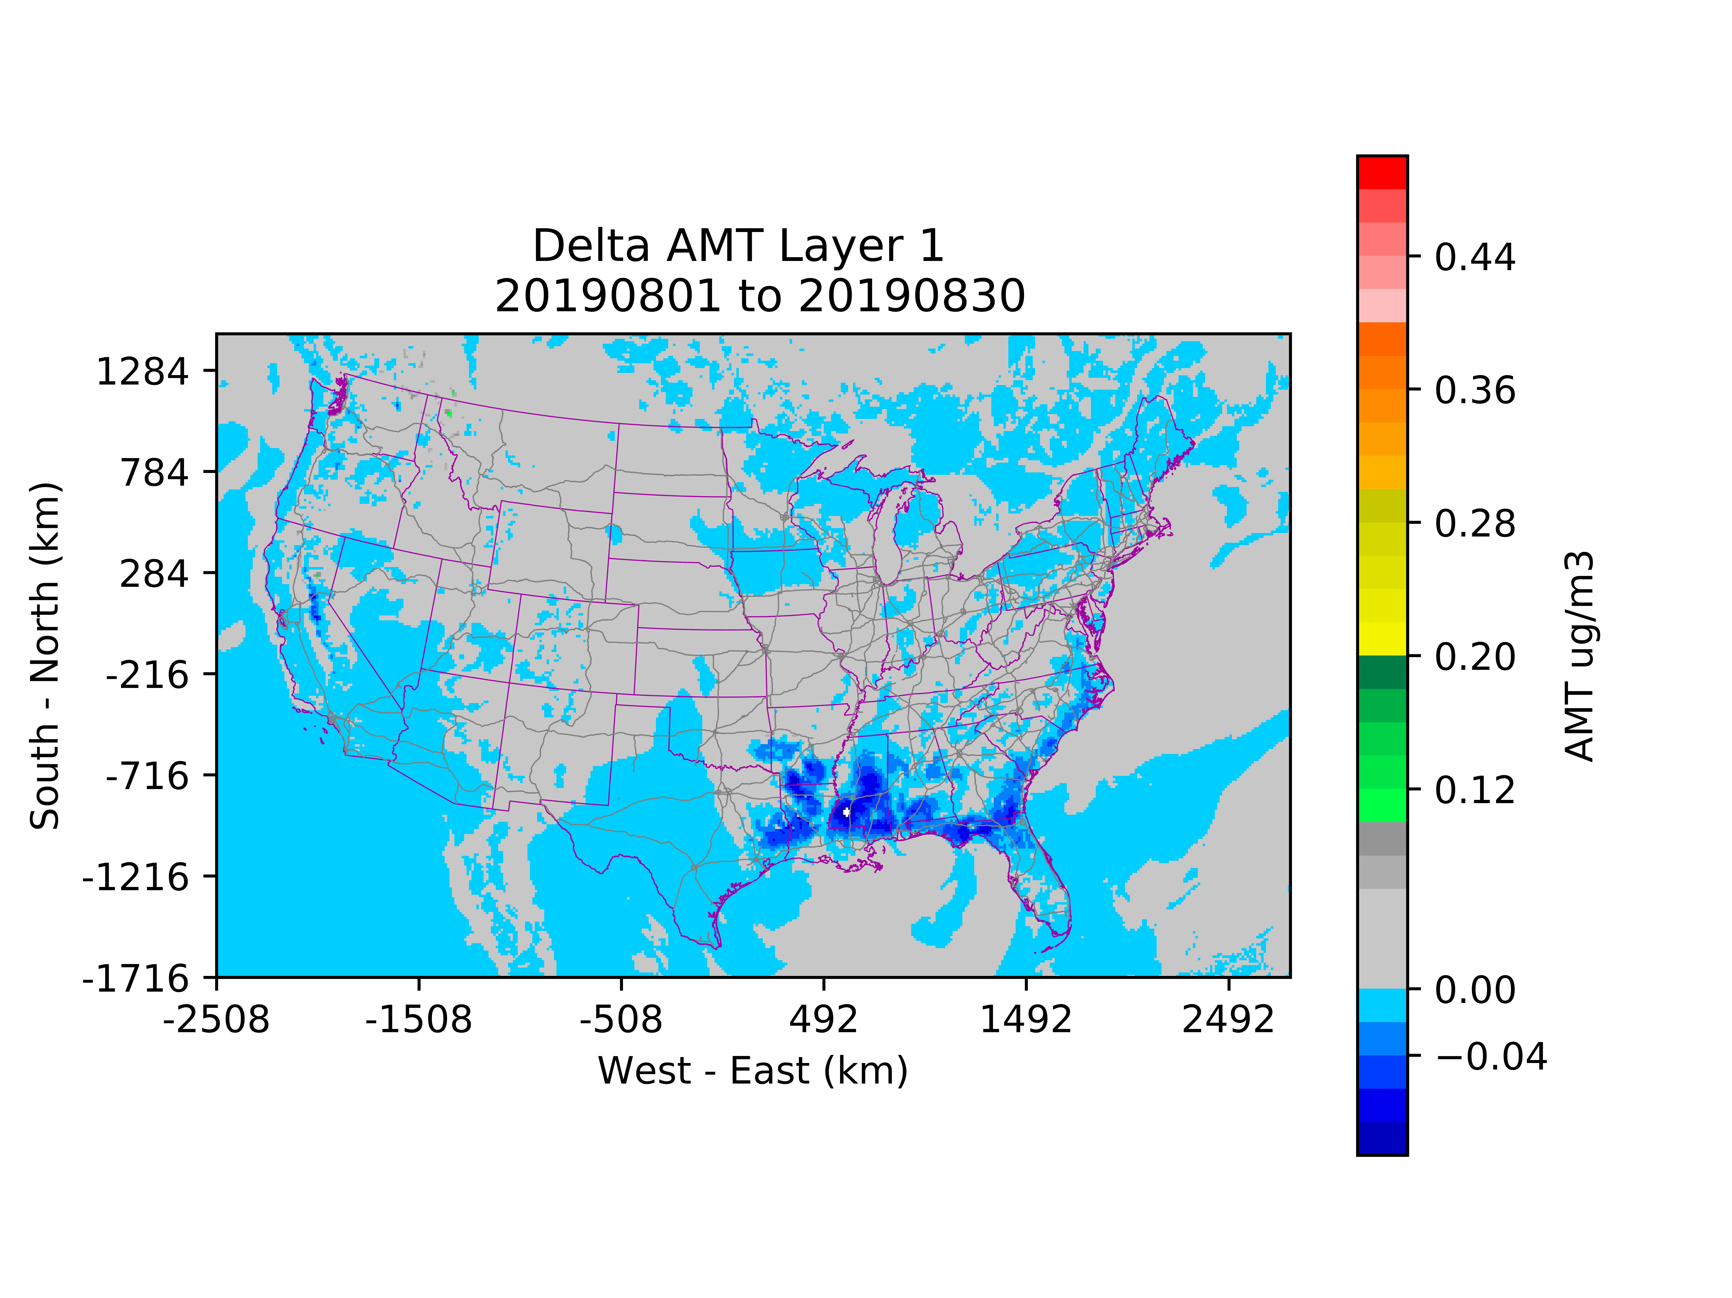
SVOC condensation from Monoterpene contribute the PM2.5 changes

Slide 15
Conclusions and Future work:
The canopy reduces photolysis during the day and significantly shifts the surface daytime ozone chemical processes rate about -110% to -250%. (Aug. 2019)
The canopy reduces the vertical transport for air pollutants (Ozone, NO_{x}, and VOCs). Delays the nighttime and morning vertical transport.
Overall shifts oxidant concentrations and changes the distribution of primary (NO_{x}) and formation of secondary pollutants (Ozone).
The canopy correction improves both Ozone and NO₂ model performance compared to AirNow observations.
Future tasks:
Canopy effects using additional model layers and sensitivity tests.
Use of field/satellite/aircraft data for improved evaluations.

Slide 16
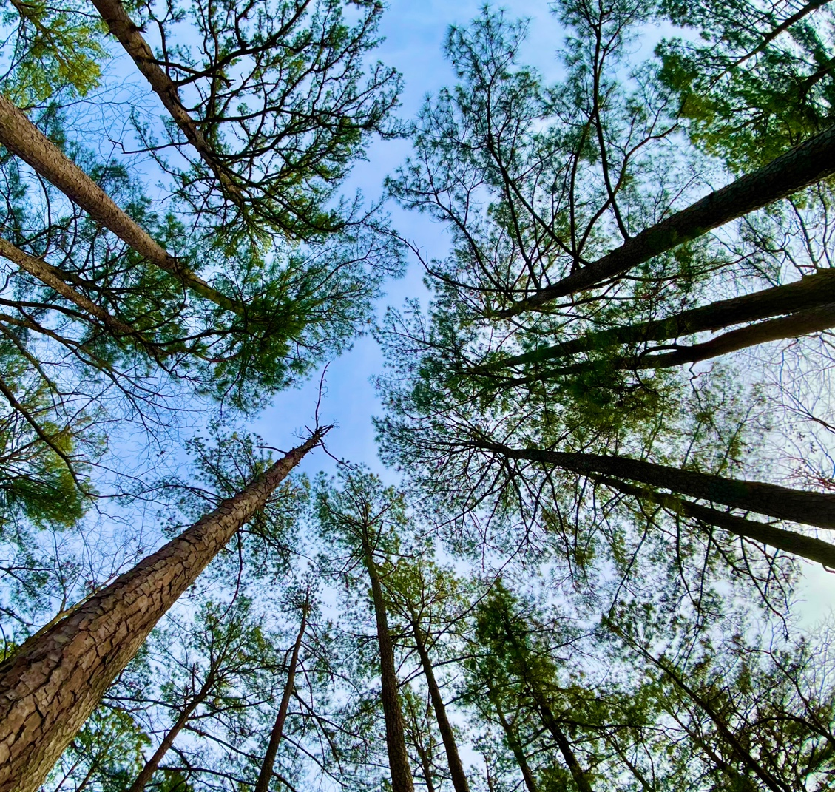
cwang48@gmu.edu
Thank you
Patrick Campbell, Siqi Ma, Irena Ivanova, Paul Makar, Daniel Tong,
Bok H. Baek
Research support by NOAA/In-Canopy Processes project & NOAA/Emission Inventories satellite project

Slide 17
Results: PM25 time series plot with PA result
PA result timeseries for average August 2019 for Canopy (left) and Canopy-Base (Right)
Delta process (Canopy - Base)

Slide 18
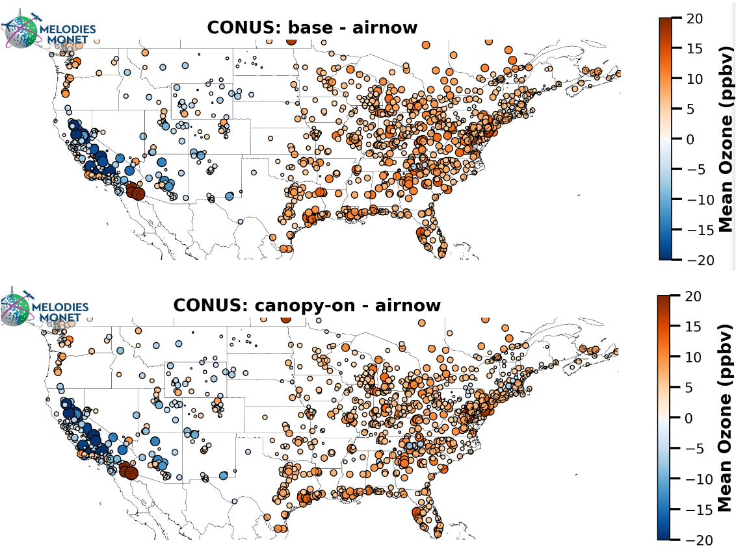
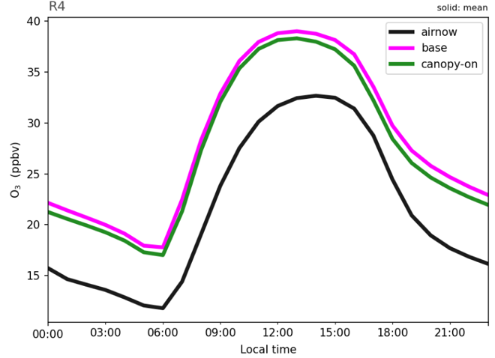
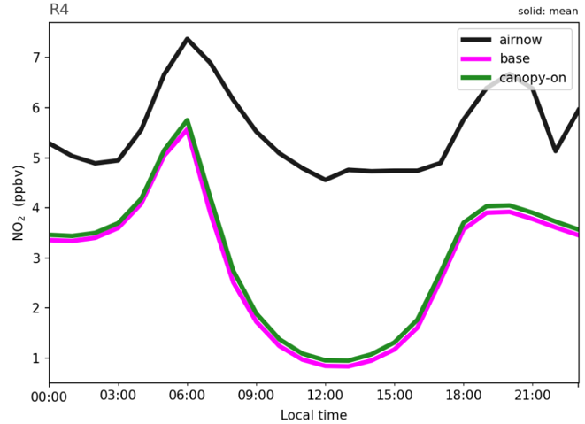
Results: Model performance
Southeast U.S. Only (EPA R4)
Ozone
MB (ppb) | +3.8
NMB (%) | +14.3
NME (%) | 33.4
IOA | 0.83
NO₂
MB (ppb) | +3.1
NMB (%) | +12.1
NME (%) | 32.7
IOA | 0.83
Reduces systematic ozone overpredictions in regions of contiguous canopies.
Larger impacts exist at the AirNow site-level, although still not situated in regions of canopies (need improved evaluation).
Further canopy tests are underway that can increase canopy impacts (e.g., increased model vertical resolution).
Notes:
Model performance evaluation.

