Slide 1
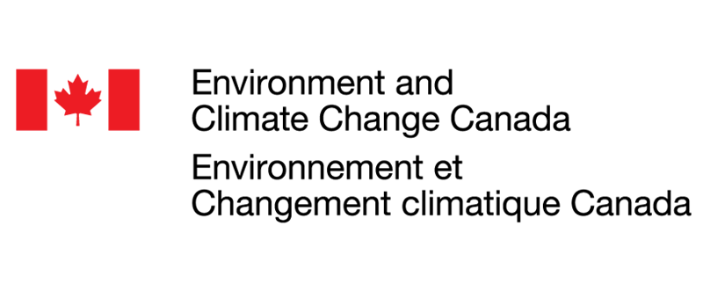
Beyond the Big-Leaf Model for NOAA’s Unified Air Quality Forecasting Capabilities
Patrick Campbell, Irena Ivanova, Wei-Ting Hung, Zachary Moon, Paul Makar, Barry Baker, Youhua Tang, Rick Saylor, Raffaele Montuoro, and Fanglin Yang
George Mason University
NOAA Air Resources Laboratory
Earth Resources Technology
Environment and Climate Change Canada
CMAS Conference: Model Development @ 1:00 P.M. October 16, 2023

Slide 2
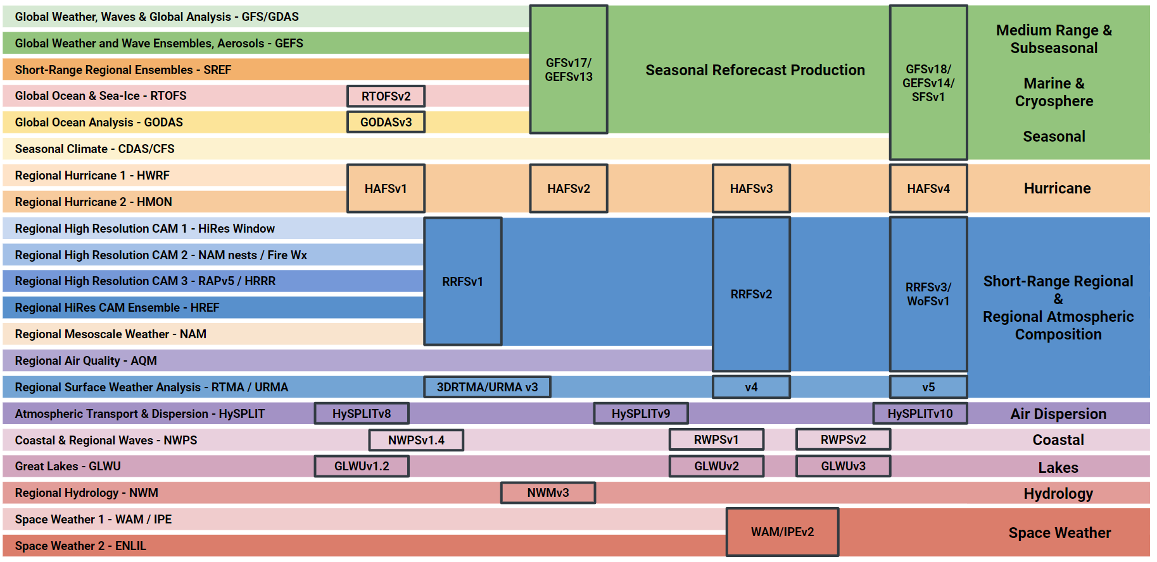
The Unified Forecast System (UFS)
https://ufscommunity.org/
Notes:
The Unified Forecast System (UFS) is a community-based, coupled, comprehensive Earth modeling system. The UFS applications span local to global domains and predictive time scales from sub-hourly analyses to seasonal predictions.
For this work, we are concenred with the regional air quality model, or AQM (highlighted in yellow box), which is coupled to the UFS within the Short-Range Regional and Regional Atmospheric Composition applications.

Slide 3
NOAA’s Next-Generation Coupled Air Quality Model
FV3 model
CMAQ (simplified)
NOAA Air Quality Model (AQM)
Vertical diffusion processes
NUOPC Layer
Include emissions
Added Infrastructure Layer
Read emissions (AQMIO)
Comp. vertical mixing
Comp. vertical mixing
OFF
IMPORT (includes grid)
Run Convection (ACM2)
Run Convection
OFF
Include emissions
OFF
Advection
Advection
Chemistry
Horizontal diffusion
OFF
Horizontal diffusion
Aerosols
Chemistry
Aerosols
EXPORT
https://github.com/ufs-community
Dr. Raffaele Montuoro (NOAA-EMC)
Notes:
So under the UFS, NOAA has developed the next generation air quality model (AQM), where each of the community codes/packages is designed to support interoperability of components and to facilitate experimentation.
Here we have the integrated unified weather model at NOAA, which uses the Finite Volume Cubed Sphere (or FV3) dynamical core for the atmosphere in the left orange box, and thus the use of CMAQ here as an Online UFS component is different than typical offline CMAQ used in the researach and regulatory communities, as shown in green box in middle.
Four Animations: In this case, in the green box, CMAQ now handles only emissions, chemistry, and aerosols, where we turn off the CMAQ embedded vertical mixing, convection, horizontal diffusion, and advection, and now rather these are more appropriately handled in the FV3 atmosphere and physics.
Four Animations: This is made possible by the development of NOAA’s Air Quality Model (or AQM) component, which uses an ESMF layer, known as NUOPC, to effectively handle the necessary coupling and I/O necessary to use CMAQ in this way.

Slide 4
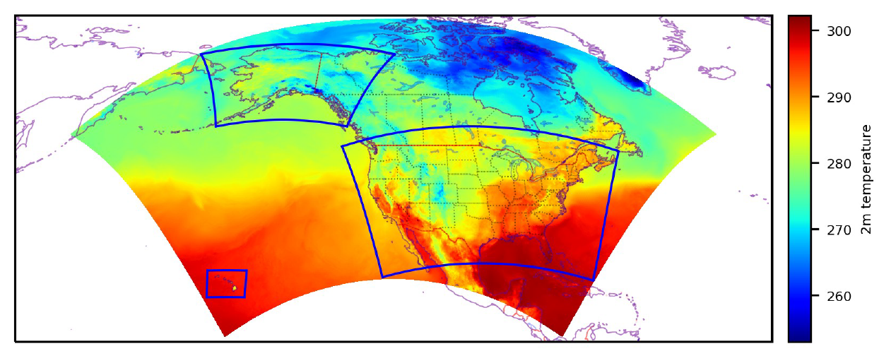
NOAA’s Current AQM Version 7: “Online-CMAQ”
UFS Online-CMAQ running in near-real time at NOAA since July 8th, 2022.
Meteorology | GFSv16-CCPP
Chemistry | CMAQv5.2.1
Emissions | NEICv2016v1 (CONUS) + Global
Biogenics | Inline MEGANv2.1
Fires | Hourly FRP + Sofiev Plume Rise (i.e., RAVE, see Li et al., 2022)
Windblown Dust | FENGSHA
CLBCs | Static AM4 Model + GEFS-Aerosols
Larger North American domain (13x13 km)
Blue boxes = Current Operational AQMv6
https://github.com/NOAA-EMC/AQM
Notes:
NOAA’s current AQM Version 7 under development (but has been running experimentally for some time and is slated for operations later this year) is known as, and hereafter referred to as “Online-CMAQ” given the coupling structure as shown in previous slide, which facilitates running CMAQ in the AQM on the same time step integrated with the FV3 atmosphere and physics.
The domain of Online-CMAQ is now a single larger North American domain at 13 km horizontal resolution (in contrast to our current operational forecast model at NOAA that used 3 smaller domains shown in blue here for CONUS, AK, and HI).
The configuration uses Global Forecast System Version 16 regional CCPP based physics/meteorology and CMAQ version 5.2.1. Other configurations include 2016 NEI modeling platform emissions, inline MEGANv2.1 biogenic emissions, NOAA’s top-down Fire Radiative Power approach for hourly biomass burning/fire emissions with plume rise, Fengsha windblown dust, and static chemical lateral boundary conditions updated with NOAA’s operational global GEFS-Aerosols for smoke and dust through the North American domain boundaries.

Slide 5
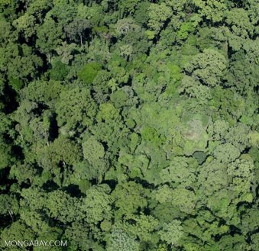
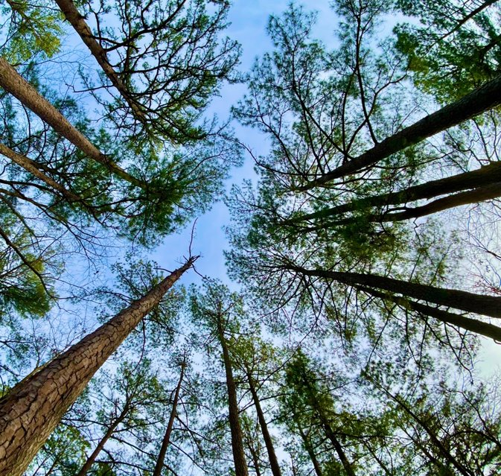
Beyond the “big-leaf” model in Online-CMAQ
The big-leaf approach is widely used in land, weather, climate, and air quality models, and typically represent the plant canopies as a homogeneous single layer without real vertical structure.
Multi-layer canopy models are more costly, but can better represent the vertical variation of within canopy physical, dynamical, and chemical traits.
Application of multilayer approaches to already costly air quality forecasting models with complex chemistry at regional to global scales presents further challenges (especially in UFS Online-CMAQ).
Single-Layer Canopy
Multi-Layer Canopy
Notes:
In this project, we aim to move beyond the big-leaf approach, which historically and currently is used in NWP and air quality forecasting models (Read Bullets):
The big-leaf approach is widely used in land, weather, climate, and air quality models, and typically represent the plant canopies as a homogeneous single layer without real vertical structure (as shown in the image and simple depiction of a single or effectively two layer canopy with typical resistance diagram in series or parallel to handle fluxes from the top of canopy).
Multi-layer canopy models are more costly, but can better represent the vertical variation of within canopy physical, dynamical, and chemical traits, and tends to represent the canopy explicitly and the individual fluxes at leaf scale (shown in the picture and diagram on the right).
This is an overall problem of scales. Application of multilayer approaches to already costly air quality forecasting models with complex chemistry at regional to global scales presents further challenges (especially in UFS Online-CMAQ).
A disparity exists between multilayer models that are process rich but limited in their generality beyond site specific studies of canopy microclimate and physiology (“correct but useless”) and
single-layer models that lack many processes known to occur in plant canopies but whose computational efficiency and ease of use make them convenient for coupling to the atmosphere in global models (“incorrect
but useful”).
Here we want to implement and develop methods that are both more “correct and useful in application”. But this is very challenging to apply multilayer approaches to already costly, regional air quality forecasting models that handle complex chemistry.
Interesting caveat is that while a single-layer structure for the canopy has essentially remained unchanged in NWP models and AQMs, the physics for soil temperature and soil water has expanded to multiple layers, as much as 20 layers up to 10-50 m deep, while additional layers are also used for snowpack.

Slide 6
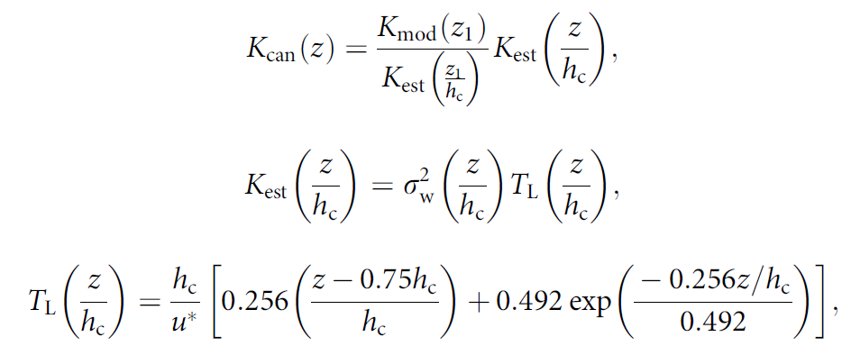
Beyond the “big-leaf” model in Online-CMAQ
Systematic ozone overpredictions in CTMs are linked to distinct vertical gradients of ozone measured within dense forest canopies of the U.S. → Incorporate canopy parameters associated with photolysis and the attenuation of light (Makar et al., 2017).
In-canopy vertical diffusivity is also modified based on the Raupach (1989) near-field theory for turbulence within the forest canopy (Makar et al., 2017):
Typical Surface O₃ Bias
Probability of beam penetration (i.e., fractional light penetration; Nilson, 1971; Monsi and Saeki, 1953) depends on LAI, leaf projection (G), clumping index (Ω), and solar zenith angle (θ).
Note: Based on Makar et al. (2017), but simplified and not exact methodology.
Notes:
Read first bullet: We note that systematic ozone overpredictions in CTMs are linked to distinct vertical gradients of ozone measured within dense forest canopies of the U.S. I show this is in our typical NOAA National Air Quality Forecasting Capability, which uses the CMAQ CTM with a typical surface ozone overprediction in eastern and northwestern U.S.
We build two parameterizations for the impacts of the canopy 1) the impacts of forest shading or photolysis attenuation and 2) the effects of reduced vertical diffusivity due to the canopy.
So first we incorporate canopy parameters associated with the attenuation of light (Makar et al., 2017), that is the top formulation, where we can calculate the probability of beam penetration, i.e., fraction light penetration. This depends on things like the canopies vertically resolved leaf area index (lai), the leaf projection, foliage clumping index and solar zenith angle.
We also parameterize a modulated in-canopy vertical eddy diffusivities based on the Raupach (1989) near-field theory for turbulence within the forest canopy. The modified turbulent diffusivity is scaled to the resolved, 1st model layer and depends on things like variance Eulerian vertical velocity and turbulent length scale.
Note here that the current, preliminary versions of these parameterizations are based on Makar et al. (2017), but not exact methodology. ​Work here is based on original FV3 model vertical structure, with simplified integrated canopy effects, and do not yet add any model layer splitting for variable forest canopy heights.​
More details:
Clumping index is a key structural parameter of plant canopies which represents the degree of foliage grouping within distinct canopy structures relative to a random distribution. This dataset provides global clumping index (CI) data for 2006 derived from the MODIS Bidirectional Reflectance Distribution Function (BRDF) data product.
G is projection of the unit leaf area in the solar zenith angle direction, and for a spherical leaf distribution, the usual assumption is that G = 0.5. Overall we assume that there is no preferred azimuth orientation/angle of the leaves and thus the probability density of the leaf projection is assumed = 0.5 for spherical leaves. Very common assumption.

Slide 7
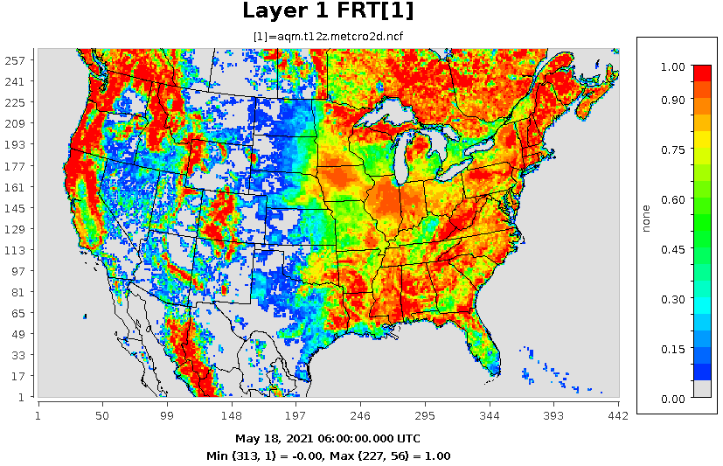
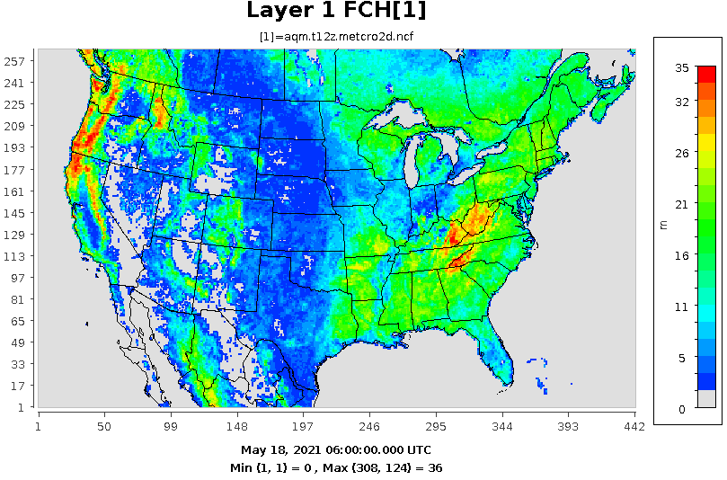
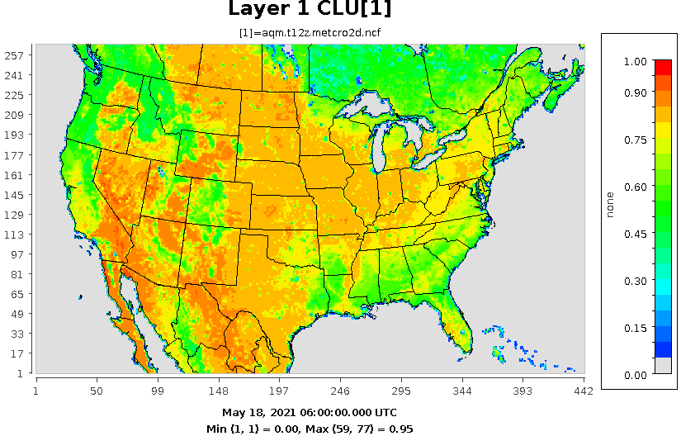
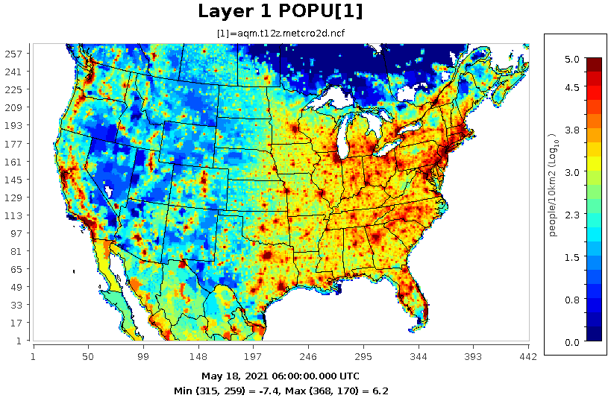
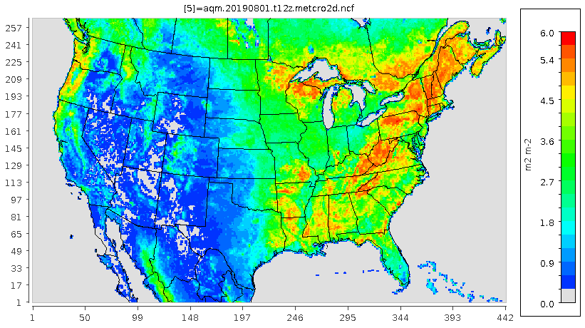
Addition of New Canopy Variables in Online-CMAQ
Forest Fraction
Canopy Height
Clumping Index
> 0.5
> 3 m
EXP(-0.5*LAI*CLU) > 0.45 and FCH > 18 m
Population Density
Leaf Area Index
Cumulative fraction of the total LAI
LAI is used with other data to input the LAI fractions going down from canopy height (hc) to 0.75 * hc, 0.50 * hc, 0.35 * hc, and 0.20 * hc.
> 10,000 people/10km²
> 0.1
Contiguous canopy thresholds
Notes:
To facilitate using these new canopy parameterizations, we add five new explicit canopy variables in Online-CMAQ, forest fraction, canopy heights, clumping index, population density, and leaf area index. These are both used to calculate the impacts of the canopy, but also define in the model which grid cells satisfy contiguous canopy conditions in each model column. These are in red below the panels.
To capture some aspect of 3D LAI structure through the canopy, we use LAI with other data to calculate the cumulative fraction of the total LAI to derive the integrated or best value of photoloysis attenuation through the canopy.
More details: Clumping index is the measure of the randomness of the leaf spatial distribution, = 1 if the leaves are randomly distributed. For a spherical leaf distribution G, or leaf projection can be assumed = 0.5.

Slide 8
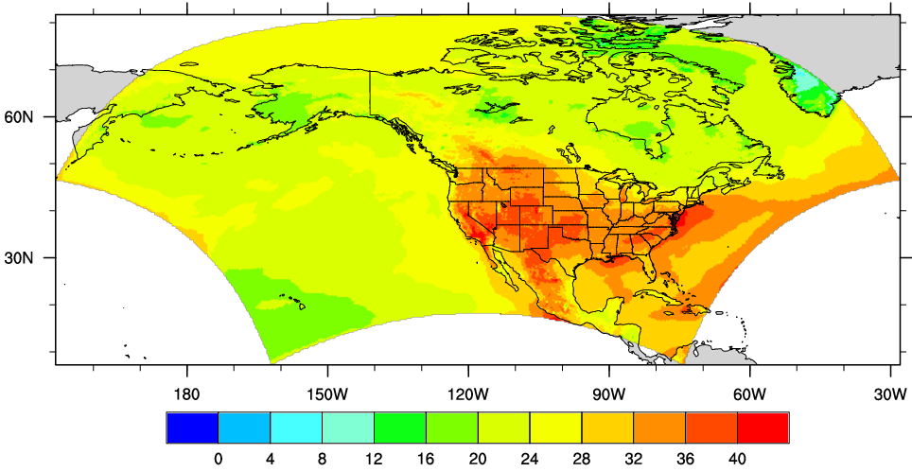
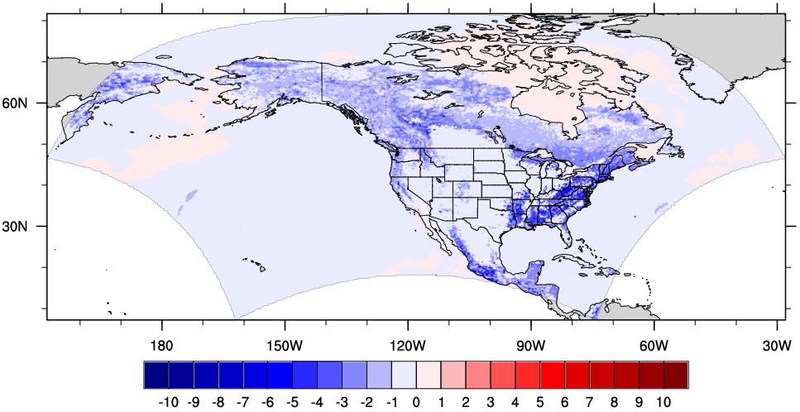
Results of Preliminary Tests During August 2023
Average Ozone Model Layer 1
Base (ppbv)
Canopy - Base (ppbv)
Maximum average grid cell ozone decrease of ~ - 10 ppb (-37% relative change).
Notes:
Next we show preliminary test results for an August 2023 simulation and the impacts of the canopy parameterizations on averaged hourly ozone. The impacts of reduced photolysis and diffusivities due to an explicit canopy effects across regions of contiguous canopies, leads to widespread, and in some cases relatively large ozone decreases. This is due to a synergetic effect of reduced photolysis during the day in the first model layer, and reducing transport of ozone titrating molecules out of the first model layer at night, both which reduce ozone concentrations.

Slide 9
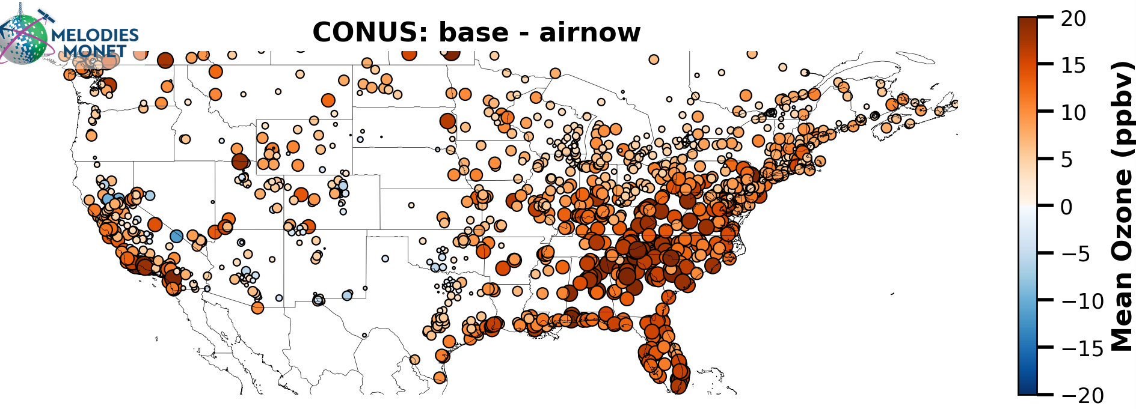
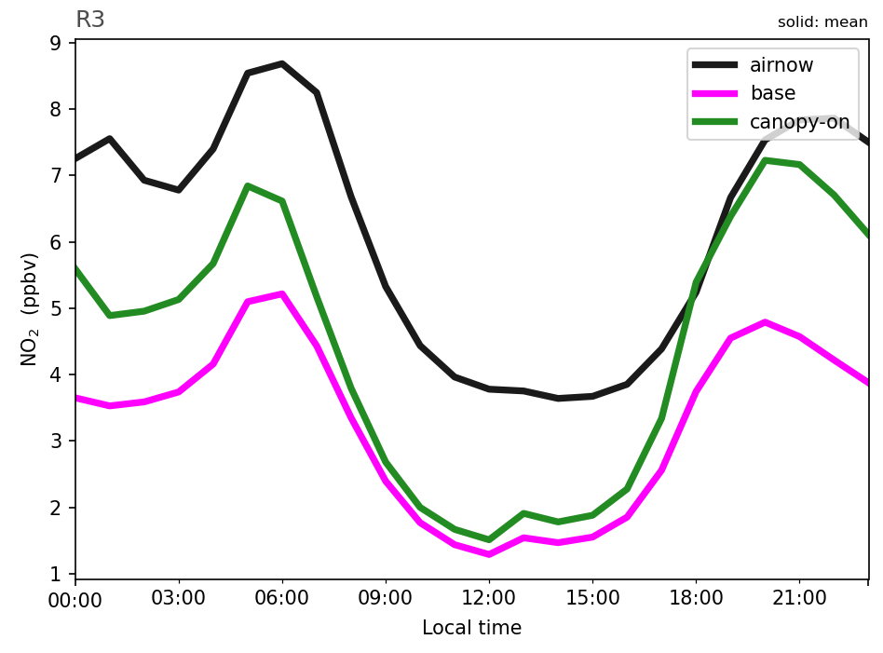
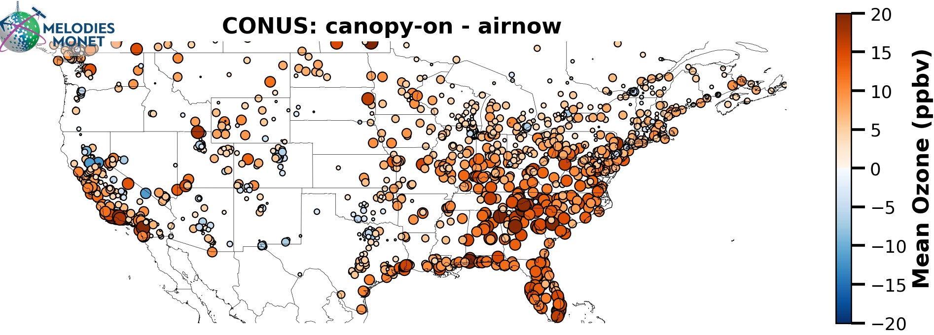
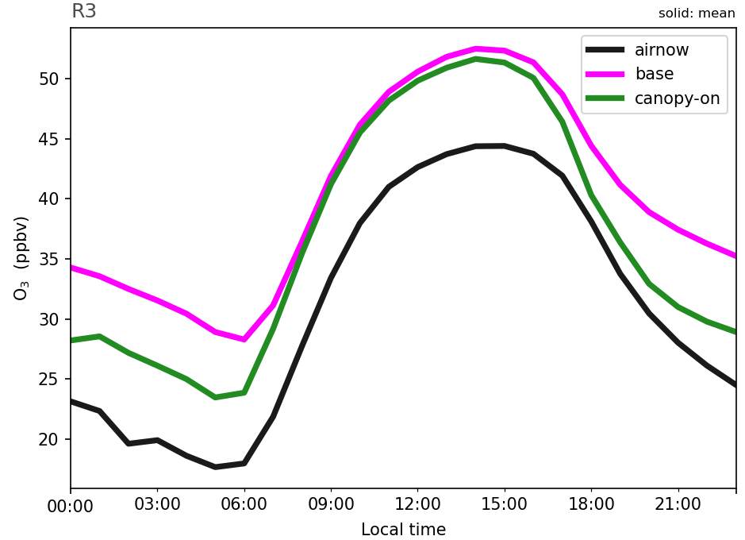
Preliminary Canopy Effects on Model Performance
August 2023 Surface O₃ Bias
August 2023 East U.S. Diurnal NO₂ and O₃
NO₂
U.S. | Base | Canopy
MB | 7.0 | 4.8
NMB | 22.4 | 15.5
NME | 32.4 | 30.3
IOA | 0.80 | 0.83
O₃
Results courtesy of Dr. Zachary Moon (NOAA-ARL/ERT)
Notes:
Here we show preliminary impacts of the canopy effects on improving model performance for Online-CMAQ, thus reducing the overpredictions in the regions of contiguous canopies, and reducing the mean bias and error, and increasing the Index of Agreement for CONUS compared to U.S. EPA AirNow surface observations of ozone.
On the right, looking only at the eastern, Mid-Atlantic regions for the diurnal pattern of surface NO2 (top) and ozone (bottom) , there is distinct increase in NO2 and reduced ozone for canopy (in green) compared to base (in pink), more prolific at night, which is in better agreement with observations (black).
/scratch/zmoon/canopy-compare/out_2023-08_warm_canopy2

Slide 10
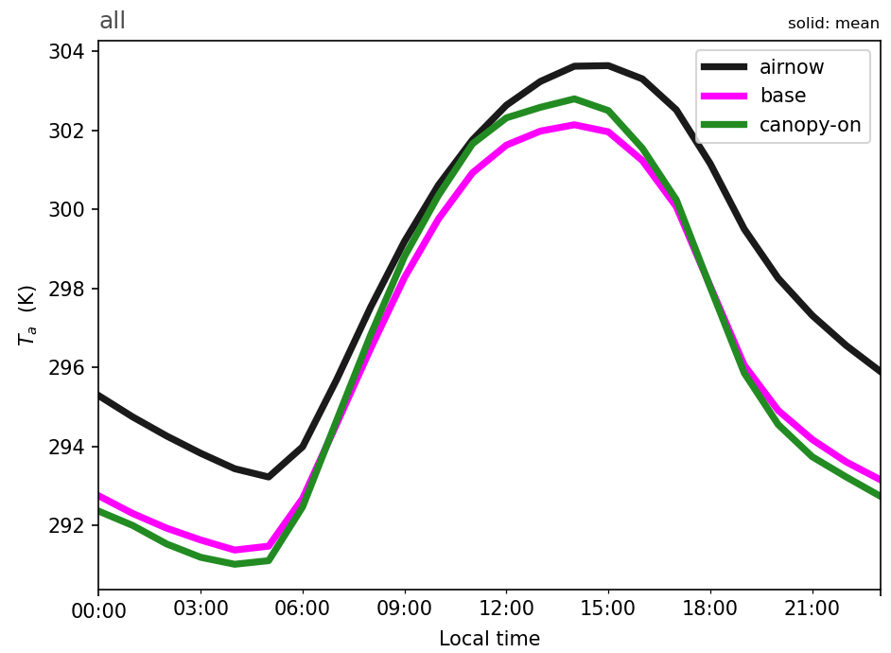
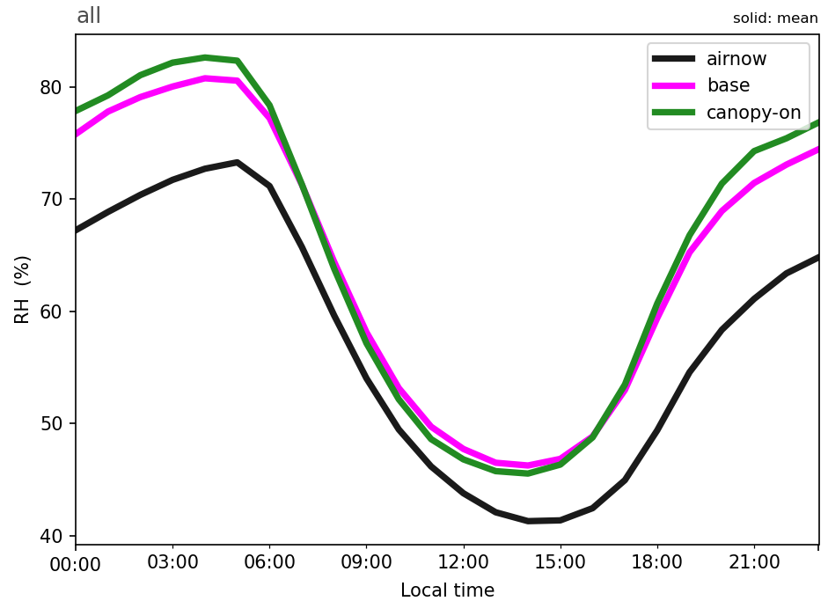
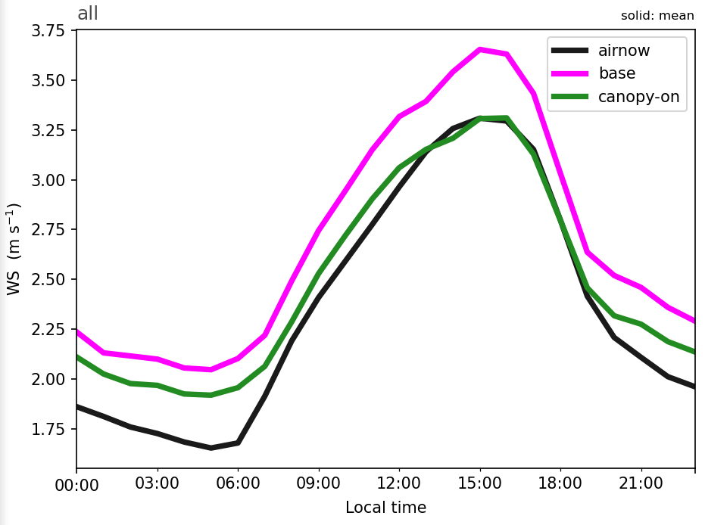
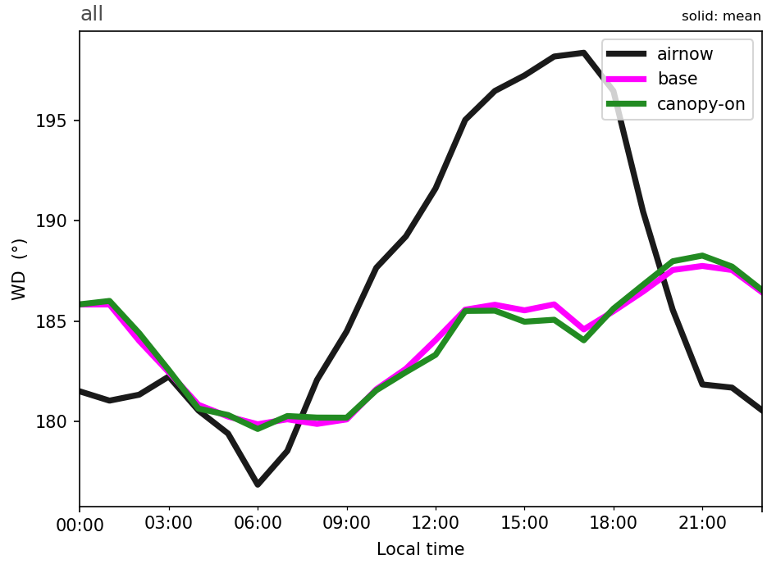
Preliminary Canopy Effects on Model Performance
Average August 2023 Meteorology
2-m Temperature
CONUS Averaged 10-m Wind Speed
Metric | Base | Canopy
MB | 0.44 | 0.27
NMB | 18.8 | 11.3
RMSE | 1.7 | 1.6
IOA | 0.76 | 0.77
2-m Relative
Humidity
10-m Wind
Speed
10-m Wind Direction
Results courtesy of Dr. Zachary Moon (NOAA-ARL/ERT)
Notes:
Further, because we have added the canopy effects on vertical eddy diffusivity parameterized into the physics codes in UFS, there are also impacts on the Online-CMAQ meteorology, mainly reducing the underpredictions of 2-m temperature during the day, and overall reduction in the 10-meter wind speed, shown in the red box, which is in better agreement with observations, and improves the model statistics across the board (shown on the right). While further analysis is necessary, the reduced eddy diffusivities due to the presence of the canopy leads to less mixing of higher winds from aloft (i.e., the presence of a virtual drag effect), and thus reducing overall wind speeds (especially during the day).

Slide 11
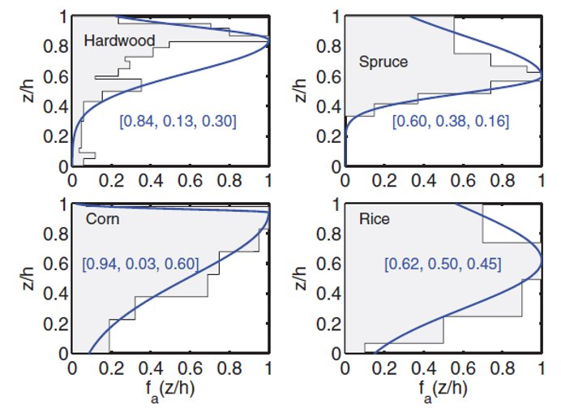
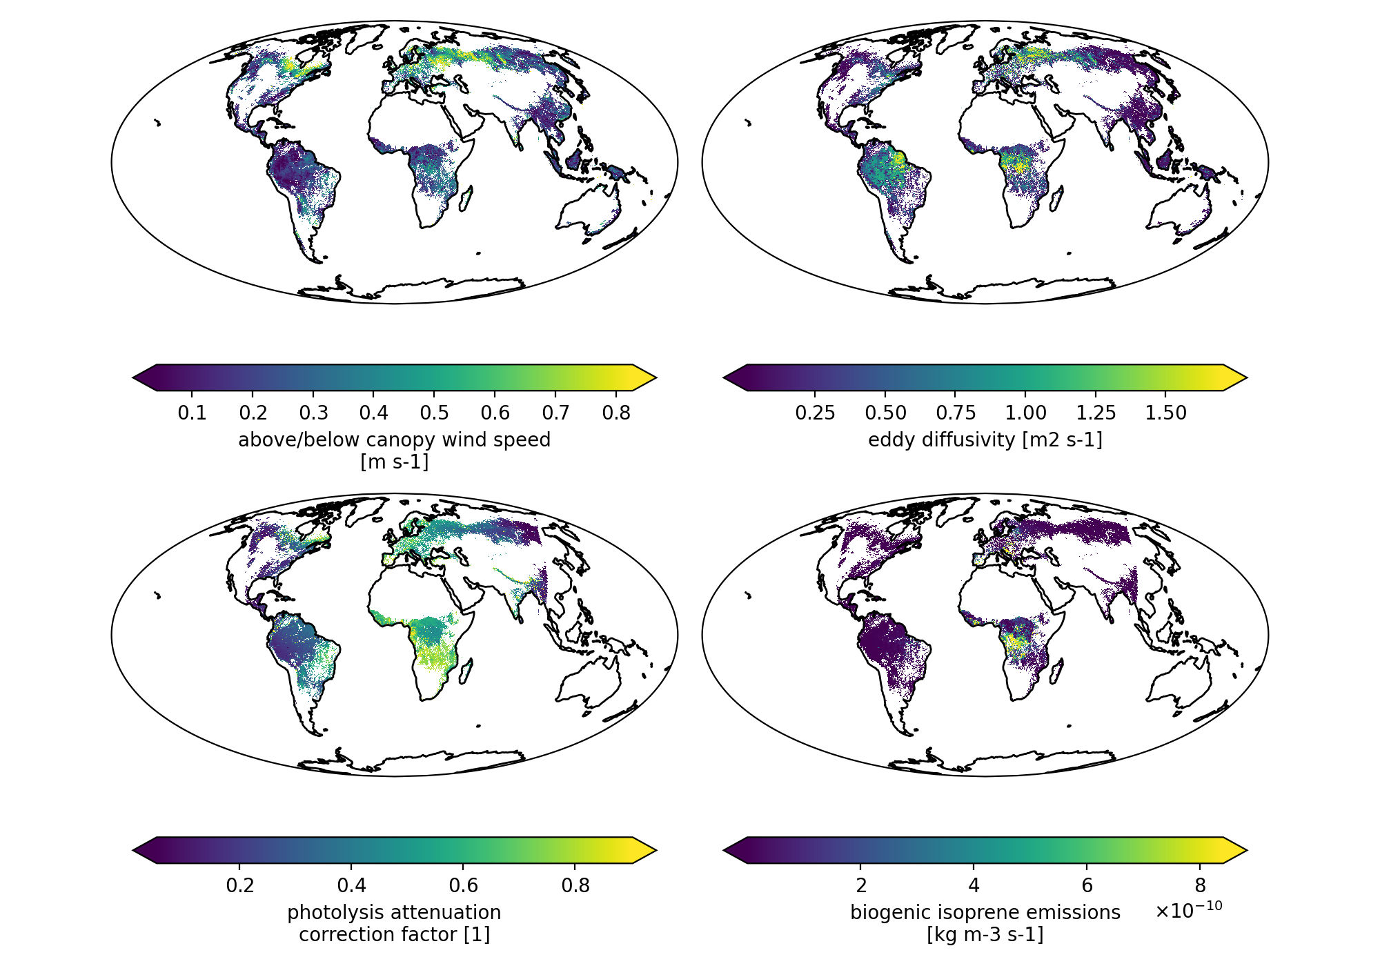
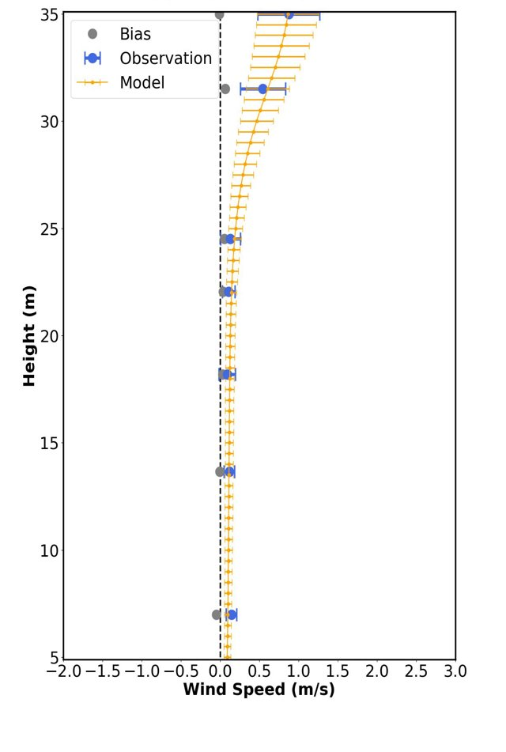
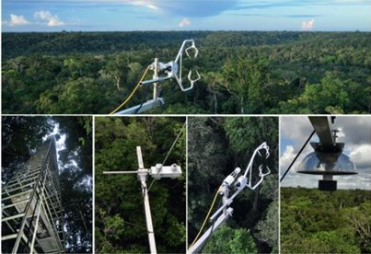
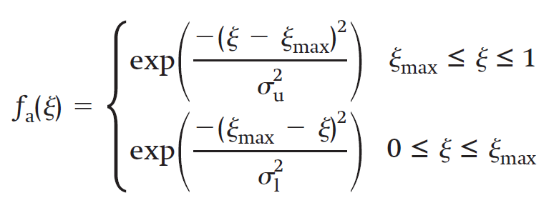
Development of the “canopy-app” for UFS applications
Currently uses prescribed shape functions to parameterize the canopy for different vegetation.
Asymmetric Gaussian Approach
https://github.com/noaa-oar-arl/canopy-app
In-Canopy Winds
Winds
Diffusivity
Go-Amazon Canopy-Wind
Comparison
Hung et al.,
2023, JAMES, submitted.
Photolysis
Biogenic Emissions
Canopy-App is not a full 1-D canopy chemistry model.
Rather explicitly and efficiently calculates certain processes.
Included processes: dry deposition, chemistry, fire behavior, etc.
Massman et al. (2017)
Notes:
Switching gears a bit, we are expanding this work we are developing the “canopy-app” for UFS applications, which is an explict, but efficient way of representing the canopy both for offline research studies and online UFS applications across scales. Canopy-app can be driven stand-alone using point/flux data or gridded input model data at any resolution, and is planned to be coupled to the UFS. On the left, we show that it can currently driven by prescribed plant shape functions from Massman et al. (2017); however, we are integrating satellite-based lidar observations of the global vertical plant biomass density (LAD) to drive canopy-app.
In the middle here, we note that the canopy-app is not a full 1-D canopy chemistry model, but rather it is used to explicitly and efficiently calculate certain processes that modulate the atmospheric composition in the layers closest to the surface, such as in-canopy winds, vertical diffusivity, photolysis attenuation, and biogenic emissions. We are expanding canopy-app to handle more processes at the explicit canopy leaf-scale such as dry depsotion, chemistry, and fire behavior modeling across scales.
An initial paper example shown on the right for canopy-app wind flow compared to observed in-canopy winds at the Go Amazon flux site show excellent agreement, and we have submitted an initial paper on this to JAMES.

Slide 12
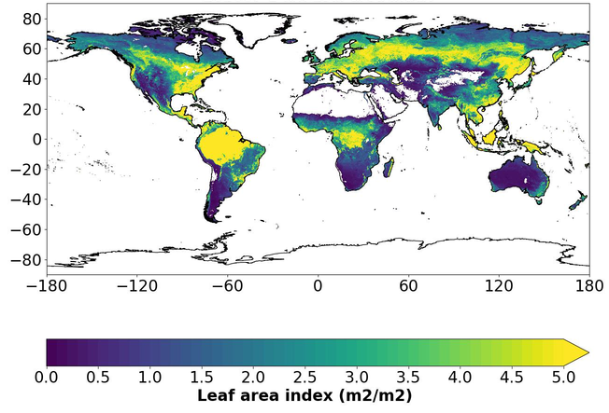
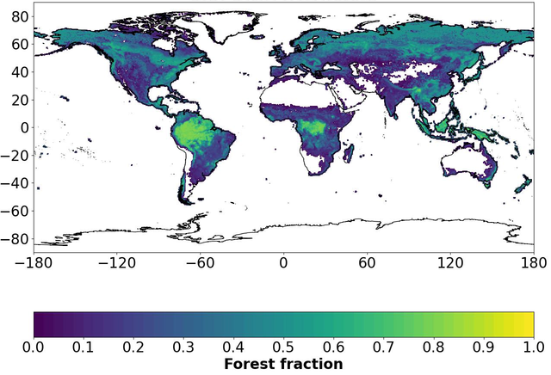
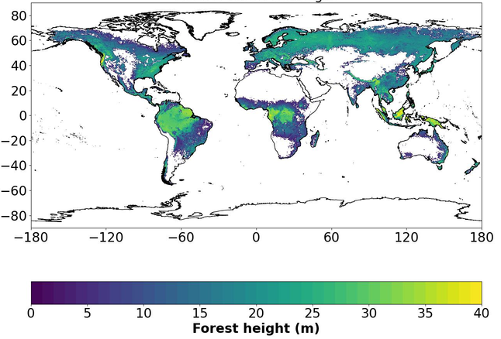
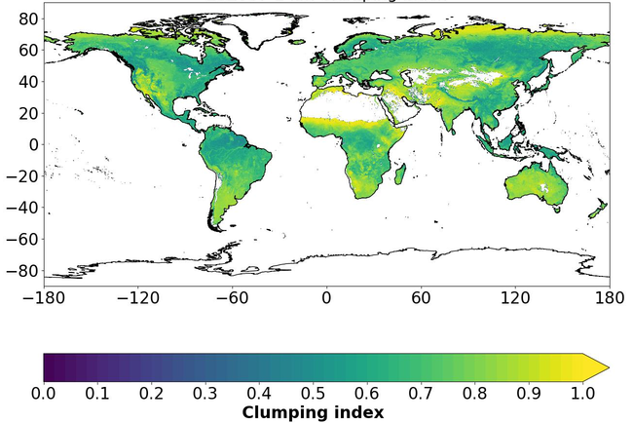
Development of a 1-km Global Canopy Dataset for the UFS
Five major canopy parameters: Gridded 1 km leaf area index (LAI), canopy clumping index (CLU), forest fraction (FFRAC), forest canopy height (FCH), and vertical distribution of plant area volume density (PAVD) - not shown.
Winter LAI and CLU are extended to global coverage based on monthly climatological values (Fang et al., 2021).
Global FFRAC is retrieved by blending MODIS Vegetation Continuous Fields and VIIRS Green Vegetation Fraction (GVF) products.
Global FCH and PAVD is adopted from the latest Northern Arizona University HPC portal raster dataset and the GEDI-Landsat dataset developed by Potapov et al. (2020).
Preliminary Canopy Dataset for July
Results courtesy of Dr. Wei-Ting Hung (NOAA-ARL/GMU)
Download Canopy Data from AWS Here:
https://nacc-in-the-cloud.s3.amazonaws.com/inputs/geo-files/gfs.canopy.t12z.2022MMDD.sfcf000.nc (@12 km w/GFS met)
https://nacc-in-the-cloud.s3.amazonaws.com/inputs/geo-files/canopy* (@ 1km canopy variables only)
Notes:
For further improvement of the canopy processes in UFS/AQM Online-CMAQ as well as being used in the canopy-app on the previous slide, we are also working on development of a global, high resolution 1 km global canopy dataset for the UFS.
There are five major canopy parameters based on satellite data including updated LAI, CLU, FFRAC, FCH, and the vertical distribution of Plant Area Volume Density (PAVD), i.e., the vertical biomass profile, or LAD.
Not repeating all the details on the slide here, but I will mention that we are using methods to extend these variables globally for all seasons and a daily gridded LAI, where below we show preliminary results of the high resolution, gridded canopy variables we are using for July.
We have made these data available for use in canopy-app or for anyone else interested in using them on our AWS Cloud server, links below.

Slide 13
Summary and Ongoing Work
Summary:
In-canopy parameterizations improves the UFS-AQM ozone predictions.
Development of the canopy-app allows for more flexible UFS applications.
Development of global 1 km canopy datasets for improved UFS characterization.
Ongoing Work:
Refine Online-CMAQ canopy code/thresholds across UFS physics & chemistry.
Integrate global 1 km canopy datasets into UFS Online-CMAQ.
Investigate canopy effects on all aspects of PM_{2.5} and species.
Use of field/satellite/aircraft data for improved evaluation of Online-CMAQ.
Continue development of “canopy-app” for novel research and the UFS.
Notes:
Read bullets.

Slide 14
More Details…
“Quantifying the effects of vegetative in-canopy photolysis and turbulence processes on U.S. air quality”: Dr. Chi-Tsan Wang (George Mason University) Dogwood Room today @ 1:40 p.m.
More details on “canopy-app” for research and the UFS: https://github.com/noaa-oar-arl/canopy-app
Acknowledgements/Funding: NOAA-WPO FY2022 In-Canopy Processes Research Project
https://wpo.noaa.gov/beyond-the-big-leaf-model-at-noaa/
Notes:
Read bullets.

