Slide 1

CMAQ: In the Beginning and Making a Mark
Dr. Alice Gilliland
Director (Acting), Center for Environmental Measurement & Modeling
Office of Research and Development, U.S. Environmental Protection Agency
22nd Annual CMAS Conference • Chapel Hill, NC • 16–18 October 2023
Disclaimer: The views expressed in this presentation are those of the author
and do not necessarily reflect the views or policies of the U.S. EPA.

Slide 2
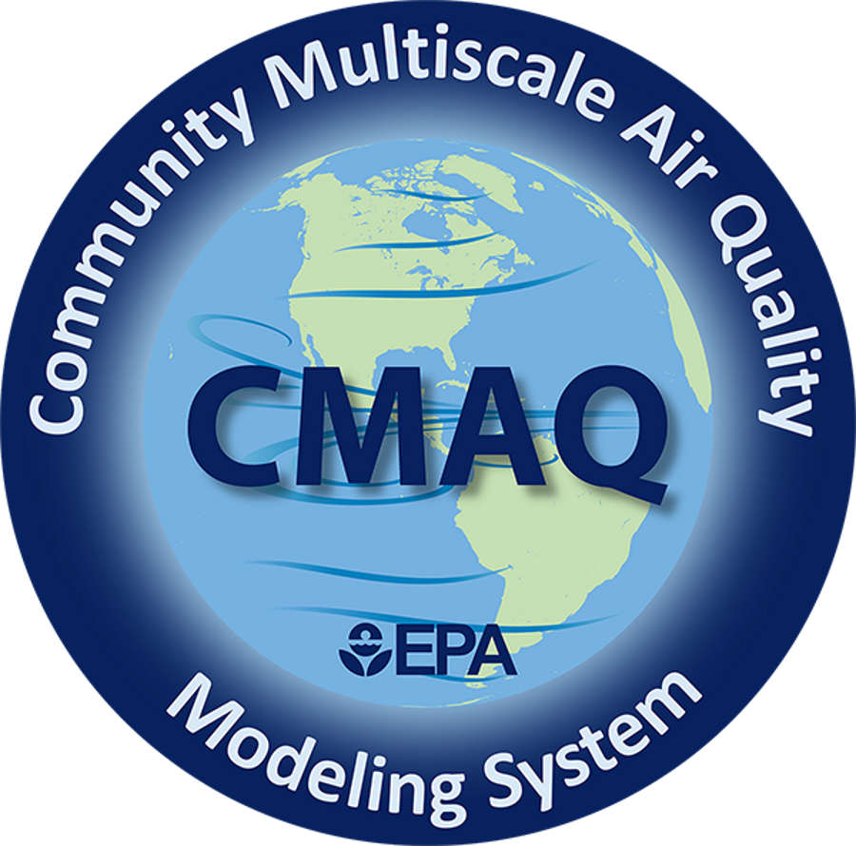
What is CMAQ?
CMAQ (see-mak) is an active open-source development project of the U.S. EPA that consists of a suite of programs for conducting air quality model simulations.
For over two decades, EPA and states have used EPA’s Community Multiscale Air Quality (CMAQ) Modeling System, a powerful computational tool for air quality management.
CMAQ brings together three kinds of models:
Meteorological models to represent atmospheric and weather activities.
Emission models to represent man-made and naturally-occurring contributions to the atmosphere.
An air chemistry-transport model to predict the atmospheric fate of air pollutants under varying conditions.
CMAQ Fact Sheet October 2022 (pdf)

Slide 3
AQ Models: Implementing the Clean Air Act
Evolution of EPA’s models guided by increasingly complex application & assessment needs
Single Pollutant
Non-reactive
Dispersion
Local/urban Scales
Single Pollutant
Reactive
Grid-based
Regional/urban Scales
Multi-pollutant,
Multi-scale
Reactive
Grid-based
Regional/urban Scales
Multi-pollutant
Multi-scale (local to hemispheric)
Interactions with climate forcing and air quality changes
Grid-based
Multi-pollutant
Near-source to global
Reactive
Atmospheric-hydrologic
Background air pollution
Met-AQ Interactions
Exposure & Health
Multimedia
Regulatory & Assessment Needs
Meteorology and Air Quality Interactions
Exposure
PSD
New Source Permitting
Standards
Assessments
O₃, PM attainment demonstrations
Regional Haze
Mercury
Toxics
1970
Regional Acid Deposition Model
Regional Oxidant Model
- Acid Deposition
- Ozone
1998
CMAQ
For PM
Neighborhood Scale CMAQ
Multi-pollutant CMAQ
Coupled
WRF-CMAQ
2019
2022
CMAQ NextGen
CMAQ
CMAQv5.3
CMAQv5.4
AQDM
UNAMAP
Model Development & Applications
Notes:
This slide is only intended to illustrate that models (and their complexity) have evolved in response to the changing reg and assessment needs, i.e., model development within the Agency has been application and need driven. Model acronyms are not important but only provided for completeness for those interested.

Slide 4
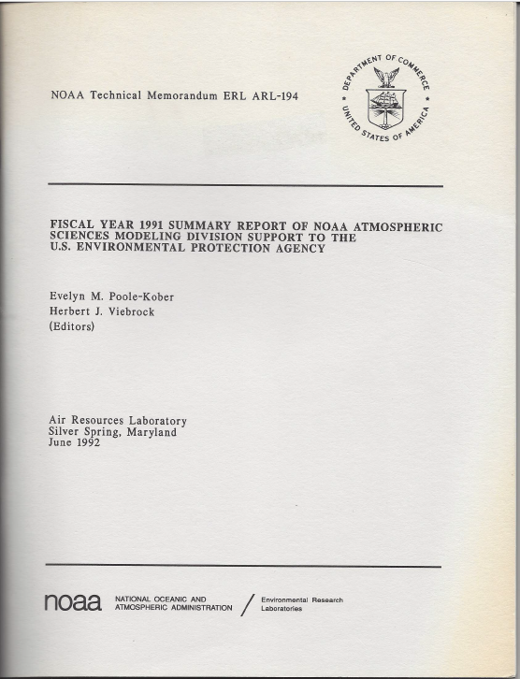
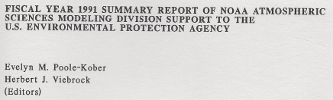
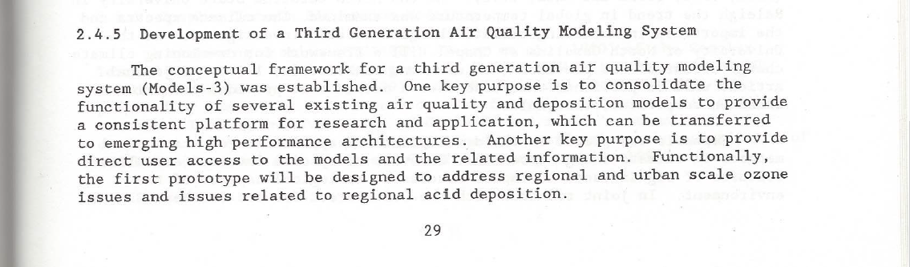
Before CMAQ, it was “Models-3”.
Designed to improve science and establish community.
1991
1993
2001
2003
2011
2013
2023
2021
1995
2005
2015
1997
1999
2007
2009
2017
2019

Slide 5
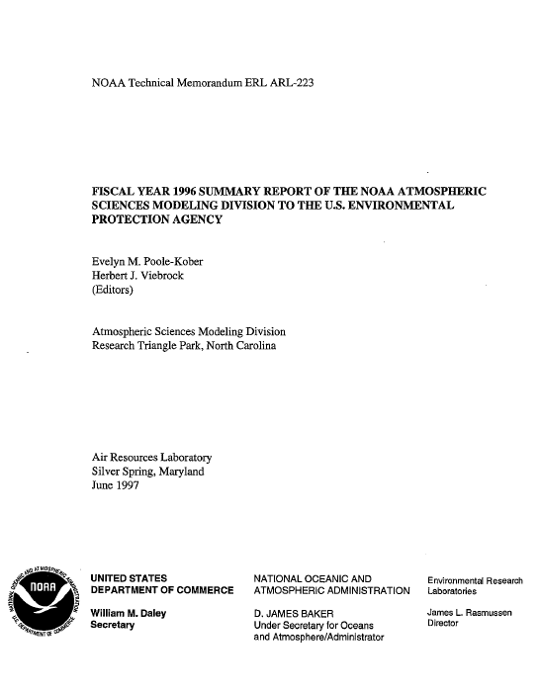
Big Plans for Models-3/CMAQ!
State-of-the-art, multi-pollutant system
Standard interface for science
Spectrum of spatial scales
Multi-scale interactions
Operational and diagnostic evaluation
Sensitivity and uncertainty analysis
Couple meteorology and chemistry
High-performance computing
Offer extensibility for anticipated AQ needs
1991
1993
2001
2003
2011
2013
2023
2021
1995
2005
2015
1997
1999
2007
2009
2017
2019

Slide 6
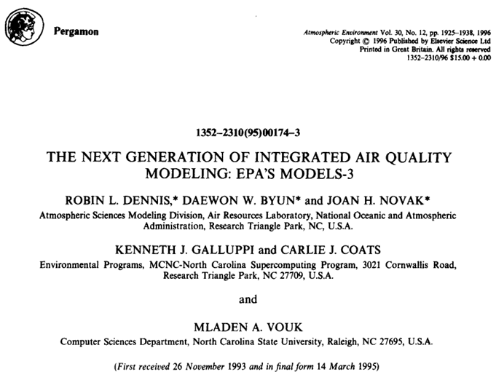
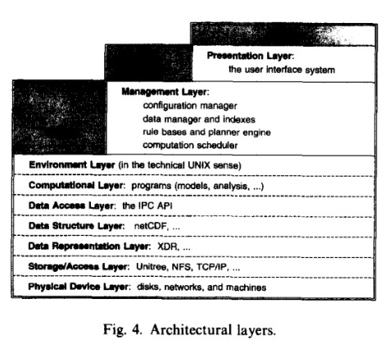
Modular, Extensible, One-Atmosphere
Regulatory Users
  Explore/compare various scenarios
  Address AQ issues simultaneously
Science Users
  Understand the physical-chemical system
  Evaluate the model
  Advance the science
1991
1993
2003
2013
2023
2001
2011
Dennis et al., Atmos. Environ., 1996
https://doi.org/10.1016/1352-2310(95)00174-3
2021
1995
2005
2015
1997
1999
2007
2009
2017
2019

Slide 7
MAQSIP: A Prototype for CMAQ
Through cooperative research with Federal scientists, colleagues at MCNC were developing the Multiscale Air Quality Simulation Platform (MAQSIP).
The scientific goals of MAQSIP were aligned with those of CMAQ.
Evolved from Coats et al. (1993) and Dennis et al. (1996).
Initially a served as a prototype for CMAQ.
Applied to study tropospheric O₃, PM, and airborne acids.
Later used by Baron AMS for forecasting and hydrology applications.
Coats, Hanna, Hwang, and Byun, 1993: Model engineering concepts for air quality models in an integrated environmental modeling system. AWMA Specialty Conf. on Regional Photochemical Measurement and Modeling Studies.
Earliest reference for MAQSIP/CMAQ!
Mathur et al., JGR-A, 2005
https://doi.org/10.1029/2004JD004918
1991
1993
2001
2003
2011
2013
2023
2021
1995
2005
2015
1997
1999
2007
2009
2017
2019

Slide 8
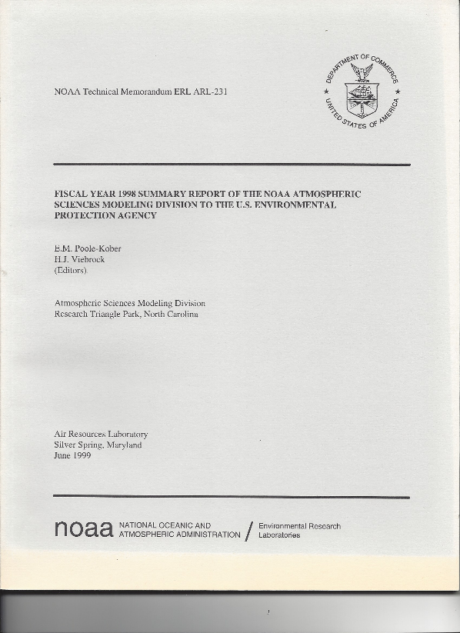

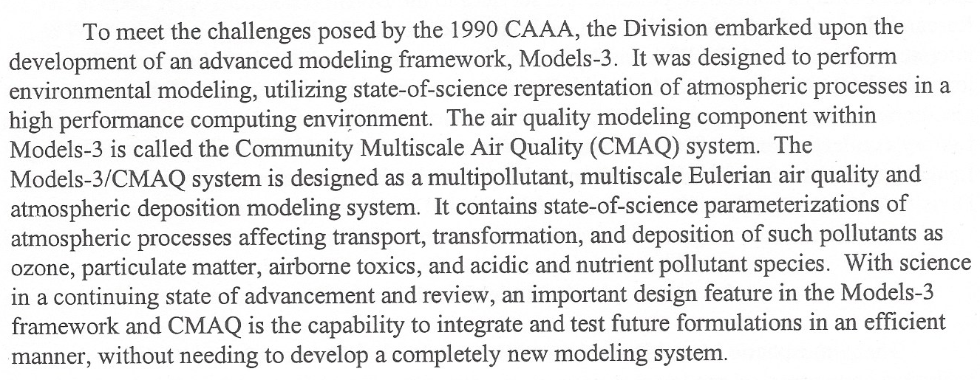
Releasing CMAQ!
1991
1993
2001
2003
2011
2013
2023
2021
1995
2005
2015
1997
1999
2007
2009
2017
2019

Slide 9
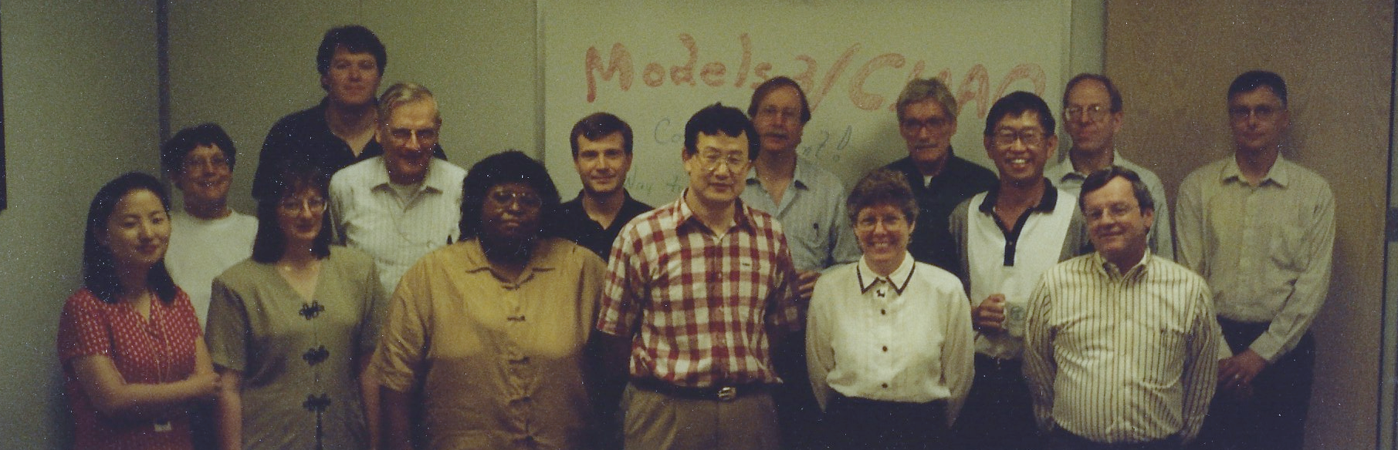
Initial Release Celebration!
Left to right: Sang-Mi Lee, Sharon Leduc, Tanya Spero, Gary Walter, Frank Binkowski, Alfreida Torian, Shawn Roselle, Daewon Byun, Jon Pleim, Joan Novak, Jeff Young, Jason Ching, Bill Benjey, Jerry Gipson, Steve Howard
Not pictured: Russ Bullock, Robin Dennis, Jim Godowitch, Ken Schere, Frank Schiermeier
1991
1993
2001
2003
2011
2013
2023
2021
1995
2005
2015
1997
1999
2007
2009
2017
2019

Slide 10
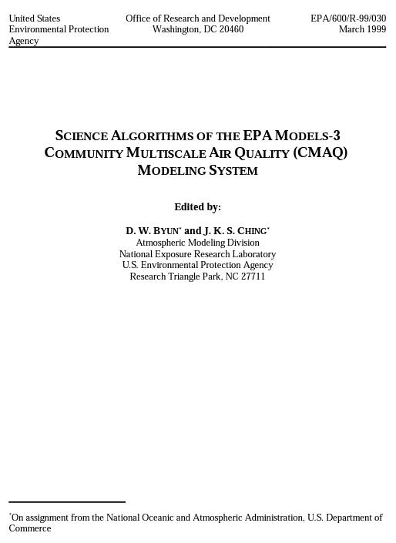
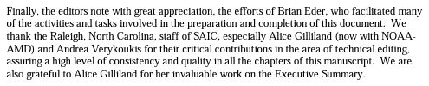
Lots of Documentation!
“The CMAQ Bible”
Contains two 2-inch printed volumes.
18 detailed sections
Remains the reference for the governing equations!
https://www.cmascenter.org/cmaq/science_documentation/
Formal journal article later published by Byun & Schere, Appl. Mech. Rev., 2006 (https://doi.org/10.1115/1.2128636). Cited more than 1750 times (CrossRef).
Find the primary CMAQ documentation today:
https://www.epa.gov/cmaq/cmaq-documentation
1991
1993
2001
2003
2011
2013
2023
2021
1995
2005
2015
1997
1999
2007
2009
2017
2019

Slide 11
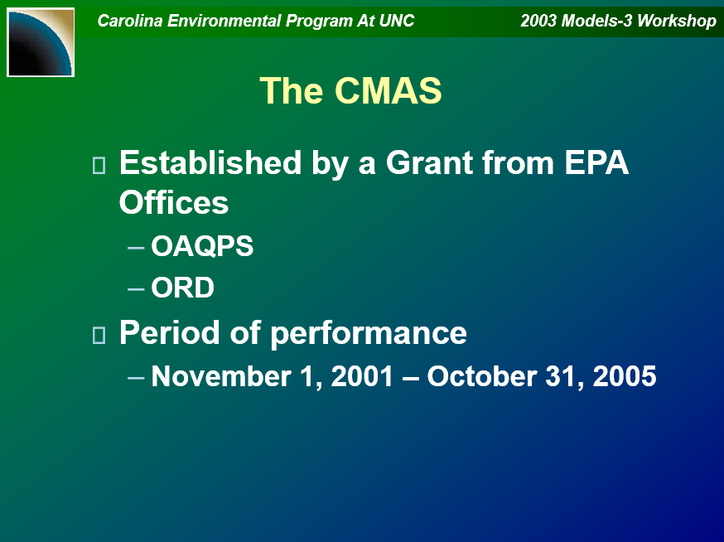
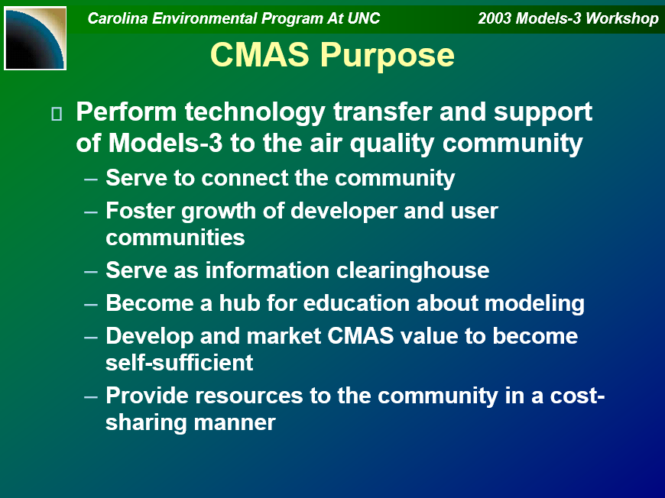
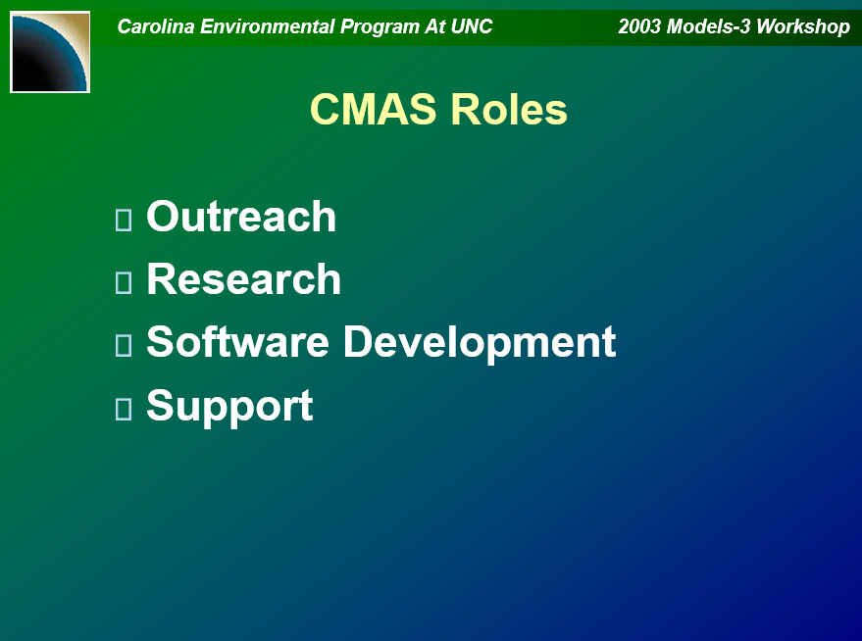
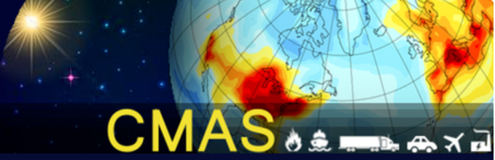

Establishing Community Modeling and Analysis System (CMAS)
Imhoff, “Status of the CMAS Center,” 2003
https://www.cmascenter.org/conference/2003/archive.html
https://www.cmascenter.org/
1991
1993
2001
2003
2011
2013
2023
2021
1995
2005
2015
1997
1999
2007
2009
2017
2019

Slide 12
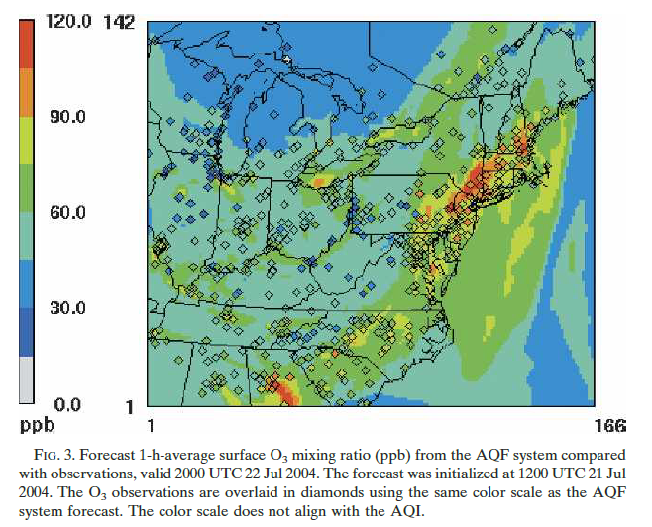
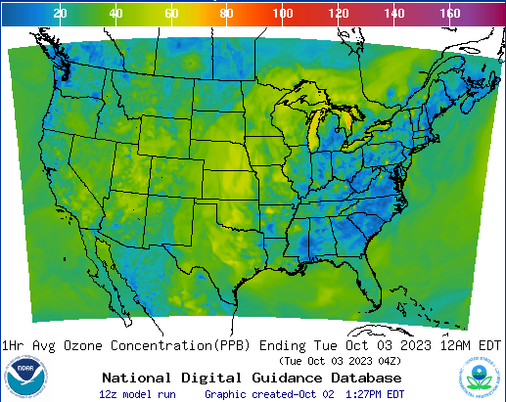
Air Quality Forecasting
Partnership between EPA, NOAA/ARL, and NOAA/NWS in late 2002.
Uses NOAA National Weather Service meteorology models with EPA emissions and CMAQ.
Initial operational system for Northeast U.S. O₃ in 2004.
Now all U.S. O₃, PM_{2.5}, smoke, and dust.
Otte et al., Wea. Forecasting, 2005
https://doi.org/10.1175/WAF855.1
https://airquality.weather.gov
1991
1993
2001
2003
2011
2013
2023
2021
1995
2005
2015
1997
1999
2007
2009
2017
2019

Slide 13
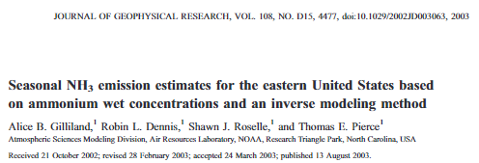
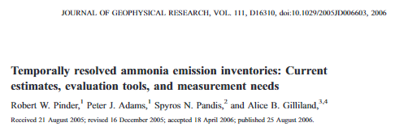
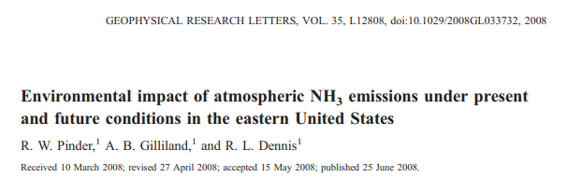
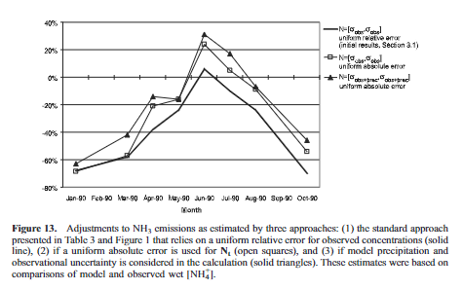
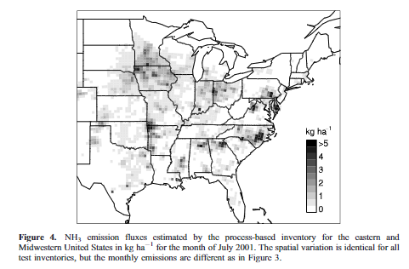
Quantifying Atmospheric Ammonia
Gilliland et al., JGR-A, 2003
https://doi.org/10.1029/2002JD003063
Pinder et al., JGR-A, 2006
https://doi.org/10.1029/2005JD006603
Pinder et al., Geophys. Res. Lett., 2008
https://doi.org/10.1029/2008GL033732
1991
1993
2001
2003
2011
2013
2023
2021
1995
2005
2015
1997
1999
2007
2009
2017
2019

Slide 14
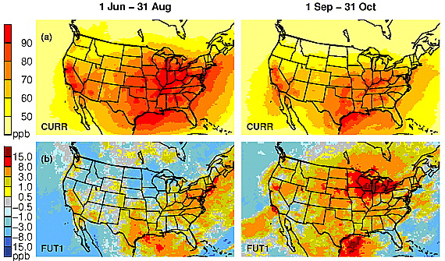
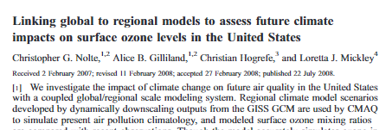
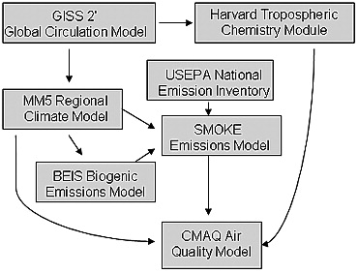
Climate Impacts on Regional Air Quality
Nolte et al., JGR-A, 2008
https://doi.org/10.1029/2007JD008497
1991
1993
2001
2003
2011
2013
2023
2021
1995
2005
2015
1997
1999
2007
2009
2017
2019

Slide 15
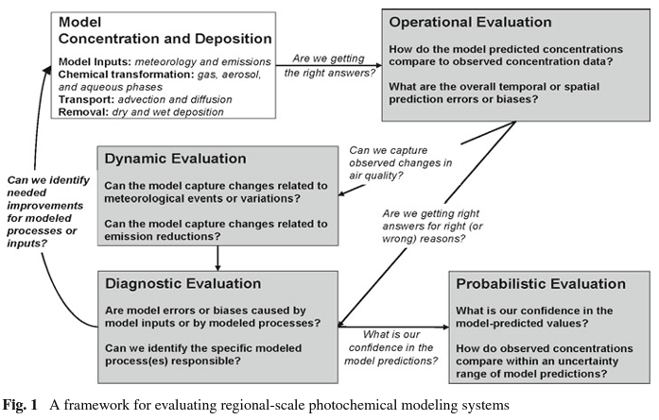
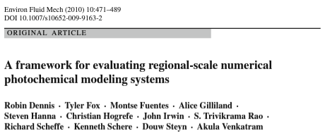
Evaluation to Inform Model Development
Considerable focus on multifaceted evaluation to quantify model performance, characterize uncertainty, and target areas of improvement for model development.
1991
1993
2001
2003
2011
2013
2023
2021
Dennis et al., Environ. Fluid Mech., 2010
https://doi.org/10.1007/s10652-009-9163-2
2015
1995
2005
1997
1999
2007
2009
2017
2019

Slide 16
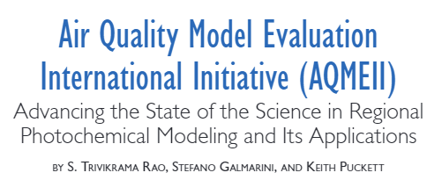
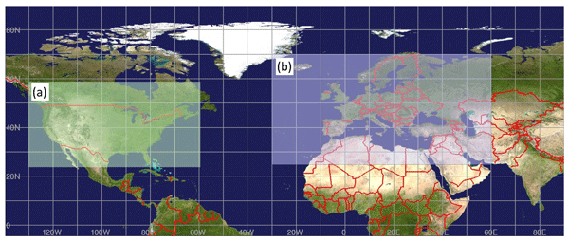
Coordinated Model Evaluation
Phase 1: Apply Dennis et al. (2010) evaluation framework across Europe and North America. [2010-2012]
Phase 2: Evaluate online coupled meteorology and chemistry transport models. [2012-2014]
Phase 3: Evaluate effects of long-range transport on regional air quality. [2014-2018]
Phase 4: Multi-framework systematic comparisons of atmospheric deposition. [2019-current]
Rao et al., Bull. Amer. Met. Soc., 2011
https://doi.org/10.1175/2010BAMS3069.1
“Grass roots” modeling activity using community to improve robustness of models supporting policy recommendations.
Galmarini et al., Atmos. Chem. Phys., 2021
https://doi.org/10.5194/acp-21-15663-2021
1991
1993
2001
2003
2011
2013
2023
2021
1995
2005
2015
1997
1999
2007
2009
2017
2019

Slide 17
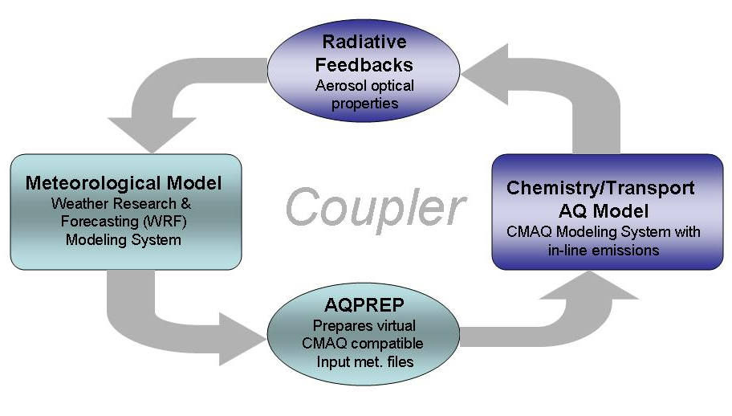
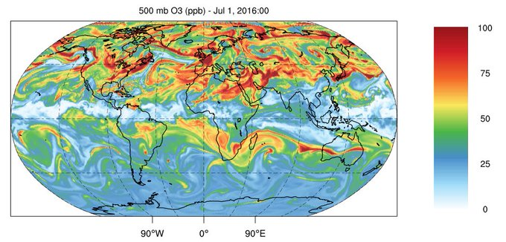
Air Quality–Meteorology Interactions
Two-way coupled MPAS-CMAQ in advanced stages of development.
Wong et al., Geosci. Model Dev., 2012
https://doi.org/10.5194/gmd-5-299-2012
Particle concentrations and composition need to be considered to accurately simulate air quality and the effects of a changing climate. CMAQ specific requirements for two-way coupled WRF-CMAQ are included as of WRFv4.4!
1991
1993
2001
2003
2011
2013
2023
2021
1995
2005
2015
1997
1999
2007
2009
2017
2019

Slide 18
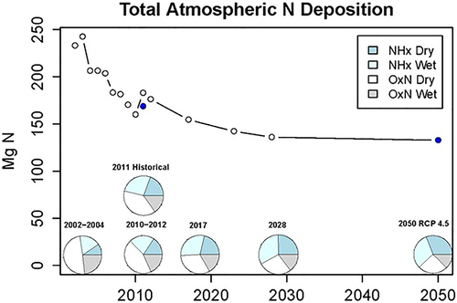
One Atmosphere → One Environment
Model Data Input
Watershed Model
Estuary Model
Prediction of Impacts
A one-environment approach more holistically considers pollutant lifecycles and their impacts on human health and the environment.
Examples here are nitrogen deposition to the Chesapeake Bay Watershed (mid-Atlantic U.S.).
Campbell et al., JGR-A, 2019
https://doi.org/10.1029/2019JG005203
1991
1993
2001
2003
2011
2013
2023
2021
1995
2005
2015
1997
1999
2007
2009
2017
2019

Slide 19
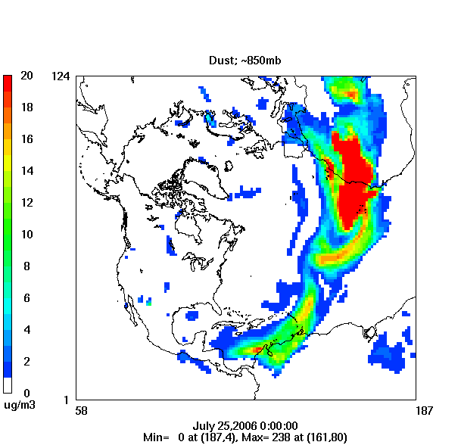
Air Quality: A Global Transport Issue
Examining U.S. air quality in context of the changing global atmosphere
CMAQ Simulation of
Trans-Atlantic Transport of Saharan Dust
Pollutants near the Earth’s surface can be lofted to higher altitudes where strong winds can efficiently transport then from one continent to another.
Need to accurately represent the global emission and transport of pollutants to estimate U.S. background pollution concentrations.
Mathur et al., Atmos. Chem. Phys., 2017
https://doi.org/10.5194/acp-17-12449-2017
1991
1993
2001
2003
2011
2013
2023
2021
1995
2005
2015
1997
1999
2007
2009
2017
2019

Slide 20
Tools for Air Quality Managers
Research or
Policy question
Air Quality Model Result and Interpretation
Detailed Emission Scaling, Isolation and Diagnostics Module
Explicit and Lumped CMAQ Model Output Module
DESID:
Integrated Source Apportionment Model
ELMO:
ISAM:
Allows easy scaling of input emissions
Easy specification of regions and aggregated emission types
Define any number of diagnostic files
Sum multiple streams to a single file
Choose individual variables, all variables, or sum variables
Simplifies the CMAQ output files
Reduces required post-processing of CMAQ output
Online processing of aggregate variables (e.g., PM_{2.5})
Instantaneous and/or average files
Reduces required disk space
Calculates source attribution estimates for user-specified O₃ and PM precursors
Quantifies contributions of emissions to pollutant levels
Maximizes flexibility with several options
Is now available as part of the standard download of CMAQ
https://github.com/USEPA/CMAQ/wiki/CMAQ-Release-Notes:-Diagnostic-Options
Murphy et al., Geosci. Model. Dev., 2021
https://doi.org/10.5194/gmd-14-3407-2021
Shu et al., Geosci. Model. Dev., 2023
https://doi.org/10.5194/gmd-16-2303-2023
Notes:
The lightest colored dashed arrows are to represent the number of processing steps (multiple levels of pre-processing model inputs, running a simulation possibly multiple times, multiple levels of post-processing) to get from the research question to appropriate model output. These tools are shortening those steps into the middle color arrows.

Slide 21
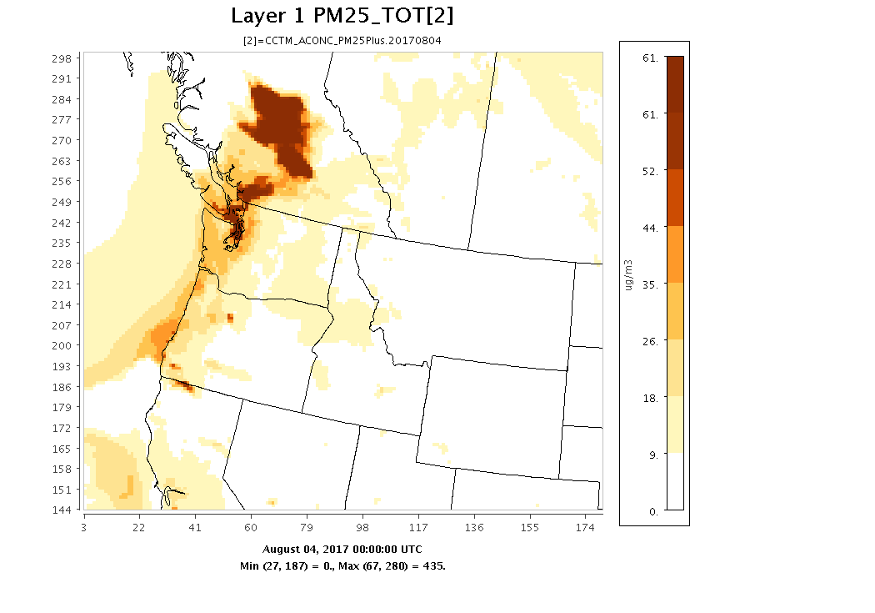
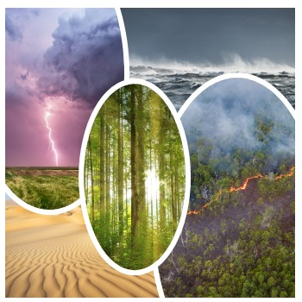
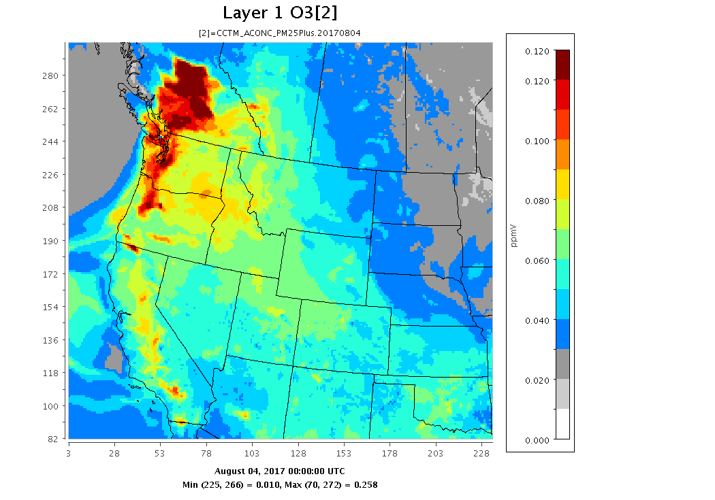
Natural Emissions
PM_{2.5}
National Lightning Detection Network
Lightning NO_{x}
Halogen Chemistry
July
Wildfires: August 4, 2017
O₃
Plants
September
Dust
Wildfires
Kang et al., Atmosphere, 2022
https://doi.org/10.3390/atmos13081248

Slide 22
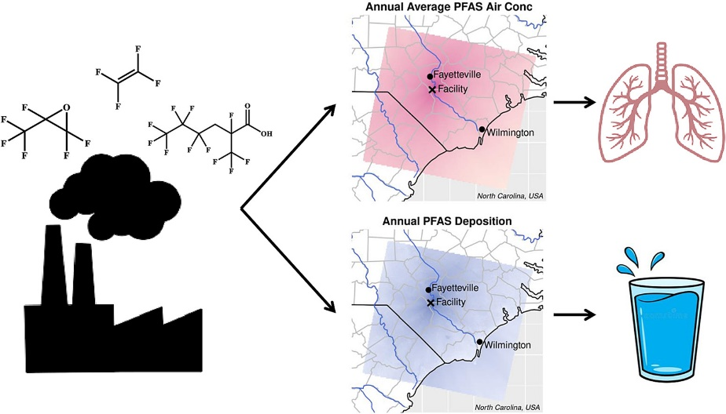
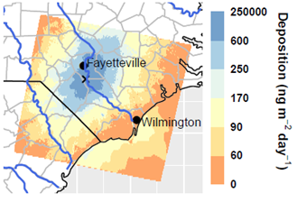
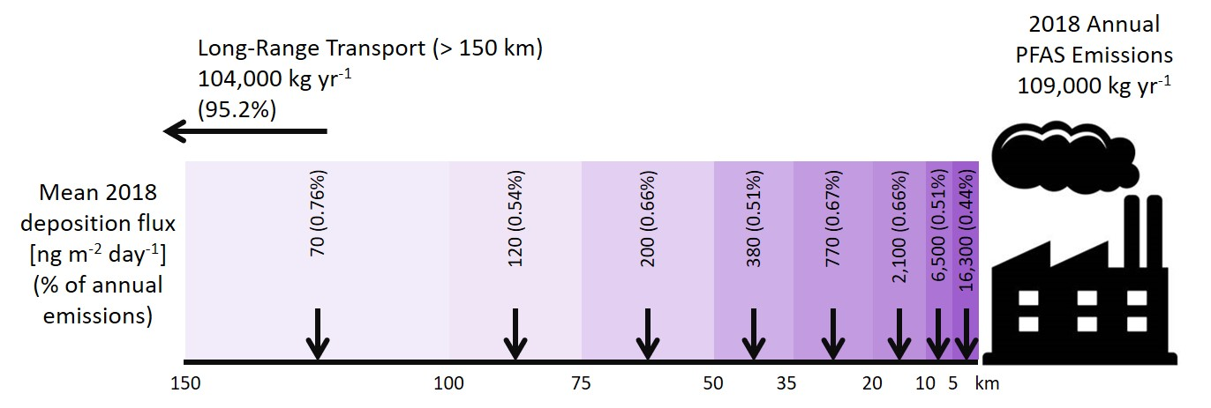
Emerging Pollutants of Concern: PFAS
CMAQ is used to simulate local atmospheric fate and transport of per- and polyfluorinated substances (PFAS).
Deposition and air concentrations are highest near the facility, decreasing rapidly with distance.
5% of total emissions by mass are deposited within ~150 km of the facility; the remaining mass is transported farther.
D’Ambro et al., Sci. Tot. Env., 2023
https://doi.org/10.1016/j.scitotenv.2023.166256
D’Ambro et al., ES&T, 2021
https://doi.org/10.1021/acs.est.0c06580
1991
1993
2001
2003
2011
2013
2023
2021
1995
2005
2015
1997
1999
2007
2009
2017
2019

Slide 23
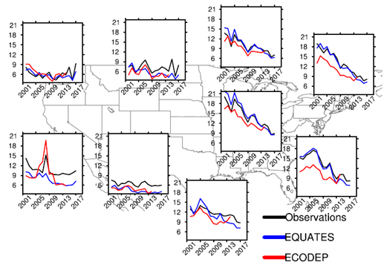
EQUATES: EPA’s Air QUAlity TimE Series
Long-term CMAQ simulations:
  Decadal CMAQ simulations have been used for a wide variety of applications, e.g., epidemiological studies, critical loads analyses, local and global air quality trends
  CMAQ modeling of 2002–2019 has been created for the Northern Hemisphere and contiguous U.S. using updated models and emissions datasets.
  Terabytes of model input and output data are available to collaborators.
EQUATES was developed by research and regulatory staff at EPA.
Data available from CMAS Data Warehouse, EPA’s Remote Sensing Information Gateway (RSIG), and by request.
CMAQv5.3.2 2002-2017 Trends
Summer Average PM_{2.5} (ug/m³)
(Graphic courtesy of Christian Hogrefe)
EQUATES modernizes the version of CMAQ (v5.3.2) and supersedes the previous time series based on ECODEP (CMAQv5.0.2) to unify modeled data for applications.
Foley et al., Data in Brief, 2023
https://doi.org/10.1016/j.dib.2023.109022
https://www.epa.gov/cmaq/equates

Slide 24
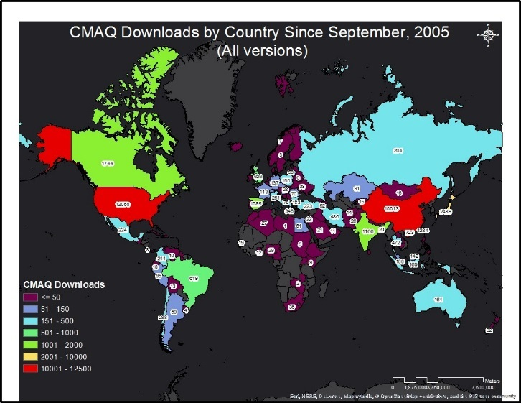
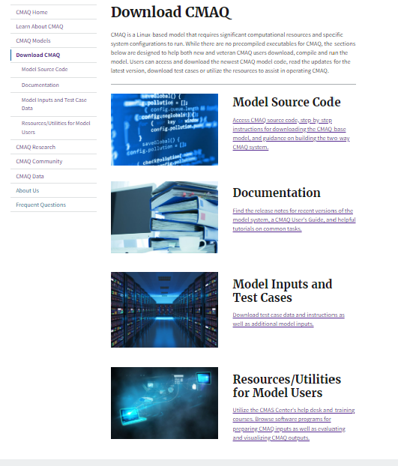
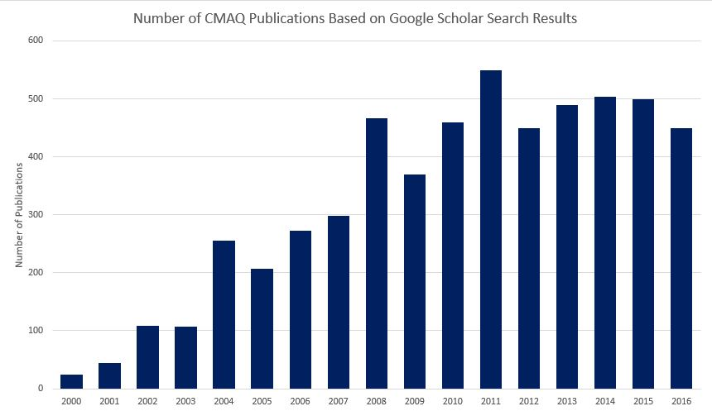
https://www.epa.gov/cmaq
Sound science is a foundation for
regulatory actions and implementation
Transparency & Reproducibility
Dissemination
External Peer Review
External panels comprised of International experts in atmospheric modeling & applications
Six peer reviews since 2000; most recent in May 2019
Panel’s findings and our responses accompany the public release of the model
CMAQ is open source and free, with a large userbase that acts as a de facto peer-review
600
Number of Publications
Documentation
Source code
Datasets

Slide 25
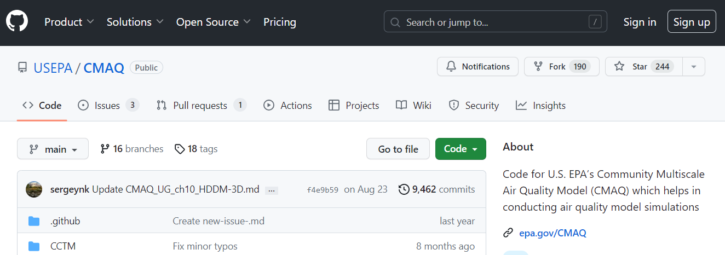
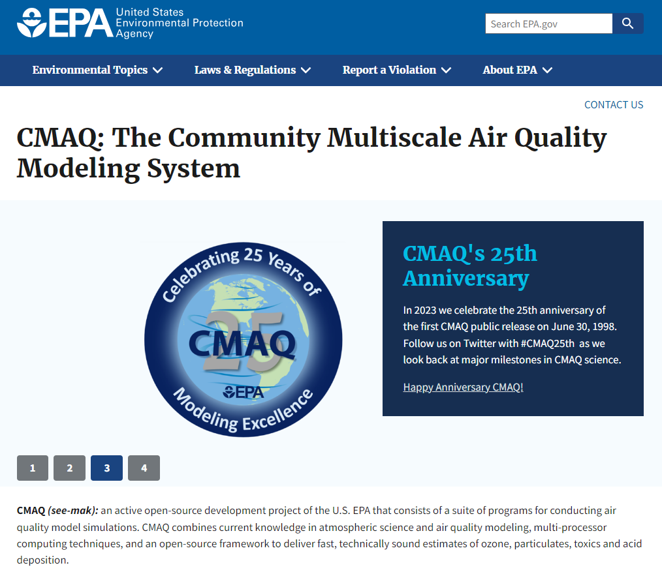
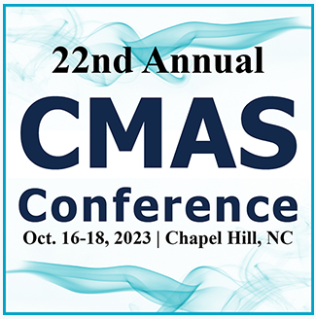

CMAQ Community Engagement
https://www.github.com/USEPA/CMAQ
https://forum.cmascenter.org
https://www.epa.gov/cmaq
https://cmascenter.org

Slide 26
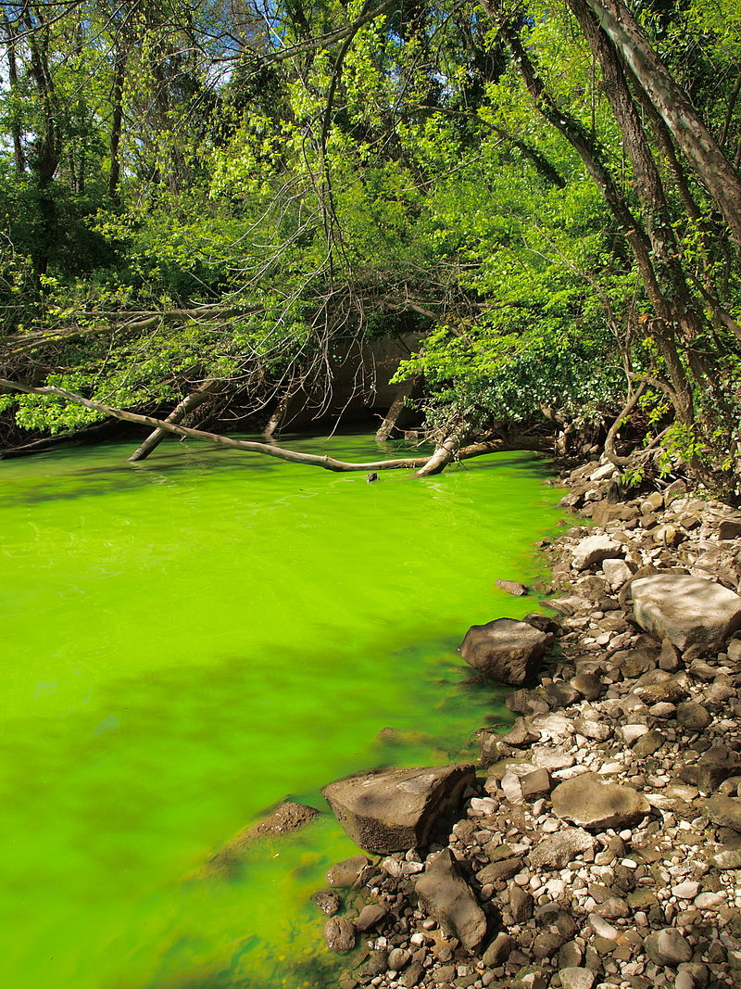
Application-Driven Model Development
Measurements and Detailed Field-Scale Modeling
Design field experiments
Application-Driven Model Development
Modify CMAQ to meet research partner needs
Model Application and Evaluation
Chesapeake Bay
Identify Model and Measurement Needs
Feedback from research partners
Climate Scenarios
Lessons from model evaluation
Develop & apply field-scale models
Emissions Development
Green Infrastructure
CMAQ development draws from partner needs. It includes a feedback cycle that links development, evaluation, and applications. It incorporates suites of observations to inform scientific advancement for Agency needs.

Slide 27
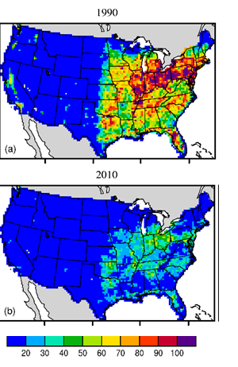
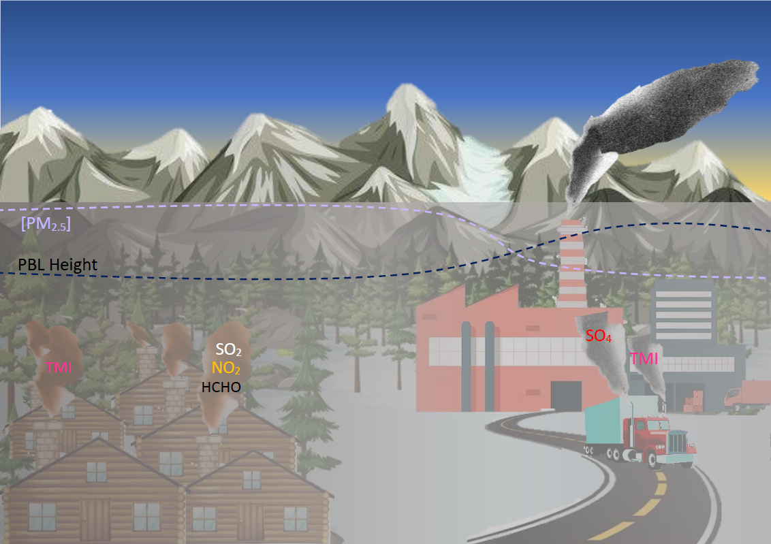






CMAQ Development and Use Cases
Urban Air Quality: Complex weather and air quality in concentrated populations.
Quantifying Influence of Adverse
Air Quality Exposure on Health:
Changes in PM_{2.5} related premature mortality
Winter PM: Specialized modeling for Alaska.
12
km
1.33 km
Emissions: Volatile chemical products from personal care products.
O₃ Transport across Long Island Sound
Air Quality-Climate Interactions:
4th National Climate Assessment
Trends resulting from evolving NAAQS
Deaths yr⁻¹ per 100000 adults
Global-to-regional modeling: Consistent
representation
of air pollution
across scales
Transcontinental transport on local AQ
Non-trivial contribution to total PM.
Projected changes in summer season O₃

Slide 28
Continual Development
CMAQ98
CMAQ4.3
CMAQ4.7.1
CMAQ5.2
CMAQ5.4
CMAQ4.0
CMAQ4.4
CMAQ5.0
CMAQ5.3
CMAQ4.1
CMAQ4.5
CMAQ5.0.1
CMAQ5.3.1
CMAQ4.2.1
CMAQ4.6
CMAQ5.0.2
CMAQ5.3.2
CMAQ4.2.2
CMAQ4.7
CMAQ5.1
CMAQ5.3.3
2001
2003
2011
2013
2023
2021
2005
2015
1999
2007
2009
2017
2019

Slide 29


The CMAQ Modeling System Today
Simulated Trends (1990-2010) in Ambient PM_{2.5}
Comprehensive Chemical Transport Model
  Emissions, advection, diffusion, chemistry, deposition
Multiscale: Global → Continental → Regional → Local
Multi-pollutant & multi-phase:
  Ozone (O₃) photochemistry
  Particulate Matter (PM)
    Sulfate, nitrate, ammonium
    Organic aerosol
    Natural aerosol (wind blown dust, sea salt)
  Acidifying and eutrophying atmospheric deposition
    Wet and dry deposition
  Air Toxics
      Benzene, formaldehyde, mercury, etc.
  Research/exploratory
    Pollen, nano-materials, PFAS
Simulated Trends (1990-2010) in Nitrogen Deposition
Zhang et al., ACP, 2018

Slide 30

CMAQ Research Impact (2022)
2022 CMAQ Publications per Coauthoring Country
194 journal & conference proceeding titles
Authors from 239 organizations across 28 countries
Over 55% of 2022 publications cited (as of March 2023) resulting in >216 citations
1410 software downloads from CMAS Center, Zenodo, and GitHub
2022 Research Impact Metrics Analysis (Courtesy: EPA-RTP Library)

Slide 31



Moving Forward with CMAQ
Chemistry for Multiple Endpoints with CRACMM
Moving from WRF
to Regional MPAS
Cloud Computing
NCAR is shifting resources from WRF to MPAS.
Cost-effective solutions for states and MJOs to increase efficiency of data sharing and support by EPA.
Pye et al., Atmos. Chem. & Phys., 2023
https://doi.org/10.5194/acp-23-5043-2023
https://www.epa.gov/cmaq/cracmm
Duda, NCAR, 2023
Joint WRF/MPAS Users Workshop
1991
1993
2001
2003
2011
2013
2023
2021
1995
2005
2015
1997
1999
2007
2009
2017
2019

Slide 32


Slide 33
In Memoriam…
This keynote is dedicated to those who steered the direction of CMAQ and are no longer with us to celebrate, including but not limited to:
Daewon Byun
Jason Ching
Adel Hanna
S.T. Rao
Frank Schiermeier
Gary Walter
Jeff Young
We thank them for their indelible contributions to the community.

