Slide 1
CMAQ at 25 Years: What It All Means for Regulatory Applications
Richard A. “Chet” Wayland
Division Director
Air Quality Assessment Division,
Office of Air Quality Planning & Standards
October 16, 2023

Slide 2
Connections Between Regulatory Analytics and CMAQ Development
CMAQ science updates and releases provide a basis for EPA/OAR and State/Local/Tribal air agency modeling to meet rulemaking and CAA requirements
Full testing and evaluation of CMAQ versions and updated science provide confidence in the use of model predictions in ways that align with needs of regulatory applications
Instrumented tools within CMAQ are essential for assessing source culpability (i.e., ISAM) and model response (i.e., HDDM)
CMAQ can be helpful in interpreting shifts in atmospheric composition amid implemented regulations (e.g., decreasing contribution of regional sulfate/nitrate to PM2.5)

Slide 3
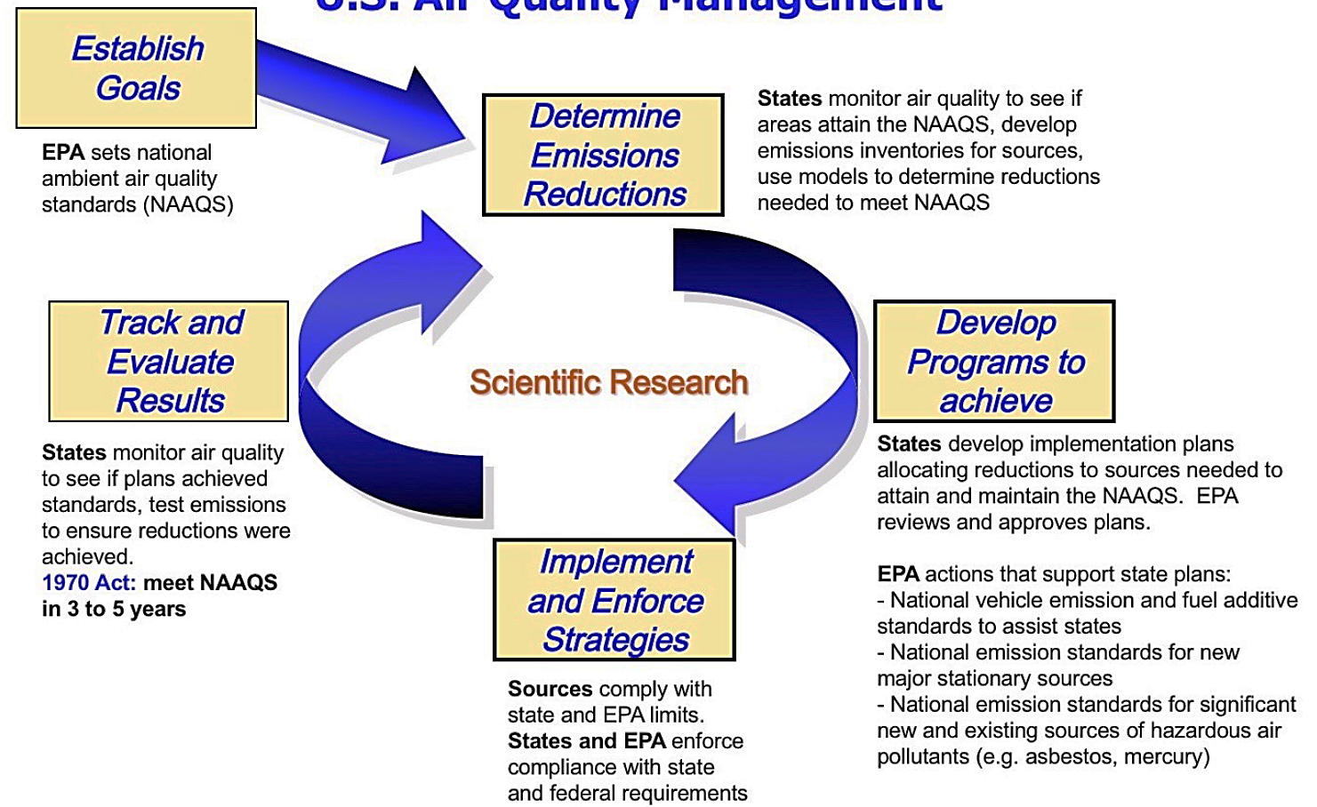
Use of CMAQ to Inform the Regulatory Air Quality Management System
CMAQ

Slide 4
Key Regulatory/Policy Questions that can be Informed by CMAQ Modeling (1 of 2)
What is the extent of the air quality problem?
In combination with monitoring data and separately for current conditions
What locations have or are expected to have future problems attaining current standards?
Who contributes to the air quality problem?
What are the contributions of individual source areas, source sectors, and/or individual sources to present and future air quality concerns including nonattainment?

Slide 5
Key Regulatory/Polich Questions that can be Informed by CMAQ Modeling (2 of 2)
What are the most cost-effective emissions reductions to achieve attainment/goals?
Determine largest/targeted air quality improvement(s) at the lowest cost of control across sources and pollutants
What are the health/welfare benefits of emissions reductions?
Control measures associated with a specific EPA/State/Local/Tribal actions (e.g., Federal rules such as Clean Power Plan, OTAQ rules, etc), or
Implementation scenarios with controls necessary for attainment of new NAAQS level (e.g., NAAQS Reviews: RIAs)

Slide 6
Role of Air Quality Modeling - States
NAAQS Implementation
State Implementation Plans (SIPs): State and local air agencies use AQM to project future attainment status and evaluate controls necessary to attain O3 and PM2.5 NAAQS as well as Regional Haze goals
Various CAA demonstrations by State, Local, and Tribal air agencies including “exceptional events”, “179B” (i.e., international transport) and others
New Source Permitting
Prevention of Significant Deterioration (PSD): Federal new source permitting program in attainment areas that requires compliance demonstrations including secondarily formed pollutants in O3 and PM2.5.

Slide 7
Role of Air Quality Modeling - EPA
EPA Rulemaking and Policy Analyses
Risk and Exposure Assessments (REAs): AQM is an essential component of estimating health impacts to the US population at different NAAQS standard levels under consideration
Regulatory Impact Analyses (RIAs): AQM provides input to the cost-benefit analysis to assess the health and environmental benefits of future year control strategies
Communication and Outreach
AQM provides data to inform the public about nature of air quality levels
AQM can provide information on differential impacts with respect to communities with EJ concerns

Slide 8
Examples of EPA/OAQPS CMAQ Applications

Slide 9
CDC Phase Project
For over a decade, EPA has developed an annual platform to characterize national surfaces of O₃ and PM_{2.5} in collaboration with the CDC
CMAQ model output and measurement data are combined to create a fused surface that has better spatial coverage than monitors alone and less uncertainty than model data alone
Data are intended to help explore the association between environmental exposures and health impacts
Ozone and PM2.5 fused fields and associated documentation are currently available for 2002-2019 at https://www.epa.gov/hesc/rsig-related-downloadable-data-files#faqsd
AQS measurement data
CMAQ predictions
Downscaler
(data fusion)

Slide 10
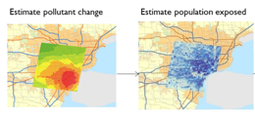
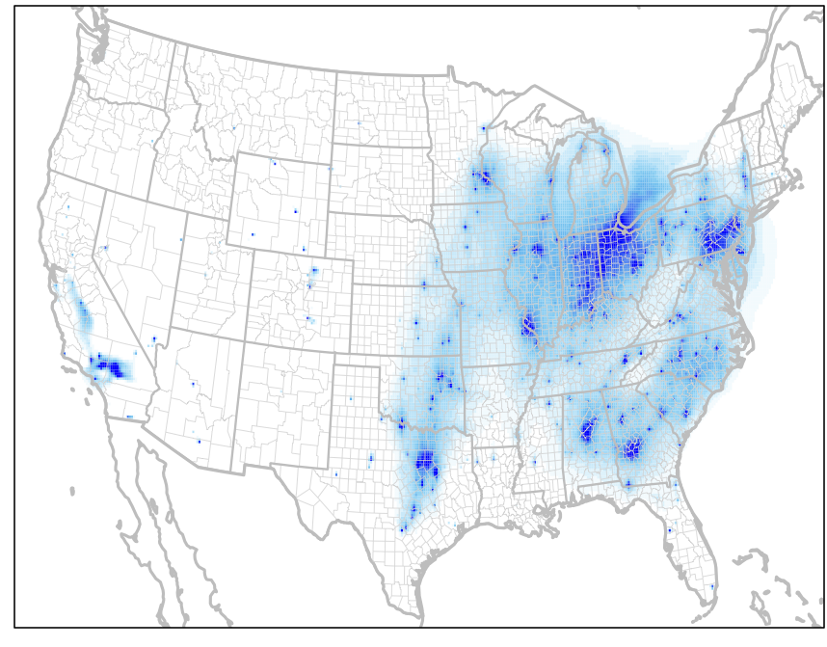
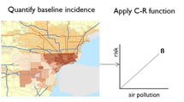
Inform Estimates of AQ Changes & Health Benefits for Regulatory Actions
Base year & projected future year emissions scenarios are developed (pre- & post-control) based on the National Emissions Inventory and complex emissions models (e.g., IPM and MOVES)
Air quality model surfaces for each emissions scenario are generated with a photochemical grid model
Differences in air quality along with location-specific health incidence rates and population are used to estimate health impacts via BenMAP
Changes in emissions
Changes in air quality
Benefits

Slide 11
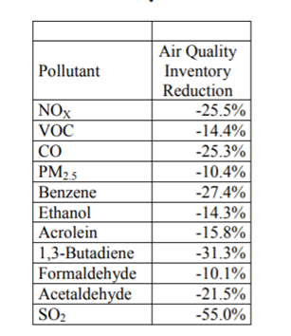
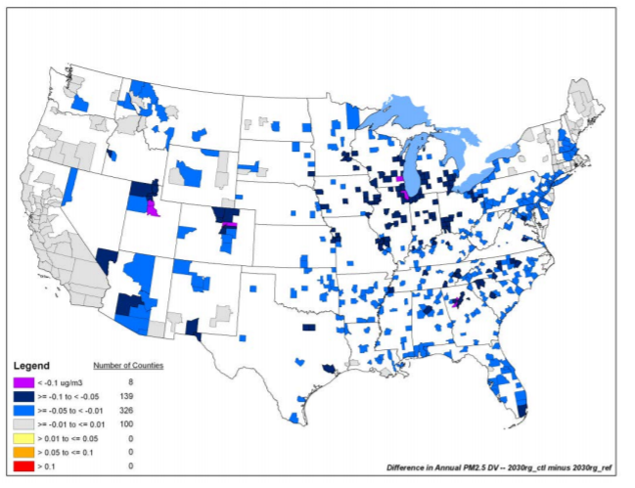
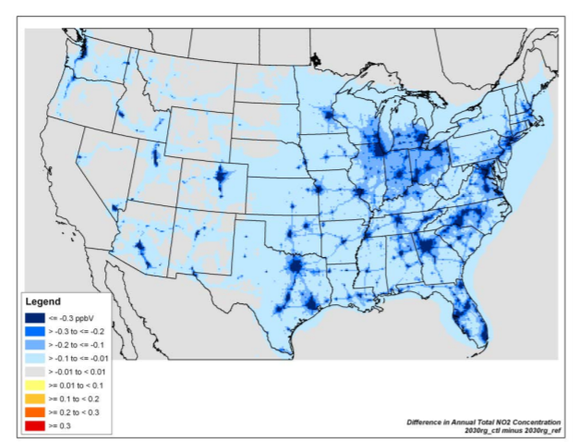
Impacts of the Tier 3 Mobile Source Rule on Air Pollution Concentrations in 2030
Emissions Reductions from Tier 3
AQ Reductions in 2030
∆ Annual PM2.5
Source: US EPA, 2014. Control of Air Pollution from Motor Vehicles: Tier 3 Motor Vehicle Emission and Fuel Standards Final Rule Regulatory Impact Analysis, EPA-420-R-14-005
∆ Annual benzene
∆ Annual NO₂

Slide 12
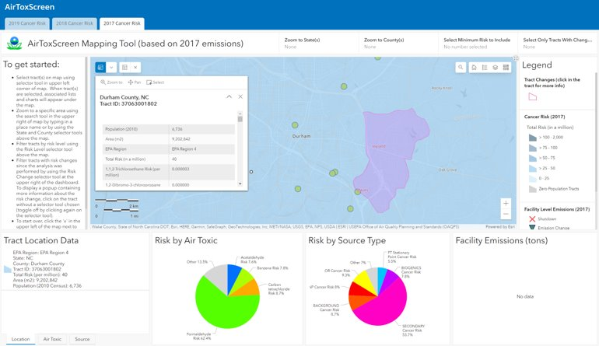
AirToxScreen: Multi-Pollutant Modeling Platform
EPA/OAQPS provides modeled hazardous air pollutant (HAP) concentrations and risk at census block level for AirToxScreen (released annually)
Emissions are from the most current National Emissions Inventory (NEI)/Emissions Modeling Platform
AQ characterization based on two models
CMAQ Multipollutant – 12 CMAQ runs
AERMOD – All anthropogenic sources
Hybrid approach: Combine CMAQ and AERMOD
results to get finer scale annual average
concentration for each HAP
https://www.epa.gov/AirToxScreen

Slide 13
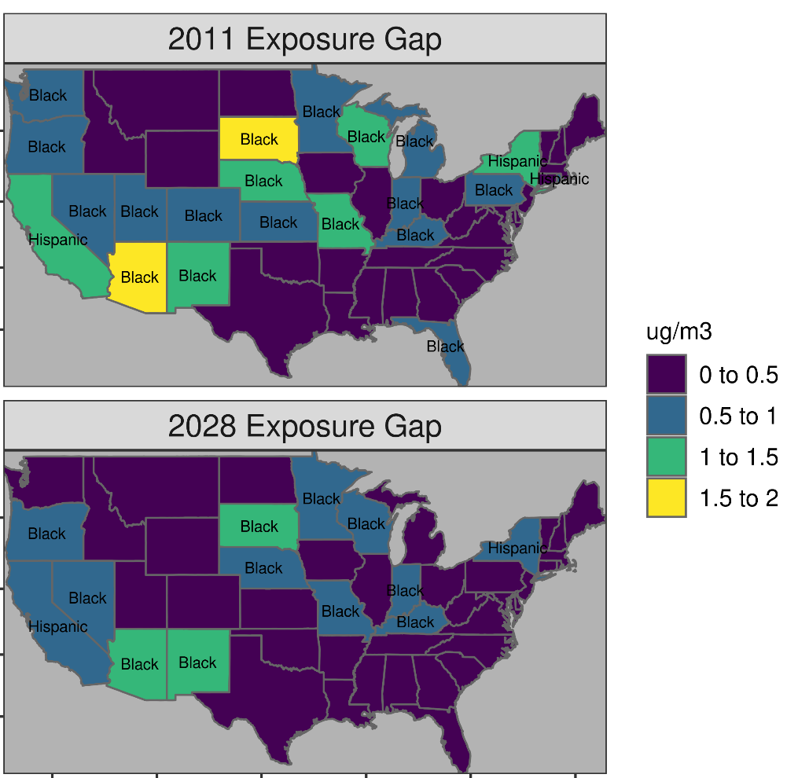
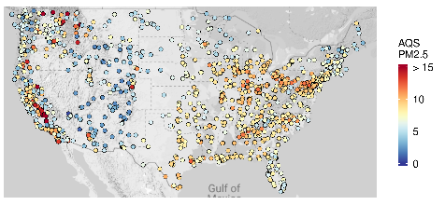
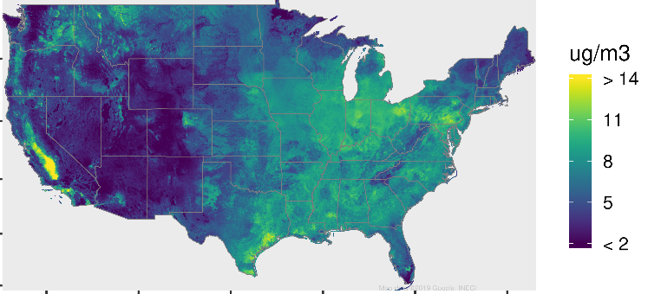
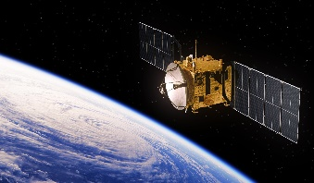
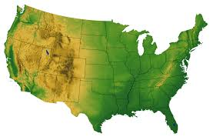
Future Year Projections: Exposure Disparities for PM_{2.5} for 2011 and 2028
CMAQ Modeling
Exposure Gap* by State Decreases from 2011 to 2028 but Most-Exposed Groups Persist
Fused PM_{2.5} Field
Monitoring
Project w/ Future
“On-the-Books”
AQ Modeling
Remote Sensing
Other Data
*Exposure gap is defined here as the difference in population-weighted concentration between the most and least exposed group (but could be defined differently, e.g., gap between low-income non-white and high-income white)
Kelly et al. (2021) Environmental Research (https://doi.org/10.1016/j.envres.2020.110432)

Slide 14
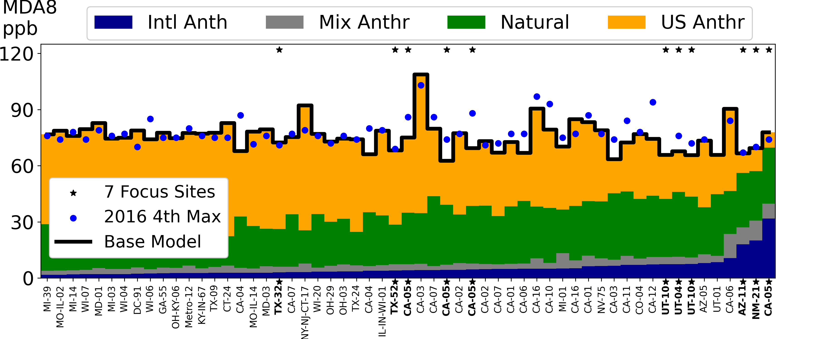
Tracking Anthropogenic and Natural Contributions
Unified Attribution Across Scales
Hemispheric CMAQ
North America CMAQ
USA CMAQ
Performance Enhances Confidence
Top 10 base model day average (black line)
2016 DV (blue dot)
Figure 1. Ozone MDA8 mixing ratios (ppb) for the 2016 4th Maximum value, the Base Model, and the contributions calculated by difference. Monitors are sorted by the Intl Anth. The stars identify the seven sites highlighted in the methods.
Results Consistent with previous modeling
International Anthropogenic contribution: 5.3±4.9 ppb (mean±std)
US Anthropogenic contribution: 40.2±13.5 ppb
Three near-border areas furthest to the right (Yuma, AZ-11; Dona Ana, NM-21; and Imperial, CA-05) stand out in three aspects: all are southwest areas on the Mexico border, all have larger Intl Anth contributions (18-32 ppb) and all have smaller US Anth contributions (8-12 ppb) compared to all other nonattainment areas.

Slide 15
Summary
CMAQ is critical element of the regulatory process
Important that the science and technology stay current
CMAS is also a critical element of the process
Important that the community stays current on that science and technology
Important to continue to foster a collaborative spirit amongst the scientific modeling community
Happy 25^{th!!}

