Slide 1
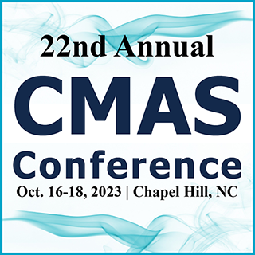
State of the
Center for Community Modeling and Analyses System (CMAS)
> 2 Decades of Serving the Community
Sarav Arunachalam
Director, CMAS Center

Slide 2
The CMAS Center at UNC https://www.cmascenter.org/
Established in 2001, the U.S. EPA’s CMAS Center has been hosted at UNC since 2003, which works with the agency to lead the international, open-source, community-based air quality modeling and analysis software used to develop policies and analyze air quality impacts
Objectives
  Serve as bridge between segments of the AQ modeling community
  Foster growth of developer and user communities
  Serve as hub for modeling education and training
Functions
  Model Research and Development
  User Support
  Applications and Training
  Outreach

Slide 3
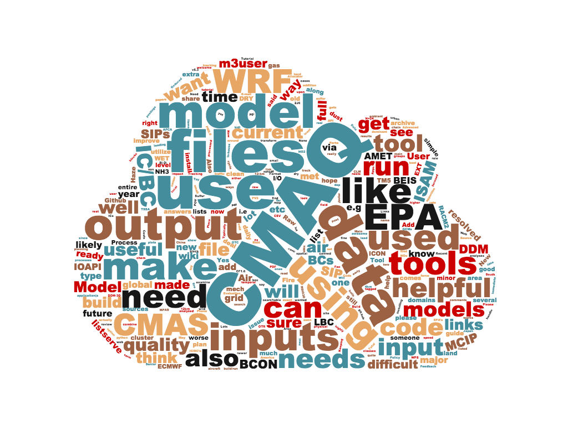
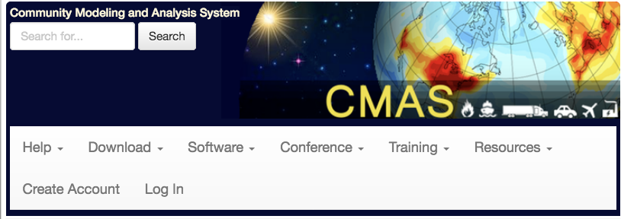
Tool Suite @ CMAS Center
22nd year of operation, serving > 10,000 users globally
See https://www.cmascenter.org
to download these tools

Slide 4
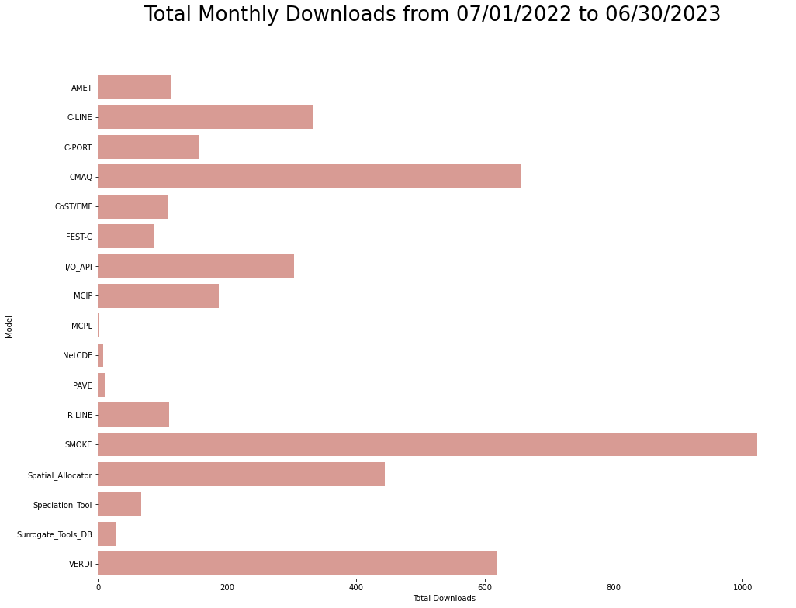
Model Downloads
USER SUPPORT
Model Releases during 2022 – 2023
CMAQ v5.4
SMOKE v5.0
CoST / EMF v4.1
AMET v1.5ª
ª AMET GUI version coming soon

Slide 5
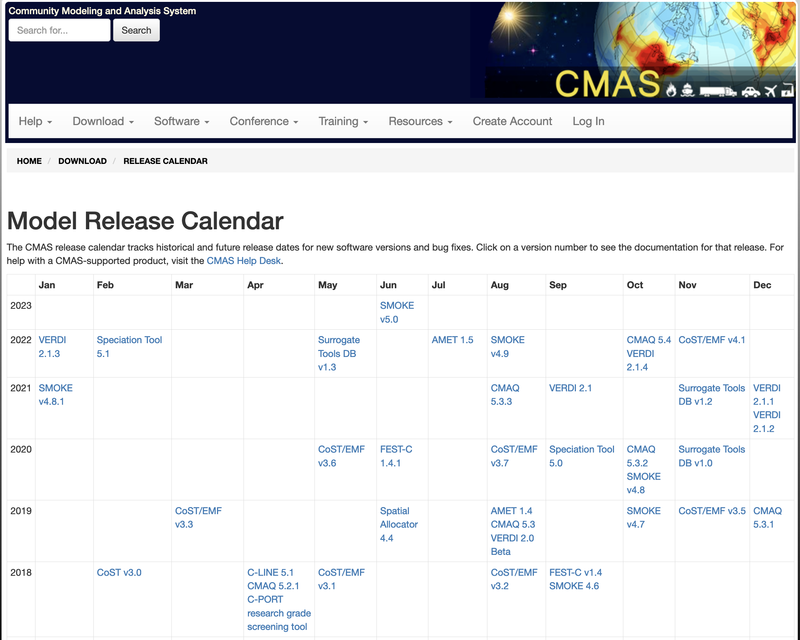
Software Release Calendar
USER SUPPORT

Slide 6




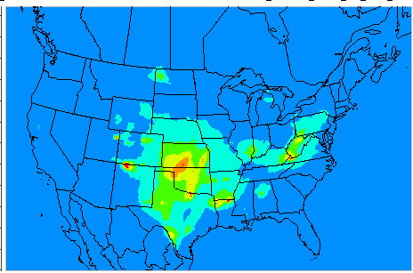

CMAS Data Warehouse
USER SUPPORT
Emissions (NEI)
Reporting
Met (WRF/MCIP)
AQ (CMAQ)
Modeling
Data Warehouse on Google Drive & AWS
Observations
Visualization
~160 TB and Growing
Cloud computing using AWS and Microsoft Azure

Slide 7
CMAS Data Warehouse
- both for and from the community
USER SUPPORT
Current datasets available for CMAS community
  Assortment of various CMAQ inputs and outputs
    From 2002 – 2017
    NEI-based modeling platform
    MCIP outputs
    CMAQ Northern Hemispheric outputs
    CMAQ Continental US outputs
  EPA’s Air QUAlity TimE Series Project (EQUATES)*
    2002 – 2019 Met, Emis and AQ Datasets @ 12-km x 12-km
    Northern Hemisphere and ConUS
  NEI 2016v3 and 2019 modeling platform
  CMAQ v5.4 for 2018 using CB6r5 and CRACMM
  1-month ConUS data from 2016 on AWS Open Data Program*
    See registry at: https://registry.opendata.aws/ and https://go.unc.edu/i9WQr
Interactive Forms interface to share datasets from researchers to others
As of 2020 on Google Drive
Added since
On Google Drive
New
*See poster by Fahim Sidi on Tuesday

Slide 8
CMAQ on the Cloud
USER SUPPORT
Significant progress in running CMAQ v5.4 on Cloud
  Extensive testing on AWS and Azure
  Using both native builds and containers
  Single node vs. Multiple nodes (ParallelCluster and CycleCloud)
  See Adams et al in Cloud Computing Session (Wed 11:10 – 11:50 pm)
Two detailed tutorials
  Best practices for running CMAQ on a Cloud (AWS and Azure)
  Access datasets from AWS S3 bucket while on compute nodes
  Join us for Tutorial by Adams, Soni, and Brown (AWS) in Cloud Computing Session (Wed 1:30 – 5:00 pm)

Slide 9
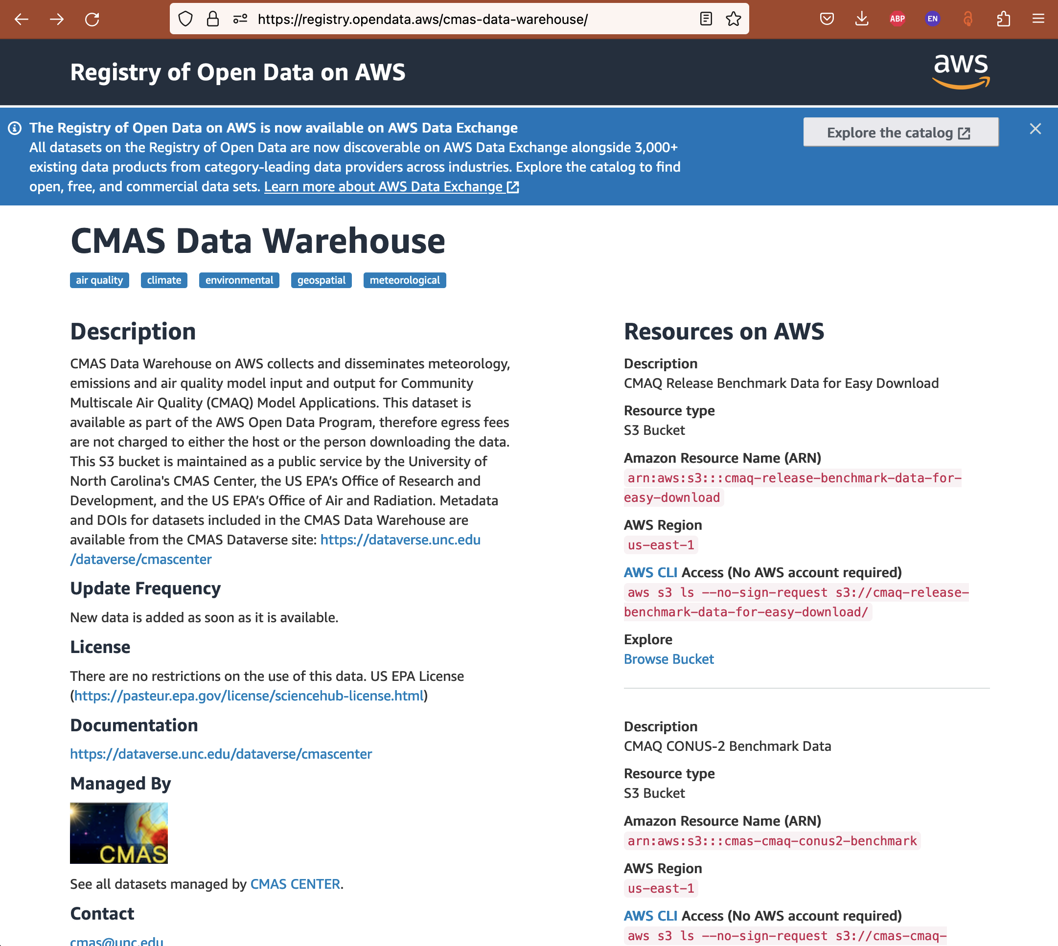
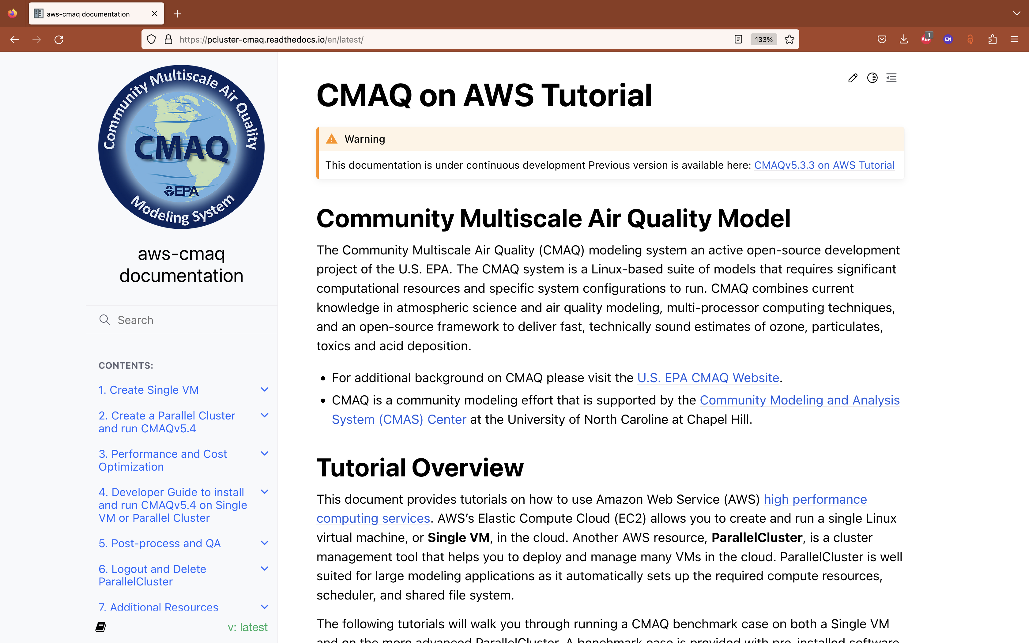
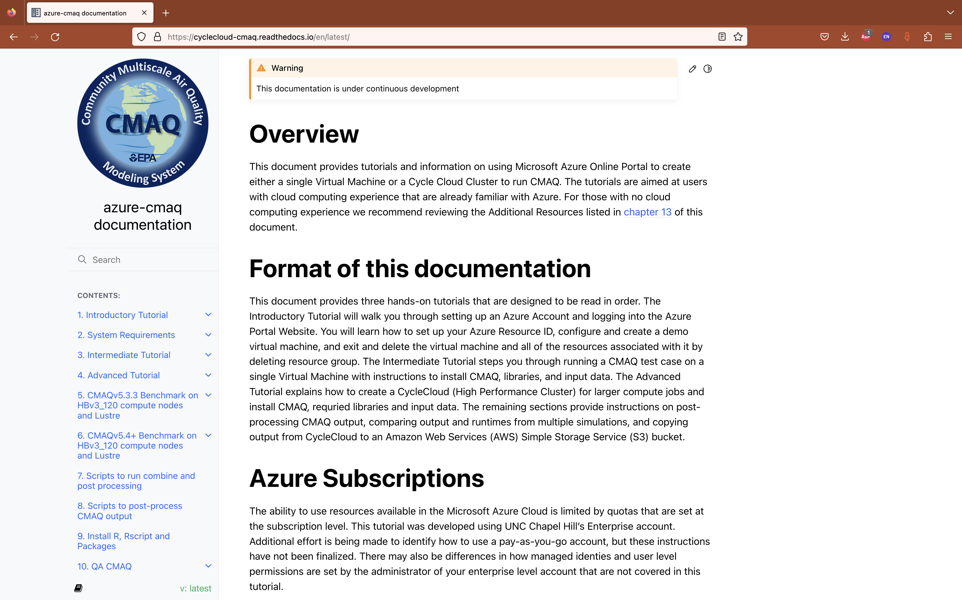

Slide 10

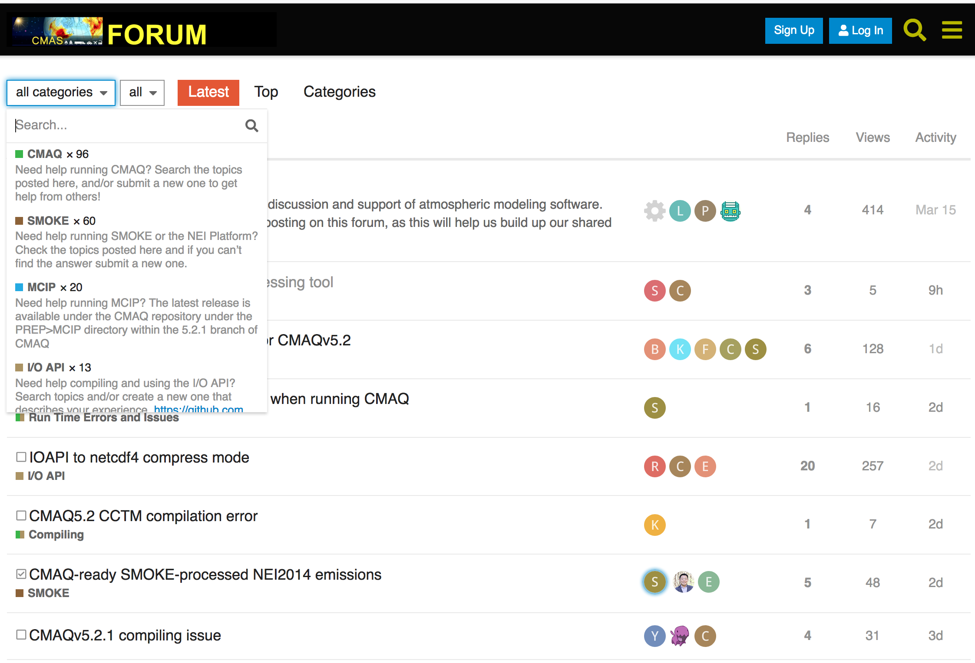
CMAS Discourse Forum http://forum.cmascenter.org
USER SUPPORT
About ~50 queries from user community each month on various CMAS products

Slide 11
Training – both Onsite and Offsite
APPLICATIONS AND TRAINING
Transitioned completely to online training
  Lecture and Hands-on components using AWS EC2 instances
  Twice a year, Spring and Fall 2023*
Conducted international training sessions
  Brazil, Bulgaria, Canada, China, Colombia, Greece, Hong Kong, India, Japan, Mexico, S. Korea
Special trainings
  Python for Air Quality Research and Applications
  Model Interpretive Analyses
* SMOKE Training October 10 – 13, 2023
CMAQ Training October 24 – 27, 2023

Slide 12
Collaboration and Information Sharing
OUTREACH
CMAS Conferences
  Annually at Chapel Hill, NC during October
  Asia
    CMAS – Asia Pacific Conference (Beijing, China in May 2018)
    CMAS – Asia Pacific Conference (Japan in July 2023)
  South America
    4th CMAS South America Conference (Belo Horizonte in July 2019)
    5th CMAS South America Conference (São Paulo in June 2024)*
Webinars
  Webinar series on special topics or new releases
CMAS Visiting Scientist Program
  Brazil, China, Hong Kong, Korea, Portugal
Special Issues with Peer-reviewed Journal Articles
  Atmos. Environ., (2004), J. Applied Meteorol. (2005),
  Environ. Fluid Mech. (2007), J. Air and Waste Mgmt. Assoc. (2020)
* Stay tuned for detailed announcements

Slide 13
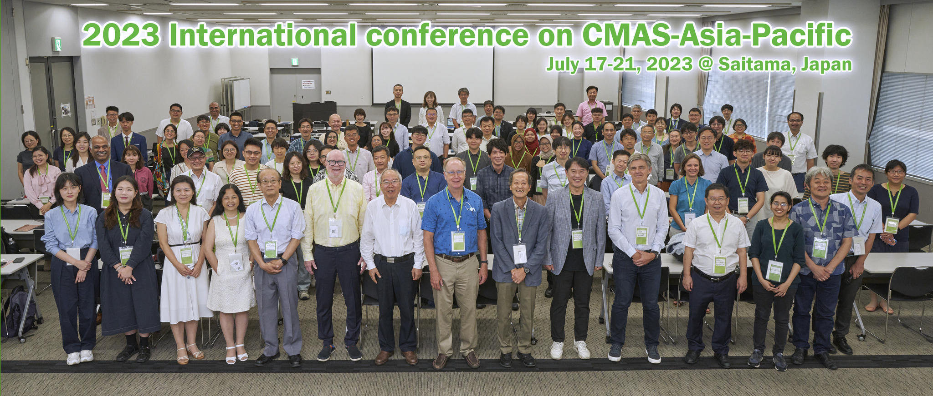
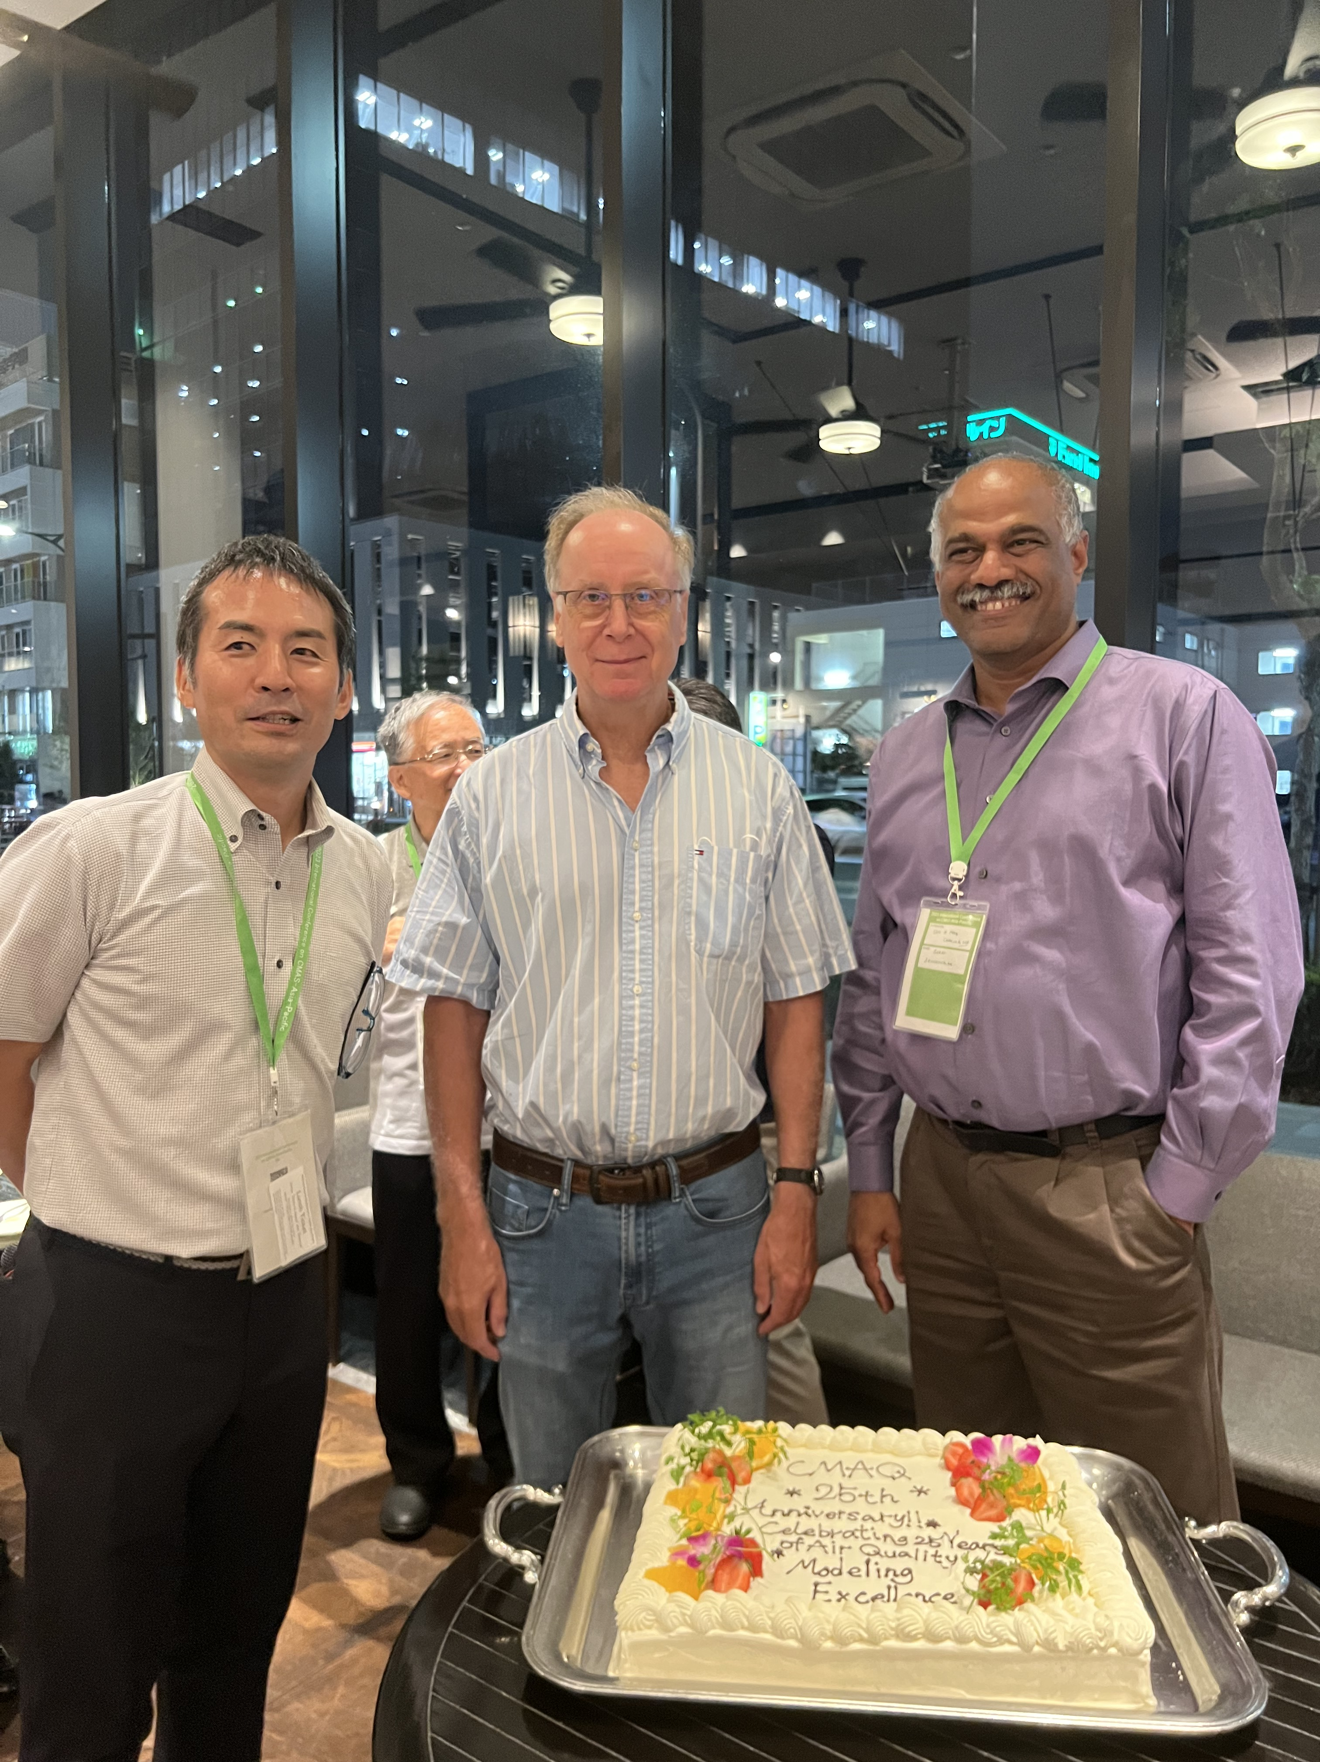
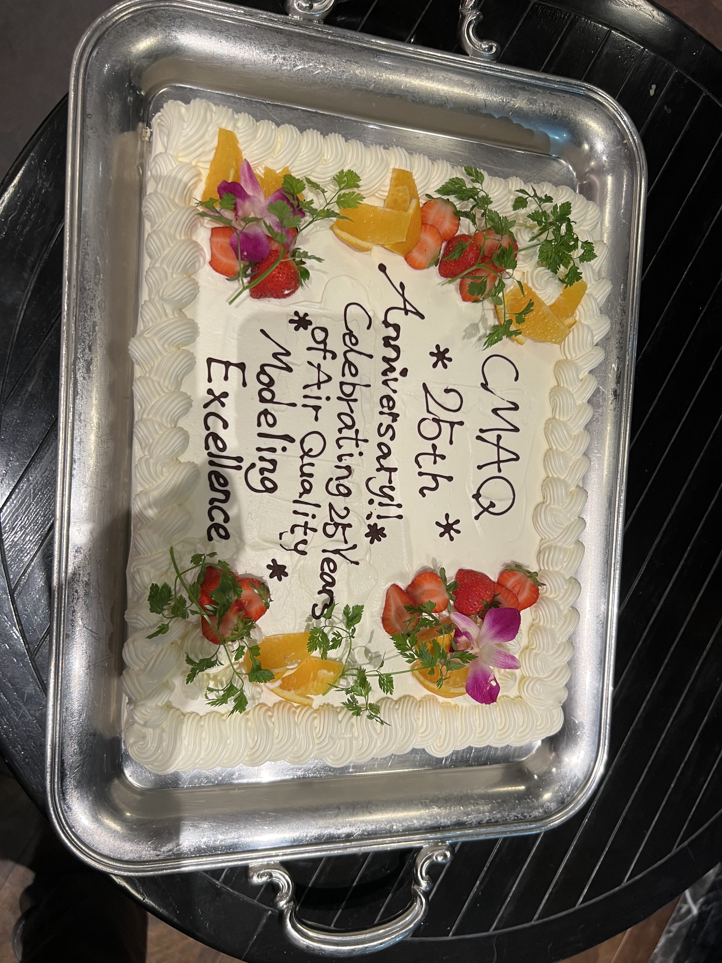

Slide 14
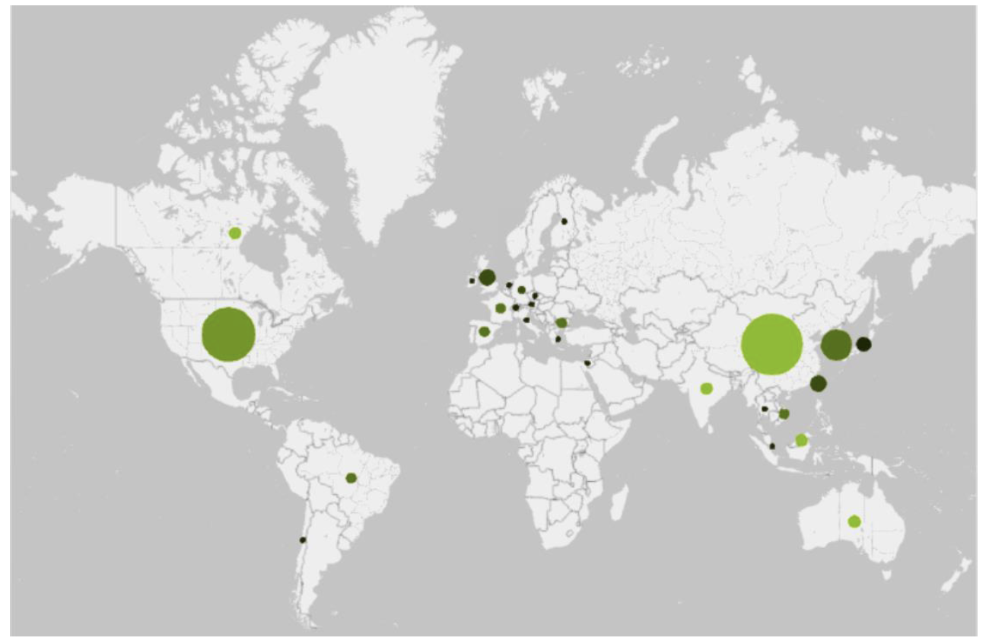
CMAQ Publications by Co-authors for Y2022
194 papers published
Data from Web of Science
Source: U.S. EPA

Slide 15
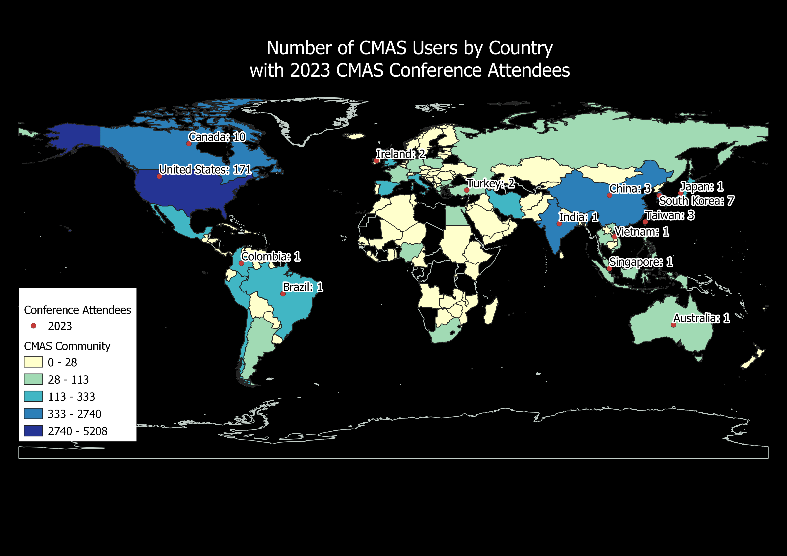
CMAS Global Footprint
OUTREACH and USER SUPPORT

Slide 16
CMAS Center Team
@ UNC
Director and Outreach
  Sarav Arunachalam
Research and Applications
  Sarav Arunachalam
Training and Conference
  Brian Naess, Liz Adams
  Catherine Seppanen
  Huy Tran
  Erin Valentine
  Manish Soni
User Support and Documentation
  Liz Adams
  Catherine Seppanen
Communications and Events
  Erin Valentine, Brian Naess, Emily Williams
Technical Editing
  Erin Valentine
External Advisory Committee (EAC)
Arastoo Pour Biazar (Univ Alabama)
Tyler Fox (US EPA)
Amir Hakami (Carleton Univ)
Prakash Karamchandani (Ramboll)
Byeong-Uk Kim (GA EPD)
Naresh Kumar (EPRI)
Rebecca Matichuk (US EPA)
Mike Moran (Env Canada)*
Talad Odman (Ga Tech)
Roger Timmis (Env Agency, UK)
Taciana Toledo (UFMG, Brazil)
Neil Wheeler (Science-One)
Yang Zhang (NCSU)
* Recently retired

Slide 17
Acknowledgements
CMAS Community
CMAS EAC Members
U.S. EPA
Kristen Foley, U.S. EPA ORD
  CMAS Center Program Officer
Poster session Co-chairs
  Yang Zhang and Taciana Albuquerque
Conference Team
  Erin Valentine, Brian Naess, UNC-IE
  Sessions Chairs from the CMAS Community, and
  UNC Student Volunteers

Slide 18


Slide 19
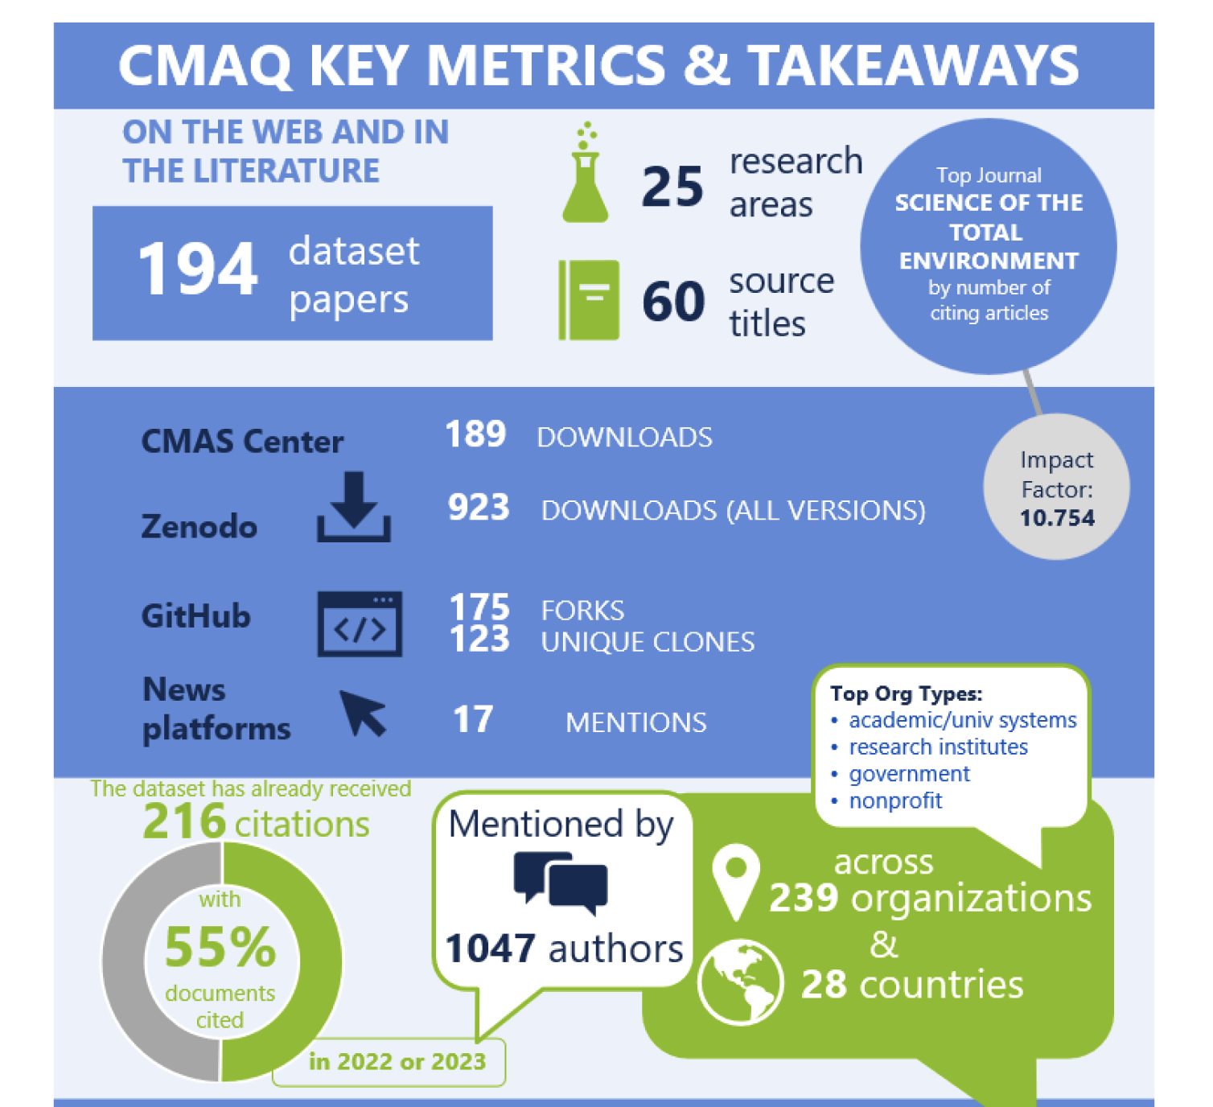
CMAQ Key Metrics and Takeaways
Source: U.S. EPA

Slide 20
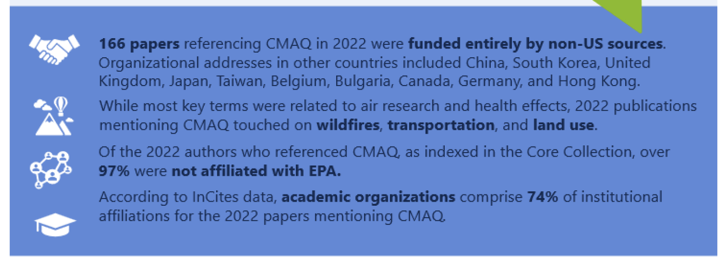
CMAQ Publications for Y2022
Source: U.S. EPA

