Slide 1
The Pandemic Bottom-up Emission Inventory Development using human Activity, Satellite Retrieval, and Chemical Transport Model
NOAA Atmospheric Chemistry, Carbon Cycle, Climate (AC4) project
Chis-Tsan Wang, B.H. Baek, Jia Xing, Siqi Ma, Kai Yang, and Daniel Tong
George Mason University

Slide 2
Motivations
The ambient measurement and satellite observational data indicated that some air pollutants (NOx and PM) largely decreased during the COVID pandemic. (Venter et. al., 2020; Tanzer-Gruener et. Al., 2020; Liu et. al., 2020; Kroll et. al. 2020)
Some studies did the CTM model sensitivity study or used simple scale method based on ambient observational data to represent the decline of emissions and reflected the air quality changes in CTM model simulation. (Liu et. al., 2021, Kang et.al., 2020)
The sensitivity study or emission adjustment by observational data can be processed fast, but those method did not consider the details of human activity changes in different emission sources.

Slide 3
Research Outline
Phase I: Developed a rapid refresh method for fast projecting the future emission by human activity data.
Phase III: Constraint the emissions with the top-down method based on the observational data (surface AQS and satellite data) using the DeepCTM and the inverse modeling process.
Phase II: Run the CMAQ model for 2019 and 2020 year and apply the model result with deep-mechanism learning method (DeepCTM) to understand the relationship between the emissions and CTM concentrations.
2019 Emission platform data
2020 Emission data
CMAQ model with Deep CTM
2019 and 2020 Human Activity data
Ambient & Satellite measurement data

Slide 4
2020 Emission Data Development
Base Emissions: U.S. EPA’s 2019ge Emissions Modeling Platform (EMP) (as of September 2022)
COVID-19 EMP Development based on the human activity datasets
  Collect the human activity datasets for 2019 and 2020, and then compute the ratio of 2020 to 2019
  Apply the 2020/2019 ratio to activity-related emission inventory sources (annual or monthly)
  Calculate the 2020 COVID-19 annual totals, and then
  Compute monthly totals based on the 2020 monthly temporal profiles, and then export them in FF10 SMOKE inventory formats
  Updated the SMOKE run scripts to correctly process monthly total inventories
  Month2Day Temporal PROfiles (TPRO): onroad (RPD), airports, and oilgas (with oil production)
Updated Sectors: nonpt, ptegu, ptnonipm, np_oil_gas, pt_oilgas, np_solvent, airports, noroad, RPD, CMV
Exempted Sectors: Onroad (RPV, RPS, RPH,,,), Hourly CEMS, RWC, AgNH3, ptfires, afdust, and ptagfires

Slide 5
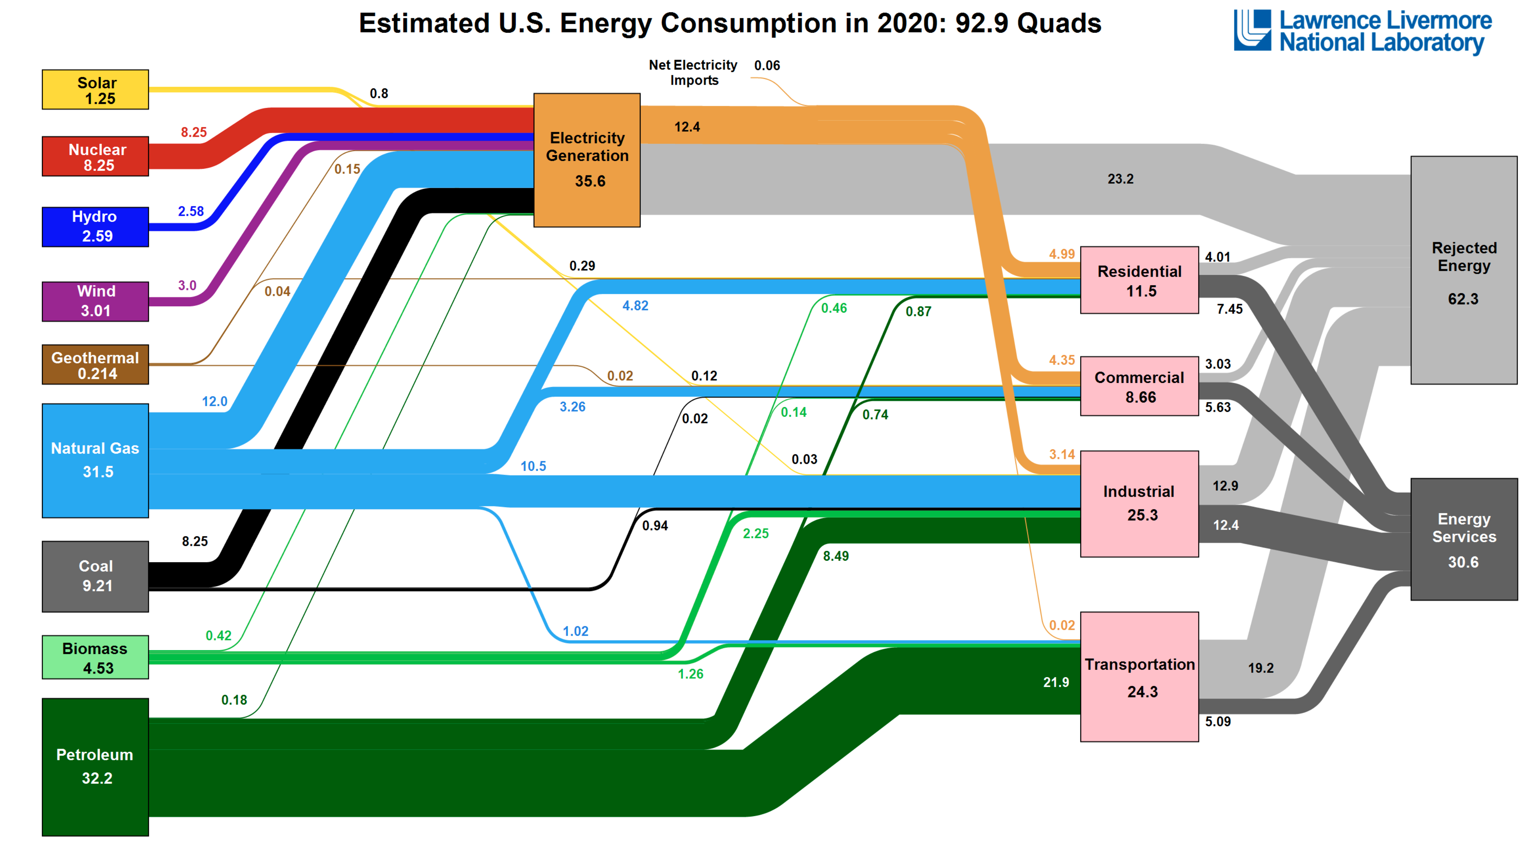
2019 : 100.2 Quads
1 Quads = 10¹⁵ BTU
1
5
2
6
4
3
Vehicles, Airport, Vessel, Railroad

Slide 6
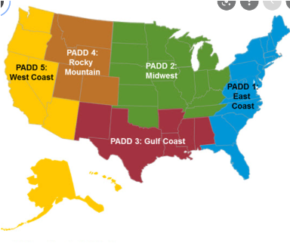
Human Activity Data Collections
U.S. EIA Data :
Electricity Generation data (Fuel type, State, Monthly)
Natural Gas Consumption (not for EGU) (State, Monthly)
Petroleum Sale End users (Fuel type, State, Yearly)
Petroleum Consumption (End user, Fuel type ,US, Monthly)
Net petroleum product (5 PADD regions, Monthly )
Petroleum Production supply (6 products, 5 regions, Monthly)
Electricity Usage (End users, State, Monthly)
U.S. DOT Data :
Daily travel distance data (County, Daily)
March 2020 US flight data (US, Daily)
Freight Weight data (Mode , State ,Monthly)
INRIX Data:
Normalized Daily VMT data (Vehicle type, State, Monthly )
Flighttrader24 Data:
Flight tracked by Flightradar24 (Global, Daily)
Petroleum Administration for Defense Districts (PADD)
Total number of temporal profiles developed (county/state, daily/month/annual, source): 5995 + no of county-vehicle VMT TPRO

Slide 7
Energy-related sectors : ptegu, ptnonipm, pt_oilgas, np_oilgas, nonpt, solvent
EIA Data
(S=State level, M=Monthly, US=US total, R=Regions)
SCC Mapping
1) Electricity Generation by fuel (S, M)
Combustion or Consumption
PTEGU or Electric Generation
Nature Gas usage : Boilers, Combustion, Industrial Process, Chemical Evaporation, Stationary Source fuel combustion (Residential, commercial, industrial), space Heater, Dryer, Roasting, Turbine, Heater
Electric Generation
2) Natural Gas Usage by end-user (S,M)
Natural Gas Consumption
3) Petroleum sale by end-user and fuel types (S,A)
Petroleum Consumption:
Distillate fuel, Kerosene, Residual fuel, Coal, Propane, Biomass.
Gasoline, Petroleum Coke, propane, propylene, total petroleum
Petroleum product usage : Boilers, Combustion, Industrial Process, Chemical Evaporation, Stationary Source fuel combustion (Residential, commercial, industrial), space Heater, Dryer, Roasting, Turbine, Asphalt concrete,
Petroleum consumption by end-user
and fuel types (US, M)
4) Petroleum Process data related
to Crude Oil (R, M)
Pt_oilgas, np_oilgas: Oil and gas Production, Exploration, product storage, transportation and
Marketing petroleum products, Refinery, Fugitive Emissions
Oil and Gas Production and supply
Petroleum Supply by fuel types (R, M)
Other data that can not be identified by energy consumption or Production.
Other : Chemical Manufacturing All process, Food and Kindred Products, Agriculture Production, and others
5) Electricity Usage by end-user (S, M)

Slide 8
Energy-related Emission Source Monthly Trends
1) Electricity Generation
2) Natural Gas Consumption in Industry and residential
4) Petroleum supply

Slide 9
Transportation: Onroad RPD
(S = state level, C = county level, M = monthly data , D = daily data, Vt = Vehicle type)
DOT VMTdata [D, C]:
County level, daily data 2019-2020, but no Vehicle type. but only total VMT, not Vt contribution.
EPA VMT data [M, C, Vt]:
County level, Monthly data, with eleven vehicle types, but only 2019, no 2020.
INRIX normalize VMT data [D, S]
State level, Daily data, three vehicle types, but only 2020 and no VMT contribution by vehicle types.
We used the DOT VMT data to calculate the County level, monthly total of 2020 to 2019, But this data missing vehicle types contribution information.
We used EPA VMT data to address the vehicle type VMT contribution for 2020 February. The vehicle type contribution to VMT will be used with INRIX data.
The INRIX data are used to identify the 2020 VMT for individual vehicle types.
The monthly total DOT VMT data can be separated into three vehicles by INRIX data vehicle contribution data.
After applied the EPA VMT February data as standard, we generate the INRIX 2020 county level, monthly total VMT contribution by vehicle types.
Goal: 2019 and 2020 monthly VMT data with Vehicle types (C, M)

Slide 10
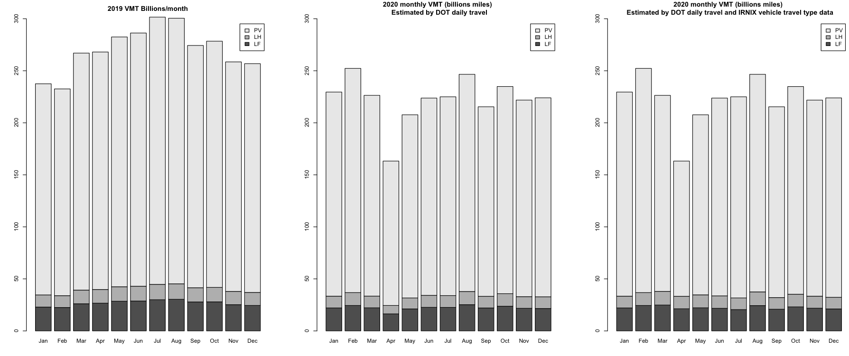
U.S. DOT VMT Changes
PV: Passenger Vehicle, LH: Long Haul, LF: Local Fleet

Slide 11
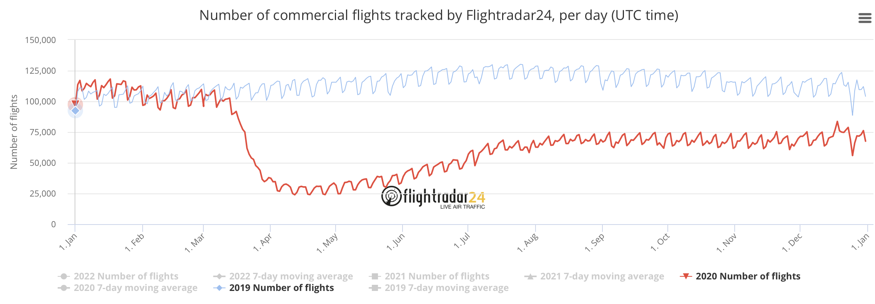
Transportation: Airports
(C = county level, M = monthly data)
Individual airport Monthly landing and take-off counts:
Airport county level profile
State total level profile
US total profile
DOT
Airport-level Activity Reports, (C, M)
Airports points emissions
Flightrader 24
History data of commercial flights (Global)
Calculate the month-to-day temporal profile for US.
DOT, Bureau of Transportation Statistics:
Airline On-Time Data, (US, Daily, March 2020 only)

Slide 12
Preliminary COVID-19 2020 EMP Results
Sectors | airports | ptegu | ptnonipm | pt_oilgas | AC4 Point draft | EPA 2020 point draft Aug 2022 | AC4_2020 vs EPA2020
2019 NOX (tons) | 140,837 | 1,028,545 | 866,977 | 442,842 | 2,479,201 |  | 1.39%
2020 NOX (tons) | 90,603 | 887,205 | 798,319 | 439,382 | 2,215,484 | 2,185,147
NOX change (%) | 64.30% | 86.30% | 92.10% | 99.20% | 89.36% | 88.1% | 1.39%
2019 VOC (tons) | 58,511 | 29,912 | 763,440 | 184,092 | 1,035,955 |  | -7.11%
2020 VOC (tons) | 38,171 | 27,073 | 723,870 | 168,885 | 957,982 | 1,031,292
VOC change (%) | 65.20% | 90.50% | 94.80% | 91.70% | 92.47% | 99.55% | -7.11%
2019 PM25 (tons) | 9,087 | 100,082 | 242,308 | 14,236 | 365,713 |  | -0.01%
2020PM25 (tons) | 5,985 | 87,940 | 227,804 | 13,906 | 335,631 | 335,671
PM25 change (%) | 65.90% | 87.90% | 94% | 97.70% | 91.77% | 91.79% | -0.01%
2019 SO2 (tons) | 17,685 | 1,048,032 | 504,057 | 38,959 | 1,608,733 |  | -0.62%
2020 SO2 (tons) | 11,341 | 854,721 | 431,459 | 38,194 | 1,335,711 | 1,343,979
SO2 change (%) | 64.10% | 81.60% | 85.60% | 98% | 83.03% | 83.54% | -0.62%
2019 CO (tons) | 516,605 | 484,817 | 1,363,324 | 234,232 | 2,598,978 |  | 5.13%
2020 CO (tons) | 335,270 | 428,567 | 1,272,253 | 228,987 | 2,264,875 | 2,154,426
CO change (%) | 64.90% | 88.40% | 93.30% | 97.80% | 87.14% | 82.90% | 5.13%
2019 NH3 (tons) | 0 | 20,965 | 68,813 | 3,767 | 93,545 |  | -2.97%
2020 NH3 (tons) | 0 | 20,701 | 66,205 | 3,980 | 90,886 | 93,664
NH3 change (%) | 0% | 98.70% | 96.20% | 105.70% | 97.16% | 100.13% | -2.97%

Slide 13
Acknowledgement
Supported by NOAA Atmospheric Chemistry Carbon Cycle &Climate (AC4) project.
USEPA OAQPS provided latest 2019 Emission (2019ge version) Inventory data and other ancillary data.
  Alison Eyth (USEPA)
DOT Daily VMT travel data
INRIX State-level normalized daily VMT data by vehicle types

Slide 14
Thank you and Questions?

Slide 15
Support information slides

Slide 16
Human Activity affected by COVID-19
Electricity Generation: Geothermal, Natural Gas, Coal, Biomass, Petroleum
Natural Gas Consumption: Residential, Commercial, Industry.
Petroleum Consumption (not for transportation): Distillate Fuel, Kerosene, Propane Residual Fuel, Coal, Biomass.
  End users: Residential, Commercial, Industry.
Petroleum Product supply: Crude Oil, Natural Gas, Distillate Fuel, Kerosene, Asphalt, Miscellaneous products.
Electricity Consumption: Residential, Commercial, Industry.
Transportation: Vehicles, Aviation, Vessel, Railroad

Slide 17
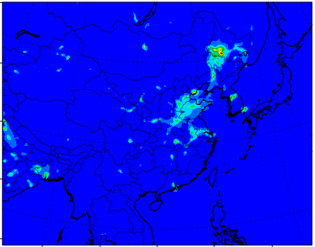
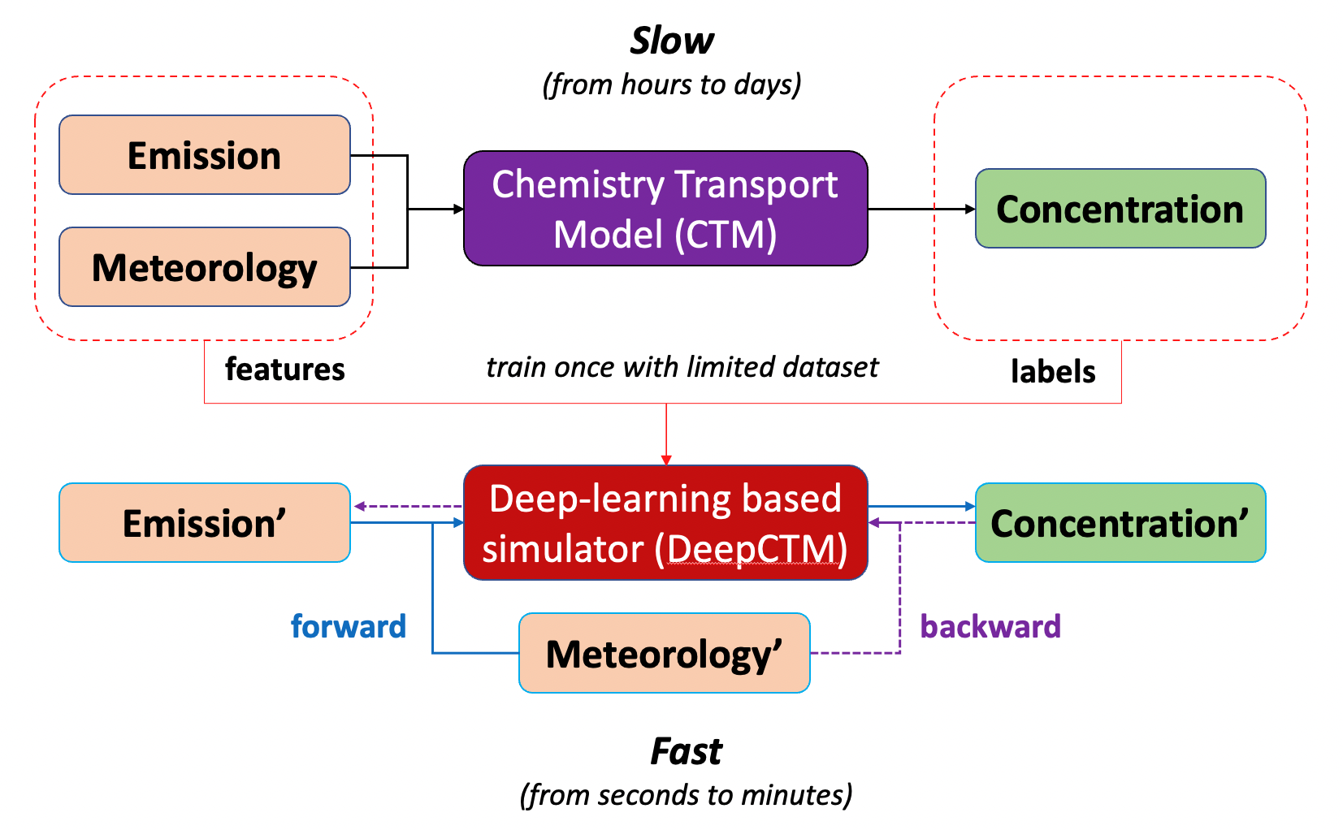
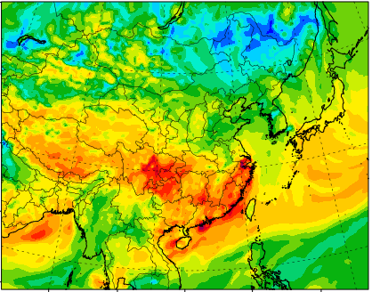
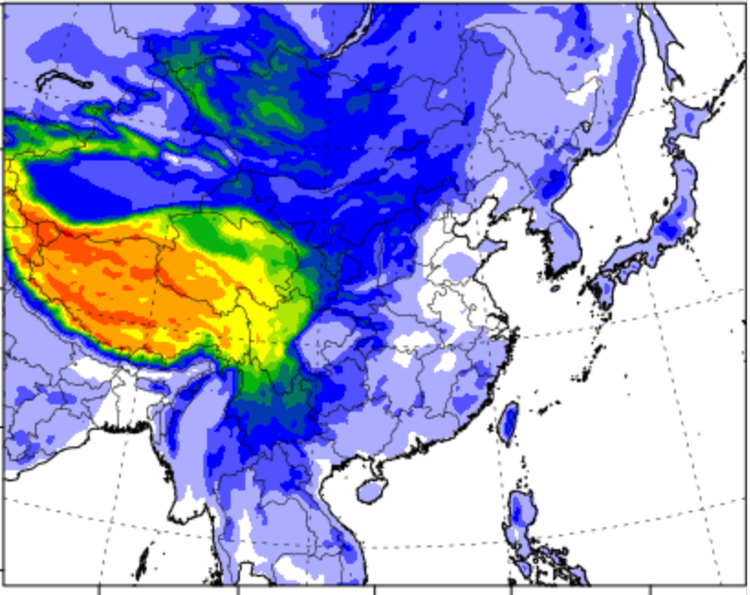
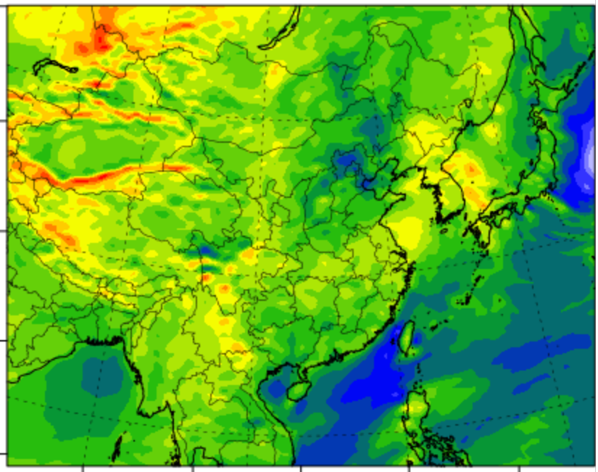
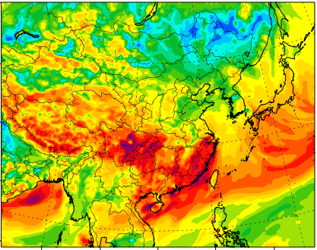
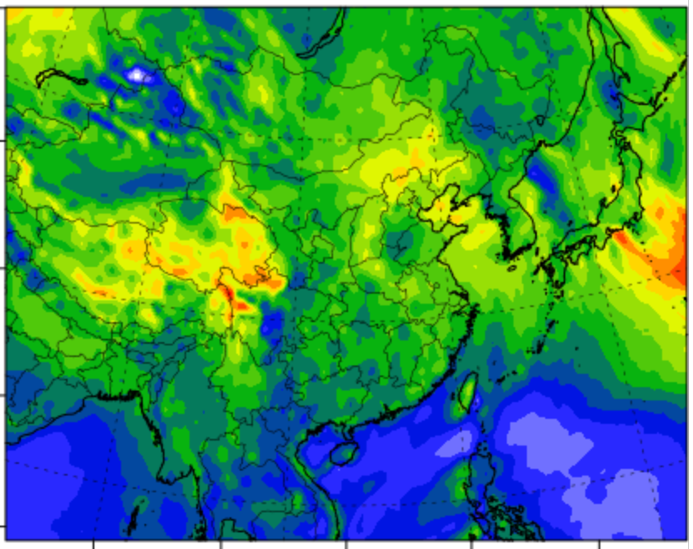
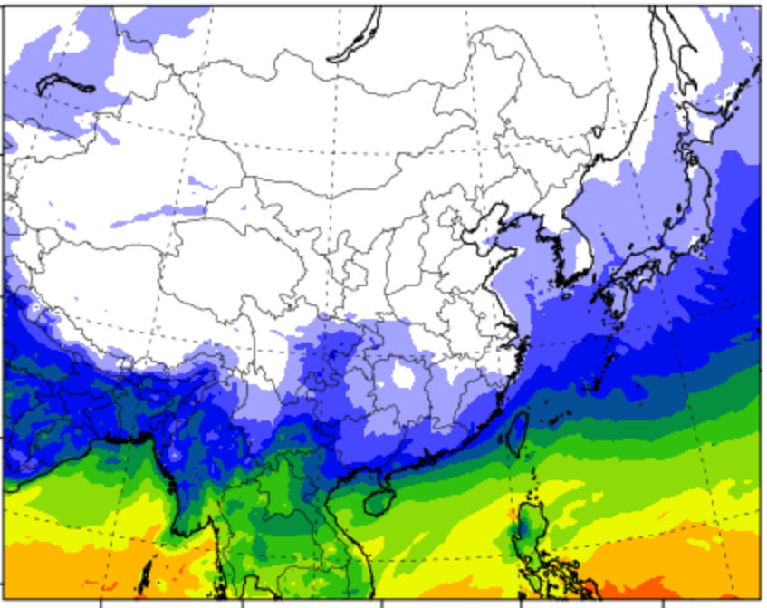
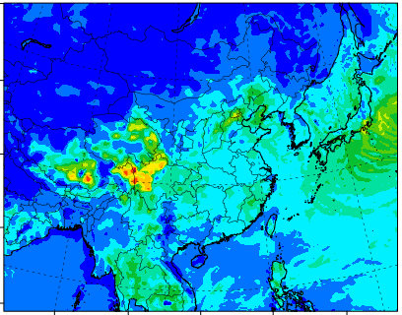
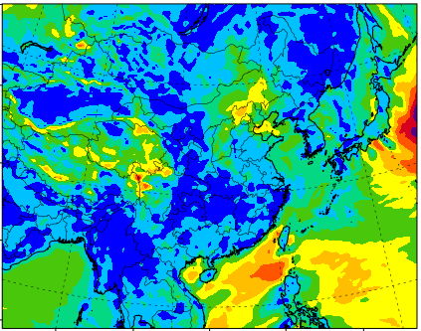
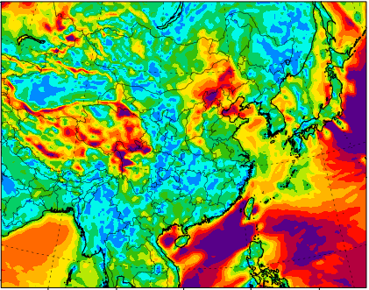
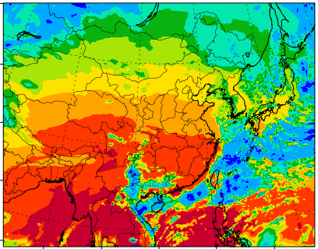
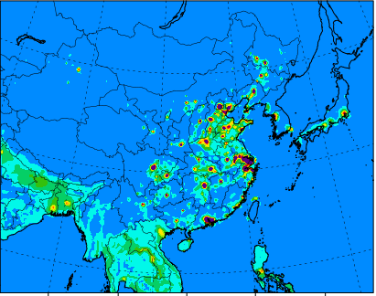
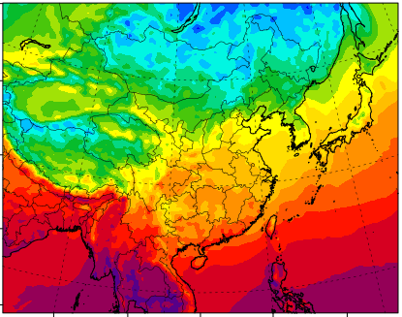
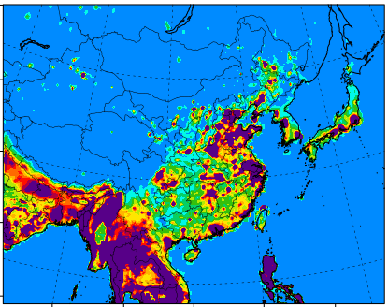















Deep-Machine Learning [DeepCTM]
C_{Concentration}= 2
$$y_{t}$$
NO2
MLP
O3
CNN
CNN
U-Net
pReLU
pReLU
Concatenate
CNN
CNN
$$h_{t−5}$$
$$h_{t−4}$$
$$h_{t−3}$$
$$h_{t−2}$$
$$h_{t−1}$$
$$h_{t}$$
pReLU
pReLU
CNN
LSTM
LSTM
LSTM
LSTM
LSTM
LSTM
CNN
$$y_{t−6}$$
$$x_{t−5}$$
$$x_{t−4}$$
$$x_{t−3}$$
$$x_{t−2}$$
$$x_{t−1}$$
$$x_{t}$$
$$geography data$$
C_{geography}= 1
C_{initial cond.}= 2
C_{Flux transport}= 2
C_{Meteorology}= 6
Study the impacts from the inputs (Emissions, Meteorology, Concentrations, and Time)
The efficiency of AQ simulations can be enhanced with ML-built emission-concentration relationship
Height of terrain
NO2
C_{Emission} = 2
V wind
O3
humidity
U wind
(Xing et al., ES&T, 2020)
PBL height
Wind speed
Short-wave radiation
convective velocity scale
2-meter temperature
NOx emission
VOC emission
CNN: convolution network; LSTM: long short term memory; U-Net structure (2-layers); MLP: multiple layers of perceptrons with threshold activation; pReLU: the parametric rectified linear unit is used as the activation function

Slide 18
Transportation: Railroad, Vessel, Nonroad
(S = state level, M = monthly data, US = US total)
DOT Freight data
(Monthly, State, Transport method)
State Level Monthly Profile
Emission Sector Mapping
Monthly Freight Weight by Railroad (S, M)
RAL_TRD
Railroad
CMV_c1c2_US
CMV_c3 _US
CMV_c1c2_CA
CMV_c3 _CA
CMV_c1c2_MX
CMV_c3 _MX
CMV_TRD_US CMV_TRD_Canada, CMV_TRD_Mexico
Freight Weight by Vessel (US, Canada, Mexico) (S, M), Port State.
EIA nonroad data
Petroleum Sale by end user (non- highway, farm, vessel, railroad) by Diesel (S,A)
Nonroad
non highway (NOR_DIS), Agricultural Equipment (FRM_DIS),
CMV_DIS_US,
RAL_DIS_US
NOR_DIS_US
FRM_DIS_US
Petroleum consumption by end user (Industry) and Diesel (US, M)

Slide 19
Transportation: Railroad, Vessel, Nonroad

Slide 20
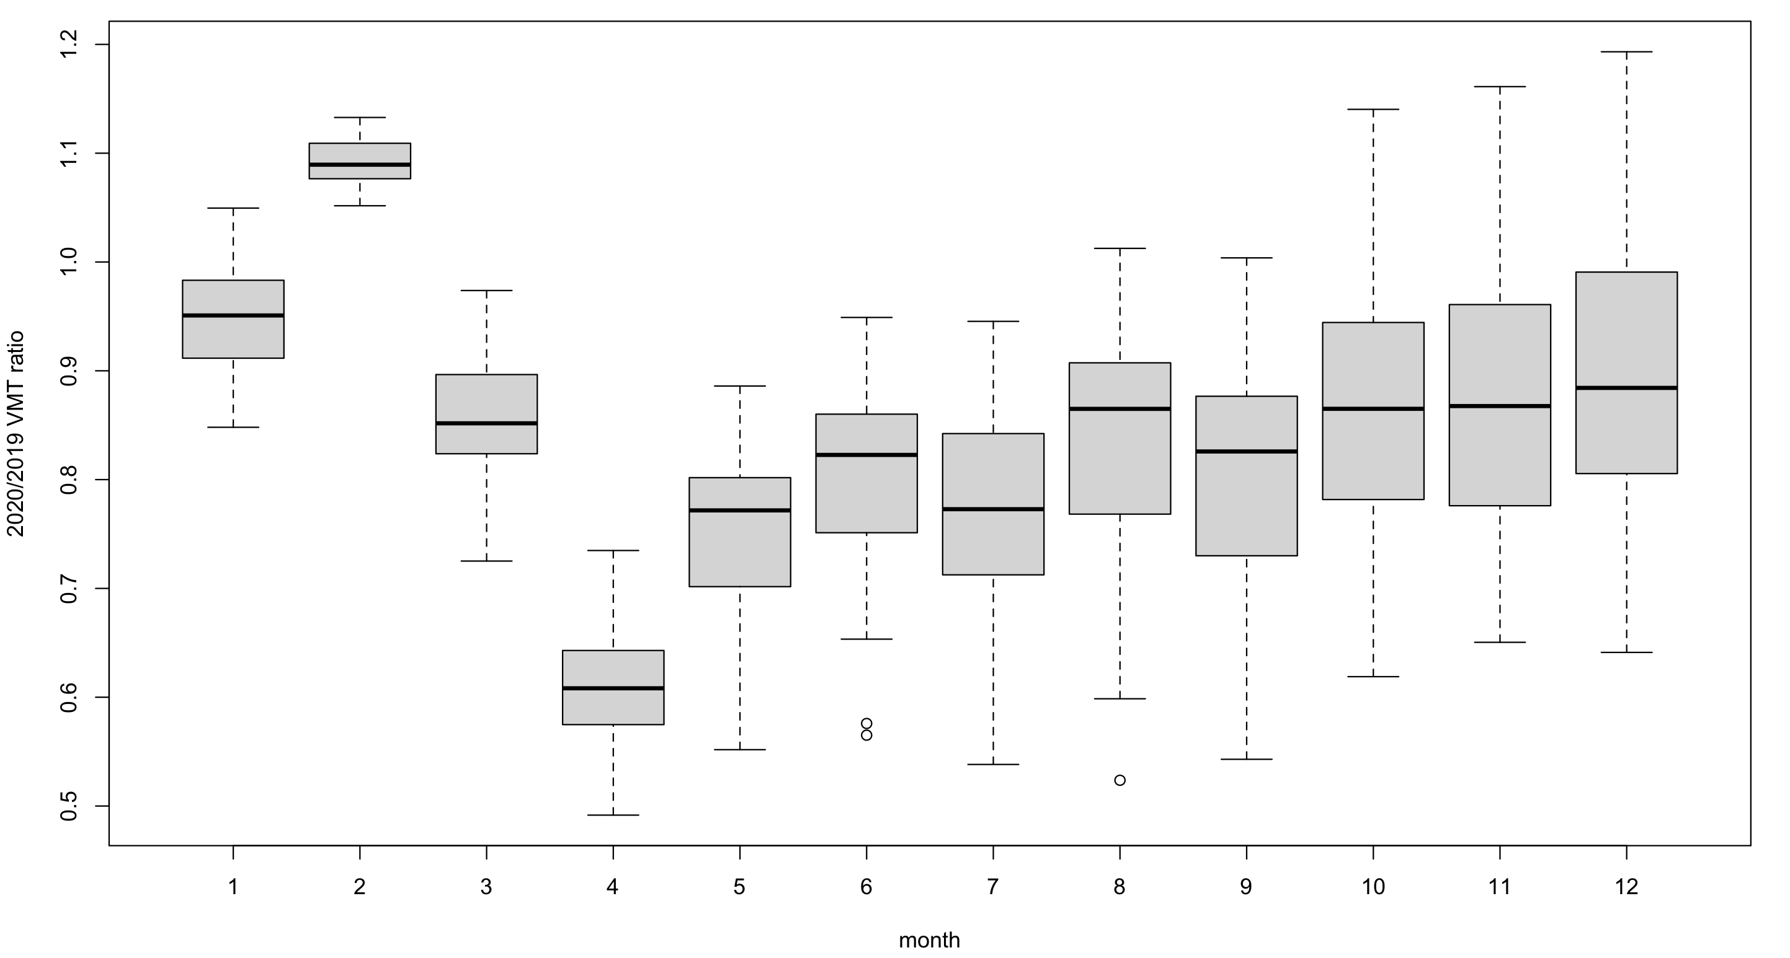
U.S. DOT VMT Changes: County level

Slide 21
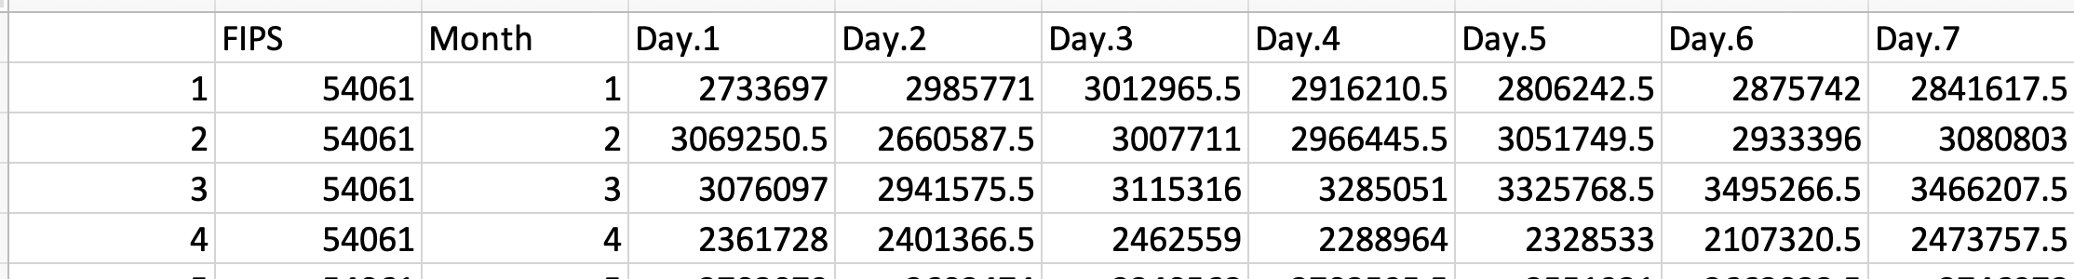
2020 VMT preparation I : Generate the DOT Daily County Total VMT
Download the Daily and stay at home data from DOT website:
https://data.bts.gov/Research-and-Statistics/Trips-by-Distance/w96p-f2qv
The file name is “Trips_by_Distance-2_org.csv”.
The rows set are each day, county level (Date 2019/01/01-2020/12/31, State and FIPS) ;
The columns are Number of Trips in various range, include (<1 miles, 1-3 miles, 3-5 miles, 5-10 miles, 10-25 miles, 25-50 miles 50-100 miles, 100-250 miles, 250-500 miles, >=500 miles, )
The Number of Trips times the middle point of travel distance range and calculate the daily county total travel distance.
df["Total Miles Driven"] = df["Number of Trips <1"] * 0.5 + df["Number of Trips 1-3"] * 1.5 + df["Number of Trips 3-5"] * 4 + df["Number of Trips 5-10"] * 7.5 + df["Number of Trips 10-25"] * 17.5 + df["Number of Trips 25-50"] * 37.5 + df["Number of Trips 50-100"] * 75 + df["Number of Trips 100-250"] * 175 + df["Number of Trips 250-500"] * 375 + df["Number of Trips >=500"] * 500
After calculate the Daily County Total (DCT) VMT, we did the data QA/QC to replace the abnormal numbers in the DCT with monthly average data.
The data for each assigned the reference county code in the last column and use this reference county code to calculate the reference county DCT VMT. This ref DCT VMT data are used as full back data.
For each individual county:
A. We checked the DCT VMT for each county in each month has the missing data less than 4 days (~10%), or we replace the them by reference county data.
B. We checked the DCT VMT for each county in each month, use the 75% + 1.5IQR and 25%-1.5IQR to identify the abnormal numbers for each county every month, and use the monthly average (without outlier) to makeup this abnormal data. If the outlier is more than 4 days, we replace them by reference county data.
Generate the DOT DCT VMT for 2019 and 2020.

Slide 22
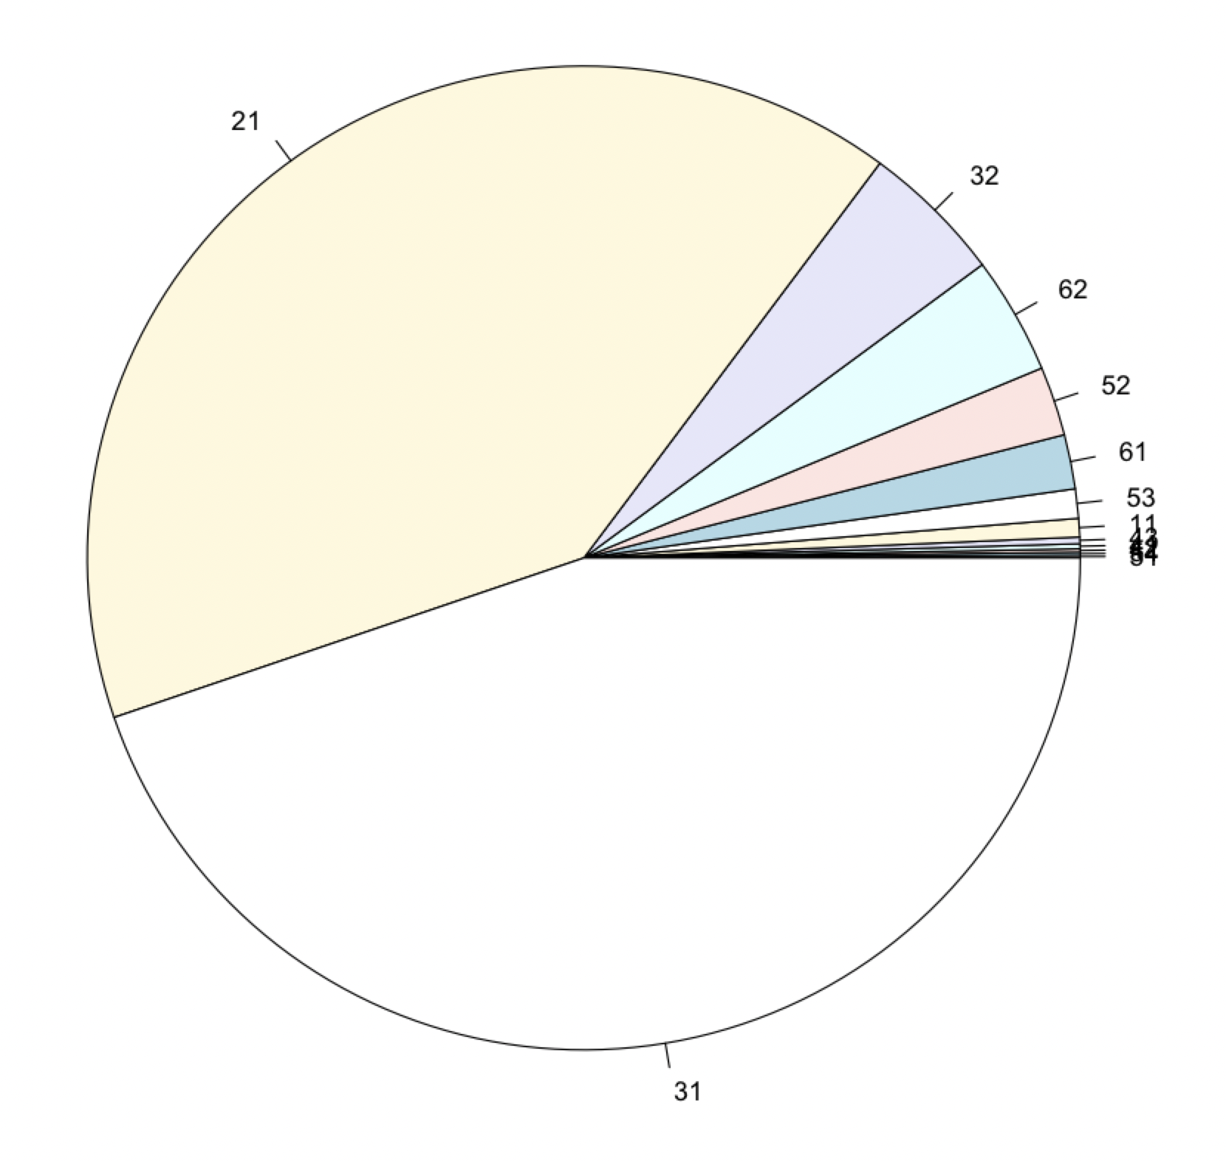
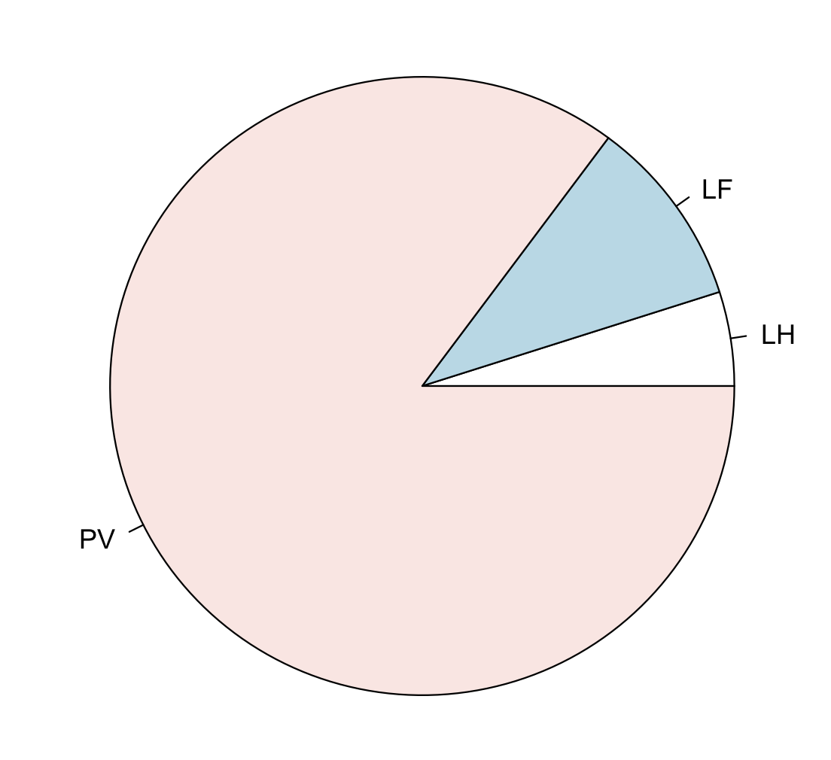
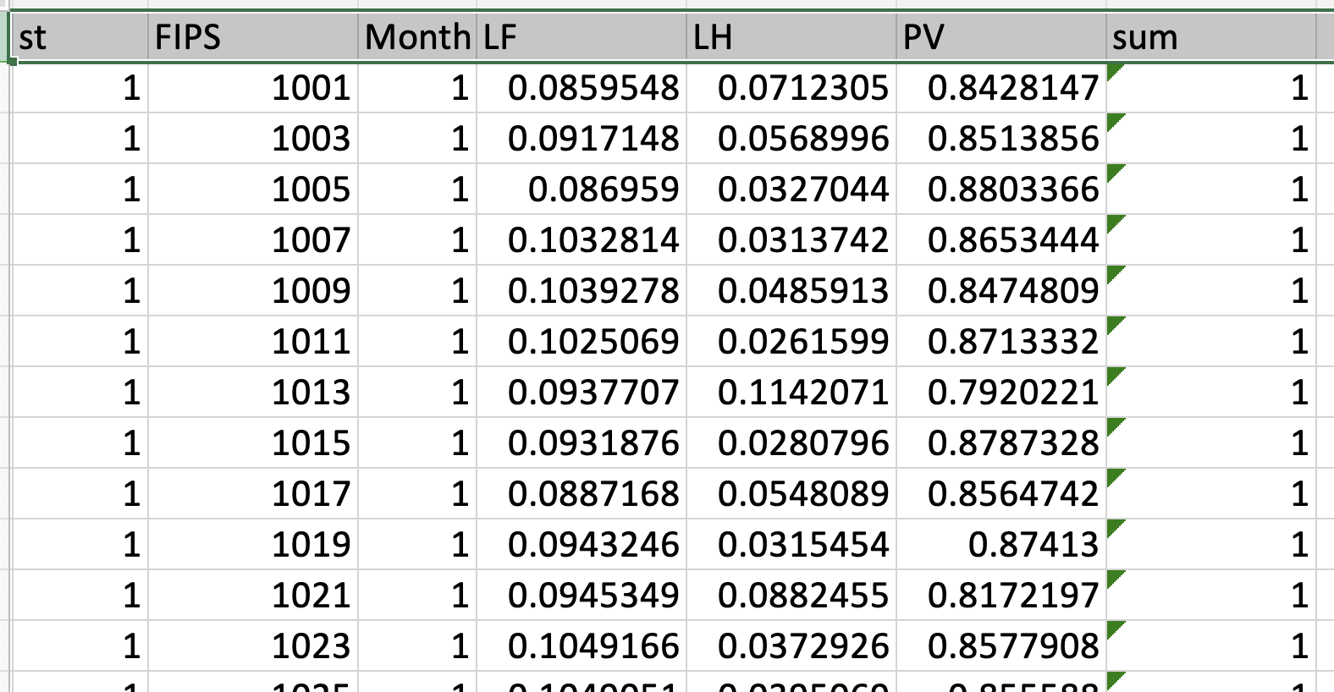
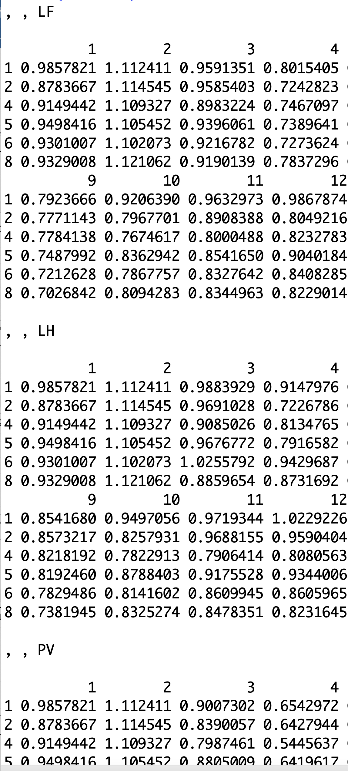
2020 VMT preparation II : Calculate the 2020/2019 County level VMT ratio by three Vehicle types
The DOT VMT data do not have Vehicle Type information. The Vehicle type informations are in 2019 EPA VMT (13 types) and INRIX normalized VMT (3 types)
We prepared a table to map EPA VMT vehicle types to INRIX vehicle types. The right figures showed the 2019 VMT contribution by vehicle types in EPA and INRIX categories.
The INRIX is normalized data by 2020 Jan and Feb, so we assume 2019 EPA VMT data in Feb 2019 has the same vehicle types VMT contribution in 2020. Then denormalized for INRIX data, After that, we get the daily VMT contribution by three vehicle types of INRIX. After this process, we first generated INRIX Monthly State Total (MST) VMT by 3 vehicle types and than use this data (INRIX MST VMT) to calculate the Vehicle monthly contribution of monthly State VMT (RHS table).
Use the vehicle type monthly contribution data with DOT DCT VMT to calculate the Vehicle type monthly VMT data for 2020.
Before we process the Monthly VMT contribution by vehicle type, we figure out that the monthly ratio between 2020/2019 have some outliers (1-2%), we set 75% +2IQR and 25%-2IQR to remove the outliers and replace with state average. We removed the outlier and generate the state level monthly 2020/2019 ratio. This data was used for outlier or missing data.
The 2020VMT and 2019 VMT already separate to 3 vehicle types, and can use to calculate the vehicle types county level monthly ratio 2020/2019.
INRIX Vt contribution
State level monthly ratio

Slide 23
Mobile Onroad Daily VMT from INRIX normalized data
EPA VMT contribution by vehicle types in Feb (We assume 2019 Feb Vehicle type data are the same as 2020 Feb)
EPA 2019ge VMT contribution by vehicle types (vehicle type SCC code)
After this process, we have the vehicle contribution in 2020, but there is NO INRIX 2019 data to calculate the ratio of 2020 to 2019. Thus, we used the DOT VMT data that have the total monthly (daily) VMT for 2019 and 2020.
Standard period of INRIX
EPA 2019 FEB VMT mapping for Vehicle type contribution

Slide 24
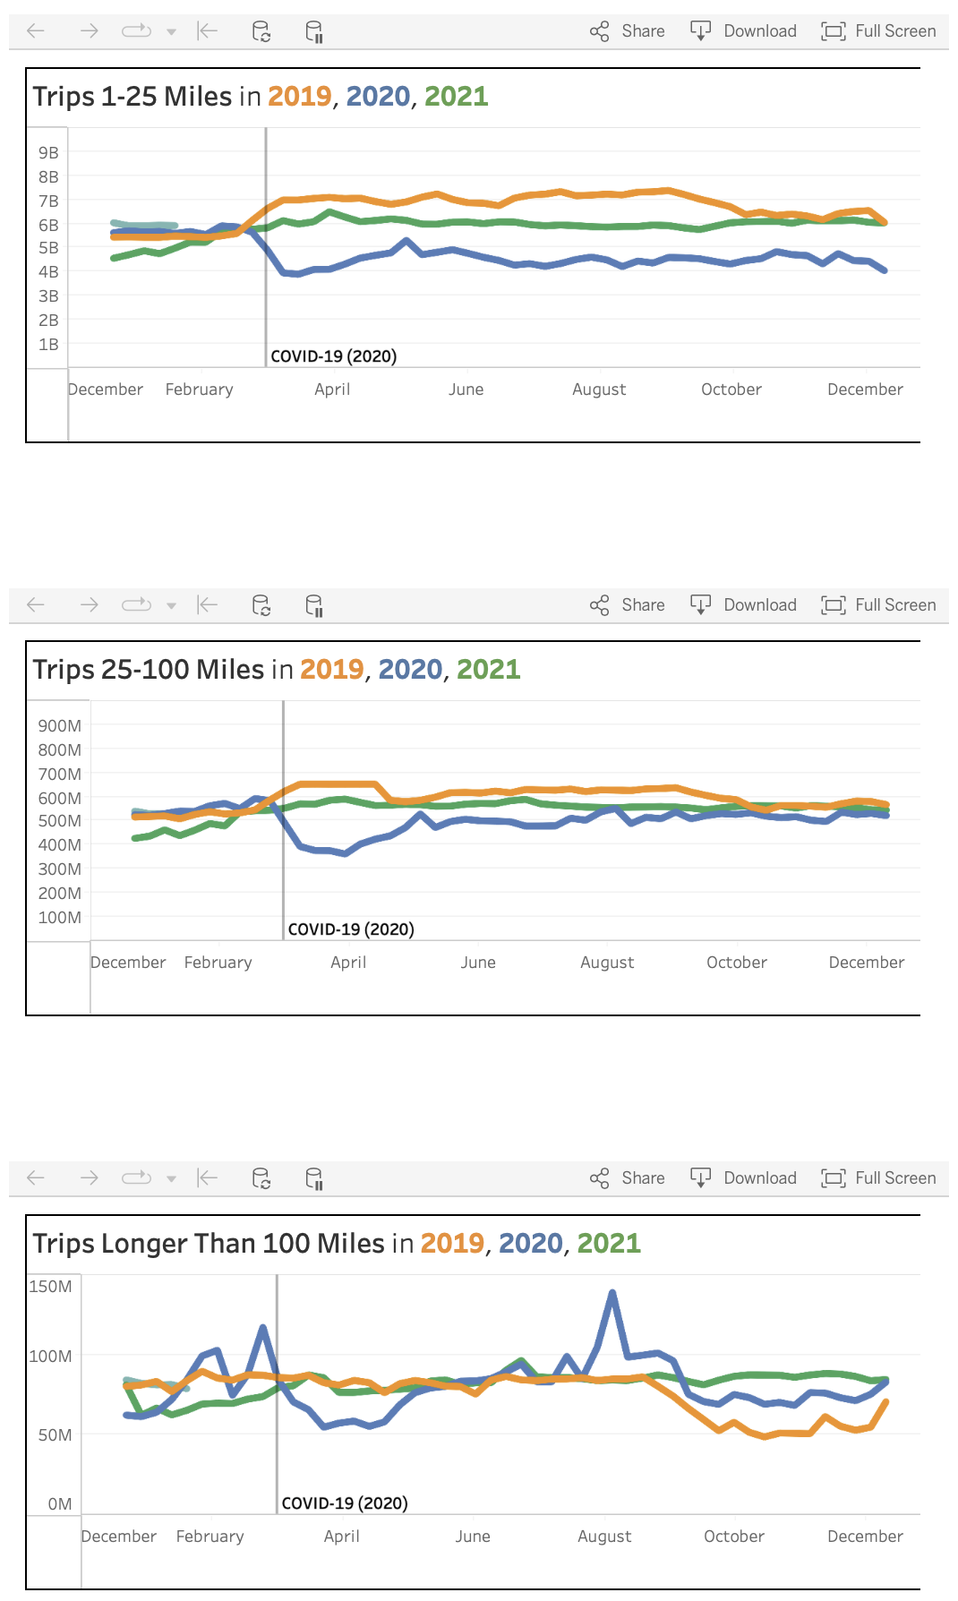
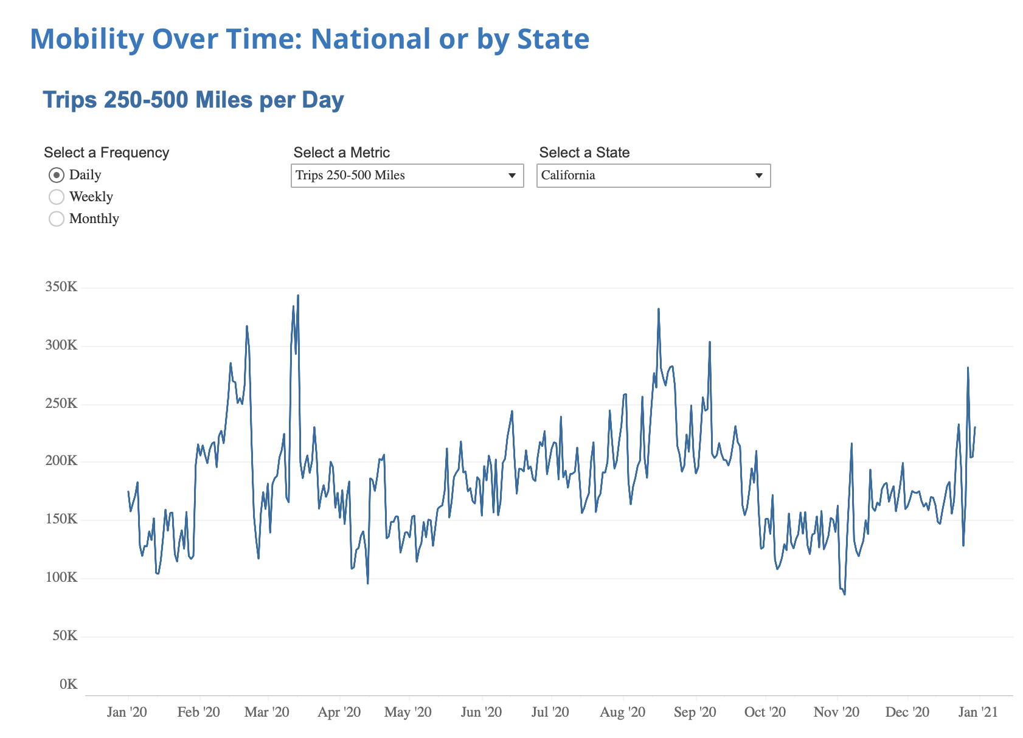
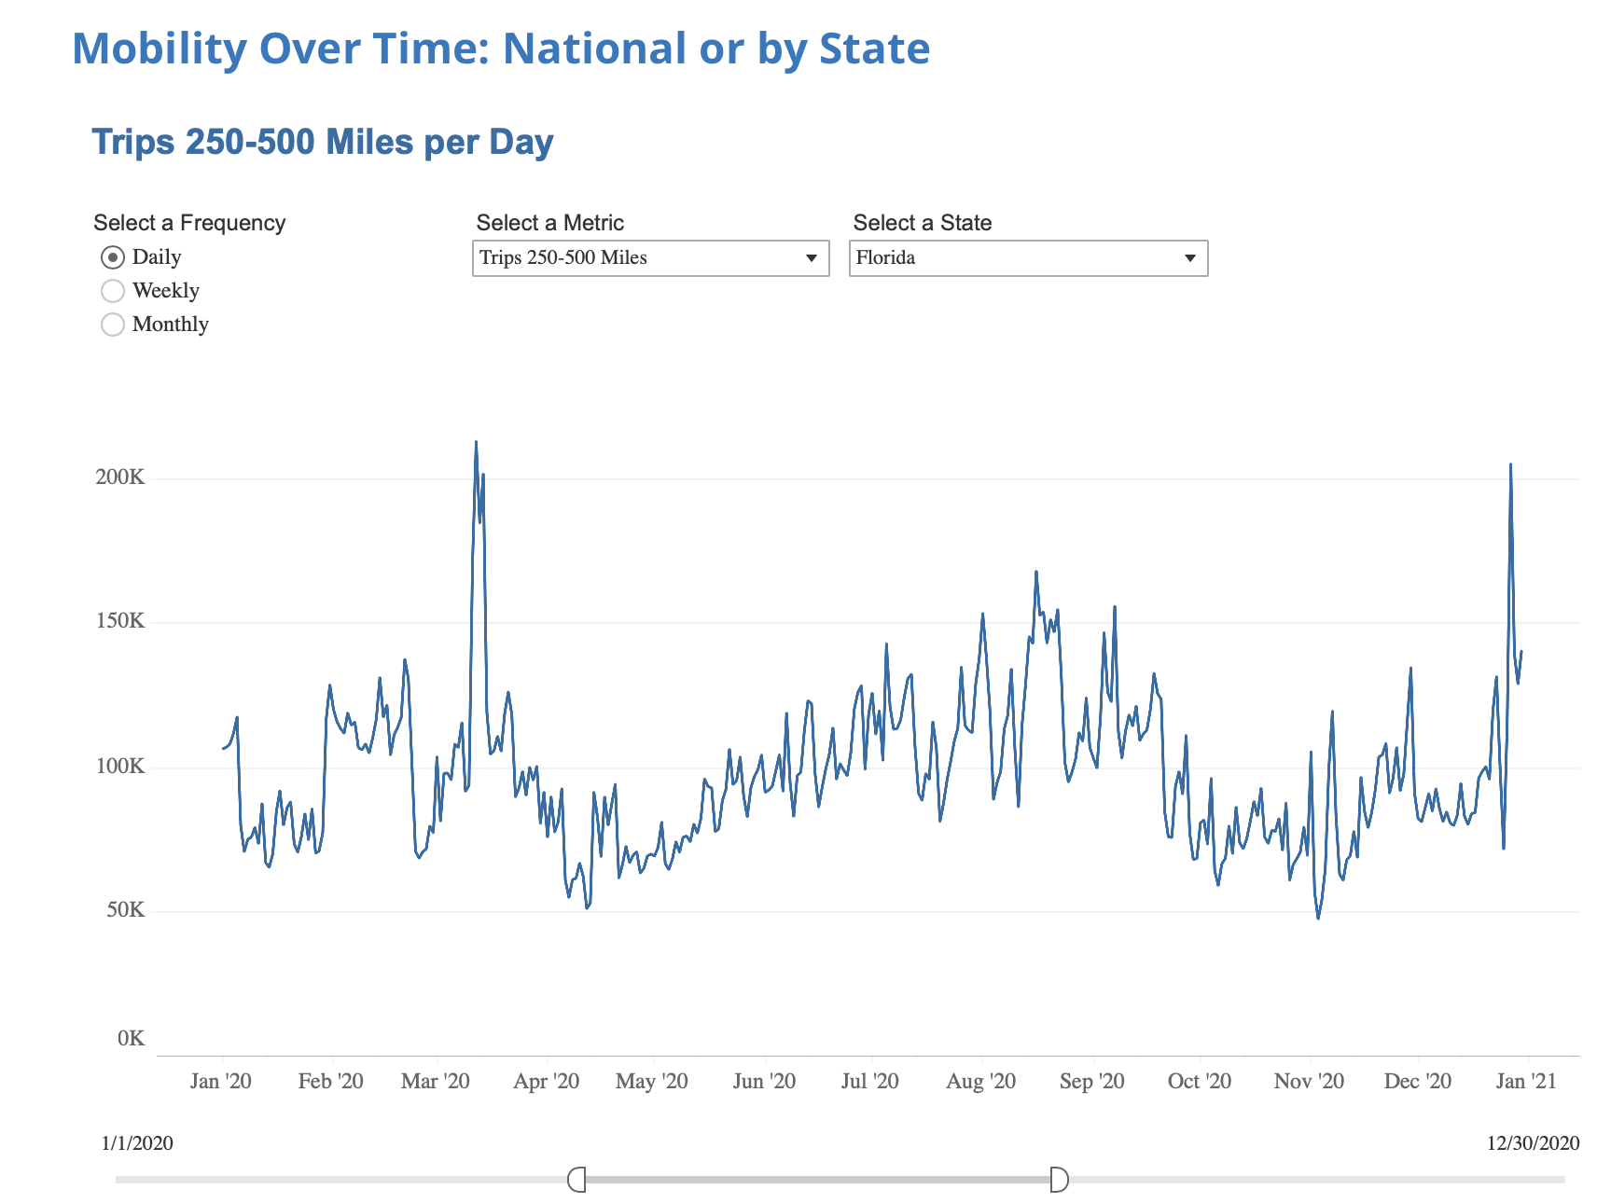
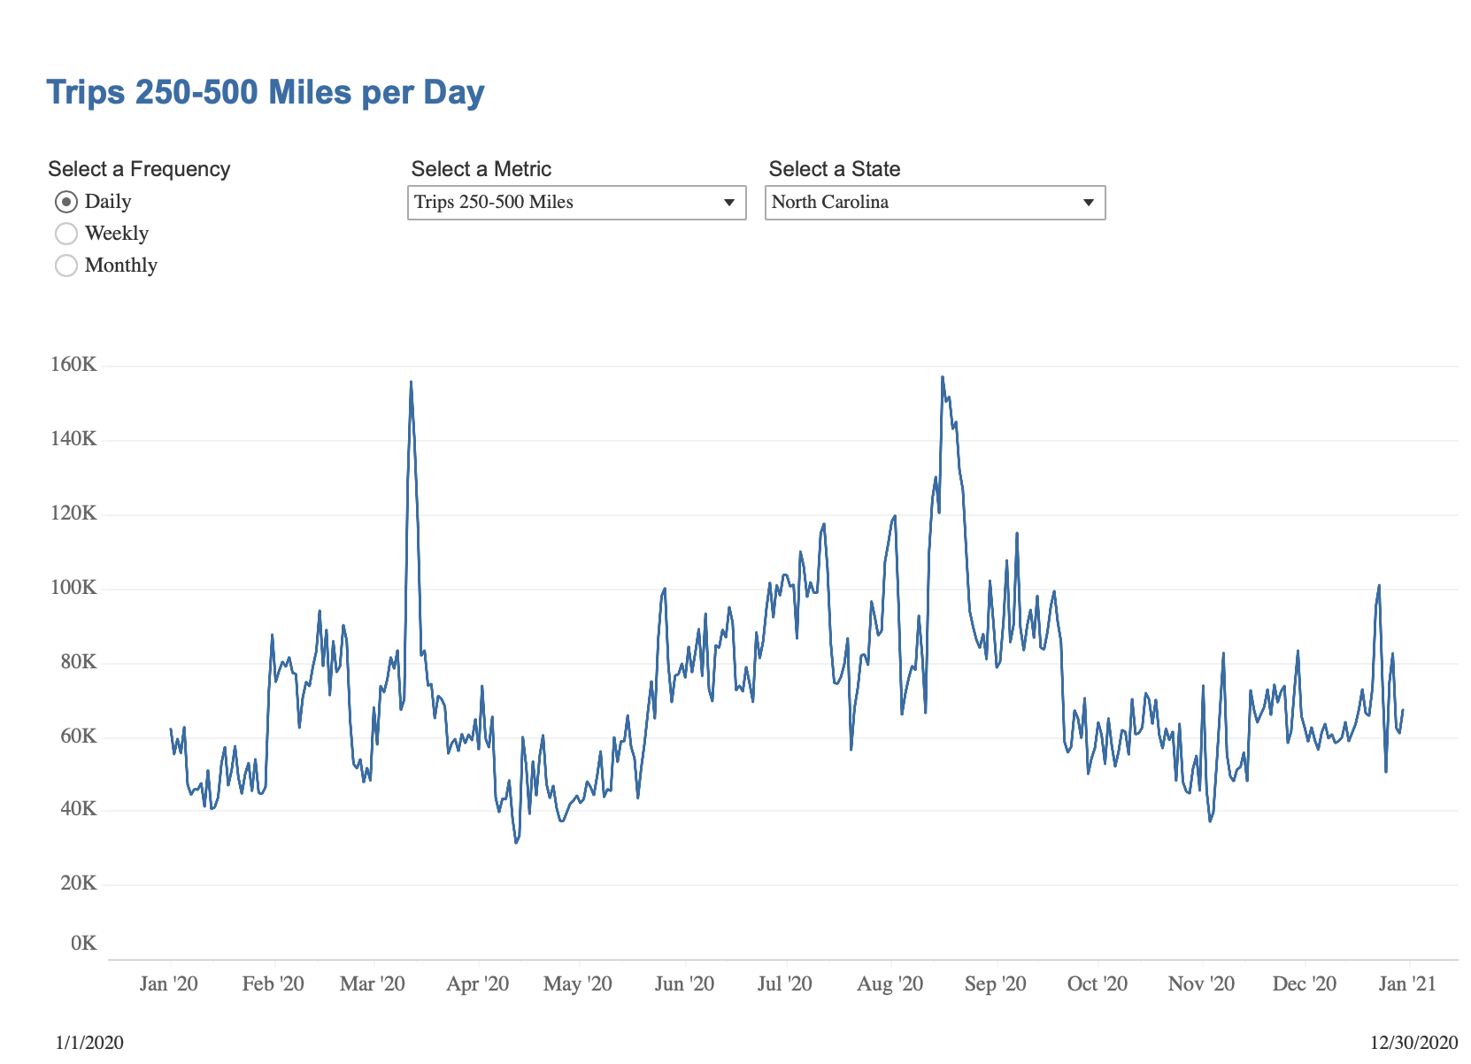
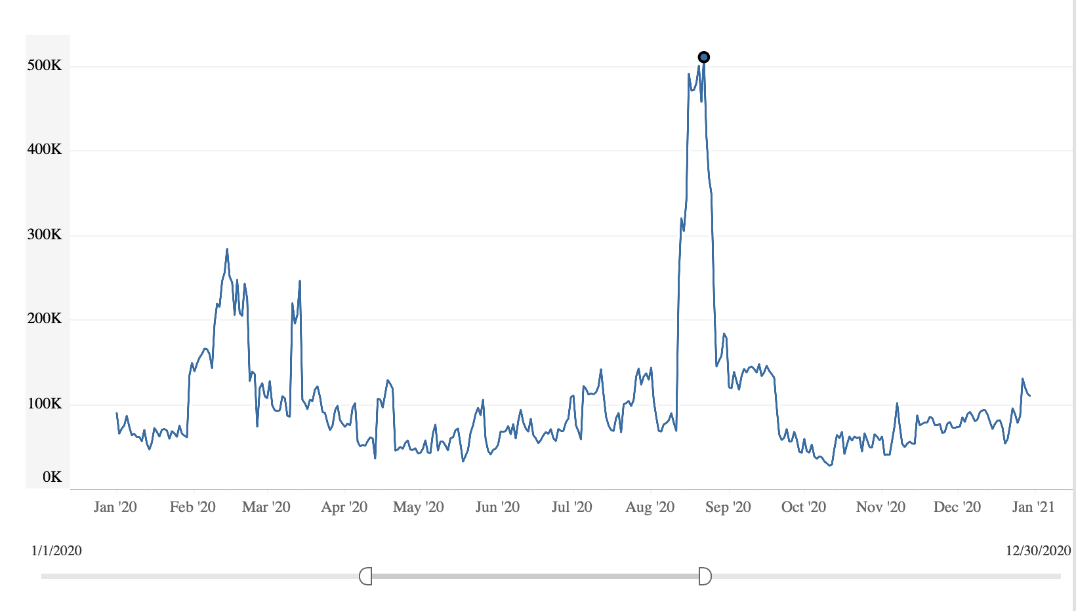
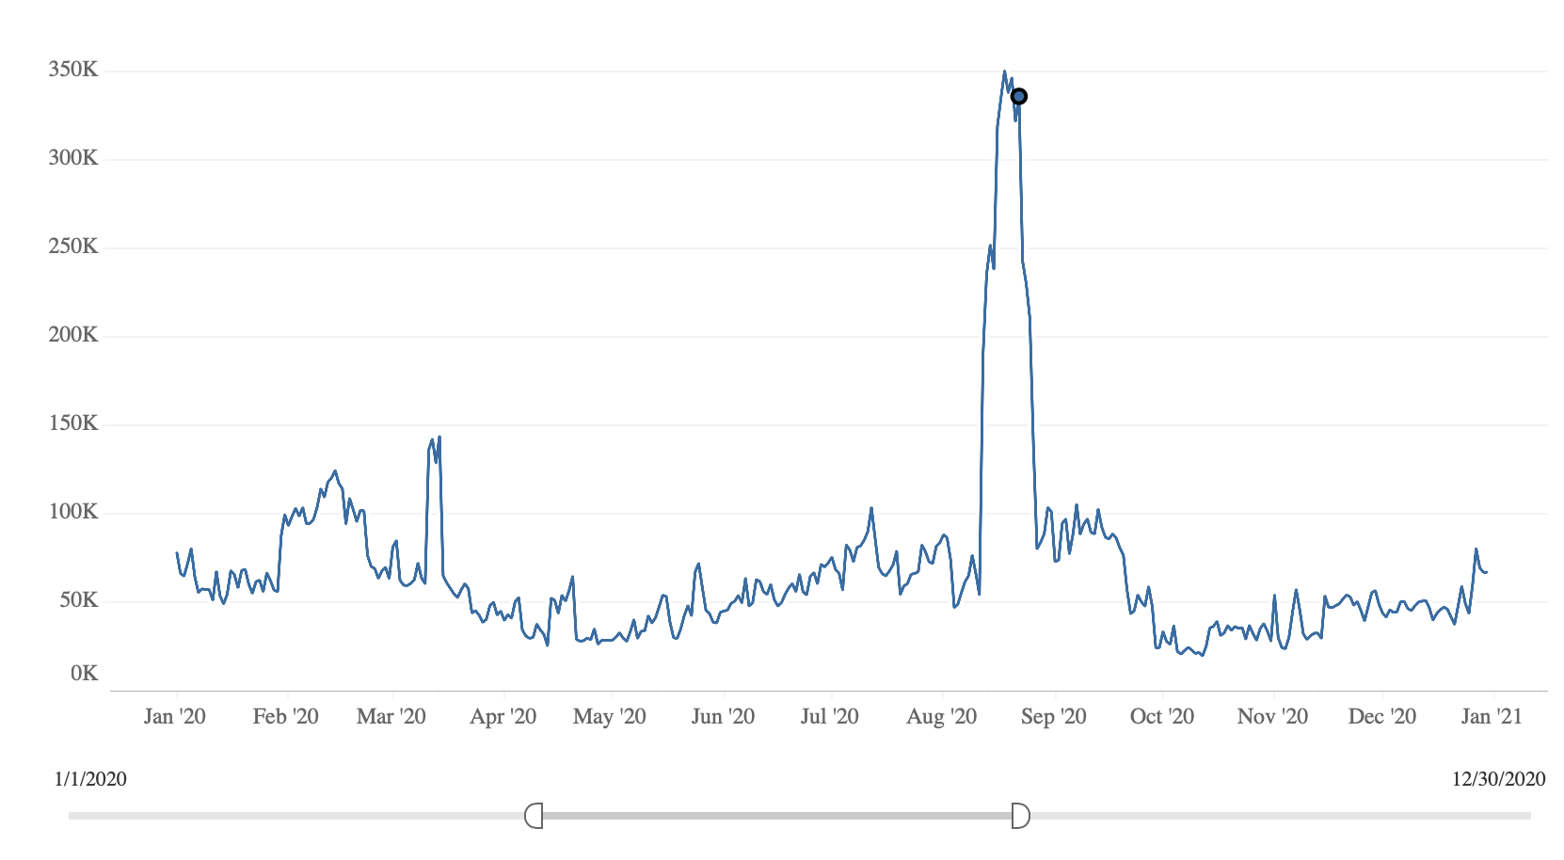
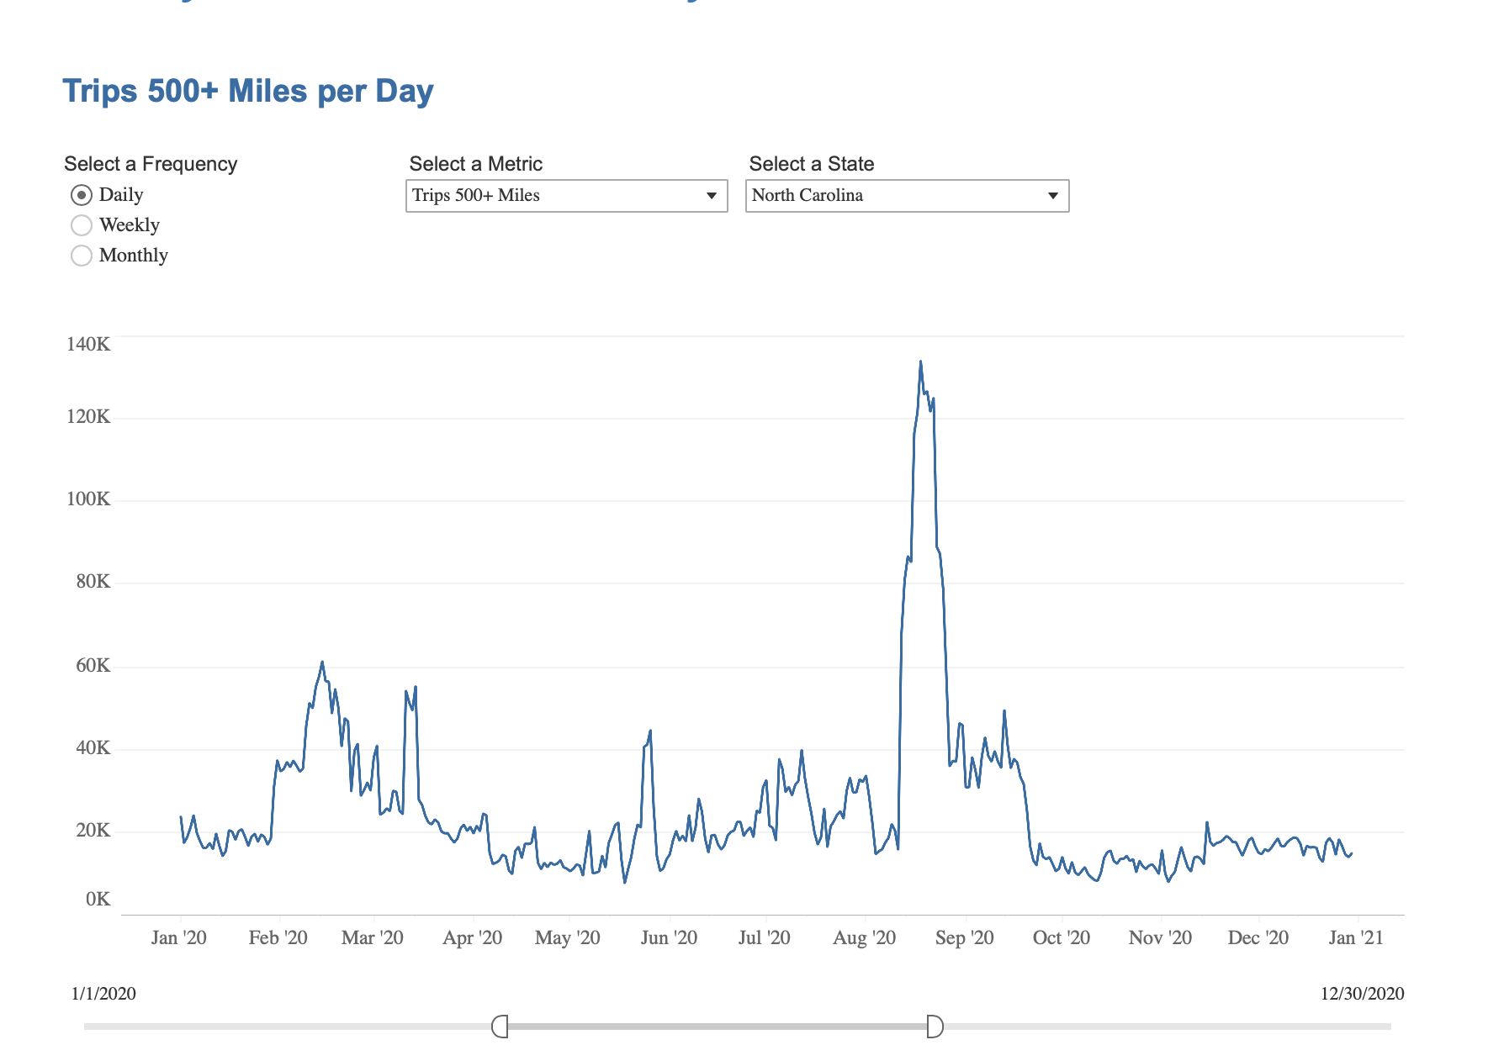
DOT original data shows the August peak, this peak shows near Aug 16 in DOT’s daily travel data
https://www.bts.gov/daily-travel
Figures made by CTW
California
Florida
North Carolina
Figures from DOT website
Figures from DOT website
250 mile -500mile
Aug16
Aug16
Aug16
500mile +

