Slide 1
COVID and beyond: COVID -19 interventions and power plant emissions in the United States
21st Annual CMAS Conference
Chapel Hill, NC October 17 – October 19, 2022
Munshi Md Rasel^{1*}, Kevin L. Chen², Rachel C. Nethery², and Lucas R.F. Henneman¹
¹Department of Civil, Environmental, and Infrastructure Engineering, George Mason University, Fairfax, VA, USA
²Department of Biostatistics, Harvard T.H. Chan School of Public Health, Boston, MA, USA
*Corresponding Author:
Munshi Md Rasel
mrasel@gmu.edu
4400 University Drive,
Fairfax, VA 22030

Slide 2
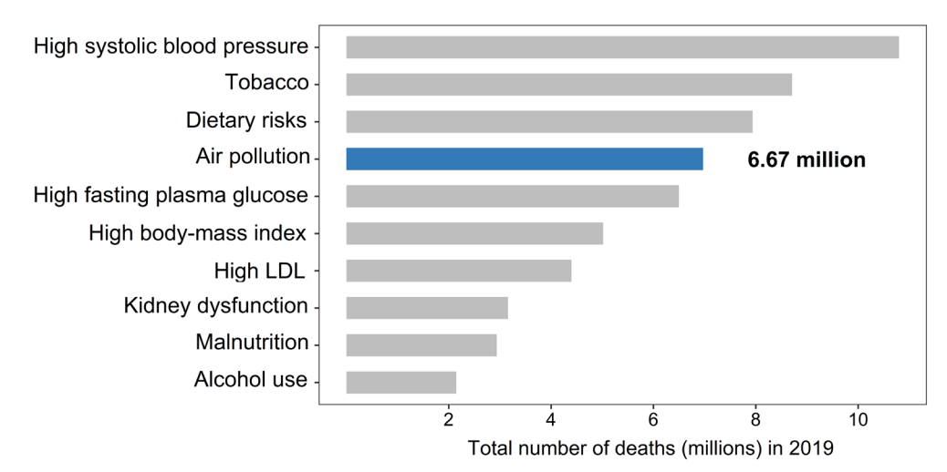
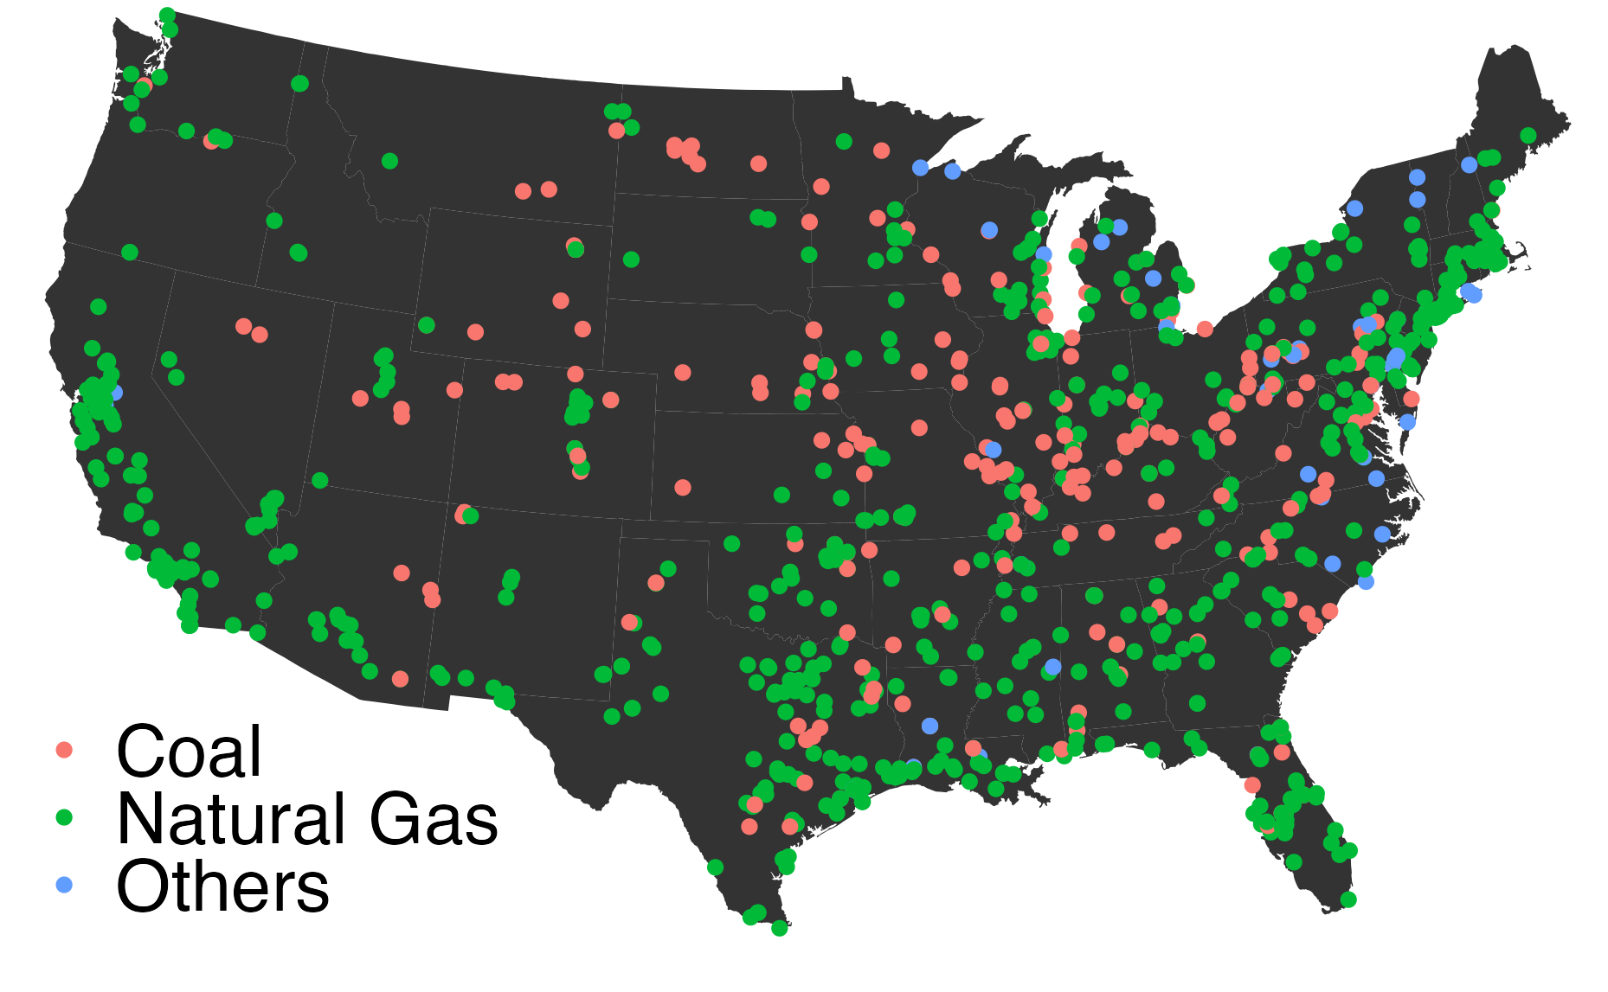
Background
Health Effects Institute. 2020. State of Global Air 2020. Special Report. Boston, MA
Power plant facilities in the U.S.
U.S. power plants have historically contributed a big role in terms of air pollution and climate impact in the country

Slide 3
Emissions of many sources decreased during COVID-19 lockdown period—what was the impact on power plant emissions?
Mobile Emissions
Lockdown (March-April, 2020)
Stationary power plant emissions??
COVID-19
Refs: https://www.who.int/health-topics/coronavirus

Slide 4
Objectives
Quantify impact of COVID-19 intervention on power plant emissions
Identify facility characteristics that drives changes in emissions
Estimate PM_{2.5} exposure changes associated with SO₂ emissions changes

Slide 5
Steps followed
Meteorological data
Power plant emissions data
Model evaluation
GSYNTH
Facility characteristics associated with emissions changes
Exposure change
GSYNTH: Generalized Synthetic Control Model

Slide 6
Generalized synthetic control (GSYNTH) model
Actual
Emissions
B$AU$
Intervention
Control period
Intervention period
Computes counterfactual values using the control period’s time-varying information
BAU: Business As Usual

Slide 7
Generalized synthetic control (GSYNTH) model
Control period: Jan 2010- Feb 2020
Intervention period: March-Dec 2020
Lockdown period: Mar-Apr
Longterm period: Mar-Dec
Analysis elements:
Electricity generating unit facilities
Weekly emissions
Covariates:
Meteorology
Precipitation, temperature, humidity, wind speed
Actual
B$AU$
Intervention
Control period
Intervention period
BAU: Business As Usual

Slide 8
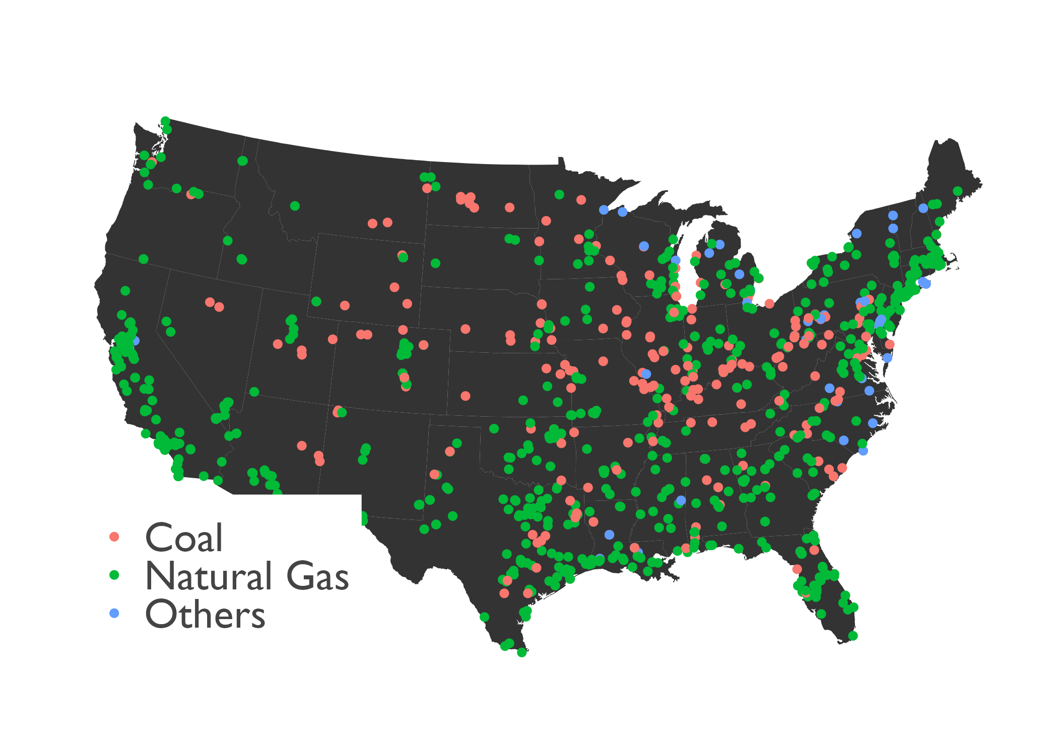
Exclusions Criteria
Operational EGUs
N=1654
EGUs operating in 2020
N=1403 remained
EGUs operating at least >2015 year
N=1310 remained
EGUs>15% operation 2010-2020
N=937 remained
Peaker Plants
N=1205 remained
937 EGU facilities
937 EGUs across the U.S. (covering >80% of original emissions) are used for this study of which 238 EGUs are coal fueled facilities
EGU: Electricity Generating Units
Peaker plants: EGUs that come online only when there is a high demand in the area

Slide 9
Significant reduction of emissions from EGUs
85% reduction
46% reduction
64% reduction

Slide 10
GSYNTH is better able to reproduce 2019 emissions than simple mean models
longterm
lockdown

Slide 11
Emissions were greater than expected after the lockdowns began
>15% increase
>40% increase
>20% increase
BAU: Business As Usual

Slide 12
Long-term effect of COVID-19 Intervention
SO₂ emissions change
NO_{x} emissions change
CO₂ emissions change
Most of the states has observed increased power plants emissions during COVID intervention
$∆E_{tot}$ : Total weekly emissions change

Slide 13
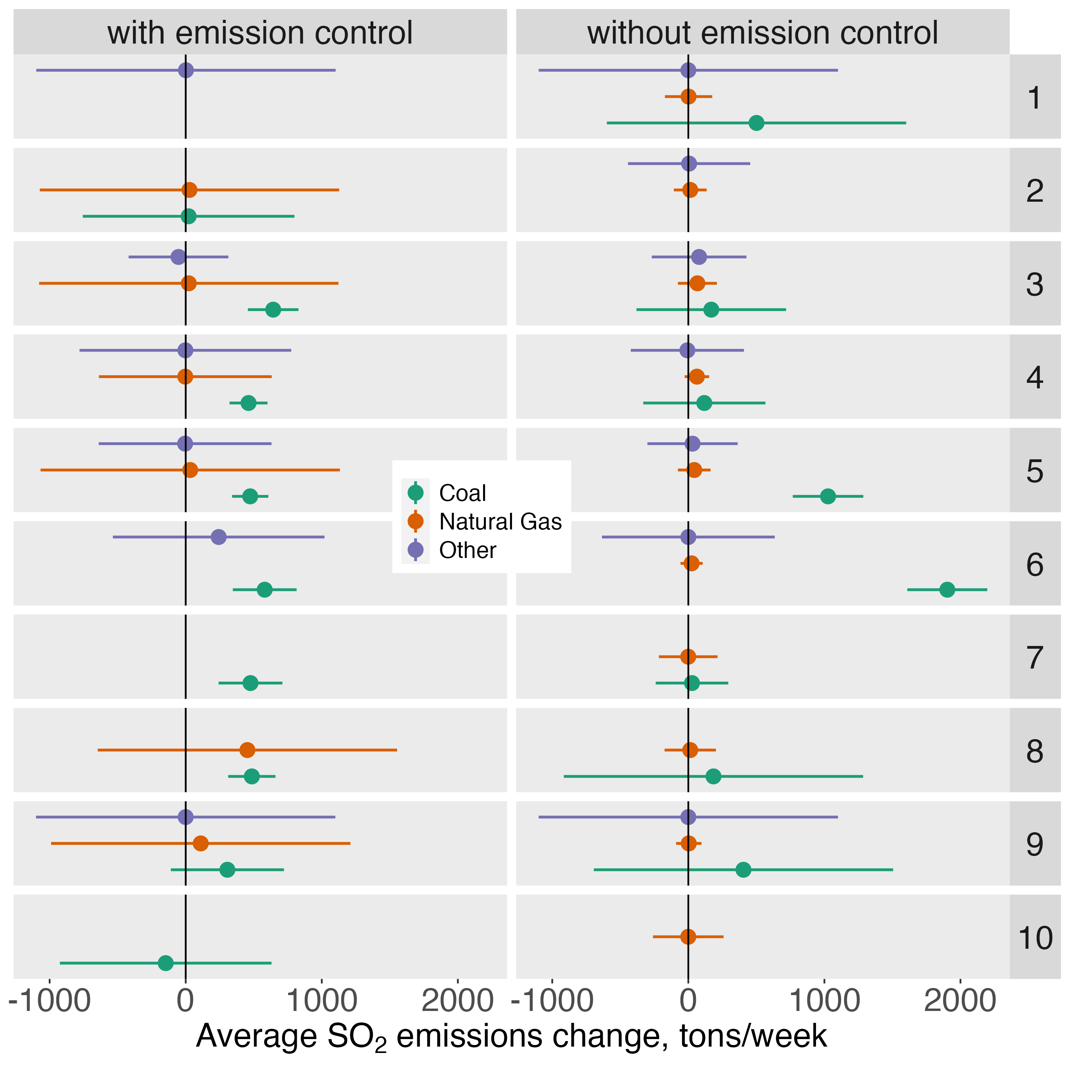
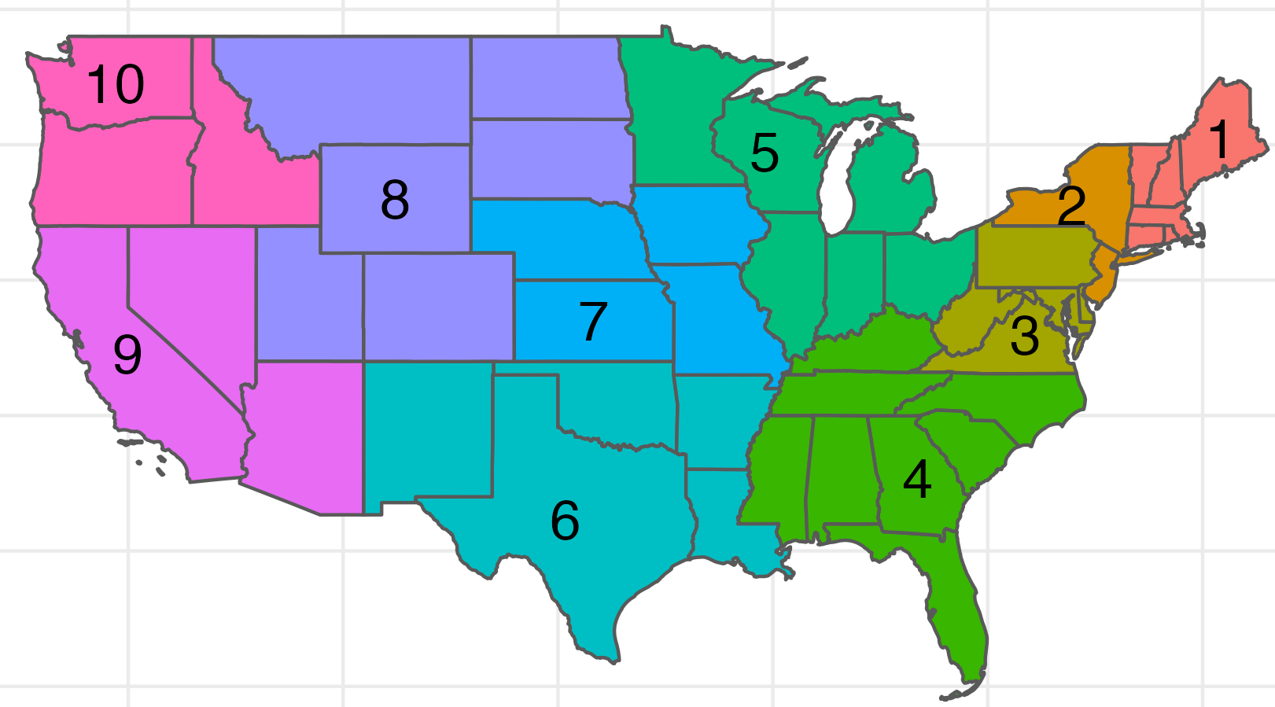
Coal facilities across the US drove emissions increases over business as usual
Coal EGU drives the emission increase
Increased SO₂ from facilities without scrubbers in Regions 5 & 6
EPA Regions
EPA Regions

Slide 14
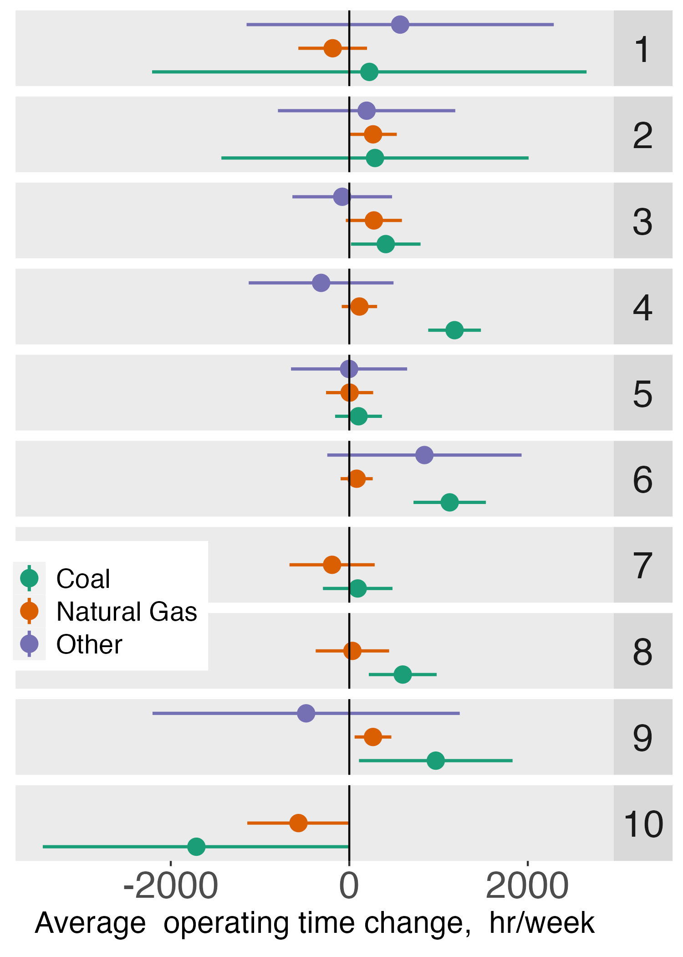
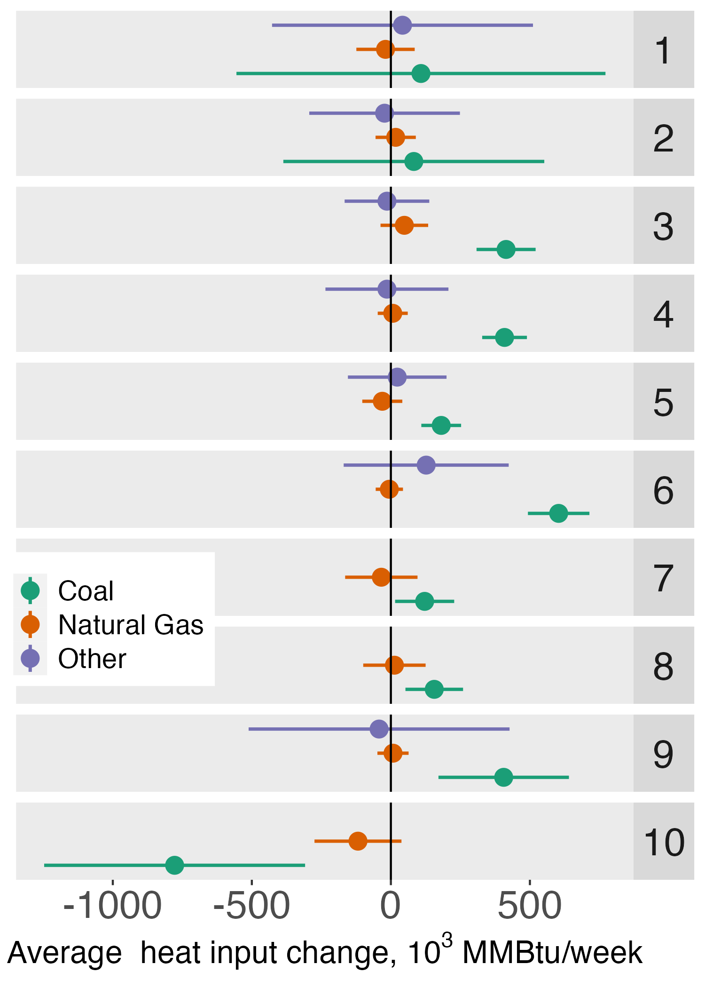
Coal facilities operated more time during intervention period
EGU facility characteristics driven emissions change
EPA Regions

Slide 15
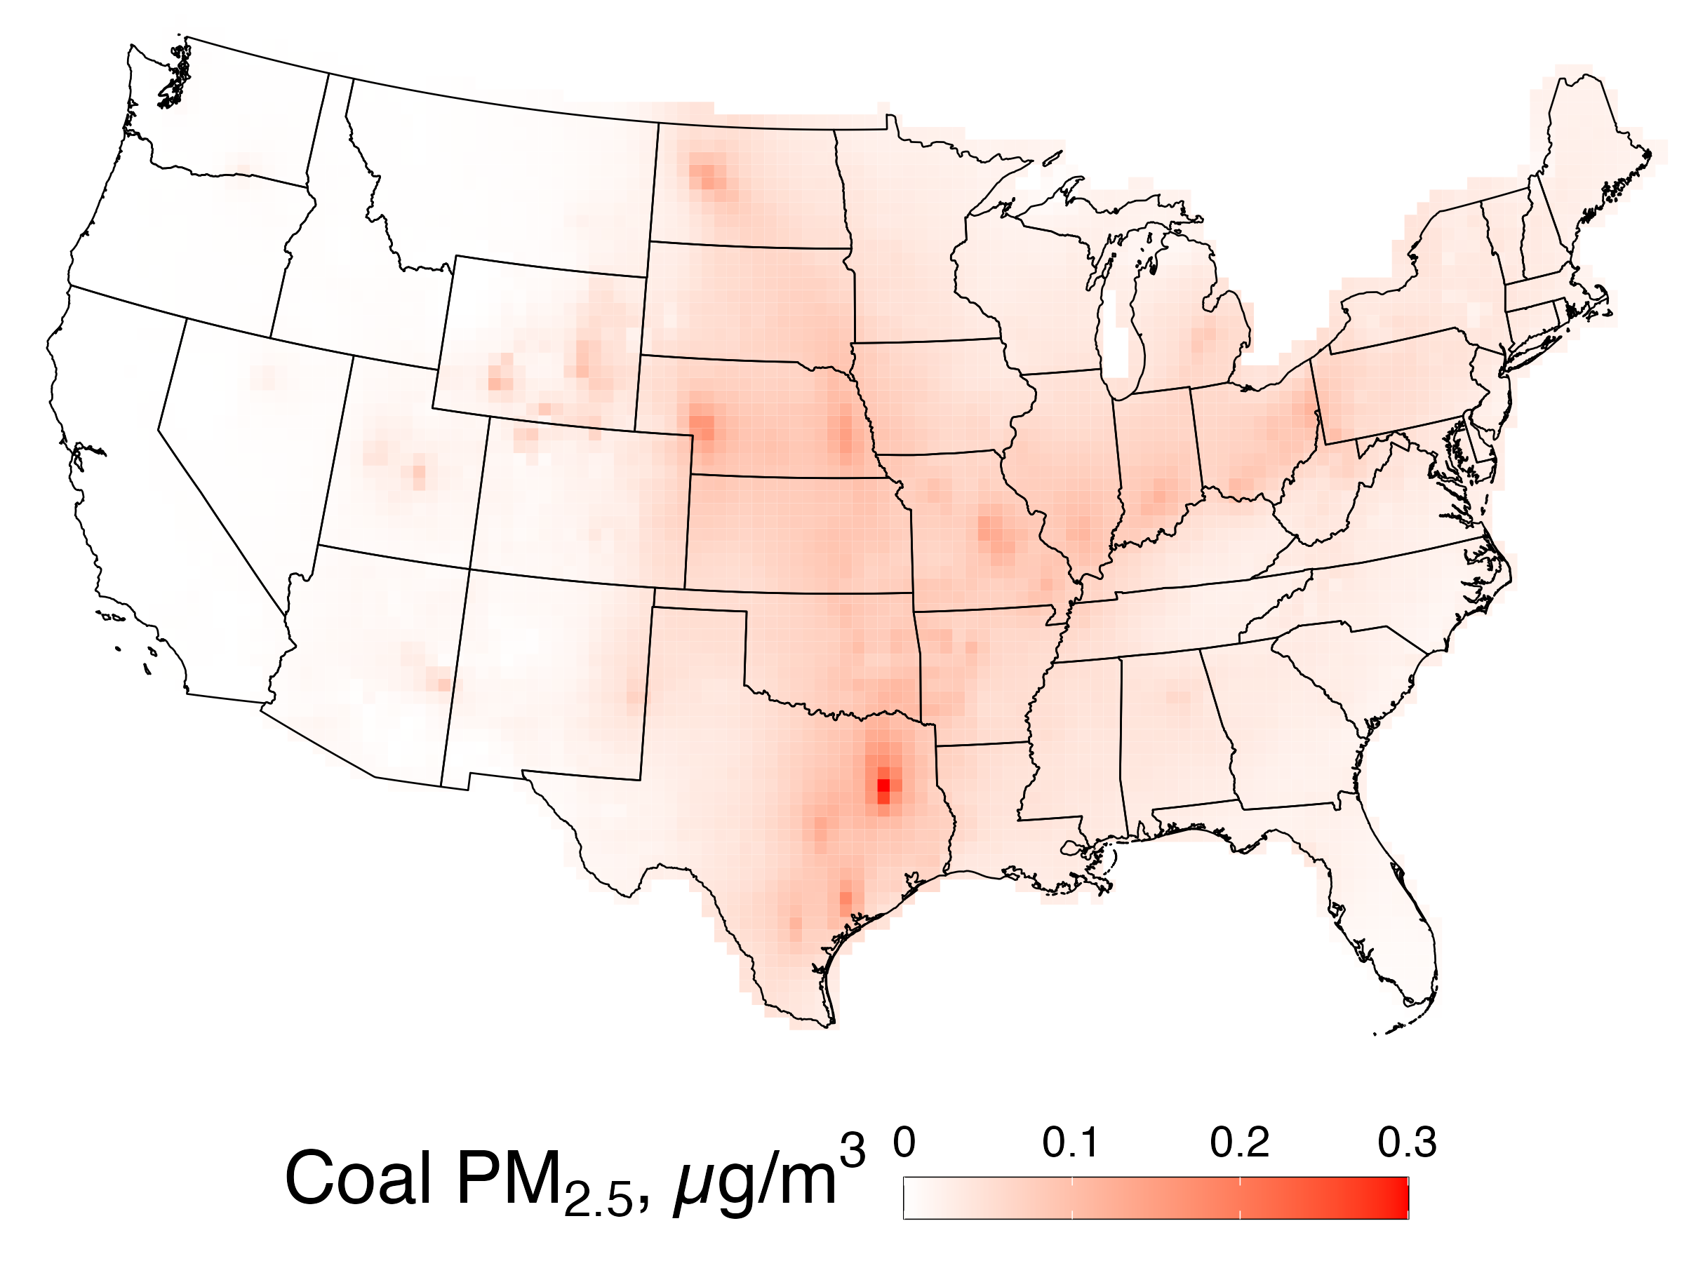
HYSPLIT Average Dispersion model (HyADS) Exposure Model
Reduced complexity model
Tracks air parcels based on wind speed and directions
Estimates unitless exposure, which is converted to “coal PM_{2.5}” with statistical model

Slide 16
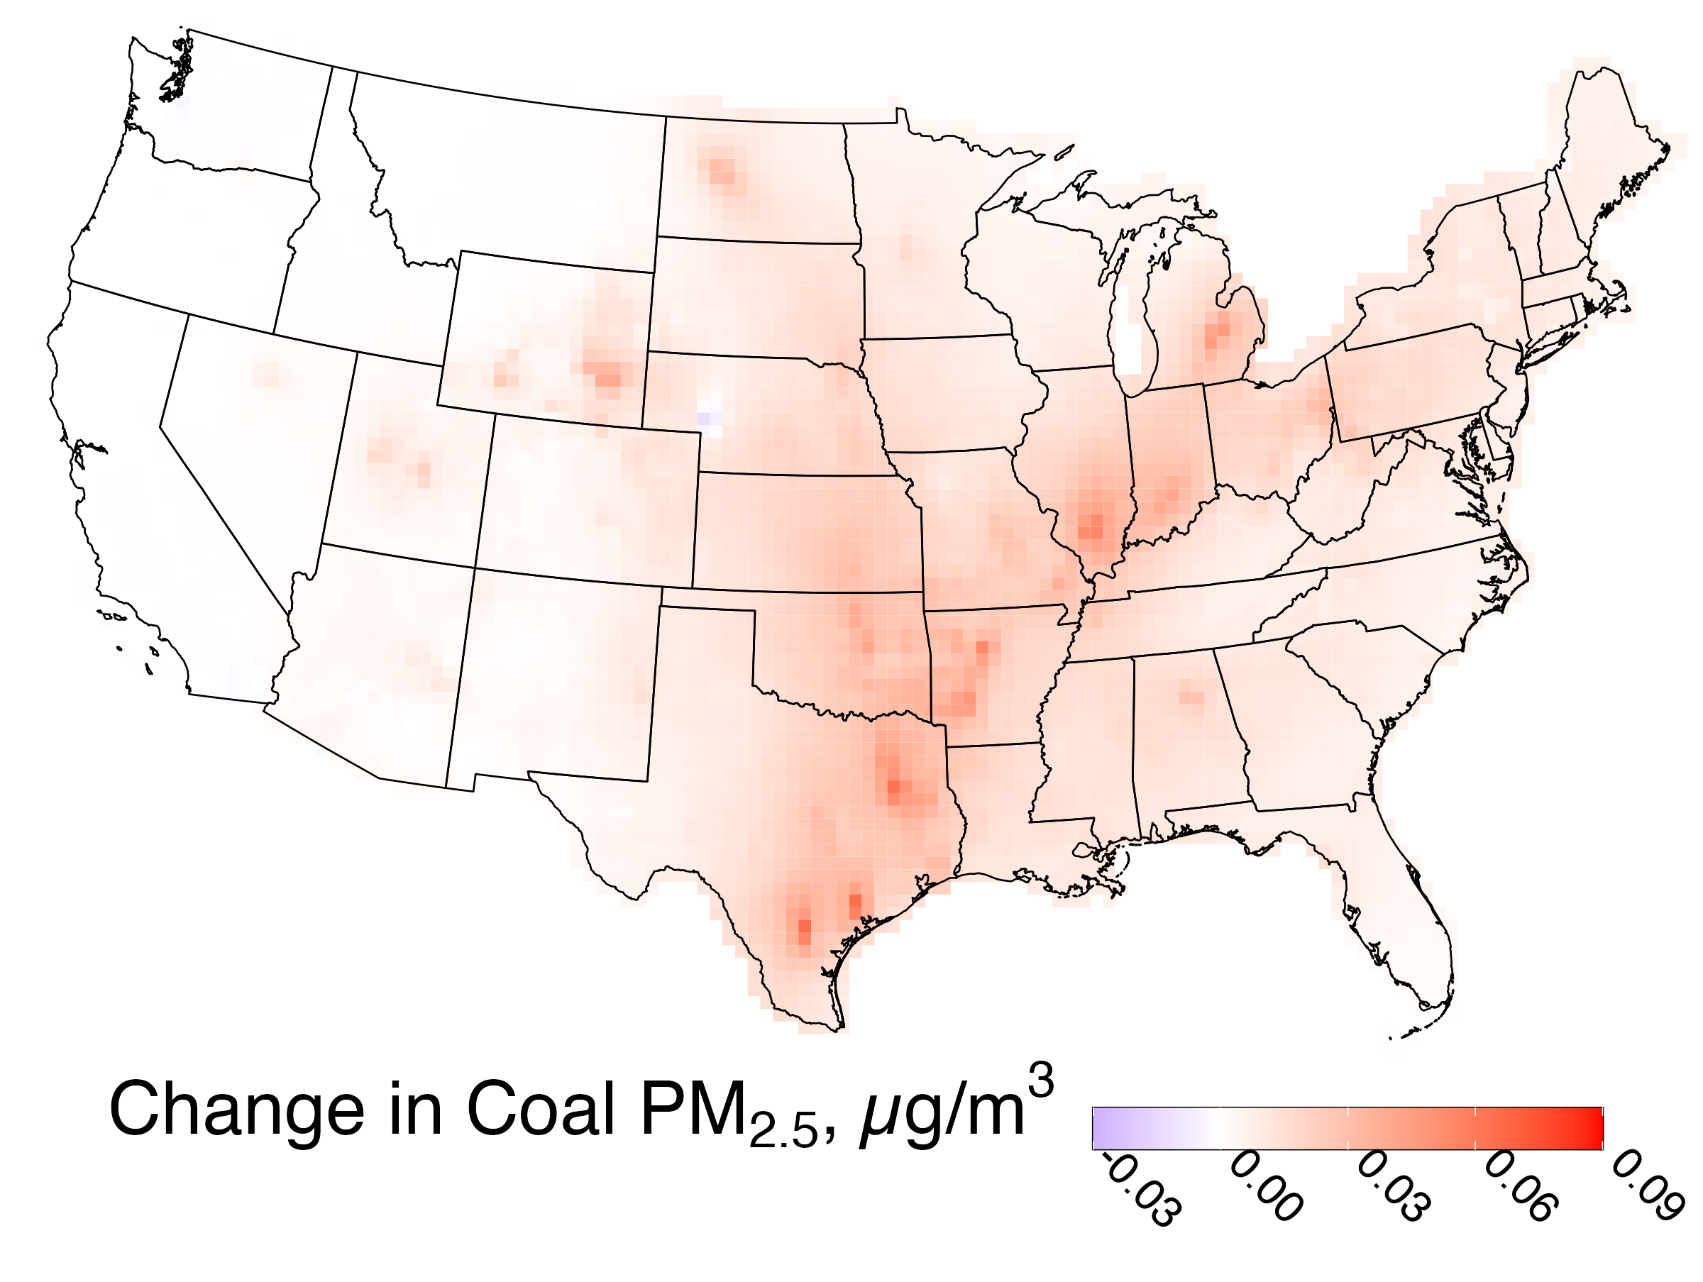
Coal SO₂ contributions to ambient PM_{2.5} increased relative from BAU
March-December, 2020
0.01µg m⁻³ (26%) increase

Slide 17
Summary
EGU SO₂, NO_{x} and CO₂ emissions increased after the COVID-19 lockdowns compared to BAU
Pronounced increases in the East
Increases driven by increased operations at coal facilities
Coal emissions drove higher exposure associated with SO₂ relative to BAU

Slide 18
Acknowledgement
This work was supported by research funding from EPA 835872 and George Mason University

Slide 19
Recommending
US coal power plant emissions changes and inequities since 1999
Presented by: Lucas Henneman
Authors: Lucas Henneman, Munshi Md Rasel, Christine Choirat, Susan Anenberg, Corwin Zigler
Time: October 18, 2022, 9am @ Grumman Auditorium

Slide 20
Thank you
Questions?
mrasel@gmu.edu

Slide 21
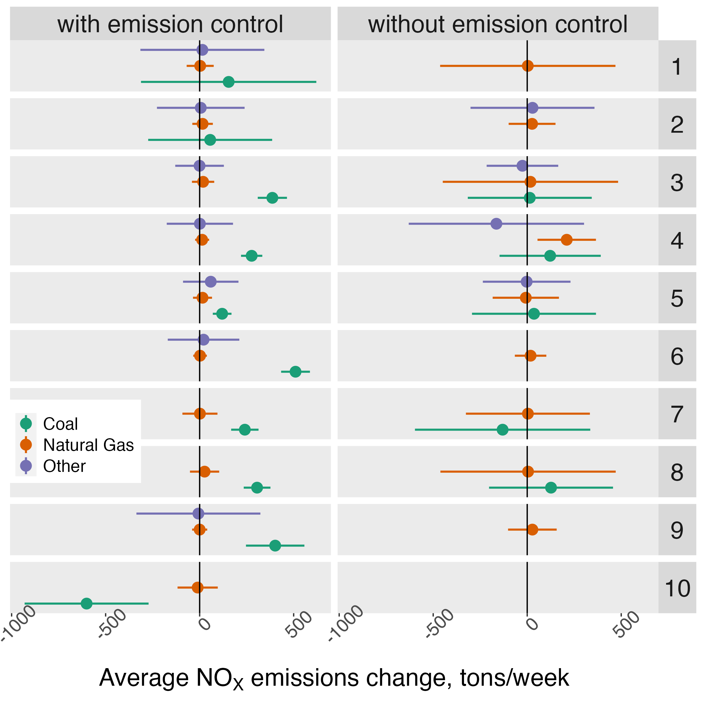

Slide 22
