Slide 1
Assessing the tradeoffs in emissions, air quality and health benefits from excess power generation due to climate-related policies for the transportation sector
Christos Efstathiou¹, Calvin Arter¹, Jonathan Buonocore² and Saravanan Arunachalam¹
¹Institute for the Environment, The University of North Carolina at Chapel Hill, NC, USA
²Boston University School of Public Health, Department of Environmental Health, Boston, MA
Presented at
The 21st Annual CMAS Conference, Oct.19, Chapel Hill, NC

Slide 2
Introduction to TRECH2
Background:
Electrification of the transportation sector with decarbonized electricity is at the core of current strategies for carbon mitigation
Cap-and-invest programs set limits on carbon emissions at the state level and require businesses to obtain allowances equal to their covered emissions (revenue to be invested)
12 East Coast States and the District of Columbia formed a regional cap-and-invest program to reduce greenhouse gas GHG emissions from transportation - Transportation Committee Initiative (TCI)
At the same time, the Regional Greenhouse Gas Initiative (RGGI) targets through a cap-and-invest program, the energy generation sector of the Northeast US
The Transportation, Equity, Climate, and Health (TRECH) study has previously evaluated the air-quality related health co-benefits of five cap-and-invest scenarios from TCI, depending on Pennsylvania’s participation in RGGI
Objectives:
The second phase of the TRECH study adds to previous efforts to quantify the impacts on emissions and public health solely from onroad sources by:
Adding the shift in energy demand related to higher deployment of electric vehicles (EV)
Addressing the role and effect of key states (i.e. Pennsylvania) and regions (Ohio River)
Assessing the effect of different combinations of policies and establishing relationships to public health through a set of illustrative scenarios

Slide 3
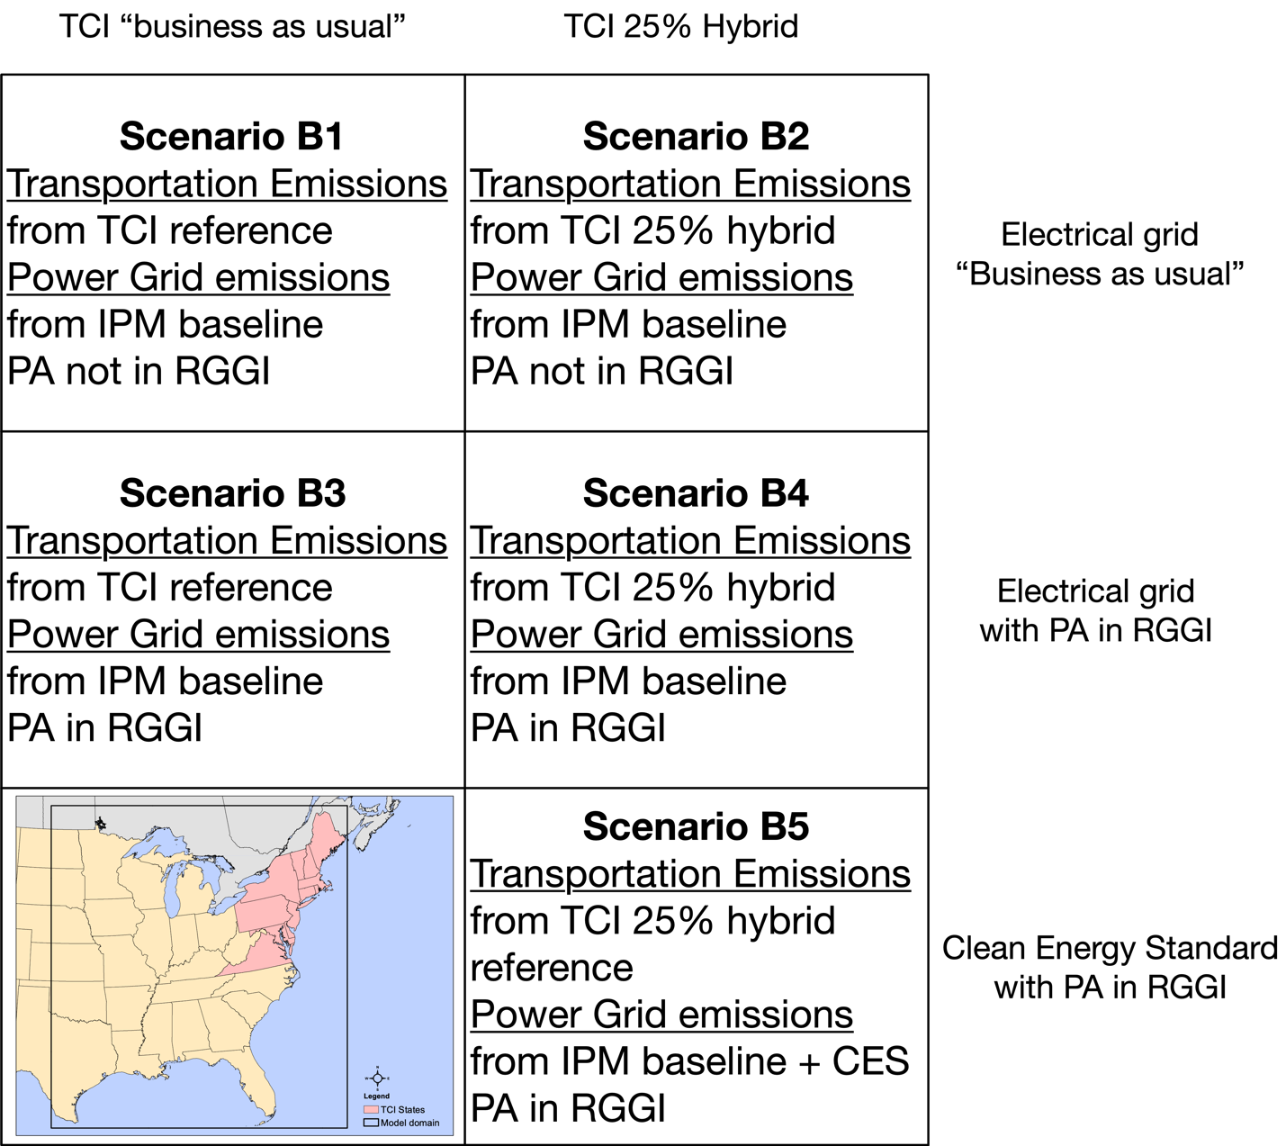
Study Design: Future Year Scenarios
2032 sector-based projections:
Onroad sector emissions under a business as usual “BAU” and a hybrid cap and invest portfolio (TCI 25% Hybrid)
Onroad sector scenarios have been discussed in phase 1 - Arter et al., 2021
Energy sector emissions under a BAU scenario, a scenario with PA in RGGI, and a Clean Energy Standard scenario with PA part of RGGI
For the energy sector, the scenarios were processed by SMOKE using output from the Integrated Planning Model (IPM) and an interface developed in R (IPM2SMOKE)
Scenario-based emissions were processed for future year 2032 using standard SMOKE methods
Simulations for 12-km East US domain for January and July of 2016 with 15 days of spinup time

Slide 4
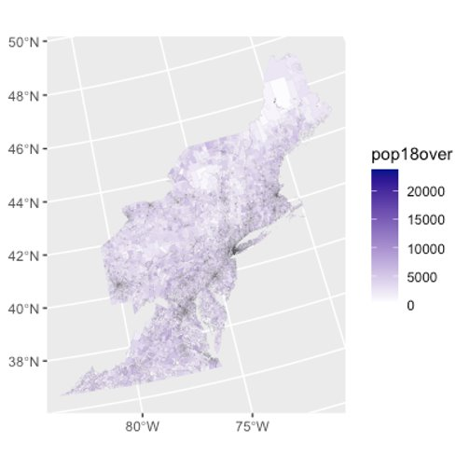
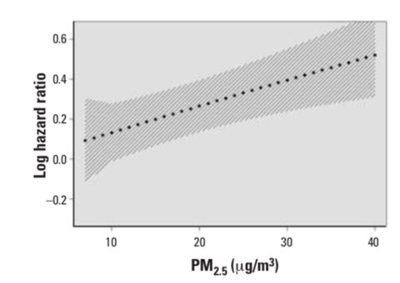
Modeling Framework
WRF
Onroad Sector – TRECH phase 1
Emission Factors
MOVES
MCIP
VMT, VPOP, VHOT
CAMSYS Investment Tool
SMOKE
CMAQ
EGU Sector – TRECH phase 2
BenMAPR
Integrated Planning Model
IPM2SMOKE
NEEDs*
2016v2 NEI
Epidemiology
Population & background health data
Other Emissions Sectors
Health Benefits

Slide 5
2032 onroad sector emissions: TCI BAU vs TCI 25% Hybrid
January
July
25% cap and invest scenario = 6% GHG (CO₂) emission by 2032 – investing with a hybrid portfolio across the broader transportation sector

Slide 6
EGU emissions from IPM with SMOKE (IPM2SMOKE):
Step 1. Establishing the emissions framework before considering IPM inputs
Based on inventories from the 2016v2 Emissions platform (A_Baseline)
Default 2030 projection included in the 2016v2 Emissions platform (A_2030proj)
Aligning the 2016v2 inventories with the 2020 inventories used by IPM (B_Baseline) namely removals and additions of EGUs in the 2016-2020 period, as IPM simulations cover 2020-2032
Step 2. Mapping State-Level emission estimates for 2032 from IPM for each one of the illustrative scenarios B1-B5, and processing the sector through
SMOKE IPM model outputs direct estimates for NO_{x} and SO₂ only, the remaining pollutants were adjusted at the unit level by averaging the difference of both NO_{x} and SO₂ at the State-level
Step 3. Merge onroad and EGU sectors along with the remaining of emissions to create CMAQ-ready inputs for each scenario
Emissions (tons/year) | Scenario
 | A_Baseline | A_2030proj | B_Baseline | B1 | B2 | B3 | B4 | B5
NO_{x} | 169,506 | 82,200 | 153,004 | 46,989 | 47,163 | 41,030 | 41,200 | 39,095
SO₂ | 141,107 | 13,866 | 114,868 | 14,543 | 13,975 | 11,721 | 11,467 | 10,152
PM_{2.5} | 13,000 | 16,725 | 11,882 | 2,470 | 2,458 | 2,138 | 2,143 | 1,910
VOC | 4,451 | 5,406 | 4,199 | 1,091 | 1,105 | 1,042 | 1,057 | 1,006
NH₃ | 3,774 | 9,089 | 3,700 | 865 | 874 | 813 | 822 | 783

Slide 7
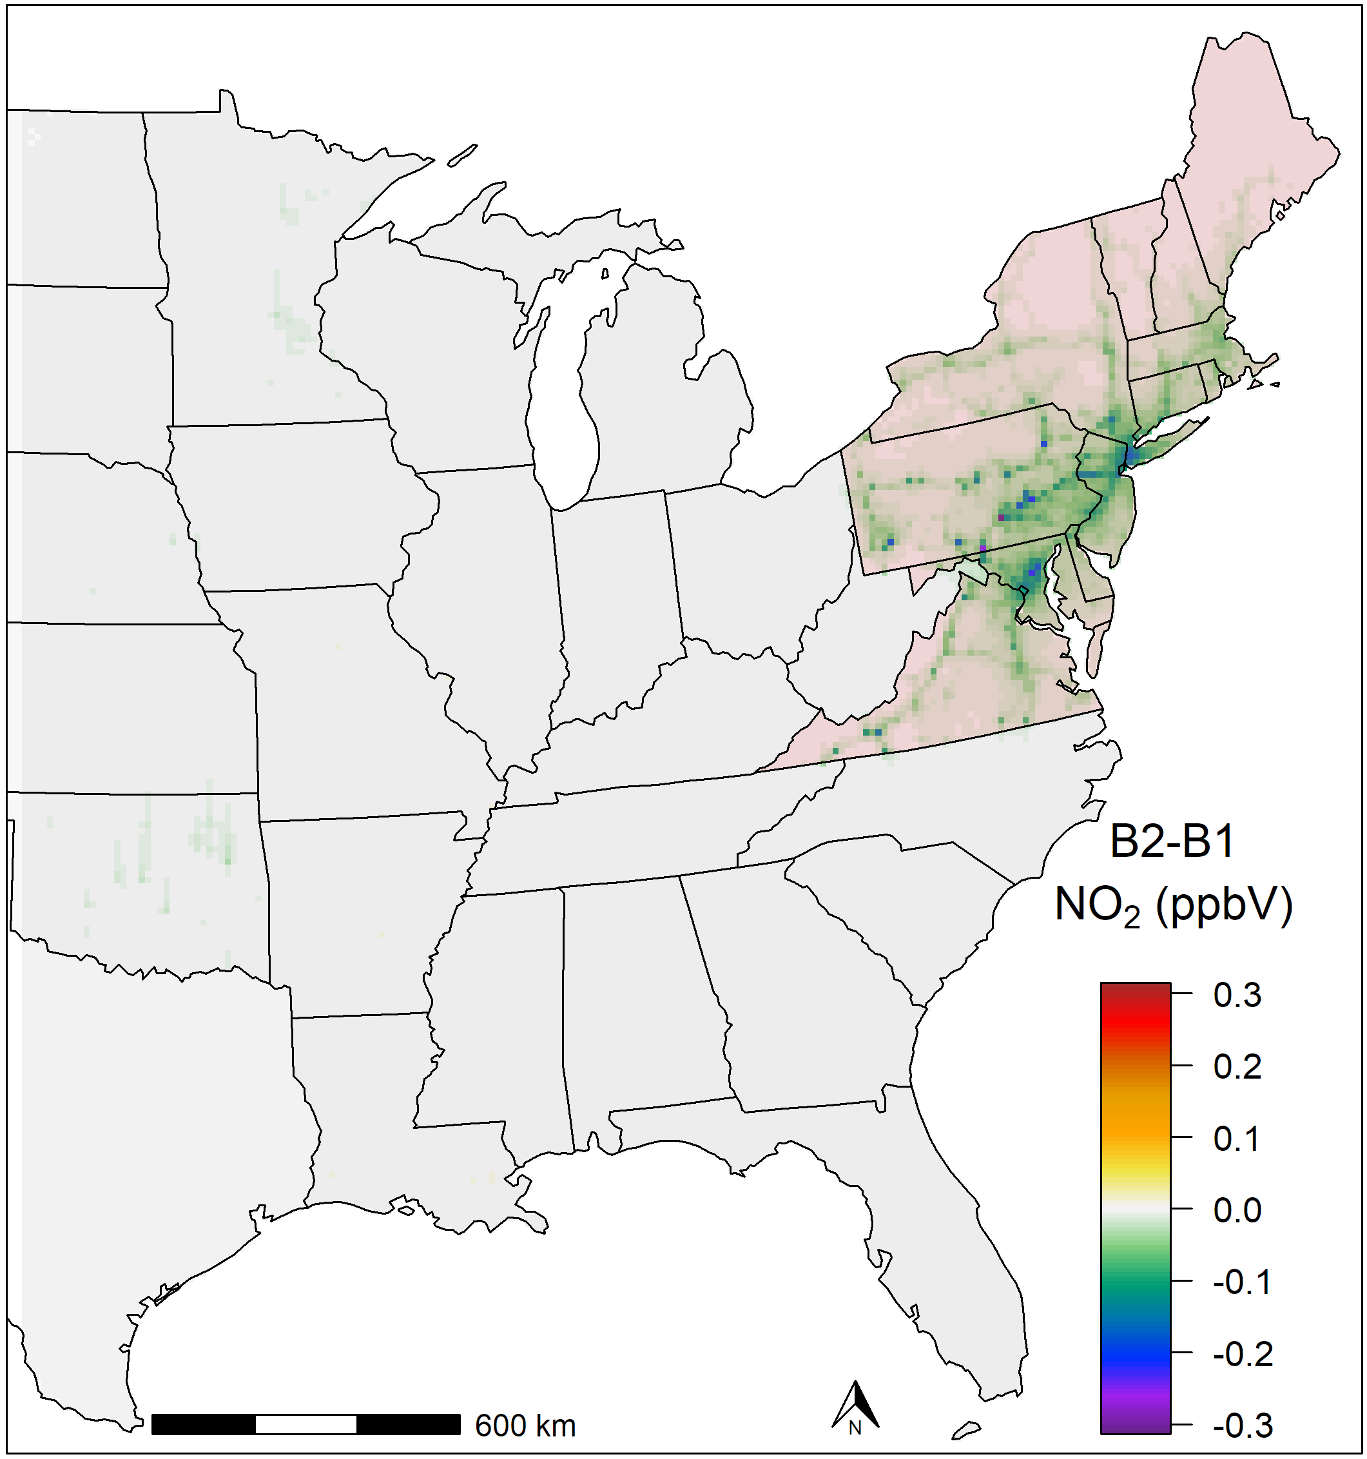
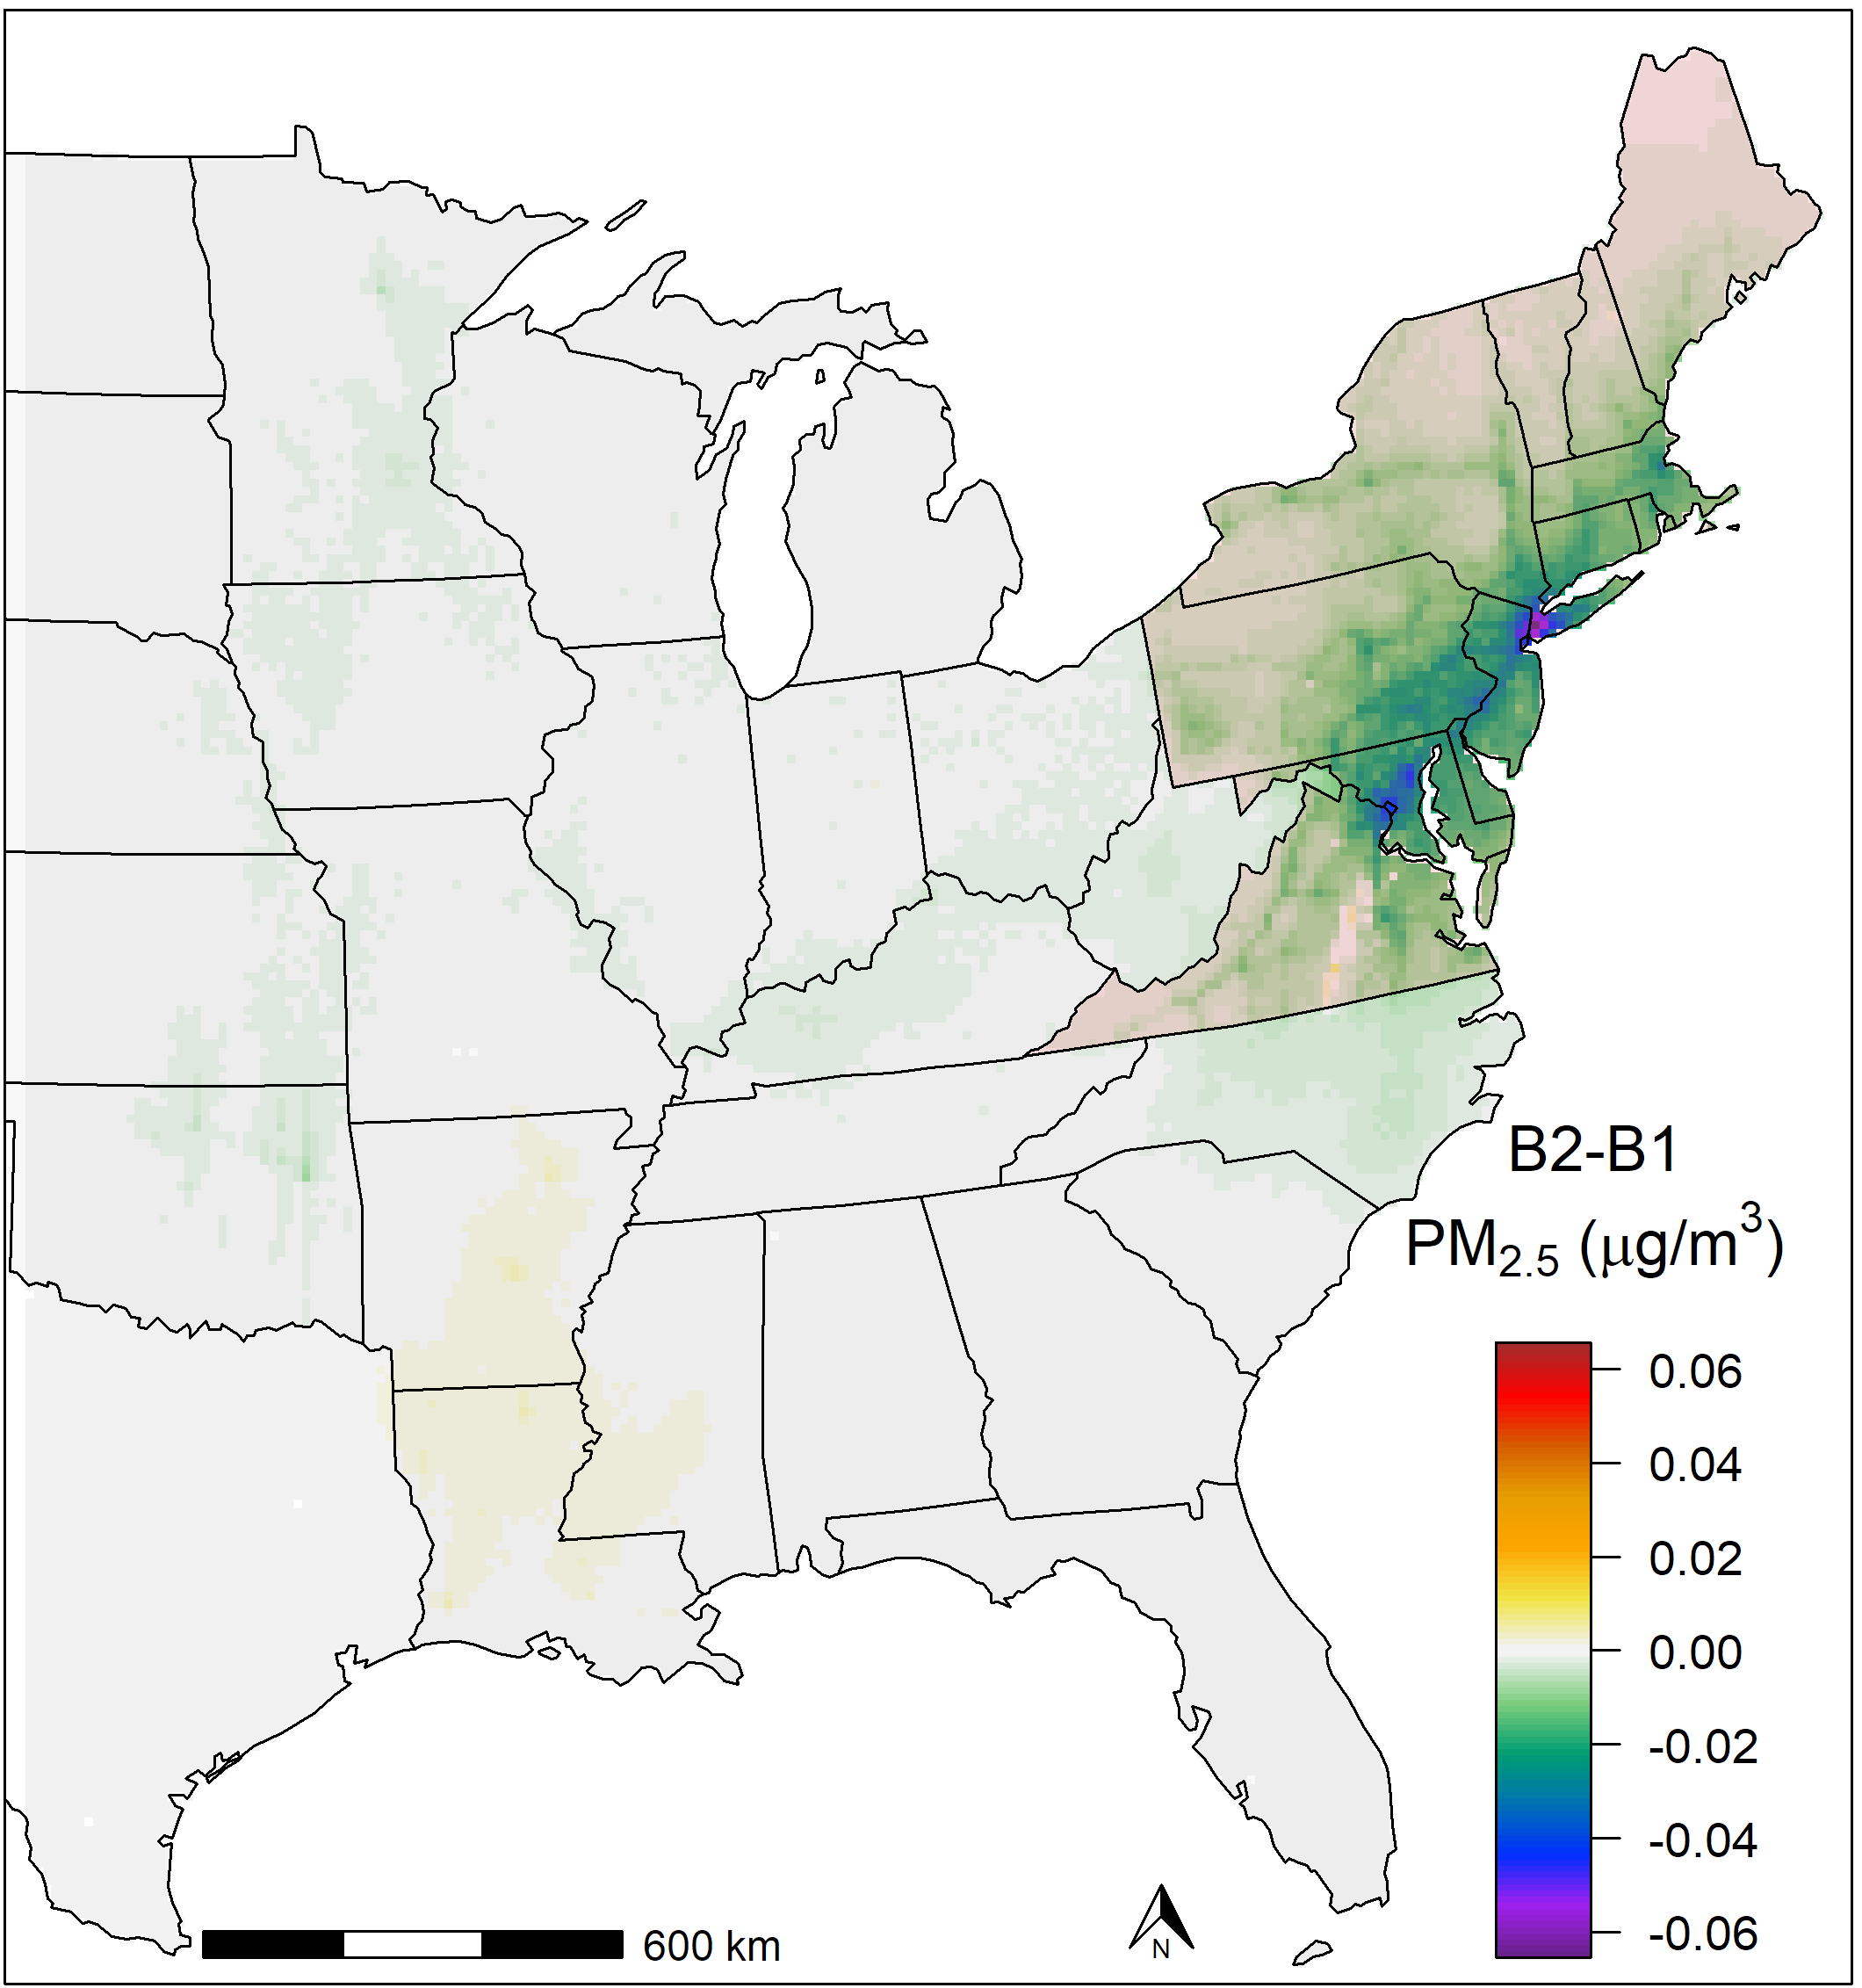
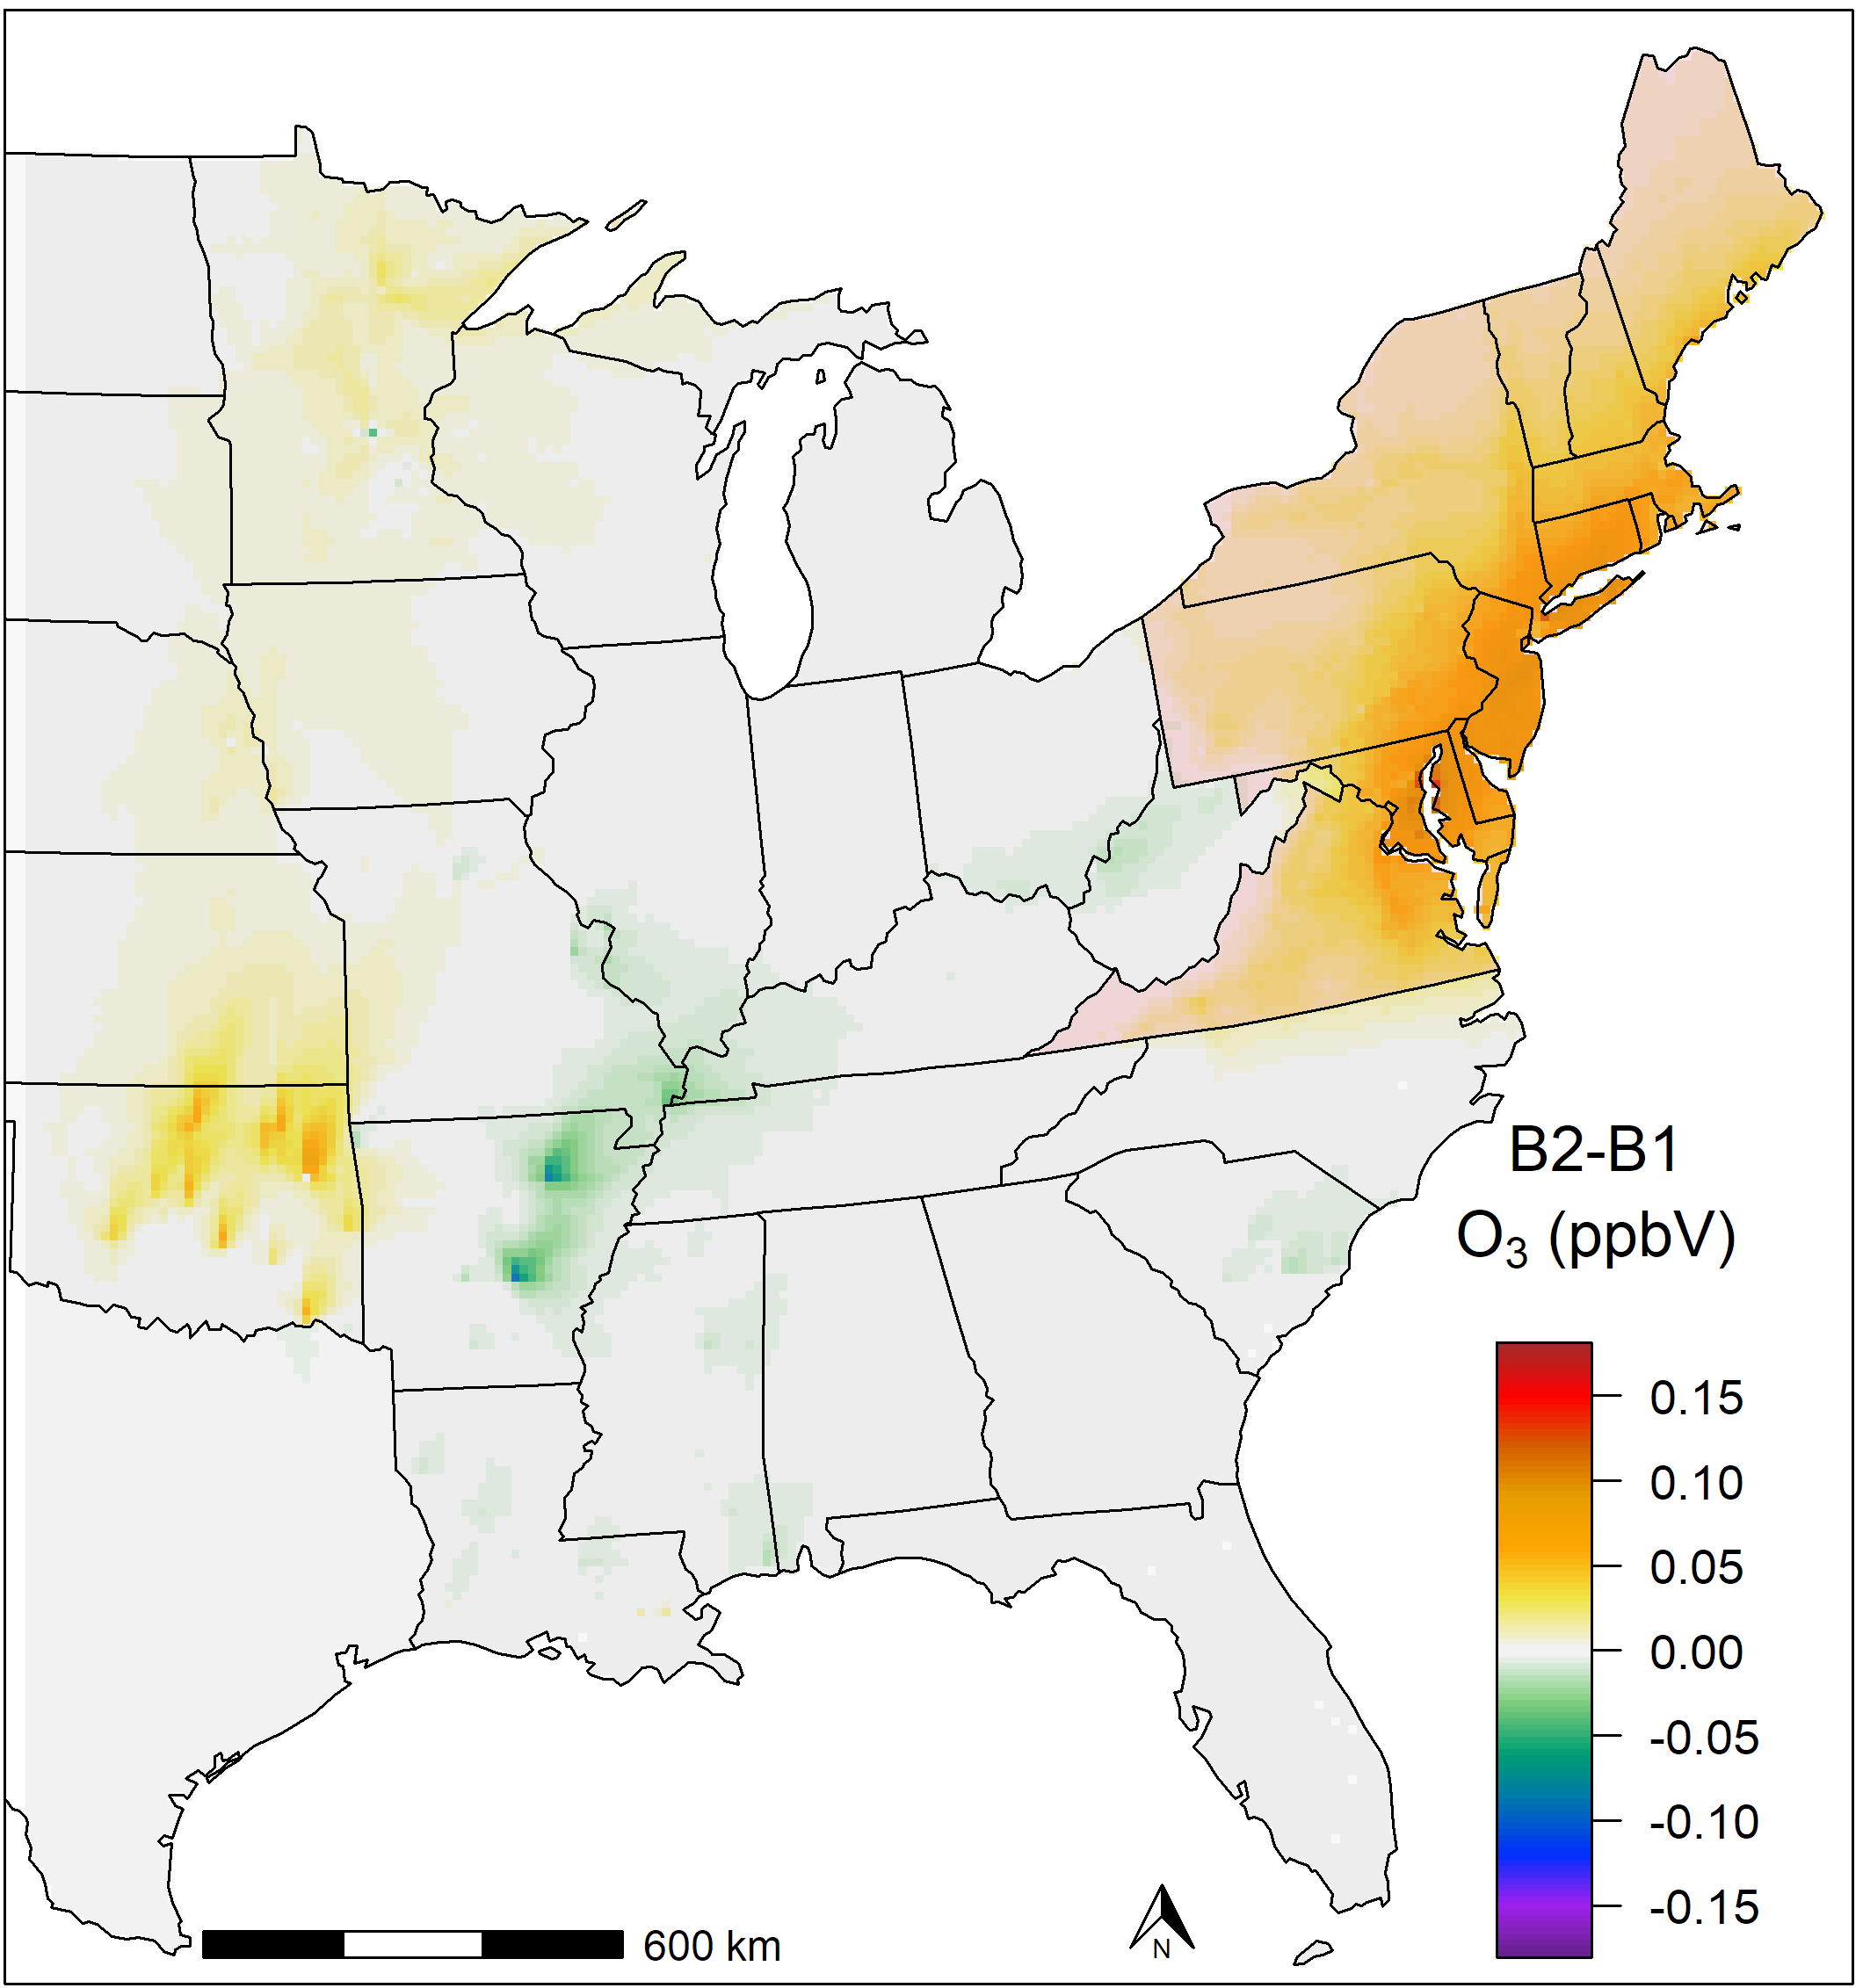
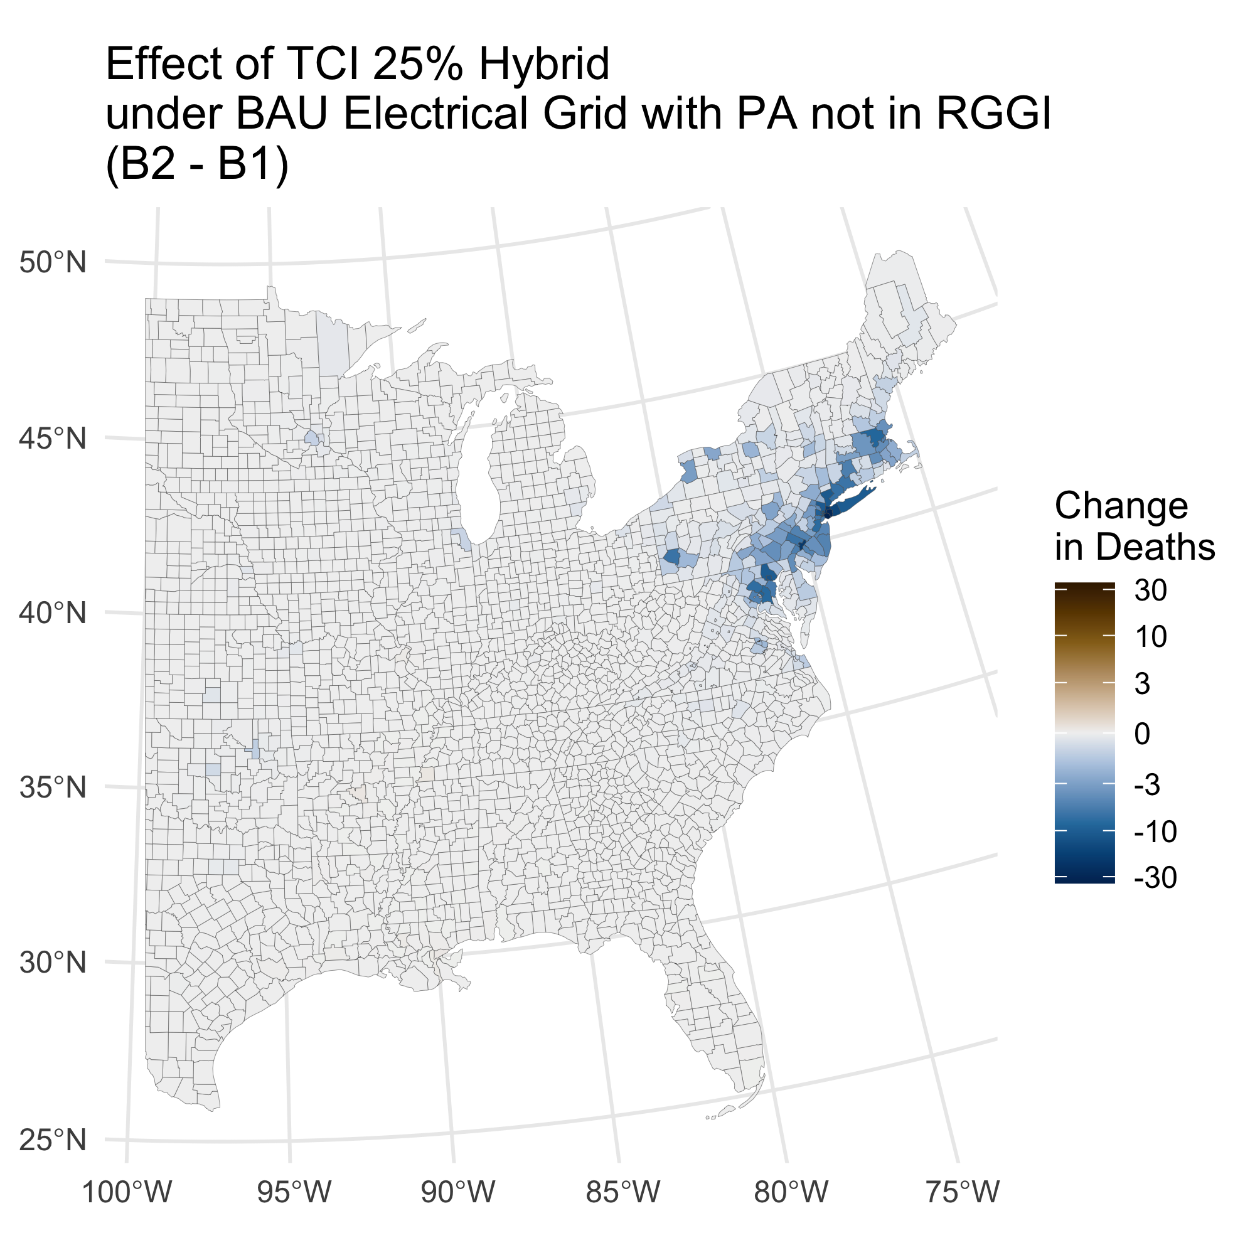
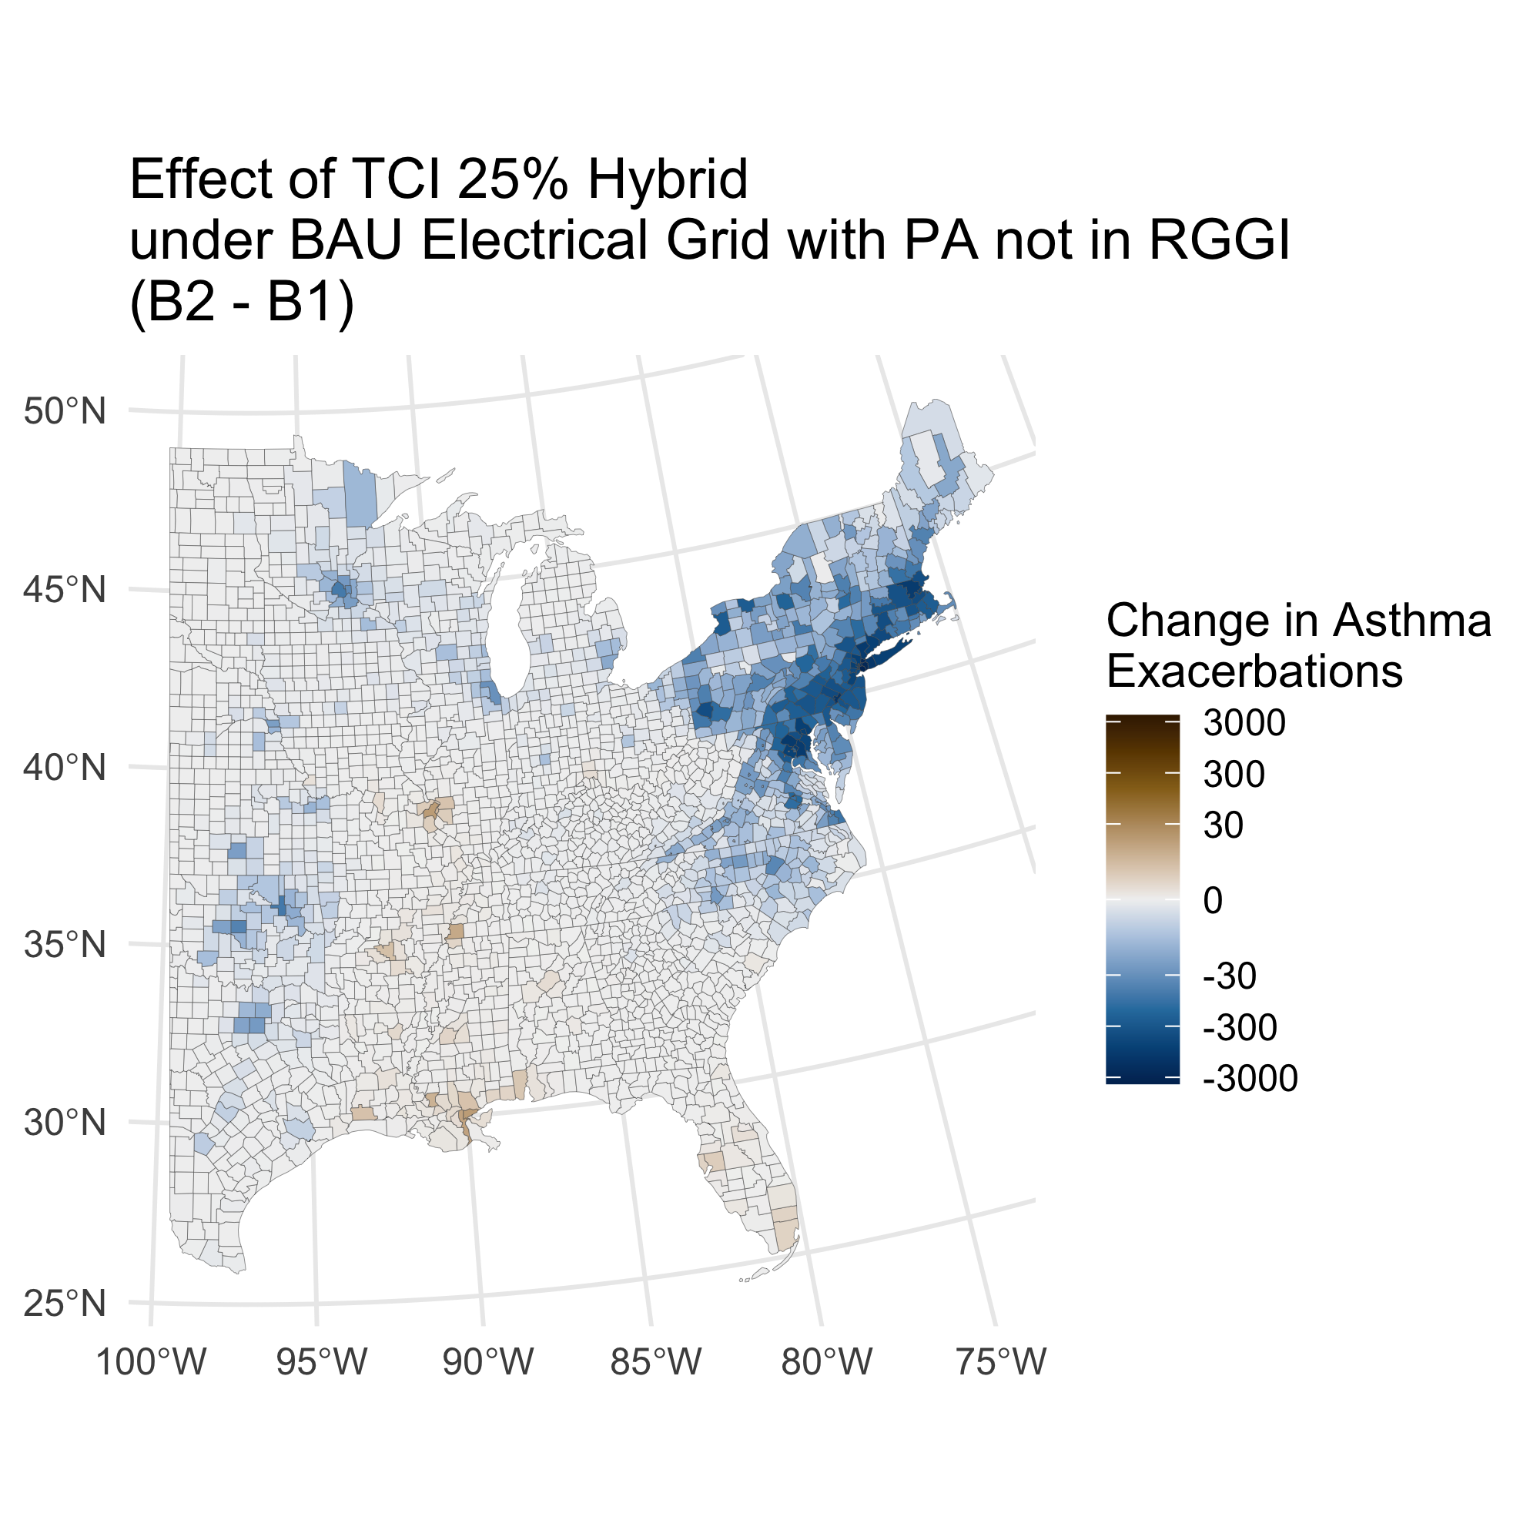
B2 – B1: Effect of TCI 25% Hybrid EV under BAU Electrical Grid with PA not in RGGI
-
+
-
+
-
Total Deaths: -550 (-340 - -780)
Total Asthma Exacerbations: -47,000 (-1,100 - -93,000)
Mortality-based value: -5,600 Mil. USD (-2,100 - -11,000)
+
-
-

Slide 8
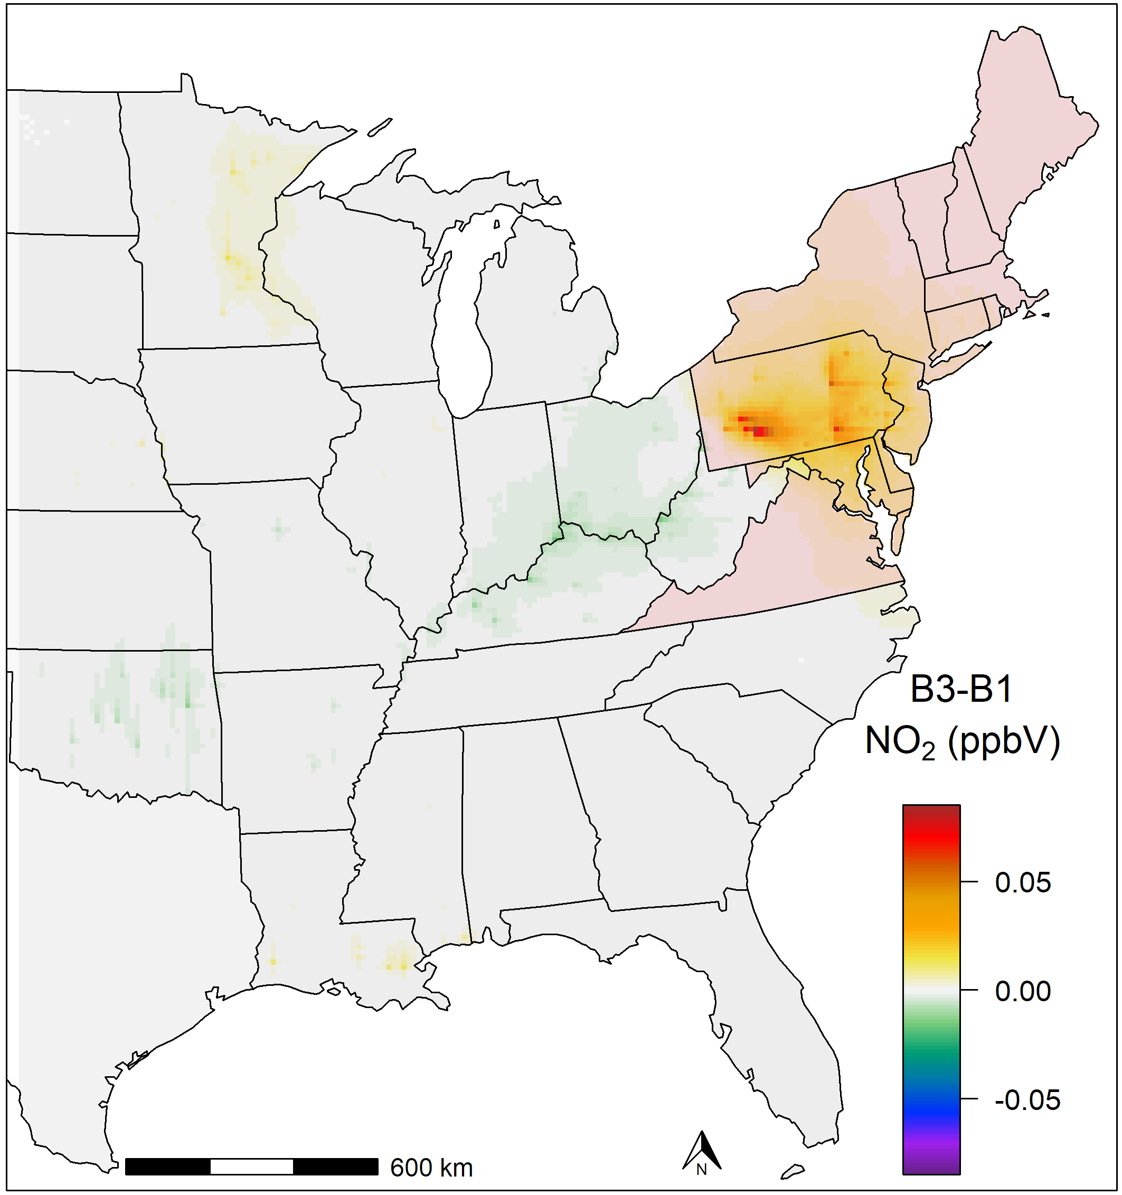
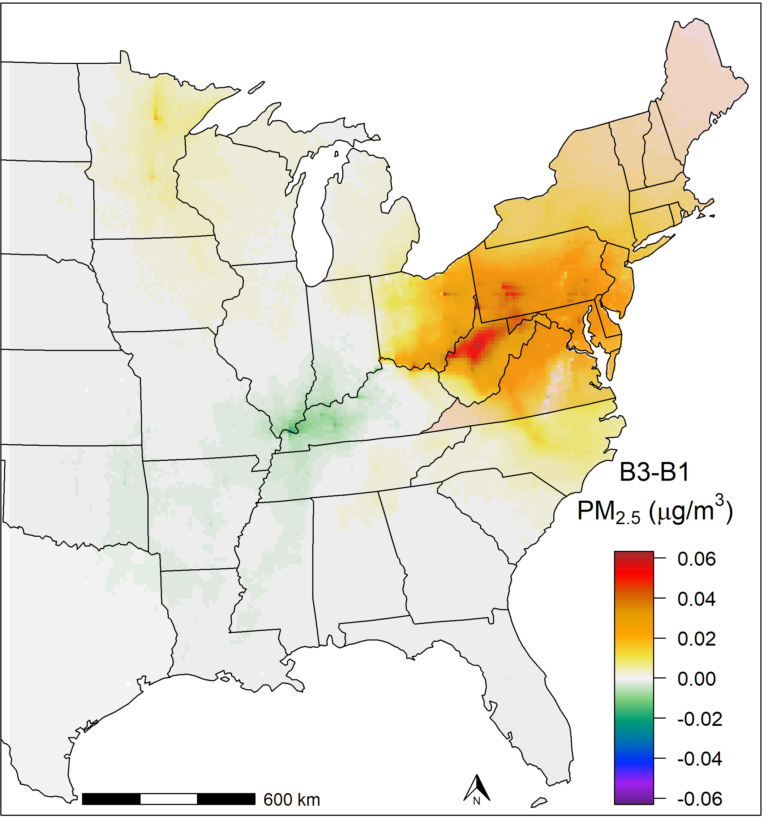
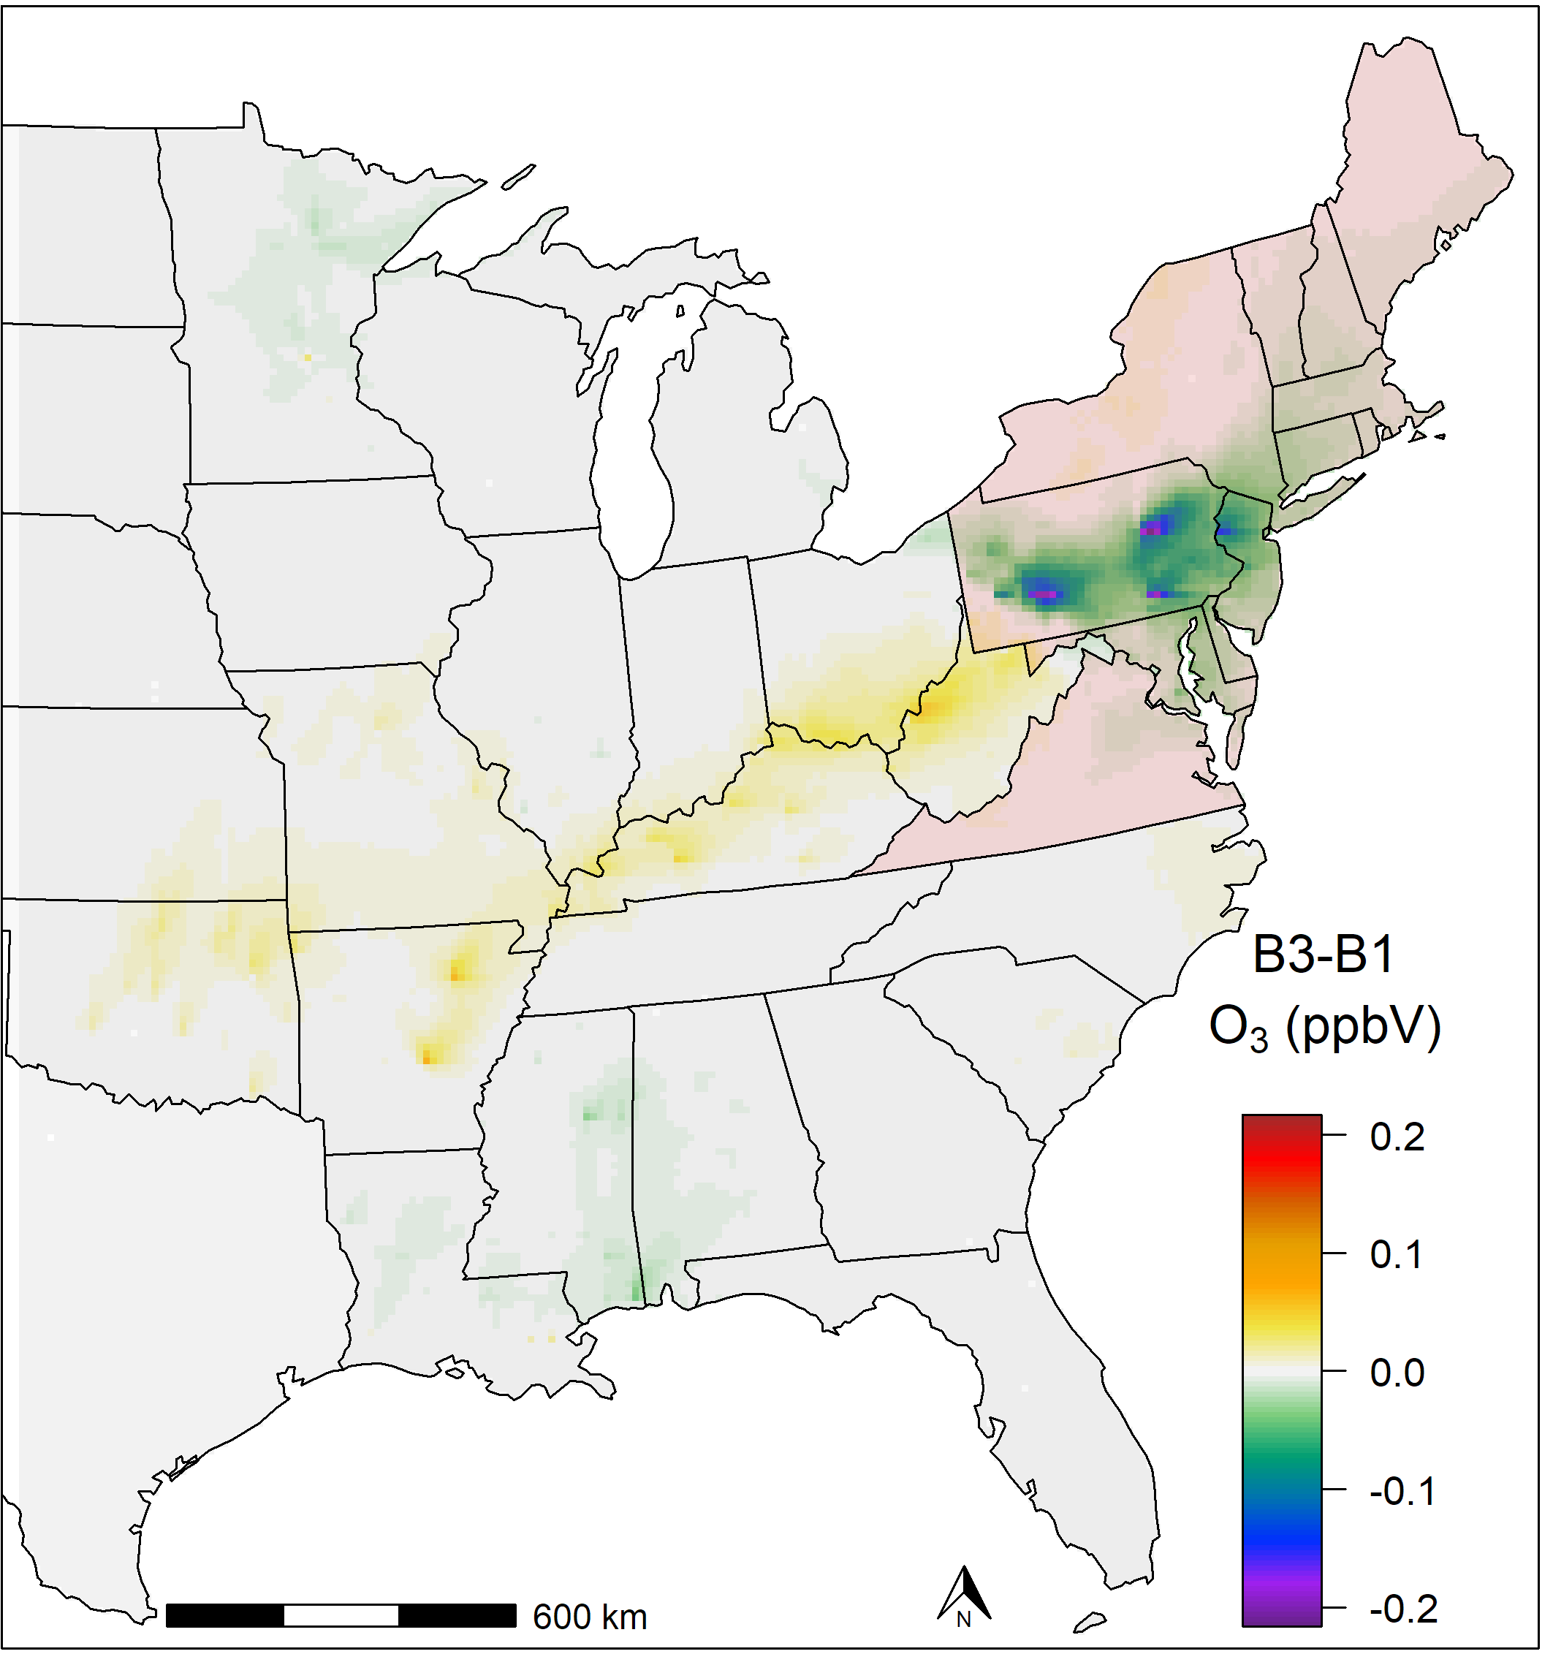
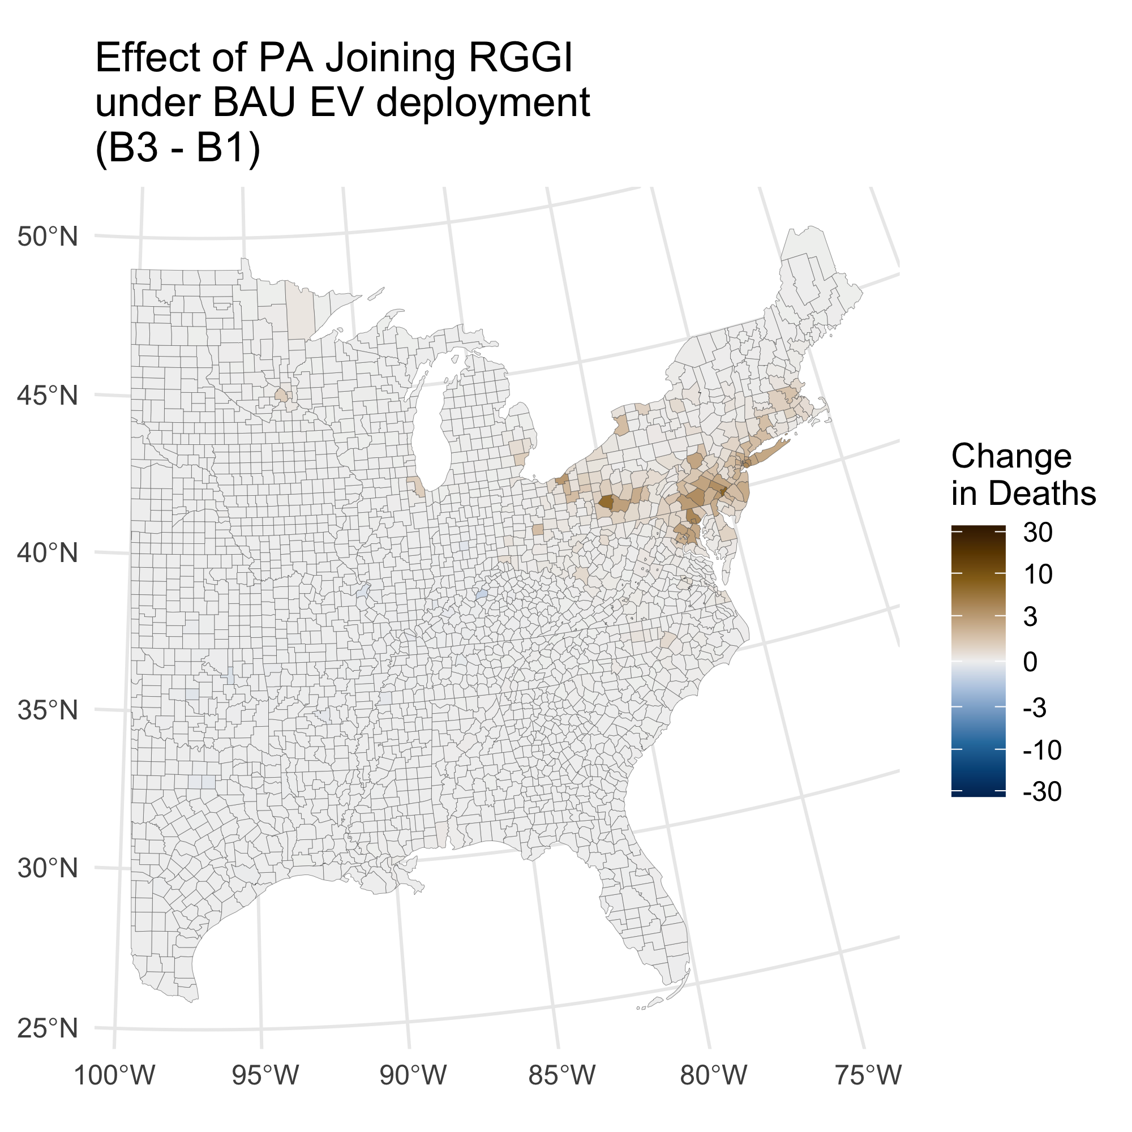
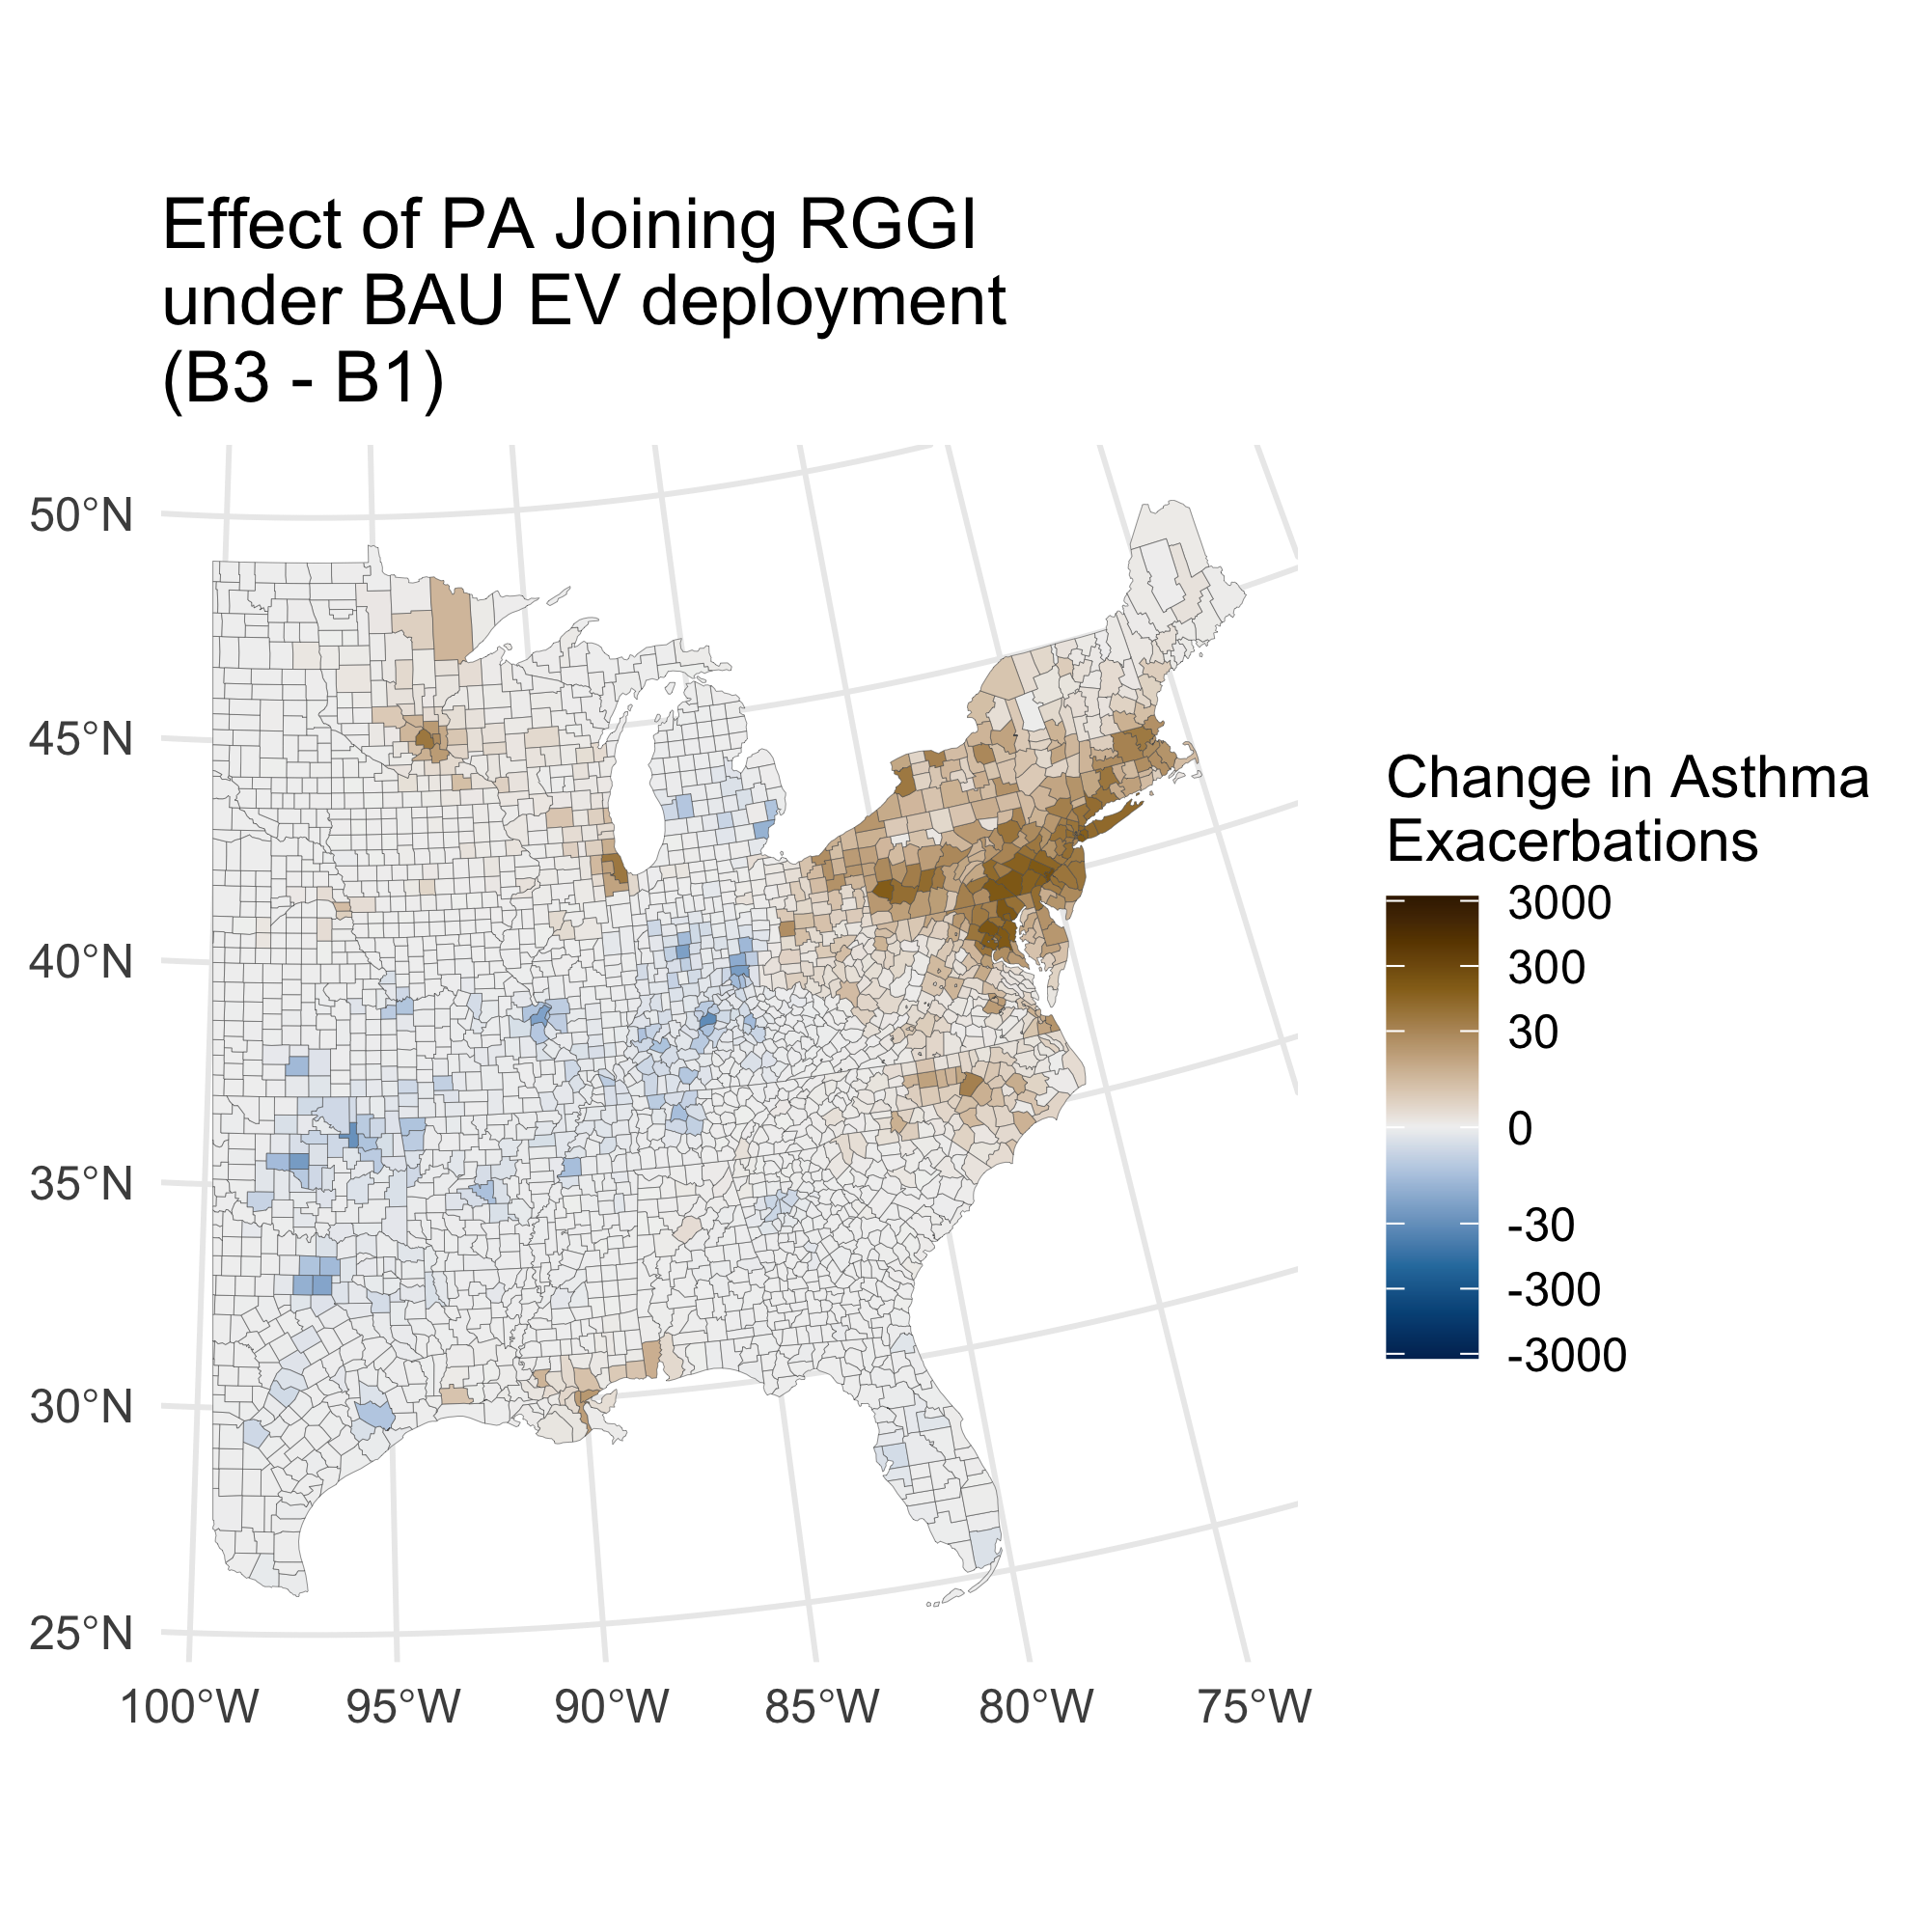
B3 – B1: Effect of PA joining RGGI under BAU EV deployment
+
Total Deaths 210 (160 - 280)
Total Asthma Exacerbations 7,000 (84 - 14,000)
Mortality based value: 2,200 Mil. USD (1,000 - 4,000)
-
-
+

Slide 9
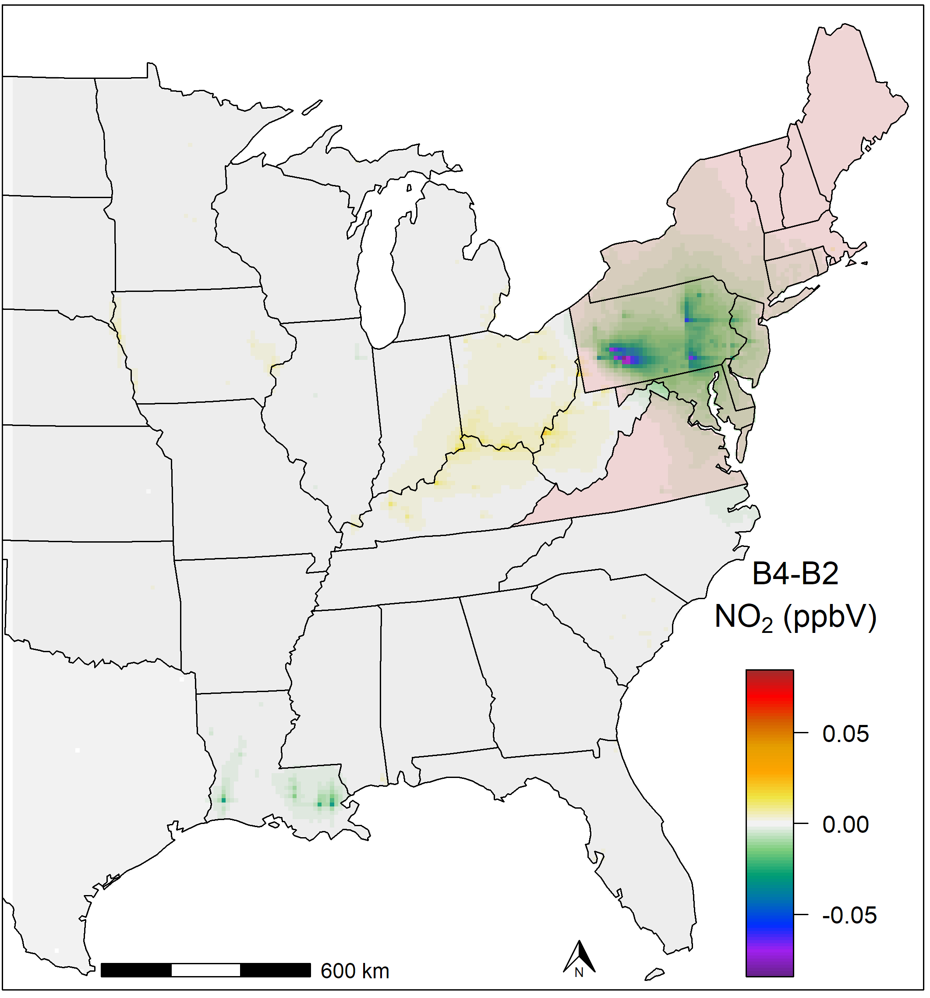
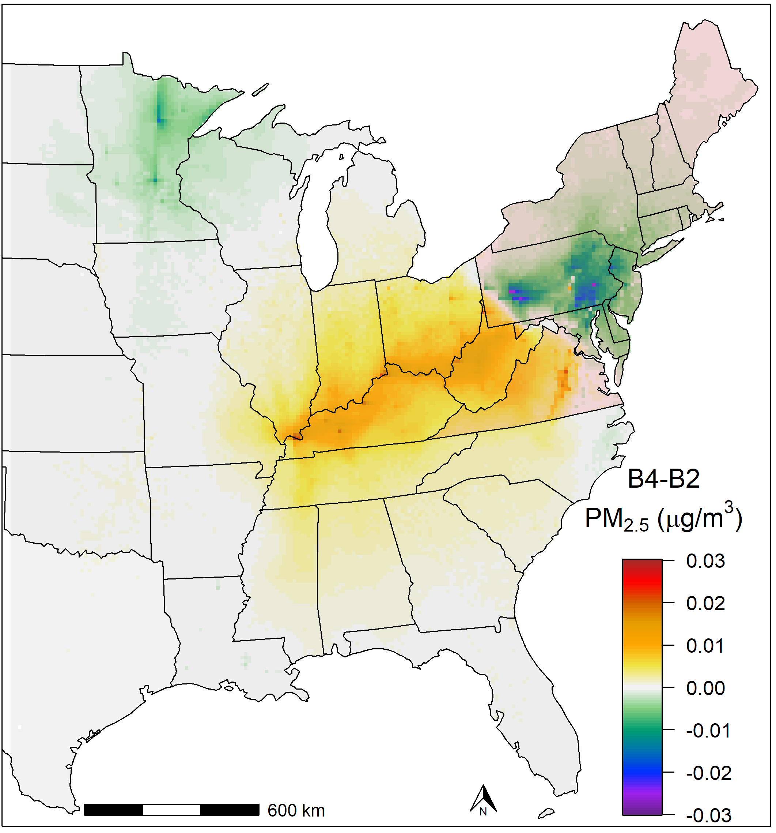
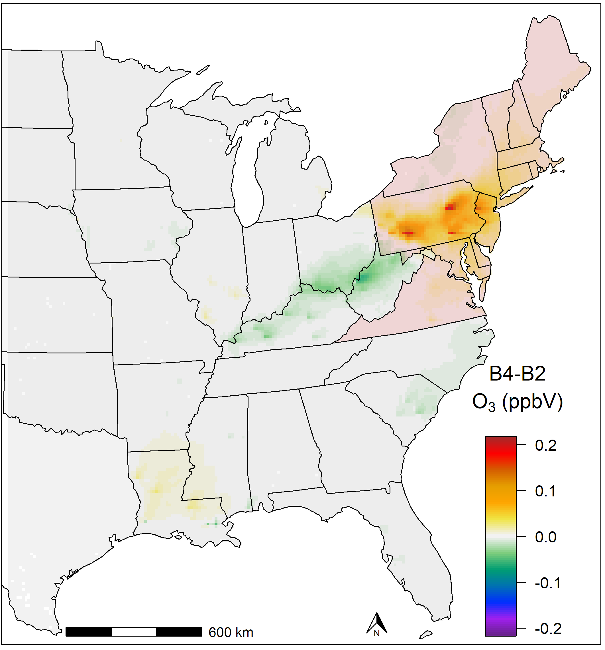
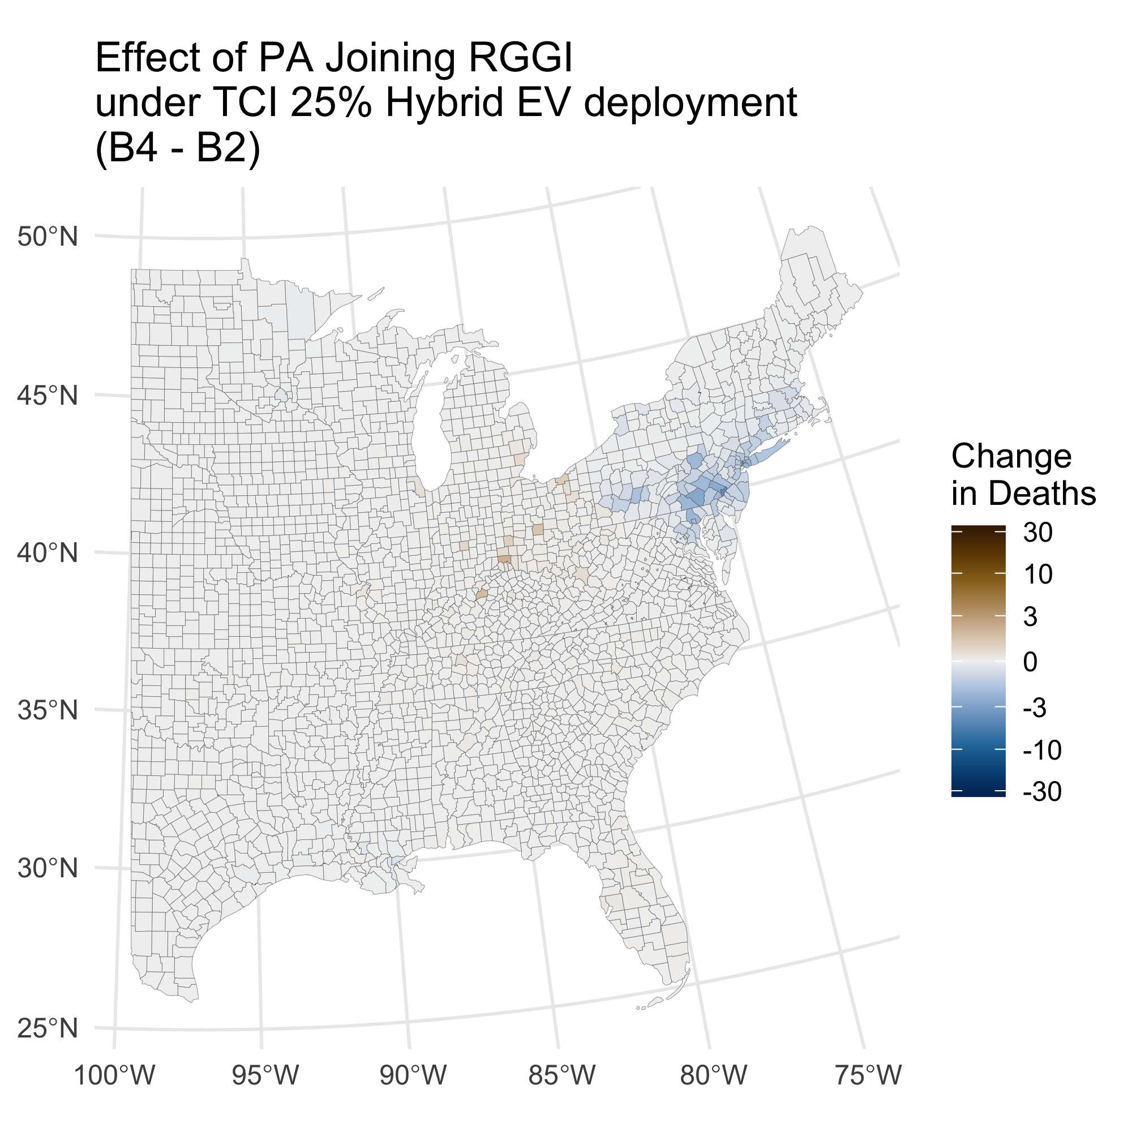
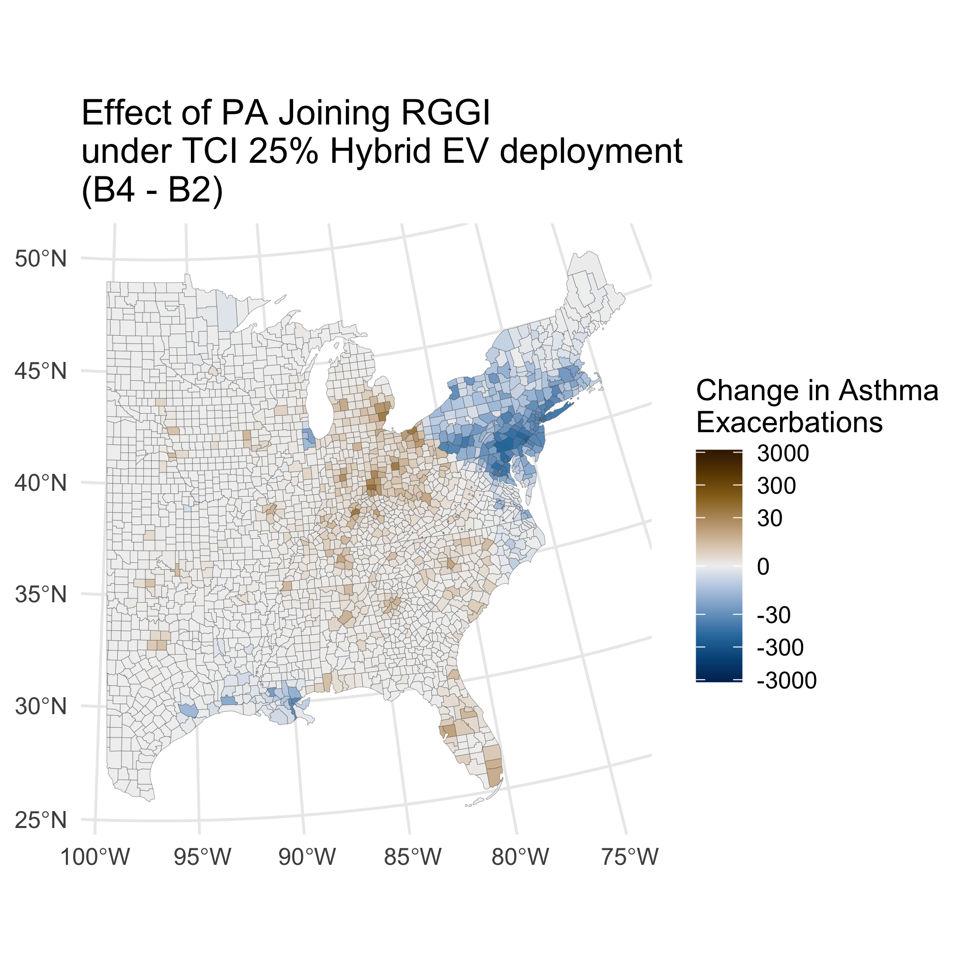
B4 – B2: Effect of PA joining RGGI under TCI 25% Hybrid EV deployment
Total Deaths: -43 (-20 - -77)
Total Asthma Exacerbations: -3,100 (-78 - -6,100)
Mortality based value: -440 Mil. USD (-120 - -1,100)
-
+
-

Slide 10
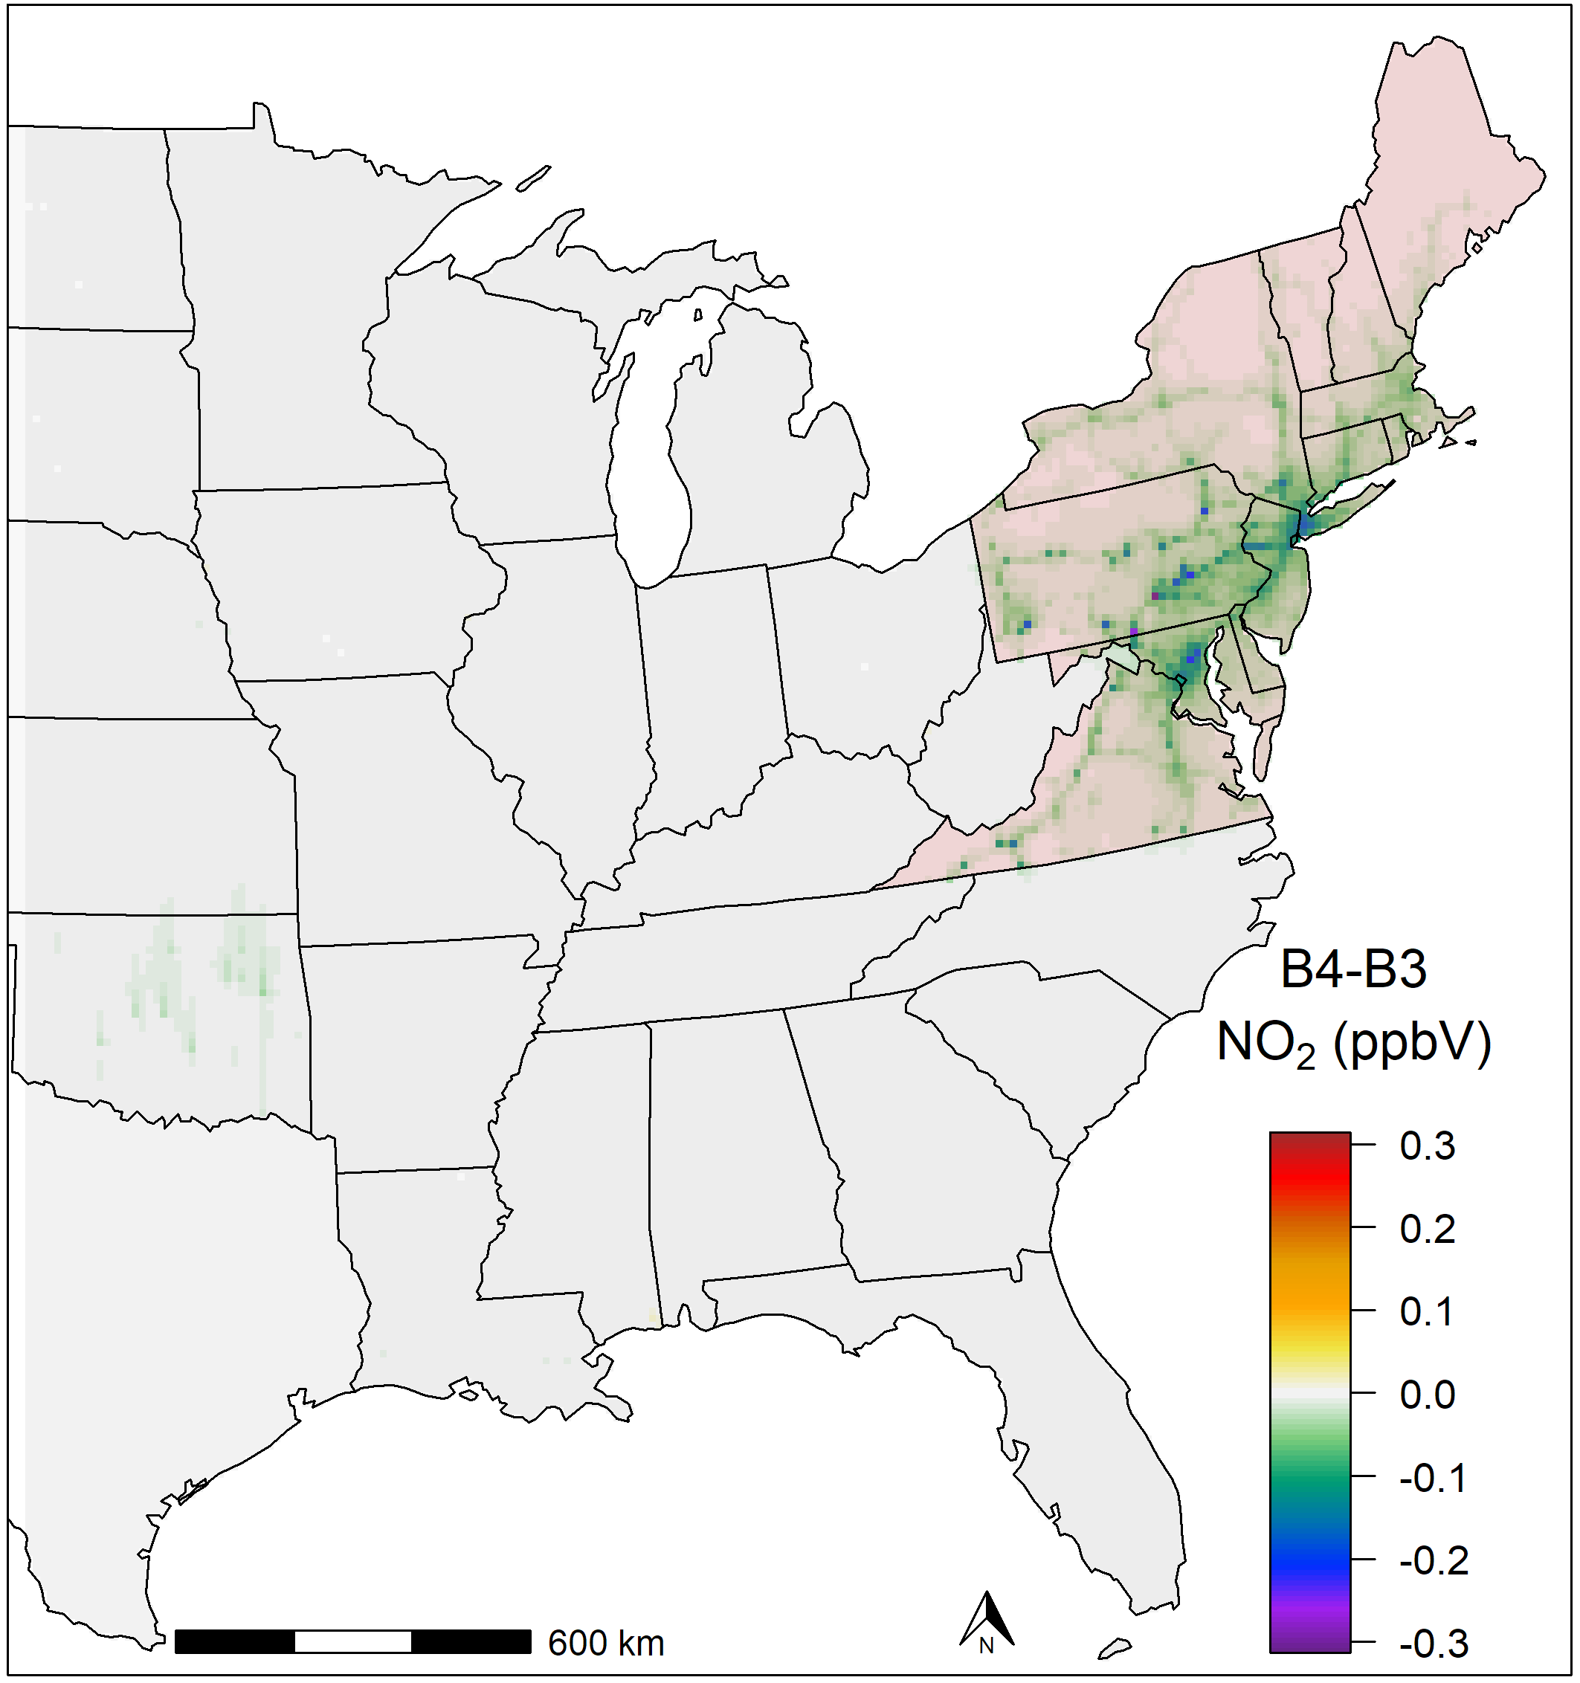
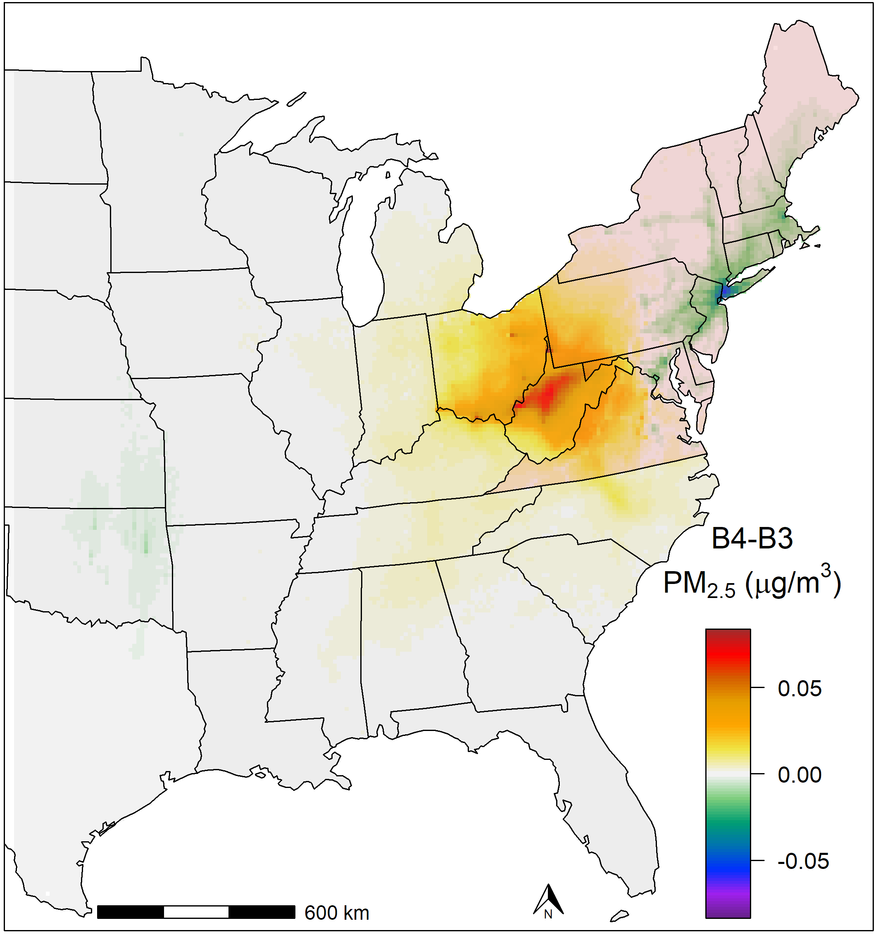
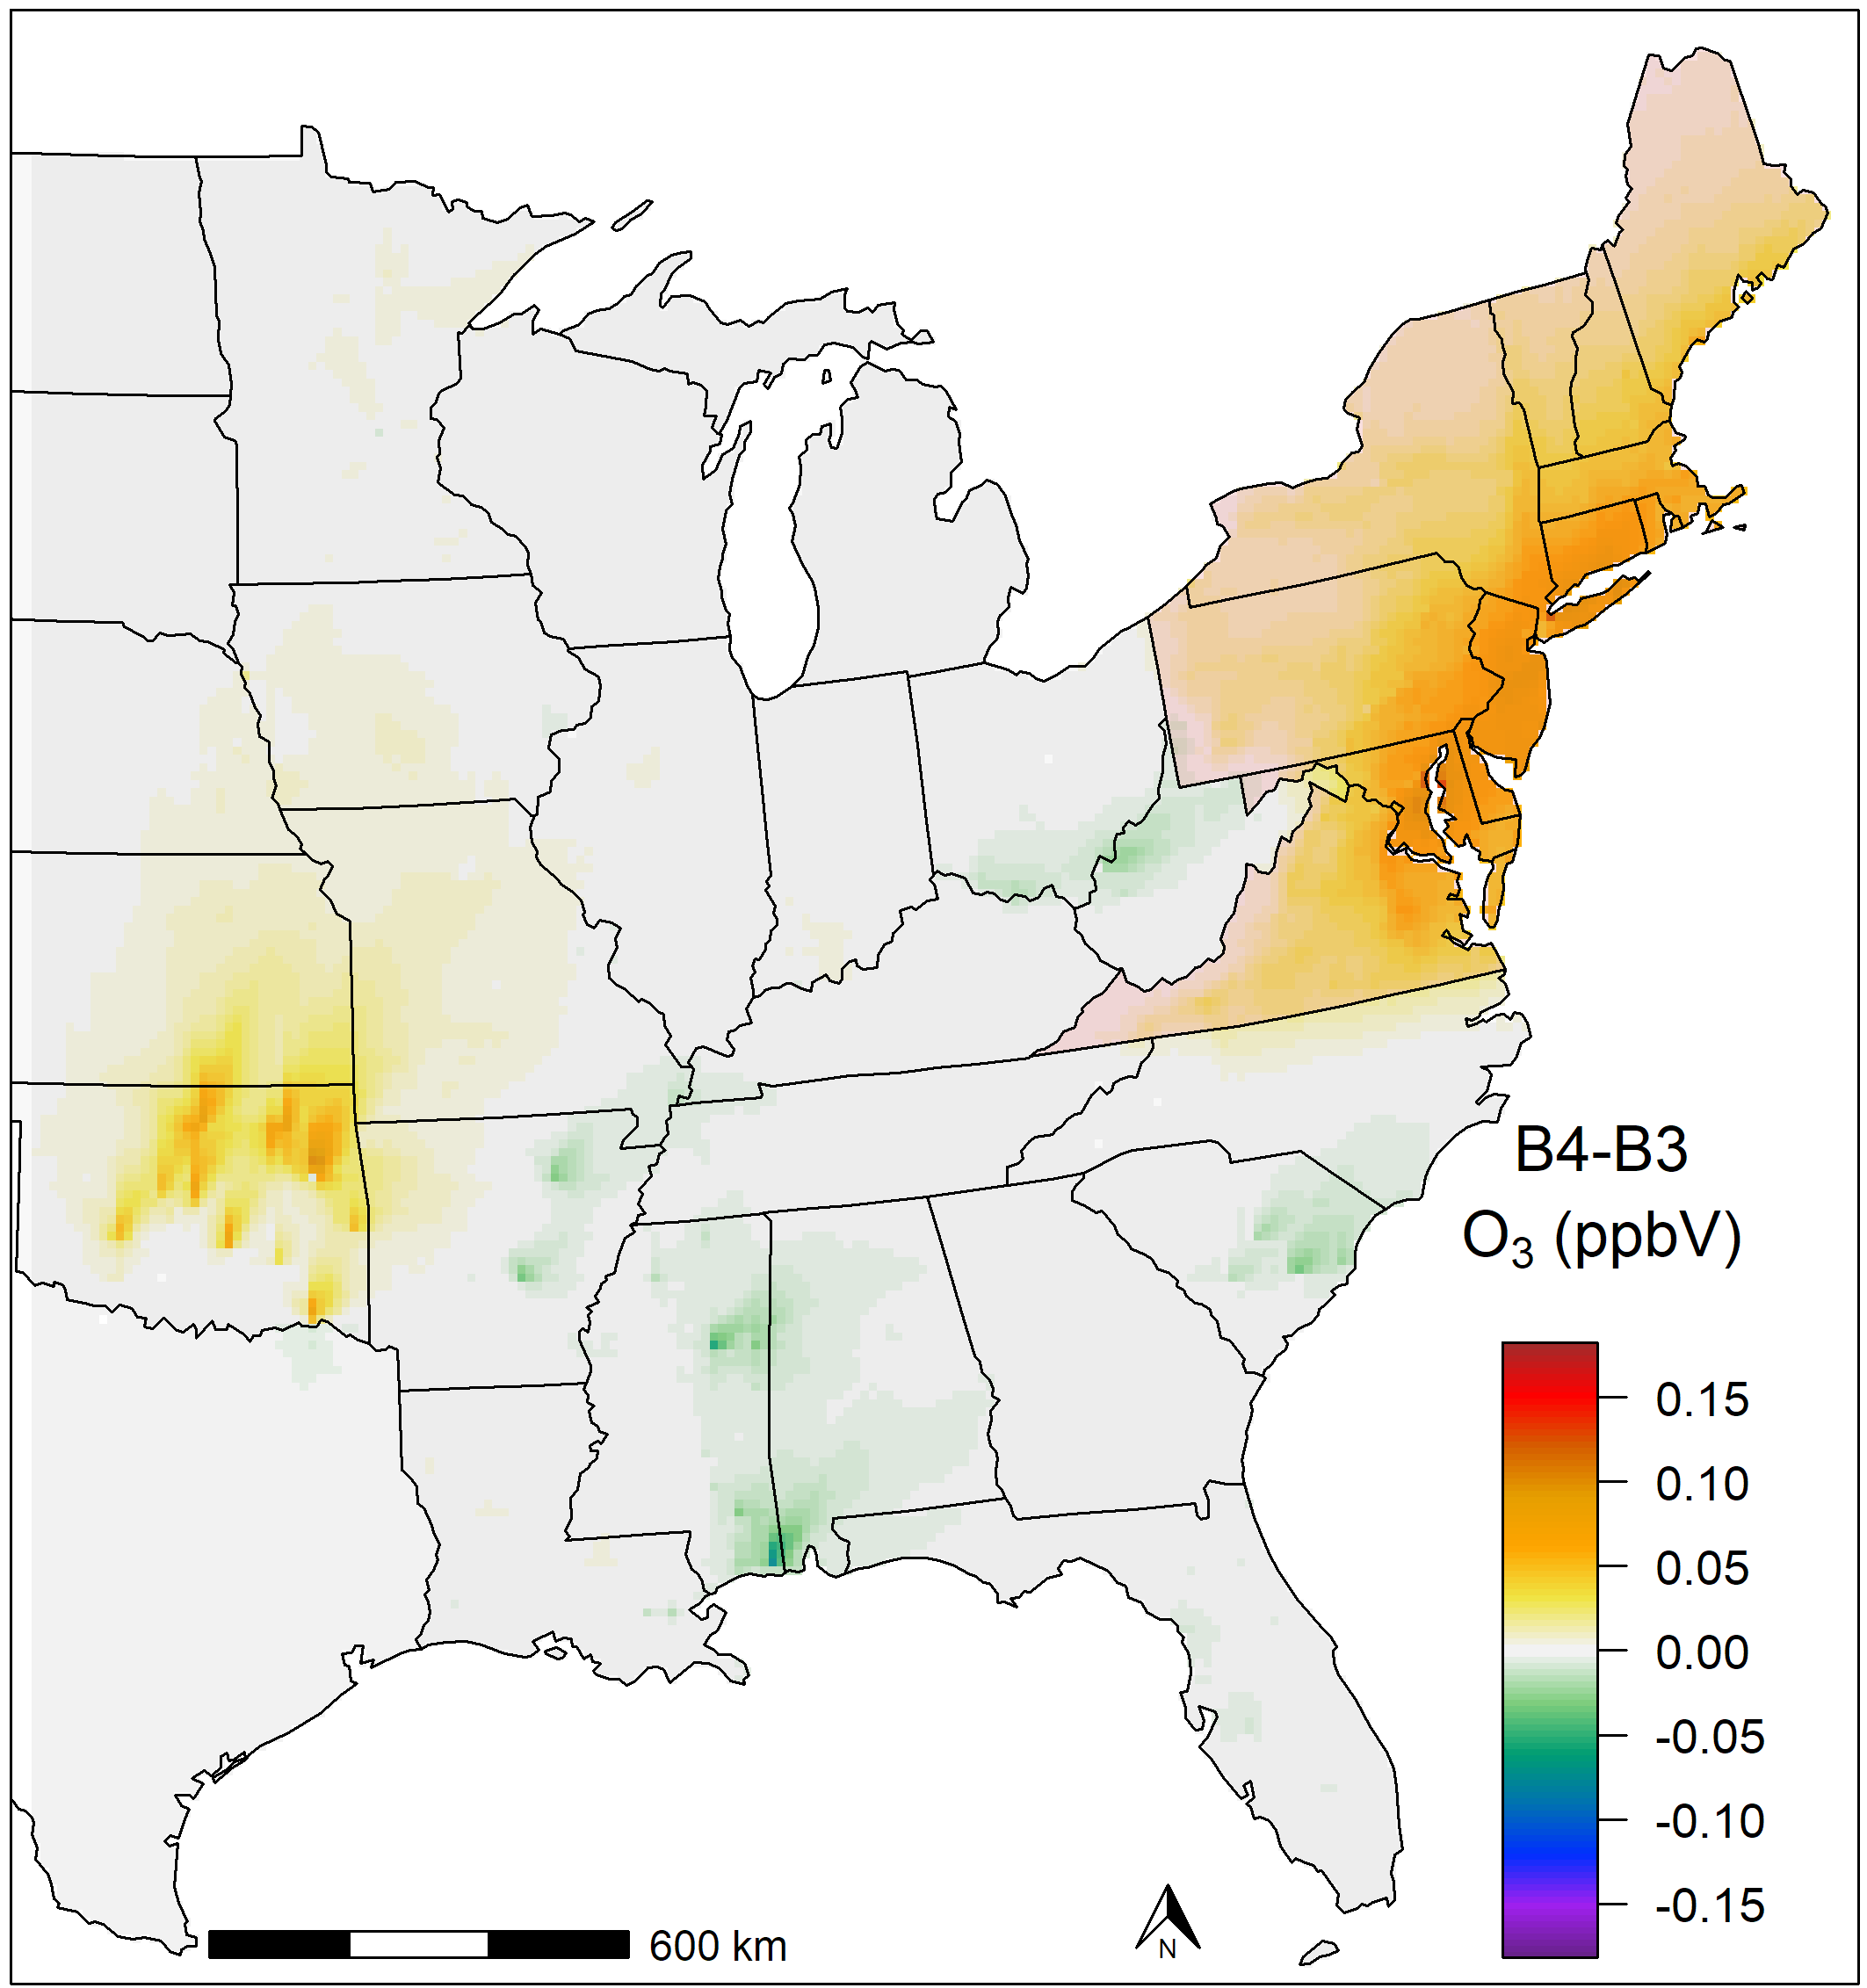
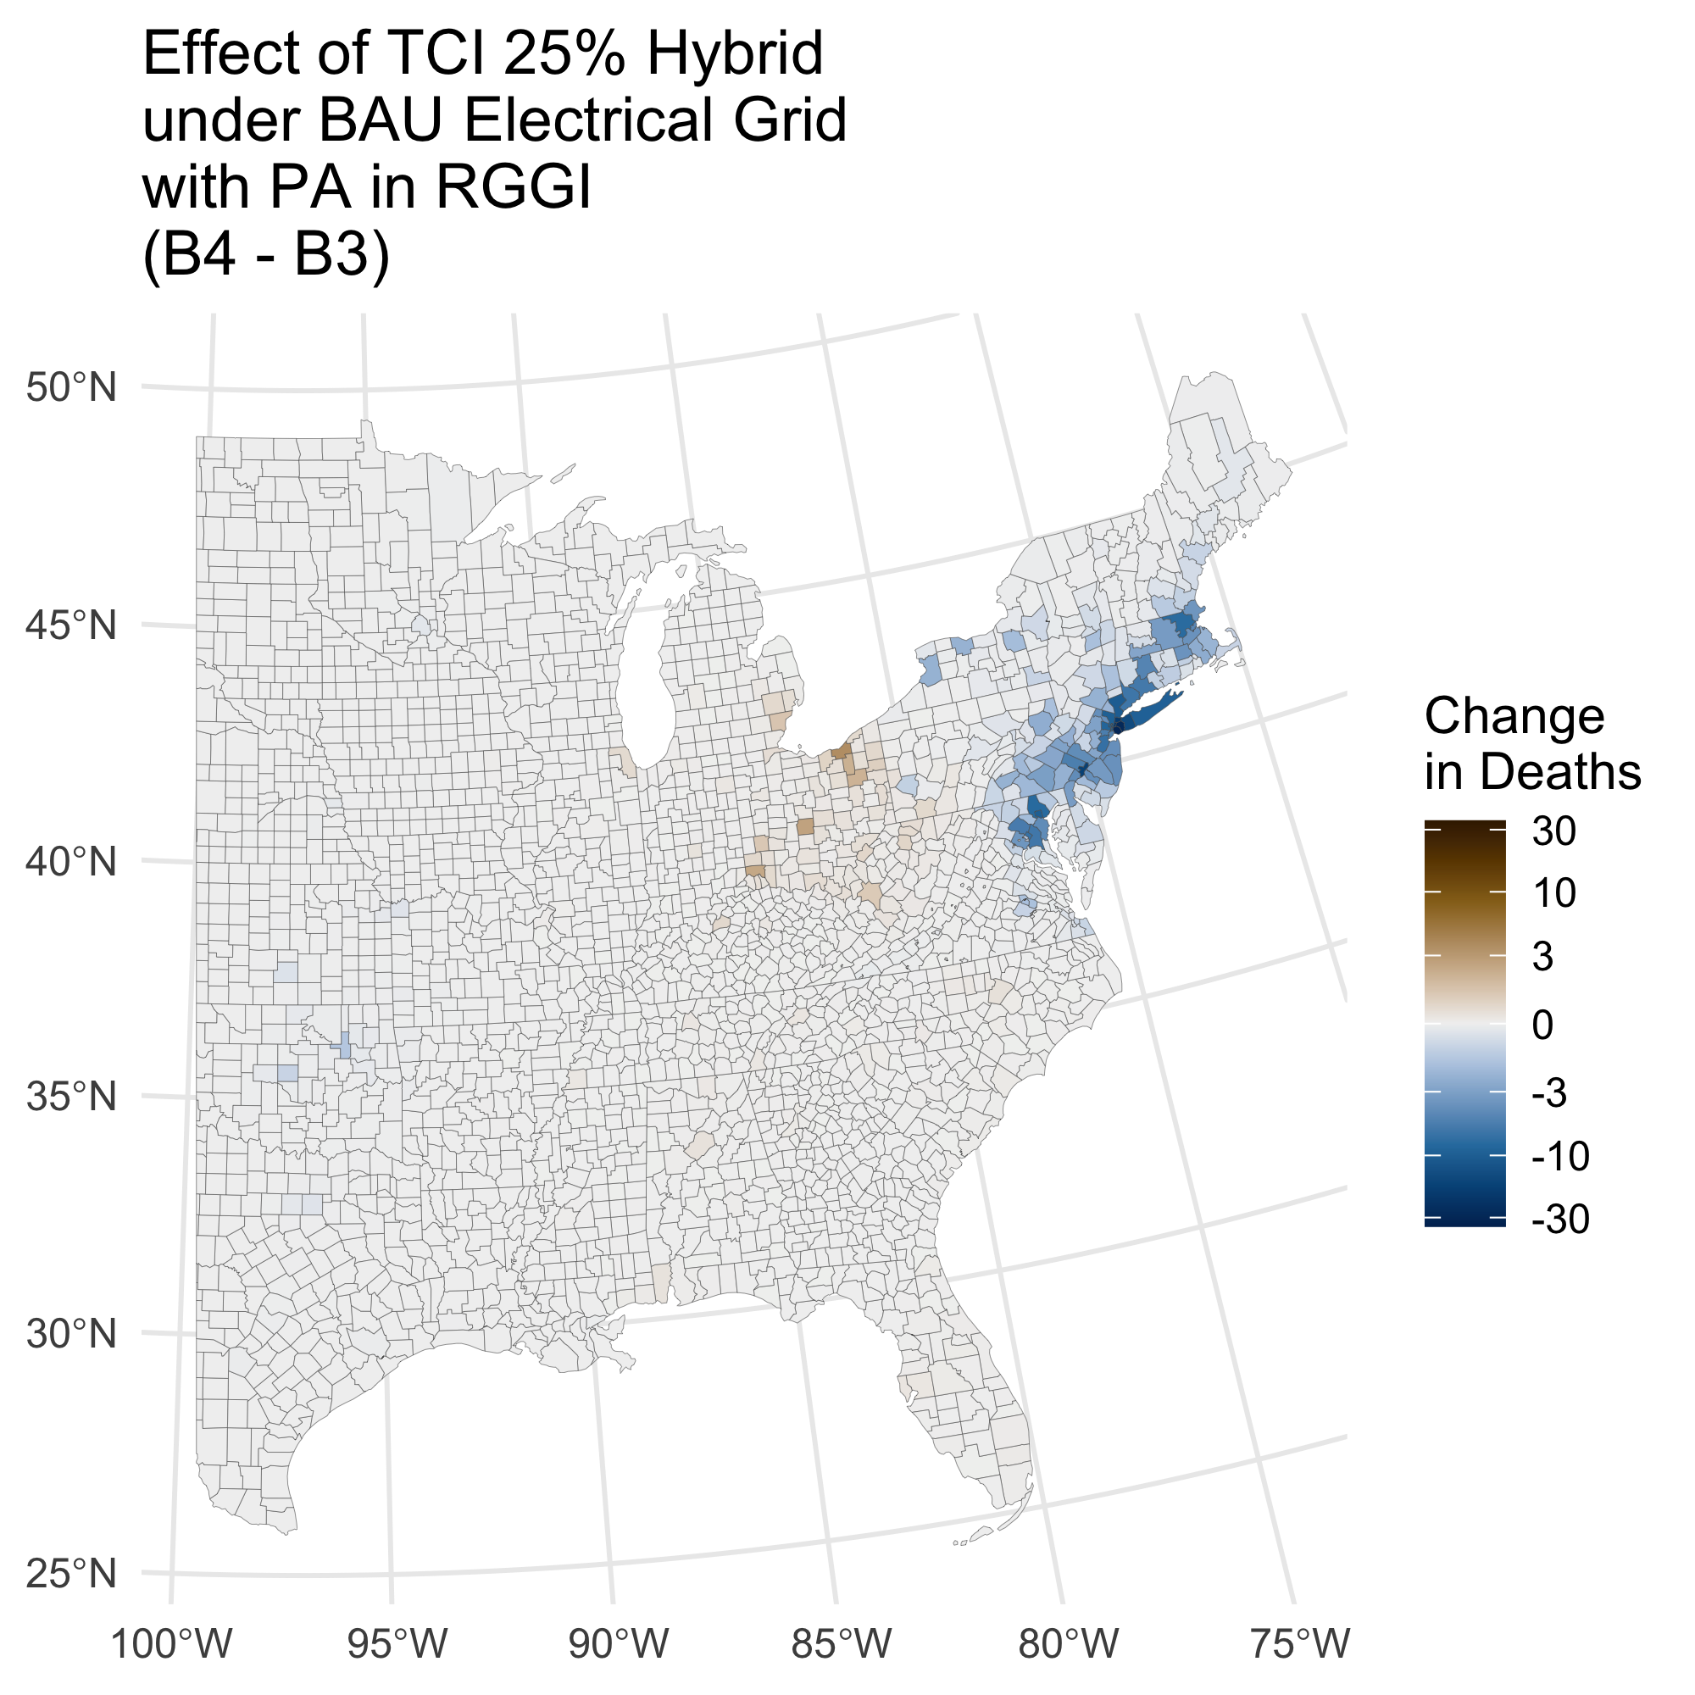
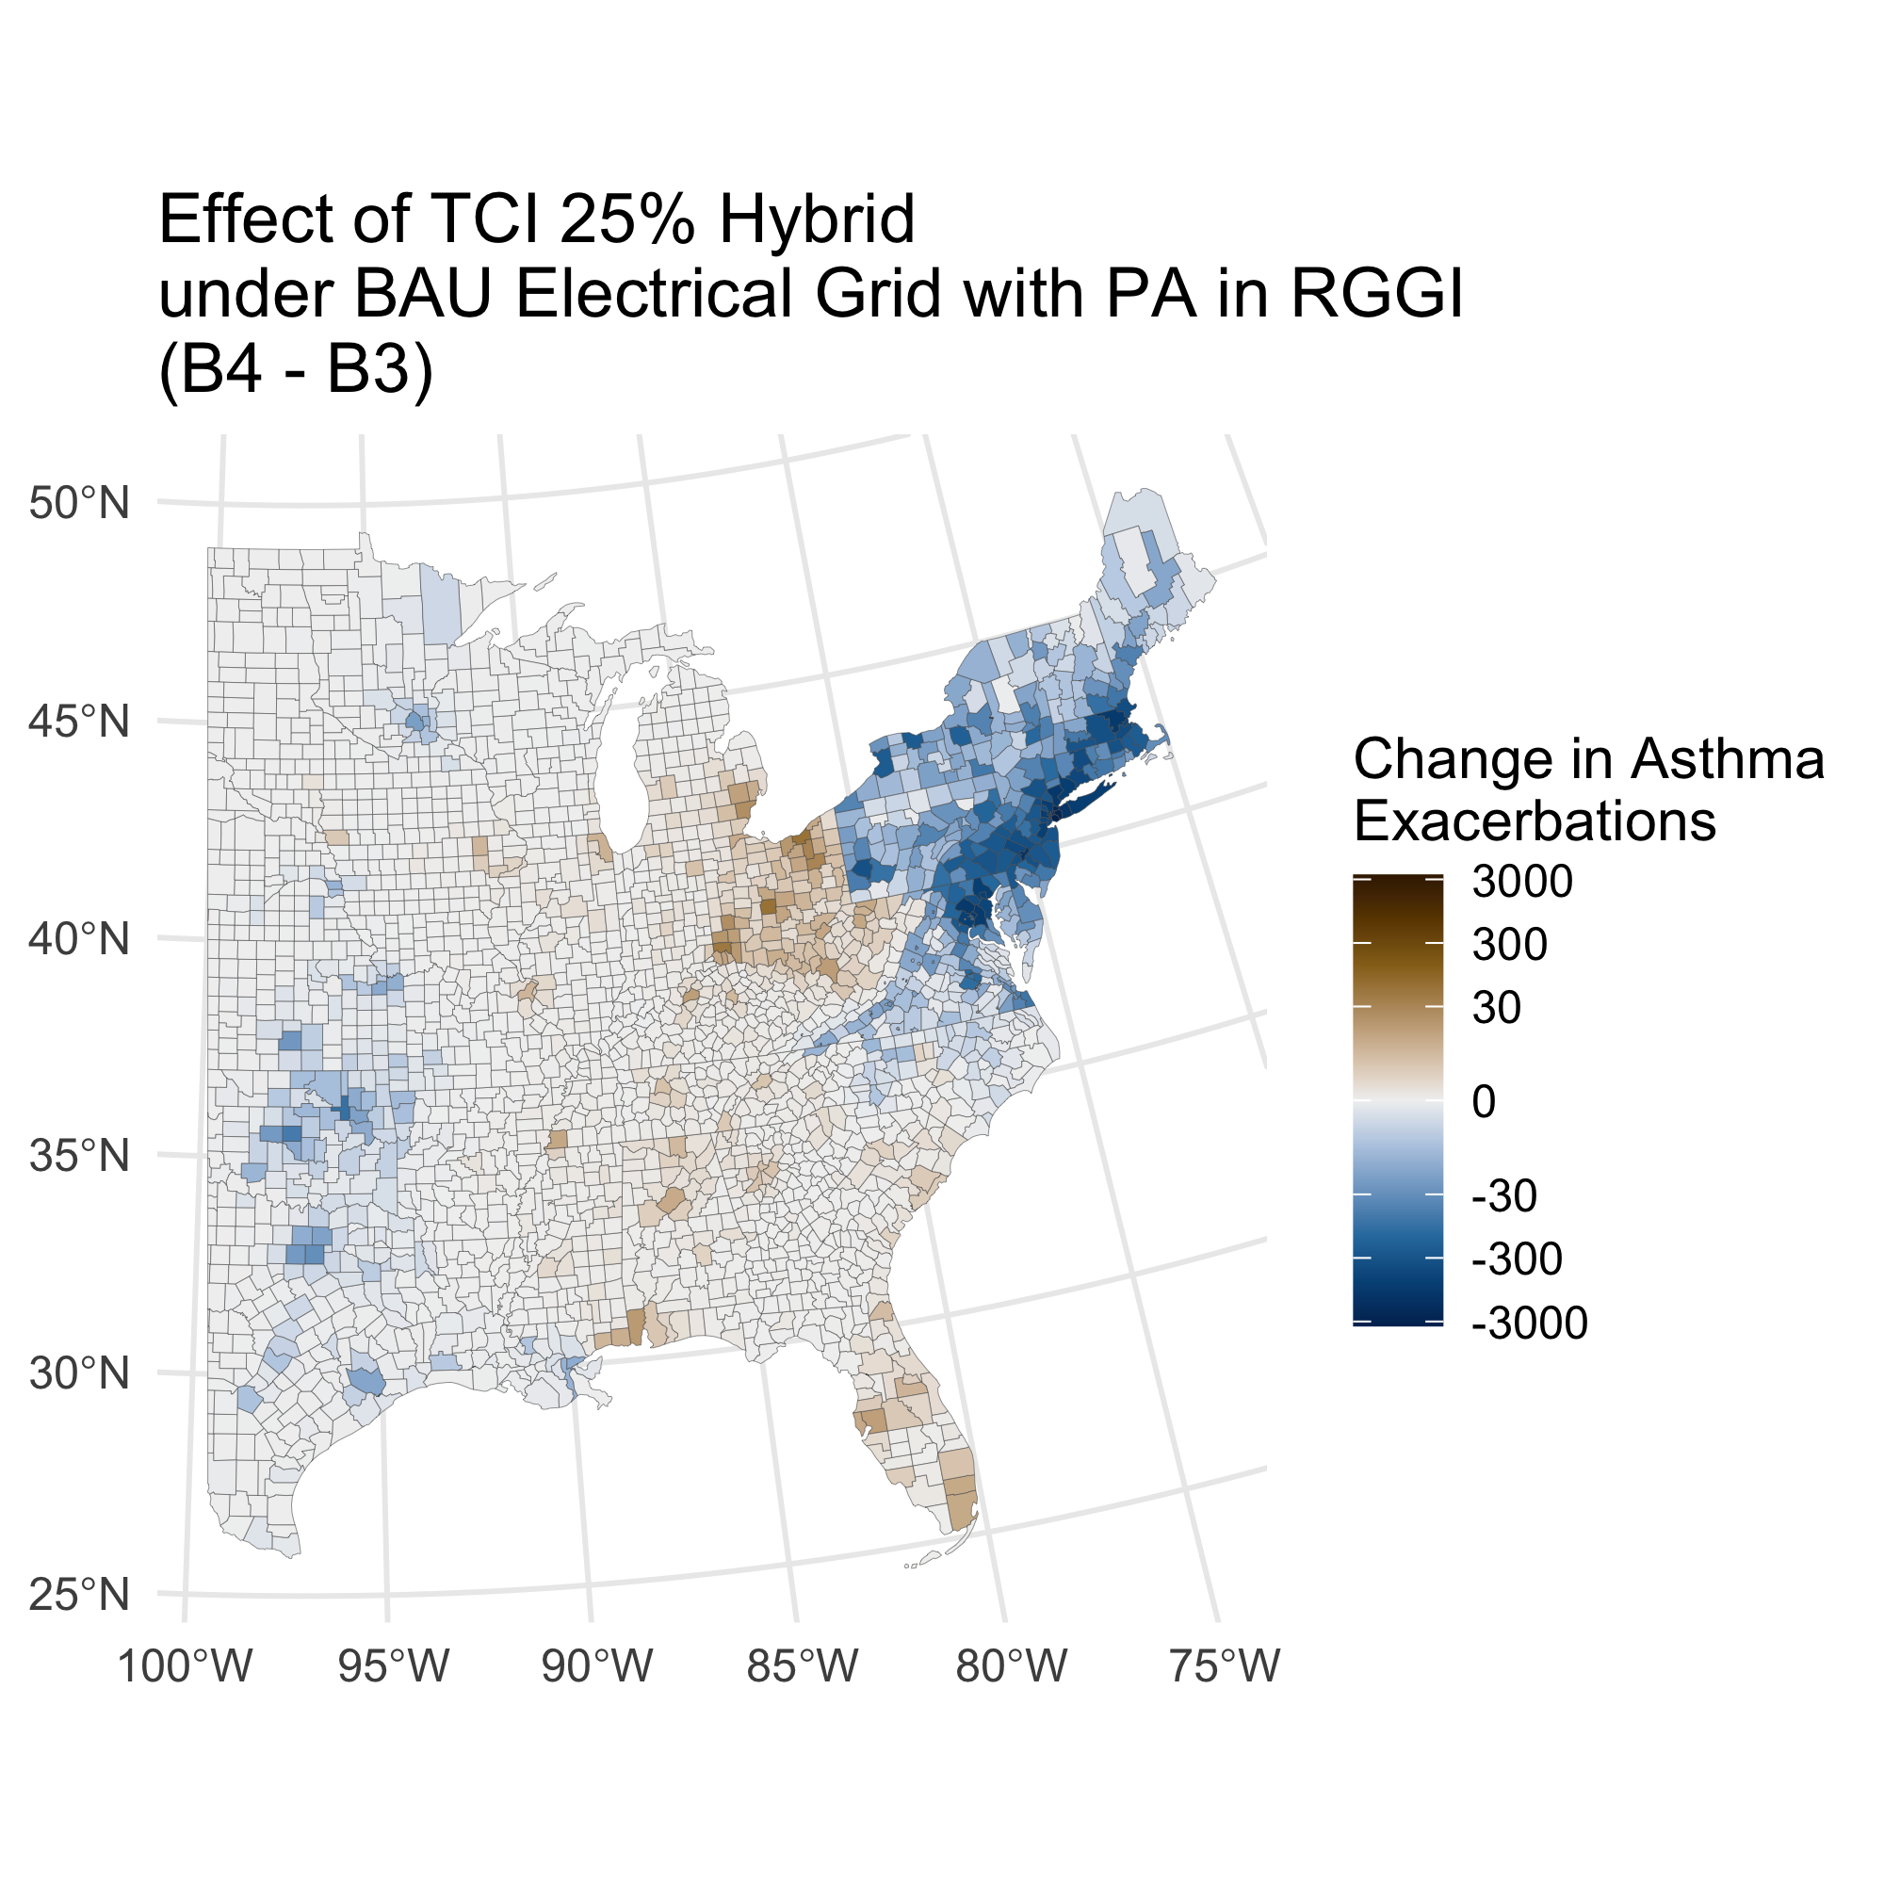
B4 – B3: Effect of TCI 25% Hybrid under BAU Electrical Grid with PA in RGGI
Total Deaths: -370 (-200 - -580)
Total Asthma Exacerbations: -43,000 (-1,100 - -85,000)
Mortality based value: -3,900 Mil. USD (-1,200 - -8,500)
+
-
-
+

Slide 11
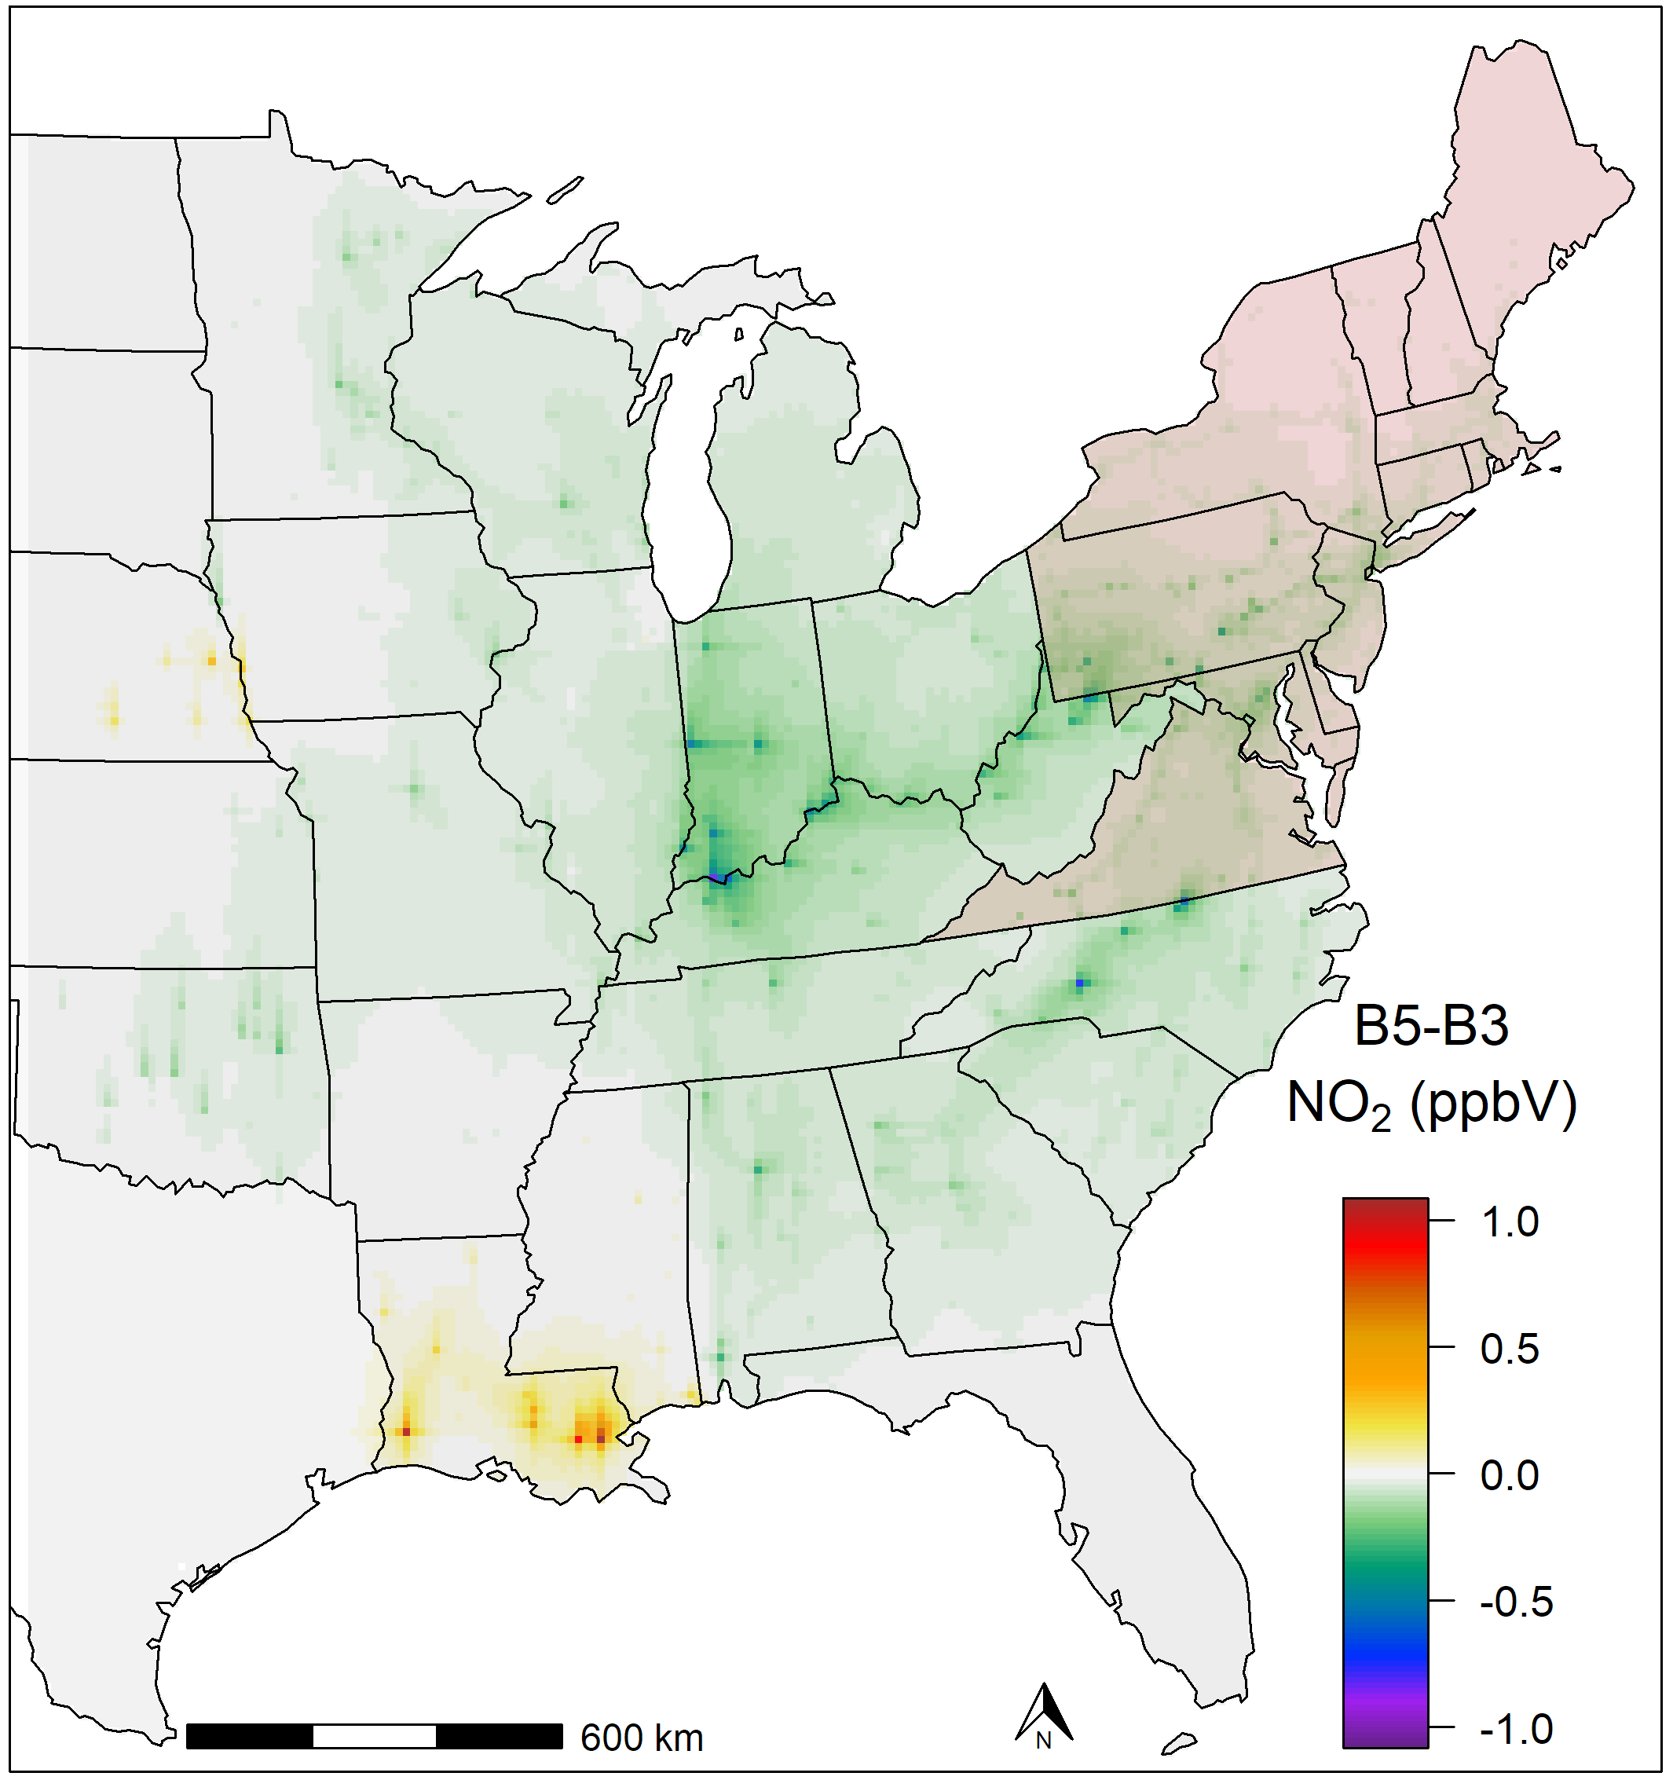
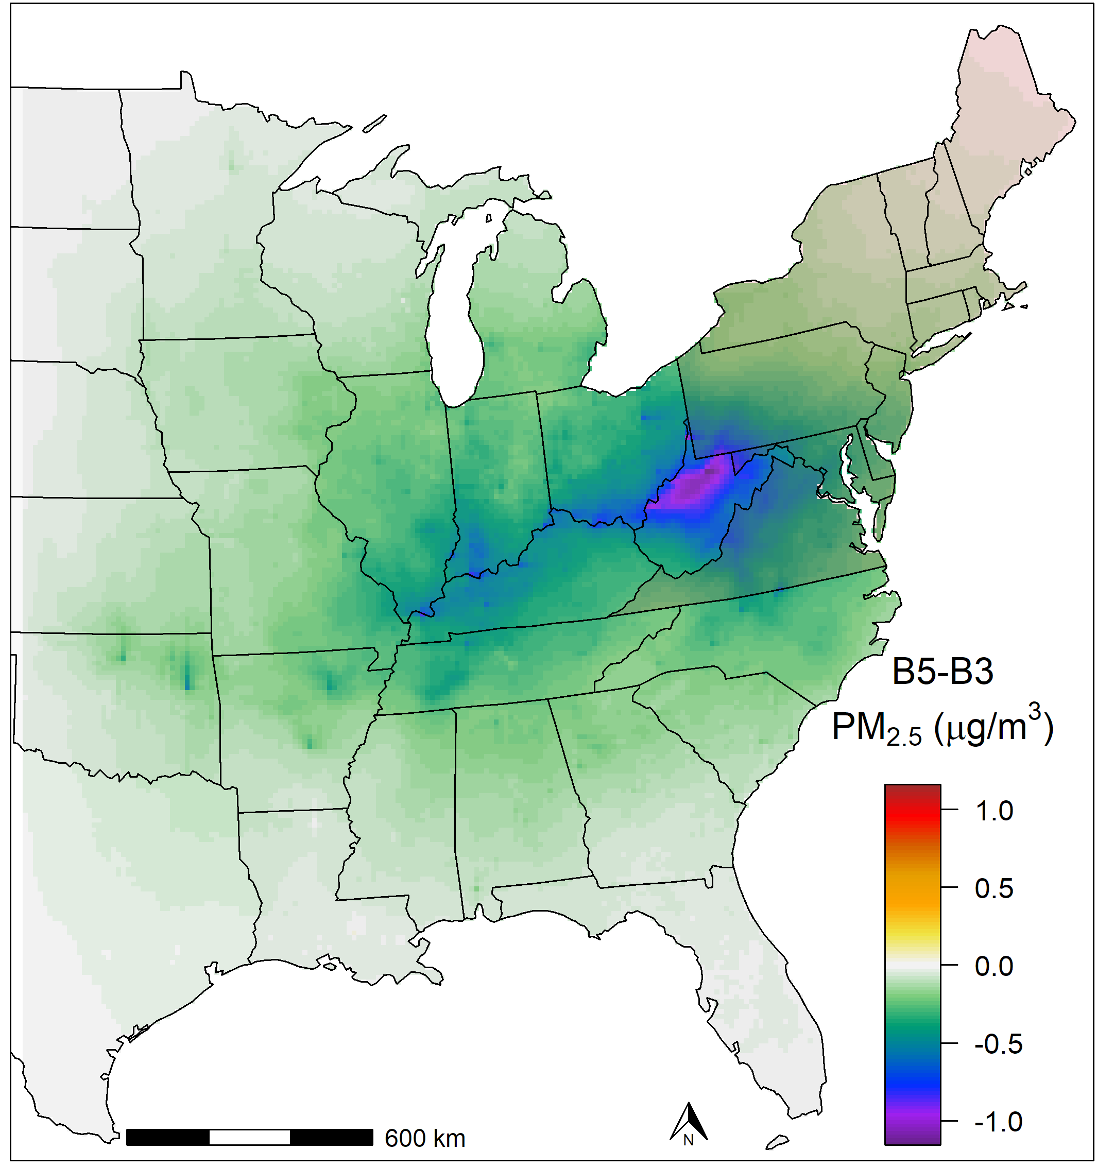
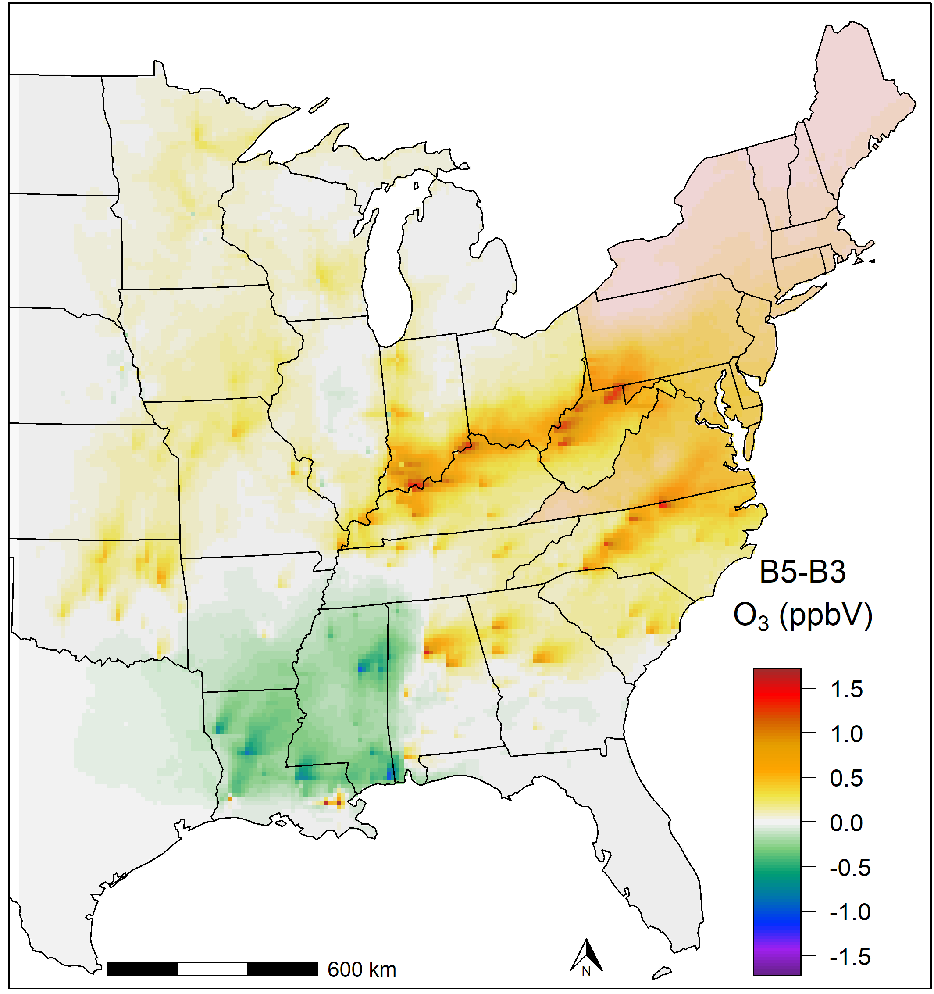
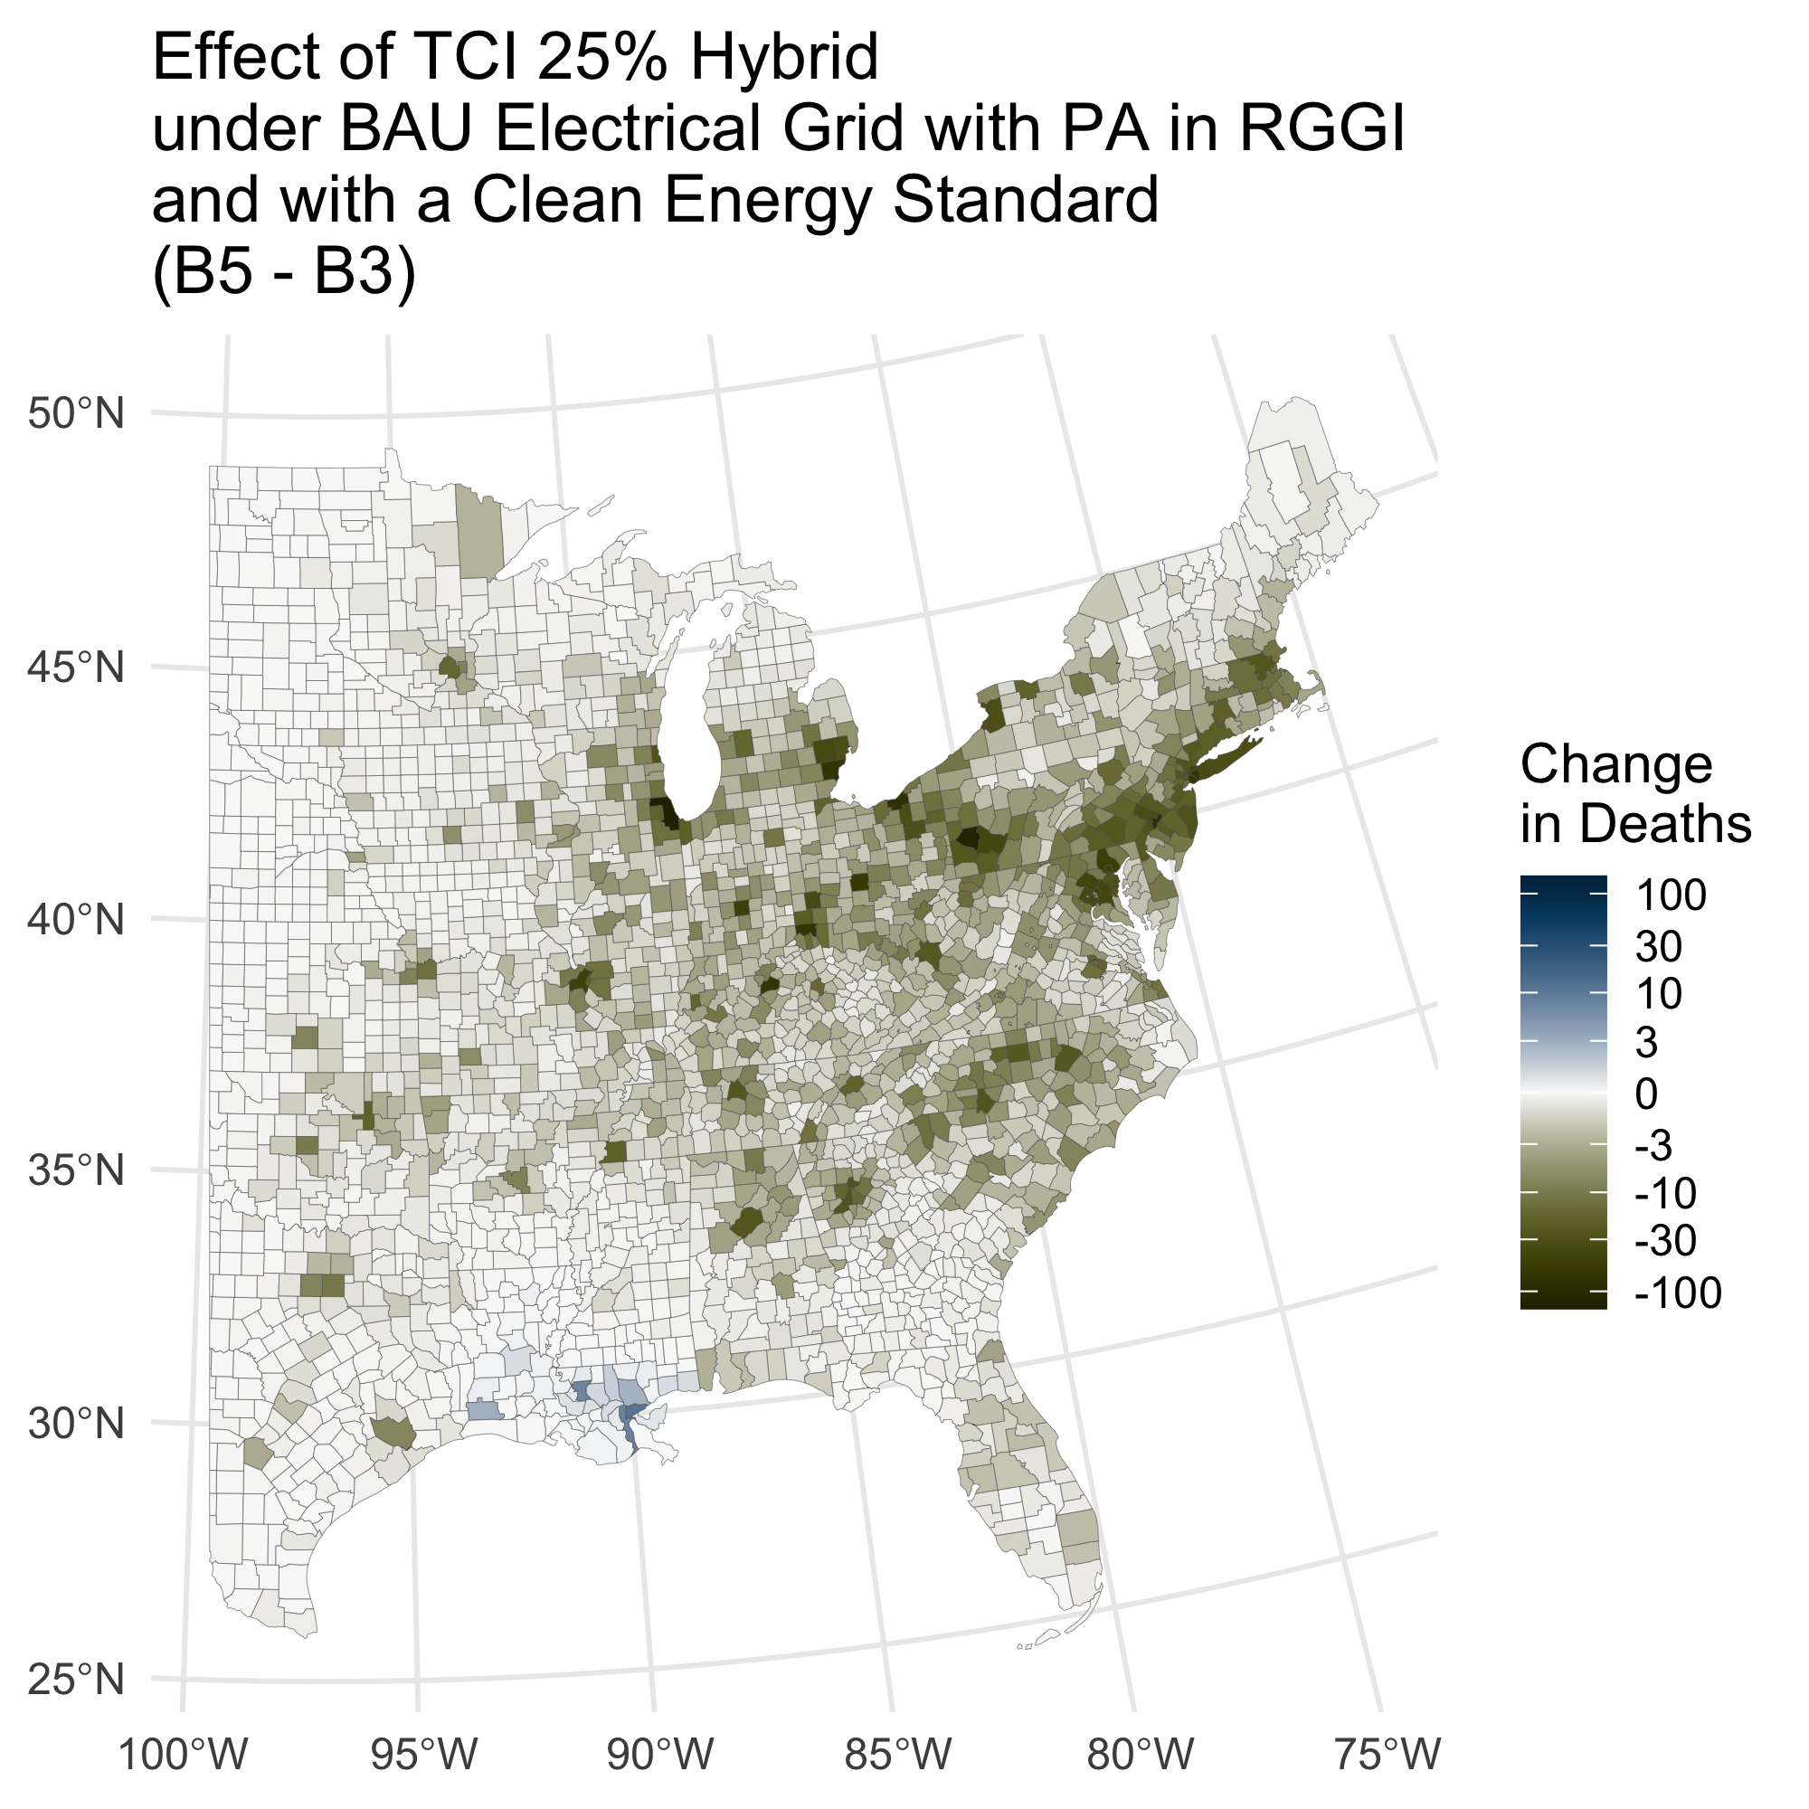
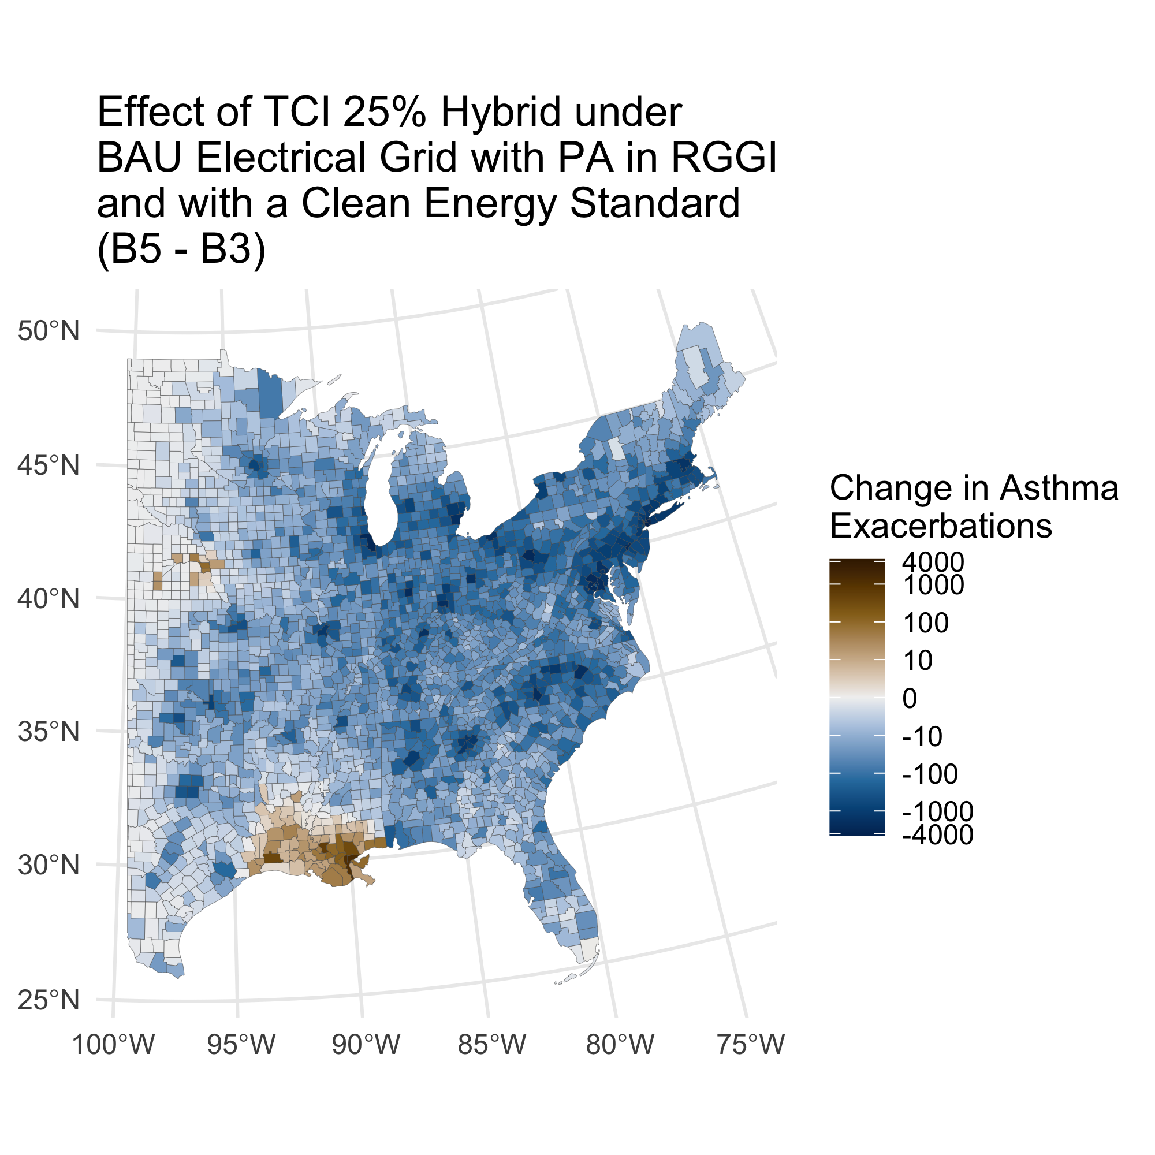
B5 – B3: Effect of TCI 25% Hybrid and a Clean Energy Standard in a BAU Electrical Grid With PA in RGGI
Deaths: -6,700 (-5,200 - -8,500)
Asthma Exacerbations: -230,000 (-2,800 - -460,000)
Mortality based value: -69,000 Mil. USD (-32,000 - -120,000)
-
-
-

Slide 12
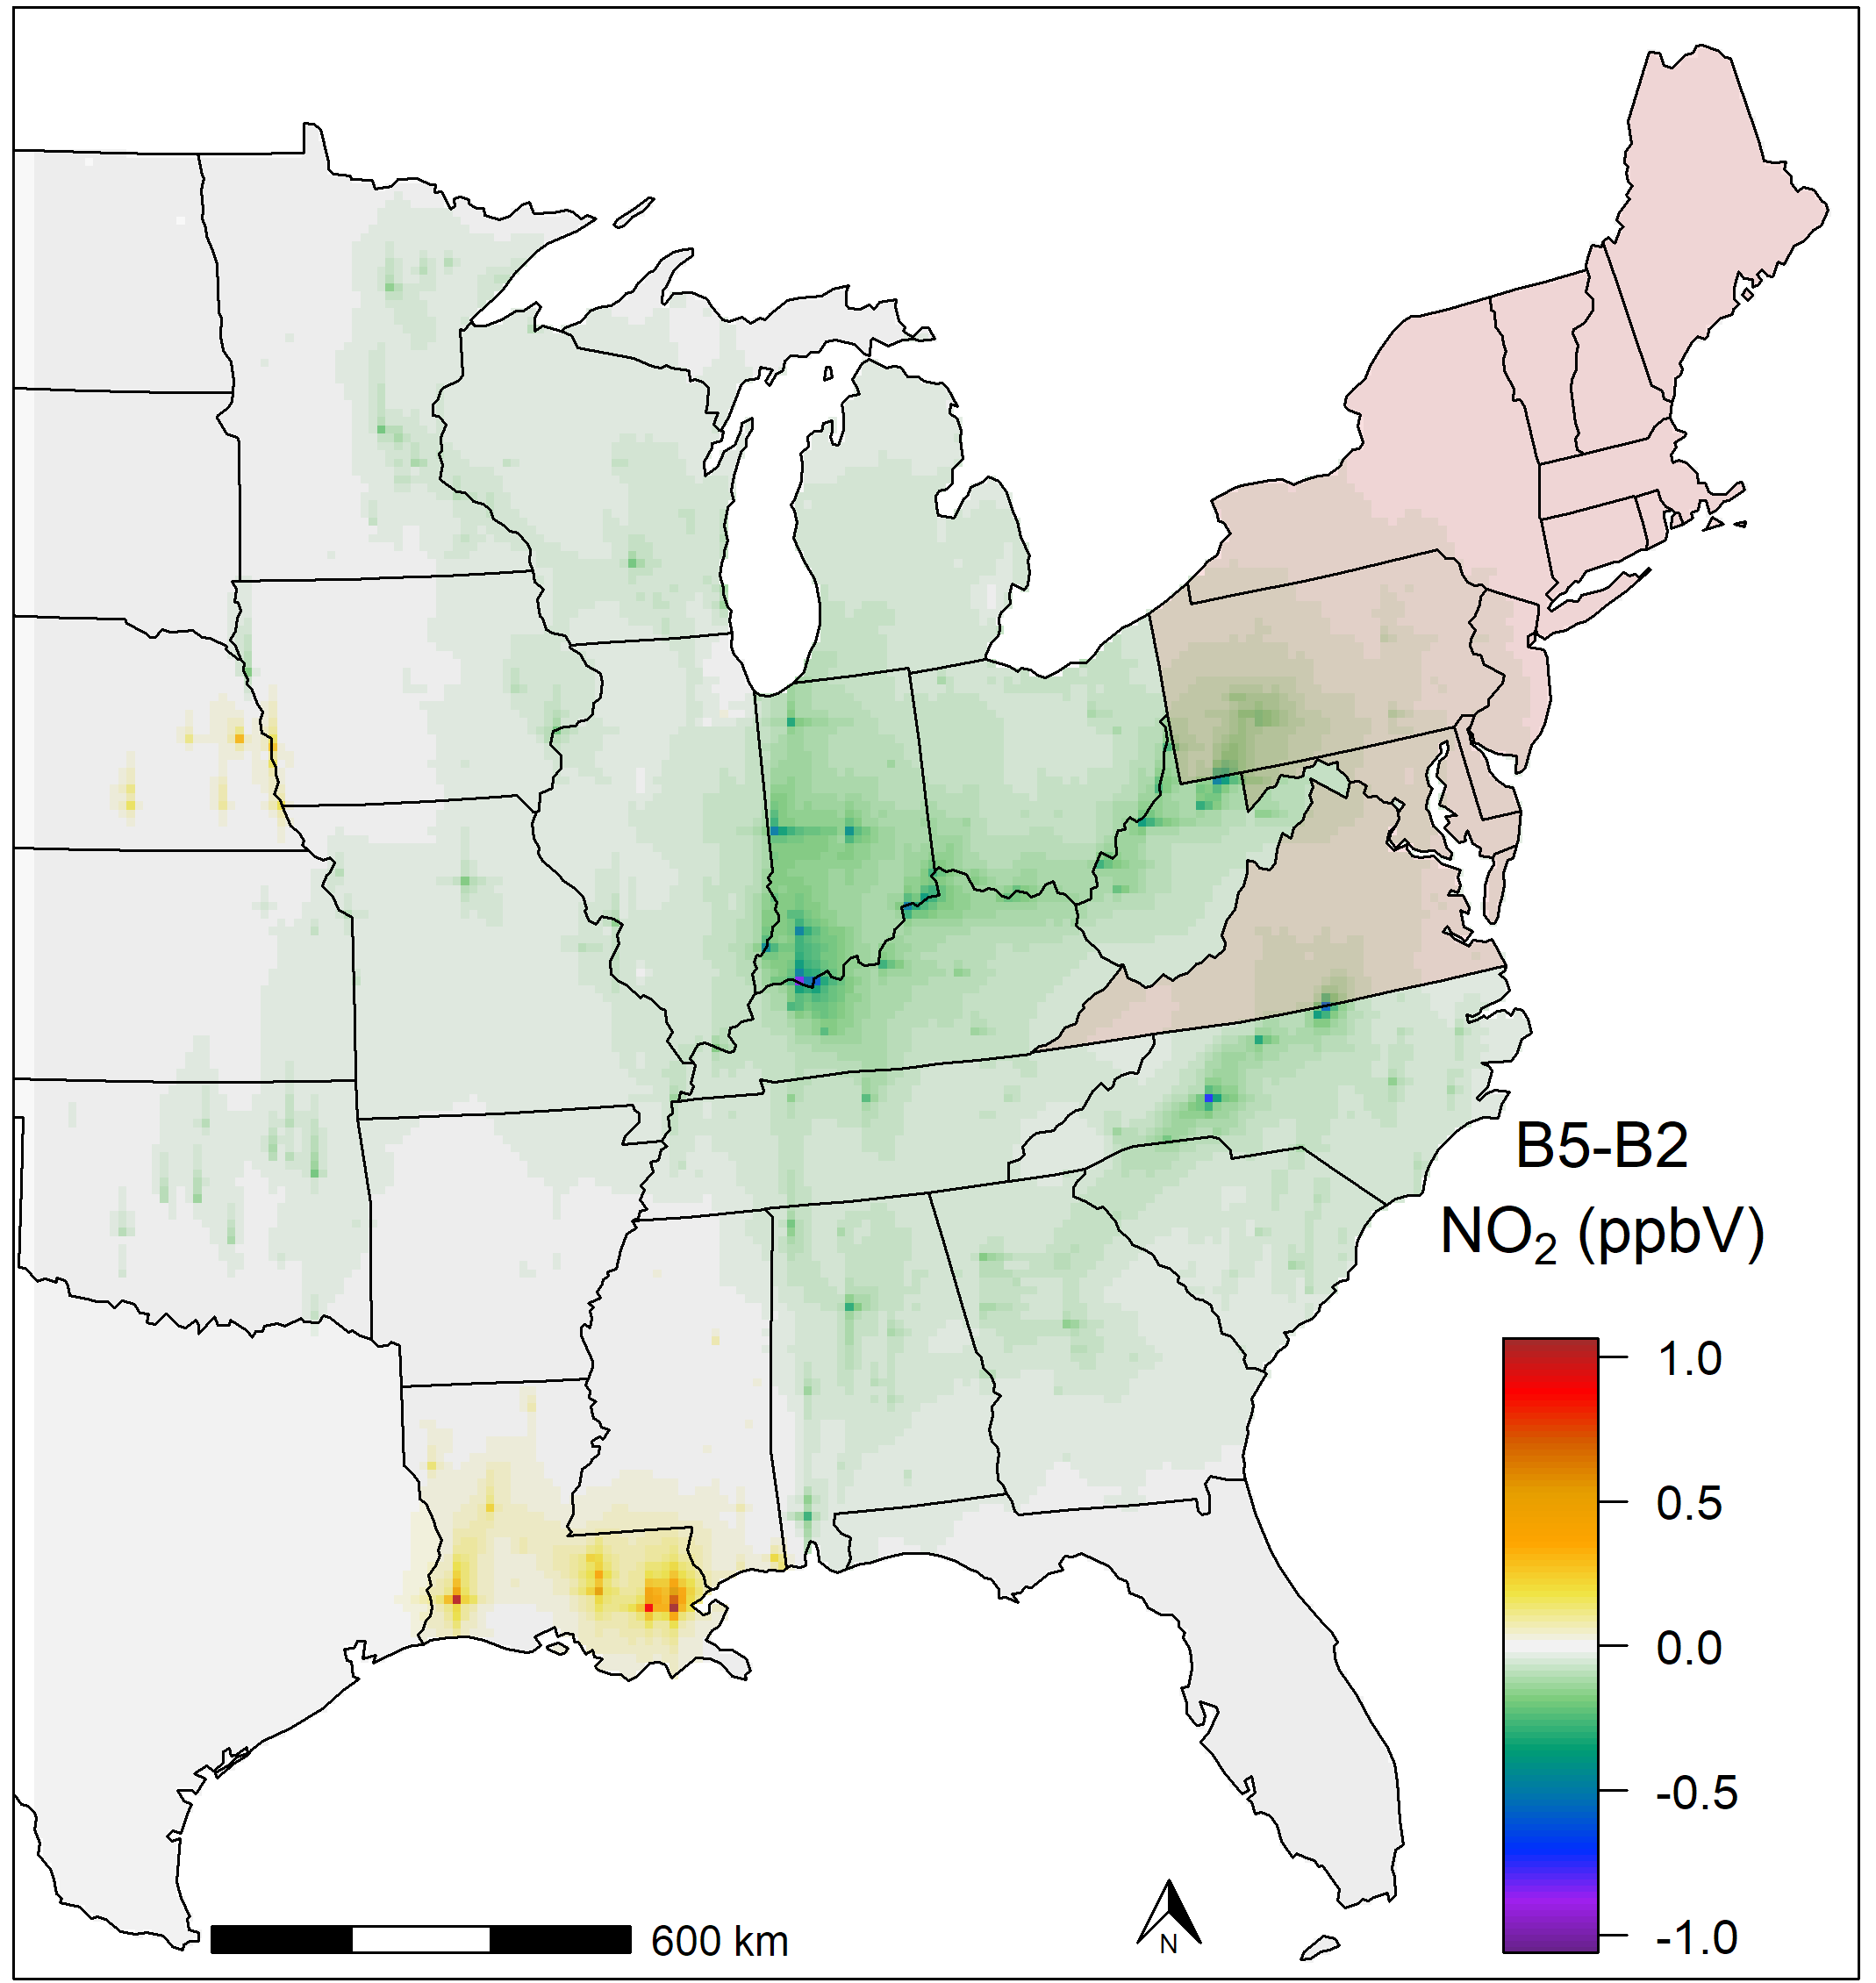
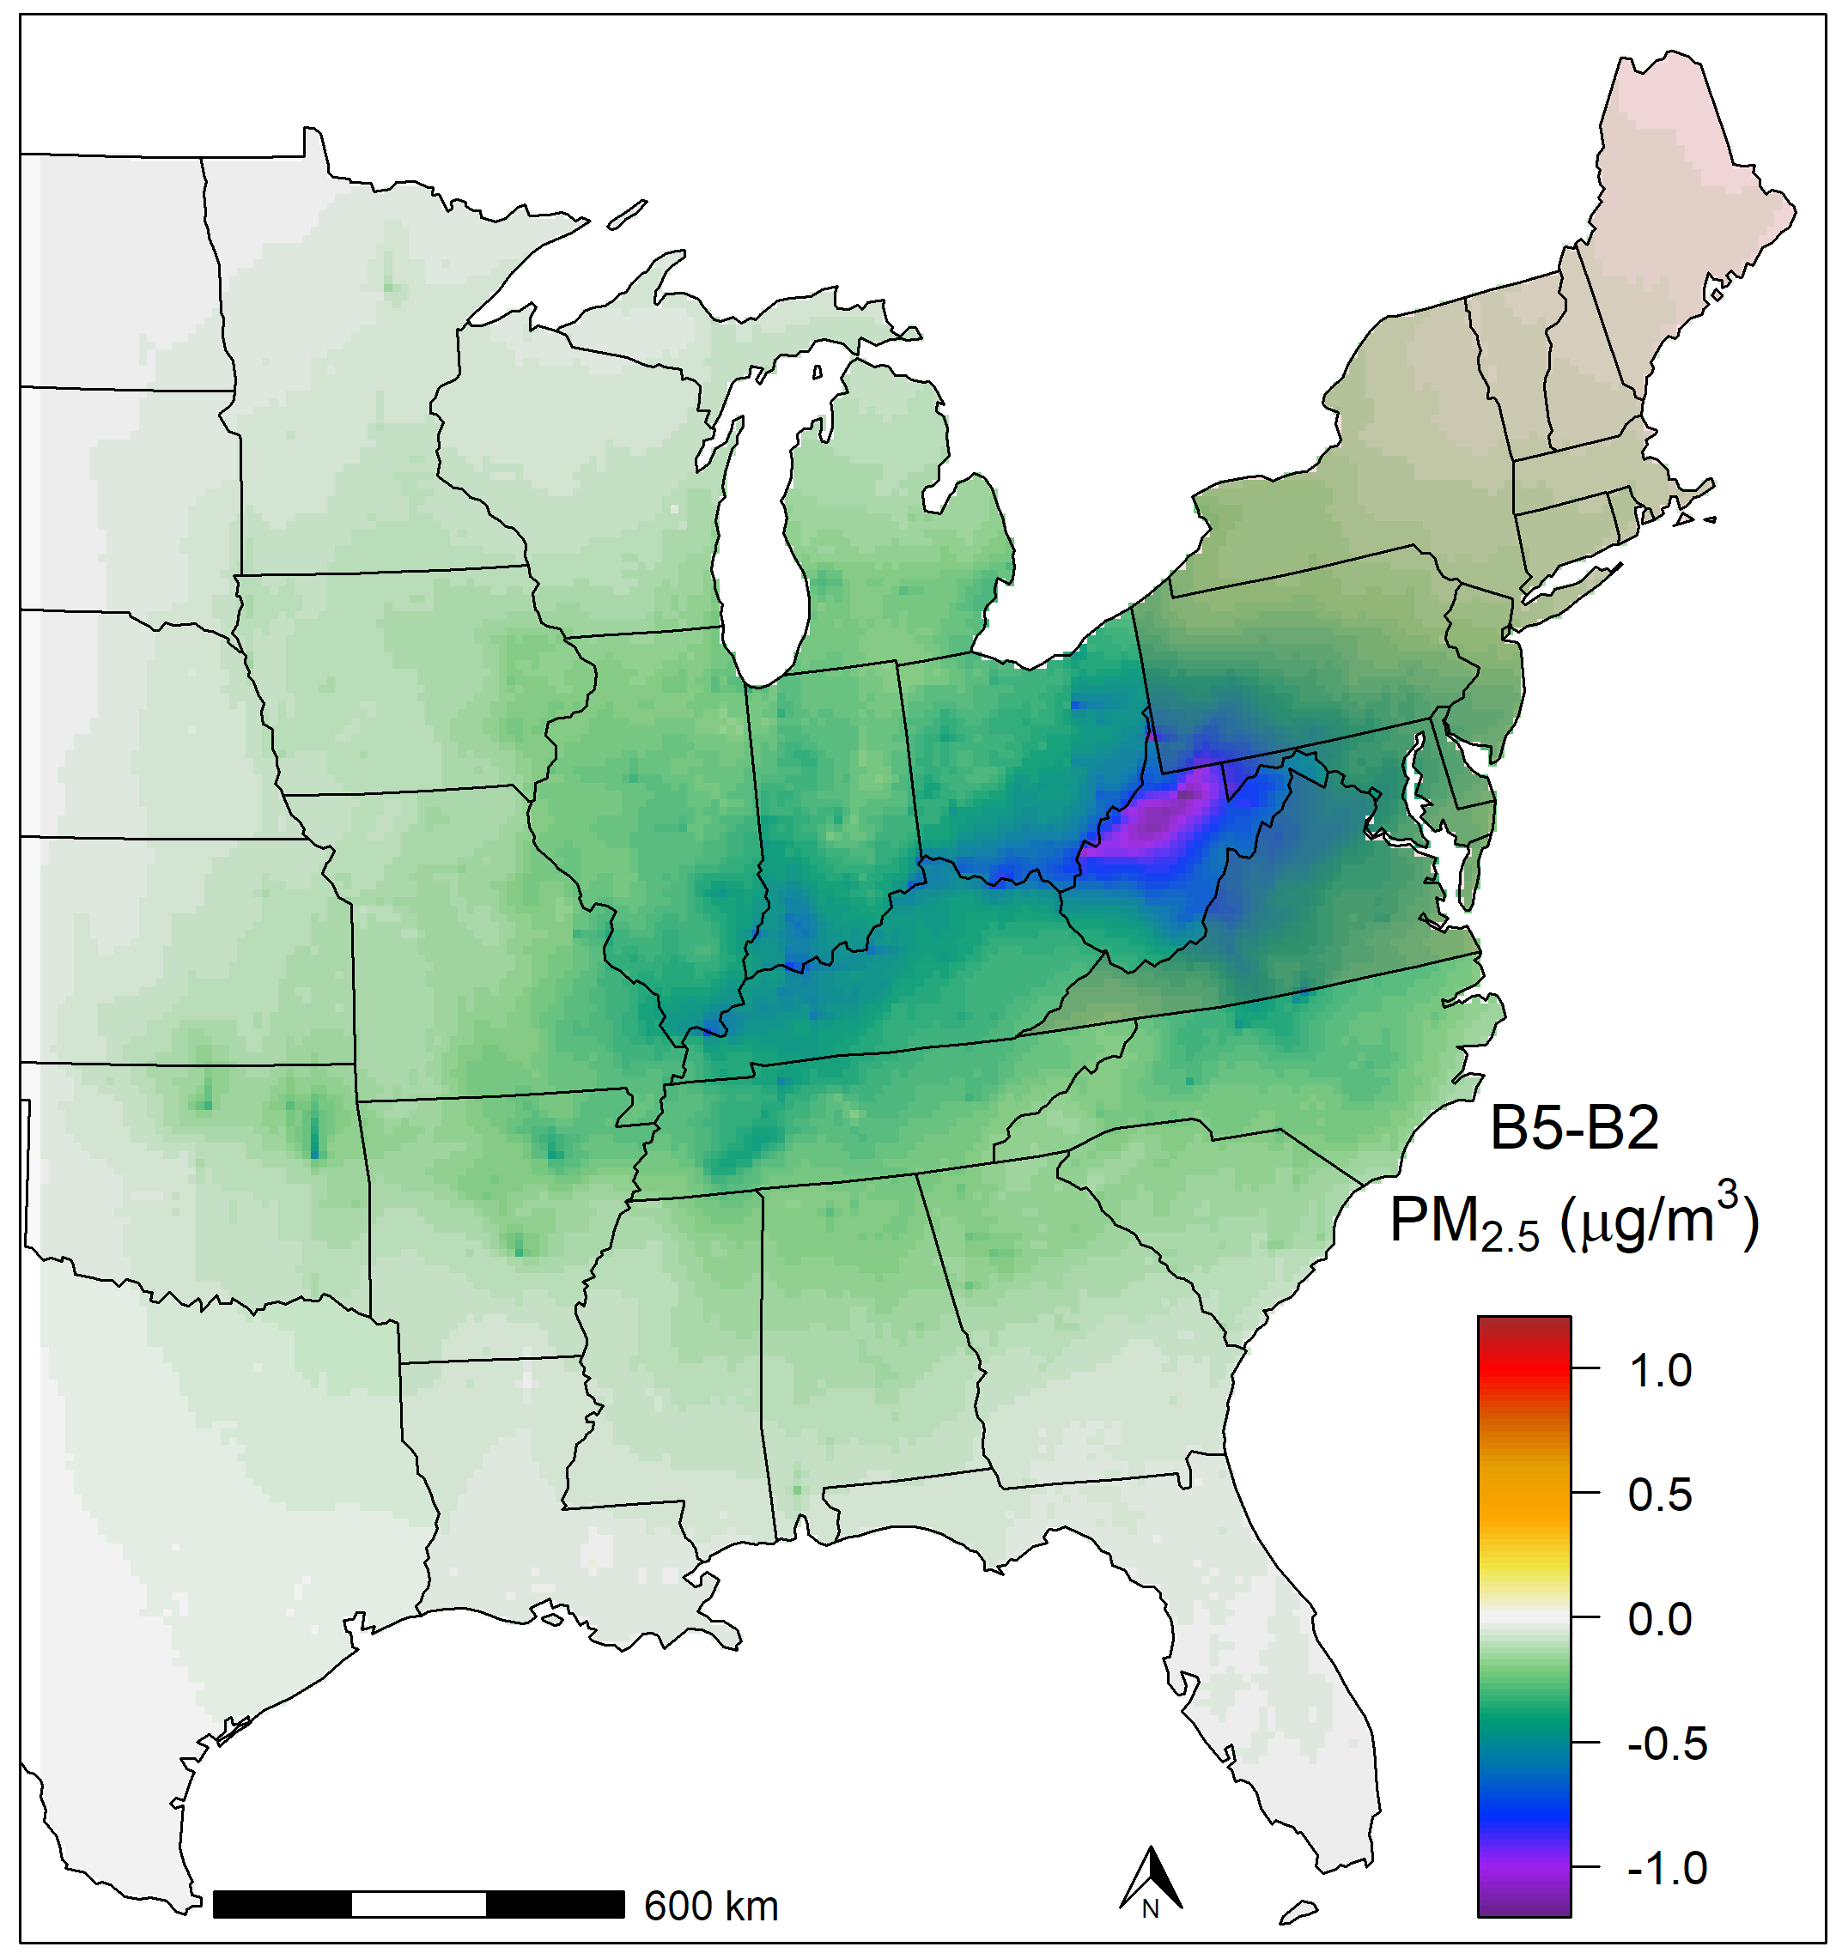
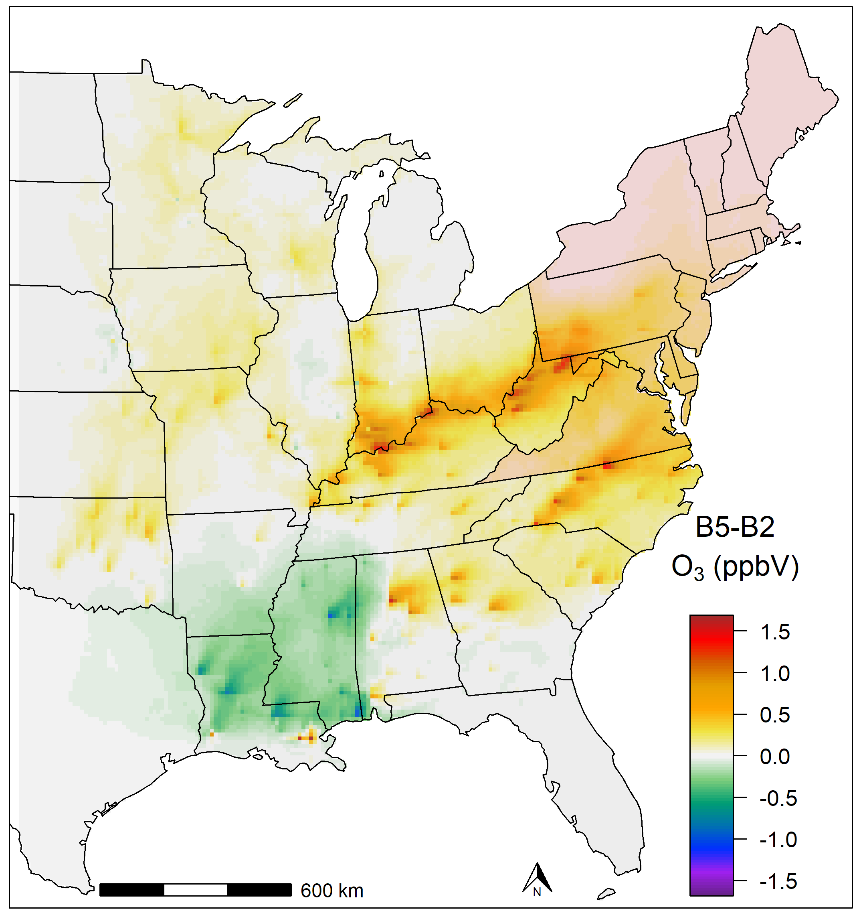
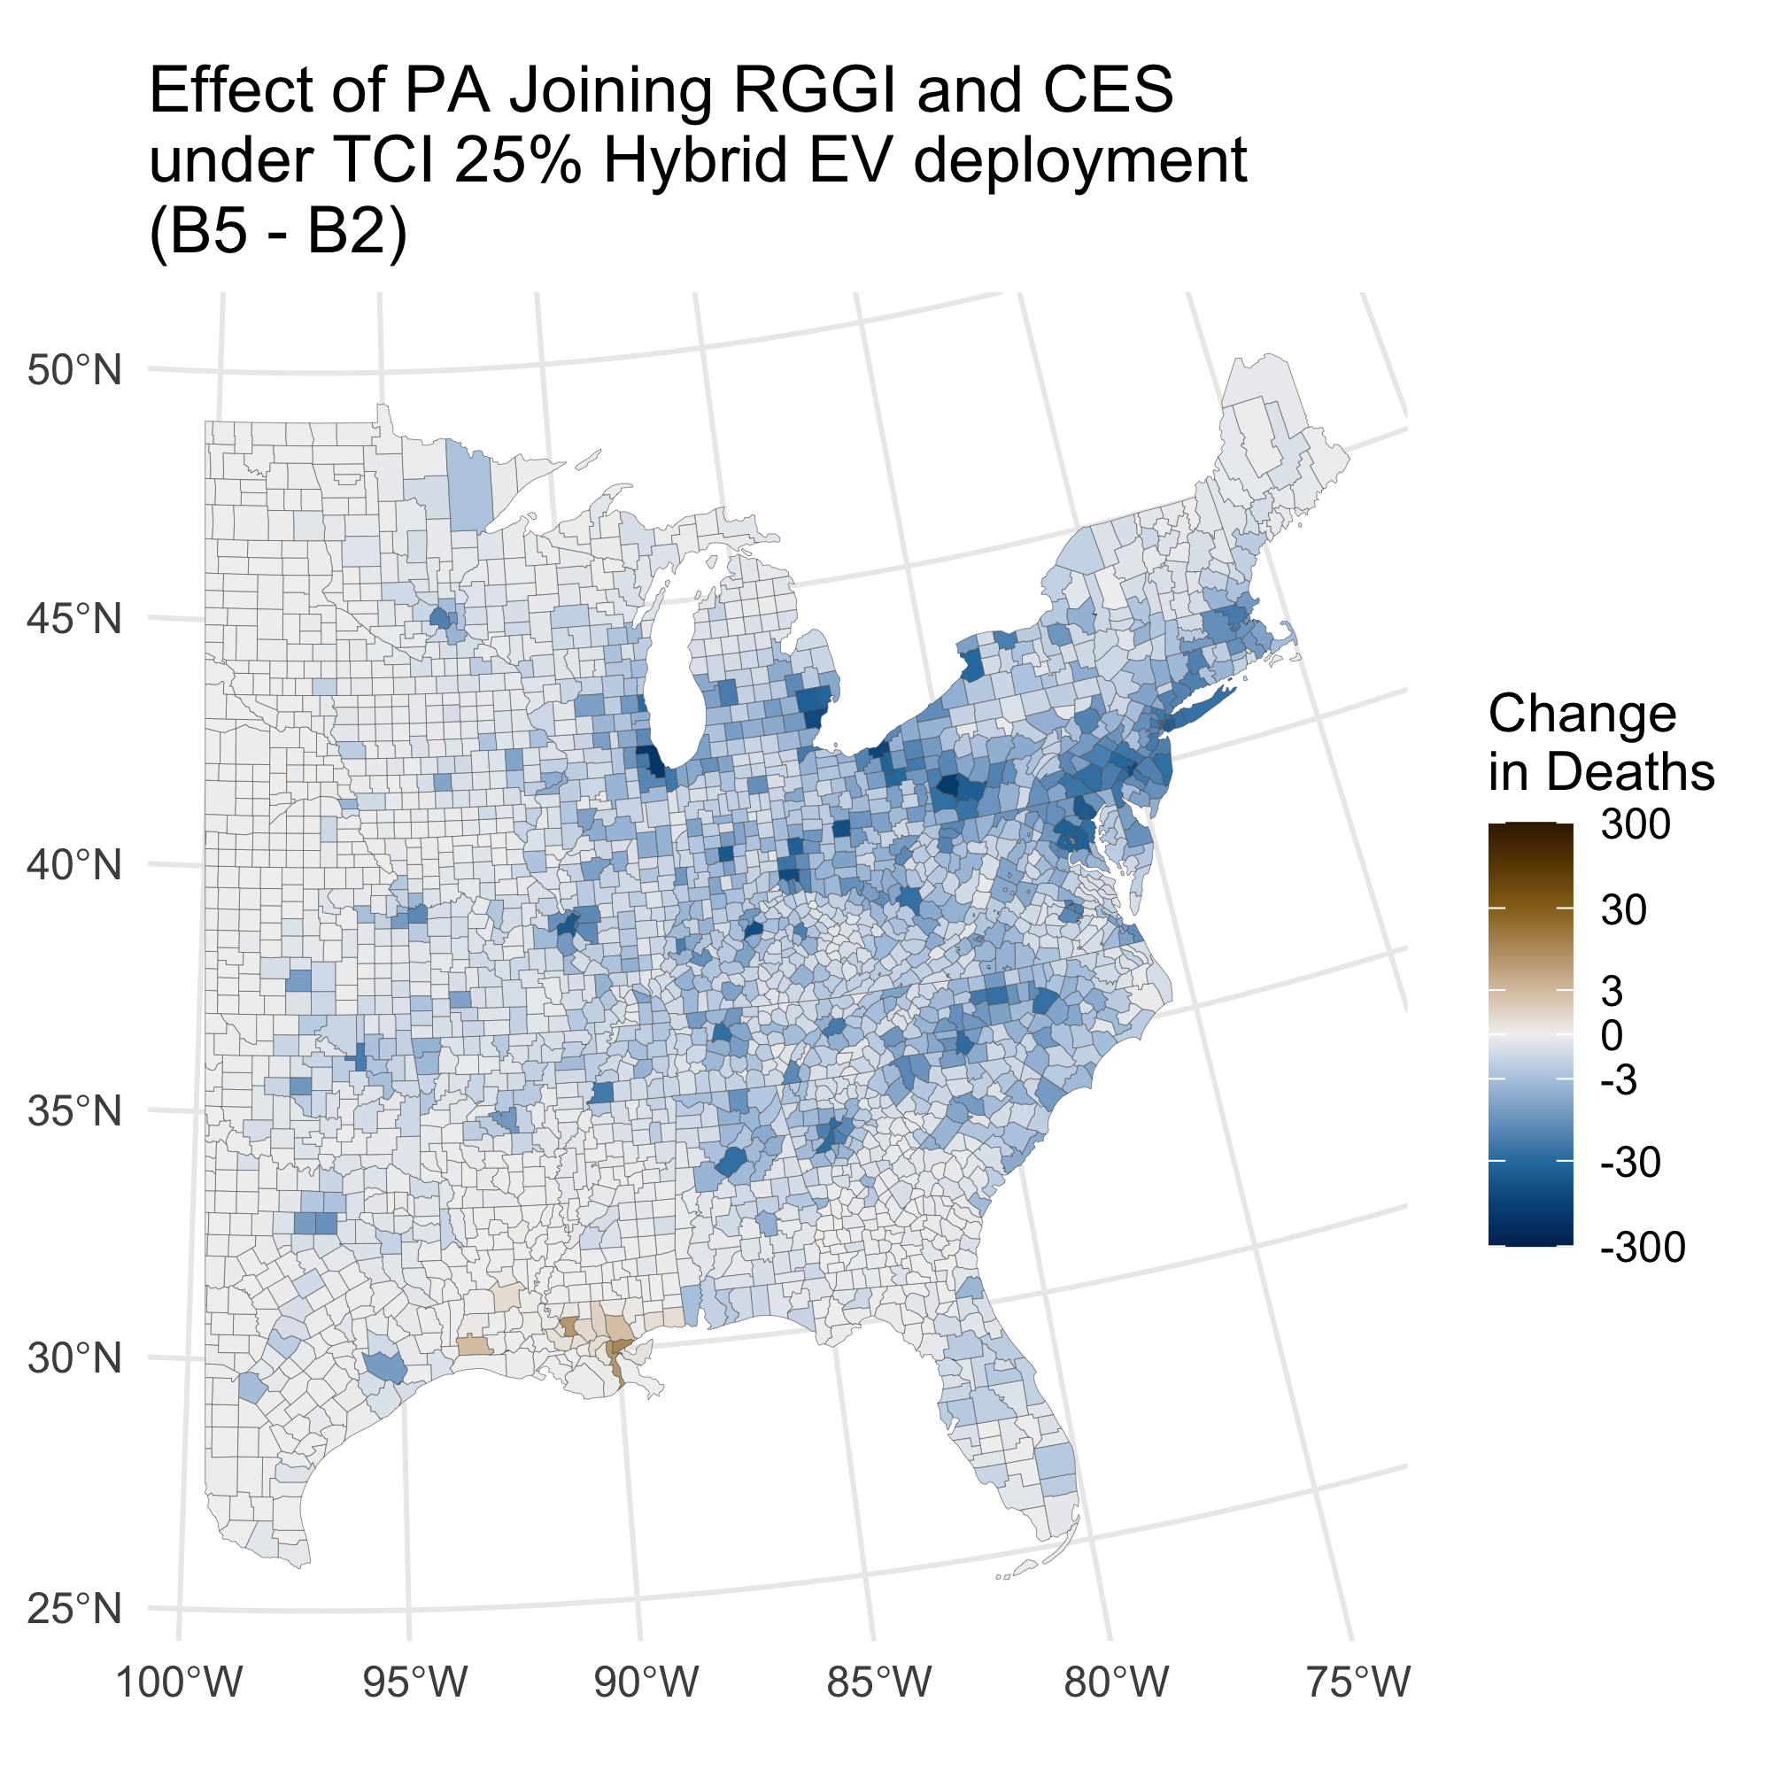
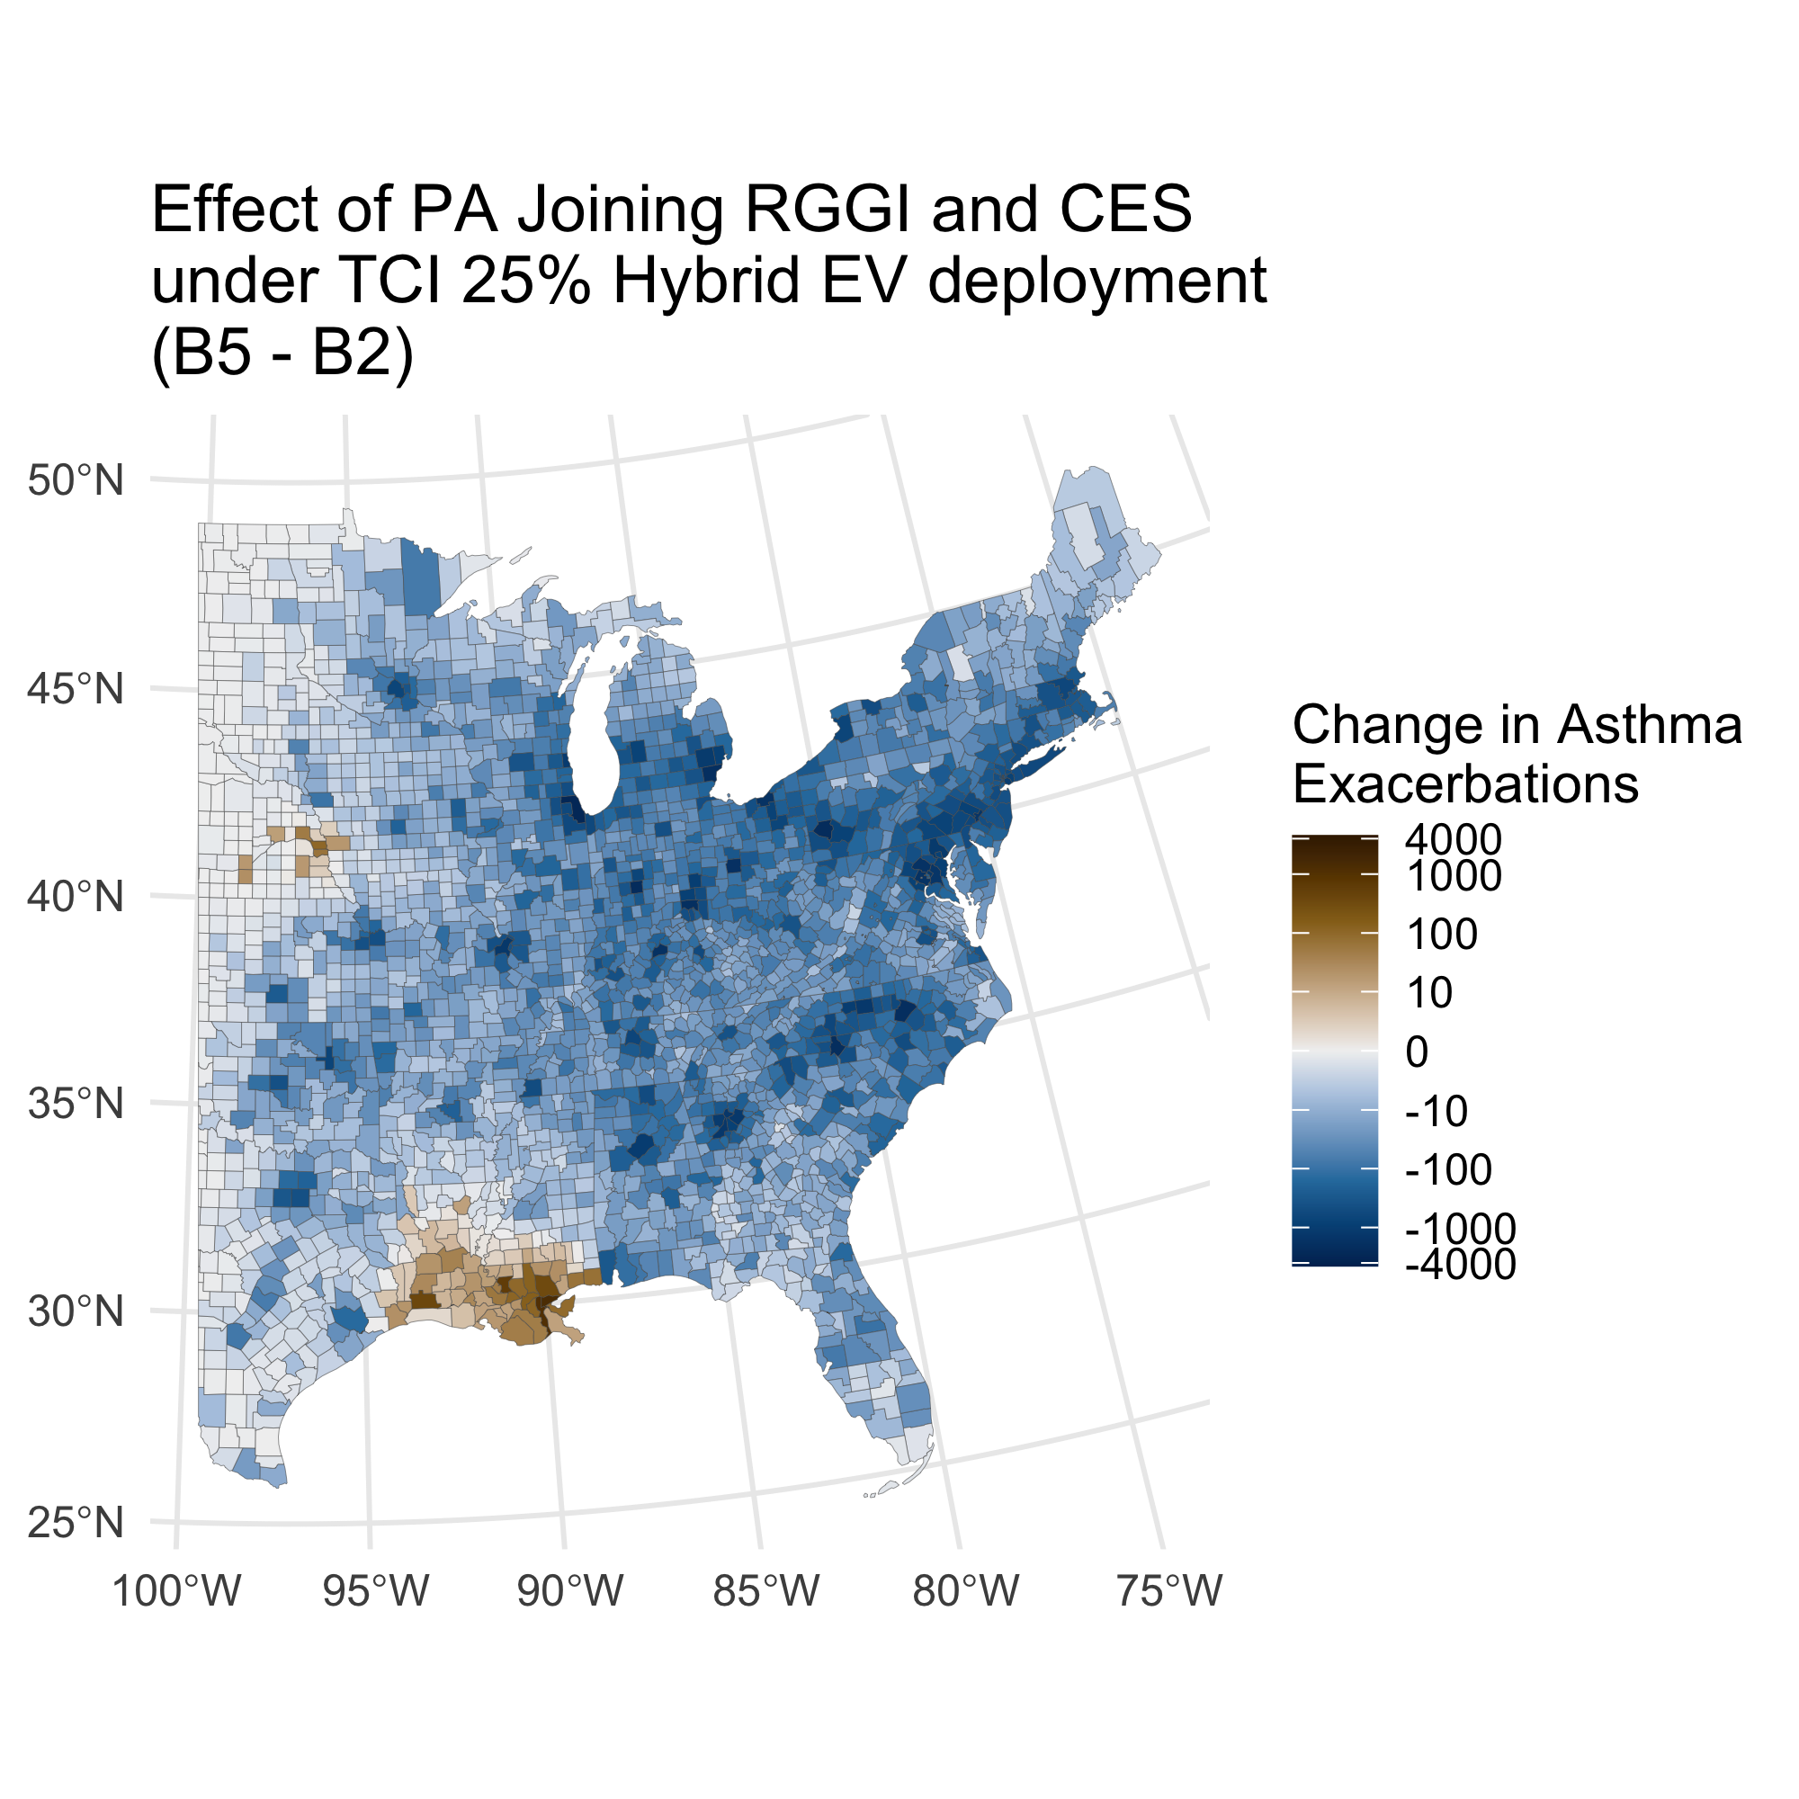
B5 – B2: Effect of PA joining RGGI and CES under TCI 25% Hybrid EV deployment
Total Deaths: -6,400 (-5,000 - -8,000)
Total Asthma Exacerbations: -190,000 (-1,900 - -380,000)
Mortality based value: -65,000 Mil. USD (-31,000 - -120,000)
-
-

Slide 13
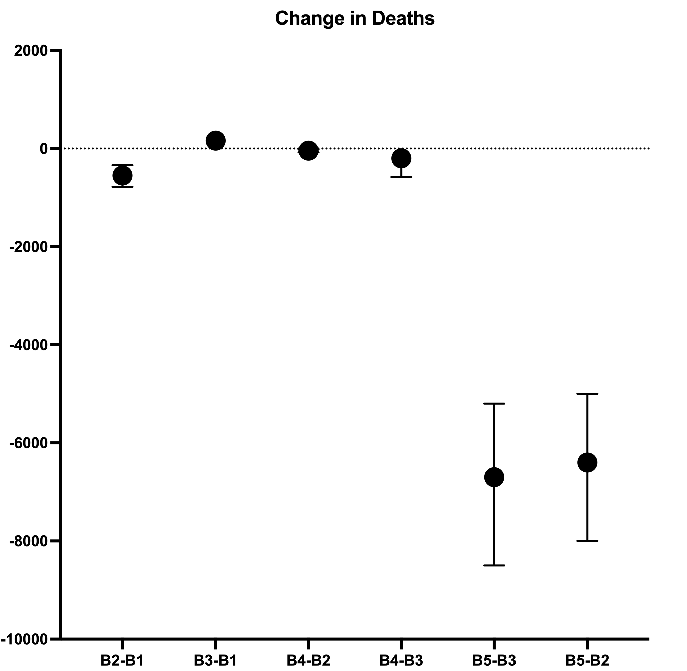
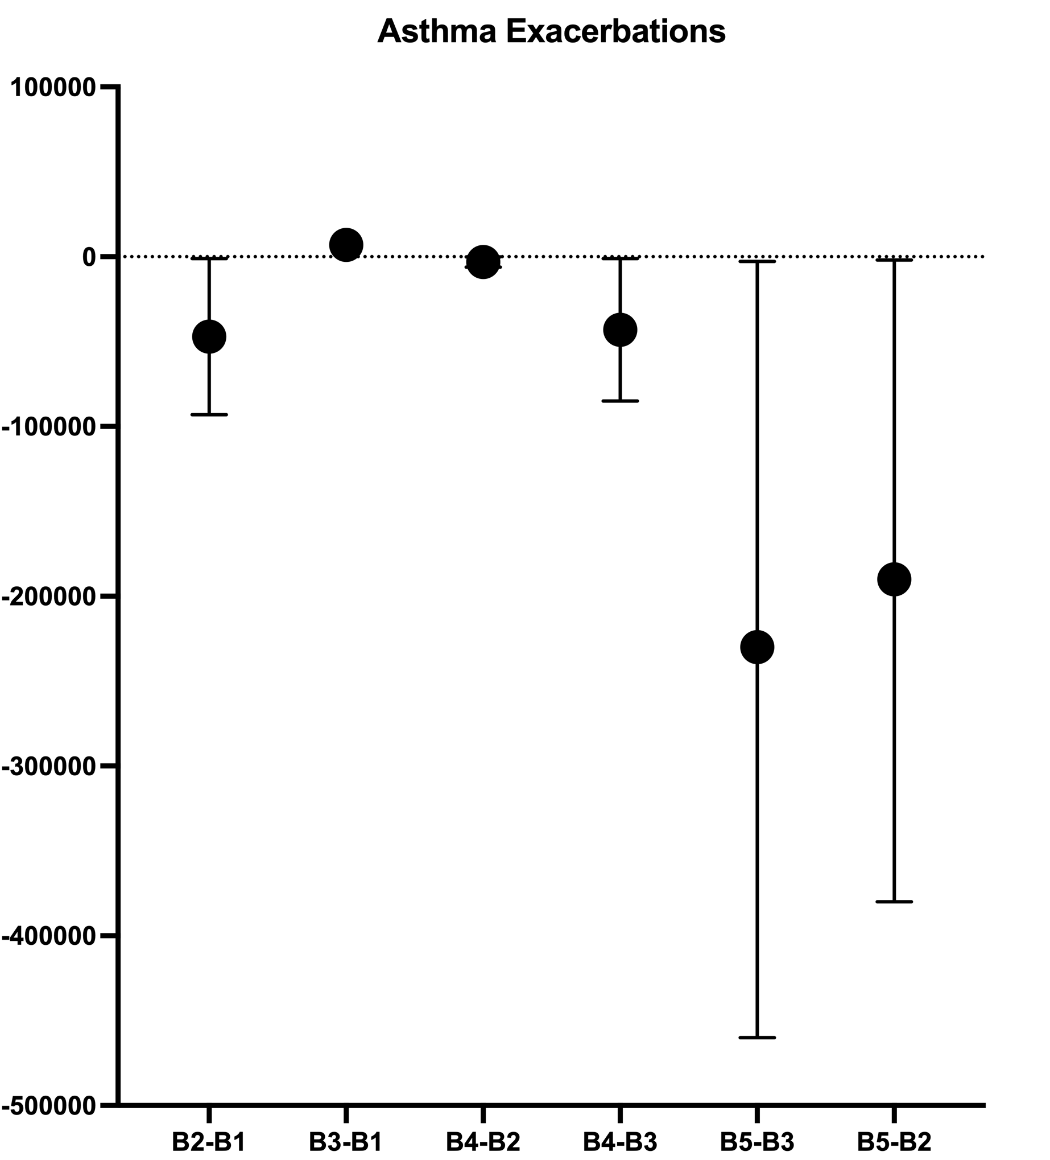
Health Impacts Comparison
Disbenefits
Benefits
B2 – B1: Effect of TCI 25% Hybrid EV under BAU Electrical Grid with PA not in RGGI
B3 – B1: Effect of PA joining RGGI under BAU EV deployment
B4 – B2: Effect of PA joining RGGI under TCI 25% Hybrid EV deployment
B4 – B3: Effect of TCI 25% Hybrid under BAU Electrical Grid with PA in RGGI
B5 – B3: Effect of TCI 25% Hybrid and CES in a BAU Electrical Grid With PA in RGGI
B5 – B2: Effect of PA joining RGGI and CES under TCI 25% Hybrid EV deployment

Slide 14
Summary
Key points:
Policies that evolve around the 25% Hybrid EV Portfolio have a significant positive effect on health co-benefits in the TCI region, while outside it:
With BAU Electric Grid, there are negative effects in Louisiana-Arkansas-Missouri
With PA entering RGGI, the positive effects weaken, and transmission shifts to Ohio, West Virginia
Departing from a BAU Electric Grid enhances the overall positive effects from vehicle electrification
PA joining RGGI has a mixed effect, depending on the degree of EV penetration
Under a BAU Electric Grid scenario, the effect is negative for TCI, Pennsylvania, Ohio River (small + in central states)
Under 25% Hybrid EV in TCI region, the effect is positive for TCI and PA, slightly negative for Ohio River (no TCI-EV)
Employing a CES has a drastic positive impact across most of the domain
Following the TCI 25% Hybrid portfolio results in additional health benefits
Transmission affects negatively Louisiana and Nebraska (Pennsylvania’s entry in RGGI reduces that to some degree)
Future work:
Tighter coupling of IPM with SMOKE with updated inventories using hourly FF10 file inputs
Include heat-based method for projecting state-level IPM estimates to pollutants other than NO_{x} and SO₂

Slide 15
Acknowledgments
Barr Foundation and Energy Foundation for funding the TRECH study Phase 1 and 2
The TRECH Study is an independent research effort with a collaboration between:
C-CHANGE, Harvard University T.H. Chan School of Public Health
Institute for the Environment, University of North Carolina at Chapel Hill
Dept. of Environmental Health, Boston University School of Public Health
Columbia Center for Children’s Environ. Health at Columbia University Mailman School of Public Health

