Slide 1

Integrating climate and health impacts in China’s power system operations
Qian Luo
PhD candidate advised by Drs. Jeremiah Johnson and Fernando Garcia Menendez
Department of Civil, Construction, and Environmental Engineering
North Carolina State University
Notes:
Good afternoon, everyone. My name is Qian Luo and I am a PhD candidate at North Carolina State University. My advisors are Drs. Jeremiah Johnson and Fernando Garcia Menendez. Today, I will talk about how to Integrate climate and health impacts in China’s power system operations

Slide 2
Power sector in China
1 M air pollution-related mortalities
30% of global CO2 emissions
10%
40%
Coal dominated
  High CO2 emissions
  Negative health impacts
Highly regulated power systems
  Equal share dispatch
  Generation efficiency is not maximized
Carbon neutrality goal by 2060
  Earlier zero emission target in the power sector
Electricity generation in China
Notes:
Here is a brief introduction of the power sector in China. First of all, it is coal dominated, releasing a lot of CO2 and other air pollutant emissions. As one of the biggest developing countries, China contributes 30% of global CO2 emissions and 40% of China’s emissions are from electricity generation. 10% of the air pollution associated mortalities in China are also caused by power plant emissions. The power system in China is highly regulated. To determine electricity generation from each power plants, China adopts “equal share” dispatch approach, under which power plants using similar fuels will be assigned similar running hours at the beginning of each year, to ensure the “fairness”. However, people are realizing that this approach does not maximize efficiency and planning to adopt market mechanisms. And the carbon neutrality goal by 2060 set by the Chinese government will strongly influence the power system planning in China. To ensure a steady transition in other sectors, the power sector is expected to achieve zero emissions earlier than 2060.

Slide 3
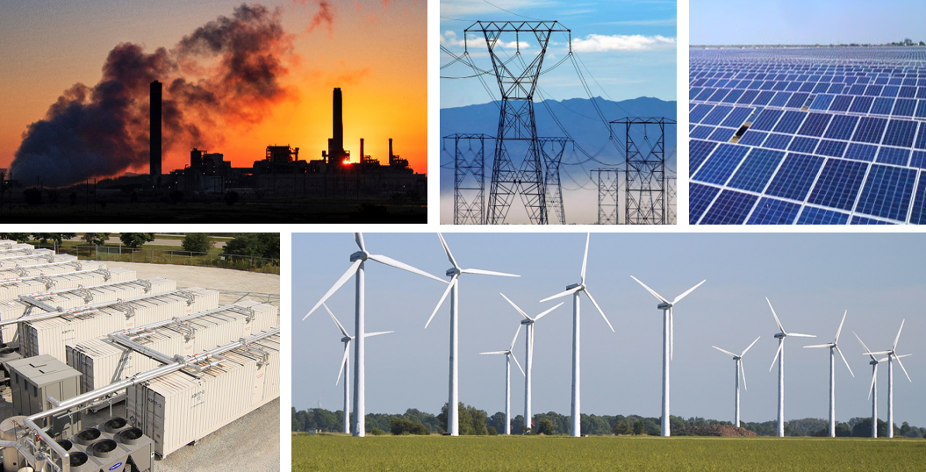
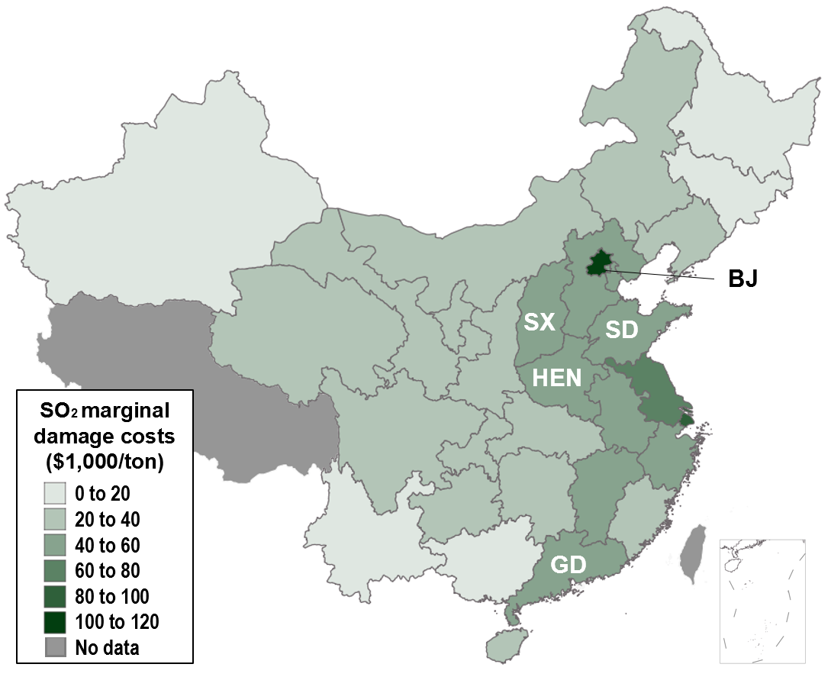
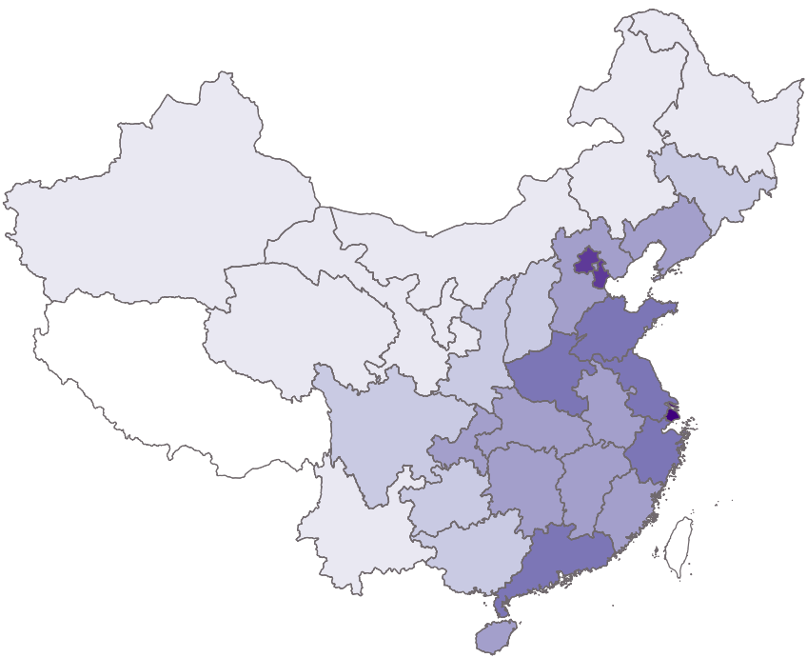































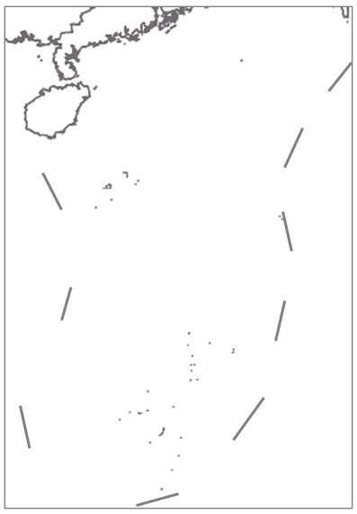

Emission externality internalization
Health damage costs ($/ton)
Health damage costs ($/MWh)
300
200
Emission damage costs ($/MWh)
100
0
Population
per km²
0 to 125
125 to 250
250 to 500
500 to 1000
1000 to 2000
2000 to 4000
No data
Value of statistical life is used to monetize health damages
Treat the health damage costs as part of system operational costs
Notes:
To mitigate negative impacts associated with power plant emissions, one major approach I am using is called emission externality internalization. I use one example here to demonstrate how I internalize health damages in power system models. First of all, I change the emission levels in different regions and run a reduced form air quality model, InMAP, multiple times to get the marginal health damages associated with one ton of air pollutant emissions. Then the value of statistical life is used to monetize those damages. Combining emission damage costs and emission rates at the generator level, I can get the health damage costs at dollar per MWh. The yellow boxplot on the right map shows the high variability of health damages at each electricity generating unit. The grey bars are for carbon ax. The last step is to treat the health damage or climate costs as part of the system operational costs, in the power system optimization model.

Slide 4
Power system modeling
Optimize system operations based on existing facilities
  Economic dispatch at the national level
  Minimize operational costs and emission externalities
    fuel and variable O&M + health and climate damage costs
  Look at year 2020
Plan for a decarbonized future
  Capacity expansion
  Minimize capital and operational costs with a carbon emission limit (costs from power plants and transmission lines)
  Plan for 2025 - 2050
Notes:
This work covers two aspects of China’s power system operations. Firstly, I applied economic dispatch to China’s power system at the national level, where electricity generation will be determined by generation efficiency and costs. This optimization is based on existing facilities and is purely operational change. Then, I investigate the impacts of transitioning from equal share to economic dispatch. To integrate health and climate impacts, I treat health and climate damages as part of the system costs when minimizing the costs. Power plants and load data for year 2020 are used in this project. The second aspect is about the power grid decarbonization, and I will talk about it later.

Slide 5
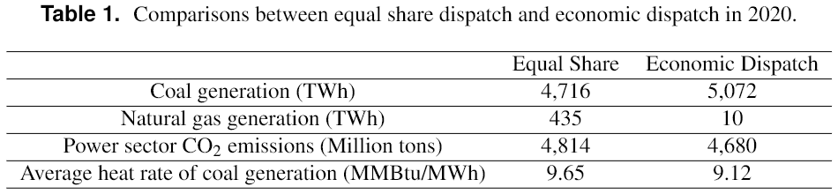
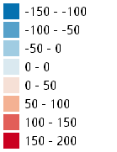

Economic dispatch
JS
Increased coal generation but 3% reductions in CO2 emissions
  Expensive gas
  Improved coal generation efficiency
ZJ
SD
AH
SH
Δ generation (TWh)
-150 to -100
-100 to -50
-50 to 0
0 to 50
50 to 100
100 to 150
150 to 200
More generation in regions with higher demand
  High transmission costs
XJ
500 TWh
3 TWh
Notes:
The table here compares equal share and economic dispatch in terms of generation portfolio, carbon emissions, and coal efficiency. No climate or health damage internalization at this point. You may have noticed that there is generation switched from gas to coal due to expensive gas, leading to more generation from coal after economic dispatch. However, this transition actually decreases carbon emissions by 3% through improved coal generation efficiency. Although 3% sounds like an insignificant number, the energy related carbon intensity in China has only dropped by 13% during the past three decades.
From the graph here, we observe that generation is shifted from low demand regions to high demand regions, as economic dispatch considers the transmission cost and electricity transmission across load zones becomes expensive.

Slide 6
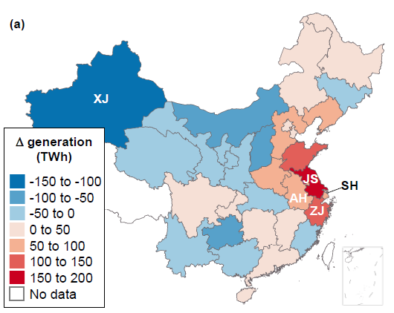
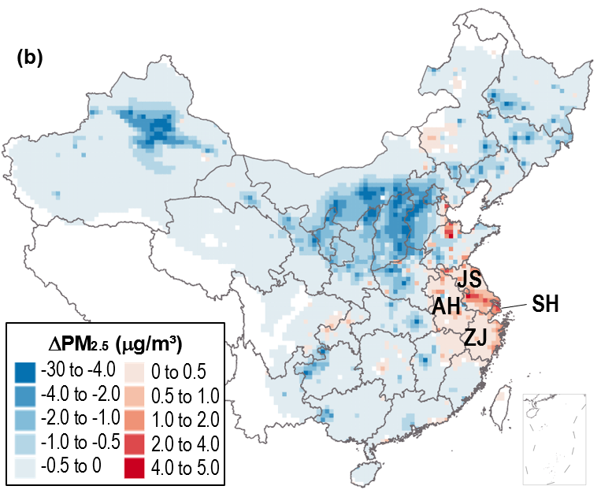
Economic dispatch
PM2.5 associated with power generation drops in most regions
PM2.5 increasing in a few eastern regions. Mortalities increase by 3,600 per year.
Over 8,000 annual avoided deaths (11% reduction compared with the equal share scenario)
Notes:
PM drops in most regions of China, indicated by the large blue area in the right map, and this leads to more than 8,000 avoided deaths per year, which is a 11% reduction when compared with the mortalities under the equal share scenario. However, in the four provinces in the east here, PM increases due to the increased generation, resulting in additional 3600 deaths per year. This unevenly distributed impacts are not something I want. Then, I incorporate emission externalities, trying to figure out if this will help mitigate negative impacts in the east.

Slide 7
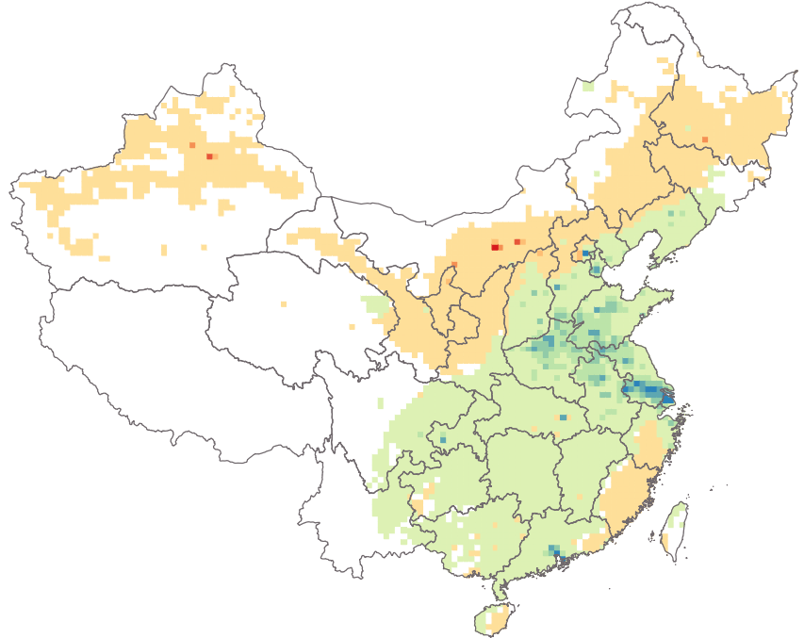
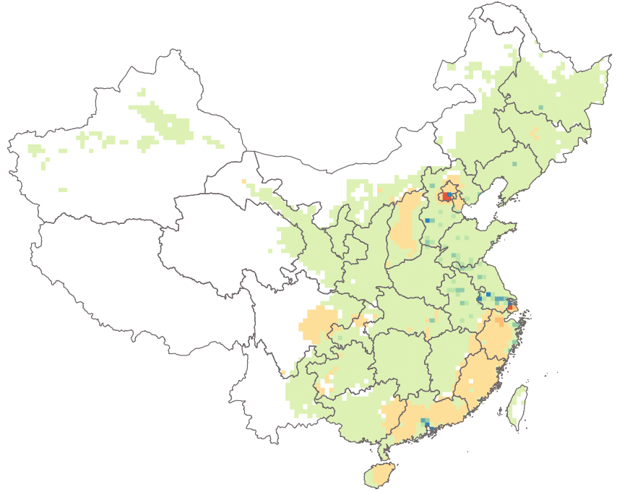
Emission externality internalization
Health damage (HD1M)
8,300 deaths avoided
245 M tons CO2 reduced
Carbon price (CP55)
3,500 deaths avoided
242 M tons CO2 reduced
Avoided Mortality (deaths/1,000 km²)
< -80
-80 to -40
-40 to -20
-20 to -10
-10 to 0
0 to 10
10 to 20
20 to 40
40 to 80
>80
5 % reductions in CO2 emissions and 5 – 12% reductions in the health impacts associated with power plant emissions when compared with economic dispatch
Mitigate the negative health impacts in Eastern China
Notes:
The two maps here are the avoided deaths after internalizing health damage and climate impacts, respectively. They are compared with the case where only power system costs are minimized. They both reduce CO2 emissions by 5% and reduce premature deaths by 5 – 12%. From the two maps here, the distribution of the health benefits are very different under the two scenarios. Health damage internalization mitigates more negative impacts by increasing electricity generation from natural gas and moving air pollutant emissions away from population centers. As a result of this, the positive health impacts mostly happen in the eastern China and many regions with lower population receive negative health impacts.
For the carbon tax case, because CO2 prices are not significantly different across the country, premature deaths drop in most regions in China.

Slide 8
Take-home messages
Economic dispatch in China can lead to significant reductions in CO2 emissions and air pollution mortalities
  3% reduction in CO2 emissions and 11% reduction in mortalities
  Achieved through improved efficiency of coal-fired generation
  Health damages increase in some regions in China due to increased electricity generation
Large climate and health benefits can be achieved by explicitly considering climate and health damages in power system operations
  Up to $16 billion annual net benefits
  Mitigate negative health impacts caused by economic dispatch
Notes:
Here are some take-home messages from this first part of this project: Adopting economic dispatch in China will reduce CO2 emissions by 3% and health damages by 11%, through improved generation efficiency. However, it may result in some negative health impacts in some regions in China due the regional shift of electricity generation. Fortunately, these negative impacts can be mitigated by considering climate and health damages in power system operations, leading to great net benefits in terms of system costs, CO2 emissions, and public health impacts.

Slide 9
Power system modeling
Optimize system operations based on existing facilities
  Economic dispatch
  Minimize operational costs and emission externalities
  Look at year 2020
Plan for a decarbonized future
  Capacity expansion
  Minimize capital and operational costs with a carbon emission limit
    costs from power plants and transmission lines)
    costs from public health damages
  Plan for 2025 - 2050
Notes:
That is all about how to optimize system operations with existing facilities. Now, I will focus on how to plan for a decarbonized power grid in China. Capacity expansion models are commonly used to determine what energy resources should be added to the system to meet future demands. To achieve deep decarbonization, a CO2 emission cap will be applied and only health damage costs will be internalized in the capacity expansion model.

Slide 10
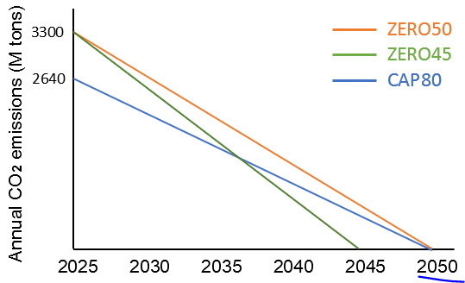
Decarbonization scenarios
Business as usual (BAU)
  No CO2 cap applied
Zero emissions in 2050 (ZERO50)
  2025 emissions from BAU work as the carbon cap for the first period
  Linearly decrease to 0 in 2050
Decarbonization acceleration
  ZERO45: Zero emissions by 2045
  CAP80: 20% lower emission limit than ZERO50
Health damage internalization (HDI)
  ZERO50 \ ZERO45 \ CAP80 + HDI
Notes:
Various scenarios are developed and compared in this work. First, the business as usual scenario has no CO2 cap. One decarbonization scenario has a zero-emission goal by 2050 and two decarbonization acceleration scenarios have zero-emission target by 2045 and 20% lower emission limit than ZERO50, respectively. A linear decrease is assumed, and the figure here show the carbon limit in each period under the three scenarios. Another set of scenarios is internalizing health damages in the decarbonization scenarios.

Slide 11
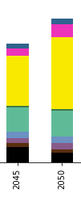
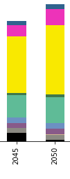
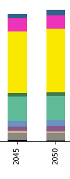
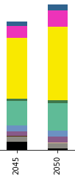
Future capacity
BAU
ZERO50
ZERO45
CAP80
Pumped Hydro
10000
Battery
8000
PV
Offshore Wind
6000
Onshore Wind
Installed capacity (GW)
Hydropower
Total CO2 emissions (M tons)
40000
Nuclear
Gas CCS
2000
Gas
Coal CCS
0
Coal
CO2 Emission
High renewable penetration level even without carbon cap
CO2 abatement costs: $6 per ton of CO2 under ZERO50
  ZERO45 and CAP80 have CO2 abatement costs at $9 and $16 per ton on the basis on ZERO50
Most is coal-CCS due to high prices of natural gas
Notes:
Similarly, let’s look at the results before health damage internalization. The figure here shows the capacity fuel mix in 2045 and 2050.
Scenarios have very high renewable penetration levels, even without any carbon emission cap, revealing the high cost-effectiveness of renewable energy and battery storage in the future. However, CO2 emissions under the BAU scenario is still 40% higher than those under decarbonization scenarios. Although adding carbon caps would increase system costs, the emission abatement cost will be as low as $6 per ton of CO2, much lower than the social cost of carbon. On the basis of ZERO50, accelerating decarbonization still has a relatively low CO2 abatement cost.
Carbon capture and storage (CCS) will be added in both 2045 and 2050 under all scenarios. However, due to high natural gas prices in China, most CCS would be coupled with coal.

Slide 12
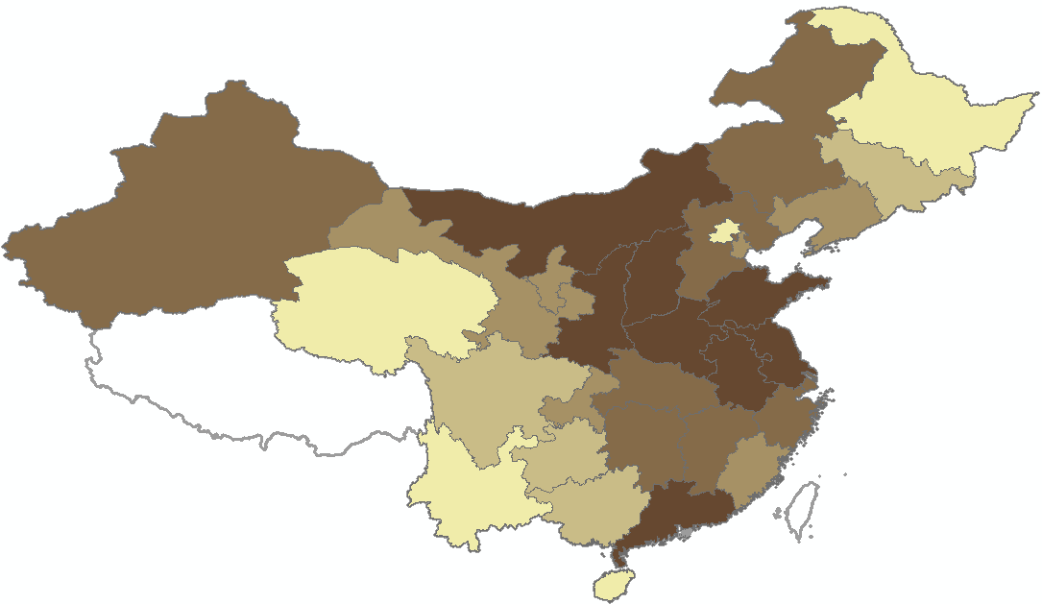
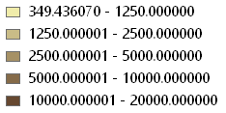
Total health damages
Monetized health damages
Health damage reductions
BAU
ZERO50
ZERO45
CAP80
BAU
Increased damages
Total Health Damages ($M)
Central and eastern China
0 – 1250
1250 – 2500
2500 – 5000
5000 – 10000
10000 – 20000
More damages in central and eastern China due to high demand, dense population, and meteorology without decarbonization
Decarbonization mitigates total health damages by 17 – 27%
Health damages increase in the period of 2045 due to new coal-CCS generation.
Notes:
Then we look at the total health impacts caused by the power sector in the future three decades. When no Carbon cap is applied, eastern and central China would receive most health damages due to high demand and meteorology. As other air pollutant emissions also drop with reducing fossil fuel-fired generations, three decarbonization scenarios reduce health damages by 17 - 27%, with CAP80 has most damage impact reductions. However, due to the addition of CCS, we find that the health damages increase in the period of 2045.

Slide 13
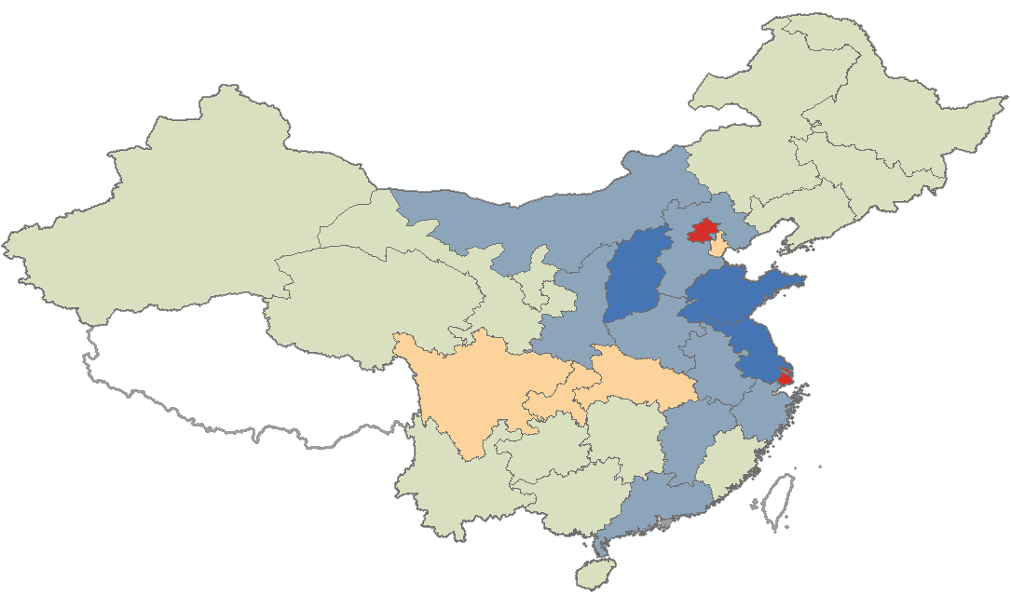
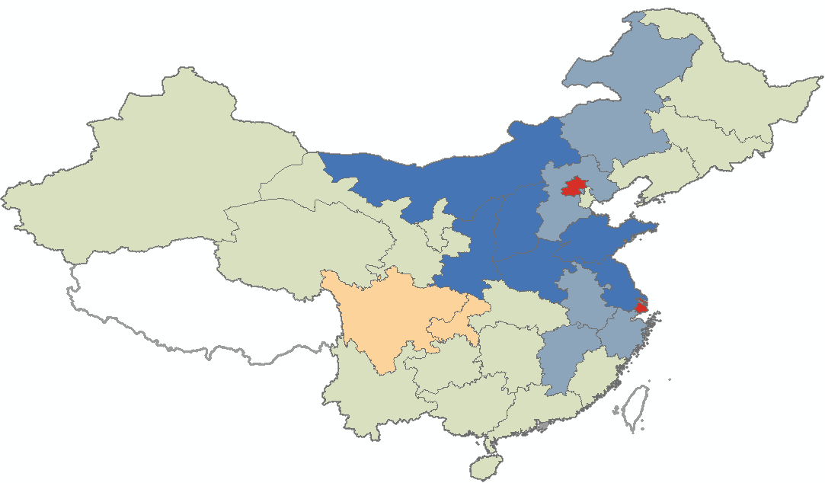
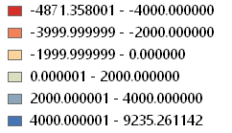
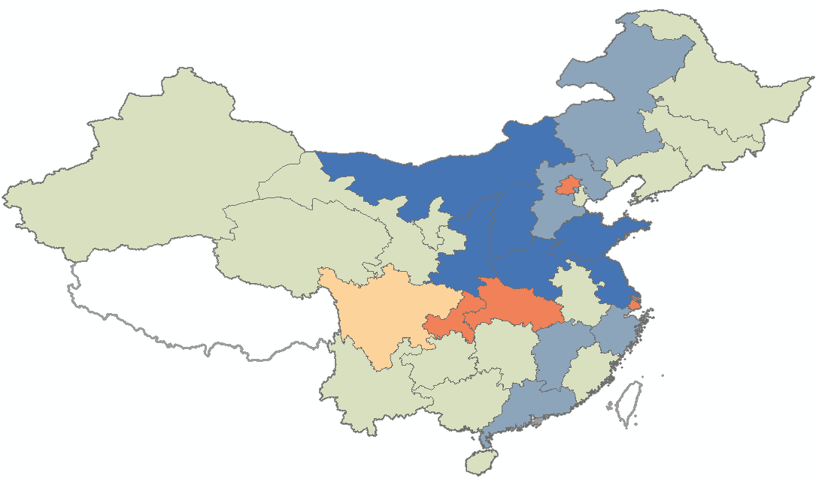
Total health damages
ZERO2050
Distribution of health impacts
  Most provinces benefit from decarbonization
  Negative impacts in Beijing, Sichuan, Chongqing, and Shanghai
  Use of Coal-CCS in regions with high electricity demand but limited renewable and nuclear potential
Avoided Health Damages ($M)
CAP80
-5000 – -4000
-4000 – -2000
-2000 – 0
0 – 2000
2000 - 4000
2000 – 10000
ZERO2045
Notes:
These negative impacts associated with CCS are not evenly distributed. Although most provinces benefit from decarbonizing the grid, indicated by large green and blue regions in the maps, there are orange and red regions that always receive negative health impacts under all decarbonization scenarios. These provinces share two common things: high demand and limited renewable and nuclear potential. Therefore, coal-CCS is added to those regions, leading to increases in air pollutant emissions and the associated health damages.

Slide 14
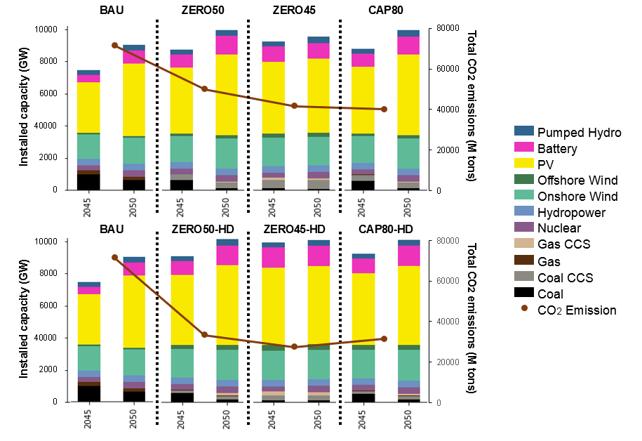
Health damage internalization
More offshore wind and gas-CCS
21 – 34% CO2 emission reductions
39 – 46% health damages mitigation
Notes:
Then, health impacts are integrated in to the decarbonization decision making process. HDI scenarios, the chart at the bottom, have more capacity from wind and gas-CCS due to their low health impacts. This transition also leads to lower CO2 emissions. 21 - 34% of CO2 emissions are further reduced on the basis of decarbonization. In spite of the great health co-benefits solely achieved by decarbonizing the power grid in China, another 39 - 46\% of the remained health damages can be mitigated by health damage internalization.

Slide 15
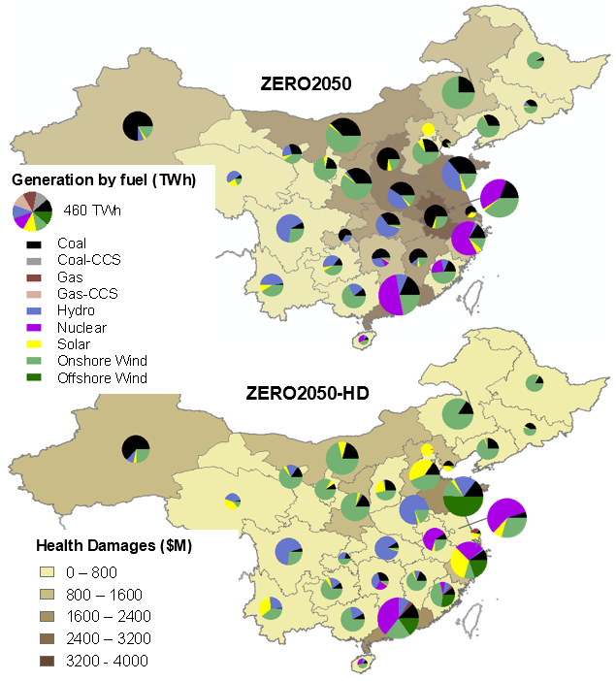
Health damage internalization
ZERO50
Coal generation drops in almost all regions but mainly exists in
  Regions with high demand
  Regions with lower marginal health damage costs
  Potential more negative impacts on ethnic minority residents
Low health impacts
ZERO50-HDI
High demand
15
Notes:
Health damage internalization will also lead to changes in the spatial distribution of electricity generation and public health impacts. Here, we compare the energy portfolio of electricity generation and the health impacts for scenarios ZERO50 and ZERO50-HD in 2030, when a great amount of coal-fired generation still exists in the system. Coal generation, the black sector, drops in almost all regions. Health damage centers would shift from central and eastern China to north and south China because regions with high demand and relatively low health damage costs still have a lot of generation from coal.

Slide 16
Health damage internalization
Coal generation is replaced by
  Offshore wind in coastal provinces
  Hydropower in provinces that have abundant water resources
16
Notes:
Total amount of electricity generation in each province does not change much as coal generation is replaced by different energy resources depending on the location. More expensive offshore wind is added to costal regions, and more hydropower is added to inland provinces that have abundant water resources

Slide 17
Health damage internalization
ZERO50
Regional shift of nuclear and hydropower
  Shifted from coastal regions to inland provinces where renewable resource is more limited
ZERO50-HDI
Notes:
There is also a regional shift of nuclear and hydro power. Generation from nuclear and hydro is shifted from coastal regions to inland provinces where renewable resource is more limited. This transition may provide some insights on how to plan the two zero-emission resources to maximize their benefits. When the resource potentials are similar, add them to regions without much wind or solar, instead of adding them to coastal regions which have diverse renewable potential.

Slide 18
Take-home messages
Operational change and long-term system planning that minimize system costs will help mitigate negative climate and public health impacts caused by power plant emissions in China
  Improved generation efficiency and rapid cost decrease of renewable energy
Integrating emission externalities into power system operation and plan will significantly reduce negative impacts but not increase “real ($)” costs much

Slide 19

Thanks!
Qian Luo ( qluo4@ncsu.edu)
Acknowledgement:
This research has been founded by National Science Foundation and Duke Energy Data Analytics Fellowship supported by the Alfred P. Sloan Foundation
19
Notes:
With that, I will stop my presentation here and I am happy to take any questions you may have.

Slide 20
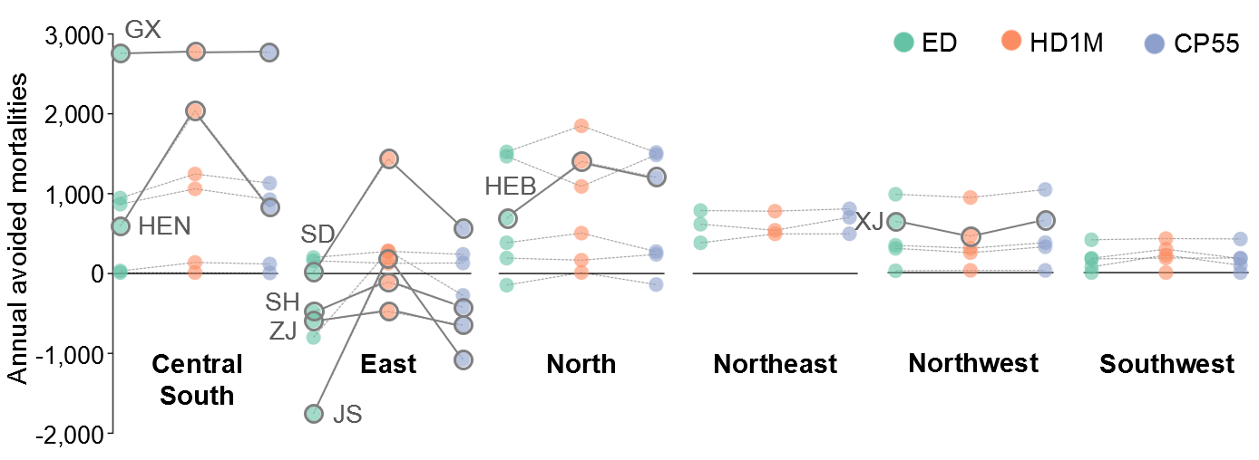
Economic dispatch
Health impacts are different across zones
  Including externalities affects Central South, East, and North China
  Health damage internalization leads to health benefits in most regions
    Negative impacts in regions with low population density, e.g.,Xinjiang
Notes:
Here, I compared the regional health benefits under three scenarios when compared with equal share. Their impacts are quite different. Considering emission externalities will mainly affect central south, east, and north China. Health damage internalization yields health benefits in most regions except for regions where population density is really low, like Xinjiang.

Slide 21
After monetizing the health and climate benefits
  Significant positive net benefits of considering emission externalities
  Considering health damages has larger costs from transmission due to more electricity shifted across load zones
  Electricity generation is more shifted within each zone when carbon tax is applied
Health damage
Carbon tax
Notes:
On the other hand, we can expect that considering emission externalities will increase the system operational costs. However, when including all monetized health and climate benefits, there are significant positive net benefits under the two scenarios. The climate benefits and health benefits are quite close, especially under the carbon tax scenario. Transmission costs significantly increase after incorporating health damages, in which more electricity is transported across load zones. Fuel costs rise a lot when carbon tax is applied. Electricity generation is more shifted within each zone

Slide 22
Health damage internalization
Net benefits
  Increased capacity investment
  But lower CO2 emissions and fewer negative health impacts
  Accelerating decarbonization have greater benefits
    More under CAP80
Notes:
On the other hand, the system investment costs, these green bars here, are expected to increase. However, along with the climate and health benefits, decarbonization with HDI leads to greater net benefits.

Slide 23
Take-home messages
A 2% increase in the system costs will enable the power system in China to achieve zero emissions in 2050
  Negative health impacts from CCS
Accelerating the decarbonization process would have more benefits than the extra costs to implement it
  Be careful when selecting the acceleration path.
By integrating health impacts into capacity expansion decision making process, HDI has more net benefits than those of traditional decarbonization scenarios
  Pay attention to the distributional impacts
Notes:
Here are the take home messages for the second part. A slight increase in the system costs will enable the power system in China to achieve zero emissions in 2050. However, due to the use of CCS, some regions will be negatively impacted in terms of public health. Accelerating the decarbonization process would have more benefits than the extra costs to implement it However, we need to be careful when selecting the acceleration path. For example, compared with CAP80, ZERO45 has a greater CO2 emission budget but lower net-benefits due to higher capacity investments in earlier time periods. Lastly, decarbonization with health damage internalization could have more net benefits than those of traditional decarbonization scenarios. But we should pay more attention to the distributional impacts, ensuring an equitable transition for everyone.

