Slide 1
On the sensitivities driving predictions from Per- and polyfluoroalkyl substance (PFAS) chemical transport modeling
Emma L. D’Ambro, H.O.T. Pye, C. Allen, K. Talgo, L. Reynolds,
K. Brehme, R. Gilliam, J.O. Bash, Ben N. Murphy
CMAS
Oct 18th, 2022

Slide 2
Disclaimer
The views expressed in this presentation are those of the author(s) and do not necessarily represent the views or policies of the U.S. Environmental Protection Agency. Any mention of trade names, products, or services does not imply an endorsement by the U.S. Government or the U.S. Environmental Protection Agency. The EPA does not endorse any commercial products, services, or enterprises.
Further, focus on particular sources of pollution does not reflect Agency policy and does not indicate any potential actions or judgements on behalf of the Agency towards those entities.

Slide 3
PFAS: per- and polyfluoroalkyl substances
GenX
Perfluoro: carbons are completely fluorinated
Polyfluoro: some hydrogens remain
Found in: food packaging, nonstick products, stain & water repellent fabrics, film-forming foam fire suppressants, and more…
Published studies: individual PFAS have demonstrated impacts on many organs & systems.
Reproduction: Reduced male fertility & birth weight, preeclampsia
Cancer: testicular, kidney
Endocrine system
Thyroid
OECD Synthesis paper on per- and polyfluorinated chemicals (PFC). 2013

Slide 4
Scientific Questions, Part I
What are the emissions from a fluorochemical manufacturing facility?
Can we model PFAS air emissions and fate using CMAQ?
What are the predicted air concentrations and deposition for the total suite of emitted PFAS? For compounds of concern (GenX)?
GenX

Slide 5
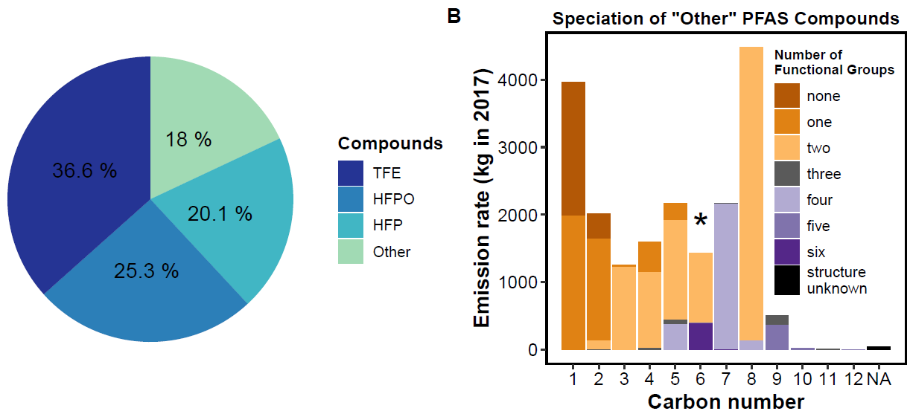
CMAQ-PFAS: facility specific PFAS emissions
109,393 kg emissions in 2017
53 individual PFAS compounds
Specific temporal profile of emissions based on production processes
~80% of emissions are from 3 small, volatile (c* ~10¹⁰ µg m⁻³), insoluble (Henry’s Law constants ~1E-3 – 10 M atm⁻¹) compounds
D’Ambro et al., ES&T, 2021
Notes:
Many compounds and a large variety and quantity of functional groups
Emissions with this level of temporal and chemical specificity do not exist for any other facility, to our knowledge
Emissions % by mass

Slide 6
CMAQ-PFAS
Domain:
Eastern NC/ Northeast SC
1 km x 1 km
Simulation details:
CMAQ v. 5.3.2 for 2018
WRF 4.0.1 (meteorology)
CB6 (chemistry module)
NEI 2014 (standard emissions, projected to 2018)
PFAS emissions from Chemours Fayetteville-Works
No PFAS oxidative chemistry included (yet!)

Slide 7
CMAQ-PFAS: performance
5 wet + dry GenX deposition measurement sites within 5 km
Modeled deposition in Fayetteville ~4x less than on the facility grounds
D’Ambro et al., ES&T, 2021

Slide 8
GenX emissions: air conc. & deposition
&
Maximum annual average air concentration = 24.6 ng m⁻³
50% of data within 0.001 – 0.01 ng m⁻³
Maximum annual deposition is 1,550 ng m⁻² day⁻¹
90th percentile is 2 orders of magnitude lower
D’Ambro et al., ES&T, 2021
Notes:
To quantify the role of episodic elevated concentrations, the cumulative time (in days) when each model grid cell is above an arbitrary threshold of 1 ng m−3
Most of the domain has 10 or fewer days above this limit, but the area immediately near the facility has >50% of the year above the threshold

Slide 9
Total PFAS emissions: air conc. & deposition
Maximum annual average air concentration = 8.5 µg m⁻³ (Median = 0.004 µg m⁻³)
Maximum annual deposition is 245,000 ng m⁻² day⁻¹, although 90th percentile is 2 orders of magnitude lower
D’Ambro et al., ES&T, 2021
Notes:
E-folding distance for air conc of 24.5 km

Slide 10
Scientific Question, Part 2
How sensitive are our results to model configuration and inputs?

Slide 11
Decreased chemical specificity
Base: 26 highest emission species explicit, remaining 23 species lumped
One lumped species with mole-weighted physicochemical properties
All Gas: in the gas phase
All Aerosol: in the particle phase
Single Partitioning Species: emitted into the gas phase and allowed to partition
D’Ambro et al., in prep
Notes:
Single partitioning species ends up being almost entirely in the gas-phase due to the overwhelmingly high volatilities
Very little mass is even slightly soluble, so it’s drowned out during the mole-weighting, essentially zero-ing out the wet deposition but also the dry deposition via wetted surfaces when species are in the gas phase
Chemical speciation does not significantly impact air conc– such a small percentage deposits so even a tripling doesn’t have a significant effect

Slide 12
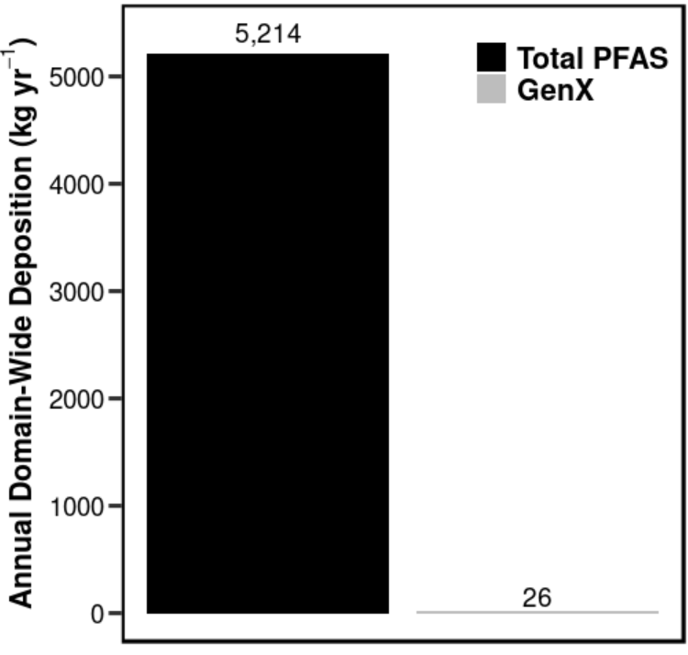
Domain-Wide Annual Deposition
If you focus on a single species (GenX), you’ll miss 99.5% of total deposition from this facility
Notes:
~5% total PFAS emissions deposit within the domain
~2.5% of GenX emissions deposit within the domain

Slide 13
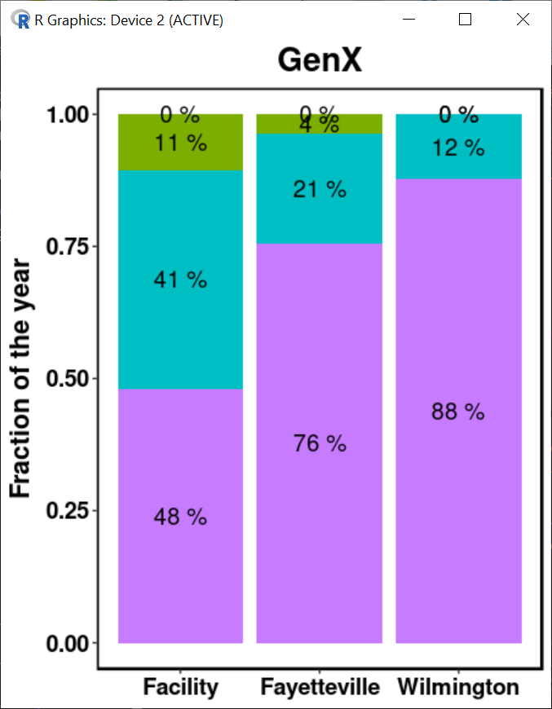
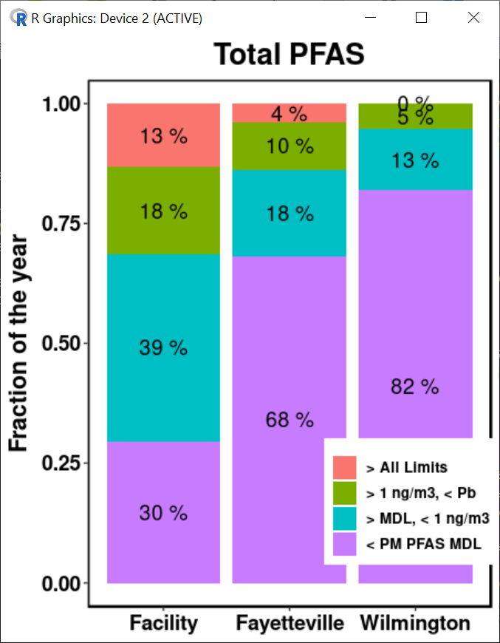
Preliminary PFAS advisories: GenX
50% of the time, total PFAS conc. < 1E-13 ng m³ at the two largest urban areas
Total PFAS can reach 3.6 µg m⁻³ in Fayetteville and 0.3 µg m⁻³ in Wilmington
GenX concentrations are ~2 orders of magnitude lower
D’Ambro et al., in prep
Notes:
No air advisory concentration for PFAS. To put air concentrations in context, the data is binned by three reference concentrations:
< PM PFAS MDL = time below the Measurement Detection Limit (MDL) of 0.005 pg m⁻³ from Zhou et al.⁶
>MDL, < GenX = time above the MDL but below the GenX drinking standard of 1.43 ng m⁻³
> GenX, < Pb = above the GenX drinking standard of 1.43 ng m⁻³ but below the 3-month NAAQS value for lead in air of 0.15 µg m⁻³
>All Limits = above the MDL, GenX standard, and Pb standard

Slide 14
Needs & future work
Needs:
Development of an air emissions inventory for all PFAS across the U.S. with both the total emission rate and chemical identity of the emissions
Coupling environmental media models to track the movement of PFAS throughout the environment after release will allow us to better characterize localized environmental fates
Current & future work:
Evaluate additional model parameters
Implementation of oxidative (transformation) chemistry into CMAQ-PFAS

Slide 15
Conclusions
We have added PFAS explicitly to CMAQ and comparisons with what little data exists are promising
Predicted air concentrations and deposition rates are highly dependent on chemical speciation
Recent US EPA health advisories focus on drinking water,
but evidence suggests these limits may be exceeded in
rainwater and atmospheric concentrations

Slide 17
Discarded slides

Slide 18
Preliminary PFAS advisories
Original health advisory: PFOS + PFOA > 70 ppt
New health advisory:
PFOS > 0.02 ppt
PFOA > 0.004 ppt
Rainwater concentrations of PFOS & PFOA >> health advisory level
US EPA
health advisory
EU EQC
Cousins et al., ES&T, 2022
Notes:
Recently the EPA has lowered the health advisory for PFOS and PFOA, prominent PFAS, in drinking water
The standards were lowered by 3-4 orders of magnitude
Compiling existing data, researchers showed the current levels of these chemicals in rainwater across the world are well above these limits
These two compounds have been released for at least half a century, although at least in the US, they were voluntarily phased out 2006 -2015
Locations in map: fluorpolymer plant = china, 5 of the urban in china, 1 urban + 1 rural in USA, 1 urban 2 rural = Sweden, 1 urban =Malta, 1 rural in Portugal, 1 rural in Canada/USA
Ppt = ug/L

Slide 19
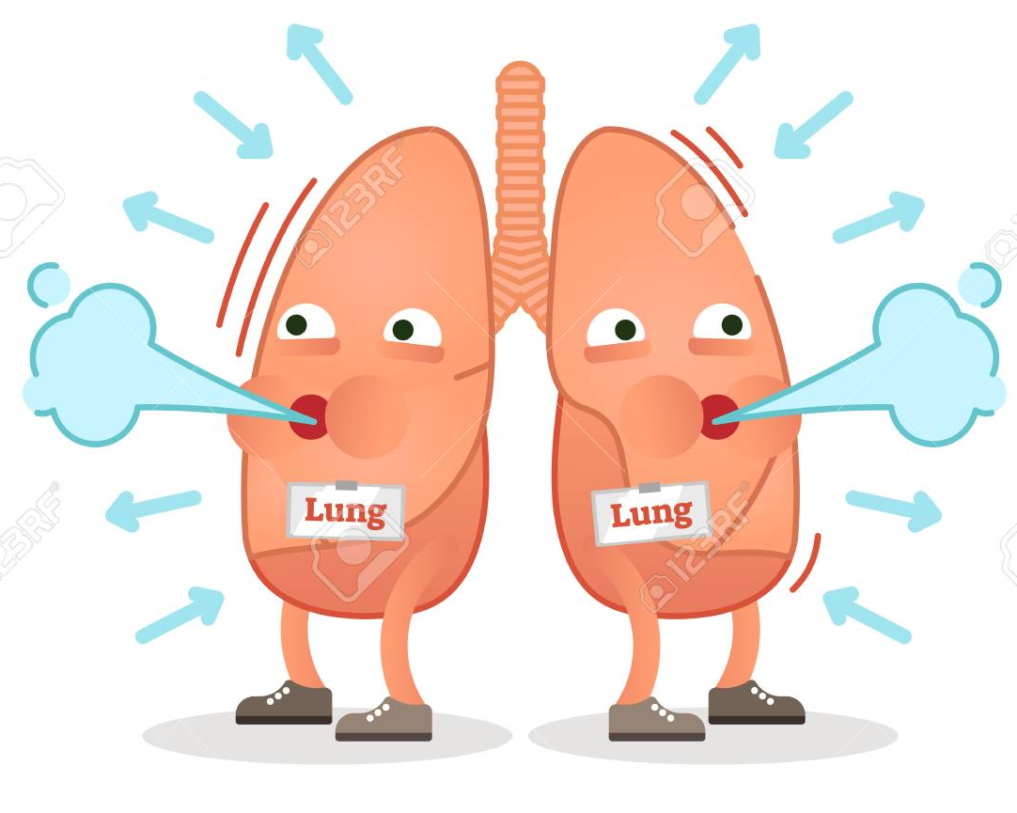
Preliminary PFAS advisories: GenX
June 2022: US EPA sets a drinking water health advisory for GenX at 10 ppt
Converting a drinking advisory to a rough inhalation estimate:
Typical drinking water consumed in a day = 2.4 L
Typical inhaled air volume in a day = 16,800 L
1.43 ng m⁻³ = the equivalent mass of GenX as 10 ppt in drinking water, assuming 100% bodily uptake from both sources
Notes:
Comparing drinking water standards to inhalation exposure is not an exact science, but rather allows us to start putting our predicted air concentrations into context
Inhalation volume based on 23 hours of restful breathing + 1hr intense breathing
Air intake reference from CARB: https://www.arb.ca.gov/research/resnotes/notes/94-11.htm

Slide 20
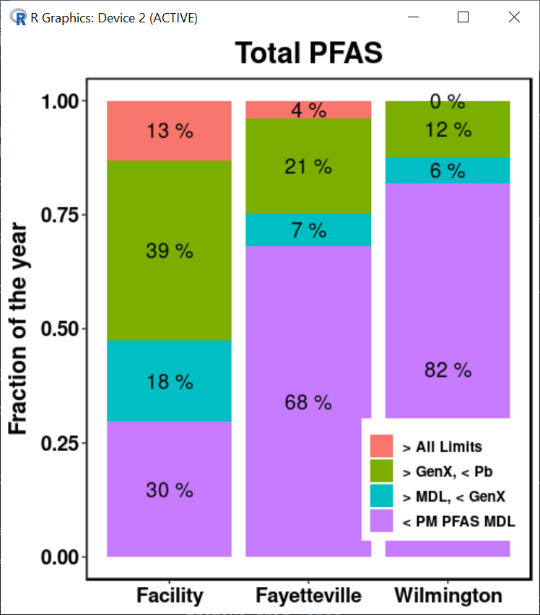
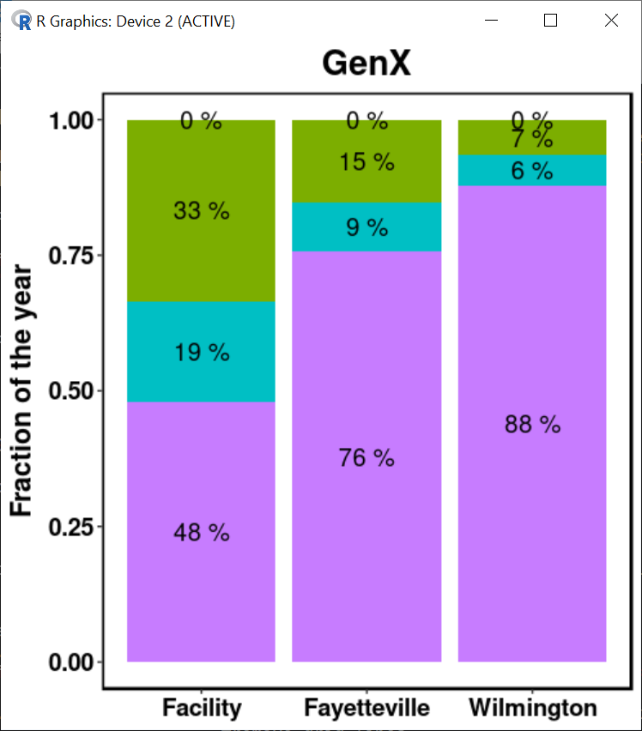
Preliminary PFAS advisories: GenX
50% of the time, total PFAS conc. < 1E-13 ng m³ at the two largest urban areas
Total PFAS can reach 3.6 µg m⁻³ in Fayetteville and 0.3 µg m⁻³ in Wilmington
GenX concentrations are ~2 orders of magnitude lower
D’Ambro et al., in prep
Notes:
No air advisory concentration for PFAS. To put air concentrations in context, the data is binned by three reference concentrations:
< PM PFAS MDL = time below the Measurement Detection Limit (MDL) of 0.005 pg m⁻³ from Zhou et al.⁶
>MDL, < GenX = time above the MDL but below the GenX drinking standard of 1.43 ng m⁻³
> GenX, < Pb = above the GenX drinking standard of 1.43 ng m⁻³ but below the 3-month NAAQS value for lead in air of 0.15 µg m⁻³
>All Limits = above the MDL, GenX standard, and Pb standard

