Slide 1
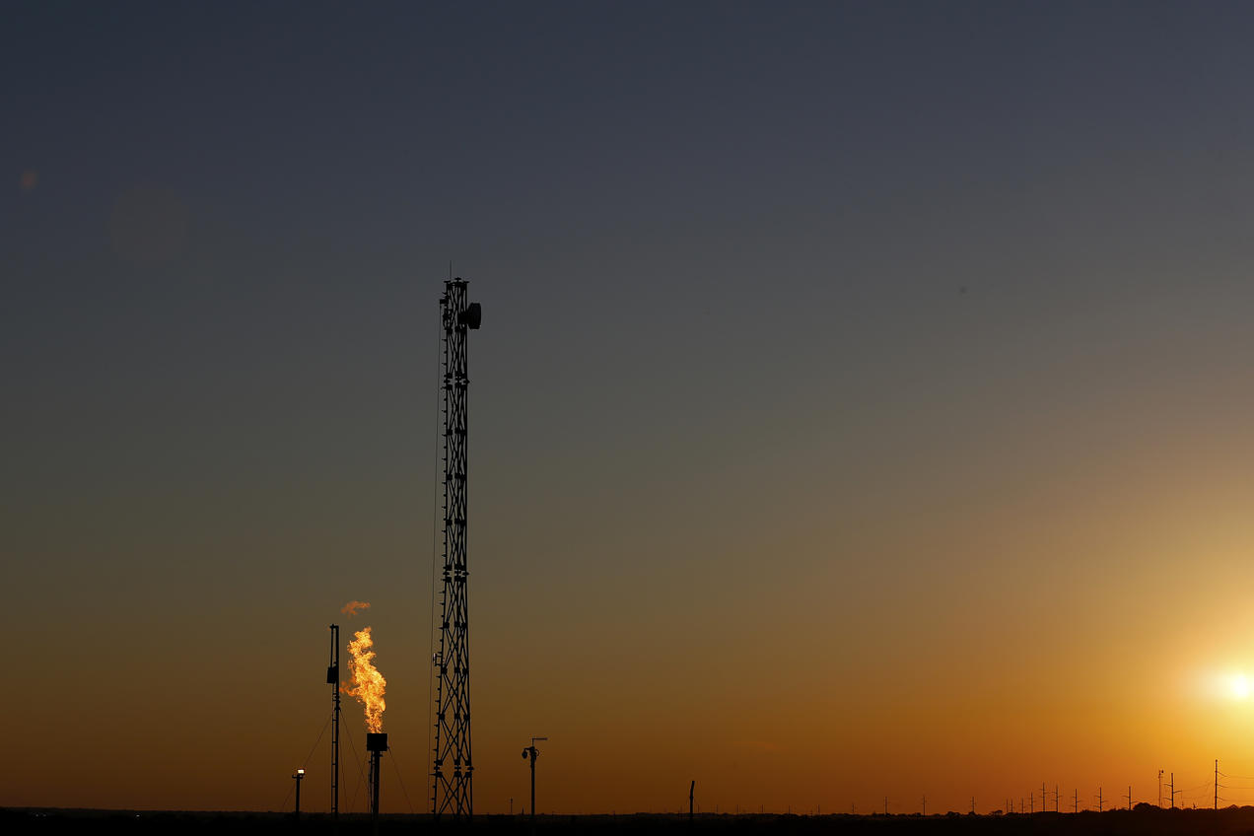
Investigation of Impacts of Flaring and Venting from Onshore Oil and Gas Production in the United States on Air Quality using CMAQ
Huy Tran¹, Jonathan Buonocore², Erin Polka², Ananya Roy³, Beth Trask³, Hillary Hull³ , Saravanan Arunachalam¹
¹Institute for the Environment, The University of North Carolina at Chapel Hill, NC, USA
²Department of Environmental Health, Boston University School of Public Health
³Environmental Defense Fund, Washington DC, USA
Presented at
The CMAS 2022 Conference, Chapel Hill, NC
Acknowledgments:
Environmental Defense Fund (EDF)
CDPHE, UDEQ, TCEQ, WDEQ, and NOAA

Slide 2
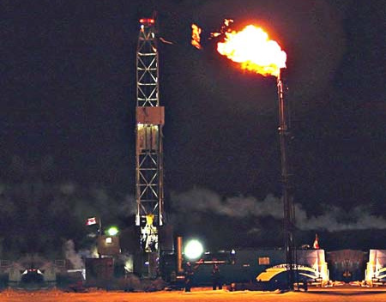
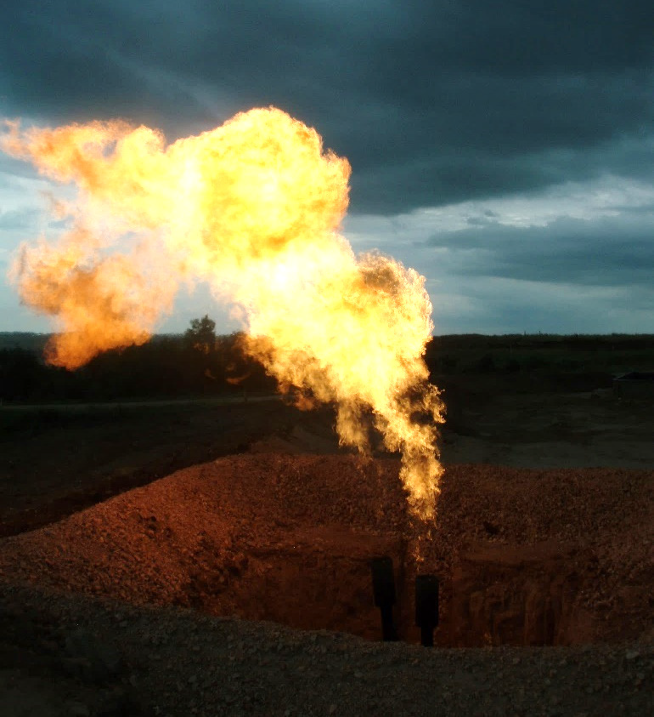
Introduction
Background:
Flaring is widely used to dispose of natural gas produced at Oil and Gas (O&G) facilities that lack sufficient infrastructure to capture all of the gas that is produced for operational, safety and economic reasons
Gas flare from well testing
Flaring is performed during various O&G production (upstream), transporting (midstream) and processing (downstream) activities in which upstream activities have the largest flared volume
O&G well drilling and completion
Well casing venting
Crude oil and condensate storage tanks
Dehydrators
Loading of oil and condensates
Oil refinery, gas plants and compressor stations
Ref: U.S. DOE, 2019
Associated gas flare at a well
Flared gas volumes are often self-reported and inaccurate Therefore, emissions from flaring could be underestimated
Objectives:
Estimate emissions from flaring (and venting) and compare to NEI
Assess air quality impacts due to O&G flaring (and venting) activities and other O&G source types in the U.S. using CMAQ brute-force and CMAQ-DDM modeling techniques
Ref: U.S. DOE, 2019
Notes:
U.S. DOE 2019 Report: “Natural Gas Flaring and Venting: State and Federal Regulatory Overview, Trends, and Impacts”

Slide 3
Emissions from O&G flaring is not well estimated in the current National Emission Inventory (NEI)
Emissions from flaring are not estimated separately but lumped in emissions from associated sources: crude oil and condensate tanks, well heads, storage tank loading, gas venting, dehydrators
Many states apply different Source Classification Code (SCC) to characterize same O&G source types making if difficult to track flaring emissions from the NEI
Inconsistent in “flaring” emissions between NEI 2017 and other emission inventories
NO_{X} emissions (tpy)
State | Rystad¹ | FOG² | NEI 2017
TX | 5,085 | 5,029 | 4,791
ND | 5,079 | 3,151 | 2,112
NM | 913 | 643 | 132
WY | 212 | 116 | 2,691
CO | 119 | 48 | 868
Rystad: contains county-level flared gas volume based on state/local agencies’ reports
FOG: Fuel-based Oil & Gas emission inventory
¹Rystad Energy, 2022
²Francoeur et al, 2021. DOI: 10.1021/acs.est.0c07352
Notes:
¹Rystad Energy. Cost of Flaring Abatement Final Report. Accessed February 2022. URL: https://blogs.edf.org/energyexchange/files/2022/02/Attachment-W-Rystad-Energy-Report_-Cost-of-Flaring-Abatement.pdf
²Colby B. Francoeur, Brian C. McDonald, Jessica B. Gilman, Kyle J. Zarzana, Barbara Dix, Steven S. Brown, Joost A. de Gouw, Gregory J. Frost, Meng Li, Stuart A. McKeen, Jeff Peischl, Ilana B. Pollack, Thomas B. Ryerson, Chelsea Thompson, Carsten Warneke, and Michael Trainer. Quantifying Methane and Ozone Precursor Emissions from Oil and Gas Production Regions across the Contiguous US. Environmental Science & Technology 2021 55 (13), 9129-9139. DOI: 10.1021/acs.est.0c07352
Most of Flare NOx in Wyoming is from SCC 2310011020 - On shore oil production crude tanks including flash (1,656 tons/yr).

Slide 4
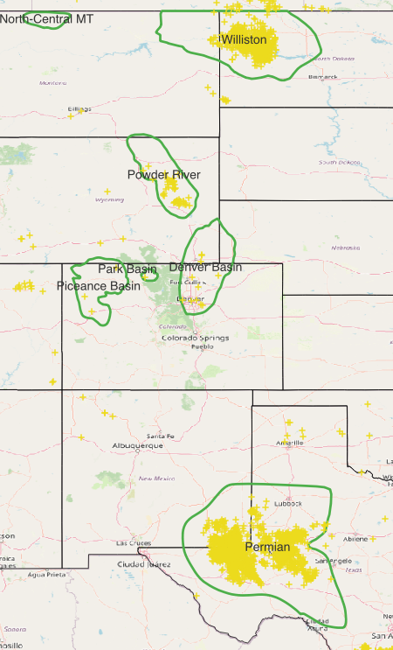
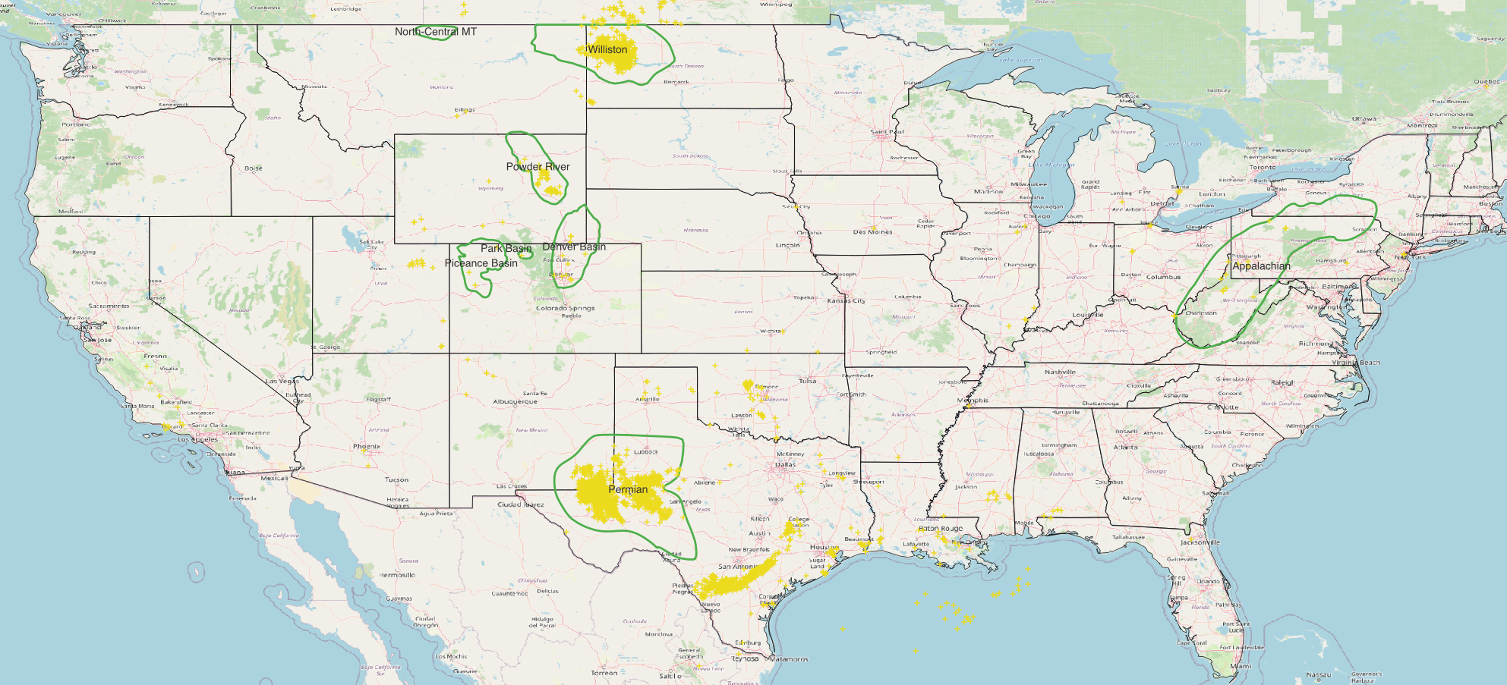
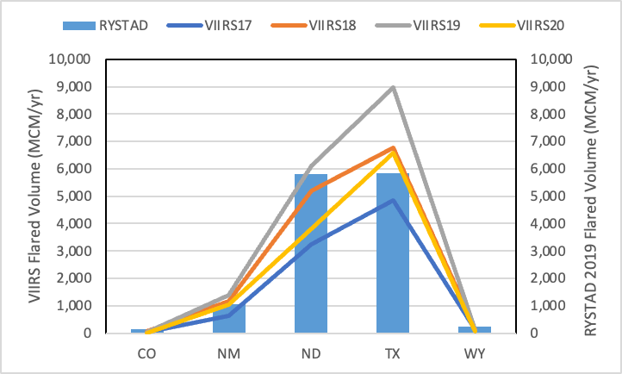
Estimations of flaring emissions from VIIRS
https://daac.ornl.gov/CMS/guides/Methane_Flaring_Sites_VIIRS.html
Flared Volume: VIIRS vs RYSTAD
(Monte Carlo simulations)
NOx = (m³ /y) * (26700±14000 BTU/m³)* (0.065±0.038 lb NOx/10⁶ BTU)
Emissions factors for NOx, CO, PM_{2.5} and SO₂ taken from literature reviews
Empirical algorithms for estimating stack parameters
In 2019: US = 17.7 BCM; Top 5 States = 16.6 BCM
NO_{X} emissions (tpy)
State | VIIRS17 | VIIRS19 | Rystad | FOG | NEI 2017
TX | 4,208 | 7,774 | 5,085 | 5,029 | 4,791
ND | 2,804 | 5,291 | 5,079 | 3,151 | 2,112
NM | 559 | 1,209 | 913 | 643 | 132
WY | 111 | 111 | 212 | 116 | 2,691
CO | 36 | 19 | 119 | 48 | 868
Good agreement between VIIRS-based and FOG’s emission estimates
Nonpoint Flaring and Venting: for 19 nonpoint O&G SCC that associated with flaring:
Emissions of NO_{X}, CO, PM_{2.5} and SO₂ are removed and replaced with corresponding VIIRS estimates (as point sources)
Emissions of VOC are taken “as is” from the 19 SCCs in counties where VIIRS are detected. This treatment consider that emissions from Flaring and Venting should be combined if they are to be controlled
Point Flaring: including flaring from major point O&G sources (22 SCCs) including compressor stations, gas plant, refinery, tank batteries, etc. Emissions are extracted from point O&G sector in the NEI 2017; co-located VIIRS removed
Notes:
Visible Infrared Imaging Radiometer Suite (VIIRS)
US Sum VIIRS-BCM 2019: 17.7 BCM
5 State Sum VIIRS-BCM 2019: 16.6 BCM

Slide 5
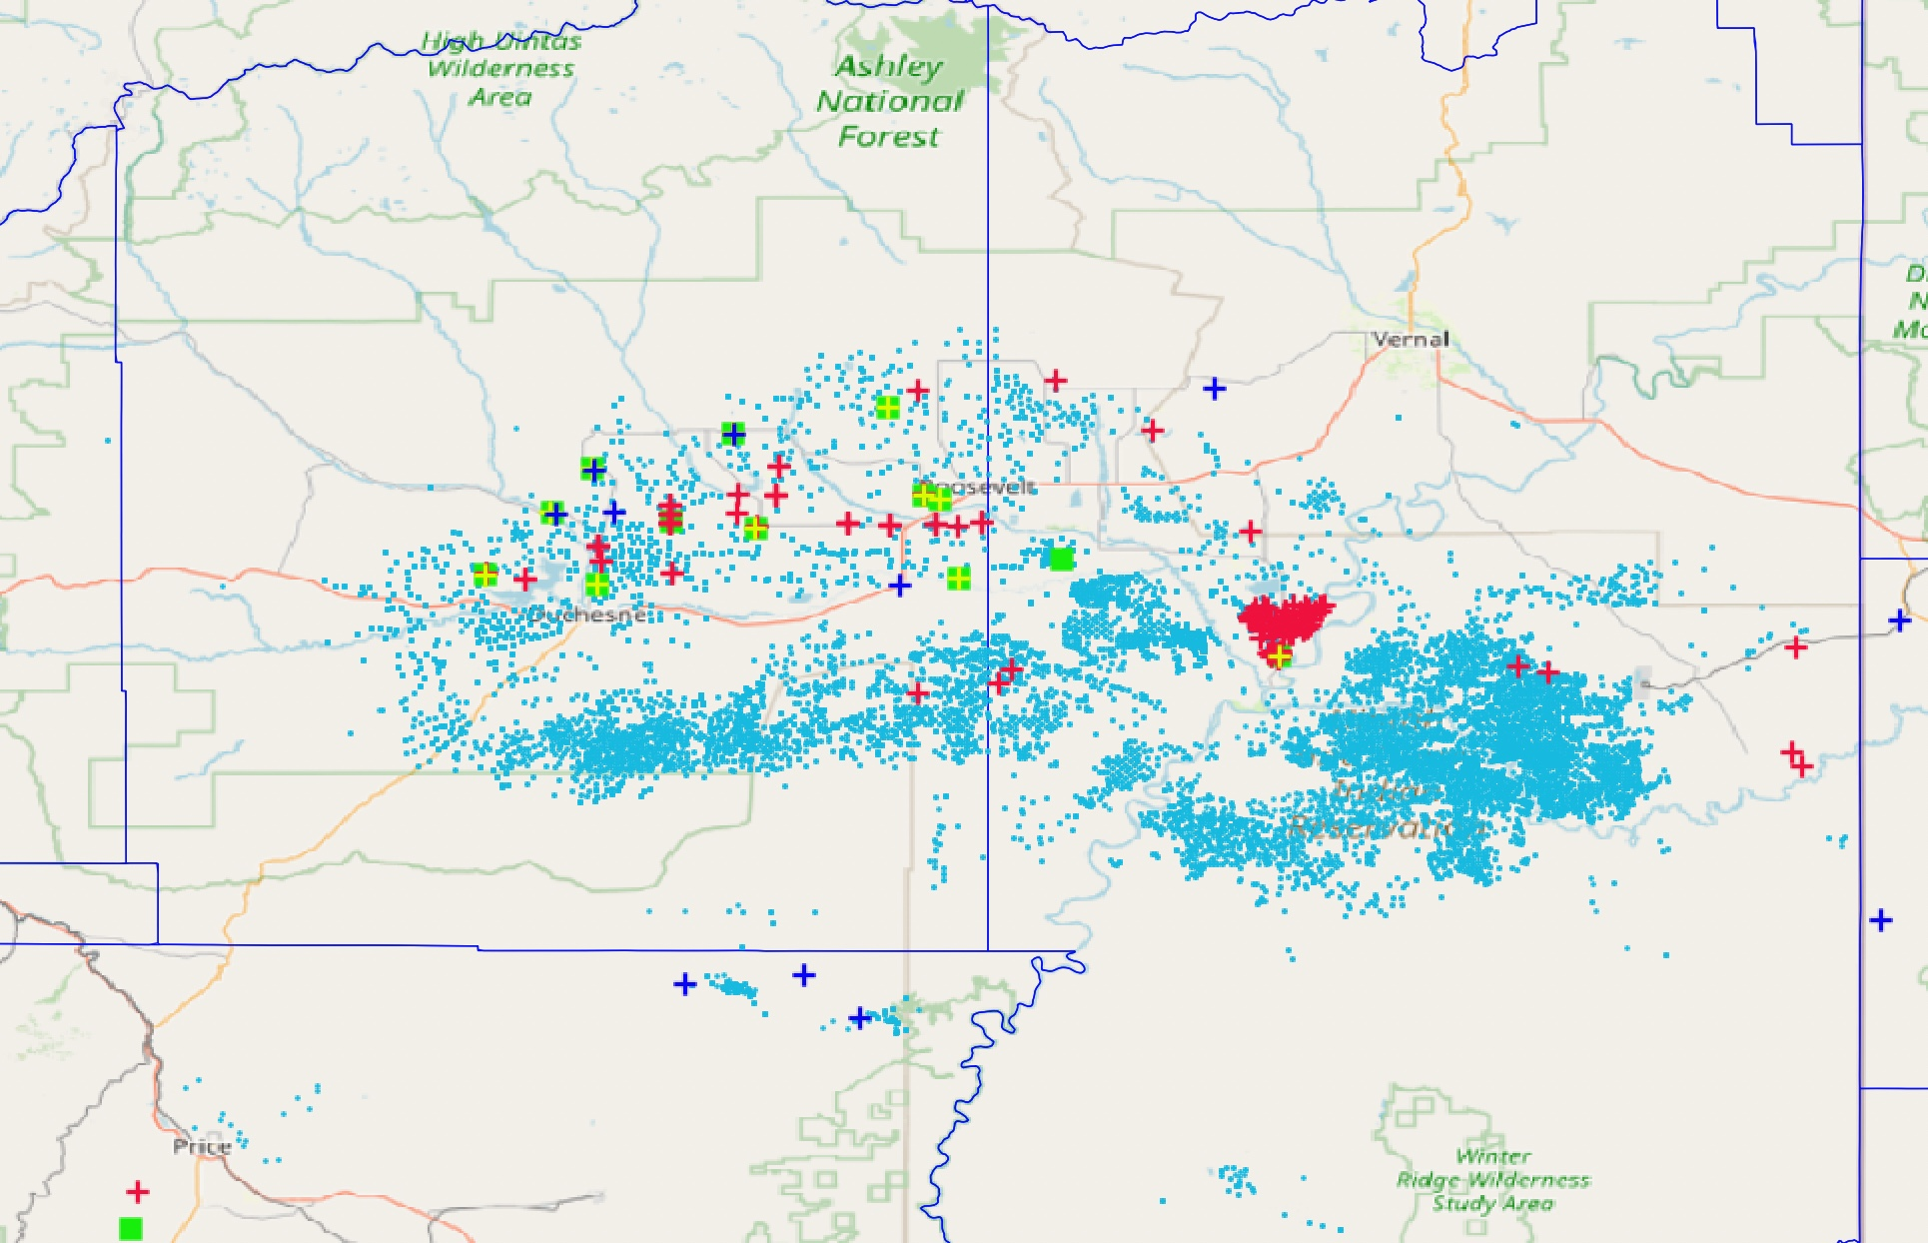
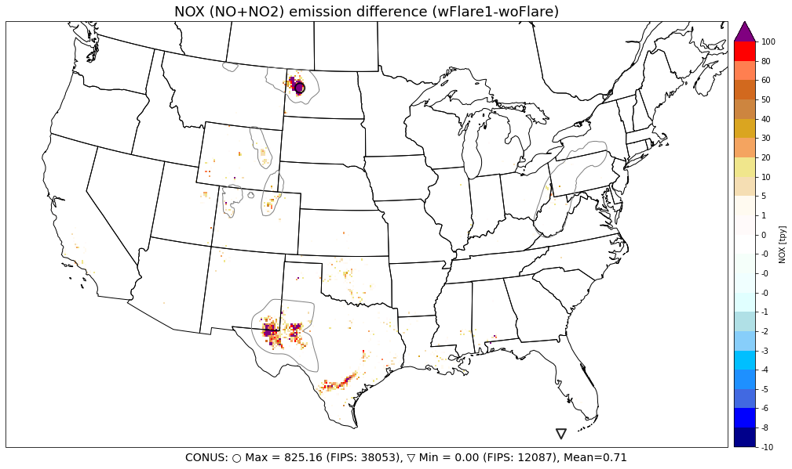
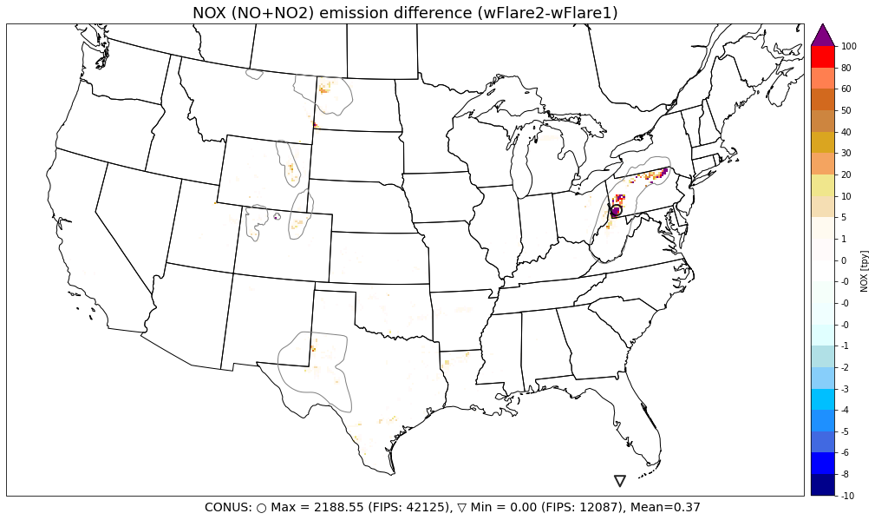
Challenges in applying VIIRS-based Flaring
Not all flares are detected by VIIRS
Uinta Basin, Utah
Use “hybrid” VIIRS & Rystad & NEI 2017 to capture all possible ranges of flare emissions.
Flare NO_{X} emissions from VIIRS-based only
Additional flare NO_{X} emissions from fusing VIIRS with Rystad and NEI

Slide 6
CMAQ Model Configurations
CONUS 12US1 domain; Base year 2016 (January, April, July, October)
Three modeling scenarios (brute-force):
Zero-out case (woFlare): including emissions from NEI 2016 for non-O&G and NEI 2017 O&G with flaring and venting emission excluded
Base case (wFlare1): including emissions from woFlare and VIIRS-based combined with NEI 2017 based point O&G flaring and venting
Alternative base case (wFlare2): including emissions from wFlare1 augmented with Rystad and NEI 2017 estimations in counties where VIIRS-based emissions are smaller or missing
Notes:
Contributions from flaring and venting: VOC = 50%, NOx = 2.5%, PM2.5 = 18%, SO2 = 81%

Slide 7
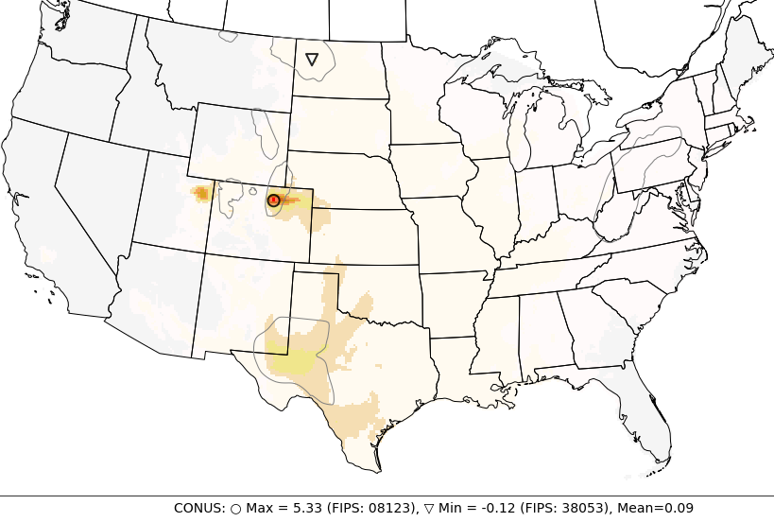
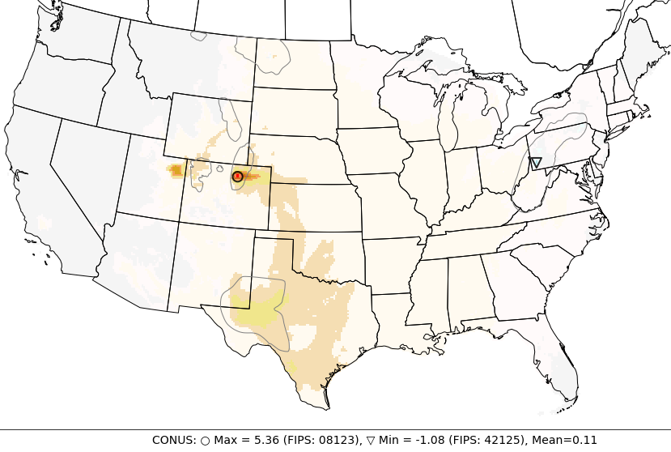
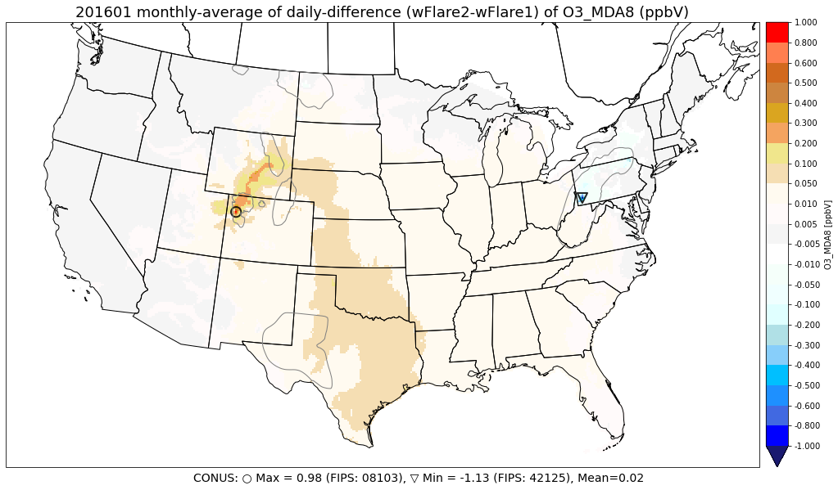
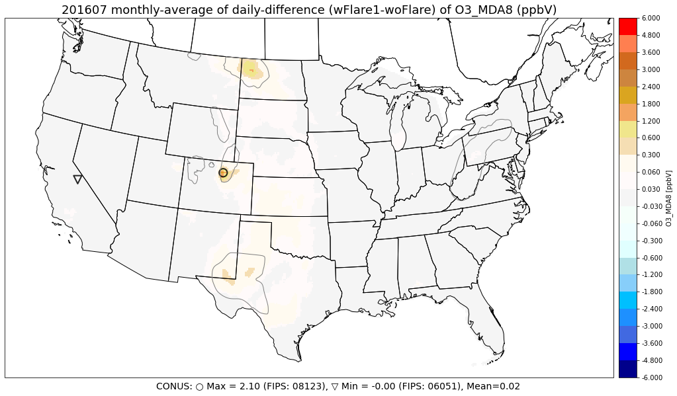
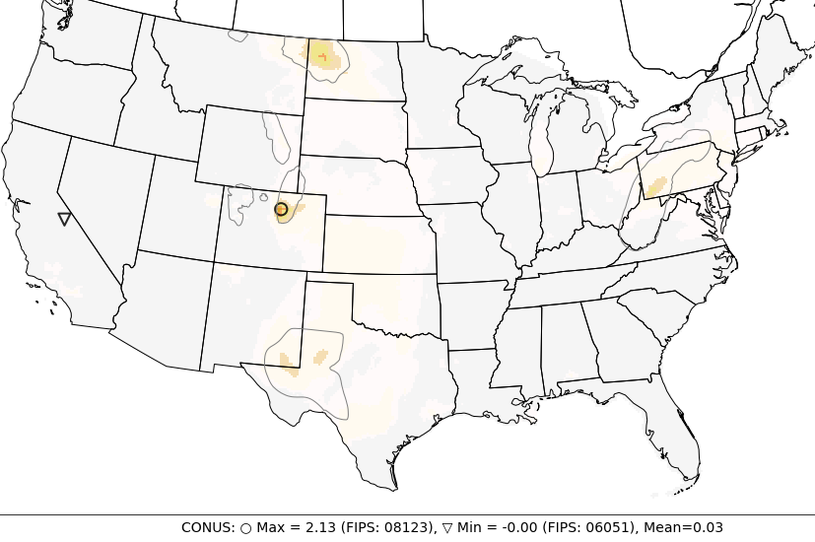
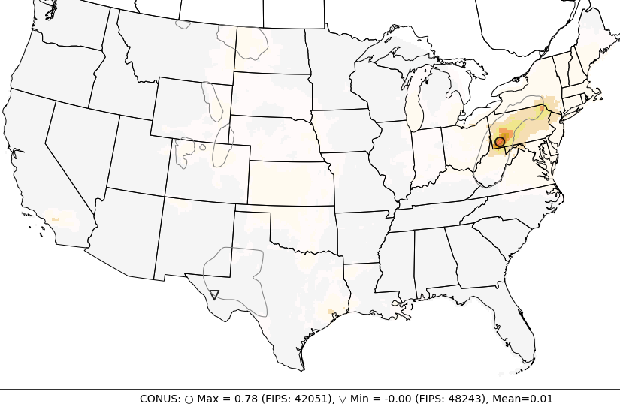
Results: Flaring and Venting Impact on O₃
Average Difference of MDA8O3 (ppbV)
Jan
Jul
wFlare2 - woFlare
wFlare2 – wFlare1
wFlare1 - woFlare
Impact on O₃ is significant (up to 5 ppbV) and is four times higher in winter than in summer months
Denver Basin observes the highest impact in comparison to other O&G basins
Marginal differences between wFlare2 and wFlare1
Large NO_{X} emission over Pennsylvania in wFlare2 led to O₃ disbenefit in winter but benefit in summer months
Notes:
Impact on O₃ is more significant in winter than in summer months: Up to 16 ppbV (47%) in wFlare1 in January and at Denver Basin. Same values for wFlare2.
On average, flaring and venting contribute 0.05 ppbV (0.15%) to O₃ MDA8 over CONUS with Denver Basin observes the highest impact (2.2 ppbV, 6.4%) in wFlare2 and wFlare1.
“Augmented” flaring and venting emissions in wFlare2 increase O₃ MDA8 impact up to 6 ppb in January over wFlare1. Excess NO_{X} emission over Pennsylvania in wFlare2 lead to O₃ disbenefit in winter but benefit in summer months.

Slide 8
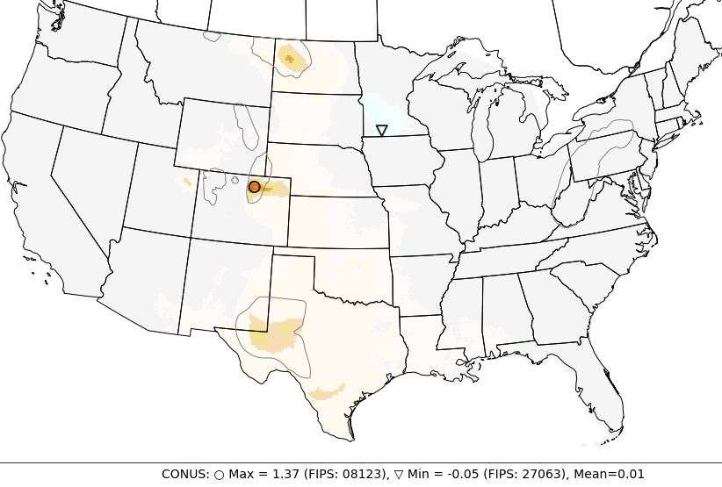
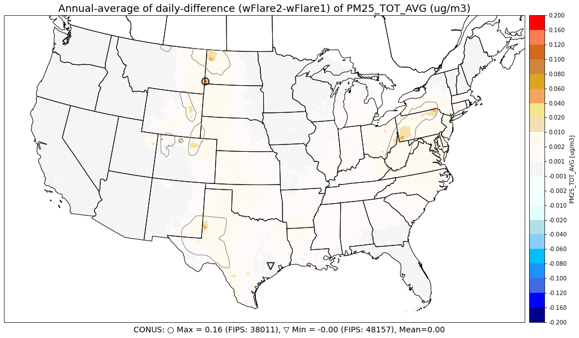
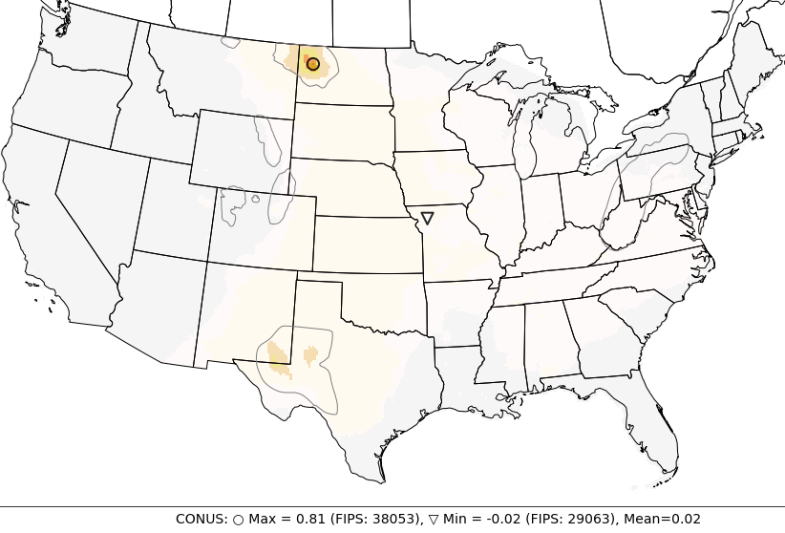
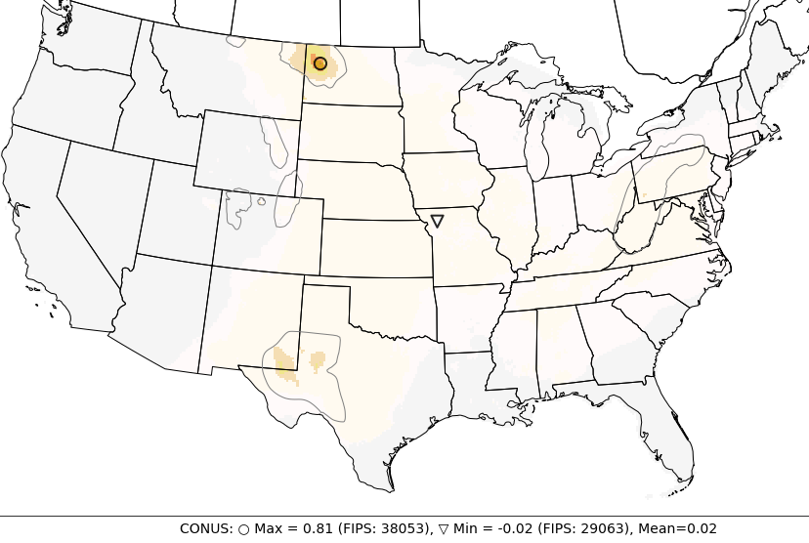
Results: Flaring and Venting Impact on PM_{2.5}
Average Difference of PM_{2.5} (µg/m³)
Annual
Jan
wFlare1 - woFlare
wFlare2 - woFlare
wFlare2 – wFlare1
Jul
wFlare1 - woFlare
wFlare2 - woFlare
Similarly impact on MDA8O3, impact on PM_{2.5} is stronger in winter than in summer (~ 2 times), and up to 1.4 µg/m³
Highest impact occurs in Denver Basin in January and in Bakken basin in July
Small disbenefit of PM_{2.5} in the Northeast regions due to decrease in NO₃ aerosol in wFlare1 and wFlare2 over woFlare
Notes:
On any day, flaring and venting contribute up to 5.2 (5.1) ug/m³, or 19% (18%) to total PM_{2.5} concentration in wFlare2 (wFlare1)
On average, flaring and venting contribute 0.01 ug/m³ (0.39%) and up to 1.4 ug/m3 to PM_{2.5} over CONUS with Bakken Basin observes the highest impact (0.57 ug/m3, 17%) in wFlare1. There are insignificant differences in wFlare2.
Small disbenefit of PM_{2.5} in the North East regions (Minnesota) due to decrease in NO₃ aerosol in wFlare1 and wFlare2 over woFlare.

Slide 9
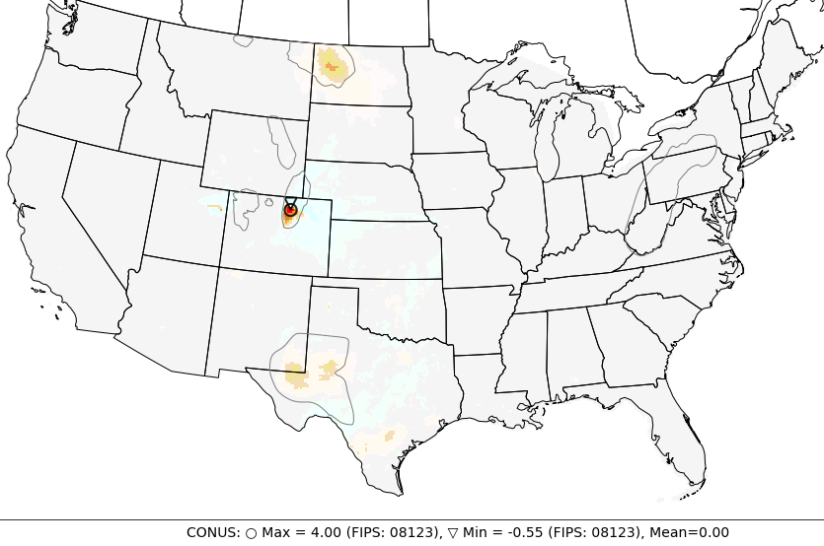
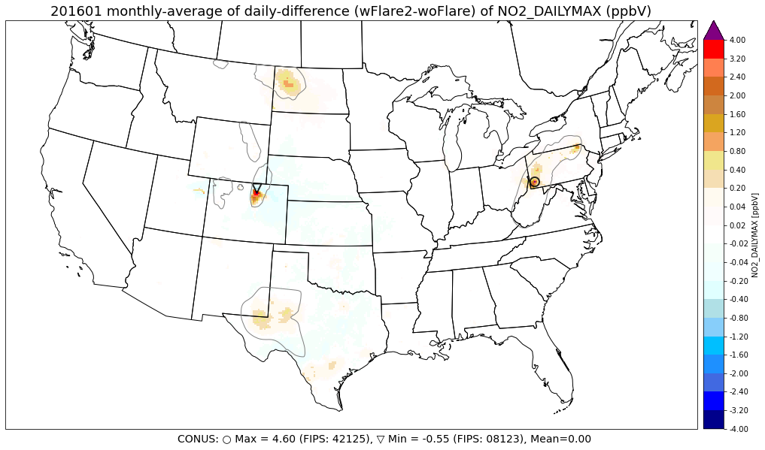
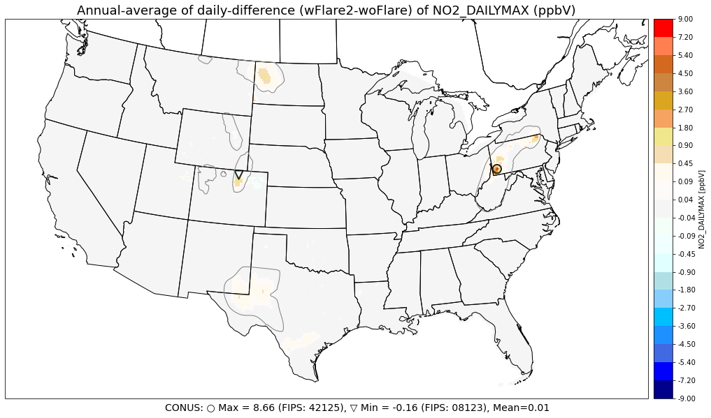
Results: Flaring and Venting Impact on NO₂
Average Difference of Daily Maximum NO₂ (ppb)
Jan
wFlare2 – wFlare1
Jul
wFlare2 - woFlare
wFlare1 - woFlare
Impact on NO₂ is stronger in summer than in winter (unlike MDA8O3 and PM_{2.5})
NO₂ disbenefit observed at downwind area of oil and gas production basins
Marcellus basin observes highest NO₂ impact in wFlare2 due to high NO_{X} emissions in Pennsylvania

Slide 10
Impacts on Air Quality Standard Exceedances
Count of exceedances
(Simple count of exceedances over 53,852,518 grid-cells x 123 days)
 | MDA8O3 > 70 ppbV |  |  | PM_{2.5} > 35 µg/m³ |  |  | NO₂ Daily Max > 100 ppbV
 | woFlare | wFlare1+ | wFlare2+ | woFlare | wFlare1+ | wFlare2+ | woFlare | wFlare1+ | wFlare2+
Texas | 6,884 | 802 | 953 | 7,653 | 0 | 0 | 0 | 0 | 0
North Dakota | 62 | 0 | 0 | 0 | 0 | 0 | 0 | 0 | 0
New Mexico | 1,178 | 62 | 155 | 0 | 0 | 0 | 0 | 0 | 0
Colorado | 2,790 | 2,015 | 2,015 | 0 | 0 | 0 | 0 | 0 | 0
Wyoming | 0 | 0 | 0 | 0 | 0 | 0 | 0 | 0 | 0
Pennsylvania | 9,517 | 62 | 527 | 6,045 | 62 | 31 | 0 | 0 | 0
CONUS | 420,474 | 3,932 | 6,496 | 34,925 | 62 | 0 | 62 | 0 | 0
MDA8O3:
Exceedances largest in Colorado (Denver Basin). No MDA8O3 exceedances due to flaring and venting emissions in January in both wFlare1 and wFlare2
Largest additional exceedances occurred in July
PM_{2.5} :
Exceedance is marginal and additional exceedances occur in January only
Decreases in nitrate and OC aerosols led to decrease in exceedances in some areas
If PM_{2.5} daily NAAQS were lowered to 30 ug/m³, flaring and venting emission would contribute 240 and 300 exceedances in wFlare1 and wFalre2, respectively
NO₂:
Flaring and venting cause no additional NO₂ exceedances until the 1-hour NO₂ standard were lowered to 60 ppbV at which wFlare1 and wFlares would add 279 and 310, respectively, to 8,726 exceedances in woFlare.

Slide 11
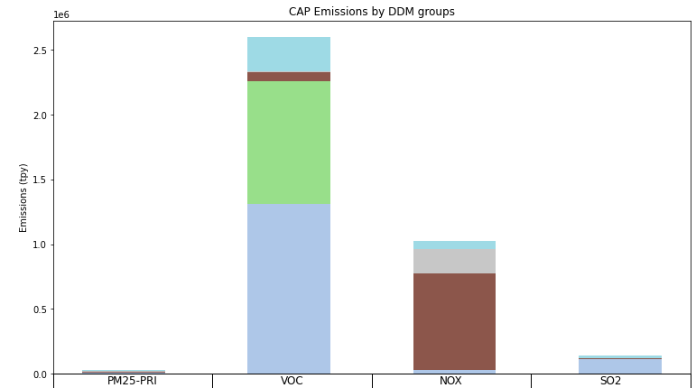
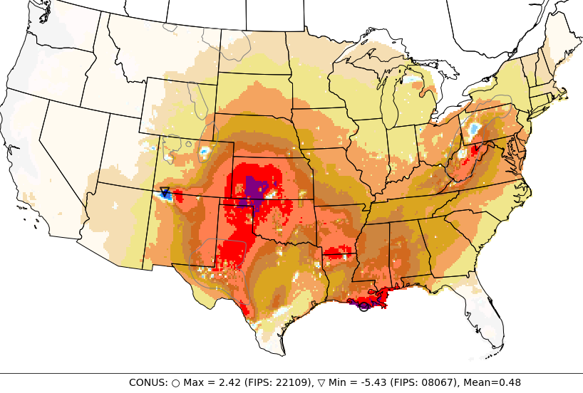
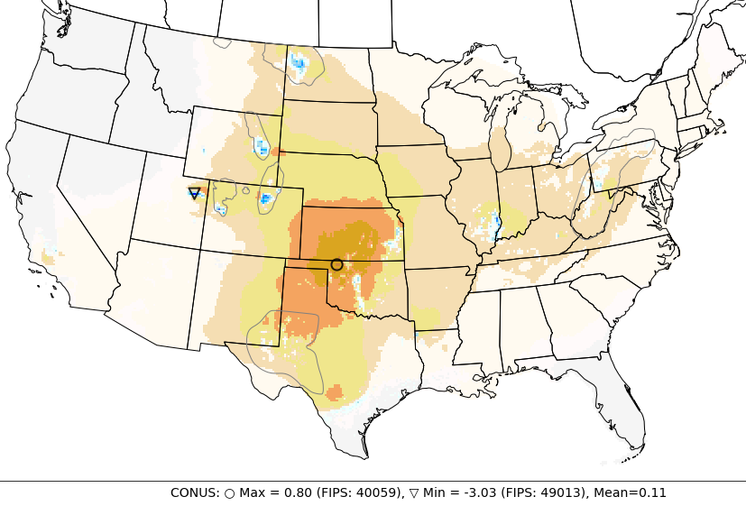
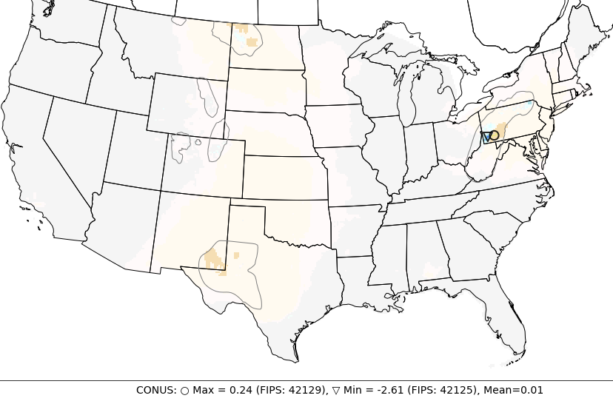
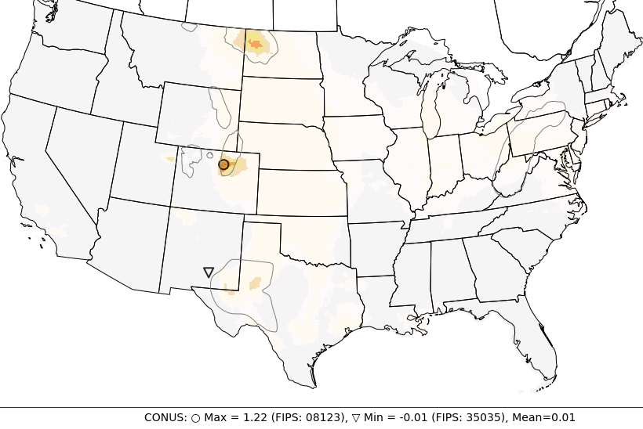
CMAQ-DDM to identify key segments that contribute to O₃, PM_{2.5}
DDM sensitivities based on wFlare2 for 4 source groups: (1) Flaring and Venting; (2) Fugitives and Pneumatics; (3) Compressor Engines; (4) Pumpjack, Well Drilling and Completions
Assess O₃ and PM_{2.5} sensitivity to NO_{X} and VOC emissions from 4 sources groups, and to SO₂ and PM_{2.5} emissions from group 1 (flaring and venting).
Oil & Gas sector
36%
O₃_ENOx
Compressors Engines
18%
50%
O₃_ENOx
73%
Pumpjack, Drilling & Completion
O₃_ENOx
O₃ (ppbV)
O₃_EVOC
Flaring and Venting
Flaring and Venting
Strong O₃ sensitivities to NO_{X} emissions from Compressor Engines and Pumpjack/Drilling/Completion
Notes:
NO_{X} emissions from Compressor Engines and Pumpjack/Drilling/Completion
have strongest impact on O₃ in area outside Oil & Gas production basin.
However, over major Oil & Gas production basins, O₃ negatively responses to NO_{X} emissions.

Slide 12
Summary
Impact of flaring and venting on O₃ concentration is significant and is stronger in winter (up to 5 ppb; 18% in MDA8O3) than in summer months (up to 2 ppb; 5%)
Highest impacts often mostly occurred over O&G production basin where VIIRS flares were detected not captured in NEI). Denver Basin observed the highest impact on O₃ and PM_{2.5}
O₃ is more sensitive to VOC than to NO_{X} emissions from flaring and venting. O₃ has strongest sensitivity to NO_{X} from compressor engines, pumpjack engines and well drilling and completions
Strongest impact on NO₂ in Appalachian basin is subject to uncertainty in NO_{X} emissions in Pennsylvania. Denver Basin observes the second highest impact on NO₂
Large uncertainties exist in current estimations of flaring and venting emissions. We have developed an approach that augments flaring emissions estimates from VIIRS-based satellite retrievals to identify flare locations
Additional improvements in emission inventory are needed for better quantification of air quality and health impacts
Next Steps
Continue perform CMAQ-DDM analysis for summer and winter months
Perform health-risk assessment due to O₃, PM_{2.5} and NO₂ based on DDM results

Slide 13
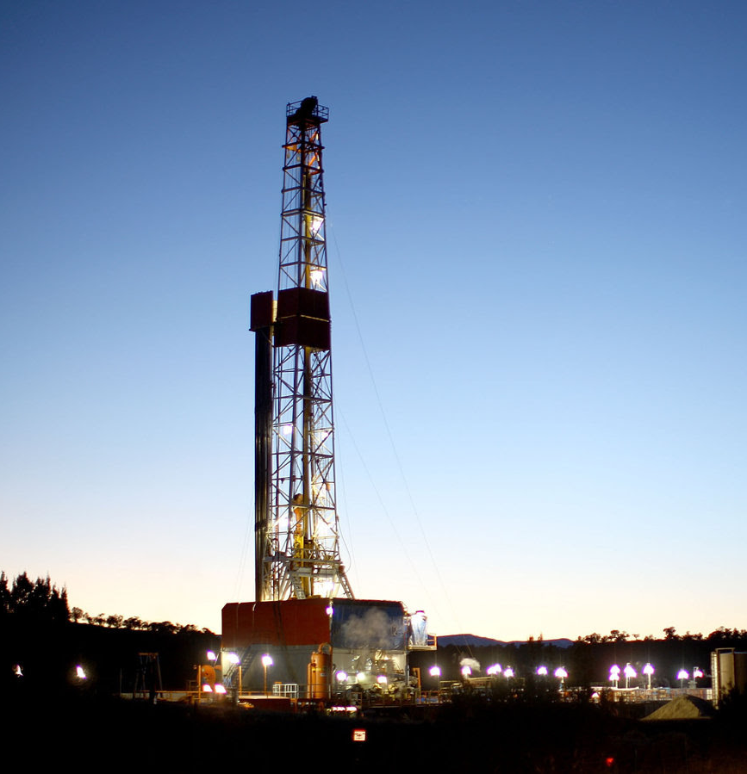
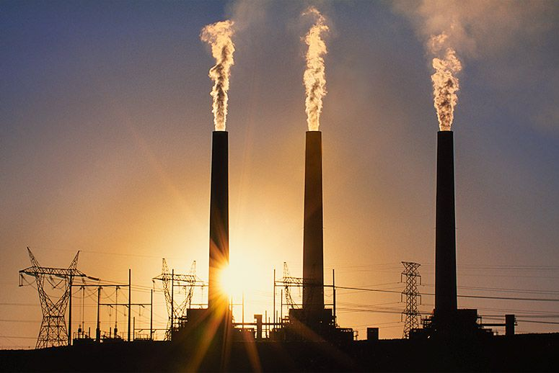
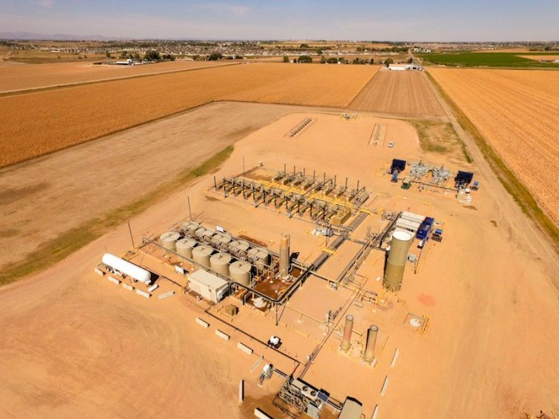
Frans Lanting/Getty Images
Ted Wood/Photo Group
Thank you

Slide 14
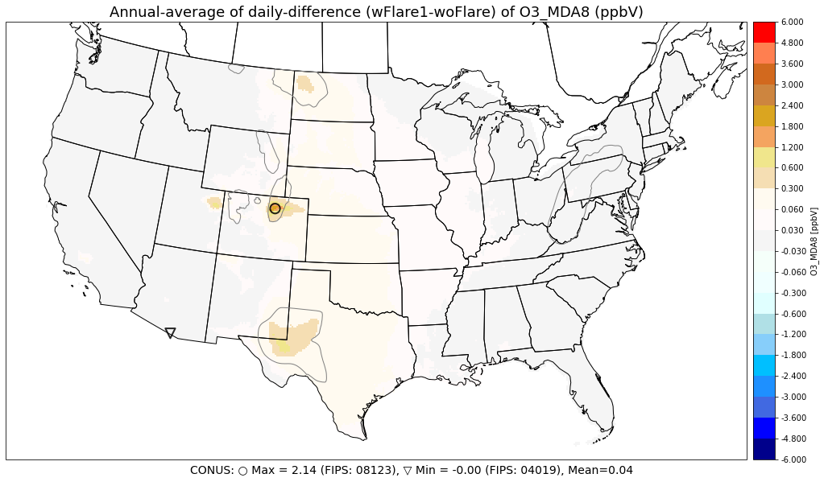
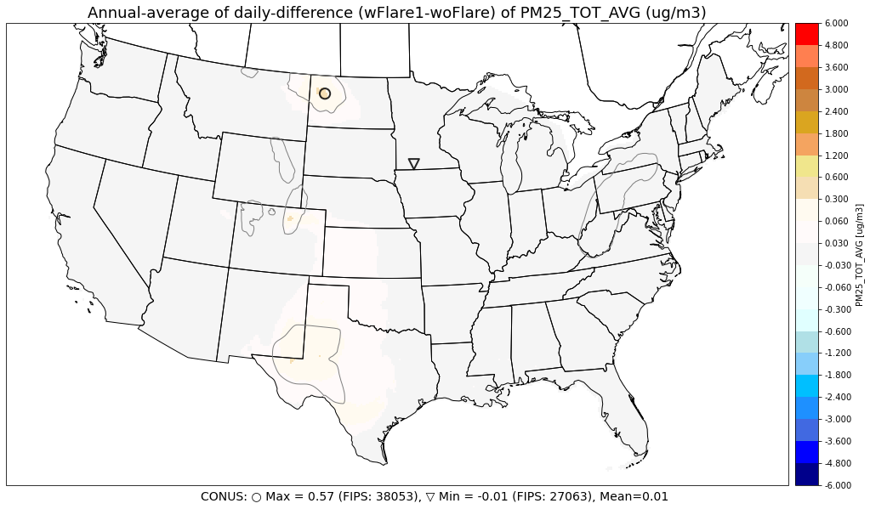
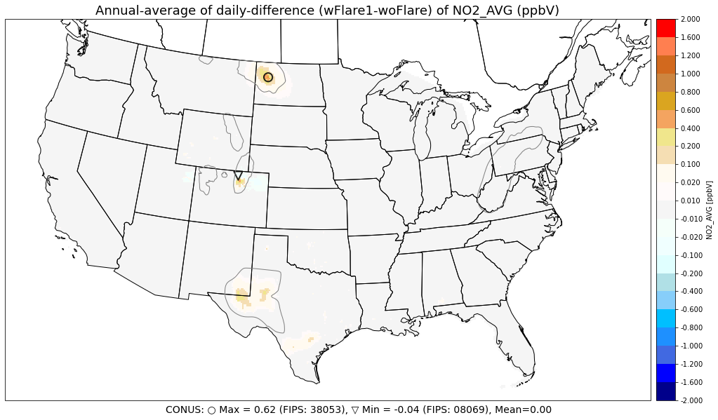
Annual Average (wFlare1 – woFlare)
Annual Average Difference (ppb)
O₃ MDA8
PM_{2.5}
O₃
NO₂

Slide 15
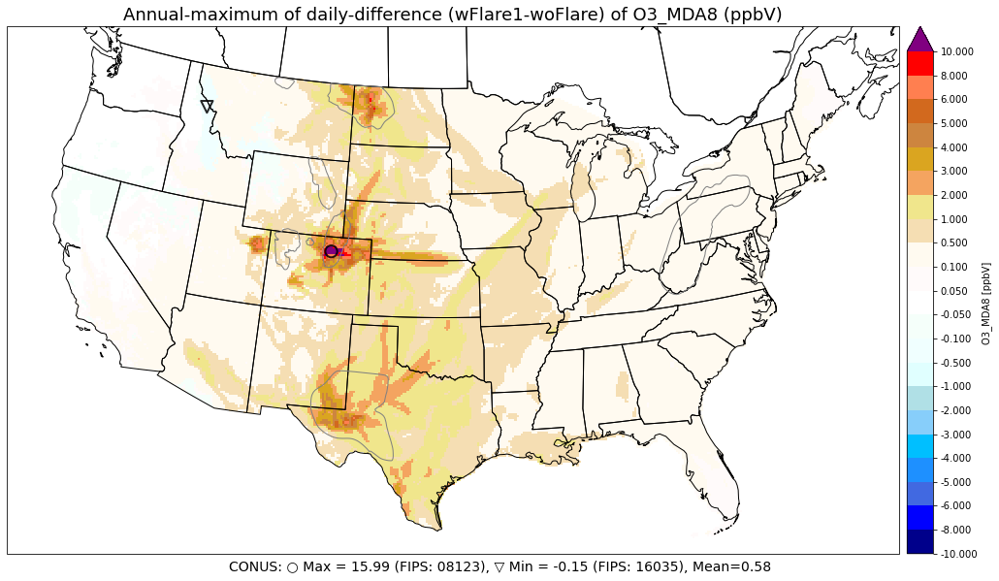
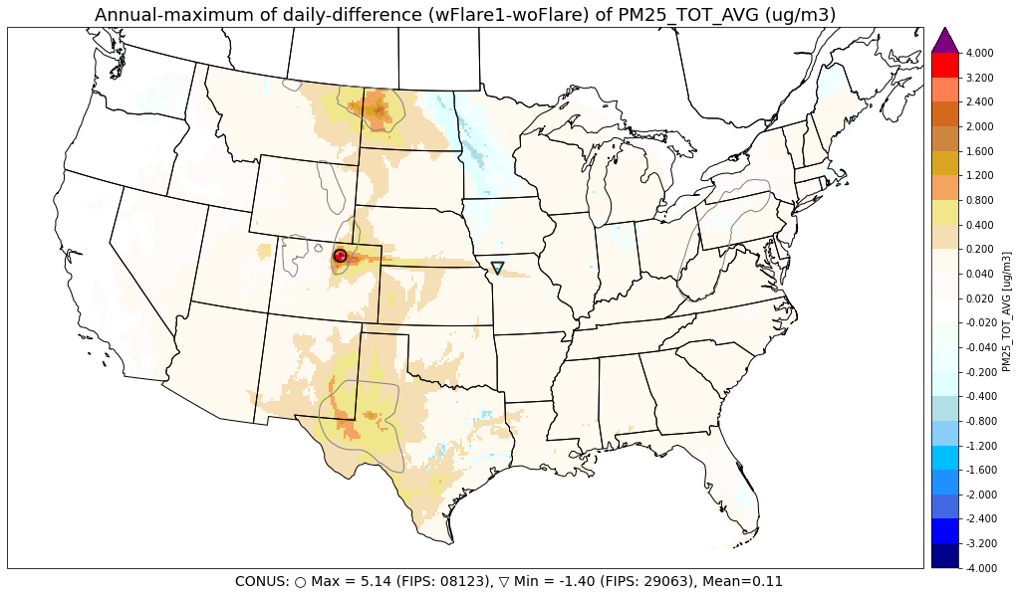
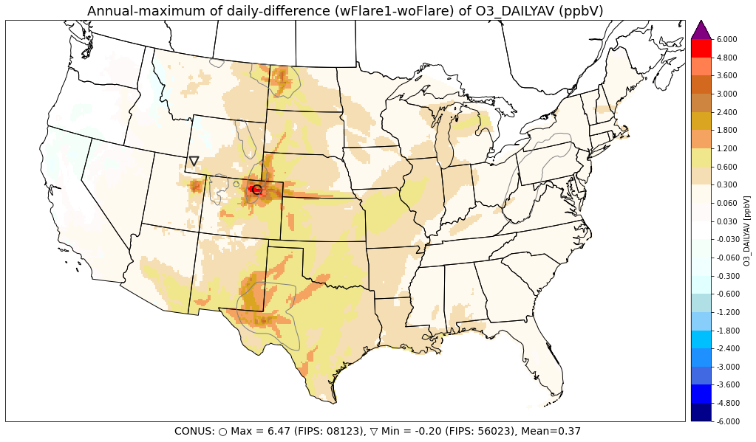
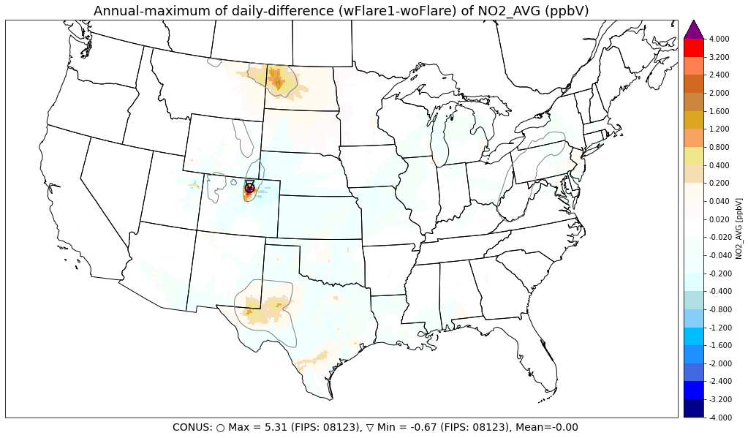
Highest Impact Analyses (wFlare1 – woFlare)
Annual Maximum Difference (ppb)
O₃ MDA8
PM_{2.5}
O₃
NO₂

Slide 16
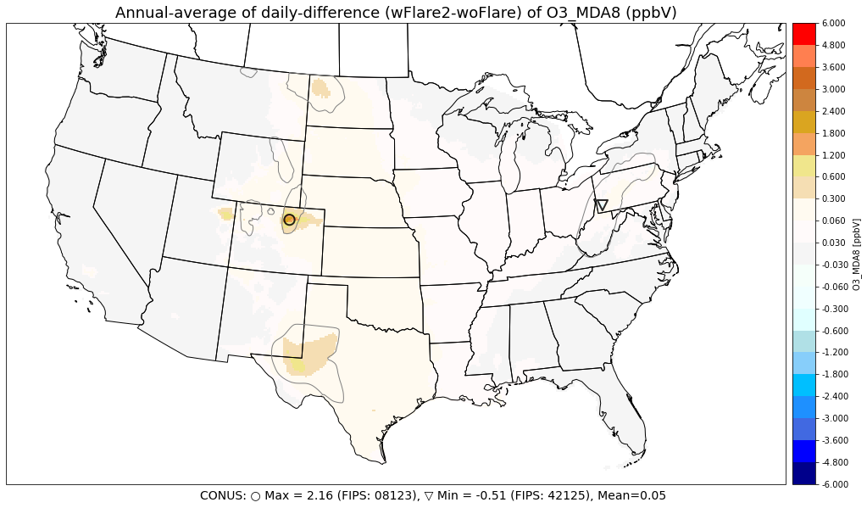
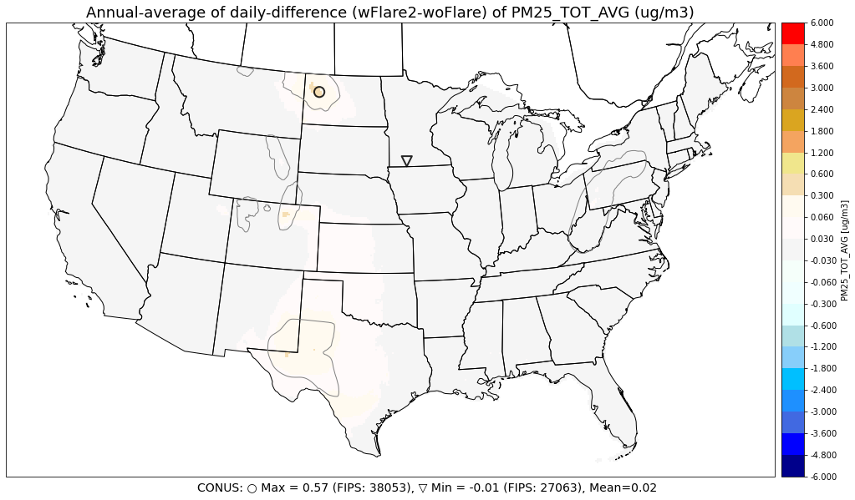
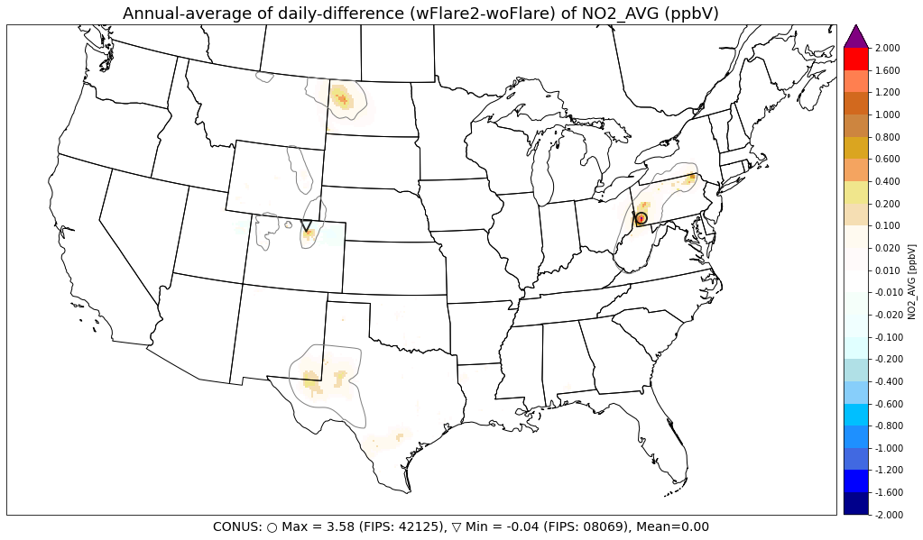
Annual Average (wFlare2 – woFlare)
Annual Average Difference (ppb)
O₃ MDA8
PM_{2.5}
O₃
NO₂

Slide 17
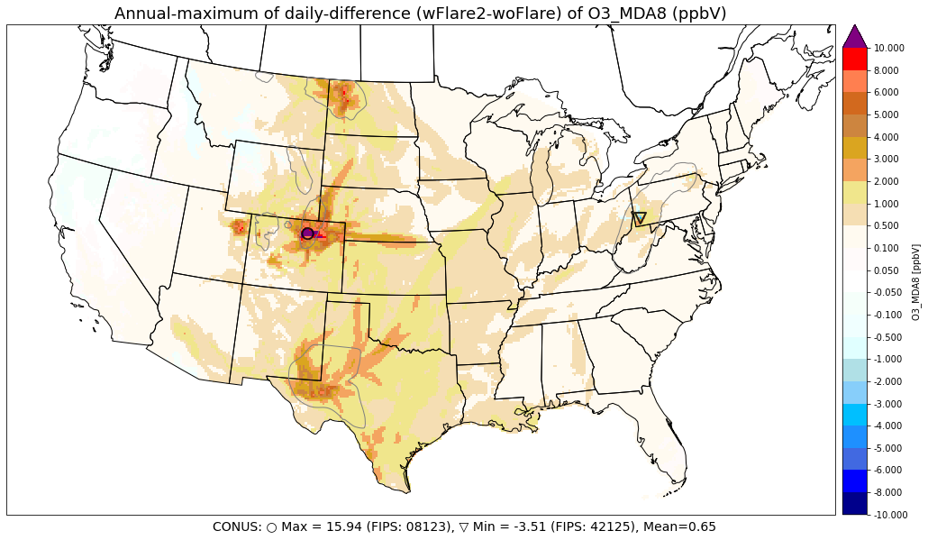
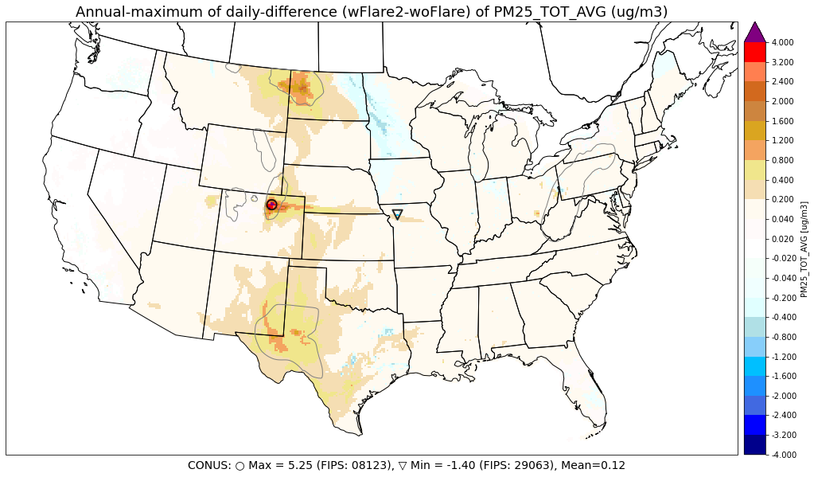
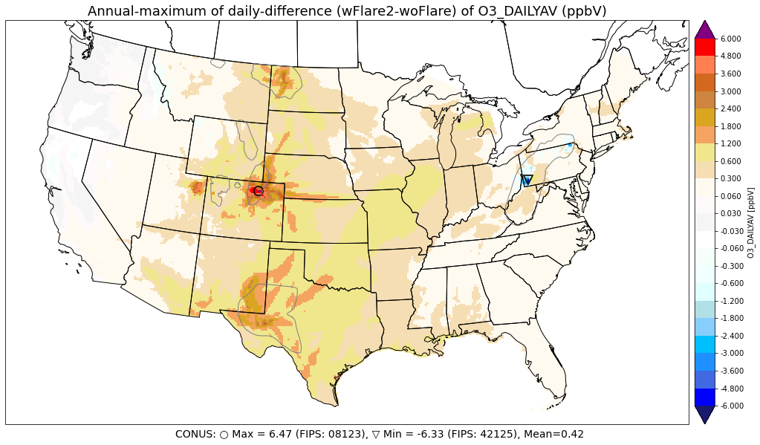
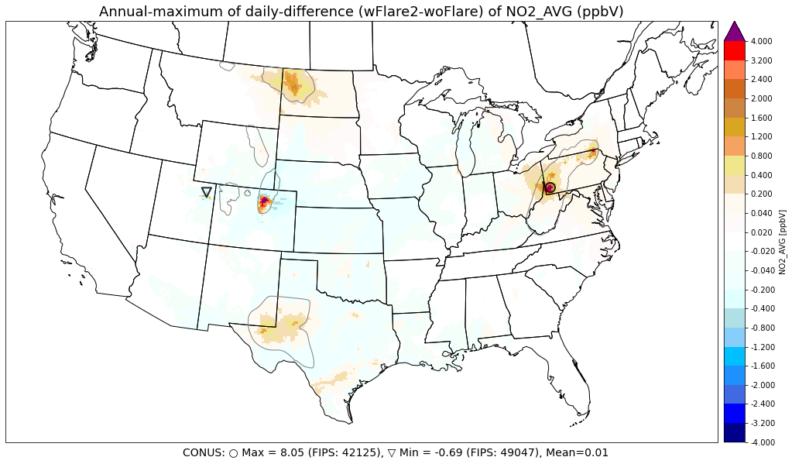
Highest Impact Analyses (wFlare2 – woFlare)
Annual Maximum Difference (ppb)
O₃ MDA8
PM_{2.5}
O₃
NO₂

Slide 18
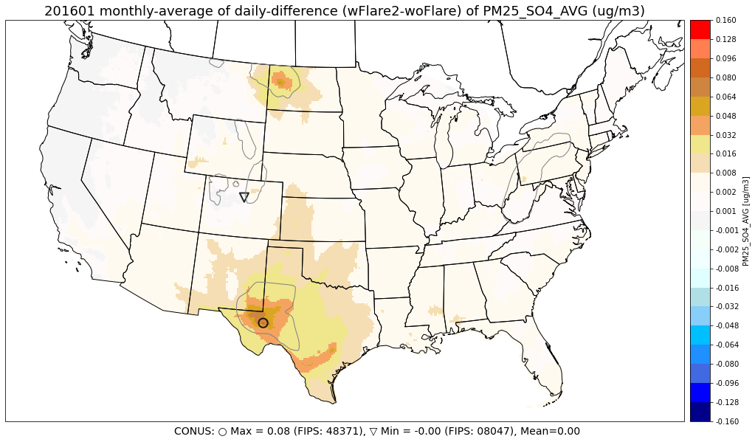
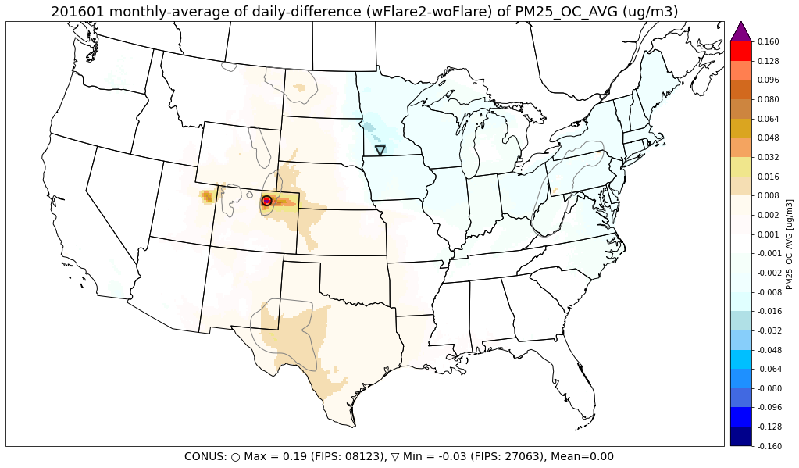
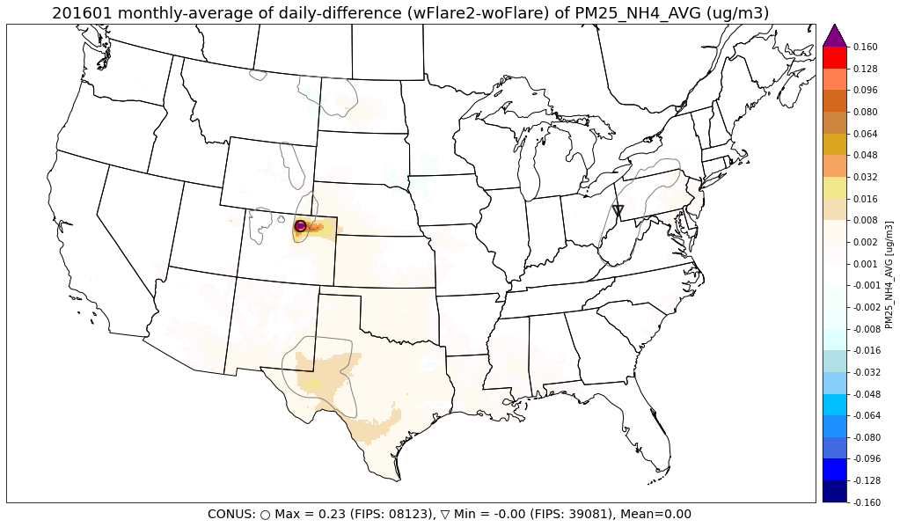
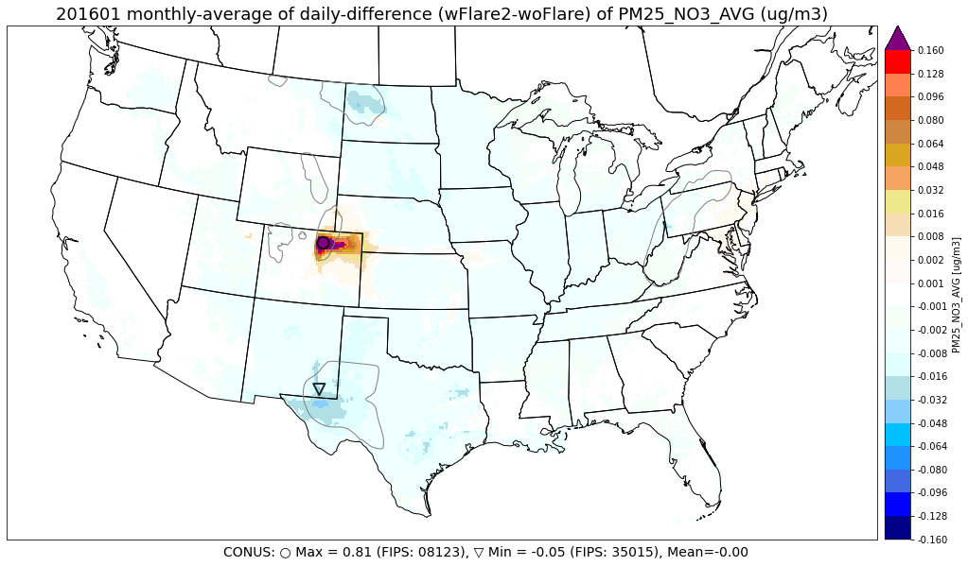
PM_{2.5} components (wFlare2 – woFlare) January
SO4
OC
NH4
EC
NO3

Slide 19
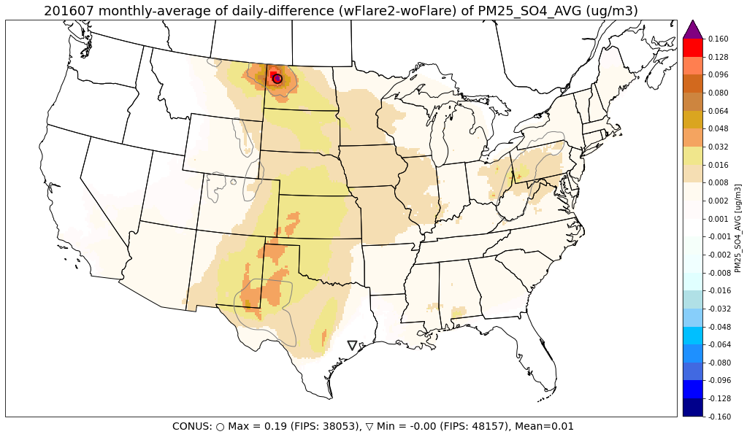
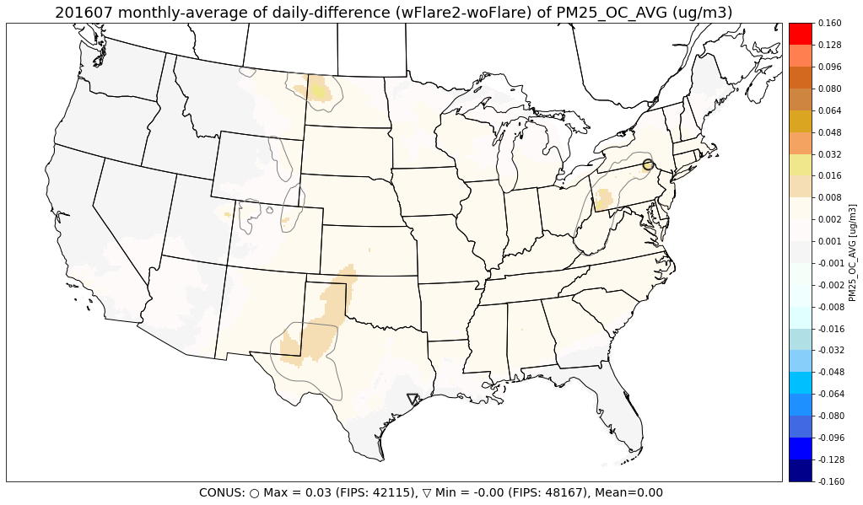
PM_{2.5} components (wFlare2 – woFlare) July
SO4
OC
NH4
EC
NO3

Slide 20
Emissions (wFlare1)
NO_{X} wFlare1
NO_{X} (wFlare1 – woFlare)
VOC wFlare1
VOC (wFlare1 – woFlare)

Slide 21
Emissions (wFlare2)
NO_{X} (wFlare2 – woFlare)
NO_{X} (wFlare2 – wFlare1)
VOC (wFlare2 – woFlare)
VOC (wFlare2 – wFlare1)

Slide 22
Emission Contributions of Flaring and Venting
NEI 2016
NEI 2017
wFlare1
wFlare2
44%
50%
1.4%
2.3%
Notes:
SA: nice work

Slide 23
O₃ sensitivity to NO_{X} and VOC emissions from Flaring and Venting
O₃_ENOx
O₃_EVOC
January
July
O₃_ENOx
O₃_EVOC
O₃ (ppbV)
Strong O₃ sensitivities to NO_{X} emissions from Compressor Engines and Pumpjack/Drilling/Completion
Notes:
NO_{X} emissions from Compressor Engines and Pumpjack/Drilling/Completion
have strongest impact on O₃ in area outside Oil & Gas production basin.
However, over major Oil & Gas production basins, O₃ negatively responses to NO_{X} emissions.

Slide 24
Brute Force vs. DDM for O₃ from Key Oil & Gas Source Types – July wFlare2)
O₃_ENOx
Brute-force Average Difference (ppb)
O₃_ENOx
Flaring and Venting
Compressors Engines
O₃_EVOC
O₃_ENOx
(Brute-force is comparable to DDM analyses for group 1 only)
Within Flaring and Venting group, ozone is more sensitive to VOC (positive) than to NO_{X} (positive/negative) emissions.
Flaring and Venting
Pumpjack, Drilling & Completion
O₃ (ppbV)
O₃_EVOC
NO_{X} emissions from Compressor Engines and Pumpjack/Drilling/Completion
have strongest impact on O₃ in area outside Oil & Gas production basin.
However, over major Oil & Gas production basins, O₃ negatively responses to NO_{X} emissions.
Fugitives and Pneumatics
Notes:
Discuss Bakken basin in color circle: We have positive ozone contribution from flaring and venting. However, ozone is negative to NOx but positive sensitive to VOC. If flare NOx is excluded, Ozone may increase in the Bakken.

Slide 25
Brute Force vs. DDM for PM_{2.5} – July
PM_{2.5}_ESO₂
SO₄_ESO₂
NH₄_ESO₂
PM_{2.5} (ug/m³)
Flaring and Venting
PM_{2.5}_EPM_{2.5}
EC_EPM_{2.5}
O₃_EVOC
Average Difference (ug/m3)
PM_{2.5} is more sensitive to SO₂ emission from flaring and venting on average over the model domain
At some hot spot, however, PM_{2.5} is more sensitive to primary PM_{2.5} emission, of which 100% is EC.
Notes:
On average: 88% is to SO2 emission
At hot spot: 64% of PM_{2.5} contributed from flaring is from primary PM_{2.5} emission (of which 100% is EC)., the remaining contributed PM_{2.5} is from SO₂ emission from which 86% is in form of SO₄ and 14% is in form of NH₄ aerosols.
Less than 2% of PM_{2.5} is contributed by NO_{X} (positive contribution) and VOC (negative contribution) emissions.

Slide 26
Brute Force vs. DDM for NO₂ – July
Monthly Average NO₂ (ppb)
Average Difference (ppb)
wFlare2
Highest NO₂ impact over Pennsylvania (up to 8 ppb). Second highest impact over Denver Basin (5 ppbV).
NO₂_ENOx
NO₂_ENOx
NO₂_ENOx
Flaring and Venting
Compressors Engines
Pumpjack, Drilling & Completion
NO₂_EVOC
NO₂ (ppbV)
On average less than 1 ppb of NO₂ contributed by NO_{X} emissions from flaring and venting (with exceptions for Pennsylvania).
Flaring and Venting
Notes:
Discuss Bakken basin in color circle: We have positive ozone contribution from flaring and venting. However, ozone is negative to NOx but positive sensitive to VOC. If flare NOx is excluded, Ozone may increase in the Bakken.

Slide 27
Abmormal high NOx emissions in Pennsylvania and Wyoming in Flare-SCCs class in NEI2017
States |  | VOC | NO_{X} | CO | PM₁₀ | PM_{2.5} | NH₃ | SO₂
Texas | non-point | 578,302 | 4,580 | 20,597 | 0 | 0 | 0 | 23,325
 | point | 604 | 1,013 | 2,780 | 10 | 9 | 0 | 7,037
North Dakota | non-point | 307,738 | 2,112 | 11,162 | 0 | 0 | 0 | 2,486
 | point | 17 | 27 | 115 | 2 | 2 | 0 | 532
New Mexico | non-point | 83,867 | 137 | 705 | 1 | 1 | 0 | 2,166
 | point | 311 | 109 | 425 | 1 | 1 | 0 | 2,424
Wyoming | non-point | 55,579 | 2,691 | 672 | 0 | 0 | 0 | 56
 | point | 385 | 264 | 338 | 4 | 4 | 0 | 2,129
Colorado | non-point | 81,867 | 868 | 0 | 0 | 0 | 0 | 0
 | point | 1,804 | 348 | 1,149 | 1 | 1 | 0 | 23
Pennsylvania | non-point | 6,608 | 7,465 | 2,631 | 195 | 192 | 0 | 1,602
 | point | 0 | 0 | 0 | 0 | 0 | 0 | 0
Most of Flare NOx in Pennsylvania is from SCC 2310021500 - On-Shore Gas Production; Gas Well Completion – Flaring (7,424 tons/yr).
Most of Flare NOx in Wyoming is from SCC 2310011020 - On shore oil production crude tanks including flash (1,656 tons/yr).

Slide 28
CMAQ overestimates MDA8O3 over eastern U.S. in summer months

Slide 29
CMAQ well approximates observed PM_{2.5}

