Slide 1
Sensitivity of Ozone to Emission Reductions in the New York City (NYC)
21st Annual CMAS Conference
October 18, 2022
Trang Tran¹, Naresh Kumar², Eladio Knipping³
¹Ramboll; ²DRI; ³EPRI
Impactful Science, Inspiring Solutions.

Slide 2
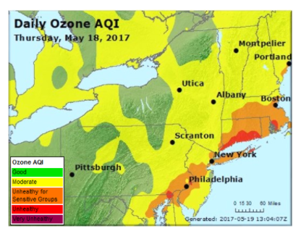
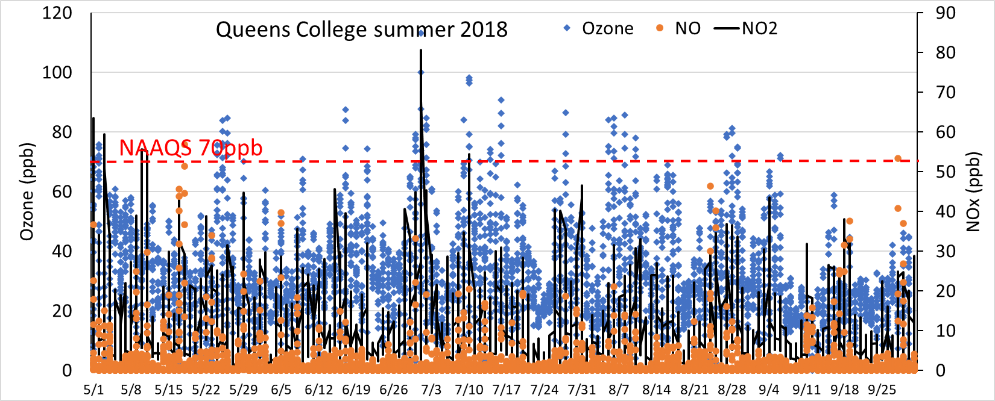
Study goal: Estimate contributions of different sources to ozone in an urban environment and examine sensitivity to emission reductions
Used Long Island Sound (LIS) area as a test bed because of availability of intensive measurements during the LISTOS period and the NYSERDA-EPRI study (O₃, speciated NOx/NOy)
Conducted diagnostic tests to improve model performance before emissions sensitivity runs
Long Island Sound (LIS) area
Queens College
2

Slide 3
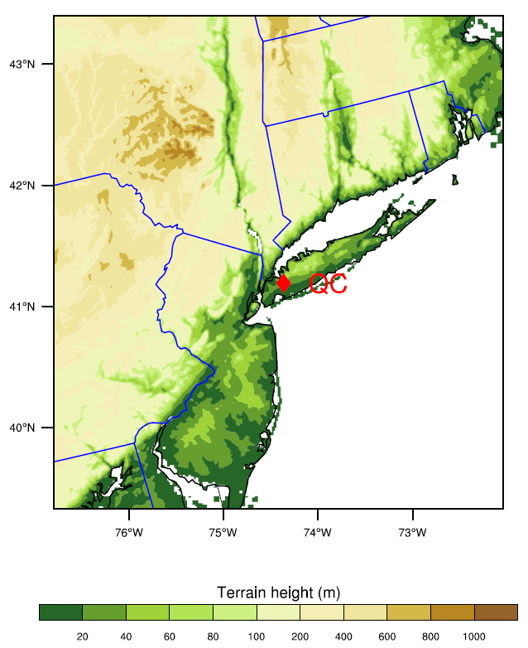
Methodology
WRF-CAMx domain
Numerical modeling:
Photochemical model: CAMx V7.0 Weather model: WRF V4.2 Emissions: NEI Version 7.2 of 2016 beta platform
Resolution: 1.33km Modeling period: 2018, May 2nd – Sept 30th
Step-by-step process:
Conduct base-case modeling using model input data from EPA
Conduct model performance for WRF and CAMx
Identify sensitivity runs to improve model performance for WRF and CAMx
Source contribution simulation using APCA (Anthropogenic Precursors Culpability Assessment) tool in CAMx
50% anthropogenic emissions reduction sensitivity simulation
Down-wind region
NYC – source region
3

Slide 4
WRF Model Performance
WRF-BASE performance: captured well temperature, humidity, wind direction but strongly overestimated windspeed.

Slide 5
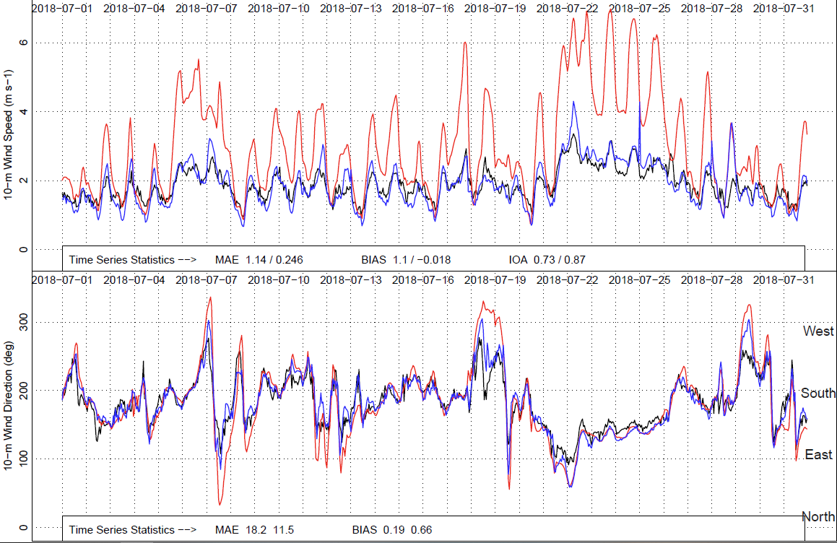
WRF Model Performance (Contd.)
Wind nudging consistently reduced wind speed overestimation
WRF-NUDGE performance statistics met generally accepted model performance benchmarks.
Black: observed Red: BASE Blue: NUDGE
Month | Bias/MAE |  |  | Bias/RMSE
 | T2 (K) | Q2 (g/kg) | WD (deg.) | WS (m/s)
JUN | 0.1/1.3 | -0.4/0.9 | -1.1/39 | 0.1/1.4
JUL | 0.2/1.3 | -0.5/1.4 | -1.4/40 | 0.1/1.5
AUG | 0.2/1.2 | -0.5/1.5 | -0.5/35 | -0.1/1.4
SEP | 0.3/1.3 | -0.3/1.2 | -0.1/35 | 0.1/1.4
Benchmark | ±0.5/2.0 | ±1.0/2.0 | ±5/40 | ±0.5/2.0

Slide 6
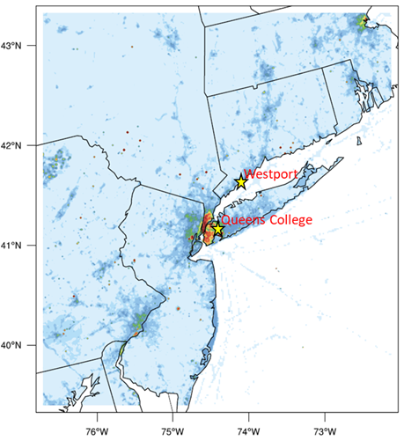
Averaged hourly NOx (left) and VOC anthropogenic emissions (right)

Slide 7
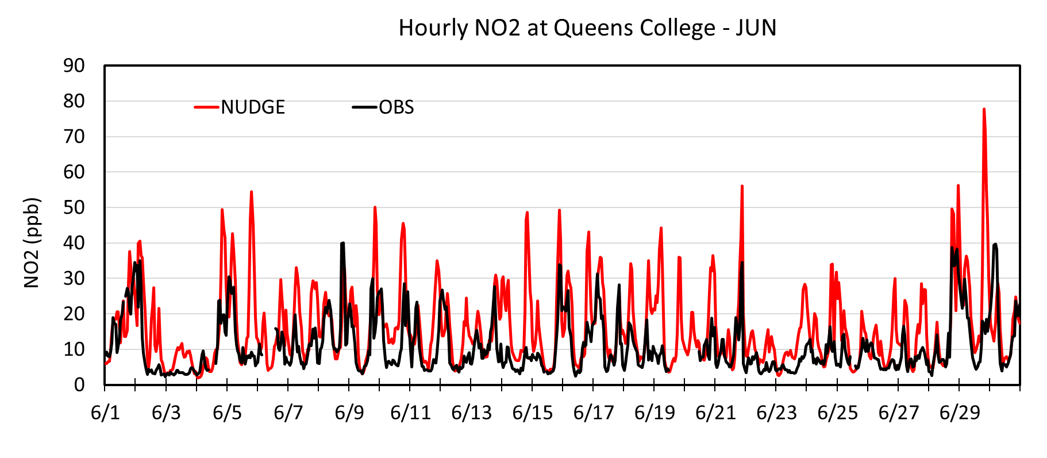
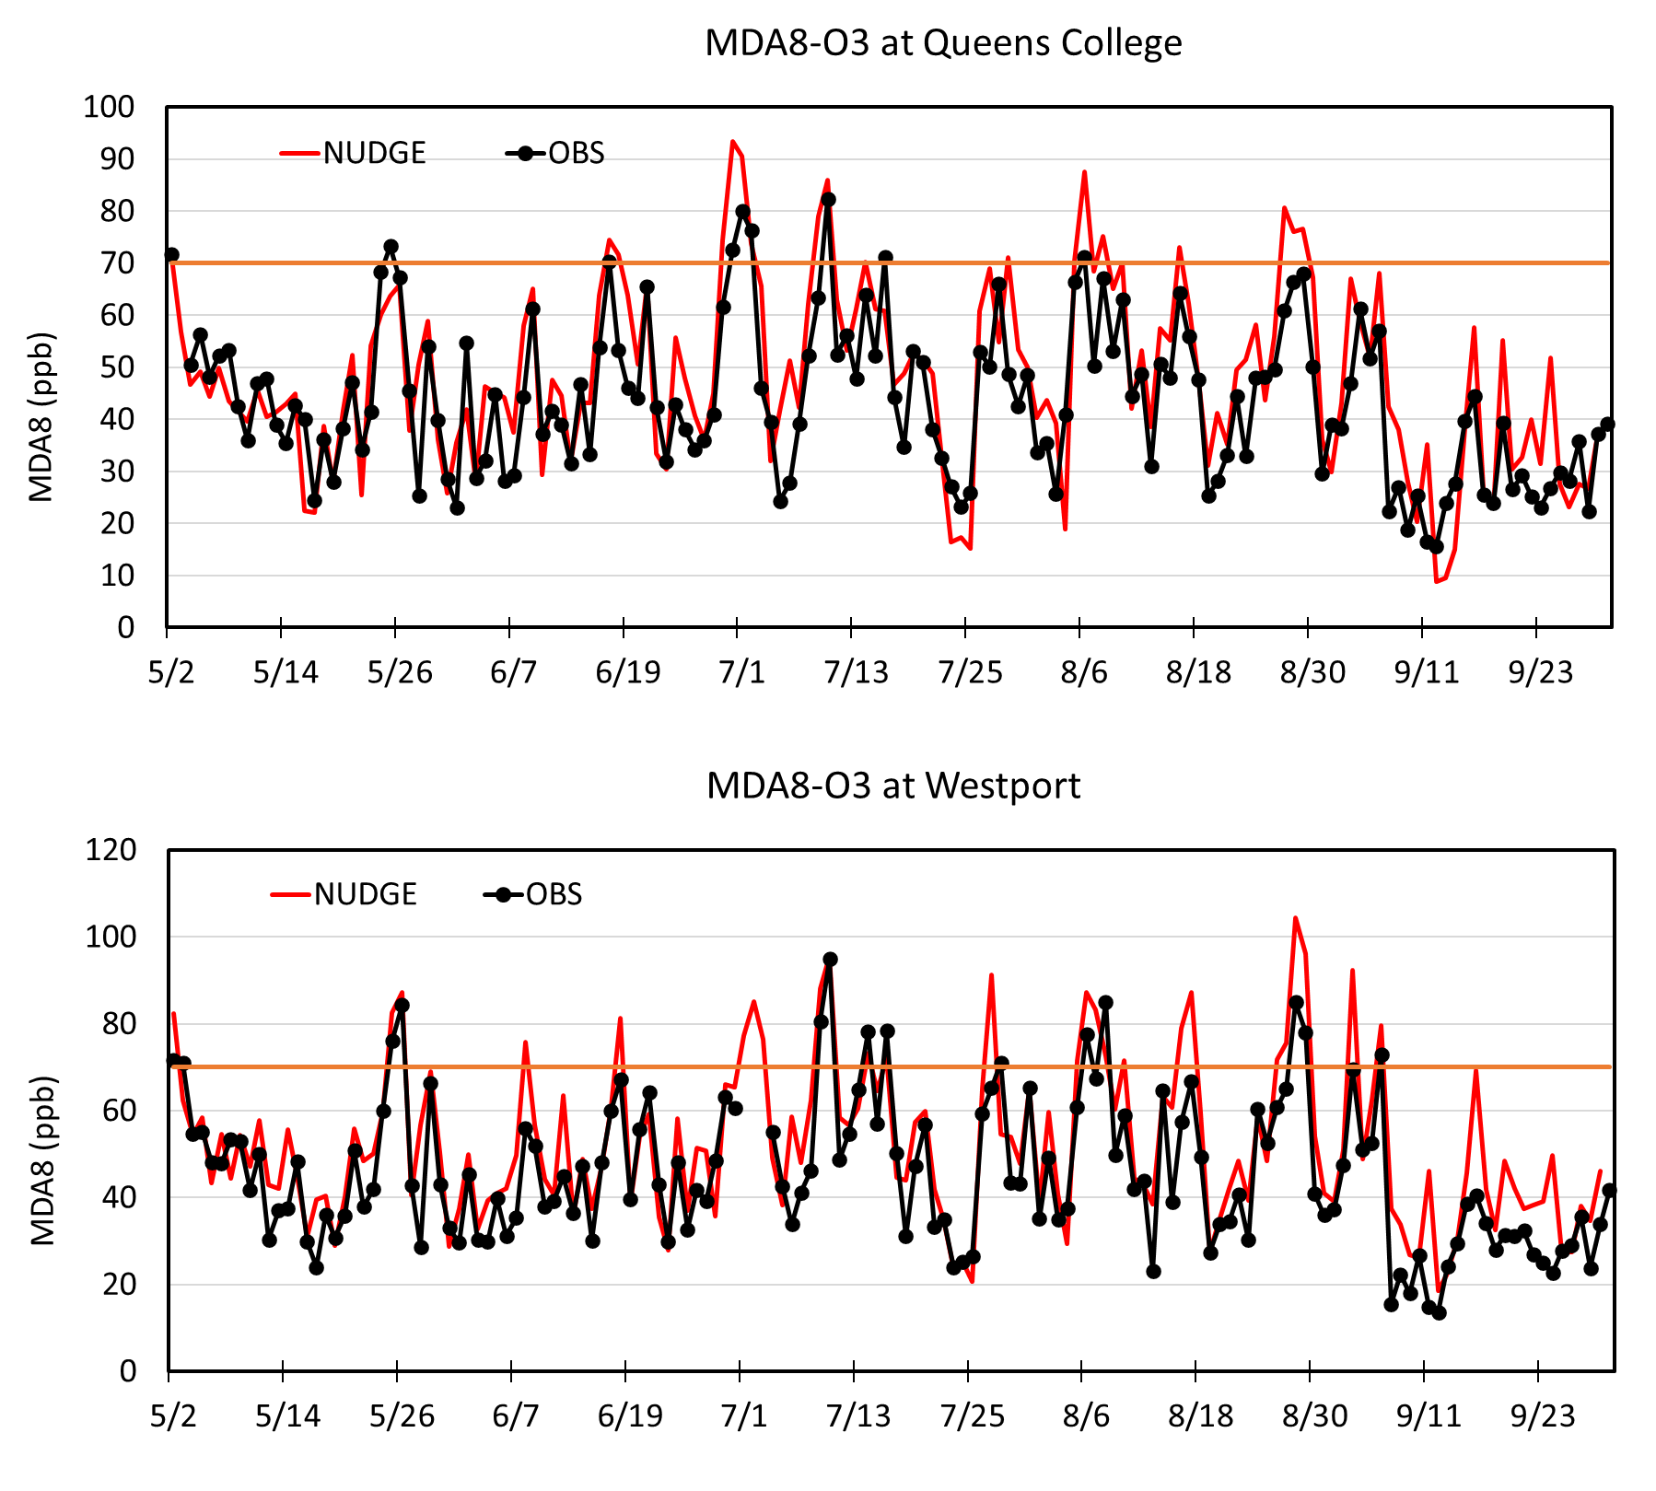
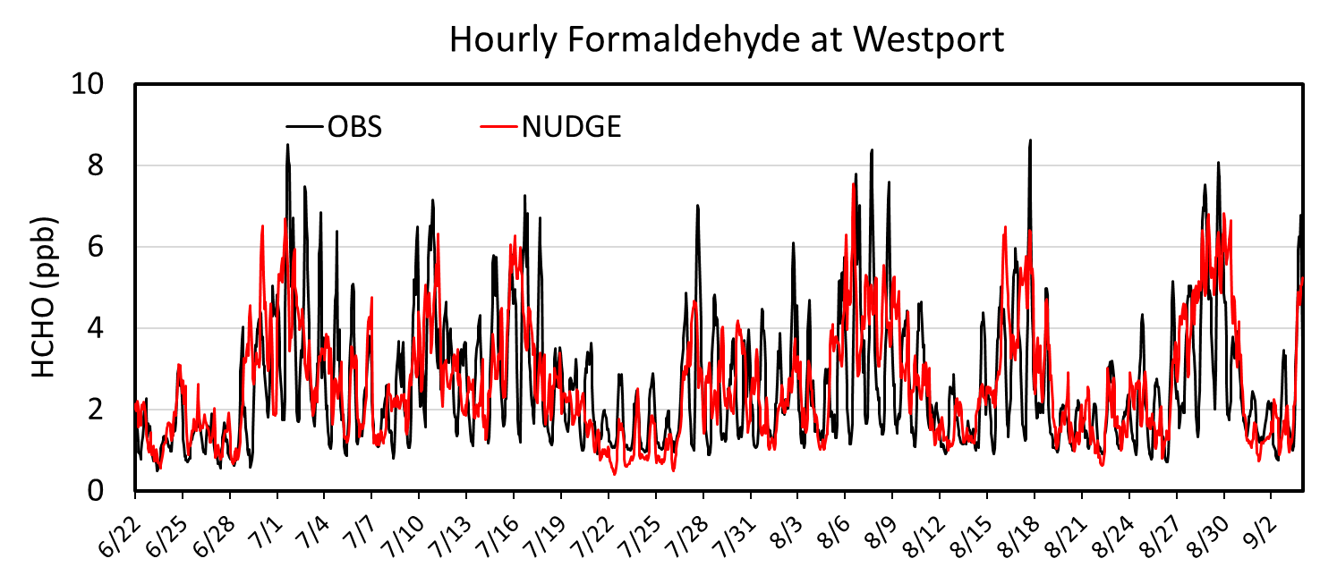
CAMx Model Performance
Simulating ozone
Temporal evolution, exceedance timing: well simulated at both source (Queens College) and downwind area (West Port)
MDA8 ozone concentrations: positive biases up to 20ppb
Simulating ozone precursors
- NO₂ concentrations: consistently overpredicted
- Formaldehyde (VOC) concentrations: well captured at Westport (the only site having in-situ data)

Slide 8
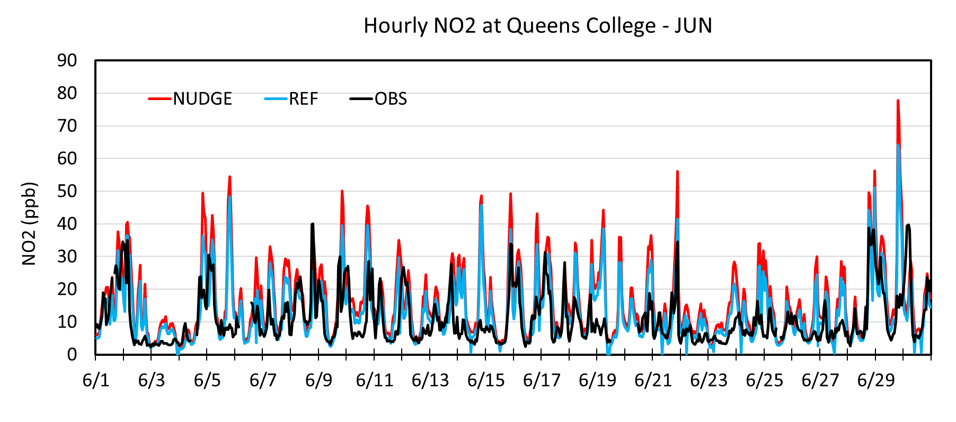
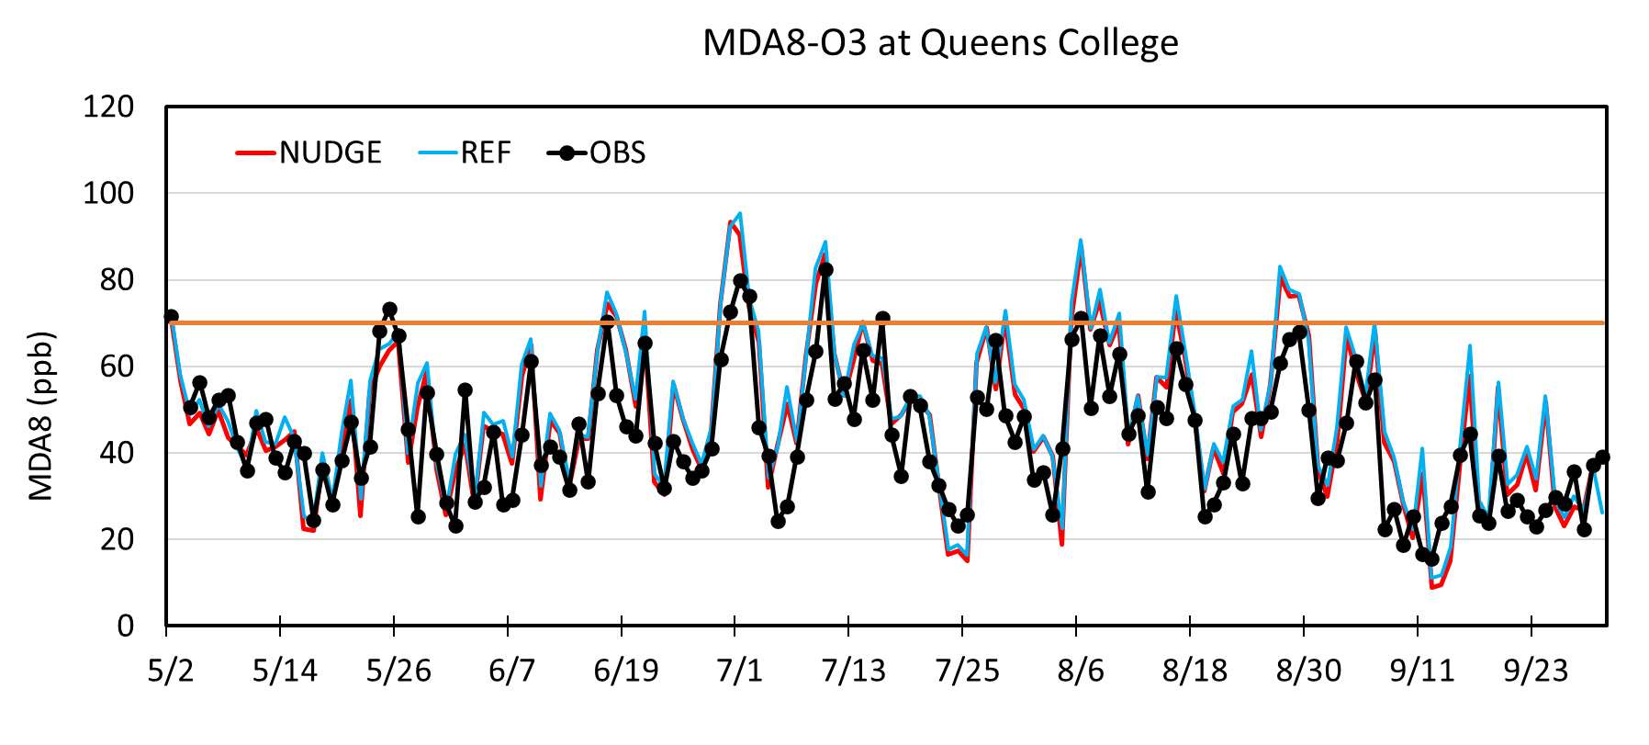
CAMx Model Performance after Emissions Adjustment
Reduced NOx emission by 22% (REF case) in NYC area based on satellite observations and previous studies
Improved CAMx model performance in simulating NO₂
Slightly increased ozone concentrations within NYC area -> VOC-limited ozone formation regime

Slide 9
Diurnal Cycle of Ozone and NO₂ Concentrations

Slide 10
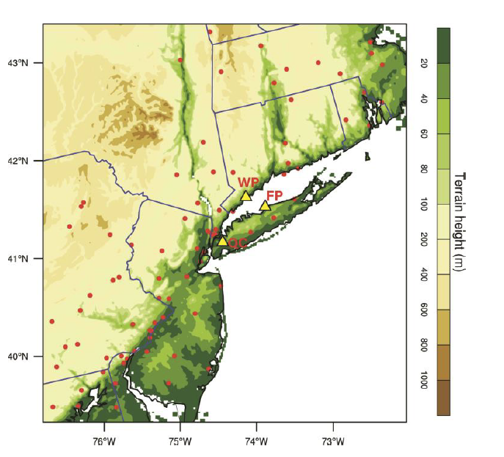
Model Performance Statistics for the REF Case
Month | NMB (%) | NME (%) | r
JUNE | 6.7 | 14.8 | 0.77
JULY | 8.6 | 16.9 | 0.80
AUGUST | 18.1 | 20.6 | 0.79
SEP | 27.1 | 31.9 | 0.77

Slide 11
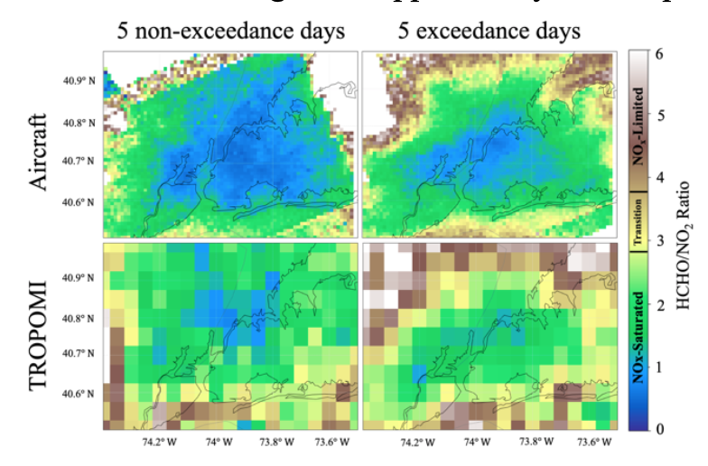
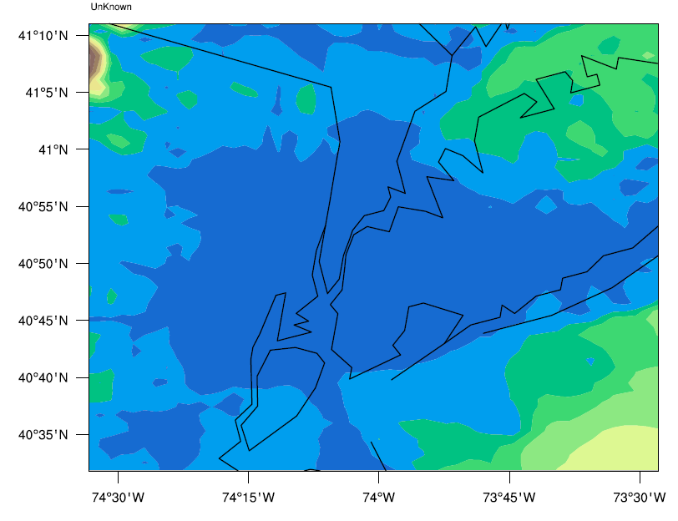
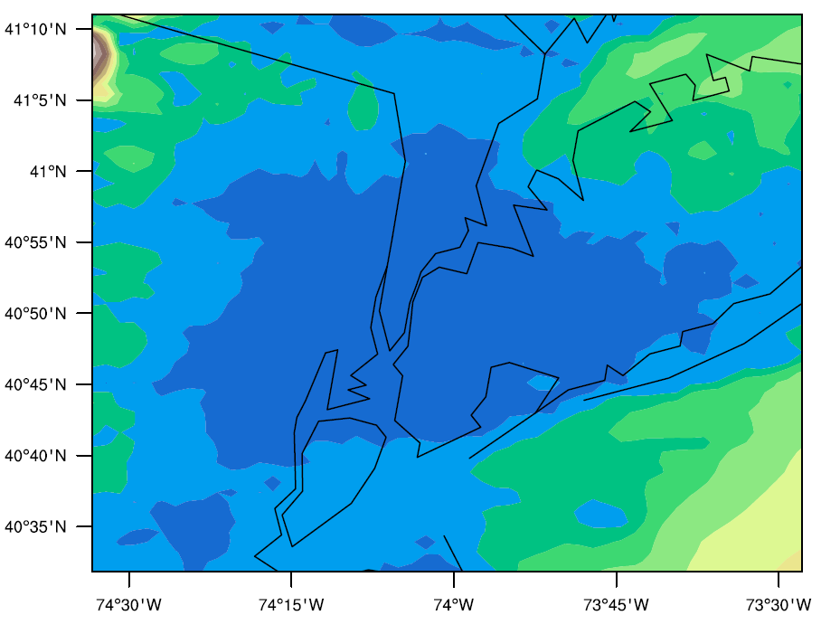
CAMx Model Performance (cont.):
REF case predicted NYC as VOC-Limited regime (e.g., NOx-Saturated) agreeing with observations. Shrinking VOC-limited regions between non-exceedance and exceedance also agreed with observations.
Obs: courtesy of Madankui Tao (Columbia University) and Alexandra Karambelas (NESCAUM)
Obs
Model

Slide 12
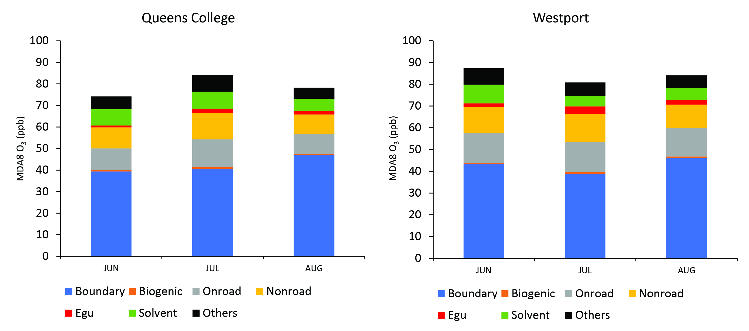
Source Contributions on Exceedance Days Using APCA tool in CAMx
Sources ranked by contribution (largest to smallest): On-road, Non-road mobile, industrial solvent, and EGU

Slide 13
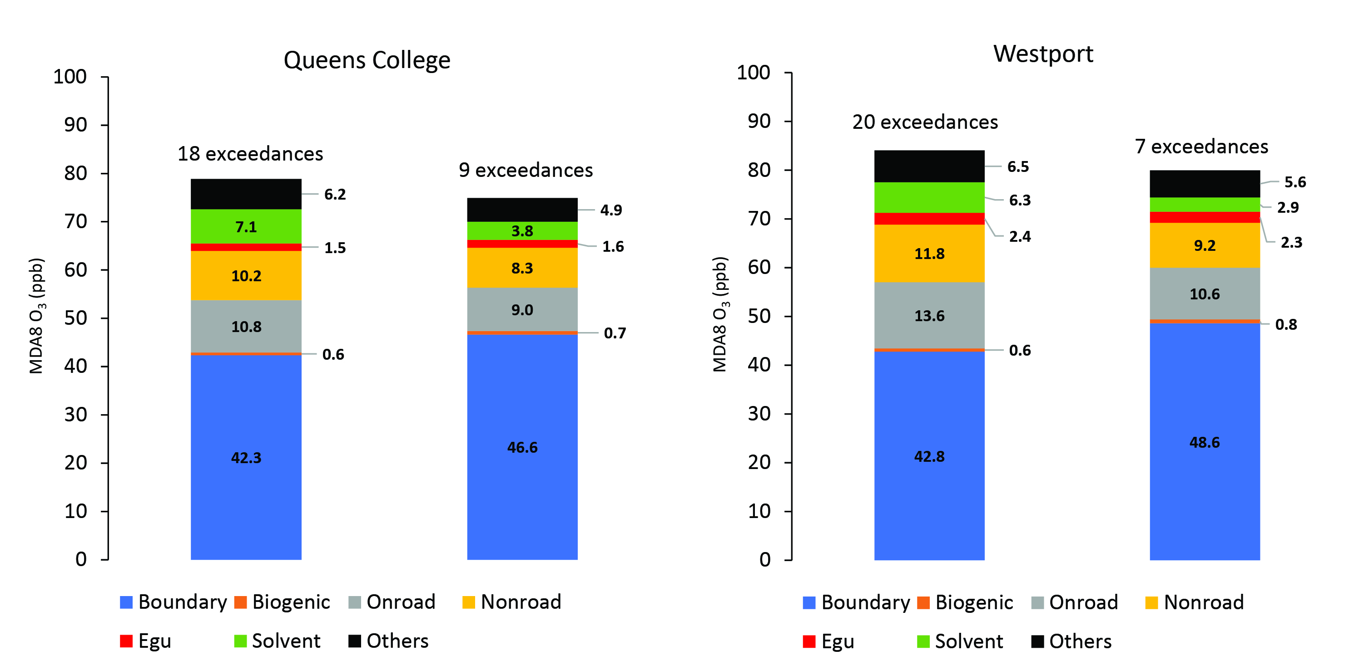
Ozone sensitivity to 50% anthropogenic emission reductions
Number of exceedances reduced by 50% for source region and by 65% for down-wind region
VOC emission reduction from industrial solvents led to largest air quality improvement
REF
Emission control
REF
Emission control

Slide 14
Summary
Both the emissions and WRF output were adjusted to improve the CAMx model performance before using the model for source apportionment.
NYC area was predicted as VOC-limited ozone formation regime -> agreed well with observations.
On-road, non-road mobile, and industrial solvent emitters were large contributors to ozone.
Reducing all anthropogenic emissions by 50% for all pollutants lowered the number of ozone exceedances by 50% for source region and by 65% for down-wind region.
Reducing VOC from solvents yielded the highest air quality improvement
It is critical to do diagnostic model evaluation before using models for regulatory purposes

Slide 15
Acknowledgments
EPRI for providing funding
Dr. Jon Pleim, EPA and Dr. Ana Torres-Vazquez, NWS – Miami for WRF’s namelist, IC/BC and emission inputs
Alexandra Karambelas, NESCAUM and Dr. Huy Tran, UNC at Chapel Hill for discussions

