Slide 1
Tutorials: CMAQ on AWS and Azure
Elizabeth Adams¹, Christos Efstathiou¹, Carlie Coats¹, Robert Zelt²,
Mark Reed², John McGee², Saravanan Arunachalam¹
¹Institute for the Environment, The University of North Carolina at Chapel Hill, NC, USA
²Information Technology Services, The University of North Carolina at Chapel Hill, NC, USA
Presented at
The 21st Annual CMAS Conference, Oct.19, Chapel Hill, NC

Slide 2
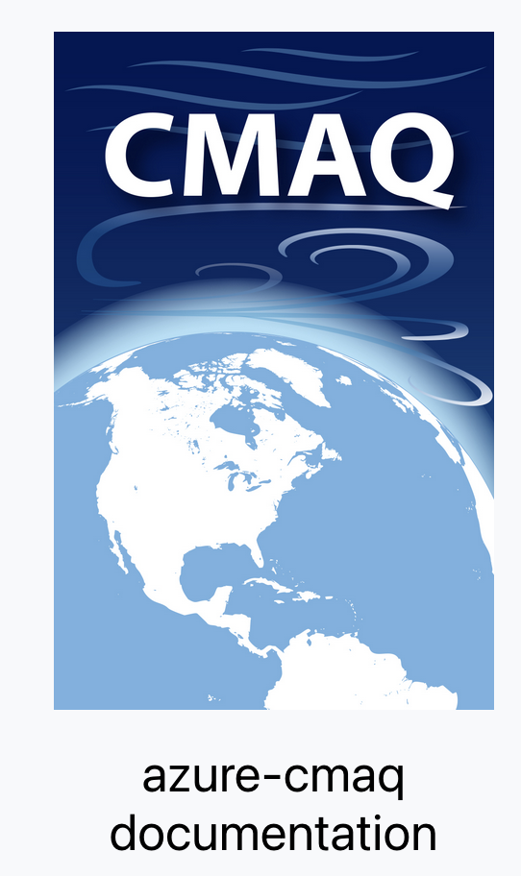
CMAQ on AWS and Azure: The Big Picture
Goal
Provide tutorial with instructions to install, run, and QA CMAQ with AWS and Azure’s HPC solutions.
Objectives:
Enable high-performance cloud computing for current and future CMAQ releases
Provide with guidance for setting up, evaluating, and optimizing the model performance in different cloud service providers (CSPs)
Establish a Benchmark/QA Suite and “target user groups” to take advantage of different CSP offerings, while showing ways of controlling the costs
Notes:
Wallgardening.

Slide 3
Tutorials for different CSPs and end-users
Online guides, tutorials, background info, solutions, performance and cost analysis, etc:
Microsoft’s Azure:
https://cyclecloud-cmaq.readthedocs.io/en/latest/
Amazon’s AWS:
https://pcluster-cmaq.readthedocs.io/en/latest/index.html
Target end-users (not mutually exclusive):
Novice users, early-stage model testing
Advanced users, that need to fully harness the HPC potential of CMAQ through annual/high resolution simulations, operational use

Slide 4
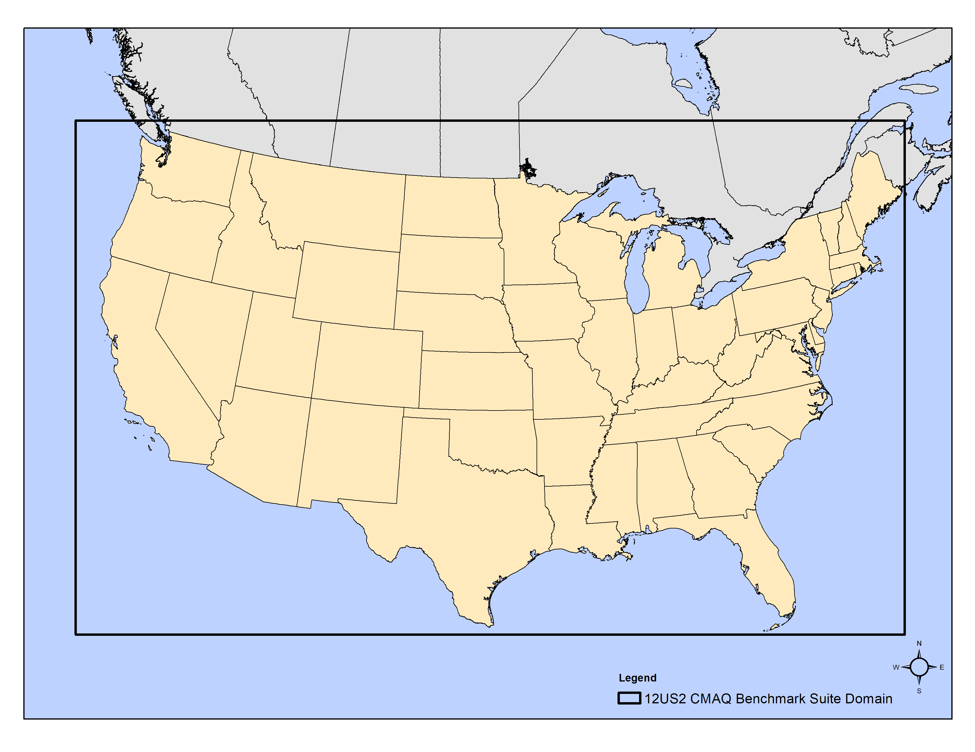
The CMAQ Benchmark Suite for the Cloud
2-day 12x12 km CONUS scenario (396 x 246 x 35)
Using CMAQ 5.3.3 with cb6r3_ae7_aq
Inputs ~50 GB, Output ~170 GB
CMAS Data Warehouse on AWS Open Data:
Collects and disseminates meteorology, emissions and air quality model input and output for Community Multiscale Air Quality (CMAQ) Model Applications.
Ingress and Egress fees are waived as part of the AWS Open Data Program.
https://registry.opendata.aws/cmas-data-warehouse/

Slide 5
Tutorial Structure
Background & Resources: Serve as a portal to provide quick introduction to Cloud basics, share useful links for newcomers.
Chapters 1: Introductory Tutorial AWS, Azure
Chapter 13: Additional Resources AWS, Azure
Model Configuration and Simulation Design
2-day CMAQ 5.3.3 simulation for CONUS 12km domain
Chapter 2: AWS, Azure
Deployment on Single VM
Chapter 3: Install software and run CMAQ: Azure
Deployment on HPC Cluster
Chapter 3: Run CMAQ using pre-loaded software: AWS
Chapter 4: Install software and Run CMAQ: AWS
Chapter 4: Install software and run CMAQ: Azure

Slide 6
Tutorial Structure continued
Post-process Workflow
Prerequisites (R & packages), Combine, and QA
Chapters 5-9
Clean-up Workflow
Moving output to an S3 Bucket: Chapter 10 AWS, Azure
Deleting the Clusters: Chapter 11: AWS, Azure
Benchmarking and Performance Optimization
Chapter 12: AWS, Azure

Slide 7
Target HPC workflows with software recipes
C-shell scripts to install libraries and CMAQ
Run scripts provided for scaling tests. Run scripts SLURM settings are dependent on compute node type, as they must match number of processors available per node.
Command line instructions to install post-processing tools and run R-based analysis scripts

Slide 8
Differences in Tutorials
The main difference between the tutorials is the way that you create the HPC Cluster:
For AWS, a YAML file specifies the configuration of the cluster, and the AWS 3.0 Command Line is used to create and login to the head node of the Parallel Cluster.
For Azure, we use the Azure Web Portal to configure the Cycle Cloud Cluster, and then use ssh commands to login to the scheduler node of the cluster.
An additional difference is the naming conventions: Instance Type versus Virtual Machine (VM) Type

Slide 9
AWS YAML File
Region: us-east-2
Region: us-east-2
Image:
Os: ubuntu2004
HeadNode:
InstanceType: c6a.xlarge
Networking:
SubnetId: subnet-018fdd14871ed2b0d
DisableSimultaneousMultithreading: true
Ssh:
KeyName: cmas-east-2
LocalStorage:
RootVolume:
Encrypted: false
Scheduling:
Scheduler: slurm
SlurmSettings:
ScaledownIdletime: 5
SlurmQueues:
- Name: queue1
CapacityType: ONDEMAND
Networking:
SubnetIds:
- subnet-018fdd14871ed2b0d
PlacementGroup:
Enabled: true
ComputeResources:
- Name: compute-resource-1
InstanceType: hpc6a.48xlarge
MinCount: 0
MaxCount: 10
Efa:
Enabled: true
GdrSupport: false
SharedStorage:
- MountDir: /shared
Name: ebs-shared
StorageType: Ebs
EbsSettings:
Encrypted: false
SnapshotId: snap-0a42094c6c2786ab5
- MountDir: /fsx
Name: name2
StorageType: FsxLustre
FsxLustreSettings:
StorageCapacity: 1200
ImportPath: s3://cmas-cmaq-conus2-benchmark
HeadNode:
InstanceType: c6a.large​
ComputeResources:
InstanceType: hpc6a.48xlarge
MaxCount: 10​
StorageType: FsxLustre
FsxLustreSettings:
StorageCapacity: 1200
ImportPath: s3://cmas-cmaq-conus2-benchmark

Slide 10
AWS Workflow
Step 1. Create a virtual environment on a linux machine to install AWS 3.0 CLI
Step 2. Configure cluster using AWS 3.0 CLI
pcluster configure –config your-cmaq.yaml
Step 3. Edit YAML file to use snapshot with pre-loaded software and lustre filesystem.
Step 4. Create Cluster and login to head node using AWS 3.0 CLI
Step 5. Verify the CMAQ software install and input data on lustre
Step 6. Run CMAQ by submitting to SLURM queue

Slide 11
Azure Workflow
Step 1. Create Virtual Machine to host the Cycle Cloud
Step 2. Use host interface to configure and create new slurm cluster
Step 3. Login to scheduler node using ssh
Step 4. Install underlying libraries and CMAQ software
Step 5. Copy input data from S3 Bucket
Step 6. Run CMAQ by submitting to SLURM queue

Slide 12
Configure/Edit Cycle Cloud
HPC VM Type:
HB120rs_v3
Max HPC Cores
10

Slide 13
Configure/Edit Cycle Cloud
Shared File System
Azure File System /data

Slide 14
Configure/Edit Cycle Cloud
Image with Lustre Client

Slide 15
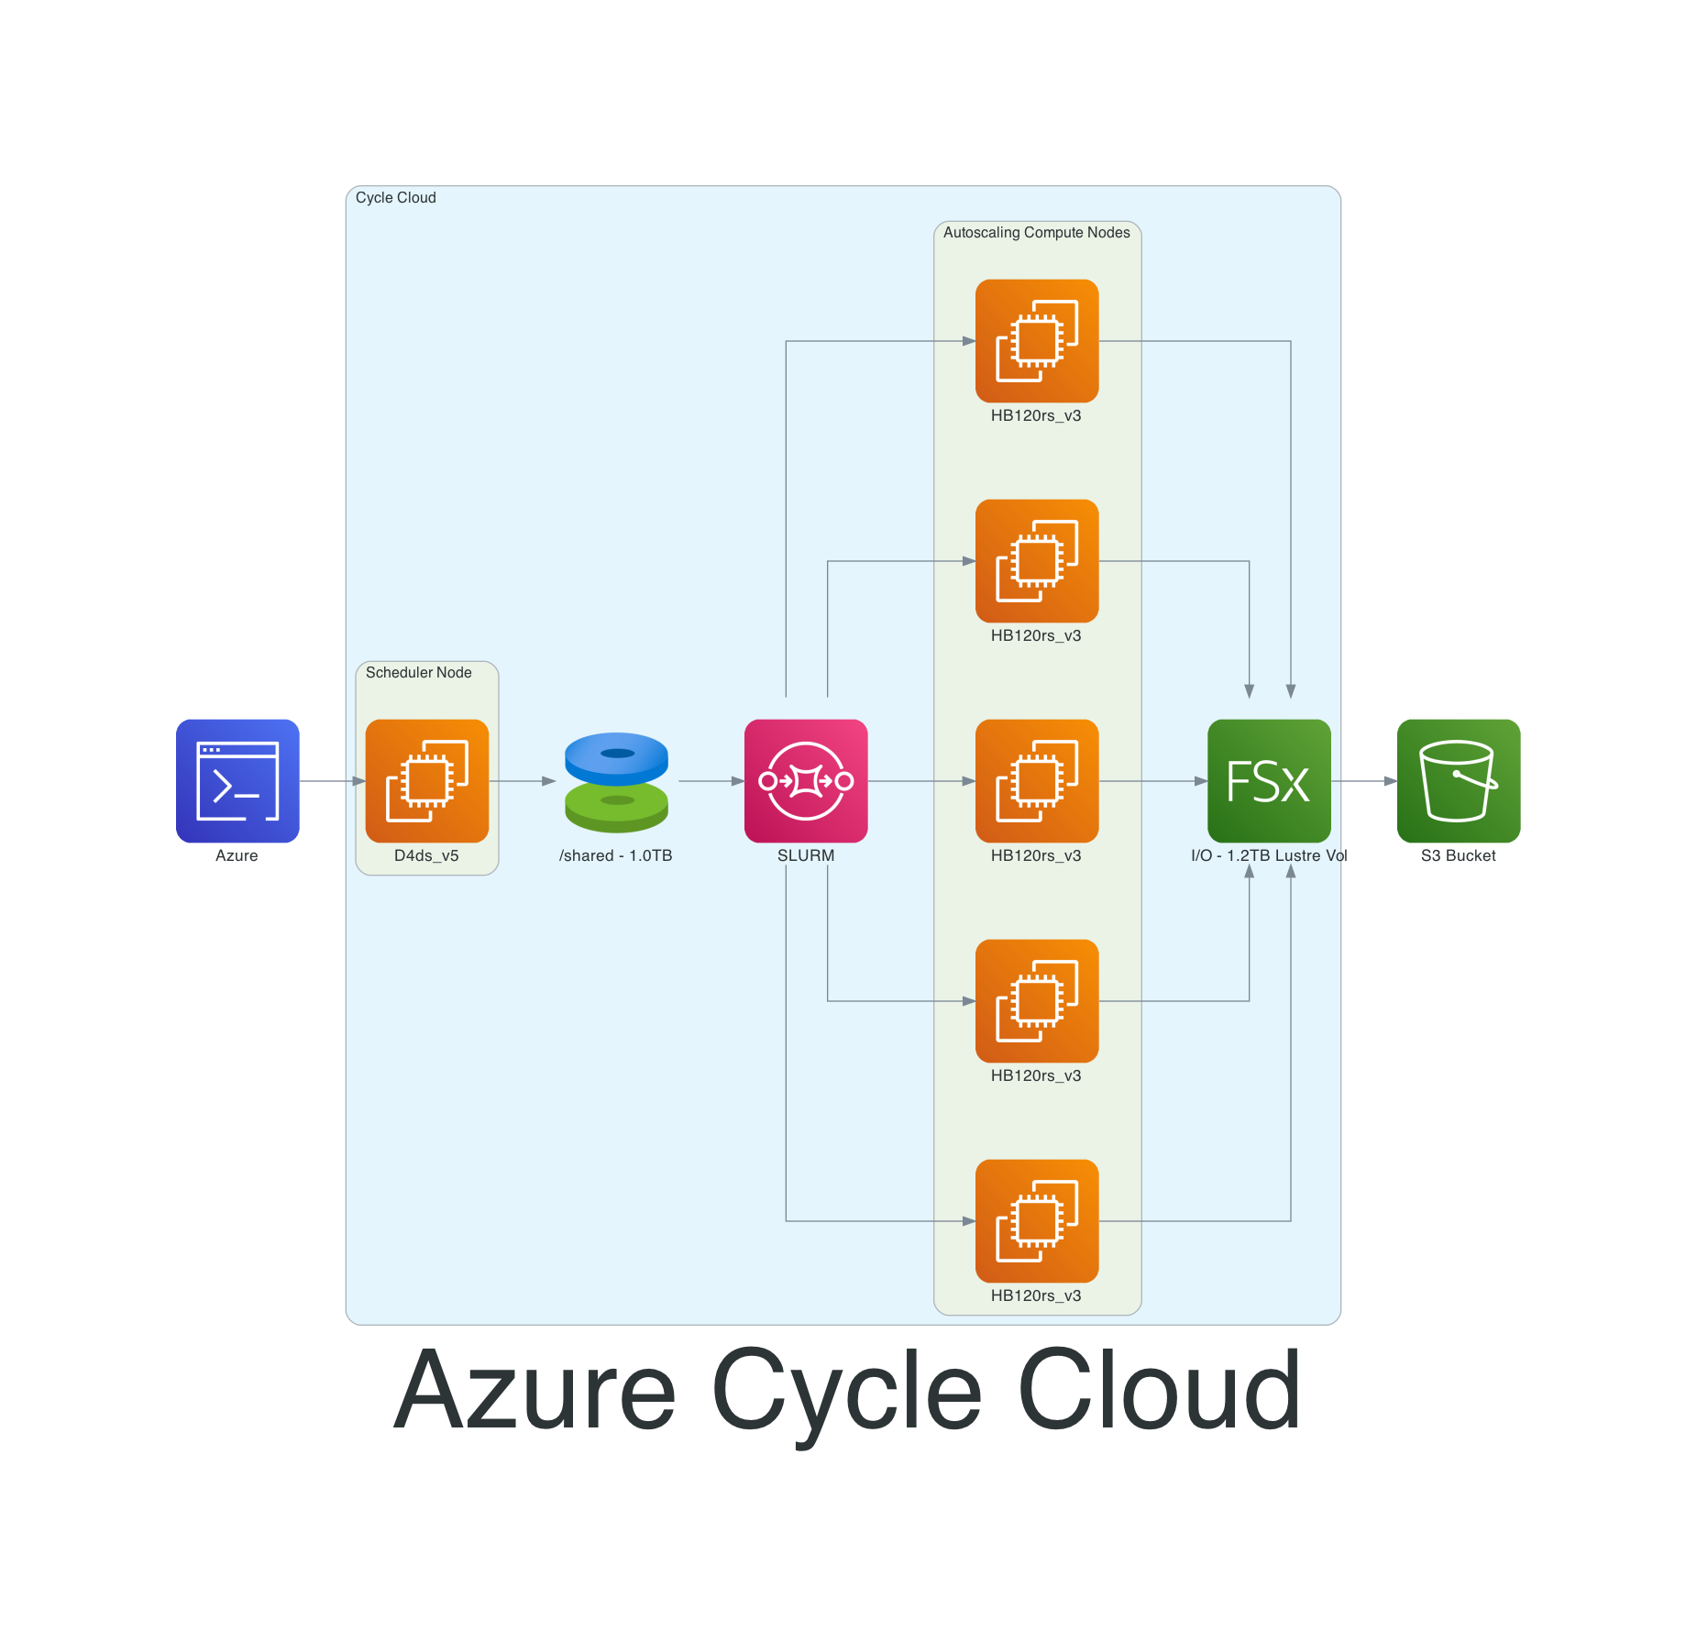
HPC Cluster Diagrams
HPC Clusters were configured to be comparable

Slide 16
HPC Autoscaling on AWS and Azure
The auto-scaling feature of SLURM on Azure Cycle Cloud and AWS Parallel Cluster allows users to run the CMAQ workload using different numbers of compute nodes in the cluster, and/or to run base and zero-out runs, at the same time.
Users submit normal SLURM job scripts, and a cluster that meets the job requirements will be provisioned and ready to start the job within a few minutes.
If the cluster remains idle for more than a preset time, the cluster will automatically shut down the compute nodes after job completion.
The head node or scheduler node remains on and available to immediately start jobs when the user uses sbatch to submit to the SLURM queue for the requested resources.

Slide 17
Notes on accounts & hardware availability – AWS and Azure
The AWS and Azure Portal are used to establish administrative and user level permissions
HPC users must request a limit increase for access to the HPC6a.48xlarge (AWS) or HB120v3 (Azure) instances. These instances may be available in limited regions.

Slide 18
Connecting to Cycle Cloud Cluster
1. Use SSH to login
ssh username@cyclecloud.ip.address
2. Load modules
module load mpi/openmpi-4.1.1
3. Change directory to scripts location
cd /shared/build/openmpi_gcc/CMAQ_v533/CCTM/scripts/
4. Submit run script using SLURM
sbatch run_cctm_2016_12US2.192.2x96.cyclecloud.lustre.csh
5. Use squeue to view the status: Configuring – CF
squeue
JOBID PARTITION NAME USER ST TIME NODES NODELIST(REASON)
2 hpc CMAQ lizadams CF 0:01 2

Slide 19
Cycle Cloud Troubleshooting
After about 5 minutes, the status will change to running or R, and you will see the log files being created.
If you see a different Status, you will need to review the squeue section of the SLURM Troubleshooting Guide
Note: the command "/opt/cycle/Slurm/cyclecloud_slurm.sh remove_nodes" is needed if you make changes to the node(s) like changing the VM type, changing the OS images, adding/modifying cloud-init, etc
cd /opt/cycle/slurm
sudo ./cyclecloud_slurm.sh remove_nodes
sudo ./cyclecloud_slurm.sh scale

Slide 20
Connecting to Parallel Cluster
Use AWS CLI 3.0 commands
1. Verify that the AWS CLI is installed by checking the version
pcluster version
{
"version": "3.1.2"
}
2. List clusters
pcluster list-clusters --region=us-east-2
{
"clusters": [
{
"clusterName": "cmaq",
"cloudformationStackStatus": "UPDATE_COMPLETE",
"region": "us-east-2",
"version": "3.1.2",
"clusterStatus": "UPDATE_COMPLETE"
}
]
}
3. Login to cluster in region us-east-2
pcluster ssh -v -Y -i ~/xxxx.pem --cluster-name cmaq --region=us-east-2

Slide 21
Run CMAQ on Parallel Cluster
1. Load modules
module load openmpi/4.1.1
2. Change directory to scripts location
cd /shared/build/openmpi_gcc/CMAQ_v533/CCTM/scripts
3. Submit job to SLURM queue
sbatch run_cctm_2016_12US2.192pe.2x96.16x12.pcluster.hpc6a.48xlarge.pin.codemod.csh
4. View status of job using squeue
squeue
JOBID PARTITION NAME USER ST TIME NODES NODELIST(REASON)
41 queue1 CMAQ ubuntu CF 0:01 2 queue1-dy-compute-resource-1-[1-2]
Note that 2 nodes were provisioned, each with 96 pes per node.
After configuring, the job will begin running, and the status changes from CF to R

Slide 22
Acknowledgments
The U.S. EPA, through its Office of Research and Development, partially funded and collaborated in the research described here under Contract EP-W-16-014 to the Institute for the Environment at the University of North Carolina at Chapel Hill.
We thank the Microsoft team for their help with running and optimizing in their systems:
Steve Roach
Rafa Salas
Roy Varghese
Brian Lepore (Lustre service preview)
We thank the following AWS team for their help with running and optimizing in their systems:
Timothy Brown
Tommy Johnston
We thank the following staff at the EPA for several inspiring and helpful discussions and contributions to this work
Kristen Foley
Chris Misenis
David Wong
Ed Anderson
Tom Pierce - retired
We thank the leaders of the Modeling in the Cloud Computing Workgroup
- Zac Adelman (LADCO)
- Steve Fine (EPA) - retiring
- Fahim Sidi (EPA) - new lead

Slide 23
Cloud Computing Workgroup
Join our Cloud Computing Workgroup:
https://github.com/CMASCenter/modeling-in-the-cloud/wiki/Modeling-in-the-Cloud-Workgroup-Charter
More to come – answer our poll to help us understand your needs:
https://forms.gle/gbWqHWAeNoFUeYuK6
Hands-on zoom sessions are available to help you get started.
Please send email request to lizadams@email.unc.edu

