Slide 1

Open-innovation and Open-development Framework for the Unified Forecast system - An EPIC Approach
Cloud Computing Session, October 19, 2022
Community Modeling and Analysis System Conference
Maoyi Huang, Ph.D., EPIC Program Manager
Weather Program Office, Oceanic and Atmospheric Research
National Oceanic and Atmospheric Administration

Slide 2
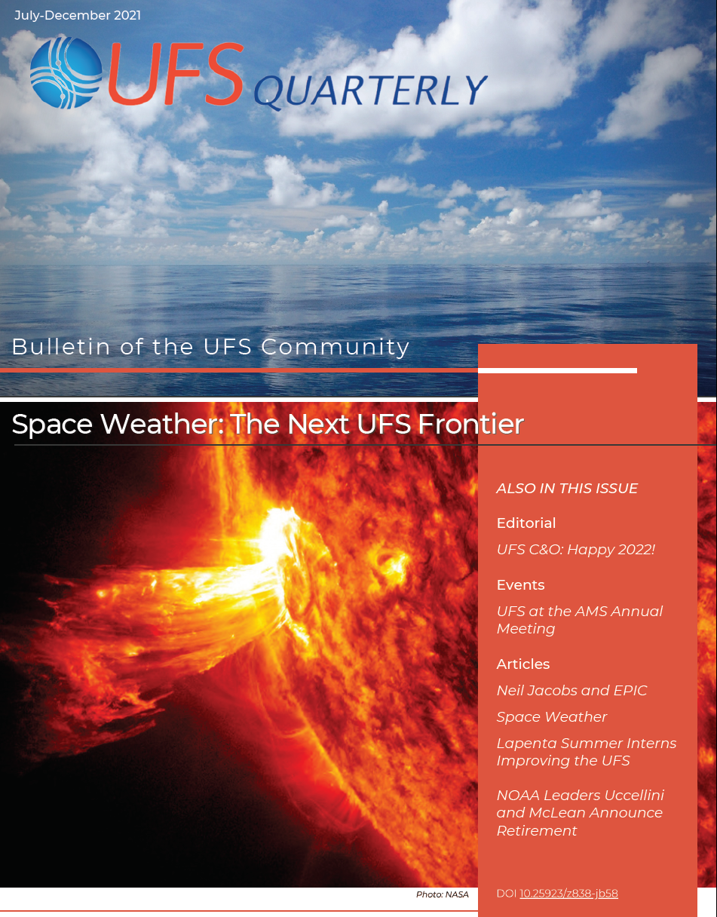
Unified Forecast System
Unified Forecast System (UFS)
Unify research and operational forecast applications into streamlined code-base
Open-development, documented, community codes
Public UFS model releases:
  Medium-Range global operational forecast system (2020)
  Short-range regional development forecast system (2021)
  Short-Range Weather Application (06/2022, 11/2022)
EPIC catalyzes the community by making the UFS accessible and user-friendly
Notes:
Atmos. Dynamical core (FV3) - NASA-GEOS, NCAR
Ocean (MOM6) - NCAR, NASA-GEOS
Data assimilation (JCSDA) - many partners
Common Infrastructure based on MoA with NCAR

Slide 3
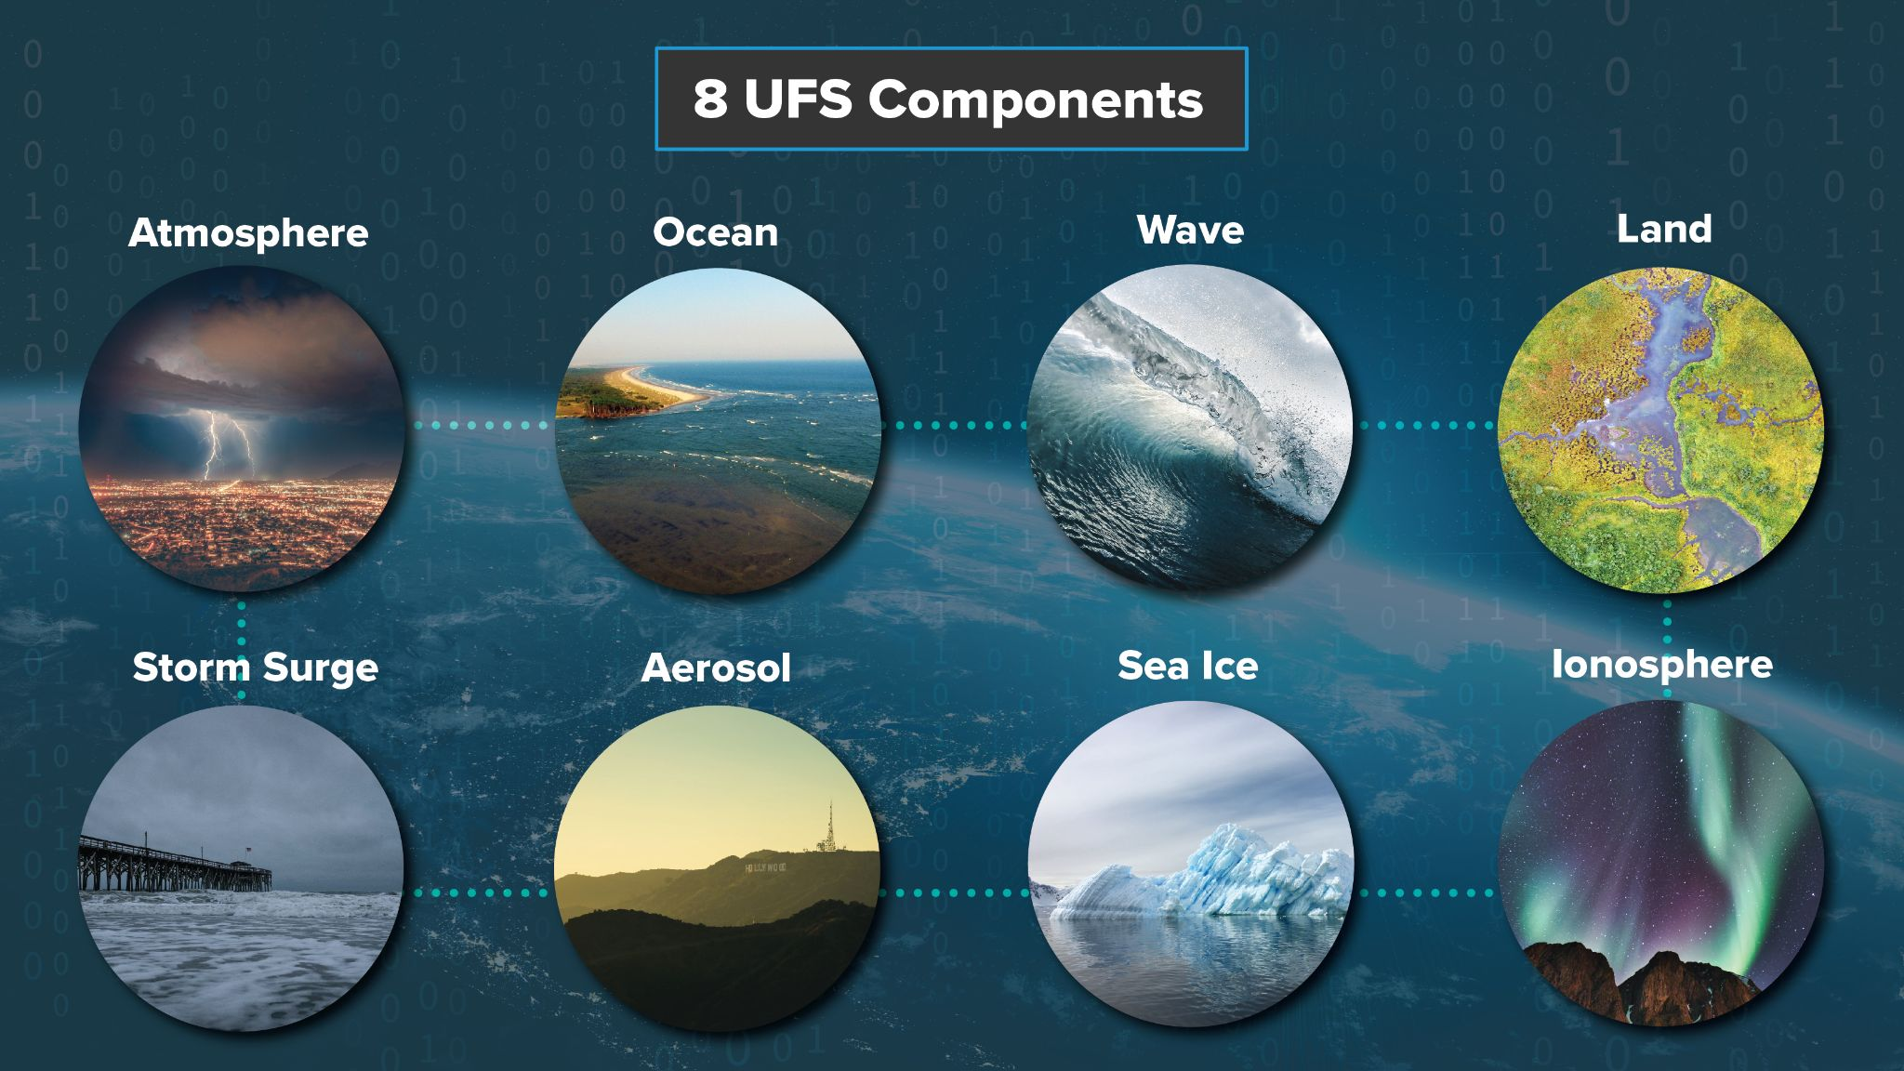
Notes:
Graphic courtesy Chris Franks

Slide 4
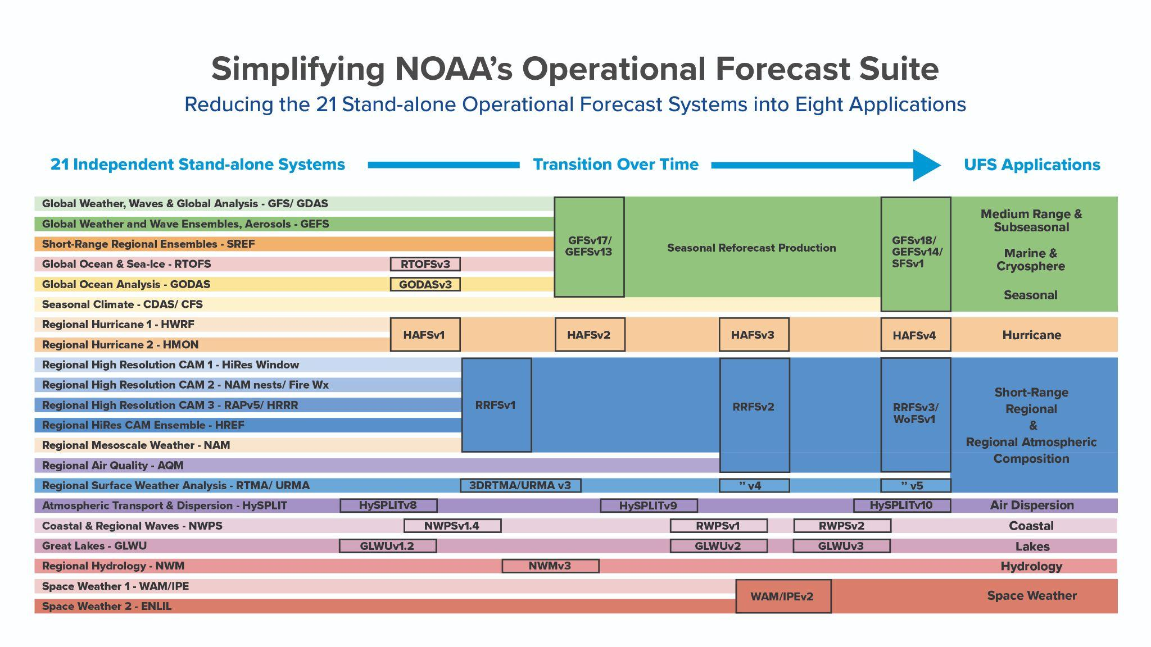

Slide 5
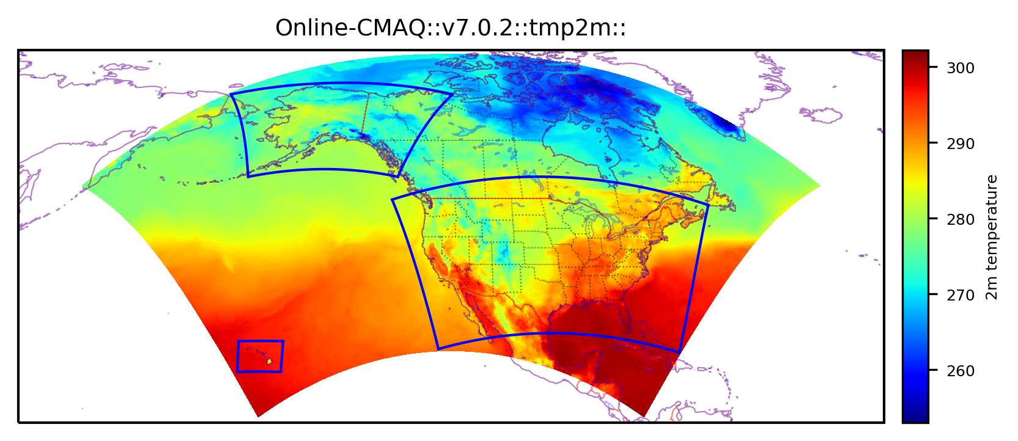
Online-CMAQ in UFS framework: single large domain
Included:
Fengsha Dust module
Bias correction
Updates to UPP_Post for 8h ozone maximum and daily average PM2.5
Corrections to LBC and wet deposition
A near-real-time online-CMAQ is running since July 8, 2022 over the North American large domain that covers all 3 current operational domains: CONUS, AK and HI.
Updates are being integrated into this near-real-time run.
Transition to operation process began
In progress:
RAVE wildfire emissions over North American domain
  retro under test, pending NRT data
Anthropogenic and biogenic emissions
  long runtime with point source emissions with plume rise
Regional workflow on WCOSS2
Libraries just installed on WCOSS2
Courtesy of the NOAA DRSA19 Wildfire Team
POC: Ivanka Stajner (EMC)

Slide 6
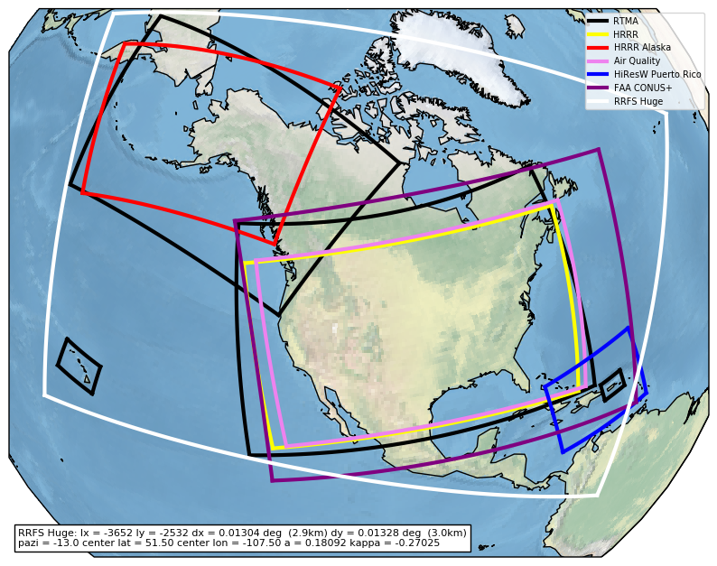
Rapid Refresh Forecast System
Hourly updating, convective allowing ensemble forecast system to replace RAP, HRRR, NAM, etc.
RRFSv2 plans to have one ensemble member feature inline coupling of CMAQ to replace NAQFC as the future air quality forecast system for the U.S.
  Refining the model resolution
  Improving representation of wildfire impacts
  Updating CMAQ
  Including data assimilation and bias correction
  Exploring the use of AI methods for prediction
Courtesy of the UFS SRW/CAM Team
POC: Jacob Carley/Ivanka Stajner (EMC), Curtis Alexander (GSL)
With contributions from EMC, GSL, PSL, CSL, NSSL, ARL, NESDIS
One proposed 3km RRFS domain choice (white) compared to existing convective allowing model domain extents (NAQFC air quality is pink, for example)

Slide 7


EPICIC
Partnering with the community for the benefit of the nation
Community
Engagement
Vision: Enable the most accurate and reliable operational numerical forecast model in the world.
Mission: To be the catalyst for community research and modeling system advances that continually inform and accelerate advances in our nation’s operational forecast modeling systems.
What EPIC is….
A virtual community model development environment
Management of cloud- ready code
Community access to NOAA observations, data & tools
Community support & engagement
Clear research & model transition to operations priorities
Expected expansion to other additional model components
EPIC: focus on the Unified Forecast System (UFS)
EPIC
Cloud Use
Notes:
Atmos. Dynamical core (FV3) - NASA-GEOS, NCAR
Ocean (MOM6) - NCAR, NASA-GEOS
Data assimilation (JCSDA) - many partners
Common Infrastructure based on MoA with NCAR

Slide 8
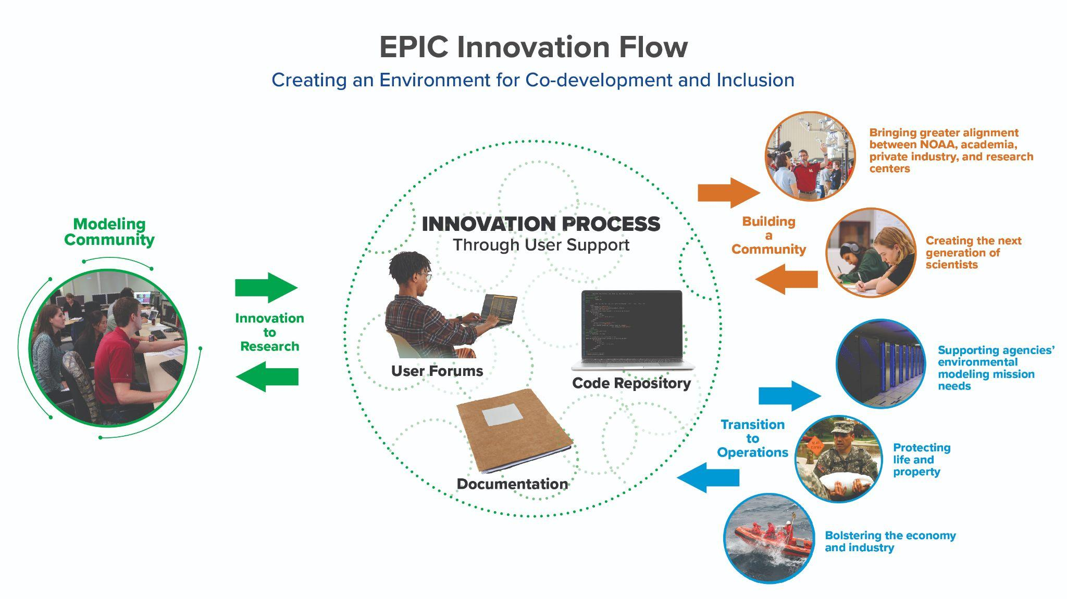

Slide 9
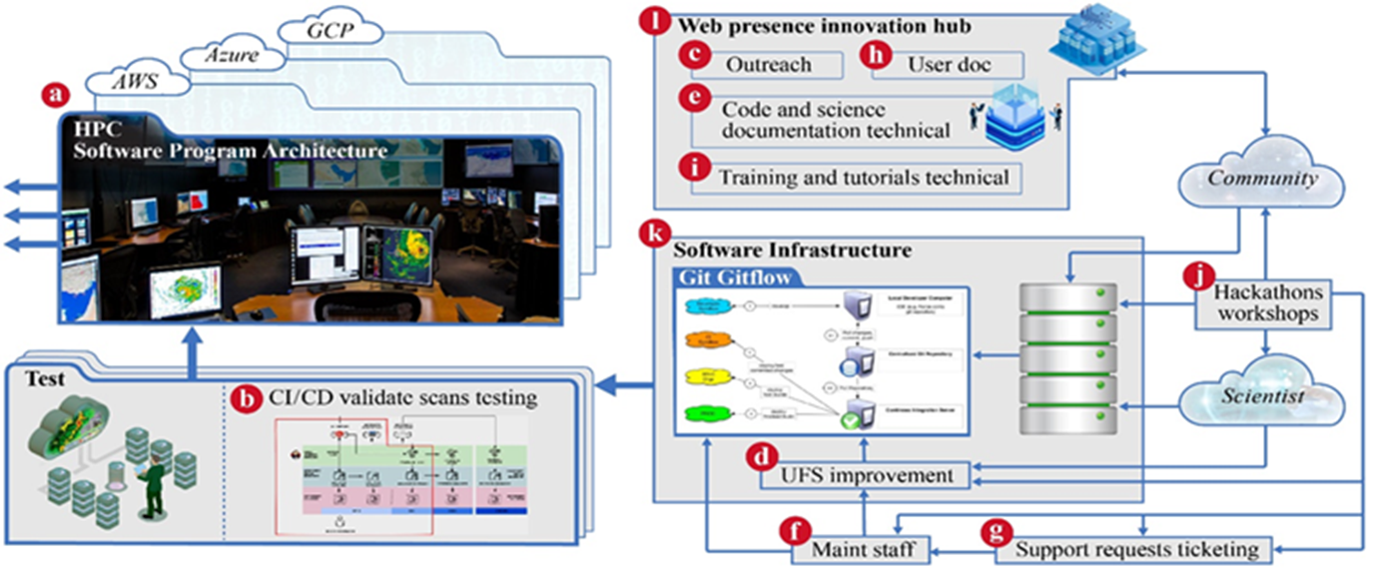
EPIC Building Blocks

Slide 10
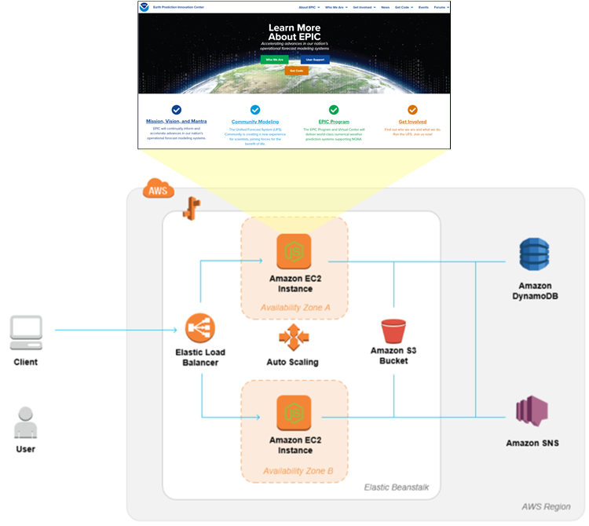
EPIC Community Portal
The EPIC Community Portal (ECP) is the centralized location for the Weather Enterprise to access EPIC-related content, both internally (e.g., events) and externally (e.g., code repositories)
The ECP went live in January of 2022, and is accessible at https://epic.noaa.gov/, and is hosted in the NOAA Multi-Cloud platform.
The ECP was enhanced with the following:
  Dashboards – Github Metrics, AWS Costs
  Webinar – recorded June 2022 AMS Short Course
  FAQ Page – program and technical questions

Slide 11
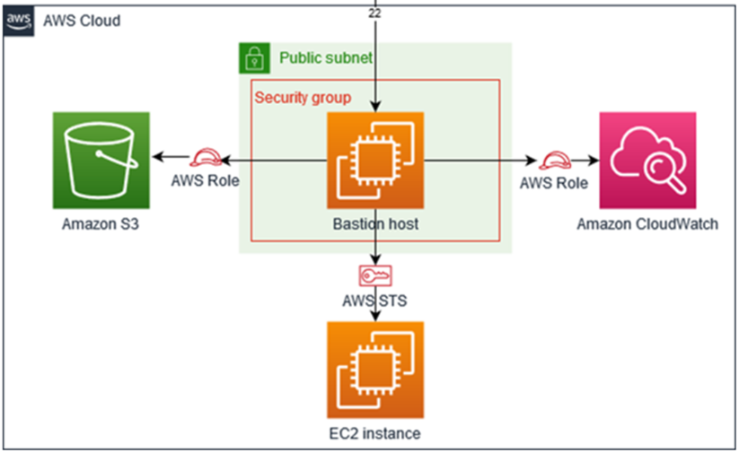
EPIC Cloud Sandbox
The EPIC Cloud Sandbox is an AWS environment that is accessible by non-NOAA users, for EPIC-related purposes.
It has been used by attendees of June 2022 AMS Short Course, code sprints and hackathons, to configure, run and evaluate the SRW Container developed by the EPIC Program.
A scaled version of the CI/CD pipeline is to be installed in the EPIC Cloud Sandbox.

Slide 12
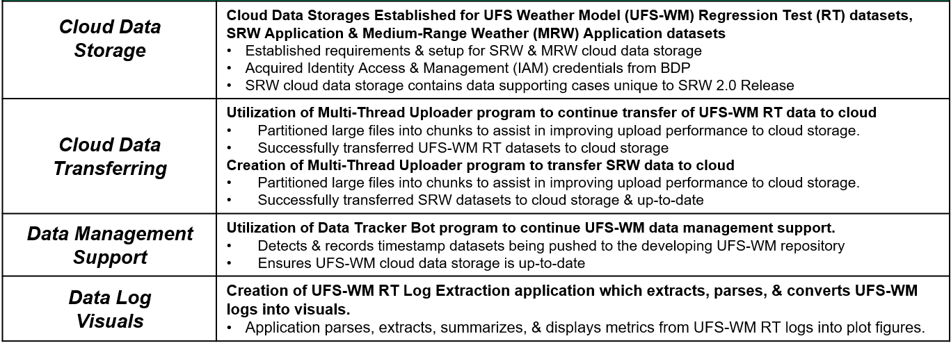
Cloud Data Management

Slide 13
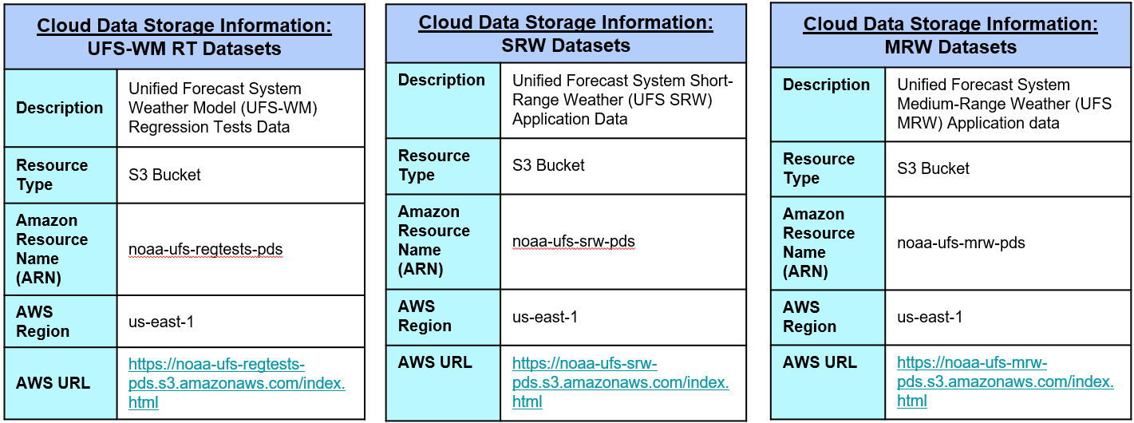
UFS Data Buckets

Slide 14
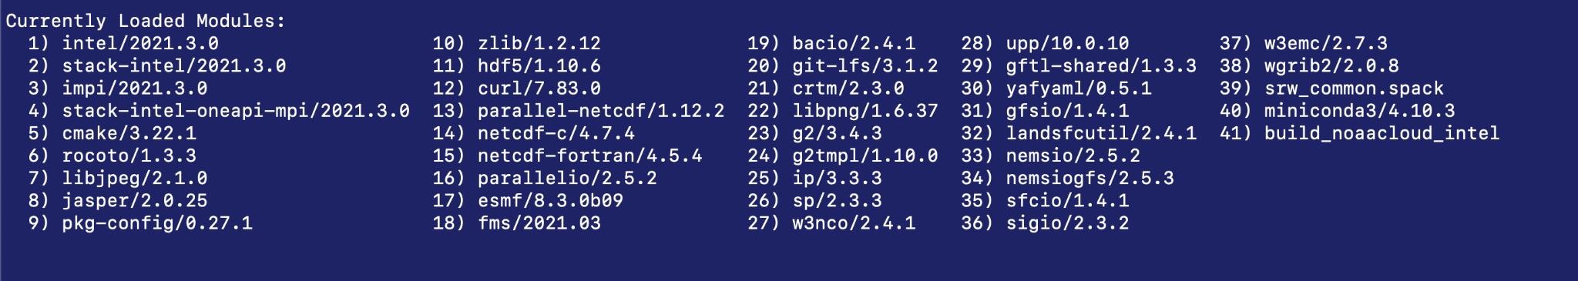
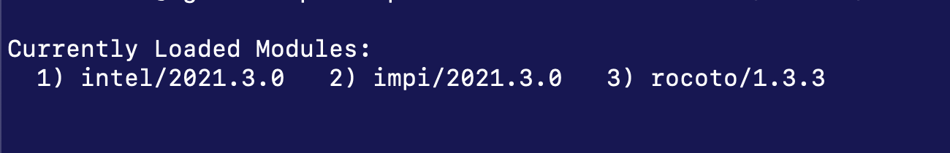
UFS Containerization
The UFS consists of many, many components and applications
A UFS Application includes the forecast model operated within a workflow, which includes numerous steps that are orchestrated by the workflow manager through the job scheduler (slurm, PBS, etc)
Components generally share a common software stack, but slight differences are common (e.g. library versions)
Building the full stack required for all the components in a given application is the biggest hurdle to portability and user-friendliness
Containers can significantly simplify all of this for end users who want to run UFS applications in the cloud
Sample Software Stack on bare metal systems
Container

Slide 15
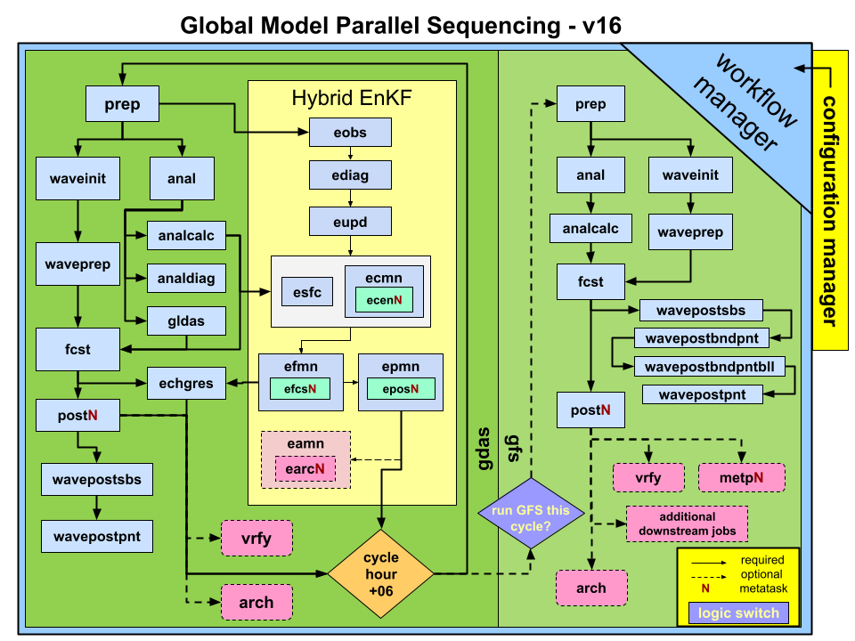
UFS Containerization, continued
Workflow example
Running the UFS weather model in a container across multiple nodes is possible with computational performance nearly identical to that on bare-metal systems
Implementing the Application workflow has been more challenging
  Workflow manager orchestrates each job/step of the workflow
  Actual jobs are submitted to the job scheduler
  Scripts generally wrap each job and set numerous environment variables and/or load modules before actually executing either serial or MPI-based jobs
Solution–Executable containers

Slide 16
Executable Container
Step | Containerized | Bare Metal
Make Grid (1 node) | 21 | 77
Make Orography (1 node) | 44 | 34
Make Surface Climatology (2 nodes) | 72 | 53
Make initial conditions (4 nodes) | 81 | 78
Make lateral boundary conditions (4 nodes) | 129 | 125
Run Forecast (1 node) | 3910 | 4025
Run Post Processor (2 nodes) | 14 | 11
Look like a regular executable on the host system,
  All required environment variables, are built into the container
Can be run via mpirun/mpiexec
The container will be released with UFS SRW v2.1 in November 2022
Computational performance is nearly identical to bare metal across all three cloud service providers
Next step:
  Integrate the container with CI/CD pipeline and workflow
  Exploration of containerized components

Slide 17
Automated Continuous Integration/Continuous Deployment pipeline
Purpose:
To accelerate and optimize code management through automation of the building of pipelines, data management, testing and performance evaluation.
Testing
Code Analysis
UFS Repos
Code Management
CI/CD
Performance Evaluation
Highlights:
Developed a method of generating custom AMIs to launch EC2 instances on demand
Designed and enabled a role-based access system
Data Management
UFS Community
Cloud & on-prem HPCs
3. Developed a procedure to connect to NOAA’s on-premise research & development HPCS
4. Integrated with the UFS-community and NOAA-EPIC GitHub organizations
5. Created a pipeline to integrate the UFS Workflow End-to-End (WE2E) tests

Slide 18
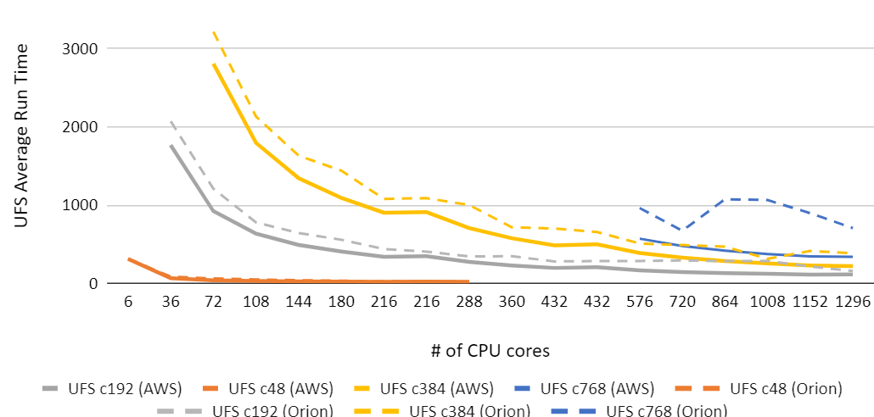
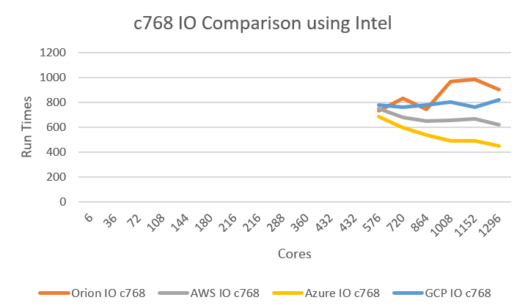
Performance & Scalability
Change of average runtime with cores
AWS vs. Orion
Benchmark tests for the UFS-WM were performed on Cloud Platforms: AWS, Azure GCP and on-premise systems: Orion; with Intel and GNU compilers and at the typical model resolutions;
The model performance and scalability on all the cloud platforms were similar;
Computational performance on cloud platforms is comparable to or sometimes outperforms that on on-premise systems.
CSPs vs. Orion (c768)

Slide 19
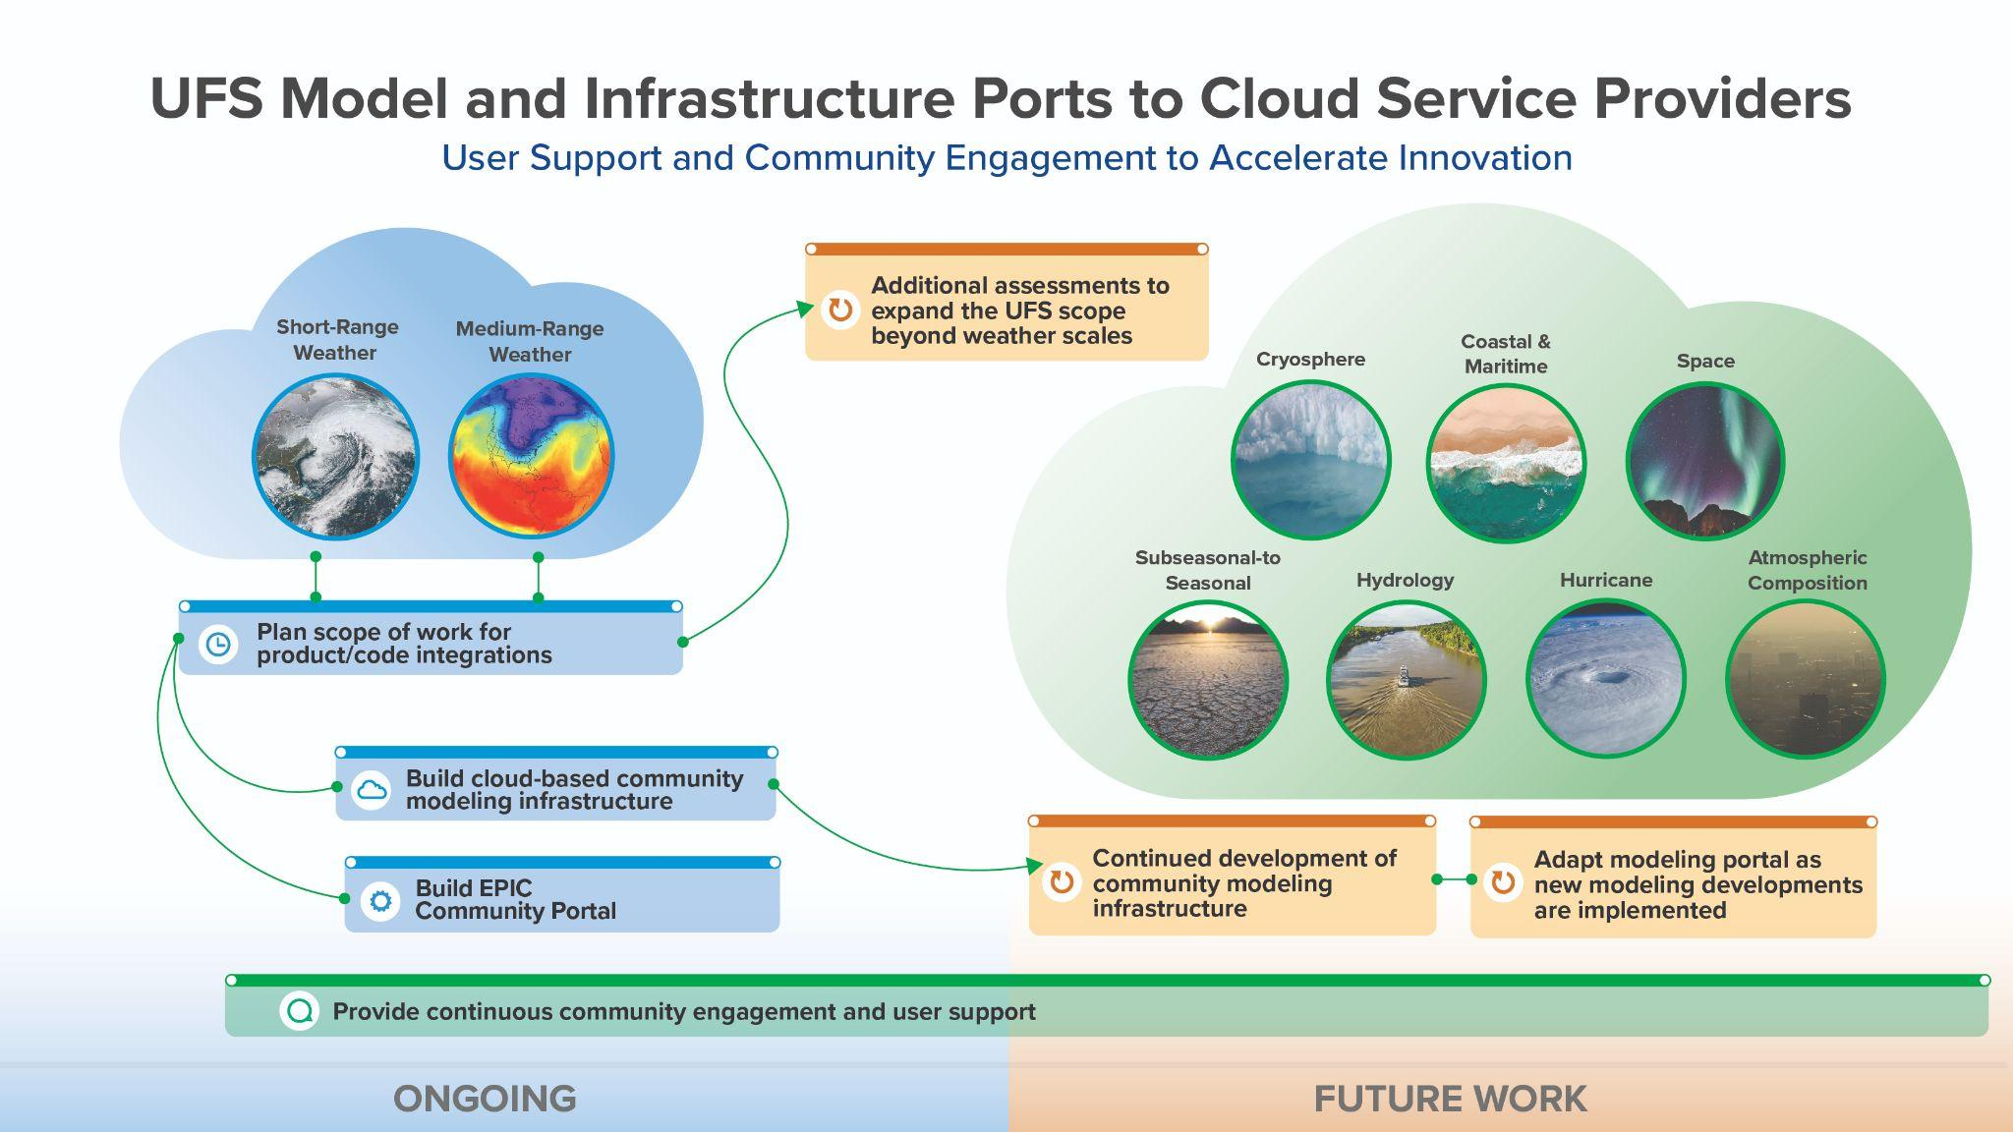

Slide 20









Acknowledgement
Advanced User Support Team
Community Engagement Team
Agile Train Leadership
Platform Team
Maoyi Huang
Henrique Alves
Leah Dubots
Krishna Kumar
Jennifer Vogt
Peter Plofchan
Chris Domanti
Farida Adimi
Luke Peffers
Keven Blackman
Fredrick Gabelmann
Stylianos Flampouris
Cam Sherrell
Boris Acha
Sylvia Chin
Zach Shrader
Jesse McFarland
Jose Guttierez
Marcus Delponte
Leron Thomas
Michael Lueken
Yi-Cheng Teng
Jong Kim
Jim Abeles
Rhae Sung Kim
Mark Potts
Lauren Frederick
Eddie Snyder
Bruce Kropp
Cameron Book
Natalie Perlin
Shawn Cebula
Gillian Petro
Mandy Parson
Jamiel Farhat
Jessica Wheeler
Amber Jenkins
Ben Brinkley
Charlene Barone
Laura Generosa
Randii Oliver
Jef Dodson

Slide 21
Thank you!
Contact: maoyi.huang@noaa.gov

