Slide 1
CMAQv5.3-hyd: a novel model to compute numerically exact first- and second-order sensitivities in CMAQ
Jiachen Liu¹, Eric Chen¹, Ryan P. Russell², Shannon L. Capps¹
¹Department of Civil, Architectural, & Environmental Engineering, Drexel University
²Department of Aerospace Engineering and Engineering Mechanics, The University of Texas at Austin
This work is funded by NSF CAREER Award#1944669, PI: Dr. Shannon Capps

Slide 2
Outline
Introduction of sensitivity analysis methods in chemical transport models
The hyperdual-step method and its implementation in CMAQv5.3.2
Demonstration of sensitivity calculations with BSOA formation in CMAQv5.3.2
Notes:
Just to give you a brief outline, the first part of my presentation will be a very brief introduction of sensitivity analysis methods in chemical transport models.
Then, I will introduce the “hyperdual-step” method and its implementation in CMAQv5.3.2. Finally, I will give some preliminary results from sensitivity calculations with BSOA formation in CMAQ. Let’s dive right in.

Slide 3
Introduction of sensitivity analysis methods in chemical transport models

Slide 4
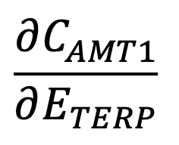
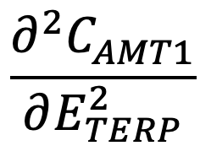
Sensitivity analysis is used to evaluate relationships between output and input variables
The responses of output variables with respect to input variables can guide policy-making processes and provide insights about the scientific process in CTMs.
How will the BSOA concentration respond to a change in biogenic precursor emission?
To answer this question, we need to calculate:
…
AMT1
Physio-Chemical Processes
…
AMT2
最后的棒棒
TERP
AMT3
Atmospheric Transport
…
AMT4
AMT5
AMT6
…
…
Notes:
Let me give a brief introduction of sensitivity analysis in chemical transport models.
Sensitivity analysis is useful to evaluate relationships between output and input variables
The responses of output variables with respect to input variables can guide policy-making process and
provide insights about the scientific process involved in CTMs.
To answer questions like: How will the BSOA concentration respond to a change in biogenic precursor emission?
We need to calculate the first and sometimes higher-order derivatives resulting from chemical transport models.

Slide 5
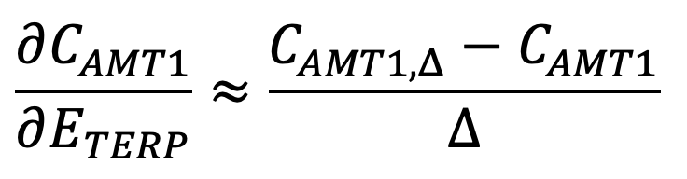
How do we estimate these partial derivatives?
Finite-difference method
Physio-Chemical Processes
Physio-Chemical Processes
TERP
AMT1
TERP+Δ
AMT1_{, Δ}
Atmospheric Transport
Atmospheric Transport
Notes:
The easiest way to conduct sensitivity analysis is by using the finite-difference method. This method is based on a first-order approximation of the model.
We run the model multiple times and use first-order or higher-order approximation of the Taylor expansion to estimate the sensitivities.

Slide 6
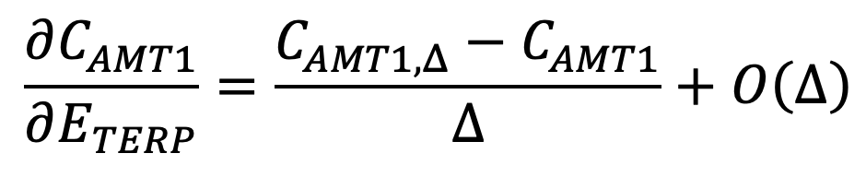
Finite difference method suffers from truncation and subtractive cancellation errors
Truncation error: we ignore the higher-order terms in the Taylor Expansion
  Can be reduced by reducing ∆
Subtractive cancellation error: when two values are too close to each other, computers cannot distinguish them.
  Can be reduced by increasing ∆
The errors become even more problematic for calculating higher-order sensitivities.
Notes:
However, this method has some disadvantages which are the truncation and subtractive cancellation errors.
Truncation errors originate from the fact that we ignore the higher-order terms in the Taylor expansion.
Subtractive cancellation errors come from the fact that when two values are too close to each other, computers cannot distinguish them.

Slide 7
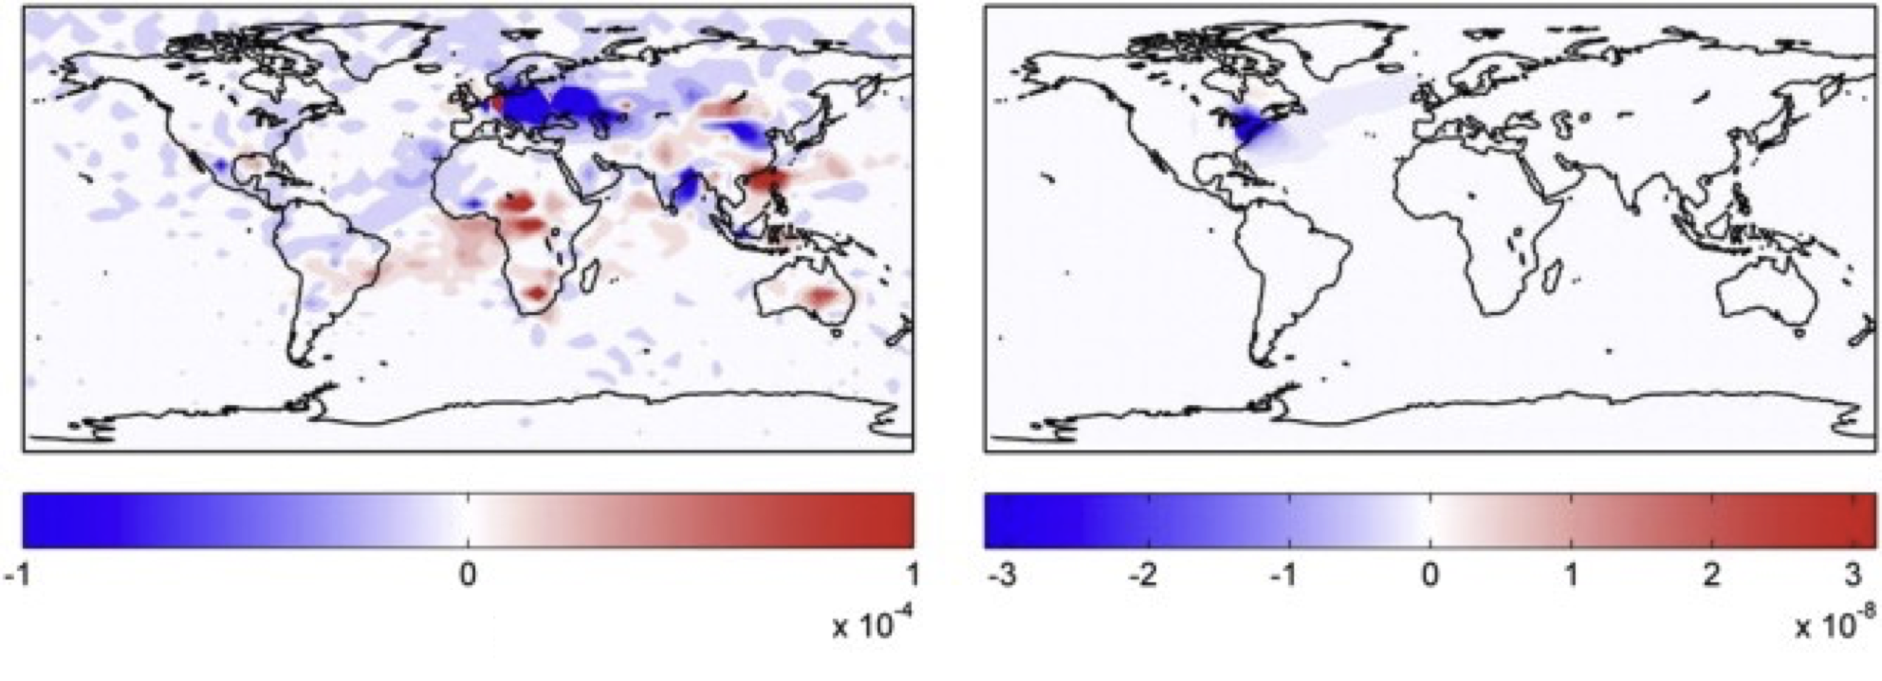
Finite difference method suffers from truncation and subtractive cancellation errors
FDM
Numerically Exact
Average monthly sensitivities of ground level O₃ with respect to 1kg of NO_{x} emission (ppb kg⁻¹)
Constantin & Barrett, 2014, Atmos. Environ.
Notes:
USE POINTER
Here I have sensitivity results from a previous study which calculate the average monthly sensitivities of ground level O3 with respect to 1kg of Nox emissions. We can see clearly that the finite difference approach in this case produces very noisy sensitivities, while the numerically exact sensitivities are much less noisy.

Slide 8
The decoupled direct method and adjoint method are difficult to update along with model
Both the decoupled direct method and the adjoint method can compute the sensitivities without truncation and subtractive cancellation errors.
They are difficult to develop and update when the model is updated because we might need to write new sensitivity equations.
The hyperdual-step method will be very easy to update compared with these two methods.
Notes:
Other methods such as the decoupled direct method (DDM) and the adjoint method

Slide 9
The hyperdual-step method and its implementation in CMAQv5.3.2

Slide 10








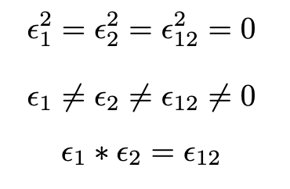
Hyperdual numbers and the hyperdual-step method provide an alternative way of computing derivatives
A hyperdual number H is defined as:
The , , , and are real and , , are non-real parts.
The key property of hyperdual numbers is that the squares of three non-real components are zero, while they are not equal to zero or any value in the real space.
Fike & Alonso, 2011
Notes:
Let’s just
The xs in this equation are real numbers and epsilons are non-real numbers.
The key property of hyperdual numbers is that the squares of three non-real components are zero, while they are not equal to zero or any value in the real space.
Think about this as imaginary numbers:
i^2 = -1 but I doesn’t equal to anything in the real space.
Because of this unique mathematical definition of hyperdual numbers, they can be used to compute first- and second-order sensitivities to machine precision. I do have detailed mathematical derivations as supplemental slides and can show it if anyone is interested, but for the sake of time of this presentation, let’s treat the method as sort of a black box.

Slide 11
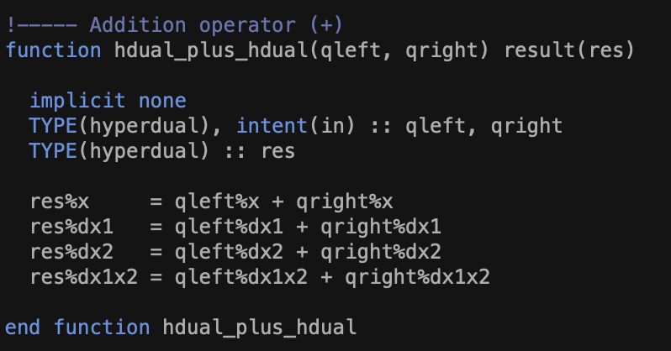
Implementation of the hyperdual-step method in CMAQ
Step #1: Develop a hyperdual number operator overloading library
HDMod.f90
Defines a new type: type(hyperdual) and all hyperdual mathematical operations used in CMAQ
Notes:
Point out how the addition of two hyperdual numbers is defined.
This is one of many functions developed in this operator overloading library, and to compute the sensitivities we need to define all mathematical operations used in CMAQ.

Slide 12
Implementation of the hyperdual-step method in CMAQ
Step #2: Change all necessary variables to be type(hyperdual), starting from CGRID
HDMod.f90
Defines a new type: type(hyperdual) and all hyperdual mathematical operations used in CMAQ
VDIFF
HADV
ZADV
HDIFF
PHOT
CLDPROC
CHEM
AERO
Notes:
The second step is to actually apply this operator overloading library to various scientific processes in CMAQ. This is done by changing all necessary variables to be the hyperdual type, starting from CGRID.

Slide 13
Implementation of the hyperdual-step method in CMAQ
Step #2: Change all necessary variables to be type(hyperdual), starting from CGRID
HDMod.f90
Defines a new type: type(hyperdual) and all hyperdual mathematical operations used in CMAQ
VDIFF
HADV
ZADV
HDIFF
PHOT
CLDPROC
CHEM
AERO

Slide 14


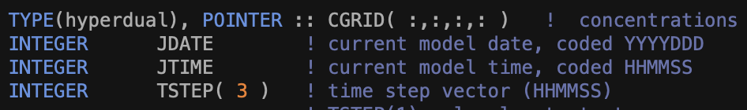
Implementation of the hyperdual-step method in CMAQ
“USE HDMod” has the hyperdual type and all mathematical operations
The CGRID changes from real to hyperdual, and contain first- and second-order sensitivities
Instead of adding new equations to calculate sensitivities, we change the variable type from real to hyperdual and store sensitivity information in hyperdual variables
Notes:
Use HDMod means that we are using the operator overloading library developed in step 1. When I say convert all variables to be hyperdual, I mean changing the real typed CGRID to hyperdual.

Slide 15
Hyperdual numbers and the hyperdual-step method provide an alternative way of computing derivatives
Physio-Chemical Processes
TERP
AMT1
Atmospheric Transport
Newly defined hyperdual components in the chemical transport model
TERP, ϵ₁
AMT1, ϵ₁
Contain Numerically Exact First and Second-Order Sensitivity Information
TERP, ϵ₂
AMT1, ϵ₂
TERP, ϵ₁₂
AMT1, ϵ₁₂
Sensitivities will be numerically exact (no truncation or cancellation errors) because of the definition of hyperdual numbers
We can get sensitivities of many outputs with respect to one or two input variables
This method will not change either real or complex number operations in the original model
Notes:
The real value carrying three backpacks which contain sensitivity information
The hyperdual calculations won’t change the concentrations in the real space.
Marked everything hyperdual with purple.
I have some slides talking about the math related to hyperdual numbers and why the derivatives are numerically exact
Numbers carrying backpacks

Slide 16
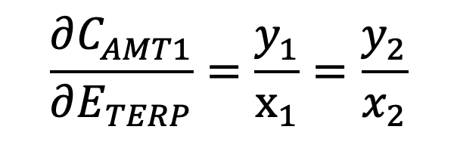
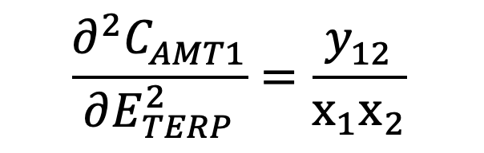
Hyperdual numbers and the hyperdual-step method provide an alternative way of computing derivatives
…
Physio-Chemical Processes
…
TERP
TERP + x₁ ϵ₁ + x₂ ϵ₂
AMT1+ y₁ ϵ₁ + y₂ ϵ₂ + y₁₂ ϵ₁₂
Atmospheric Transport
…
…
The numerically exact sensitivities for AMT1 concentration to TERP emission is:
We can get first- and second-order sensitivities of many output variables to TERP by a single run of the model

Slide 17
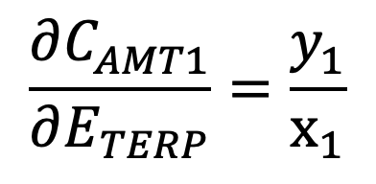
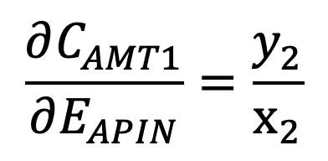
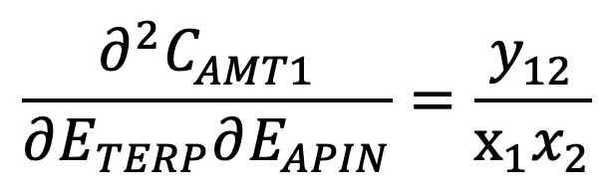
Hyperdual numbers and the hyperdual-step method provide an alternative way of computing derivatives
…
Physio-Chemical Processes
…
TERP
TERP + x₁ ϵ₁
AMT1+ y₁ ϵ₁ + y₂ ϵ₂ + y₁₂ ϵ₁₂
APIN
APIN + x₂ ϵ₂
Atmospheric Transport
…
…
The numerically exact sensitivities for AMT1 concentration to TERP and APIN emission is:
We can get first-order sensitivities of many output variables to TERP and APIN, and cross sensitivities of many output variables to TERP+APIN
Notes:
MT on Multiple species
AMTNO3J at the end of nighttime. AMTNO3J at the end of daytime.
Embed the notation
Temporal component in the notation, |_24hour

Slide 18
Demonstration of sensitivity calculations with BSOA formation in CMAQ

Slide 19
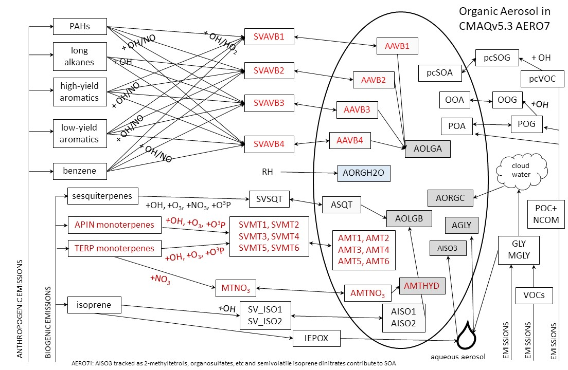
Retrieved from: https://github.com/USEPA/CMAQ/blob/5.3/DOCS/Release_Notes/aero7_overview.md
Notes:
https://github.com/USEPA/CMAQ/blob/5.3/DOCS/Release_Notes/aero7_overview.md
Not that new anymore since we have CMAQv5.4 now

Slide 20

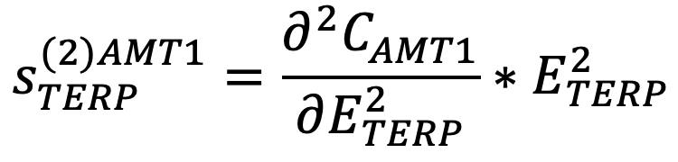
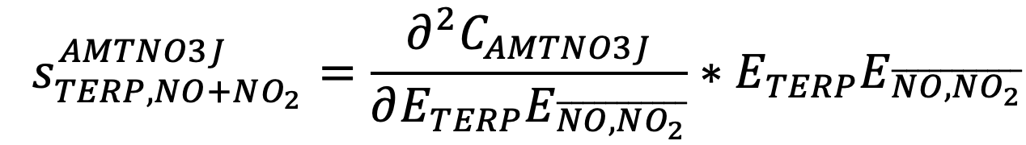
Semi-normalized sensitivities are calculated
The sensitivities here are all semi-normalized and averaged over 24 hours:
First-order semi-normalized sensitivity of AMT1 concentration to TERP emission
Second-order semi-normalized sensitivity of AMT1 concentration to TERP emission
Semi-normalized cross sensitivity of AMTNO3J concentration to TERP emission and average NO and NO₂ emission
Notes:
Notation here might need a change. Should I use a more detailed notation?

Slide 21
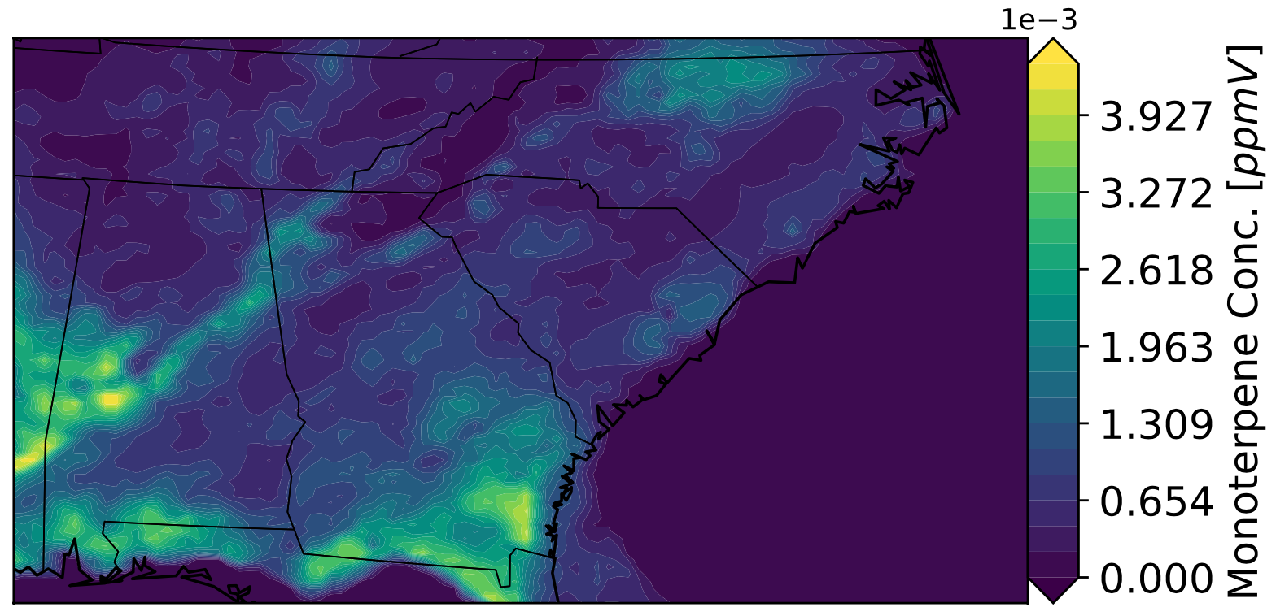
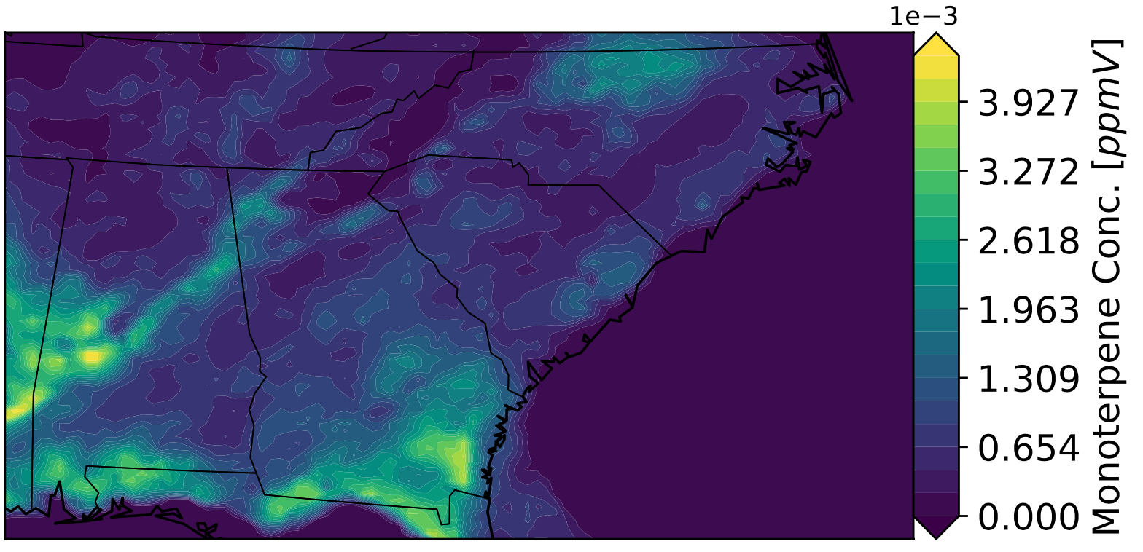
Maps of Monoterpene concentrations in the normal and hyperdual runs
Real
Hyperdual
The average concentration of monoterpene in ppmV for July 1st, 2016
The hyperdual modules don’t affect the regular CMAQ run results.

Slide 22



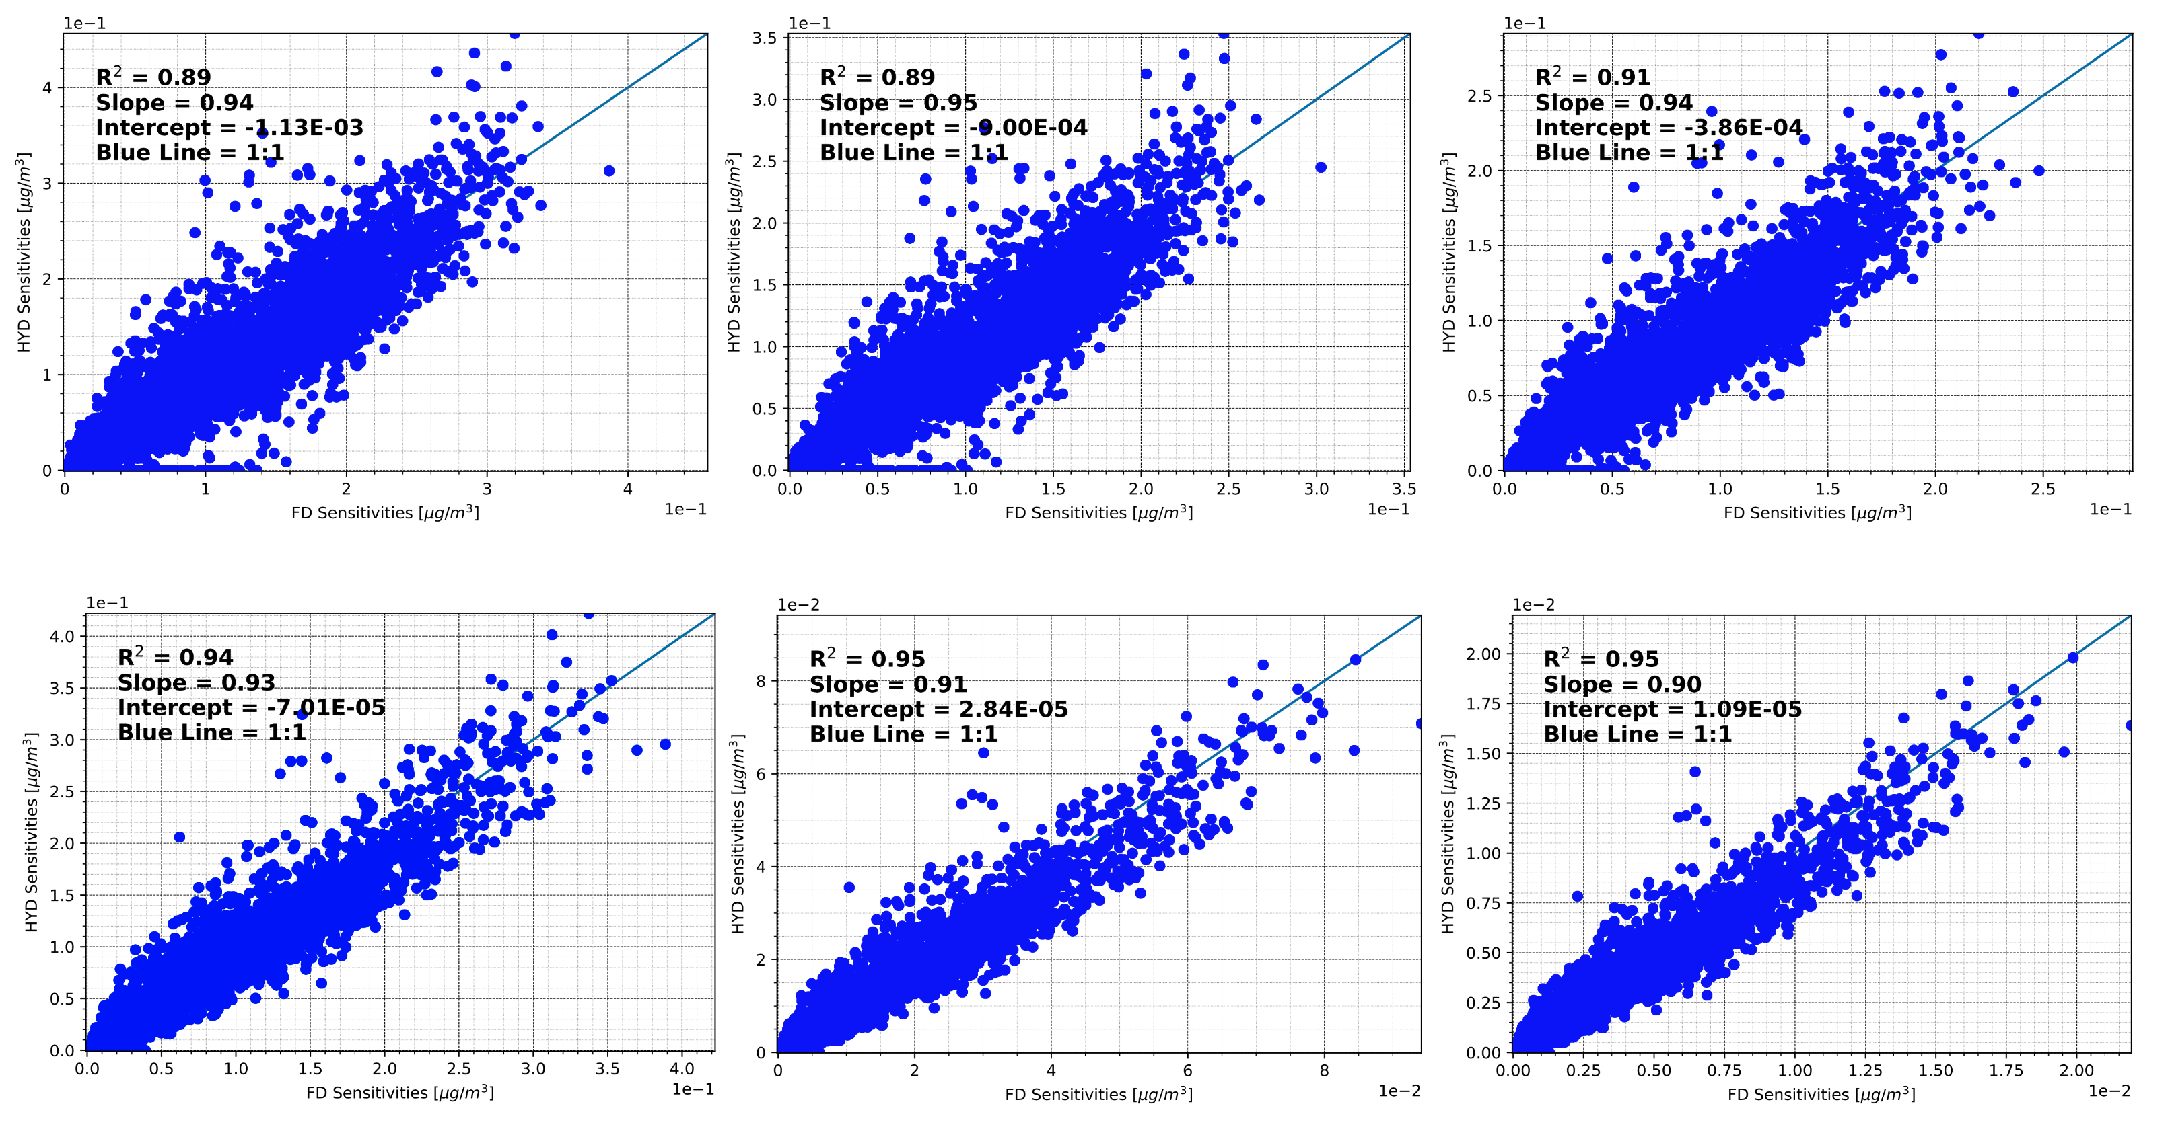



One-to-one plot of averaged 24-hour sensitivities for AMT concentration to TERP emission.
In general, the first-order sensitivity calculated from the hyperdual-step method agrees well with the brute-force approach

Slide 23
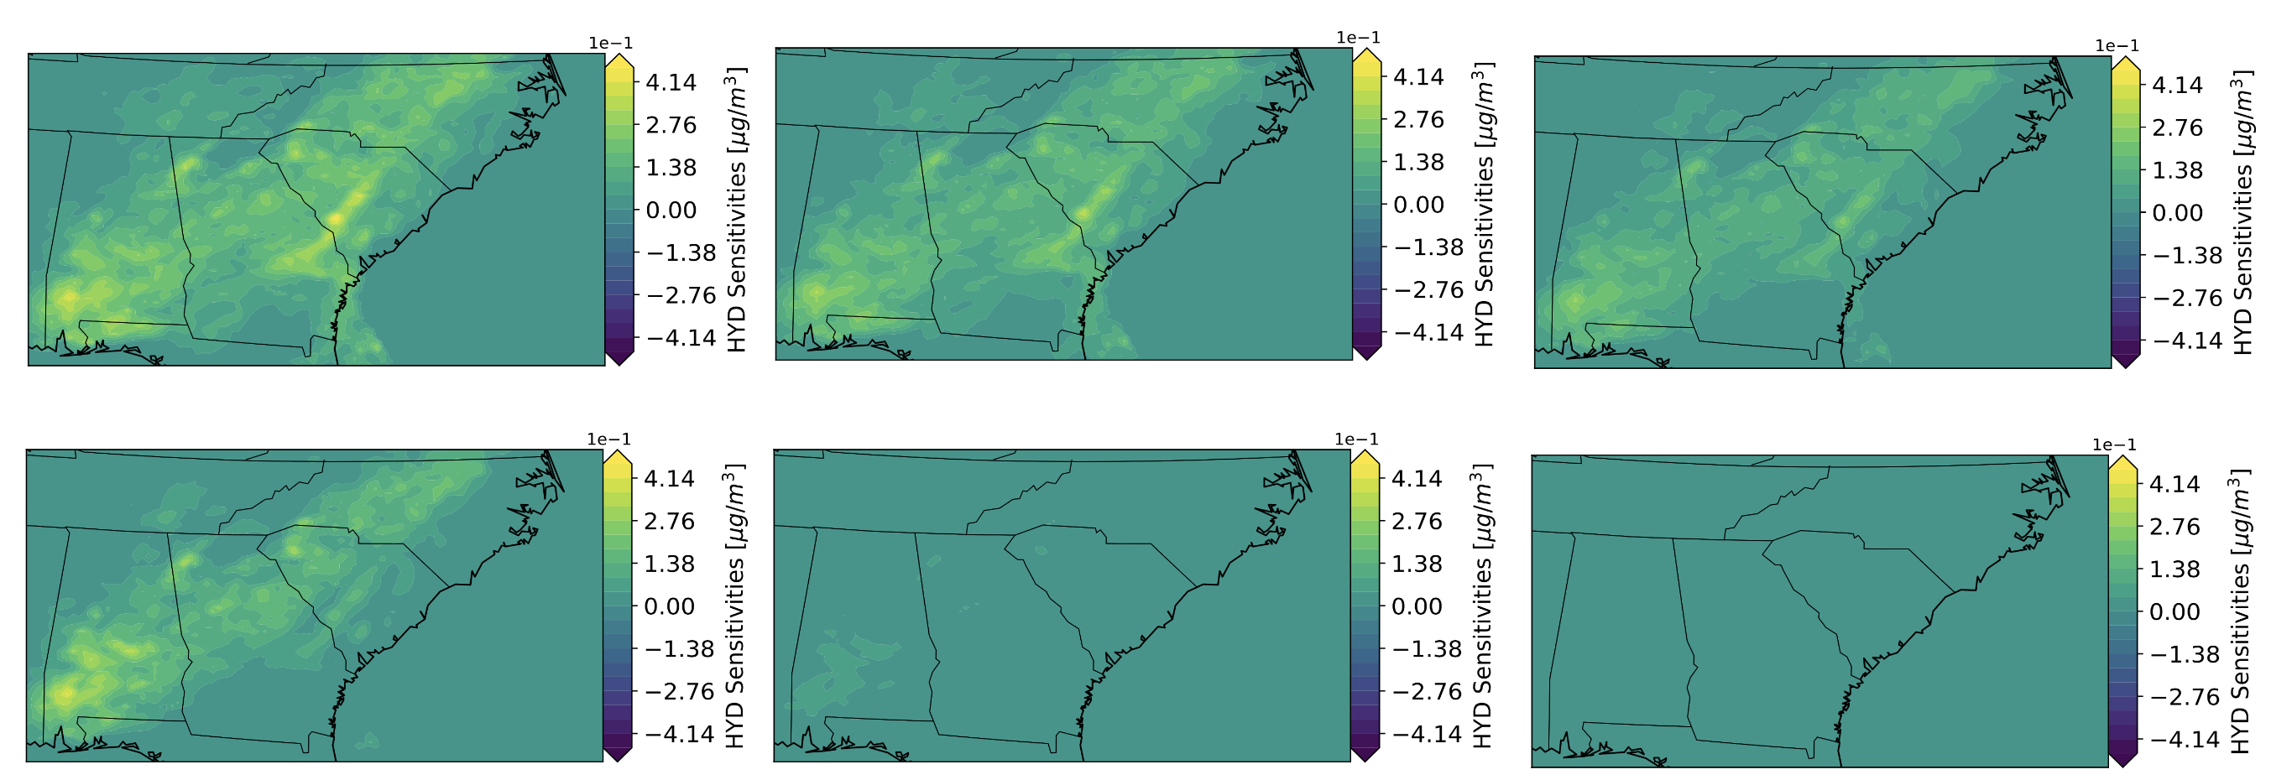
Maps of averaged 24-hour first-order sensitivities for AMT concentration to TERP emission.
We can clearly see the difference in sensitivities among products with different volatility
Notes:
Same pattern for all species

Slide 24
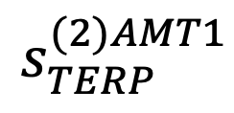
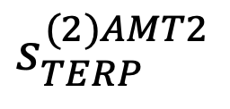
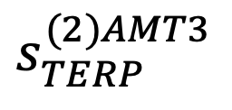
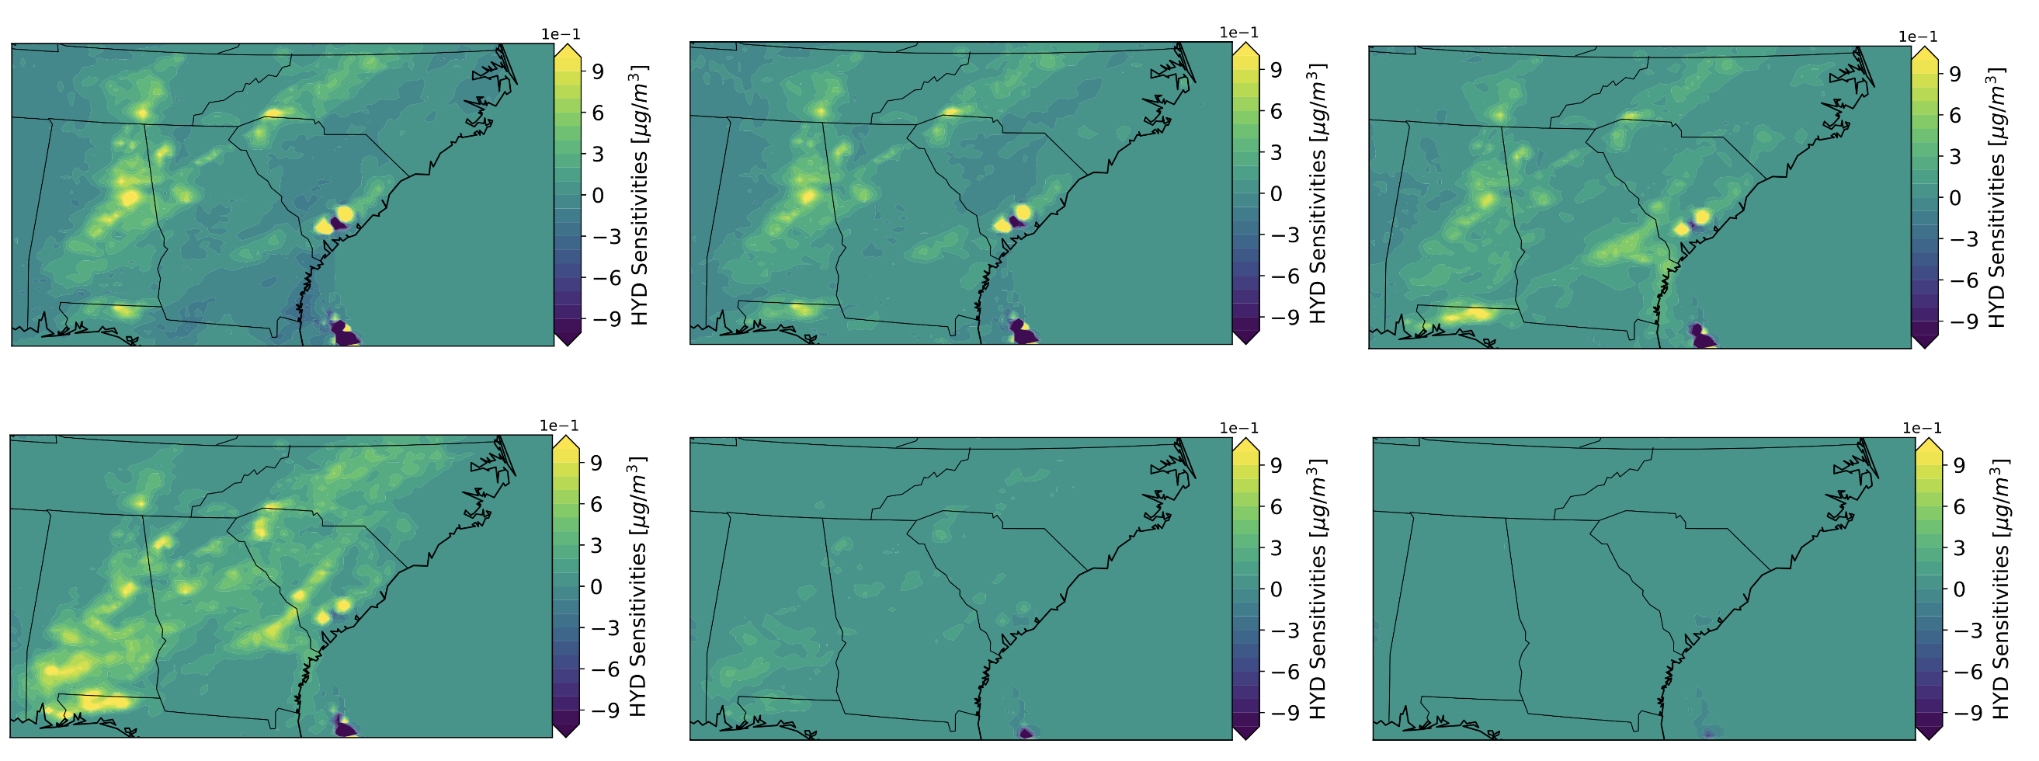
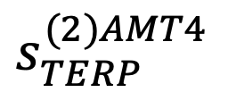


Maps of averaged 24-hour second-order sensitivities for AMT concentration to TERP emission.
Second-order sensitivities describe the nonlinear aspects of AMT formation with respect to monoterpene

Slide 25

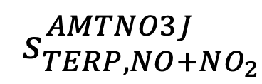
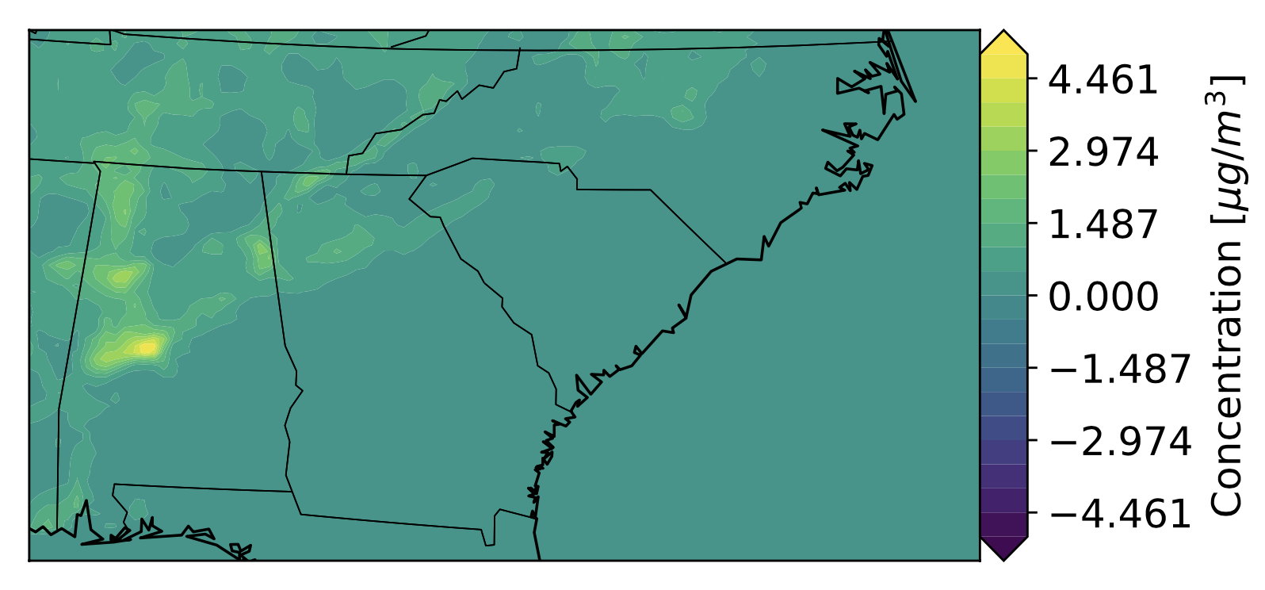
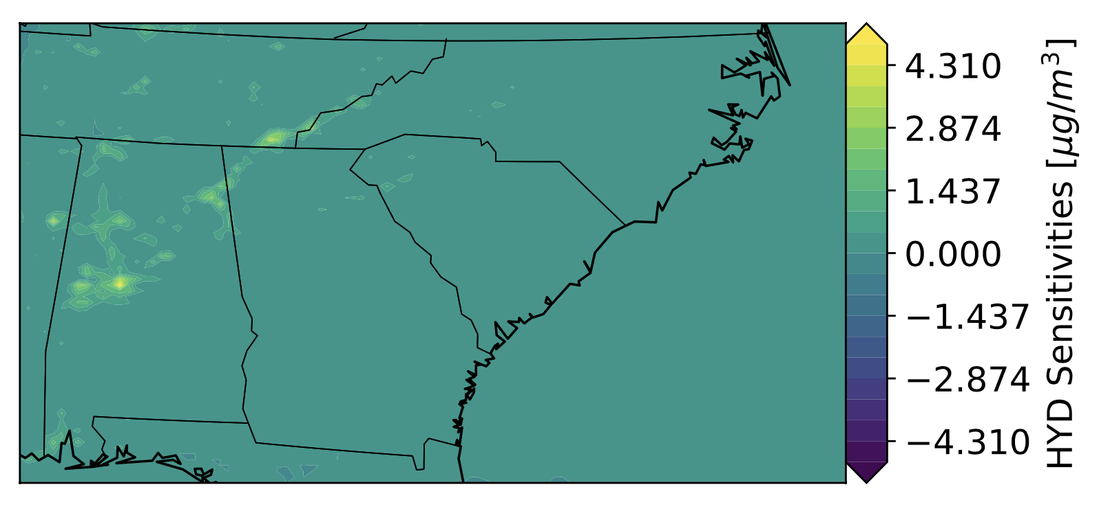
Semi-normalized cross sensitivity for AMTNO3J with respect to monoterpene and NO+NO₂ emission Tian
An increase in future temperature and more emission of biogenic monoterpene, the sensitivity of monoterpene nitrate products to NO_{x} will increase
Notes:
If we graph the concentration of PM2.5 with respect to monoterpene here, it will have a positive slope but concaving down.
Mean of NO and NO2.

Slide 26
Conclusion and Future direction
We demonstrated the implementation of a novel sensitivity analysis method in CMAQv5.3.2.
We compared it with traditional methods using a newly added BSOA formation mechanism.
We will update the method to the newly released CMAQv5.4 and new chemical mechanisms.
We will add more control parameters in the model for users to perturb emission / concentration of interest.
Notes:
CRACMM and CB6R5

Slide 27
References
United States Environmental Protection Agency. 2020. CMAQ (Version 5.3.2) [Software]. Available from https://doi.org/10.5281/zenodo.4081737
Donahue, N.M., Robinson, A.L., Stanier, C.O., Pandis, S.N., Coupled Partitioning, Dilution, and Chemical Aging of Semivolatile Organics. Environmental Science & Technology 2006 40, 2635–2643.. doi:10.1021/es052297c
Saha, P. K. and Grieshop, A. P.: Exploring Divergent Volatility Properties from Yield and Thermodenuder Measurements of Secondary Organic Aerosol from α-Pinene Ozonolysis, Environmental Science & Technology, 2016 50, 5740-5749, https://doi.org/10.1021/acs.est.6b00303.
Xu, L., Pye, H. O. T., He, J., Chen, Y., Murphy, B. N., and Ng, N. L.: Experimental and model estimates of the contributions from biogenic monoterpenes and sesquiterpenes to secondary organic aerosol in the southeastern United States, Atmospheric Chemistry and Physics, 2018, 12613-12637, https://doi.org/10.5194/acp-18-12613-2018, 2018.
Constantin, B. V.; Barrett, S. R. H., Application of the complex step method to chemistry-transport modeling. Atmospheric Environment 2014, 99, 457-465.
Fike, J.; Alonso, J. In The Development of Hyper-Dual Numbers for Exact Second-Derivative Calculations, 49th AIAA Aerospace Sciences Meeting including the New Horizons Forum and Aerospace Exposition, 2011-01-04; American Institute of Aeronautics and Astronautics: 2011.
Zhang, H.; Yee, L. D.; Lee, B. H.; Curtis, M. P.; Worton, D. R.; Isaacman-Vanwertz, G.; Offenberg, J. H.; Lewandowski, M.; Kleindienst, T. E.; Beaver, M. R.; Holder, A. L.; Lonneman, W. A.; Docherty, K. S.; Jaoui, M.; Pye, H. O. T.; Hu, W.; Day, D. A.; Campuzano-Jost, P.; Jimenez, J. L.; Guo, H.; Weber, R. J.; De Gouw, J.; Koss, A. R.; Edgerton, E. S.; Brune, W.; Mohr, C.; Lopez-Hilfiker, F. D.; Lutz, A.; Kreisberg, N. M.; Spielman, S. R.; Hering, S. V.; Wilson, K. R.; Thornton, J. A.; Goldstein, A. H., Monoterpenes are the largest source of summertime organic aerosol in the southeastern United States. Proceedings of the National Academy of Sciences 2018, 115 (9), 2038-2043.

Slide 28
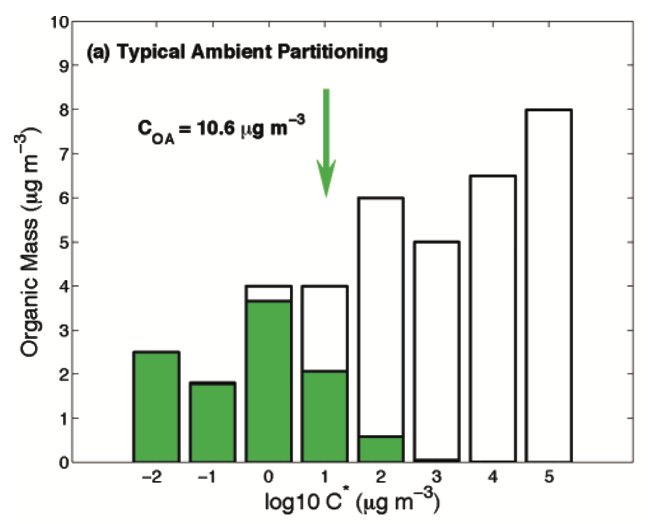
New BSOA formation mechanisms were added to CMAQv5.3.2
The gas-phase and aerosol photooxidation products of TERP are categorized into different volatility bins with a volatility basis set approach.
This approach replaced the old Odum 2-product approach and lead to better simulation of BSOA from monoterpene photoxidation in southeastern US.
There are six aerosol products (AMT1 – AMT6) and six gas-phase products (SVMT1 – SVMT6) from APIN and TERP grouped by different volatilities.
Donahue et. al., 2006, ES&T
Saha and Greishop, 2016, ES&T
Xu et. al., 2018, ACP
Notes:
VBS, reduce text, show figure from donahue paper
Instead of calculating the explicit products from the reactions of APIN and TERP, we group the products based on their volatility using a figure like this
Green bar: condensed-phase or aerosol phase, transparent bars: gas-phase

Slide 29
Example run: Aerosol photoxidation and semivolatile monoterpene nitrate aerosol products in the Southeast US
Several new BSOA formation mechanisms were added to CMAQ in the recent update.
We will present AMT1-AMT6 (aerosol photoxidation products) with respect to monoterpene (TERP).
We will also present some of the sensitivities of semi-volatile organic nitrates from monoterpene oxidation (AMTNO3J) with respect to emission its precursor: monoterpenes (TERP) and NO₂ and NO to demonstrate the cross-sensitivities.
Zhang et al., 2018, PNAS
Notes:
Make sure to mention the CMAQ outputs are the same!

Slide 30
New BSOA formation mechanisms were added to CMAQv5.3.2
Gas
Aerosol
SVMT1
AMT1
SVMT2
AMT2
SVMT3
AMT3
TERP
More volatile
SVMT4
AMT4
SVMT5
AMT5
SVMT6
AMT6
Notes:
From now on, terp -> monoterpene, and I will use the aerosol name for all the later parts of my presentation.

Slide 31
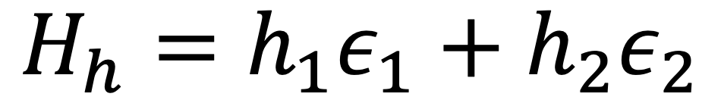
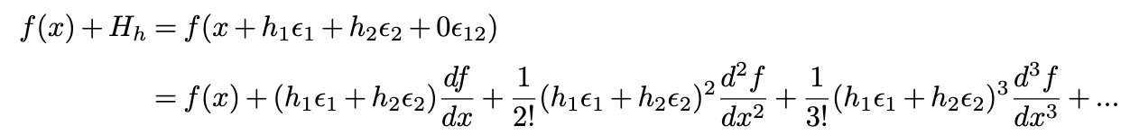
Hyperdual numbers and the hyperdual-step method provide an alternative way of computing derivatives
Let’s name the input variable as x₀ and the output variable as f(x₀)
Then, we perturb the input variable with a hyperdual number:
Expand the equation with Taylor Expansion
Fike & Alonso, 2011

Slide 32
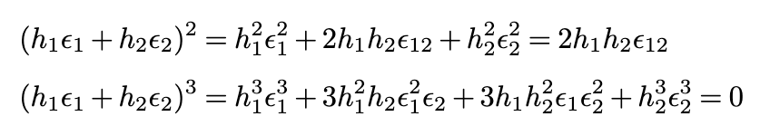

Hyperdual numbers and the hyperdual-step method provide an alternative way of computing derivatives
Fike & Alonso, 2011

Slide 33
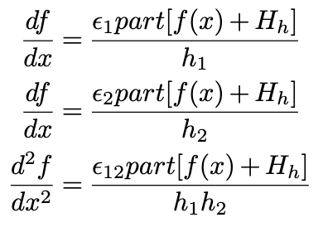
Hyperdual numbers and the hyperdual-step method provide an alternative way of computing derivatives
The first-order and second-order sensitivities are separated into different terms.
Both the first- and second-order sensitivities here are exact. All higher-order terms are 0 because of the definition of hyperdual numbers.
Fike & Alonso, 2011

Slide 34
Several steps are required to apply the hyperdual-step method to CTMs
Develop a hyperdual number operator overloading library
  Defines all operations used in the CMAQ
Iteratively convert variables to be hyperdual numbers
  Starting from the species concentration arrays in CMAQ.
  Convert all variables that are related to the species concentration array to be compatible with hyperdual numbers calculations
Add sensitivity (i.e., , , ) values as new outputs from the model
  In addition to the gridded concentration of species, the sensitivity information is saved to separate files with the same grid information.
  Three additional output files are generated

