Slide 1
Evaluating Methods of Representing Lightning NO_{x} Emissions Across the Northern Hemisphere
J. Mike Madden, Daiwen Kang, James D. East, Golam Sarwar,
Christian Hogrefe, Rohit Mathur, and Barron H. Henderson
U.S. Environmental Protection Agency
Research Triangle Park, NC, USA
21st Annual Community Modeling and Analysis System (CMAS) Conference
October 17-19, 2022
Disclaimer: The views expressed in this presentation are those of the authors and do not necessarily represent the views or policies of the U.S. Environmental Protection Agency.
Office of Research and Development
Center for Environmental Measurement & Modeling

Slide 2
Motivation
The importance of natural emissions, like lightning NO_{x} (LNO_{x}), will increase as anthropogenic emissions decrease for parts of the world.
LNO_{x} emissions can be represented in CMAQ by different approaches…
Climatological datasets
Monthly climatology* from the Global Emissions InitiAtive (GEIA)
Parameterization from hourly lightning flash data
World Wide Lightning Location Network (WWLLN)
National Lightning Detection Network (NLDN).
Uncertainties:
Differences between LNO_{x} emissions configurations.
The impact of LNO_{x} on simulated air quality (particularly O₃).
2
Notes:
*Note in the presentation the use of a diurnal profile during the presentation and go into a few details.

Slide 3
Model Cases
Four annual hemispheric Community Multiscale Air Quality^{1,2,3} (CMAQ) simulations are performed for 2016.
LNO_{x} Configurations | Details
“WWLLN” | Hourly Lightning Flash Data from the World Wide Lightning Location Network (WWLLN)³
“WWLLNs” | An adjusted/scaled version of the WWLLN run using monthly mean ratios from WWLLN and the National Lightning Detection Network (NLDN)^{4,5}
“GEIA” | Climatological LNO_{x} Emissions from the Global Emissions InitiAtive (GEIA)^{6,7}
Another simulation is conducted without LNO_{x}, which is defined as “NO_LNOX”.
¹Byun, D.W. and K.L. Schere (2006), ²Appel, K.W., et al. (2019), Kang et al. (2022), ³Rodger, C.J., et al. (2006), ⁴Cummins, K.L., et al. (1998), ⁵Nag, A., et al. (2014), ⁶Graedel, T.E., et al. (1993), ⁷Vukovich and Eyth (2019)

Slide 4
Total Seasonal Lightning Emissions (Tg N)
 | Winter | Spring | Summer | Fall
WWLLN Annual Sum of N: 2.1 Tg
WWLLNs Annual Sum of N: 3.2 Tg
GEIA Annual Sum of N: 8.5 Tg
Notes:
The GEIA figures and total numbers above include both GEIA lightning NO and NO2.
Make comments about:
-Winter: more representation of tropical lightning emissions for colder months.
-During the summer, the scaled WWLLN configuration with NLDN accentuates U.S. Great Plains and Midwestern lightning emissions, as well as Southern Europe.
-GEIA emissions are smoother, more broad-scale.
-During the summer, GEIA estimates considerably more lightning nox emissions

Slide 5
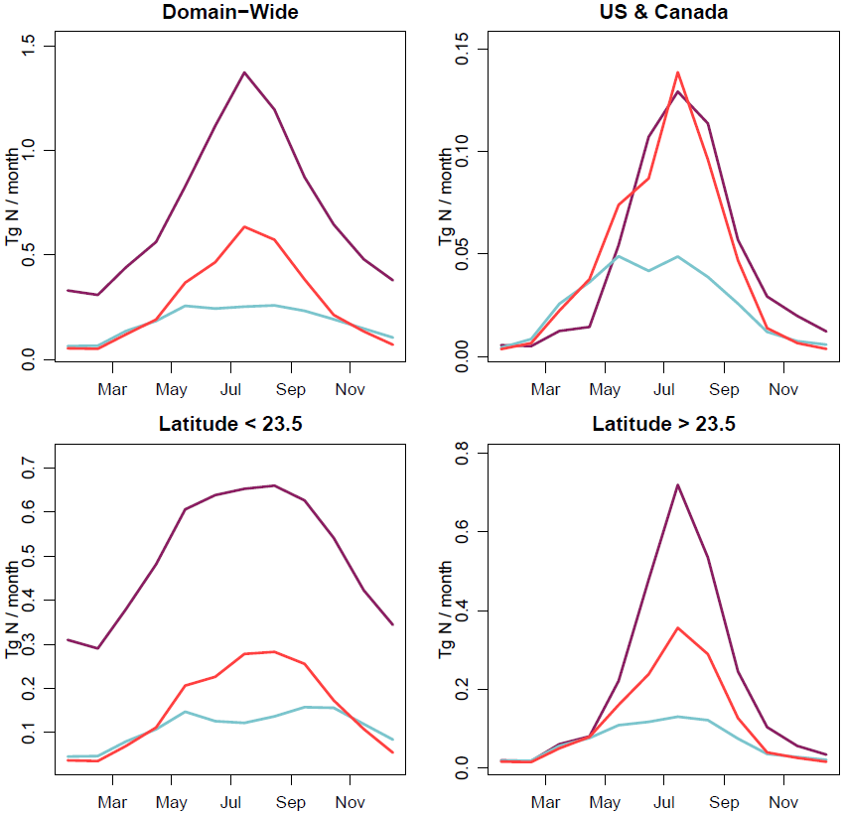
Full Hemispheric Domain
United States & Canada
Monthly Total
Lightning Nitrogen Emissions for 2016
—GEIA —WWLLN —WWLLNs
Characteristics
Latitude ≤ 23.5
Latitude > 23.5
Larger differences during warmer months
Tropical LNO_{x} comprises a significant percentage of total hemispheric LNO_{x}…
Notes:
Note: The GEIA numbers include NO & NO2 (double checked)
/work/MOD3EVAL/jmadden/Projects/hemisphere/plotting_r/timeseries/LNOX_Emissions/ts_emis_ltngno_cmaqv532_ALL_CASES_FOUR_REGIONS_CMAS_geia_monthly_totals.NITROGEN_ONLY.R

Slide 6
Additional Notes on LNO_{x} Emissions
Percentage of Total Hemispheric Lightning NO_{x} between Equator and 23.5N.
Tropical LNO_{x}
X 100%
There is more agreement on this percentage during warmer months – lesser agreement for colder months.
Total Hemispheric LNO_{x}
—GEIA —WWLLN —WWLLNs

Slide 7
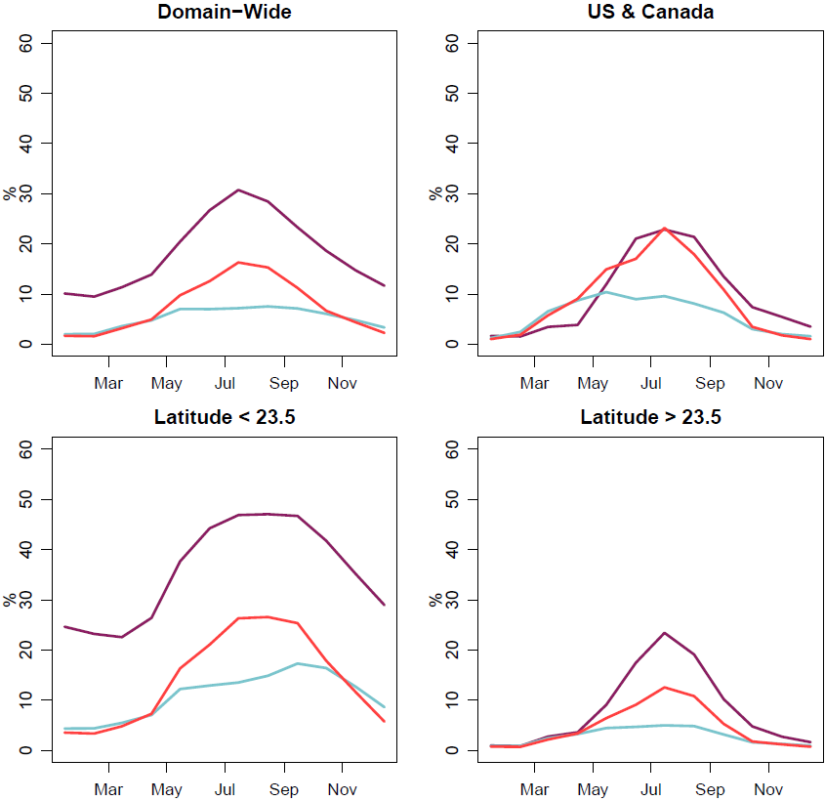
Additional Notes on LNO_{x} Emissions
Percentages of Total NO_{x} Emissions that are from Lightning
Full Hemispheric Domain
United States & Canada
—GEIA —WWLLN —WWLLNs
For the most part, GEIA reports higher percentages of LNO_{x} throughout the hemisphere…
Latitude < 23.5
Latitude > 23.5
As seen in the hemispheric and tropical panels, the difference between GEIA and WWLLNs is mostly consistent throughout 2016.
Notes:
GEIA reports higher percentages of LNO_{x} throughout the hemisphere (with a small exception for the United States and Canada.)

Slide 8
Common Model Configurations
Feature | Setting
Domain | Northern Hemisphere (horizontal)
Horizontal Resolution | 108km
Vertical Levels | 44 Levels; Surface-50hPa
Simulation Period | 2016
Initial Conditions | Results from a previous hemispheric model simulation.
Boundary Conditions | Default conditions of the hemispheric model.
Anthropogenic Emissions | HTAPv2 (Hemispheric Transport of Air Pollution)*
Biogenic Emissions | Biogenic Emissions Inventory System (BEIS) for the United States; Model of Emissions of Gases and Aerosols from Nature (MEGAN) for remaining areas. Updated halogen emissions are used for marine environment.
*Except for the United States, China, and Canada, where country-specific emissions inventories are used.

Slide 9
Effects of LNO_{x} on Air Quality, July 2016
Northern Hemisphere | WWLLN | WWLLNs | GEIA
Differences in Monthly Mean Surface O₃ for July (“WWLLN” is to be interpreted as “WWLLN minus NO_LNOX”, & so on.)
United States | WWLLN | WWLLNs | GEIA
Differences in Monthly Mean Surface O₃ for July
Notes:
Note in the presentation that the ozone difference may be higher than shown in the plots… you can mention that we limited the scale to 10 ppbv.

Slide 10
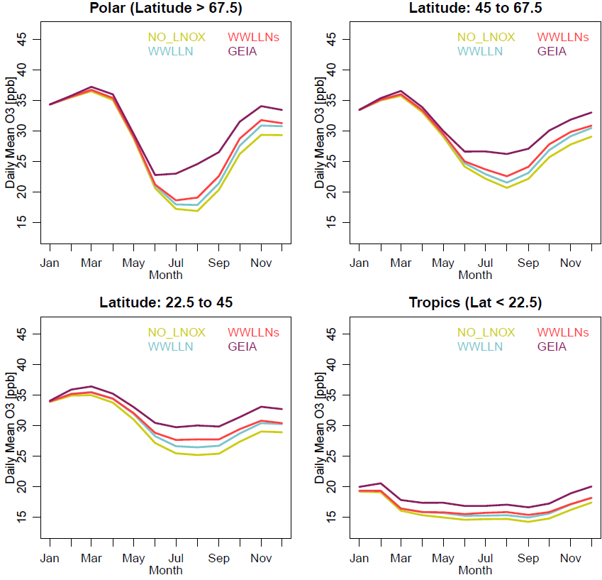
Effects on Air Quality
Daily Means of CMAQ Surface O₃ (ppb)
—NO_LNO_{x} —GEIA
—WWLLN —WWLLNs
The inclusion of LNO_{x} generally increases surface O₃, with larger differences between configurations for the warmer months.
The O₃ differences, between the simulations conducted with WWLLN/WWLLNs & GEIA, are accentuated for higher latitudes.

Slide 11
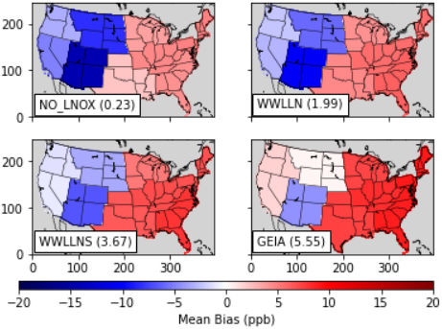
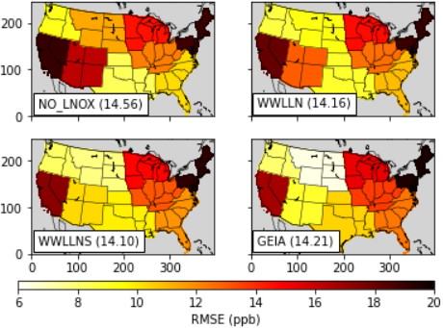
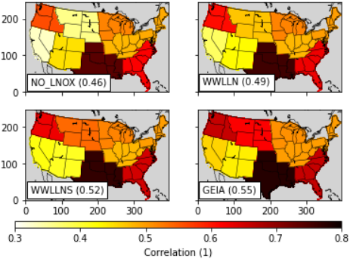
Effects on Air Quality
A performance analysis for July 2016, using AQS data, reveals that the introduction of LNO_{x} improves simulated estimates of surface-level O₃ for the Western U.S. (the opposite for the Eastern U.S.).
Mean Bias
RMSE (ppb)
Correlation
(The number inside the text box within each panel represents the statistic for the entire US).
We also see improved upper-air O₃ estimates, for example…

Slide 12
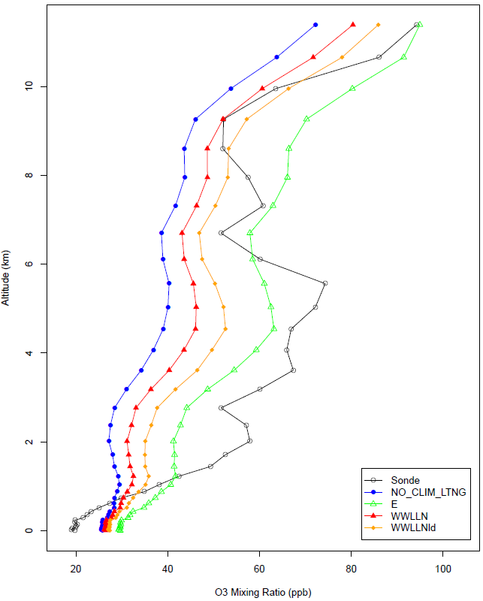
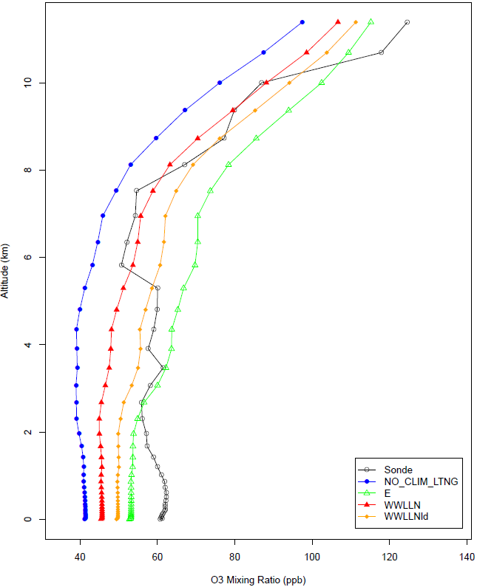
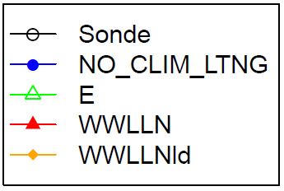
Mean Ozonesonde & CMAQ Profiles for July
Locations in the Western U.S.
Trinidad Head, CA | Boulder, CO
Available Dates:
July 7, 14, 20, & 28, 2016
Available Dates:
July 6, 13, 20, & 27, 2016
Vertical analyses show improvements in the O₃ profile relative to the NO_LNO_{X} case.
The GEIA simulation shows consistently higher magnitudes for most locations and heights.
Sonde
NO_LNOX
GEIA
WWLLN
WWLLNs
Sonde
NO_LNOX
GEIA
WWLLN
WWLLNs

Slide 13
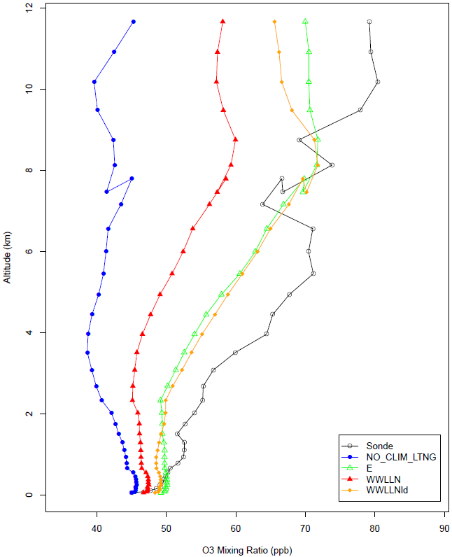
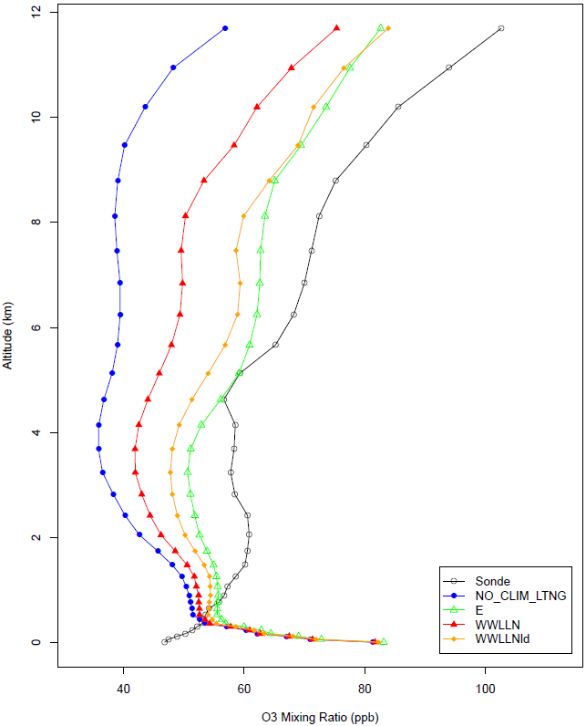
Mean Ozonesonde & CMAQ Profiles for July
Locations in the Eastern / Southern U.S.
Huntsville, AL | Wallops, VA
Similar conclusions are made for locations in the Eastern / Southern U.S.
Overall, the addition of LNO_{x} results in a better representation of O₃ throughout the vertical profile.
Available Dates:
July 1, 9, 16, 23, & 30, 2016
Available Dates:
July 8, 13, & 19, 2016
Sonde
NO_LNOX
GEIA
WWLLN
WWLLNs
Sonde
NO_LNOX
GEIA
WWLLN
WWLLNs
Notes:
Transition sentence to next slide: “What about the vertical ozone across the hemisphere and across time?”

Slide 14
Comparing Against WOUDC Ozonesonde Data
 | Winter | Spring | Summer | Fall
NO_LNO_{x}
WWLLNs
GEIA
50mb
SFC
50mb
SFC
50mb
SFC
Equator to 90N
Equator to 90N
Equator to 90N
Equator to 90N
NMB

Slide 15
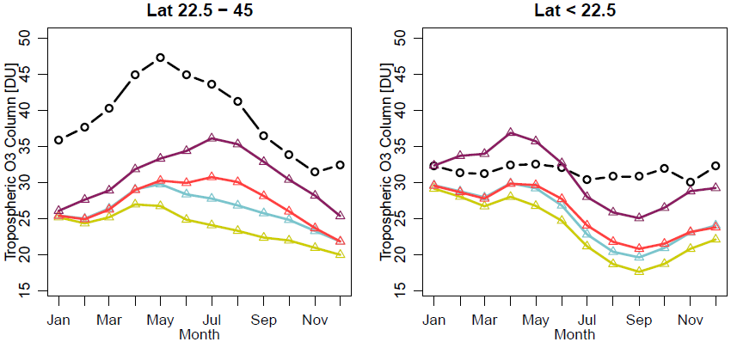
Comparisons Against OMI
Tropospheric O₃ Column Comparisons (DU)
Latitude 22.5 – 45N
Tropics, Latitude < 22.5
The inclusion of LNO_{x} results in a broad increase of tropospheric column O₃ across time and latitude.
Differences between simulated tropospheric O₃ columns and OMI are generally larger with increasing latitude, with larger biases during winter and spring months.
—NO_LNO_{x} —GEIA —WWLLN —WWLLNs
—OMI

Slide 16
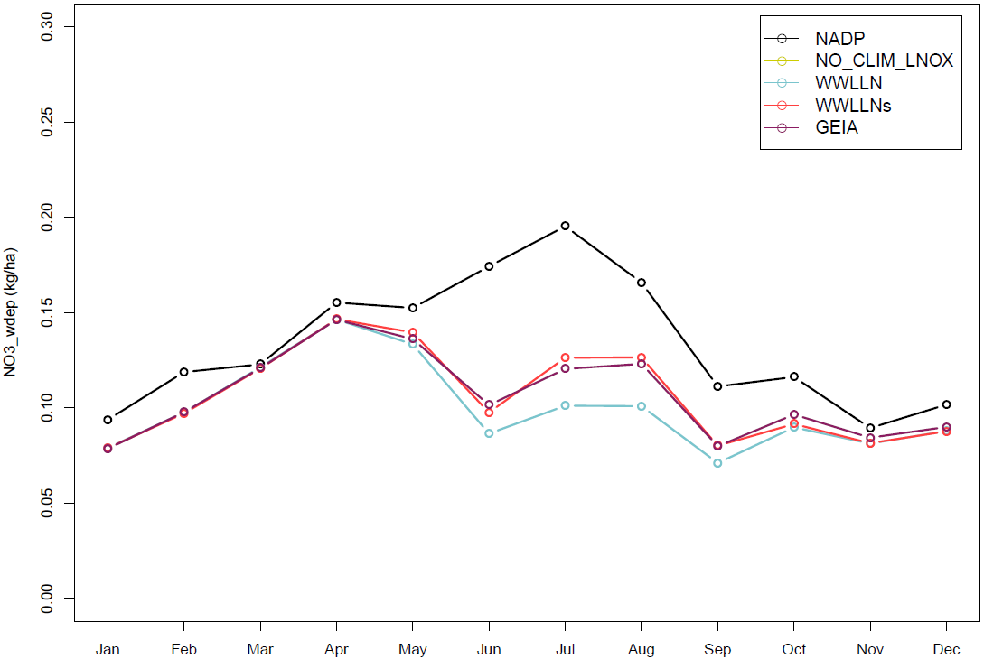
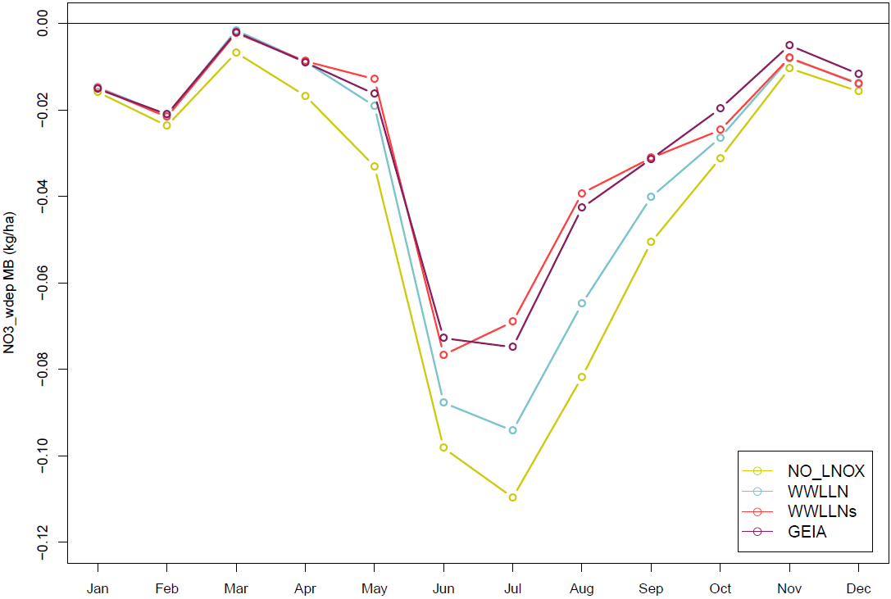
Timeseries of NO₃⁻ Wet Deposition, 2016 (United States, Comparison to NADP)
Monthly Mean
Wet Deposition
(kg ha⁻¹)
NADP
NO_LNO_{x}
WWLLN
WWLLNs
GEIA
Mean Bias
NO_LNO_{x}
WWLLN
WWLLNs
GEIA
The inclusion of LNO_{x} also results in improved estimates of NO₃⁻ wet deposition.

Slide 17
Summary
LNO_{x} emissions, from the various configurations, differ by latitude, height, and magnitude.
Work is still needed to narrow the ranges of observed estimates to more adequately simulate the presence and effects of LNO_{x}.
The inclusion of LNO_{x} emissions results in improvements in vertical ozone, NO₃⁻ wet deposition, and near-surface O₃ (the latter for areas that typically show underpredictions.)

Slide 18
Future Work
Comparisons to other years are ongoing…
2016 should not differ widely from adjacent years.
For earlier years however, the contribution of anthropogenic emissions is larger. A comprehensive analysis through time (say 2002 to 2019) is needed to establish trends for emissions and their effects on air quality in the Northern Hemisphere.
The need for global analyses…
While the hemispheric simulations provide valuable insights, these simulations are “stepping-stones” for global analyses.

Slide 19
Thank you / References
Chameides, W.L. (1986), The role of lightning in the chemistry of the atmosphere. In The Earth’s Electrical Environment, Chap. 6, National Academy Press, Washington, D.C.
Vukovich, J., and A. Eyth (2019), Technical Support Document, Preparation of Emissions Inventories for the Version 7.1 2016 Hemispheric Emissions Modeling Platform, U.S. EPA Office of Air Quality Planning and Standards.
Byun, D.W., and K.L. Schere (2006), Review of the governing equations, computational algorithms, and other components of the models-3 community multiscale air quality modeling system, Appl. Mech. Rev., 59, 51-77.
Appel, K.W., et al. (2019), Description and evaluation of the community multiscale air quality (CMAQ) modeling system version 5.1, Geosci. Model Dev., 10, 1703-1732.
Kang, D., et al. (2019a), Simulating lightning NOx production in CMAQ: evolution of scientific updates, Geosci. Model Dev., 12, 3071-3083.
Kang, D., et al. (2022), Assessing the impact of lightning NO_{x} emissions in CMAQ using lightning flash data from WWLLN over the Contiguous United States, Atmosphere, 13(8), 1248.
Rodger, C.J., et al. (2006), Detection efficiency of the VLF World-Wide Lightning Location Network (WWLLN): initial case study, Ann. Geophys., 24, 3197-3214.
Cummins, K.L., et al. (1998), A combined TOA/MDF technology upgrade of the U.S. National Lightning Detection Network, J. Geophys. Res, 103, 9035-9044.
Nag, A., M.J. Murphy, K.L. Cummins, A.E. Pifer, and A. Cramer (2014), Recent evolution of the U.S. National Lightning Detection Network, 23rd Intl. Lightning Detection Conference & 5th Intl. Lightning Meteorology Conference, 18-21 March, Tucson, AZ.
Graedel, T.E., et al. (1993), A compilation of inventories of emissions to the atmosphere, Global Biogeochem. Cy., 7, 1-26.
Additional References Available Upon Request:
Madden.Mike@epa.gov

