Slide 1
Estimating Mexican EGU Impacts on Ozone in El Paso with SCICHEM
Chase Calkins, Eric Hunt, and Matthew Alvarado
Verisk Atmospheric and Environmental Research
Lexington, MA, USA
2022 CMAS Conference
18 October 2022
This presentation is based on work supported by the State of Texas through a contract from the Texas Commission on Environmental Quality (TCEQ). The conclusions are the authors’ and do not reflect TCEQ policy.

Slide 2
Motivation
El Paso has multiple ozone monitors with design values above the 2015 Ozone National Ambient Air Quality Standards (NAAQS).
Air quality in El Paso is affected by both US and Mexican pollution sources.
A new natural gas combined-cycle power plant ( “Norte III”) located in Ciudad Juárez began operating in June 2020.
  One of the biggest gas-fired plants in Mexico (605 tons of NO_{x} per year).
  Not included in EPA modeling platforms for 2019 or earlier
The purpose of this project was to use SCICHEM v3.3 to assess the ozone impact of four Mexican electrical generating units (EGUs) near Ciudad Juarez on El Paso, Texas.

Slide 3

SCICHEM v3.3
A Second Order Closure Integrated Puff Model with Chemistry
A reactive non-steady-state plume dispersion model that can calculate
  Single source and multi-source impacts
  Short-range calculations (for example, 1-hour SO₂, 1-hour NO₂, 24-hour secondary PM_{2.5}, or 8-hour ozone concentrations at fence line receptors)
  Long-range calculations for primary and secondary pollutant impacts (e.g., O₃, PM_{2.5})
https://github.com/epri-dev/SCICHEM

Slide 4
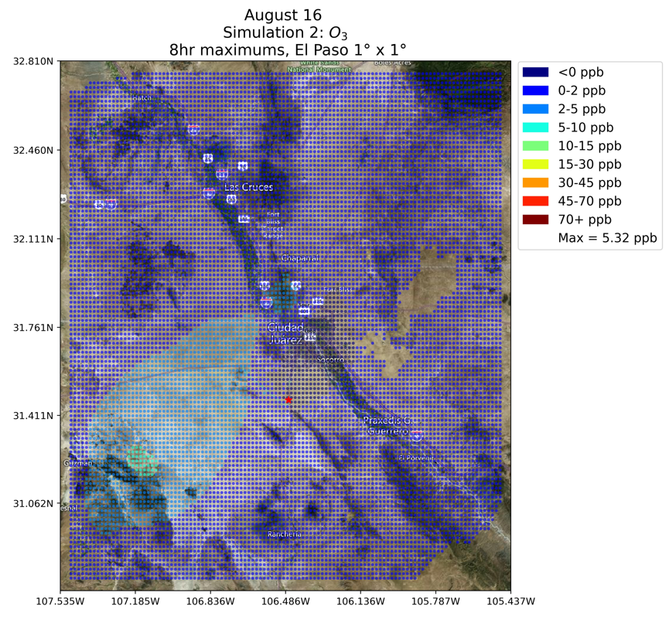
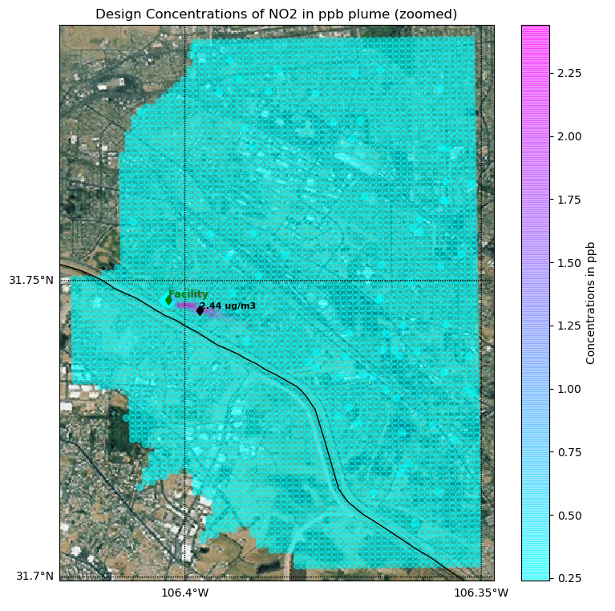
Run Modes in SCICHEM
AERMOD-like
  Tracer: Used for near-source dispersion of relatively unreactive compounds (e.g., fence line 1-hr SO₂)
  NO_{x}-only Fast Chemistry: Used for fence line studies of 1-hr NO₂
Detailed Chemistry for Regional Studies
  Ozone: Includes only gas-phase chemistry following CB6r2
  PM_{2.5}: Includes both gas and aerosol chemistry

Slide 5
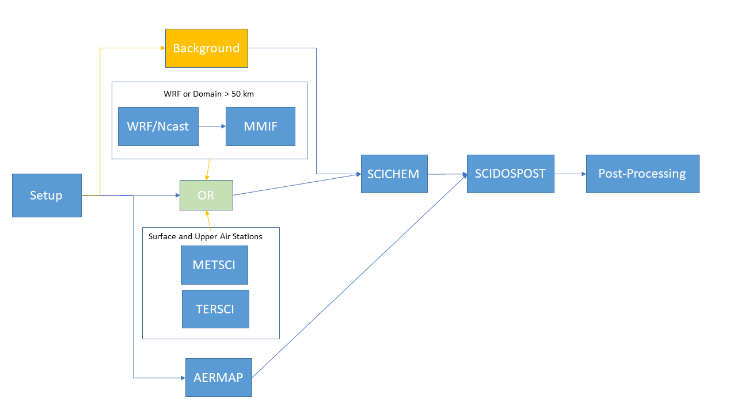
SCICHEM Processing Steps
TERSCI – terrain processor
CTM2SCICHEM – extracts background data from CAMx or CMAQ output
METSCI – meteorological processor
MMIF – WRF data processor
SCICHEM – dispersion model
SCIDOSPOST – dispersion model post-processor

Slide 6
Facility Overview
The Samalayuca I Power Plant: “Sam I”
  316MW oil fired power plant.
The Samalayuca II CCGT Power Station: “Sam II”
  Three-unit, 522 MW natural gas power plant.
The Chihuahua III power station: “Chi III”
  275 MW gas-fired power station.
The Norte III power plant: “Norte III”
  907 MW natural gas combined-cycle power plant that opened in June 2020.

Slide 7
Modeling Inputs
Receptors
  Receptors were a single 2 km by 2 km resolution grid covering the 4 km El Paso modeling domain used by TCEQ (180 km by 180 km).
  Receptor elevations are from USGS National Elevation Data (NED) at 30-meter resolution and processed by TERSCI and AERMAP.
Meteorology Data
  Meteorology data for August 2019 were provided by TCEQ as WRF output files for the 4 km El Paso modeling domain.
  Processed using MMIF to prepare meteorological input files for SCICHEM.
Chemical Background Data
  CAMx output data for August 2019 were provided by TCEQ as CAMx netCDF output files for the 4 km El Paso modeling domain.
  Converted to the NetCDF classic format and then processed into SCICHEM-ready files using the CTM2SCICHEM preprocessor.
  Created regional GIS file covering TCEQ El Paso/Ciudad Juarez domain for background averaging

Slide 8
Stack Parameters
Facility Source Parameters. Values estimated from SCC code are in italics
Plant | unit_id | process_id | scc | Height (m) | Diam. (m) | Temp. (ºC) | Vel. (m/s)
Sam I | 2CH01 | 2ECM01A | 20100201 | 82.38 | 3.81 | 307.39 | 22.46
Sam I | 2CH01 | 2ECM01B | 10100401 | 82.38 | 3.81 | 125.61 | 22.46
Sam I | 2CH02 | 2ECM02A | 20100201 | 82.38 | 3.81 | 307.39 | 22.92
Sam I | 2CH02 | 2ECM02B | 10100401 | 82.38 | 3.81 | 125.61 | 22.92
Sam II | 4CH02 | 4ECM02 | 20100201 | 18.00 | 1.50 | 307.39 | 3.30
Sam II | 4CH03 | 4ECM03 | 20100201 | 45.72 | 5.20 | 307.39 | 19.38
Sam II | 4CH04 | 4ECM04 | 20100201 | 45.72 | 5.20 | 307.39 | 19.74
Sam II | BLANK | 4ECM01 | 10100601 | 80.43 | 3.14 | 113.33 | 14.29
Chi III | BLANK | 2ECM01 | 20100201 | 18.90 | 3.05 | 307.39 | 18.68
Chi III | BLANK | 2ECM02 | 20100201 | 18.90 | 3.05 | 307.39 | 18.68
Norte III | N/A | N/A | N/A | 35.00 | 5.50 | 89.00 | 23.72
Initial estimates were taken from the US EPA 2016v2 emission modeling platform.
Missing stack parameters were filled in using US EPA defaults for each SCC code.
For Norte III, the environmental impact statement parameters were used.

Slide 9
August Emissions for Each EGU
Annual and August emissions of NO_{x} and VOCs for each site.
Plant | unit_id | process_id | scc | Annual |  | August
 |  |  |  | NO_{x} (US ton) | VOC (US ton) | NO_{x} (kg) | VOC (kg)
Sam I | 2CH01 | 2ECM01A | 20100201 | 658.9 | 15.4 | 54290 | 1270.6
Sam I | 2CH01 | 2ECM01B | 10100401 | 0.5 | 0.0 | 33 | 0.5
Sam I | 2CH02 | 2ECM02A | 20100201 | 59.7 | 1.4 | 4916 | 115.0
Sam I | 2CH02 | 2ECM02B | 10100401 | 327.9 | 5.3 | 21735 | 351.5
Sam II | 4CH02 | 4ECM02 | 20100201 | 846.7 | 9.3 | 69760 | 763.0
Sam II | 4CH03 | 4ECM03 | 20100201 | 537.1 | 8.8 | 44248 | 725.9
Sam II | 4CH04 | 4ECM04 | 20100201 | 546.2 | 9.0 | 45002 | 738.3
Sam II | BLANK | 4ECM01 | 10100601 | 0.2 | 0.0 | 22 | 0.5
Chi III | BLANK | 2ECM01 | 20100201 | 395.0 | 6.5 | 32542 | 533.9
Chi III | BLANK | 2ECM02 | 20100201 | 389.9 | 6.4 | 32125 | 527.0
Norte III | BLANK | N/A | 20100201 | 605.0 | 9.9 | 49845 | 817.8

Slide 10
Emission Temporal Profiles
Figure 1. Daily temporal profile (#33 from the EPA 2016v2 Emission Modeling Platform) used for all sites.
Figure 2. Weekly temporal profile (#8 from the EPA 2016v2 Emission Modeling Platform) used for all sites.
Figure 3. Monthly Temporal profiles used for each site by SCC code.

Slide 11
VOC Speciation
VOC speciation profiles (mass fractions) by SCC code.
SCC | VOC/ NONHAPTOG Profile | CH₄ | ACET | PAR | PRPA | TOL | UNR
10100401 | 0001 | 0.1897 | 0.4828 | 0.3276 | 0 | 0 | 0
10100601 | 0003 | 0.6364 | 0 | 0.2951 | 0.0455 | 0.0227 | 0.0003
20100201 | 0007 | 1.0 | 0 | 0 | 0 | 0 | 0

Slide 12
Emission Scenarios
Scenario I, 2019 Status Quo: Operation of the three incumbent Mexican EGUs (Sam I, Sam II, Chi III) during the 2019 ozone season.
Scenario II, Only Norte III: A 2023 scenario where all three incumbent Mexican EGUs have been shut down and replaced by the Norte III EGU.
Scenario III, No Oil: A 2023 scenario where the oil powered EGU (Sam I) has been shut down and the other three natural gas-powered EGUs (Sam II, T Chi III, and Norte III) operate consistently.
Scenario IV, All On: A 2023 scenario where the three natural gas powered Mexican EGUs operate consistently and the oil powered Mexican EGU (Sam I) is used as a peaking unit.

Slide 13
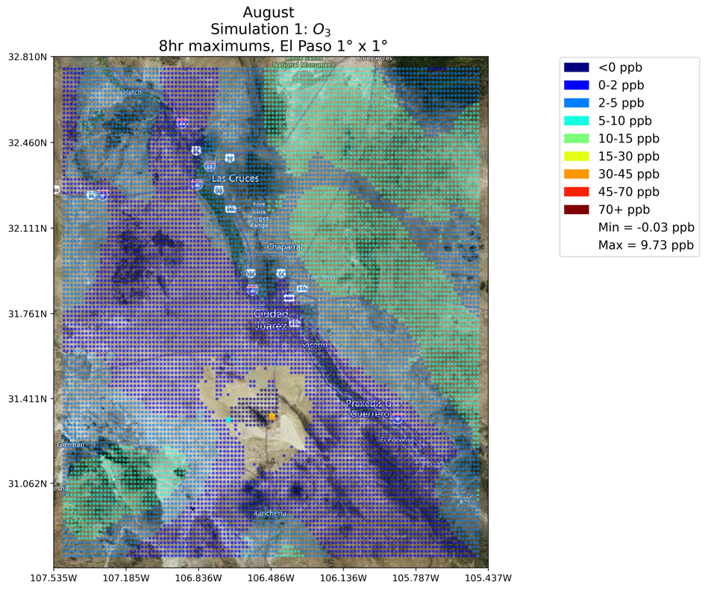
Scenario I, 2019 Status Quo
Maximum impacts (> 5 pbb) are generally southwest and northeast of El Paso, TX
Maximum MDA8 O₃ impact of 9.7 ppb

Slide 14
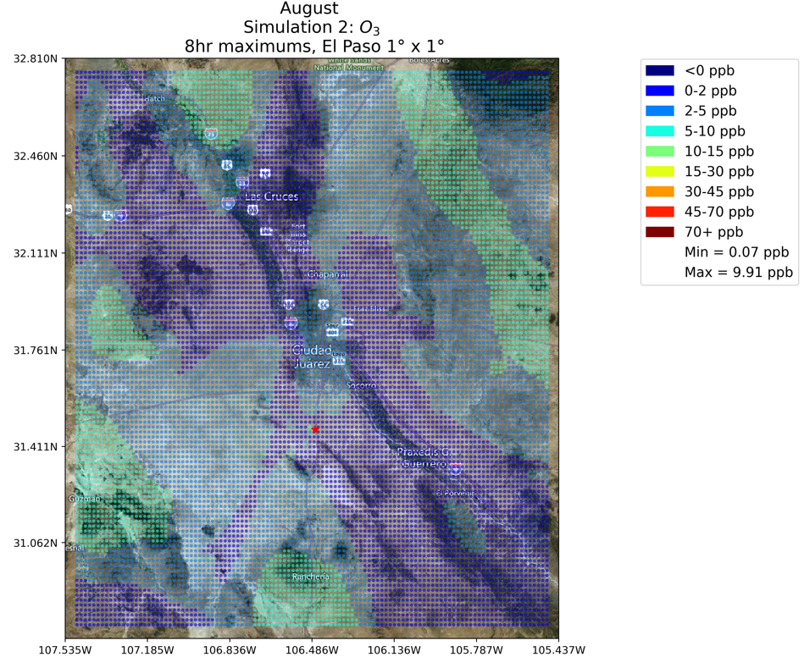
Scenario II, Only Norte III
Maximum impacts (> 5 pbb) now include north and south areas, further outside El Paso
Maximum MDA8 O₃ impact of 9.9 ppb, negligible change

Slide 15
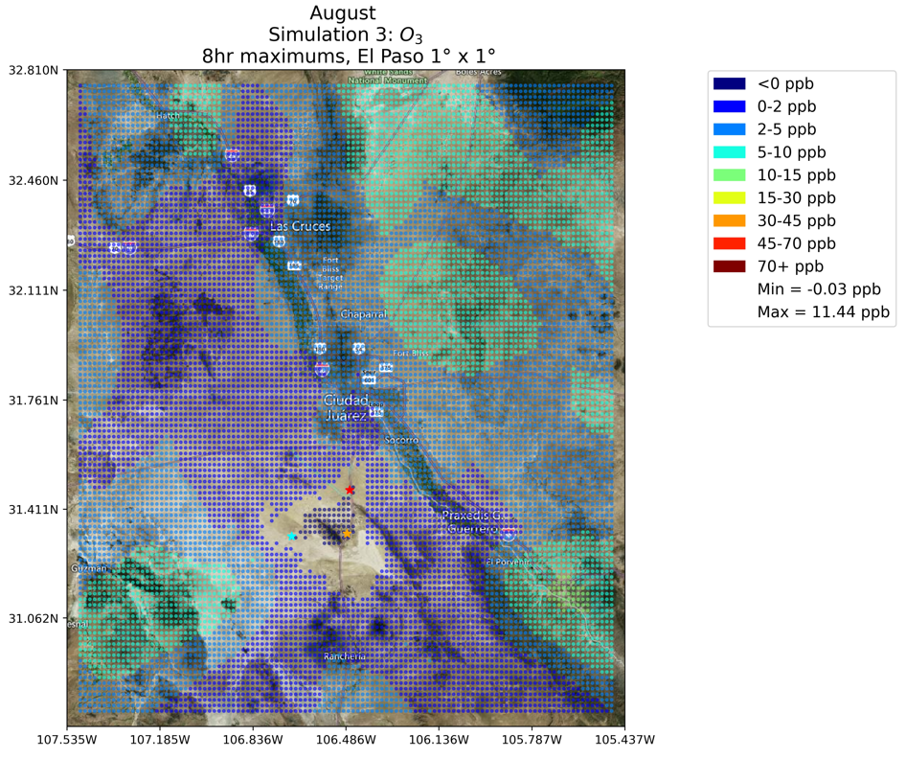
Scenario III, No Oil
Maximum MDA8 O₃ impact of 11.4 ppb, increase above status quo

Slide 16
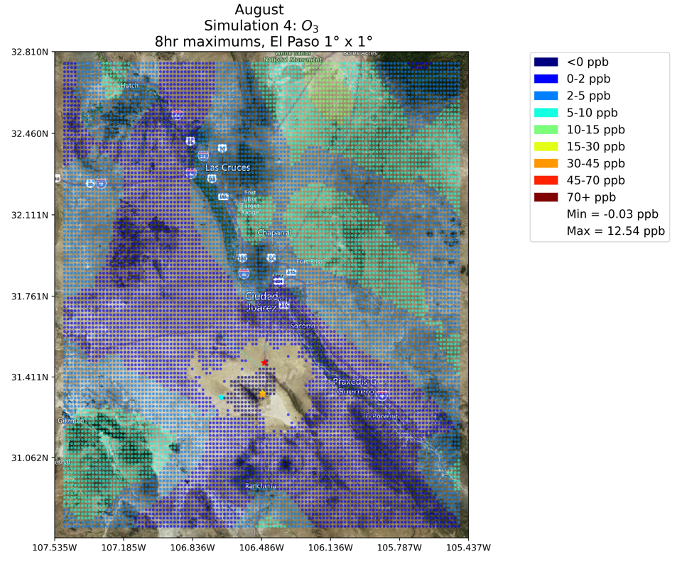
Scenario IV, All On
Maximum MDA8 O₃ impact of 12.5 ppb, increase above status quo

Slide 17
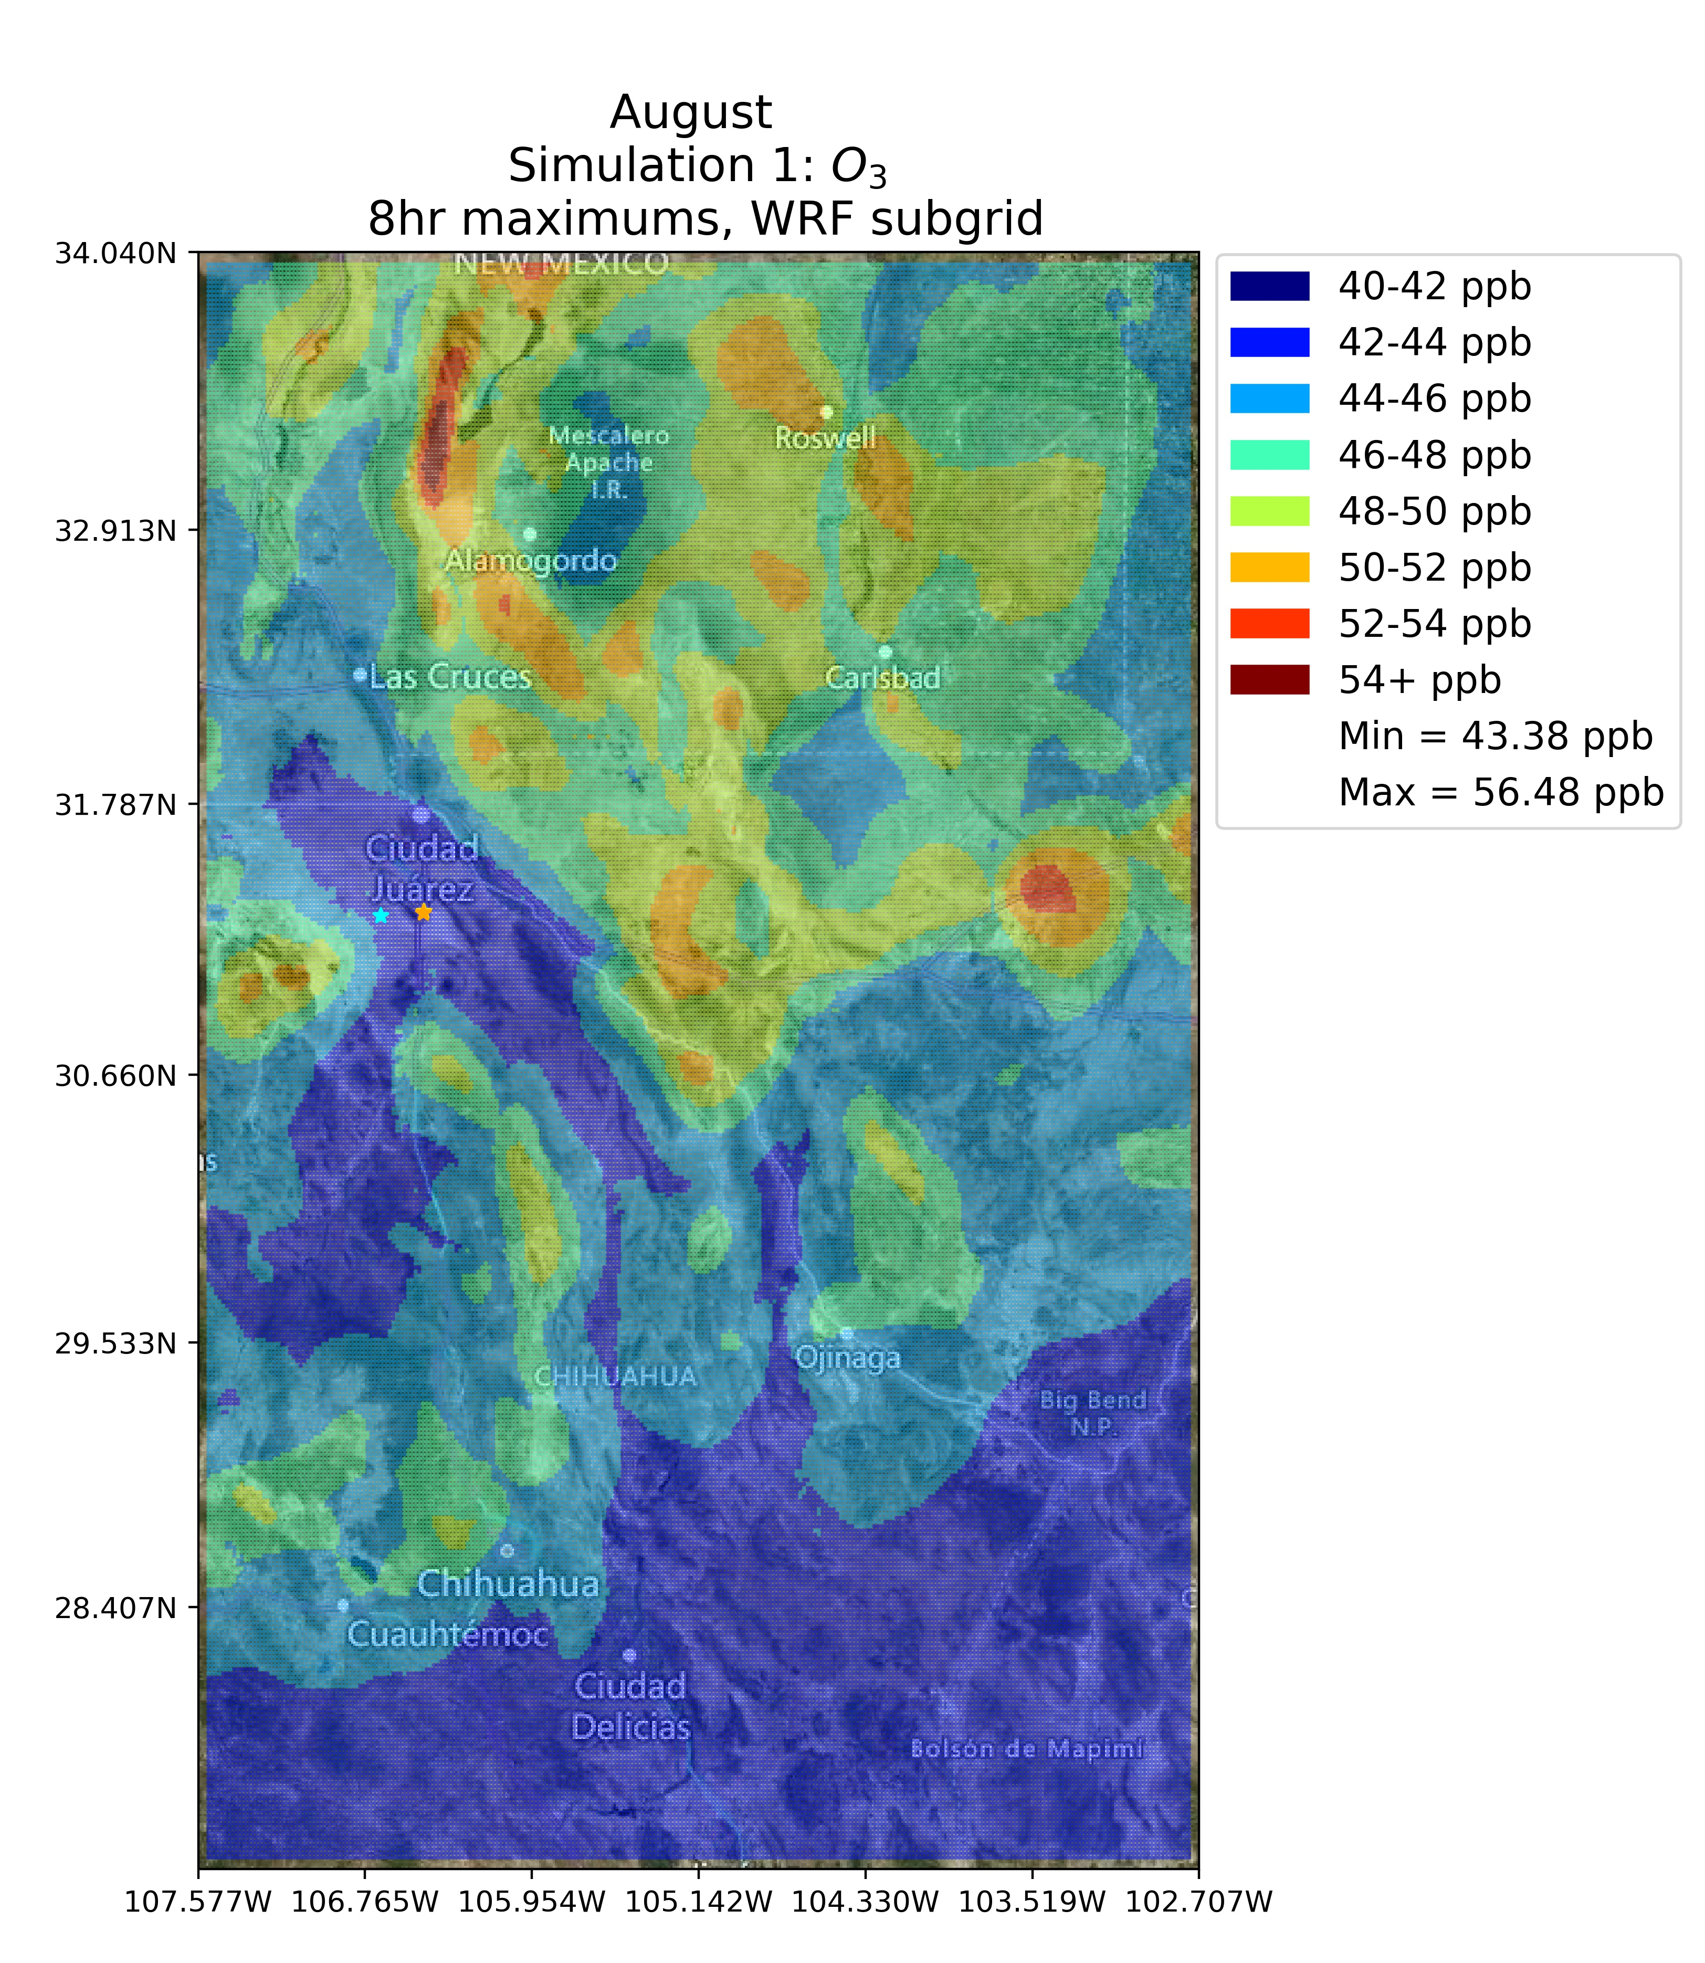
Comparison with O₃ Monitors
Site | Obs. | I | II | III | IV
Ascarte | 66.3±10.8 45-97 | 44.8±1.3 44-52 | 44.8±0.5 44-47 | 44.9±1.3 44-53 | 44.5±2.3 42-50
Chamizal | 69.5±14.3 48-108 | 44.8±1.3 44-51 | 44.8±0.7 44-48 | 45.0±1.6 44-52 | 44.9±1.5 44-50
El Paso UTEP | 67.4±13.0 48-94 | 44.9±1.4 44-51 | 44.8±0.7 44-48 | 44.9±1.4 44-51 | 44.9±1.6 44-52
Ivanhoe | 66.3±10.8 49-89 | 44.8±1.3 43-51 | 44.8±0.5 44-46 | 44.9±1.3 44-51 | 44.5±2.3 34-50
Skyline Park | 66.1±12.1 49-103 | 45.0±1.6 44-52 | 44.9±0.8 44-48 | 45.0±1.4 44-51 | 45.0±1.9 43-54
Socorro Hueco | 63.3±8.4 48-82 | 44.7±1.3 42-51 | 44.6±0.2 44-45 | 44.7±1.1 43-50 | 44.4±2.1 34-49
SCICHEM simulations are biased low by 18-25 ppbv.
  Partially due to the spatially constant regional background used in SCICHEM.
  However, using the original CAMx output only reduces the bias by 5-15 ppb
  Main issue is thus the underestimate of MDA8 O₃ in CAMx background

Slide 18
Conclusions
Scenario IV with all four EGUs running tends to have the largest MDA8 O₃ impacts, with a maximum impact of 12.5 ppbv for August 2019.
Replacing the incumbent EGUs (Scenario I) with Norte III (Scenario II) still gives a similar maximum MDA8 O₃ (9.7 ppb to 9.9 ppb, respectively).
Adding the two incumbent gas EGUs to Norte III increases the maximum impact from 9.9 ppb to 11.4 ppb.
The maximum O₃ impacts of the Mexican EGUs in Texas tend to happen outside the city of El Paso.
CAMx background data underestimates the MDA8 O₃ on several of the high O₃ days in August 2019, leading to an underestimate in the total MDA8 O₃ and its variability by SCICHEM.

Slide 19
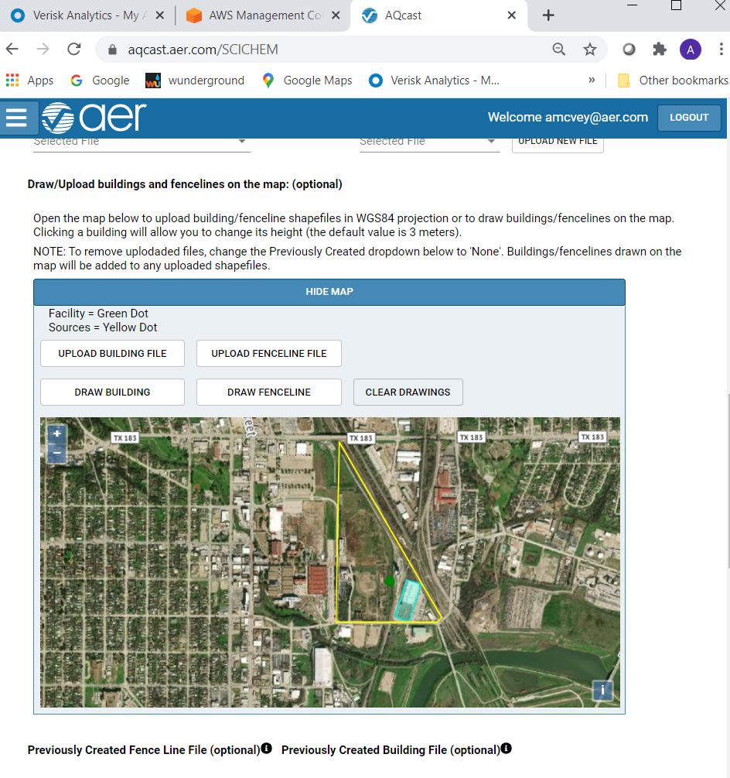
AQcast: SCICHEM User Interface and Output (https://aqcast.aer.com/SCICHEMPreview)
Secure login restricts access to your data
Can upload facility GIS files or draw directly on the map
Weather data source locations also displayed on a map (not shown)
Final output includes all input and output files, as well as quick plots for review

