Slide 1
Use of NOAA’s Global Forecast System Data in the Cloud for Community Air Quality Modeling
Patrick Campbell, Weifeng (Rick) Jiang, Zachary Moon, and Sonny Zinn
2022 CMAS Conference
Cloud Computing
October 19, 2022

Slide 2
The Global Forecast System Version 16 (GFSv16)
NOAA’s Environmental Monitoring Center (EMC) upgraded GFS model from v15.3 to v16
in February 2021
Major switch to a FV3-based dynamical core
Increased vertical layers (resolution) from 64 to 127
Extended model top from 54 (upper stratosphere) to 80 km (mesopause)
Thinner first model layer thickness (20 m)
Higher-resolution global horizontal grids of ∼ 25 and 13 km
Improved physical parameterizations
Upgraded to the Global Data Assimilation System (GDAS) version 16
Changed the format of forecast output history files from binary to NetCDF
Provides hourly output out to 72-hr (3 d) forecast
FV3: Finite-Volume
Cubed Sphere
Campbell et al., GMD (2022)

Slide 3
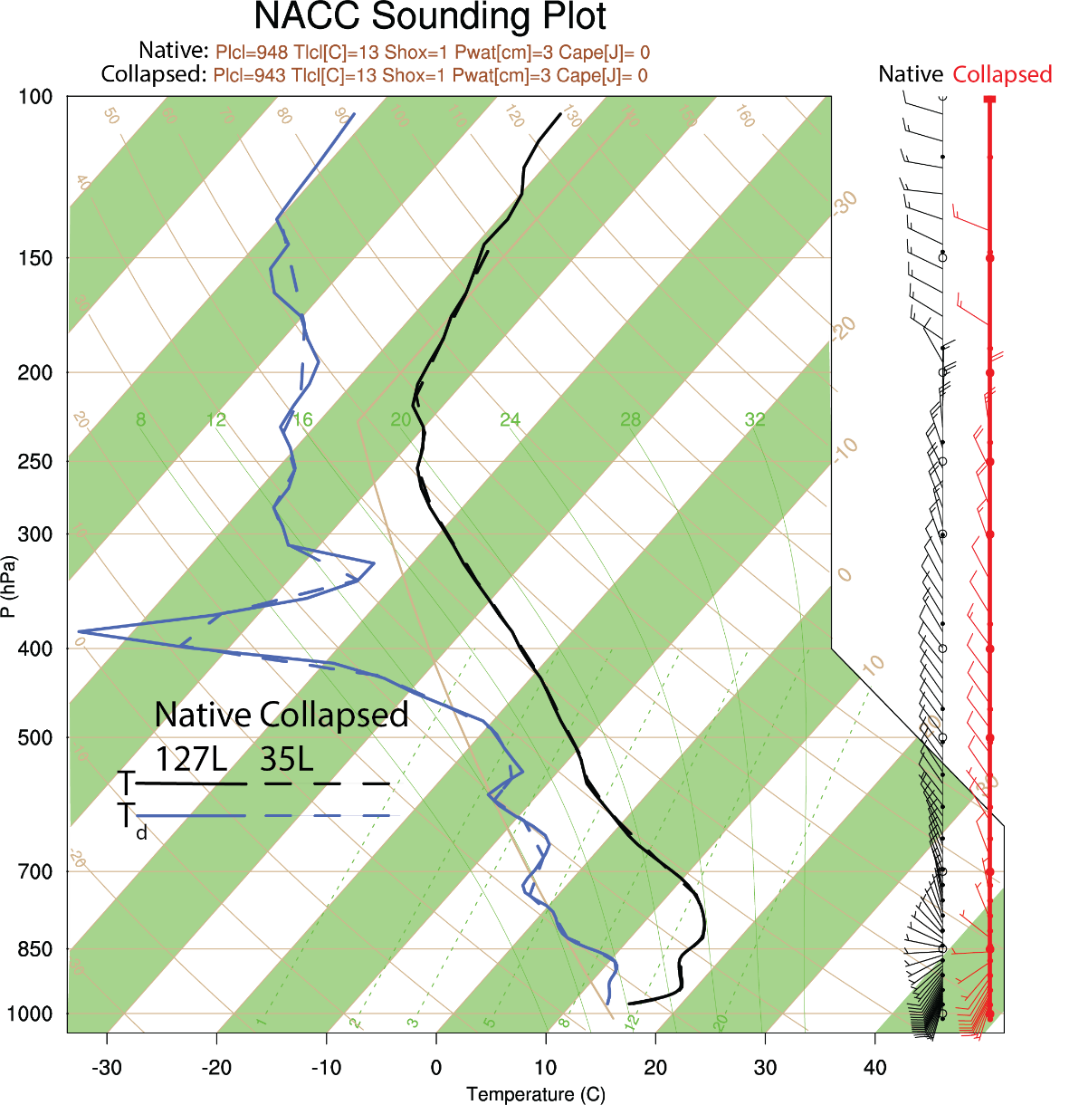
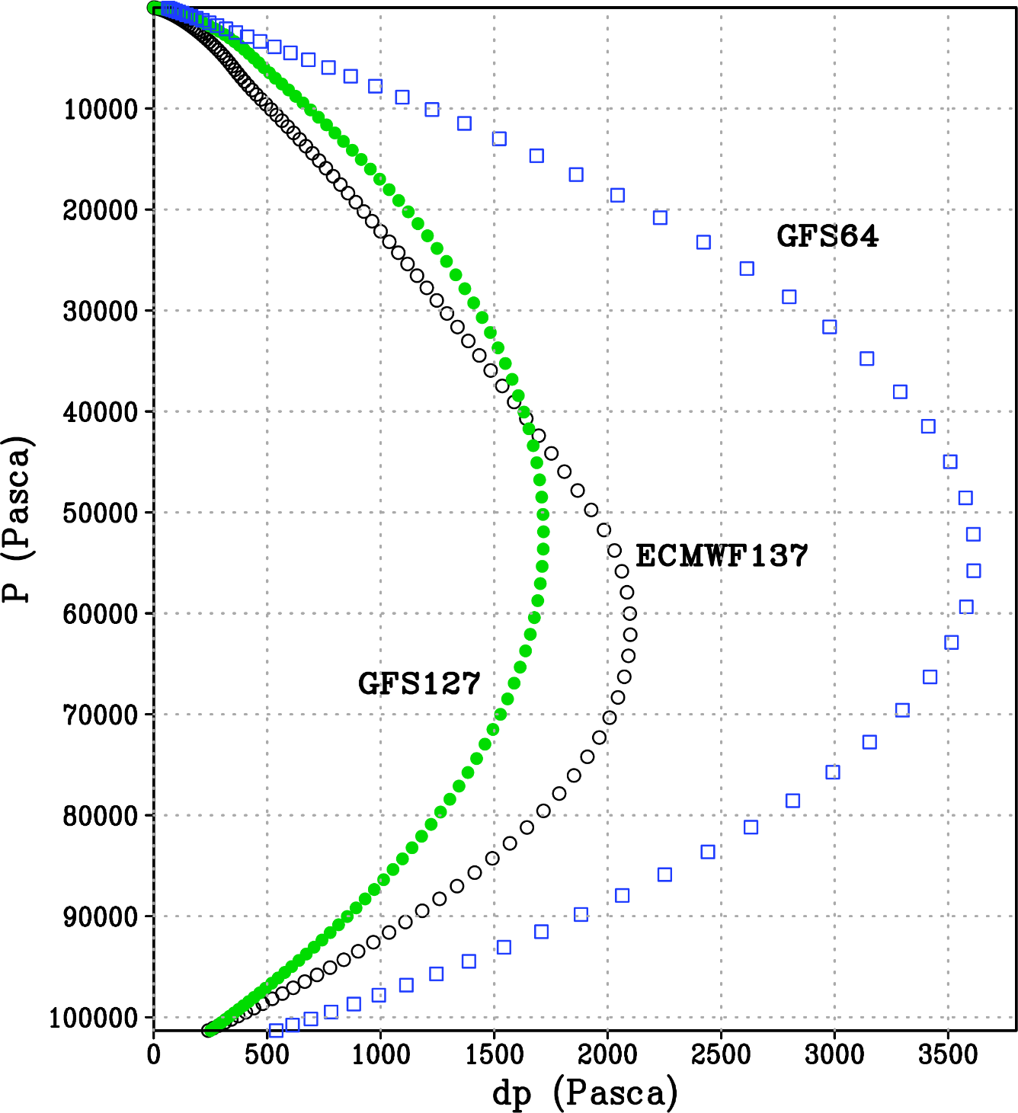
The NOAA-EPA Atmosphere Chemistry Coupler
The NOAA-EPA Atmosphere-Chemistry Coupler (NACC) (i.e., “knack”: meaning an acquired skill) is adapted from EPA’s Meteorology-Chemistry Interface Processor (MCIP) version 5 (Otte and Pleim, 2010).
NACC is used for NOAA’s latest operational NAQFC (based on CMAQv5.3.1) and is available to the greater scientific community at: https://github.com/noaa-oar-arl/NACC.
Directly Interpolated Fields
Redefined Vertical Structure
FV3/GFSv16
C768 (~13 km)
GFSv16 has higher vertical resolution with 127L and thinner 1st layer (20 m thick) than previous GFS.
NACC uses either native or collapsed GFSv16 layers, and there is good agreement in structure.
NACC
12km
Campbell et al., GMD (2022)

Slide 4
Why use NOAA GFSv16 in the Cloud?
Obtaining and running gridded meteorological models (e.g.WRF) for CMAQ regional applications across the globe can be both time and resource intensive.
Use of NOAA’s current operational GFSv16 gridded (NetCDF) input data is very large and cumbersome to process for the scientific air quality modeling community.
Cloud computing and storage platforms are desirable as they are highly-customizable, on-demand, and much more scalable than traditional local servers…User-Ready!

Slide 5
Main Objective:
Provide a cloud interface to GFS-driven CMAQ applications for any regional domain globally…
“NACC-in-the-Cloud”

Slide 6
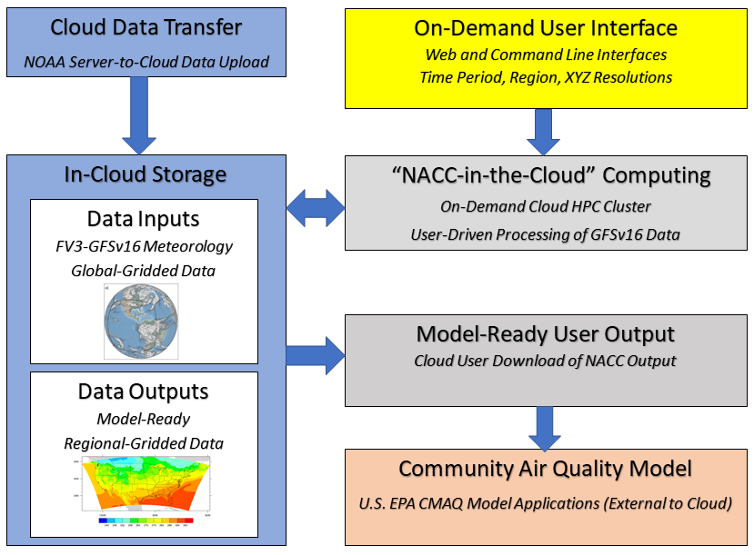
Methods: Cloud-Based Data Transfer and Processing

Slide 7
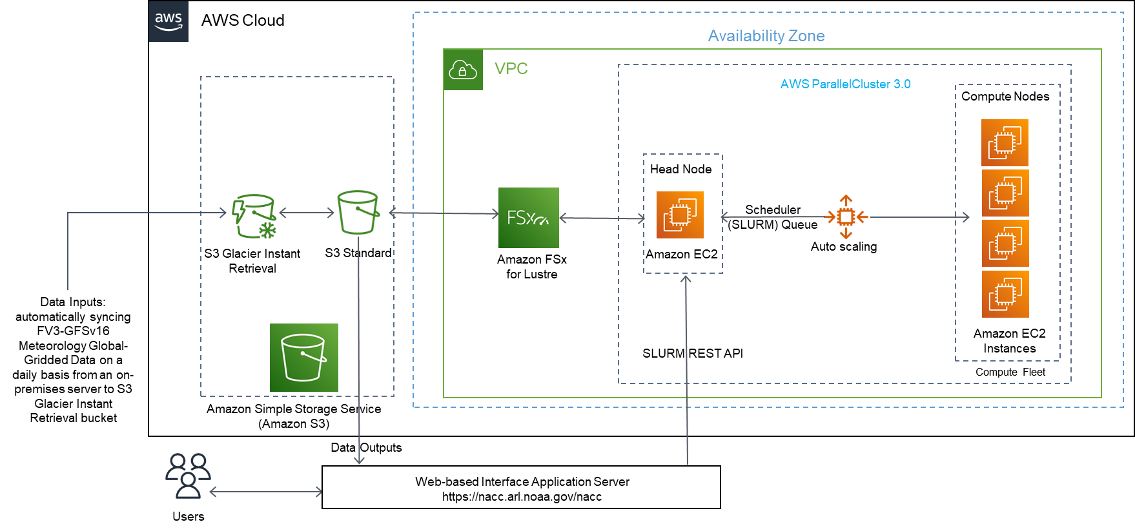
Methods: Streamlined AWS-Based Development

Slide 8
Methods: Development of a Web-Based User Interface
Web app based on the next-gen ARL READY framework (using the Java Spring ecosystem)
Real-time Environmental Applications and Display sYstem: https://www.ready.noaa.gov/index.php
NACC namelist and job script generated using Python based on web app form input, communicated via an API endpoint of the web app
Slurm job submission via Slurm REST API using a generated Python client library
A cron job syncs generated outputs from the Amazon FSx for Lustre file system to an Amazon S3 bucket, where they can be downloaded
S3 URLs are presented to the user in the web app interface
Will add user email notification that job is done and S3 URLs are ready for pickup

Slide 9
Results: NACC-in-the-Cloud Web Demo
https://nacc.arl.noaa.gov/nacc/
For Lambert conformal (GDTYP=2), P_ALP and P_BET are the true latitudes of the projection cone, and P_GAM is the central meridian of the projection. XCENT and YCENT, are the reference longitude and latitude for the domain.
See the I/O API grid doc for more information.
Notes:
nacc.test
$1983*DoC2096%

Slide 10
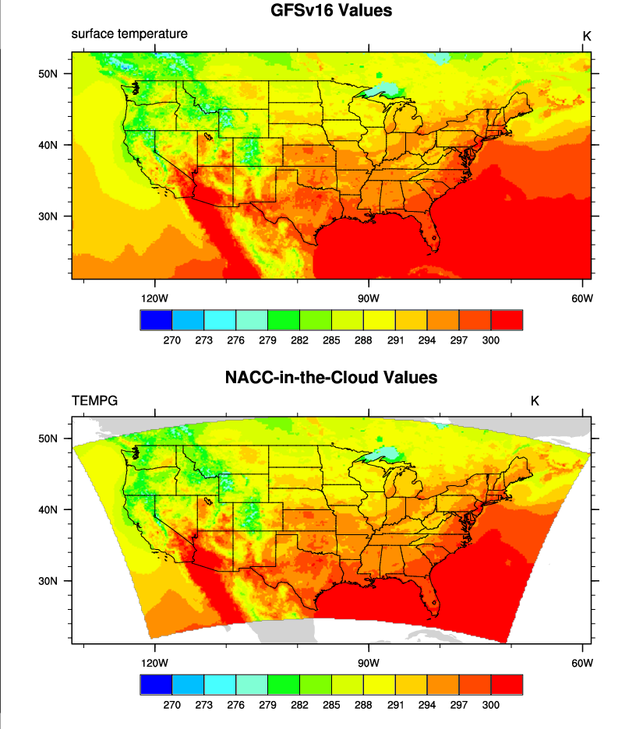
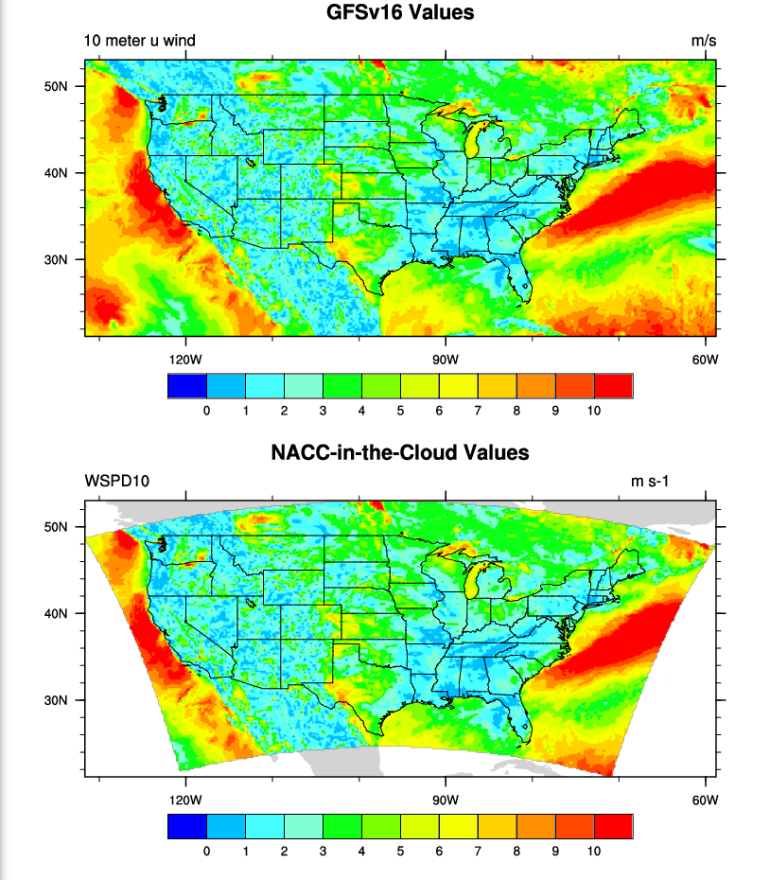
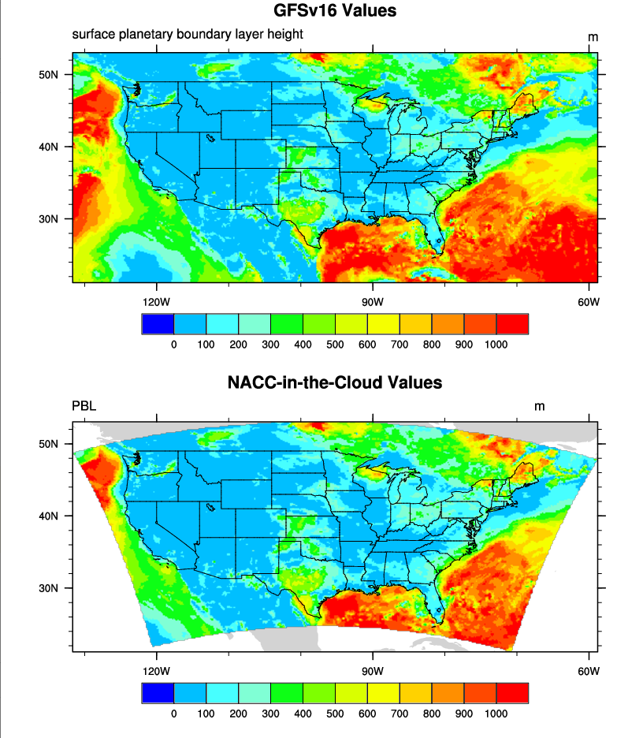
Results: GFSv16 and NACC-in-the-Cloud Comparison
Surface Temperature
10-m Wind Speed
PBL Height
C768 (~13 km)
C768 (~13 km)
C768 (~13 km)
12 km
12 km
12 km
Excellent agreement with GFSv16 inputs and NACC-in-the-Cloud outputs!

Slide 11
Conclusions and Path Forward
NACC-in-the-Cloud prototype has been developed with a functional web-based user interface (https://nacc.arl.noaa.gov/nacc/)
Add additional features and release NACC-in-the-Cloud for testing for entire operational GFSv16 hourly data record (March 23, 2021 - Current Day)
Development of GitHub repository, user documentation, and technical paper availability to the community
Expand funding for development of complete NACC-CMAQ application in AWS-HPC, including flexibility to other meteorological and AQM applications

Slide 12
Where to access NACC-in-the-Cloud?
NACC-in-the-Cloud URL:
https://nacc.arl.noaa.gov/nacc/
New Requests for Access May be sent to:
https://forms.gle/jUWFKLyY6WGKySkv6
Please fill out the NACC-in-the-Cloud
User Google Form at:
https://forms.gle/ETwKS2qzoHndaruJ9

