Slide 1
Evaluating and Comparing the Effects of WRF Setup Variables
Corey L. Smithson, Natalie White, Hans Klomp, Bradley R. Adams
Brigham Young University
Notes:
Biographical Info
Using Models the effects of Urban Growth in the Salt Lake Area

Slide 2

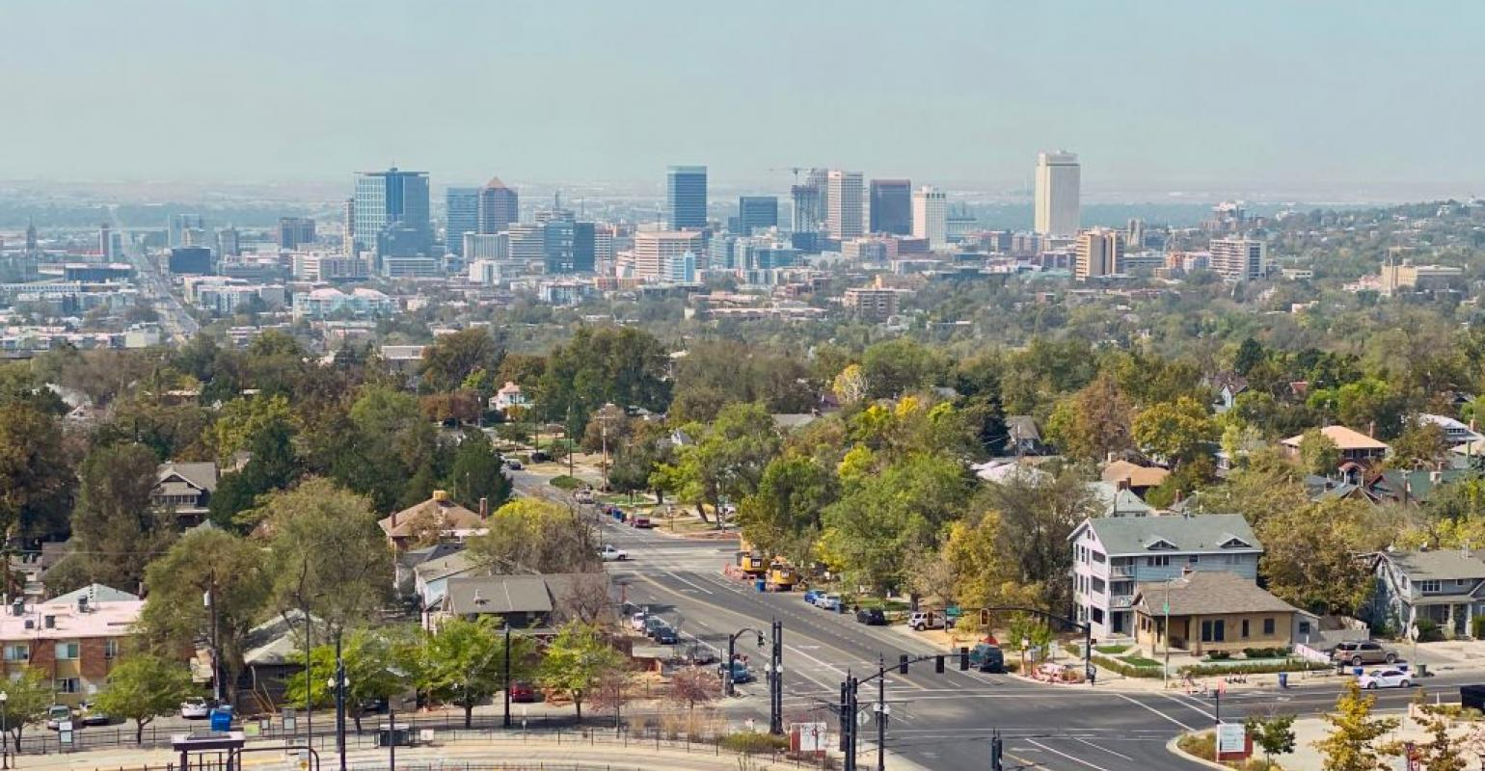
Introduction
Determine effect of urban growth in greater Salt Lake area (GSLA) on the local meteorological (met) conditions using an urban canopy model (UCM)
Major Tasks:
  Develop and validate a WRF-based UCM for the GSLA
  Evaluate met changes based on various urban growth scenarios
  Document model setup and usage to enable additional studies
Notes:
Formal explanation
Develop/ validate model
Evaluate growth Scenarios
Create user guide for future growth studies

Slide 3
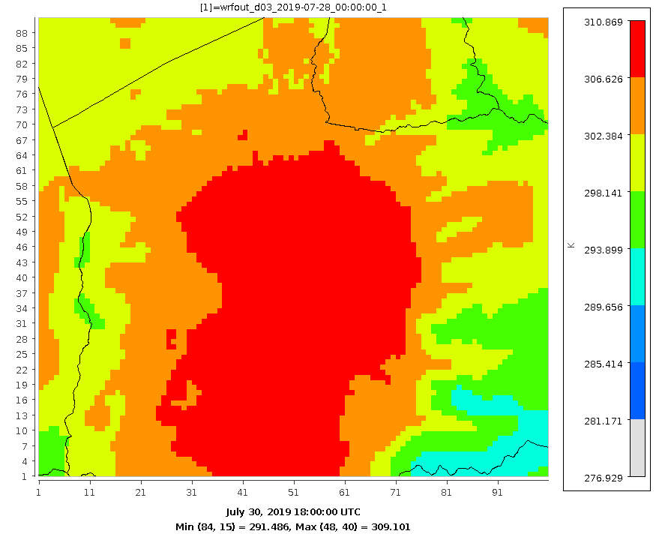
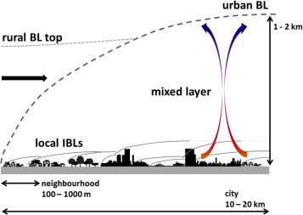
Urban Canopies
Refer to effects of characteristics of urban regions on local met conditions
Can cause temperature increases upwards of 7° C (compared to rural areas)
These meteorological conditions typically result in increased concentrations of pollutants such as PM2.5 and ozone.
Results in an increase in the boundary layer height
Significantly affects local wind patterns
https://www.sciencedirect.com/science/article/pii/S2212095514000558

Slide 4
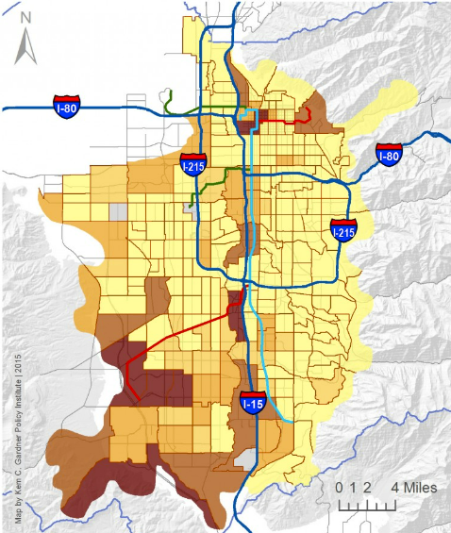


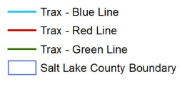
Motivation
Increasing urbanization within GSLA has contributed to development of an urban canopy
GSLA does not meet federal ozone air quality standards
GSLA urban canopy effects will increase as population growth and urbanization continue
Percent Change 2010-2014
Source:
Kem C Gardner
Policy Institute
University of Utah

Slide 5
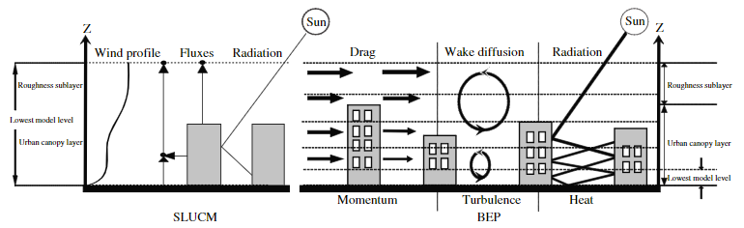
Urban Canopy Models (UCM)
UCMs can improve meteorological models by including effects of urban areas on a mesoscale
UCMs use bulk urban characteristics to determine effects of the urban canopy
WRF can be configured using various types of UCMs of varying complexity
Single-layer UCM represents urban areas by including estimations of street canyons, roofs, and roads
Notes:
What is a UCM-models effects at a mesoscale
No model = No City
Slab: uses urban based values for land use boundary conditions
Single Layer: uses a one layer with associated parameters
Multi-Layer: uses multiple layers to describe, requires more inputs and computational time

Slide 6
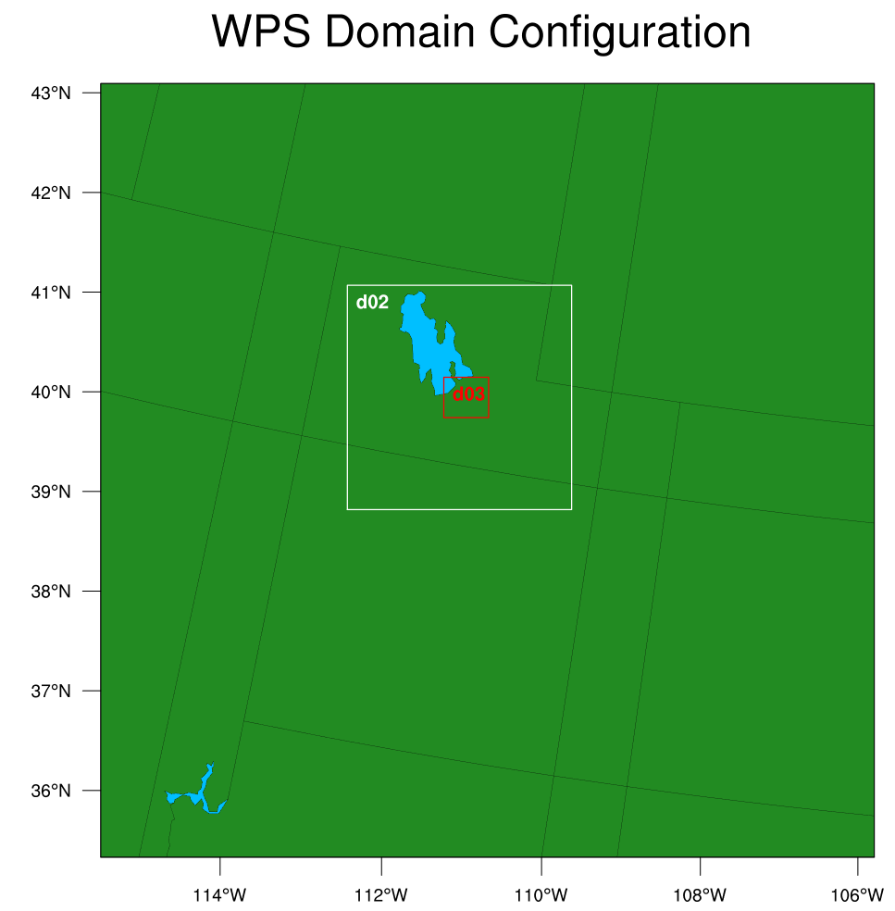
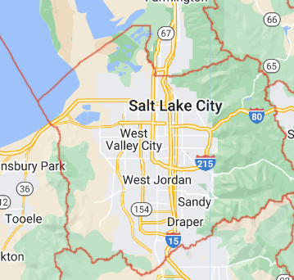
Geographical Area of Interest
Notes:
Domain
Boundaries
Transient study – 10 days
Mesh size (10,000 nodes per domain) .5, 2.5, 12.5 km is usual 12, 4, 1.3km

Slide 7
Model Development
WRF with UCM requires a wide range of inputs including physics schemes, grid specifications, and boundary conditions
Sensitivity Studies were performed to identify the effects of adjusting some of these variables:
  Grid Resolution
  Domain Size and Location
  Simulation Lead Time
  Land Surface Model Used
  Urban Canopy Model Type
  Number of Urban Classifications Used
Model to model results used to quantify sensitivities
Comparison to met measurements used to determine most accurate inputs

Slide 8
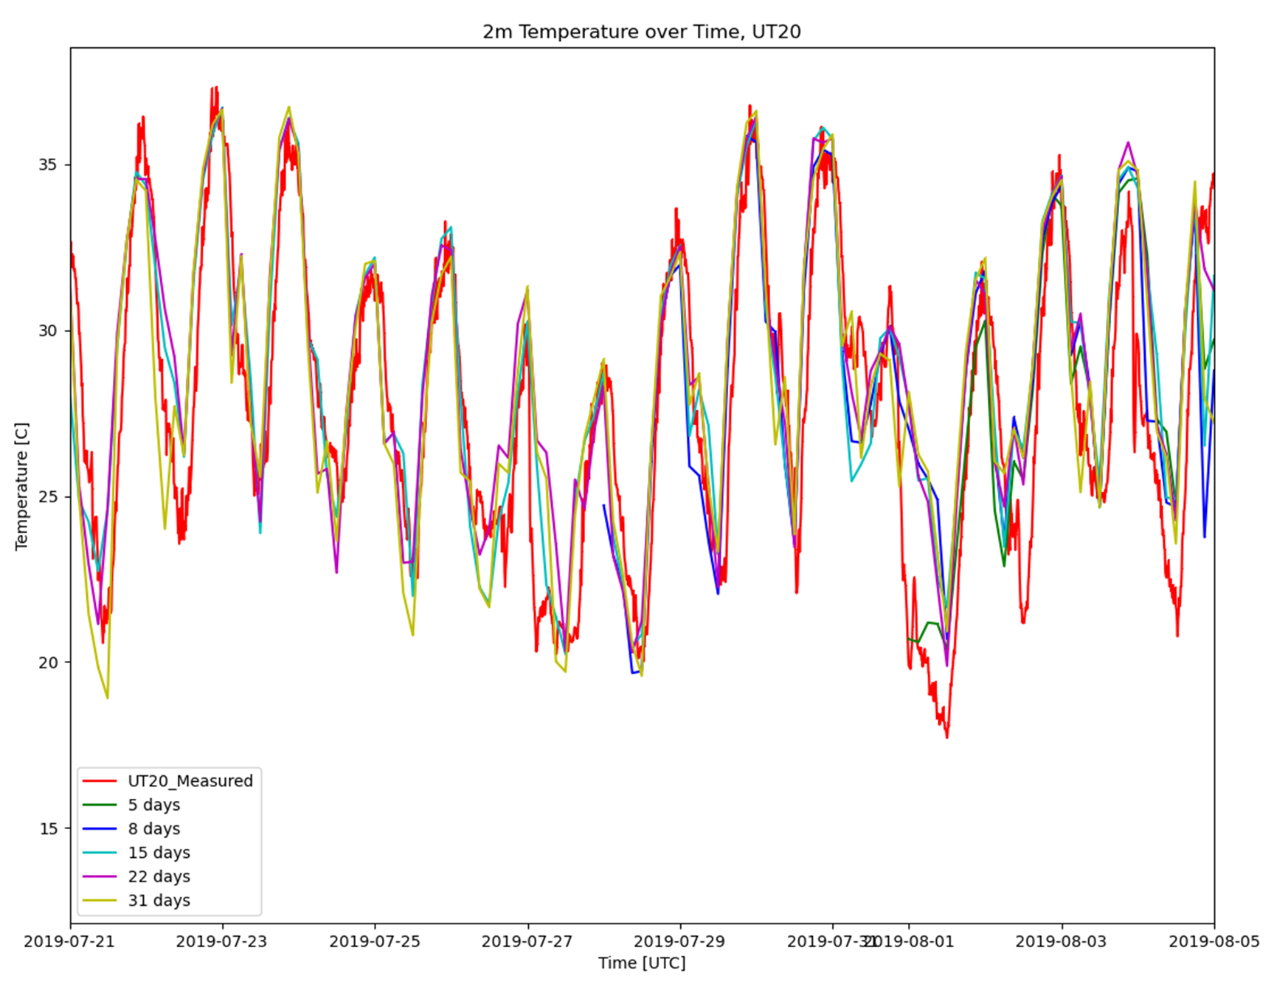
Lead Time Sensitivity
Lead times longer than 3 days show minimal differences in predicted 2-meter temperatures
Notes:
What are we looking at?
What is the conclusion?

Slide 9
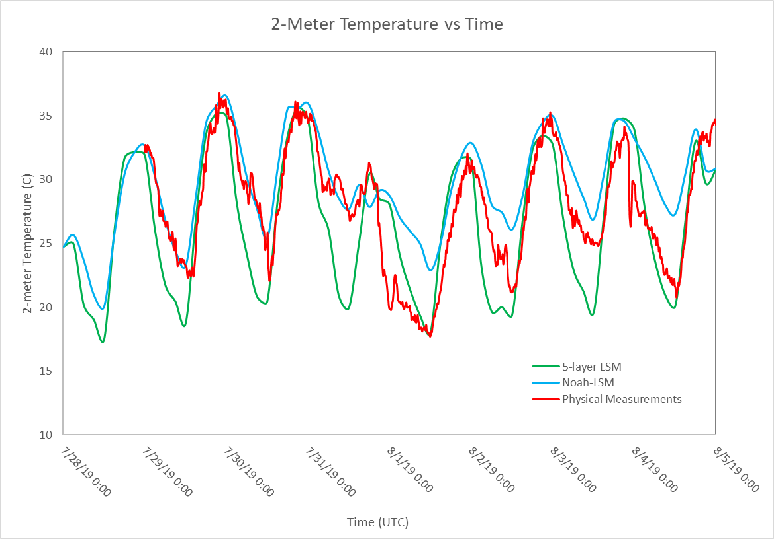
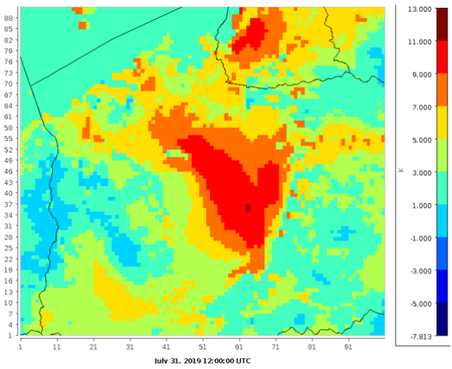
Land Surface Models
Difference between predicted 2-meter temperatures using the default 5-layer surface model vs the NOAH-LSM model (urban effects)
Notes:
Upwards of 9 degree

Slide 10
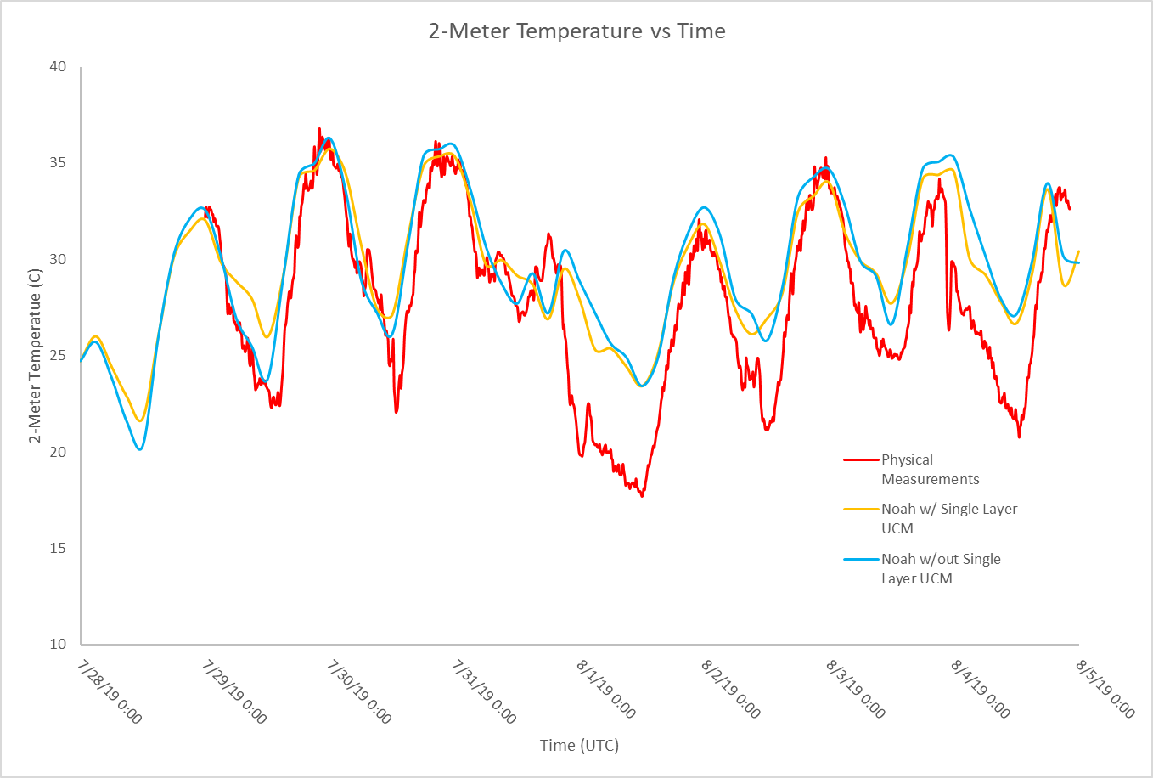
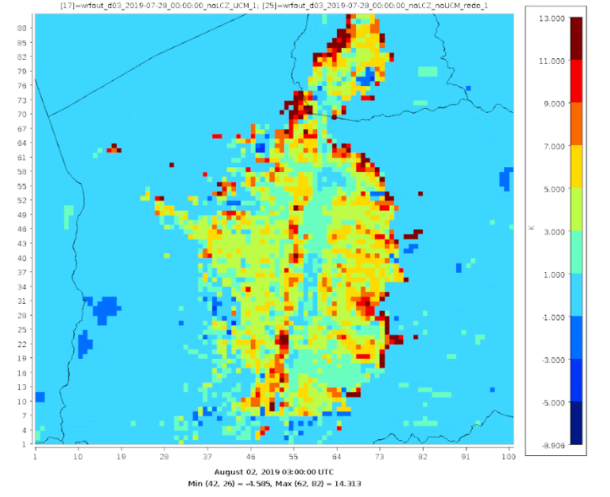
Single Layer UCM
Urban Locations show similar temperatures
Single layer UCM predicted lower suburban temperatures
Notes:
Explain cases
3-7

Slide 11
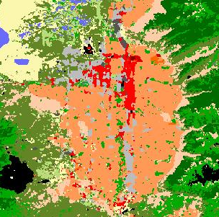
Local Climate Zones (LCZ)
LCZs, or Local Climate Zones, map urban and rural areas into land use categories used by WRF
By default, WRF uses 3 urban categories; LCZs use 11
LCZ data generated using WUDAPT
Notes:
LCZs resolve urban properties better
Differentiate between land use categories and land surface model

Slide 12
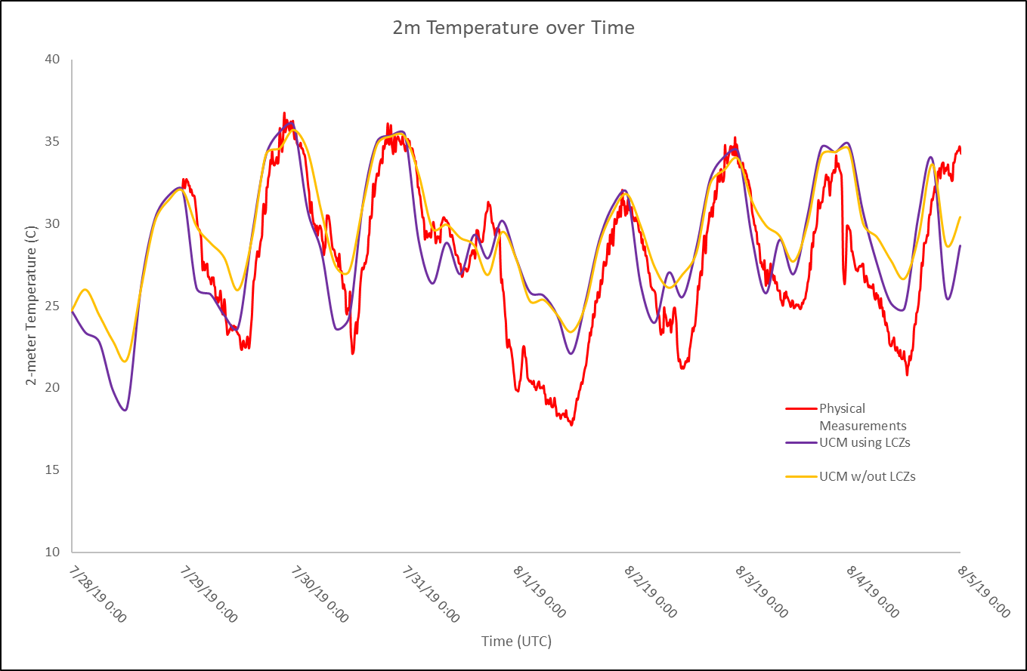
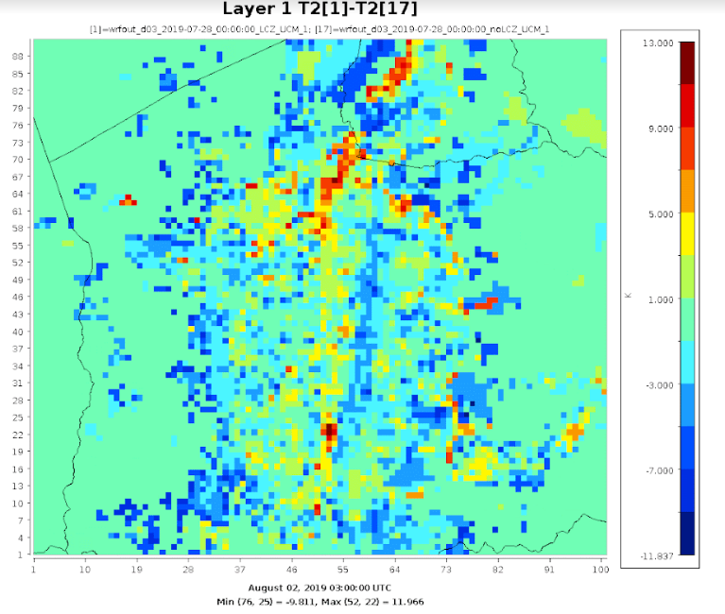
LCZ Sensitivity
2-meter temperature differences occur at night over multiple locations
Downtown area higher temperature with LCZs
Notes:
5-9

Slide 13
Conclusions
Implemented UCM and LCZ in WRF to better model GSLA met conditions
Lead times longer than 3 days show minimal differences in predicted 2-meter temperatures
Noah-LSM showed increase in 2-meter temperature in urban areas
Single layer UCM predicted lower urban temperatures
LCZs resulted in higher downtown temperatures compared to default land use categories
Preliminary results suggest the most accurate model of GSLA will include LCZs and a single layer UCM
Notes:
3-7
5-9
5-9

Slide 14
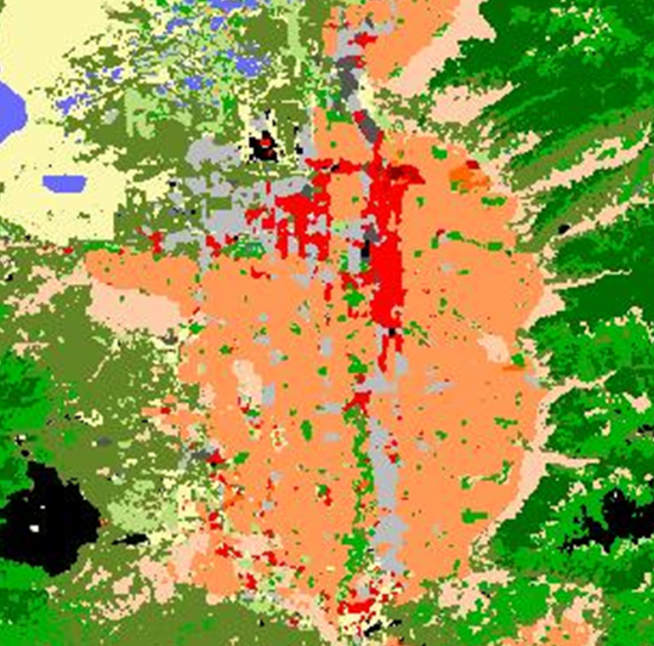
Next Steps
Study urban parameters used by single layer UCM to determine which best match GSLA measurements
Evaluate geography inputs that include varied land use categories representing urban growth
  Double downtown area
  Metro area in south valley
  Conversion of single family to multi-family housing

Slide 15
Acknowledgments
Funding for this research was provided by the Utah Division of Air Quality Science for Solutions Contract #200762
High performance computing resources were provided by the BYU Office of Research Computing
Eric Monson assisted in developing scripts used to execute simulations

