Slide 1
Comparing Emissions and OH Reactivity of VOCs in three chemical mechanisms (CB6, SAPRC07, RACM2)
Siqi Ma¹, Daniel Tong^{1,2}, Havala Pye³, Yang Zhang⁴, Chi-tsan Wang², Xiaoyang Chen⁴, Daiwen Kang³, Benjamin Murphy³, Bok Haeng Baek²
1. Department of Atmospheric, Oceanic and Earth Sciences, George Mason University, Fairfax, VA 22030 USA
2. Center for Spatial Information Science and Systems, George Mason University, Fairfax, VA 22030 USA
3. US Environmental Protection Agency, Research Triangle Park, NC, 27709 USA
4. Department of Civil and Environmental Engineering, Northeastern University, Boston, MA 02115 USA
CMAS 2022
October 17-19, 2022

Slide 2
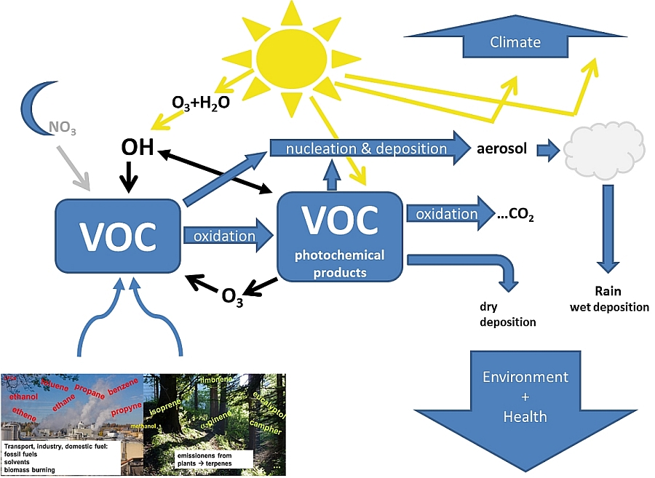
VOC Chemistry and Influence on Air Quality Prediction
VOC cycle in the atmosphere
VOCs are key precursors to tropospheric ozone and secondary organic aerosols.
Chemical mechanisms differ in VOC grouping methods.
During the grouping process, the chemical reactivity of VOCs may be altered, causing unknown effects on air quality modeling results.
https://www.dwd.de/EN/research/observing_atmosphere/composition_atmosphere/trace_gases/cont_nav/voc_node.html
Objectives:
1) Comparing the VOC emissions and OH reactivity of different chemical mechanisms;
2) Investigating their impacts on the O₃ and NO₂ prediction.

Slide 3
Model Configuration
Emission model and tool
Models/Tools: Speciation Tool v5 for chemical speciation
SMOKEv4.7
Emission Inventory: US EPA National Emissions Inventory 2016v1
Anthropogenic: 8 area source sectors, 4 mobile source sectors and 8 point source sectors
Biogenic: BEIS 3.61 as in SMOKEv4.7
Chemical Mechanisms: CB6r3, SAPRC07, RACM2 with AE6 aerosol mechanism
Air quality model setup
Model: WRFv4.0 for meteorological simulations
CMAQv5.3.1 for air quality simulations
Date: Four representative months (January, April, July, October) in 2019
Domain: Contiguous United States (CONUS) 12 km
Meteorological: ECMWF ERA5, 0.25° × 0.25°, 4/day
Initial Conditions: CMAQ profile IC
Boundary Conditions: GEOS-Chem monthly data

Slide 4
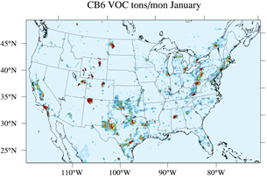
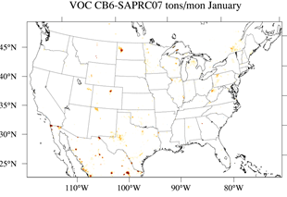
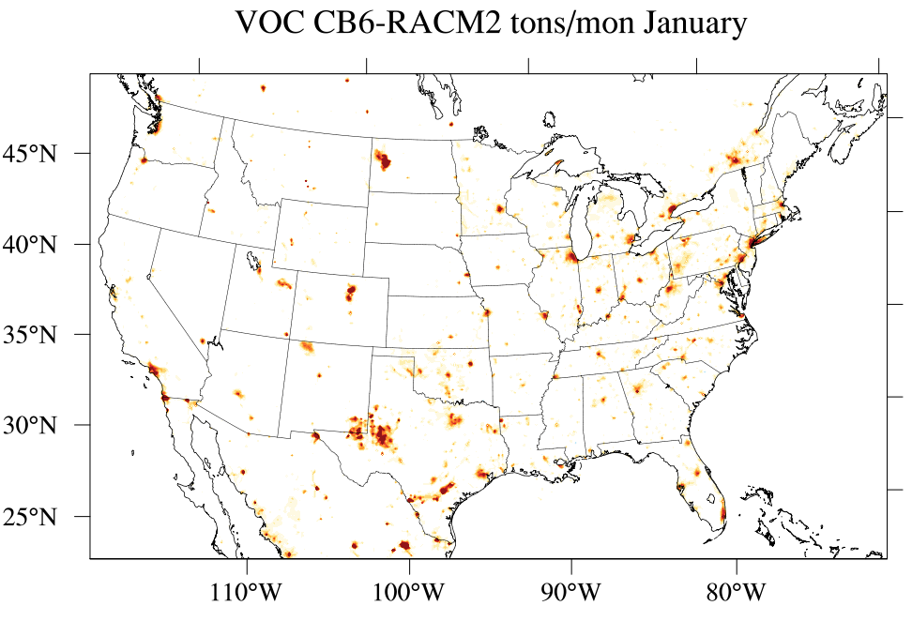
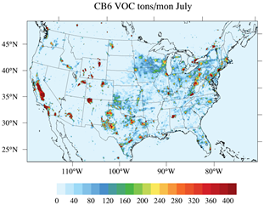
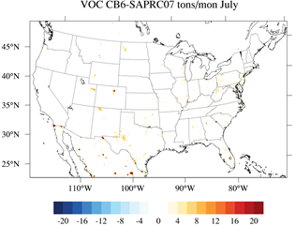
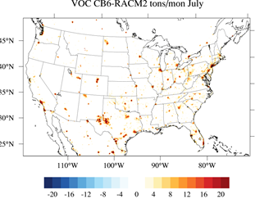
Reactive Anthropogenic VOC Emissions from CB6, SAPRC07, and RACM2
Distributions in January and July
VOC emissions mainly in urban areas and oil/gas well locations; So are their differences.
CB6 emissions are the highest among three mechanisms.
CB6 VOC
VOC (CB6-SAPRC07)
VOC (CB6-RACM2)
January
July
Tons/mon

Slide 5
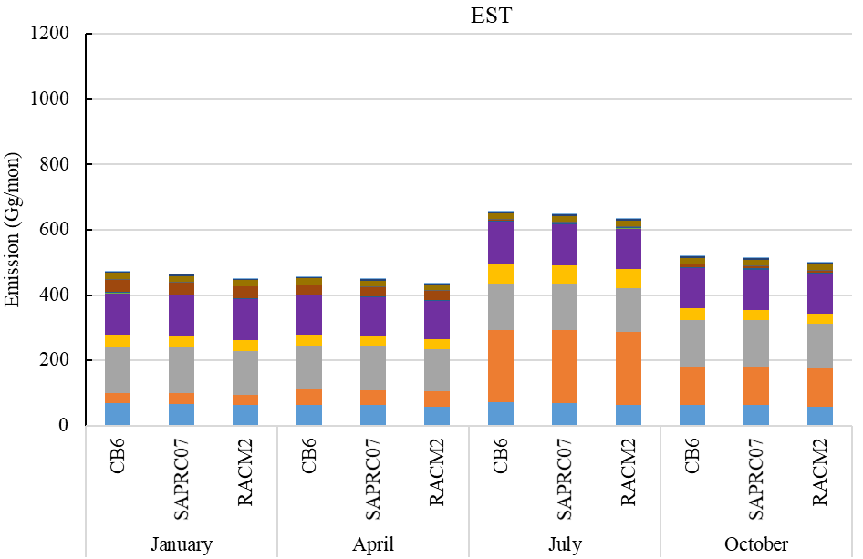
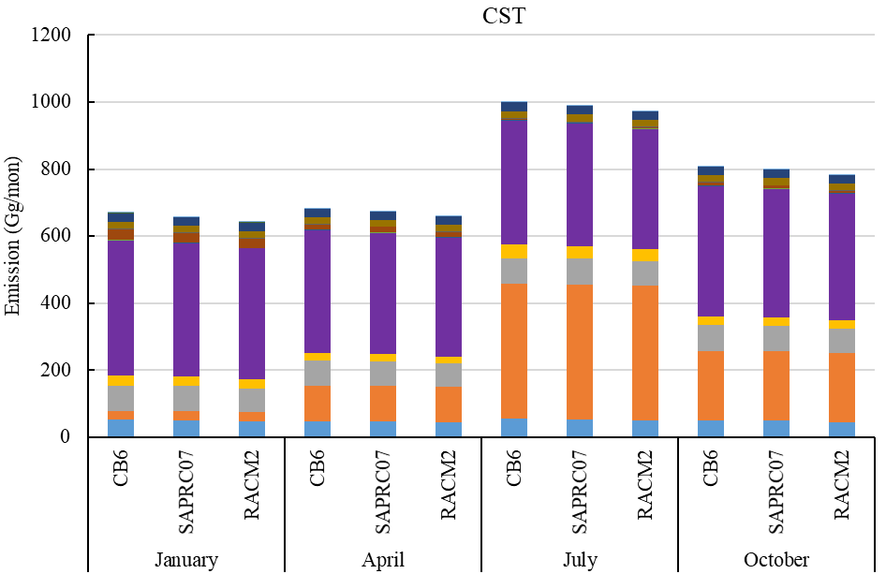
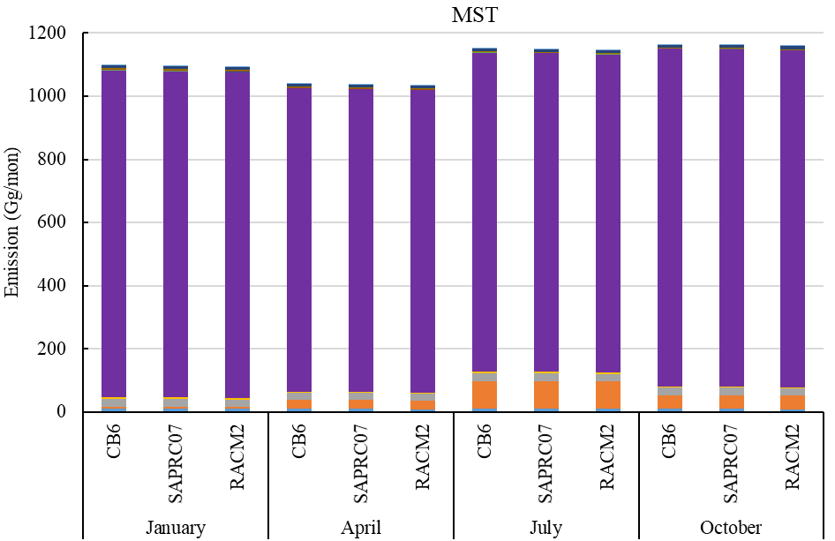
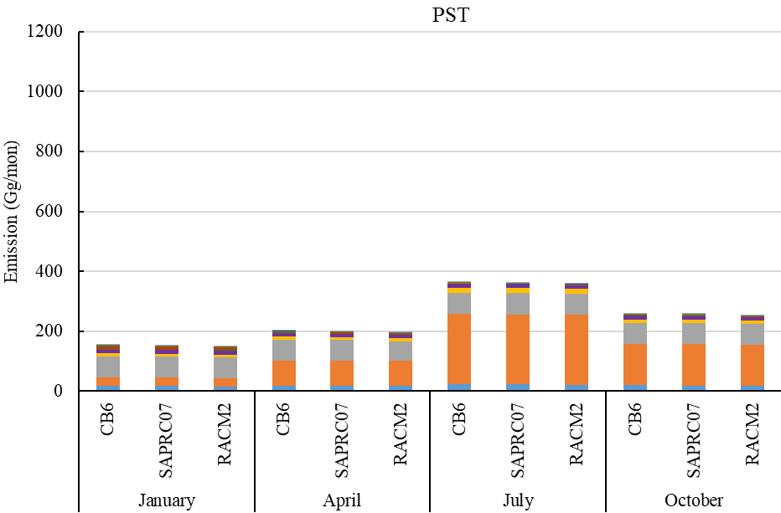
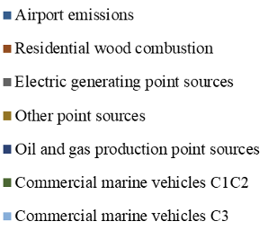
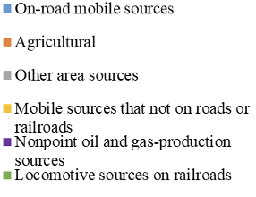
Anthropogenic VOC Emissions from CB6, SAPRC07, and RACM2
Emissions by Time Zone
Eastern time zone (EST)
Central time zone (CST)
Higher transportation emissions appear in EST, oil and gas emissions are mainly in CST and MST.
CST contributes the largest NMVOCs (45%), while MST emits highest CH₄ (56%).
VOCs from CB6 are the highest in each sector.
EST shows the largest differences in four months.
Mountain time zone (MST)
Pacific time zone (PST)

Slide 6
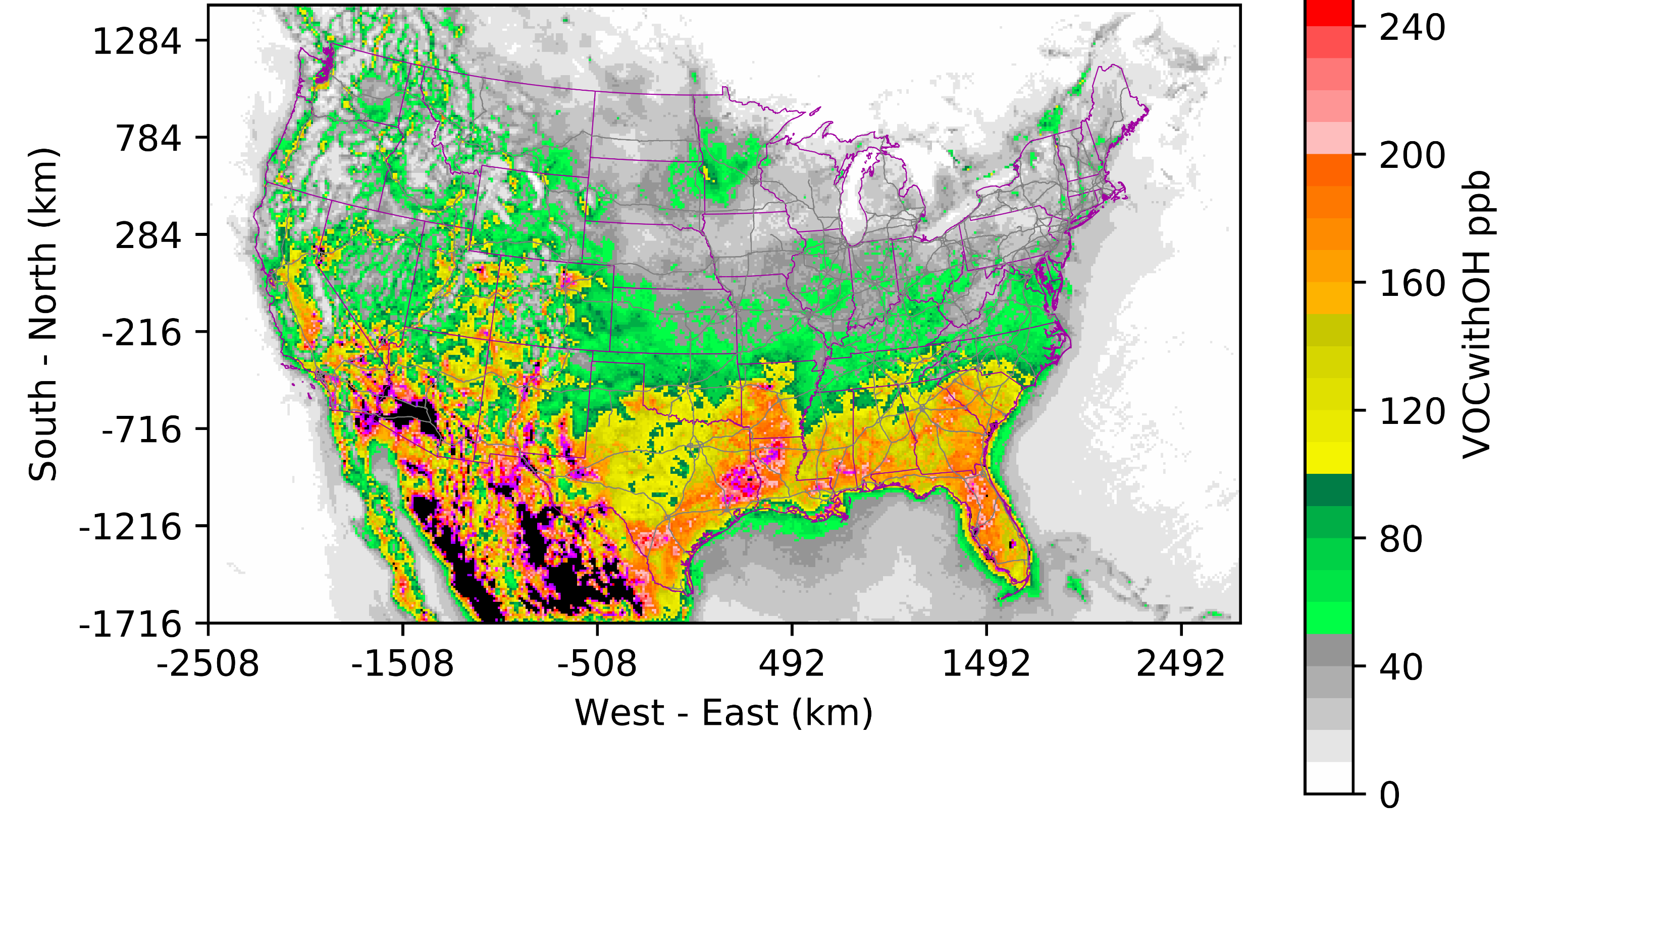
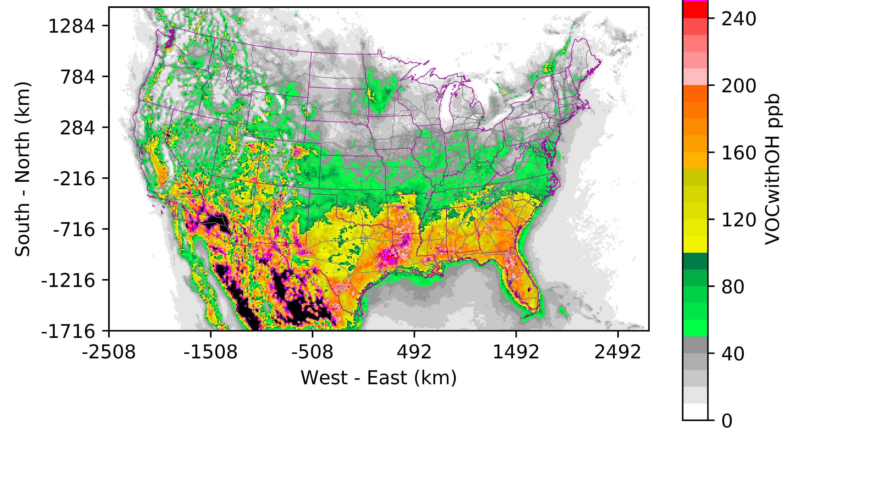
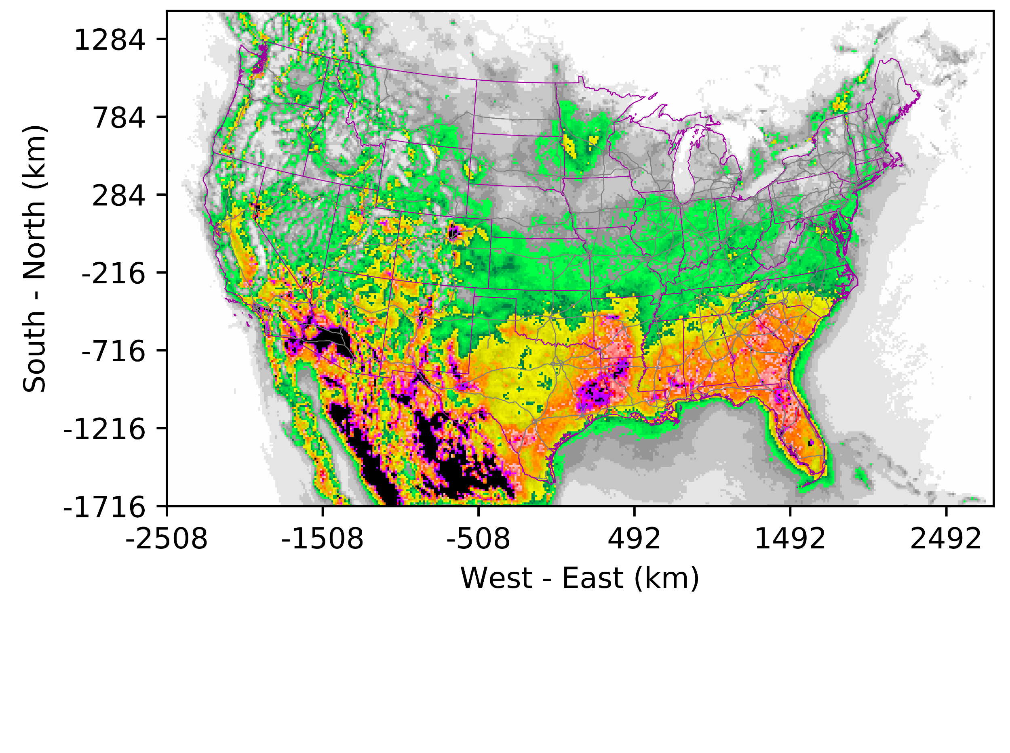
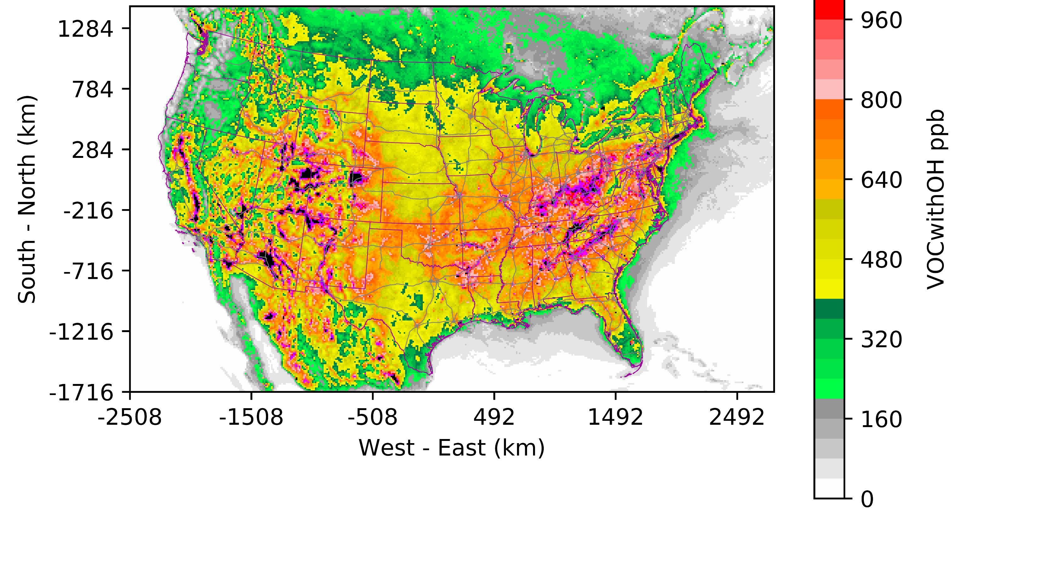
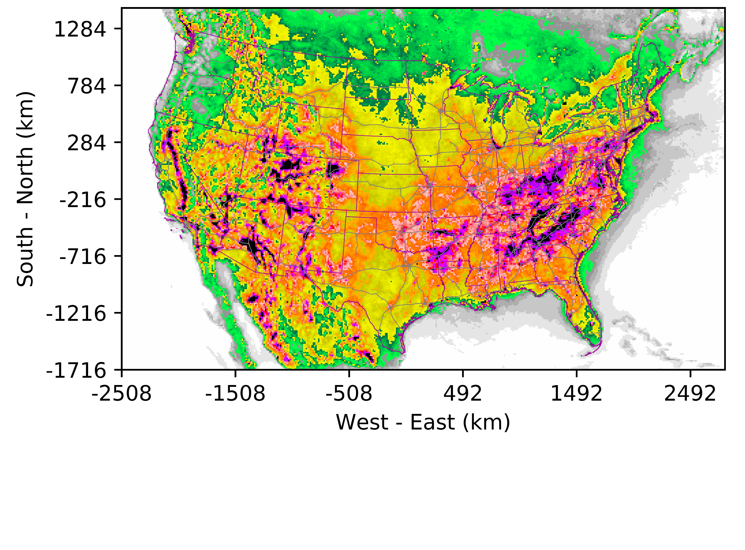
OH Reactivity of VOCs
Process analysis:
Jan 6~20, 2019
Jul 6~20, 2019
Accumulated VOC-OH reaction rate: RACM2>CB6>SAPRC07
More reactivity over the southeast, Rocky Mountains and Central Valley
CB6
CB6-SAPRC07
CB6-RACM2
SAPRC07
RACM2
January
July

Slide 7
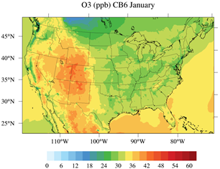
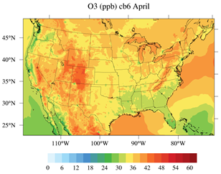
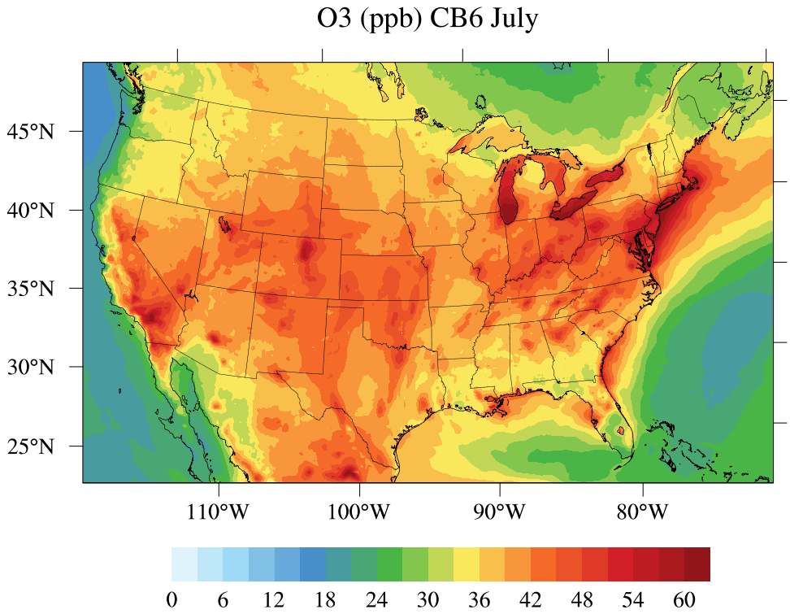
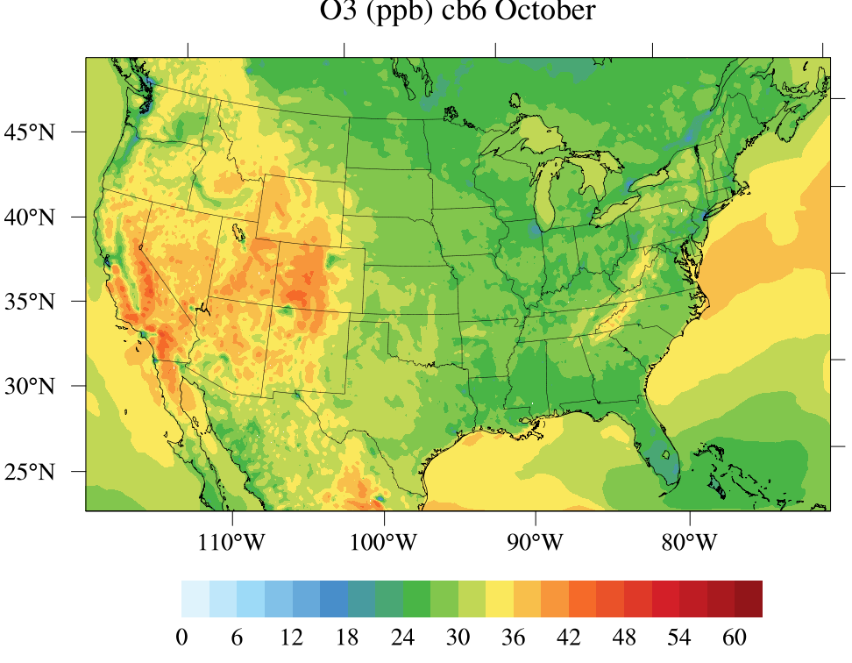
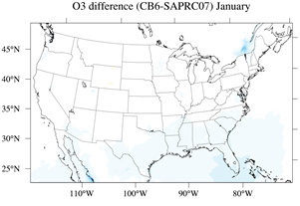
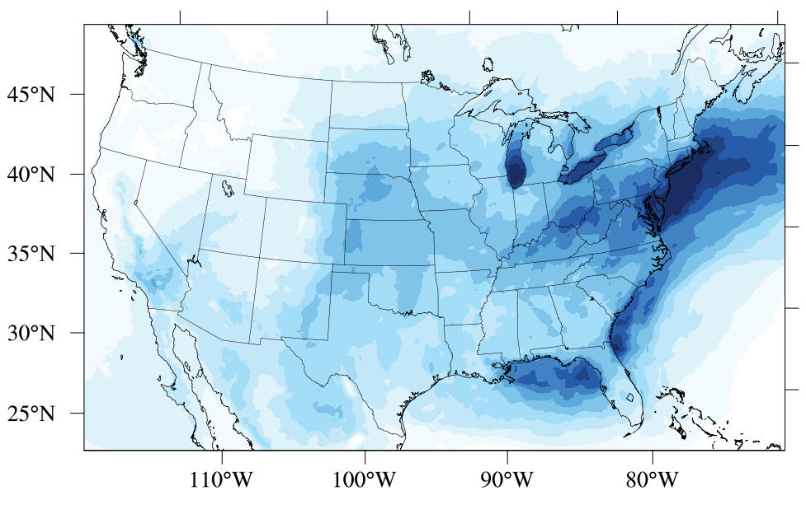
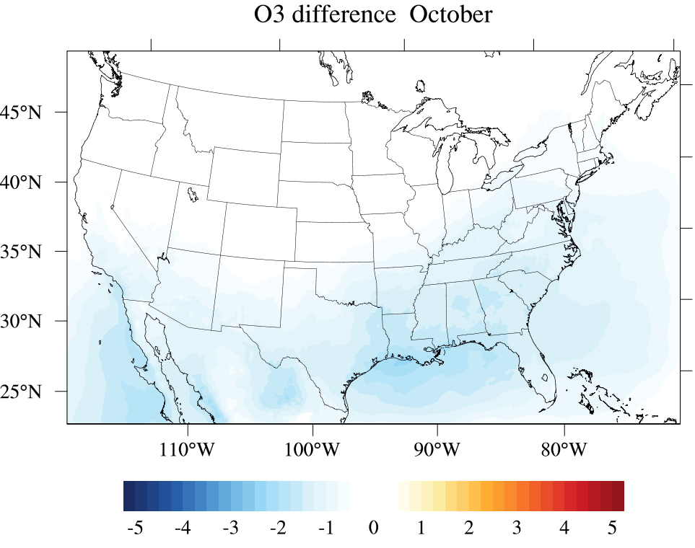
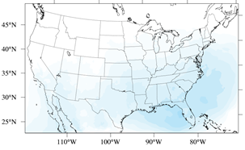
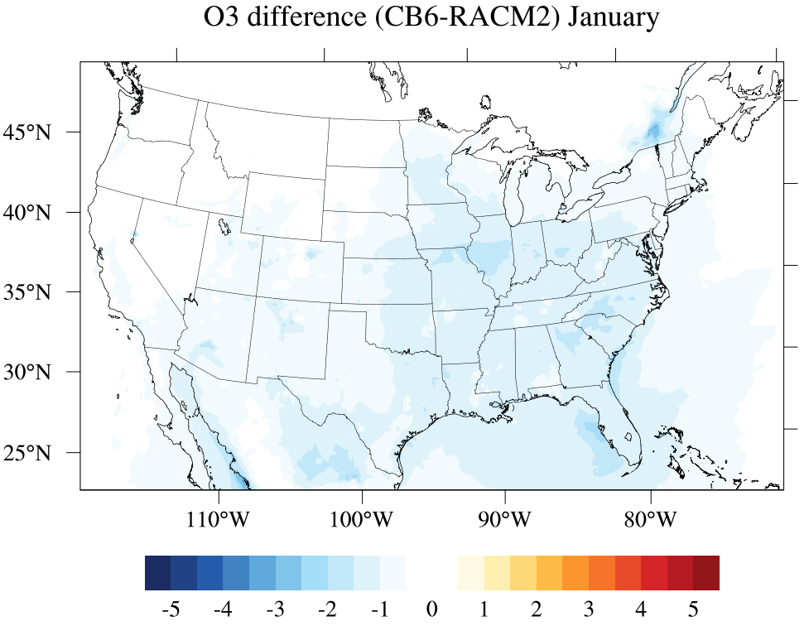
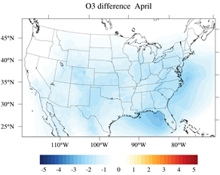
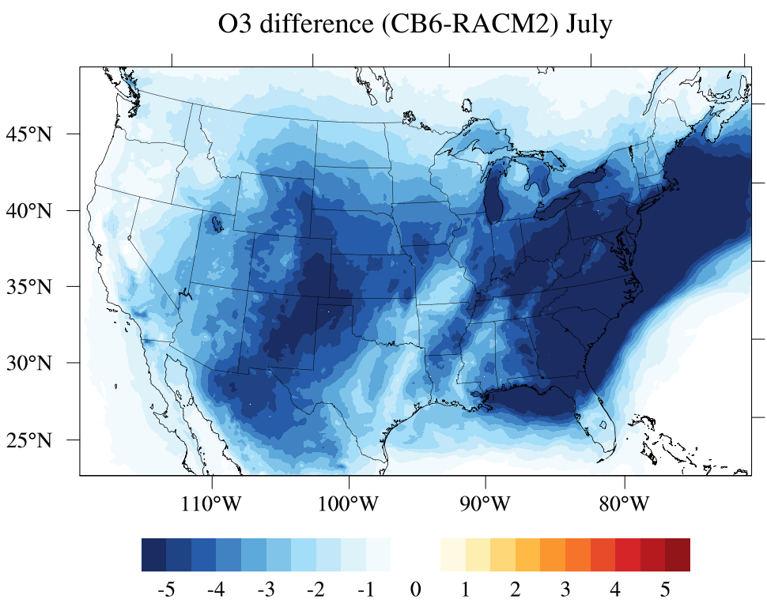
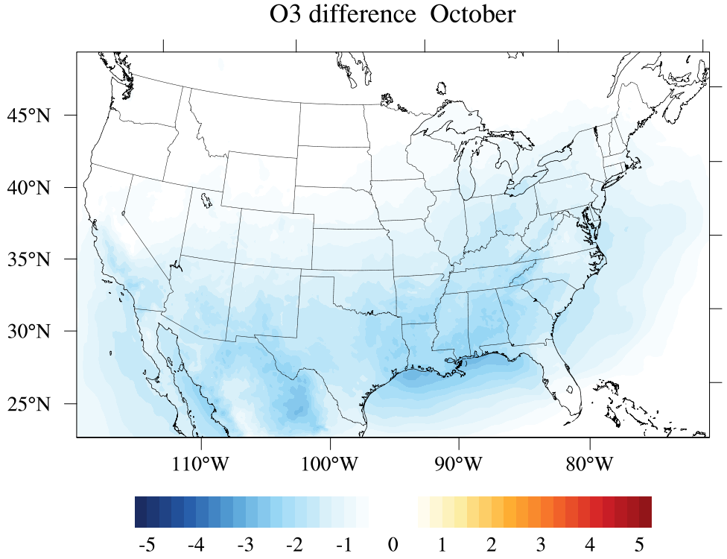
Effects on Surface Ozone (8-Hour Max)
January
April
July
October
CB6
ppb
CB6-SAPRC07
CB6-RACM2
ppb

Slide 8
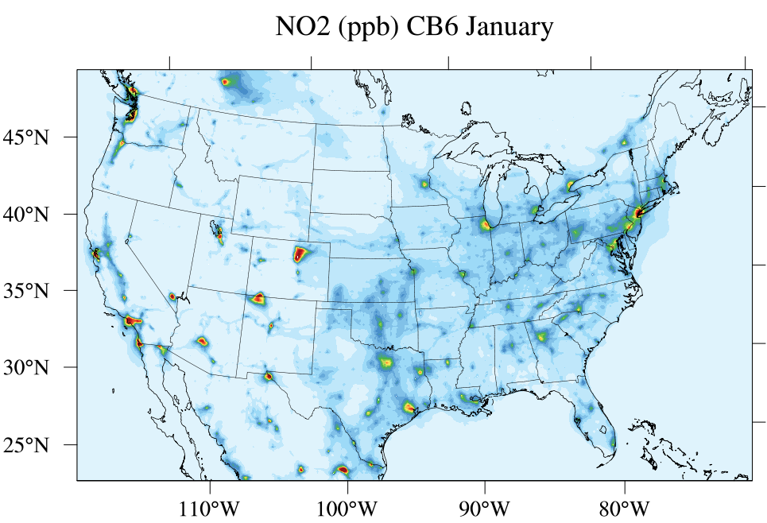
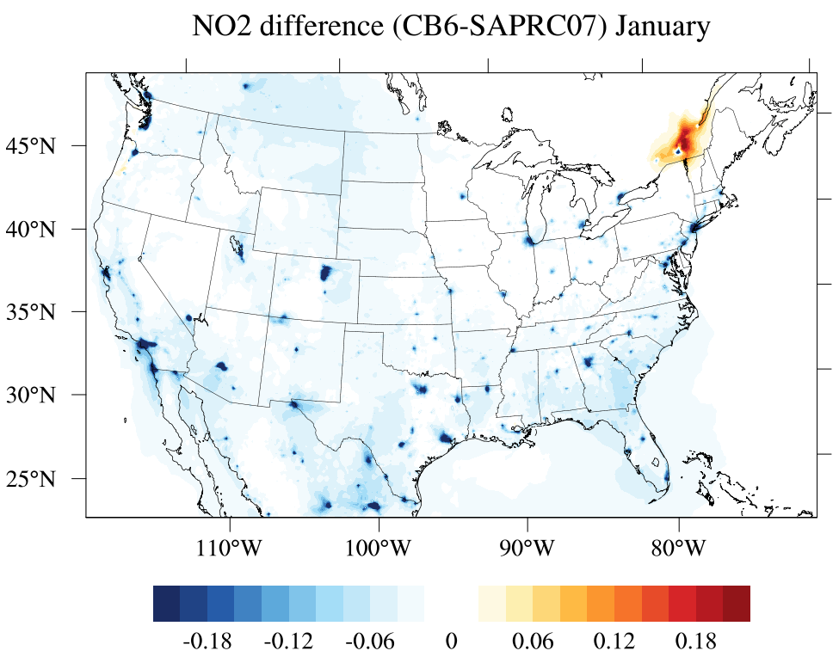
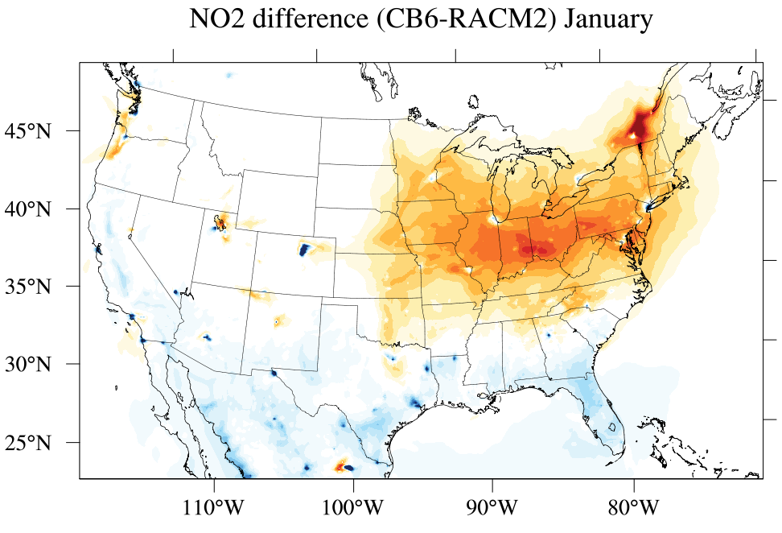
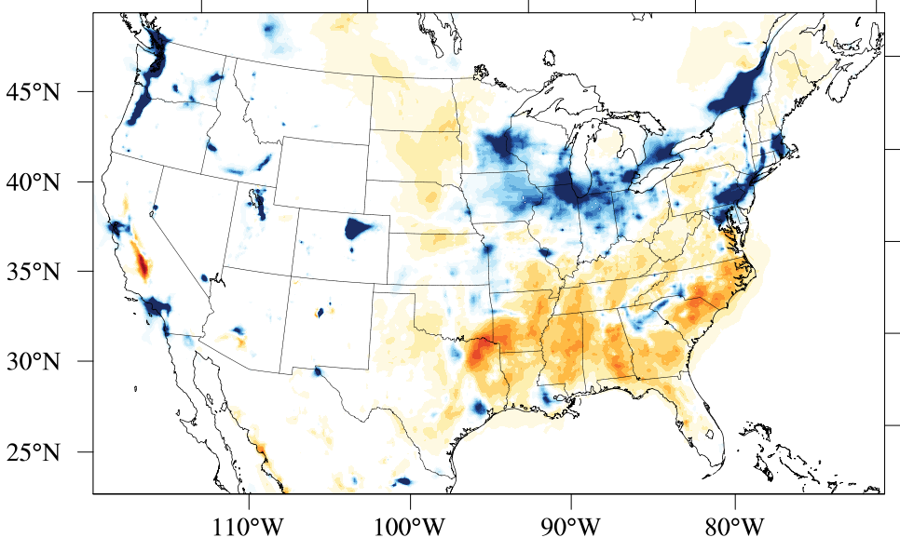
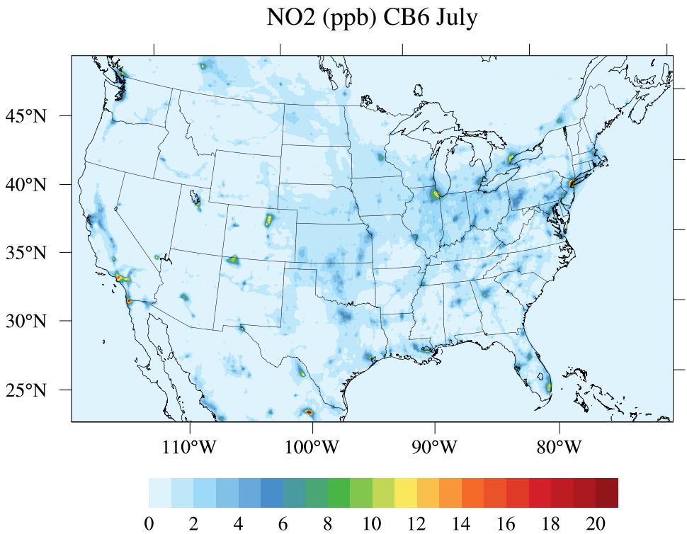
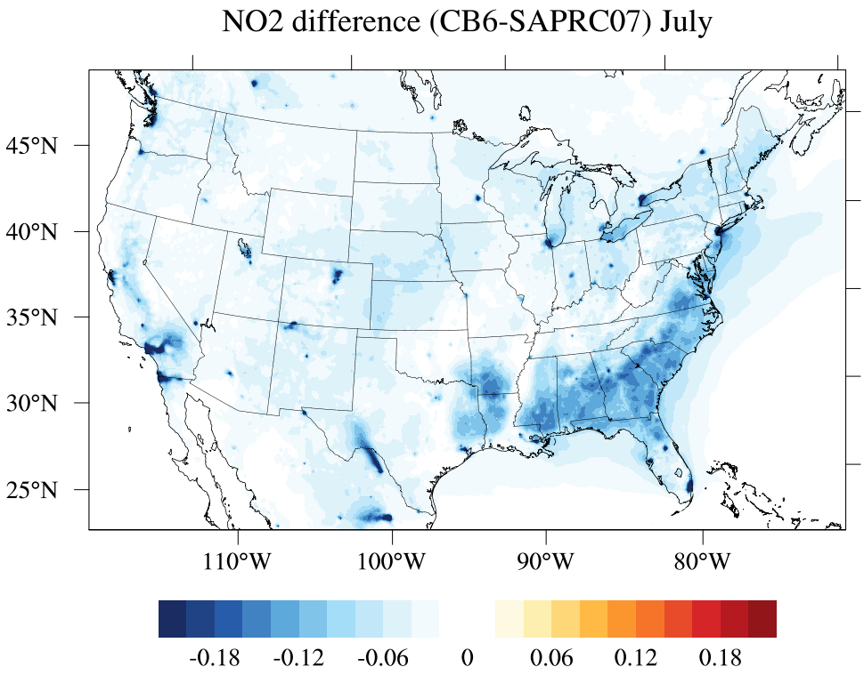
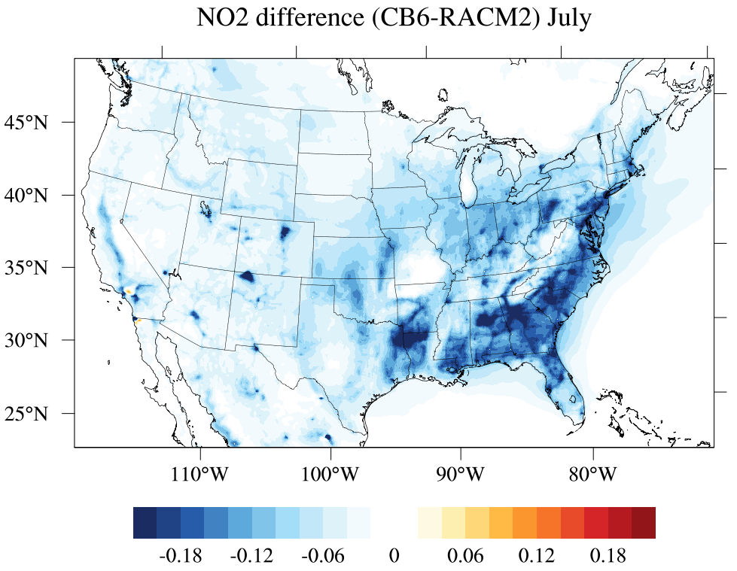
Effects on Surface NO₂
SAPRC07 produce more NO₂ in January while RACM2 is higher in July.
Differences appear high in the northeast (January) and southeast (July).
CB6 NO₂
CB6-SAPRC07
CB6-RACM2
PNO3 (CB6-RACM2)
-
+
+
-
January
July
ppb

Slide 9
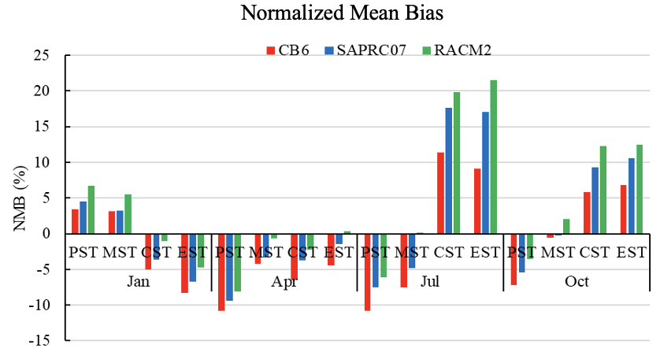
Which Mechanism Produces Better O₃ Prediction?
Normalized Mean Bias
Simulations are usually biased low in January and April while higher in July and October.
RACM2 has lower discrepancies when the simulations are underestimated while CB6 shows opposite results.
On average, CB6 performs better in most time.

Slide 10
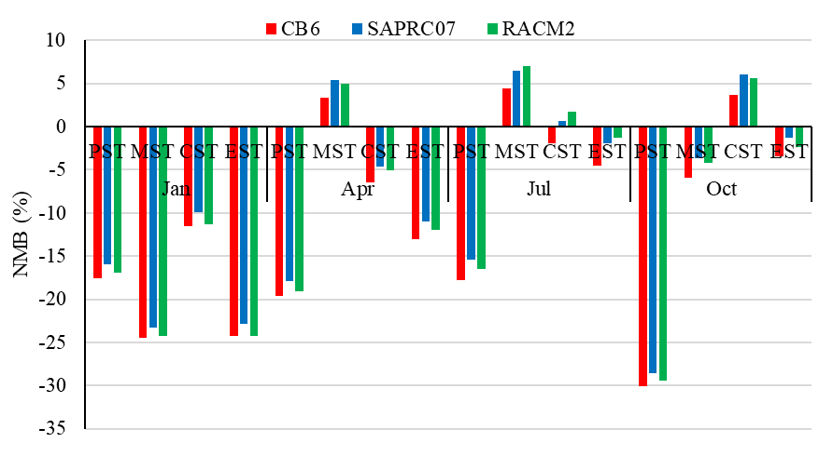
How about NO₂ Prediction?
Normalized Mean Bias
All mechanisms underestimate the NO₂ concentration.
NMB in SAPRC07 are slightly lower.

Slide 11
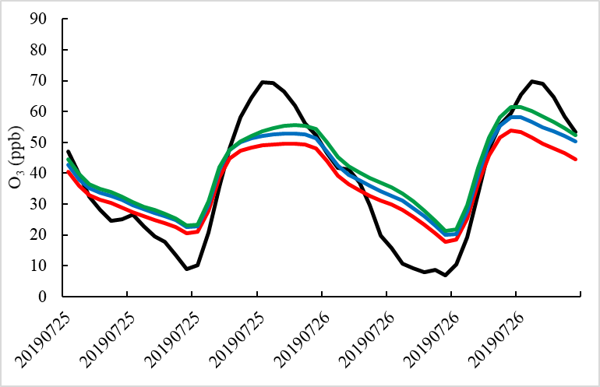
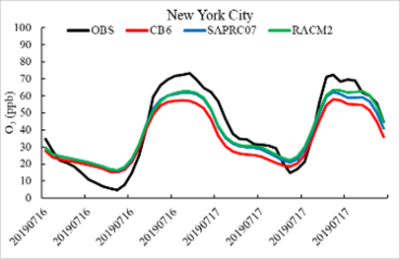
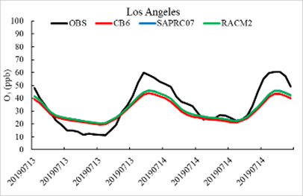
High Ozone Prediction over Major Cities
New York City
Houston
Phoenix
Los Angeles
 | CB6 | SPARC07 | RACM2
CORR | 0.97 | 0.98 | 0.98
RMSE | 10.29 | 7.81 | 7.46
 | CB6 | SPARC07 | RACM2
CORR | 0.97 | 0.97 | 0.96
RMSE | 10.46 | 10.09 | 10.40
 | CB6 | SPARC07 | RACM2
CORR | 0.93 | 0.94 | 0.94
RMSE | 16.92 | 14.66 | 12.75
 | CB6 | SPARC07 | RACM2
CORR | 0.96 | 0.97 | 0.97
RMSE | 9.35 | 8.38 | 8.38
Simulations with 3 mechanisms underestimate the O₃ peaks while overestimate valleys.
The correlations are comparable, RACM2 usually has lower RMSEs.
CORR: Correlation RMSE: Root Mean Square Error

Slide 12
Conclusions
Reactive VOC mass emissions in CB6 are higher than in SAPRC07 and RACM2.
VOC-OH reactivity in RACM2 is the highest.
Differences of predicted O₃ primarily appear in July. CB6 performs better during low/median O₃ days but SAPRC07 and RACM2 perform better on high O₃ days.
The effect on NO₂ simulations is small compared to that for O₃.
DISCLAIMER
The views expressed in this presentation are those of the authors and do not necessarily represent the views or policies of the U.S. EPA.

