Slide 1
ECCC’s First-generation 10 km North America Reforecast dataset for air quality
Xihong Wang¹, Nedka Pentcheva¹, Maxim Bulat¹, Rabab Mashayekhi¹, Annie Duhamel¹, Mike Moran^{2*}, Verica Savic-Jovcic², and Jack Chen²
¹ Air Quality Policy-Issue Response Section, Meteorological Service of Canada
ECCC, Montreal, Quebec, Canada
² Air Quality Research Division, Science and Technology Branch
ECCC, Toronto, Ontario, Canada
* emeritus
21th Annual CMAS Conference 17-19 Oct. 2022 Chapel Hill, North Carolina, U.S.A

Slide 2
Background
ECCC continuously improve its air quality forecasting program and operational services
  Reanalysis of air quality is one of the recommendations set by WMO Global Atmospheric Watch Programme (GAW)
  ECCC has been contributing in this direction by developing a long-term (offline) surface analysis of air pollutants (i.e., O3,PM2.5,PM10,NO2,NO,SO2) from 2002-present
Long-term, high resolution reforecast/reanalysis datasets with seamless and contiguous coverage over North America are suitable for:
Quantify pollution trends and building a climatology of surface pollutants
Support health/epidemiological and ecological studies
Evaluate and improve air quality model science and forecast operations
Optimize policy decision making:
--- evaluate the efficiency of existing pollution control strategy
--- assess options of abatement measures and regulations

Slide 3
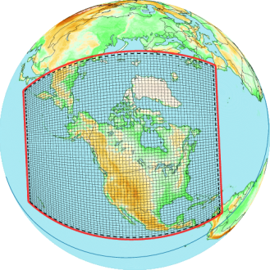
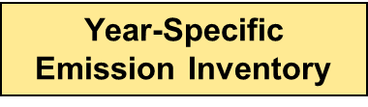
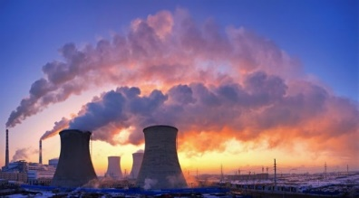
ECCC’s Regional Air Quality Deterministic Reforecast System: RAQDRS
Basic characteristics:
Stable version GEM-MACH v2.4.6-LTS.19 as a kernel
In-line chemical transport model with
One-way coupling (meteorology affects chemistry)
High resolution North America domain at 10-km grid spacing, 80 vertical levels up to 0.1 hPa
Full process representation of atmospheric chemistry
2-bin PM size distribution and 8 components
Hourly anthropogenic, biogenic and biomass burning emissions
The Initial and boundary conditions of meteorology provided by the 10-km regional deterministic reanalysis data products (RDRS)
No chemical analysis. Initial chemical conditions are recycled from the previous 24-h forecast.
24-hour runs launched once daily (00 UTC)
RDRS (10km)
Meteorological Reanaysis data
GEM-MACH model
GEM: Global Environmental Multi-scale model
RDRS: Regional Deterministic Reanalysis System
GEM-MACH: Global Environmental Multi-scale - Modelling Air quality and Chemistry

Slide 4
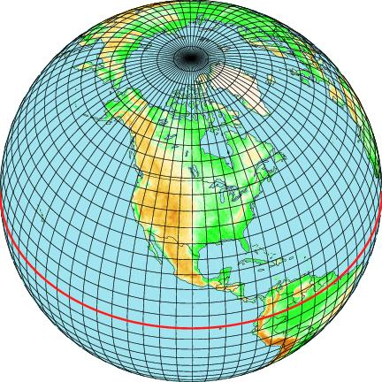
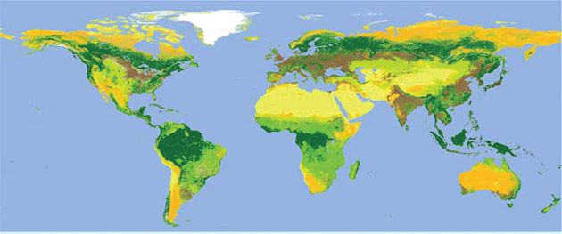
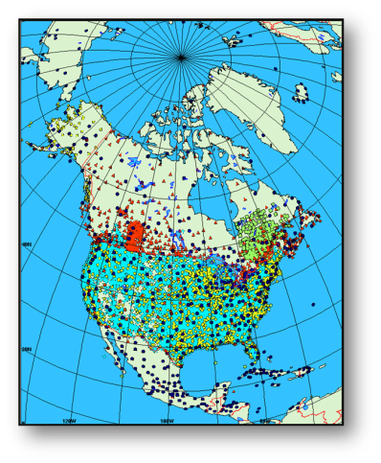
Regional Deterministic Reanalysis System (RDRS) provides the Initial and boundary conditions
GEM GDRS (39 km)
atmospheric model
GEM RDRS (10 km)
atmospheric model
Global reanalysis ERA-Interim: 1979 - today (~80km/6h)
RAQDRS - Regional Air Quality Deterministic
Reforecast System
Precipitation and Land surface data assimilation:
CaPA and CaLDAS
Initialisation + forcing
Initialisation
Assimilation
GEM-Surf (39 km)
surface model
Surface observations
CaPA - Système Canadien d'Analyse de Précipitation
CaLDAS - Canadian Land Data Assimilation System
OA – Objective Analysis
G(R)DRS -Global (Regional) Deterministic Reforecast System
RAQDRS -Regional AQ Deterministic Reforecast Reforecast System

Slide 5
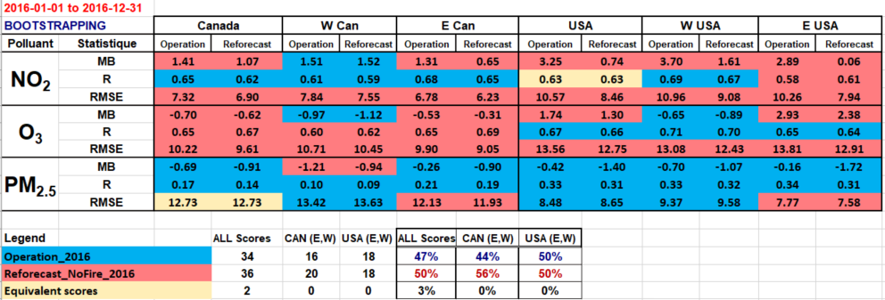
Forecast -vs- Reforecast Verification
--- Annual Mean Hourly Statistical Scores (2016-01-01 to 2016-12-31)
Subjected to bootstrap test for statistical significance:
Red shading --- reforecast system is better
Blue shading --- operational model is better
Yellow shading --- equivalent scores
VAQUM: Verification of Air Quality Models

Slide 6
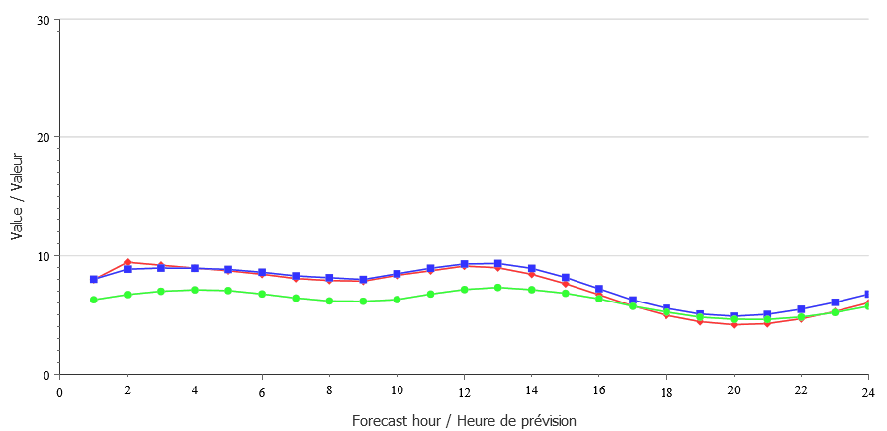
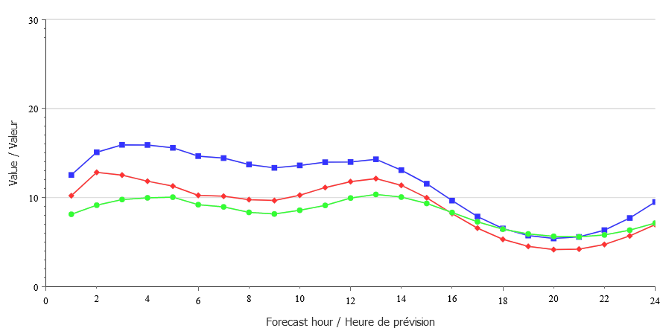
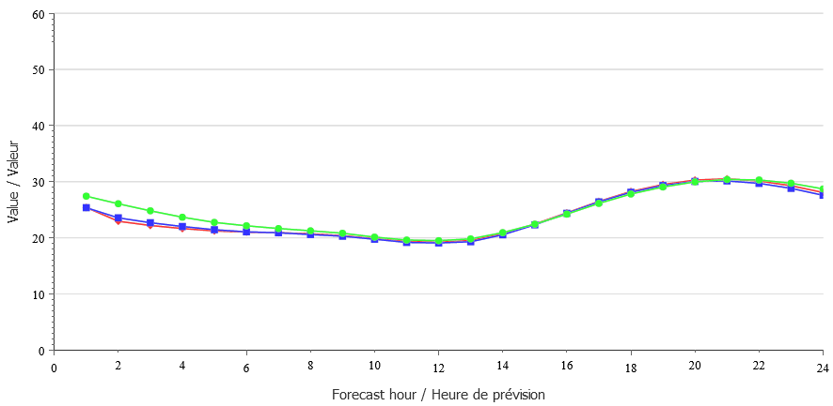
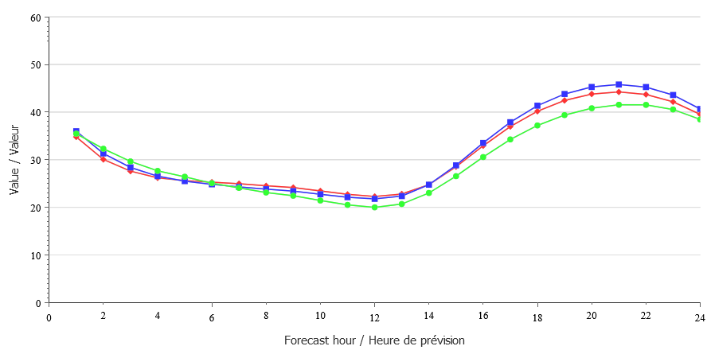
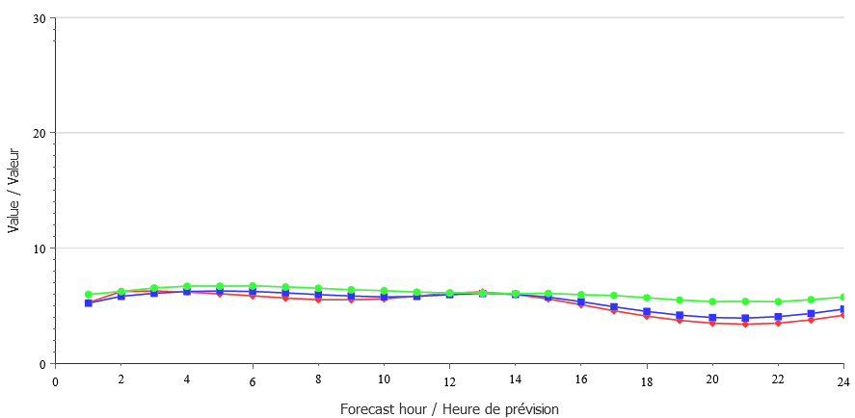
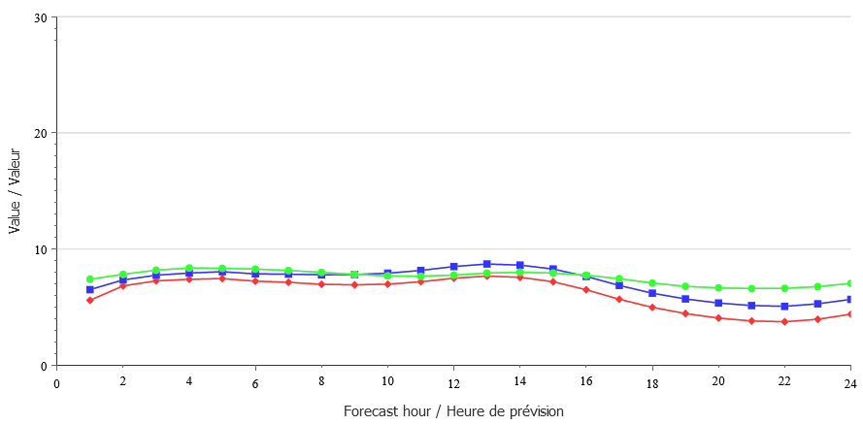
Verification: Forecast -vs- Reforecast
--- Annual mean 24-h diurnal time series (2016-01-01 to 2016-12-31)
30
30
Operational model
Reforecast
Observation
Canada
USA
NO₂
[ppb]
20
20
10
10
0
0
60
60
50
50
O₃
[ppb]
40
40
30
30
20
20
10
10
0
0
30
30
PM_{2.5}
[ug/m³]
20
20
10
10
0
0

Slide 7
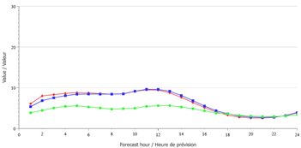
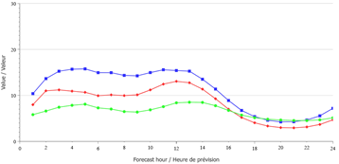
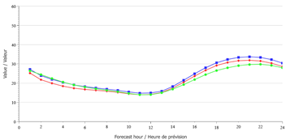
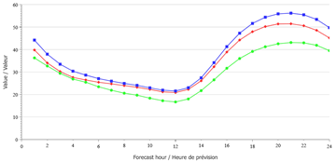
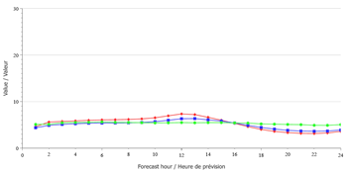
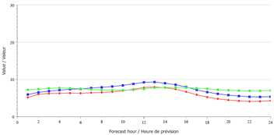
Verification: Forecast -vs- Reforecast
--- Mean 24-h diurnal time series (2016-07-01 to 2016-09-30; Summer)
30
Canada
30
USA
Operational model
Reforecast
Observation
20
20
NO₂
[ppb]
10
10
0
0
60
60
50
50
O₃
[ppb]
40
40
30
30
20
20
10
10
0
0
30
30
20
20
PM_{2.5}
[ug/m³]
10
10
0
0

Slide 8
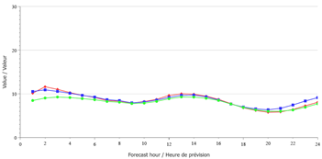
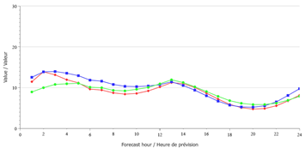
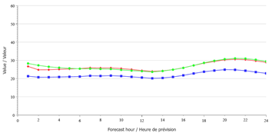
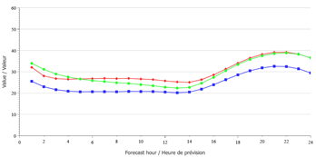
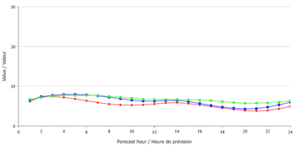
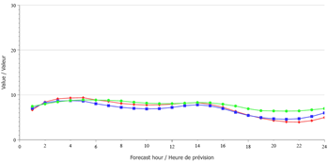
Verification: Forecast -vs- Reforecast
--- Mean 24-h diurnal time series (2016-01-01 to 2016-03-31; Winter)
30
Canada
30
USA
Operational model
Reforecast
Observation
20
20
NO₂
[ppb]
10
10
0
0
60
60
50
50
O₃
[ppb]
40
40
30
30
20
20
10
10
0
0
30
30
20
20
PM_{2.5}
[ug/m³]
10
10
0
0

Slide 9
Summary
A high resolution (10-km) Regional Air Quality Deterministic Reforecast System (RAQDRS) over North America has been developed that is based on ECCC’s operational air quality forecast model, GEM-MACH.
RAQDRS processes emissions from anthropogenic, biogenic, and daily-specific biomass burning sources. The latest 10-km atmospheric reanalysis data from the regional deterministic reforecast system developed at ECCC is used to drive the AQ model.
The reforecast data products have been evaluated against the surface air-quality measurements and the ECCC operational forecast data products (i.e. 3 key surface pollutants, NO2, O3 and PM2.5). Overall, the reforecast and operational forecast systems compare well. RAQDRS data over the United-States part of the domain are improvement comparing to the operational data.
For years 2014-2016, in addition to the treatment of anthropogenic and biogenic emissions, two wildfire emissions datasets were tested: EQUATES and CFFEPS. Comparisons among the three resulting datasets have shown that even on the regional and seasonal scale wildfire emissions have large effect on surface PM2.5 concentrations. Detailed analysis of the two different representations of the fire emissions is underway.

Slide 10
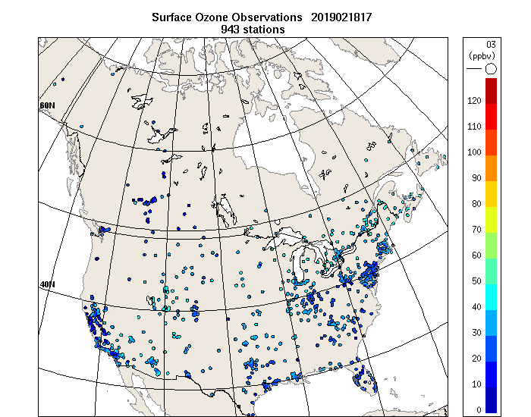
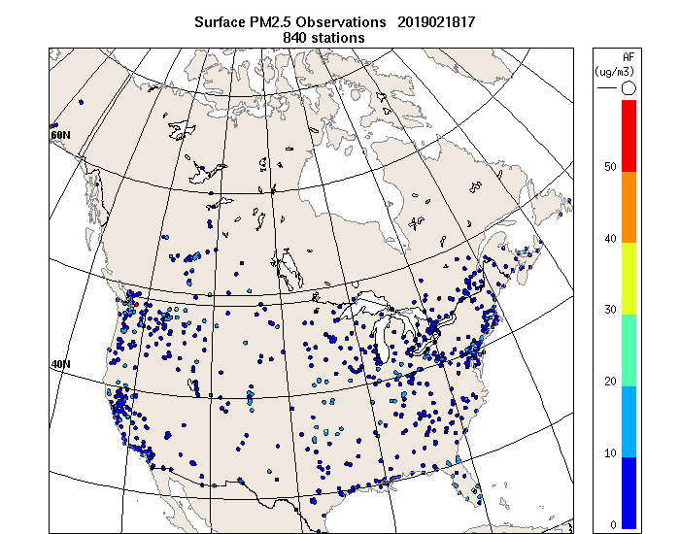
Next Steps
Finalize the year-specific emission inventories and launch the air quality reforecast for the full period of 2002-2017
Detailed validation/comparison of two different representations of wildfire emissions in order to set path for further improvement of the reforecast with more realistic representation of emissions by adding the wildfire component
Update model versions for the new versions of the meteorological and AQ reforecast systems in the future.
Produce hourly surface analyses of 6 pollutants
(O3,PM2.5,PM10,NO2,NO,SO2) covering North
America for the period of 2002-2017
O3
PM_{2.5}
Ménard, R and M. Deshaies-Jacques. Evaluation of analysis by cross-validation. Part I: Using verification metrics. Atmosphere 2018, 9(3), 86, doi:10.3390/atmos9030086
Ménard, R and M. Deshaies-Jacques. Evaluation of analysis by cross-validation. Part II: Diagnostic and optimization of analysis error covariance. Atmosphere 2018, 9(2), 70; doi:10.3390/atmos9020070

Slide 11
THANK YOU / MERCI
For any questions regarding the dataset, please contact
Xihong.Wang@ec.gc.ca
Nedka.Pentcheva@ec.gc.ca

