Slide 1
Scaling NWP workloads on AWS to achieve your research goals
Timothy Brown
aws-hpc-weather@amazon.com

Slide 2
Agenda
AWS HPC Overview
Parallel Cluster Manager
Installing Applications
Application Performance Results

Slide 3
AWS ParallelCluster
One-stop shop to set up your HPC cluster
Integrated with AWS services you need
Amazon FSx for Lustre
Amazon EC2 instances
EFA
NICE DCV
AWS Batch
Notes:
AWS ParallelCluster simplifies deployment and management of HPC clusters. ParallelCluster uses a simple text file to model and provision all the resources needed for your HPC applications in an automated and secure manner. It also supports multiple instance types and job submission queues, and job schedulers like AWS Batch and Slurm.
This year, AWS ParallelCluster has been designated as the first Intel Select Solution in the cloud. This designation certifies the combination of compute, fabric, memory, storage, and software used ensures a high standard of performance and compatibility for HPC.
Another exciting development this year is that you can now create multiple job submission queues inside of ParallelCluster and specify multiple instance types within each queue. This simplifies multi-stage workflows and the ability to run multiple workloads with distinct needs from a single cluster.

Slide 4
AWS ParallelCluster
Region
VPC
AWS ParallelCluster
Availability Zone
Public subnet
Private subnet
Head Node
SSM connection
GPU queue
SLURM
Job Queue
Amazon EC2
Auto Scaling
DCV
Compute queue
Case
data
hpc6a
hpc6a
hpc6a
S3 bucket
Amazon FSx for Lustre
High memory queue
Notes:
FSx Lustre
S3
EBS
Local Storage (NVME, IO2)
4

Slide 5
x86 Instance Snapshot for Weather and Climate
Hpc6a.48xlarge
AMD Milan CPU, up to 3.6GHz frequency
96 cores/instance
384 GiB/instance
100 Gbps Networking Bandwidth w/ EFA
C6i.32xlarge
Intel Icelake CPU, up to 3.5GHz frequency
64 cores/instance
256 GiB/instance
50 Gbps Networking Bandwidth w/ EFA
C5n.18xlarge
Intel Skylake CPU, up to 3.5GHz frequency
36 cores/instance
192 GiB/instance
100 Gbps Networking Bandwidth w/ EFA
Hpc6a.48xlarge
OD: 3c/core-hr
1Y AURI: 2.21/core-hr
3Y AURI: 1.41c/core-hr
C6i.32xlarge
OD: 8.5c/core-hr
1Y AURI: 5.43c/core-hr
3Y AURI: 3.26c/core-hr
C5n.18xlarge
OD: 10.8c/core-hr
1Y AURI: 6.35c/core-hr
3Y AURI: 3.41c/core-hr
* OD == On-Demand * AURI == All Upfront Reserved Instances * All pricing info is for Ohio (us-east-2) Region

Slide 6
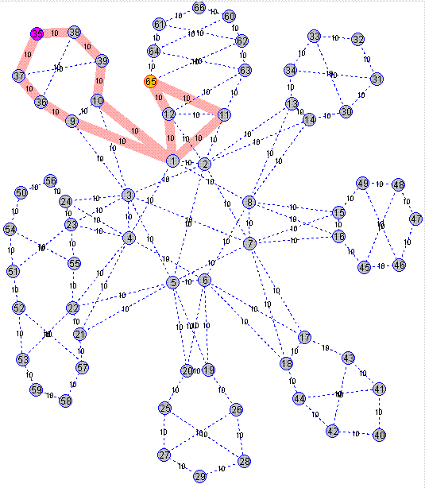
Elastic Fabric Adapter – Networks built to scale
Up to 400 Gbps networking bandwidth
OS bypass
GPUdirect and RDMA
Libfabric core supports wide array of MPIs and NCCL
ECMP-enabled packet spraying and cloud-scale congestion control
At ~40,000 cores (400 nodes), Hpc6a+EFA shows nearly 100% scaling efficiency
Elastic Fabric Adapter
Scaling
Notes:
As many HPC applications require high levels of inter connected instance communication, a high speed network interface is crucial.
EFA is a network device that you can attach to your Amazon EC2 instances to bypass the kernel for fast network communication. With EFA, tightly-coupled HPC applications have access to lower and more consistent latency, as well as higher throughput than traditional TCP channels. EFA enhances the performance of instance-to-instance communication that is so critical for scaling latency-bound HPC applications. EFA is optimized to work on the existing AWS network infrastructure, without modification to your code, and it can scale depending on application requirements. Most applications will work, as is, once a supported version of MPI is made available to that application.
EFA uses libfabric, so you can use any of the MPIs that support that out of the box. Right now, that’s Open MPI, Intel MPI and MVAPICH. A lot of programming models are moving to libfabric, so you can expect this list to grow. EFA started with OS bypass features to take the busy work of moving packets out of the kernel and put them into the Nitro card which owns the slicing and dicing of data and pushes it out over the wire. When I mentioned earlier that building for HPC in a real, live cloud as large as AWS is really different ... well, this is what lead us to invent EFA and the layer that sits underneath it: the Scalable Reliable Datagram or SRD for short. At the scale of our cloud data centers, the network fabric quickly becomes complicated. You get a feel for what I mean from the animation on the right - to build a network at a huge scale, you end up having a LOT (and I mean A LOT) of pathways between any two points. Other network fabrics like Infiniband see this as a challenge to be managed - pick a path, the fastest path - and hammer the packets across it, keeping an eye out for performance degradation or packets drops which can happen (quite a lot actually), and be ready to switch to another path, if you need to. That makes sense from Infiniband’s POV, because it maintains that all packets have to arrive in order, and this is pretty much the only way it can achieve that, given its design. The result is that Infiniband is at the mercy of packet latency. But EFA sees things differently: it looks and sees - oh wow, there are thousands of possible pathways. That’s good news. This is because EFA doesn’t fixate on the order the packets can arrive. If it’s necessary at the application layer, we can assert it later on further up EFA’s libfabric stack. So, with that constraint relaxed, EFA takes the whole payload of data that an MPI or NCCL code wants to move, and sprays all the packets across all the pathways ... all at once.
As you can see in the ANSYS Fluent example on the right, EFA offers significantly better scaling performance vs a non-EFA enabled instance.

Slide 7
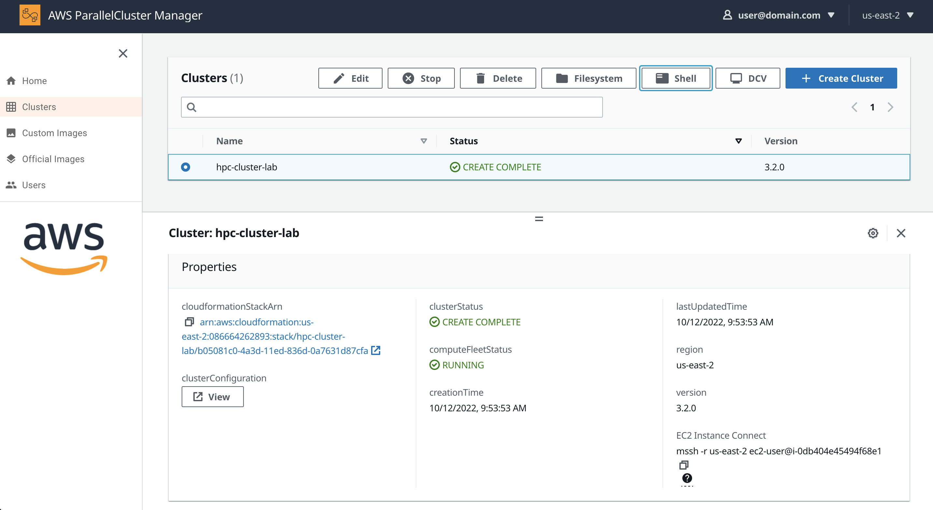
15-minutes to create a HPC Cluster
Create-Cluster Wizard
Connect via the browser (or SSH)
Stop a cluster
(preserve all data)
Then resume later
Notes:
ParallelCluster is the glue that links all the components, Compute, Networking, Storage, and Scheduling together. It lets you easily create clusters, the Manager is the admin console, i.e. the manager you can get going in 5-minutes and have a cluster that can scale to 10’s of thousands of cores. Then shut it down later, saving the config as Infrastructure as code (IaC).

Slide 8
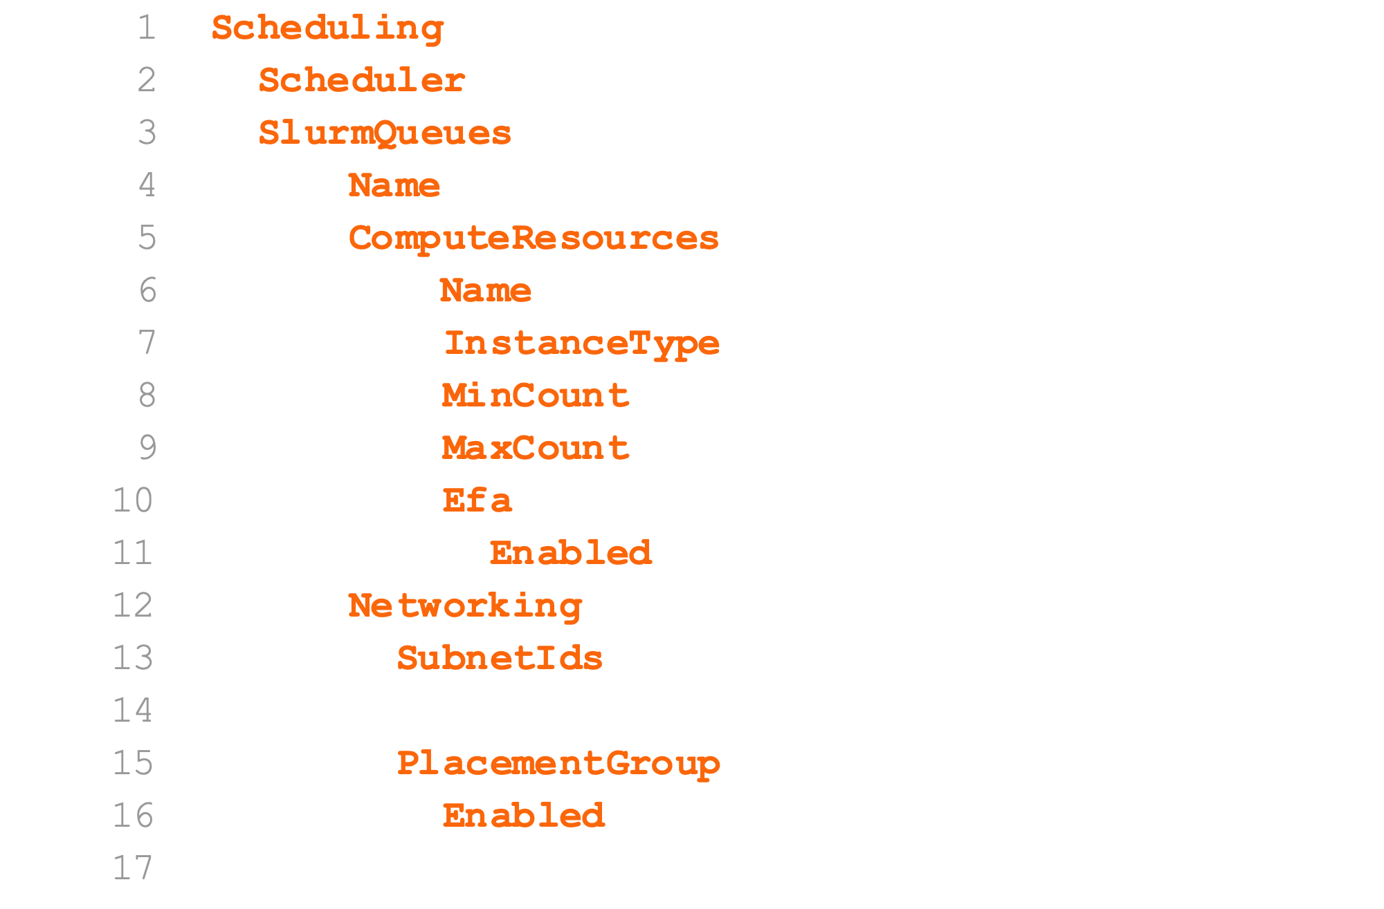
Slurm
Slurm is the built-in scheduler with ParallelCluster.
We have specified 0 nodes
running by default.
Use Slurm’s power management.

Slide 9
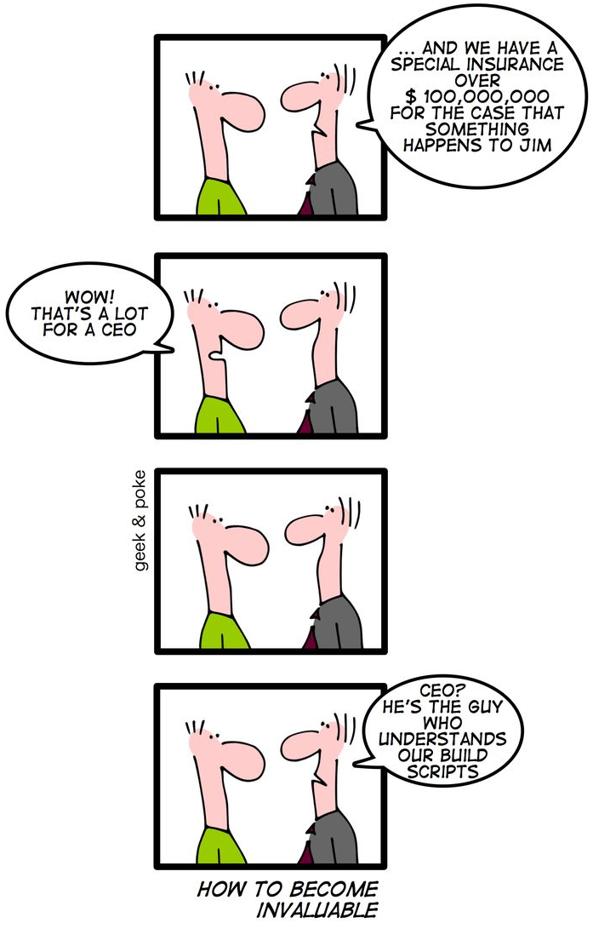
Installing Software
Common ways
Custom Amazon Machine Image (AMI)
via packer
Package managers (Spack, Easybuild, …)
By hand
https://geek-and-poke.com/geekandpoke/2010/5/14/how-to-become-invaluable.html

Slide 10
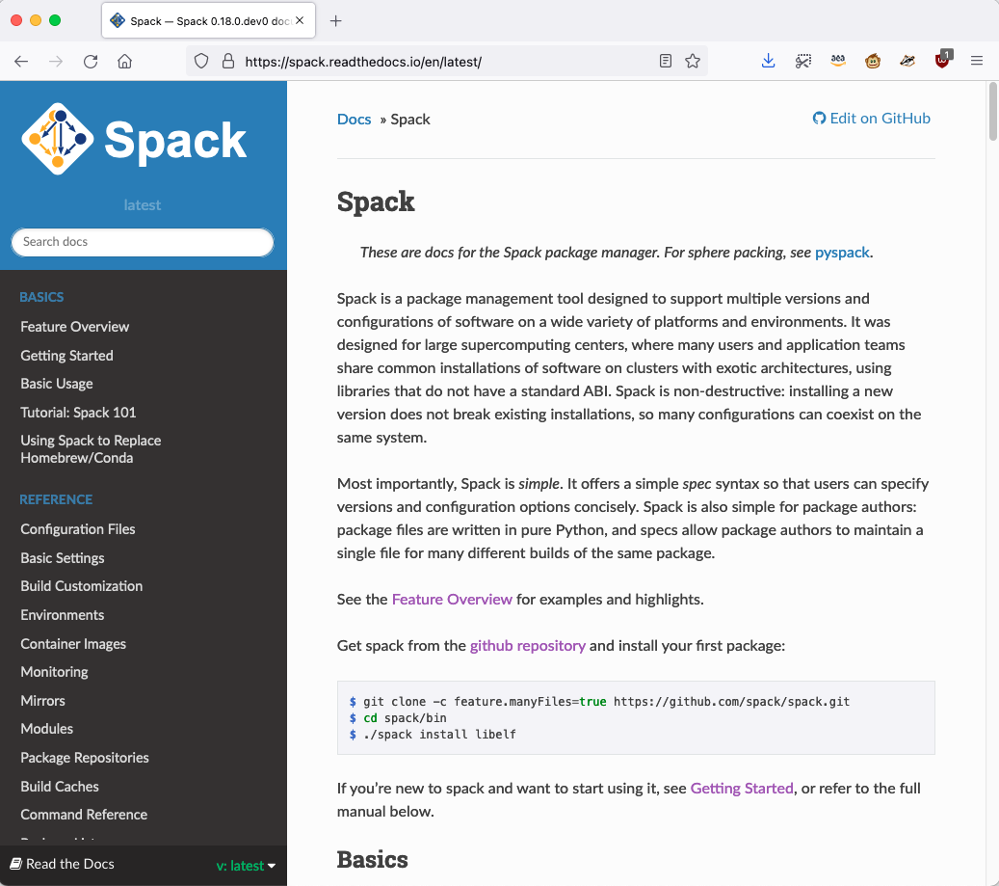
Spack – Package Manager
We are going to use Spack¹ to install all our packages.
Spack binary cache
https://binaries.spack.io/develop
1. Todd Gamblin, Matthew P. LeGendre, Michael R. Collette, Gregory L. Lee, Adam Moody, Bronis R. de Supinski, and W. Scott Futral.
The Spack Package Manager: Bringing Order to HPC Software Chaos.
In Supercomputing 2015 (SC’15), Austin, Texas, November 15-20 2015. LLNL-CONF-669890.

Slide 11
Spack External Packages
We define the external packages in $SPACK_ROOT/etc/spack/packages.yaml

Slide 12
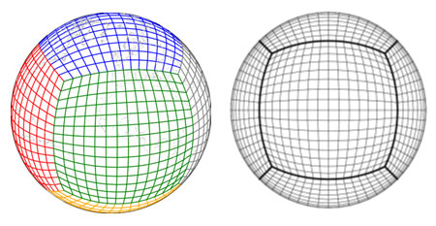
UFS Weather Model
Version 2.0.0
Global C768 with 65 vertical levels
2 day forecast
Model timestep is 150 seconds
C768 → 768 cells per direction per face → 13 km resolution

Slide 13
Building UFS Weather Model With Spack
spack install –j 12 ufs-weather-model%intel^intel-oneapi-mpi+external-libfabric
Spack Arguments and Flags | Description
install | Install a package.
-j 12 | Parallel build with 12 cores.
ufs-weather-model | The package to install.
%intel | Specify the Intel compiler (icc and ifort).
^intel-oneapi-mpi | Use the Intel OneAPI MPI library.
+external-libfabric | Use an external fabric for MPI.

Slide 14
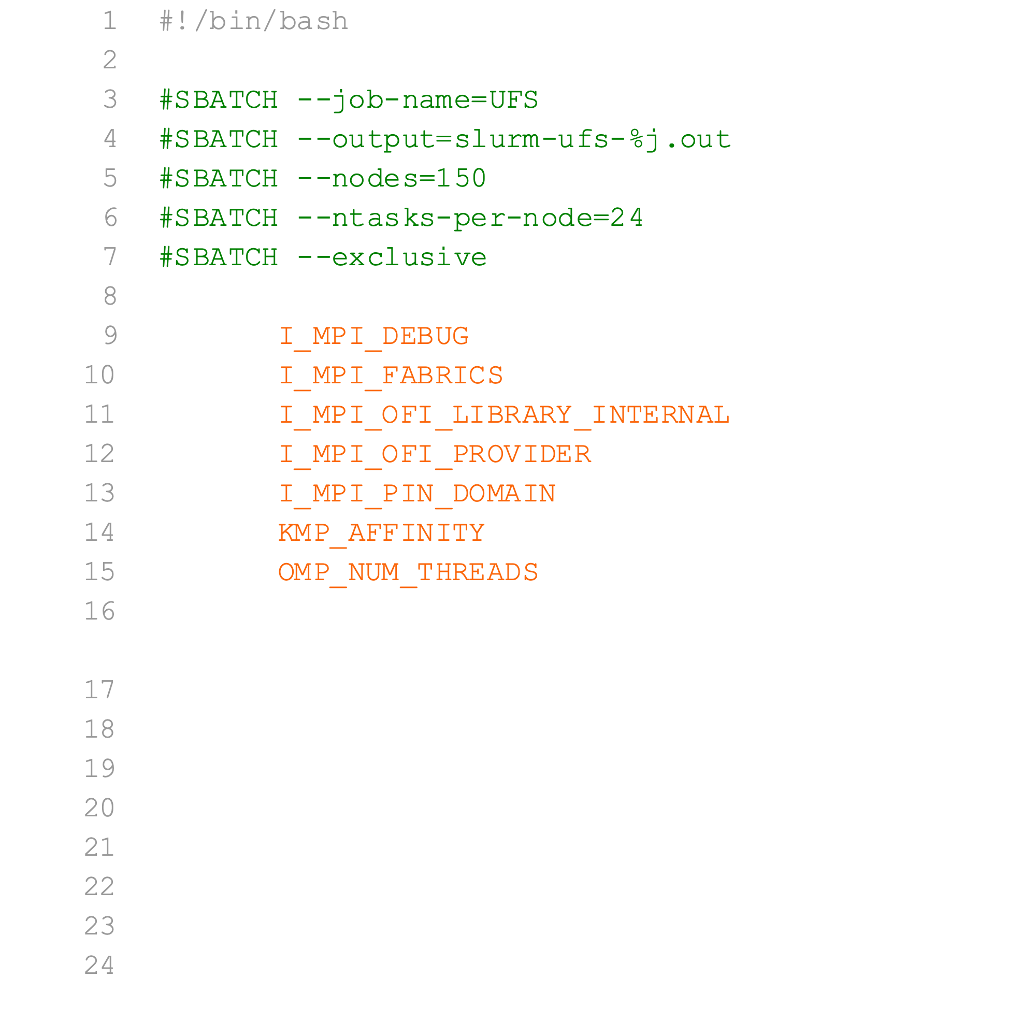
Running UFS Weather Model
I_MPI_OFI_LIBRARY_INTERNAL must be
set to 0 before loading Intel MPI
Specify EFA as the fabric adaptor
Confirm EFA is used, when I_MPI_DEBUG=4
(slurm job output text)

Slide 15
Scale Up Performance

Slide 16
Scale Up Cost

Slide 17
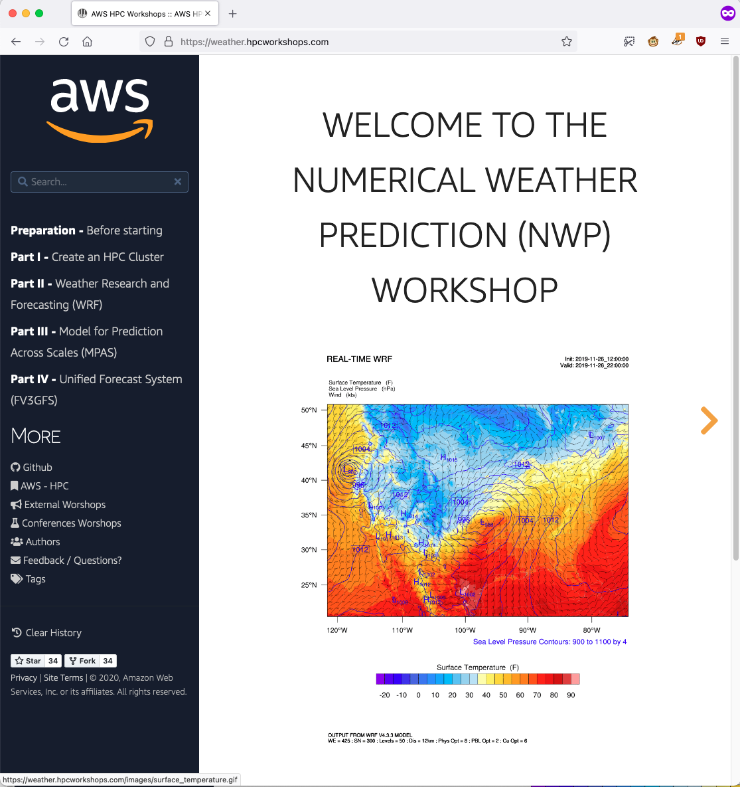
Weather Workshops https://weather.hpcworkshops.com

Slide 18
Thank you
If you have any additional questions, please feel free to reach out.
Timothy Brown
aws-hpc-weather@amazon.com

Slide 19
Weather Models Run On AWS
WRF ARW
MPAS Atmosphere
UFS Atmosphere (FV3GFS)
Unified Model
Harmonie
ICON

