Slide 1
Retrospective, Multiannual Evaluation of the Canadian Operational Regional Air Quality Deterministic Prediction System against North American Surface Observations
Michael D. Moran¹, Alexandru Lupu¹, Verica Savić-Jovčić¹, Junhua Zhang¹, Qiong Zheng¹, Rabab Mashayekhi², Sylvain Ménard², Jack Chen¹, Konstantinos Menelaou², Rodrigo Muñoz-Alpizar², and Dragana Kornić²
¹Air Quality Research Division, ECCC, Toronto, Ontario, Canada
²Canadian Centre for Meteorological and Environmental Prediction, ECCC, Montreal, Quebec, Canada
21st CMAS Conference, 17–19 October 2022, Chapel Hill, North Carolina

Slide 2
Motivation
In an operational setting, proper evaluation of an air quality model is constrained mostly by:
frequent model version changes;
uncertainty in projected emissions;
limited availability of near real-time observations of relevant species.
To better understand model weaknesses and areas of improvement:
use consistent version of model;
run for extended period (multiple years);
use year-specific emissions.
Model performance in this diagnostic evaluation might be an upper bound on operational performance.

Slide 3
System Configuration
Model
GEM-MACH 3.1 (based on GEM 5.1)
Chemistry Mechanism
Gas-phase: 47 species
Aerosol: 2 bins, 8 components, HETV thermodynamic model
Model Configuration
Domain: Canada, US, and Northern Mexico
Horizontal grid resolution: 10 km
Vertical grid: 84 levels up to 0.1 hPa
Run cycle: 12-h integrations every 12 hours
Simulation period: 2013–16
Emissions
Year-specific APEI (CA) and EQUATES (US, MX) inventories
No biomass burning
Biogenic: BEIS 3.09 with BELD3
Lateral Boundary Conditions
Chemistry: MOZART 4
Meteorology: Global GEM @ 15-km resolution
Reference
Moran, M.D., S. Ménard, and D. Kornić, 2021. Regional Air Quality Deterministic Prediction System (RAQDPS): Upgrade from version 022 to version 023. Technical note, November, Canadian Centre for Meteorological and Environmental Prediction, Montreal, 48 pp.
Scan or click

Slide 4
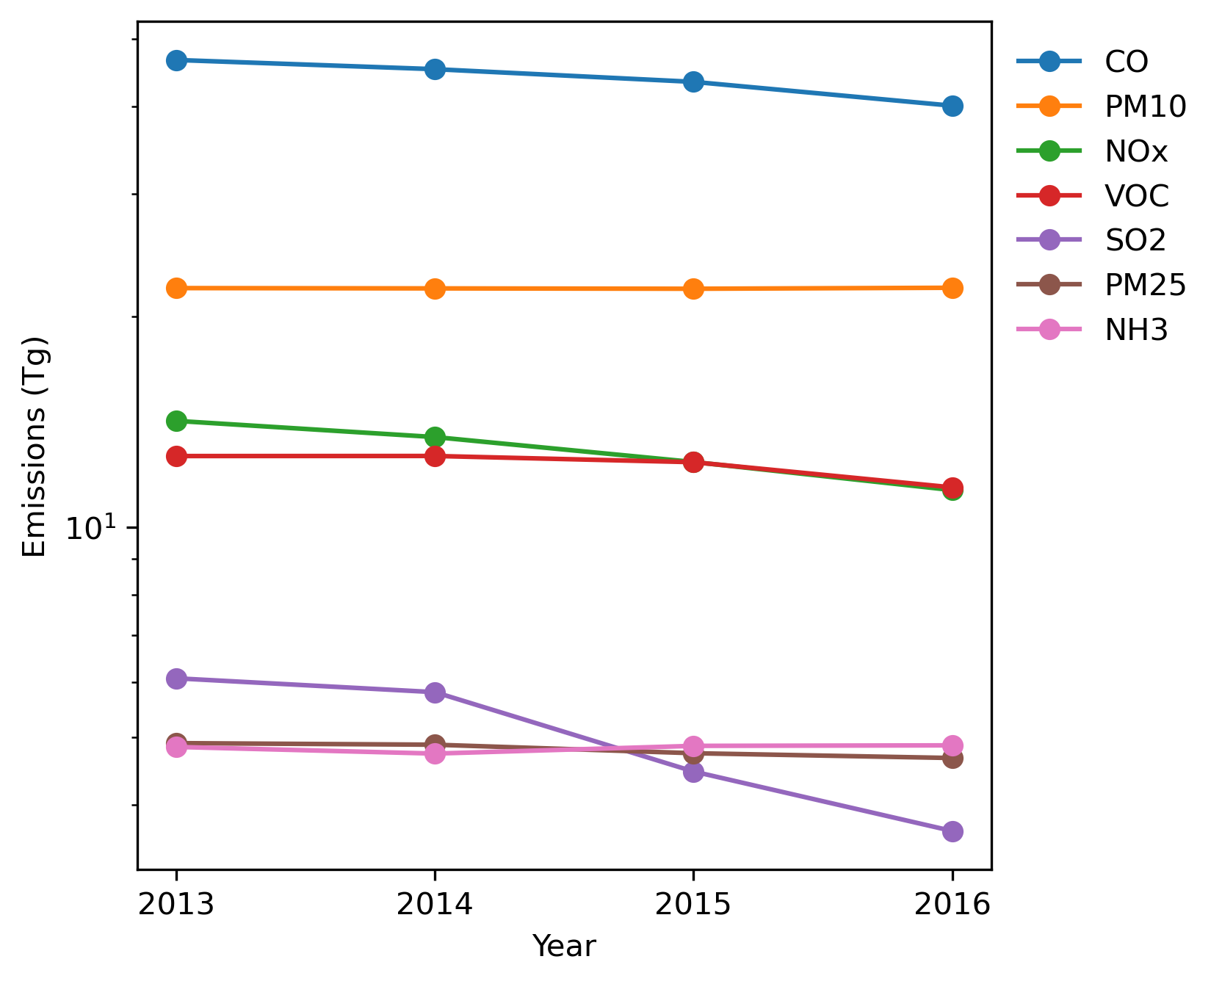
Anthropogenic Emissions
Year-specific APEI (Canada) and EQUATES (U.S. and Mexico) inventories for 2013–16
Large monotonic decrease over the 4-year period for SO₂ (40%), NO_{x} (20%), and CO (10%)

Slide 5
Surface Observations Used for Evaluation
Network | Matrix | Species | Sampling duration
AQS | air pm25 pm10 | O₃, NO₂, NO, CO, SO₂, HCHO, C₂H₄, C₅H₈ PM_{2.5} PM₁₀ | 1 hour
CAPMoN (Canada) | air aerosol (total) precip | HNO₃, SO₂ SO₄, NO₃, NH₄, Cl, Na SO₄, NO₃, NH₄ | 1 day
CASTNET | air aerosol (total) | O₃, HNO₃, SO₂ SO₄, NO₃, NH₄, Cl, Na | 1 hour, 1 week
CSN | pm25 | SO₄, NO₃, NH₄, OC, EC, Si, Al, Ca, Fe, Ti, Na, Cl | 1 day
IMPROVE | pm25 | SO₄, NO₃, OC, EC, Si, Al, Ca, Fe, Ti, Na, Cl | 1 day
NADP/AIRMoN | precip | SO₄, NO₃, NH₄ | 1 day
NADP/AMoN | air | NH₃ | 2 weeks
NADP/NTN | precip | SO₄, NO₃, NH₄ | 1 week
NAPS (Canada) | air pm25 | O₃, NO₂, NO, CO, SO₂, NH₃ PM_{2.5}, SO₄, NO₃, NH₄, OC, EC, Si, Al, Ca, Fe, Ti, Na, Cl | 1 hour, 1 day

Slide 6
Ozone Monthly Statistics
AQS (hourly)
AQS: negative bias in spring
NAPS: negative bias in spring and summer
Negative bias may be due to chemical lateral boundary conditions and missing stratospheric intrusion in spring
NAPS (hourly)

Slide 7
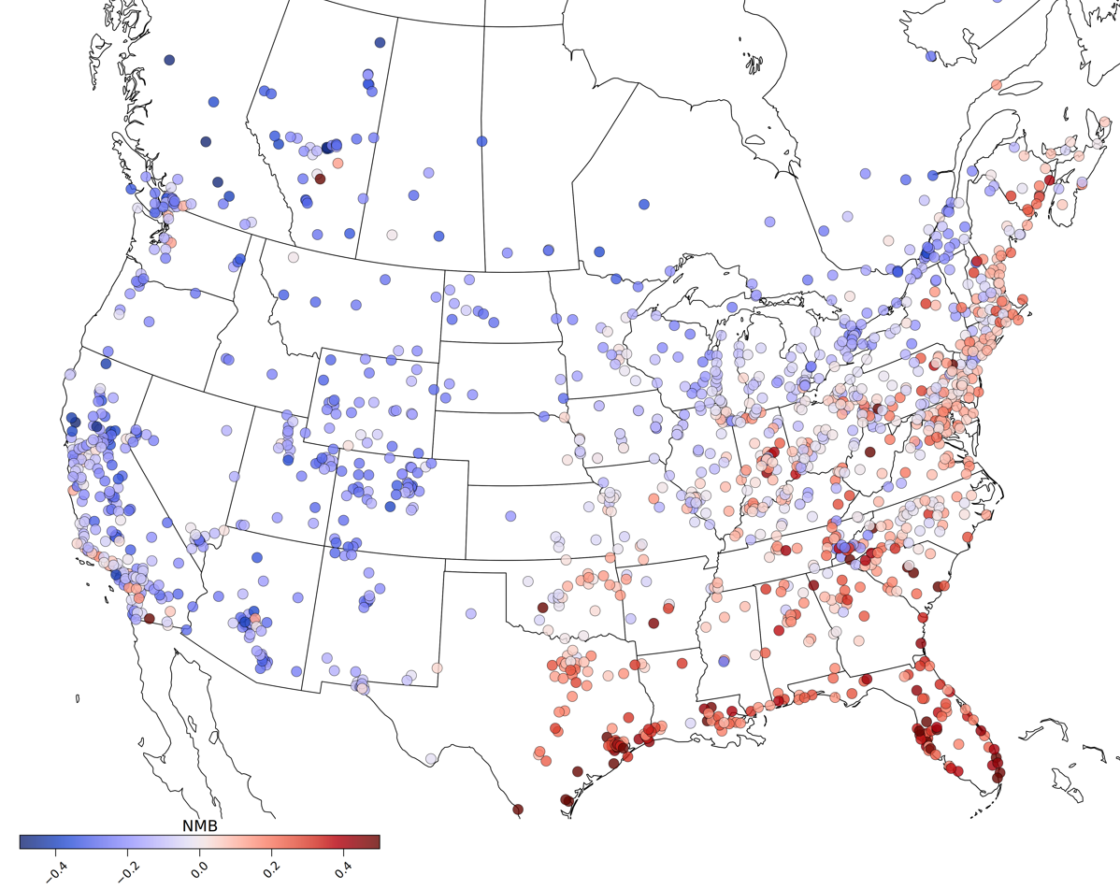
Ozone NMB by Station – July 2014
Compensating errors: while overall the bias for July (all 4 years) is near zero, W domain has negative bias, E & SE domains have positive bias
W negative bias: chemical boundary conditions
E & SE positive bias: missing halogen chemistry in marine boundary layer; isoprene emissions and chemistry might also be a factor

Slide 8
Fine PM Monthly Statistics
AQS (hourly)
AQS: Negative bias in spring and summer; could be due to underprediction of OM (not shown)
NAPS: Missing biomass burning emissions likely contribute to large interannual variability of NMB
Decrease in U.S. SO₂ and NO_{x} emissions is reflected in both observations and model
NAPS (hourly)

Slide 9
Sulfur Dioxide Monthly Statistics
AQS (hourly)
Consistently large positive bias for both AQS and NAPS
Low R for hourly observations, but high R for CASTNET weekly averages (not shown) – a consequence of SO₂ emitters being mostly point sources
Steady decrease in annual emissions is seen in both observations and model
NAPS (hourly)

Slide 10
Fine Sulfate Monthly Statistics
CSN (daily)
Consistently large negative bias for both CSN and IMPROVE; given that SO₂ is overestimated, this might suggest an issue with the sulfur chemistry
Decrease in SO₂ annual emissions is seen in both observations and model
IMPROVE (daily)

Slide 11
Sulfate Wet Deposition Monthly Statistics
NADP/NTN (weekly)
Negative bias in spring and summer
Positive bias in winter
Decrease in SO₂ annual emissions is seen in both observations and model
CAPMoN (daily)

Slide 12
Fine EC Monthly Statistics
CSN (daily)
Consistent positive bias suggests an overestimation of emissions
Large NMB and poor R values for IMPROVE for August 2015 are likely due to missing biomass burning emissions
IMPROVE (daily)

Slide 13
Summary and Conclusions
A comprehensive multi-year model evaluation allows systematic model weaknesses and possible model improvements to be identified at the same time, e.g.,
model representation of springtime O₃ maximum and specification of O₃ lateral boundary condition;
summertime fine PM underprediction and link to underprediction of fine SO₄ and fine OM
Model statistical scores were found to behave similarly overall for the four simulation years considered (2013–2016)
Spatial plots of station-level NMB values can show regional clustering and differences, including compensating station-level errors that affect network-level statistics (e.g., AQS ozone in July)
Large monotonic reductions in U.S. SO₂ emissions from 2013 to 2016 were reflected in both observed and modeled monthly time series of SO₂ and bulk fine PM concentration (AQS), fine SO₄ concentration (CSN, IMPROVE), and SO₄ wet deposition (NADP)

