Slide 1
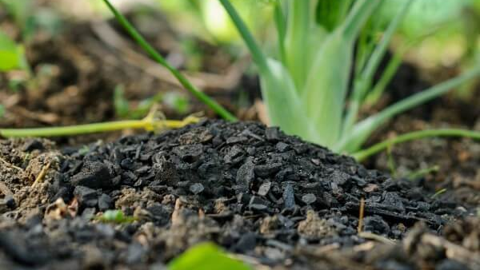


Modeling Agricultural Reactive Nitrogen Emissions with Soil Carbon Amendments using an Enhanced Version of Fertilizer Emissions Scenario Tool for CMAQ (FEST-C)
Lina Luo¹, Daniel Cohan¹, Caroline Masiello¹, and Taras Lychuk²
¹Rice University, ²Agriculture and Agri-Food Canada
Presentation to 21st Annual CMAS Conference
October 18, 2022

Slide 2
Why we care about reactive N emissions
N₂O: Potent greenhouse gas (climate)
  ~100 year lifetime
  273x as potent as CO₂
NH₃: Forms particulate matter (health)
  Impacts depend on NO_{x}, SO₂, meteorology & population downwind
NO_{x}: Forms particulate matter and ozone (health)
  Impacts depend on NH₃, VOCs, meteorology & population downwind

Slide 3
How is reactive N released from soils
Agriculture is the largest source of reactive nitrogen emissions
& leading contributor to PM health effects in US

Slide 4
Enhanced Fertilizer Emissions Scenario Tool for CMAQ (FEST-C*)

Slide 5
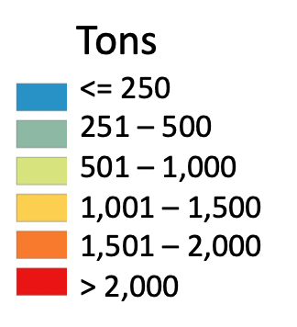
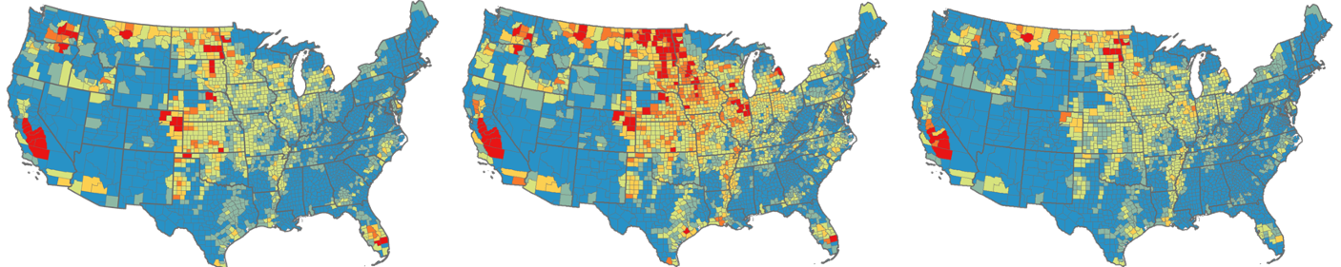
Agricultural Emissions of Reactive Nitrogen Simulated by FEST-C*
NO_{x}
NH₃
N₂O
Emissions
Emissions are highest in intensely fertilized regions and vary with meteorology and soil conditions
Luo et al., Environmental Science & Technology, 2022

Slide 6
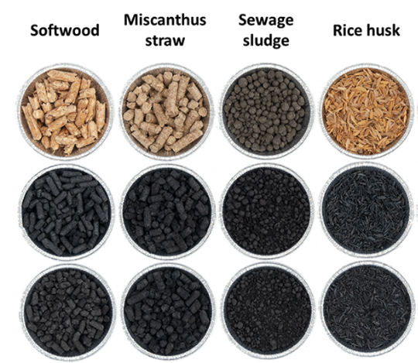
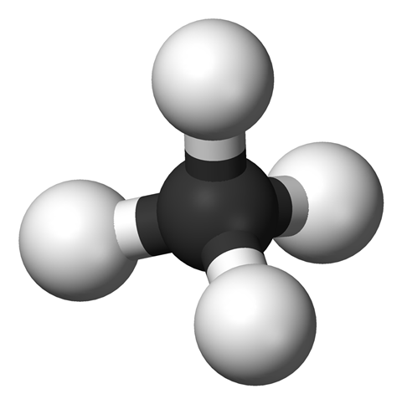
Potential Impacts of Soil Amendments
Rice
husk
Stimulation
pH
pH
Cation exchange capacity (CEC)
Bulk density (BD)
C & N dynamics
Sewage
sludge
Bulk density
CEC
Pyrolysis
Miscanthus
straw
Water
Carbon
Zero-
valent carbon
Methane
Mitigation
NH₃
NO_{x}
N₂O
Soil Amendments
Impacts on nitrogen emissions
Feedstocks
Soil mixtures
Zhang et al., GCB Bioenergy, 2021

Slide 7
Modeling of Biochar with FEST-C*
Biochar impacts on soils
Simulation configurations
Cation exchange capacity (CEC): ↑
pH: ↑ (less acidic)
Carbon pool allocation
  2% for active pool
  60% to slow pool
  38% to passive pool
Bulk density: ↓
Year : 2011
Domain: U.S. fertilized soils
Biochar application
  Type: hardwood biochar
  Timing: 1st fertilizer application day
  Tillage depth: 15cm
  Rate: 5 ton/ha or 20 ton/ha
  CEC: 185 cmolC/kg
  Carbon content: 72.9%
  Bulk density: 0.64 ton/m³
Lychuk et al., Mitig Adapt Strateg Glob Change, 2014

Slide 8
Comparisons of Modeled and Observed Impacts of Biochar on N₂O and NH₃ Emissions
●N₂O: 9 sites
▲NH₃: 2 sites
FEST-C* biochar model tends to capture the observed sign of emissions variations but predict smaller changes than are observed
Simulated Impact (%)
Edwards et al., Soil Bio. Biochem, 2018
Deng et al., PloS ONE, 2015
Gao et al., Soil Use Manage, 2021
Verhoeven et al., Agric. Ecosyst. Environ, 2014
Observed Impact (%)

Slide 9
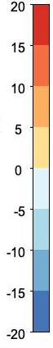
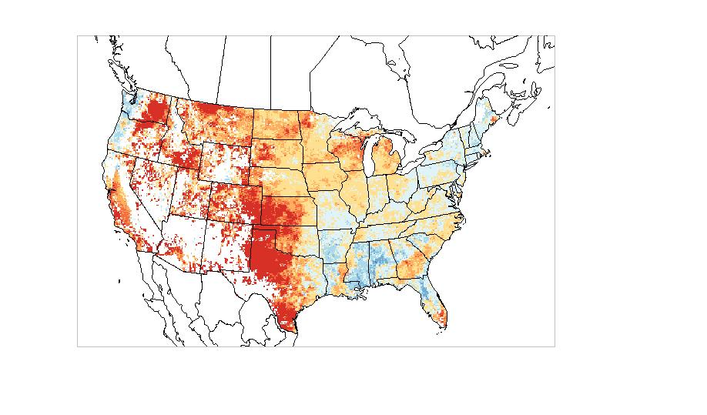
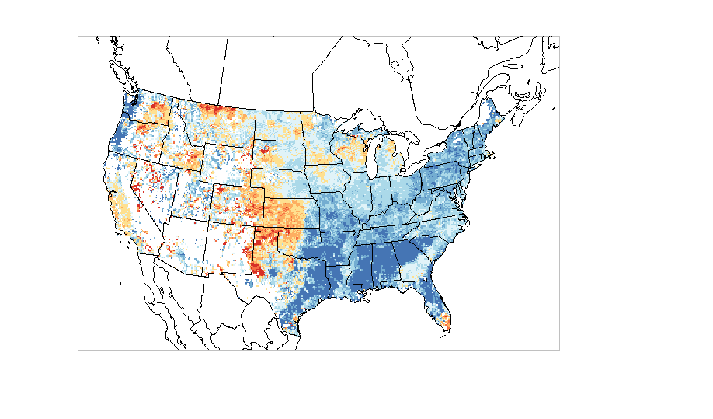
Impact of Biochar on N₂O Emissions
> 20
15
10
5
0
-5
-10
-15
< -20
Biochar 5 ton/ha
Biochar 20 ton/ha
Increase
Relative variation (%)
Decrease
NH₃ and NO_{x} had similar spatial patterns
Mitigation of emissions occurred most in the Southeast and under high-dose application.
High-dose (20 ton/ha) biochar application showed more favorable impacts

Slide 10
Driving Factors for Variations of Nitrogen Emissions
under Biochar Applications
Base case
Nitrification is the primary process (~ 80%) for N₂O emissions from fertilized soils, influenced mainly by NH₄⁺ level
Biochar case
Direct changes
Indirect changes

Slide 11
Why 20ton/ha case generates more favorable impacts
Biochar 5 ton/ha
N₂O
Mineralization > Immobilization
Biochar 20 ton/ha
N₂O
Mineralization < Immobilization

Slide 12
Impact of Biochar on Inorganic Nitrogen Budget Pathways
Biochar 20 ton/ha vs. Base case
NH₃
N₂O
NO
N₂O
N₂
% Change
Other benefits : ↓ N loss via runoff & percolation
Trade-offs effects: ~5% ↓ N in crop yield due to N input from net mineralization

Slide 13
Conclusions
Incorporated biochar algorithms to FEST-C* to simulate soil C amendments and their influence on reactive N emissions
High-dose application of biochar amendments mitigated nitrogen emissions across most agricultural regions
Net effects depend most on how nitrification is affected
Need more field measurements to assess model performance
Notes:
In summary, we develop

Slide 14

Acknowledgements
Funding:
Dr. Kristen Foley (EPA): Meteorology data
Dr. Stephen Del Grosso (USDA): Soil N₂O data
Dr. Jesse Bash, (EPA): NH₃ estimation
Dr. Dongmei Yang (UNC) and Dr. Limei Ran (USDA): FEST-C model
Dr. Luca Doro and Dr. R. César Izaurralde (Texas A&M AgriLife Research) and Dr. Curtis Jones (UMD): EPIC model
Dr. Quazi Z. Rasool (PNNL): N cycling scheme
Dr. Nick Muller and Peter Tschofen (CMU): APEEP model
Dr. Taras Lychuk, Biochar algorithms

Slide 15


Slide 16
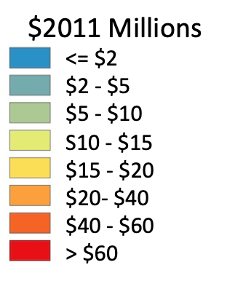
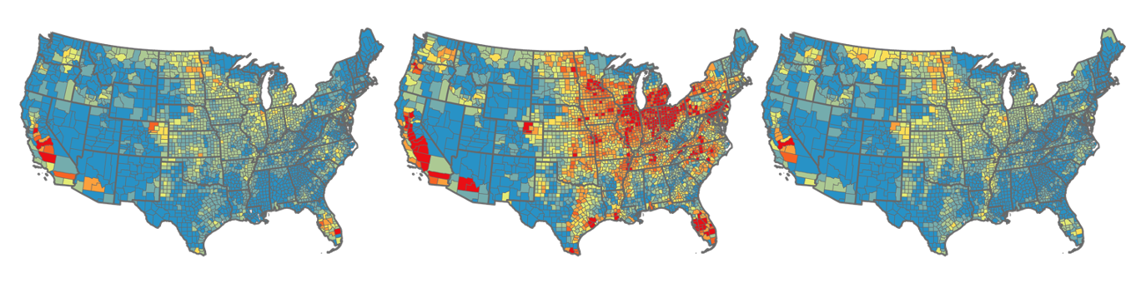
Spatially Variable Impacts of Agricultural Soil Emissions
Linking FEST-C* with Reduced Form Air Quality Health Model APEEP
Emissions
APEEP
APEEP
Social cost of N₂O
Total damage
($)
NO_{x}
NH₃
N₂O
In most counties, NH₃ emissions have largest impact
Luo et al., Environmental Science & Technology, 2022

Slide 17
Driving Factors for Variations of Nitrogen Emissions
under Biochar Applications
Biochar case
Changes of influencing variables and their impacts on N₂O emissions
↑ increase ↓ decrease ⎯ no change
Changes upon biochar applied | C | CEC | pH | BD | Water content | T (ºC) | Respiration | NH₄⁺ | NO₃⁻
Influencing variables | ↑ | ↑ | ↑ | ↓ | ↑ | ↑ | ↑↓ | ↑↓ | ↑↓
N₂O emissions | ↑↓ | ↓/− | ↑/−/↓ | ↓ | ↑ | ↑ | ↑↓ | ↑↓ | ↑↓
Except for nitrogen availability, the more biochar applied, the greater changes in soil properties
Net changes of N₂O largely depends on nitrification processes
Notes:
cmol kg moles of charge per kilogram soil

