Slide 1
Potential Impact of Future Climate on Winter Time Particulate Matter in the Western U.S
Abiola S. Lawal, Cam Phelan, Heather Holmes, Cesunica Ivey
CMAS 2022
October 17th 2022

Slide 2
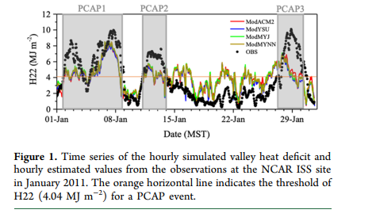
Why is it important to look at Wintertime Particulate: Connection to PCAP/CAP
An event where elevated levels of particulate matter are caused due to an inversion layer (cold layer) below a warm layer (above)
Prevents mixing and leads to higher levels particulate matter.
CAP: Cold Air Pool
PCAP: Persistent Cold Air Pool (Lasting a couple of days)

Slide 3
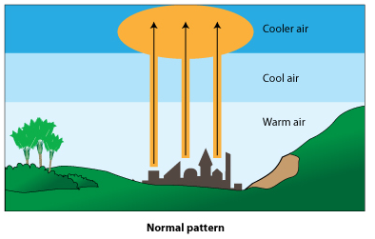
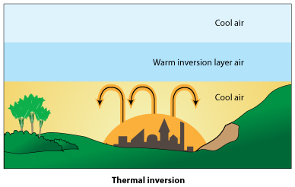
An Illustration of Winter Time Particulate Matter
2
1
Cooled Air pool
Mountainous terrain allows for a pool of cold air to gather
3
Pollutants are trapped
Build up over time
More reaction chemistry
Health implications
Visibility
Results in elevated particulate matter
Persistent Cold Air Pool (PCAP)

Slide 4
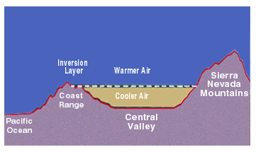
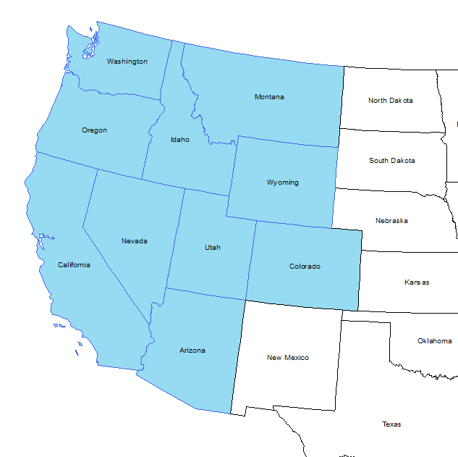
Conditions that favor formation of a PCAP
PCAPs are characterized by episodes of elevated particulate matter and pollutant trapping
Geography matters
Tends to persist in the western mountainous regions due “trapping” between ridges
Loss of horizontal transport
Physical Dynamics created by meteorological conditions
A loss of heat leading to a cooled air and inversion layer.
Cold conditions: Winter Time PM
Heat loss: Heat valley deficit (VHD)
Chemical Dynamics
Atmospheric chemistry (PM largely comprised of nitrate)
Daytime and night time chemistry can affect it.
Winter time chemistry
Emissions
Source profiles: different sectors have different impact
Temporal
Definition: Anything lasting from 2 days to 3 days
Notes:
https://www.valleyair.org/newsed/ca_primer/bigpicture/IIIA4a.html

Slide 5
Project falls under umbrella of NIH funded project
To improve our understanding of winter time particulate matter.
Particulate matter that is trapped primarily consists of secondary aerosol (80%)
Goal: Through novel air quality modeling techniques, improve our understanding of sources and chemical formation mechanics in regards to aerosol formation. Will help with mitigation strategies.
Will collect health data for 12 “mountainous cities”
Dr. Cesunica Ivey (PI)
Air Quality modeling
Dr. Heather Holmes (PI)
WRF Modeling/Meterology
Dr. Jenna Krall
Biostatistics
Dr. Calvin Riss
Epidemiology
Notes:
Limitation with source apportionment models as typically used for primary aerosol

Slide 6
Air Quality Modeling: AQMEL Group at UCB
kinetics/emissions/meteorology.
Emissions
Source Apportionment
ISAM/DDM
Develop new speciation profiles
Meteorology
Levels: 41 vs 35
Short wave and long wave radiation parameters
Microphysics
Aerosol Reaction chemistry
Evaluate differences between AE7 and AE6 (Cam Phelan’s poster please check it out)
Chemical kinetics and process

Slide 7
Objective
Improve prediction of PCAP episodes (mitigation)
Modeling
Emissions
Meteorology
Reaction chemistry
Part of prediction is to also see what will happen in the future

Slide 8
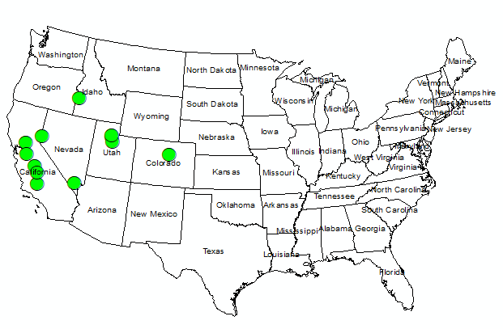
Focus on 12 Western Sites
State | Site
Utah | Utah
Utah | Salt Lake
Utah | Davis
Colorado | Denver
Nevada | Washoe
Nevada | Clark
California | Sacramento
California | Fresno
California | Stanislaus
California | Kern
California | Tulare

Slide 9
First Step is to identify a PCAP: Group at Univ Utah
Need to first get a measure of bulk atmospheric stability: Valley Heat Deficit
(original version)
$VHD= c_{p}\int_{sfc}^{h}{ρ\left(z\right)[θ\left(h\right)−θ(z)]}dz$.
Changes to VHD:
h: height of the top of the temperature inversion
To find h, a PBLH is found using the bulk Richardson number (R_{B}) and finding the point below the PBLH where a temperature inversion exists.
If PBLH determination fails, set h to 4000 m.
c_{p} : Specific heat of air (1005 J kg⁻¹ K⁻¹)
𝜌(𝑧): Density of layer
𝜃(ℎ): Potential temperature at height h
𝜃(z): Potential temperature of layer
sfc: surface height
h: mean ridge height
VHD: MJ/m2
This typically takes a trained meteorologist, and examination of sounding data
Notes:
I will add more – from Colgan

Slide 10
After PCAP episode is identified……. What trends are we looking for?
Identify the episode (PCAP)
Correlation between modeled/observed PM and PCAP
Correlation between (mod/obs) PM/PCAP and meteorology variables
CMAQ and WRF
SMOKE-2016 NEI platform
2016 National Emissions Inventory (NEI) was used as base case and to scale future emissions.
Sparse Matrix Operator Kerner Emissions (SMOKE) modeling system
Air Quality Modeling
The Community Multiscale Air Quality (CMAQ) system
CMAQv 5.3.2
12km by 12km grid size

Slide 11
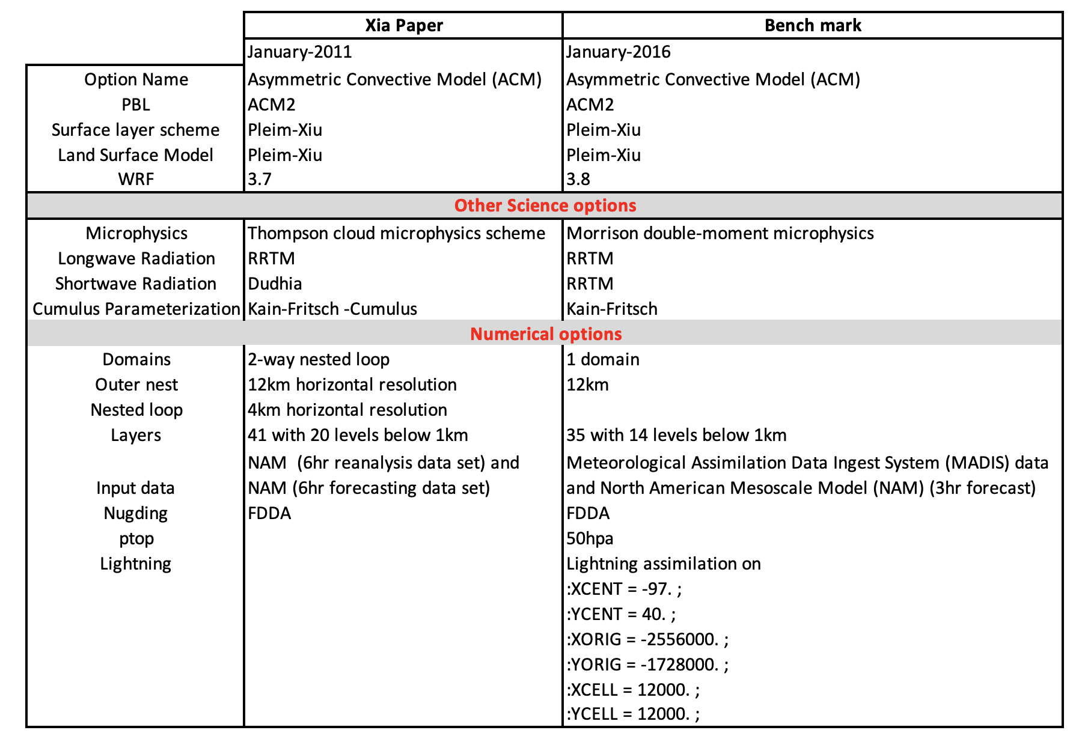
2016 JAN Base Case: Focused on WRF Differences

Slide 12
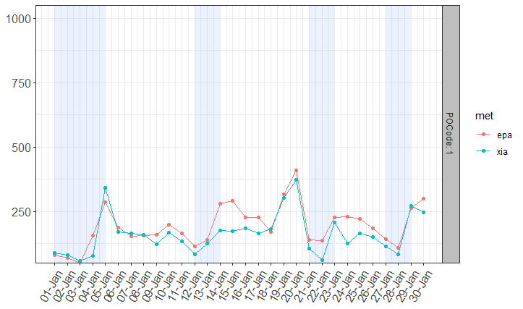
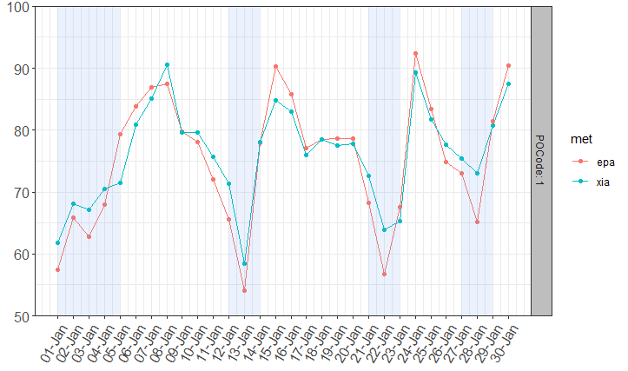
Jan 2016 Salt Lake
PBLH
RH
(m)
%
Correlation between RH and PCAP
Shaded areas are PCAP episodes

Slide 13
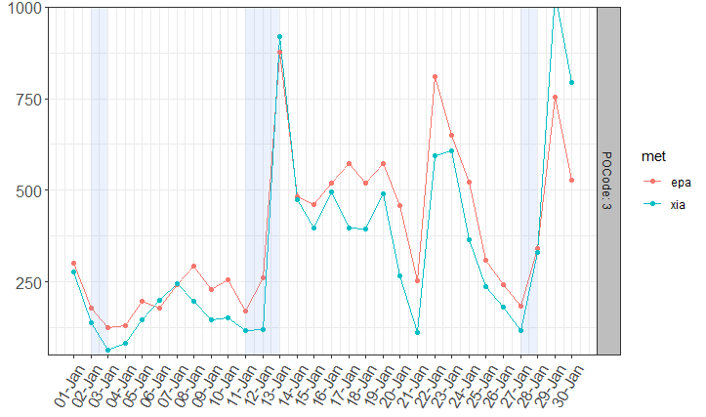
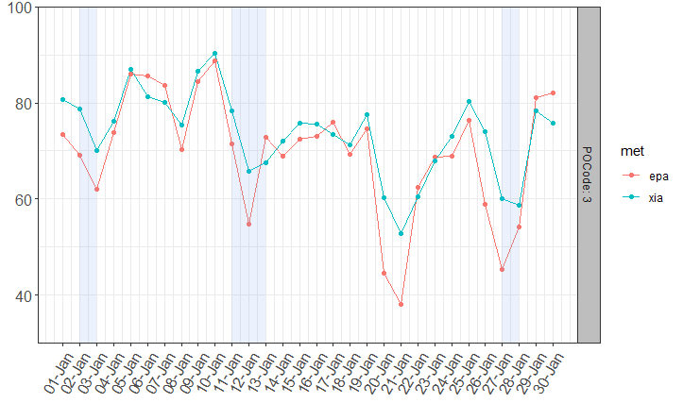
Jan 2016 Reno
RH
PBLH
(m)
%
Correlation between PBLH/RH and PCAP
Shaded areas are PCAP episodes

Slide 14
Taking these preliminary trends as a way to determine important PCAP predictors. We use this, to try to predict episodes in the future 2050?

Slide 15
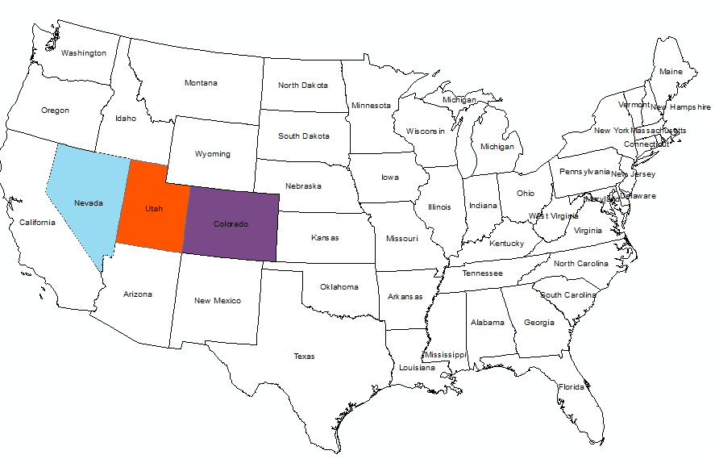
State | Site
Utah | Salt Lake
Colorado | Denver
Nevada | Washoe

Slide 16
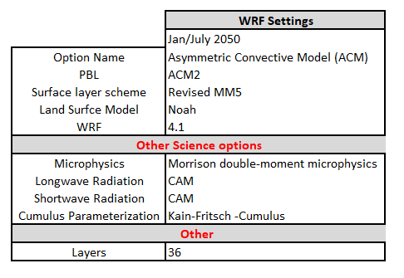
SMOKE-WRF-CMAQ
SMOKE-2016 NEI platform GT NEMS
2016 National Emissions Inventory (NEI) was used as base case and to scale future emissions.
Sparse Matrix Operator Kerner Emissions (SMOKE) modeling system
Meteorology
Community Earth System Model Version 1 (CEMSI)
Global model developed by the National Center for Atmospheric Research (NCAR)
Weather Research Forecasting (WRF) Model v4.1
Used to downscale the global model
Two climate scenarios: RCP4.5/RCP8.5
Air Quality Modeling
The Community Multiscale Air Quality (CMAQ) system
CMAQv 5.3.2
12km by 12km grid size

Slide 17
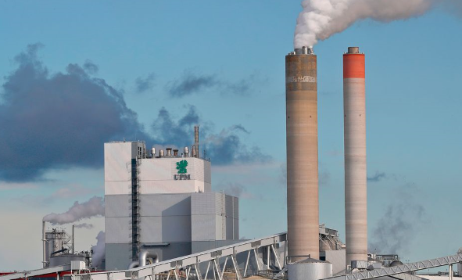
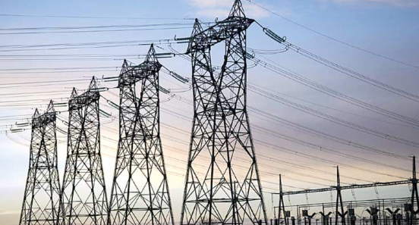
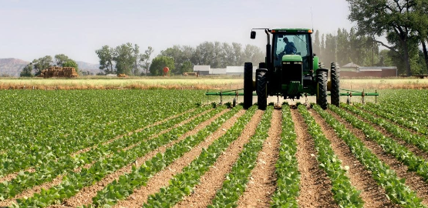
Emissions Other Sectors
2050 emissions for other sectors were estimated using the GT-NEMS forecast model which assesses energy distribution, with demand in combination with technology changes and regulations.
Electricity Power Generation Power Units
Area Source and Non Point (Residential, Commercial, Agriculture and Industrial sectors)
Biogenic emissions: Biogenic Emissions Inventory System (BEIS) version 3.61
Details of the methods can be found in recently published article by Shen et al.
Relaxed Energy Policies Coupled with Climate Change Will Significantly Undermine Efforts to Attain US Ozone Standards (2019). Published in One Earth. DOI:https://doi.org/10.1016/j.oneear.2019.09.006

Slide 18
Results

Slide 19
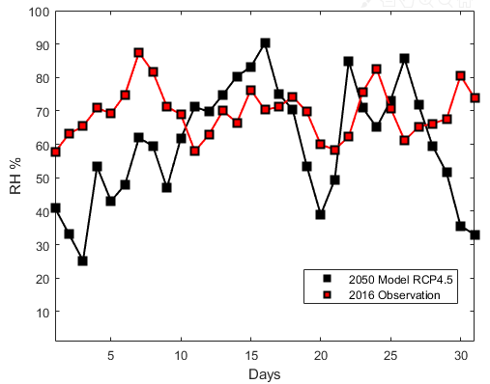
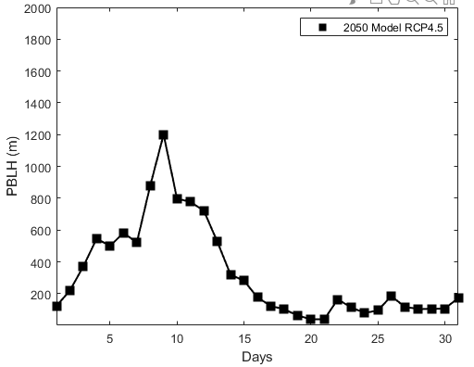
Salt Lake Utah
Estimated PCAP

Slide 20
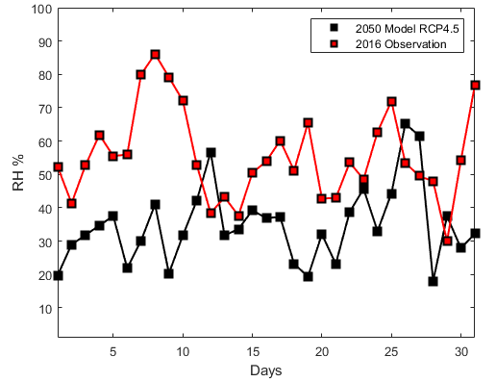
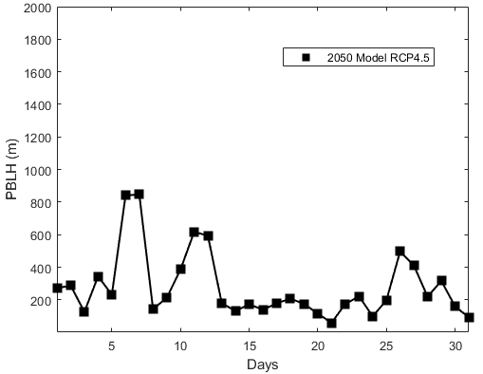
Denver, Colorado
Estimated PCAP

Slide 21
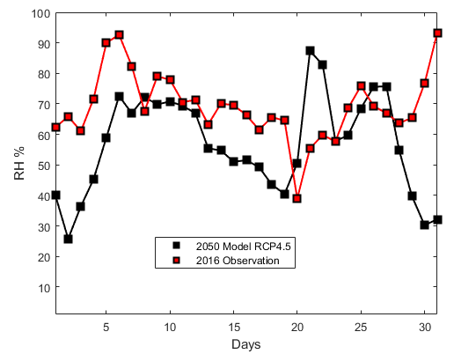
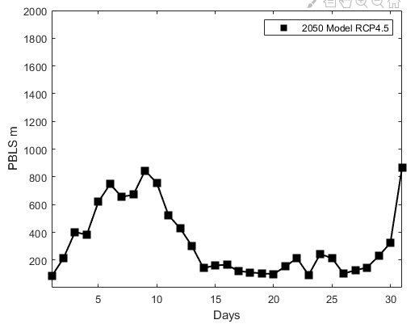
Reno, Nevada
Estimated PCAP
Notes:
Add a map from arcgis to highlight the state

Slide 22
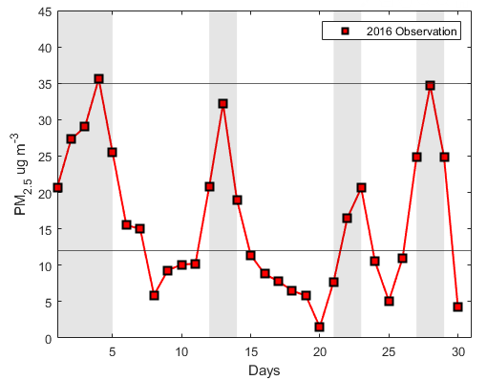
Salt Lake UT: 2016 Observations match with PCAP
Shaded areas are PCAP episodes

Slide 23
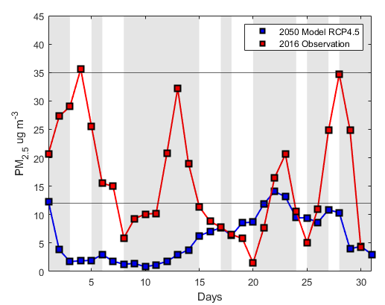
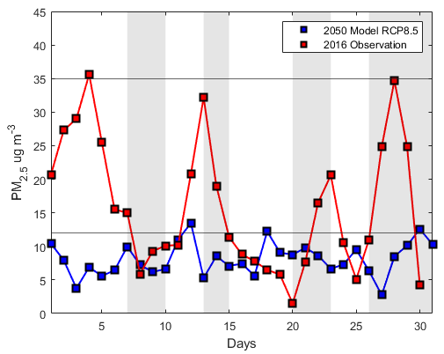
Salt Lake UT: RCP4.5 and RCP8.5 (VHD calc)
Shaded areas are PCAP episodes
Notes:
Modeled are typically lower than observations
This points to the variability in meteorology from global climate models
Reduced emissions in the future, likely reason for lower PM
Very hard to make predictions and capture
But meteorology predicts more PCAP episodes and longer durations

Slide 24
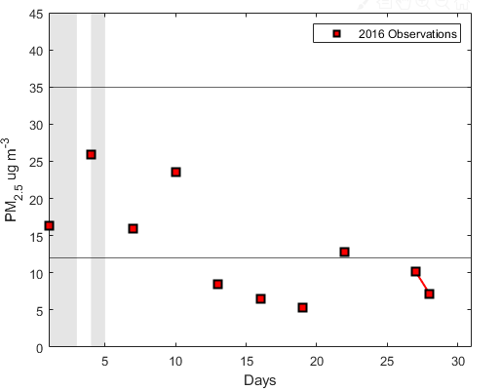
Denver CO: 2016 observations match with PCAP
Shaded areas are PCAP episodes
Notes:
This points to the variability in meteorology from global climate models
Reduced emissions in the future, likely reason for lower PM
But meteorology predicts more PCAP episodes and longer durations

Slide 25
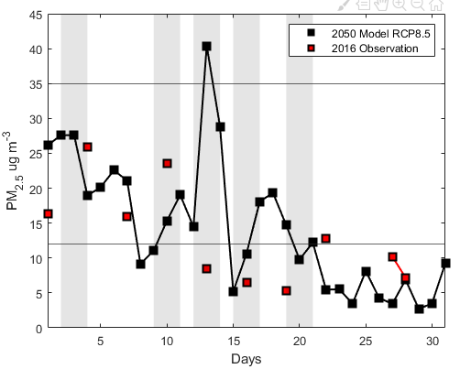
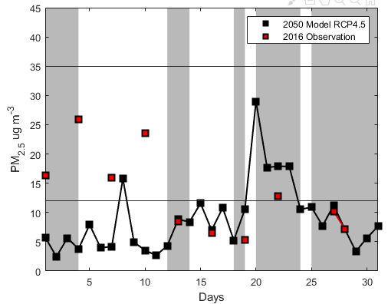
Denver CO: RCP4.5 and RCP8.5 (VHD calc)
Shaded areas are PCAP episodes

Slide 26
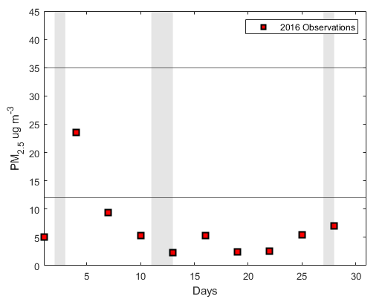
Reno NV: 2016 Observations match with PCAP
Shaded areas are PCAP episodes

Slide 27
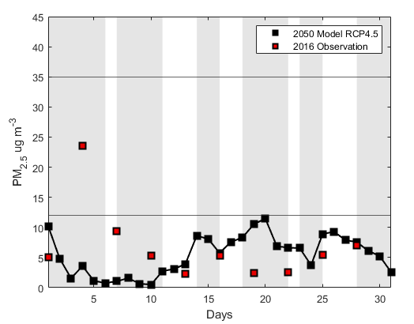
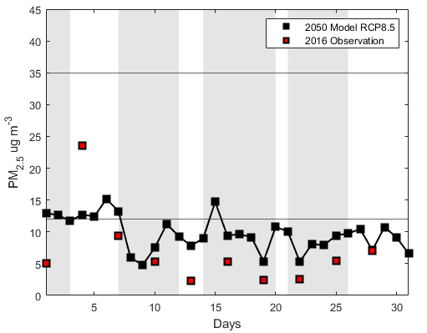
Reno NV: RCP4.5 and RCP8.5 (VHD calc)
Shaded areas are PCAP episodes

Slide 28
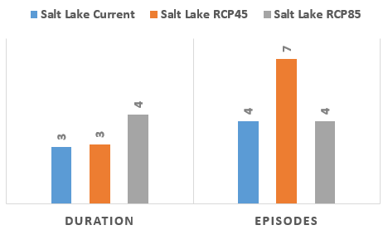
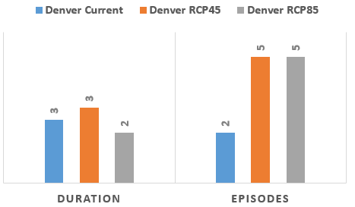
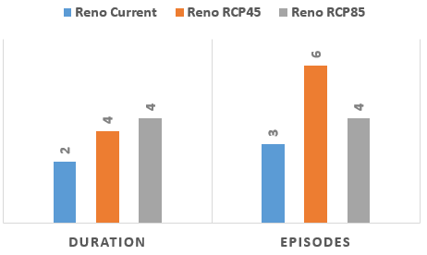
PCAP Overall Metrics

Slide 29
Effects analysis (Meteorology vs PM)
PM_{2.5}
PM_{2.5}
PM_{2.5}

Slide 30
Conclusions
Uncertainty in future emissions and meteorology makes it hard to predict potential PCAP events.
However, if meteorological variables (PBLH, RH) are important, then data from this preliminary investigations, means there are likely to be atmospheric conditions that favor PCAP events.
In the case of increased wild fires, this can have health implications.
Automation of formula for calculation of Valley Heat Deficit to identify PCAP events shows promise.
More work (through the NIH project), is ongoing to quantify areas of uncertainty in CMAQ
Aerosol chemistry (CMAQ)
Emissions modeling (DDM)

Slide 31
Acknowledgements: Collaborators
Research reported in this presentation was supported in whole by National Institute of Environmental Health Sciences of the National Institutes of Health under award number R01 ES032910-01. The content is solely the responsibility of the authors and does not necessarily represent the official views of the National Institutes of Health.

Slide 32
Thank you for listening

Slide 33
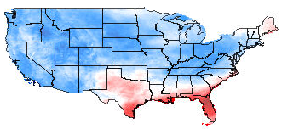
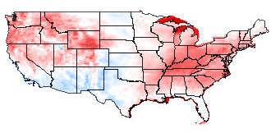
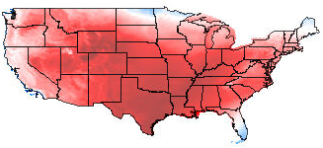
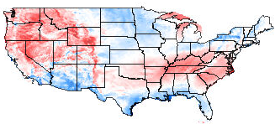
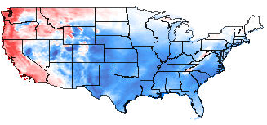
2050 WRF Differences: RCP45 – RCP85
SOLAR RAD w/m2
PBLH (m)
TEMP ºC
WSPD10 (m/S)
RH %
Notes:
Will add setup in a neat table

