Slide 1

Ozone Sensitivity Analysis to NOx and VOC Emissions and the Impact of International Anthropogenic Emissions in Maricopa County
Rene Nsanzineza
Arizona Department of Environmental Quality (ADEQ)

Slide 2
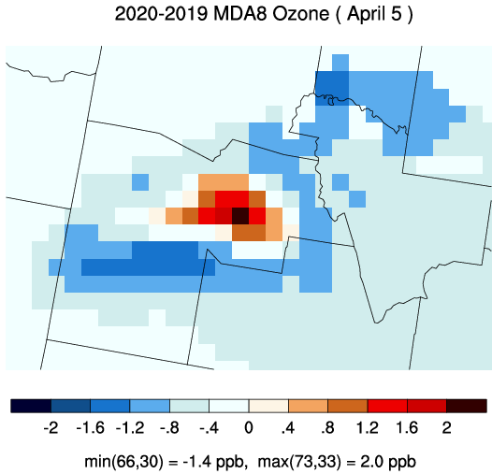
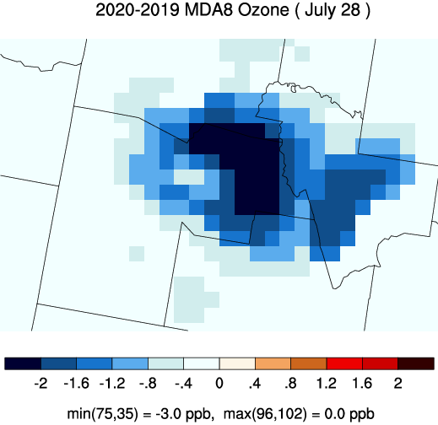
Background
Background
  ADEQ studied the impact of the emissions reductions from COVID-19 isolations on ozone in 2020
  The study found different ozone response to emissions reductions in Spring and Summer. Reducing NOx emissions led to ozone increase in the spring on some days and ozone decrease in the summer on all days.
Notes:
In 2020, we studied the impact of the stay at home order on ozone in the Maricopa County. The county makes up most of the Phoenix-Mesa NAA.
We used the 2016 NEI platform and projected the emissions from mobile sources from 2016 to 2019 and 2020. In addition, we assumed the emissions from other sources were constant from 2016 to 2020.
Therefore, the difference between the 2019 and 2020 model runs was attributed to COVID-19 impact.
We observed that ozone increases in the phoenix urban core area despite emissions decrease in the spring
Ozone decreases with emissions in all parts of phoenix in the summer

Slide 3
Problem Statement
Study Questions
  How does ozone in Maricopa County respond to changes in local NOx and VOC emissions?
  What is the influence of meteorology in this ozone-NOx-VOC dynamic?
  How much does international anthropogenic emissions contribute to ozone in the Maricopa County?
Objectives/Goals
  Validate the model with ozone ground observations
  Characterize ozone responses to local NOx & VOC changes, especially on exceedance days
  Estimate the contribution of international anthropogenic emissions
Notes:
A few questions emerged from the study highlighted in the previous slide.
Following that study, we wanted to understand clearly how ozone in Maricopa county responds to changes in local NOx and VOC emissions
We also wanted to assess how seasonal changes affect the dynamic of ozone-NOx_VOC
Finally, we needed to quantify how much international anthropogenic emissions affect ozone in Maricopa County
The objectives of this study was to try and answer these questions

Slide 4
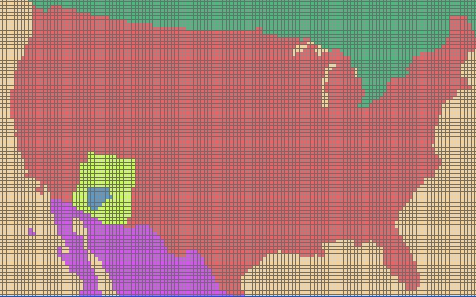
Study Approach
Run CAMx photochemical model with first-order Decoupled Direct Method (DDM) and High-order (HDDM) tools activated
Model output analysis
Run the model with (baseline) and without (scenario) anthropogenic emissions outside of the U.S. and then calculate the difference between the two model runs.
Notes:
We used CAMx model and its sensitivity analysis tools to carry out this study.
Decoupled Direct Method (DDM) and High order Decoupled Direct Method (HDDM) tools were used to calculate concentration sensitivity to changes in NOx and VOC emissions
HDDM was applied to emissions in Maricopa County (blue) while DDM was applied to the rest of Arizona (in yellow). No sensitivity calculation for the rest of the modeling domain
We separated sensitivity calculation of Biogenic and Anthropogenic emissions with Agricultural Fires emissions included in Anthropogenic Emissions

Slide 5
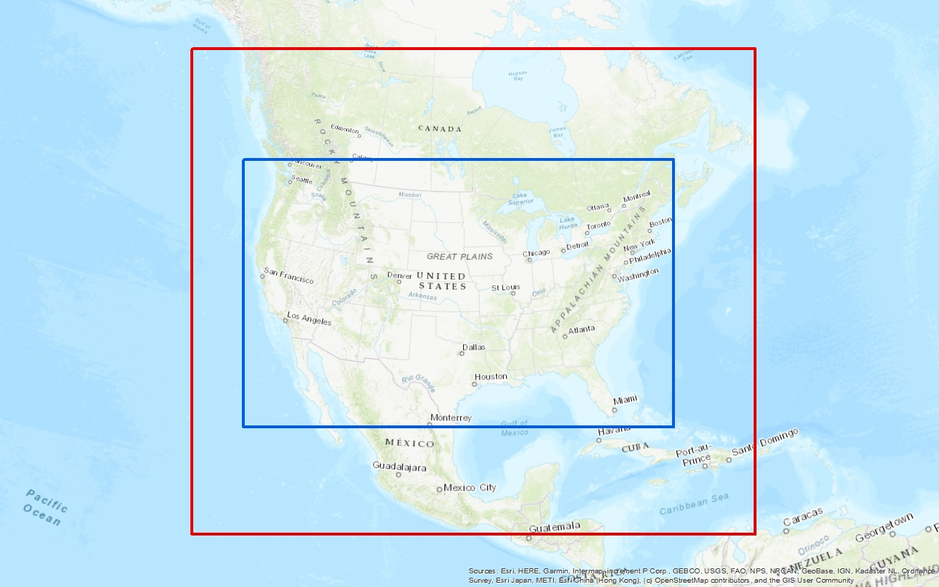
Model Set Up
  Platform version: 2016 EPA v1 model platform via Intermountain West Data Warehouse
  Domain: 36US3(36 km) and 12US2 (12 km)
  Initial/Boundary Conditions: extracted from the EPA’s 2016 run of hemispheric CMAQ run
  Meteorology: 2016 run of the Weather Research and Forecasting (WRFv3.8) model
  Run periods including 7-days spin up period
    April 13-25 (spin up period 13-19)
    May 16-31 (spin up period 16-22)
    June 18-30 (spin up period 18-23)
    July 13-31 (spin up period 13-19)
36US3
12US2
Notes:
In this study, we used the 2016 EPA version 1 modeling platform with 36 km and 12 km grid domains.
The IC/BC were extracted from the 2016 run of hemispheric CMAQ and the meteorology used were from a 2016 run of WRF model version 3.8
Since the sensitivity analysis tools significantly increase the model simulations time, we decided to model periods with observed ozone exceedance in April through July.
The modeled periods amounts to 6 days in April, 9 days in May, 7 days in June, and 12 days in July

Slide 6
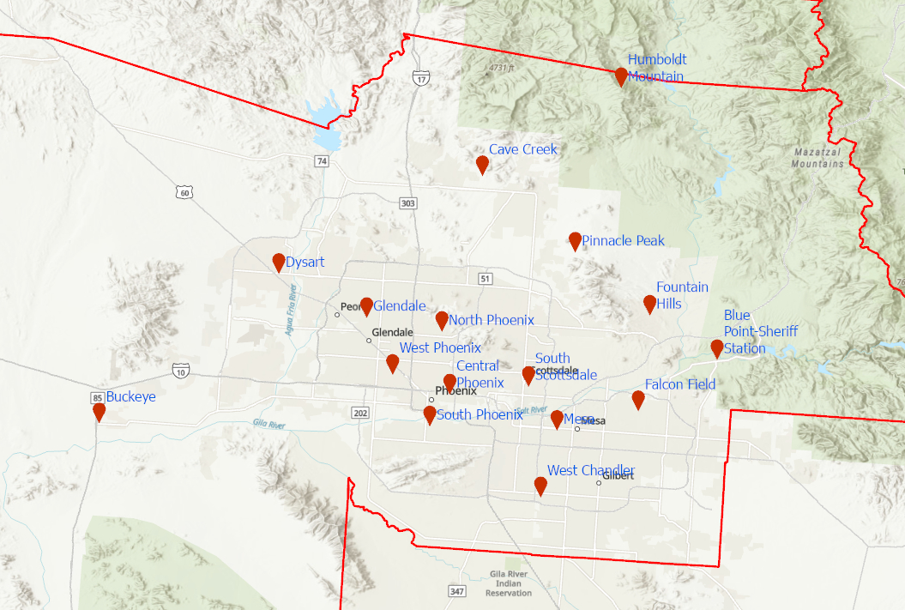
Maricopa County Air Monitoring Sites
North Phoenix monitoring site
2016
11 exceedance in 2016
Maximum Daily 8-hour Average
(MDA8) value of 78 ppb
4th MDA8 : 75 ppb
2020
15 exceedance
Maximum Daily 8-hour Average
(MDA8) value of 94 ppb
4th MDA8 : 87 ppb
Notes:
The modeled ozone was compared with monitored ozone throughout the Maricopa County.
As shown on the map, most monitors are located in the Phoenix urban core with a few monitors of on the east side of the city at the base of the mountains
In the next slide, we will summarize the model performance results at the north phoenix monitor, one of the Phoenix urban core monitors
This site is one of the regularly ozone NAAQS exceeding monitor with 11 exceedance in 2016 and 15 exceedance in 2020

Slide 7
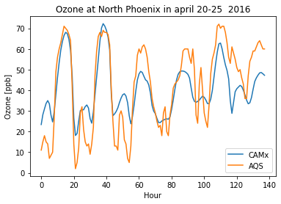
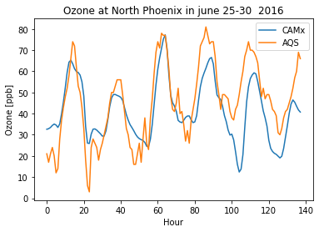
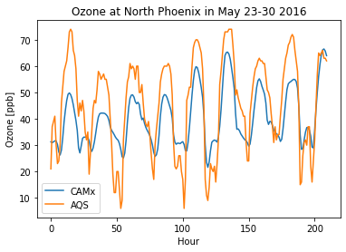
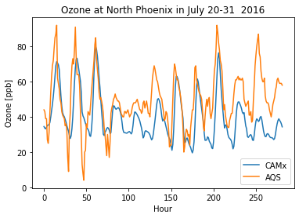
Model Performance Evaluation
All Sites in Maricopa County
Metric | NMB |  | NME
Goal | ≤±5% |  | ≤15%
Criteria | ≤±15% |  | ≤25%
Month | Hourly |  | MDA8
 | NMB | NME | NMB | NME
April 20-25 | 1.7 | 21.9 | -11.0 | 12.2
May 23-31 | -11.1 | 22.6 | -20.2 | 20.3
June 24-30 | -7.1 | 23.4 | -12.5 | 15.2
July 20-31 | -15.8 | 23.3 | -16.6 | 17.0
Performance goals and criteria based on previous photochemical model studies summarized in Emery et al. 2017
Notes:
Overall, CAMx well predicted monitored ozone trend and patterns
CAMx overpredicted observed hourly ozone minima below 20 ppb
CAMx underpredicted observed hourly ozone maxima above 60 ppb
The model performance meets the criteria NMB and NME outlined in Emery et al., except on three occasions
The model underestimates ozone in the summer as expected

Slide 8
Development of Ozone Isopleth
3 HDDM and 2 DDM Coefficients are produced
  C: Maximum Daily Average 8-hour ozone concentrations
  S_{V}: first-order sensitivity to anthropogenic VOCs emissions
  S_{N}: first-order sensitivity to anthropogenic NOx emissions
  S_{VN}: cross second-order sensitivity to anthropogenic NOx and VOCs emissions
  S_{VV}: second-order sensitivity to anthropogenic VOCs emissions
  S_{NN}: second-order sensitivity to anthropogenic NOx emissions
Focus only on emissions from Maricopa County
Notes:
We used second order Taylor series to estimate ozone concentration at various levels of NOx and VOC emissions changes
The first order term of the series is in the purple box while the second order term of the series is in the red box
We used python to visualize in a 2-dimension space the estimated ozone concentrations calculated using this Taylor series expansion

Slide 9
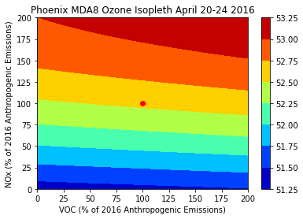
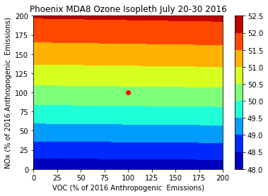
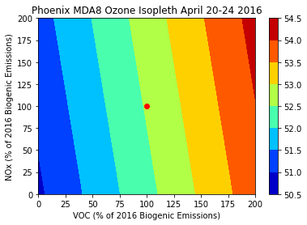
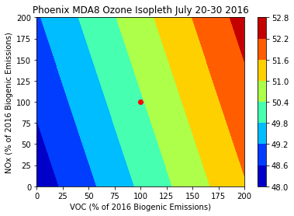
MDA8 Ozone Isopleth
Notes:
Top figures show ozone isopleth for anthropogenic emissions at all monitors in Maricopa County in April and July
Bottom figures show isopleth for biogenic emissions at all monitors in Maricopa County in April and July
Linear ozone response to anthropogenic NOx emissions changes in the Spring and Summer
Minimal ozone response to anthropogenic VOC emissions changes in the Spring and no ozone response in the Summer
Linear ozone response to biogenic VOC emissions changes in the Spring and Summer
Minimal ozone response to biogenic NOx emissions changes in the Spring and Summer

Slide 10
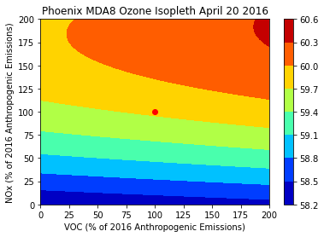
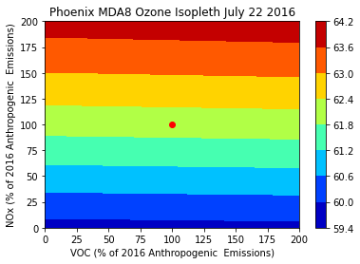
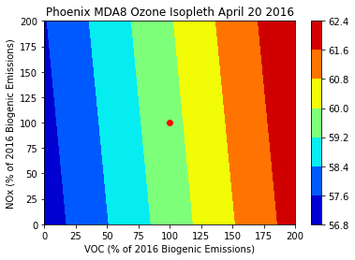
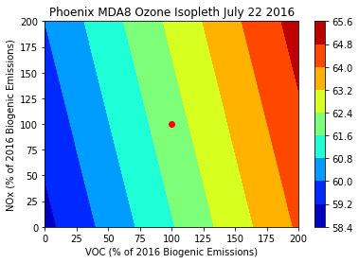
MDA8 Ozone Isopleth(Exceedance Days)
Notes:
Top figures show ozone isopleth for anthropogenic emissions at all monitors in Maricopa County on exceedance days
Bottom figures show isopleth for biogenic emissions at all monitors in Maricopa County on exceedance days
Non-linear ozone response to anthropogenic NOx emissions changes in the Spring and linear ozone response in the Summer

Slide 11
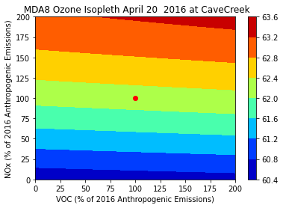
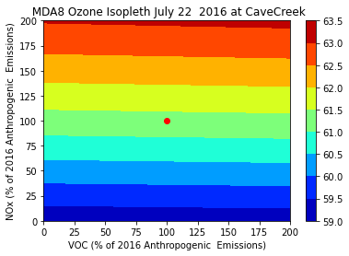
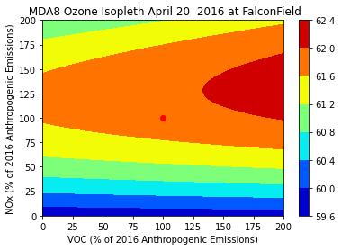

MDA8 Ozone Isopleth(Exceedance Days)
Notes:
Top figures show ozone isopleth for anthropogenic emissions at cave creek monitor on exceedance days. This monitor is located North of Phoenix urban core
Bottom figures show isopleth for anthropogenic emissions at falcon field monitor on exceedance days. This monitor is located just East of Phoenix urban core
The difference in ozone response to NOx and VOC changes in the spring at these two monitors highlights a common pattern observed at other monitors across the Phoenix valley
For a given emissions changes, the ozone response varies from one monitor to another.

Slide 12
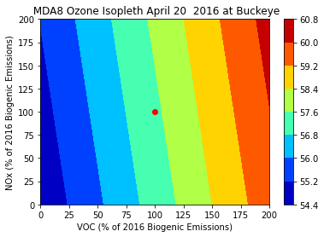
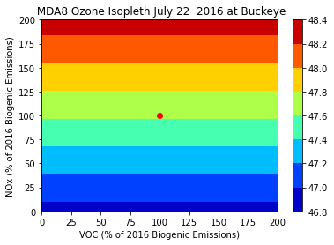
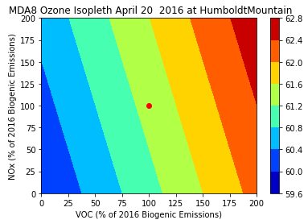
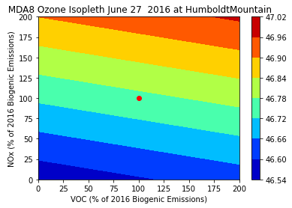
MDA8 Ozone Isopleth(Exceedance Days)
Shift from minimal ozone response to biogenic NOx emissions changes in the Spring and to strong ozone response in the Summer at some monitors
Notes:
Top figures show ozone isopleth for biogenic emissions at Buckeye monitor on exceedance days. This monitor is located West of Phoenix urban core
Bottom figures show isopleth for biogenic emissions at Humboldt mountain monitor on exceedance days. This monitor is located North of Phoenix urban core
Unexpected shift in ozone response to biogenic VOC emissions changes from a strong linear response in the Spring to minimal /no response in the summer
More investigation is needed to figure out what prompted this behavior at these two monitors.

Slide 13
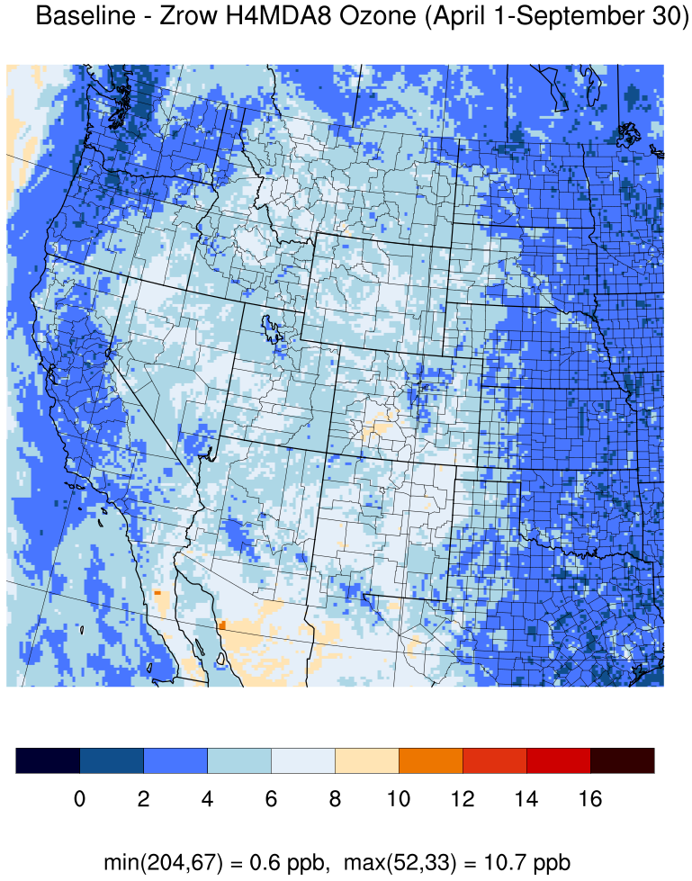
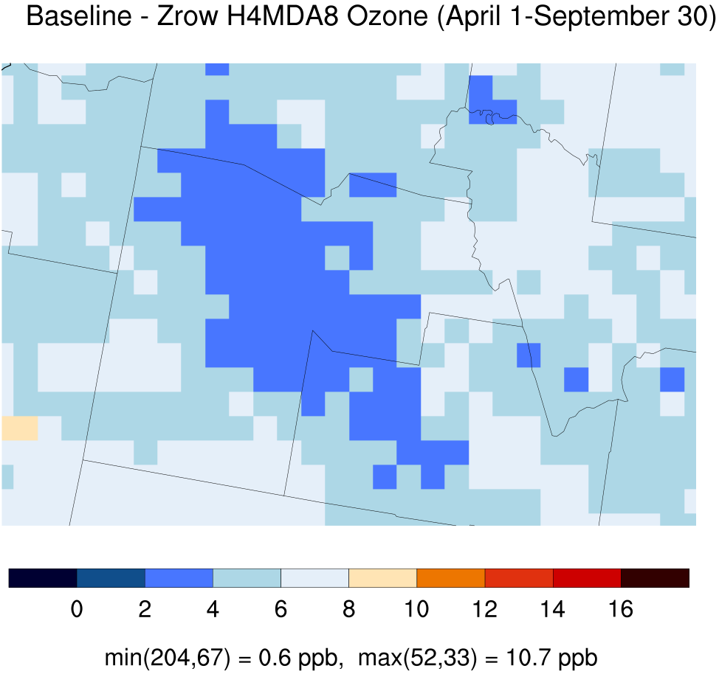
International ozone transport to Maricopa County
Notes:
For the international ozone contribution, we run the model twice with and without international anthropogenic emissions using the 2017 EPA model platform. Then we analyzed the difference between the two model runs
The international ozone contribution in the Maricopa County ranges between 2 ppb and 6 ppb for the 4th MDA8 ozone
The average and median contributions from international anthropogenic emissions to ozone DV at monitors in Maricopa County is 4.0 and 3.9 parts per billion (ppb), respectively.
The highest contribution occurred at Humboldt Mountain and Tonto National Monument (5.3 ppb) on the north and east side of the valley and the lowest contribution occurs at Buckeye (3.2 ppb) on the west side of the Phoenix valley.

Slide 14
Phoenix-Mesa Ozone Nonattainment Area DV
International O3 Transport to Phoenix - Mesa NAA Ozone Design Values
County |  | 2017 DV Data
 | Name | Baseline | Without International Anthro. Emissions | Difference
Maricopa | West Phoenix | 73.7 | 69.8 | 3.9
 | Mesa | 76.3 | 72.4 | 3.9
 | North Phoenix | 75.3 | 71.4 | 3.9
 | Falcon Field | 75.0 | 71.1 | 3.9
 | Glendale | 68.0 | 64.7 | 3.3
 | Pinnacle Peak | 76.7 | 72.2 | 4.5
 | Central Phoenix | 71.0 | 67.6 | 3.4
 | South Scottsdale | 69.3 | 65.7 | 3.6
 | South Phoenix | 70.7 | 66.7 | 4.0
 | West Chandler | 71.0 | 67.0 | 4.0
 | Cave Creek | 71.0 | 66.7 | 4.3
 | Dysart | 71.0 | 67.7 | 3.3
 | Buckeye | 65.3 | 62.1 | 3.2
 | St Johns | 66.0 | 62.7 | 3.3
 | Station Center | 72.3 | 68.6 | 3.7
 | Red Mountain | 75.7 | 71.8 | 3.9
 | Lehi | 73.7 | 69.9 | 3.8
 | High School | 72.7 | 68.9 | 3.8
 | Humboldt Mountain | 73.0 | 67.7 | 5.3
 | Blue Point-Sheriff Station | 73.7 | 69.5 | 4.2
 | Fountain Hills | 71.3 | 67.3 | 4.0
 | Rio Verde | 68.0 | 63.9 | 4.1
 | JLG Supersite | 74.3 | 70.7 | 3.6
Gila | Tonto NM | 74.0 | 68.7 | 5.3
Pinal | AJ Maintenance Yard | 74 | 69.6 | 4.4
 | Casa Grande Airport | 66.3 | 62 | 4.3
 | Sacaton | 65.7 | 61.4 | 4.3
 | Queen Valley | 73.7 | 68.8 | 4.9
Average | All monitoring sites | 71.7 | 67.7 | 4.0
Median | All monitoring sites | 72.5 | 68.2 | 3.9
Notes:
As you can see in this table, the results show that without contributions from international anthropogenic emissions,
all 2017 ozone DV at monitors in the Phoenix-Mesa NAA would have attained the 2015 ozone NAAQS except for the monitors at Mesa, North Phoenix, Falcon Field, Pinnacle Peak, and Red Mountain.

Slide 15
Summary
Overall, CAMx prediction of monitored ozone was acceptable and within the performance range of other modeling studies. However, CAMx greatly overestimated observed ozone below 20 ppb
Ozone in Maricopa County strongly responds to anthropogenic NOx emissions and biogenic VOC emissions from the Maricopa County.
Shift from non-linear ozone response to anthropogenic NOx emissions in the spring to linear ozone response in the summer at some monitors
Unexpected shift from minimal ozone response to biogenic NOx emissions in the spring to strong response in the summer at some monitors
The international anthropogenic emissions contribution to ozone design values in Maricopa County ranges between 3 ppb and 5 ppb
Notes:
As a quick summary, in this study we found that
CAMx overestimate measured ozone below 20 ppb, but the model performance is comparable to other previous modeling studies
Maricopa County ozone strongly responds to changes in local anthropogenic NOx and biogenic VOC emissions
This ozone response shift from non-linear in the spring to linear in the summer
Finally, we estimated the contribution of the international anthropogenic emissions to ozone design value in Maricopa County ranges from 3 to 5 ppb.

