Slide 1
Community Multiscale Air Quality (CMAQ) Modeling and Analysis on the Cloud
Elizabeth Adams¹, Christos Efstathiou¹, Carlie Coats¹, Robert Zelt²,
Mark Reed², John McGee², Saravanan Arunachalam¹
¹Institute for the Environment, The University of North Carolina at Chapel Hill, NC, USA
²Information Technology Services, The University of North Carolina at Chapel Hill, NC, USA
Presented at
The 21st Annual CMAS Conference, Oct.19, Chapel Hill, NC

Slide 2
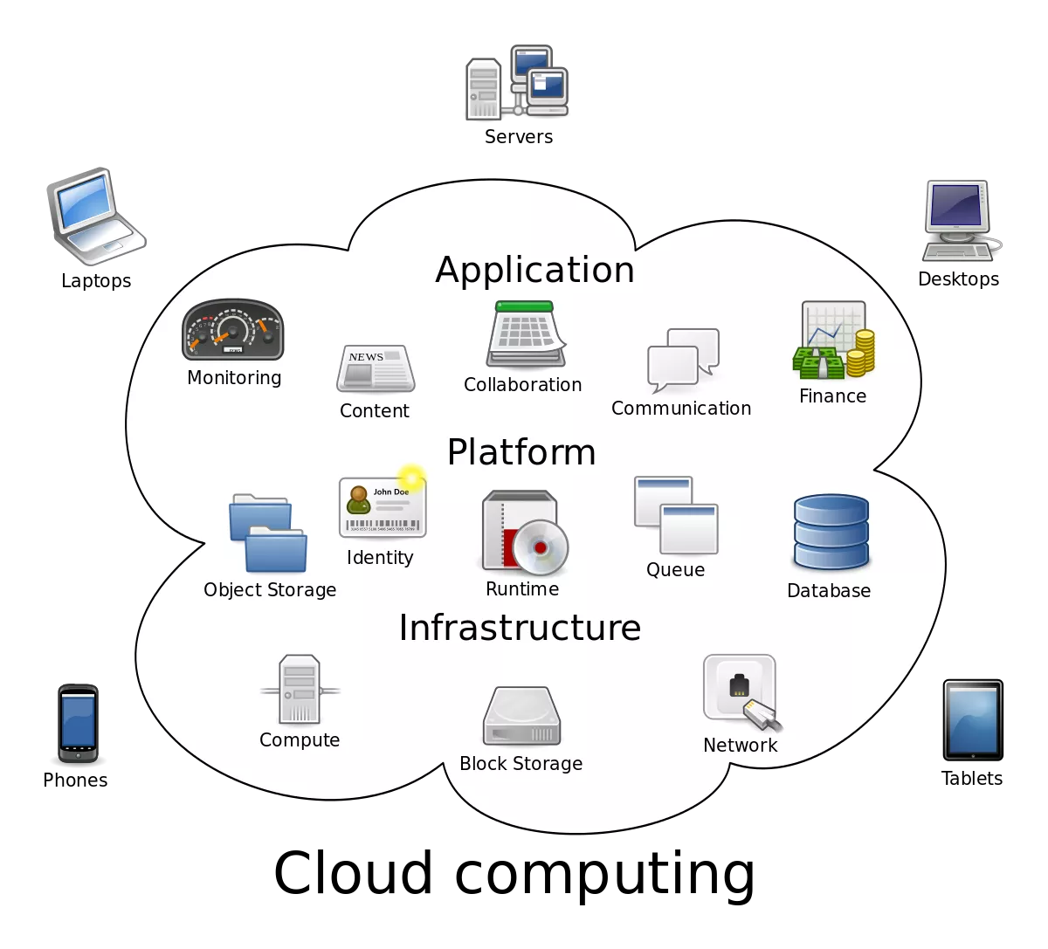
Introduction
Background:
Numerical Weather Prediction models such as the Weather Research and Forecasting have been made available for select Cloud Service Providers (CSPs)
CSPs continue to enhance the services and infrastructure allowing for new, faster systems and technologies that reach end-users faster
The CMAQ modeling community can benefit from enabling cloud resources
Potential to enhance the traditional modeling dialectic, not just code speedup
Source: Lifewire / Sam Johnson
Objectives:
Enable high-performance cloud computing for current and future CMAQ releases
  Provide with guidance for setting up, evaluating, and optimizing the model performance in different cloud service providers (CSPs)
  Establish a Benchmark/QA Suite and “target user groups” to take advantage of different CSP offerings, while showing ways of controlling the costs
Notes:
Wallgardening.

Slide 3
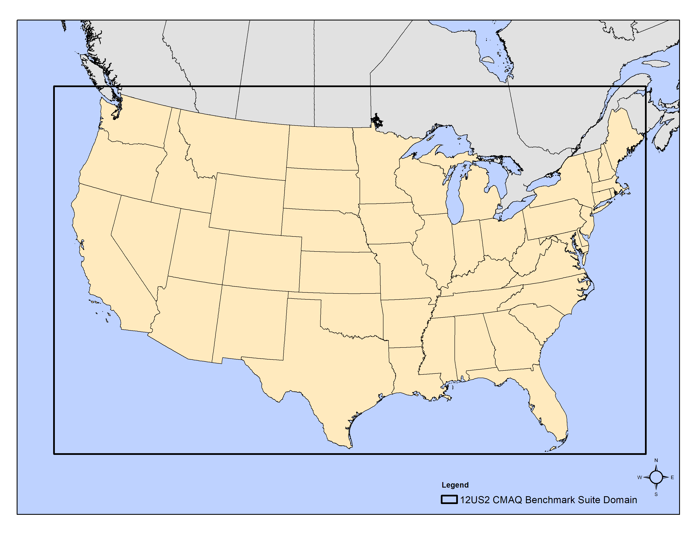
The CMAQ Benchmark Suite for the Cloud
2-day 12x12 km CONUS scenario (396 x 246 x 35)
Using CMAQ 5.3.3 with cb6r3_ae7_aq
Inputs ~50 GB, Output ~170 GB
Following the EQUATES paradigm
EQUATES: EPA’s Air QUAlity TimE Series Project
https://www.epa.gov/cmaq/equates
CMAS Data Warehouse on AWS Open Data:
Collects and disseminates meteorology, emissions and air quality model input and output for Community Multiscale Air Quality (CMAQ) Model Applications.
Ingress and Egress fees are waived as part of the AWS Open Data Program.
https://registry.opendata.aws/cmas-data-warehouse/

Slide 4
Target HPC hardware
 | Azure | AWS
CPU(s) | 120 | 96
Thread(s) per core | 1 | 1
Core(s) per socket | 60 | 48
Socket(s) | 2 | 2
NUMA node(s) | 4 | 4
Model name | 7V73X 64-Core Processor | 7R13 Processor
Stepping | 2 | 1
CPU MHz | 1846.549 | 2649.986
BogoMIPS | 3693.09 | 5299.97
L1d cache | 32K | 3 MiB
L1i cache | 32K | 3 MiB
L2 cache | 512K | 48 MiB
L3 cache | 98304K | 384 MiB
AMD EPYC 3rd Gen “Milan” systems
Implementations can differ between CSPs
HB120v3 (Azure): 200 Gb/sec HDR InfiniBand from NVIDIA Networking to enable supercomputer-scale MPI workloads
hpc6a.48xlarge (AWS): Elastic Fabric Adapter enabled by default for 100 Gbps networking for inter-instance communications
Pinning, the binding of a process or thread to a specific core, can improve the performance of CMAQ code by increasing the percentage of local memory accesses
System of choice after testing other processors (i.e. Intel Xeon)
Storage:
Local ephemeral storage: free fast NVMe SSDs of fixed space ~ 1.8T in Azure
Cost-effective shared filesystems: NFS mount points in Azure – EFA mount points in AWS
Advanced shared filesystems: Lustre implementations in Azure & AWS (also Azure Netapp Files - ANF)

Slide 5
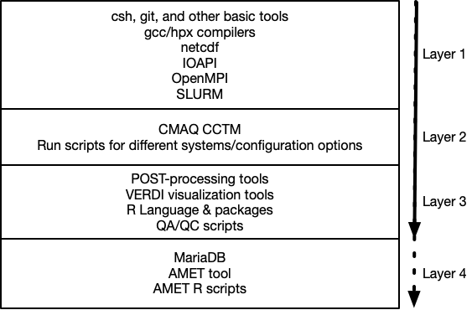
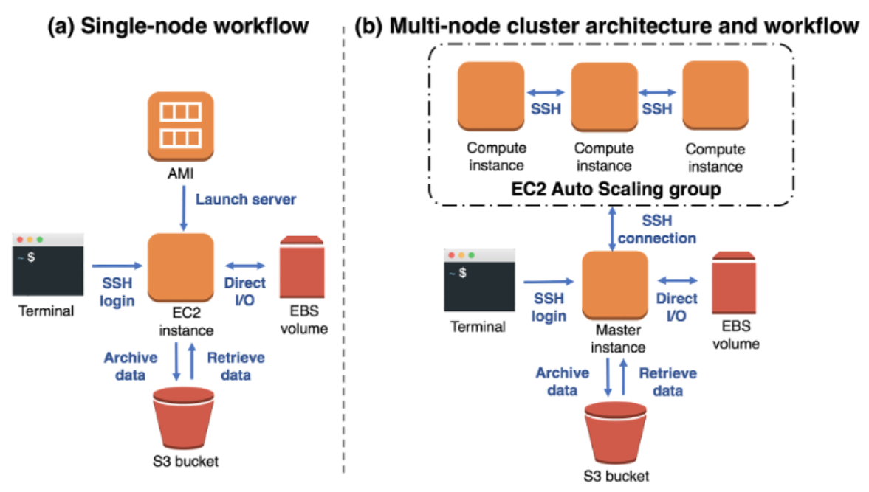
Target HPC workflows with software recipes
Compiled intermediate and advanced tutorials to guide installing layers of software for different workflows
Compiled branches of installation recipes using different storage options (i.e. local, lustre, ANF)
Compiled tutorials on installing post-processing tools and R-based analysis
Future Layer: AMET tool
Source: Powers, J. G., Werner, K. K., Gill, D. O., Lin, Y.-L. & Schumacher, R. S. Cloud Computing Efforts for the Weather Research and Forecasting Model. B Am Meteorol Soc 102, E1261–E1274 (2021).

Slide 6
Single-node scaling results on Azure
Key points:
NVME is ephemeral but faster, comes at no additional cost
Cost of the VM 3.6$/hr projected to $769 for an annual simulation
Fastest time with 117 cores, completed in 8.9 days
Premium SSD NFS mount is performing well in this setup

Slide 7
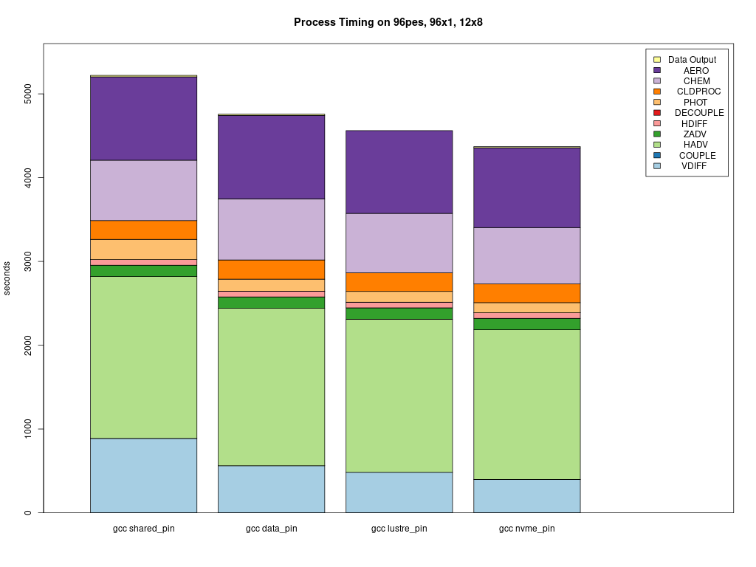
Performance using different storage on Azure
NFS
ANF
Lustre
NVMe
Notes:
Speed depends on size for shared filesystems. VDIFF

Slide 8
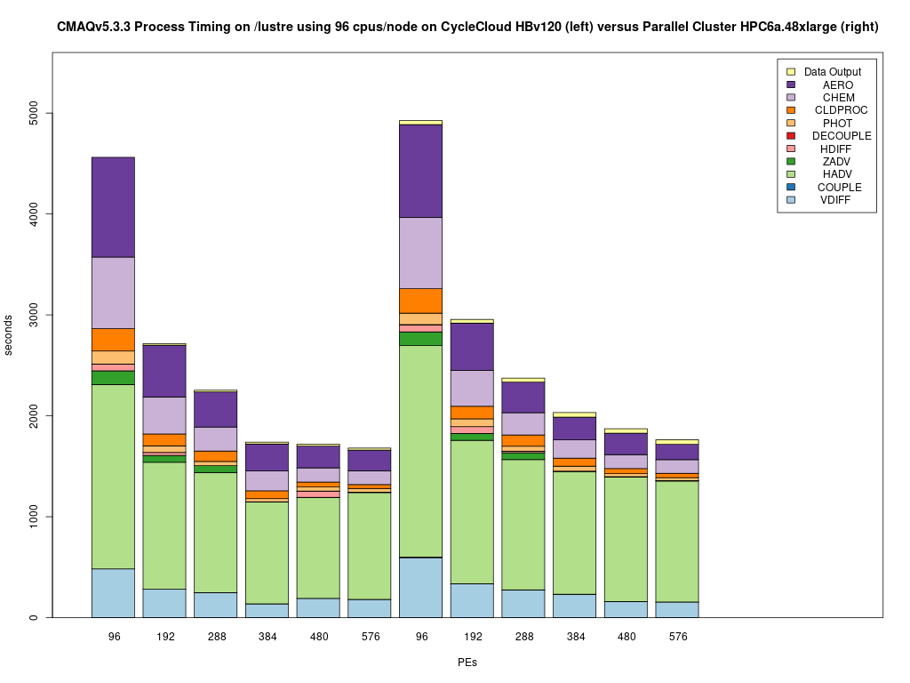
HPC cluster scaling comparison
Key points:
Tested 1 - 6 nodes = 96-576 cores
Azure results shown with pinning enabled
AWS results are not optimized with respect to pinning (also less L3 memory)
Both systems scale well on lustre, better than slower filesystems
Differences scaling may be due to effect of pinning and/or CPU version
Azure
AWS

Slide 9
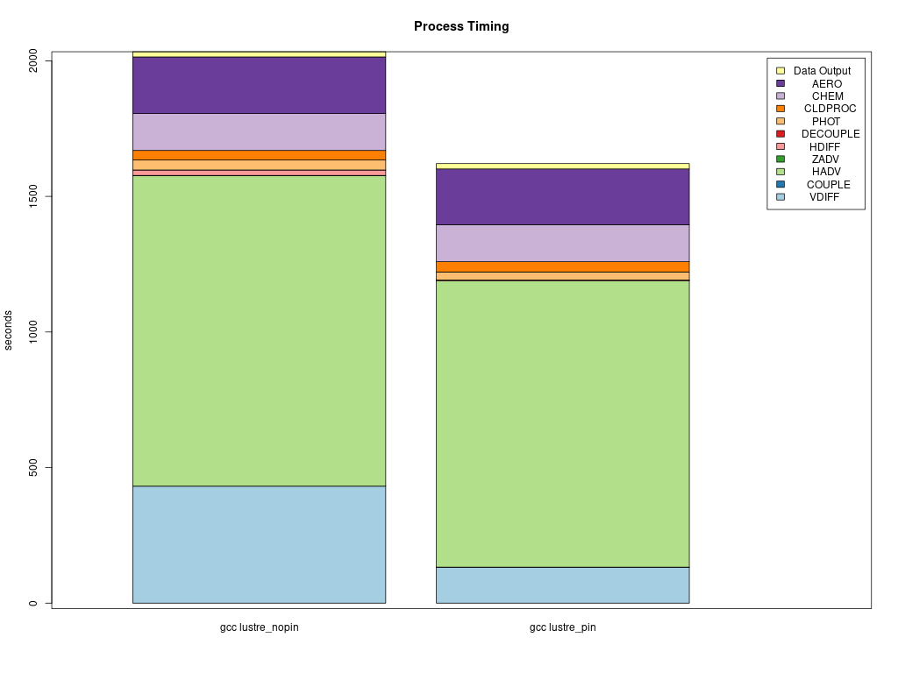
Effect of pinning on Azure with 576 cores
HDiff
VDiff

Slide 10
Spreading across more nodes in Azure Lustre
Key points:
2-day Benchmark Suite showed similar scaling on a fast parallel filesystem with 96 and 64 cores
96-core pinning was slightly faster up to 4 nodes
After that, 64 cores/node show better performance
At 6 nodes, 64 core/node performs faster
CMAQ Domain decomposition works in favor of 64 cores (8x8) and there is still overhead for other simulations to be run on the parallel

Slide 11
Cost related considerations
HPC clusters on the cloud require additional resources that come with additional cost
  CSPs have limits set up by default to avoid various issues
  Users can setup warnings in their accounts to be in control
  Users can profile the costs of a cluster in a test-phase to help project the long-term costs
Compute VM fees charged only on demand
Parallel filesystems can be configured to provision at the SLURM level on demand, keeping the storage cost low (lustre/BeeOND)
Long-term storage strategy is necessary
Compute Node | Cores | Nodes | Annual Cost | Days to Complete Annual
Hpc6a.48xlarge (AWS) | 96 | 1 | $734 | 10.6
Hpc6a.48xlarge (AWS) | 192 | 2 | $883 | 6.37
HBv3-120 (AWS) | 96 | 1 | $952.9 | 11.03
HBv3-120 (AWS) | 192 | 2 | $1033.3 | 4.87
Compute VM cost of Annual CONUS (extrapolated from 2-day run)
Isolating the compute VM costs, system cost/performance is similar
Single VM can be a cost-effective solution for some users/domains
*Storage costs not included

Slide 12
Tutorials for different CSPs and end-users
Online guides, tutorials, background info, solutions, performance and cost analysis, etc:
Microsoft’s Azure:
https://cyclecloud-cmaq.readthedocs.io/en/latest/
Amazon’s AWS:
https://pcluster-cmaq.readthedocs.io/en/latest/index.html
Target end-users (not mutually exclusive):
Novice users, early-stage model testing, data analysis/QA tasks, episode research, developers
Advanced users, that need to fully harness the HPC potential of CMAQ through annual/high resolution simulations, operational use
Join our Cloud Computing Workgroup:
  https://github.com/CMASCenter/modeling-in-the-cloud/wiki/Modeling-in-the-Cloud-Workgroup-Charter
More to come – answer our poll:
https://forms.gle/gbWqHWAeNoFUeYuK6

Slide 13
Summary
Users have several options to choose from depending on their needs and choice of CSP
Single VM can be viewed as an early-stage testing setup, research and visualization platform with overhead for even more demanding domains
HPC Clusters are faster and more costly – larger, finer resolution domains and more intensive operational deployments can benefit
System specific optimization like pinning is essential to get the best performance
It is not just about #cores: spreading jobs across more node can result in better scaling in advanced filesystems such as Lustre
Code modifications to address latency related crashes on slow filesystems
Significant knowledge gained in being able to run CMAQ on the cloud on popular cloud-based HPC systems that will benefit CMAS community
Next Steps
  Update tutorials for CMAQ 5.4
  Package images that include the model, QA, and R analysis and visualization tools
  Parallel I/O API implementation (and possibly builds with different netcdf formats)
  Better performance metrics (Grafana – CMAQ runscript analysis – file system tuning)
  Other parallel file systems developed for HPC (BeeGFS)
  Test scaling with more computationally demanding domains (i.e. 4x4 km)

Slide 14
Acknowledgments
The U.S. EPA, through its Office of Research and Development, partially funded and collaborated in the research described here under Contract EP-W-16-014 to the Institute for the Environment at the University of North Carolina at Chapel Hill.
We thank the Microsoft team for their help with running and optimizing in their systems:
  Steve Roach
  Rafa Salas
  Roy Varghese
  Brian Lepore (Lustre service preview)
We thank the following AWS team for their help with running and optimizing in their systems:
  Timothy Brown
  Tommy Johnston
We thank the following staff at the EPA for several inspiring and helpful discussions and contributions to this work
  Kristen Foley
  Chris Misenis
  David Wong
  Ed Anderson
  Tom Pierce - retired
We thank the leaders of the Modeling in the Cloud Computing Workgroup
  - Zac Adelman (LADCO)
  - Steve Fine (EPA) - retired
  - Fahim Sidi (EPA) - new lead

