Slide 1
GPU Accelerated CMAQ Simulation
Khanh Do, George Delic, Bryan Wong, Cesunica Ivey
2022 CMAS Conference

Slide 2
Motivation
Traditional CMAQ
CPU Intensive processes and long simulation time
Require lots of computing power
8 to 32 threads per each run
Graphics processing unit (GPU)
More than 10,000 CUDA cores (NVIDIA RTX 3090)
Compute Unified Device Architecture (CUDA) released in 2007
World’s first solution for general computing on GPUs (GPGPU)
GPU is used to accelerate the Community Multiscale Air Quality (CMAQ) model
Parallelize and vectorize independent loops
Target numerically intensive routines (horizontal advection, gas chem)
Increase efficiency and reduce simulation time
Background/Objective
Timing
Method
hrsolver
Gear Solver
CMAQ Performance
Future Work

Slide 3
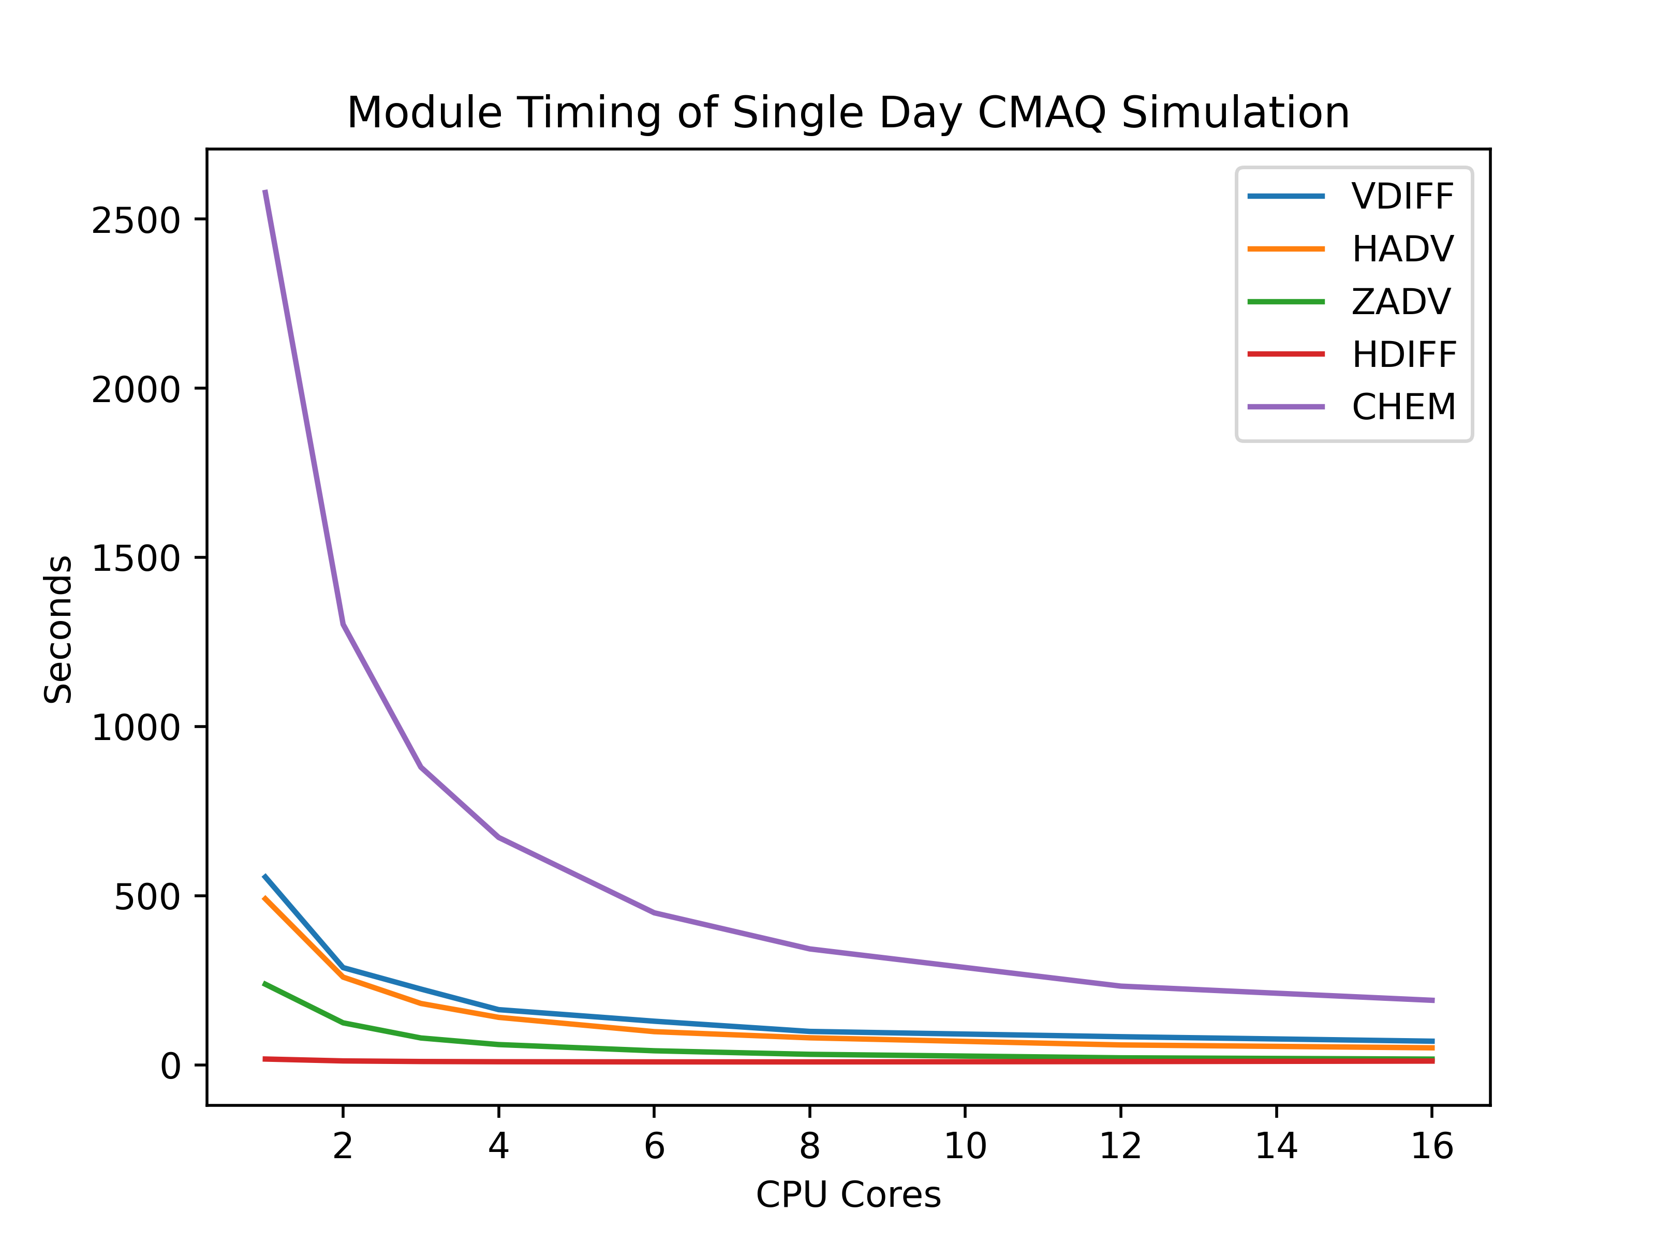
The Slowest Science Module in CMAQ
CMAQ configurations
Parallelization with OpenMPI
SAPRC-07 mechanism
4x4 km resolution
11 vertical layers
156x102 grids
Southern California
Computer configurations
Ryzen R9 5950x with 16 cores
16 GB of memory DDR4
Figure 1: CMAQ Module Timing for one day simulation period.
Expectation: Double CPU cores, computational time decreases by half.
$$t=\frac{1}{n}$$
Figure 2: Timing for one iteration step.
Background/Objective
Timing
Method
hrsolver
Gear Solver
CMAQ Performance
Future Work

Slide 4
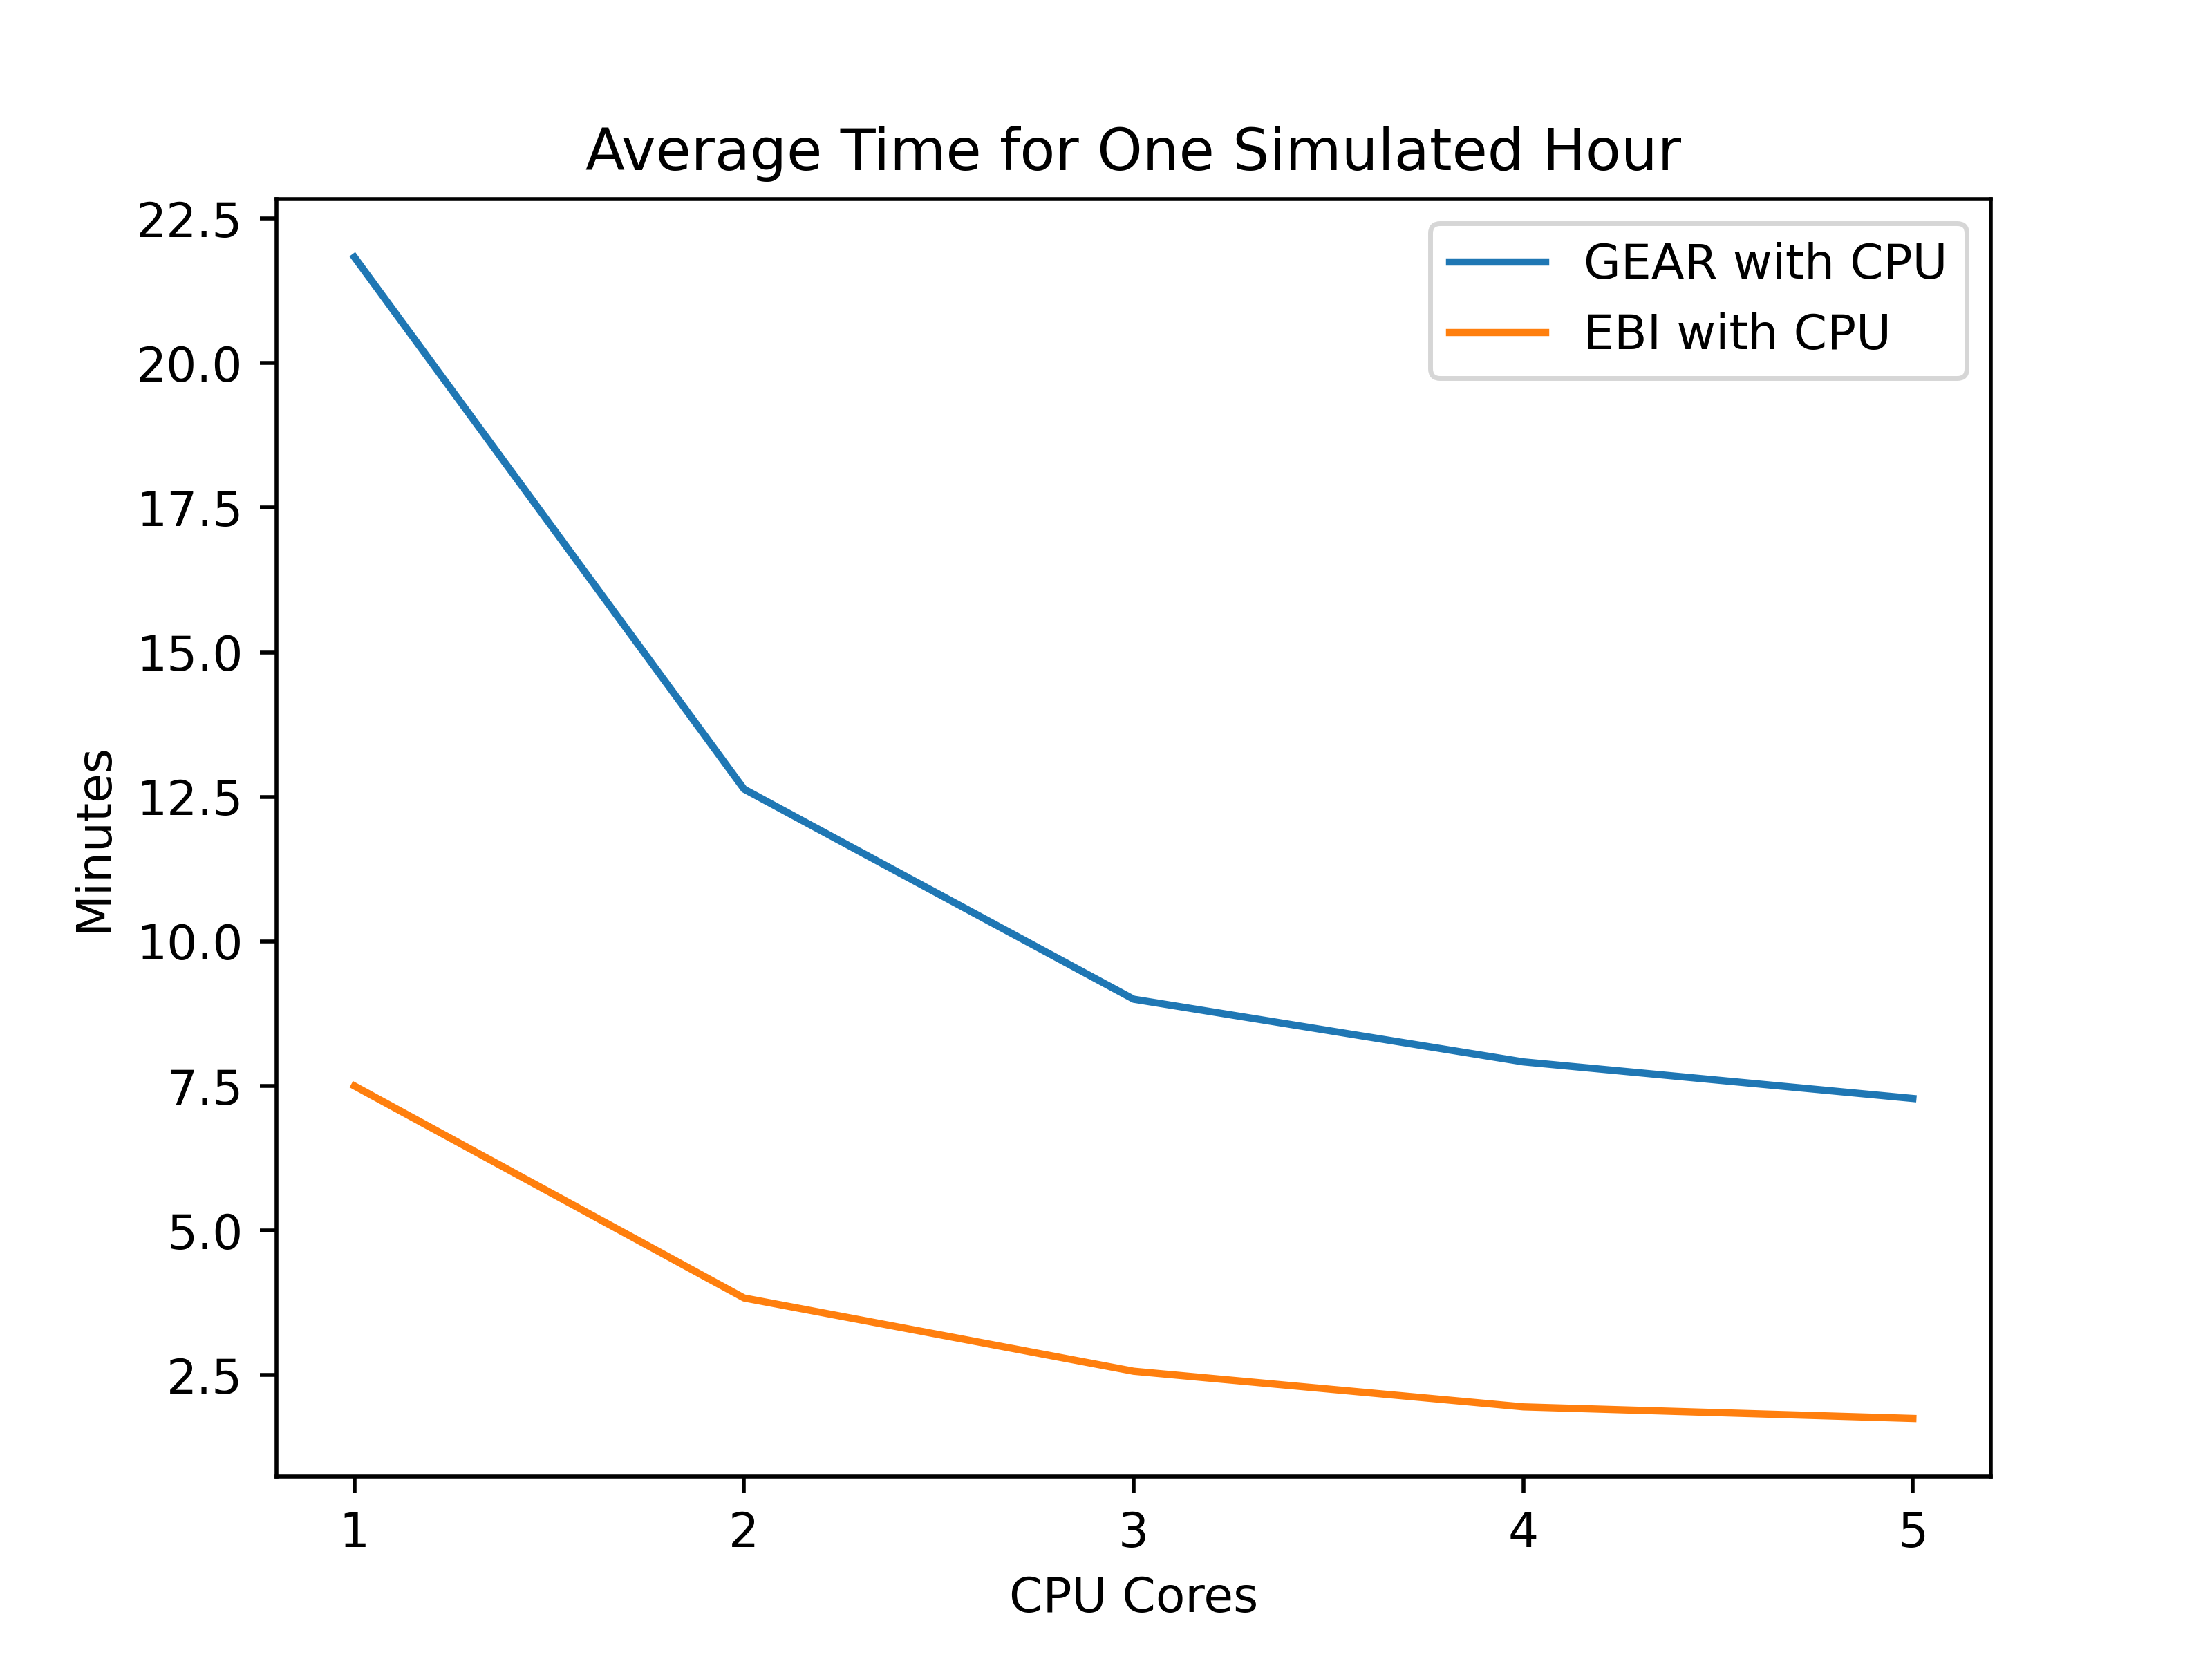
CMAQ CHEM Solver
EBI (1993)
EBI is the fastest but less accurate, convergence errors (stiff ODEs)
Rosenbrock (1997)
SMVgear (1994)
Gear solver used to obtain accurate solutions to stiff ODE problems
Highly vectorized and incorporated with sparse matrix to improve computational performance
Slowest solver due to computing partial derivative, matrix decomposition, and backsub
CMAQ spends about 20% on EBI, 30% on Rosenbrock, and 50% on smvgear solver (George Delic)
Figure 3: Time for one hour simulation with EBI and GEAR solver.
Background/Objective
Timing
Method
hrsolver
Gear Solver
CMAQ Performance
Future Work

Slide 5
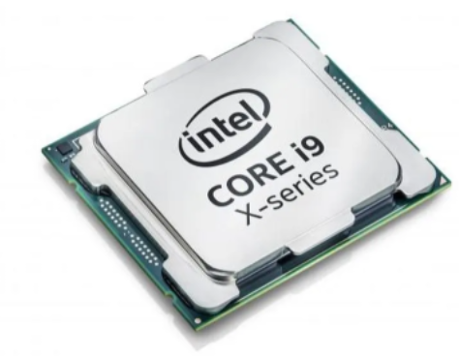
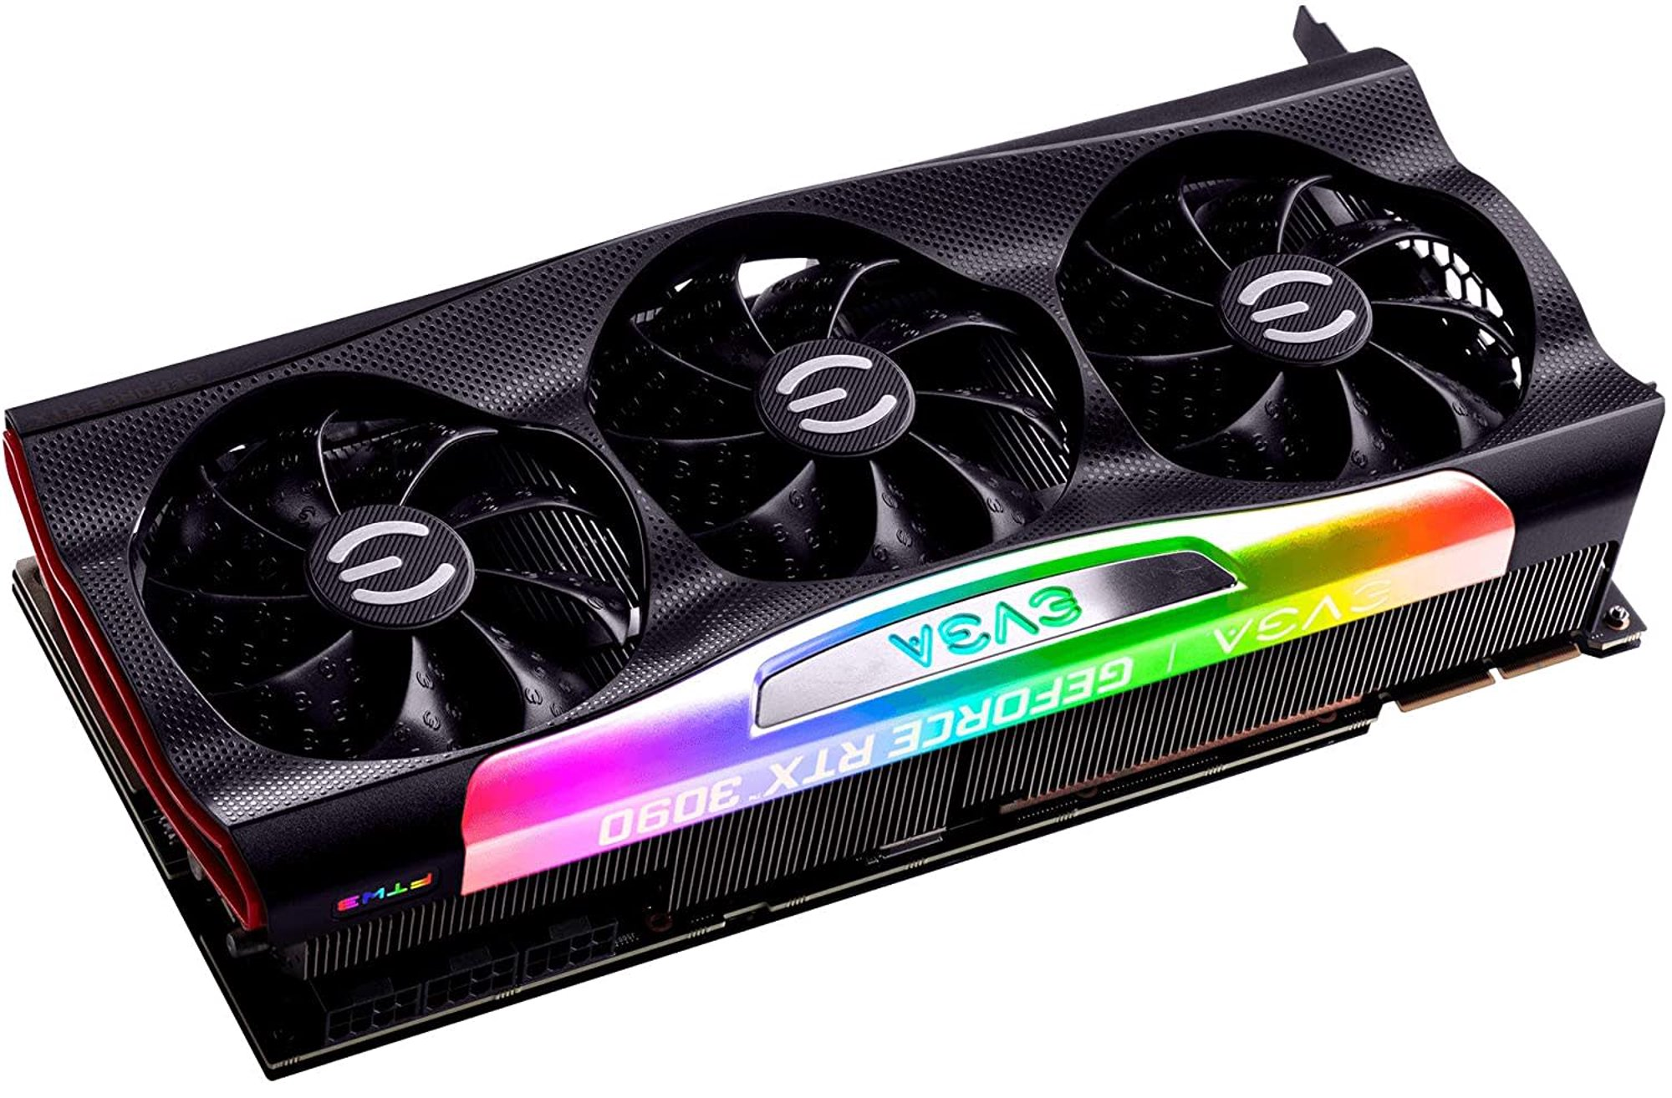
Why GPU?
Central processing unit (CPU)
Very fast, smart, and low latency
Handle complex program
Have very few cores and limitations in parallelization
Graphics processing unit (GPU)
Thousands of cores
Made up of many smaller and more specialized cores
Speed up the massive workload by divided into many processes
Traditionally known for rendering which GPU drawing millions of polygons each second (output billion pixels per second)
Handle independent repetitive tasks
Intel Core i9 CPU
NVIDIA RTX 3090
Background/Objective
Timing
Method
hrsolver
Gear Solver
CMAQ Performance
Future Work

Slide 6
Methods
Determine the CMAQ slowest process
CHEM solver, advection, diffusion process
Create GPU-friendly data structure and algorithms (matrix operations)
Scalable
EBI, ROS, and GEAR solver
Design compilation compatibility with the CUDA platform
Perform code independent analysis
Parallelizing can intentionally alter the results
Only work with independent loops
Background/Objective
Timing
Method
hrsolver
Gear Solver
CMAQ Performance
Future Work

Slide 7
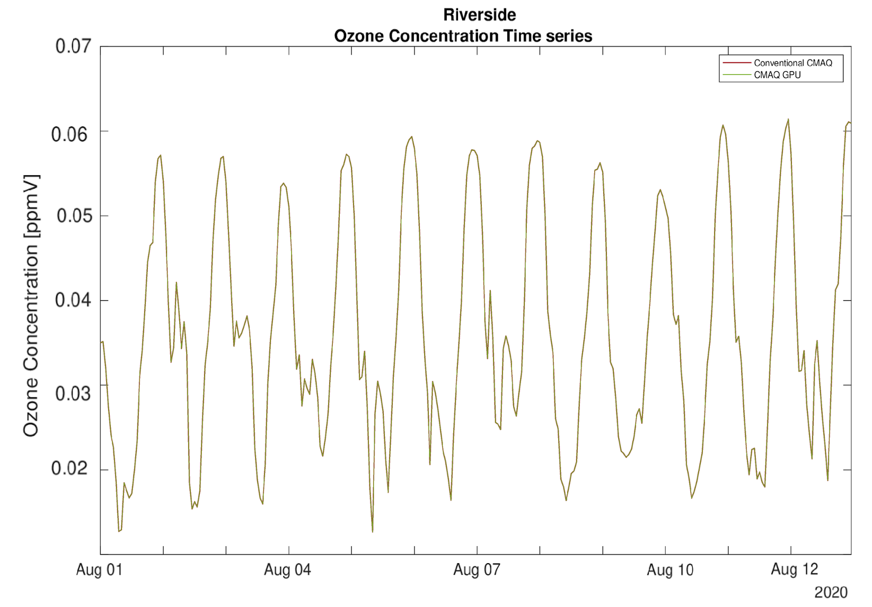
Compilation with CUDA Platform
Traditional CMAQ is compiled with Intel/GNU Fortran compiler
OpenMPI (GCC or ICC)
All current CMAQ modules/subroutines
Execute by the CPU
nvfortran
Codes execute by the GPU
Codes transfer data between CPU and GPU
One step compilation for CCTM
by integrating CUDA platform to the makefile
Simplify compilation process and make it easy for future improvements.
Figure 4: Ozone outputs from CMAQ compiled using MPICH/OpenMPI and MPICH/OpenMPI + nvfortran are the same over 14 days simulated period. Outputs must be the same cross different compilation methods.
Background/Objective
Timing
Method
hrsolver
Gear Solver
CMAQ Performance
Future Work

Slide 8
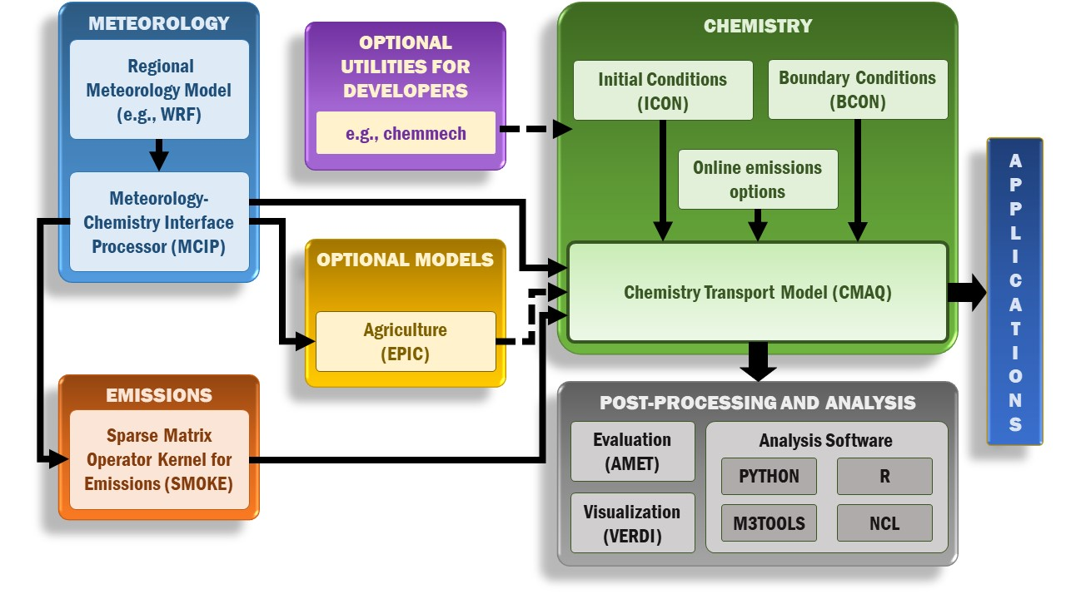
CMAQ Flowchart
The driver.F calls all the subroutines and modules to perform simulation. The science processes (sciproc.F) contains all of our interest subroutines that we want to modify.
Showing on the diagram is the simplified version of CMAQ program.
chksummer.F
pa_update.F
hadv.F
zadv.F
couple_wrf.F
sciproc.F
decouple_wrf.F
hdiff.F
driver.F
vdiff.F
cldproc.F
phot.F
chem.F
pa_output.F
grsmvgear.F
Figure 5: Visualization of GEAR solver location.
Background/Objective
Timing
Method
hrsolver
Gear Solver
CMAQ Performance
Future Work

Slide 9
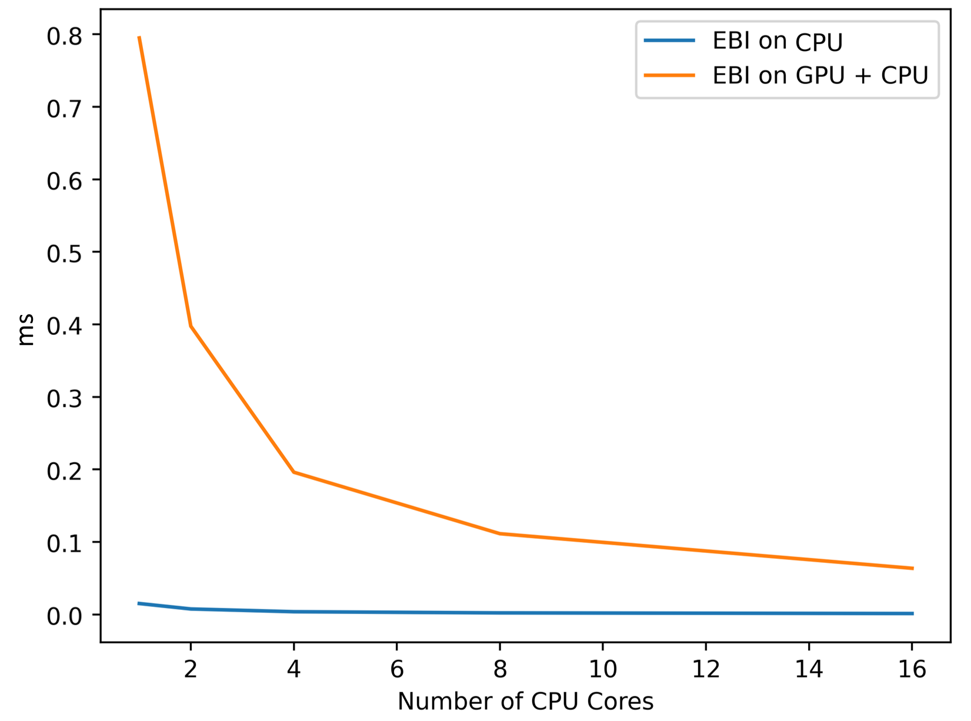
GPU EBI Solver
EBI is very efficient
CPU version takes 7x10⁻² ms to solve for 1 grid cell
GPU version takes 5x10⁻² ms for data transfer between memory for 1 iteration ($\sim$15 iteration to converge)
If we only need 1 time data transfer per grid cell, still slower than CPU
Gear solver
BLKSIZE
Scalable
Chem Solver for One Iteration
Figure 6: Timing the EBI solver for one iteration step per grid cell. CPU + GPU version is significantly slower than the traditional CMAQ.
Background/Objective
Timing
Method
hrsolver
Gear Solver
CMAQ Performance
Future Work

Slide 10
Timing Gear Solver Module (BLKSIZE = 50)
GEAR_DRIVER
FIND_DEGRADE
5X10⁻⁵ s
FINAL_DEGRADE
10⁻⁵ s
SVMGEAR
2x10⁻² s
SUBFUN
10⁻⁴ s
PDERIVE
0.2x10⁻³ s
Gear for gas phase subroutine
CPU only
DECOMP
0.8x10⁻³ s
BACKSUB
0.6x10⁻⁴ s
Background/Objective
Timing
Method
hrsolver
Gear Solver
CMAQ Performance
Future Work

Slide 11
GPU GEAR Solver Flowchart
Repeat until converged
Some updates to the GEAR driver
Some updates to the GEAR driver
Some updates to the GEAR driver
GEAR driver
grpderiv.F
grpdecomp.F
grsubfun.F
grbacksub.F
Convergence check
intermediate.F
intermediate.F
intermediate.F
intermediate.F
data transfer
host <-> device
data transfer
host <-> device
data transfer
host <-> device
data transfer
host <-> device
pdkernel.cuf
dckernel.cuf
sfkernel.cuf
bskernel.cuf
On host
On device
Background/Objective
Timing
Method
hrsolver
Gear Solver
CMAQ Performance
Future Work

Slide 12
Performance of the CMAQ-GPU
BLKSIZE 7000 | grpderiv.F (second) | grdecomp.F (second) | grsubfun.F (second) | grbacksub.F (second)
GPU Time | 0.07 | 0.11 | 0.037 | 0.05
CPU Time | 0.04 | 0.13 | 0.017 | 0.013
Table 1: CMAQ simulation was in series (1 CPU core) with BLKSIZE of 7000. The time was for one each iteration
GPU Kernels perform the same operations as the CPU subroutines, but it is much faster (several order of magnitudes)
GPU Time = copy data to device + kernel time + copy results to host
It spends about 99% of the time for data transferring
Background/Objective
Timing
Method
hrsolver
Gear Solver
CMAQ Performance
Future Work

Slide 13
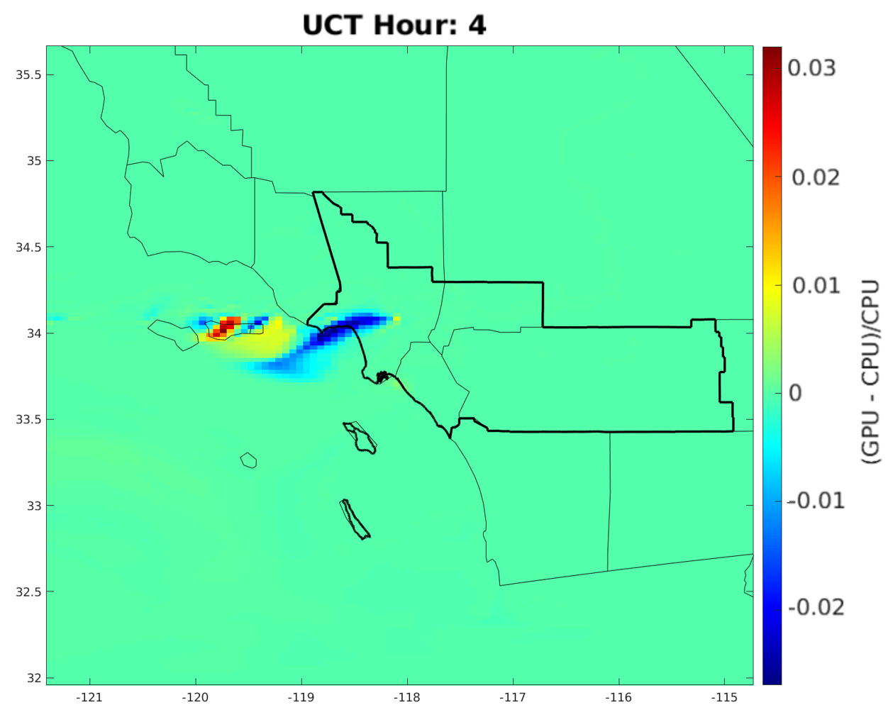
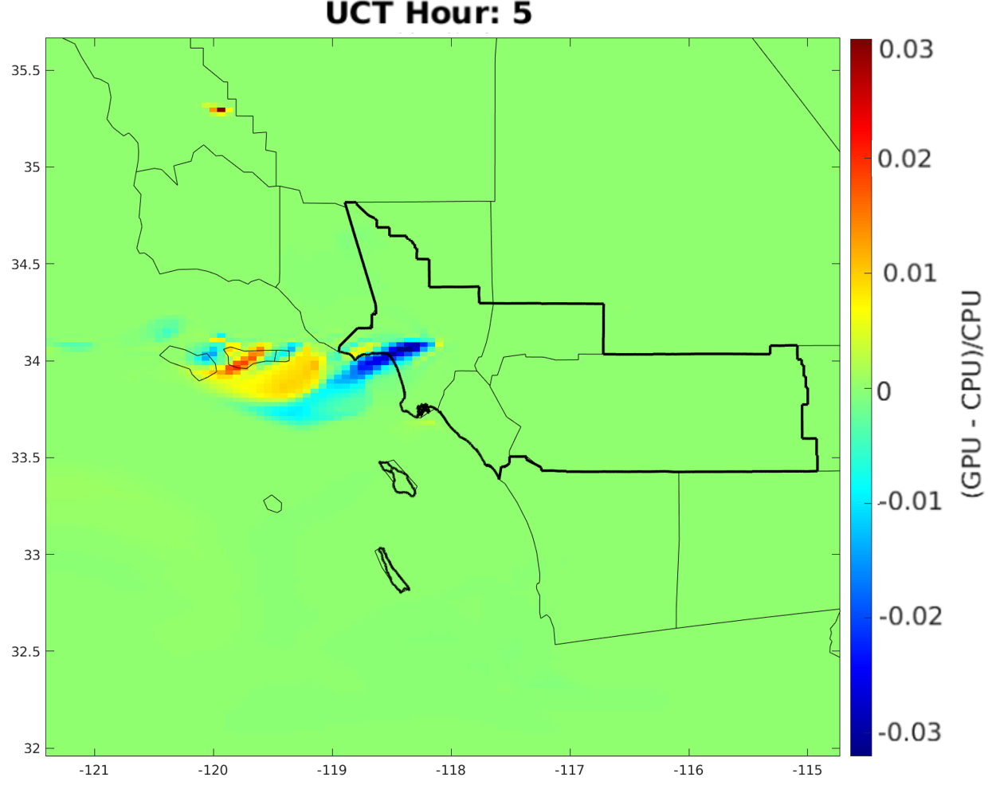
Error
Max difference is 9.1%
0.24% of the simulation results have a difference greater than 1%
Errors from parallelizing dependent loops, conversion check
Figure 7: Percentage difference between traditional CMAQ and CMAQ-GPU.
Background/Objective
Timing
Method
hrsolver
Gear Solver
CMAQ Performance
Future Work

Slide 14
GPU GEAR Solver Flowchart
GEAR driver
intermediate
Init and Update
pderiv
decomp
subfun
backsub
convergence check
reduce time-step
finish
On host
On device
Background/Objective
Timing
Method
hrsolver
Gear Solver
CMAQ Performance
Future Work

Slide 15
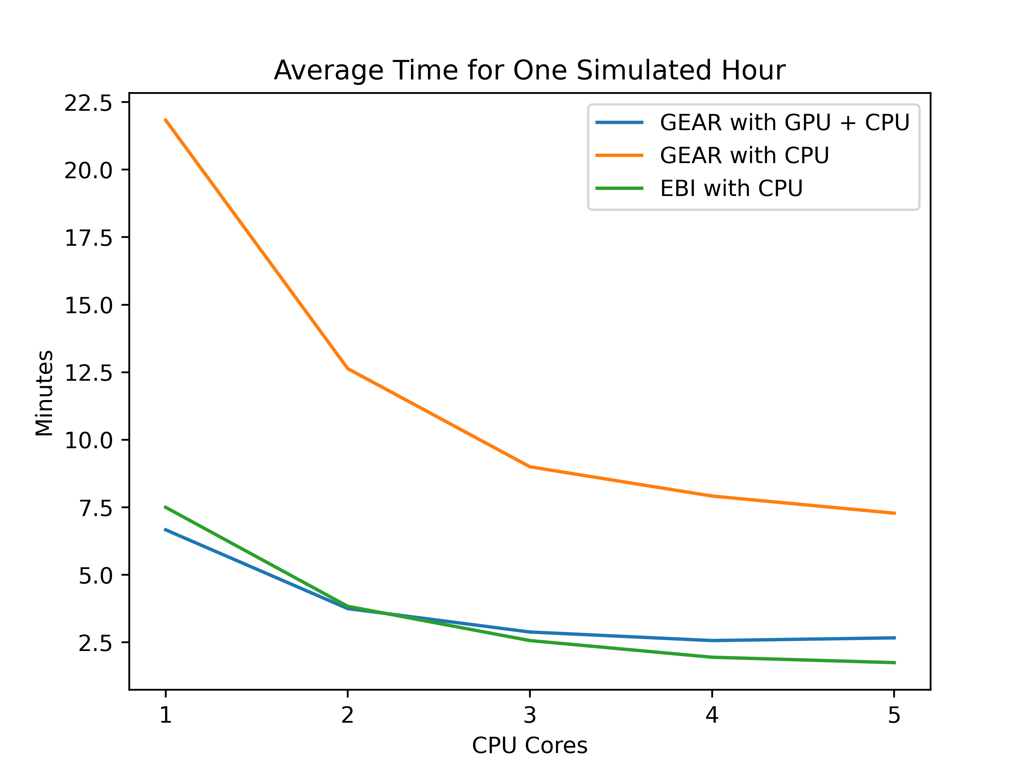
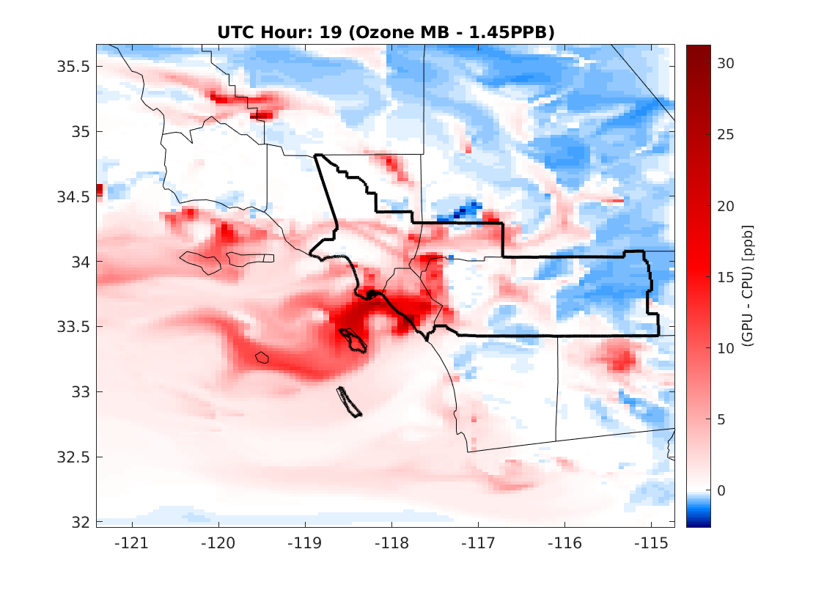
Preliminary Results of a Fully Ported Gear Solver
With only 1 GPU, CMAQ-GPU for GEAR is comparable with EBI.
Simulation time can be greatly reduced for systems with multiple GPUs.
The errors between CPU and CPU + CPU versions are huge
Feedback loop to check for conversion
Parallelize dependent loops
Figure 8: CMAQ-GPU benchmark
Figure 9: Difference between traditional CMAQ and CMAQ-GPU
Background/Objective
Timing
Method
hrsolver
Gear Solver
CMAQ Performance
Future Work

Slide 16
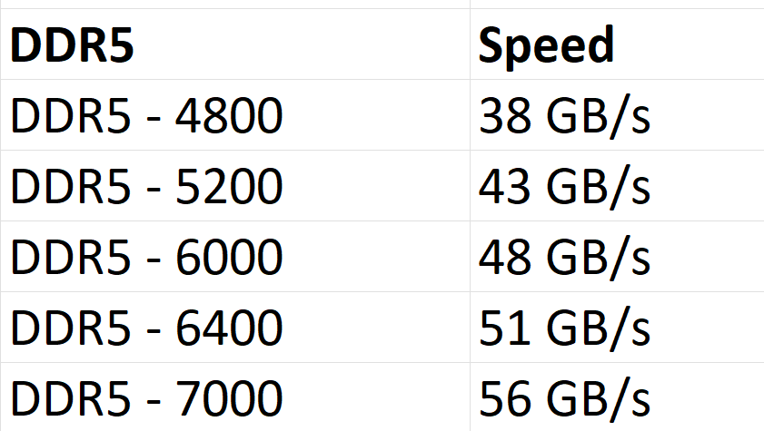
Hardware Optimization
Can We Further Improve CMAQ Simulation Time?
Kernel optimization
Hardware optimization
Modern hardware
Multiple GPUs
Port more CMAQ modules/subroutines onto the GPU (HAVD, CLDPROC)
Data transfer rates and bandwidths are double in a couple of years
DDR6 is twice times as fast as DDR5
Background/Objective
Timing
Method
hrsolver
Gear Solver
CMAQ Performance
Future Work

Slide 17
Future Work
Complete porting GEAR to the GPU
Compare results with the CPU version
Simplify and optimize GPU kernels
Simplify the process of CMAQ compilation with GPU assisted CMAQ
Effect of GPU on integrated process and reaction rate analyses
Perform long-period simulations (2017-2024 and 2047-2054) to investigate meteorological drivers of ozone levels in SoCAB
Background/Objective
Timing
Method
hrsolver
Gear Solver
CMAQ Performance
Future Work

Slide 18
Summary
Chem solvers are the slowest module of CMAQ
We can compile CMAQ GPU by combining the GCC compiler (for CPU codes) and nvfortran (for GPU codes). The outputs of the program are not different compared to traditional CMAQ
We ported the EBI solver on the GPU, but the computation time was much slower than the traditional CMAQ
Cost of transferring data between the host (system) to the device (GPU)
Small loop computation which did not take advantage of GPU
We replaced EBI solver on CMAQ with SMVGear
Variable block size (larger block size, bigger data array)
Large sparse vectorized matrices fully utilize the GPU
Significant improvement even with a system with only one GPU
Simulation results show errors
Background/Objective
Timing
Method
hrsolver
Gear Solver
CMAQ Performance
Future Work

Slide 19
Thank you and Acknowledgments
Cesunica Ivey
Air Quality Modeling and Exposure Lab (AQMEL)
Nanoscale & Mesoscale Energy Materials Research Group
Bryan Wong
Prithviraj Yuvaraj
Jose Rodriguez Borbon
George Delic from Hiperism Consulting LLC
This material is based upon work supported by the National Science Foundation under Grant No. 2053560. Any opinions, findings, and conclusions or recommendations expressed in this material are those of the author(s) and do not necessarily reflect the views of the National Science Foundation.

Slide 20
Back-up Slides

Slide 21
First ported GEAR version
Repeat until converged
Some updates to the GEAR driver
Some updates to the GEAR driver
Some updates to the GEAR driver
Convergence check
GEAR driver
grpderiv.F
grpdecomp.F
grsubfun.F
grbacksub.F
intermediate.F
intermediate.F
intermediate.F
intermediate.F
data transfer
host <-> device
data transfer
host <-> device
data transfer
host <-> device
data transfer
host <-> device
pdkernel.cuf
dckernel.cuf
sfkernel.cuf
bskernel.cuf
Second ported GEAR version
GEAR driver
intermediate
Init and Update
pderiv
decomp
subfun
backsub
convergence check
reduce time-step
On host
On device
finish

Slide 22
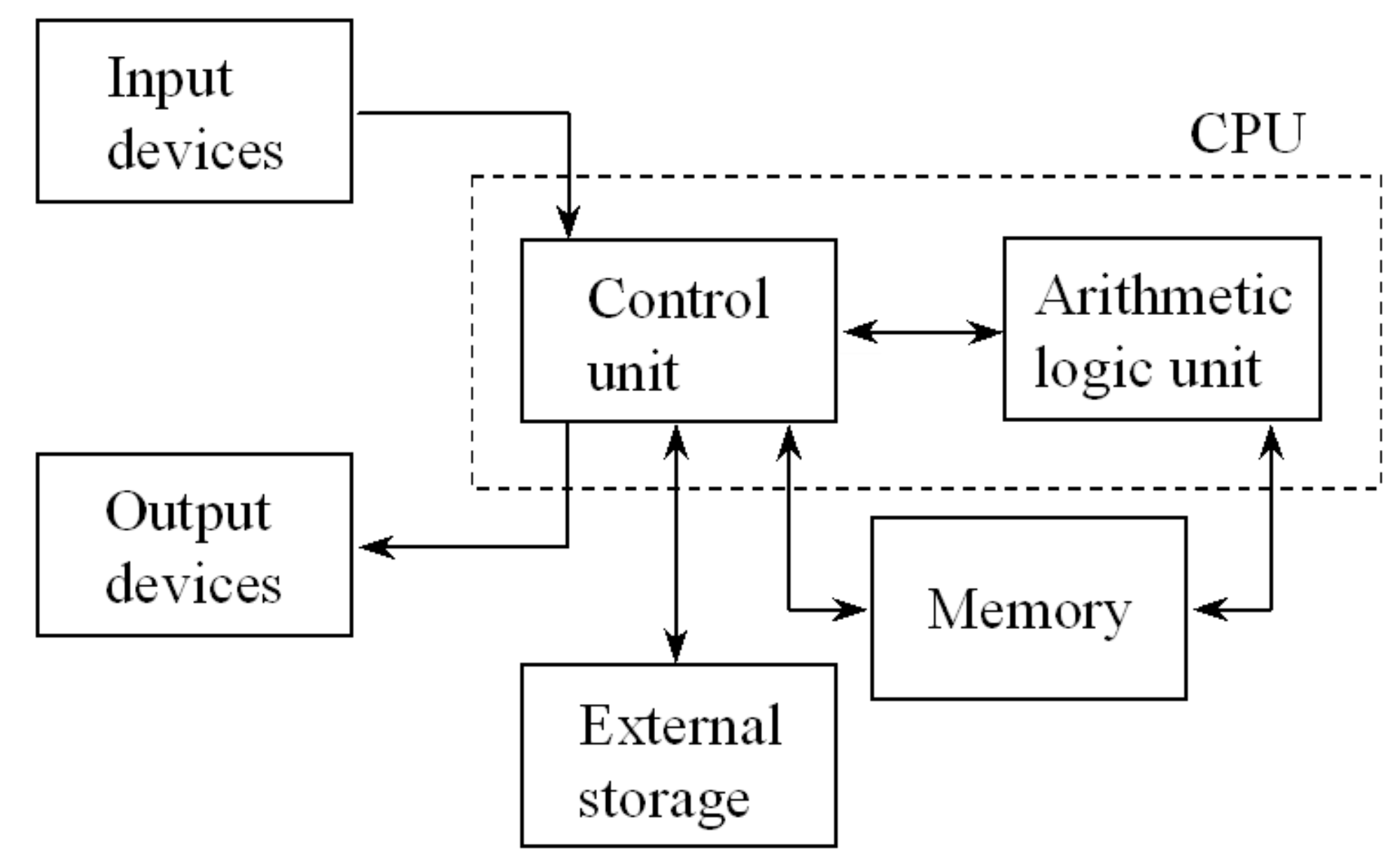
Simple Computer Architecture
Program and data are loaded from storage and stored in system memory
Outputs are temporarily stored in memory and written to a hard drive for long term storage
All processes are executed by the CPU
Modern CPUs have 2-16 cores per CPU
Most of today’s programs are written for the CPU
(Keyboard, mouse)
20,000 MB/s
20,000 MB/s
100 MB/s
(Monitor, printer)
Figure: Simple computer architecture

Slide 23
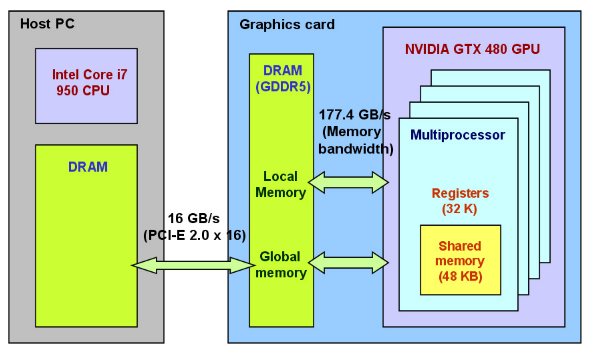
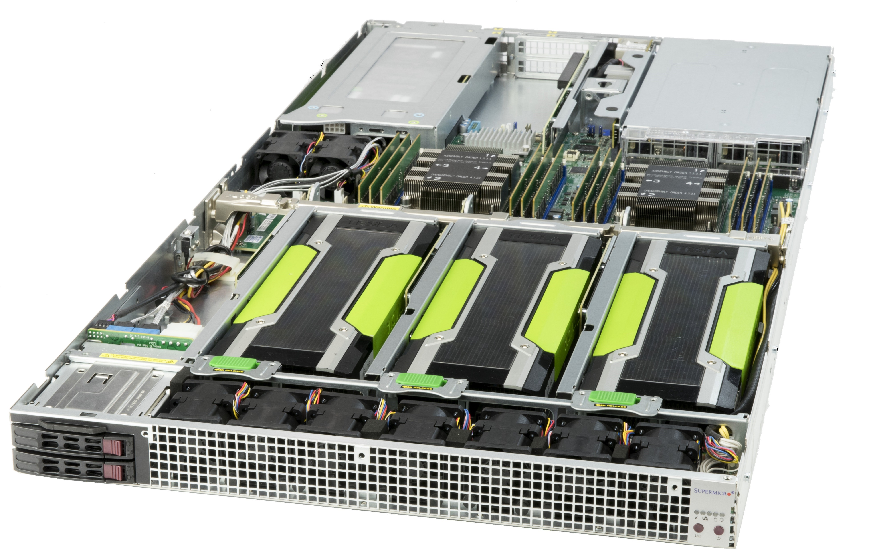
Simple Computer Architecture with a GPU
GPUs
Device/Host Memory Allocation
Figure: Computer with a GPU
Figure: Memory space on host and device (Seo at al., 2011)
Figure: GPU server

Slide 24
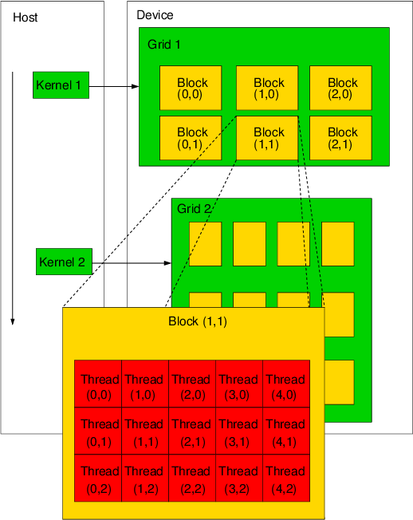
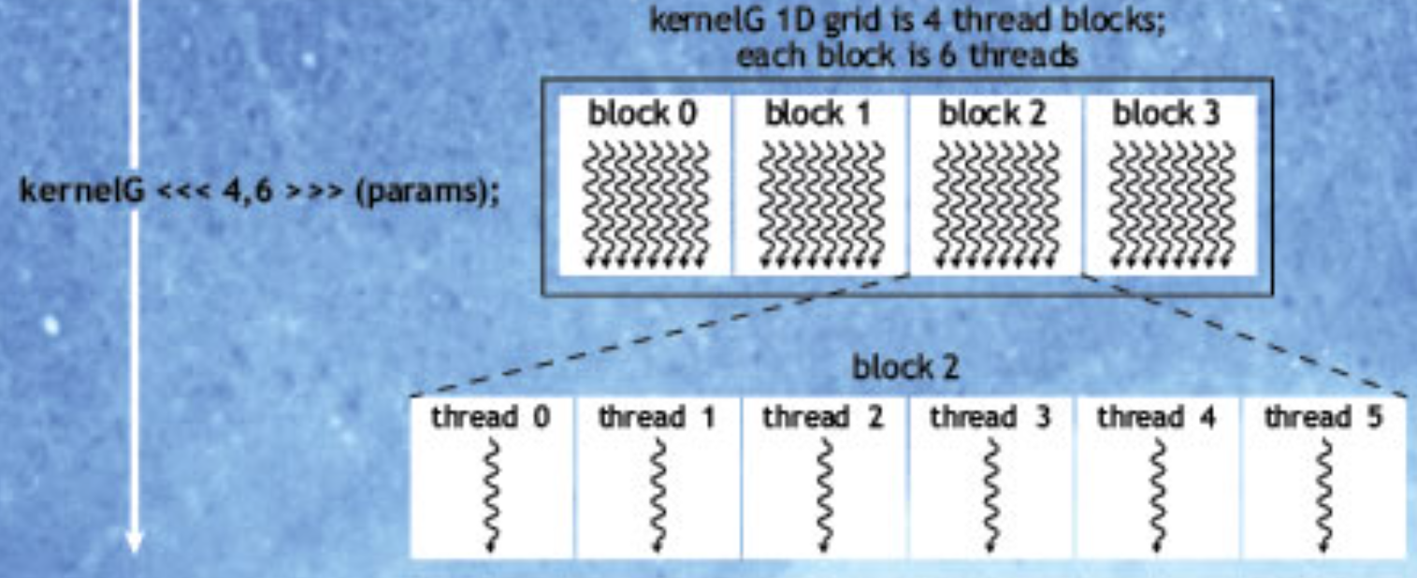
Launching GPU Kernel
Figure: CUDA programing model (Gulati et al., 2009)

Slide 25
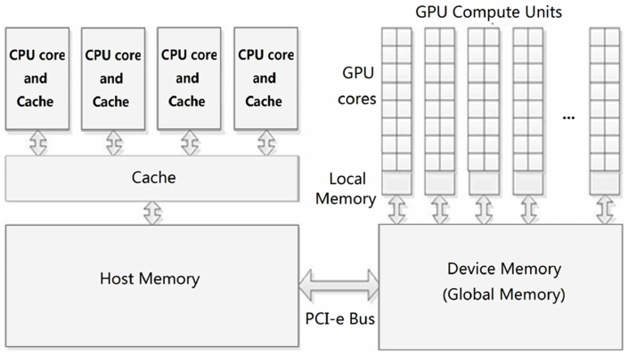
Hardware Optimization
Current hardware
DDR4 2666MHz
PCIe 3.0
CPU with 9 MB cache
Double channel memory
< 9 MB
Limited by DDR4 Transfer Speed
Limited by PCIe 3.0 bandwidth
DDR4 21GB/s
4GB
PCEe 3.0
16GB/s
Figure 12: Transfer bandwidth limitation
Background/Objective
Timing
Method
hrsolver
Gear Solver
CMAQ Performance
Future Work

Slide 26
The effects of BLKSIZE on CMAQ Performance
CMAQ needs to solve the chem concentrations in all the grid cells
If the BLKSIZE is 1, the times that CMAQ calls the GEAR solver are equal to the number of total grid cells (row x column x height)
If the BLKSIZE is 1000, CMAQ calls the GEAR solver less than 1000 times (row x column x height/BLKSIZE)
Advantages
More independent computation per one function call
Optimized for GPU computation
Disadvantages
Resulting in large arrays. Arrays with 1000 x 5400 dimensions are more than 40 megabytes
CPU caches are small (30MB for high-end CPU). If an array is larger than CPU caches, the CPU must grab the extra data from system memory (RAM) which decreases the overall efficiency
Background/Objective
Timing
Method
hrsolver
Gear Solver
CMAQ Performance
Future Work

Slide 27
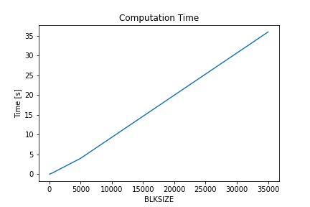
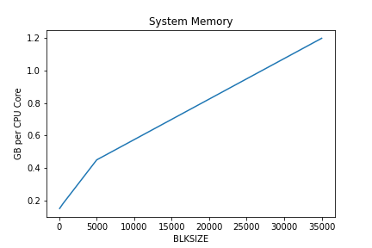
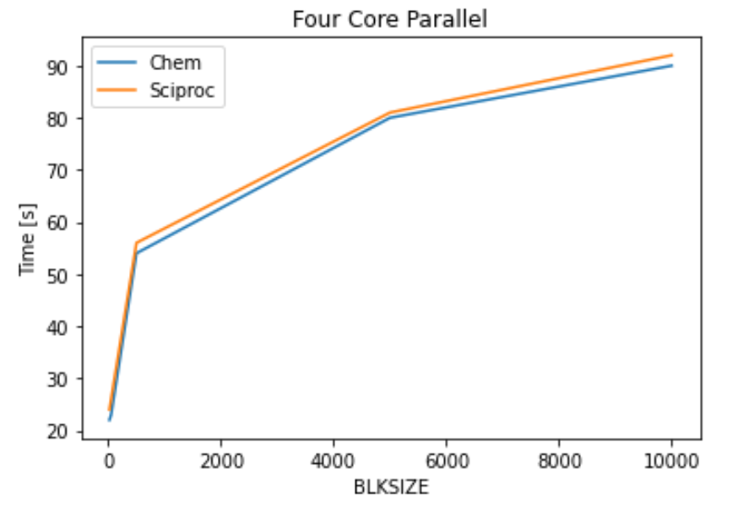
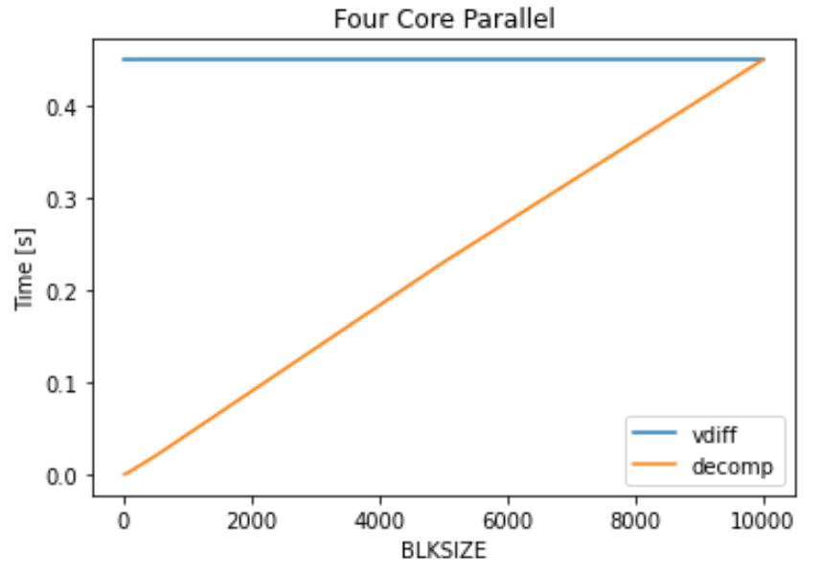
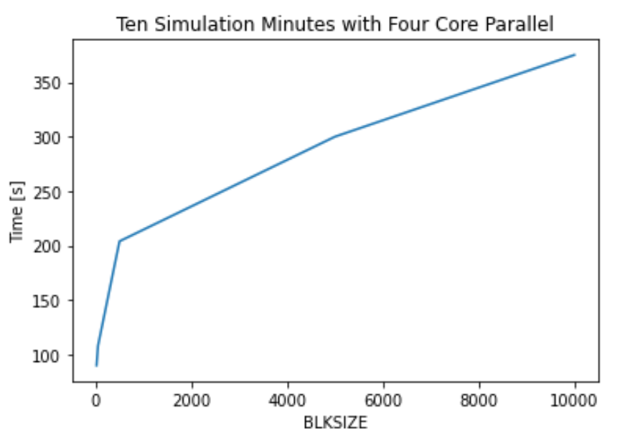
SMVGEAR(CPU only) with Different BLKSIZE
Linearly increase computation time with increased block size
Total computation time for CMAQ remained the same
The default CMAQ BLKSIZE is 50
Linearly system memory
Figure 7: Effect of BLKSIZE on computational time and system memory.
Effects of BLKSIZE on CMAQ performance
Increase in BLKSIZE has negative effects on CMAQ performance
CHEM process (GEAR solver) is largely affected. The change of other processes, such as vdiff is negligible with BLKSIZE
Figure 8: Effect of BLKSIZE on simulation time for different processes.
Background/Objective
Timing
Method
hrsolver
Gear Solver
CMAQ Performance
Future Work

