Slide 1




Resilience Benefits of Replacing Diesel Backup Generators with PV-Plus-Storage Microgrids for California Public Buildings
Sunjoo Hwang¹, Sopitsuda Tongsopit², Noah Kittner^{1,3}
¹Department of Environmental Sciences and Engineering, Gillings School of Global Public Health,
University of North Carolina at Chapel Hill
²Independent Researcher (formerly with the California DGS and currently with the California Energy Commission)
³Department of City and Regional Planning, University of North Carolina at Chapel Hill

Slide 2
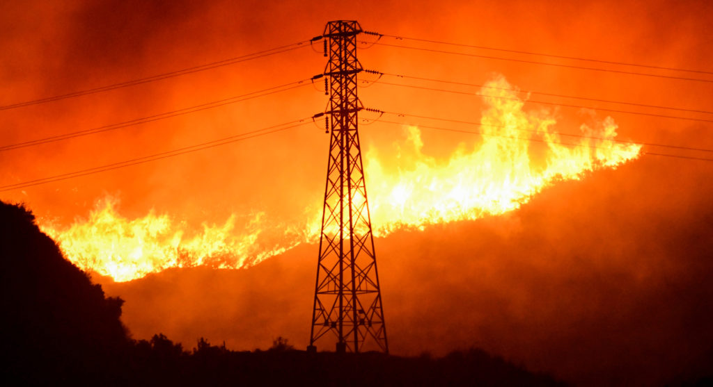
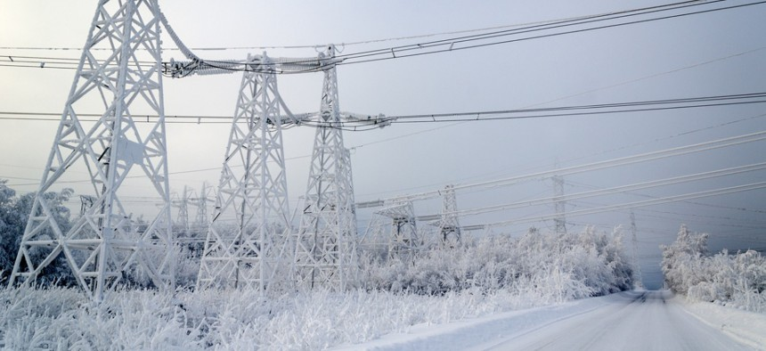
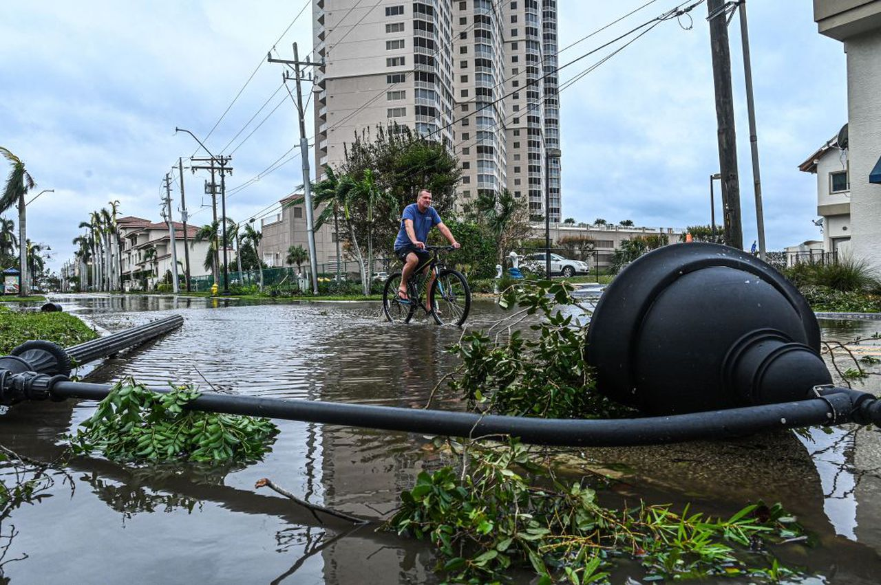
02
Power Outages
in the United States
Photo by Gene Blevins.
Photo by Polina Petrenko.
Photo by Giorgio Viera.
California (2019)
Texas (2021)
Florida (2022)
3M
lost power due to public safety power shutoffs
4M
lost power due to winter storm Uri
2M
lost power due to Hurricane Ian

Slide 3
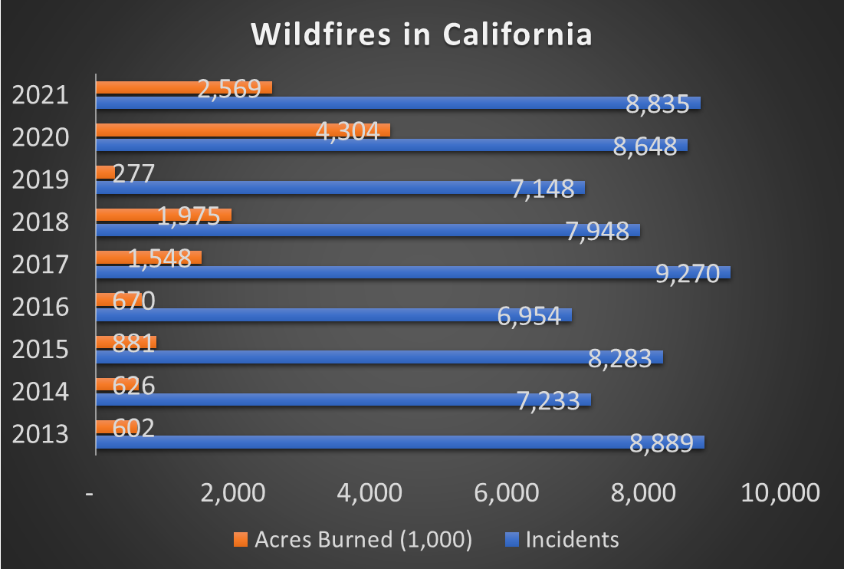
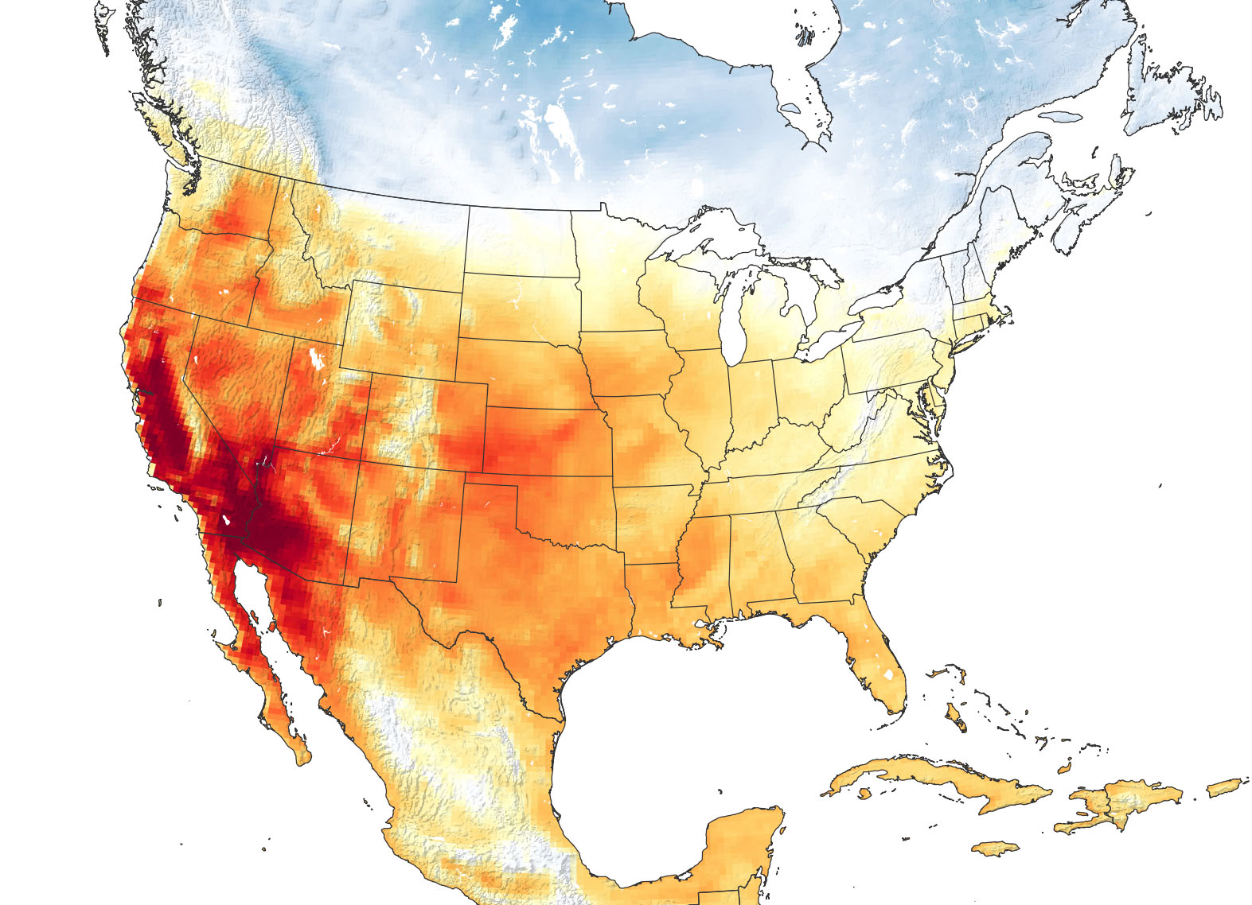

03
Wildfires and Extreme Heat in California
Death Valley
128 °F
(June 2021)
Palm Springs
122 °F
(June 2021)
Sacramento
116 °F
(Sep 2022)
Fairfield
116 °F
(Sep 2022)
Source: CAL Fire
Source: NASA Earth Observatory

Slide 4
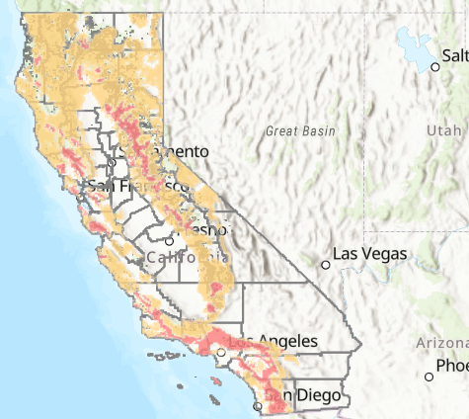

04
Power Outages in California
Extreme heat and wildfires cause problems in electricity demand and supply.
  Extreme heat increases electricity demand and causes supply failure (e.g., transformer failure).
  Grid infrastructure can be impacted by wildfires.
High Fire Threat District
PSPS Events (2013-2020)
Public Safety Power Shutoff (PSPS)
Customers
Impacted
3.2 M
Avg. Duration
(hours)
41 (max 163)
California Public Utilities Commission (CPUC) gives electric utilities authority to shut off electric power in order to protect public safety (CPUC Code Sections 451 and 399.2(a)).
Source: CPUC

Slide 5
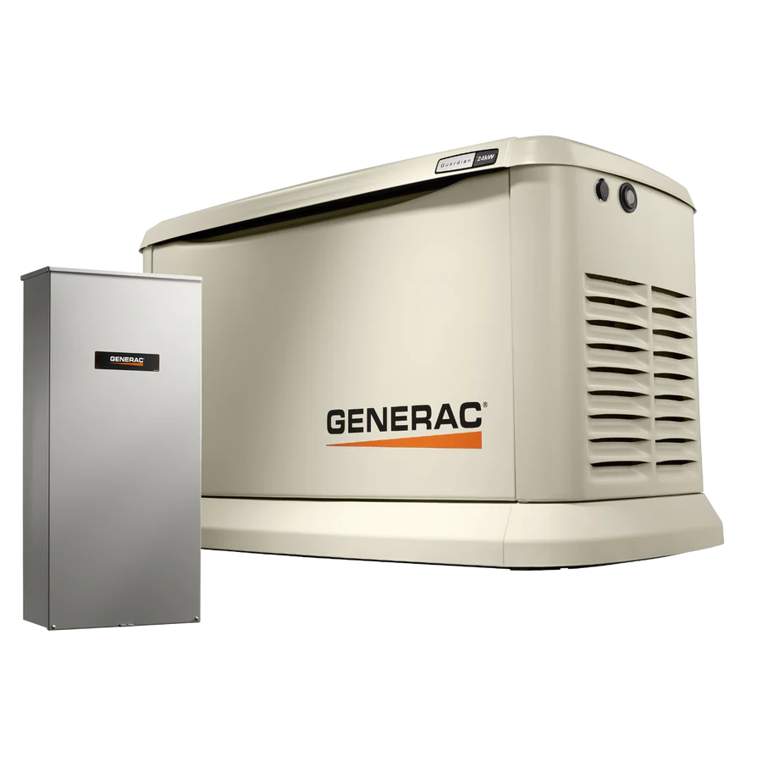
05
Backup Generator Demand Surge
Concerns about grid reliability have raised demands for backup power, including diesel generators.
California
Bay Area Air Quality Management District
recorded a 34% increase from 2018 to 2021.
South Coast Air Quality Management District
recorded a 22% increase from 2020 to 2021.

Slide 6
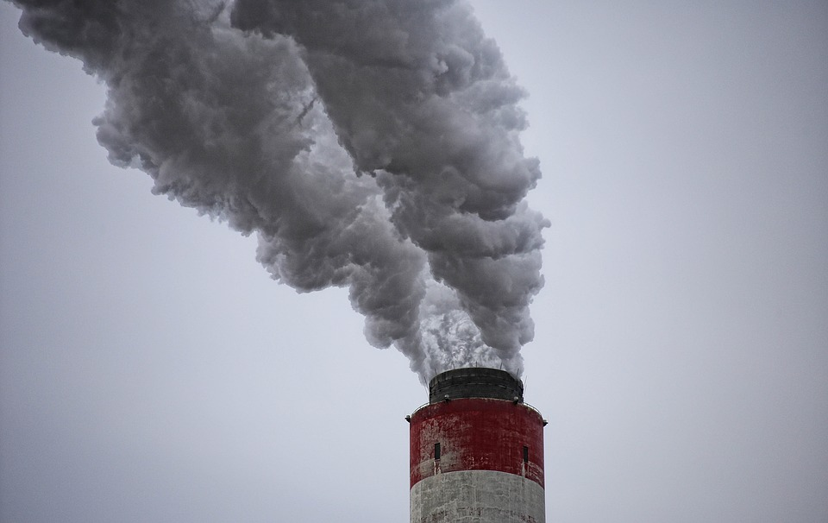
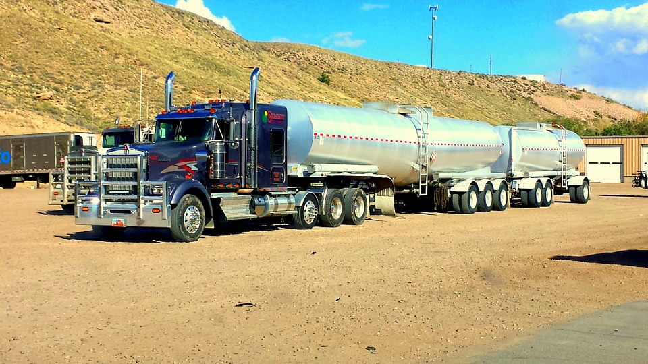

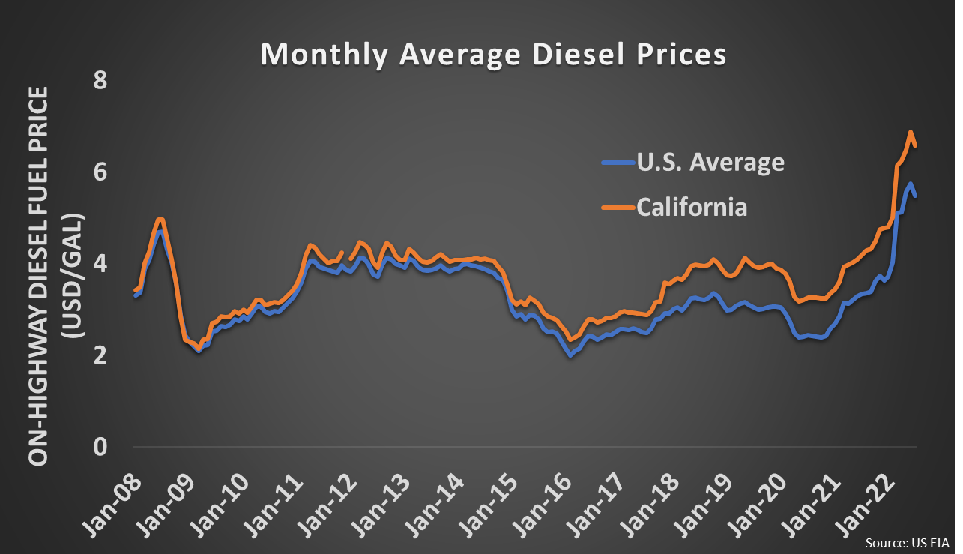
06
Risks of Diesel Backup Generators
Fuel supply risk during an emergency due to road closures
Emissions from burning diesel
Fuel storage risk due to degradation
Price of diesel fuel
Source: Diesel Now.

Slide 7
07
Research Question
Is the diesel fuel a reliable energy source for outages?
How can we quantify the value of having resilient electricity systems across different categories (finances, outages, and emissions)?
What is the opportunity cost of meeting resilience needs without diesel?

Slide 8
08
Study Methods
Designed a 20-year analysis for a transportation public facility for the California Department of Transportation (Caltrans) District 11 that serves San Diego County (8-hour ozone non-attainment area).
Backup power generation: diesel generators vs. PV-plus-battery microgrids
Used empirical data such as building load profiles, monthly electricity bills, actual costs of PV and battery, diesel prices, and emissions factors for the California region.
Assumed that the site would experience a single outage annually and the backup power generation would meet the site’s critical load (50%) during the outage.

Slide 9
09
Scenarios Analysis
What type of energy technology?
PV-plus-battery microgrid
Diesel backup generator
How long does an outage last?
12 hours
24 hours
41 hours
#1
#2
#3
#4
#5
#6

Slide 10

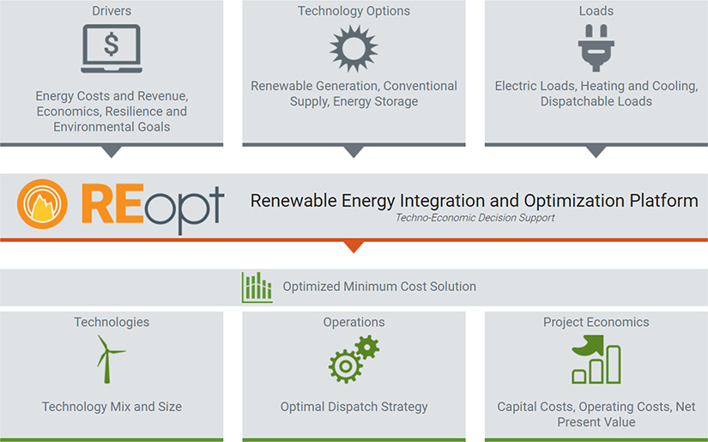
10
Energy Model
an energy integration and optimization model that was developed by
NREL(National Renewable Energy Laboratory) in 2007.

Slide 11
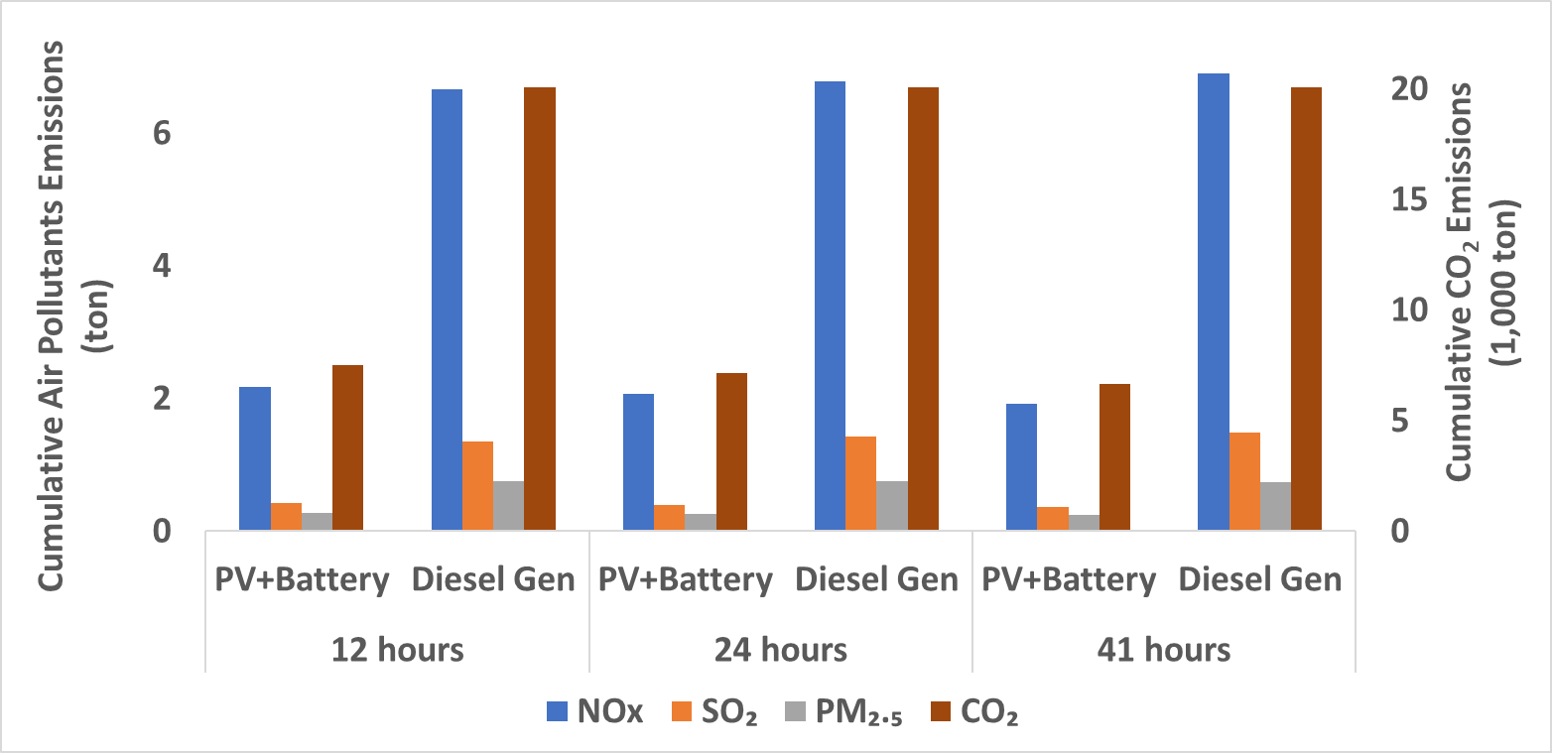
11
Results: Cumulative Emissions over 20 Years

Slide 12
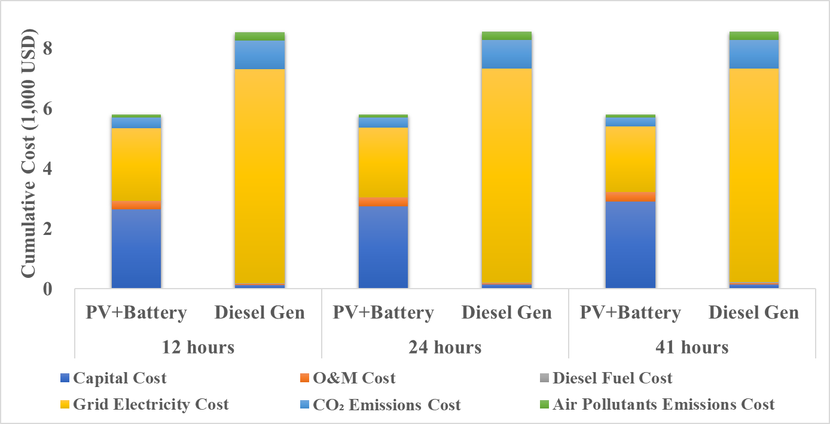
12
Results: Cumulative Costs over 20 Years

Slide 13
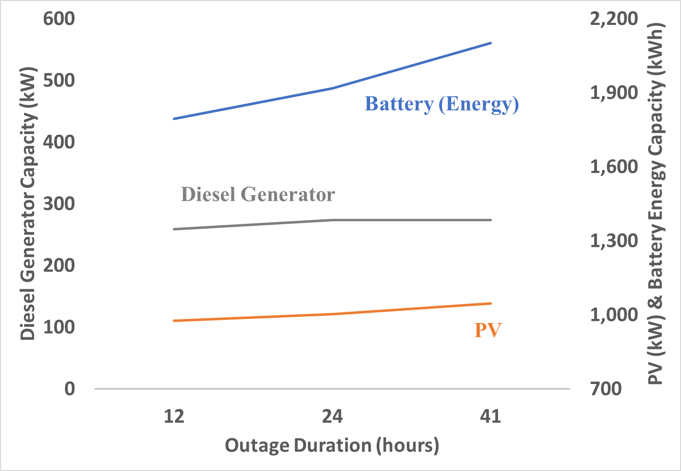
13
Results: Marginal Resilience Curve

Slide 14
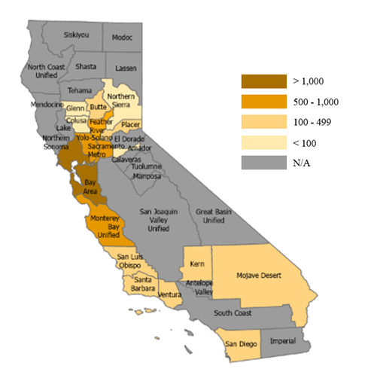
14
Expanded analysis
There exist 5,466 diesel backup generators installed in public buildings/critical facilities in the 17 air districts, and their total capacity is about 2,322 MW.
The annual benefit of replacing those diesel generators with PV-plus-battery microgrids would be over $1 billion.
The number of diesel-fueled backup generators in public buildings and critical facilities by California air district.
(Source: California Air Resources Board)

Slide 15
15
Conclusion
This research defines resilience quantitatively and demonstrates significant benefits of replacing diesel backup generators with PV-plus-battery microgrids for public buildings in California.
This study looked at different durations of an outage including longer ones given that more sustained outages are expected due to climate change.
One public building application would save ~ $3M of public expenditures and reduce over 10,000 tons of CO₂ emissions over a 20-year period.
The replacement in public buildings in the 17 air districts would save over $1B annually.
The benefits of PV-plus-battery microgrids over diesel generators would increase as prices of PV and battery system are in a decreasing trend.
The marginal resilience curve indicates that increasing energy storage capacity outweighs increasing PV capacity for outages longer than 12 hours.

Slide 16


16
Acknowledgments
Dr. Noah Kittner
Dr. Sopitsuda Tongsopit
California Department of General Services
California Air Resources Board

Slide 17
Thank You!
Any Questions?
Sunjoo Hwang
shwang2@unc.edu

