Slide 1
The Impact of Altering Emission Data Precision on the Community Multiscale Air Quality Model
David Wong§ and Michael Walters§,†
§Center for Environmental Measurement & Modeling
U.S. Environmental Protection Agency
Research Triangle Park, NC, USA
†Oak Ridge Associated Universities
CMAS Conference Oct 17 – 19, 2022
Office of Research and Development
Center for Environmental Measurement & Modeling

Slide 2
Disclaimer: The views expressed in this presentation are those of the authors and do not necessarily reflect the view, or policies, of the U.S. EPA.

Slide 3
Motivation and Background Information
Model input and output files can be huge, can have multiple set (bases on time, or simulation parameters), might be required keeping for a long period of time
Files are in netCDF format which is stored in 32-bits precision (about 7 digits)
A number, e.g. 123.4567 in scientific notation: 1.234567x10² (mathematical form) or 0.1234567E+03 (Fortran)

Slide 4
Types of Compression
Lossless compression - is a class of data compression that allows the original data to be perfectly reconstructed from the compressed data. For examples, gzip and bzip2
Lossy compression - the class of data encoding methods that uses inexact approximations and partial data discarding to represent the content. For example, Bit Grooming

Slide 5
A New Tool
It is a Fortran program
Format a numerical value in scientific format (Fortran: 0.abcdeExy) and allow users to choose how many digits to keep
Write out the altered value
original | keep 5-digits | keep 4-digits | keep 3-digits
0.005666635 | 0.0056666 | 0.005667 | 0.00567
3.437405e-06 | 3.4374e-06 | 3.437e-6 | 3.44e-6
0.0005319762 | 0.00053198 | 0.000532 | 0.000532
3.437e-06 | 3.437e-06 | 3.437e-06 | 3.44e-6
100150.0 | 100150.0 | 100200.0 | 100000.0

Slide 6
An Example of an Emission File
 | Original Size | gzip | bzip2
orig | 850932740 | 469940092 (55.23%) | 480742081 (56.50%)
new5 | 850932488 | 463229960 (54.44%) | 436867960 (51.34%)
new4 | 850932488 | 430703334 (50.62%) | 318626099 (37.44%)
new3 | 850932488 | 328965913 (38.66%) | 209085714 (24.57%)

Slide 7
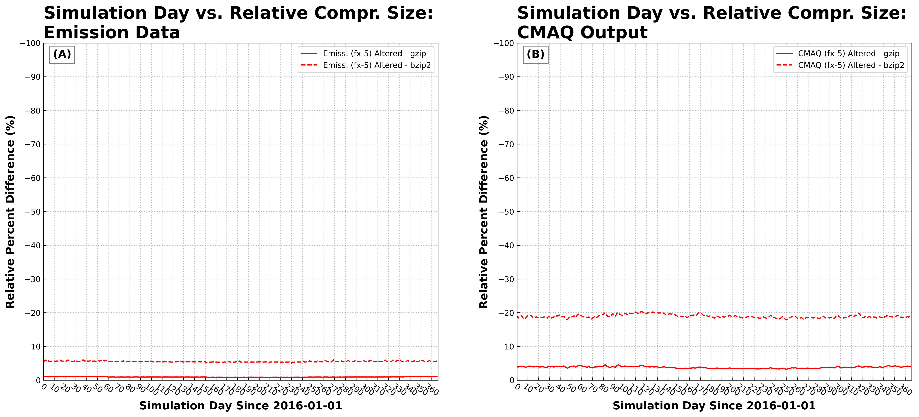
Compression Results (N = 5)

Slide 8
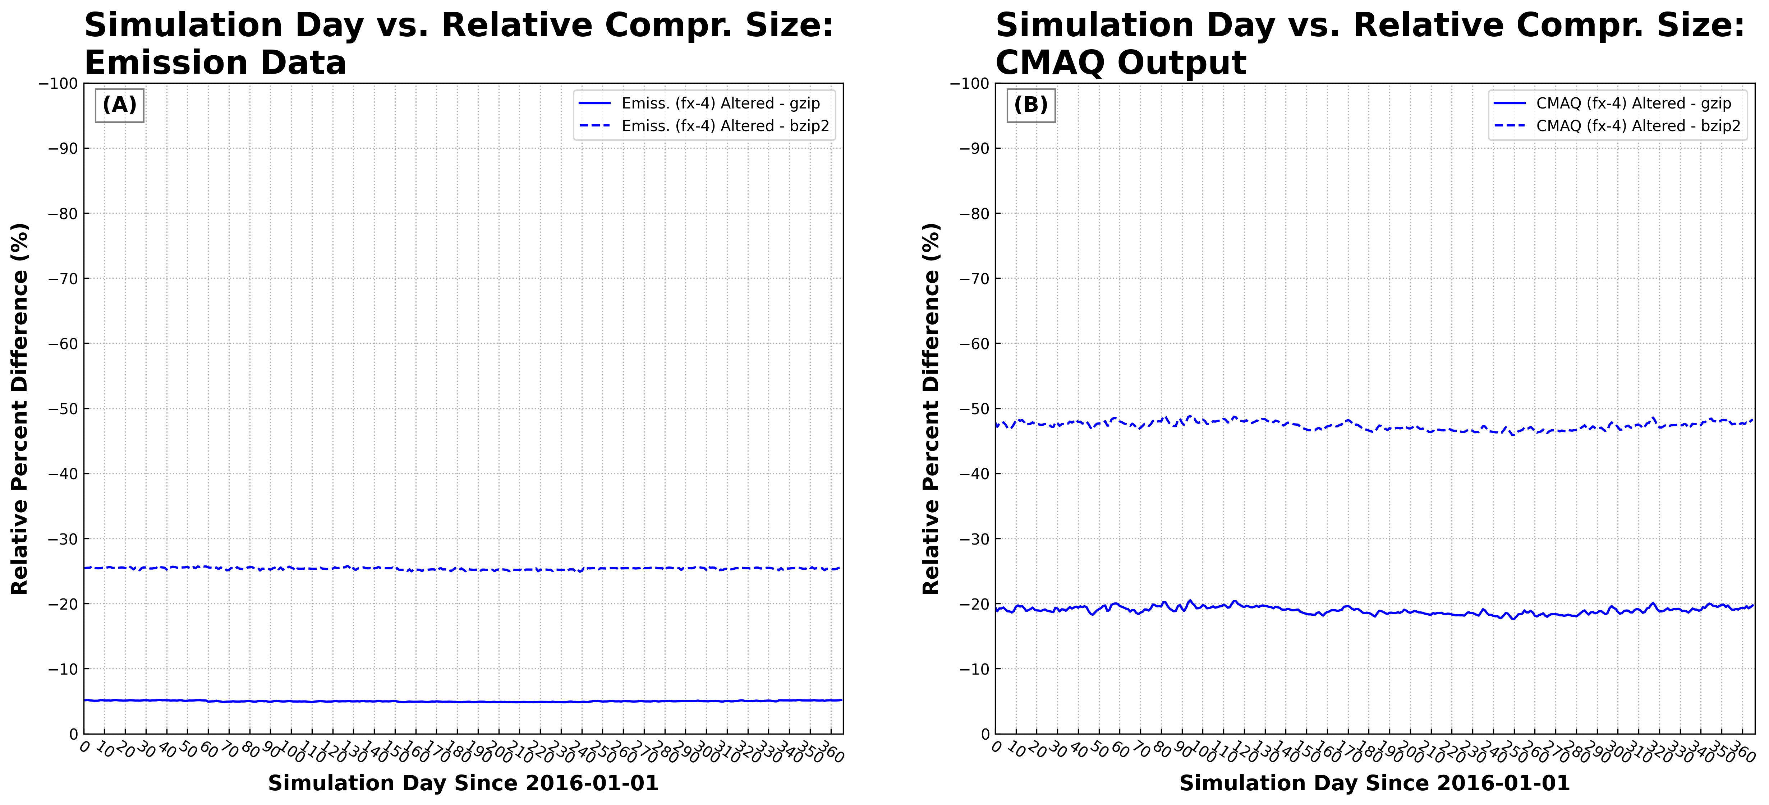
Compression Results (N = 4)

Slide 9
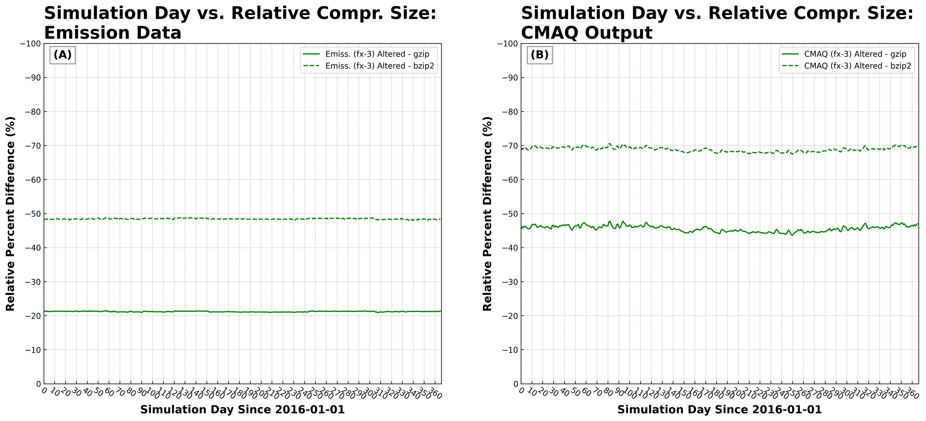
Compression Results (N = 3)

Slide 10
Simulation Setup (2016 Annual Run)
OUTPUT
met data
emissions
emissions
CMAQ
misc
OUTPUT
There are 2 gridded emission files and 9 point source files
There are 9 output files, CGRID, MEDIA and SOILOUT won’t be altered

Slide 11
Simulation Cases

Slide 12
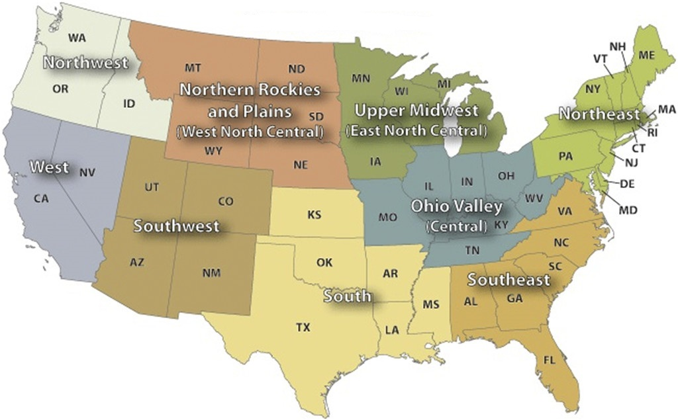
US Climate Regions
Courtesy of NOAA (https://www.ncei.noaa.gov/access/monitoring/reference-maps/us-climate-regions)

Slide 13
Annual Domain-wise Stats of daily average PM_{2.5}

Slide 14
Annual Domain-wise Stats of MDA8 O₃ (ppb)

Slide 15
Annual Domain-wise Stats of daily average NH₃ (μg/m³)

Slide 16
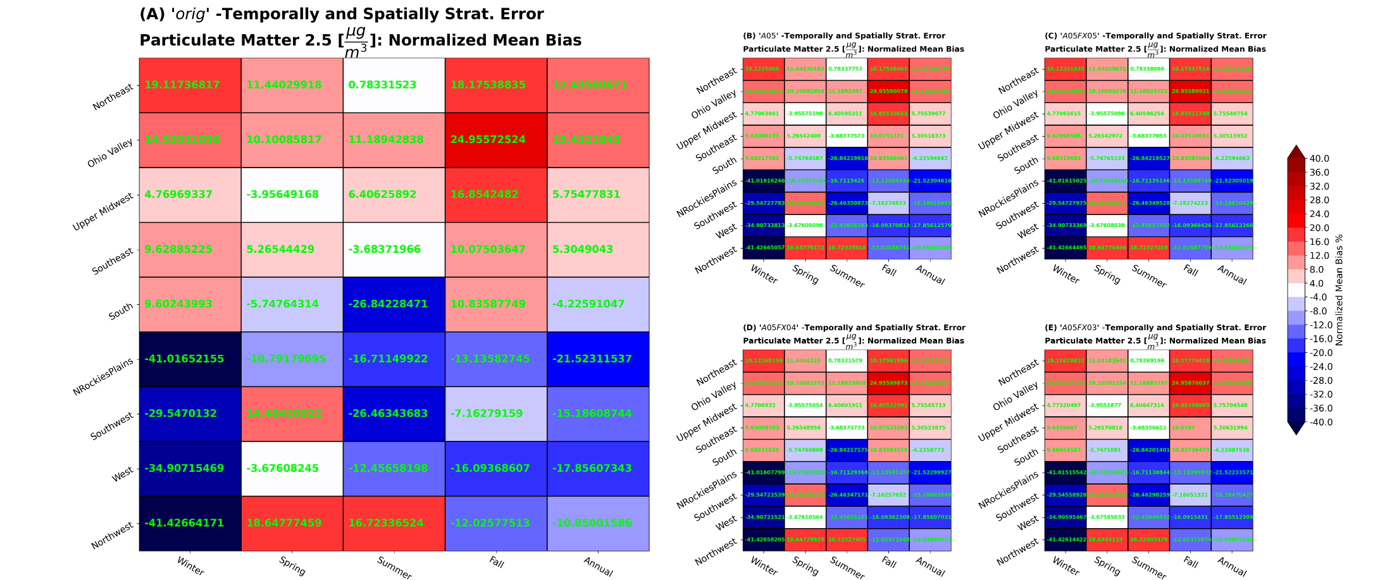
The Regional and Temporal Performance of PM_{2.5} (NMB) (N = 5)

Slide 17
The Regional and Temporal Performance of PM_{2.5} (NMB) (N = 4) )

Slide 18
The Regional and Temporal Performance of PM_{2.5} (NMB) (N = 3) )

Slide 19
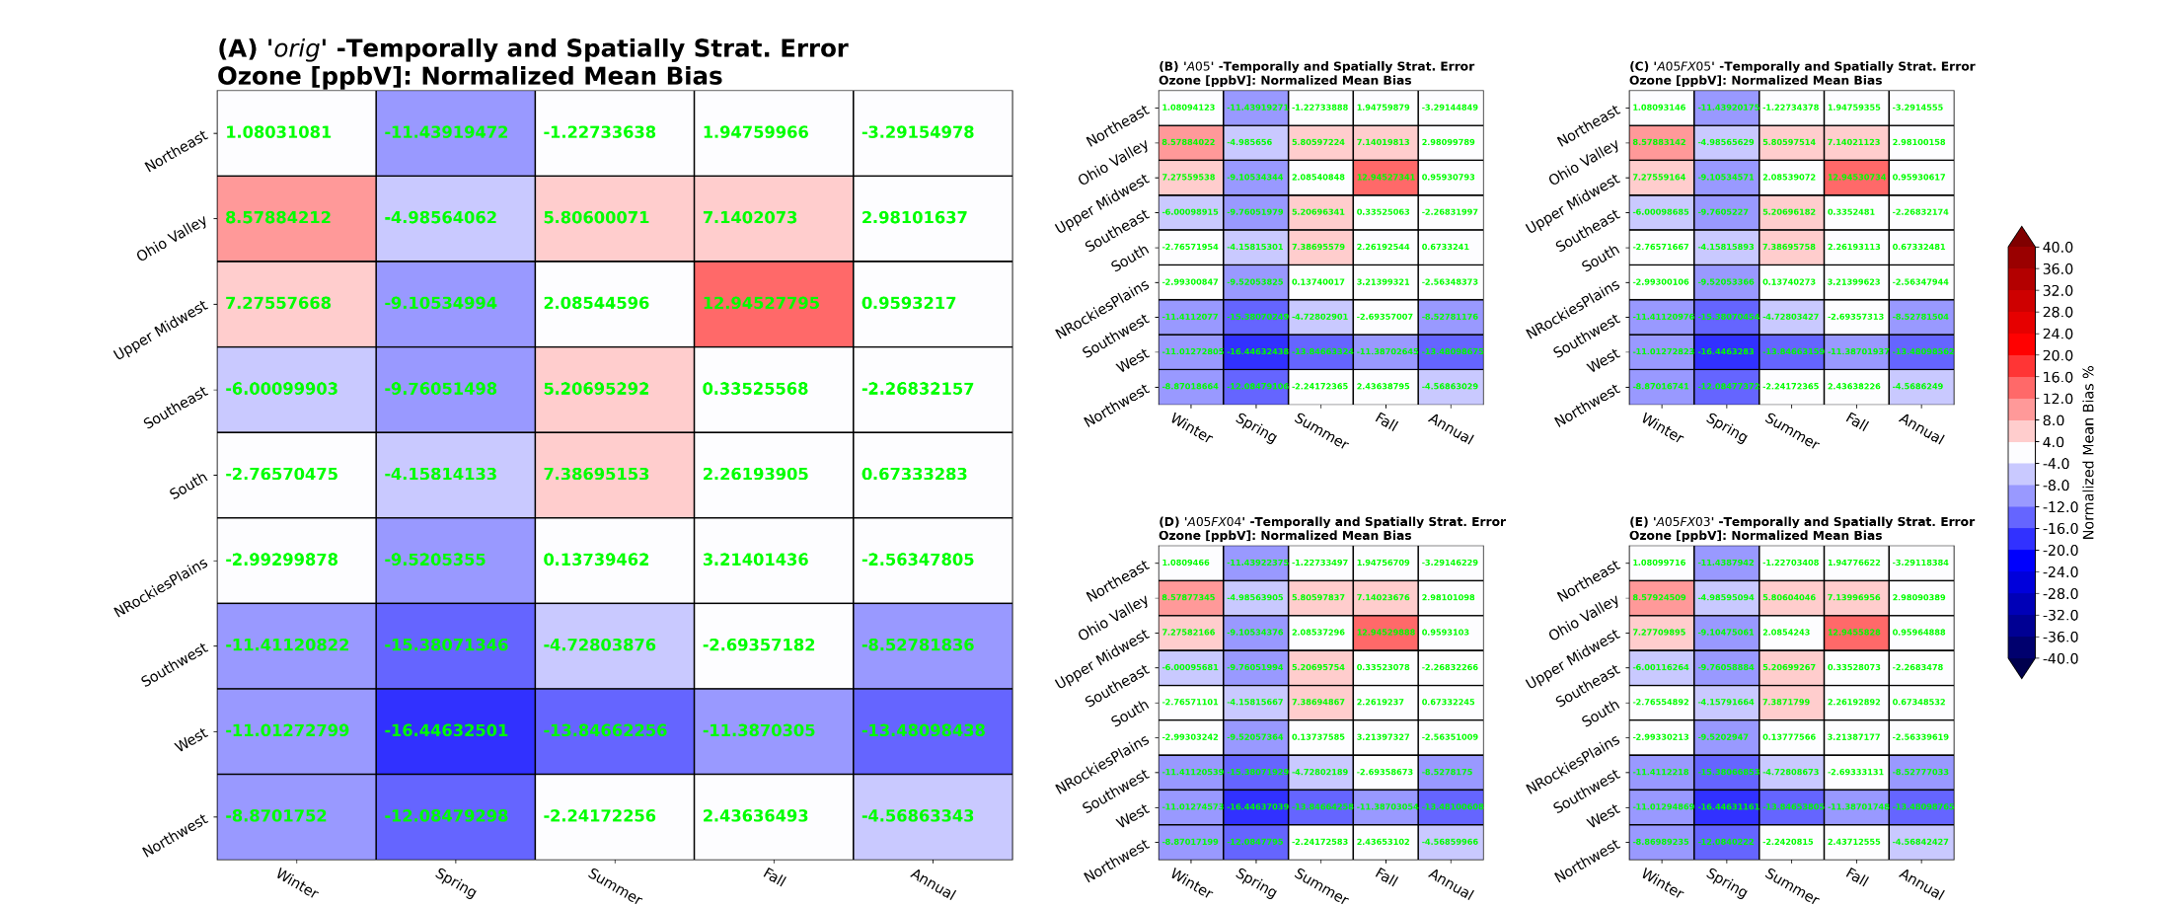
The Regional and Temporal Performance of MDA8 O3 (NMB) (N = 5)

Slide 20
The Regional and Temporal Performance of MDA8 O3 (NMB) (N = 4)

Slide 21
The Regional and Temporal Performance of MDA8 O3 (NMB) (N = 3)

Slide 22
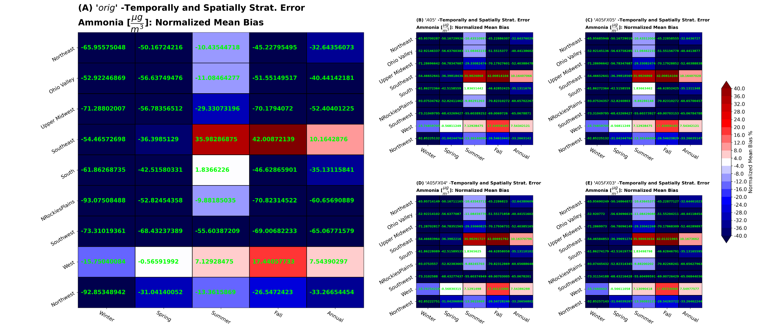
The Regional and Temporal Performance of NH₃ (NMB) (N = 5)

Slide 23
The Regional and Temporal Performance of NH₃ (NMB) (N = 4)

Slide 24
The Regional and Temporal Performance of NH₃ (NMB) (N = 3)

Slide 25
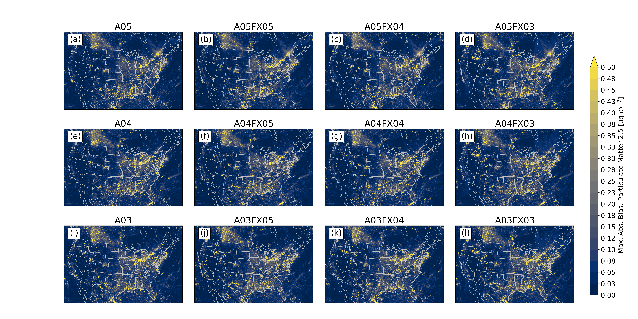
Annual Maximum Absolute PM_{2.5} Bias, Model to Model

Slide 26
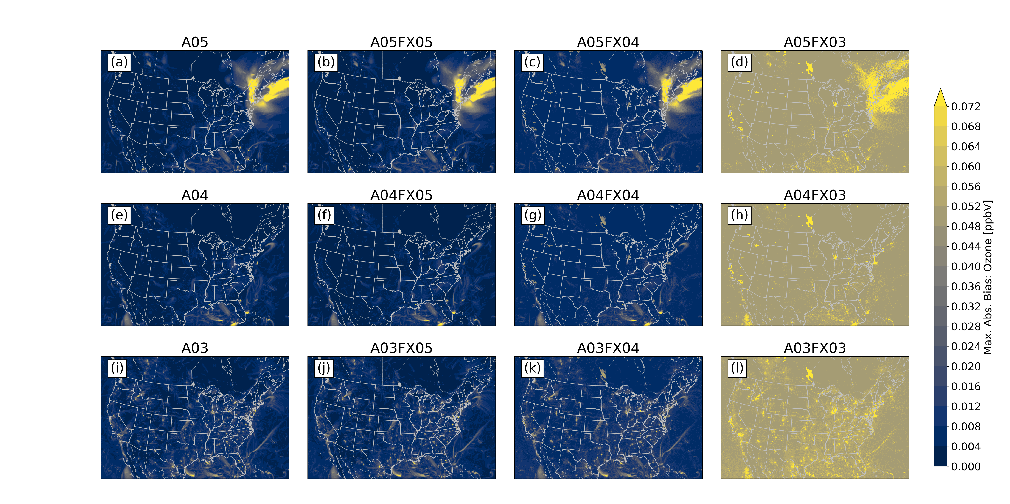
Annual Maximum Absolute O₃ Bias, Model to Model

Slide 27
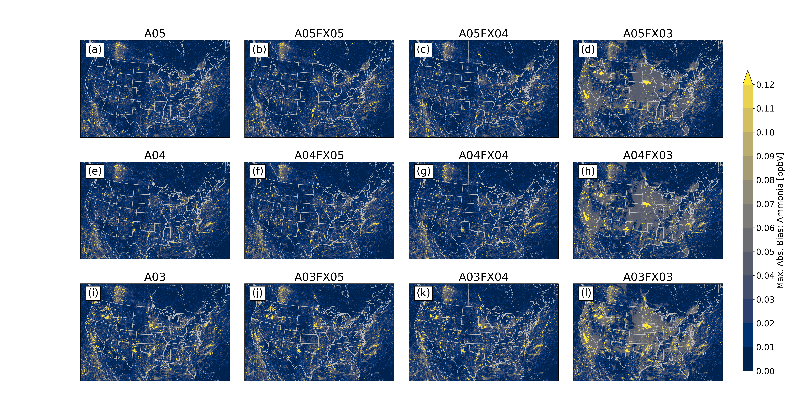
Annual Maximum Absolute NH₃ Bias, Model to Model

Slide 28
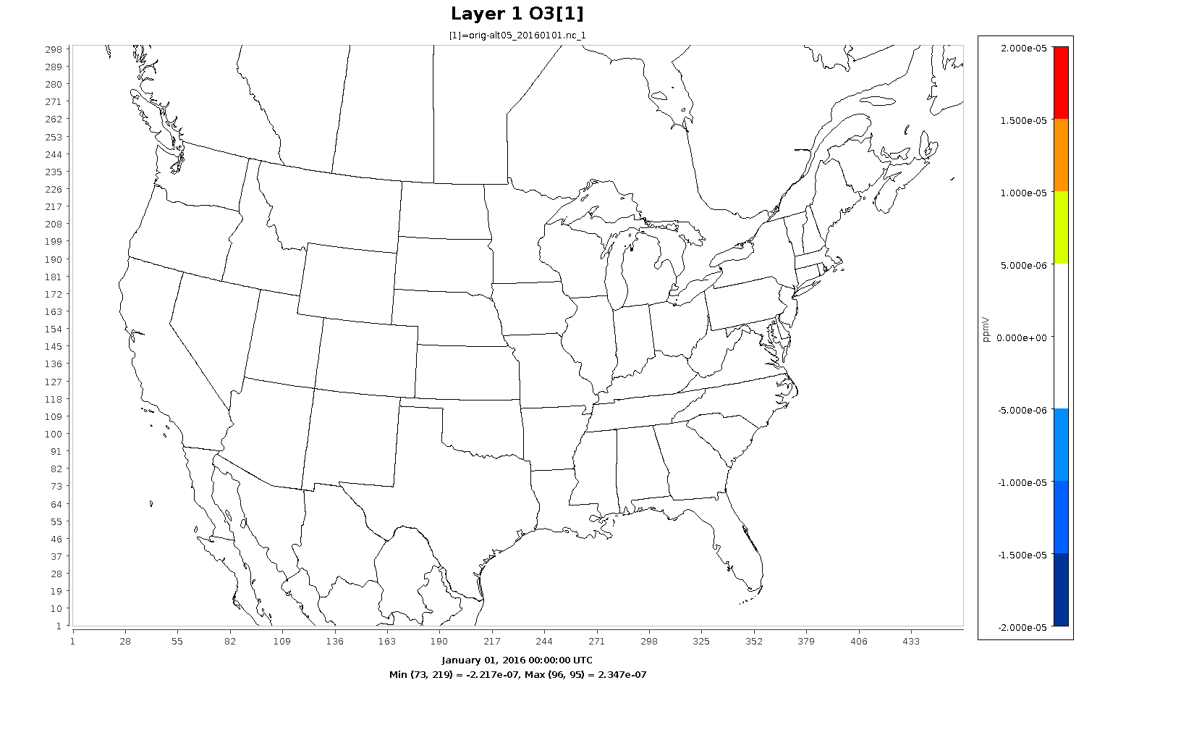
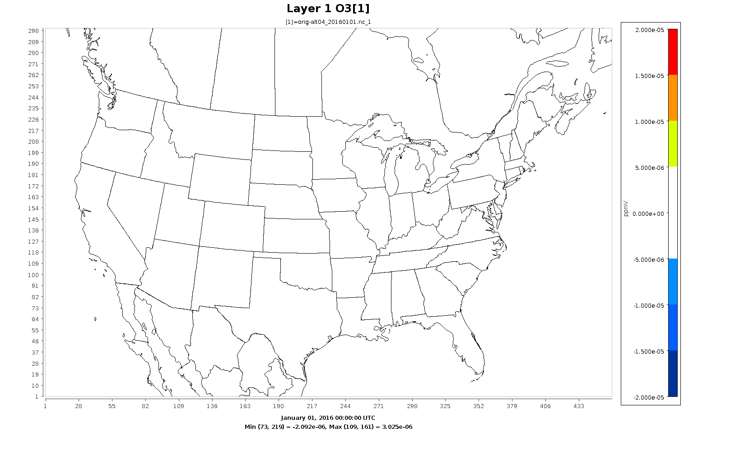
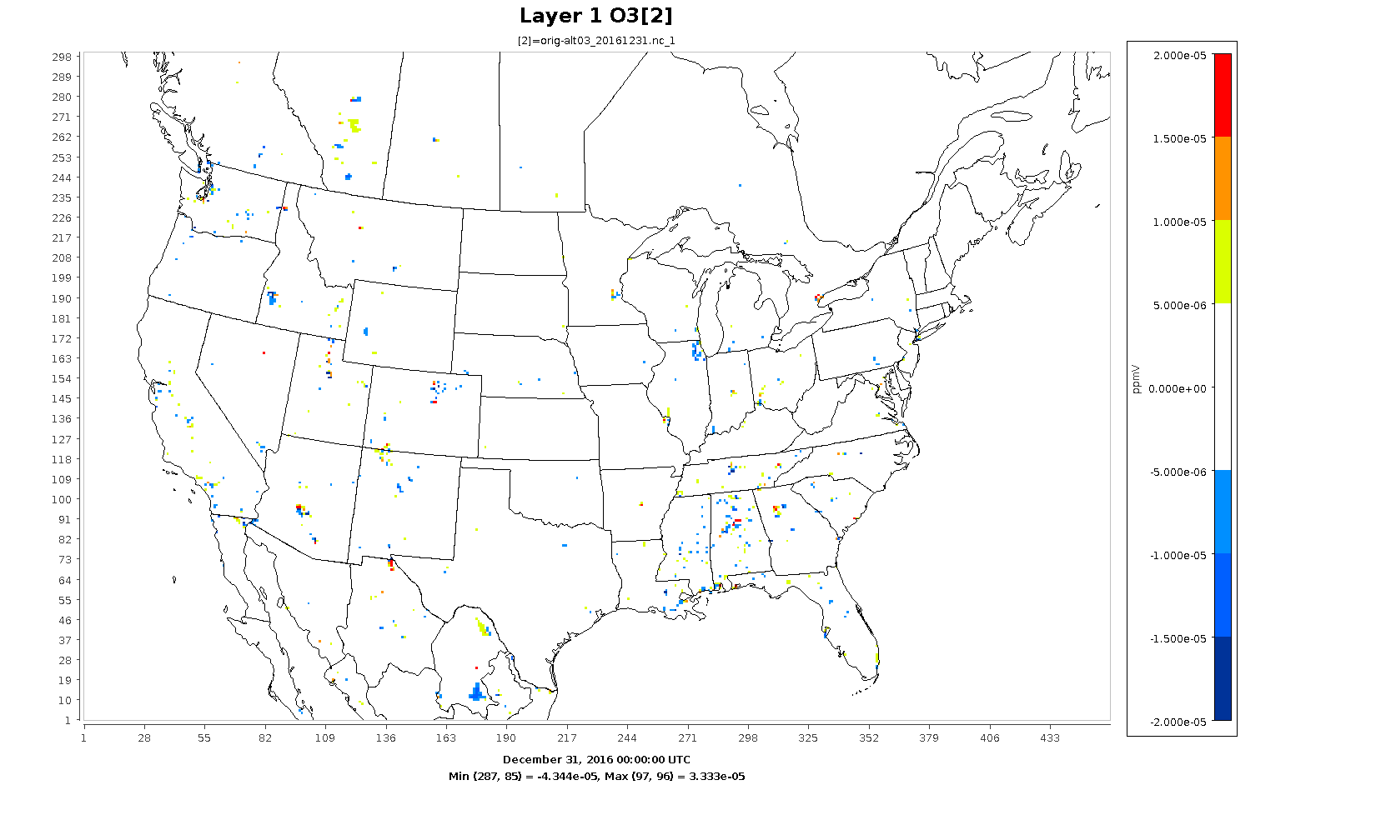
O₃ Model Bias (orig – alt*)

Slide 29
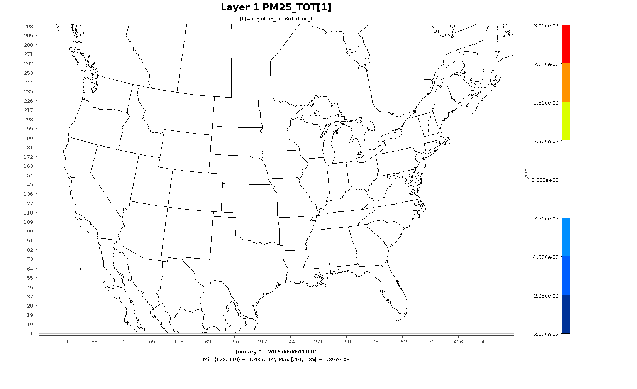
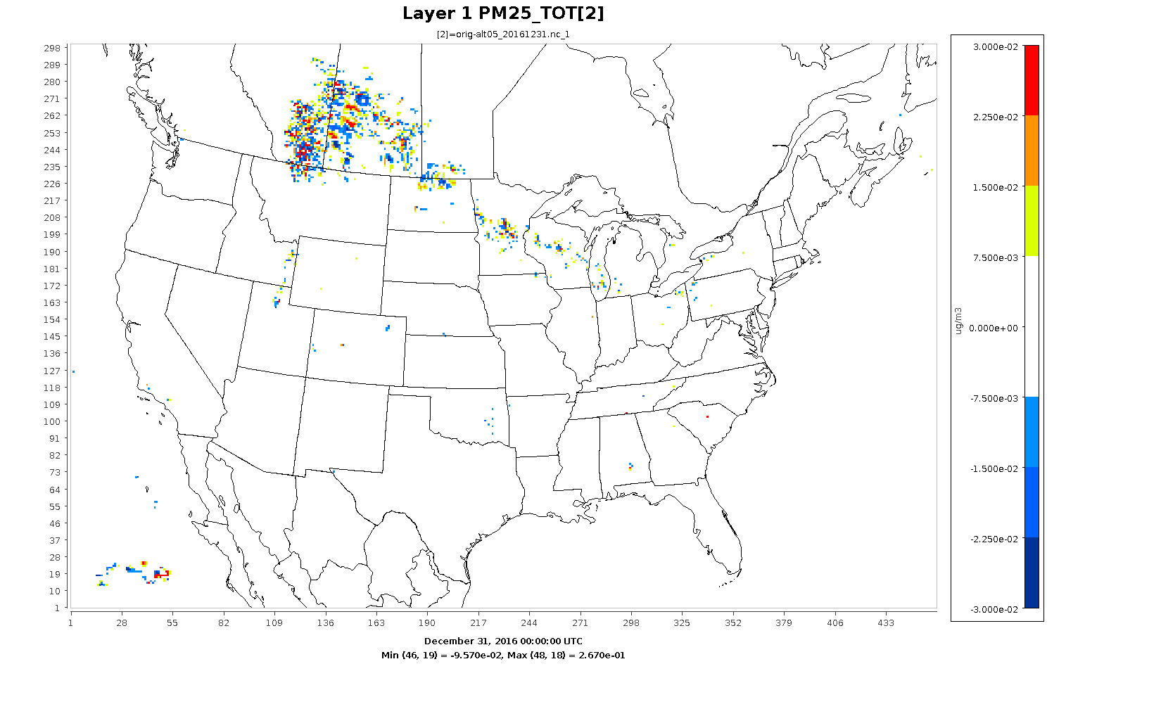
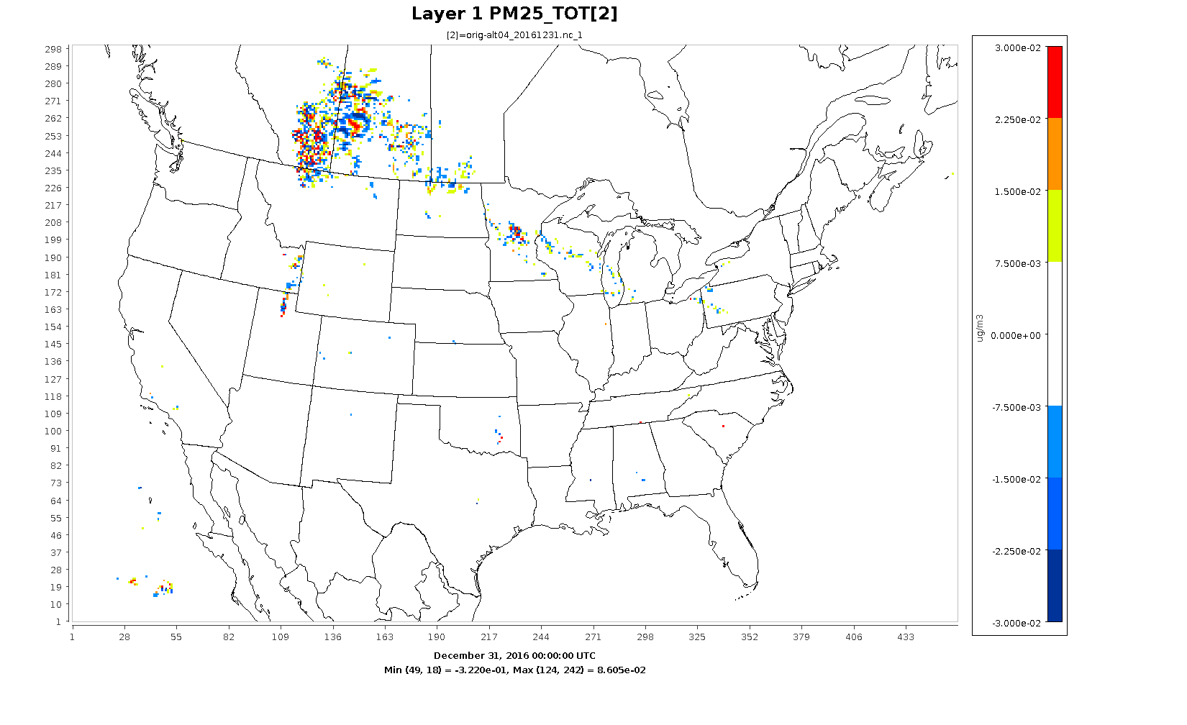
PM₂₅ Model Bias (orig – alt*)

Slide 30
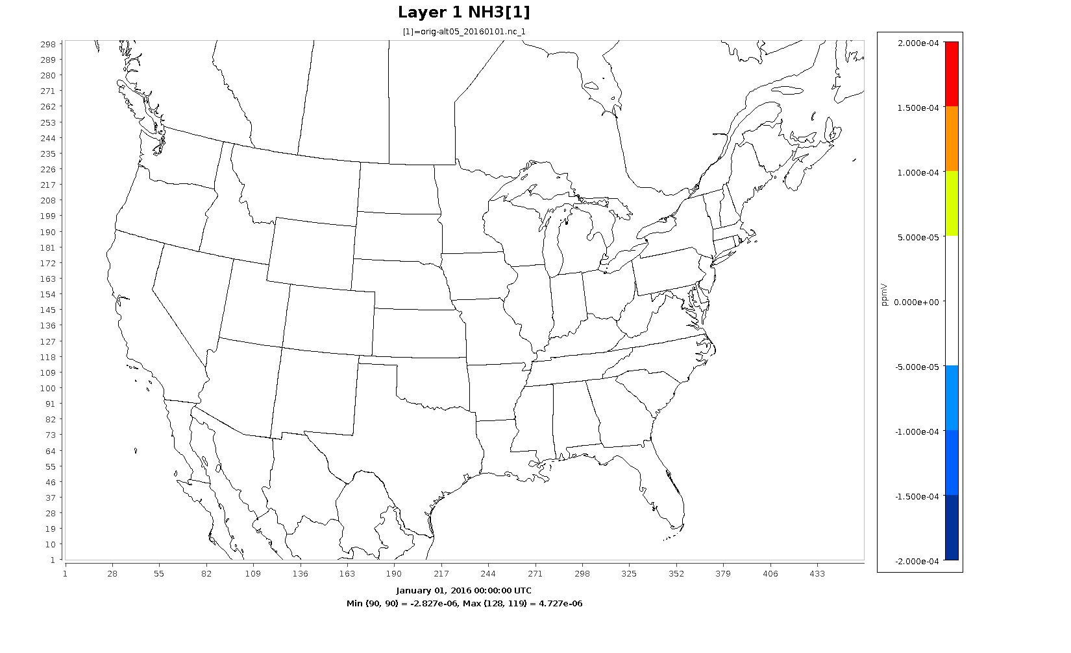
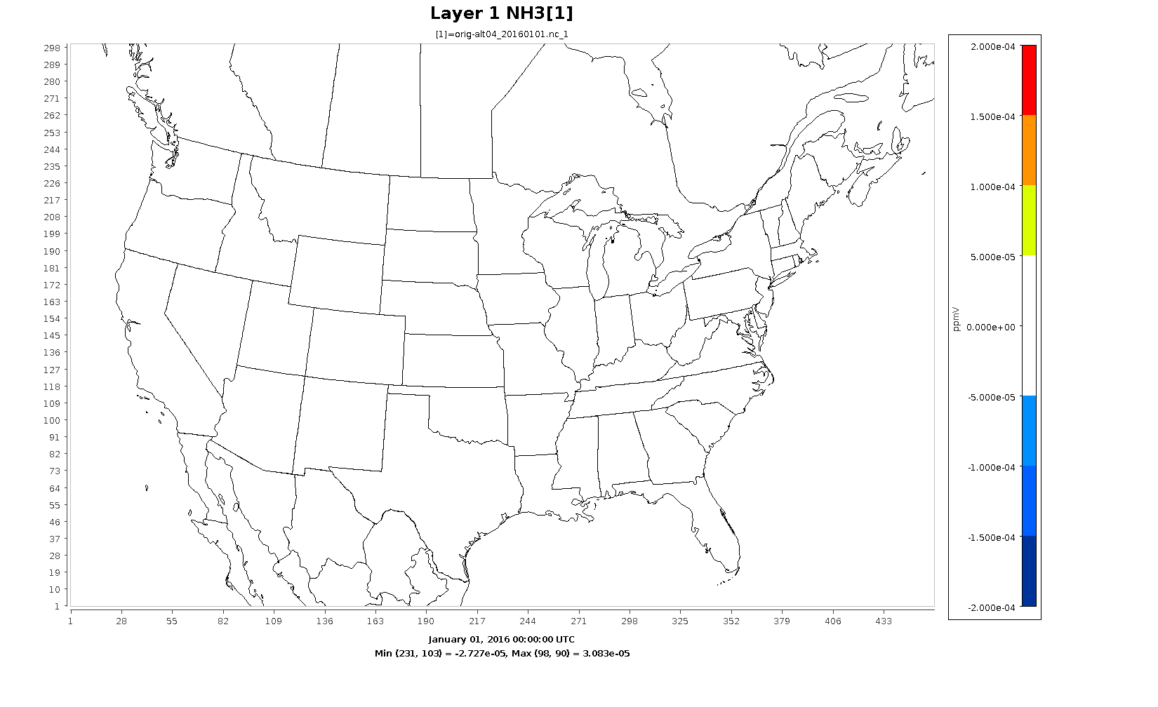
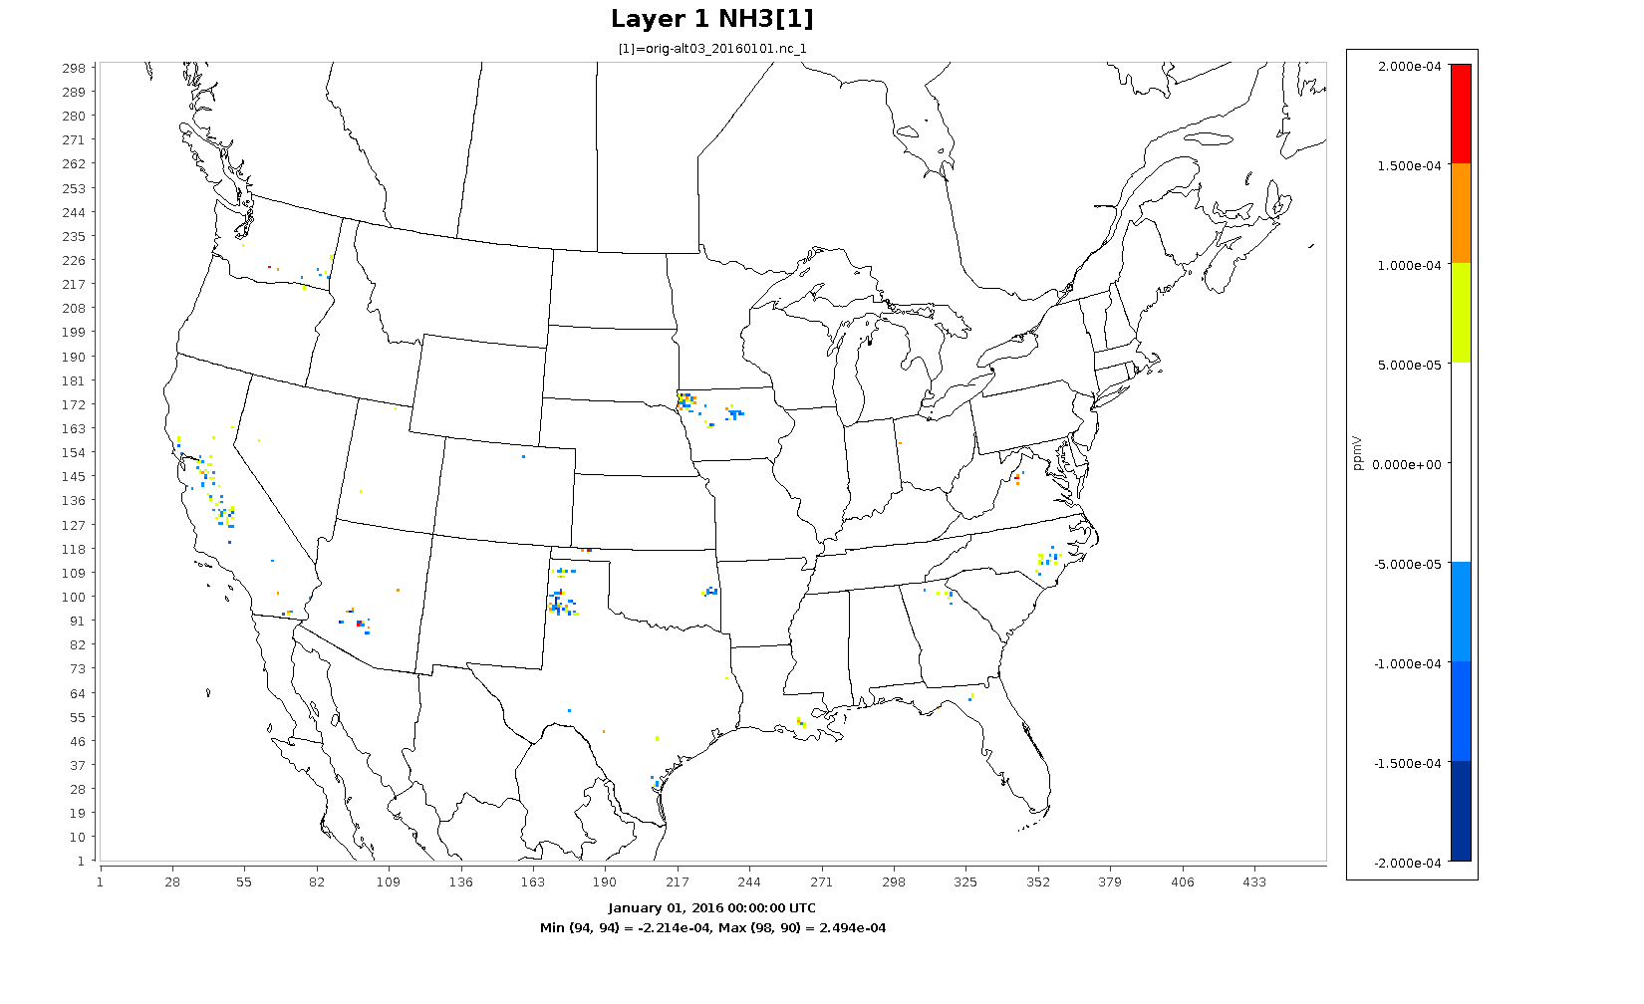
NH₃ Model Bias (orig – alt*)

Slide 31
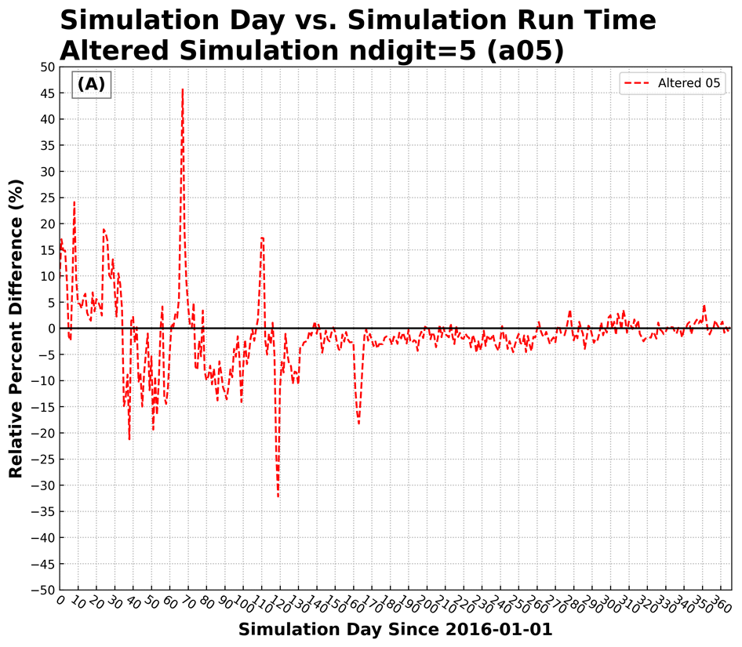
Run Time

Slide 32
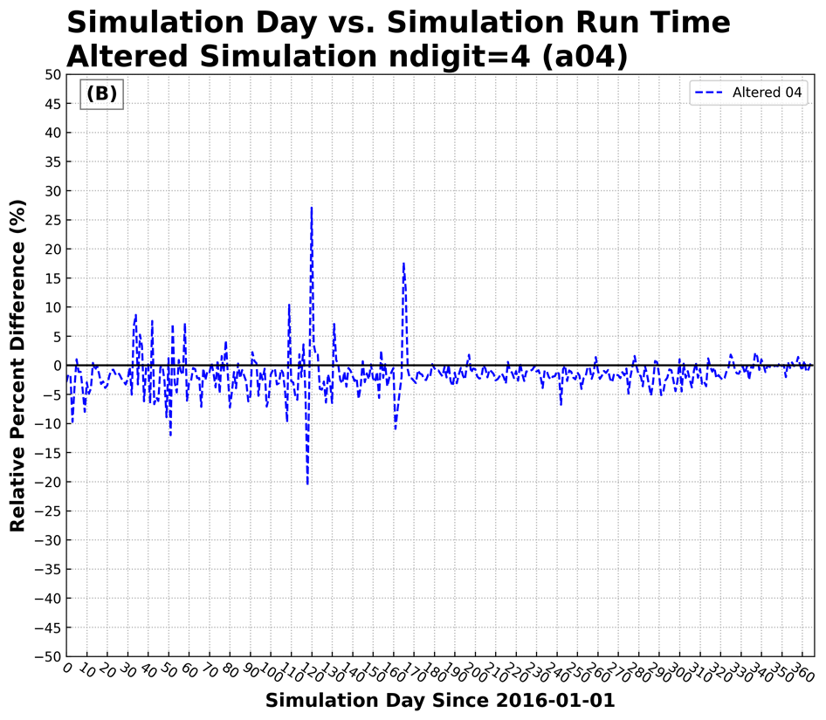
Run Time (cont’d)

Slide 33
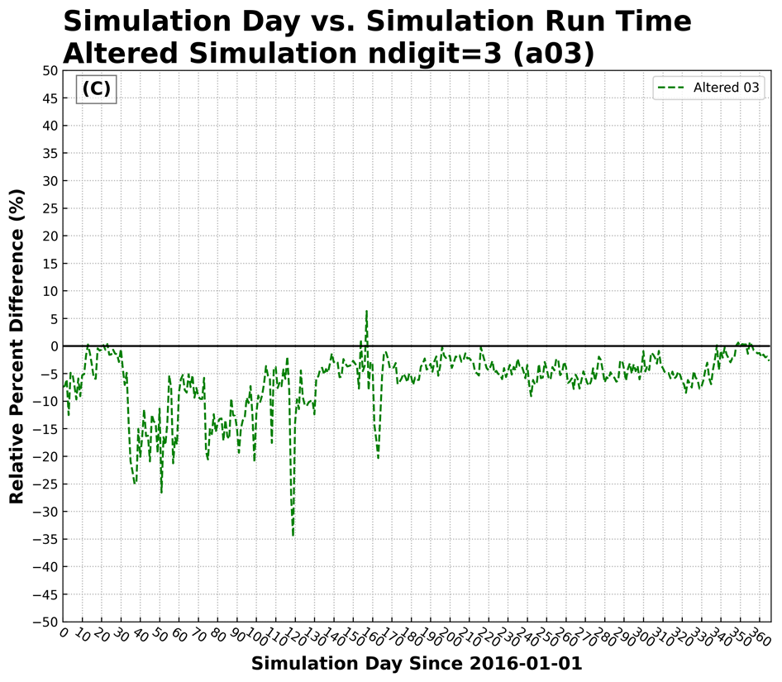
Run Time (cont’d)

Slide 34
Conclusions
This new approach is considered as a lossy compression method.
Bzip2 performs better than gzip.
With bzip2, the relative daily emission files (2 grided and 9 point sources) compression between altered case vs original case are about 6%, 25%, and 48% for N = 5, 4, and 3, respectively.
With bzip2, the relative daily output files (7 out of 10 are altered) compression between altered case vs original case are about 19%, 47%, and 69% for N = 5, 4, and 3, respectively.
With the altered emission input and/or with altered output, no significant statistical differences were found in model performance.

Slide 35
Future Work
Similar study is undergoing for met model, WRF.
Eventually a combination of altering met model input and emission input will be apply to the WRF-CMAQ coupled model to evaluate the full impact.

