Slide 1

Impact of Severe Drought on Air Quality in California
Huazhen Liu
PhD Student
Gillings School of Global Public Health
Department of Environmental Sciences and Engineering
Jared H. Bowden, Timothy Glotfelty, Jordan Kern, J. Jason West

Slide 2
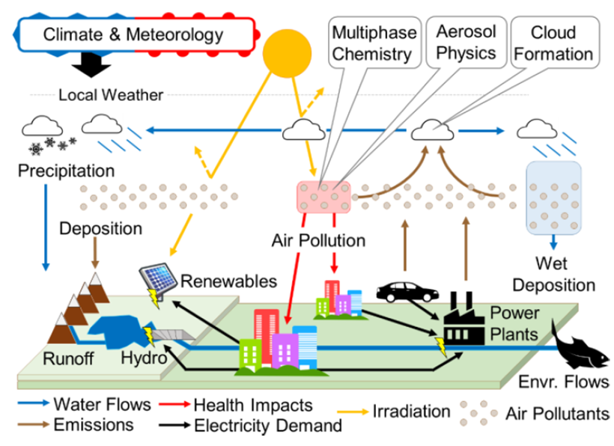
Impacts of Drought
Hydrology
Society
Reduced runoff and hydropower
Increased electricity demand
Meteorology
Higher temperature & lower humidity
Anthropogenic emissions
Reduced precipitation
(wet deposition)
Increased fossil electricity generation
Increased stagnation
Ecosystems
Increased wildfire
Interactions and feedbacks among climate, meteorology, hydrology, emissions, pollution, technology, and ecosystems
Deteriorated air pollution
Biology
Reduced stomatal uptakes

Slide 3
Drought and Air Quality
A review of previous studies on relationships between drought and air quality
Most studies identified drought affecting air quality via natural processes, seldom focusing on the change in anthropogenic emissions during drought periods.
Statistical analysis on observations was widely used by these studies. Some of them also employed global models, such as GEOS-Chem. However, regional models like WRF-Chem were rarely used in this research field.
[Wang et al., 2015; Wang et al., 2017; Achakulwisut et al., 2018; Demetillo et al., 2019; Hu et al., 2019; Lin et al., 2020; Lei et al., 2022]

Slide 4
Motivation
Advance our holistic understanding of the dynamic connections and feedbacks among climate change, meteorology, drought, power plant emissions, and air pollution.
Objectives
1
2
Analyze relationships between drought and air pollution in California using observations.
Quantify the contributions of different processes leading to these relationships using WRF-Chem model.

Slide 5
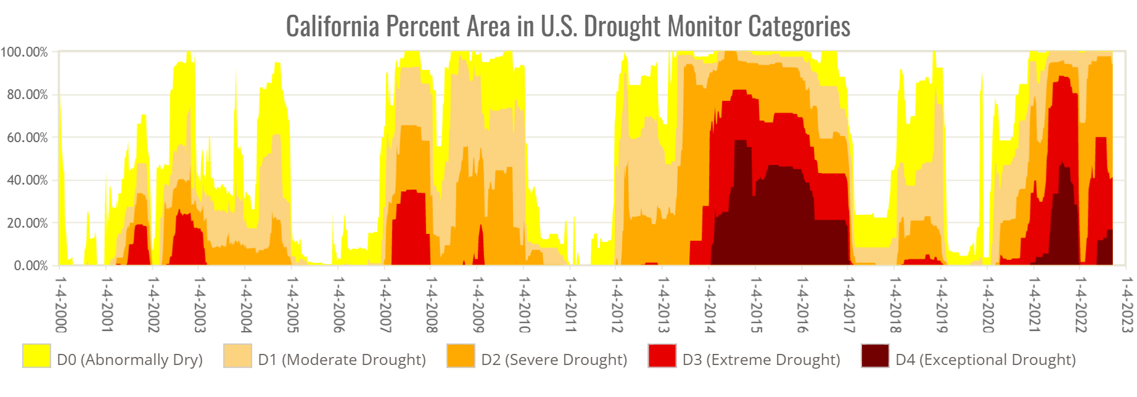
Drought Conditions in California
U.S. Drought Monitor: a combination of Palmer Drought Severity Index, CPC Soil Moisture Model, USGS Weekly Streamflow, Standardized Precipitation Index, and Objective Drought Indicator Blends.
[Source: https://droughtmonitor.unl.edu/DmData/TimeSeries.aspx]

Slide 6
Climate Divisions in California
PDSI: Palmer Drought Severity Index
Category | Extreme Drought | Severe Drought | Moderate Drought | Mid-Range | Moderately Moist | Very Moist | Extremely Moist
PDSI Value | -4.00 and lower | -3.00 – -3.99 | -2.00 – -2.99 | -1.99 – 1.99 | 2.00 – 2.99 | 3.00 – 3.99 | 4.00 or greater
California Climate Divisions

Slide 7
Air Quality in California
Distribution of air pollutants monitoring stations

Slide 8
Air Quality During Drought Periods
Climate division | Start date | End date | Duration (months) | Mean PDSI | Mean PM_{2.5} (μg/m³) | Mean ozone (ppb)
C1 | 03/2015 | 11/2015 | 9 | -3.544 | 7.076 | 35.185
 | 03/2021 | 12/2021 | 10 | -4.154 | 12.293 | 33.596
 | Non-drought periods |  |  | 0.027 | 7.963 | 32.112
Climate division | Start date | End date | Duration (months) | Mean PDSI | Mean PM_{2.5} (μg/m³) | Mean ozone (ppb)
C2 | 03/2015 | 11/2015 | 9 | -3.524 | 7.748 | 46.327
 | 12/2020 | 09/2021 | 10 | -4.481 | 12.164 | 43.531
 | Non-drought periods |  |  | 0.332 | 8.869 | 41.717
Climate division | Start date | End date | Duration (months) | Mean PDSI | Mean PM_{2.5} (μg/m³) | Mean ozone (ppb)
C3 | 11/2013 | 04/2015 | 18 | -4.137 | 4.693 | -
 | 09/2020 | 09/2021 | 13 | -4.155 | 15.405 | 49.544
 | Non-drought periods |  |  | 0.711 | 4.552 | -

Slide 9
Air Quality During Drought Periods
Climate division | Start date | End date | Duration (months) | Mean PDSI | Mean PM_{2.5} (μg/m³) | Mean ozone (ppb)
C4 | 04/2013 | 12/2015 | 33 | -5.222 | 7.922 | 35.988
 | 04/2021 | 09/2021 | 6 | -4.492 | 7.746 | 37.865
 | Non-drought periods |  |  | 0.167 | 8.347 | 35.406
Climate division | Start date | End date | Duration (months) | Mean PDSI | Mean PM_{2.5} (μg/m³) | Mean ozone (ppb)
C5 | 03/2013 | 03/2016 | 37 | -5.657 | 12.641 | 47.862
 | 11/2020 | 11/2021 | 13 | -4.908 | 13.665 | 44.368
 | Non-drought periods |  |  | 0.674 | 11.583 | 46.272

Slide 10
Air Quality During Drought Periods
Climate division | Start date | End date | Duration (months) | Mean PDSI | Mean PM_{2.5} (μg/m³) | Mean ozone (ppb)
C6 | 06/2012 | 12/2016 | 55 | -5.815 | 11.308 | 44.004
 | 11/2017 | 12/2018 | 14 | -5.069 | 11.552 | 43.480
 | 02/2021 | 12/2021 | 11 | -4.725 | 10.756 | 45.530
 | Non-drought periods |  |  | 0.715 | 11.051 | 44.048
Climate division | Start date | End date | Duration (months) | Mean PDSI | Mean PM_{2.5} (μg/m³) | Mean ozone (ppb)
C7 | 01/2014 | 11/2014 | 11 | -3.974 | 10.478 | 53.307
 | 05/2016 | 11/2016 | 7 | -3.437 | 8.997 | 52.881
 | 04/2018 | 09/2018 | 6 | -3.717 | 10.546 | 58.459
 | 11/2020 | 12/2021 | 14 | -3.931 | 9.277 | 46.157
 | Non-drought periods |  |  | 0.167 | 7.725 | 47.658

Slide 11
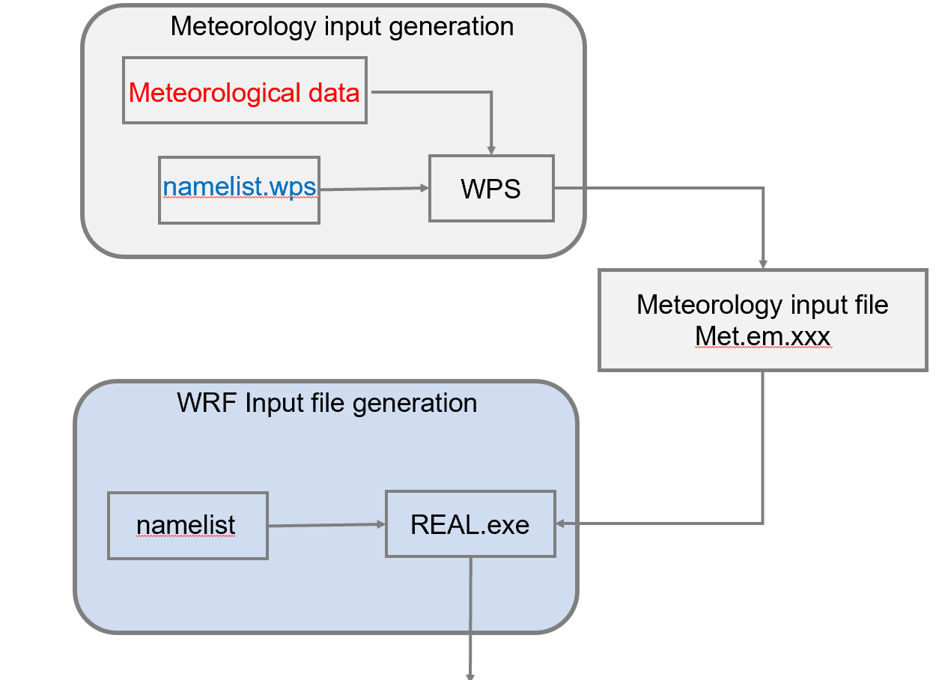
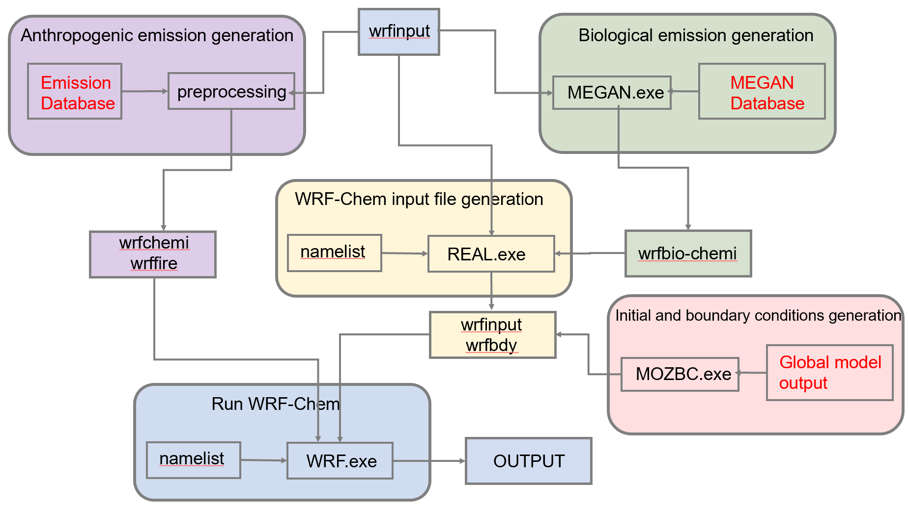
WRF-Chem Simulation
Separate the contributions of meteorological and biological processes and increased anthropogenic emissions.
Increased electricity demand
Increased fossil electricity generation
Reduced hydropower

Slide 12
Study Periods
Anthropogenic emissions
Biogenic emissions
Meteorology
Composite Year Periods Representing the Full Annual Cycle of Different Climate Regimes in California
Simulation 1
Drought
Non-Drought
Drought Regimes | Periods
Drought | April 2021 – November 2021
 | December 2013 – March 2014
Wet | January 2005 – December 2005
Neutral | October 2019 – January 2020
 | February 2010 – September 2010
Simulation 2
Simulation 3
WRF-Chem Simulation Experiments
Simulation 4
Simulation 5
Simulation 6
Simulation 7

Slide 13
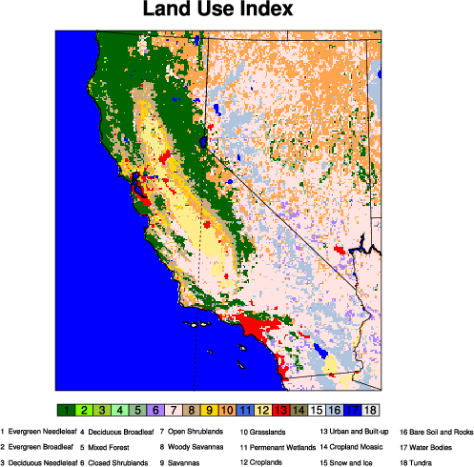
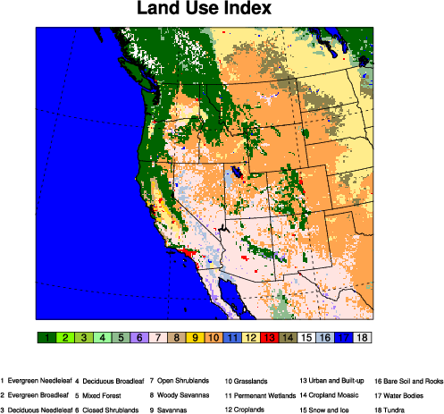
Simulation Area
Spatial resolution: 12km-4km
Meteorological data: ERA5

Slide 14
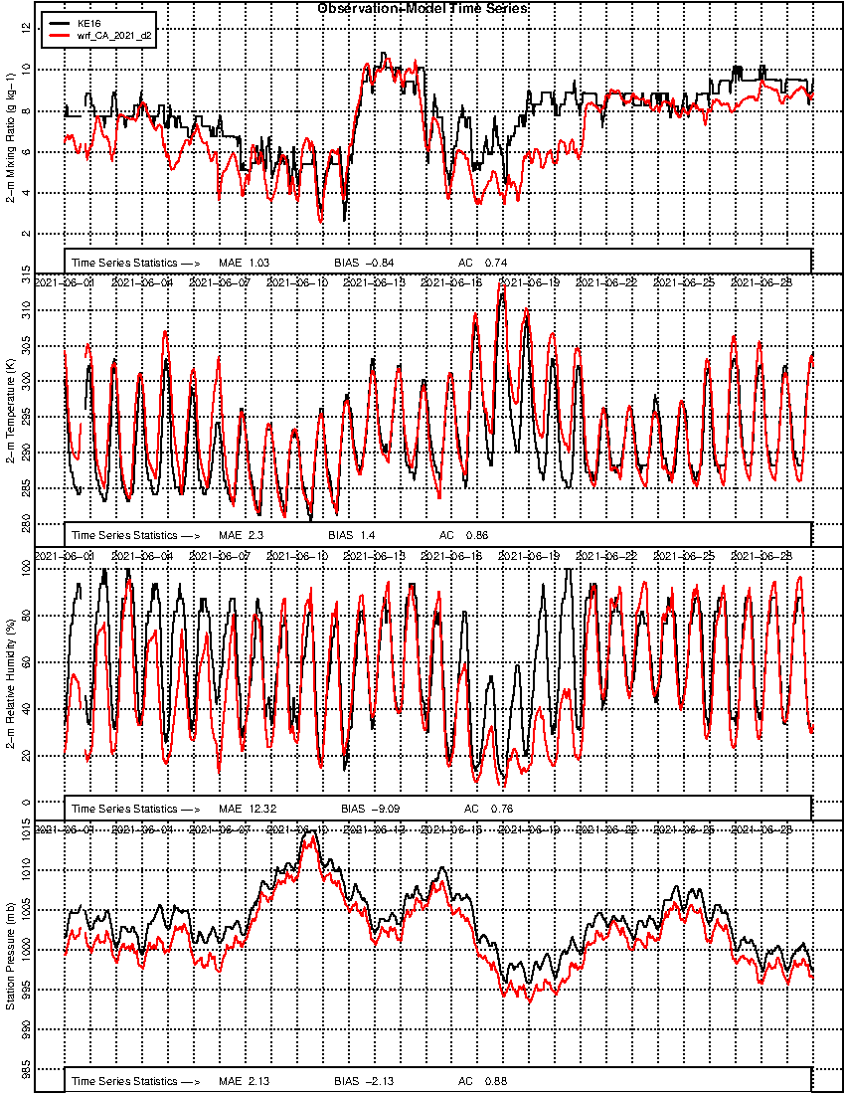
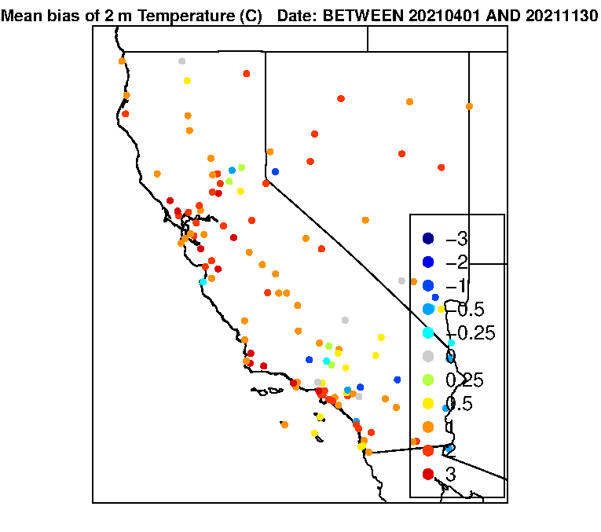
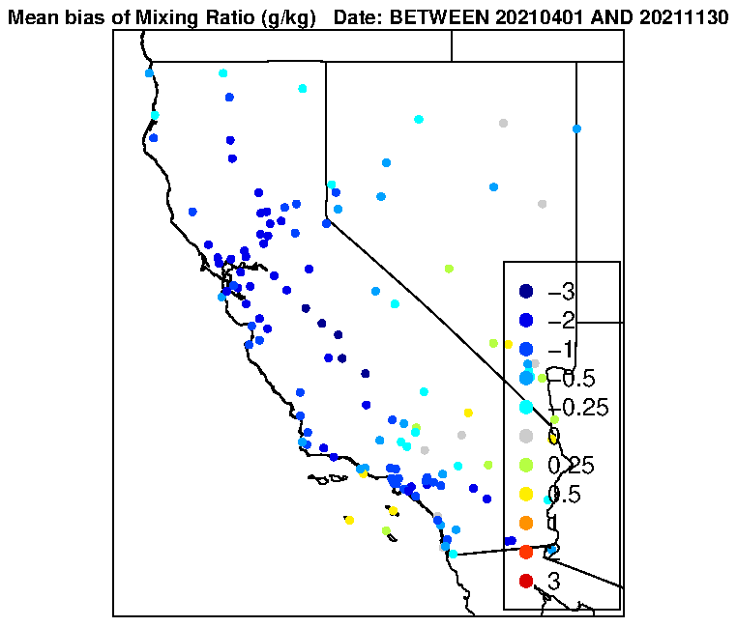
WRF Model Evaluation
Observations
WRF simulations
Observation-Model Time Series
Comparison between WRF simulations with observations MADIS during the “Extreme Drought of 2021”
2m Mixing Ratio (g/kg)
2m Temperature (K)
2m Relative Humidity (%)
Temperature at 2m
20210401-20211130
Mixing ratio of water vapor
20210401-20211130
Surface Pressure(mb)
Too warm
Too dry
KE16 (20210601-20210630)

Slide 15
Results
There are some differences between the air quality of drought and non-drought periods in California, but a more robust analysis is required to understand and isolate those differences.
When simulating meteorology during drought periods in California, WRF model overestimated temperature while underestimated humidity by failing to cool down and catch high humidity.
Future work
1
Further analyze observations to infer changes in air quality during droughts, and relationships with meteorological, hydrological, electric power, and emissions data
2
Improve WRF performance.
3
Test and evaluate WRF-Chem simulations.
4
Separate the contributions of different processes using WRF-Chem model.

Slide 16
Acknowledgements
Advisor
Jason West
Collaborators
Jared Bowden (NCSU)
Timothy Glotfelty (NCSU)
Jordan Kern (NCSU)
Funding Source
NSF

Slide 17
Thanks for your attention!
Questions?

