Slide 1

Evaluation of Regional-Scale CMAQv5.4 for North America
K. Wyat Appel, Christian Hogrefe, Kristen Foley, Robert Gilliam, Daiwen Kang, George Pouliot, Benjamin Murphy, Havala Pye, Bryan Place, Jonathan Pleim, Jesse Bash, Golam Sarwar, Sergey Napelenok, David Wong, Rohit Mathur, Fahim Sidi, Chris Nolte, Jeff Willison, Kathleen Fahey, William Hutzell, Emma D’Ambro, Tanya Spero, and Donna Schwede (retired)
Atmospheric and Environmental Systems Modeling Division
Center for Environmental Measurement and Modeling
Office of Research and Development, US EPA
The views expressed in this presentation are those of the authors and do not necessarily reflect the views or policies of the U.S. Environmental Protection Agency.
17 October 2022
21st Annual CMAS Conference
Chapel Hill, NC

Slide 2
CMAQv5.4 – Updates and New Features
Science updates and new features
  Gas and Aerosol Chemistry
    Carbon Bond mechanism updated to version CB6r5 (see Golam Sarwar’s presentation on Wednesday)
    A new chemical mechanism, the Community Regional Atmospheric Chemistry Multiphase Mechanism (CRACMM) v1.0 available in v5.4 (see Havala Pye’s presentation on Wednesday)
    Two-Dimensional Volatility Basis Set (2D-VBS) for SOA formation and aging (contribution from Tsinghua University)
  Land Surface Exchange
    Extensive updates to aerosol dry deposition in both the M3Dry and STAGE models
  Biogenics
    BEIS model updated to improve consideration of land-use
    The Model of Emissions of Gases and Aerosols from Nature (MEGAN) v3.2 now available as an option in v5.4
  Explicit and Lumped air quality Model output Module (ELMO)
    streamlines the definition, calculation, and maintenance of over 170 aggregate particulate matter parameters
  Instrumented Models
    Instrumented versions of CMAQ are now fully integrated into the base model
    CMAQ-ISAM has added flexibility to define how secondarily formed gaseous species are assigned to sources of parent reactants
    CMAQ-DDM-3D sensitivity calculations accessed through compiler flags in the build script
Release schedule
  AMETv1.5 released August 2022: https://github.com/USEPA/AMET
  CMAQv5.4 released October 2022: https://github.com/USEPA/CMAQ
  VERDIv2.1.4 released October 2022: https://github.com/CEMPD/VERDI
  CMAQv5.4 FAQ: https://github.com/USEPA/CMAQ/wiki/CMAQv5.4-Series-FAQ

Slide 3
CMAQ Inputs and Configuration
 | CMAQv5.3.3 | CMAQv5.4
WRF Version | 4.3.3 | 4.3.3
MCIP Version | 5.3.3 | 5.3.3
Boundary Conditions | v5.3.3 Hemispheric CMAQ (M3Dry and STAGE) | v5.4 Hemispheric CMAQ (M3Dry and STAGE)
Chemical Mechanism | CB6r3 | CB6r5 and CRACMMv1.0
Aerosol Module | AERO7 | AERO7
Deposition Scheme | M3Dry and STAGE (Shu et al., 2022) | M3Dry (Pleim at al., 2022) and STAGE (Emerson et al.)
Bi-directional Ammonia | Yes | Yes
Wind-blown Dust | No | No
Lightning NOx | Yes | Yes
Biogenic Model | BEIS | BEIS/MEGAN
All simulations are 2018 CONUS 12-km annual simulation; BCs provided by HCMAQ simulations (Christian Hogrefe’s presentation)
MCIP from the same 2018 WRF v4.3.3 simulation used in all simulations (WRF simulations use lightning assimilation)
2018 emissions are the same as those used for the EQUATES project

Slide 4
Ozone

Slide 5
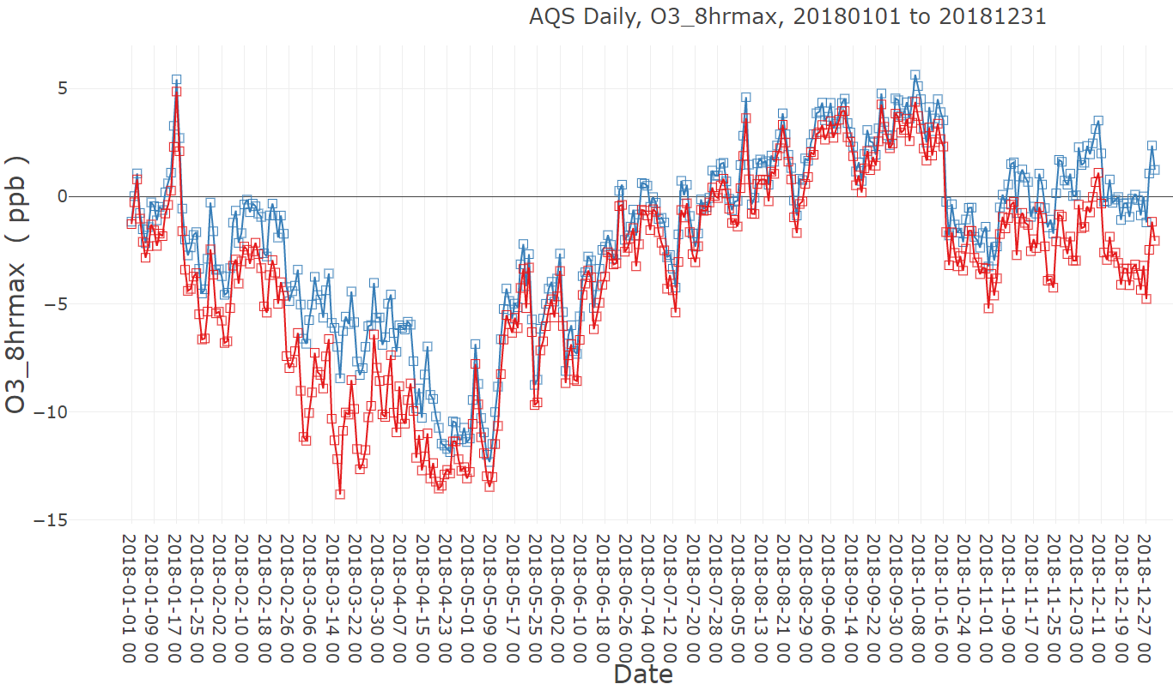
MDA8 O₃ Bias (Daily) – v5.3.3 vs v5.4 (M3Dry)
Reduced underestimation of O₃ in winter and spring with v5.4
v5.4
v5.3.3
Slightly higher O₃ from late spring through fall with v5.4

Slide 6
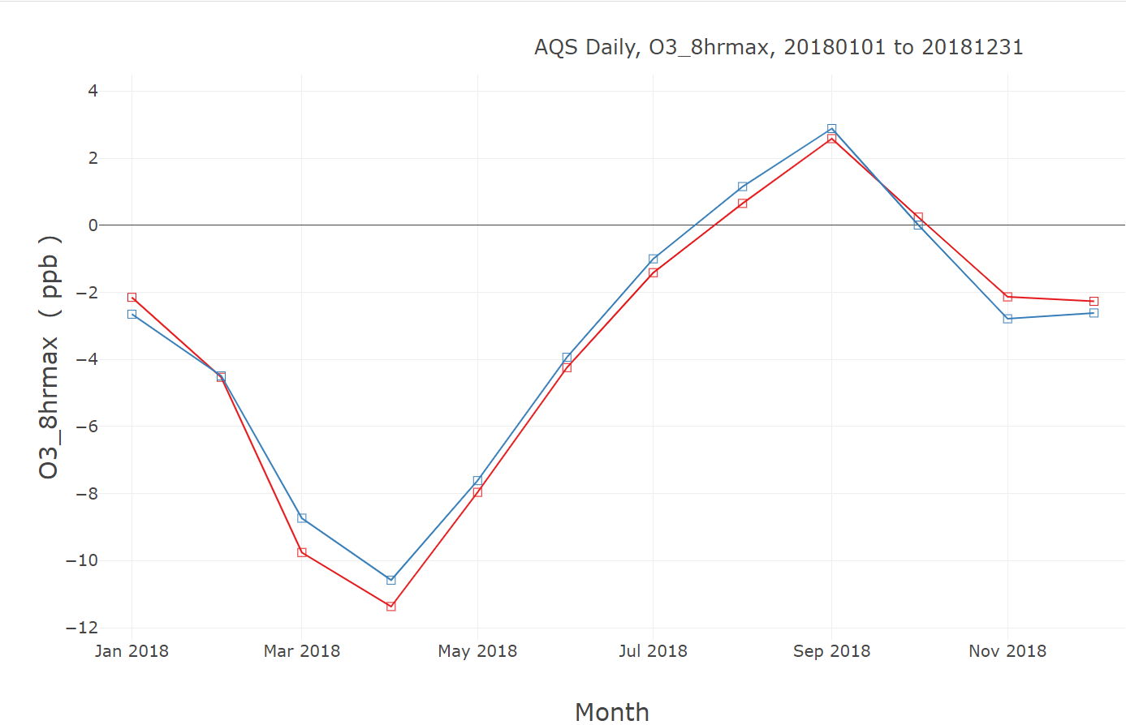
MDA8 O₃ Bias (Monthly) – v5.3.3 vs v5.4
v5.3.3 M3Dry
v5.3.3 STAGE

Slide 7
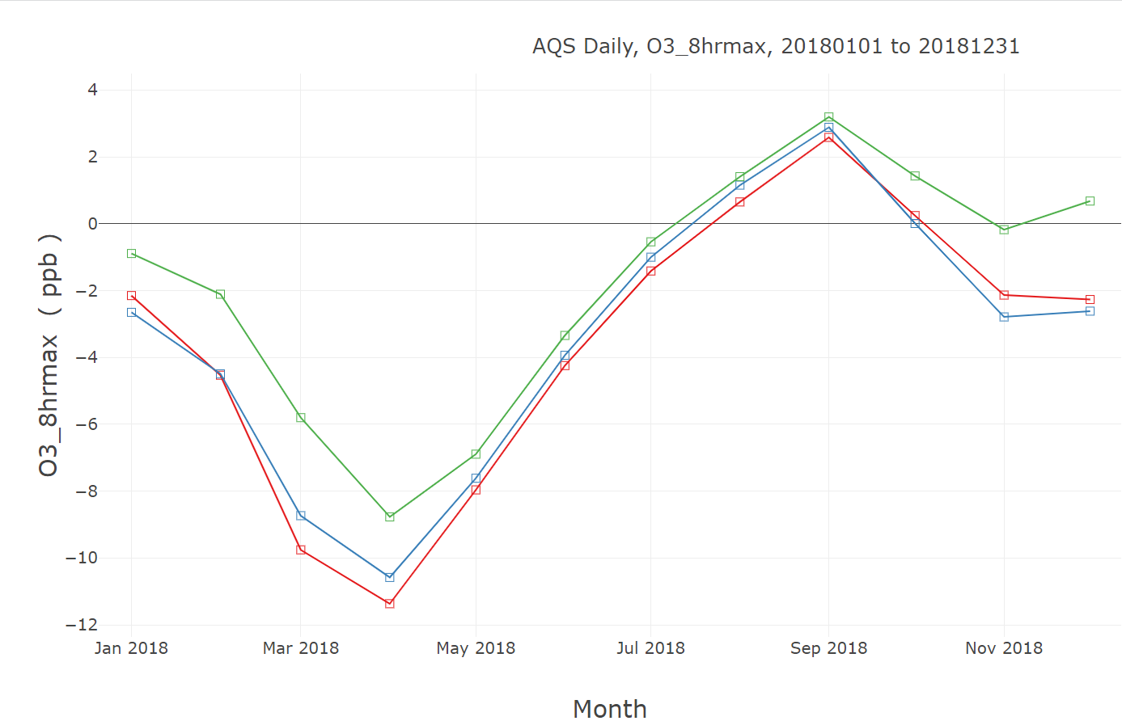
MDA8 O₃ Bias (Monthly) – v5.3.3 vs v5.4
v5.3.3 M3Dry
v5.3.3 STAGE
v5.4 M3Dry

Slide 8
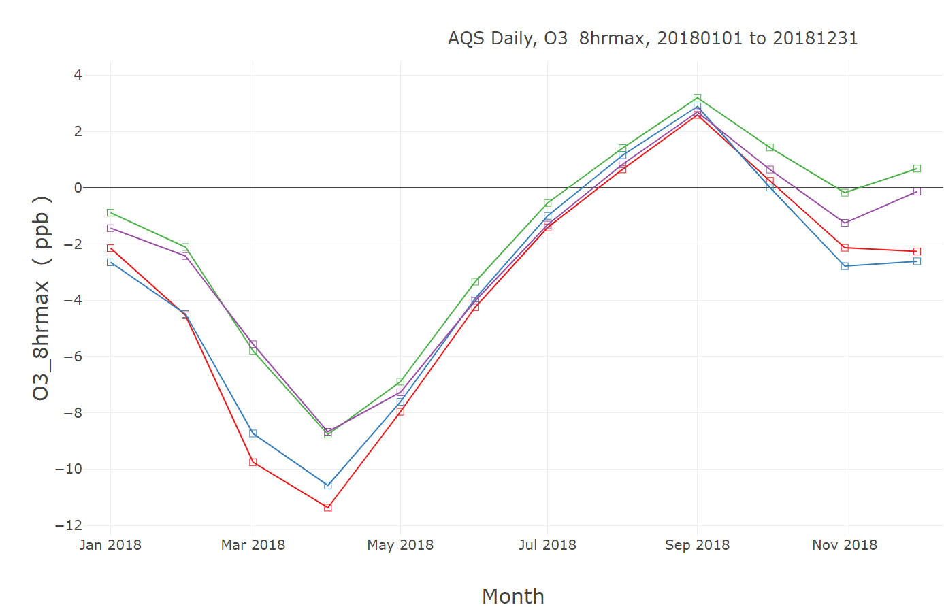
MDA8 O₃ Bias (Monthly) – v5.3.3 vs v5.4
v5.3.3 M3Dry
v5.3.3 STAGE
v5.4 M3Dry
v5.4 STAGE

Slide 9
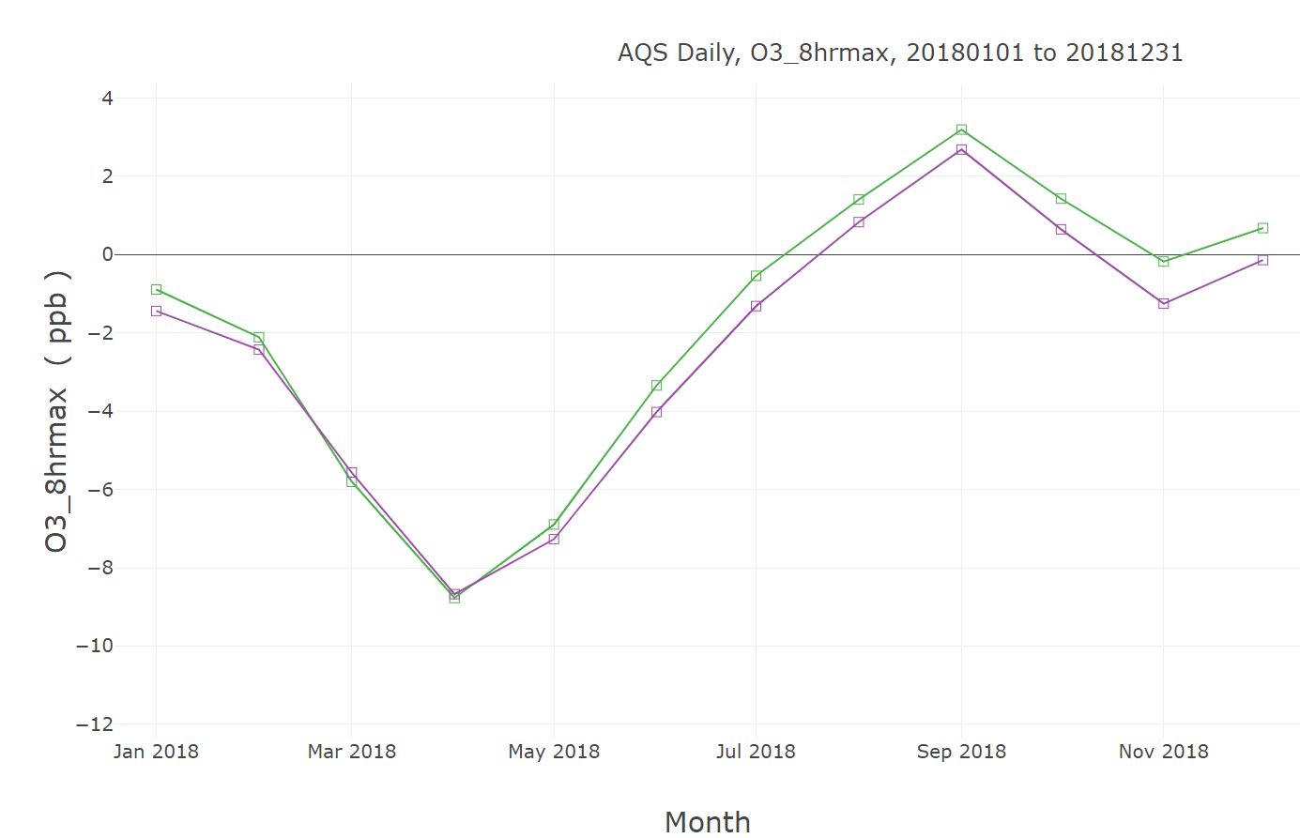
MDA8 O₃ Bias (Monthly) – CB6r5 vs. CRACMM
v5.4 M3Dry
v5.4 STAGE

Slide 10
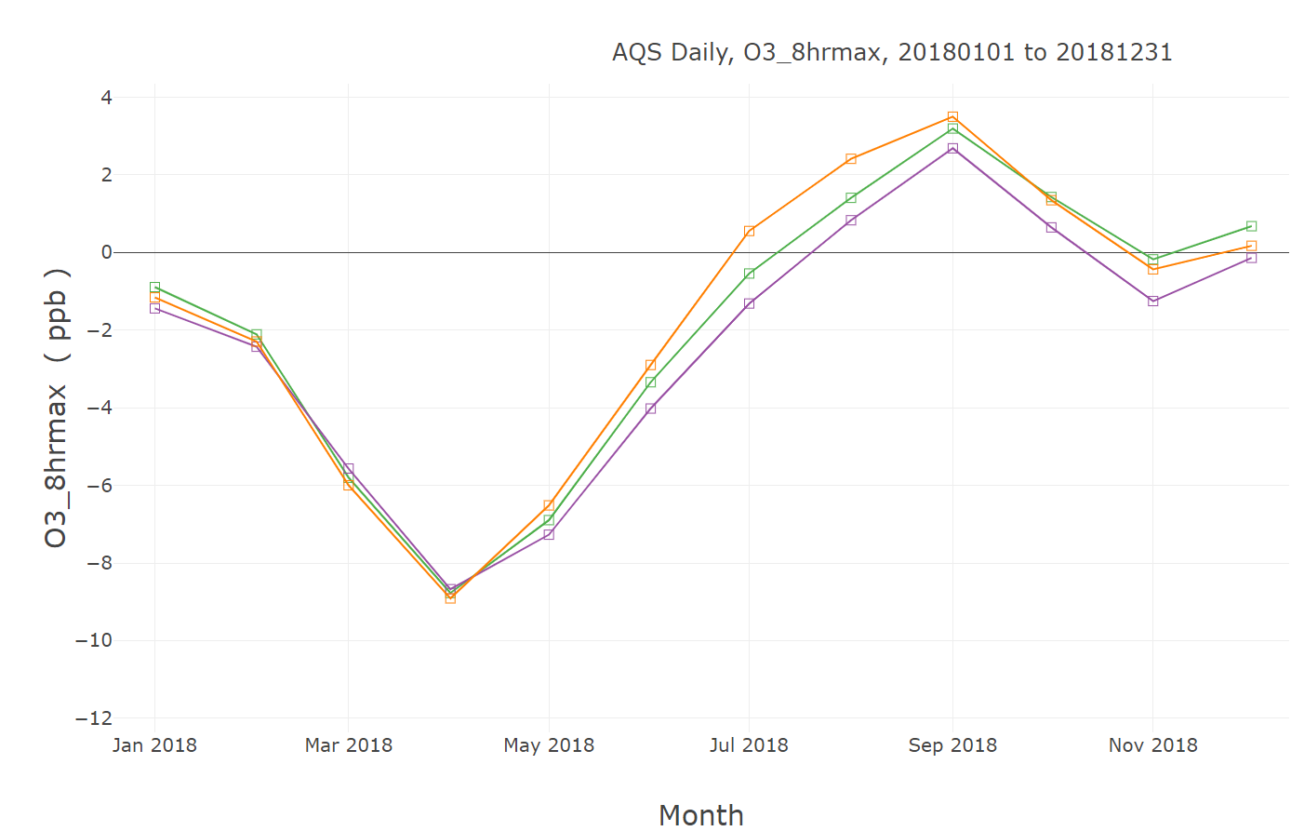
MDA8 O₃ Bias (Monthly) – CB6r5 vs. CRACMM
v5.4 M3Dry
v5.4 STAGE
v5.4 M3Dry, CRACMM

Slide 11
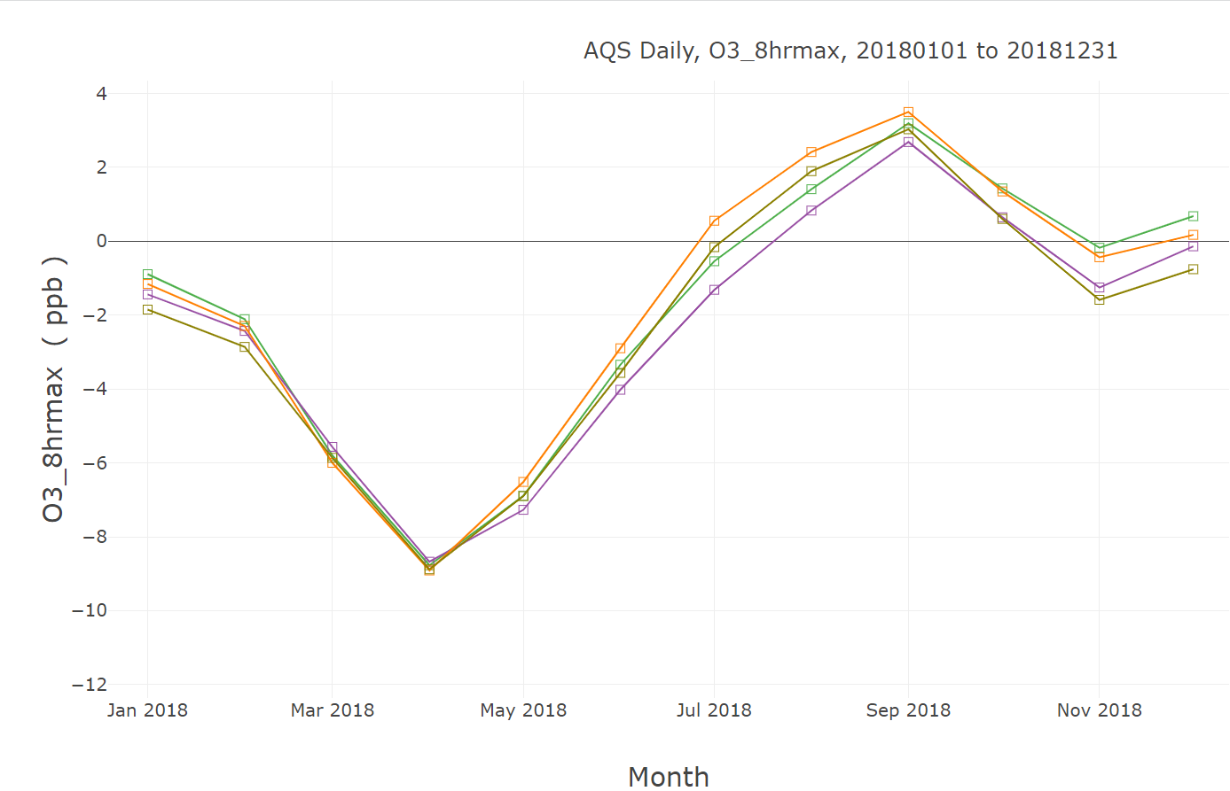
MDA8 O₃ Bias (Monthly) – CB6r5 vs. CRACMM
v5.4 M3Dry
v5.4 M3Dry
v5.4 STAGE
v5.4 STAGE
v5.4 M3Dry, CRACMM
v5.4 M3Dry, CRACMM
v5.4 STAGE, CRACMM

Slide 12
MDA8 O₃ Bias (Monthly) – BEIS vs. MEGAN
v5.4 M3Dry
v5.4 STAGE

Slide 13
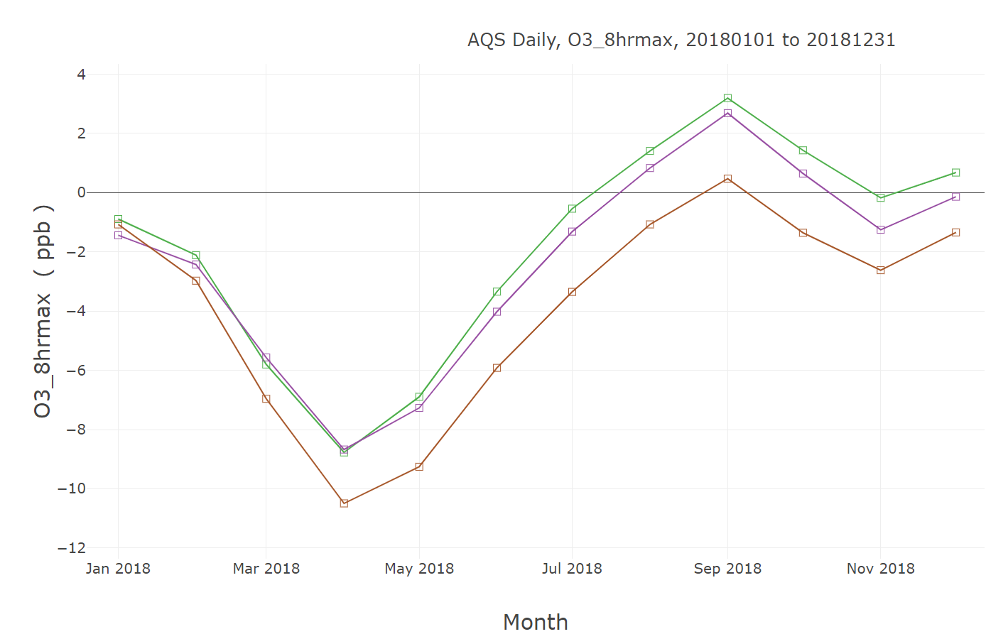
MDA8 O₃ Bias (Monthly) – BEIS vs. MEGAN
v5.4 M3Dry
v5.4 M3Dry
v5.4 M3Dry
v5.4 STAGE
v5.4 STAGE
v5.4 STAGE
v5.4 M3Dry, CRACMM
v5.4 M3Dry, CRACMM
v5.4 M3Dry, MEGAN
v5.4 STAGE, CRACMM

Slide 14
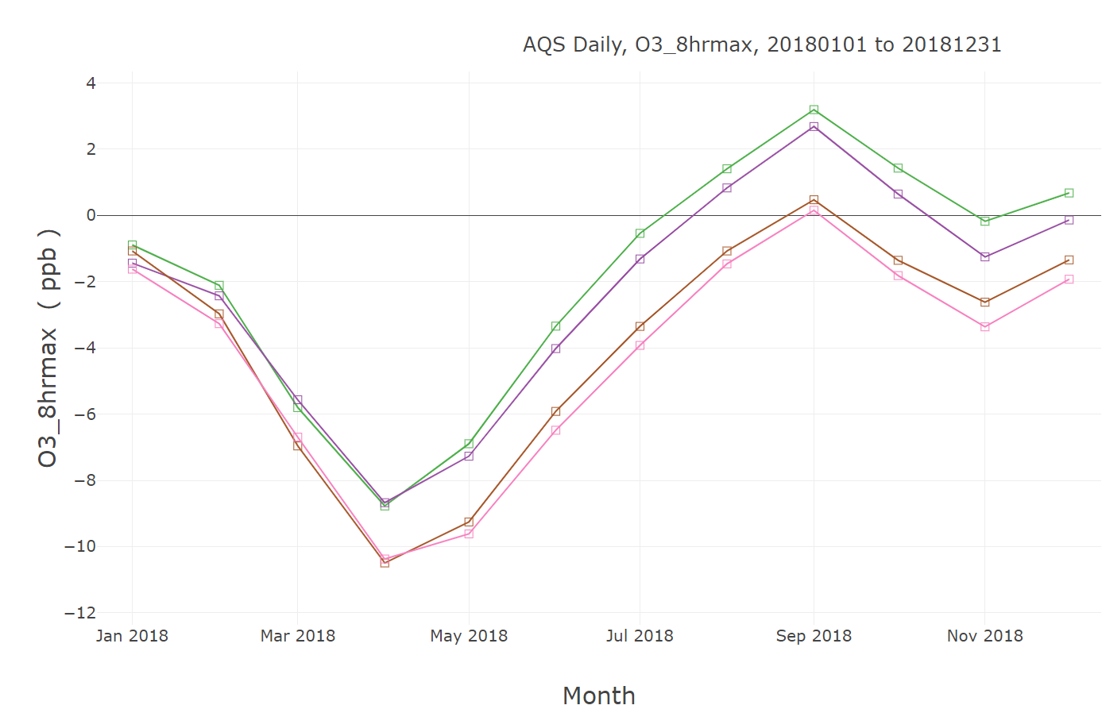
MDA8 O₃ Bias (Monthly) – BEIS vs. MEGAN
v5.4 M3Dry
v5.4 M3Dry
v5.4 M3Dry
v5.4 M3Dry
v5.4 STAGE
v5.4 STAGE
v5.4 STAGE
v5.4 STAGE
v5.4 M3Dry, MEGAN
v5.4 M3Dry, CRACMM
v5.4 M3Dry, CRACMM
v5.4 M3Dry, MEGAN
v5.4 STAGE, CRACMM
v5.4 STAGE, MEGAN

Slide 15
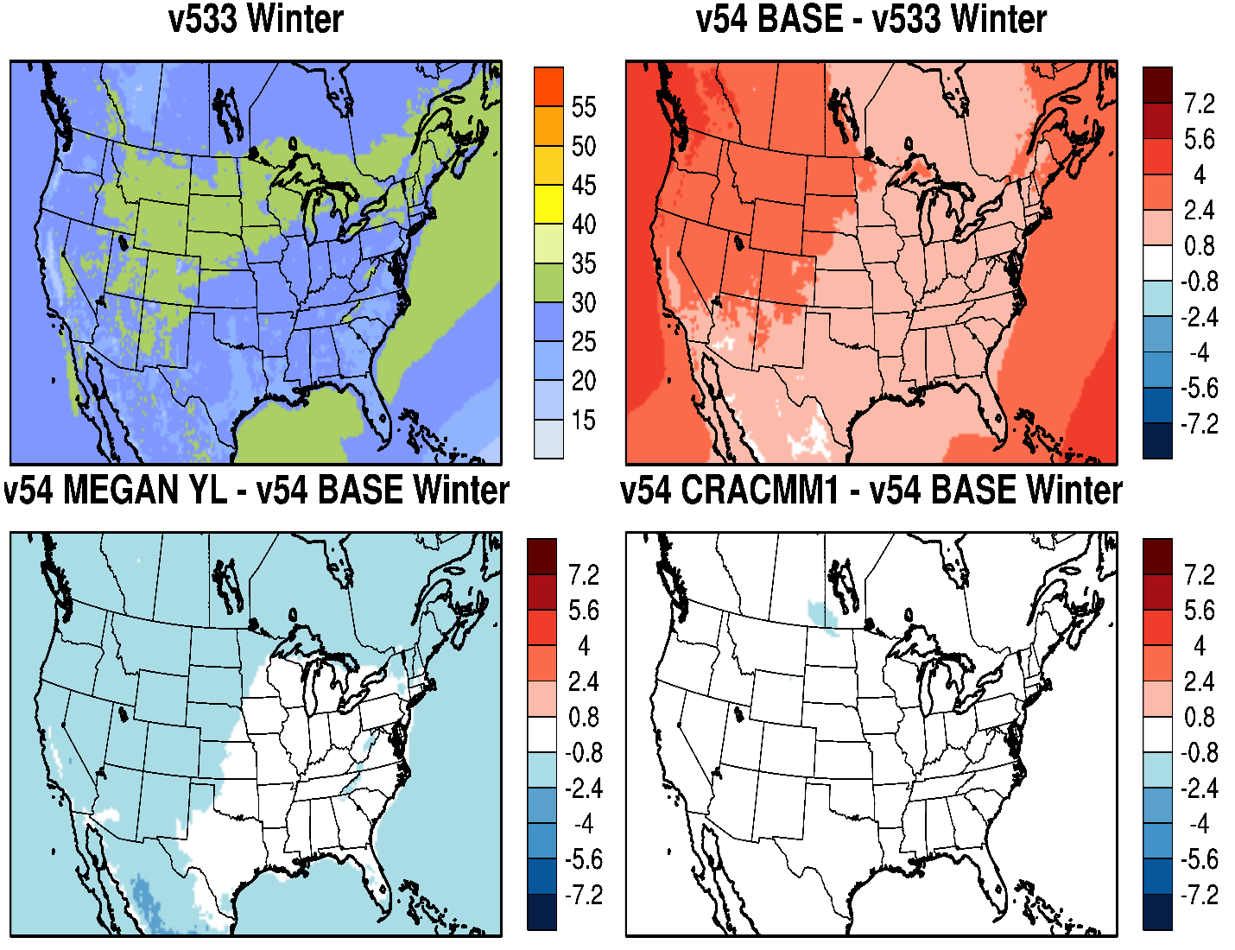
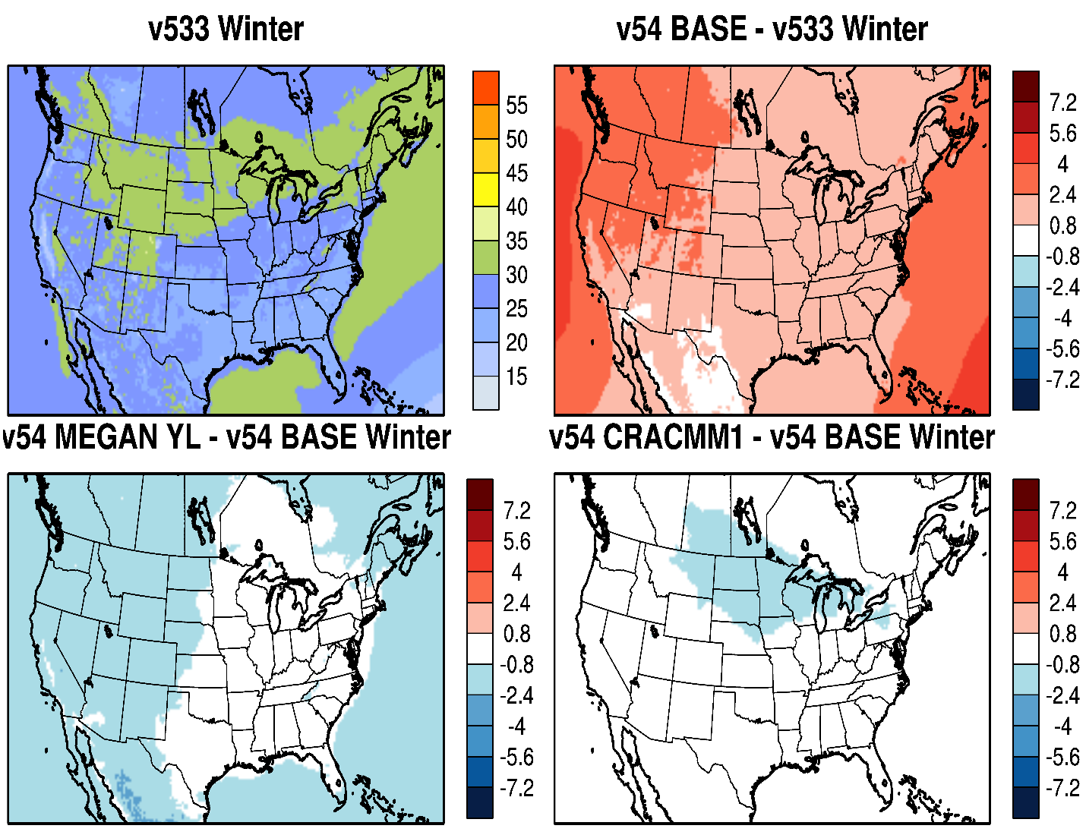
O₃: Impact of CMAQ Updates and Options (Winter)
M3Dry
STAGE
Slight decrease in wintertime O₃ with MEGAN
Increase in wintertime O₃ with CMAQv5.4 due to revised marine halogen chemistry in v5.4

Slide 16
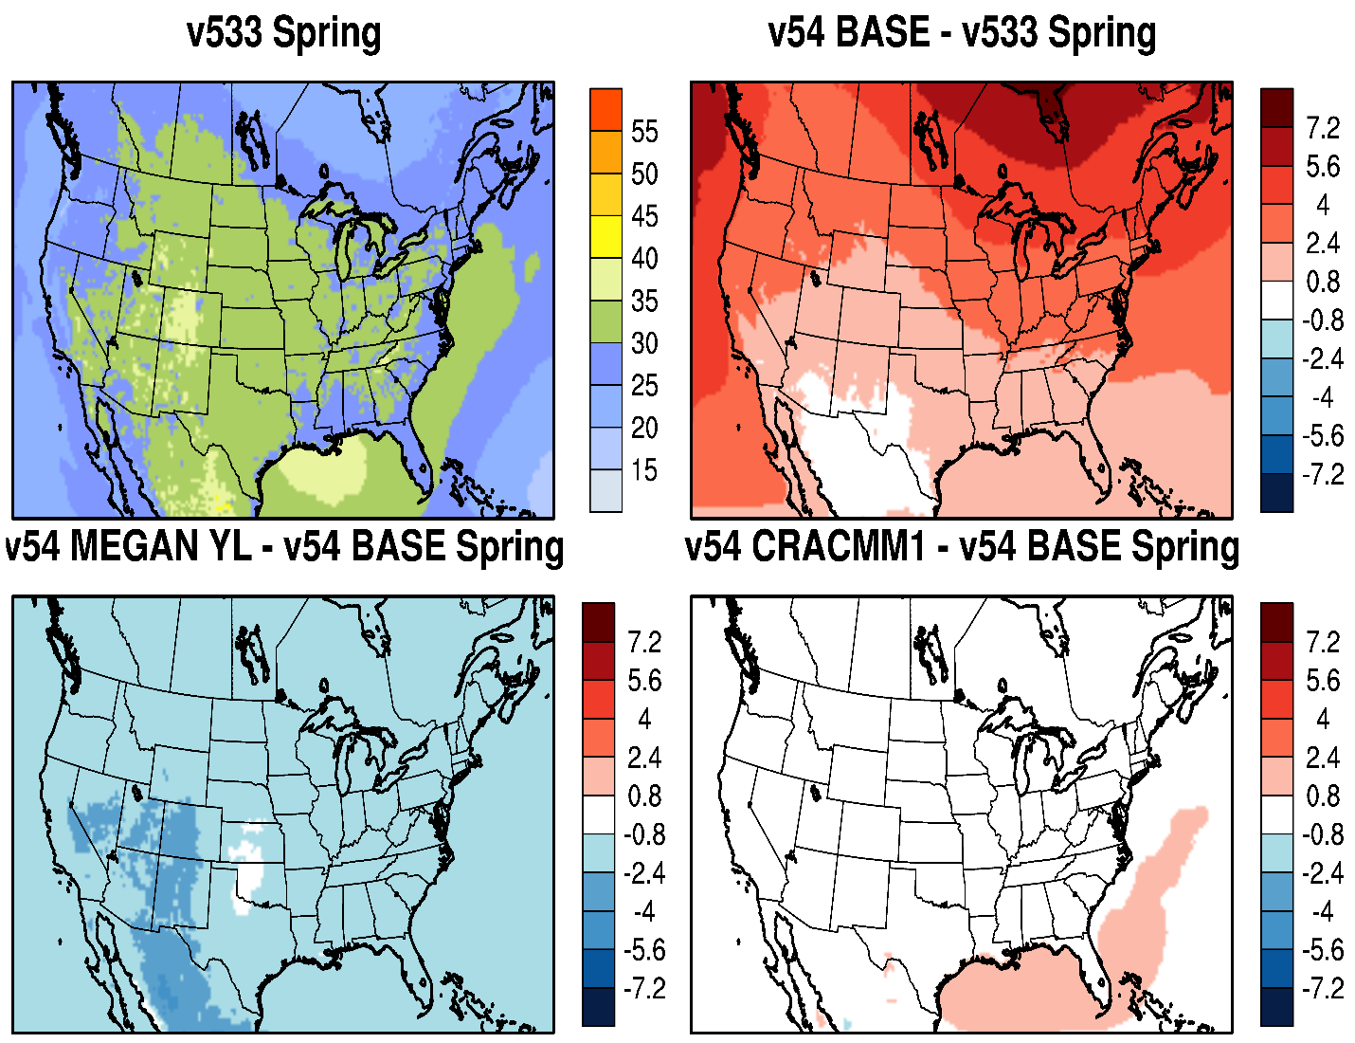
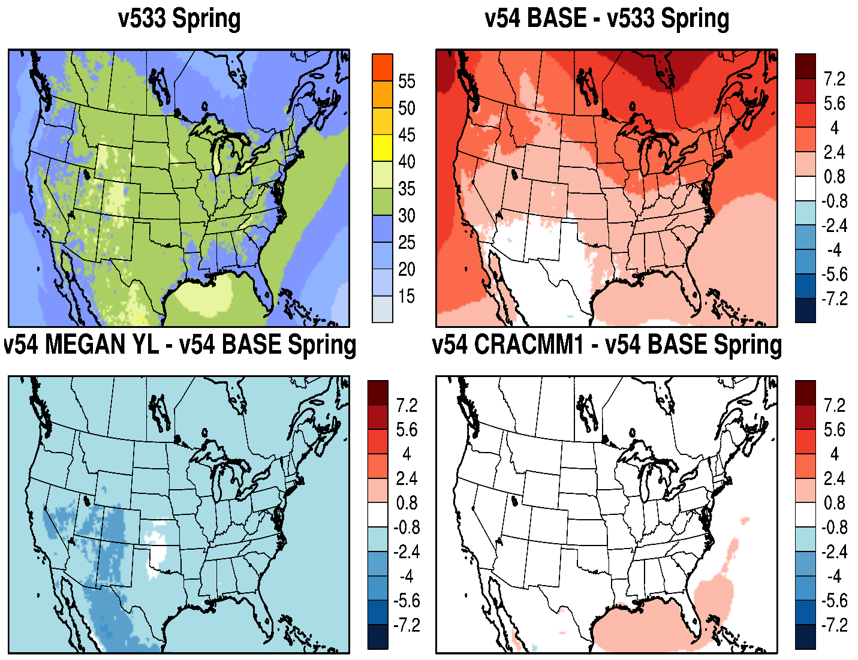
O₃: Impact of CMAQ Updates and Options (Spring)
M3Dry
STAGE
Larger decrease in springtime O₃ in SW U.S. with MEGAN
Continued large increase in springtime O₃ in CMAQv5.4, particularly over higher latitudes (driven by BCs)

Slide 17
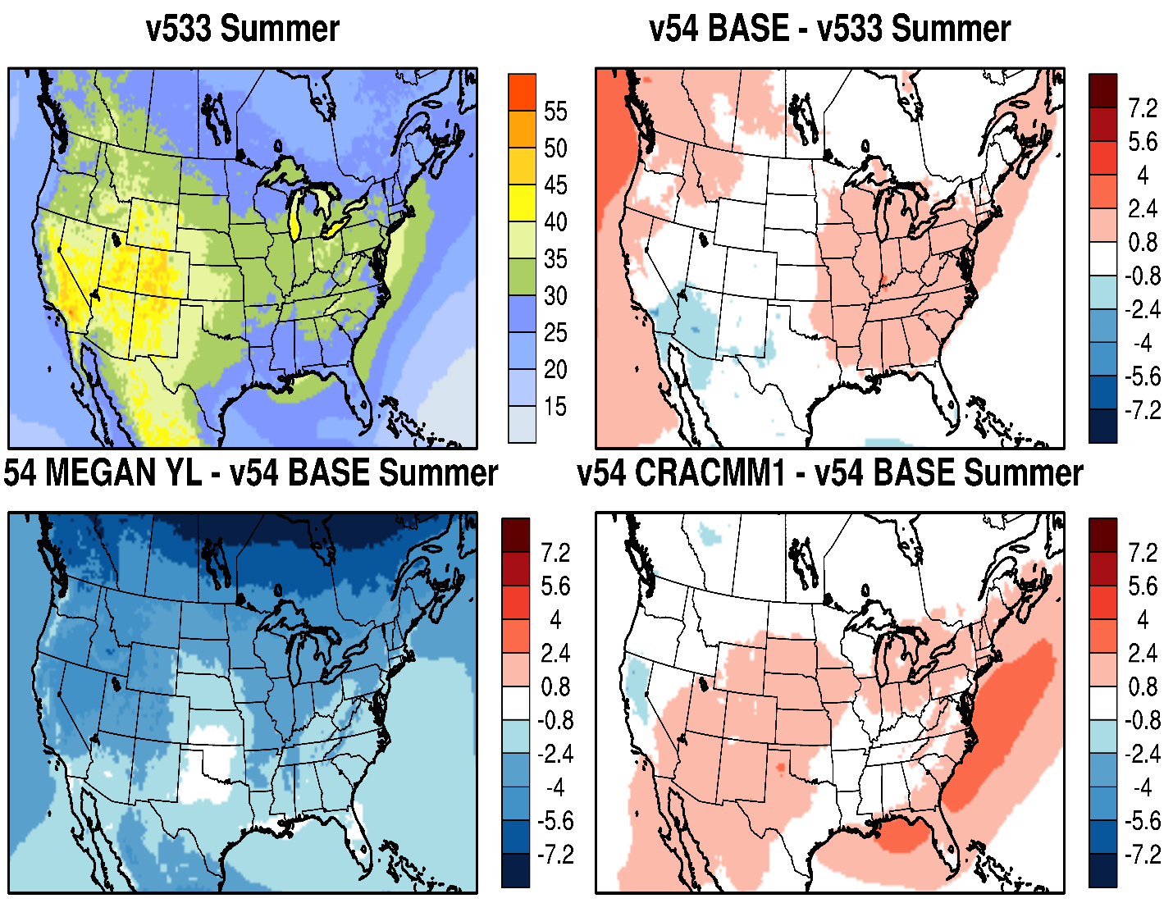
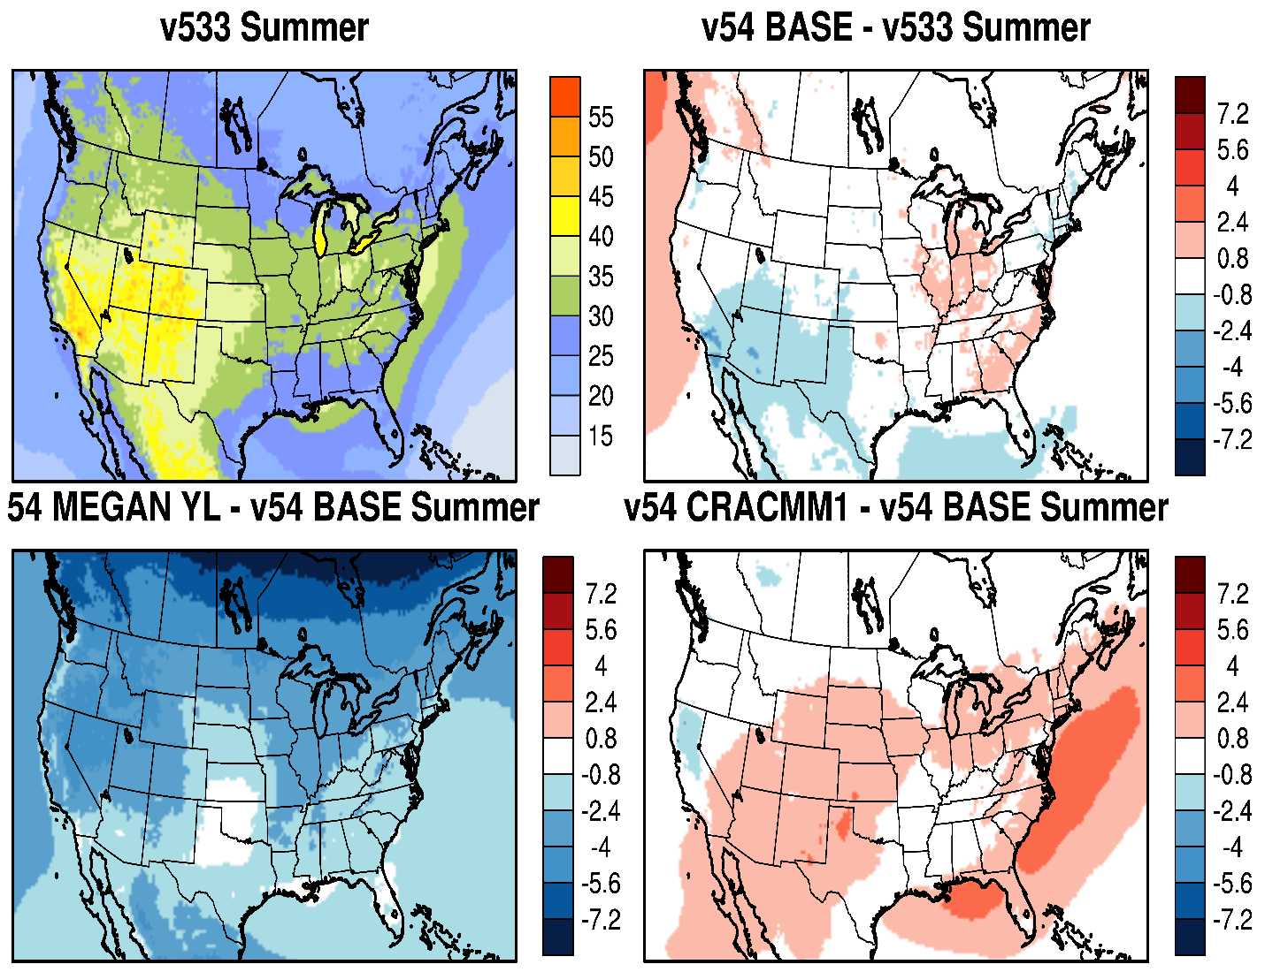
O₃: Impact of CMAQ Updates and Options (Summer)
M3Dry
STAGE
Large decrease in summertime O₃ over higher latitudes with MEGAN due to BCs
Slightly higher summertime O₃ with CRACMM
Only slightly higher summertime O₃ in v5.4 in eastern U.S. with M3Dry

Slide 18
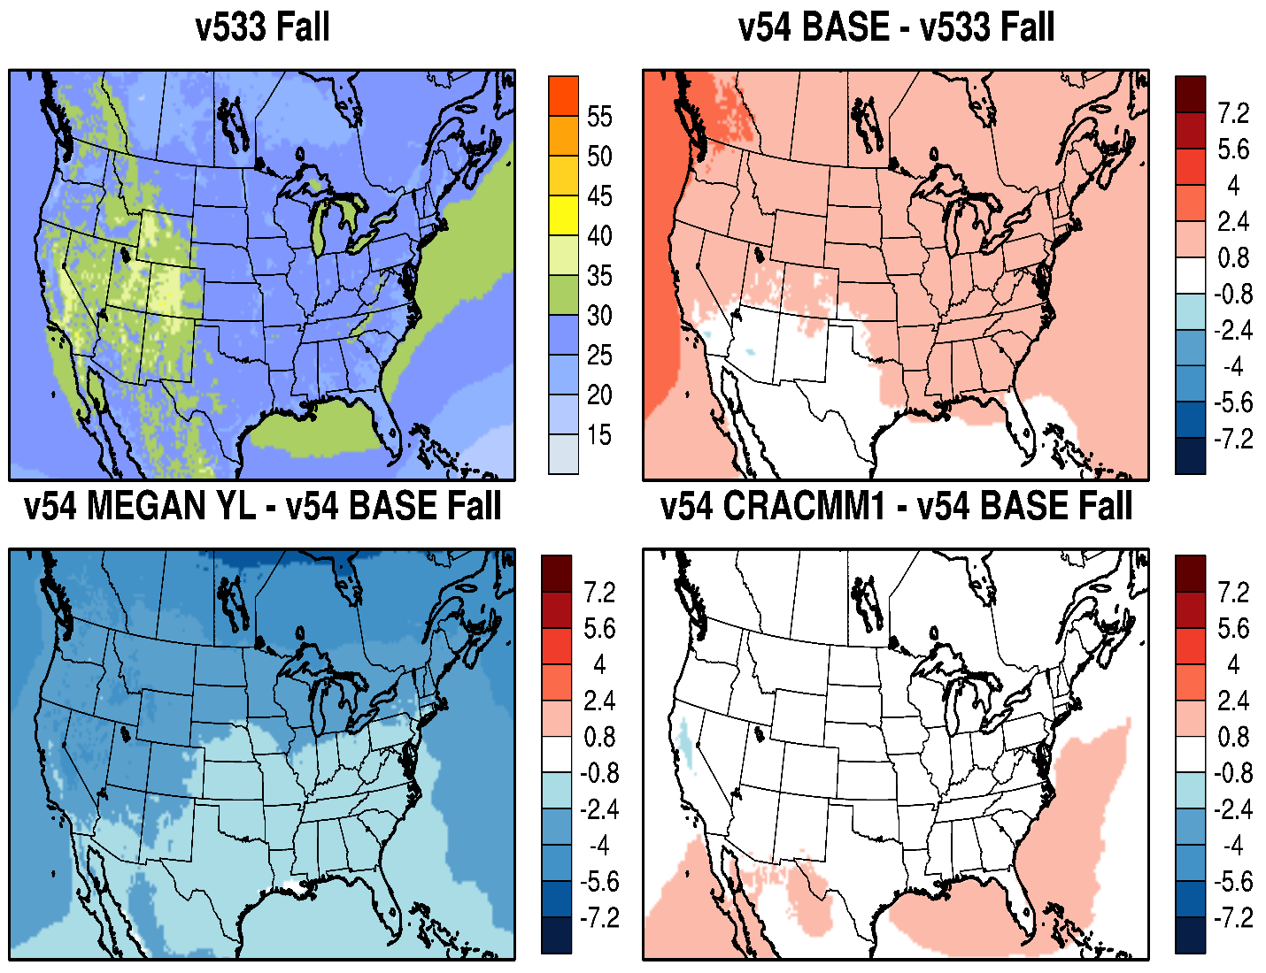
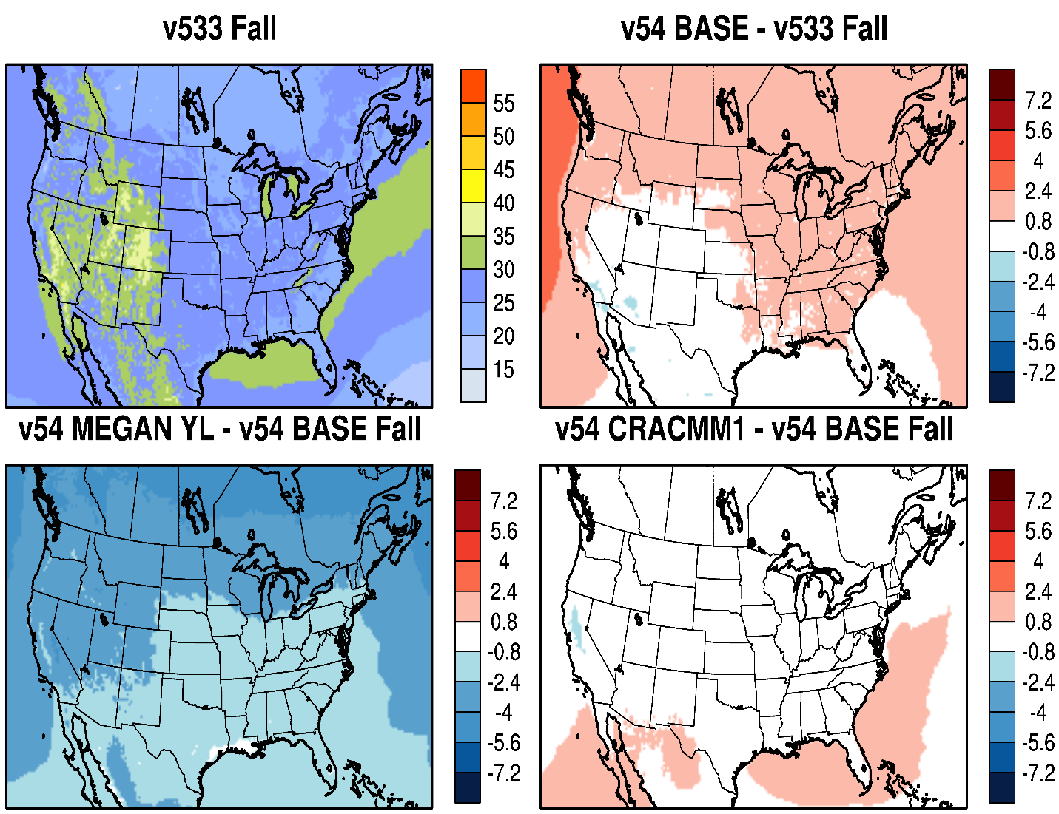
O₃: Impact of CMAQ Updates and Options (Fall)
M3Dry
STAGE
Continued lower O₃ in fall with MEGAN
Slightly higher O₃ in fall with v5.4, again due primarily to increase O₃ from BCs

Slide 19
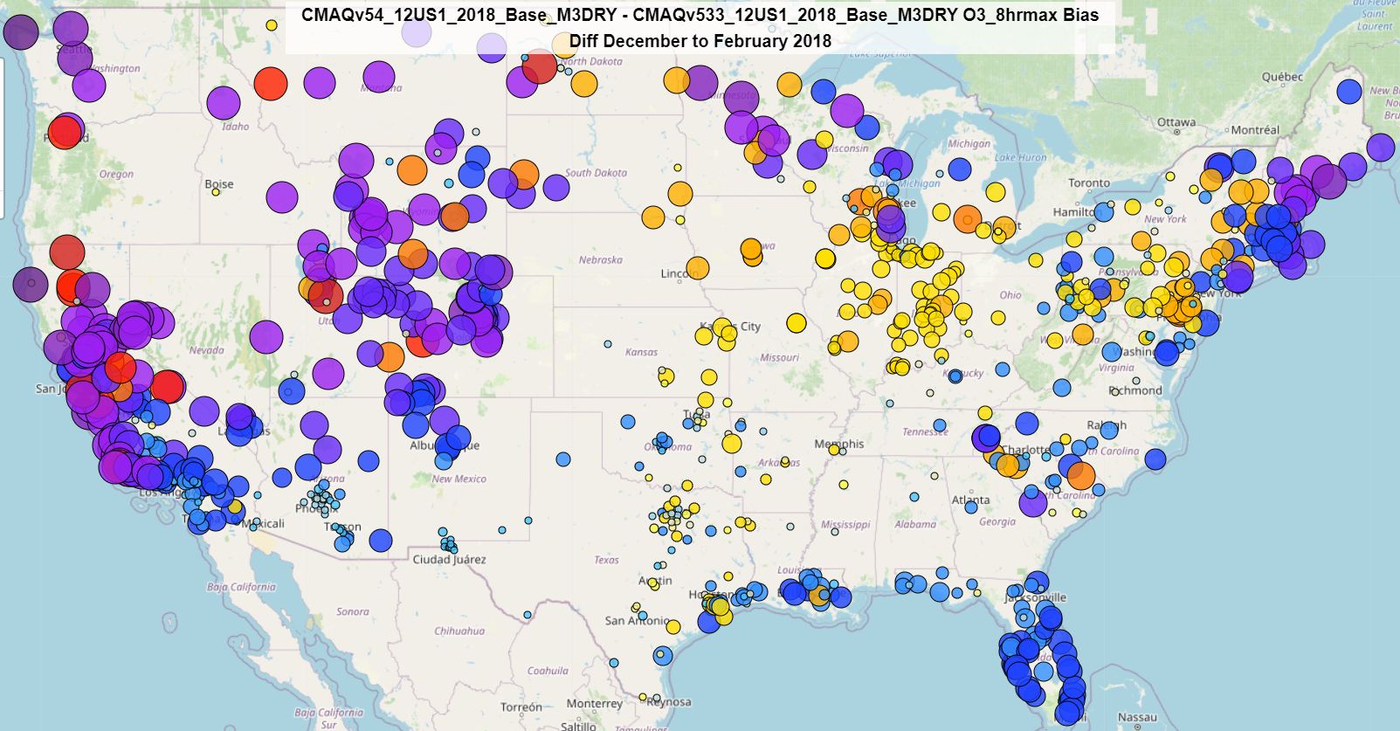
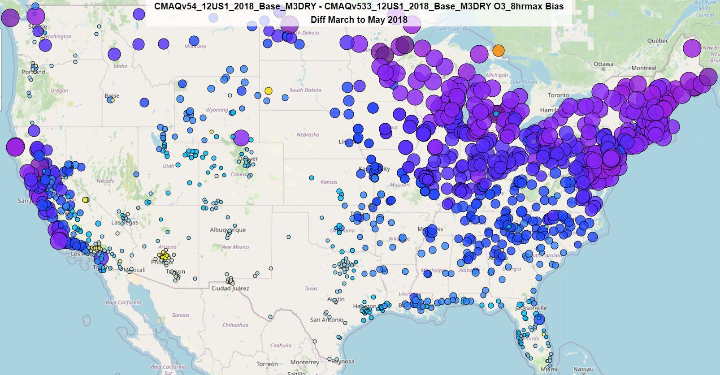
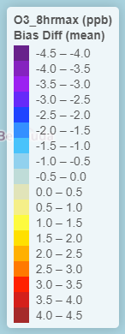
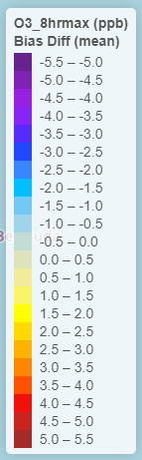
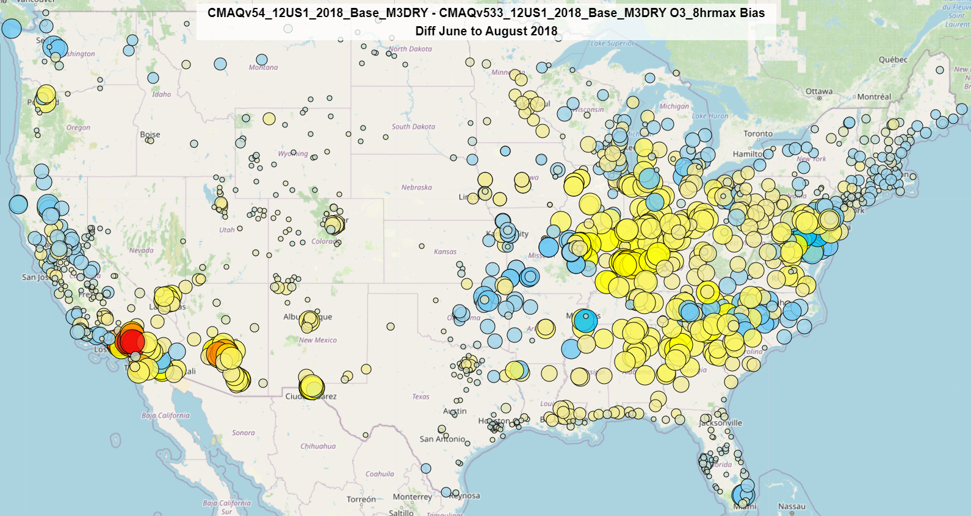
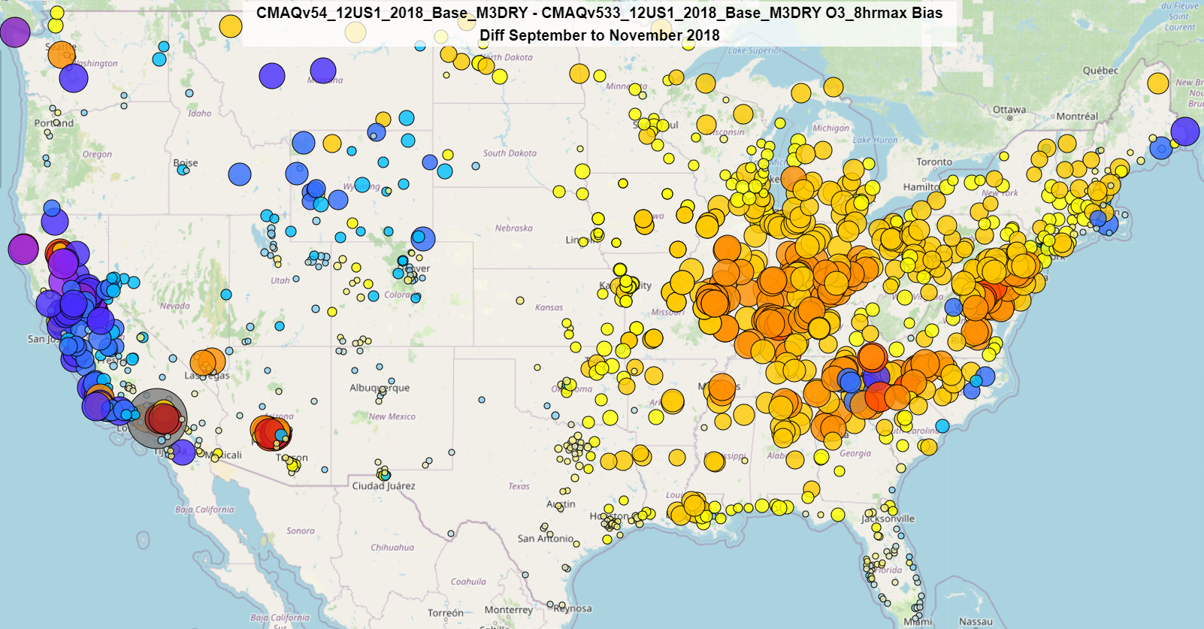
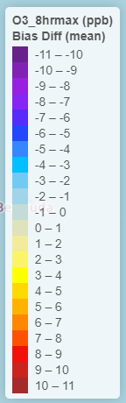
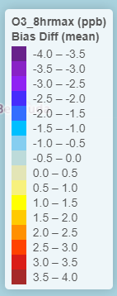
MDA8 O₃: CMAQv5.4 - v5.3.3 Seasonal Bias Difference (M3Dry)
Higher MDA8 O₃ bias in the eastern U.S., but lower bias in the west in fall
Improved Bias
Improved Bias
Winter
Worse Bias
Spring
Worse Bias
Large reduction in MDA8 O₃ bias in winter (western U.S.) and spring (CONUS)
Improved Bias
Improved Bias
Worse Bias
Worse Bias
Summer
Fall
Cool colors indicate lower bias with v5.4; Warm colors indicate higher bias with v5.4 (range varies by season)

Slide 20
PM_{2.5}

Slide 21
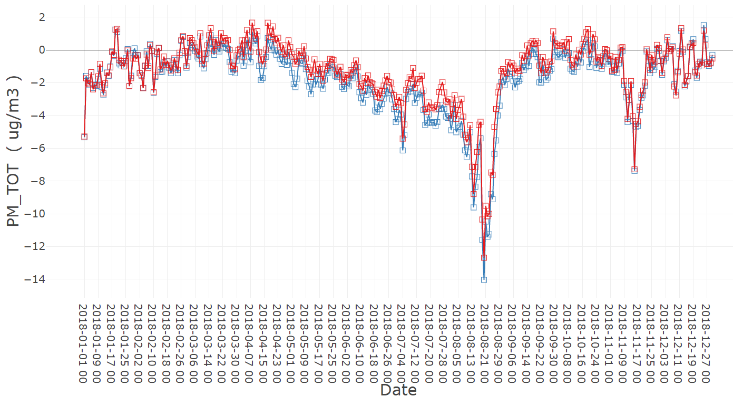
PM_{2.5} Bias (Daily) – v5.3.3 vs v5.4 (M3Dry)
v5.3.3
v5.4
PM_{2.5} estimates lower with v5.4 compared to v5.3.3 for spring though fall
Broad underestimation of PM_{2.5} related to record wildfire activity in 2018

Slide 22
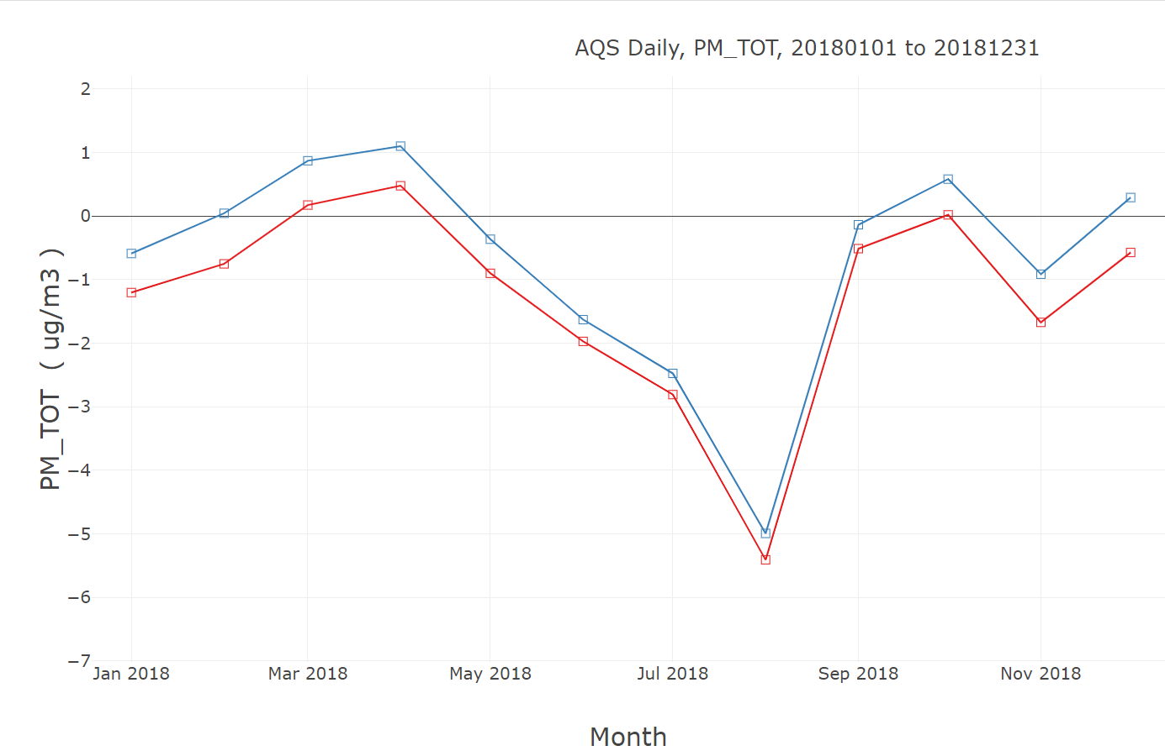
PM_{2.5} Bias (Monthly) – v5.3.3 vs v5.4
v5.3.3 M3Dry
v5.3.3 STAGE

Slide 23
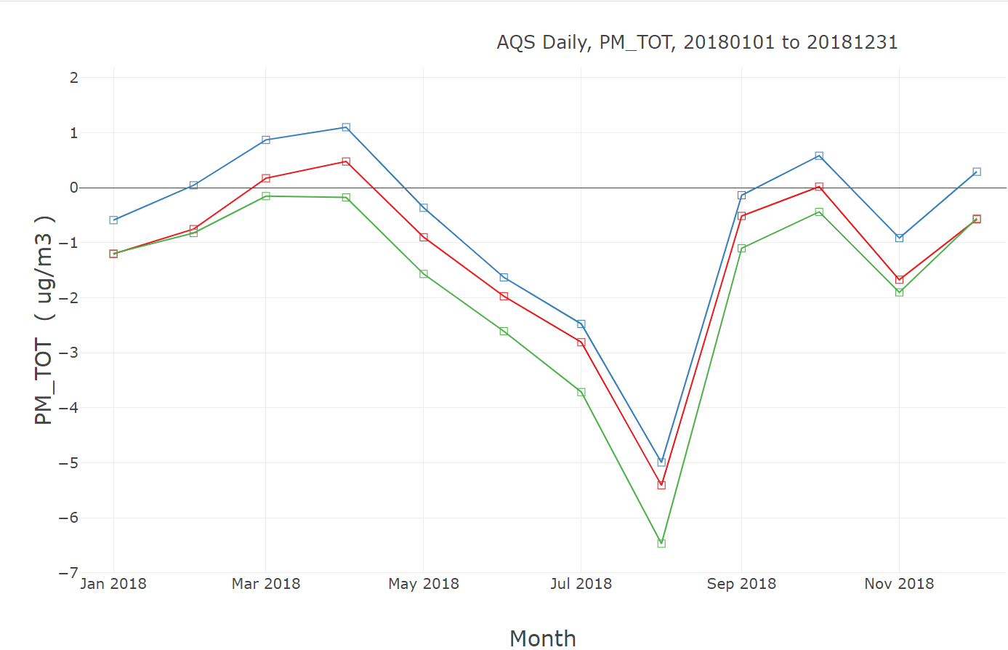
PM_{2.5} Bias (Monthly) – v5.3.3 vs v5.4
v5.3.3 M3Dry
v5.3.3 STAGE
v5.4 M3Dry

Slide 24
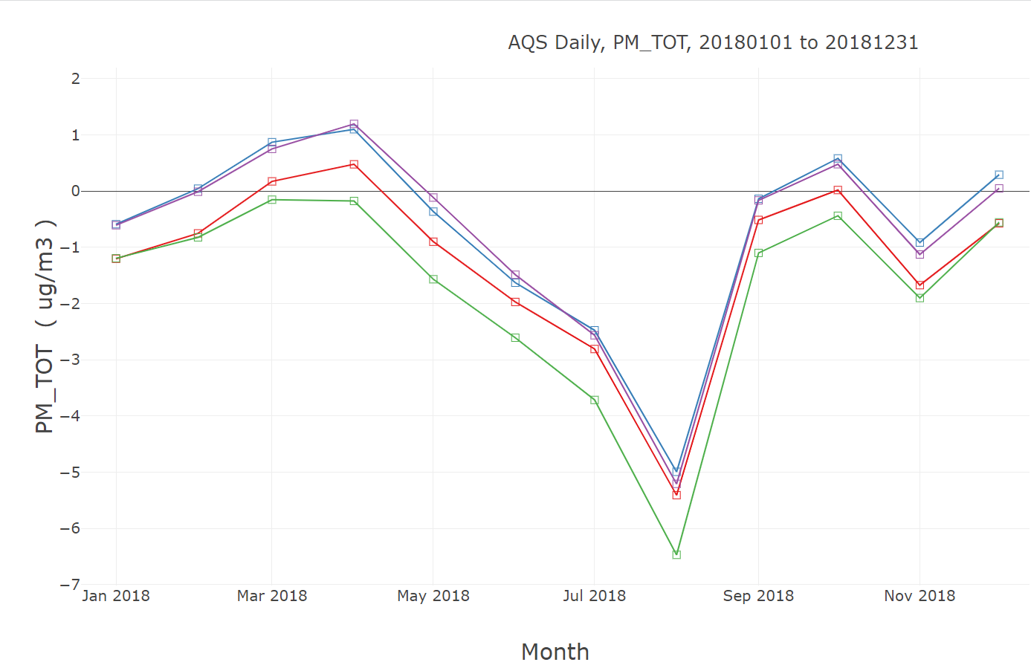
PM_{2.5} Bias (Monthly) – v5.3.3 vs v5.4
v5.3.3 M3Dry
v5.3.3 STAGE
v5.4 M3Dry
v5.4 STAGE

Slide 25
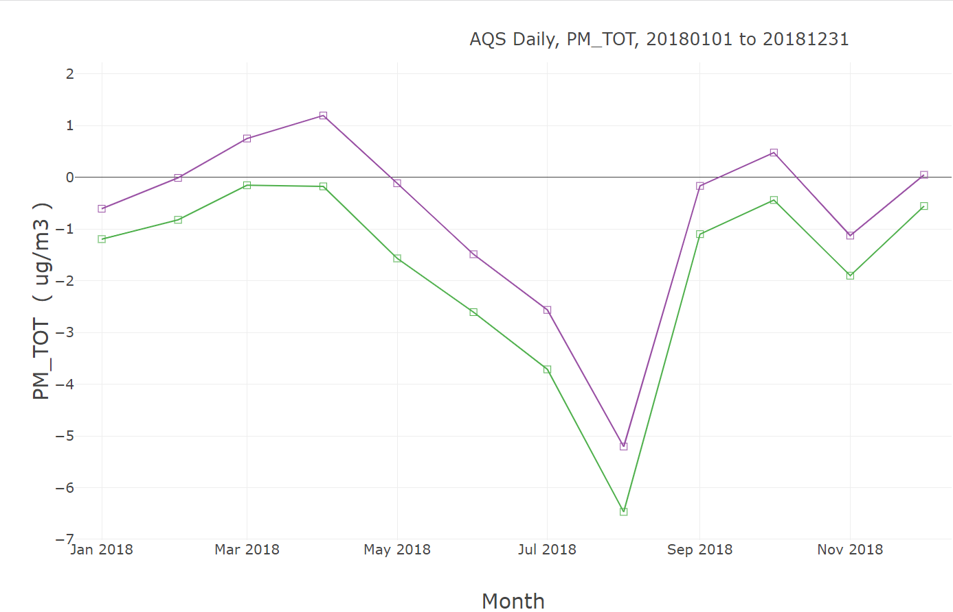
PM_{2.5} Bias (Monthly) – CB6r5 vs. CRACMM
v5.4 M3Dry
v5.4 STAGE

Slide 26
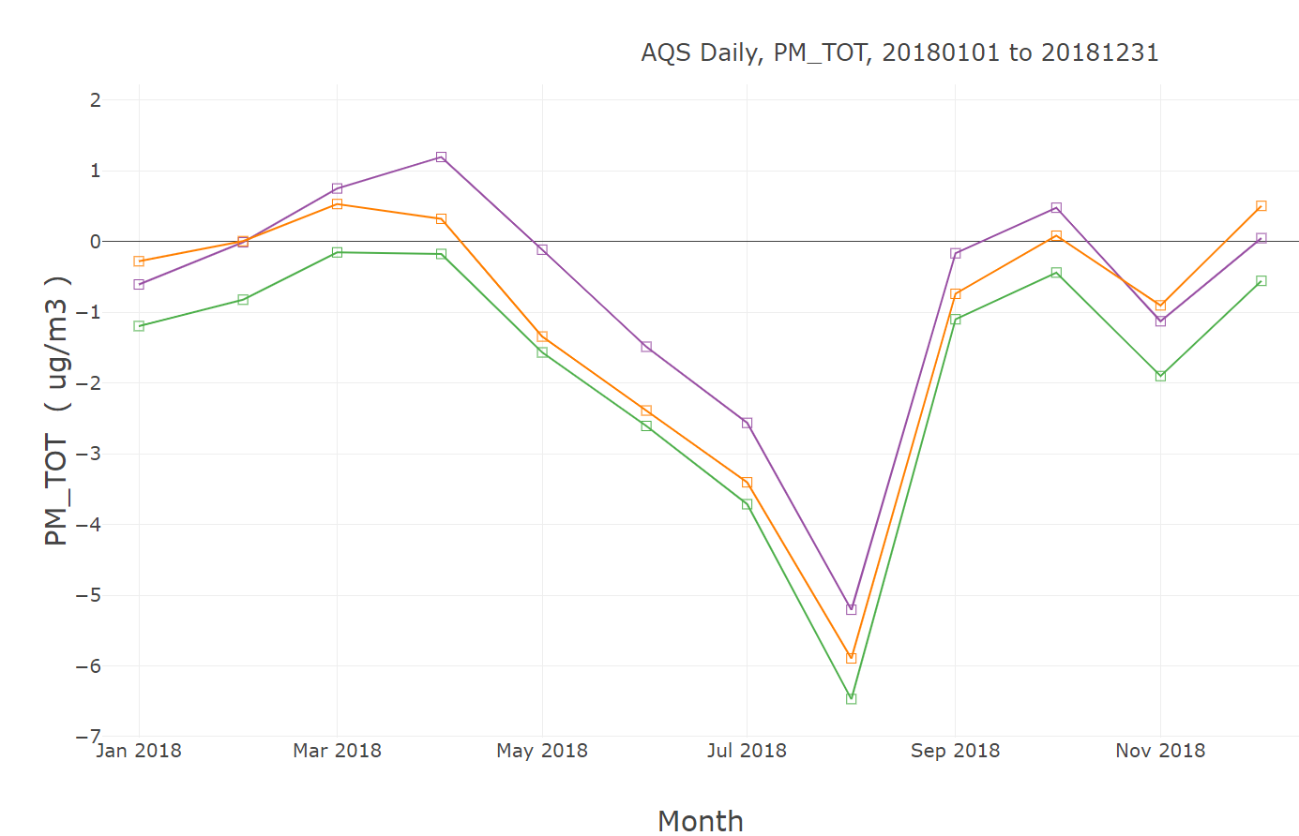
PM_{2.5} Bias (Monthly) – CB6r5 vs. CRACMM
v5.4 M3Dry
v5.4 STAGE
v5.4 M3Dry, CRACMM

Slide 27
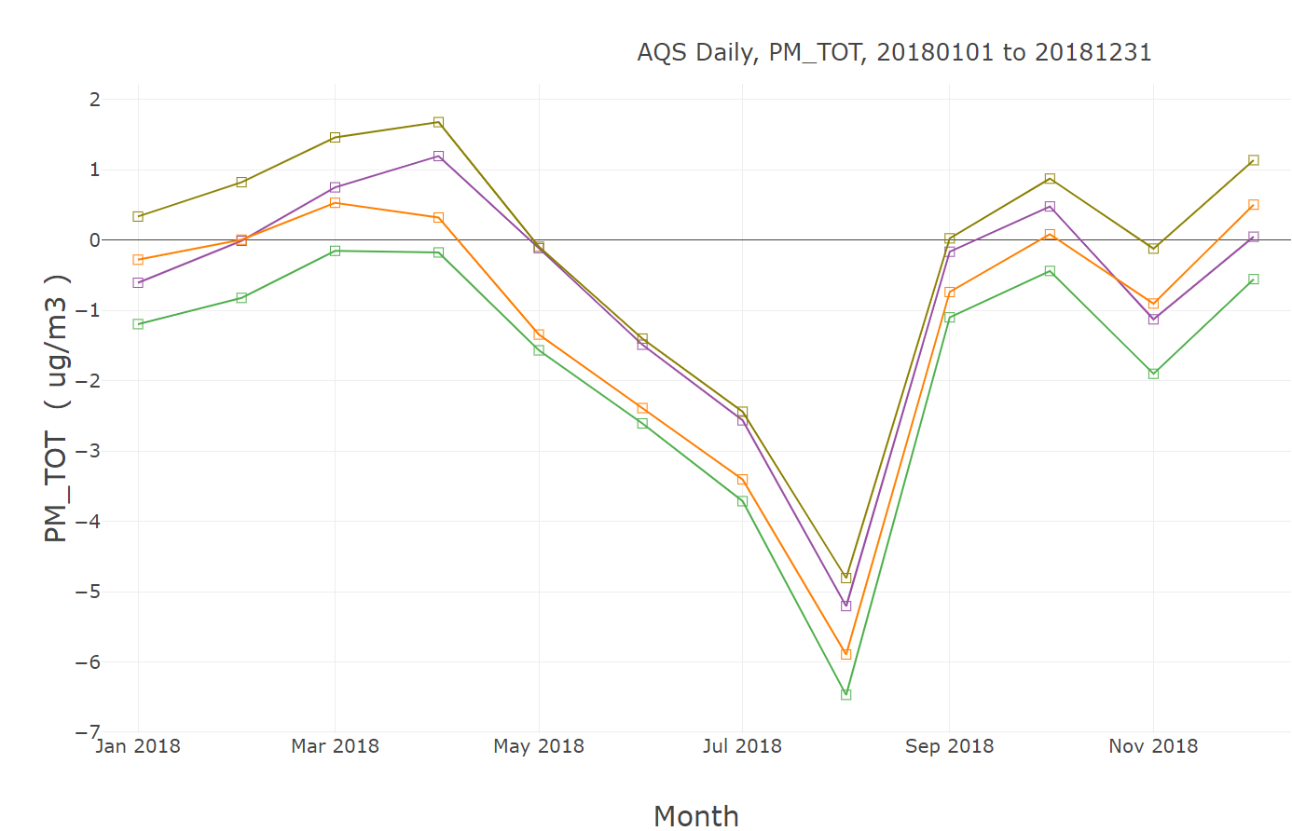
PM_{2.5} Bias (Monthly) – CB6r5 vs. CRACMM
v5.4 M3Dry
v5.4 STAGE
v5.4 M3Dry, CRACMM
v5.4 STAGE, CRACMM

Slide 28
PM_{2.5} Bias (Monthly) – BEIS vs. MEGAN
v5.4 M3Dry
v5.4 STAGE

Slide 29
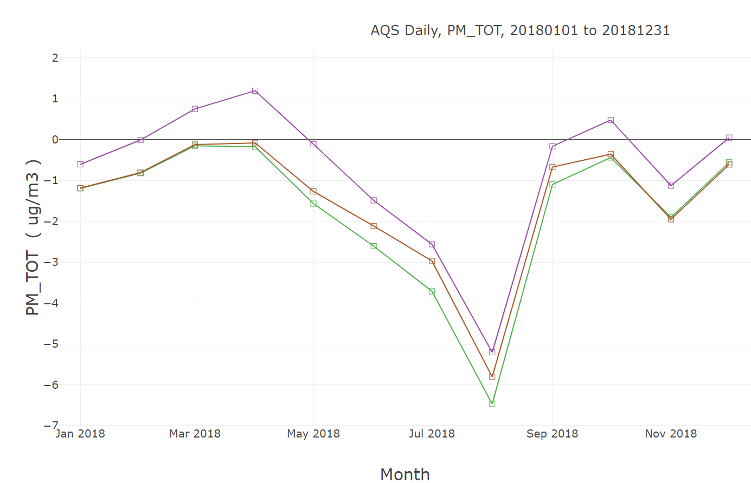
PM_{2.5} Bias (Monthly) – CB6r5 vs. CRACMM
v5.4 M3Dry
v5.4 STAGE
v5.4 M3Dry, MEGAN

Slide 30
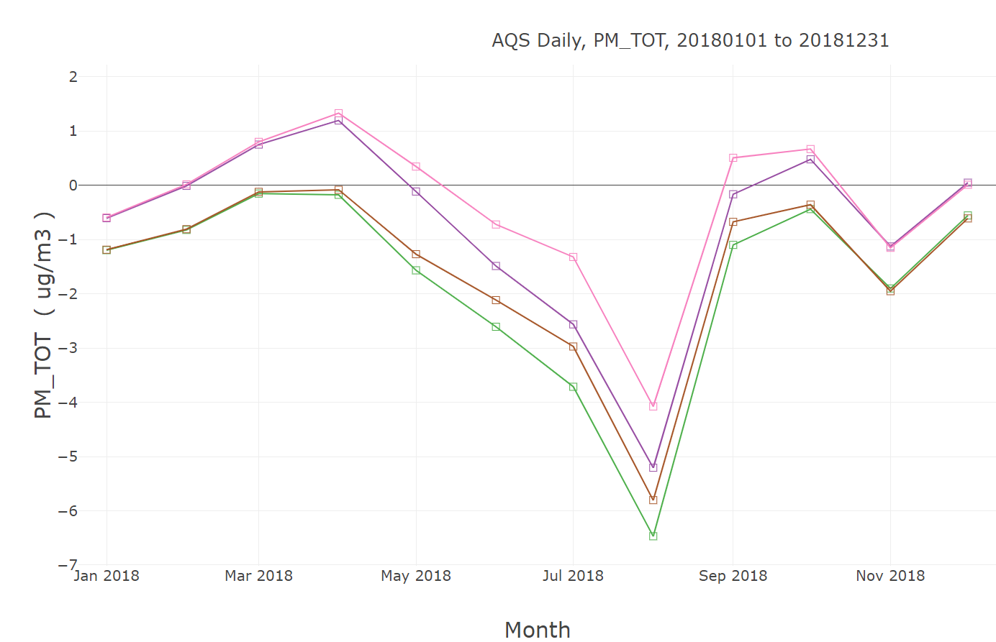
PM_{2.5} Bias (Monthly) – CB6r5 vs. CRACMM
v5.4 M3Dry
v5.4 STAGE
v5.4 M3Dry, MEGAN
v5.4 STAGE, MEGAN

Slide 31
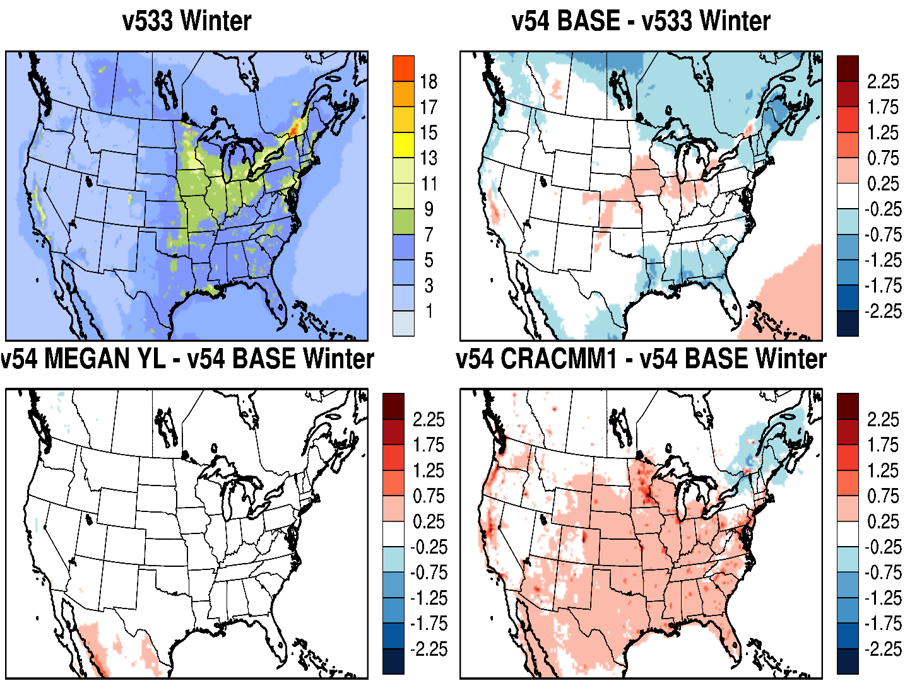
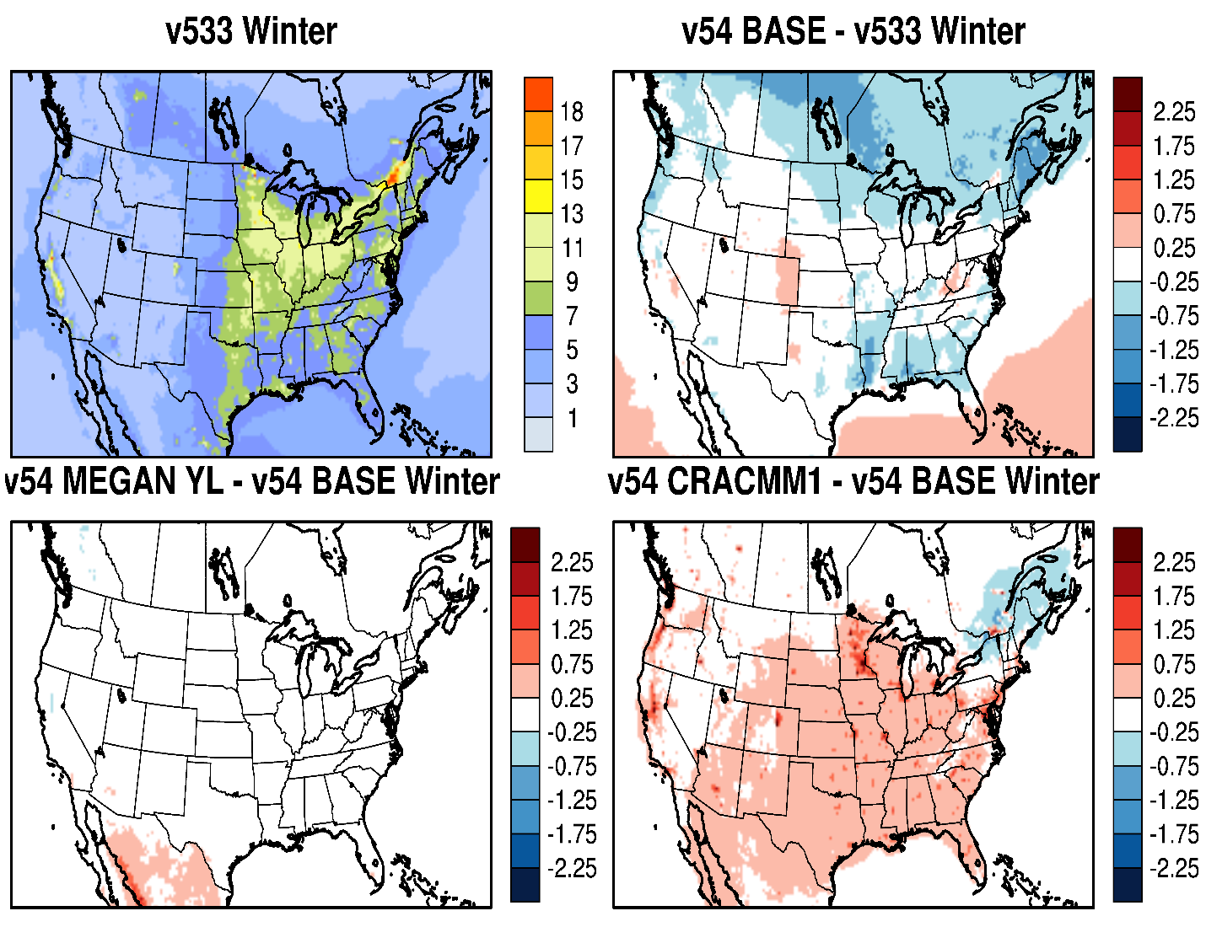
PM_{2.5}: Impact of CMAQ Updates / Options (Winter)
Increase in wintertime PM_{2.5} with CRACMM
M3Dry
STAGE
Mixed impact on wintertime PM_{2.5} with CMAQv5.4 w/ both M3Dry and STAGE (larger increase in SJV with M3Dry)

Slide 32
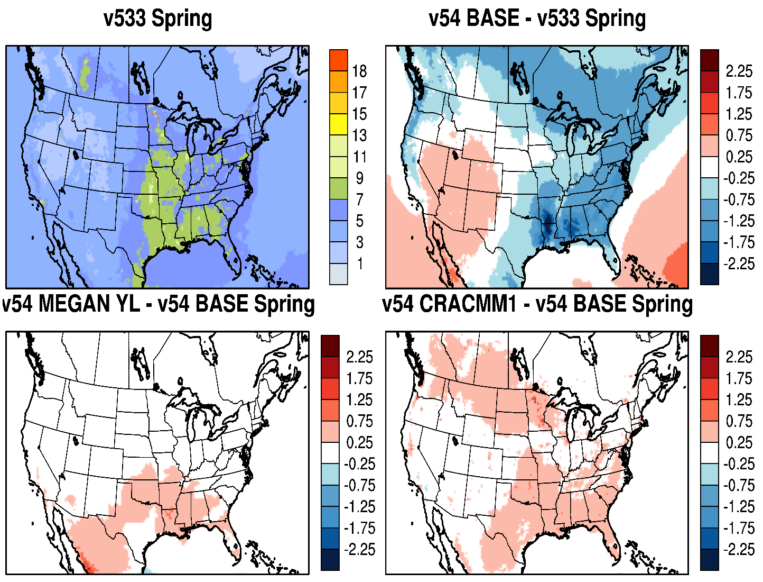
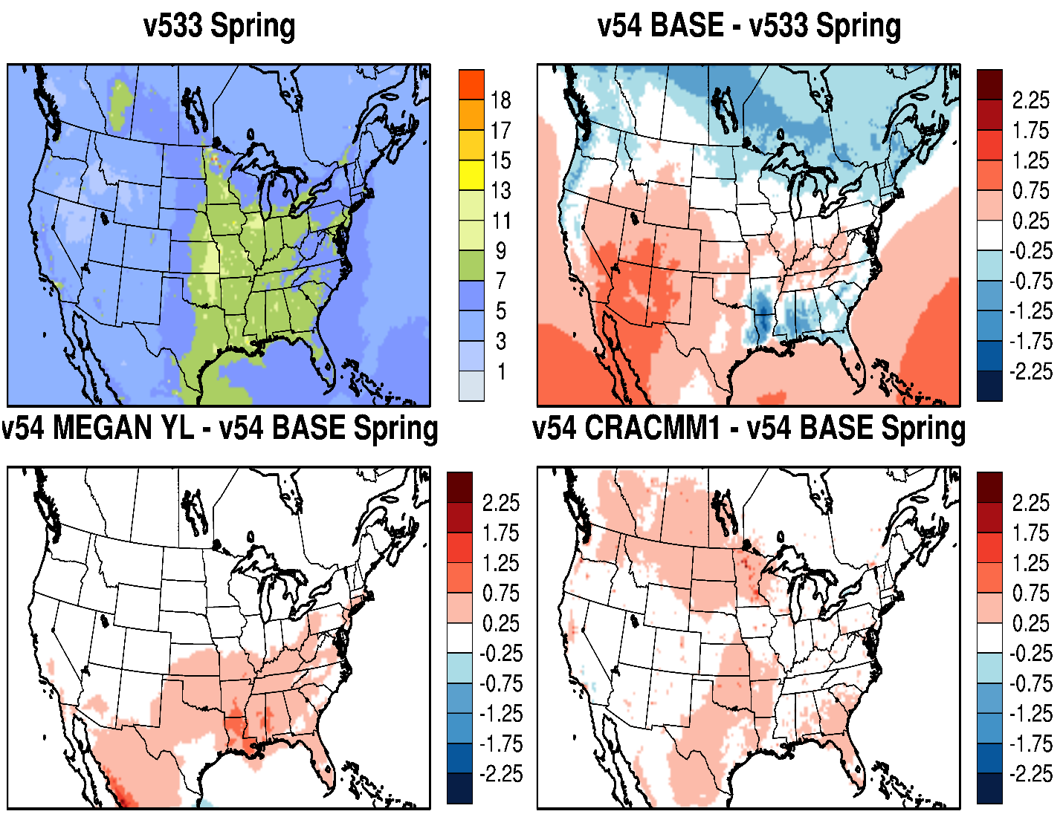
PM_{2.5}: Impact of CMAQ Updates / Options (Spring)
Small increases in springtime PM_{2.5} with MEGAN and CRACMM
M3Dry
STAGE
M3Dry has lower PM_{2.5} in spring compared to STAGE due to greater impact from increased aerosol dry deposition

Slide 33
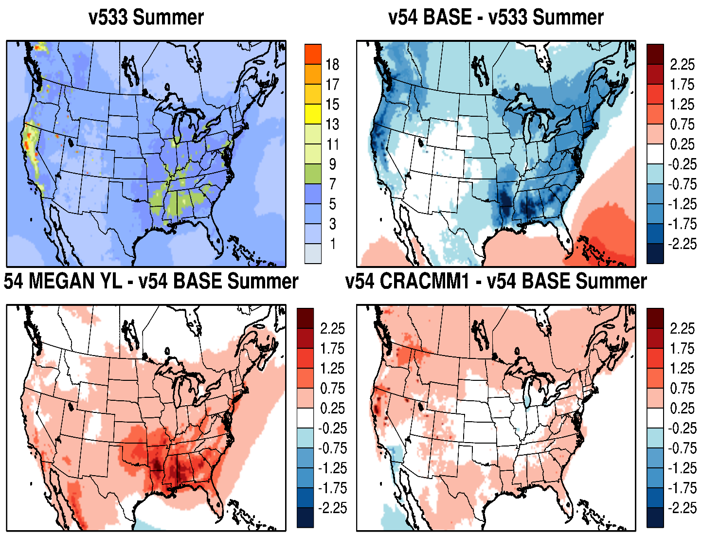
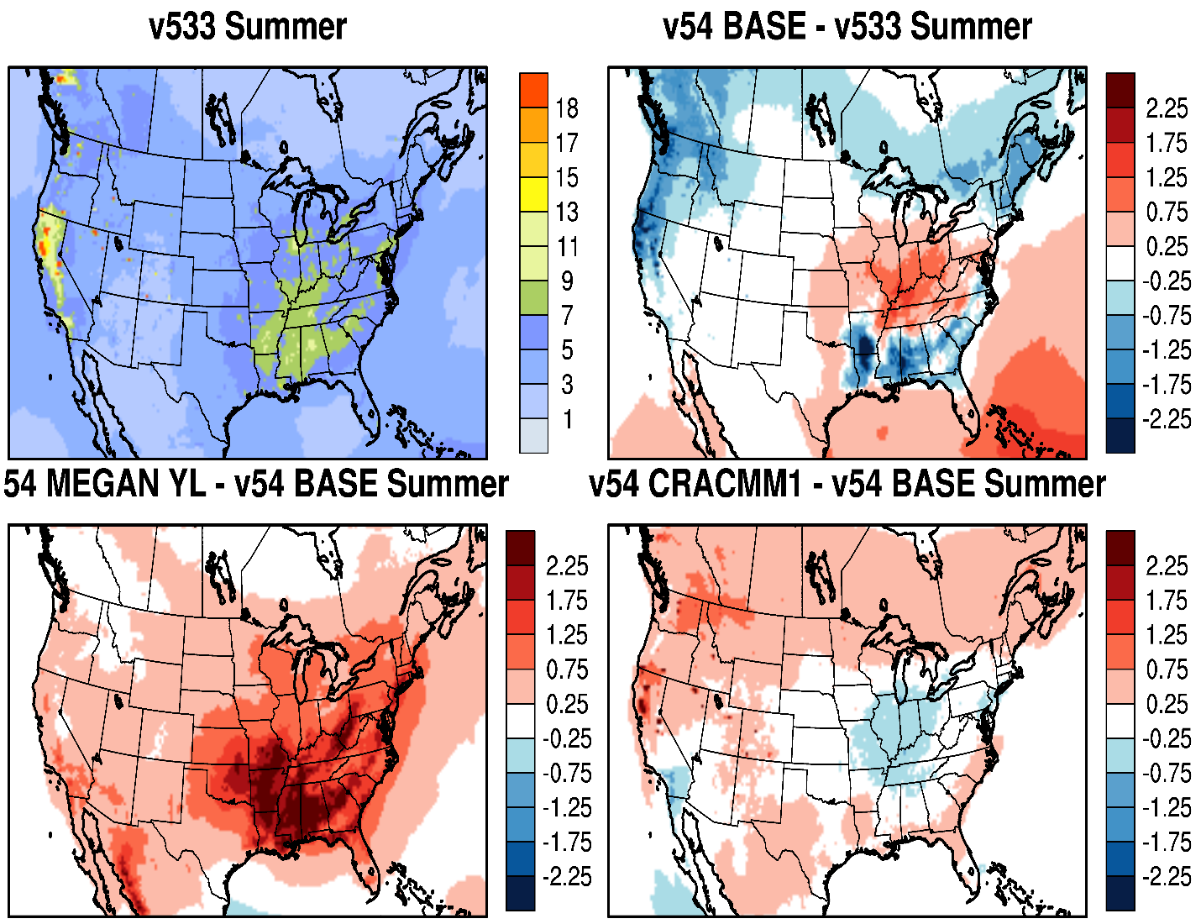
PM_{2.5}: Impact of CMAQ Updates / Options (Summer)
Large increase in summertime PM_{2.5} in SE U.S. with MEGAN (larger in STAGE than M3Dry)
M3Dry
STAGE
Mix of increased/decreased summertime PM_{2.5} with CRACMM with M3Dry and STAGE
Large decrease in PM_{2.5} in eastern U.S. with M3Dry; mix of increase/decrease with STAGE due to increased aerosol deposition in M3Dry/STAGE and counteracting effects of higher isoprene and lower monoterpene in BEIS3/BELD5 and BEIS4/BELD6

Slide 34
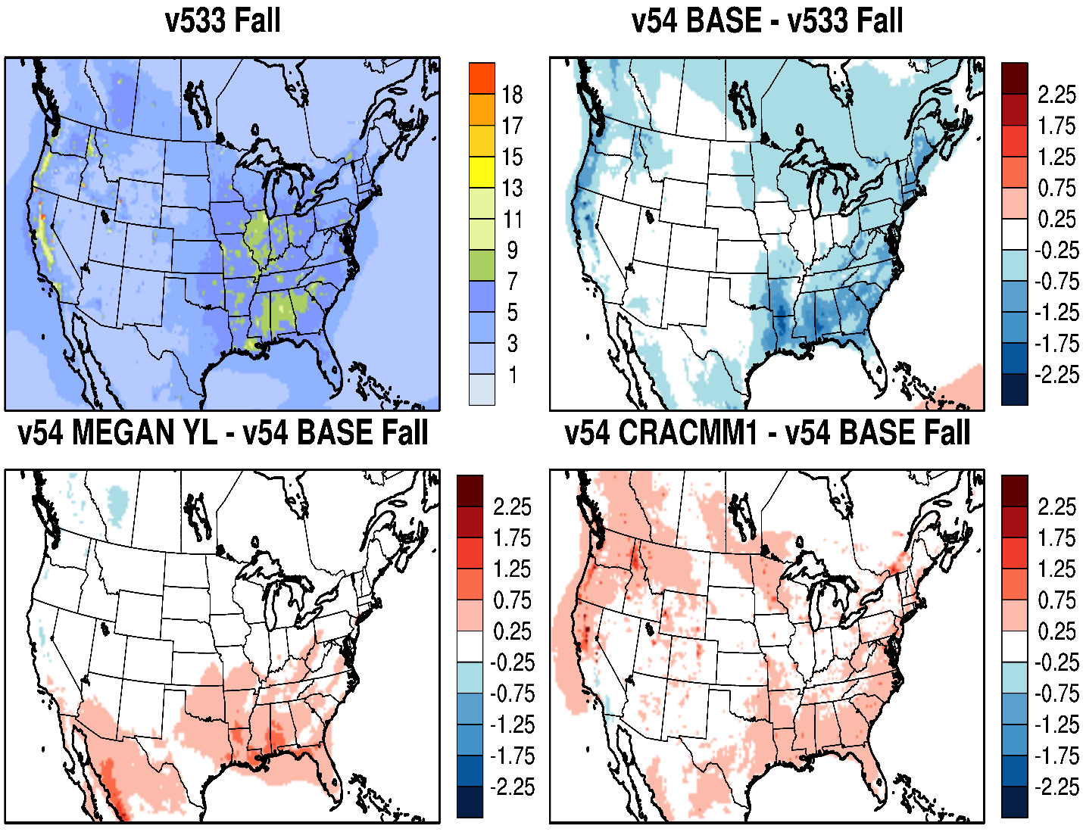
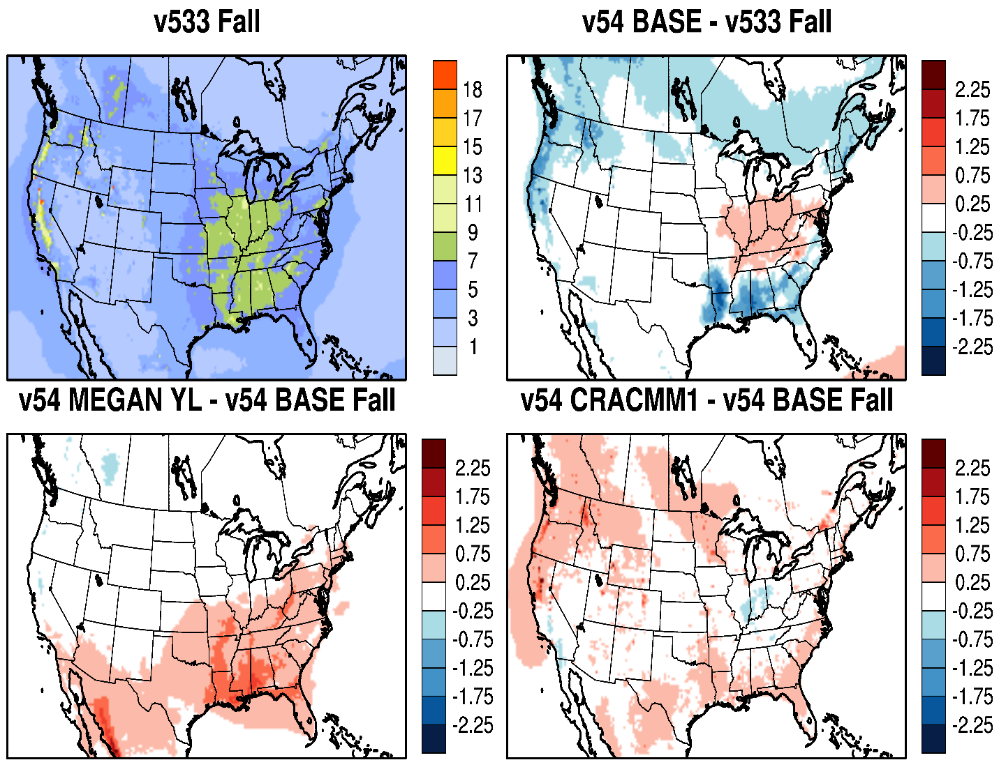
PM_{2.5}: Impact of CMAQ Updates / Options (Fall)
Continued increase in PM_{2.5} in fall in the SE U.S. with MEGAN
M3Dry
STAGE
CRAMM results in mostly higher PM_{2.5} in fall, but relatively small (some isolated areas with larger increases)
Continued lower PM_{2.5} with M3Dry in fall and a mixed impact in the eastern U.S. with STAGE

Slide 35
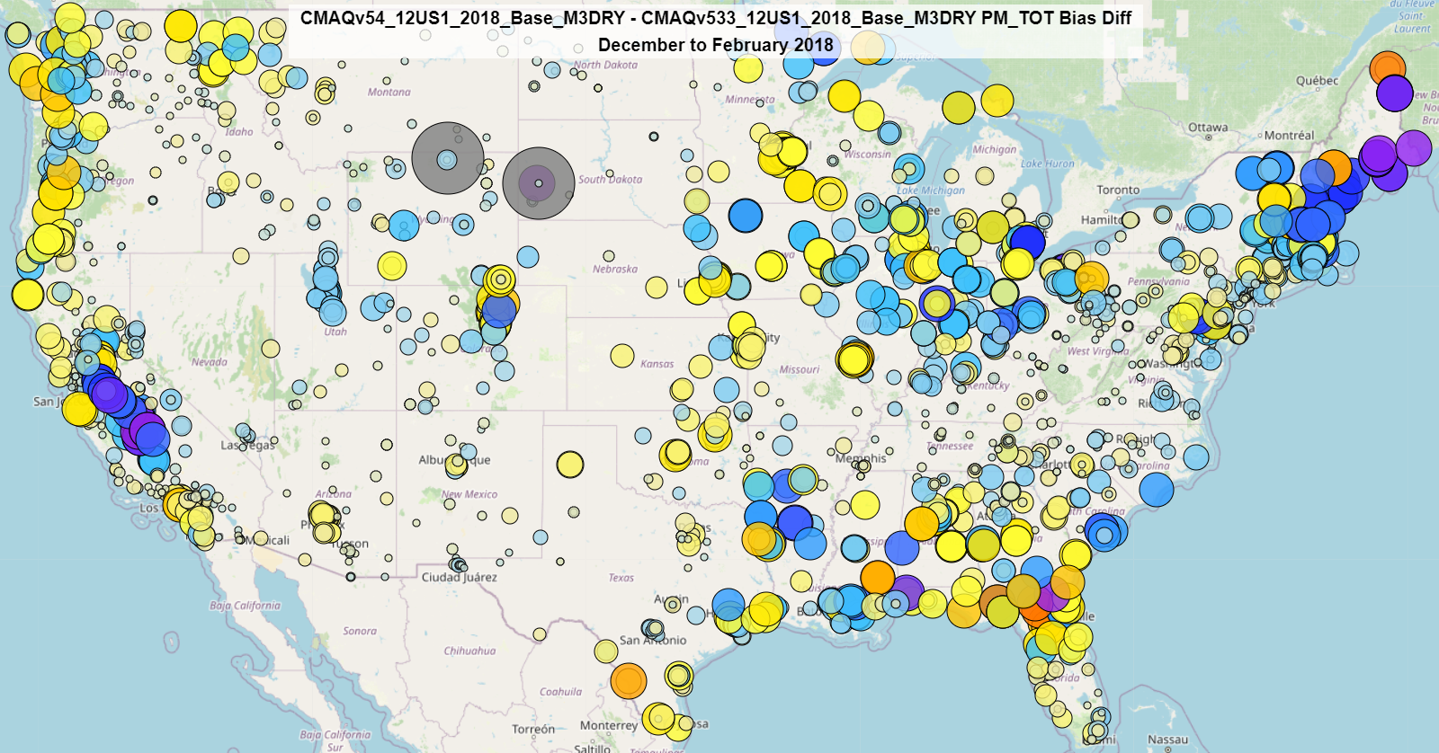
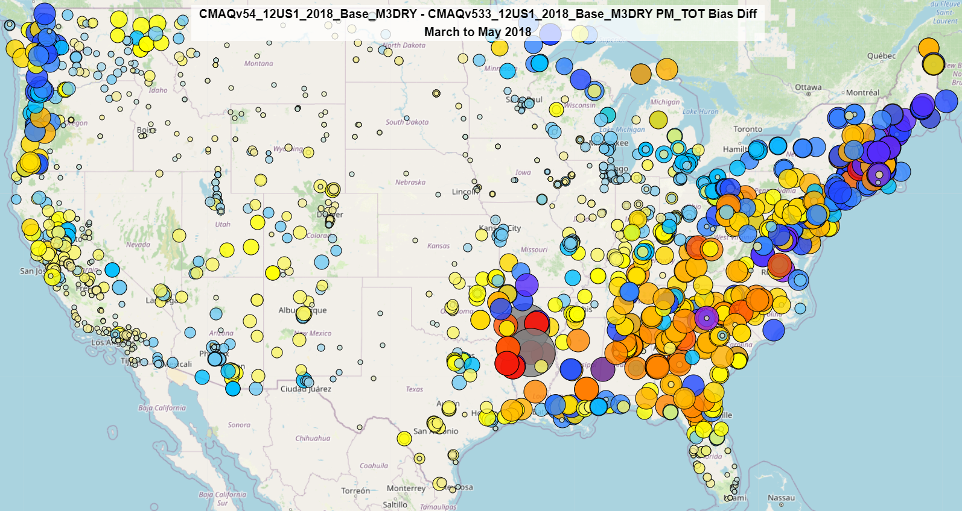
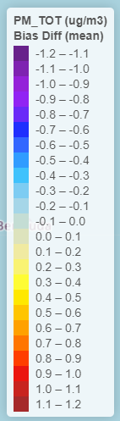
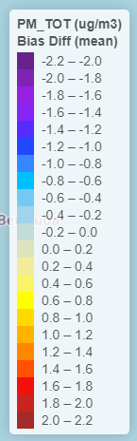
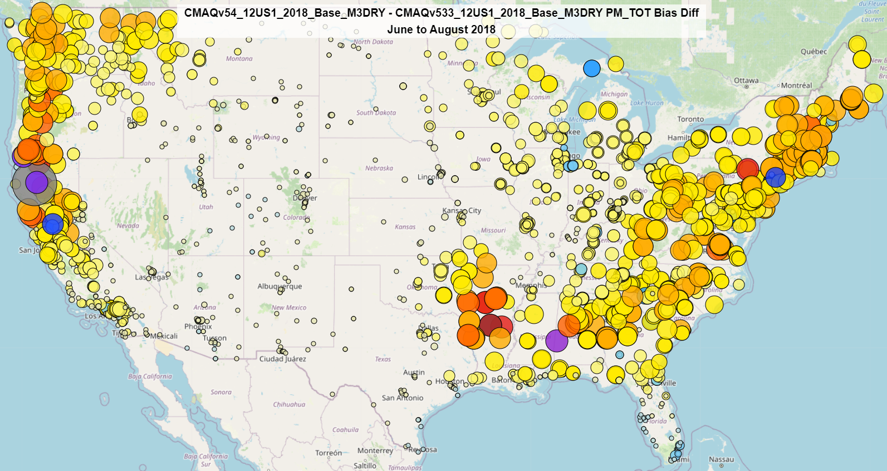
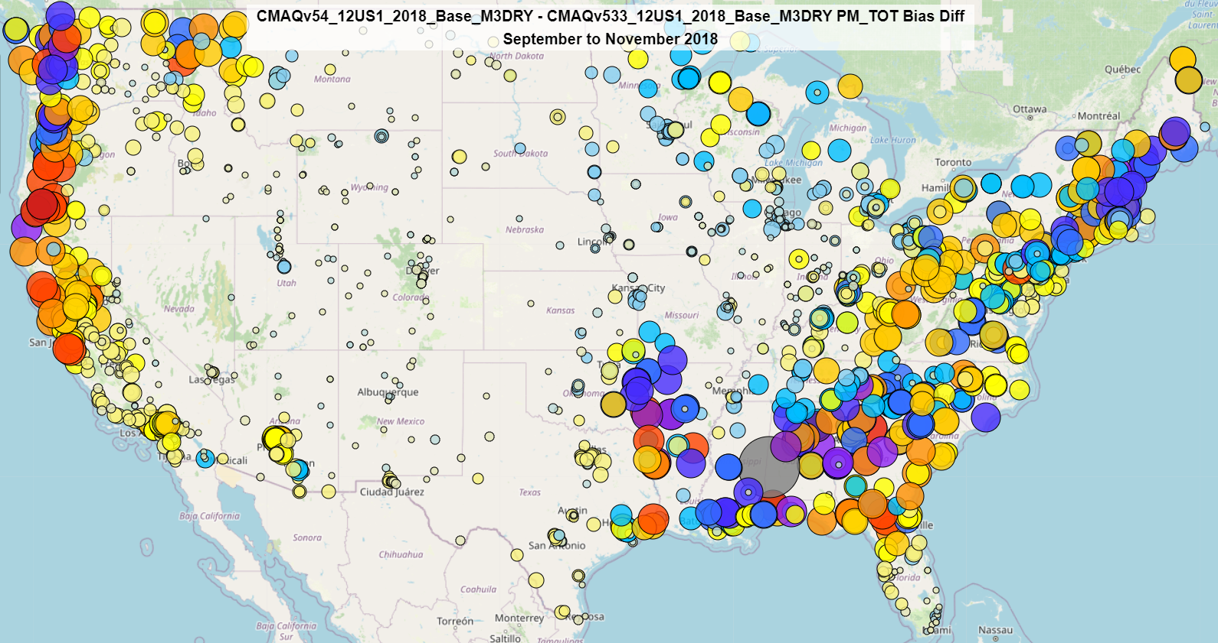
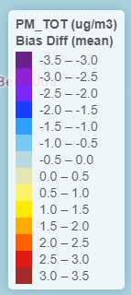
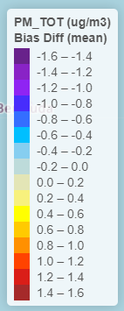
PM_{2.5}: CMAQv5.4 - v5.3.3 Seasonal Bias Difference
Higher PM_{2.5} bias with v5.4 in the summer (due to lower PM_{2.5} overall)
Improved Bias
Improved Bias
Winter
Worse Bias
Spring
Worse Bias
Mixed bias difference pattern between v5.3.3. and v5.4 in the winter, spring, and fall
Improved Bias
Improved Bias
Worse Bias
Worse Bias
Summer
Fall
Cool colors indicate lower bias with v5.4; Warm colors indicate higher bias with v5.4

Slide 36








PM_{2.5} – STAGE vs. M3Dry Seasonal Bias Difference
Lower bias with STAGE in the summer due to higher consistently higher PM_{2.5} compared to M3Dry
M3Dry Better
M3Dry Better
STAGE Better
STAGE Better
Winter
Spring
Mixed bias difference pattern between M3Dry and STAGE in the winter, spring, and fall
M3Dry Better
M3Dry Better
M3Dry Better
STAGE Better
STAGE Better
STAGE Better
Summer
Fall

Slide 37
Summary
Ozone
  Higher O₃ with v5.4 in winter and spring improves underestimation in v5.3.3
    Higher O₃ largely due to updates in marine chemistry in v5.4
    O₃ performance for M3Dry and STAGE are comparable
  Slightly higher O₃ in summer with v5.4 increases bias
    increase is small compared to the winter/spring improvement
  CRACMM results in slightly higher O₃ from late spring through summer compared to CB6r5
  MEGAN significantly reduces O₃, especially early spring through late fall compared to BEIS
Total PM_{2.5}
  Generally lower PM_{2.5} throughout the year with v5.4 w/ M3Dry; similar PM_{2.5} with STAGE with v5.4
    primarily the result of modifications to the dry deposition in M3Dry and STAGE
  CRACMM results in generally higher PM_{2.5} compared to CB6r5
    increase is most pronounced in the cooler months
    overall, results with CRACMM are comparable to CB6r5
  MEGAN results in higher PM2.5 compared to BEIS
    increase is most pronounced in the warmer months

Slide 38
Acknowledgements
UNC/CMAS
  Liz Adams
  Sarav Arunachalam
Additional CRACMM Team Members
  Christine Allen
  Matt Coggon
  Sara Farrell
  Faye McNeill
  Ivan Piletic
  Rebecca Schwantes
  Emily Saunders
  Karl Seltzer
  Heather Simon
  William R. Stockwell
  Luke Valin
  Forwood Wiser
  Lu Xu
Additional CMAQv5.4 Team Members
  Sarah Benish
  Russ Bullock
  James East
  Barron Henderson
  Jerry Herwehe
  Hosein Foroutan
  Mike Madden
  Megan Mallard
  Rebecca Miller
  Tom Pierce (retired)
  Uma Shankar
  Qian Shu
  Alan Vette

Slide 39
Supplemental Slides

Slide 40

MDA8 O₃ Bias (Monthly) – v5.3.3 vs v5.4
v5.3.3 M3Dry

Slide 41

MDA8 O₃ Bias (Monthly) – v5.3.3 vs v5.4
v5.3.3 M3Dry
v5.3.3 STAGE
v5.4 M3Dry
v5.4 STAGE
v5.4 M3Dry, CRACMM

Slide 42

MDA8 O₃ Bias (Monthly) – v5.2.1 vs v5.3
v5.3.3 M3Dry
v5.3.3 STAGE
v5.4 M3Dry
v5.4 STAGE
v5.4 M3Dry, CRACMM
v5.4 STAGE, CRACMM

Slide 43

MDA8 O₃ Bias (Monthly) – v5.3.3 vs v5.4
v5.3.3 M3Dry
v5.3.3 STAGE
v5.4 M3Dry
v5.4 STAGE
v5.4 M3Dry, CRACMM
v5.4 STAGE, CRACMM
v5.4 M3Dry, MEGAN

Slide 44

MDA8 O₃ Bias (Monthly) – v5.3.3 vs v5.4
v5.3.3 M3Dry
v5.3.3 STAGE
v5.4 M3Dry
v5.4 STAGE
v5.4 M3Dry, CRACMM
v5.4 STAGE, CRACMM
v5.4 M3Dry, MEGAN
v5.4 STAGE, MEGAN

Slide 45

PM_{2.5} Bias (Monthly) – v5.3.3 vs v5.4
v5.3.3 M3Dry

Slide 46

PM_{2.5} Bias (Monthly) – v5.3.3 vs v5.4
v5.3.3 M3Dry
v5.3.3 STAGE
v5.4 M3Dry
v5.4 STAGE
v5.4 M3Dry, CRACMM

Slide 47

PM_{2.5} Bias (Monthly) – v5.3.3 vs v5.4
v5.3.3 M3Dry
v5.3.3 STAGE
v5.4 M3Dry
v5.4 STAGE
v5.4 M3Dry, CRACMM
v5.4 STAGE, CRACMM

Slide 48

PM_{2.5} Bias (Monthly) – v5.3.3 vs v5.4
v5.3.3 M3Dry
v5.3.3 STAGE
v5.4 M3Dry
v5.4 STAGE
v5.4 M3Dry, CRACMM
v5.4 STAGE, CRACMM
v5.4 M3Dry, MEGAN

Slide 49

PM_{2.5} Bias (Monthly) – v5.3.3 vs v5.4
v5.3.3 M3Dry
v5.3.3 STAGE
v5.4 M3Dry
v5.4 STAGE
v5.4 M3Dry, CRACMM
v5.4 STAGE, CRACMM
v5.4 M3Dry, MEGAN
v5.4 STAGE, MEGAN

