Slide 1

Hemispheric-Scale Evaluation of CMAQv5.4
Christian Hogrefe, K. Wyat Appel, Kristen Foley, Golam Sarwar, Jonathan Pleim, Jesse Bash, Jeff Willison, Daiwen Kang, Robert Gilliam, George Pouliot, and Rohit Mathur
U.S. Environmental Protection Agency, Research Triangle Park, NC, USA
21st Annual CMAS Conference
October 17 - 19, 2021
Disclaimer: The views expressed in this presentation are those of the authors and do not necessarily reflect the views or policies of the U.S. EPA.
Office of Research and Development
Center for Environmental Measurement & Modeling, Atmospheric & Environmental Systems Modeling Division

Slide 2
2018 Hemispheric CMAQ (H-CMAQ) Simulations
The H-CMAQ modeling platform is used to
efficiently quantify the effects of different model updates and science options*
characterize large-scale atmospheric composition to provide boundary conditions for the 12km CMAQv5.4 evaluation simulations (presentation by Wyat Appel)
evaluate modeled fields against ground-based, aloft, and remote sensing data
*see poster by Fahim Sidi for an overview of CMAQv5.4 updates

Slide 3
Model Configuration for Base Simulations
Domain: Northern Hemisphere at 108 km grid spacing and 44 vertical layers up to 50 mb
WRF: v4.3.3, KF convective scheme with trigger 1, PX land surface model, ACM2 PBL scheme, MODIS land use, Morrison microphysics, RRTMg radiation, lightning assimilation using WWLLN
Emissions: EQUATES (see Foley et al. 2020 CMAS presentation):
  Anthropogenic:
    U.S.: EQUATES 12 km emissions patched into the 108 km domain
    Non-US: 2010 HTAP with year-specific scaling from CEDS and Tsinghua University
  Fires: BlueSky Pipeline (U.S.) and FINN (non-U.S.)
  Biogenic VOC: CAMSv2.1 (based on MEGAN2.1)
  Soil NO: CAMSv2.1 (Yienger and Levy, 1995 with updates based on recent literature)
  Lightning: GEIA climatology
CMAQ:
  CB6 with detailed halogen chemistry
  Aero7
  M3Dry and STAGE dry deposition schemes

Slide 4
List of 2018 CMAQ Simulations Using M3Dry
Label | CMAQ | Aerosol Dry Deposition | Biogenic VOC | Soil NO | Lightning NO
v533 | CMAQv5.3.3 | Shu et al. (2022) | CAMS | CAMS | GEIA
v54 BASE | CMAQv5.4 | Pleim et al. (2022, accepted) | CAMS | CAMS | GEIA
v54 MEGAN YL | CMAQv5.4 | Pleim et al. (2022, accepted) | MEGAN3.2 | MEGAN3.2 (Yienger-Levy approach) | GEIA
v54 MEGAN BDSNP | CMAQv5.4 | Pleim et al. (2022, accepted) | MEGAN3.2 | MEGAN3.2 (Berkeley-Dalhousie approach) | GEIA
v54 WWLLNS* | CMAQv5.4 | Pleim et al. (2022, accepted) | CAMS | CAMS | Scaled World Wide Lightning Location Network
*The v54 WWLLNS sensitivity is not directly related to any CMAQv5.4 updates or science option, but was included here to provide additional context for the lightning NO emission research presented by Mike Madden, Daiwen Kang, and James East

Slide 5
List of 2018 CMAQ Simulations Using STAGE
Label | CMAQ | Aerosol Dry Deposition | Biogenic VOC | Soil NO | Lightning NO
v533 | CMAQv5.3.3 | Shu et al. (2022) | CAMS | CAMS | GEIA
v54 BASE | CMAQv5.4 | Emerson et al. (2020) | CAMS | CAMS | GEIA
v54 MEGAN YL | CMAQv5.4 | Emerson et al. (2020) | MEGAN3.2 | MEGAN3.2 (Yienger-Levy approach) | GEIA
v54 MEGAN BDSNP | CMAQv5.4 | Emerson et al. (2020) | MEGAN3.2 | MEGAN3.2 (Berkeley-Dalhousie approach) | GEIA
v54 Pleim | CMAQv5.4 | Pleim et al. (2022, accepted) | CAMS | CAMS | GEIA
Almost all simulations were performed using both the M3Dry and STAGE dry deposition scheme

Slide 6
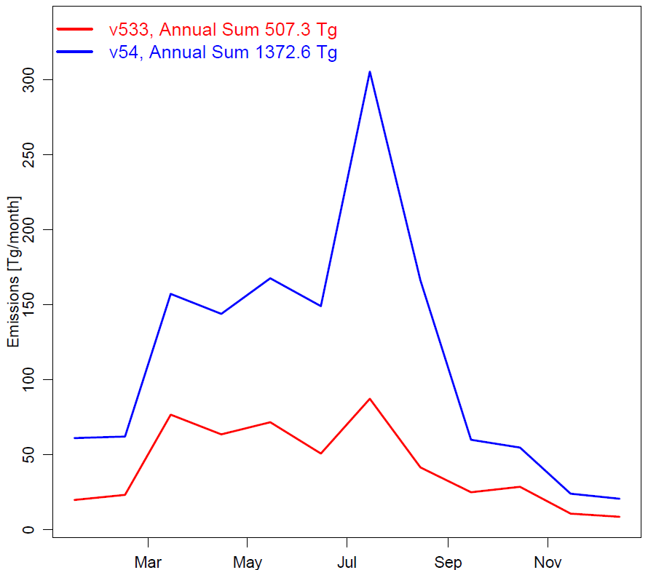
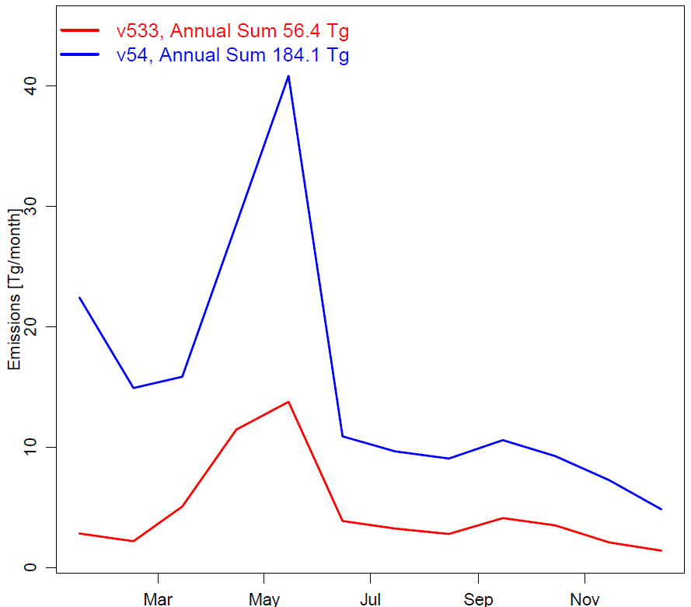
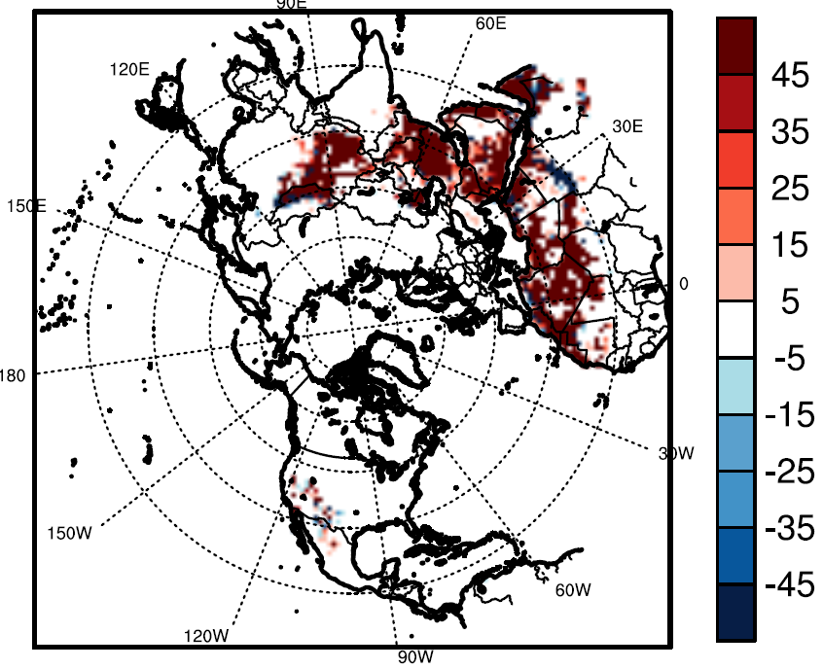
Updates to Windblown Dust in CMAQv5.4
CMAQv54 – CMAQv53 Annual Totals (Gg)
Domain Total (Tg)
China Grid Cell Total (Tg)
v533
v54
v533
v54
Windblown dust emissions increase significantly in CMAQv5.4 → see poster by Fahim Sidi for additional details
  CMAQv5.3.3 annual total: 507 Tg; CMAQv5.4 annual total: 1,373 Tg
Expected to increase PM_{2.5} inflow into the 12 km CONUS domain

Slide 7
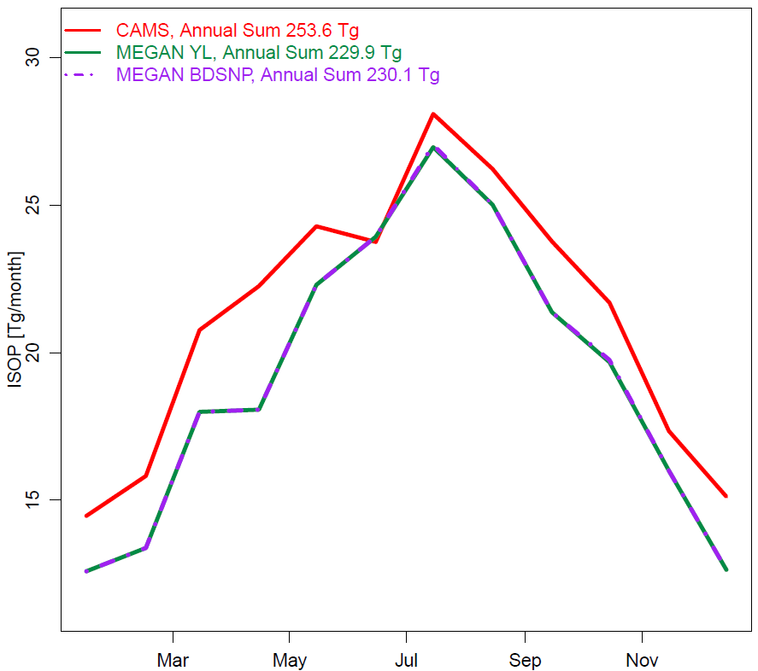
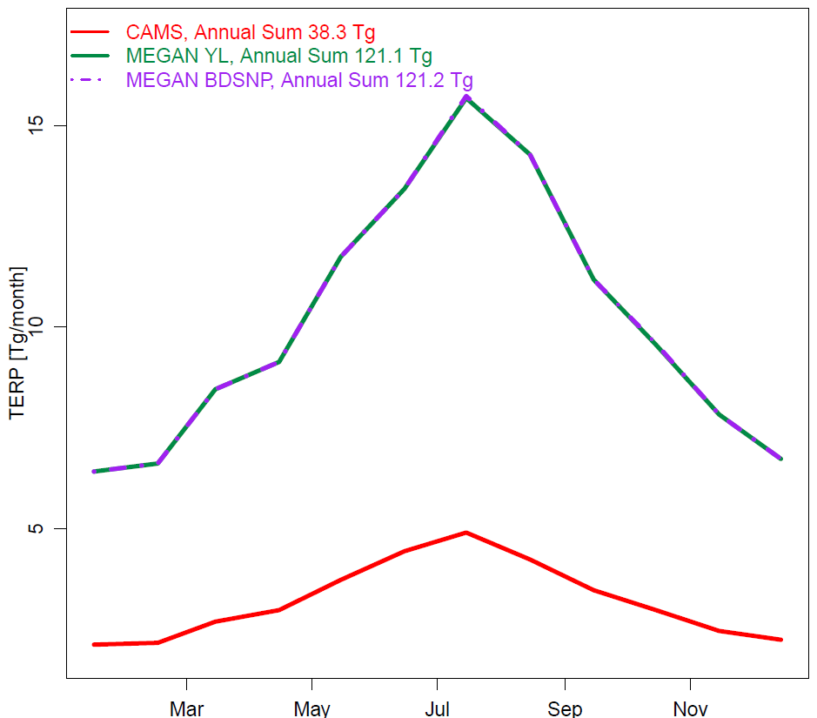
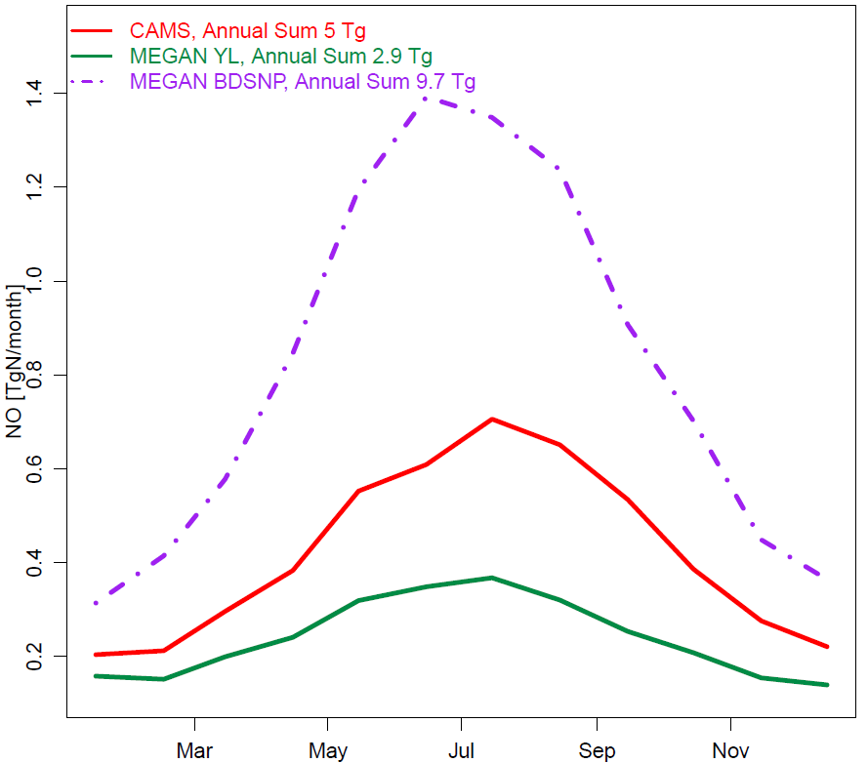
MEGAN3.2 Inline Biogenics Option in CMAQv5.4
Domain Total Isoprene Emissions (Tg)
Domain Total Monoterpene Emissions (Tg)
Domain Total Soil NO Emissions (Tg)
CAMS
MEGAN YL
MEGAN BDSNP
CAMS
MEGAN YL
MEGAN BDSNP
CAMS
MEGAN YL
MEGAN BDSNP
Change in MEGAN domain total emissions relative to CAMS (based on MEGAN2.1)
  10% decrease for isoprene, 300% increase for monoterpenes
  40% decrease for soil NO using YL parameterization, 100% increase using BDSNP

Slide 8
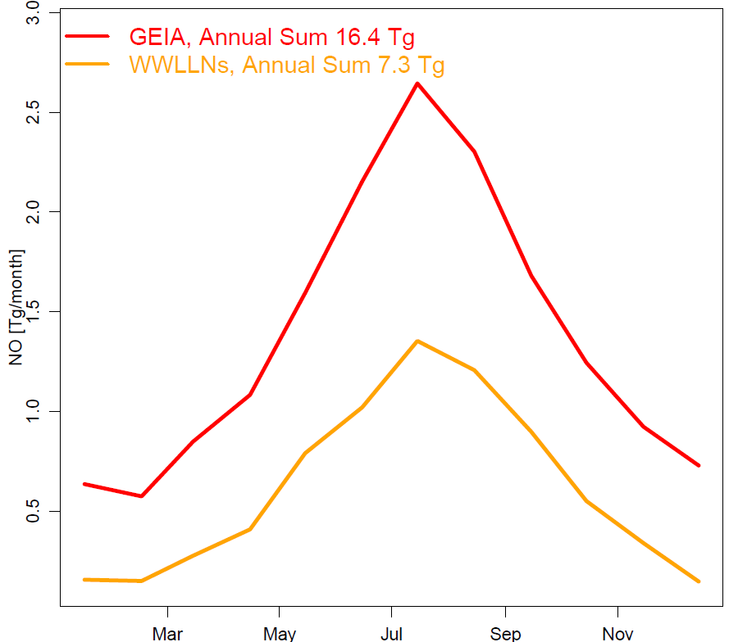
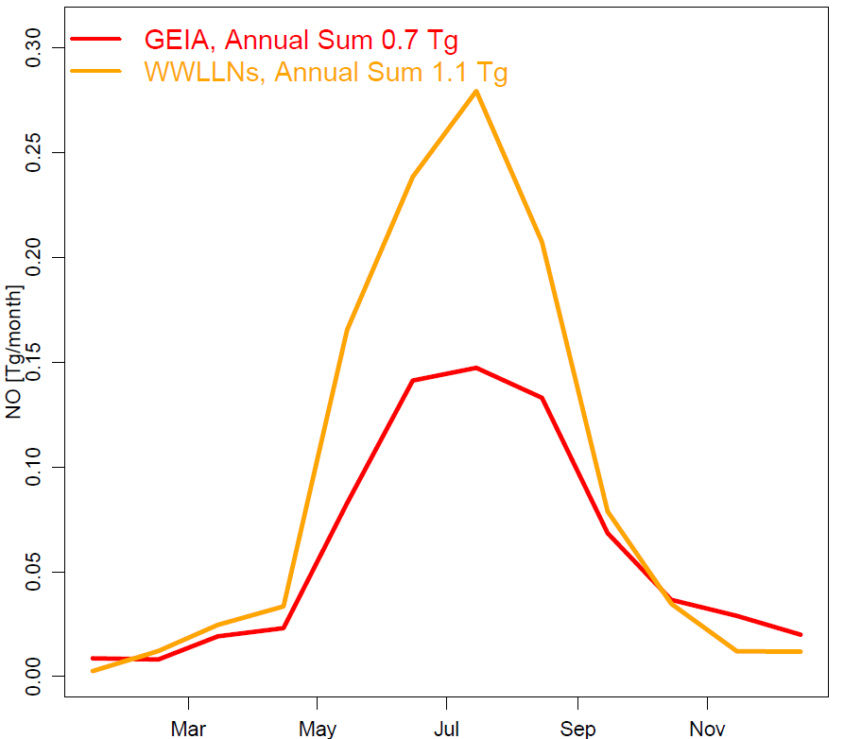
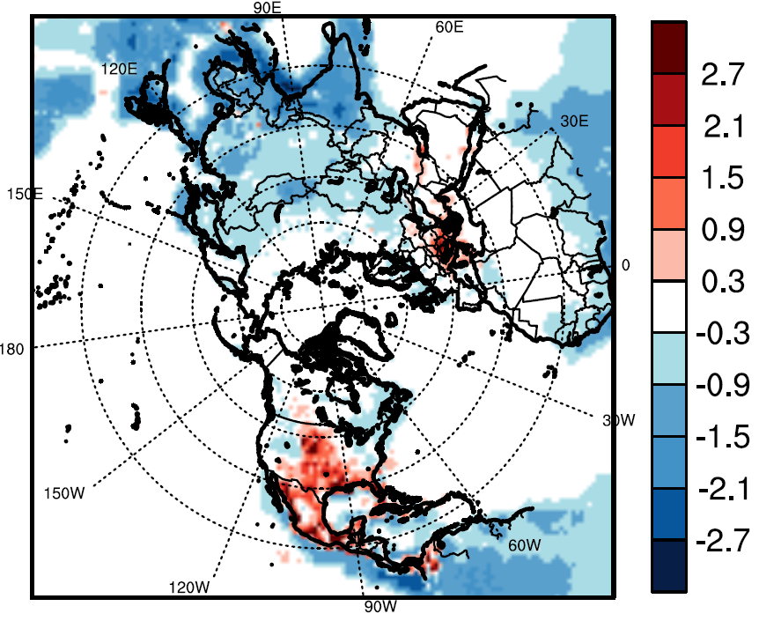
Lightning NO Emissions – GEIA vs. WWLLNS
Domain Total (Tg)
U.S. Grid Cell Total (Tg)
WWLLNS – GEIA Annual Totals (Gg)
GEIA
WWLLNs
GEIA
WWLLNs
WWLLNS lightning NO emissions are generally lower than GEIA (exception: U.S.).
  GEIA annual total: 16.4 Tg NO; WWLLNs annual total: 7.3 Tg NO
See presentations by Mike Madden, Daiwen Kang, and James East for more on lightning NO

Slide 9
O₃ Results

Slide 10
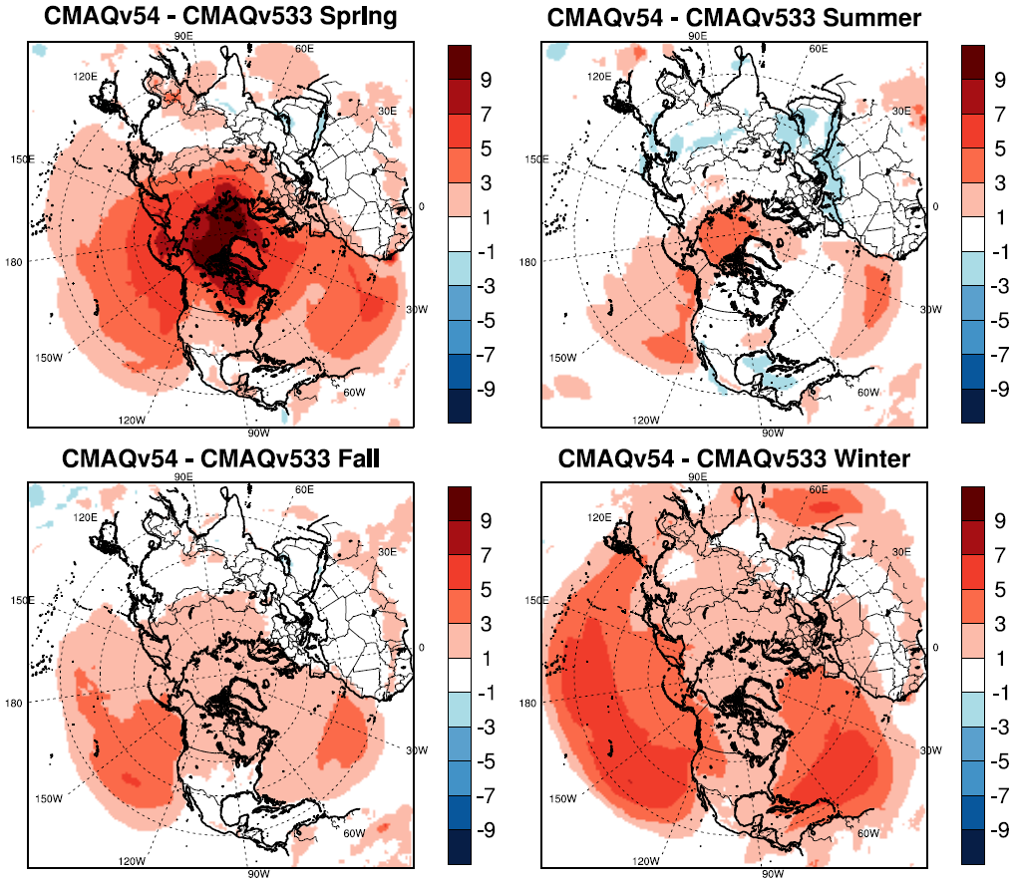
Seasonal Mean O₃ Changes, CMAQv5.4 BASE - CMAQv5.3.3
Widespread systematic increases of 1 – 7 ppb in seasonal mean surface O₃, especially during winter and spring
These increases are mostly due to updates to the representation of detailed halogen chemistry in CMAQv5.4 (see presentation by Golam Sarwar for details)
These results are for M3Dry, very similar results for STAGE

Slide 11
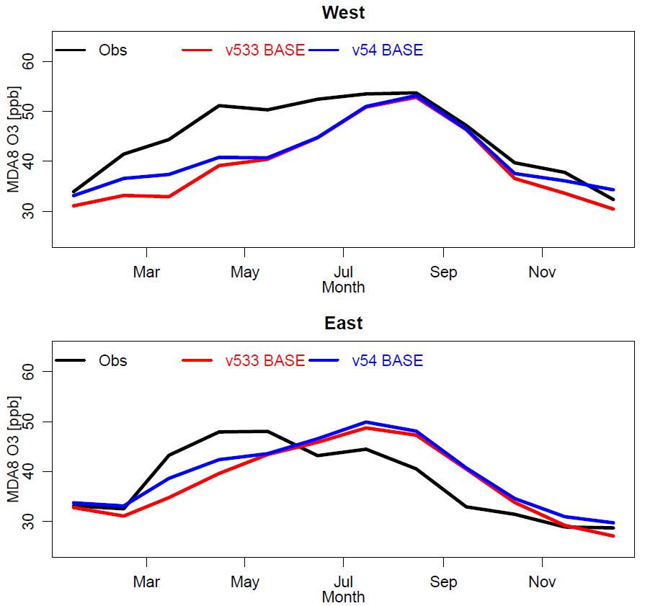
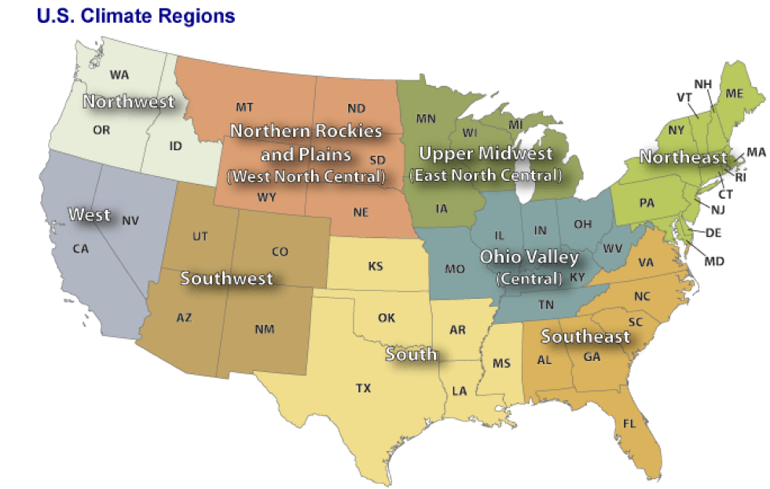
BASE MDA8 O₃ Comparison to AQS Observations, Monthly Network Average
O₃ increases in CMAQv5.4 tend to reduce cool season underpredictions, but springtime underestimations and summer overestimations in the eastern U.S. remain
These results are for M3Dry, very similar results for STAGE
East
West

Slide 12
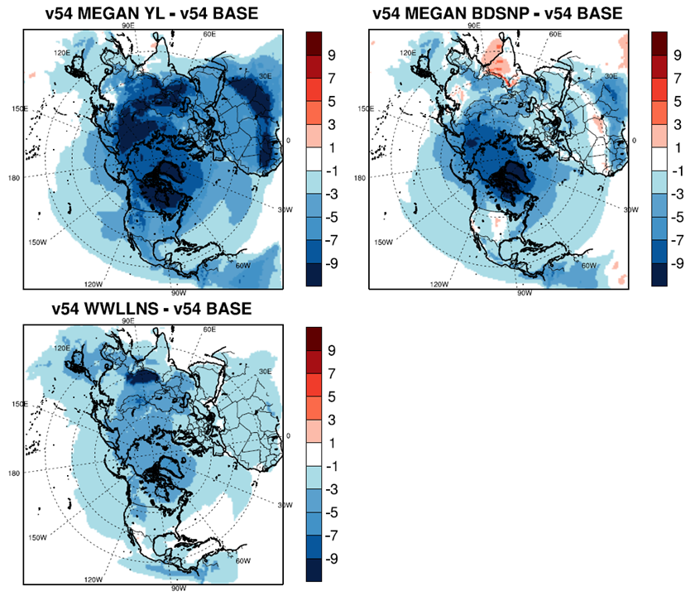
Summer Mean O₃ Changes, Sensitivities - CMAQv5.4 BASE
For most regions, all sensitivities explored here reduce summertime O₃; reductions over the US range from 1-7 ppb (exception: increase in agricultural regions for MEGAN BDSNP)
The decreases are largest for MEGAN YL (lower isoprene and soil NO emissions)
While lightning NO emissions in WWLLNs are higher than GEIA over the U.S., O₃ still decreases due to reduced lightning NO emission elsewhere in the domain
Biogenic VOC and Soil NO
Lightning NO

Slide 13
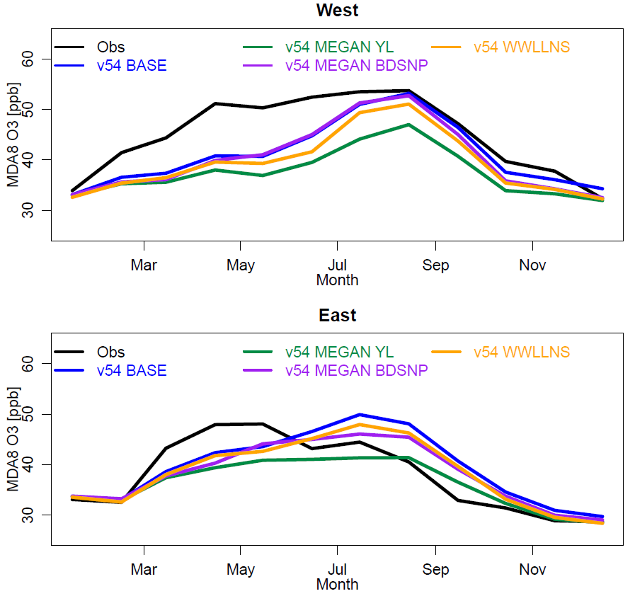
Impact of Sensitivity Simulations on Model Bias, AQS Sites
Observations
v54 BASE
v54 MEGAN YL
v54 MEGAN BDSNP
v54 WWLLNS
The lower isoprene and soil NO emissions in MEGAN YL worsen underpredictions in the west and improve summertime performance in the east
Using WWLLNS instead of GEIA degrades summer model performance in the west and improves summer performance in the east
These results are for M3Dry, very similar MEGAN sensitivity results for STAGE

Slide 14
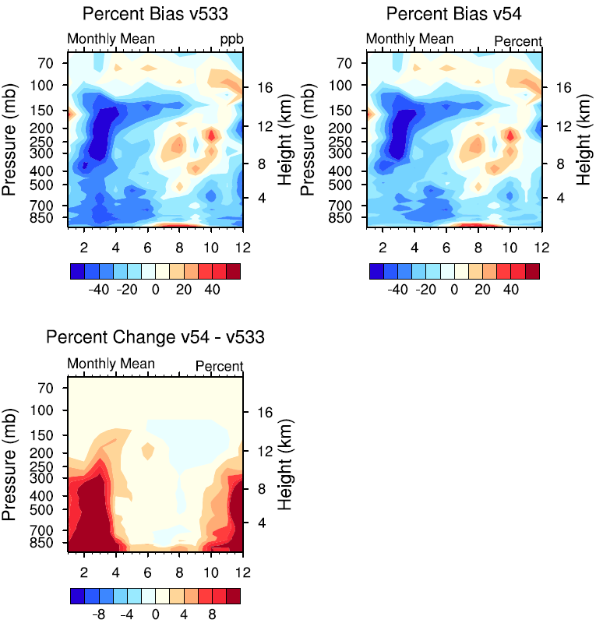
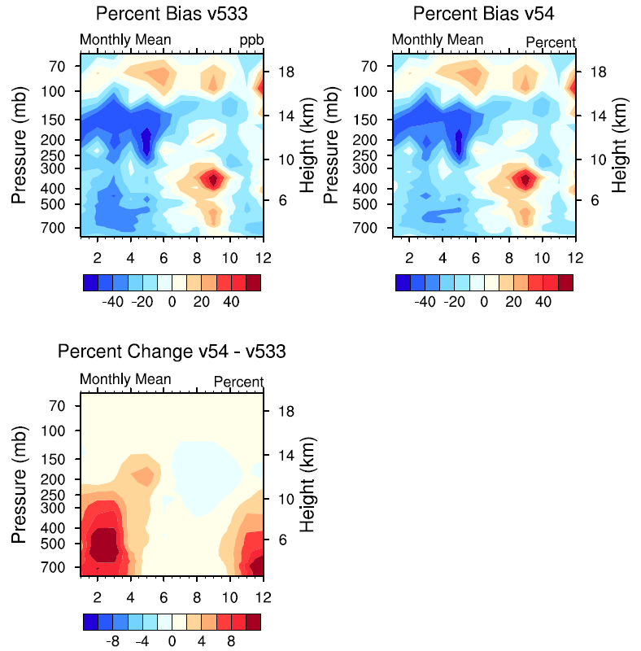
Aloft O₃ Performance at Selected Ozonesonde Sites
Time-Height Cross Sections of Percentage Bias and Change in Monthly O₃, 2018
Trinidad Head, CA
Boulder, CO
CMAQv5.4 increase in non-summer O₃ improves but does not eliminate pronounced negative upper tropospheric springtime bias
These results are for M3Dry, very similar results for STAGE

Slide 15
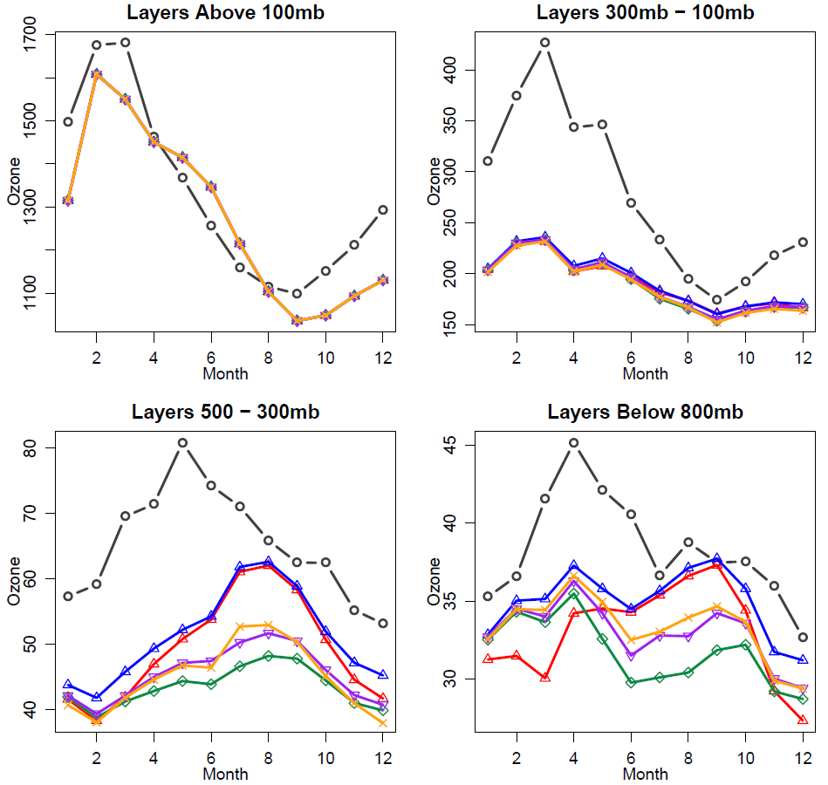
Monthly Variations at 26 Ozonesonde Sites Across the Northern Hemisphere
Observations
v533 BASE
v54 BASE
v54 MEGAN YL
v54 MEGAN BDSNP
v54 WWLLNS
Generally good representation of O₃ above 100 mb
The effects of v5.4 revised halogen chemistry are most pronounced in the lower and mid troposphere outside of summer
Changing the representation of biogenic or lightning NO emissions reduces low- and mid-tropospheric O₃ relative to v5.4 BASE, with the largest reductions occurring in summer
Comparisons of satellite-derived and CMAQ tropospheric O₃ columns show similar features
→ also see poster by Barron Henderson

Slide 16
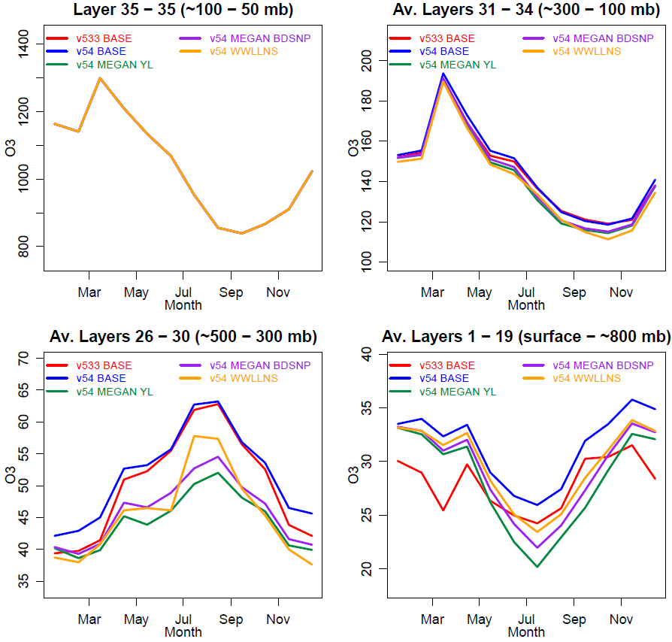
12US1 Boundary Conditions, Western Boundary
v5.3.3 BASE
v5.4 BASE
v5.4 MEGAN YL
v5.4 MEGAN BDSNP
v5.4 WWLLNS
Both the updates to detailed halogen chemistry in CMAQv54 and the science options for the representation of biogenic VOC, soil NO, and lightning NO emissions have a pronounced impact on the estimate of large-scale background O₃ at the boundaries of the 12km modeling domain
These results are for M3Dry, very similar results for STAGE

Slide 17
Fine PM Results

Slide 18
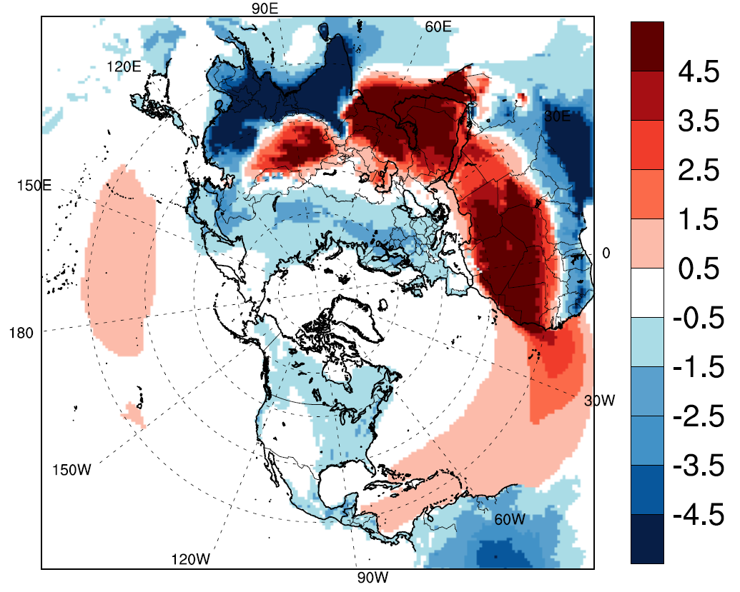
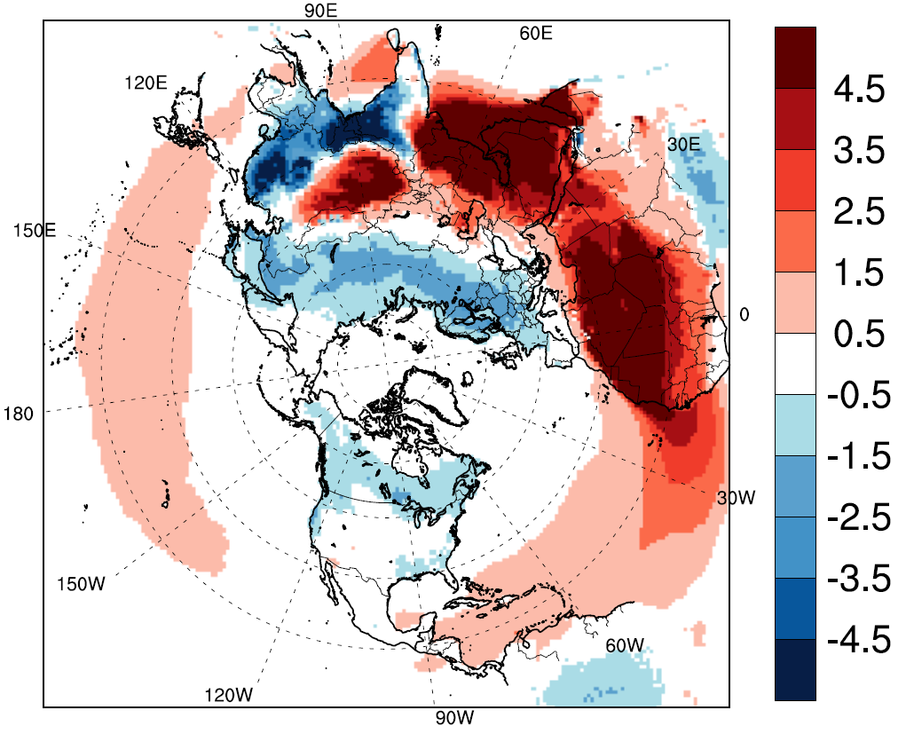
Annual Mean Surface Total Fine PM Changes, CMAQv5.4 BASE - CMAQv5.3.3
Increased Aerosol Deposition
M3Dry
Increased Dust Emissions
STAGE (Emerson)
µg/m³
µg/m³
Both M3Dry and STAGE show the opposing effects of increased dust emissions and increased aerosol dry deposition
Decreases due to stronger dry deposition over vegetated regions are more pronounced for M3Dry

Slide 19
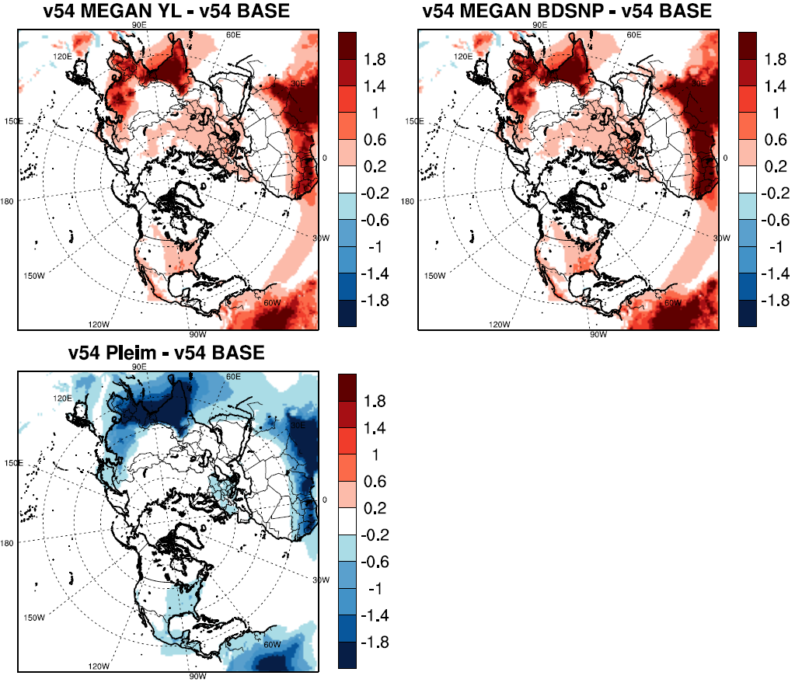
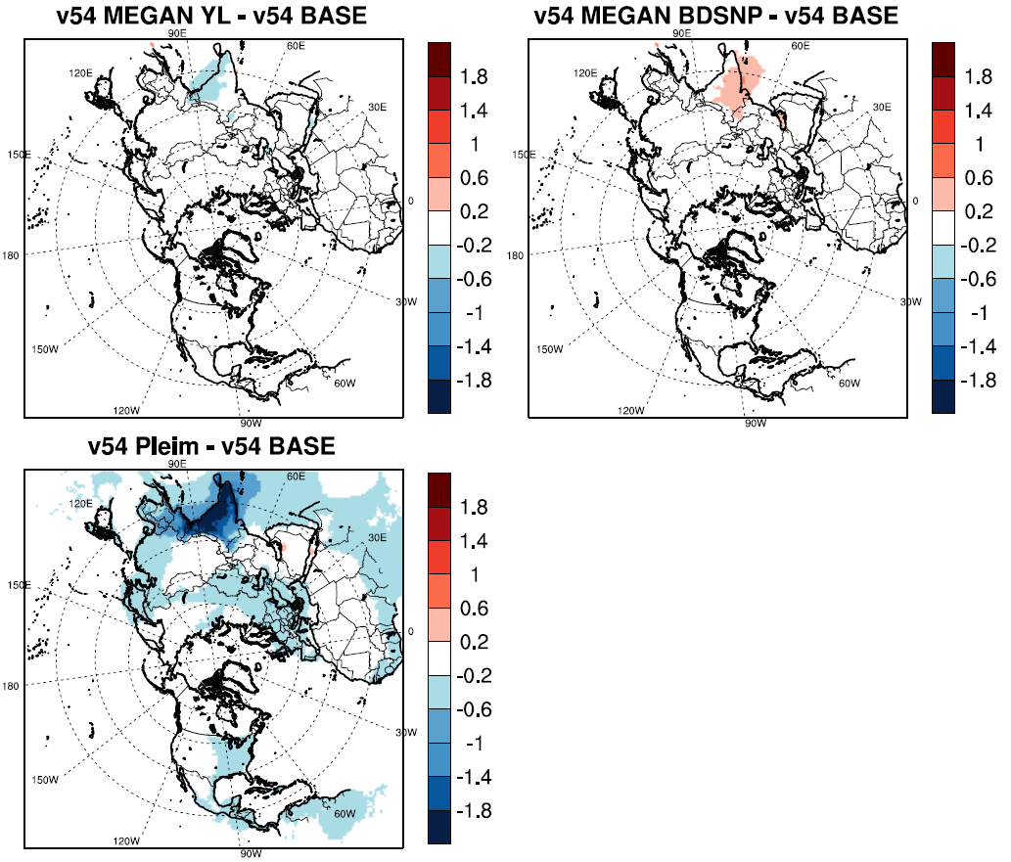
Annual Mean Surface PM Species Changes, Sensitivities - CMAQv5.4 BASE (STAGE)
Organic Carbon
Sulfate
Increased MEGAN monoterpene emissions cause increases of annual mean OC by 0.2 – 1.0 µg/m³ over the eastern U.S. and more substantial amounts in tropical regions
µg/m³
µg/m³
µg/m³
µg/m³
↑ Biogenic Sensitivities ↑
↓ Aerosol Dry Deposition Sensitivity ↓
Using Pleim et al. (2022) instead of Emerson et al. (2020) to represent aerosol dry deposition in STAGE causes OC and sulfate decreases of 0.2 µg/m³ or more over vegetated regions
µg/m³
µg/m³

Slide 20
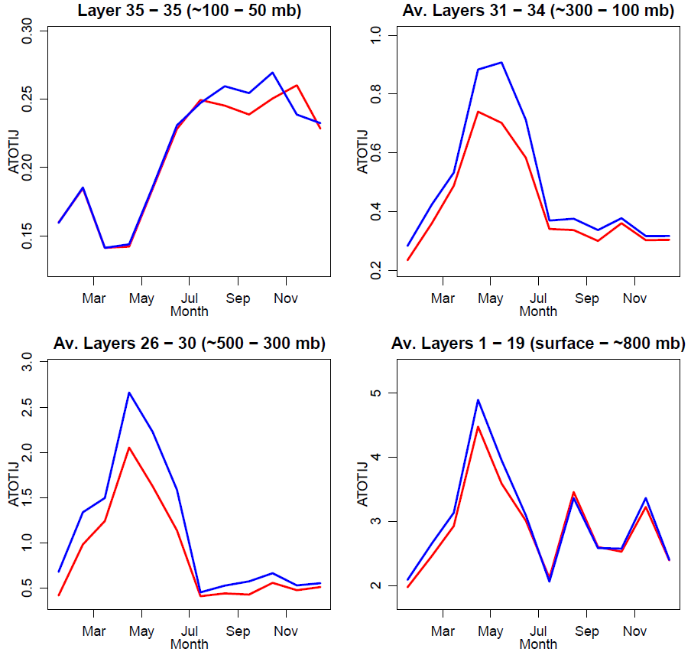
12US1 Boundary Conditions, Total Fine PM
Western Boundary
CMAQv5.3.3 (M3Dry)
CMAQv5.4 (M3Dry)
(µg/m³)
(µg/m³)
Monthly mean fine PM at the western boundary increases by up to ~0.5 µg/m³ from CMAQv5.3.3 to CMAQv5.4
The increase is largest in the lower and mid-troposphere during spring
(µg/m³)
(µg/m³)

Slide 21
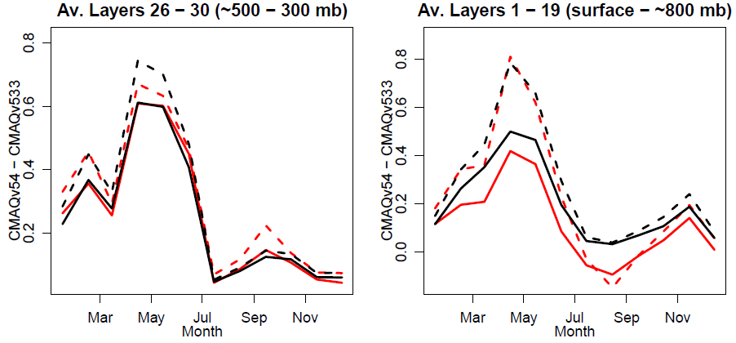
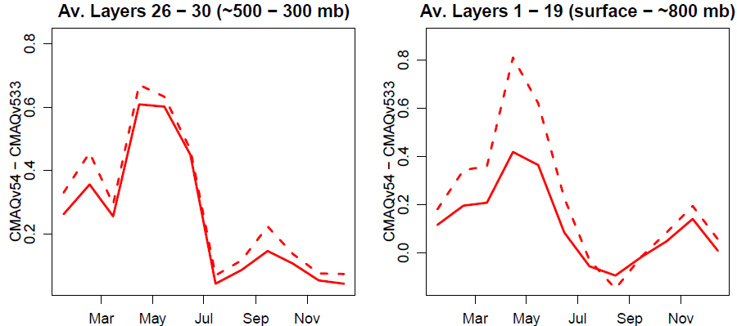
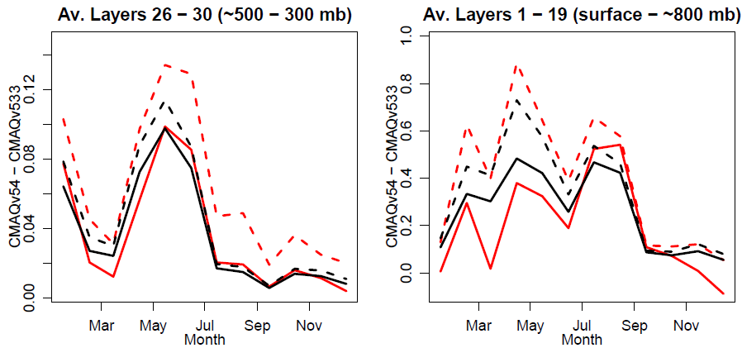
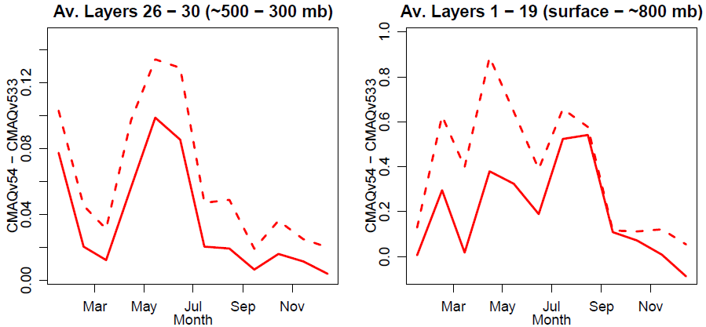
Differences in 12US1 Boundary Conditions
Western Boundary
(µg/m³)
(µg/m³)
v5.4 – v5.3.3, Total Fine PM, M3Dry
v5.4 – v5.3.3, Total Fine PM, STAGE
v5.4 – v5.3.3, Total Fine PM, M3Dry
v5.4 – v5.3.3, Total Fine PM, STAGE
v5.4 – v5.3.3, Crustal PM, M3Dry
v5.4 – v5.3.3, Crustal PM, STAGE
Most of the lower and mid-tropospheric increase in total fine PM in CMAQv5.4 is due to the increase in crustal PM, consistent with increased dust emissions
The larger increase in aerosol dry deposition in M3Dry dampens more of the effects of these increased emissions compared to STAGE
Southern Boundary
(µg/m³)
(µg/m³)

Slide 22
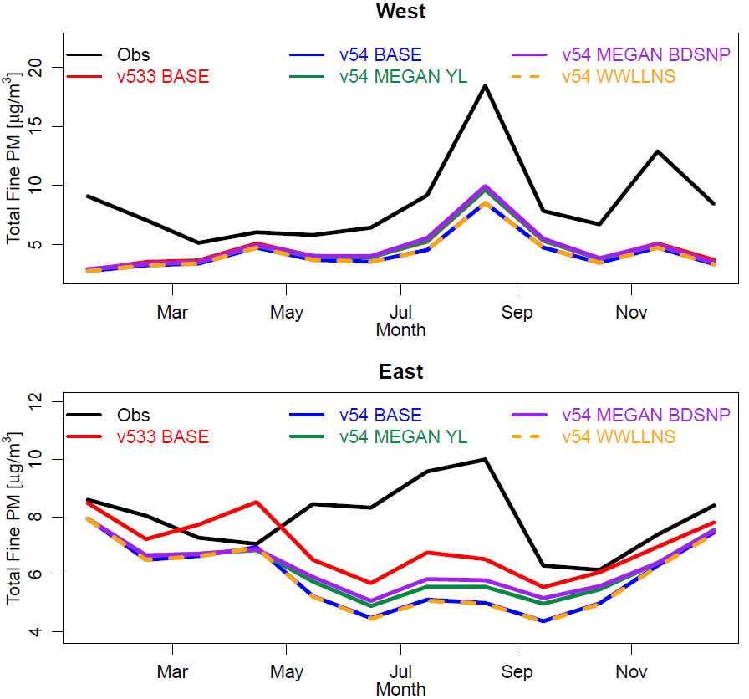
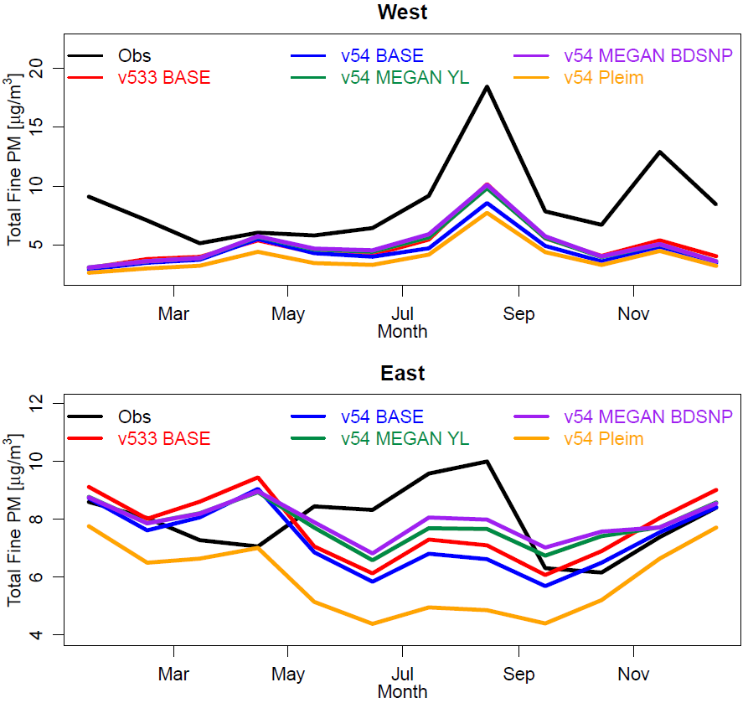
Total Fine PM Comparison to AQS Observations
M3Dry
STAGE
West
East
While noticeable differences exist between model versions, dry deposition schemes, and science options, the underestimation of PM throughout the year in the West and during summer in the East is present in all simulations

Slide 23
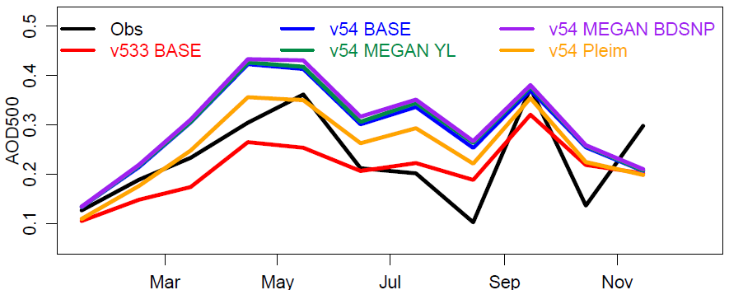
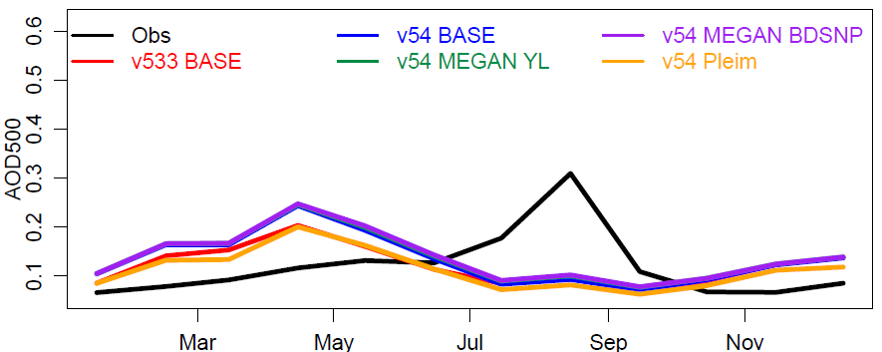
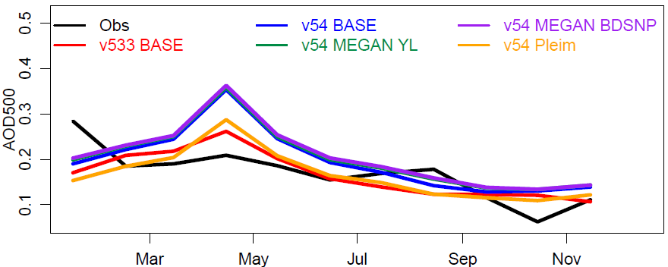
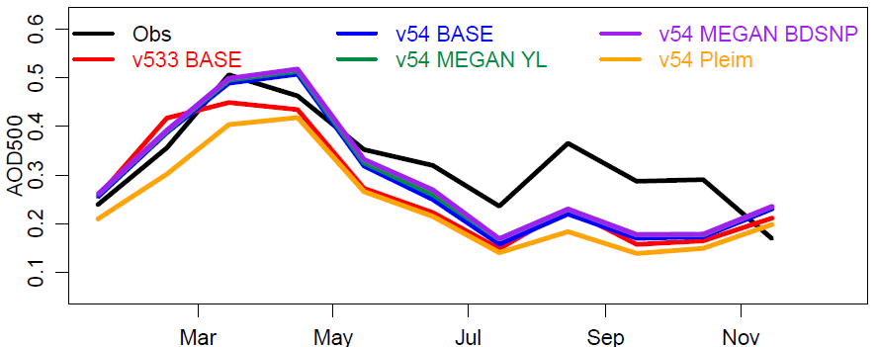
AOD Comparison to AERONET Observations
Sahara + Middle East, STAGE
North America, STAGE
Europe, STAGE
Asia, STAGE
Largest effect of model update over dust source region
Also see poster by Rebecca Miller for more H-CMAQ AOD analysis

Slide 24
Summary
Many of the science updates and options available in CMAQv5.4 affect the simulated large-scale atmospheric composition and estimated pollutant inflow into the CONUS
O₃:
  Widespread systematic increases of 1 – 7 ppb in seasonal mean surface O₃, especially during winter and spring, largely due to updates in detailed halogen chemistry
  Alternate representations of biogenic VOC, soil NO, and lightning NO cause similar changes in lower and mid-tropospheric O₃, especially during summer
  Challenges remain to capture observed springtime peaks in the upper troposphere
Fine PM:
  Increased dust emissions, different updates to aerosol dry deposition, and the new MEGAN3.2 inline biogenic VOC option all affect simulated PM, both at the surface and aloft
  The changes often counteract each other, net impacts vary by location, season, and species
H-CMAQ provides an efficient testbed for assessing the impacts of model updates and science options

Slide 25
Extra Slides

Slide 26
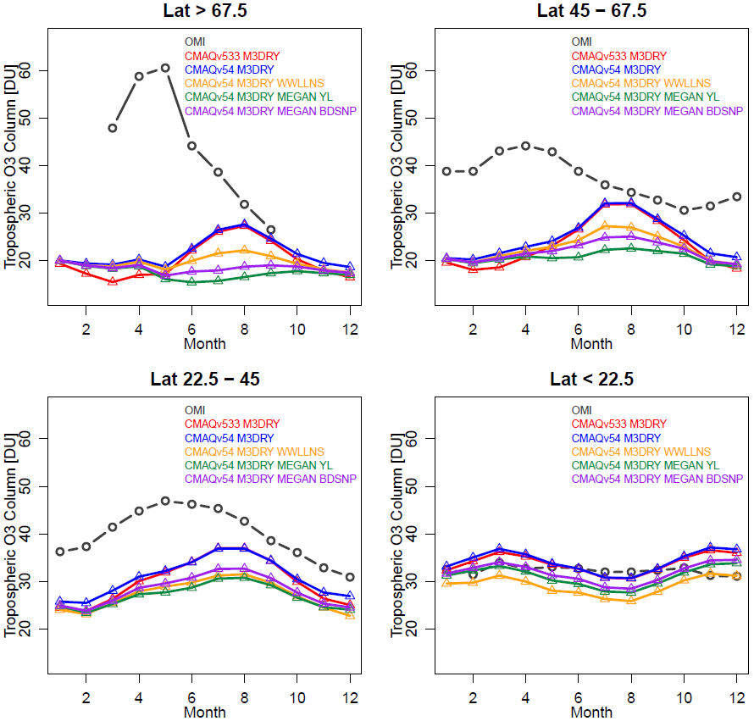
Comparison for Tropospheric Column O₃*
OMI*
v533 BASE
v54 BASE
v54 MEGAN YL
v54 MEGAN BDSNP
v54 WWLLNS
Comparisons are consistent with ozonesonde analysis
Springtime underestimations are most pronounced at higher latitudes
Also see poster by Barron Henderson for more background on using satellite data for model evaluation
  *OMI tropospheric ozone column (PROFOZ product) level 2 data processed with cmaqsatproc (https://github.com/barronh/cmaqsatproc)
    Liu et al., 2010, Atmos. Chem. Phys., 10, doi:10.5194/acp-10-2521-2010
    Kim et al., 2013, Atmos. Chem. Phys., 13, doi:10.5194/acp-13-9321- 2013

Slide 27
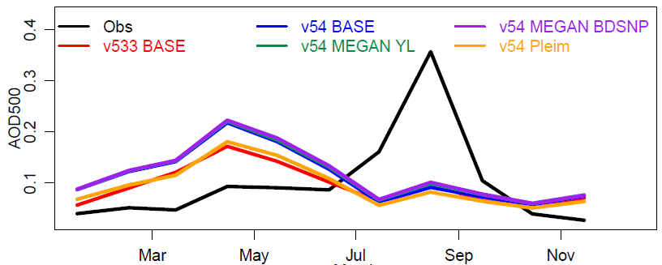
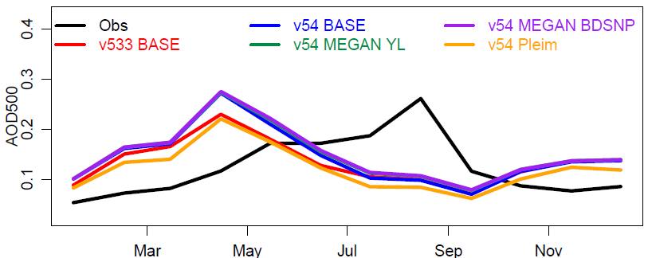
AOD Comparison to AERONET Observations
Western U.S., STAGE
Eastern U.S., STAGE
Observations
CMAQv5.3 STAGE BASE
CMAQv5.4 STAGE BASE
CMAQv5.4 MEGAN YL
CMAQv5.4 MEGAN BDSNP
CMAQv5.4 Pleim
Underestimation of observed summer AOD peak is consistent with surface fine PM comparisons and likely points to challenges with modeling the impacts of fires

