Slide 1
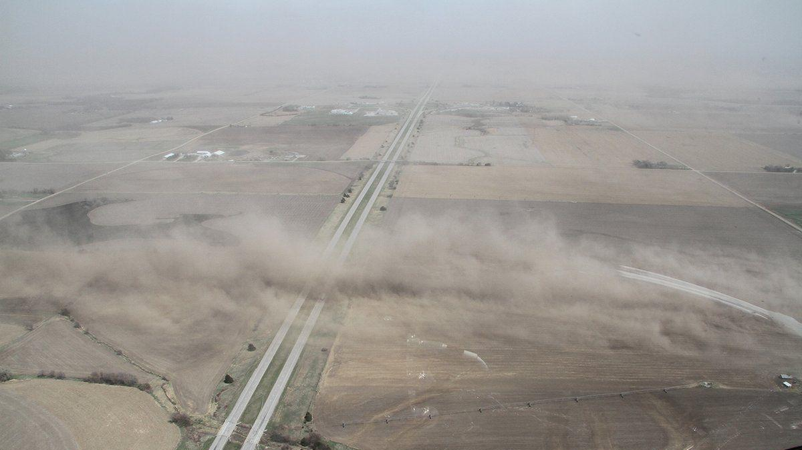
Improving Estimates of Wind-Blown Dust from Natural and Agricultural Lands
Pradeepa Vennam, Chris Emery and Greg Yarwood
Ramboll US Consulting, Inc
CMAS Conference 2022

Slide 2
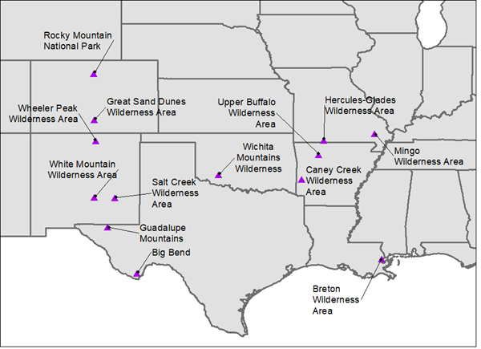
Introduction
Project was conducted under the Texas Air Quality Research Program
  Wind-blown dust (WBD) emissions derived from “WBDUST” CAMx preprocessor
  Large WBD under predictions vs. rural IMPROVE monitoring
  Update the WBDUST emission model
    Formulation from review of other WBD models (improve known limitations)
    Spatially/temporally resolved cropland data (increase emissive areas)
IMPROVE Monitoring Sites
Notes:
Under predictions not just in magnitude but little to zero emissions spatially and temporally.

Slide 3
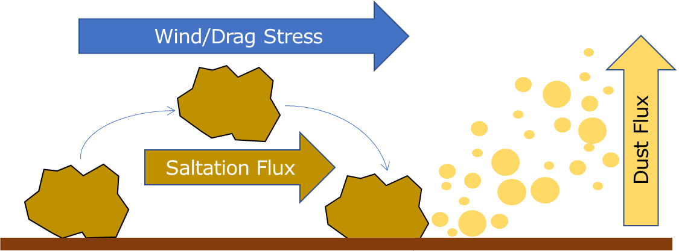
How WBDUST Works
V1 based on global model: Astitha et al., 2012 (A12), Klingmueller et al., 2018 (K18)
  Uses CAMx meteorology & landcover, global soil characterization, (optional) global LAI
Parallels other WBD models – highly parameterized
  Wind stress (U*) > threshold → drives “saltation” process
    Lifts large dirt particles that “sand blast” fine dust particles
  WBD emission flux scales from saltation flux
Many specific conditions must align:
  Meteorology (wind speed/stress)
  Soil conditions (type/composition, moisture)
  Vegetation (type, coverage/density)
Notes:
If global LAI is not provided, LAI taken from CAMx landcover defaults.
Dirt particles range 10-1000 um.
Dust in this context is PM10.

Slide 4
Starting Point and Literature Review of Other Models
WBDUST v1.0
A12/K18 for global climate/chemistry modeling
more detail needed for regional modeling
WRF-Chem/AFWA: LeGrand et al. (2019)
Moderately more detailed, some simplifications
WBDUST v2.0
CMAQ: Foroutan et al. (2017; F17)
Moderately more detailed, practically designed for readily available supporting datasets
WRF-Chem/UoC: LeGrand et al. (2019)
Substantially more detailed, lack of routine supporting datasets

Slide 5
Updates to WBDUST
Select specific updates
Improve certain methods/assumptions
Adopt several features of the F17 scheme
Balance technical rigor and detail supported by available data
Include important process details with no additional data burden
Better characterize emissions spatially/temporally without ad hoc limits
Continue to use CAMx-ready input files and global soil characterization
Remove the K18 barren land mask
Notes:
Add detail for important processes with no additional data burden
Generate accurate emissions spatially and temporally without ad limits

Slide 6
Agricultural Landcover Datasets – CropScape tool
256 vegetation categories
Year-specific US 30-m landcover & crop data (NASS, 2021)
1997-2020 geo-referenced raster data
256-pixel vegetation types
Massive and burdensome to use
Python tool
Recast data: CAMx landcover + specific crop categories (42 total)
Reproject: 30-m data to CAMx grid fractions
42 CAMx/WBDUST categories

Slide 7
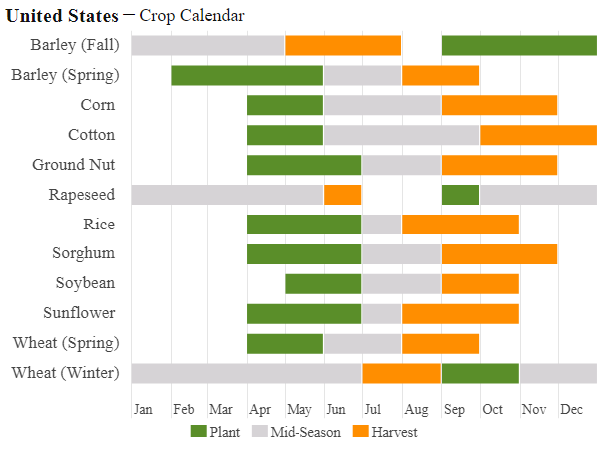
Agricultural Landcover Datasets – CMAQ Crop Calendar
State-level cultivation schedules for 18 crops
  CMAQ does not reference specific source of data
  Not year-specific, simple format, easy to use
  Basis for defining periods of tilled croplands
CropScape is cross-referenced to crop calendar
Crops converted to “barren” (tilled) during planting seasons
https://ipad.fas.usda.gov/countrysummary/Default.aspx?id=US
Notes:
The figure represents the type of schedule in the CMAQ crop calendar, but the latter is state-specific and has a few more crop types.
A fraction (25%) of crops are assumed to be tilled and emissive on any given date during their respective planting seasons.

Slide 8
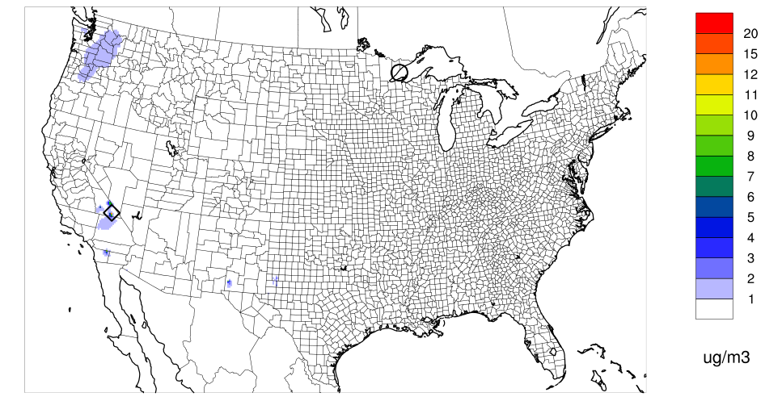
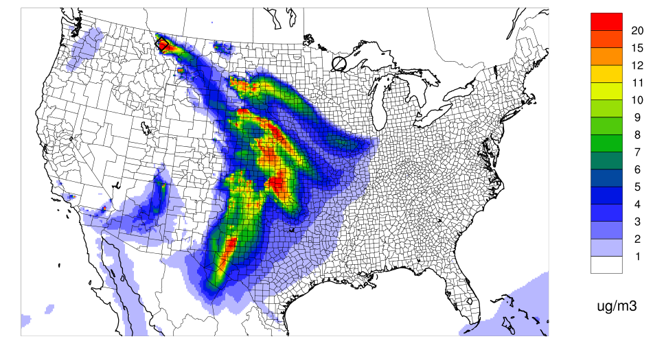
Evaluation of Updated WBDUST
Inert CAMx Tests (April 6, 2016)
WBDUST v1.0
WBDUST v2.0
Notes:
Top time series are obs vs. Runs 0-4, bottom time series are obs vs. Runs 8-9.
Time series are CM, isopleth plots are fine dust.

Slide 9
Evaluation of Updated WBDUST
Chemical CAMx Tests – Species Comparison at Big Bend
Summer under predictions

Slide 10
Evaluation of Updated WBDUST
Chemical CAMx Tests – Species Comparison at Caney Creek
Fall-Spring over predictions
Summer under predictions

Slide 11
Conclusions
Model-observation agreement for fine and coarse WBD improved substantially
On par with observations in all seasons
WBD cation impacts on secondary PM compounds (not presented here)
Increases and decreases in SO₄, NO₃, NH₄
Overpredictions in spring and autumn, underpredictions in summer
WBD minerals are adequately characterized
SO₄ impacts (<0.1 µg/m³) mostly in eastern US
NO₃ increases (>0.1 µg/m³) in western US
Small NH₄ decreases in western US
Notes:
WBD elemental compositions are adequately characterized (Fe has notable high bias)
Small SO₄ impacts (<0.1 µg/m³) mostly in eastern US
Modest NO₃ increases (>0.1 µg/m³) in western US from more neutralizing cations in WBD
Small NH₄ decreases in western US as NH₃ is displaced by WBD cations

Slide 12
Next Steps and Recommendations
Estimating WBD is difficult
  Important to characterize vegetation types/cycles (especially croplands)
  Numerous phenomena must align to generate dust (meteorology, soil & vegetation conditions)
  All bring complex mix of compounding and compensating errors
Remaining over and under estimates indicate need for further improvement
Elemental speciation: need to review and update as new information becomes available
Updates may be necessary as WRF simulations improve, especially for rain/soil moisture
Notes:
Land use: We encourage the use of the most detailed land type coverages available
Spring time: Fraction of cultivated/emissive areas at any given time during the planting seasons, Fraction of irrigated lands (no irrigation is implicitly assumed)
Elemental speciation: Iron is an important catalyst for aqueous sulfate production

Slide 13
Thank You
The preparation of this presentation was funded by a grant from the Texas Air Quality Research Program (AQRP) at The University of Texas at Austin through the Texas Emission Reduction Program (TERP) and the Texas Commission on Environmental Quality (TCEQ). The findings, opinions and conclusions are the work of the author(s) and do not necessarily represent findings, opinions, or conclusions of the AQRP or the TCEQ.
Pradeepa Vennam
pvennam@ramboll.com

Slide 14
References
Astitha, M., J. Lelieveld, M.A. Kader, A. Pozzer, A. de Meij, 2012. Parameterization of dust emissions in the global atmospheric chemistry-climate model EMAC: impact of nudging and soil properties. Atmos. Chem. Phys., 12(22):11057-11083, 2012. doi:10.5194/acp-12-11057-2012.
Foroutan, H., J. Young, S. Napelenok, L. Ran, K.W. Appel, R.C. Gilliam, J.E. Pleim, 2017. Development and evaluation of a physics-based windblown dust emission scheme implemented in the CMAQ modeling system. J. Adv. Model. Earth Syst., 9, 585–608, doi:10.1002/2016MS000823.
Klingmueller K., S. Metzger, M. Abdelkader, V.A. Karydis, G.L. Stenchikov, A. Pozzer, J. Lelieveld, 2018. Revised mineral dust emissions in the atmospheric chemistry-climate model EMAC (MESSy 2.52 DU_Astitha1 KKDU2017 patch). Geosci. Model Dev., 11, 989–1008, https://doi.org/10.5194/gmd-11-989-2018.
LeGrand, S.L., C. Polashenski, T.W. Letcher, G.A. Creighton, S.E. Peckham, J.D. Cetola, 2019. The AFWA dust emission scheme for the GOCART aerosol model in WRF-Chem v3.8.1. Geosci. Model Dev., 12, 131–166, https://doi.org/10.5194/gmd-12-131-2019.
NASS, 2021. "CropScape-cropland data layer." USDA National Agricultural Statistics Service: Washington, DC.
https://nassgeodata.gmu.edu/CropScape/
https://www.nass.usda.gov/Research_and_Science/Cropland/sarsfaqs2.php

