Slide 1

Machine Learning Approach to Quantify the Impact of Meteorology on Tropospheric Ozone in the Inland Empire, CA
Khanh Do, Manasi Mahish, Arash Kashfi Yeganeh, Ziqi Gao, Charles L. Blanchard, Cesunica E. Ivey
2022 CMAS Conference

Slide 2
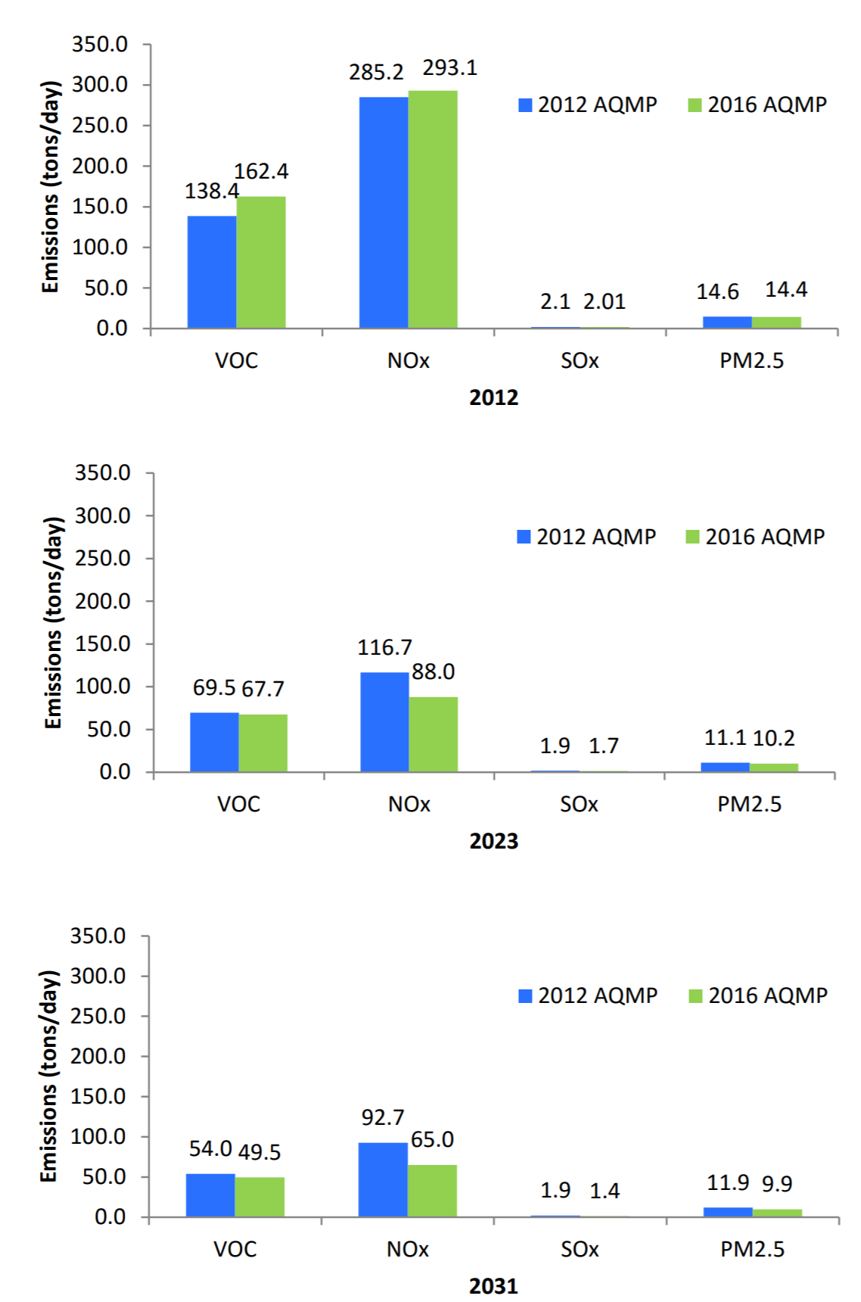
Motivation
Emission reduction
  NOx emissions decreased from 1425 tons/day to 650 tons/day (1993-2012)
  Projection for 2023 is 250 tons/day
  Reactive organic gases (ROG) decreased from 1522 tons/day to 534 tons/day (1993-2013)
Control vehicle emissions and reduce cars’ emissions
Alternative clean fuels
Figure 1: Comparison of on road emissions estimated using EMFAC 2011 in the 2012 AQMP and EMFAC 2014 in the 2016 AQMP (AQMP 2016).
Motivation
Objectives
Methods
Data
Results
ML vs. CMAQ
Conclusion

Slide 3
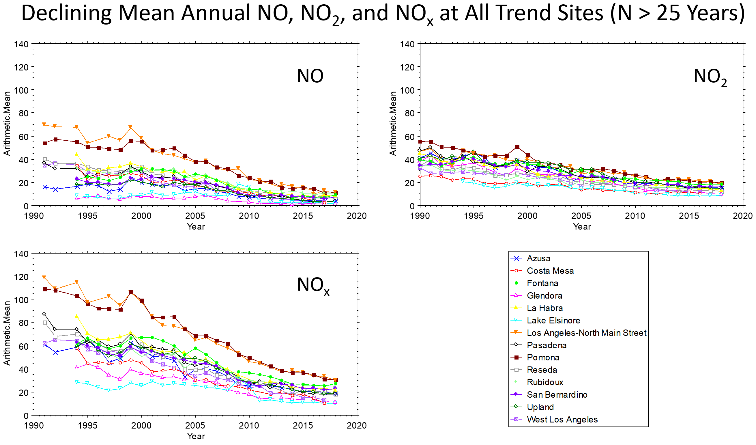
Motivation
Significantly decreased as a result of the emissions control programs implemented by the South Coast Air Quality Management District
Since 2014, the 8-hour ozone design value for SoCAB has marginally increased
Is it conjectured that shifts in meteorology have impacted ozone improvements in recent years?
Figure 3: Ozone design values for the South Coast from 2006 to 2020 ( https://www.epa.gov/air-trends/air-quality-design-values). 2009 design value was missing, using Los Angeles-San Bernardino design value for substitution.
Figure 2: 25 years of historical data of mean annual NO, NO₂, NO_{x} (Source: Ozone-Met Study Quarter 1 Report)
Motivation
Objectives
Methods
Data
Results
ML vs. CMAQ
Conclusion

Slide 4
Objectives
Exploit large meteorology and air quality datasets
  Enhance the prediction of ozone levels in South Coast Air Basin (SoCAB)
  Investigate the role of meteorology in ozone formation
  Determine the most critical factors influencing ozone exceedance hours
Evaluate multiple machine learning algorithms
  Random forest, neural network, SVM, K-NN
  Find the most suited model for predicting ozone concentrations and exceedances in Southern California
  Minimum set of features (meteorology + air quality) that accurately represent the ozone levels
Motivation
Objectives
Methods
Data
Results
ML vs. CMAQ
Conclusion

Slide 5
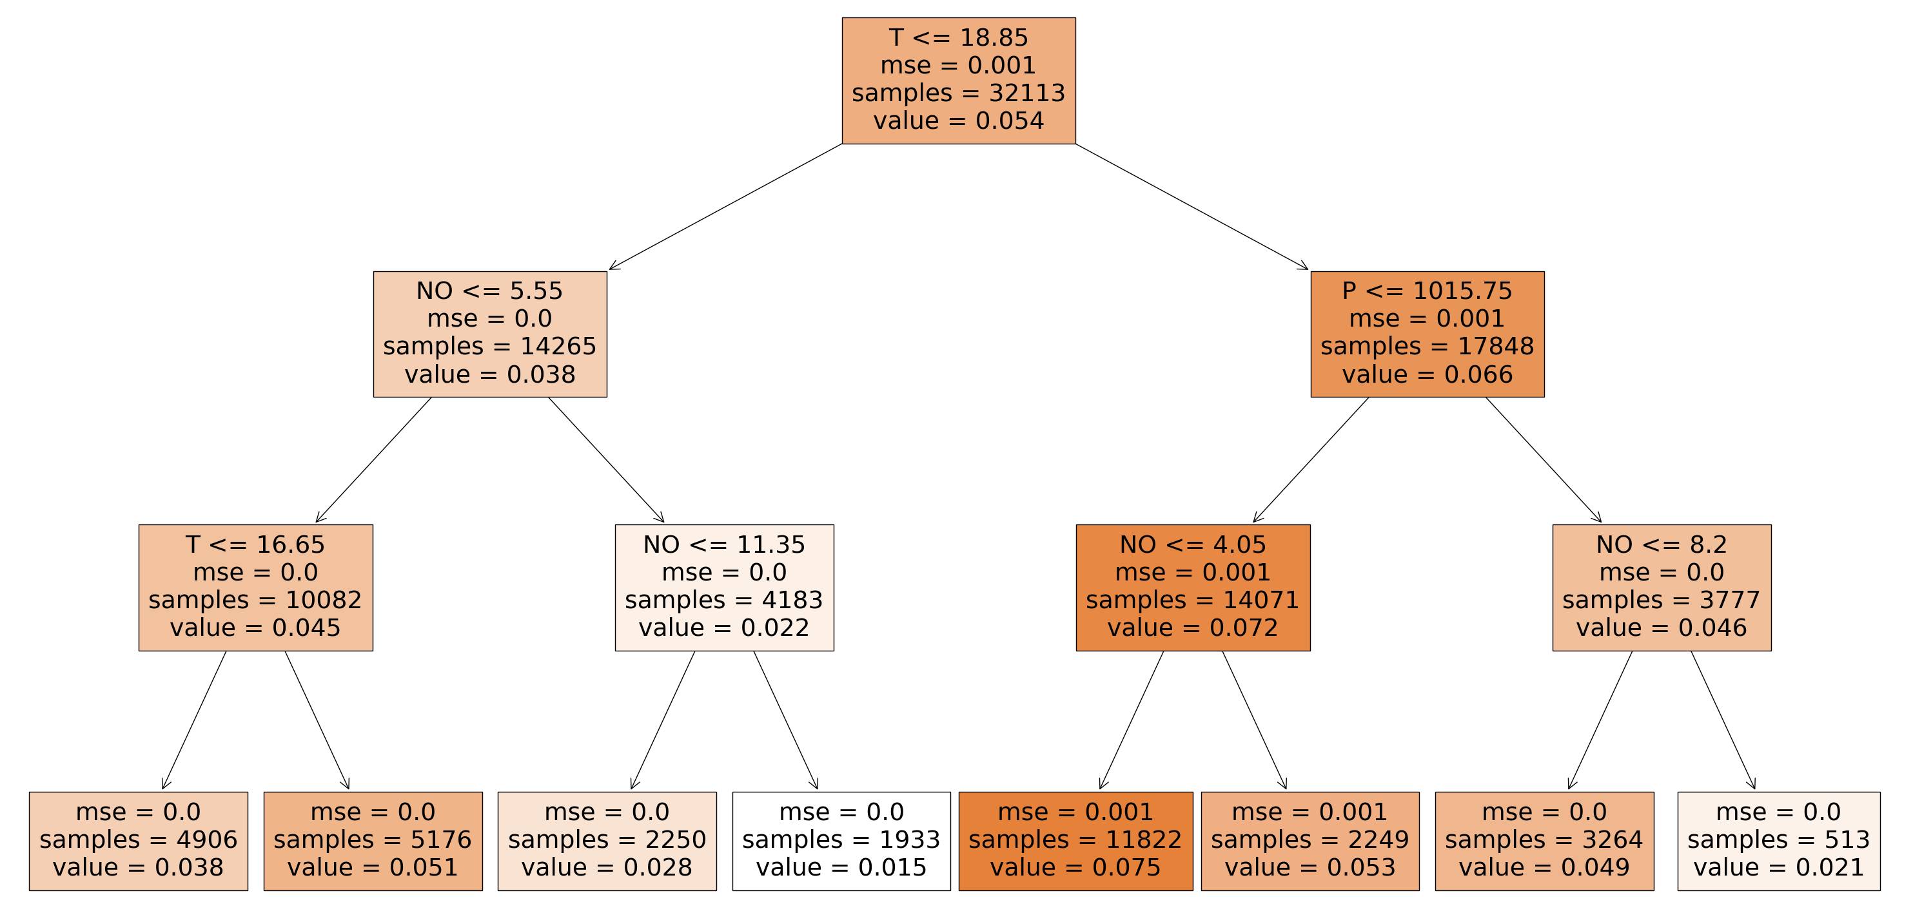
Methods
Random forest regression is the preferred method due to optimal performance
Predict ozone concentrations
  Random forest regression
  Trained on meteorological data and air quality data from 1994-2018
  Nine features are temperature, relative humidity, pressure, wind speed, wind direction, visibility, dew point temperature, NO, NO₂
  Open source SciKitLearn library
  16 trees
Figure 4: Three node decision trees based on air quality and meteorological input from 2014-2018. The meteorology data is from LAX, and air quality data is from Fontana. The predictions were made based on 12:00 noon to 5:00 PM training data.
Motivation
Objectives
Methods
Data
Results
ML vs. CMAQ
Conclusion

Slide 6
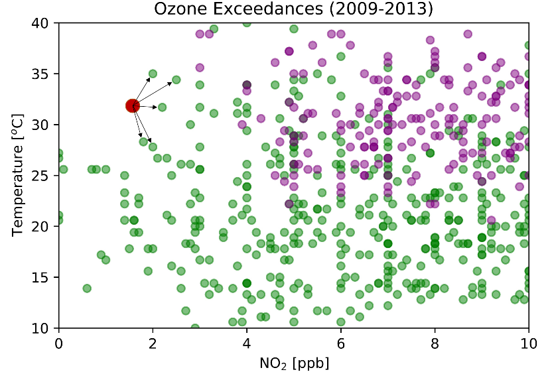
Methods
Find the closest sample in the training dataset and assign the label
Predict ozone exceedances
  Predicting ozone exceedance hours using k-nearest neighbor (K-NN)
  On every 5-year increment from 1994-2018
  Use probability of detection (PoD) to determine good models
The optimum k value is 16
  Overfitted when k is small
  Underfitted when k is large
  Varying k from 1 to 8000 and keep other parameters constant
Figure 5: The classification is in two dimensions, coded as a binary variable (green = non-exceedances, purple = exceedances). The predicted class of the red point is chosen by the majority vote amongst the 5-nearest neighbors.
Motivation
Objectives
Methods
Data
Results
ML vs. CMAQ
Conclusion

Slide 7
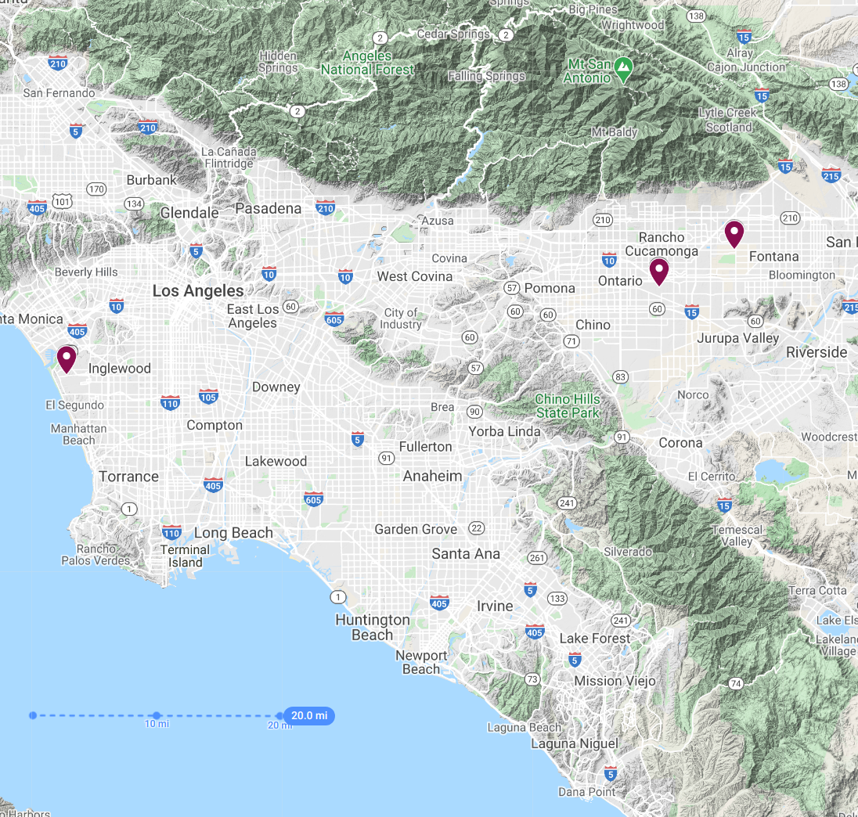
Data Collection and Preprocessing
Data from 1994 to 2018
Meteorological data are sampled from LAX and ONT international airports
  Temperature, relative humidity, pressure, wind speed, wind direction, visibility, dew point temperature
Fontana air quality data are retrieved from Air Quality System (AQS) data mart
  NO, NO₂, O₃
80% for training and 20% for model testing and validation
Fontana
ONT
LAX
Figure 6: Air quality and meteorology data sampling locations, Southern California.
Motivation
Objectives
Methods
Data
Results
ML vs. CMAQ
Conclusion

Slide 8
ML Algorithm Evaluation
Regressor | CC | Slope | Intercept | R² | RMSE | MAE
RFR | 0.927 | 0.875 | 0.00605 | 0.861 | 0.009 | 0.006
Neural Network | 0.860 | 0.807 | 0.00703 | 0.689 | 0.014 | 0.011
SVR | 0.787 | 1.03 | 0.0194 | 0.619 | 0.028 | 0.024
K-NN | 0.921 | 0.869 | 0.00702 | 0.848 | 0.010 | 0.007
Table 1: Ozone prediction evaluation metrics for four regressors (random forest, neural network, support vector machine, and K-nearest neighbors). The models were trained on nine features from 1994 to 2018. The models were constructed using 80% of data and evaluated using 20% of the data from the 2014-2018 period. The evaluations are in the unit ppm.
Classifier | PoD | Accuracy | Failure to Predict
SVM | 0.07 | 0.83 | 0.93
Neural Network | 0.76 | 0.71 | 0.24
K-NN | 0.81 | 0.71 | 0.19
Perceptron | 0.83 | 0.69 | 0.17
Table 2: Ozone prediction evaluation metrics for four classifiers (support vector machine, neural network, k-nearest neighbors, and perceptron). The models were trained on nine features from 1994 to 2018. The models were constructed using 80% of data and evaluated using 20% of the data from the 2014-2018 period. The evaluations are in the unit ppm.
Motivation
Objectives
Methods
Data
Results
ML vs. CMAQ
Conclusion

Slide 9
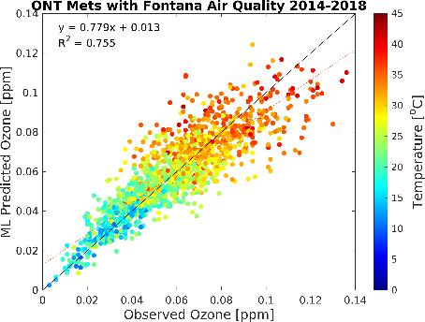
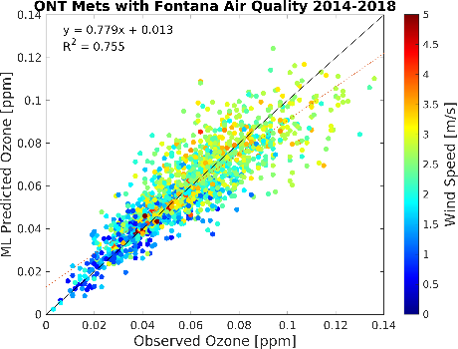
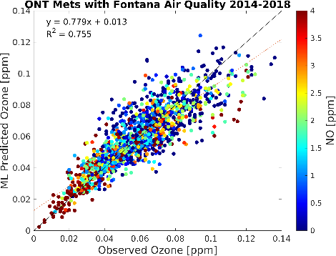
Fontana Ozone Concentrations Predicted by RFR
Figure 7: Scatter plots of observational O₃ (x-axis) and RFR predictions (y-axis) for the model using Fontana air quality and meteorology from the ONT international airport monitoring station. The plots are for the latest five-year increment from 2014-2018. The color bar shows temperature (a), wind speed (b), and NO (c). Plots for other periods are provided in the SI. (Do et al., Environmental Science: Atmospheres, Under Revision)
Motivation
Objectives
Methods
Data
Results
ML vs. CMAQ
Conclusion

Slide 10
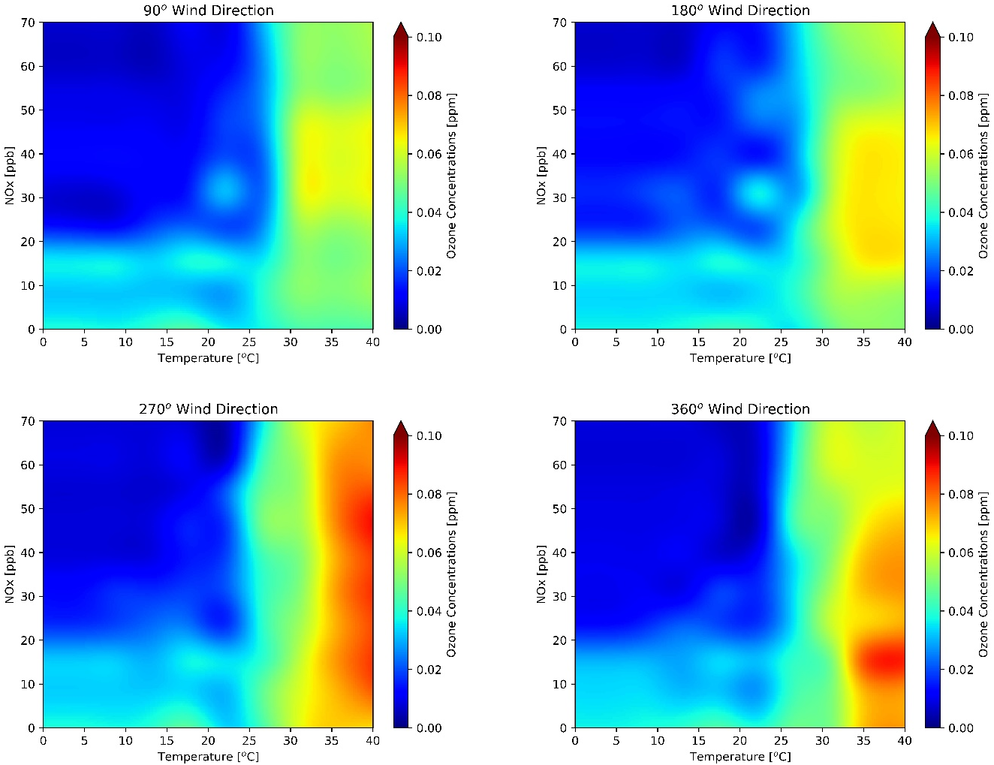
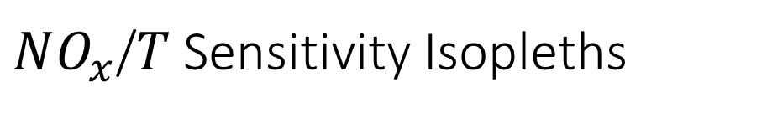
$NO_{x}$/$T$ Sensitivity Isopleths
Ozone concentrations are strongly dependent on temperature, wind direction, and NOx
Highest ozone: high temperature, wind direction from 270-360 degree
Figure 8: Contour plots generated by the RFR model trained on ONT meteorology and Fontana air quality at constant wind speed (9 m/s), visibility (16000 m), dynamic pressure, dynamic relative humidity, and at four discrete wind directions: (a) 90°, (b) 180°, (c) 270°, and (d) 360°.
(Do et al., Environmental Science: Atmospheres, Under Revision)
Motivation
Objectives
Methods
Data
Results
ML vs. CMAQ
Conclusion

Slide 11
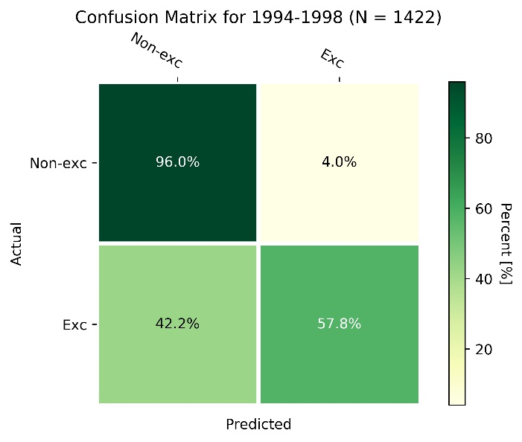
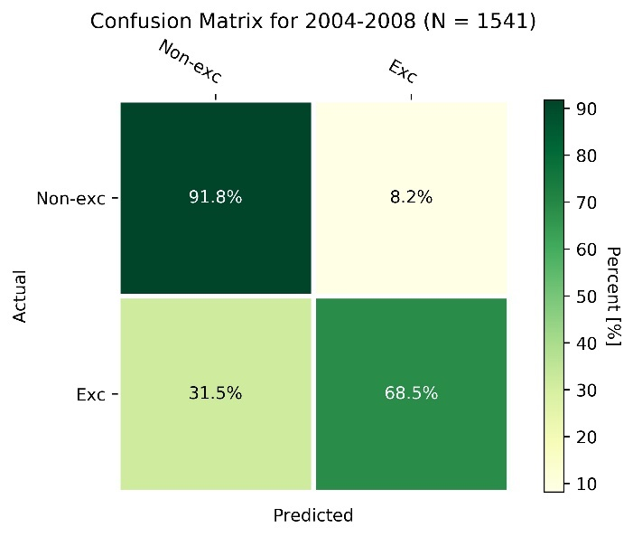
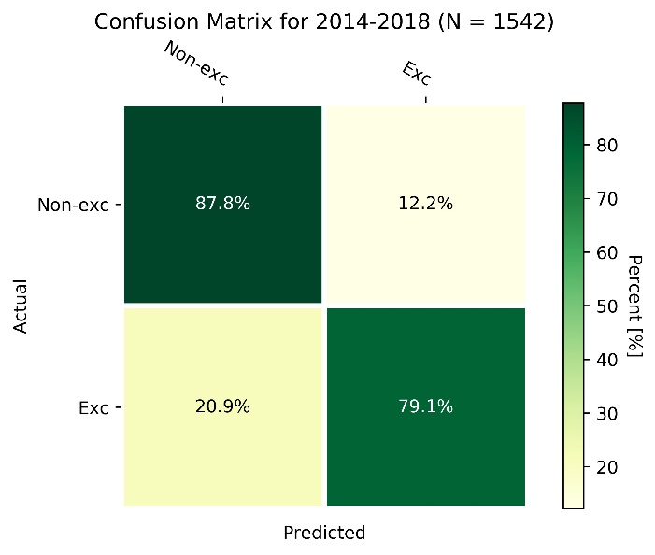
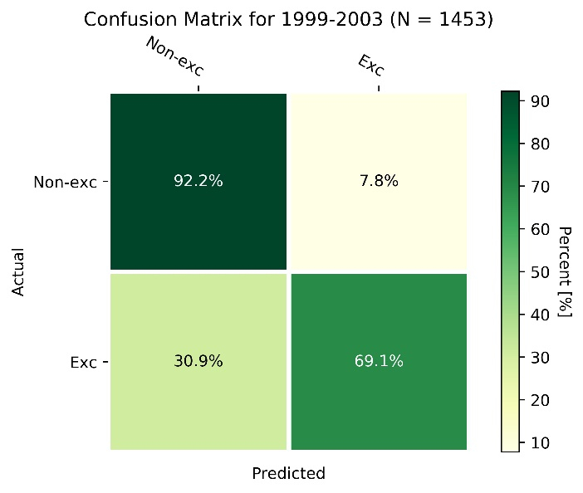
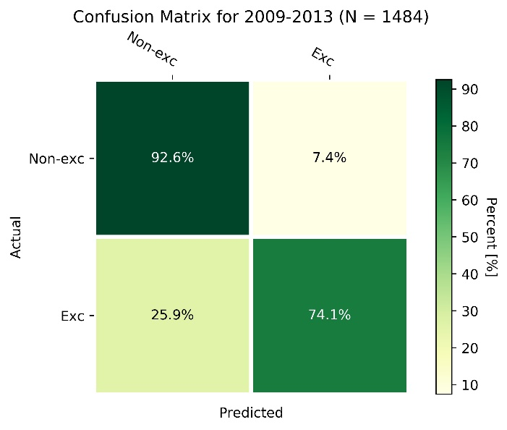
Ozone Exceedances
The dominance of correct non-exceedance prediction (quartile I) and correct exceedance prediction (quartile 4); Better prediction in recent years
Figure 9: Confusion matrix for ozone exceedances evaluated for the K-NN model for the periods (a) 1994-1998, (b) 1999-2003, (c) 2004-2008, (d) 2009-2013, and (e) 2014-2018. N is the total number of valid data points. (Do et al., Environmental Science: Atmospheres, Under Revision)
Motivation
Objectives
Methods
Data
Results
ML vs. CMAQ
Conclusion

Slide 12
Ozone Exceedances
High PoD and accuracy scores
  From 0.58 for the earliest period to 0.81 for the latest period, indicating the improving model performance in later years
  Accuracy is above 0.71
  Miss detection only 19% for the latest years
Year | PoD | Accuracy | Failure to detect
1994-1998 | 0.58 | 0.84 | 0.42
1999-2003 | 0.69 | 0.87 | 0.31
2004-2008 | 0.69 | 0.86 | 0.31
2009-2013 | 0.74 | 0.87 | 0.26
2014-2018 | 0.81 | 0.71 | 0.19
Table 3: Summary statistics for KNN exceedance hour predictions. Exceedance hours occurred when ozone concentrations were greater than or equal to 70 ppb. The K-NN model was evaluated using 20% of the data from 1994-2018. The probability of detection was calculated as the number of correct exceedance predictions divided by the total actual exceedances. Accuracy is the correct predictions for non-exceedance and exceedance hours divided by the total hourly observations.
Motivation
Objectives
Methods
Data
Results
ML vs. CMAQ
Conclusion

Slide 13
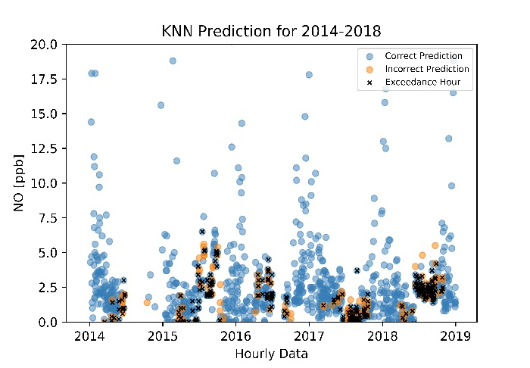
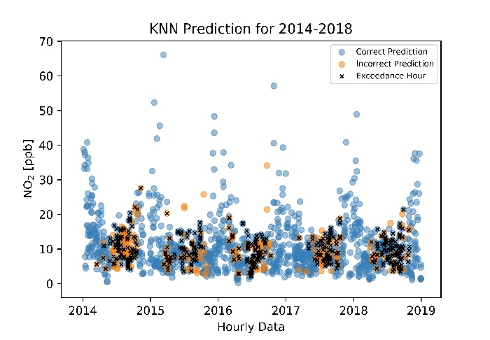
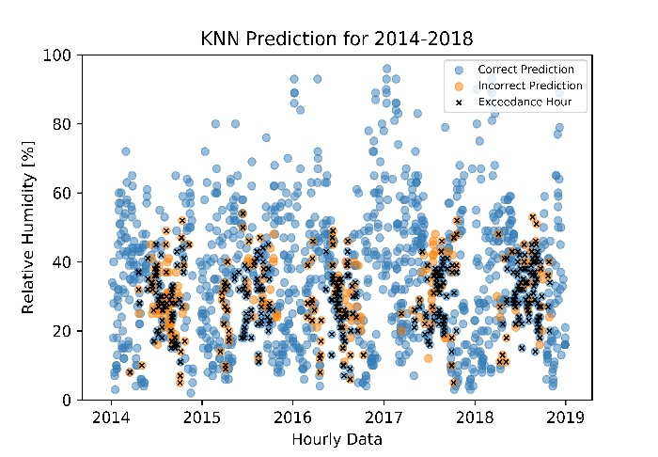
Ozone Exceedances
Meteorology is the driving force
  No exceedances below 22 ºC
  No exceedances above 60% of RH, high NOx, and low wind speed
  Exceedances mostly occurred in summertime
High RH associated with low temperatures and ozone, and low NOx
Figure 10: Non-exceedance/exceedance hours for observed input variables: (a) temperature in ˚C, (b) wind direction in degrees, (c) NO in ppb, (d) NO2 in ppb, (e) wind speed in m/s, and relative humidity in %. Predictions were made using KNN for the years 2014-2018 for Fontana using Ontario meteorology. Hourly data from 12 pm to 5 pm were chosen to capture the peak ozone period. (Do et al., Environmental Science: Atmospheres, Under Revision)
Motivation
Objectives
Methods
Data
Results
ML vs. CMAQ
Conclusion

Slide 14
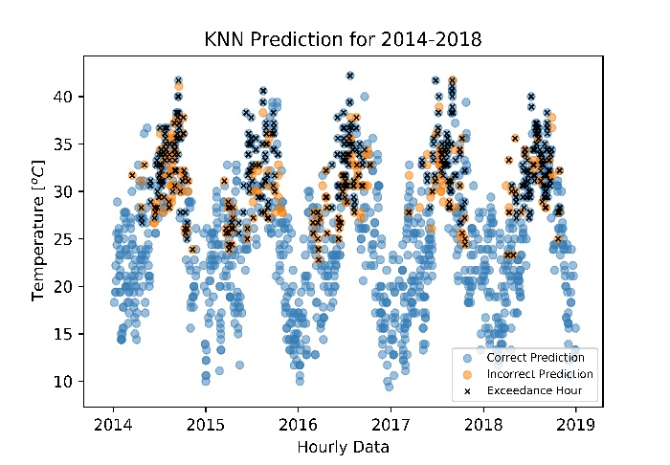
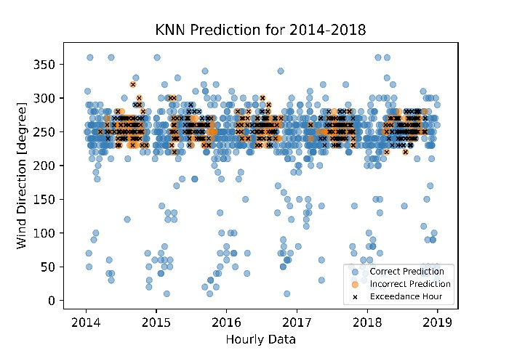
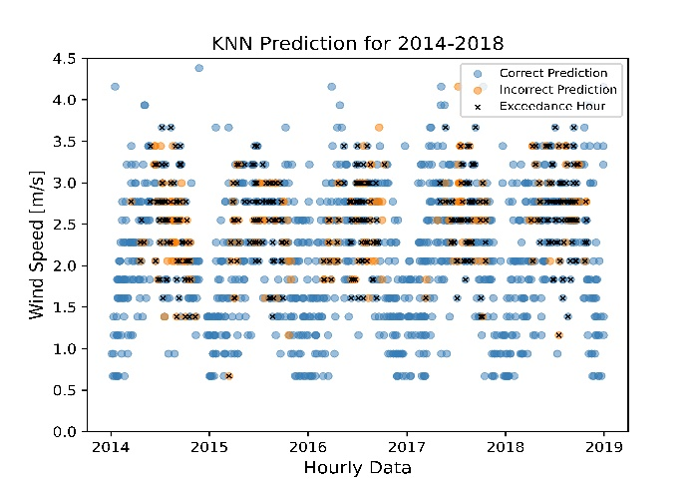
Ozone Exceedances
Meteorology is the driving force
  No exceedances below 22 ºC
  No exceedances above 60% of RH, high NOx, and low wind speed
  Exceedances mostly occurred in summertime
High RH associated with low temperatures and ozone, and low NOx
Figure 10: Non-exceedance/exceedance hours for observed input variables: (a) temperature in ˚C, (b) wind direction in degrees, (c) NO in ppb, (d) NO2 in ppb, (e) wind speed in m/s, and relative humidity in %. Predictions were made using KNN for the years 2014-2018 for Fontana using Ontario meteorology. Hourly data from 12 pm to 5 pm were chosen to capture the peak ozone period. (Do et al., Environmental Science: Atmospheres, Under Revision)
Motivation
Objectives
Methods
Data
Results
ML vs. CMAQ
Conclusion

Slide 15
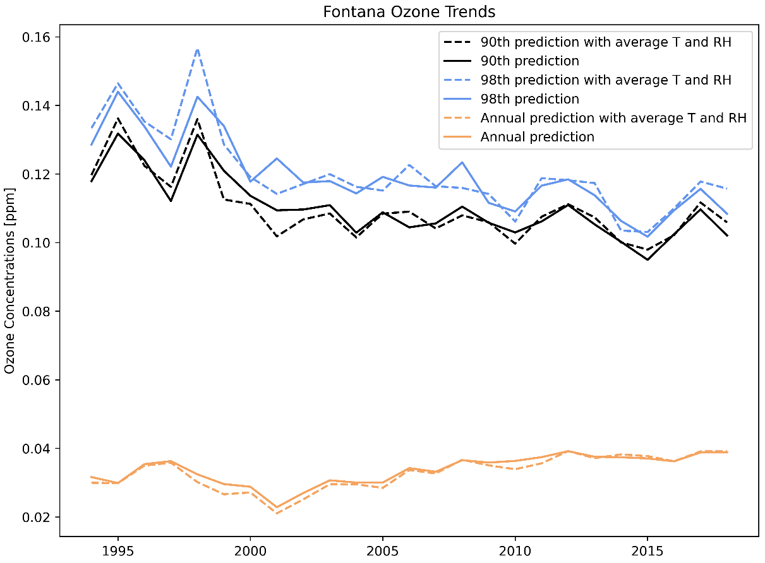
Effects of Meteorology
ML model easily predicts changes of the target (ozone) label with a perturbation of input features
Minimizing the effects of heat waves or foggy days by averaging T and RH from 1994 to 2018
Adjusted line shows a strong downward ozone trend from 1994 to 2010 but resisting further decrease
Meteorology has a minor effect on the annual average
Figure 12. Fontana ozone trends for 90th (black), 98th (blue) percentile, and annual average (orange). The dash lines were predicted with hourly average temperature and RH from 1994 to 2018. The solid lines were predicted with actual values. (Do et al., Environmental Science: Atmospheres, Under Revision)
Motivation
Objectives
Methods
Data
Results
ML vs. CMAQ
Conclusion

Slide 16
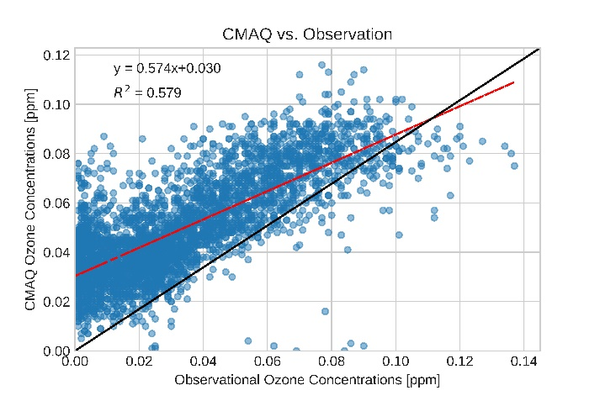
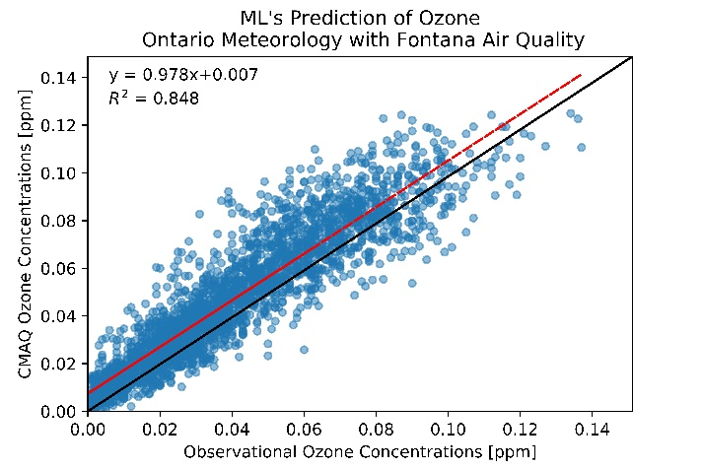
ML vs. CMAQ
CMAQ configurations
  SAPRC-07 mechanism
  4x4 km resolution
  11 vertical layers
  156x102 grids
  Southern California
Machine learning
  Ability to test for sensitivity of features
  Fast, but focus on one location
  Quality of data
CMAQ
  Much greater scale
  Provide simulation data over large domain
  Multiple air pollutant species
Figure 13. Scatter plots of CMAQ simulation for Fontana for 2017 ozone season.
Figure 14. Scatter plots of RFR predictions for Fontana for 2017 ozone season.
Month | MBE | NMB | MAE | MFB | MFE
5 | 6.059286 | 0.125268 | 8.270714 | 0.133177 | 0.173034
6 | 8.99 | 0.141363 | 11.56667 | 0.145812 | 0.179497
7 | 9.504032 | 0.140691 | 13.125 | 0.138504 | 0.192391
8 | -3.76042 | -0.04737 | 13.84077 | -0.03533 | 0.175221
9 | 13.95382 | 0.235017 | 15.64347 | 0.225449 | 0.247755
Table 3: CMAQ MDA8 Fontana
Motivation
Objectives
Methods
Data
Results
ML vs. CMAQ
Conclusion

Slide 17
Conclusion
A set of nine features captured the ozone dynamics in the SoCAB
Ozone exceedances occurred at high temperatures, lower observed NOx, wind speed above 3 m/s, and RH between 10% – 50%
Errors in estimating the emissions from AQMD
CTMs and ML serve different purposes
  CTMs for future ozone predictions in response to emission controls
  ML gives predictions based on historical data
RFR successfully reconstructed the ozone trend in Fontana with Ontario meteorology
K-NN detects ozone exceedance hour with high accuracy and PoD
Motivation
Objectives
Methods
Data
Results
ML vs. CMAQ
Conclusion

Slide 18



Thank You and Acknowledgments
Cesunica Ivey
Air Quality Modeling and Exposure Lab (AQMEL)
Prof. Armistead G. Russell
Dr. Sang-Mi Lee
South Coast Air Quality Management District (SCAQMD)
Graduate Assistant in Areas of Need (GAANN)
This manuscript was prepared as a result of work sponsored, paid for, in whole by the South Coast Air Quality Management District (SCAQMD). The opinions, findings, conclusions, and recommendations are those of the authors and do not necessarily represent the views of SCAQMD. SCAQMD, its officers, employees, contractors, and subcontractors make no warranty, expressed or implied, and assume no legal liability for the information in this letter. SCAQMD has not approved or disapproved this manuscript, nor has SCAQMD passed upon the accuracy or adequacy of the information contained herein.

Slide 19
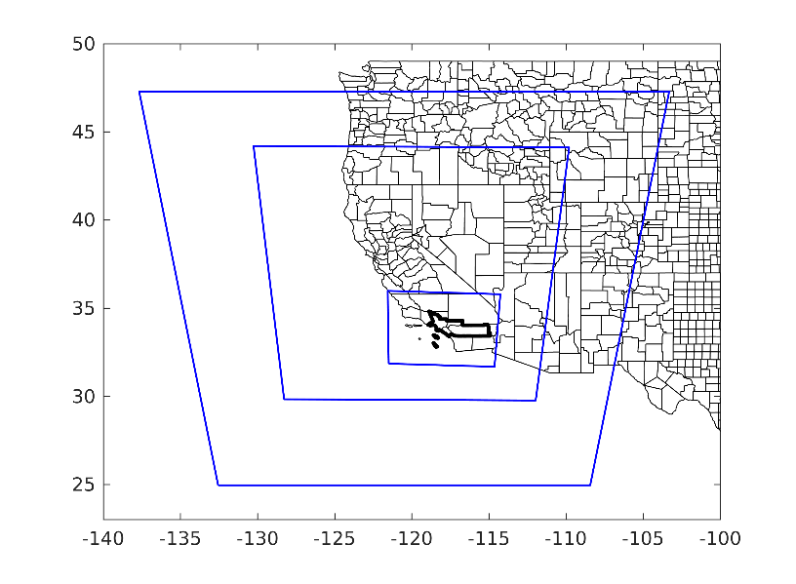
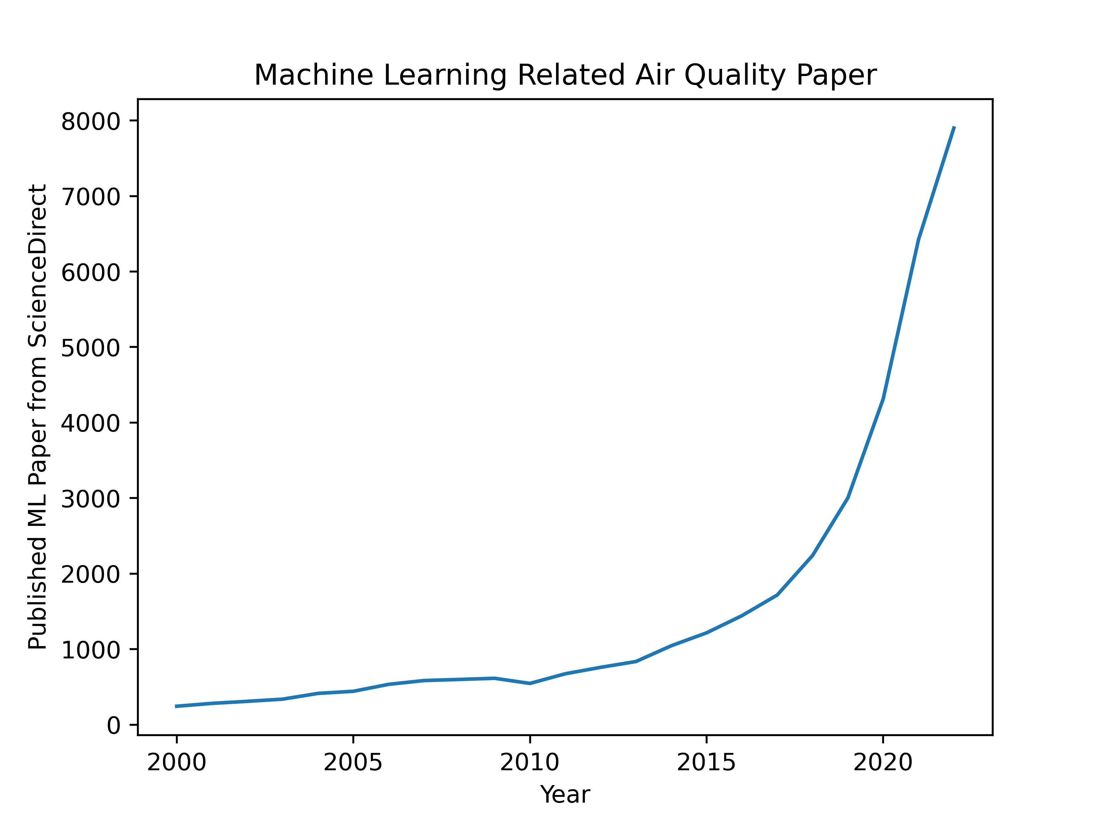
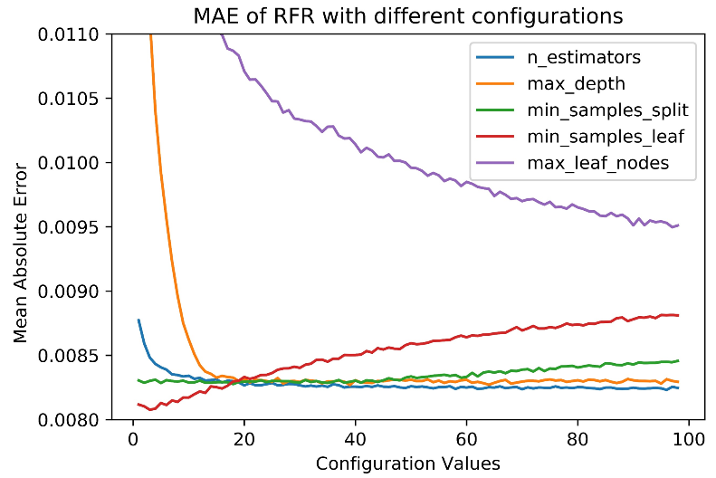
Backup Slides
RFR with different hyperparameter values. The value of the tuning parameter was varied from 1 to 100 while keeping others constant. Mean absolute error is in units of ppm.
Nesting of model domains for WRF. The outer most domain has 36 km horizontal resolution, and the first and second inner domains have 12 and 4 km resolution, respectively. The South Coast Air Quality Management District boundary is in bold.

Slide 20
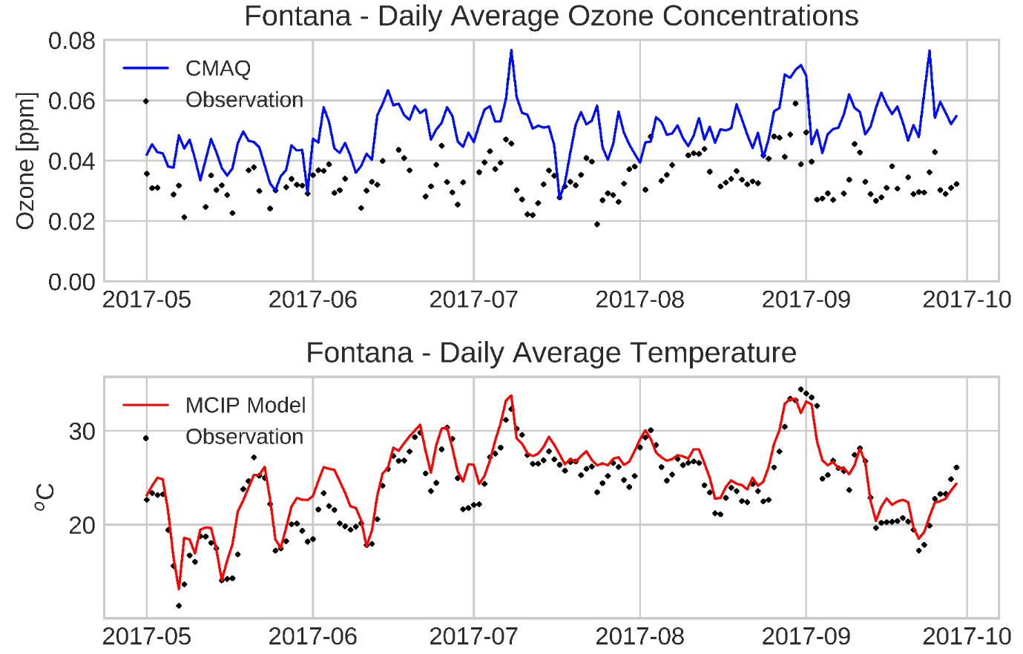
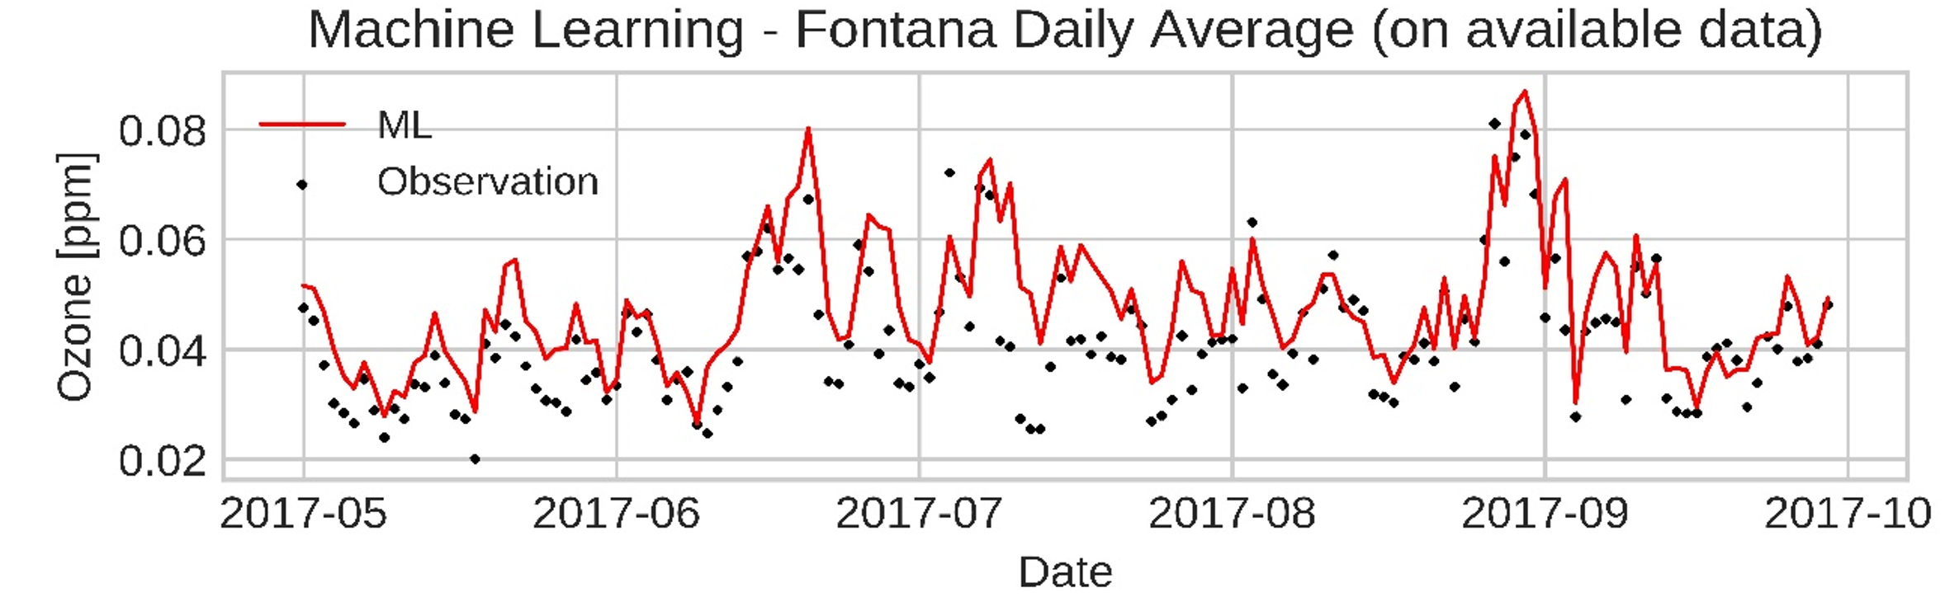
Testing the performance of K-NN by varying the number of nearest neighbors while keeping other parameters constant.
Time series of daily average ozone concentrations (a) of CMAQ outputs (blue line) and observation (black dots), daily average temperature (b) from WRF (red line) and observation (black dots), and (c) ML predictions (red line) and observation (black dots) in Fontana, CA. The Fontana daily average calculation for ML was based on available data, which was not restricted to twenty-four data points per day. Due to the missing data, the ML outputs were sparser than CMAQ simulation. Therefore, the computed daily average observations from hourly data were the different between (a) and (c).

Slide 21
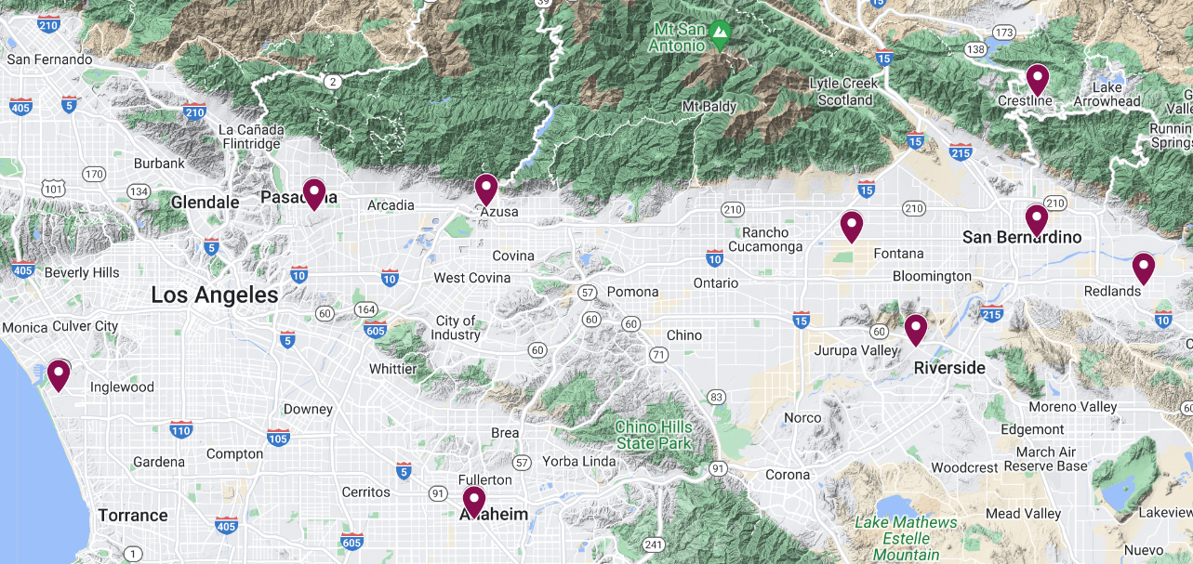
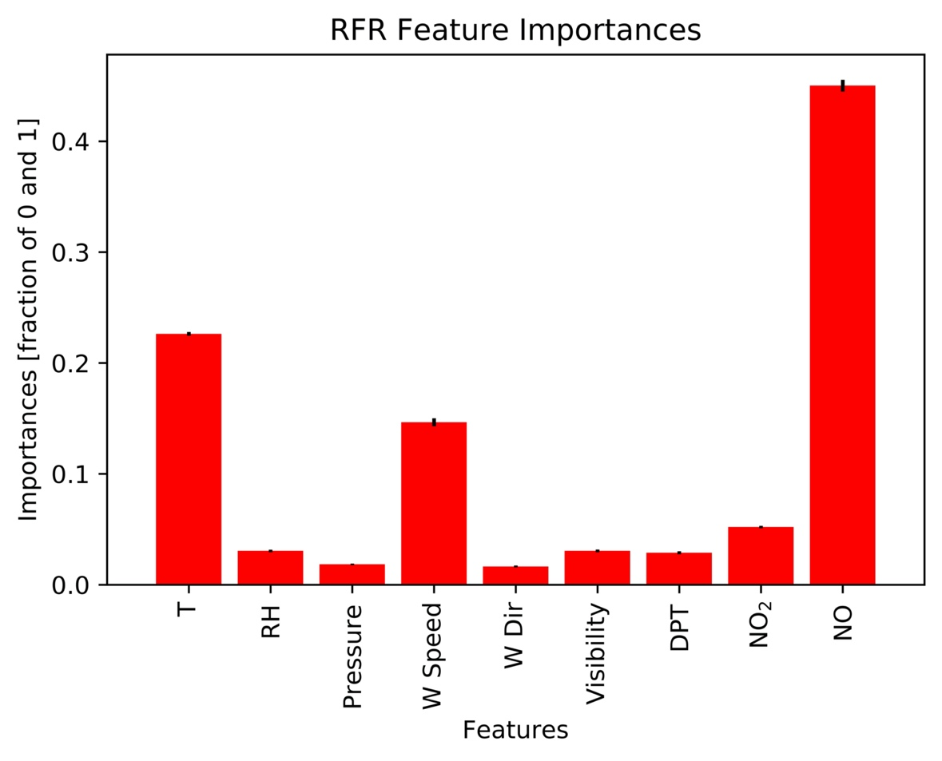
Nine evaluation sites from SCAQMD. From left to right, LAX, Pasadena, Anaheim, Azusa, Fontana, Riverside, San Bernardino, Crestline, and Redlands. The labels are very small.
Feature importance generated from the RFR model

Slide 22
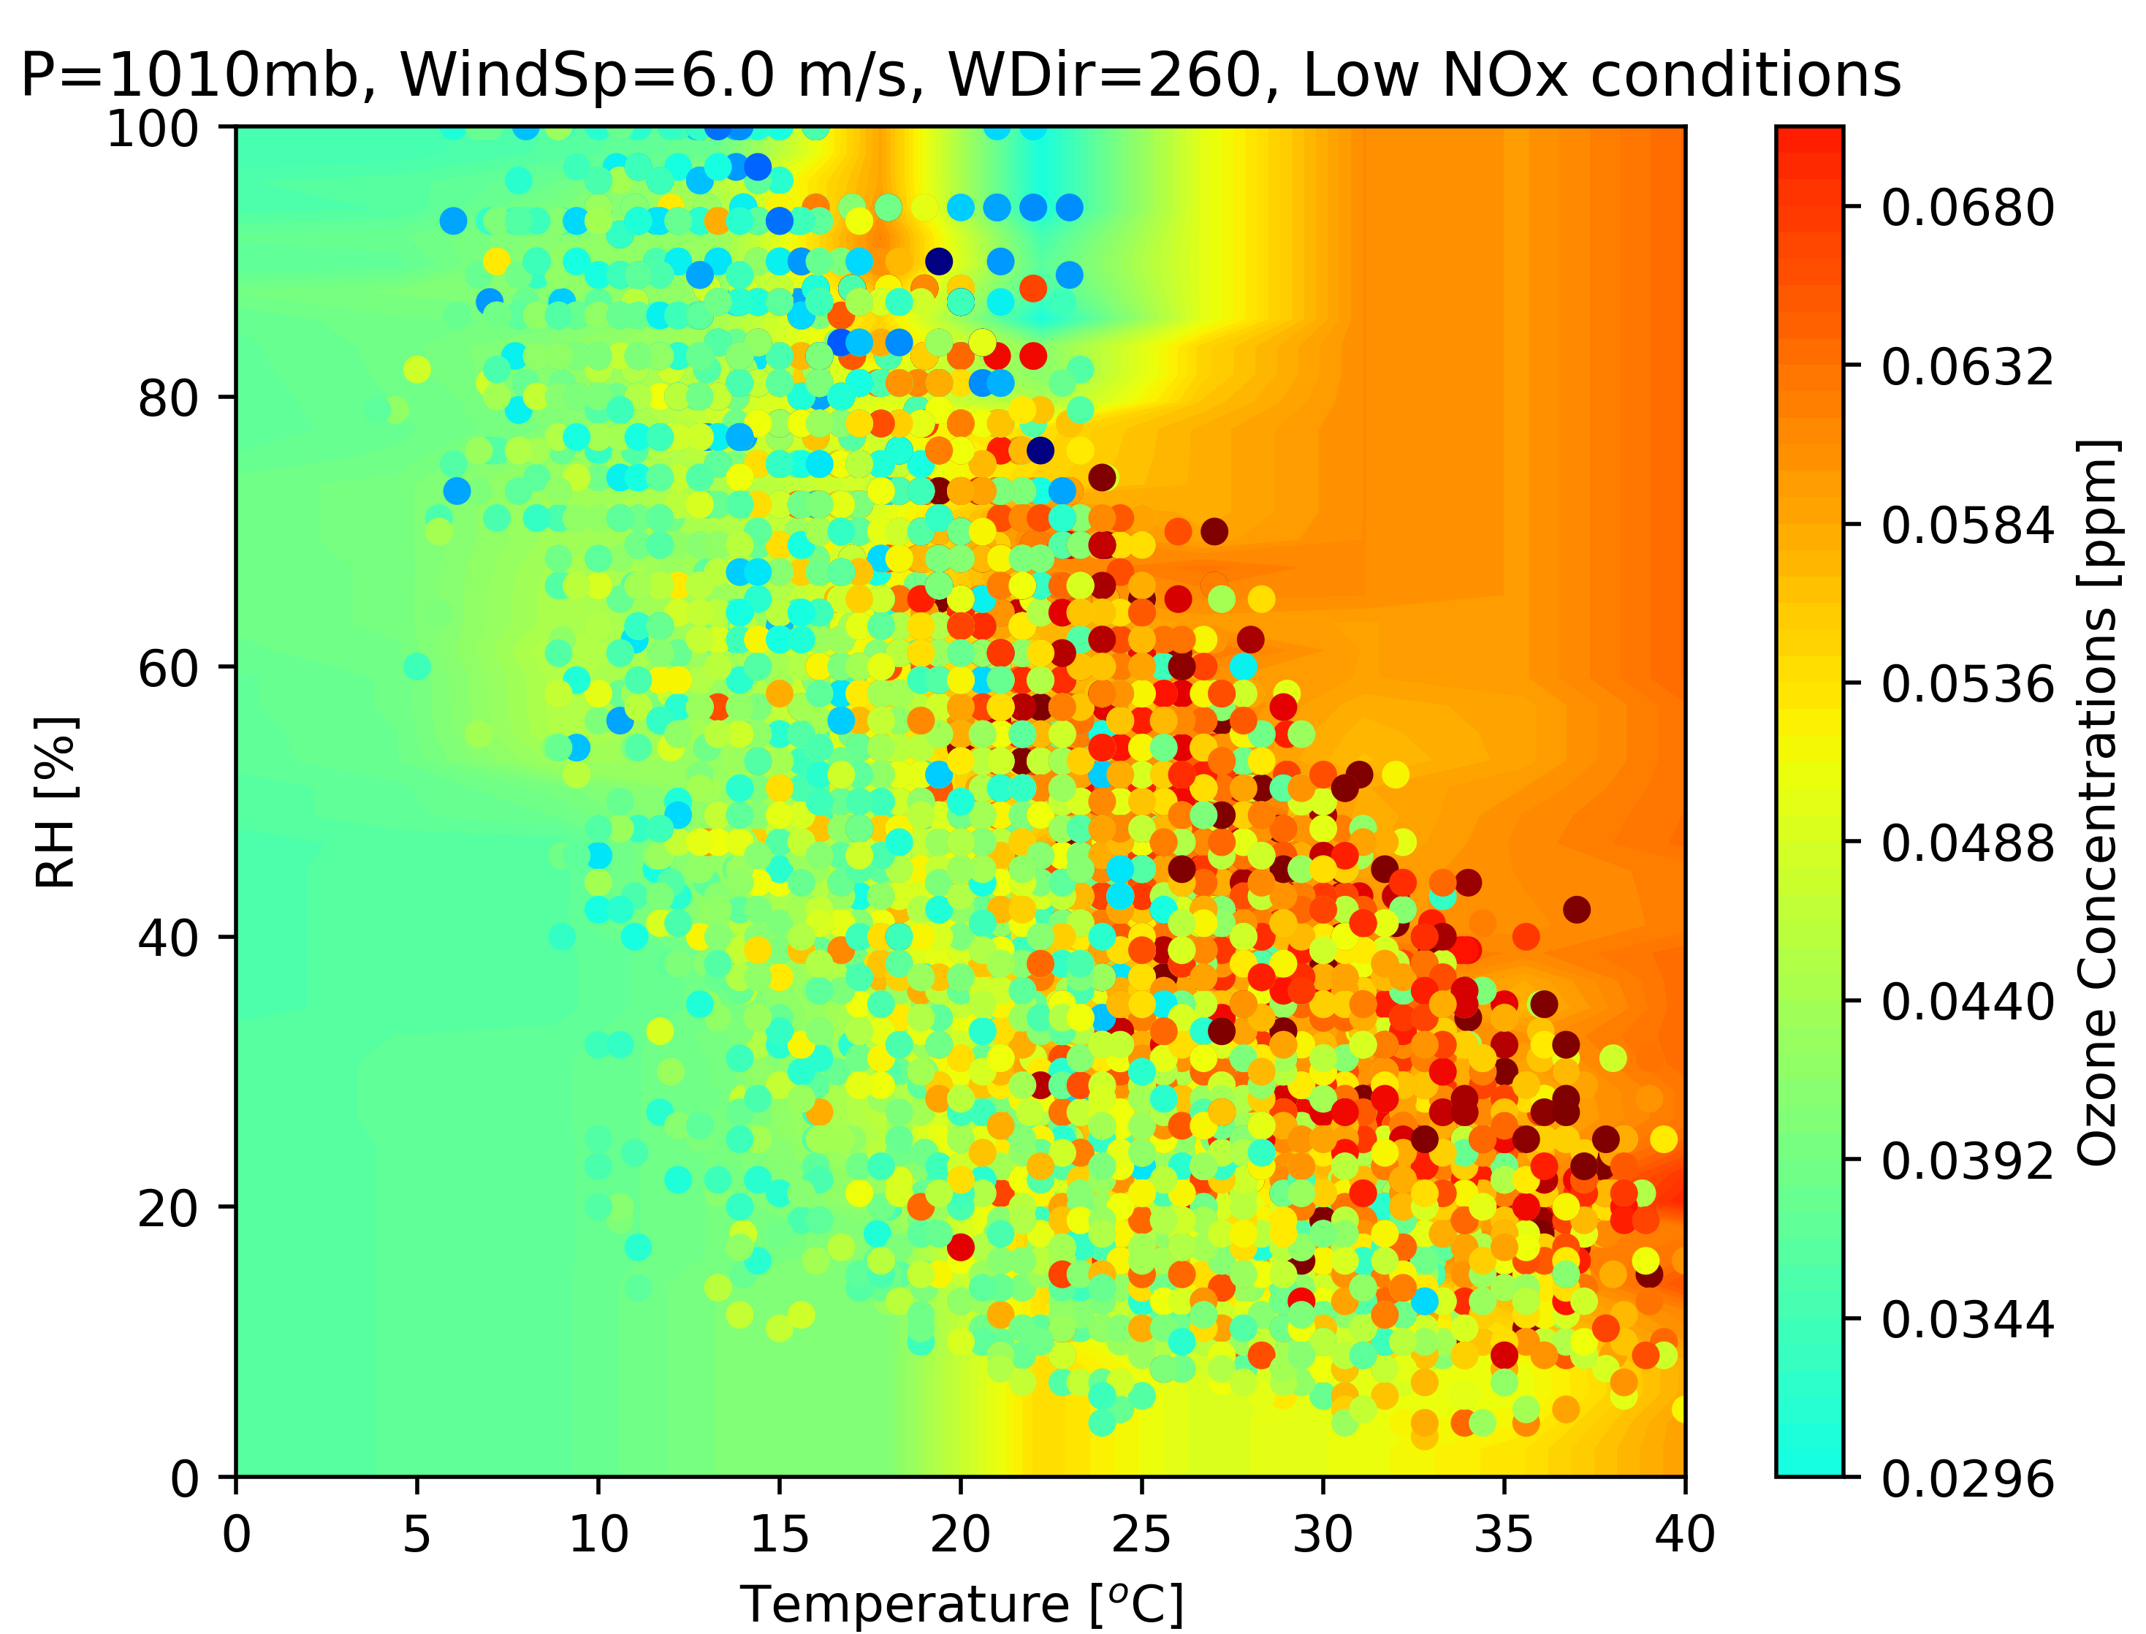
Contour plots generated by the RFR model trained on ONT meteorology and Fontana air quality at constant wind speed (6.0 m/s), visibility (16000 m), wind direction from 260 degree, and 1010 mb pressure. The dots are observational data plotted on the top of the contours.
Contour plots generated by the RFR model trained on ONT meteorology and Fontana air quality at constant wind speed (9 m/s), visibility (16000 m), dynamic pressure, dynamic relative humidity, and at four discrete wind direction levels (90, 180, 270, 360). The dots are observational data plotted on the top of the contours. You may create ONE figure for S8 as well

Slide 23
Scatter plots of CMAQ simulation (a) and RFR predictions (b) for Fontana for 2017 ozone season.
Month | MBE | NMB | MAE | MFB | MFE
5 | 6.059286 | 0.125268 | 8.270714 | 0.133177 | 0.173034
6 | 8.99 | 0.141363 | 11.56667 | 0.145812 | 0.179497
7 | 9.504032 | 0.140691 | 13.125 | 0.138504 | 0.192391
8 | -3.76042 | -0.04737 | 13.84077 | -0.03533 | 0.175221
9 | 13.95382 | 0.235017 | 15.64347 | 0.225449 | 0.247755
CMAQ MDA8 Fontana

Slide 24
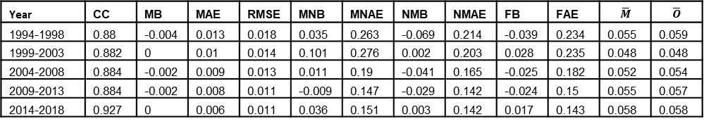
Ten-fold cross-validation for the RFR for the period from 1994 to 2018
Summary statistics for the RFR model vs. observational data from the Fontana air quality monitoring station. The differences between the model means and observational means were minimal. Biases and errors are in units of ppm.
Year | CC | MB | MAE | RMSE | MNB | MNAE | NMB | NMAE | FB | FAE | $$\overline{M}$$ | $$\overline{O}$$
1994-1998 | 0.88 | -0.004 | 0.013 | 0.018 | 0.035 | 0.263 | -0.069 | 0.214 | -0.039 | 0.234 | 0.055 | 0.059
1999-2003 | 0.882 | 0 | 0.01 | 0.014 | 0.101 | 0.276 | 0.002 | 0.203 | 0.028 | 0.235 | 0.048 | 0.048
2004-2008 | 0.884 | -0.002 | 0.009 | 0.013 | 0.011 | 0.19 | -0.041 | 0.165 | -0.025 | 0.182 | 0.052 | 0.054
2009-2013 | 0.884 | -0.002 | 0.008 | 0.011 | -0.009 | 0.147 | -0.029 | 0.142 | -0.024 | 0.15 | 0.055 | 0.057
2014-2018 | 0.927 | 0 | 0.006 | 0.011 | 0.036 | 0.151 | 0.003 | 0.142 | 0.017 | 0.143 | 0.058 | 0.058

Slide 25
ML vs. CMAQ
CMAQ configurations
  SAPRC-07 mechanism
  4x4 km resolution
  11 vertical layers
  156x102 grids
  Southern California
Figure 13. Time series of daily average ozone concentrations (a) of CMAQ outputs (blue line) and observation (black dots), daily average temperature (b) from WRF (red line) and observation (black dots), and (c) ML predictions (red line) and observation (black dots) in Fontana, CA. The Fontana daily average calculation for ML was based on available data, which was not restricted to twenty-four data points per day. Due to the missing data, the ML outputs were sparser than CMAQ simulation. Therefore, the computed daily average observations from hourly data were the different between (a) and (c).

