Slide 1

Updates on VERDI’s New Functionality and Development
Daiwen Kang¹, Donna Schwede (retired), Jerry Herwehe¹, Tony Howard², Yadong Xu³, Liz Adams⁴, Cody Simmons², Heidi Paulsen¹, and Steve Beaulieu³
¹U.S. EPA
²General Dynamics Information Technology (GDIT)
³Applied Research Associates (ARA)
⁴CMAS Center, Institute for the Environment, UNC
21st Annual CMAS Conference, Chapel Hill, North Carolina
October 17-19, 2022
Office of Research and Development
Center for Environmental Measurement & Modeling

Slide 2
What is VERDI?
VERDI: Visualization Environment for Rich Data Interpretation
VERDI is a Java-based tool for visualizing and analyzing modeling and observational data and producing publication-quality graphics on multiple platforms

Slide 3
Background and History
A successor to PAVE (Package for Analysis and Visualization of Environmental data) which is outdated technology (Unix-based software written in C and Motif) and has not been updated or maintained on an ongoing basis
Initial development of VERDI was done by the Argonne National Laboratory, and further development was performed by the UNC Institute for the Environment, Lockheed Corporation, and General Dynamics Information Technology under contract to the U.S. EPA

Slide 4
Supported Modeling Systems/File Conventions and Plot Types
File Formats:
  CMAQ (I/O API)
  WRF (netCDF)
  CAMx (UAM-IV)
  MPAS (netCDF)
  Text-based ASCII formats (observations)
Plot Types:
  2D tile plots
  Vertical cross sections
  Scatter plots
  Timeseries line and bar plots
  3D Contour plots
  Vector-tile plots
  Areal interpolation plots
  Observation-tile plots (overlay over model outputs)
Platforms:
  Linux
  Windows
  Mac
Interfaces:
  GUI
  Scripting (batch-generated images and/or data files)
Notes:
.

Slide 5
Updates in Recent Releases
VERDI v2.1:
  Enhanced user interface and interactive features related to observation overlays (e.g., preview feature, custom symbols)
  Added support for setting legend levels from a batch script
  Improved error messaging (e.g., an observation data set does not contain data for the map being shown)
  Updated Java Runtime Environment to OpenJDK 16.02
VERDI v2.1.1 – 2.1.3:
  Mainly fixed security vulnerability caused by Apache log4j software
  Updated from log4j 2.0.16 to 2.17.1

Slide 6
Updates in Recent Releases (Cont’d)
VERDI v2.1.4:
  Updated Java Runtime Environment to OpenJDK 17.0.2 (close security vulnerability loopholes)
  Ability to display 3-D contour plot
  Ability to display “zgrid” tile plot for MPAS dataset
  Allow user to modify scatter plot dot size
  Added capability to export animation plot in mp4 movie format
  Allow tabbed panes that were closed to be reopened

Slide 7
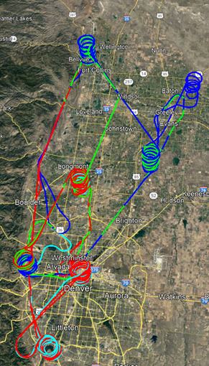
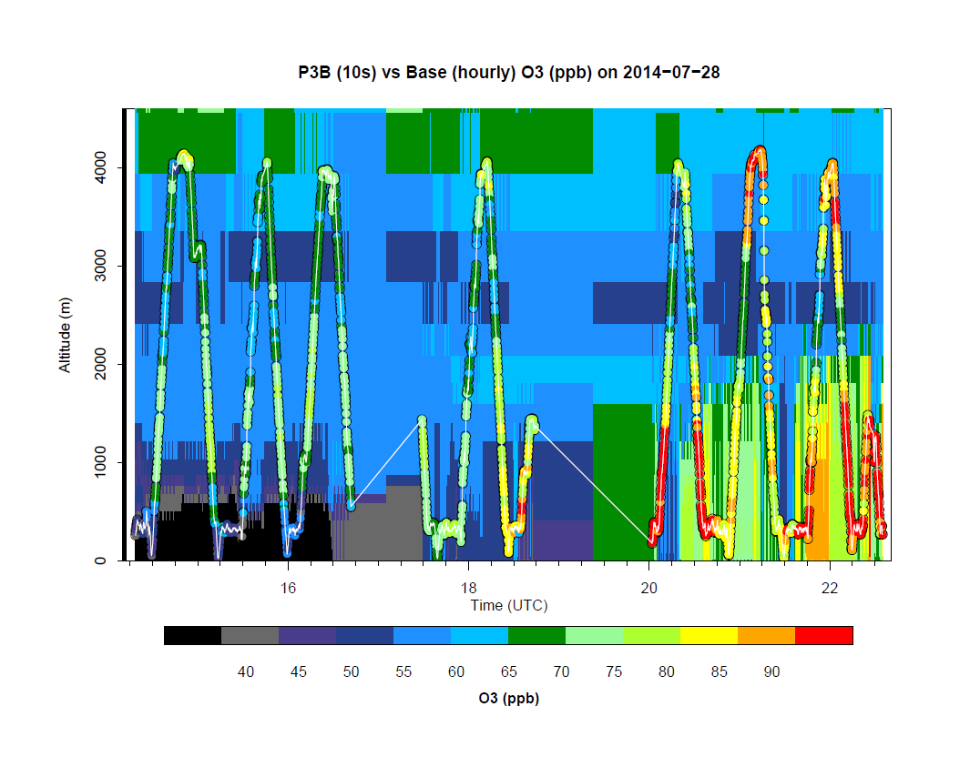
Work in Progress
Visualization of aircraft measurements (ICARTT data format)
Paired model-observation overlay plots (vertical temporal cross sections)

Slide 8
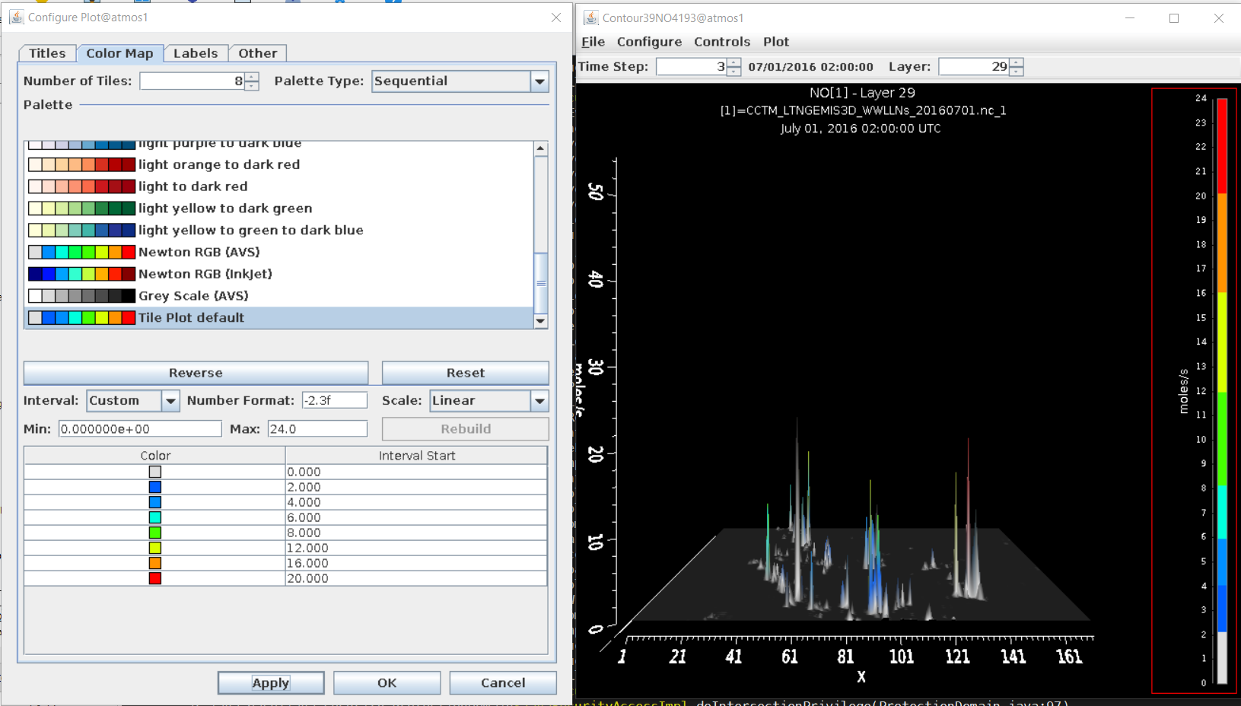
Known Major Issues
The “Contour” plot functions are not fully developed
The name “contour” doesn’t conform to convention
The vertical axis and the color legend bar present redundant messaging and don’t make much sense
“Make Animated GIF” to save as animated images doesn’t work

Slide 9
Proposed Modification
Change the name “Contour Plot” to “3D Surface Plot”
The vertical axis (z-axis) can represent the vertical model layers (customizable for a range of layers) and the color scheme represents the values at each grid cell vertically
3D Surface plot can be used to animate plume evolution over time (model steps) and space
Z
Y
X
Notes:
use

Slide 10
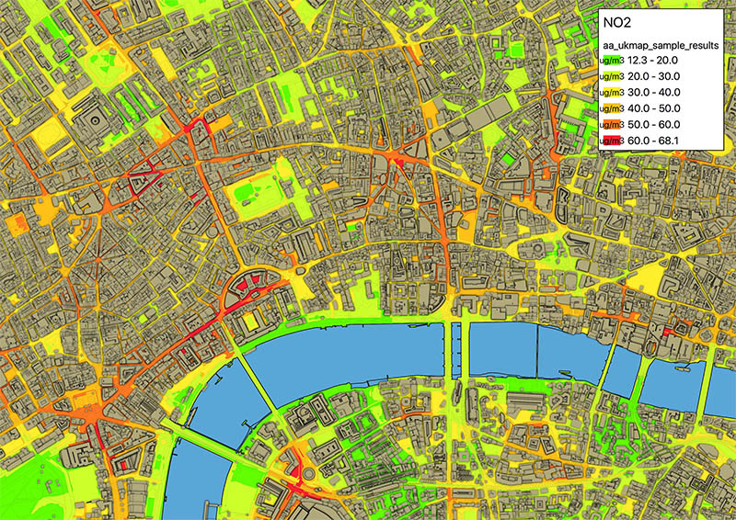
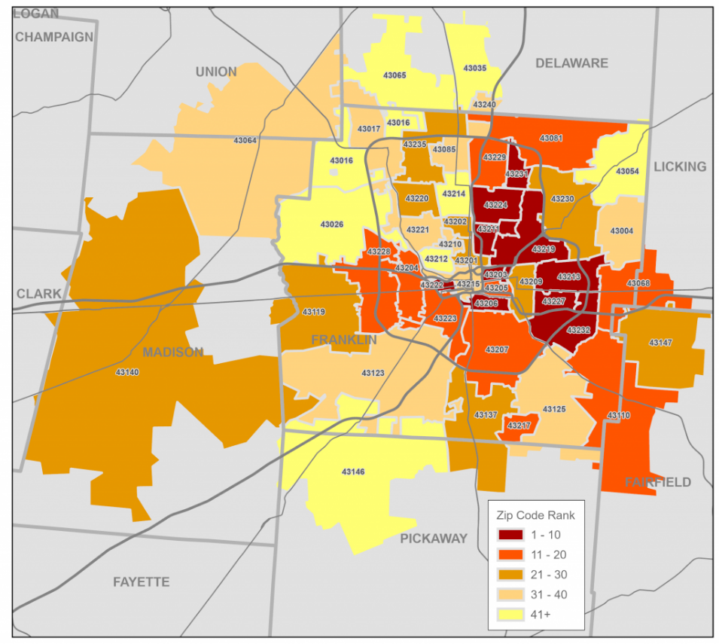
Planned Development in FY2023
Visualize fine scale model and observational data:
  Model and observational data of atmospheric chemistry and meteorology on street-level maps or zip-code based districts
  Census-data-based maps and plots to facilitate Environmental Justice (EJ) focused applications
Street-level pollutant concentrations
An example of zip-code map

Slide 11
Planned Development in FY2023 (Cont’d)
Visualization of diverse remote sensing and satellite data
  Remote sensing technologies such as satellite, sonde, and lidar provide a diverse array of observations to evaluate the model’s performance both horizontally and vertically.
Reading and exporting data in geodatabase format
  Spatial data analysis and visualization are dependent on a set of related files that store the location, shape, and attributes of geographic features
  These spatial files are available in two storage formats: shapefile (.shp) and geodatabase (.gdb) (https://www.adci.com/blog/shapefile-vs.-file-geodatabase-which-is-right-for-you)
  VERDI currently has the mechanism to work with shapefile format, but not with geodatabase

Slide 12
Summary and Future Work
VERDI has undergone continuous development and testing to meet the visualization and analysis needs of the atmospheric modeling community
  Previous development of VERDI has greatly advanced the capabilities of the tool
  Updates have increases security and compliance to IT accessibility protocols and policies
Future development
  Potential cloud computing framework with access to remote datasets
  Adapt to possible I/O system updates in CMAQ
  New functionality (features) will be added/modified based on user feedback (either via CMAS forum at: https://forum.cmascenter.org or directly contact the PI)

Slide 13
Disclaimer
Questions/comments and suggested improvements are always welcome, contact Daiwen kang (PI):
Kang.Daiwen@epa.gov
The views expressed in this presentation are those of the authors and do not necessarily reflect the views or policies of the U.S. EPA

