Slide 1

A Review of Emissions Modeling Platforms for the Years 2016 through 2019
Alison Eyth, Jeff Vukovich, Caroline Farkas, Janice Godfrey, Karl Seltzer
U.S. EPA Office of Air Quality Planning & Standards
Sarah Roberts
U.S. EPA Office of Transportation and Air Quality
Christine Allen, James Beidler
General Dynamics Information Technology
CMAS Conference
October 18, 2022

Slide 2
Overview
The purpose of this presentation is to clarify the purpose and contents of emissions modeling platforms, including how to access EPA platforms and associated documentation
This presentation was developed in part due to the many questions that arise about EPA emissions modeling platforms including questions from the CMAS forum
Some summaries of emission trends from the recent emissions modeling platforms will also be reviewed

Slide 3
Uses of Emissions Modeling Platforms
Support regulatory and non-regulatory air quality modeling
Regulatory examples
  Ozone transport: www.epa.gov/interstate-air-pollution-transport
  National Ambient Air Quality Standards: www.epa.gov/naaqs
  Motor vehicle emissions regulations: www.epa.gov/regulations-emissions-vehicles-and-engines
Non-regulatory examples
  Support annual air quality modeling project that is a collaboration between EPA and the Centers for Disease Control and Prevention (CDC)
    Review air quality model performance for historic modeled years
    Fused air quality surface data using downscaling files on EPA’s RSIG site
  Support AirToxScreen that replaced the National Air Toxics Assessment (NATA)
Notes:
CDC EPHT: multidisciplinary collaboration that involves ongoing collection, integrations, analysis, interpretation, and dissemination of data. It supports links of air quality data with human health outcome for use by various public health agencies throughout the U.S. It assists with the CDC’s response to requests calling for improved understanding of how the environment impacts human health.

Slide 4
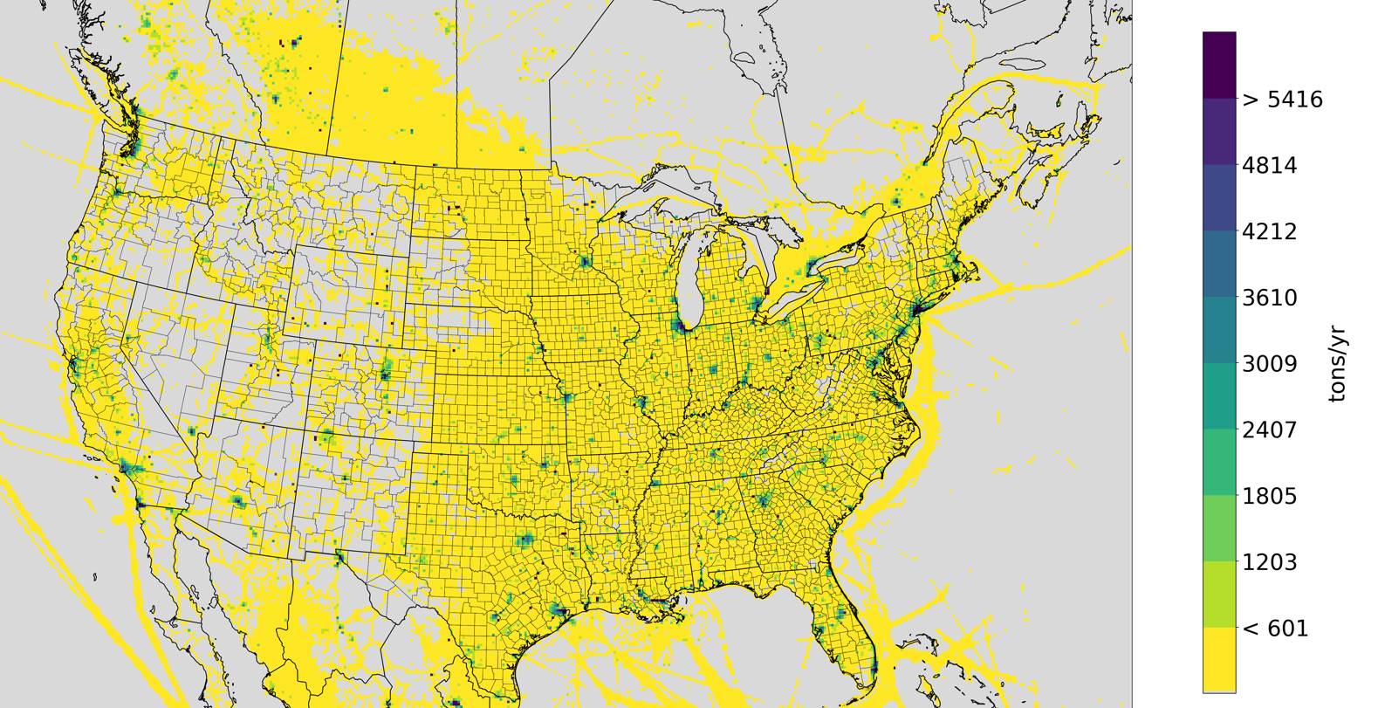
Emissions Modeling Platform
Emissions Modeling Software
Hourly, speciated
point and gridded
emissions
Meteorological
Data: humidity,
temperature,
precipitation,
radiation, …
SMOKE
(+ scripts,
models, tools)
Emission
Inventories*
National Emissions
Inventory + Hourly
and Year-specific
data (e.g., CEMS)
Quality Assurance
Logs and Summaries
Ancillary Data
Speciation and Temporal Profiles, Spatial Surrogates,
County information,
Cross references,
etc.
SMOKE stands for Sparse Matrix Operator Kernel Emissions modeling system (see http://cmascenter.org)
* For historic and future years
Notes:
The emissions modeling platform includes many complicated pieces. Future year emission inventories are needed for regulatory analyses

Slide 5
Emissions Modeling Platforms and the NEI
Emissions modeling platforms start with emissions from the National Emissions Inventory (NEI)
Full NEIs are developed every three years (e.g., 2011, 2014, 2017)
  Triennial NEIs include emissions inventories for all sectors
  Inventories are specific to the triennial year
  Incorporate data received from state, local, and tribal (S/L/T) agencies integrated with EPA-developed data
  See www.epa.gov/air-emissions-inventories
For interim years, only point source data are submitted to the NEI
  The emissions modeling platform inventories for other data categories are typically developed without much S/L/T submitted data and methods vary by sector
  The 2016v1 regulatory platform data were developed through a collaborative process with S/L agencies and multi-jurisdictional organizations (MJOs)
Notes:
Interim years include 2018, 2019, 2016

Slide 6
Pollutants in the NEI and Modeling Platforms
Criteria air pollutants (CAPs):
  These have ambient concentration limits or are precursors to pollutants with limits
  Carbon Monoxide (CO)
  Nitrogen oxides* (NO_{x})
  Volatile Organic Compounds* (VOC)
  Sulfur dioxide (SO₂)
  Particulate matter less than 2.5 microns (PM_{2.5})
  Particulate matter less than 10 microns (PM₁₀)
  Ammonia (NH₃)
  Lead (Pb)
Hazardous air pollutants (HAPs):
  187 listed HAPs from Section 112(b) of the 1990 Clean Air Act Amendments
  Include acid gases (e.g. HCl), heavy metals (e.g., mercury), organic compounds
  (e.g., formaldehyde)
Greenhouse gases (GHGs) such as CO₂ are included for fires, mobile sources, and point sources (where reported), but not currently for nonpoint sources

Slide 7
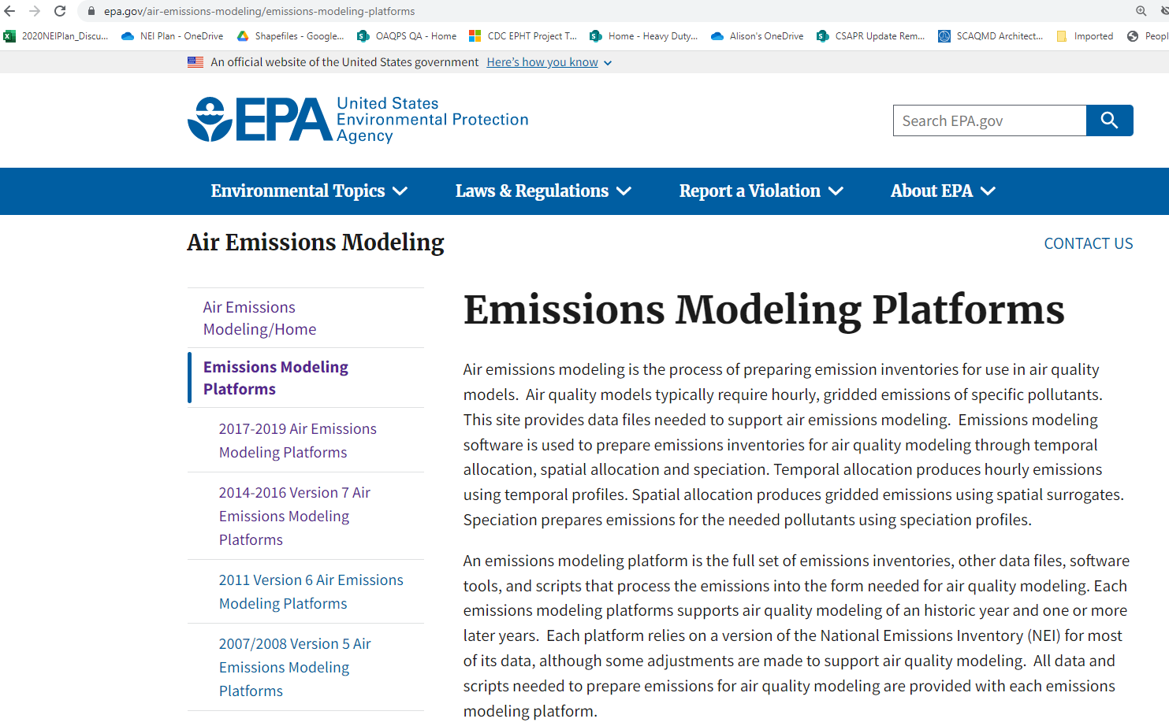
Finding EPA Emissions Modeling Platforms
EPA posts its platforms to www.epa.gov/air-emissions-modeling
  This includes pages for 2014-2016 platforms and 2017-2019 platforms
Important:
when you drill down to a
specific platform, you will
find a Technical Support
Document that describes
methods and data used to
create emissions for that
platform

Slide 8
Finding Emissions Modeling Platform Data
Platform data on the FTP site are linked from the platform web page
The FTP site includes the following:
  Emission Inventories for the U.S., Canada, and Mexico
    These can be for a historic base year only, regulatory may include future years
  Activity data and emission factors for onroad mobile sources
  Spatial surrogates, temporal profiles and speciation profiles
  Spatial, temporal, and speciation cross reference files
  Other ancillary data needed to run SMOKE
  Scripts to run SMOKE
  Summaries of emissions at various levels of resolution

Slide 9
Regulatory Emissions Modeling Platforms
2016 platforms have been used for regulatory purposes in recent years
  2016beta was released in spring 2019 with future years of 2023 and 2028
    2016beta used a lot of 2014NEI-based data and was used for regional haze analyses
  2016v1 was released in fall 2019 with some updates in early 2020
    2016v1 was used for the Revised Cross-State Air Pollution Rule Update
  2016v2 and was released in fall 2021 with future years of 2023, 2026, and 2032
    2016v2 was used for the proposed Good Neighbor Plan for the 2015 Ozone NAAQS
  2016v3 is currently under development in 2022 and uses very little data from 2014 NEI
Data and documentation availability
  The 2014-2016 Platforms web page provides documentation, input data, scripts and summaries for the 2014, 2015, and for each of the 2016 platforms
  Meteorological data and air quality model-ready emissions for 2016beta and 2016v1 are available on the Intermountain West Data Warehouse
  CMAS Dataverse has premerged emissions for 2016v1, 2016v2, and others

Slide 10
Other Recent Emissions Modeling Platforms
The EPA developed emissions modeling platforms for each of the years 2017, 2018, and 2019 – see the 2017-2019 Emissions Modeling Platforms page
These were used to support a collaboration with CDC and for AirToxScreen
Technical support documents are available for each platform
The 2017 platform has a complete package of scripts and SMOKE input data
The 2018 and 2019 platforms have documentation and SMOKE input data but do not yet include portable scripts
  These platforms have S/L/T data for point sources but not for most other sectors
Compared to the regulatory platforms, the number of summaries for these platforms is more limited

Slide 11
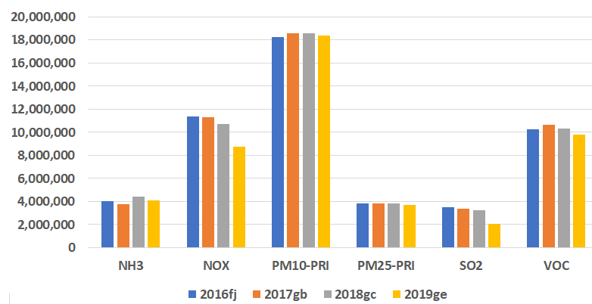
U.S. Anthropogenic Emissions from 2016 to 2019
Pollutant | 2016fj*(M tons) | 2017gb* (M tons) | 2018gc* (M tons) | 2019gc* (M tons)
CO | 41.6 | 42.0 | 39.9 | 39.0
NH₃ | 4.0 | 3.8 | 4.4 | 4.5
NO_{x} | 11.4 | 11.3 | 10.7 | 8.7
PM₁₀ | 18.3 | 18.6 | 18.6 | 18.4
PM_{2.5} | 3.8 | 3.9 | 3.8 | 3.7
SO₂ | 3.5 | 3.4 | 3.3 | 2.1
VOC | 10.2 | 10.6 | 10.3 | 9.8
* These national emissions totals do not include fire or biogenic emissions;
2019 emissions for some sectors in AK, HI, PR, and VI are approximated from 2018 levels
(tons/yr)
Notes:
PM is flat, NH3 is increasing in 18 and 19, NOx is somewhat decreasing and while 2019 is lower than the other years

Slide 12
Use of Year-Specific Data in Interim Year Platforms
Agricultural: fertilizer is year-specific; livestock are adjusted by animal counts
Airports, nonpoint and non-US data are adjusted from a recent year’s inventory
Biogenic: use year-specific data, plus methods and land-use data evolved
Commercial Marine Vessels:
  2017 data based on ship transponder data with emissions using 2017 NEI methods
  2016 and 2018 are adjusted versions of 2017
  2019 and 2020 are based on year-specific transponder data using 2020 NEI methods
Fires: year-specific data are always used, plus methods evolving
Fugitive dust: use year-specific meteorological adjustments and paved road dust are scaled according to year-specific vehicle miles traveled (VMT)
Nonroad: output from year-specific runs of MOVES
Onroad: year-specific activity data (e.g., VMT, starts), emission rates, and other inputs
Notes:
Residential wood combustion: use year-specific data for temporal allocation

Slide 13
U.S. Emissions Modeling Sector Abbreviations
afdust = area fugitive dust
airports = aircraft + ground support (as point sources)
beis = biogenic emissions
cmv_c1c2 = category 1 and 2 (small-medium) commercial marine vessels (CMV)
cmv_c3 = category 3 (large) CMV
fertilizer = agricultural fertilizer
livestock = agricultural livestock
nonpt = other nonpoint sources
nonroad = mobile sources not on roadways (excluding CMV, rail, and airports)
onroad = mobile sources on roadways
np_oilgas and pt_oilgas = nonpoint and point oil and gas
np_solvents = nonpoint solvents
ptagfire = agricultural fires as points
ptegu = electric generating units
ptfire-wild = wild fires
ptfire-rx = prescribed fires
ptnonipm = non-EGU point sources
rail = line haul locomotives
rwc = residential wood combustion (RWC)
Notes:
Sectors starting with pt are treated as point sources – except airports; includes point, nonpoint, and mobile; Canada and Mexico sectors not in this list

Slide 14
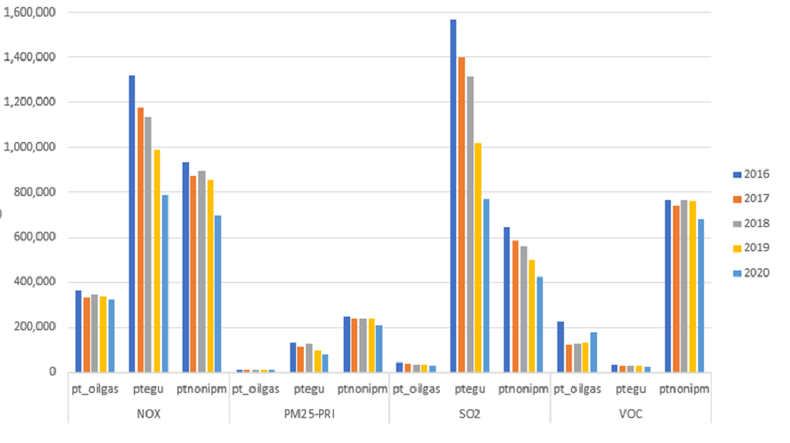
Year-specific data for Point Sources
Large point sources submit to NEI every year
Small point sources are carried forward from the most recent triennial year if not submitted
Year-specific hourly Continuous Emissions Monitoring System (CEMS) data are used for EGUs
(tons/yr)
Notes:
Oil and gas point source emissions go up and down; EGU NOx and SO2 are going down smoothly (although 2021 may be higher); non-EGU point vary and depend on submission methods

Slide 15
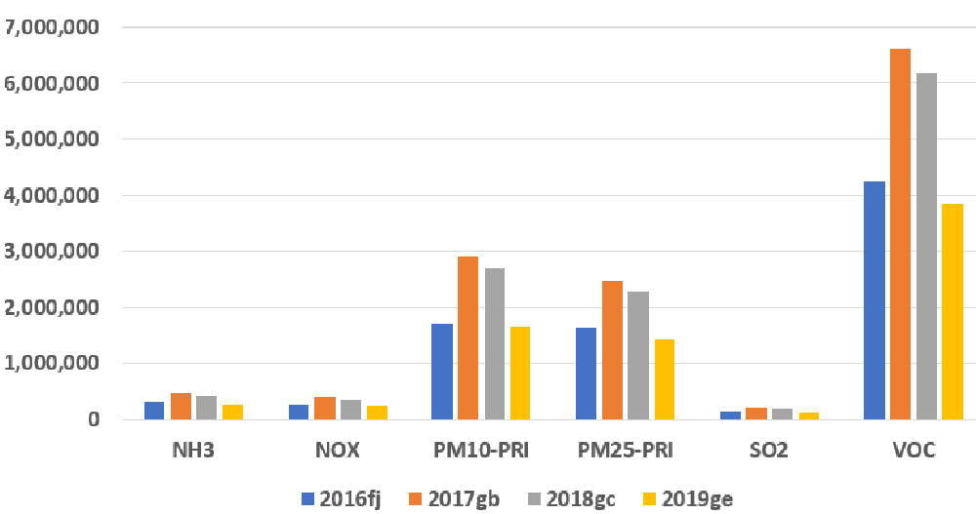
Wild and Prescribed Fire Emissions by Year
(tons/yr)

Slide 16
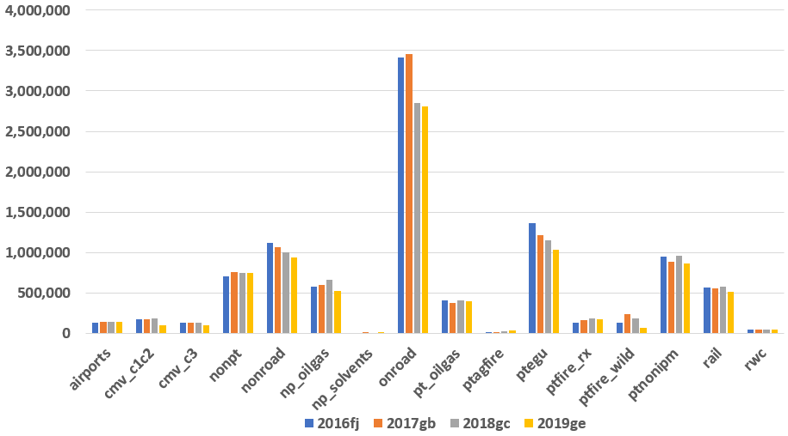
NO_{x} Emissions by Sector in Recent Years
Key sectors:
onroad,
EGUs,
nonroad,
non-EGUs
oil and gas
(tons/yr)

Slide 17
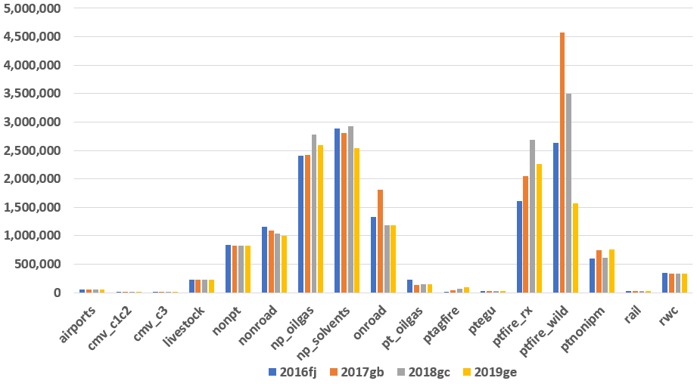
VOC Emissions by Sector in Recent Years
Key sectors:
biogenic (25M tpy)
fires,
solvents
oil and gas,
onroad,
nonroad
(tons/yr)

Slide 18
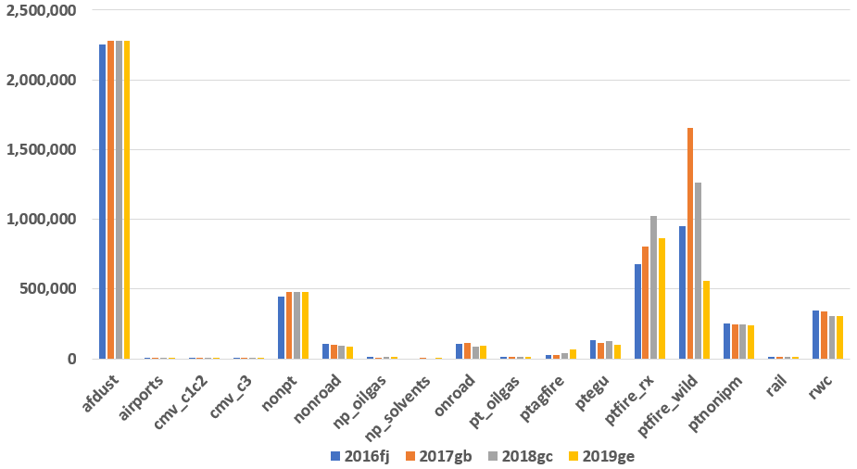
PM_{2.5} Emissions by Sector in Recent Years
Key sectors:
fugitive dust
fires,
nonpoint,
res. wood comb.
(tons/yr)

Slide 19
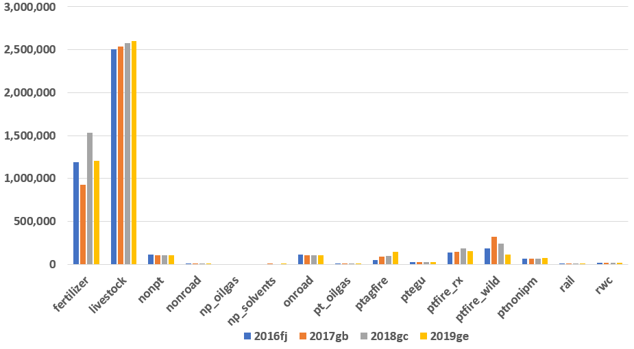
NH₃ Emissions by Sector in Recent Years
Key sectors:
ag. livestock
ag. fertilizer
fires
(tons/yr)

Slide 20
Overview of 2016-2019 Emissions by Sector
Sectors with steady decreases of key pollutants
  Electric generating units, onroad, nonroad
Sectors with variable emissions
  Oil and gas, fires, non-EGU point sources, fertilizer
Sectors that are adjusted from a triennial / base year inventory
  Airports, nonpt, fugitive dust, livestock, rail, non-U.S.
Sectors with year-specific temporal allocation
  Residential wood comb., fertilizer, livestock, onroad, biogenic, EGUs, fires
Sectors for which methods have changed
  Solvents, commercial marine vessels, fires, onroad, biogenic

Slide 21
Acknowledgements and Contacts
OAQPS National Emissions Inventory Team Members
  Rich Mason, Ron Ryan, Jennifer Snyder, Art Diem, Tesh Rao, Lindsay Dayton
Office of Transportation and Air Quality Commercial Marine Vessel Inventory Developers
  Michael Aldridge, Daniel Bizer-Cox
Office of Research and Development NEI Contributors
  George Pouliot, Jesse Bash
For follow up questions contact emissionsmodeling@epa.gov
Training materials on emissions modeling can be found here:
  https://www.epa.gov/air-emissions-modeling/emissions-modeling-training

Slide 22
Appendix

Slide 23
HAPs Included in Air Quality Modeling
Some HAPs are included explicitly in gridded photochemical air quality modeling
  naphthalene, benzene, acetaldehyde, formaldehyde, methanol, and HCl are part of Carbon bond 6 (CB6)
Additional gaseous and particulate matter HAPs can be included in special multi-pollutant Community Multiscale Air Quality (CMAQ) model runs with an additional focus on toxics
  Gaseous HAPs include
  Polycyclic aromatic hydrocarbons (PAH) can be modeled as grouped species with similar unit risk estimates
  Particulate HAPs include forms of arsenic, beryllium, cadmium, chromium, lead, manganese, mercury, and nickel
Dispersion models like AERMOD can model the CMAQ-supported HAPs plus:
    Over 100 additional gaseous organic HAPs
    antimony, cobalt, selenium, acid gases, calcium cyanamide, phosphine, phosphorus, titanium tetrachloride
    Acetonitrile
    Acrolein
    Acrylic acid
    Acrylonitrile
    Benzo[a]Pyrene
    1,3-Butadiene
    Carbon tetrachloride
    Carbonyl sulfide
    Chloroform
    Chloroprene
    1,4-Dichlorobenzene(p)
    1,3-Dichloropropene
    Ethylbenzene
    Ethylene dibromide (Dibromoethane)
    Ethylene dichloride (1,2‑Dichloroethane)
    Ethylene oxide
    Hexamethylene-1,6‑diisocyanate
    Hexane
    Hydrazine
    Maleic anhydride
    Methyl chloride
    Propylene dichloride (1,2‑Dichloropropane)
    Quinoline
    Styrene
    1,1,2,2-Tetrachloroethane
    Tetrachloroethylene (Perchloroethylene)
    Toluene
    2,4-Toluene diisocyanate,
    Trichloroethylene
    Triethylamine
    Xylenes
    Vinyl chloride
Notes:
HAP modeling with both CMAQ and AERMOD were previously used to compute concentrations for the National Air Toxics Assessment and more currently as part of EPA’s Air Toxics Data Update.

Slide 24
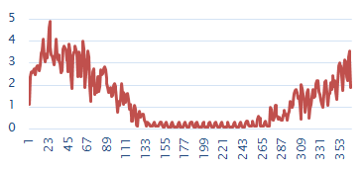
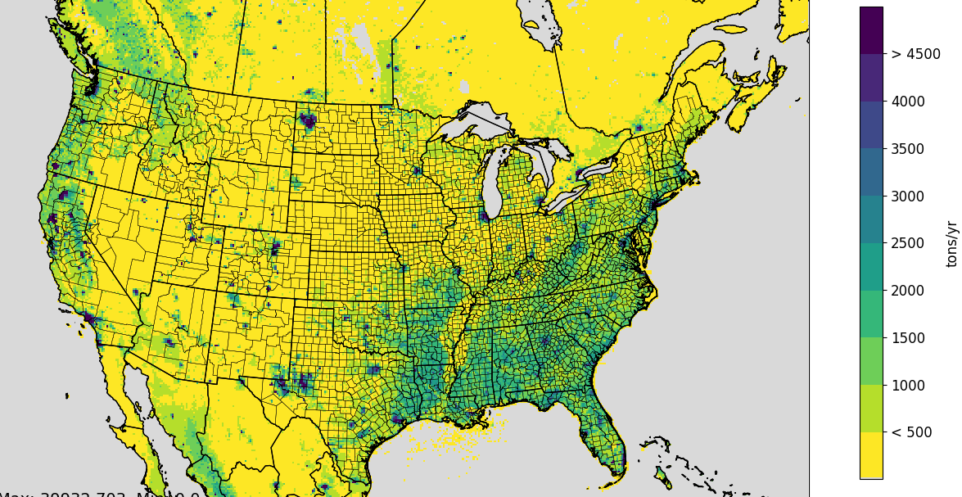

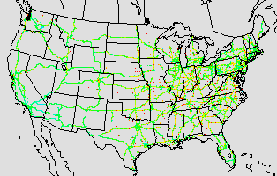
Emissions Modeling Process
Steps and data needed to convert emissions inventories into the resolution and formats needed by air quality models
Temporal Allocation
Temporal Profiles
Emission Inventories
(annual/
monthly/daily
hourly)
+
Ancillary data +
Meteorology
Speciation Profiles
Speciation
Spatial Allocation
Hourly, speciated, gridded (or point) emissions for air quality modeling
Spatial Surrogates
Note: Plume rise is typically
handled within the AQM
Notes:
Key is hourly – by day, season, etc – difference b/w NEI and emissions modeling

Slide 25
Emissions Modeling Sectors and Cases
The NEI data categories are split into finer “sectors” for emissions modeling
Each sector is run through SMOKE separately to create speciated, hourly, gridded (or point) emissions (aka “premerged”)
  SMOKE is available from the CMAS center (http://cmascenter.org)
Each sector has an abbreviation and these will be used in upcoming charts and maps (e.g., ptegu, cmv_c3, rwc – see next slide)
Additional non-U.S. data are added to cover Canada and Mexico
  These data are mostly in separate sectors from the U.S. emissions
  For Caribbean island countries, only fires are included
Modeling “cases” include a full set of emissions for the AQ model
  Case labels include the year modeled plus an abbreviation (e.g., 2019ge_cb6_19k)
  ‘g’ references 2017 NEI; ‘e’ is the fifth iteration of emissions for that NEI platform;
  cb6 is the speciation in the AQM; and 19k is 2019 meteorology run with configuration ‘k’

Slide 26
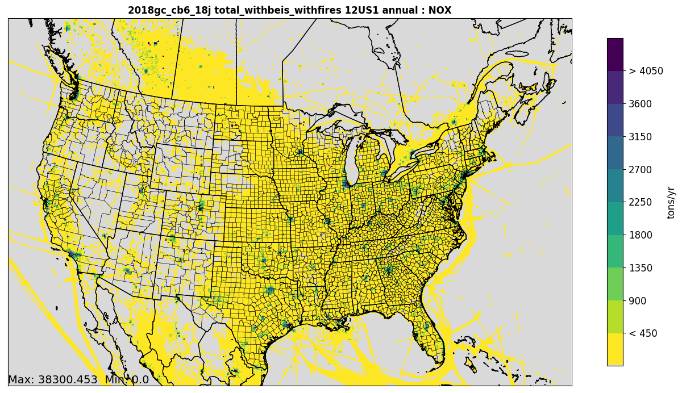
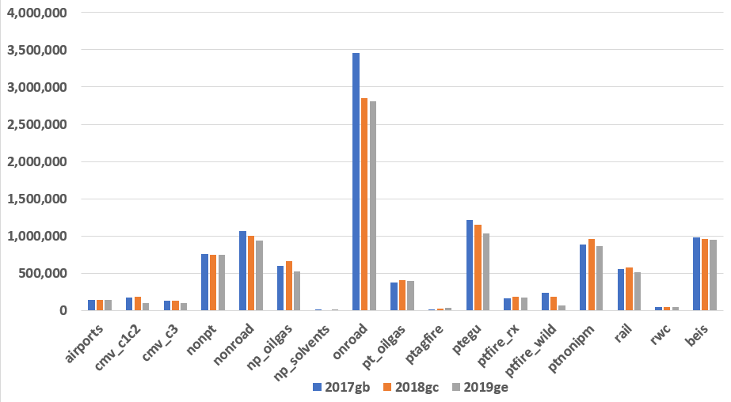
Total NOx
NO_{x} emissions are primarily from onroad, commercial marine vessels (CMV), EGU (ptegu), nonroad, non-EGU point (ptnonipm, pt_oilgas), biogenic (beis) and locomotive emissions. Many sectors decreased from 2017 to 2019, but a few show different patterns.
CMV emissions in chart are
from state waters only
(tpy)

Slide 27
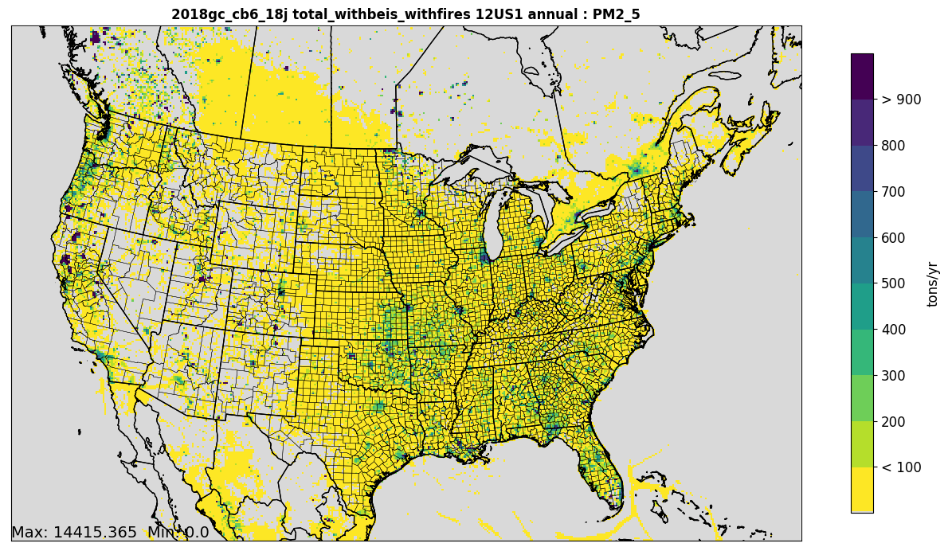
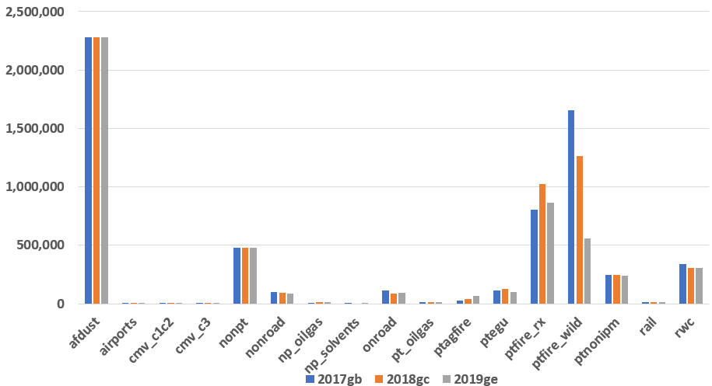
Total PM_{2.5}
PM_{2.5} emissions are primarily from wildland and prescribed fires (ptfire), fugitive dust (afdust), res. wood combustion (rwc), and other nonpoint (nonpt) sources. Fires were higher in 2017 than in 2018 or 2019.
(tpy)

Slide 28
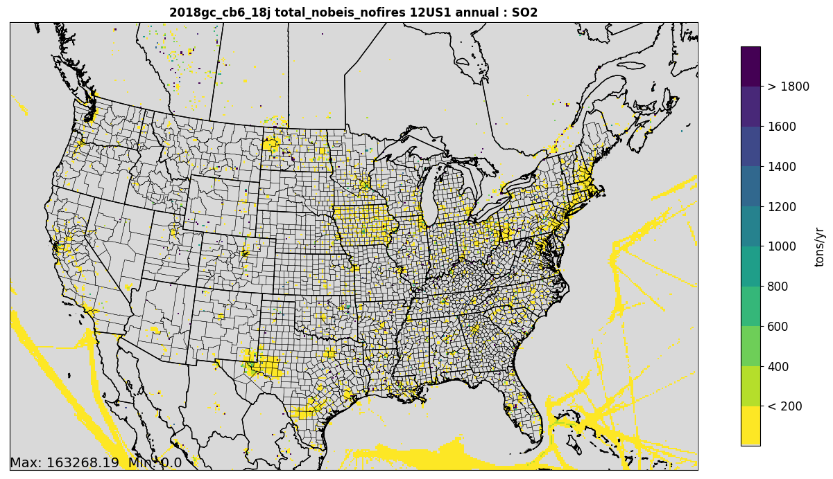
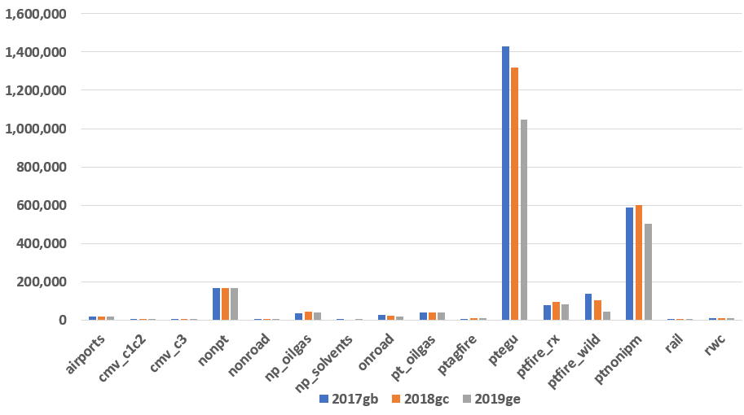
Total SO₂
SO2 emissions are primarily from EGU and non-EGU point sources. The EGU and non-EGU SO2 reduced substantially from 2017 through 2019.
(tpy)

Slide 29
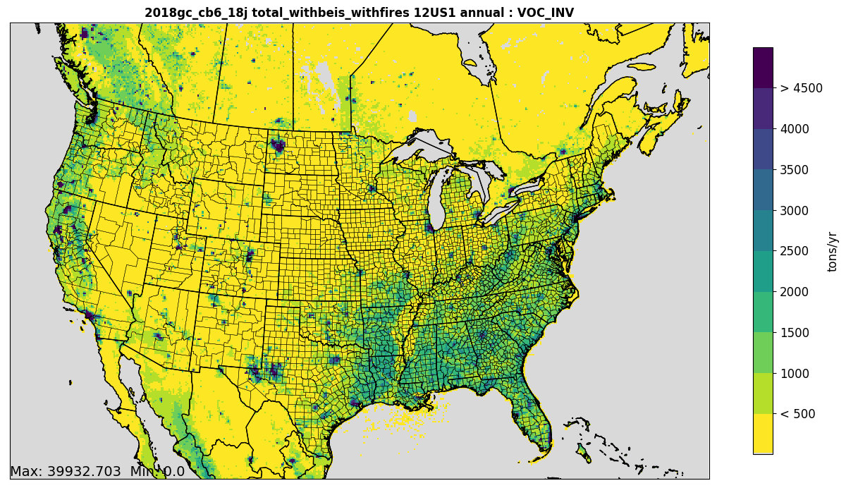
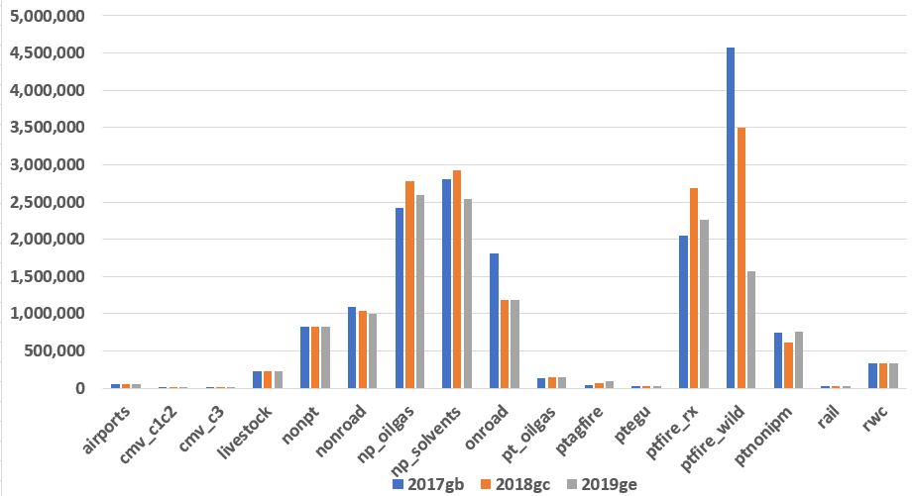
Total VOC
VOC emissions are primarily from biogenic (beis*), fires, solvents, oil and gas, onroad and nonroad sources.
(tpy)
* beis contributes 25M tons of VOC

