Slide 1
Mortality and Morbidity Attributable to Wildland Fire Smoke in California from 2008-2018
October 18, 2022
UCLA Fielding School of Public Health, Department of Environmental Health Sciences
Howard University Graduate Program in Atmospheric Science, Washington, D.C.
University of Washington, School of Environmental and Forest Sciences
Professor Joseph Wilkins, PhD
Dr. Diane Garcia-Gonzales, MPH, PhD
Rachel Connolly, MS, PhD Candidate
Professor Miriam E. Marlier, PhD
Dr. Jason Su, PhD
Dr. Richard T. Burnett, MSc, PhD
Professor Michael Jerrett, MA, PhD
Dr. Jihoon June, PhD
Claire Schollaert, PhD Candidate

Slide 2
Background/Overview
Knowledge gap: Long-term mortality and morbidity impacts resulting from years of increasing wildfire exposures within the state
Wildfires in CA have grown in severity & frequency
Wildfire smoke contributes to ~50% of PM_{2.5} in western US
Wildfire PM_{2.5} exposure impacts health
Potential for long-term impacts from wildfire PM_{2.5}
Liu et al. 2015,
Reid et al. 2016,
Cascio 2018
Black et al. 2017
Burke et al. 2021, Westerling et al. 2006, Radeloff et al. 2018
Burke et al. 2021
Background
Notes:
Wildfires in California have grown in severity and frequency over the last several decades for multiple reasons, including climate change and an expansion of the wildland urban interface, or the WUI. A recent study found that wildfires can contribute up to half of fine particulate matter, or PM2.5, in western regions of the US. There is well-established evidence of impacts of wildfire PM2.5 exposure on several health outcomes, including hospitalizations and respiratory illness. However, there is less evidence quantifying the mortality impacts resulting from long-term PM2.5 exposure from wildfires specifically, though there are many established epidemiological functions for the long-term impacts of all-source PM2.5 on mortality.

Slide 3
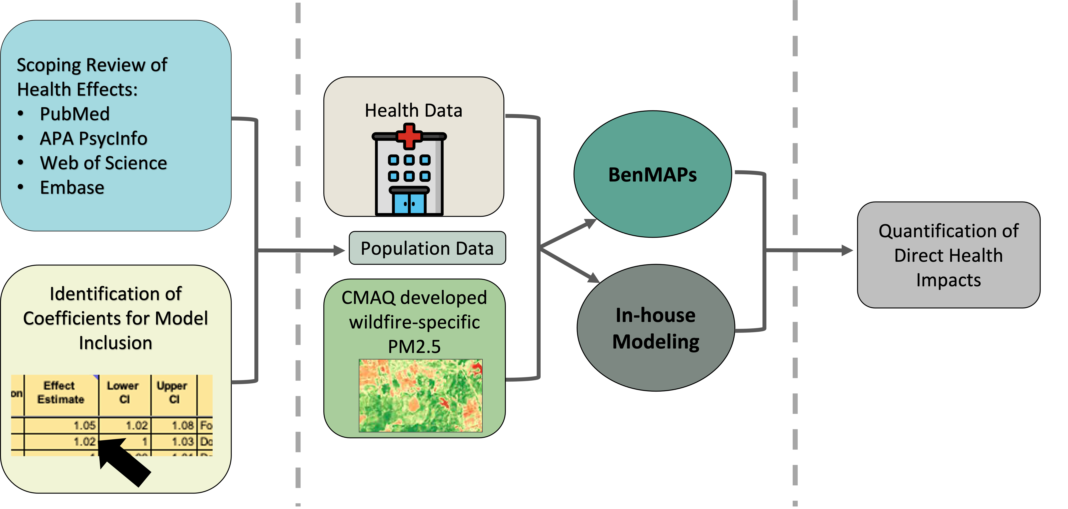
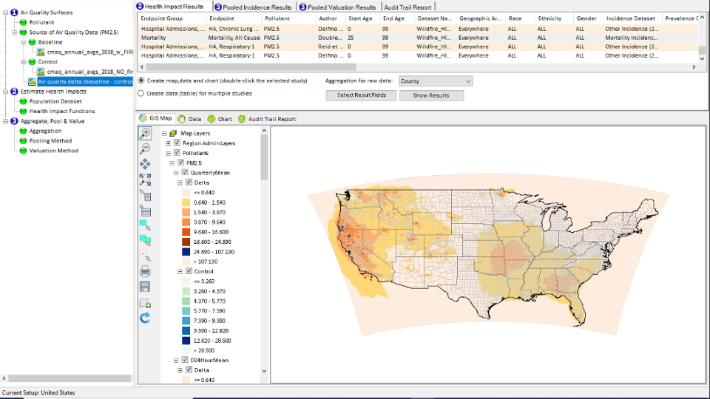
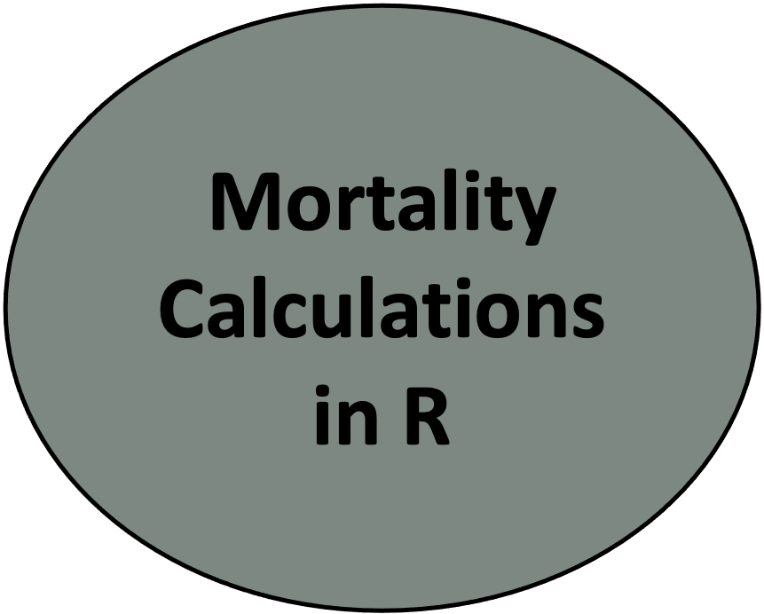
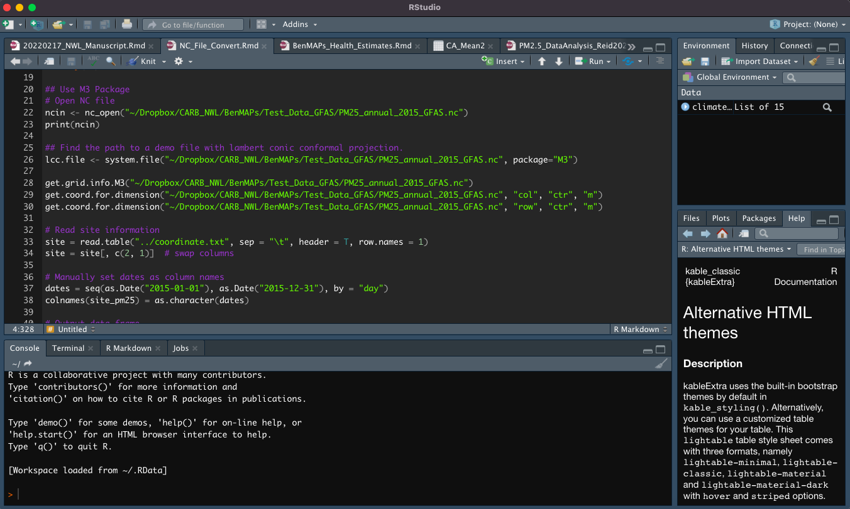
Methods: Overview
Literature Review
Tool
Development
Quantification/ Results
Quantification/ Results
Articles (Reviews & Meta-Analyses)
WoS
(n = 687)
PsycArticle
(n = 130)
Embase
(n = 667)
PubMed
(n = 418)
Studies Merged & Duplicates Removed
Studies excluded
(n = 868)
Abstract/Title Screening
(n = 907)
Studies excluded
(n = 24)
Full Text Review
(n = 39)
Articles Included in Final Report (n = 15)
* This is not a final product.
Methods
Methods
Notes:
This slide provides the overall methodology for a California Air Resources Board (CARB) project led by the project PI, Dr. Michael Jerrett from UCLA.
First, the team conducted a comprehensive literature review of the health impacts of PM2.5 emissions from wildfire smoke, to identify appropriate dose-response relationships, assess for certainty in their relationship, and identify coefficient for model inclusion. They extracted the dose-response values from these review articles which resulted in over 700 measured health outcomes ranging from respiratory, cardiovascular, mortality, mental health, etc.
As a second step, they aggregated coefficients with appropriate populations and environmental data to calculate impact estimates through two different methods. In short, they used BenMAPs to estimate health outcomes for all morbidity estimates by including identified co-efficients from Step 1. And second, they used R-programming to calculate mortality. These two methods used different health datasets but where the methods overlapped, for mortality, the results were very similar.
The team is still working on the final analyses, so please note that this project is on-going and the results and overall methods (shared on the current slide) are still preliminary.
Hospital Icon: https://www.stockio.com/free-icon/healthy-icons-hospital (free icon source)
NDVI: https://themappingcompany.wordpress.com/2016/08/31/ndvi-python-script/ - Not sourced properly (assuming image is not easily identifiable)
Burning Photo: https://prairieecologist.com/tag/prescribed-burning/ (not properly attributed)

Slide 4
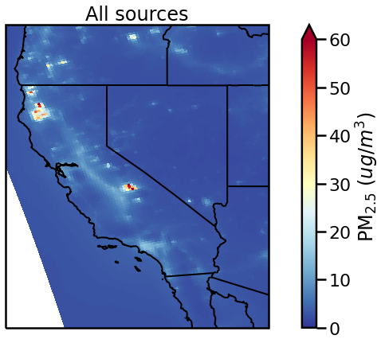
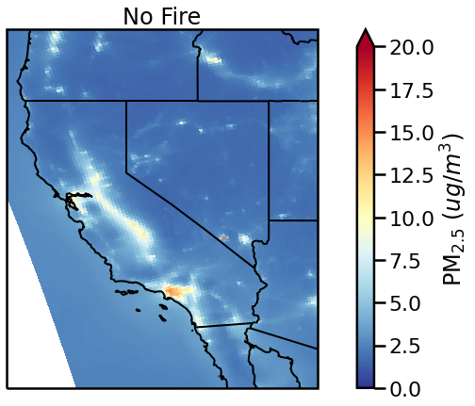
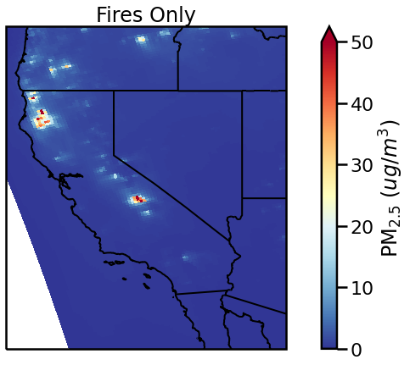
Methods: CMAQ Estimates, Annual PM_{2.5} for 2015
Dataset details: 2008-2018, 12km grid, includes wildfires and prescribed fires. Note: Change in scale for each panel. Units are µg/m³.
Conducted model validation using ground station observations for all 11 years of data (AMET)
Wilkins JL, Pouliot G, Foley K, Appel W, Pierce T. The impact of US wildland fires on ozone and particulate matter: a comparison of measurements and CMAQ model predictions from 2008 to 2012. Int J Wildland Fire. 2018;27(10):684–98.
Methods
Notes:
Note – explain that we conducted validation analysis against ground station observations.
We modeled PM2.5 at the 12km scale with and without fire contributions for the years of 2008-2018 using CMAQ. These maps show PM2.5 estimates for an example year, 2015, throughout the state. The panel on the left is all sources PM2.5, the middle shows estimates with all fire sources removed, and the right is just the fire contributions. You can see here that the spatial distribution of fire-associated PM2.5 is significantly different from general PM2.5, which is spread more throughout the urban areas here as we can see in the middle panel.
Spatial Resolution: 12 km
Source: Wilkins et al. (2018)
Model Configuration:
SMARTFIREv2 emissions
Simulations with and without fire emissions
Includes wildfires and prescribed burns

Slide 5
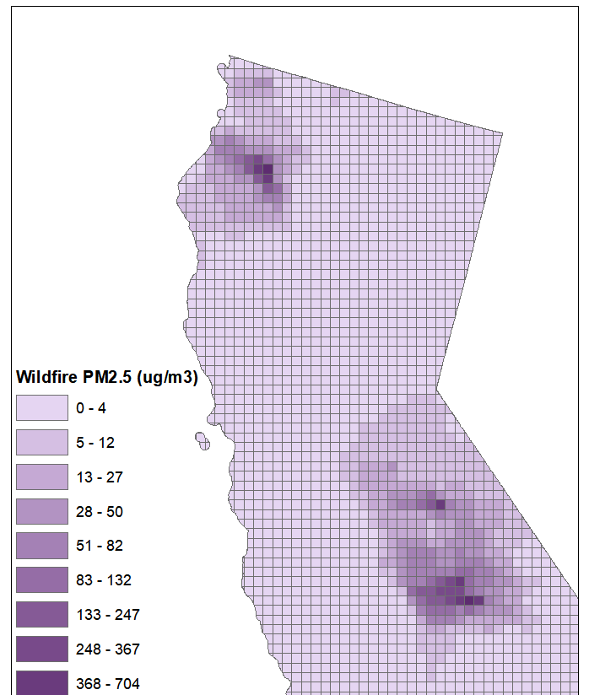
Methods: Data Processing (Mortality)
Methods
Notes:
These modeled estimates are at a 12-kilometer grid scale as shown in the left panel, which is just an example of a peak wildfire day. We received the modeled data at the daily level, and we have isolated the fire concentrations, processed the data into annual averages and aggregated it to the zip code level for the mortality analysis. If a given zip code contains one or more grid cells, the modeled PM2.5 estimates were averaged for that zip code.
For this analysis, used publicly available mortality data for California from the California department of public health. We have extracted deaths data by zip code and age, exported from the California health and human services website. Then, we removed all deaths for individuals less than 25 years of age, since the epidemiological studies used to develop the dose-response functions between PM2.5 and mortality only apply to adults above that age. Additionally, for all age groups, any death count less than 11 are suppressed within the dataset for confidentiality reasons. Therefore, we have implemented substitution procedures to fill in the missing deaths.

Slide 6
Methods: Mortality and Valuation Calculations
Mortality Equation: $ΣΔm_{ij}=\left(1− \frac{1}{e^{\left(βwl ∗ Δ{PM}_{2.5ij}\right)}}\right)∗d_{ij}$
Valuation Equation: $ΣΔmij ∗ VSL$= Economic valuation attributable to wildfire smoke
Where:
β_{wl} = pollutant mortality dose-response value for 1 unit$(µ$g/m³)
𝚫PM_{2.5ij} = change in pollutant concentration from wildland fire smoke in year i and zip code j
d_{ij} = total deaths in year i and zip code j
Δm_{ij} = total mortality burden from wildfires
VSL = Value of a statistical life; $8.7 million in 2015 dollars
Methods
Notes:
Since there are no long-term PM2.5 dose-response values for wildfires specifically, we developed a novel dose-response value with advisement from Dr. Richard Burnett, who is a statistician with expertise in this field. This value, which is the beta value up on this slide, was calculated using an existing dose-response value for short-term exposure to PM2.5 during wildfire events and both long- and short-term dose response values for ambient all-source PM2.5. (sources used for this calculation: Pope et al. 2019, Doubleday et al. 2020 , Orellano et al. 2020)
We estimated mortality using a well-established health impact function. We used data on adult deaths in each zip code throughout the state and the change in PM2.5 exposure due to wildland fires from the CMAQ data to ultimately calculate premature mortality impacts using our calculated dose-response value. And we can develop valuation estimates using the value of a statistical life from the US EPA, which is about $8.7 million in 2015 dollars.

Slide 7
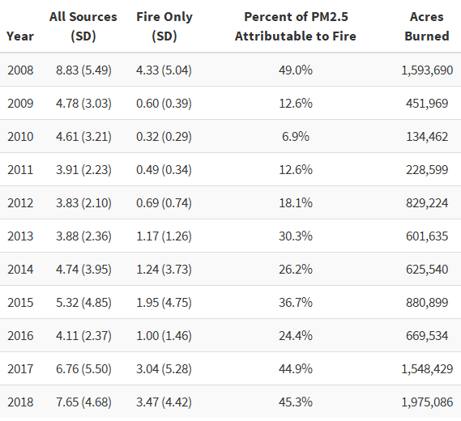
Preliminary Results: Model Validation
Fire-Only PM_{2.5} NAAQS Exceedances, 2008-2018
Source for acres burned: CAL FIRE, 2022
Quantification/Results
Notes:
Percent of PM2.5 attributable to fire > 44% for the high fire years of 2008, 2017, 2018

Slide 8
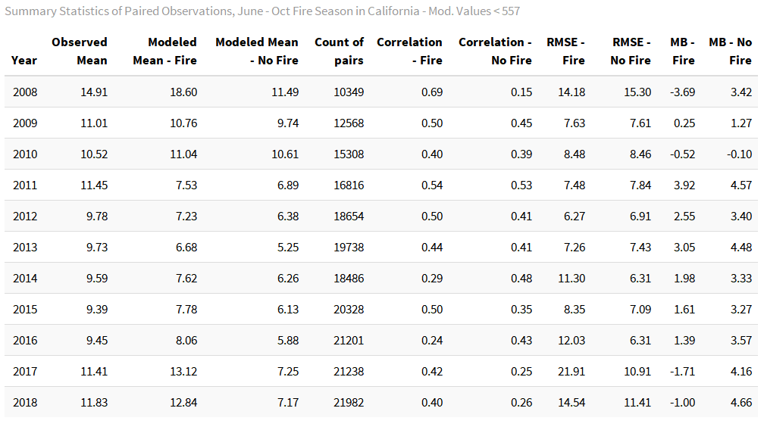
Preliminary Results: Model Validation
Fire Season (June – October) Statistics Summary
Quantification/Results
Notes:
These are results with modeled values >557 capped at 557 (the largest observed value in the validation dataset).

Slide 9
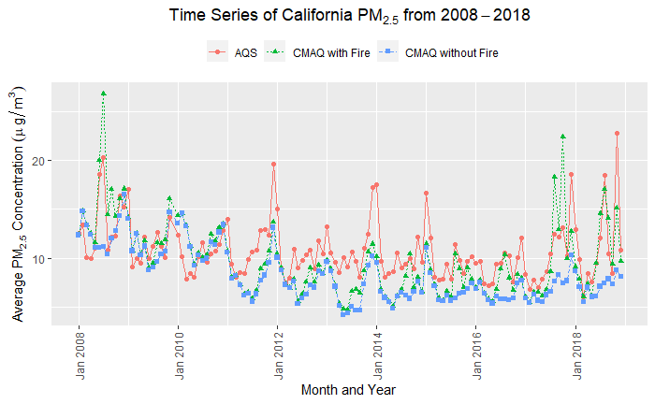
Preliminary Results: Model Validation
Quantification/Results
Notes:
Includes AQS, CASTNET, IMPROVE.

Slide 10
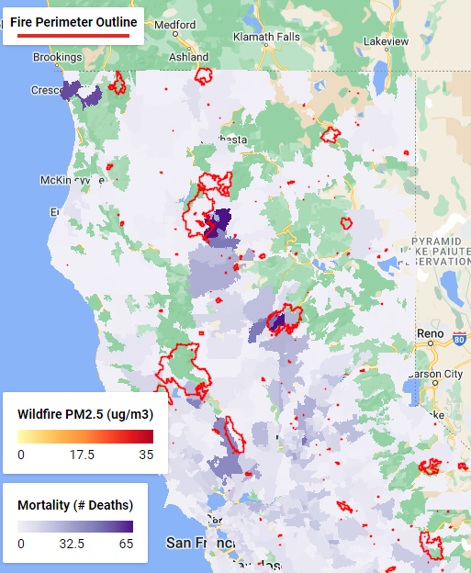
Preliminary Results: Mortality
Year | Total Mortality from Wildland Fire-PM_{2.5} | Valuation in Billions (2015 $)
2018 | 11,560 | $100.6
2017 | 11,390 | $99.1
2016 | 4,020 | $35.0
2015 | 3,210 | $28.0
2014 | 1,920 | $16.7
2013 | 3,070 | $26.7
2012 | 1,540 | $13.4
2011 | 1,360 | $11.9
2010 | 1,160 | $10.1
2009 | 2,020 | $17.6
2008 | 9,100 | $79.2
Quantification/Results
Notes:
Note: this slide is the results from the analysis without any outliers removed. We also conducted sensitivity analyses by removing the data points outside of the 99.9th percentile of the dataset. (example from that analysis: total mortality for 2018 is reduced to approx. 10,900)
On this slide we have some preliminary mortality results. We can see that for really high wildfire years, such as 2008, 2017 and 2018, with more than 1.5 million acres burned, the mortality and valuation impacts are very substantial at approximately 10,000 deaths valued at up to $100 billion dollars with respect to the VSL.
The map on the right shows the Northern California fires of 2018 and associated mortality impacts in purple. We can see the substantial impact from the Carr fire up north, the Camp Fire in the middle of the map and the Mendocino Complex on the left.

Slide 11
Methods: Environmental Benefits Mapping and Analysis Program - Community Edition (BenMAP-CE; Morbidity)
Tool Development
Notes:
For those not familiar, BenMAPs is an opensource program that relates air quality changes to human health benefits and estimates the number and economic value from health impacts resulting from changes in air pollution concentrations in case, from wildfire specific PM2.5. This tool was developed by the U.S. Environmental Protection Agency to analyze national-scale air quality policies and was used for this project to evaluate and calculate the health impacts from various wildfire management actions within the state.
The UCLA research team customized inputs using the 12 km PM2.5 CMAQ, the identified health functions from the extensive database in the literature review, and customized equations based on consultation with our contacts at the EPA.

Slide 12
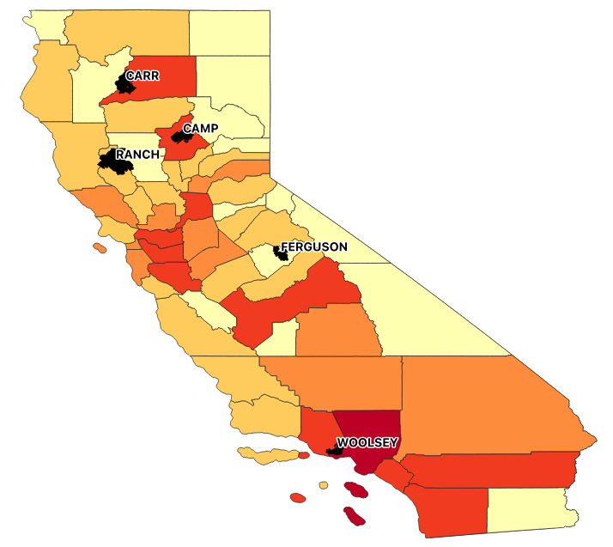
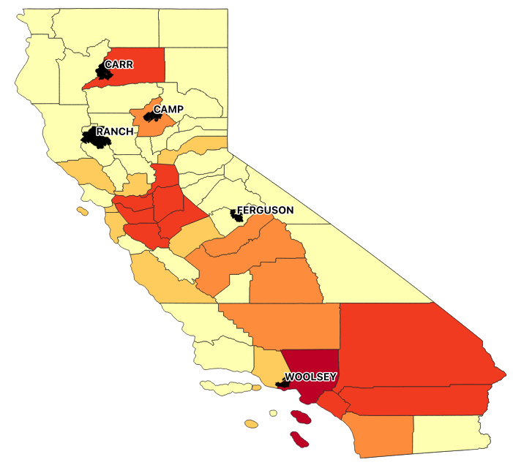
Preliminary Results: 2018 CMAQ PM_{2.5} Delta & Mortality and All-Cause Respiratory Related ER Visit Estimates (BenMAP-CE)
Estimated Mortality
(>24 years old)
Estimated Respiratory Morbidity (All-Cause)
Quantification/Results
Notes:
Right Map: health estimates for ER visits for all respiratory health outcomes which have a similar geographic pattern as mortality (left map).
Initial results for the year 2018:
2018 was a year with intensive wildfires throughout the state including the Ranch, Carr, and Camp fires in Northern California, the Ferguson fire in the central part of the state, and the Woolsey fire in Southern California. These wildfires had substantial geographic impacts with the Ranch fire alone burning over 400,000 acres.
This slide identifies those fires on a map of the state showing county-level borders. The graduated colors represent the estimated mortality and morbidity outcomes. The research team estimates large impacts in Southern California, specifically in LA county, home to ~10 million of the state residents and also large impacts in other southern California counties like Orange, Riverside, and San Diego, other heavily populated areas where higher density would translate to more people exposed. Throughout the entire state, the team calculated ~11,000 all-cause deaths associated with PM2.5 specific wildfire smoke using the BenMAPs program with a state-wide economic impact of over $90 billion dollars ($127-billion adjusted for 2022). Similar results are estimated for ER visits from all-cause respiratory morbidities with a statewide estimate of ~10,700 cases and a total economic impact of ~$10 million (~$11 million adjusted for 2022).

Slide 13
Preliminary BenMAPs Health Estimates (2008 -2018)
Quantification/Results
Notes:
Preliminary morbidity and mortality estimates calculated for 2008 – 2018.
Slide shows 11 years of the total number of morbidity and mortality estimates (via BenMAPs only) associated with wildland fire specific PM2.5 smoke.

Slide 14
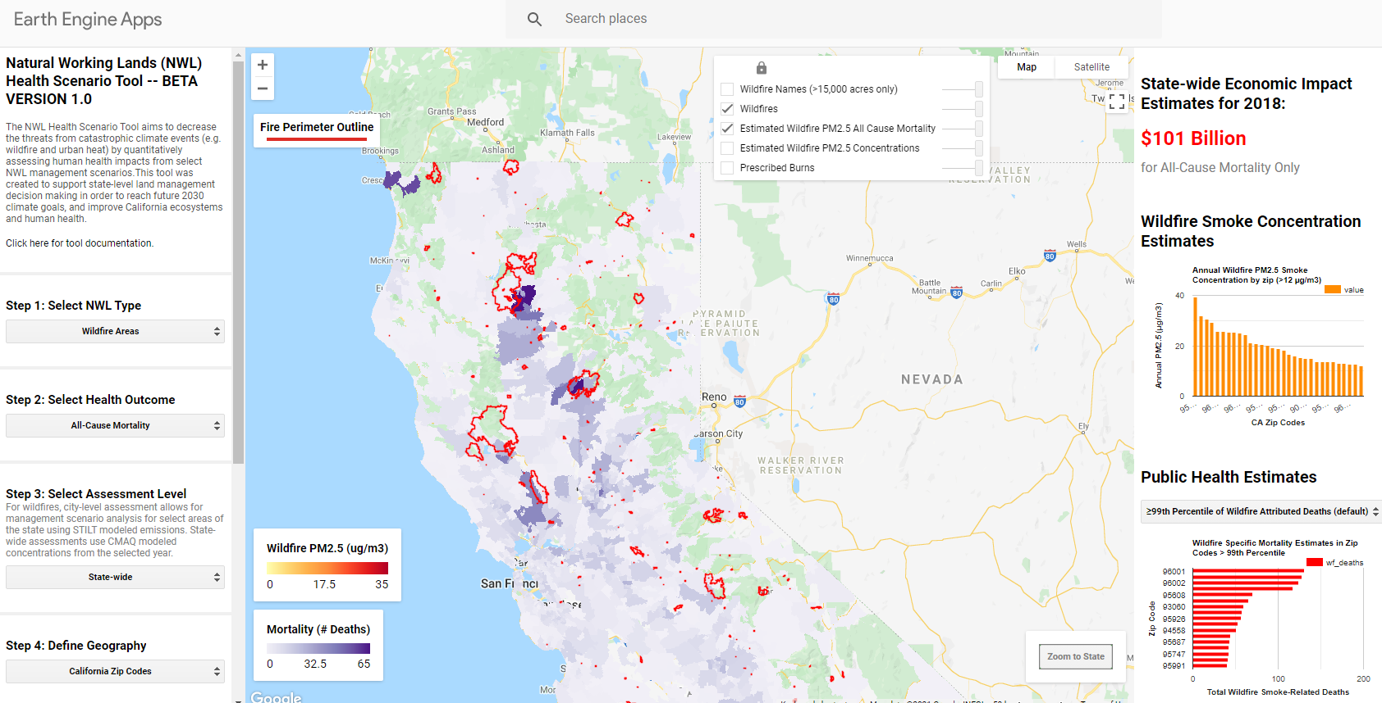
Preliminary Results: Google Earth Engine Tool
Quantification/Results
Notes:
We do already have the preliminary data and results up in the beta version of the health scenario tool we are building and this is a screenshot of that showing results for 2018. We are going to be adding in future scenarios, including the impacts of prescribed burning emissions specifically, using an adjoint modeling approach and applying modeled sensitivities.
People can email any questions about this process to Diane and Rachel

Slide 15
Next Steps and Future Research Directions
Conduct population equity analysis (assigning exposure concentrations and health outcomes to sociodemographic groups)
Building out Google Earth Engine tool for use with environmental justice and climate decision-making
Updating community vulnerability index to identify smoke PM_{2.5}-related vulnerabilities for communities located at the wildland-urban interface (WUI, Rappold 2017)
Conduct wildland fire-PM_{2.5} mortality and morbidity analysis for the continental United States
Notes:
In terms of next steps, we plan to conduct a population equity analysis using the CMAQ data and mortality impacts. We plan to explore several exposure trends, investigating questions such as – have any population groups have been disproportionately exposed to wildfire smoke? How have exposure trends changed over the eleven-year period with respect to exposed populations? We will also explore fire intensity trends; investigating these types of scenarios can highlight potential wildfire mitigation strategies to target through policies and programs.
Through two NASA grants (shown on the next two slides), we will continue to develop the online health scenario tool on Google Earth Engine, as well as update a previously developed CVI to identify smoke PM2.5 vulnerabilities for communities at the WUI.
We will also conduct a mortality and morbidity analysis of wildland fire PM2.5 impacts for the entire CONUS

Slide 16
DATA INTEGRATION PROJECT
Mapping Vulnerable Populations in California to Climate-Related Hazards
Thematic Focus:
PI/Co-I(s): Miriam Marlier¹, Michael Jerrett¹, Joe Wilkins², Paul English³
Institution(s): 1. UCLA, 2. Howard University, 3. Tracking California
EJ Community(ies): 3-5 community-based organizations identified by tool
Public Health
Air Quality
Wildfires
Climate Hazards
Extreme Heat
Urban Heat Islands
Project Summary: Climate-related hazards present a growing health threat for populations around the world. In the State of California, wildfire-contributed air pollution (“smoke pollution”) and extreme heat contribute to numerous adverse health outcomes. Certain communities are more vulnerable due to underlying health or socioeconomic characteristics, co-exposures, and/or lack of adaptive capacity. In this study, we will integrate Earth science information of smoke pollution and extreme heat with socioeconomic data to assess climate vulnerability. We will produce a publicly available tool for California for sustained use with environmental justice and climate decision-making activities in local communities and at the State level. Our study will address the following questions:
1. What is the distribution of individual and combined climate-related hazards over the past decade in California?
2. How do adverse climate-related health outcomes correlate with population vulnerability indicators?
3. How can geospatial data of climate-related vulnerability support environmental justice communities?
Satellite Earth Observations:
CALIPSO
MODIS
MISR
Supported by Earth observations:
CMAQ atmospheric model
GridMET
Geography:
CA

Slide 17
LANDSCAPE ANALYSIS
Assessment of Wildland Fire-Related Environmental Exposure Issues
Impacting Vulnerable Populations in California
PI/Co-I(s): Dr. Joseph L. Wilkins, and Dr. Miriam Marlier.
Institution(s): Howard University, UCLA
EJ Community(ies): California (African-American, Latinx, etc.)
Thematic Focus:
Project Summary:
One of the major target areas of the Federal EJ 2020 plan is to place emphasis on communities with poor air quality and low-income populations. Low-income populations are among those most at-risk to adverse health effects as they may experience disproportionately high exposures and may have limited adaptive capacity. As wildfire frequency and severity has increased in California and other fire prone regions around the world over the past several decades. This trend is projected to continue with future climate change. Communities located in the rural versus the urban wildland-urban interface (WUI) may be particularly vulnerable to smoke PM2.5 exposures due to their close proximity to fire sources, but there is limited research on health outcomes in these specific communities. This proposed study will examine smoke PM2.5 exposures in the WUI via a spatial community vulnerability index. Our study will integrate Earth science information and socioeconomic datasets to inform climate vulnerability assessments for environmental justice communities across the State of California. In this study, we propose integrating Earth science information and socioeconomic datasets to inform vulnerability assessments for environmental justice communities. At current, there is a lack of scientific data on the specific smoke PM2.5-related vulnerabilities for communities located at the WUI. Thus, the aims for our research are two-fold: (1) map a decadal distribution of exposures to smoke PM2.5 in California’s WUI areas, and (2) assess vulnerability characteristics and health implications due to these exposures.
Satellite Earth Observations:
MODIS
Suomi NPP (VIIRS)
Geography:
State of California
Notes:
NASA Socioeconomic Data and Applications Center (SEDAC)
Wildfire, climate hazards, public health and AQ,

Slide 18
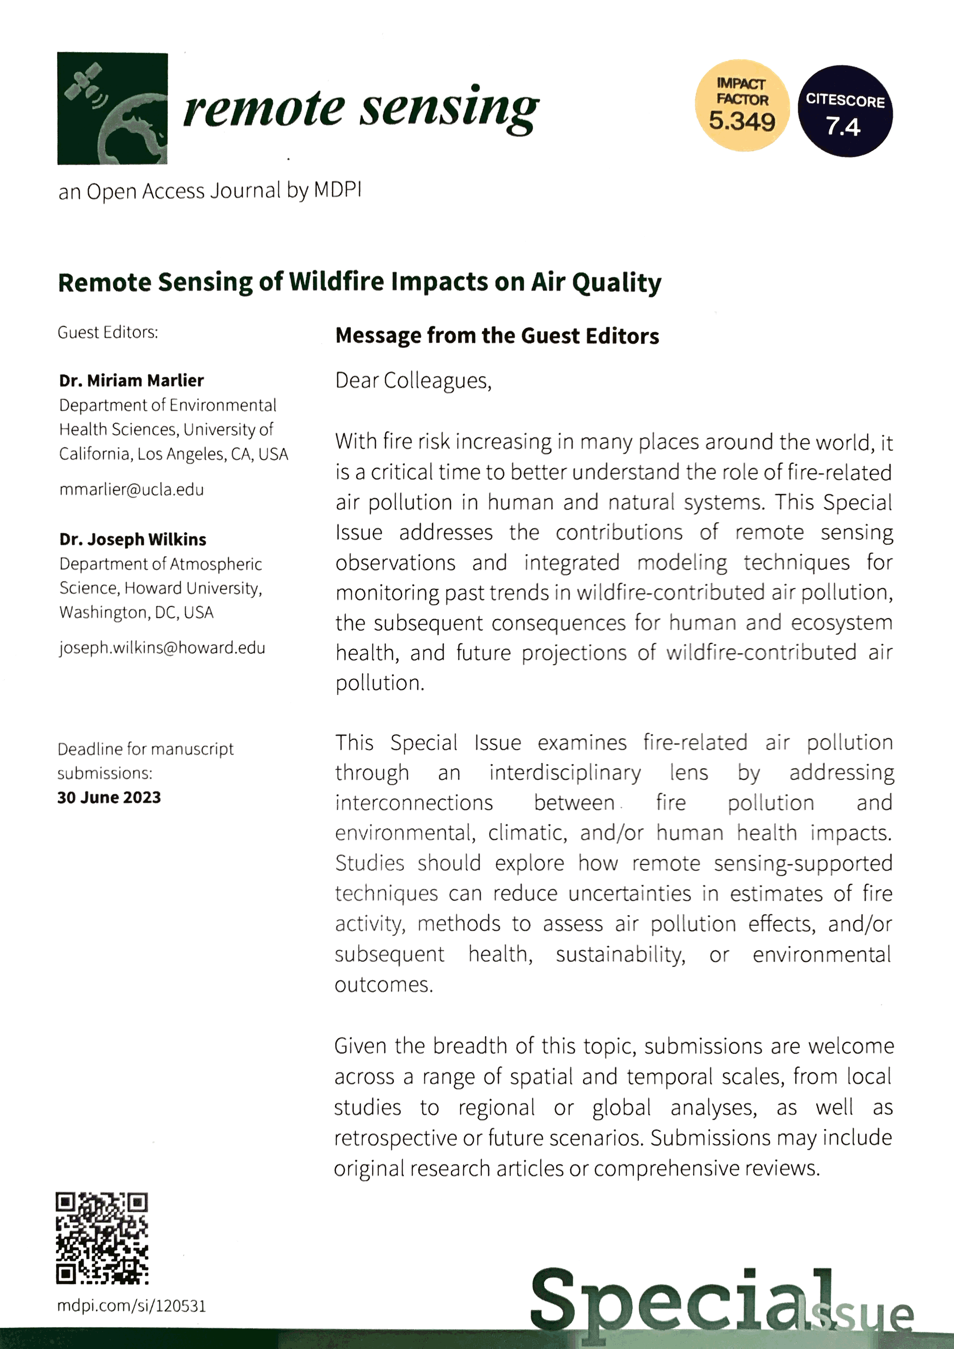
Special Issue
For more information Please reach out to me or speak to me here at this conference.
Deadline -- 30 June 2022
Please express your interest soon as possible to us!

Slide 19
Acknowledgements
California Air Resources Board (funding support – Grant #19RD015)
Cynthia Garcia
Bonnie Holmes-Gen
Barbara Weller
NASA (funding support – Grants # 80NSSC22K1480 & # 80NSSC22K1684 )
US Environmental Protection Agency
Neal Fann
Wyat Appel

Slide 20
References
Black, C., Tesfaigzi, Y., Bassein, J. A., & Miller, L. A. (2017). Wildfire smoke exposure and human health: Significant gaps in research for a growing public health issue. Environmental Toxicology and Pharmacology, 55, 186–195. https://doi.org/10.1016/j.etap.2017.08.022
Burke M, Driscoll A, Heft-Neal S, Xue J, Burney J, Wara M. The changing risk and burden of wildfire in the United States. Proc Natl Acad Sci USA. 2021 Jan 12;118(2):e2011048118.
CAL FIRE. Historical Wildfire Activity Statistics – Redbooks. 2022. https://www.fire.ca.gov/stats-events/
Cascio WE. Wildland fire smoke and human health. Science of the total environment. 2018 May 15;624:586–95.
Doubleday A, Schulte J, Sheppard L, Kadlec M, Dhammapala R, Fox J, et al. Mortality associated with wildfire smoke exposure in Washington state, 2006–2017: a case-crossover study. Environmental Health. 2020 Jan 13;19(1):4.
Liu JC, Pereira G, Uhl SA, Bravo MA, Bell ML. A systematic review of the physical health impacts from non-occupational exposure to wildfire smoke. Environ Res. 2015 Jan;136:120–32.
Orellano P, Reynoso J, Quaranta N, Bardach A, Ciapponi A. Short-term exposure to particulate matter (PM10 and PM2.5), nitrogen dioxide (NO2), and ozone (O3) and all-cause and cause-specific mortality: Systematic review and meta-analysis. Environ Int. 2020 Sep;142:105876.
Pope CA 3rd, Lefler JS, Ezzati M, Higbee JD, Marshall JD, Kim S-Y, et al. Mortality Risk and Fine Particulate Air Pollution in a Large, Representative Cohort of U.S. Adults. Environ Health Perspect. 2019/07/24 ed. 2019 Jul;127(7):77007–77007.
Radeloff VC, Helmers DP, Kramer HA, Mockrin MH, Alexandre PM, Bar-Massada A, et al. Rapid growth of the US wildland-urban interface raises wildfire risk. Proc Natl Acad Sci USA. 2018 Mar 27;115(13):3314.
Rappold, A. G., Reyes, J., Pouliot, G., Cascio, W. E., & Diaz-Sanchez, D. Community vulnerability to health impacts of wildland fire smoke exposure. Environmental Science & Technology. 2017;51(12), 6674-6682.
Reid CE, Brauer M, Johnston FH, Jerrett M, Balmes JR, Elliott CT. Critical Review of Health Impacts of Wildfire Smoke Exposure. Environmental Health Perspectives. 2016 Sep 1;124(9):1334–43.
Westerling AL, Hidalgo HG, Cayan DR, Swetnam TW. Warming and Earlier Spring Increase Western U.S. Forest Wildfire Activity. Science. 2006 Aug 18;313(5789):940.
Wilkins JL, Pouliot G, Foley K, Appel W, Pierce T. The impact of US wildland fires on ozone and particulate matter: a comparison of measurements and CMAQ model predictions from 2008 to 2012. Int J Wildland Fire. 2018;27(10):684–98.

Slide 21
Thank you!
Contact:
Principal Investigator, Dr. Joseph Wilkins: joseph.wilkins@howard.edu
Diane Garcia-Gonzales: dgonzales98@ucla.edu
Rachel Connolly: rachelconnolly@g.ucla.edu
Principal Investigator, Dr. Michael Jerrett: mjerrett@ucla.edu

