Slide 1
Improving the Computational Performance of Air Quality Models with Machine Learning Tools
Obin Sturm and Anthony Wexler, University of California Davis
21st Annual CMAS Conference
UNC Chapel Hill

Slide 2
Introduction and Definitions
Machine Learning (ML) used in many ways in air quality modeling.
This talk is about using ML for “Operator Replacement”.
Definition of Operator: A computational component of an air quality model
$$\frac{∂C}{∂t}=transport+photochemical reactions+aerosol dynamics=\sum{{\left.\frac{∂C}{∂t}\right]}_{i}}$$
.
$$∆C=\int_{t}^{t+∆t}{\frac{∂C}{∂t}dt}=\sum_{i}{\int_{t}^{t+∆t}{{\left.\frac{∂C}{∂t}\right]}_{i}dt}}=\sum_{i}{∆C_{i}}$$
$∆t$ is the operator splitting time step
$∆C_{i}$ is each operator’s change to the concentration vector

Slide 3
Introduction and Definitions
Definition of Operator Replacement: Mercilessly ripping the physics/chemistry –based code out of the model and replacing it with code that has learned the same input-output relationship.
Why do such a thing?
Computational speed
ML algorithms can be much faster than the physchem-based code
Even if they’re not, some can work on GPU, which scream
Might they even get the physics and chemistry as good or better? We’ll see.
Why avoid this?
ML hides the physics and chemistry in a black box
How can you be sure you covered the input-output space sufficiently well that there are not unforeseen troubles within this space

Slide 4
Approach
Find a computationally intensive part of the air quality model
Identify the range of input variables relevant to air quality modeling
Obtain training and test cases
Might take that time consuming code and run lots of test cases
Might run an air quality model that uses this code and siphon off input-output cases
Train an ML model on a fraction of these cases
Reserve the rest for testing
Test the ML model to characterize its accuracy and speed
A note on speed improvement
Wall clock time not computational time is the key criterion
Parallelization may mean that data transport between CPUs is more important to wall clock than computational time

Slide 5
Example: Aerosol Thermodynamics
Computationally intensive
What do you really need from thermodynamics?
Vapor pressure of volatile species for condensation/evaporation: ammonia, nitric acid, hydrochloric acid, some organics
Water content
Prior work is on electrolytes
Thermodynamically-relevant inputs
Mole fraction of cations, mole fraction of anions
Temperature, humidity
How well does it do?

Slide 6
Example: Aerosol Thermodynamics
NH₃
HNO₃

Slide 7
Example: Aerosol Thermodynamics
Speed improvement 4-1000 times
Depends on circumstances
High humidity, not phase change, fast
Low humidity, phase changes, slow
Acidic aerosol less likely to phase change, fast
Only 4-5 hidden layers, depending
Why do the figures looks so primitive?
Potukuchi and Wexler, Predicting vapor pressures using Neural Networks, Atmos. Environ. 31:741-753, 1997
H₂O

Slide 8
Example: Photochemical and Aerosol ML Models
Goals
Develop a ML framework that conserves mass to machine precision
Don’t we wish our chemistry models could do that?!?
Use chemically informed inputs
Strategy for conserving mass
Have the ML algorithm learn the fluxes of atoms between species instead of learning the concentration in/out relationship
But we only know the concentration in/out relationship; we don’t know the atoms fluxes
Stoichiometry to the rescue

Slide 9
Example: Photochemical and Aerosol ML Models

Slide 10
Example: Photochemical and Aerosol ML Models
Simple photochemical model
Gas Phase
Section 1
Section 2
Section 3
Section 4
Section 5
Section 6
Section 7
Section 8
Sectional aerosol model

Slide 11
Example: Photochemical and Aerosol ML Models

Slide 12
Example: Photochemical and Aerosol ML Models
Carbon
Nitrogen
Atom Conservation Test

Slide 13
Example: Volatility Basis Set
Goals
Reduce the number of species being carried around
Why?
Hurts both computational and wall clock time (advection clog)
Strategy
Find a set of species, actual or contrived, that represent the dynamics of the system
Hopefully, linear manifold to still use mass conservation framework

Slide 14
Example: Volatility Basis Set
Approach
Atmospheric dynamics can be represented by fewer species than we use
Use ML methods to find a smaller set of pseudo-species that represent the system dynamics
A linear combination of these pseudo-species gives the actual species – a linear manifold
Linear Dimension Reduction
Linear Dimension Expansion
Physics and Chemistry
Reduced Species Set at t
Reduced Species Set at t+Δt
Full Species Set
Full Species Set

Slide 15
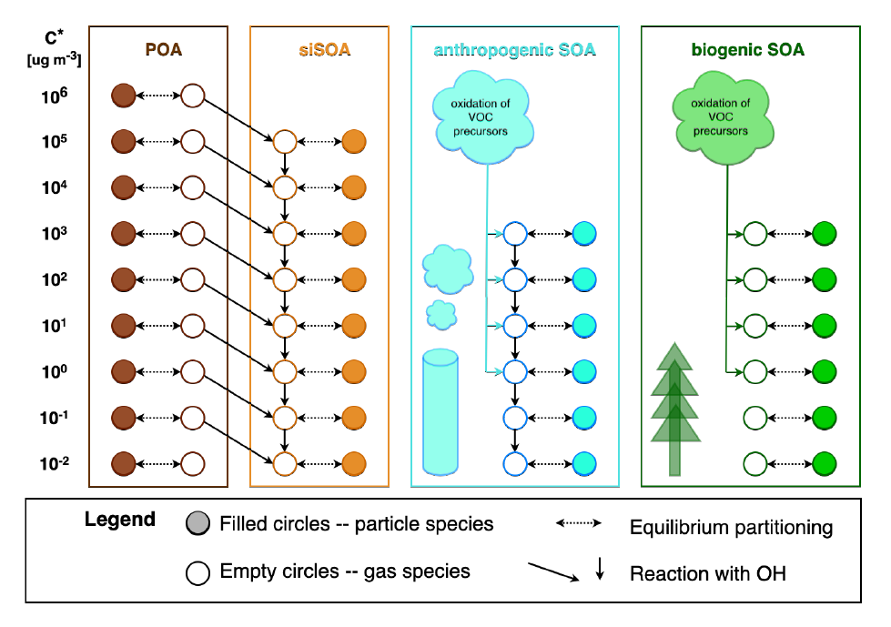
Example: Volatility Basis Set
VBS approach in LOTOS-EUROS v2.2.1
58 species (siSOA is SOA from semi- and intermediate volatility VOCs)

Slide 16
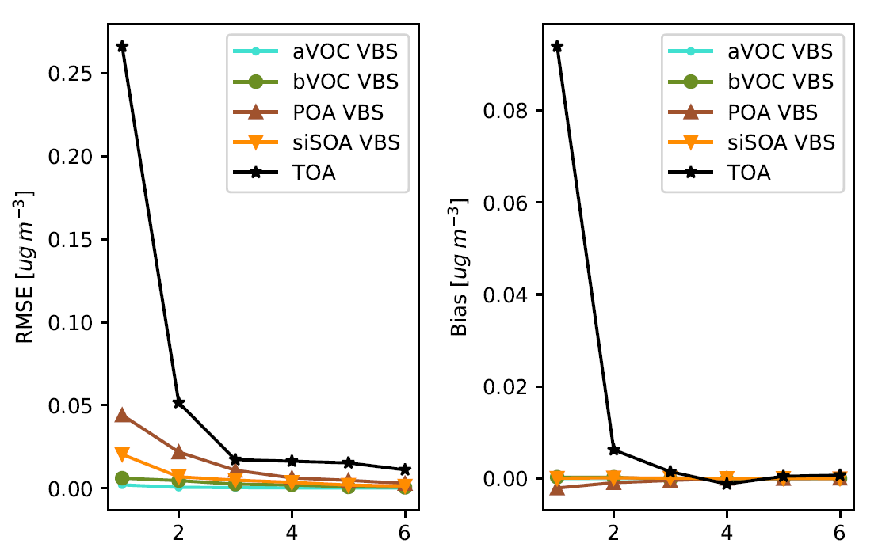
Example: Volatility Basis Set
Use non-negative matrix factorization to find pseudo-species
58 species -> 3 pseudo species
1/20 the species to advect
large improvement in wall clock time
Number of Pseudo-Species
Number of Pseudo-Species

Slide 17
Recent Publications
Geiss, A., Silva, S. J., & Hardin, J. C. (2022). Downscaling atmospheric chemistry simulations with physically consistent deep learning. Geoscientific Model Development, 15(17), 6677–6694. https://doi.org/10.5194/gmd-15-6677-2022
Harder, P., Watson-Parris, D., Stier, P., Strassel, D., Gauger, N. R., & Keuper, J. (2022). Physics-Informed Learning of Aerosol Microphysics (arXiv:2207.11786). arXiv. http://arxiv.org/abs/2207.11786
Keller, C. A., & Evans, M. J. (2019). Application of random forest regression to the calculation of gas-phase chemistry within the GEOS-Chem chemistry model v10. Geoscientific Model Development, 12(3), 1209–1225. https://doi.org/10.5194/gmd-12-1209-2019
Kelp, M. M., Jacob, D. J., Kutz, J. N., Marshall, J. D., & Tessum, C. W. (2020). Toward Stable, General Machine-Learned Models of the Atmospheric Chemical System. Journal of Geophysical Research: Atmospheres, 125(23), e2020JD032759. https://doi.org/10.1029/2020JD032759
Müller, E. H. (2022). Exact conservation laws for neural network integrators of dynamical systems (arXiv:2209.11661). arXiv. https://doi.org/10.48550/arXiv.2209.11661
Richter-Powell, J., Lipman, Y., & Chen, R. T. Q. (2022). Neural Conservation Laws: A Divergence-Free Perspective (arXiv:2210.01741). arXiv. http://arxiv.org/abs/2210.01741
Silva, S. J., Burrows, S. M., Evans, M. J., & Halappanavar, M. (2021a). A Graph Theoretical Intercomparison of Atmospheric Chemical Mechanisms. Geophysical Research Letters, 48(1), e2020GL090481. https://doi.org/10.1029/2020GL090481
Silva, S. J., Ma, P.-L., Hardin, J. C., & Rothenberg, D. (2021b). Physically regularized machine learning emulators of aerosol activation. Geoscientific Model Development, 14(5), 3067–3077. https://doi.org/10.5194/gmd-14-3067-2021
Sturm, P. O., Manders, A., Janssen, R., Segers, A., Wexler, A. S., & Lin, H. X. (2022). Advecting Superspecies: Efficiently Modeling Transport of Organic Aerosol with a Mass-Conserving Dimensionality Reduction Method. https://eartharxiv.org/repository/view/3430/
Sturm, P. O., & Wexler, A. S. (2020). A mass- and energy-conserving framework for using machine learning to speed computations: A photochemistry example. Geoscientific Model Development, 13(9), 4435–4442. https://doi.org/10.5194/gmd-13-4435-2020
Sturm, P. O., & Wexler, A. S. (2022). Conservation laws in a neural network architecture: Enforcing the atom balance of a Julia-based photochemical model (v0.2.0). Geoscientific Model Development, 15(8), 3417–3431. https://doi.org/10.5194/gmd-15-3417-2022

Slide 18
Conclusions
Field is in its infancy
Only 25 years since our 1997 paper!
Lots of potential to dramatically improve speed of models
And even more opportunities to screw it up!
Could we actually do better than physics/chemistry based models?
How would we know?
Smaller grid sizes possible
Better physics/chemistry parameterizations
What will those creative minds think of next?

