Slide 1
2018 AirToxScreen: EPA’s Screening-Level Assessment Tool for Outdoor Air Toxics
Caroline Farkas and Matthew Woody, U.S. EPA
Art Diem, Rod Truesdell, James Thurman, Sharon Phillips, Alison Eyth,
Julia Black, Doug Solomon, Jeanette Reyes, Christine Allen, James Beidler
October 18, 2022

Slide 2
Overview
Background
Emissions & Multi-Pollutant Platform
Modeling
2018 AirToxScreen Results
AirToxScreen Mapping Tool
Other uses of AirToxScreen
The future of AirToxScreen

Slide 3
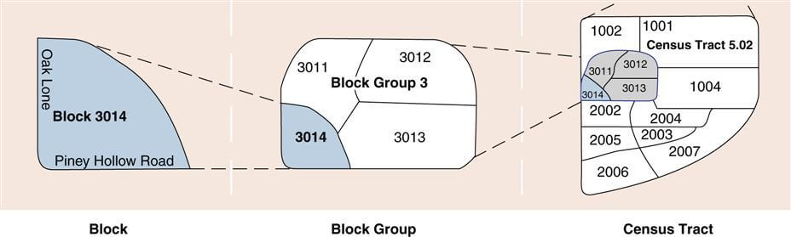
AirToxScreen: Background
EPA’s AirToxScreen replaces NATA, EPA’s screening-level national risk assessment for air toxics
AirToxScreen provides annual screening-level estimates of the risk of cancer and chronic noncancer hazard indices from inhalation of more than 100 air toxics.
Estimates and concentrations are based on EPA’s NEI and Multi-Pollutant Platform
Risk estimates are at the census tract level assuming a 70-year exposure

Slide 4
AirToxScreen: Emissions & Multi-Pollutant Platform
Multi-Pollutant Platform
2018 NEI
Biogenics
Fires
2018 CMAQ Modeling
HYBRID Approach
Risk Calculation and Assessment
Point Sources
Mobile Sources
2018 AERMOD Modeling
Non-Point Sources
2018 SLT Point Source Review
Uses National Emissions Inventory and the Multi-Pollutant Platform
  Emissions: Reflect all outdoor sources; uses 2018 Emissions Modeling Platform
  Air quality modeling: Uses both photochemical and dispersion models to predict concentrations
Initial AirToxScreen release reflected a snapshot of 2017 emissions with most recent release reflecting 2018 emissions.

Slide 5
AirToxScreen: Photochemical Air Quality Modeling
Photochemical Model: CMAQ v.5.3.2
  Meteorology
    CONUS: WRF ARW v3.8
    Non-CONUS (3-km Hawaii and Puerto Rico/Virgin Islands and the 9-km Alaska domains): WRF ARW 4.1.1
  Configuration
    Base year run (primary and secondary annual average concentrations)
    Zero-out run (for biogenics and fires, primary annual average concentrations)
    Ramp-up period of 10 days
    Vertical layers from surface to 50 mb
  Initial and Boundary Conditions
    GEOS-Chem v.12.0.1
    2 x 2.5-degree resolution
  58 air toxics modeled
CMAQ Modeling Domain Configurations
Domain | Map Projection | Grid Resolution | Coordinate Center | True Latitudes | Dimensions & Vertical Extent
Continental US | Lambert Conformal | 12 km | 97 W, 40 N | 33 and 45 N | 459 x 299 x 35
Alaska | Lambert Conformal | 9 km | 63 N, 155 W | 60 and 70 N | 312 x 252 x 35
Hawai’i | Lambert Conformal | 3 km | 21 N, 157 W | 19 and 22 N | 225 x 201 x 35
Puerto Rico / Virgin Islands | Lambert Conformal | 3 km | 18 N, 66 W | 17 and 19 N | 150 x 150 x 35
Notes:
Weather Research and Forecasting Model – Advanced Research WRF
GEOS-Chem MET: Goddard Earth Observation System Forward Product (GEOS_FP), 72 layers

Slide 6
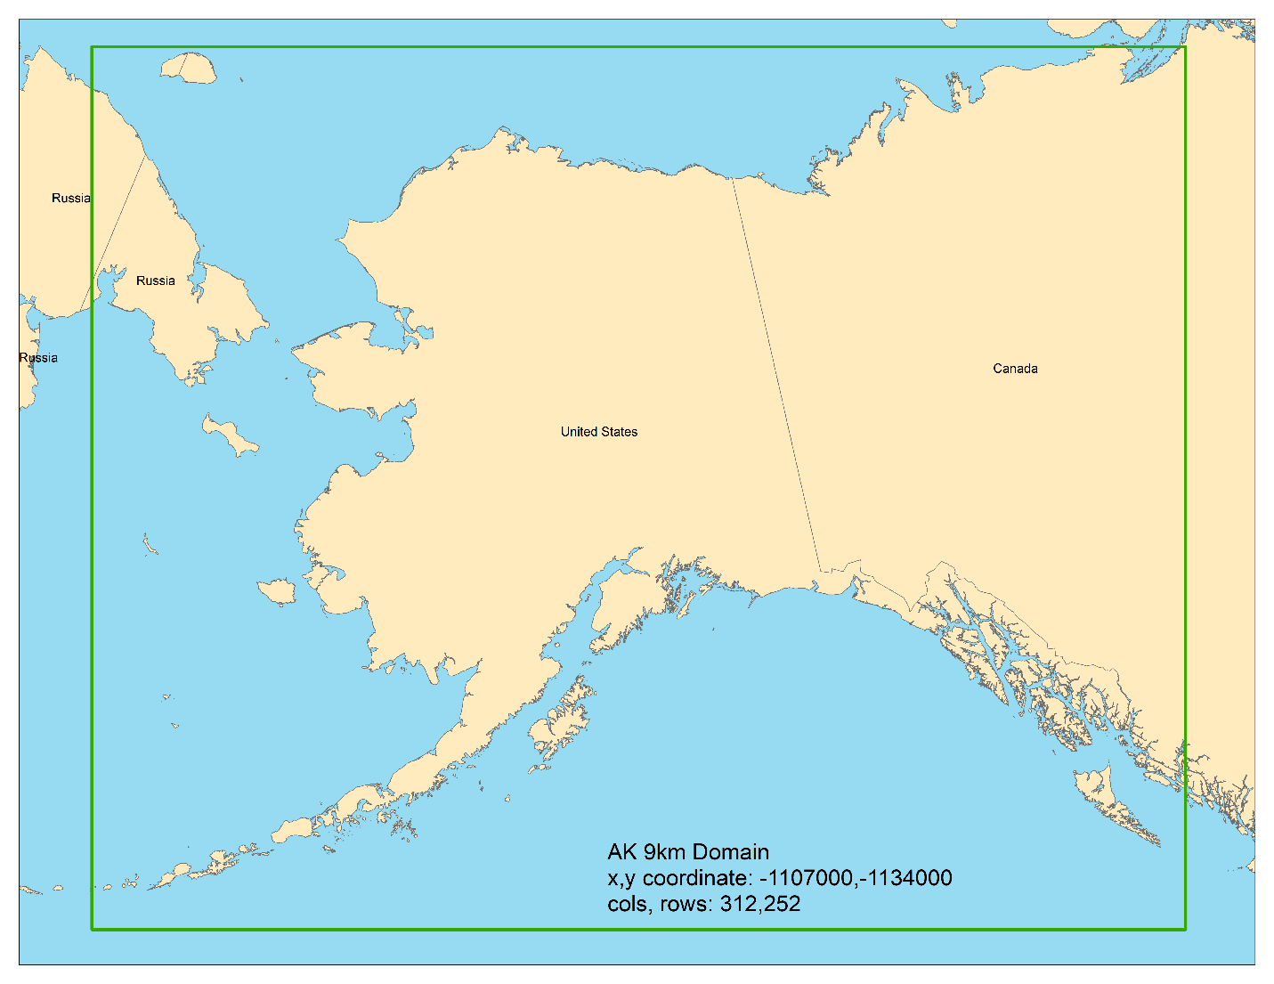
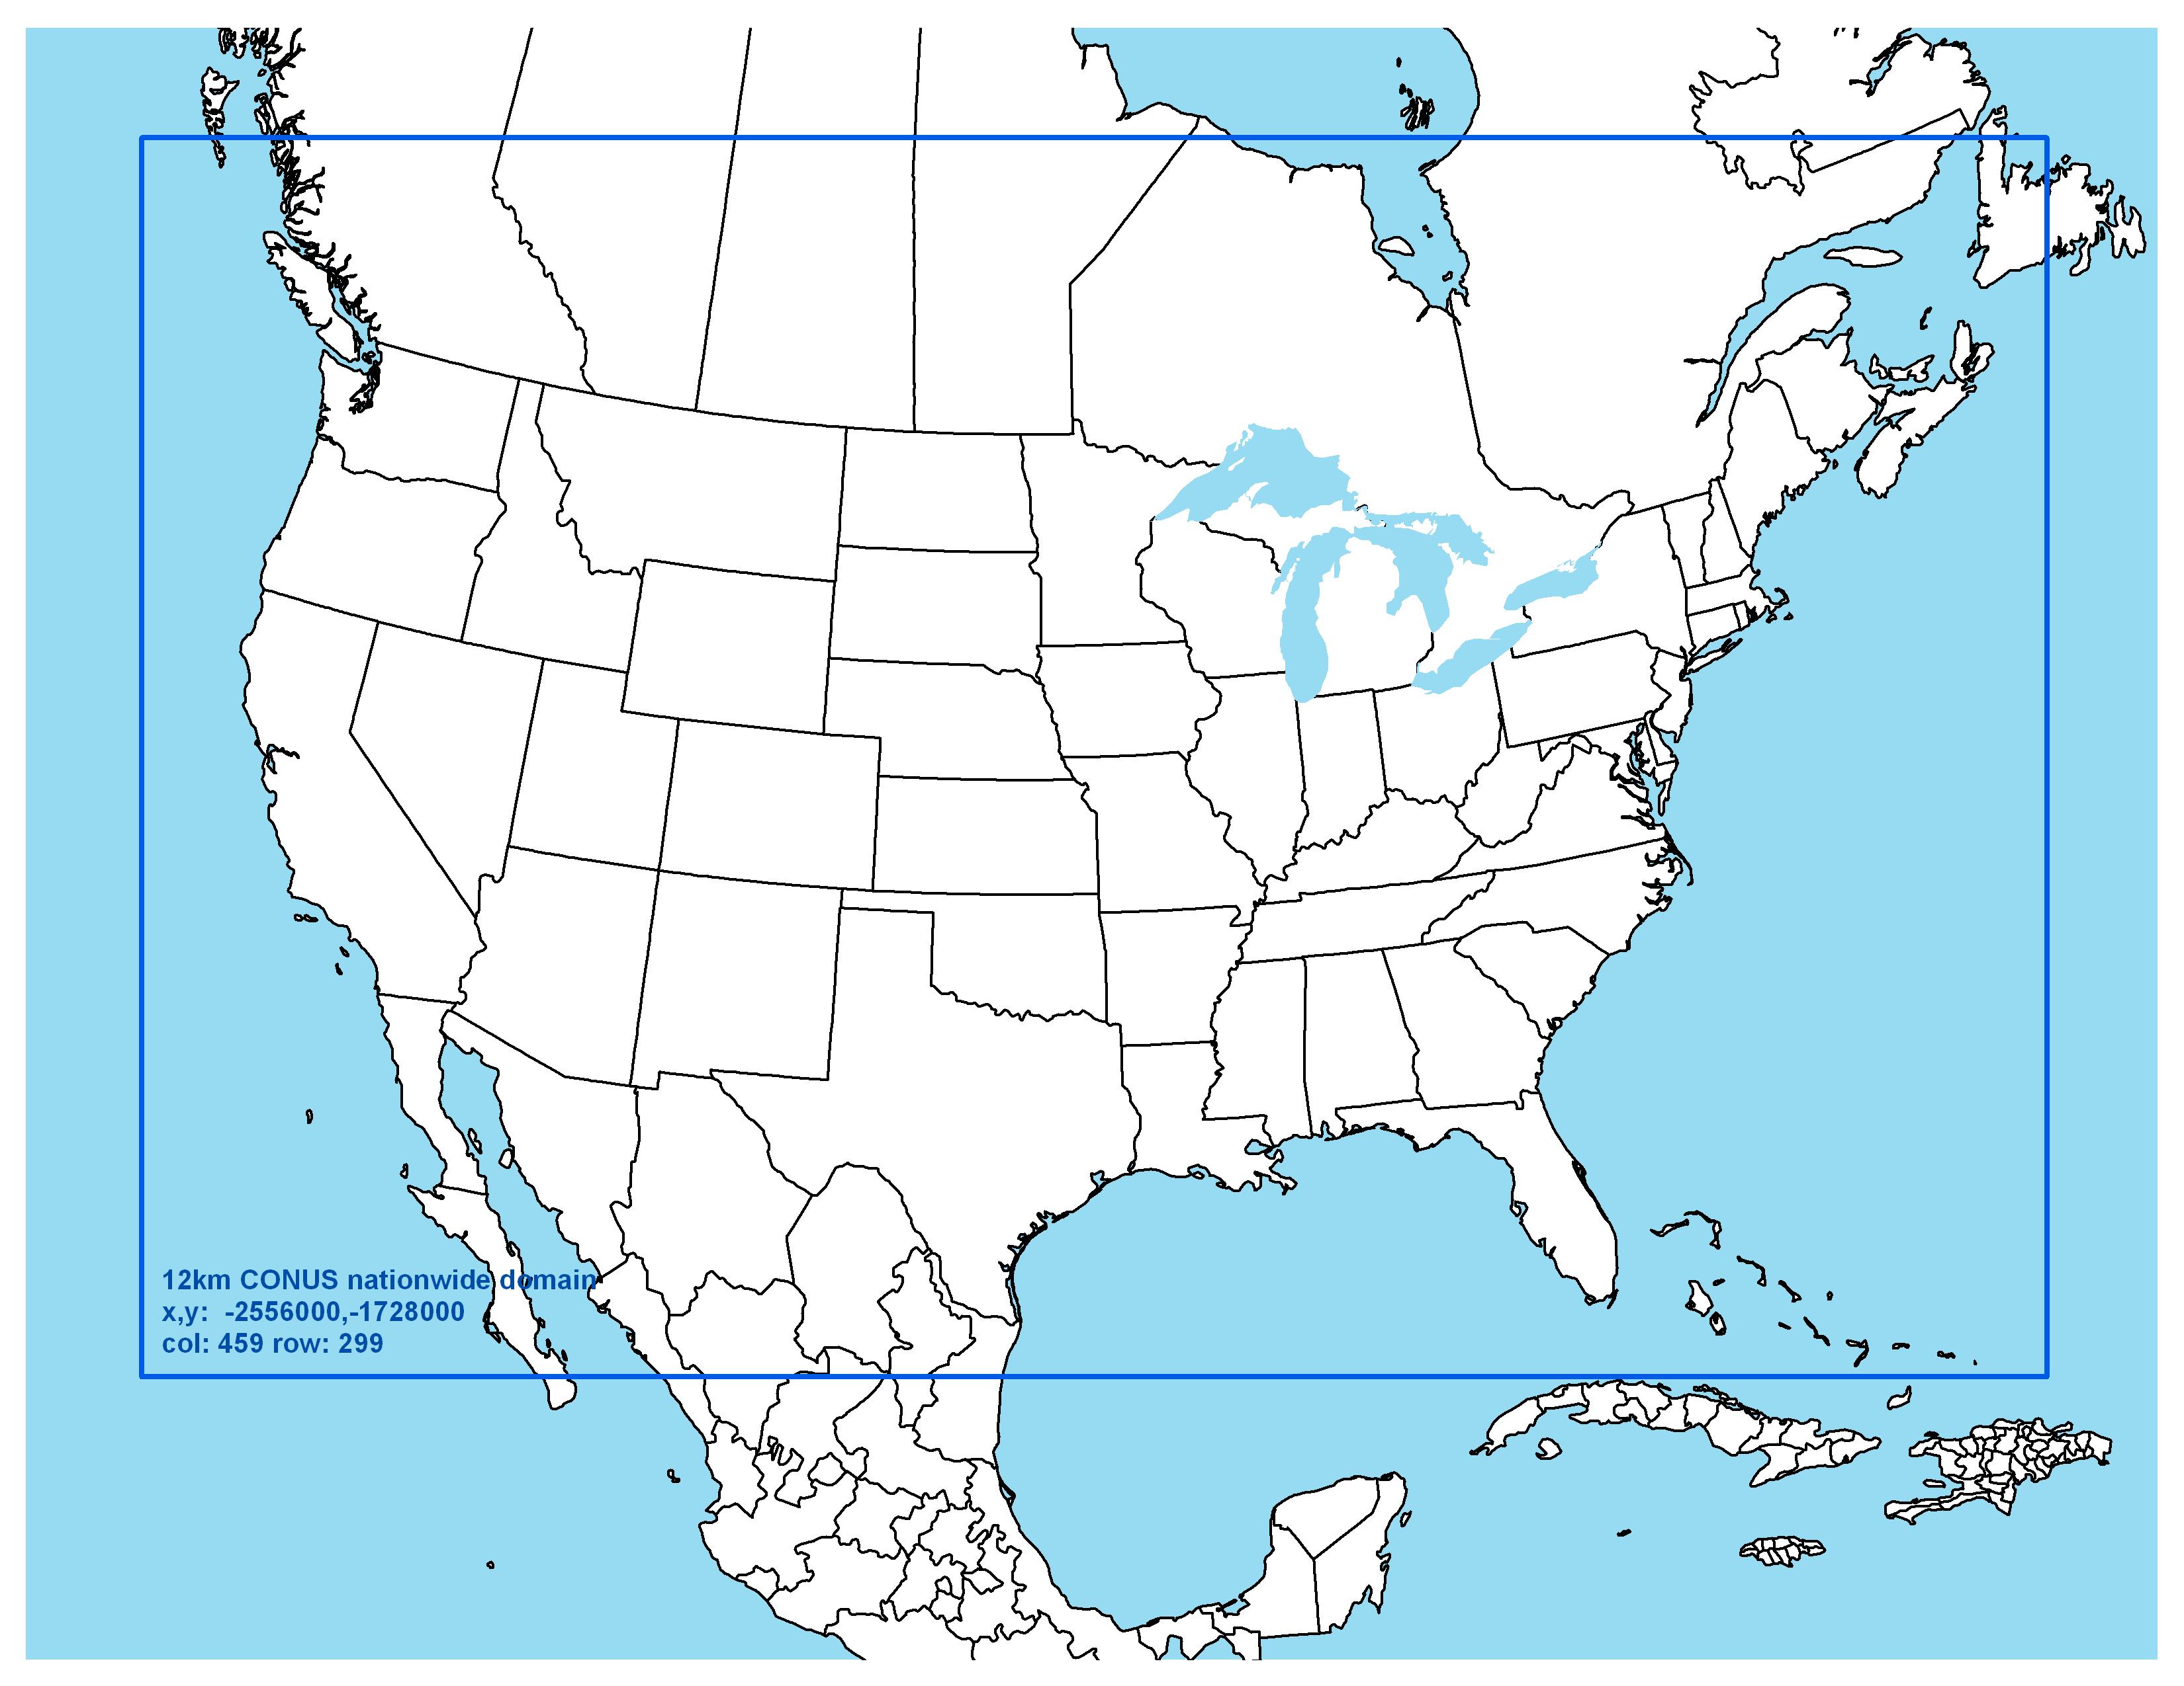
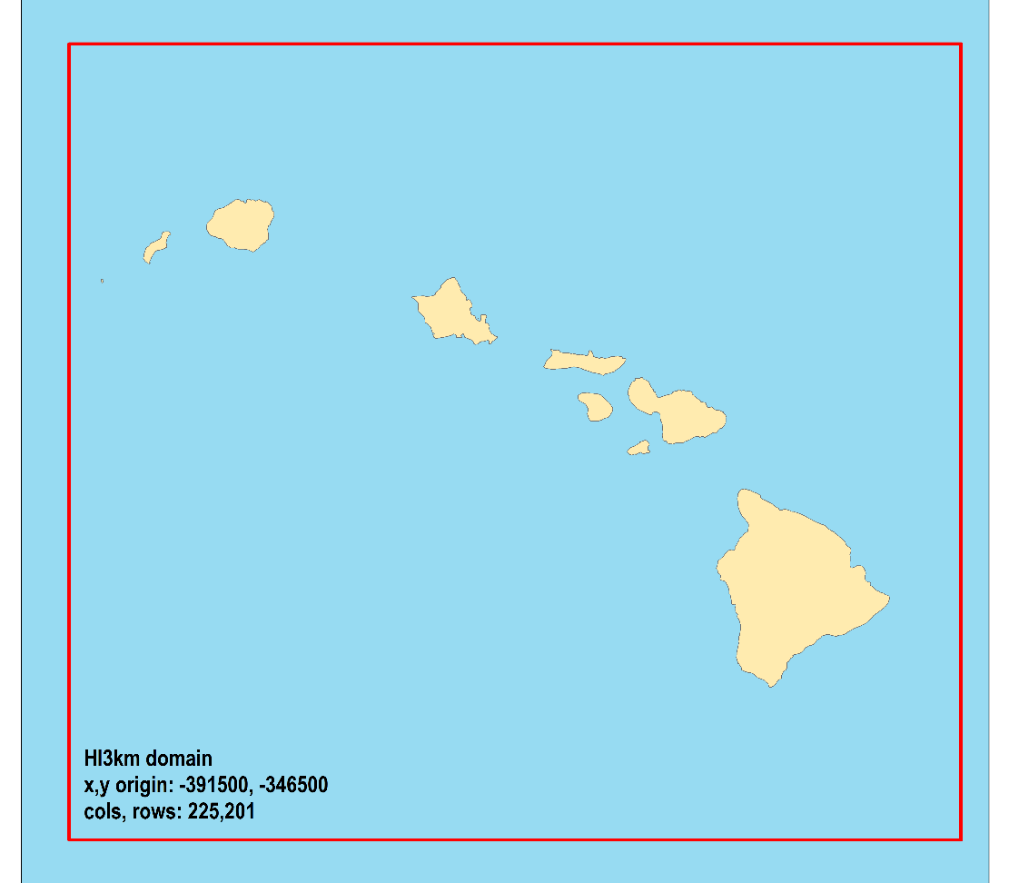
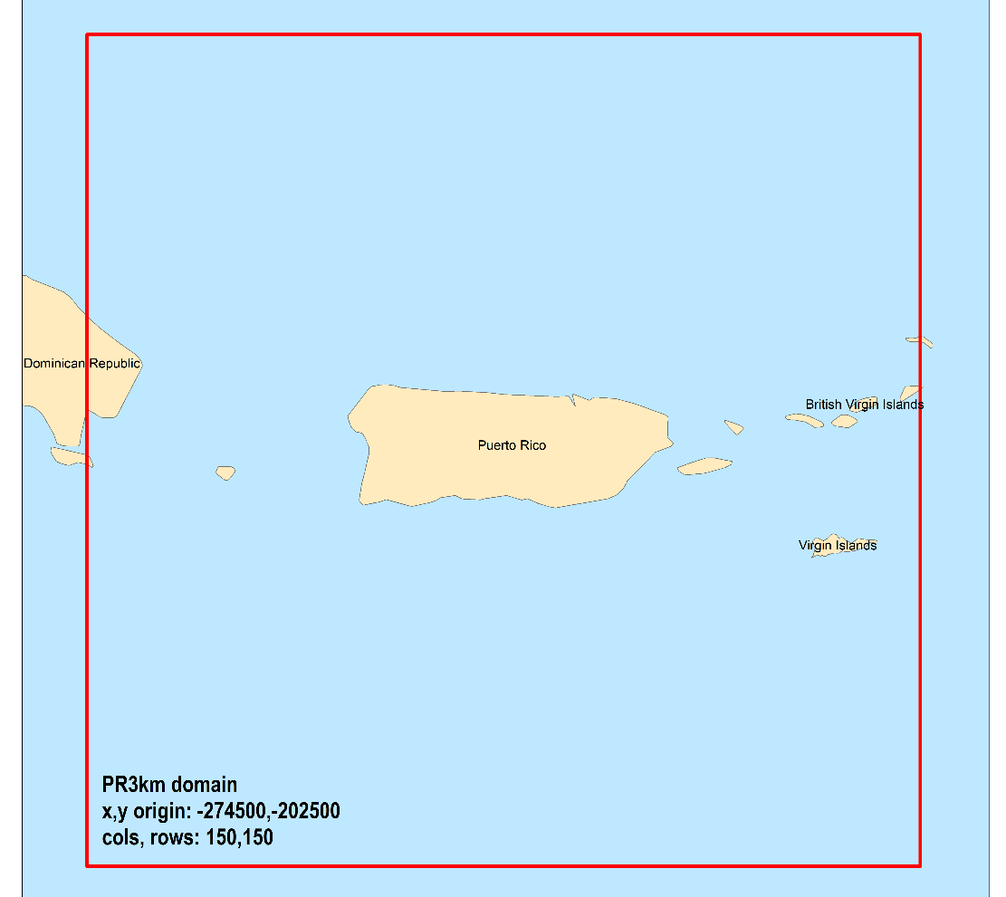
Multi-Pollutant Platform Domains
CONUS Domain
Non-CONUS Domains

Slide 7
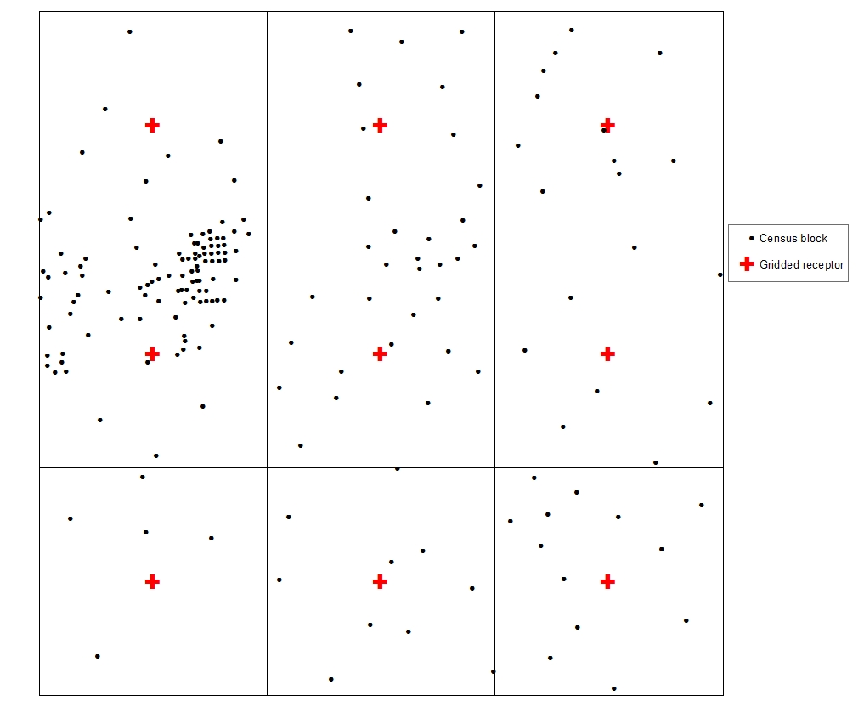
AirToxScreen: Dispersion Air Quality Modeling
Dispersion Model: AERMOD v.21112
  Emissions sources: point, nonpoint, onroad and nonroad (fires and biogenics excluded)
  Receptor placement
    Equally spaced “gridded” receptors
      CONUS: 1 km in highly populated areas, 4 km otherwise
      Non-CONUS: 1 km in Hawaii, Puerto Rico, Virgin Islands; 3 km in Alaska
    Populated census-block centroid receptors
    Monitoring site receptors
  All available air toxics modeled

Slide 8
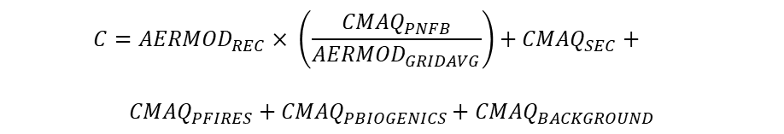
AirToxScreen: Hybrid Approach to Generate Concentrations
Hybrid Model
  Combines photochemistry, long range transport, fires, secondary, and biogenics from CMAQ with near-field gradients of AERMOD
  Use CMAQ zero out runs to calculate anthropogenic, fires, secondary, and biogenics concentrations
  Initially demonstrated by Detroit multi-pollutant project and has since been applied at national level since 2011 NATA
$$C={AERMOD}_{REC}× \left(\frac{{CMAQ}_{PNFB}}{{AERMOD}_{GRIDAVG}}\right)+{CMAQ}_{SEC}+$$
$${CMAQ}_{PFIRES}+{CMAQ}_{PBIOGENICS}+{CMAQ}_{BACKGROUND}$$

Slide 9
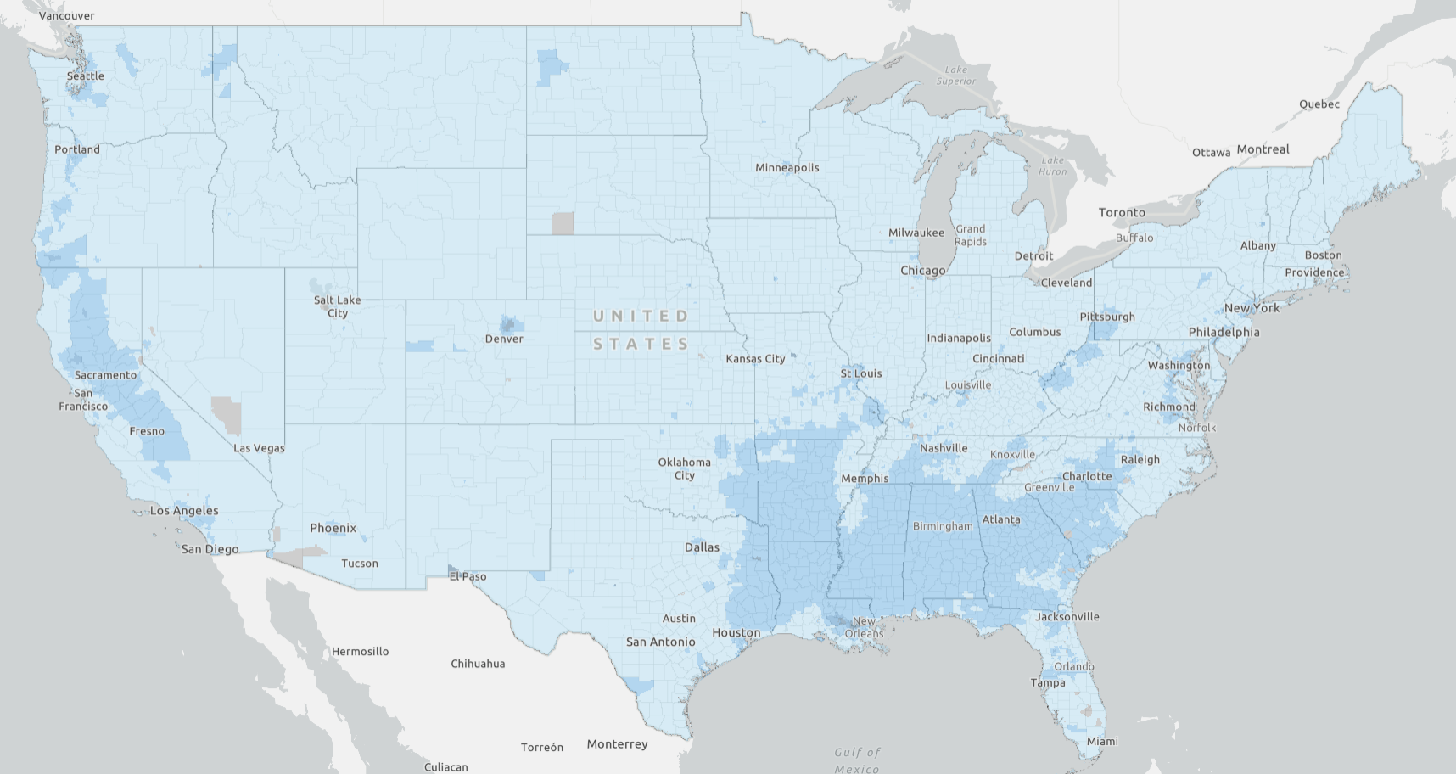
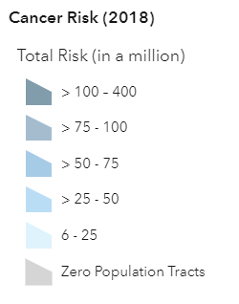
Overview of Cancer and Non-Cancer Risk Results
Cancer risks
  National average cancer risk is 20-in-1 million
  72 census tracts with cancer risks ≥100-in-1 million across 24 areas of the country
Respiratory chronic noncancer hazard index (HI)
  National average HI is 0.3
  130 tracts with a respiratory
  HI > 1 across 25 areas of the
  country

Slide 10
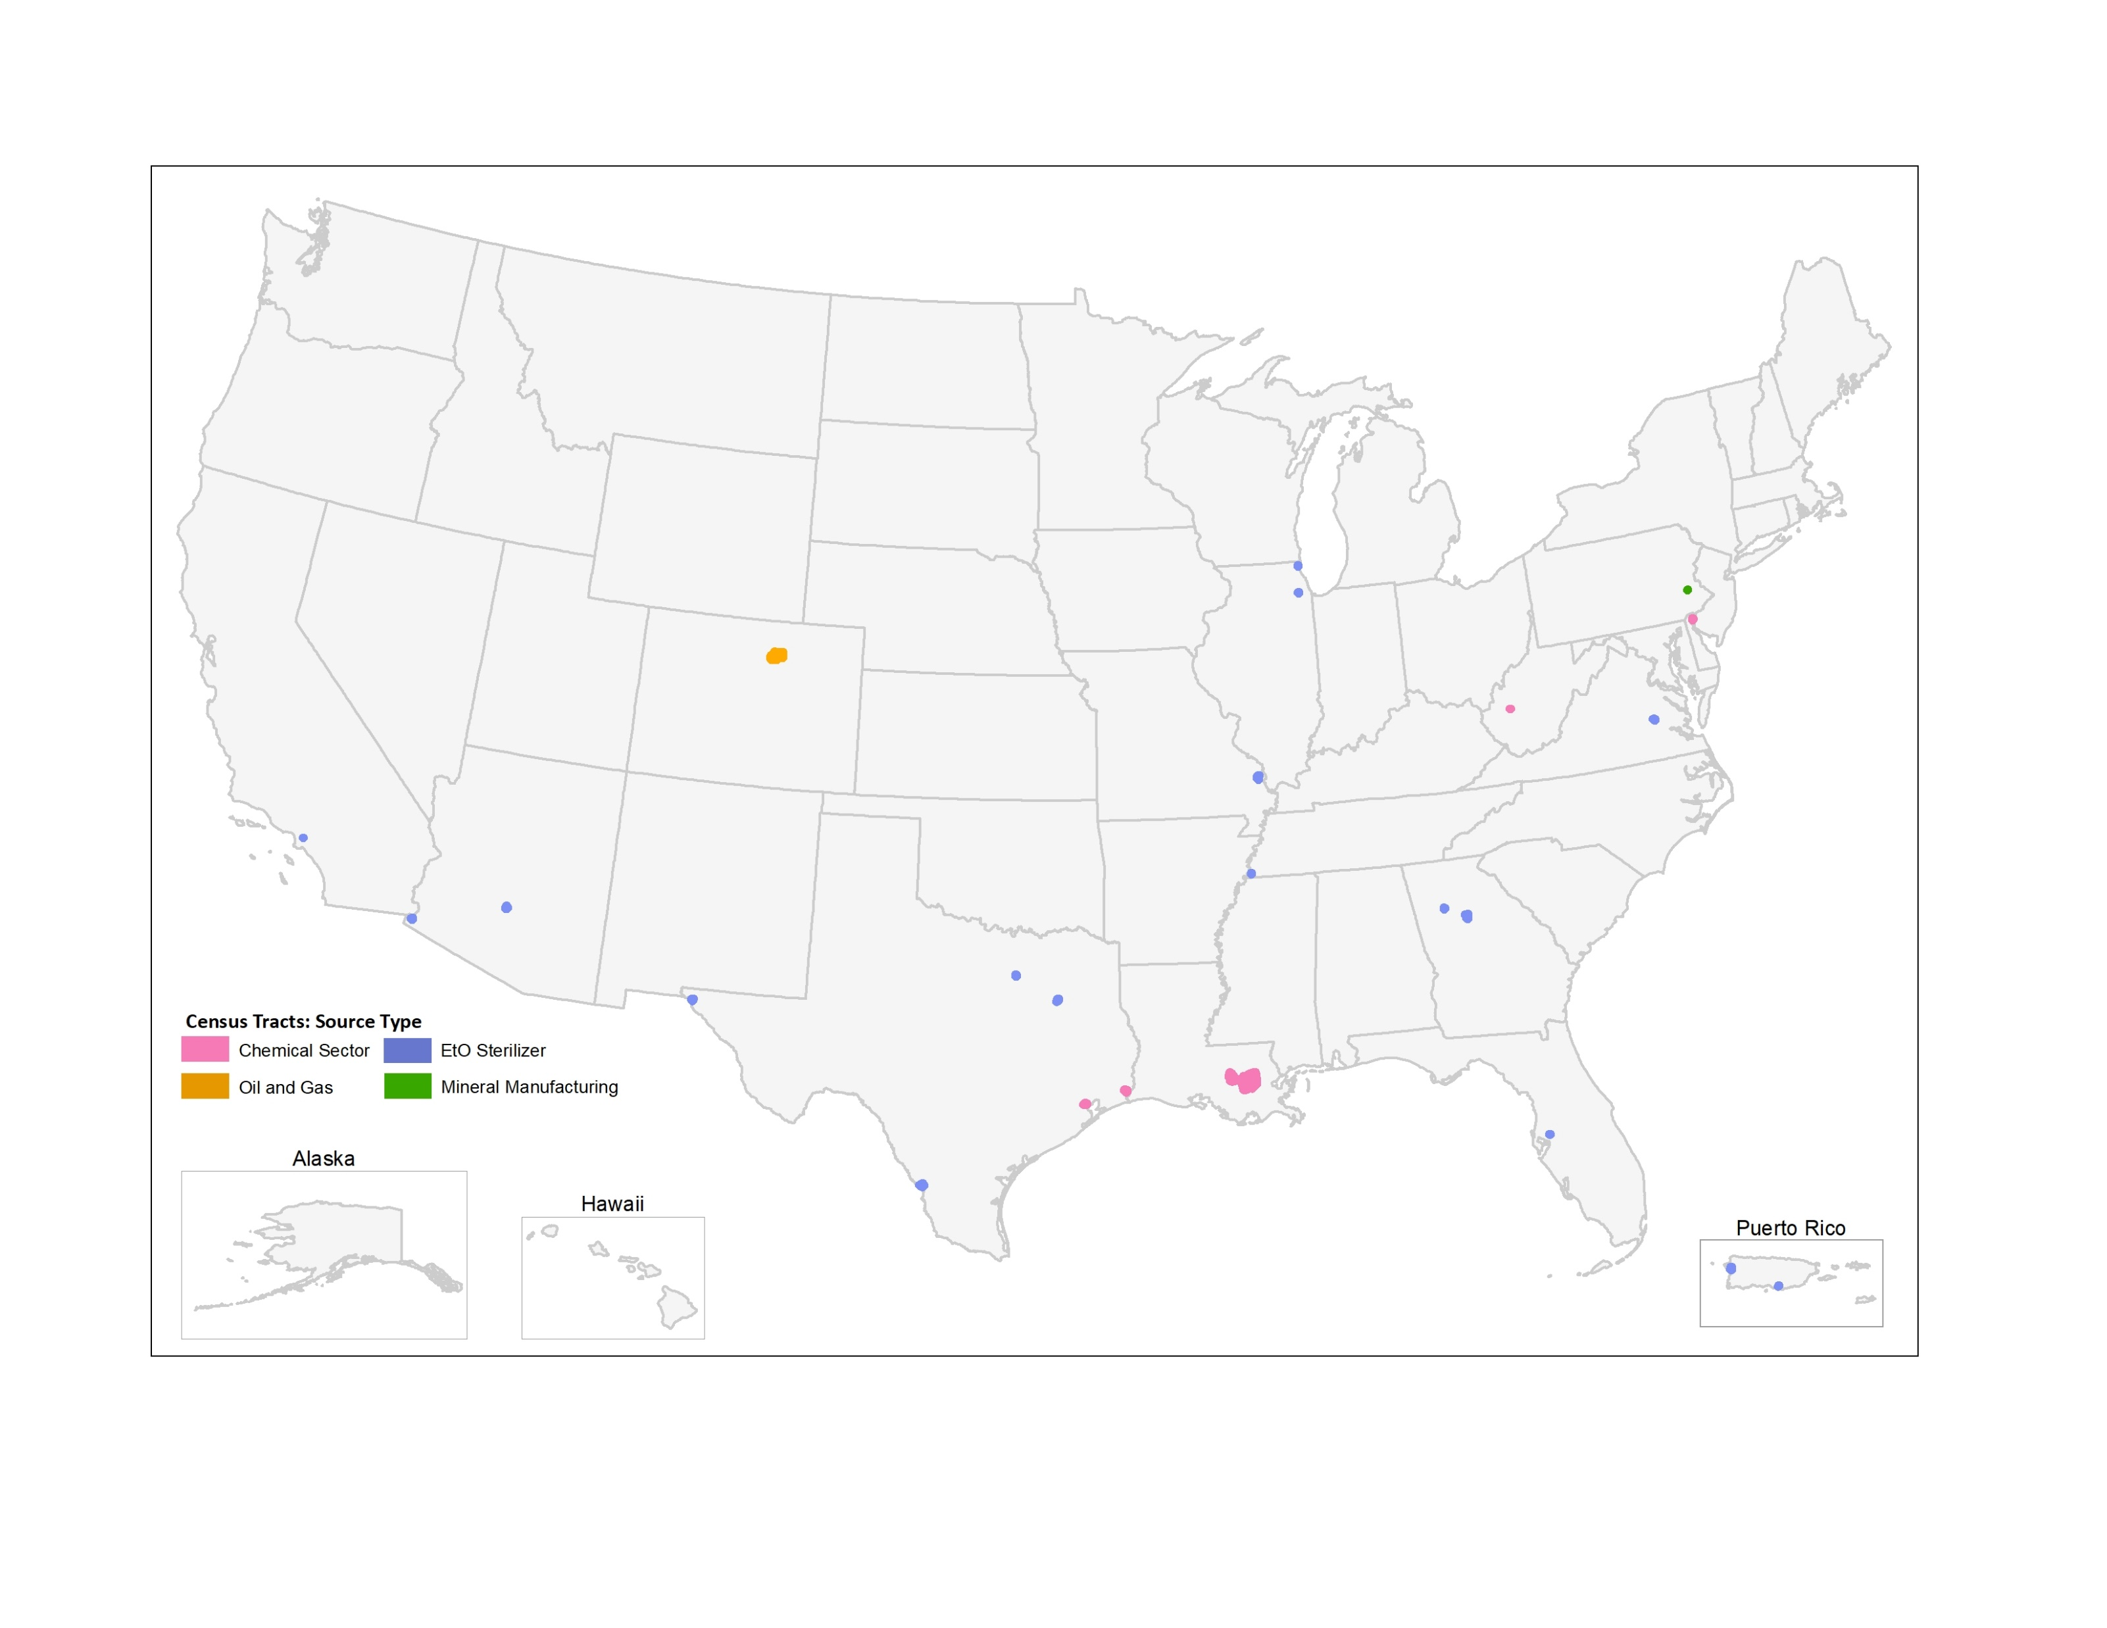
Census Tracts with Cancer Risks > 100-in-1-million

Slide 11
AirToxScreen Mapping Tool
The AirToxScreen Mapping Tool equips users to answer the following questions:
  What is the risk from air toxics in my area?
  What pollutants drive those risks?
  Where do those emissions come from?
Current Functionality:
Total Cancer Risk Dashboard, shows tract-level total cancer risk, source contributions, & facility emissions
Phased Improvements:
Hazard Indices dashboard
Modeled Ambient Concentrations dashboard
Emissions “Deep Dive” dashboard

Slide 12
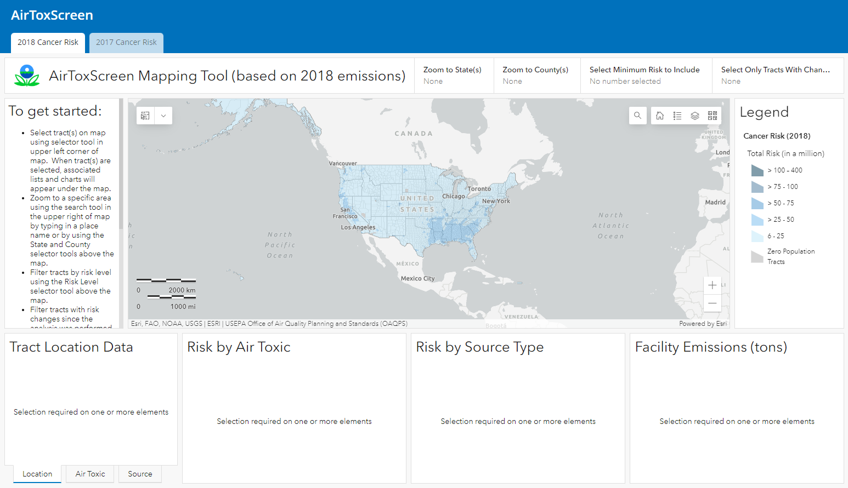
https://gispub.epa.gov/AirToxScreen

Slide 13
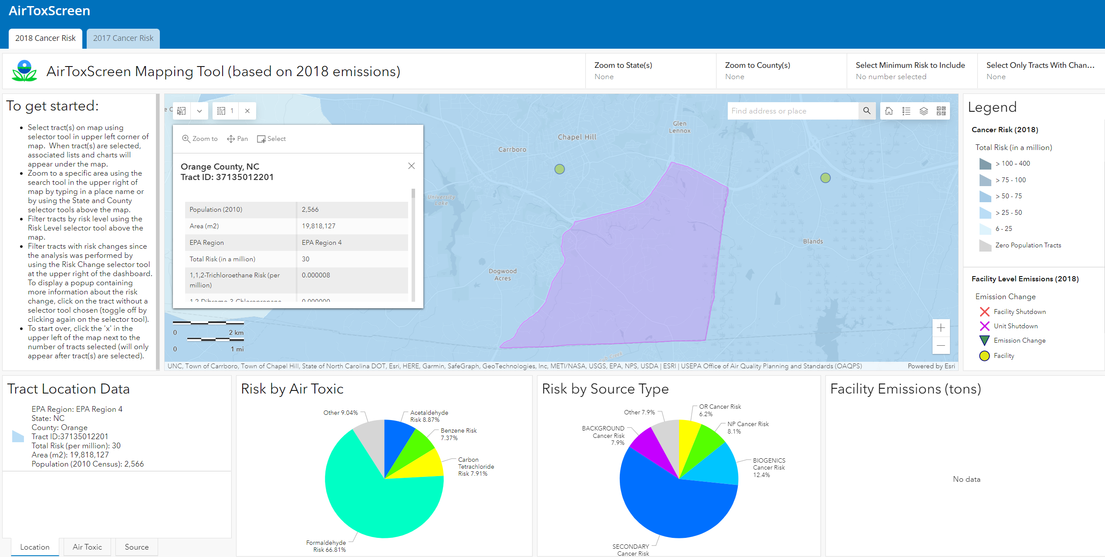

Slide 14
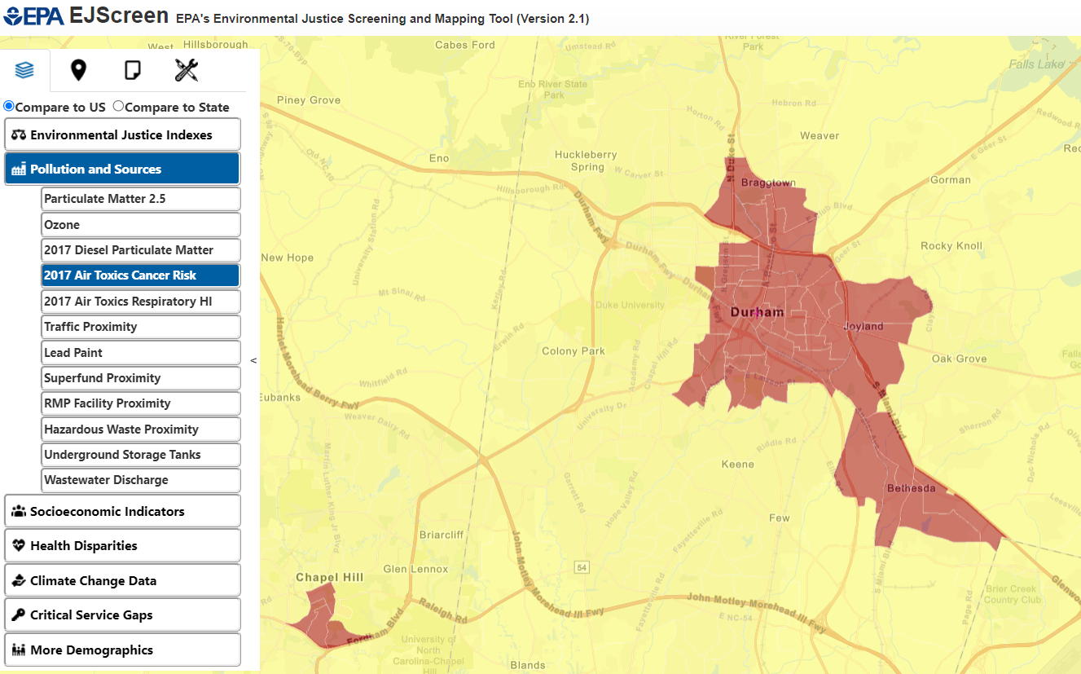
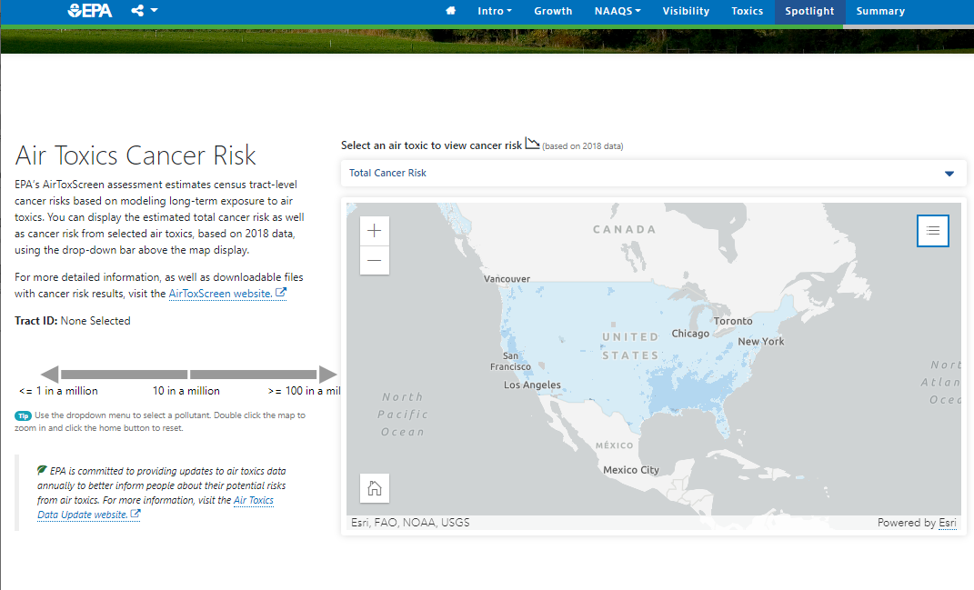
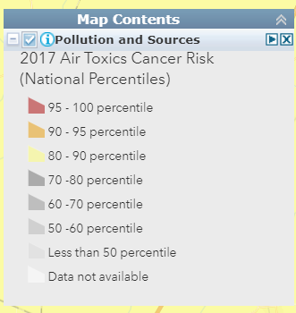
Uses of AirToxScreen Data
Our Nation’s Air Trends Report
(Released June 2022)
www.epa.gov/air-trends
EJScreen
(v2.1 released Oct 2022)
www.epa.gov/ejscreen

Slide 15
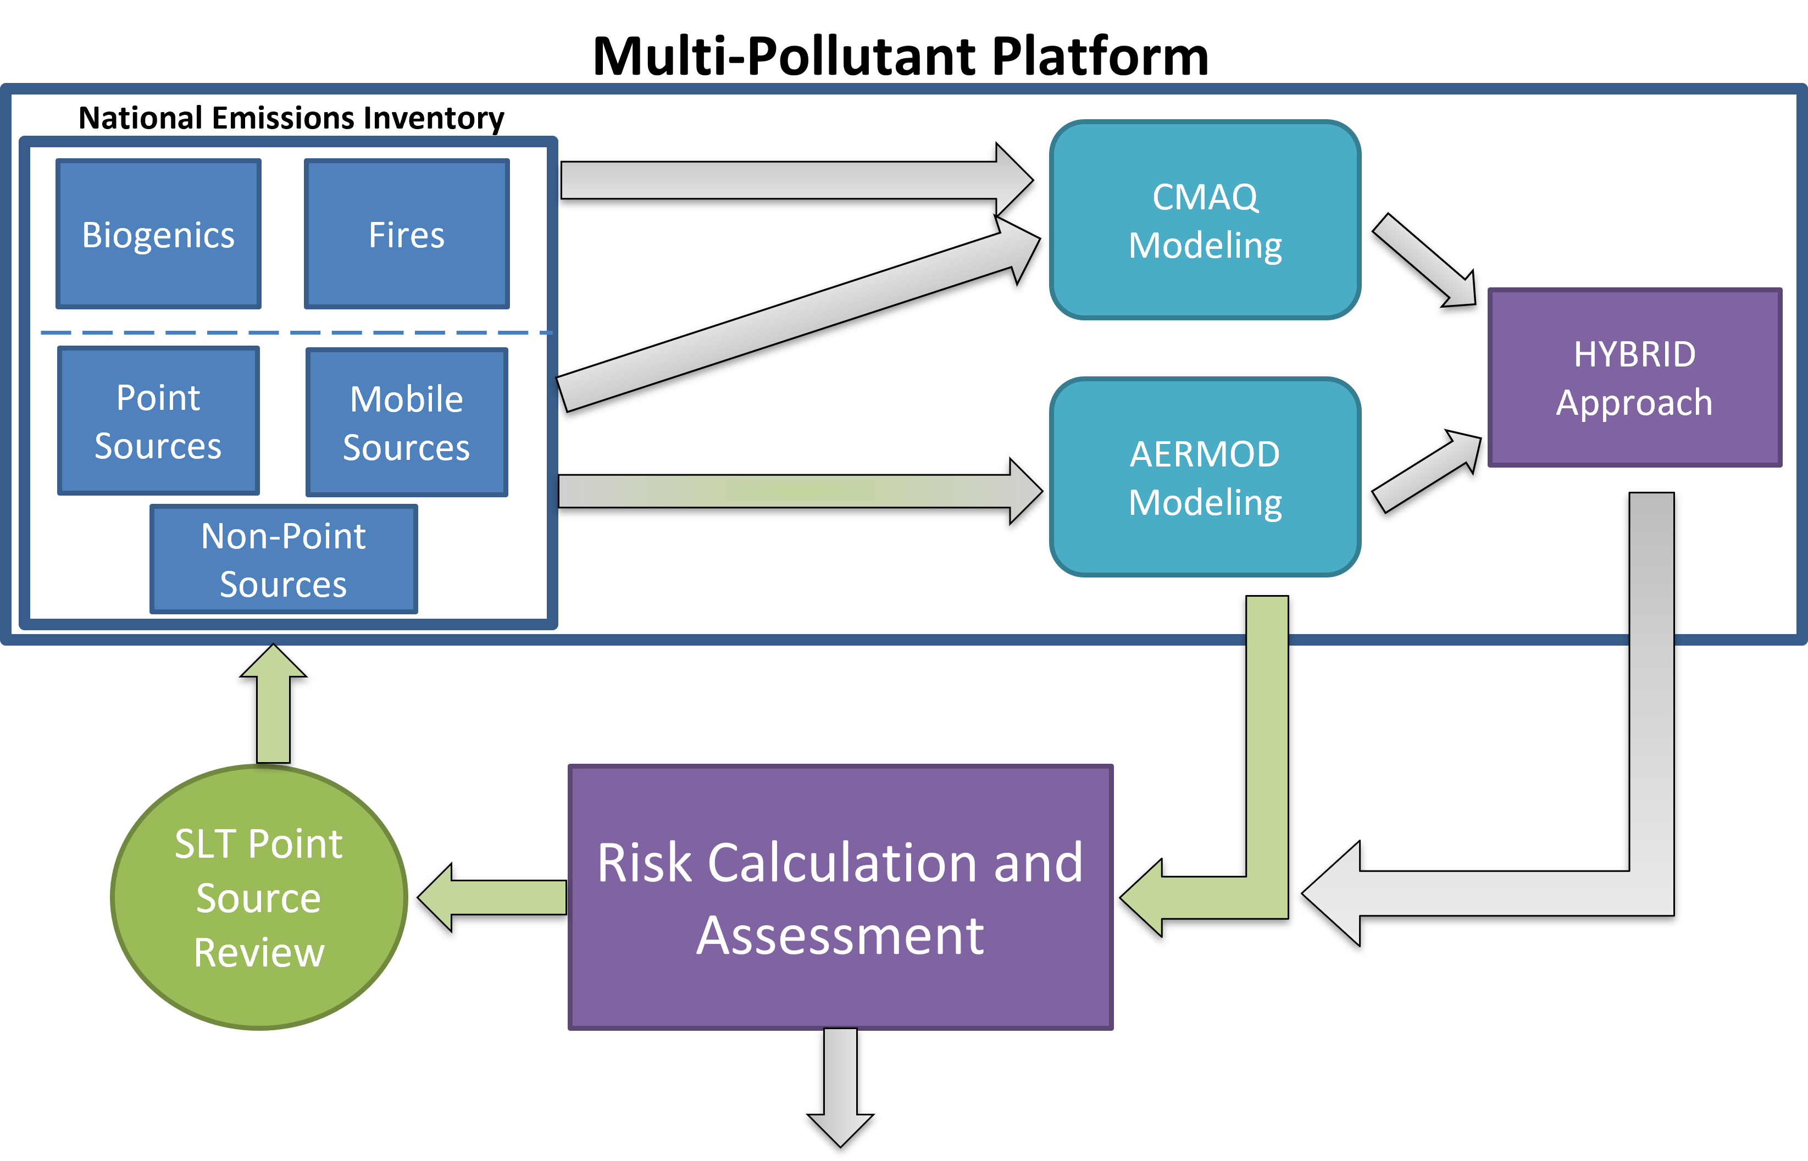
The Future of AirToxScreen
2019 AirToxScreen
  Tentative release Dec 2022
2020 AirToxScreen
  First “regular schedule” AirToxScreen
  Transitioning to block-level point source risk
  Scheduled for release Winter 2023-2024
AirToxScreen

