Slide 1
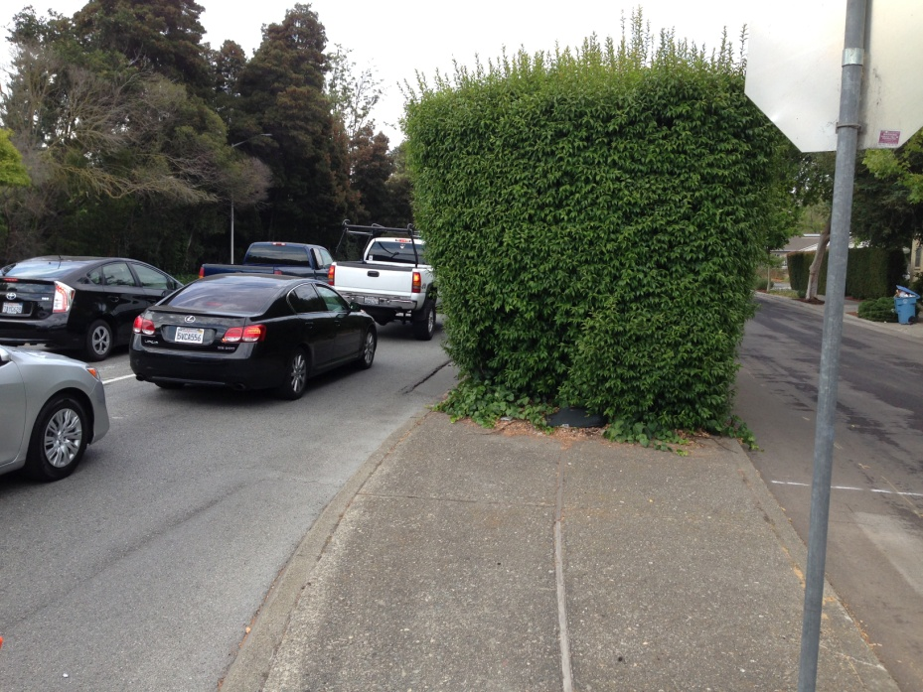
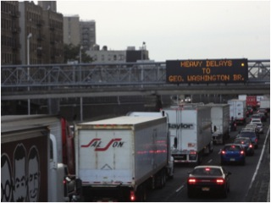
Resolving the effect of roadside green infrastructure on near-road air quality in a multi-regime modeling framework
Richard Baldauf, U.S. Environmental Protection Agency
CMAS Annual Meeting
October 19, 2022

Slide 2

Introduction
Interest in planting more trees and providing more urban green space has grown in recent years
  Global planting programs such as the Trillion Trees Initiative
  Climate adaptation and mitigation projects for stormwater management, urban cooling, and CO₂ sequestration
Recent research shows that urban green infrastructure can also impact local air pollution and mitigate select SLCPs, notably black carbon
  Promoting urban vegetation can have multiple benefits on climate change mitigation, air quality, and overall improved public health
  Care is needed on the design and implementation of urban green infrastructure development, especially when sited near large roadways and other air pollution sources
SLCPs = short-lived climate pollutants

Slide 3
Presentation Overview
Background
  Air pollution health concerns
  SLCP climate concerns
  Air quality and SLCPs mitigation opportunities
Urban green infrastructure and air pollution
  Mechanism of air pollution mitigation by vegetation
  Research on vegetation air pollution mitigation
Dispersion modeling framework
Relevant resources
Conclusions

Slide 4
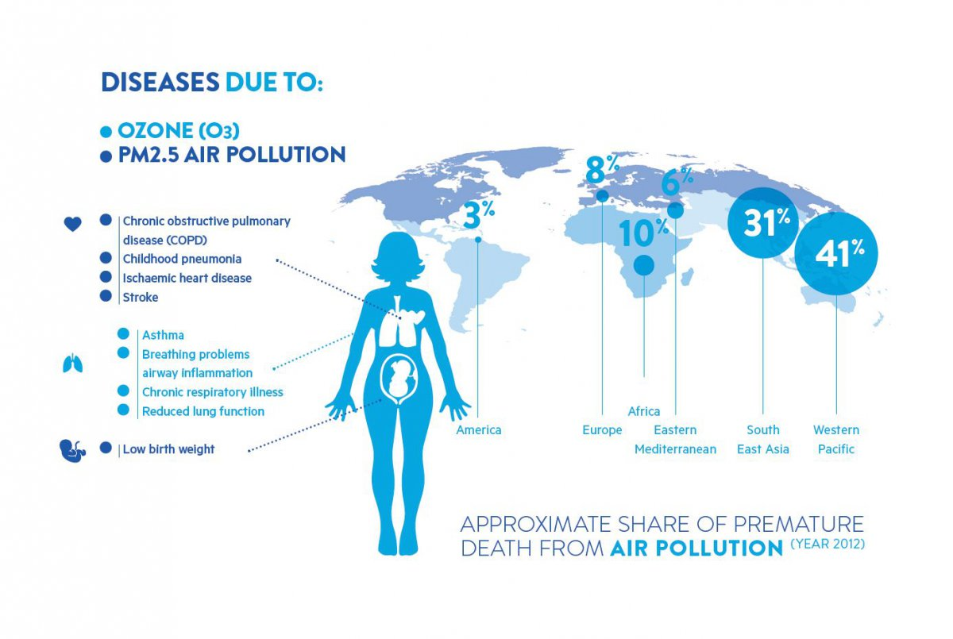
Air Pollution Health Effects

Slide 5
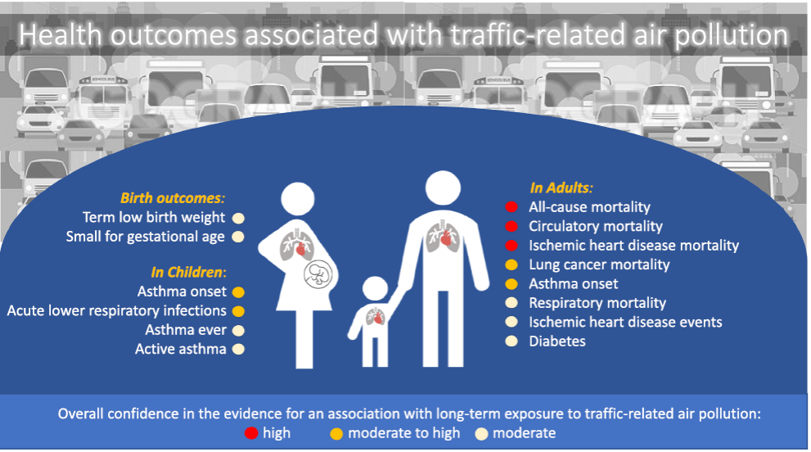
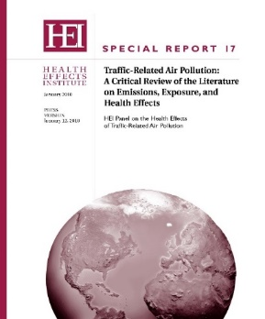
Health Concerns from Transport
People living, working and going to school near highways and large transportation facilities face increased health risks
Other studies have also linked other adverse effects including:
Childhood leukemia
Cognitive development
Neurological disorders including autism
Notes:
Reference:
Health Effects Institute, 2010: Traffic-Related Air Pollution: A Critical Review of the Literature on Emissions, Exposure, and Health Effects, p. xv.
See: http://www.sonomatech.com/project.cfm?uprojectid=1163
https://www.healtheffects.org/publication/traffic-related-air-pollution-critical-review-literature-emissions-exposure-and-health
Perez L., Lurmann F., Wilson J., Pastor M., Brandt S., Kunzli N., and McConnell R. (2012) Near-roadway pollution and childhood asthma: implications for developing "win-win" compact urban development and clean vehicle strategies. Environ. Health Persp., (Published online), ed. doi: 10.1289/ehp.1104785. Available on the Internet at http://ehp.niehs.nih.gov/wp-content/uploads/2012/10/ehp.1104785.pdf (found about 8% of childhood asthma was partly due to living within 75 m of a major road).
Right:
References:
Effect of exposure to traffic on lung development from 10 to 18 years of age: a cohort study
By: Gauderman, W. James; Vora, Hita; McConnell, Rob; et al.
LANCET Volume: 369 Issue: 9561 Pages: 571-577 Published: FEB 17 2007

Slide 6
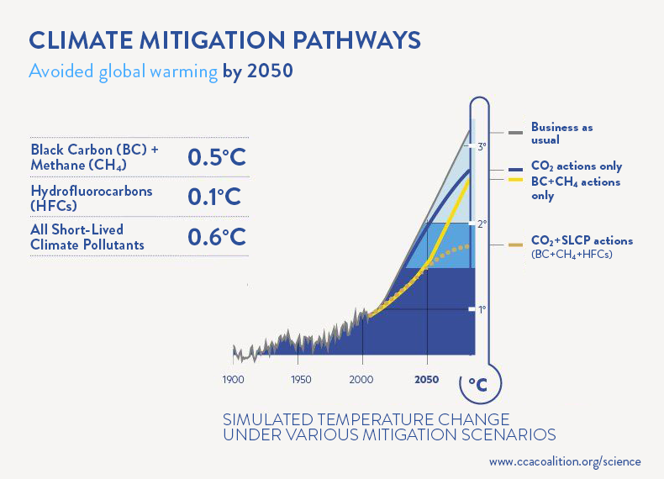
Short-Lived Climate Pollutants (SLCPs)

Slide 7
Transport Mitigation Options
Mitigating transport emissions, exposures, and health effects can be achieved by:
  Reducing vehicle direct emissions
  Reducing vehicle use and activity
  Reducing ambient air concentrations through urban and transportation development
    Increasing urban green infrastructure and green space

Slide 8
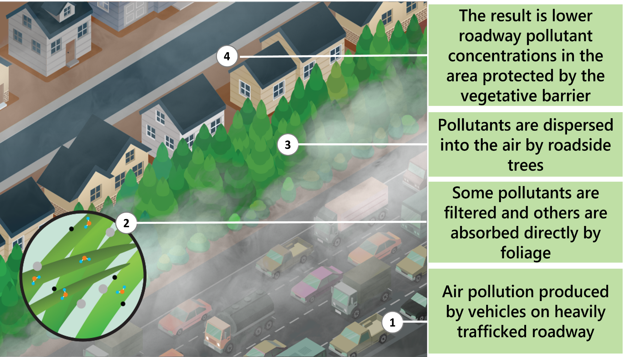
How Urban Vegetation Mitigates Air Pollution and SLCPs

Slide 9
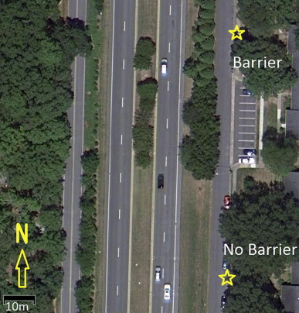
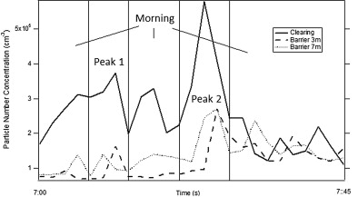
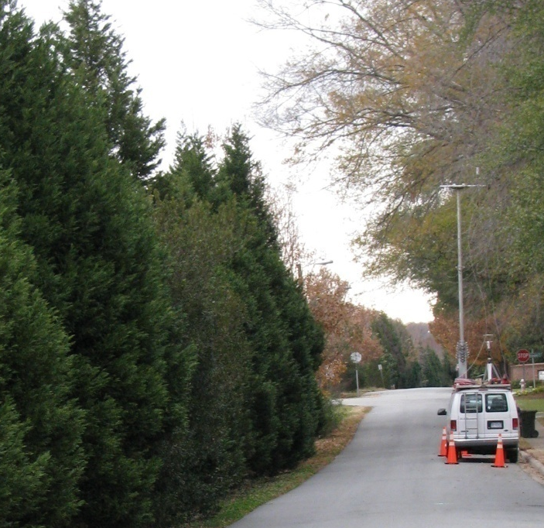
Research Example
Steffens et al 2012, Atmospheric Environment, 50, pp.120-128
Steffans et al. (2012)
Particulate matter including black carbon was reduced downwind of the vegetation
Higher reductions occurred closer to ground-level with winds from the road
Reductions in particle number could be 50% or greater

Slide 10
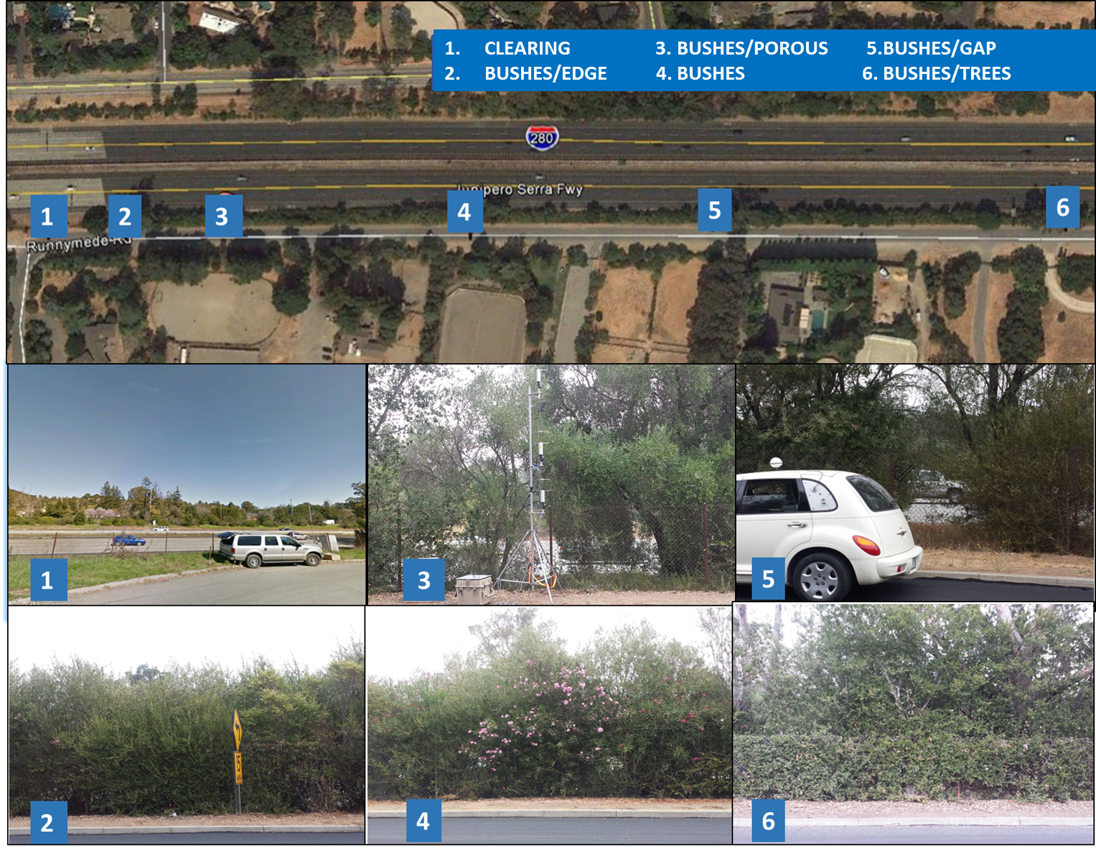
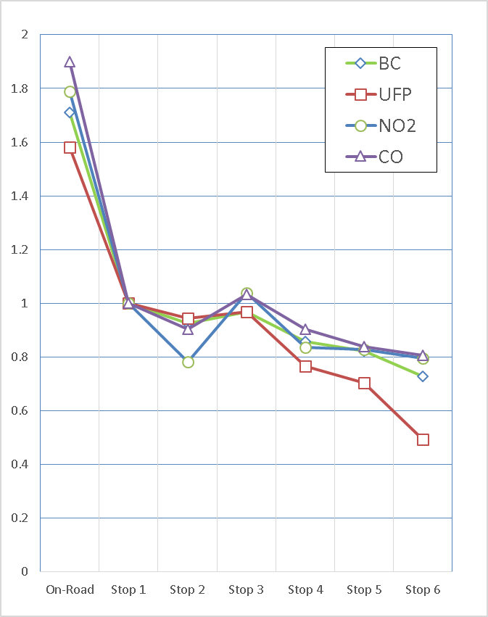

Research Example
1
2
3
4
Plant conditions can affect the levels of downwind pollution
    Thick, tall and full coverage reduced pollution downwind of the road
    Gaps and porous vegetation led to no reductions or even higher levels downwind of the road
5
6
Baldauf et al., in press

Slide 11
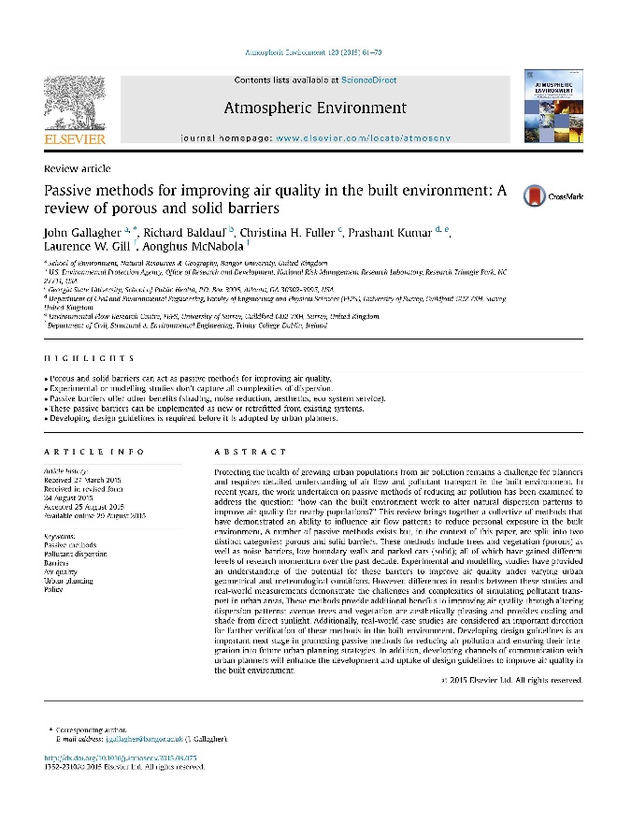
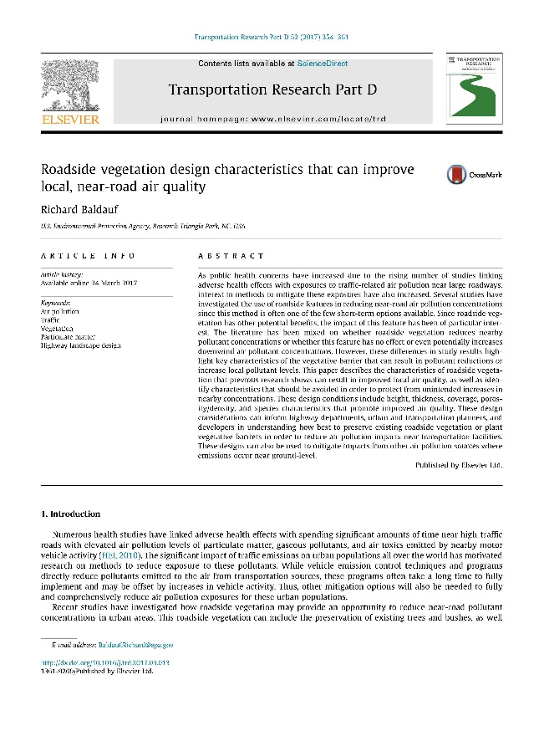
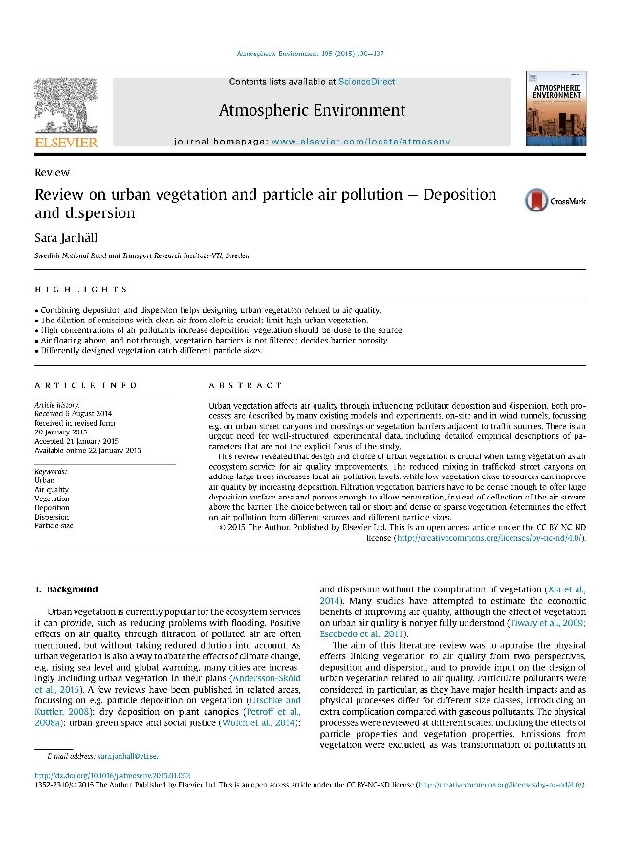
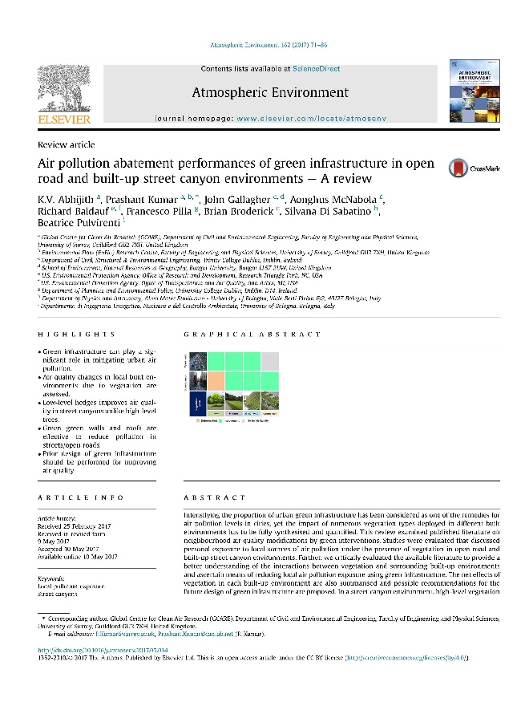
Review Articles
Janhäll, 2015. Atmospheric Environment, 105, pp.130-137
Gallagher et al, 2015. Atmospheric Environment, 120, pp.61-70
Baldauf, 2017. Transport Res Part D: Transport & Environ, 52, pp.354-361
Abhijith et al, 2017. Atmospheric Environment, 162, pp.71-86

Slide 12
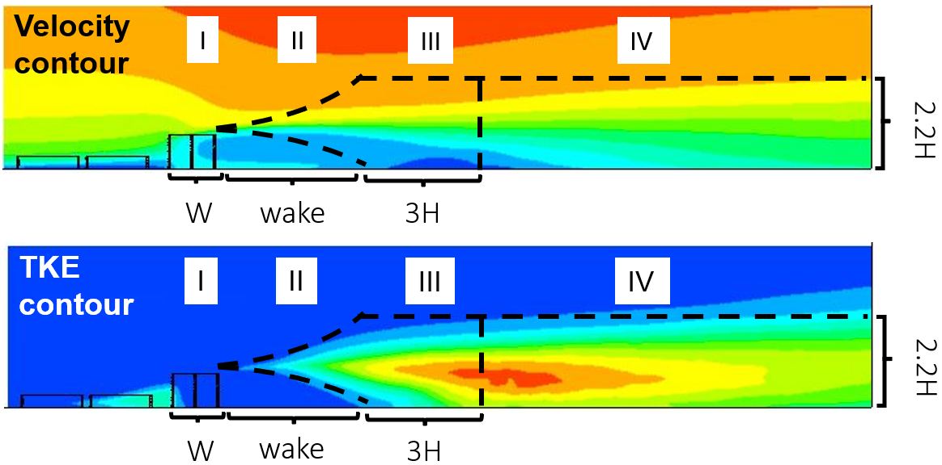

Modeling Framework
Parameterization framework: the multi-regime approach
Four regimes:
I: Vegetation
II: Wake
III: Transition
IV: Recovery
Goal for parameterization:
Describe the Gaussian parameters for each regime
$$C\left(x,z\right)=\frac{A}{σ_{z}U}\left\{exp\left(−\frac{1}{2}{\left(\frac{z−z_{s}}{σ_{z}}\right)}^{2}\right)+exp\left(−\frac{1}{2}{\left(\frac{z+z_{s}}{σ_{z}}\right)}^{2}\right)\right\}$$

Slide 13
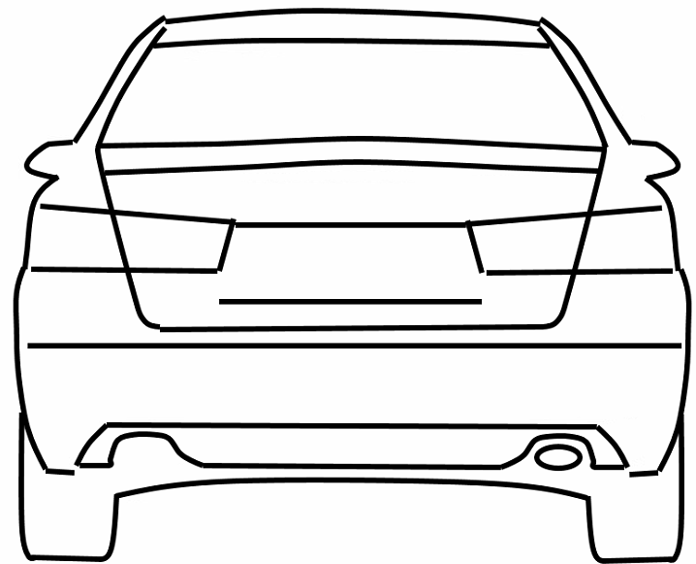





Modeling Framework
Overall parameterization procedure
Inputs
Key Parameters
Concentration (Output)
$$wake$$
U (10 m)
LAD/LAI
$$z_{s}$$
TKE ($m^{2}/s^{2}$)
H
U
$$C\left(x,z\right)=\frac{A}{σ_{z}U}\left\{exp\left(−\frac{1}{2}{\left(\frac{z−z_{s}}{σ_{z}}\right)}^{2}\right)+exp\left(−\frac{1}{2}{\left(\frac{z+z_{s}}{σ_{z}}\right)}^{2}\right)\right\}$$
W
$$σ_{z}$$
Vegetation width (W)
Vegetation height (H)
Vegetation LAD
Vegetation LAI
Local wind speed @10m (U)
$$A$$

Slide 14
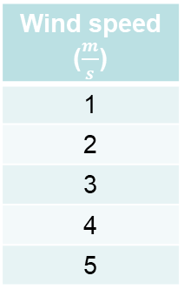
Modeling Framework
CFD-assisted parameterization
5 wind speeds
5 dimensions
3 LAI values
Wind speed ($\frac{m}{s}$)
1
2
3
4
5
Height (m) | Width (m)
2 | 2.5
4 | 6
6 | 8
8 | 10
10 | 12
LAI
4
7
11
x
x
= 75 LES cases
60 train cases
15 test cases
LAI: 4
H: 2 m
H: 10 m
LAI: 11
Notes:
LES: Large Eddy Simulation, a type of turbulence solver that tends to be more accurate but computationally intensive.

Slide 15
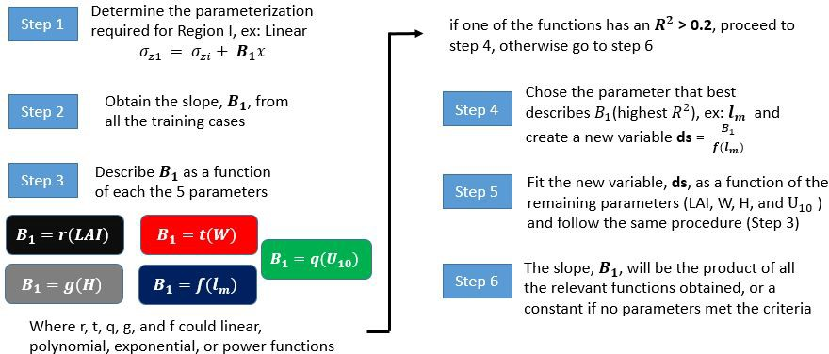
General parameterization procedure
Modeling Framework

Slide 16
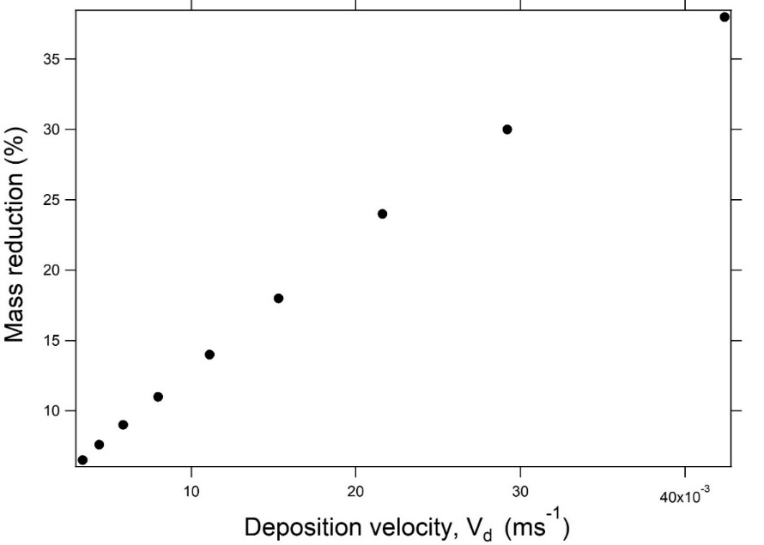
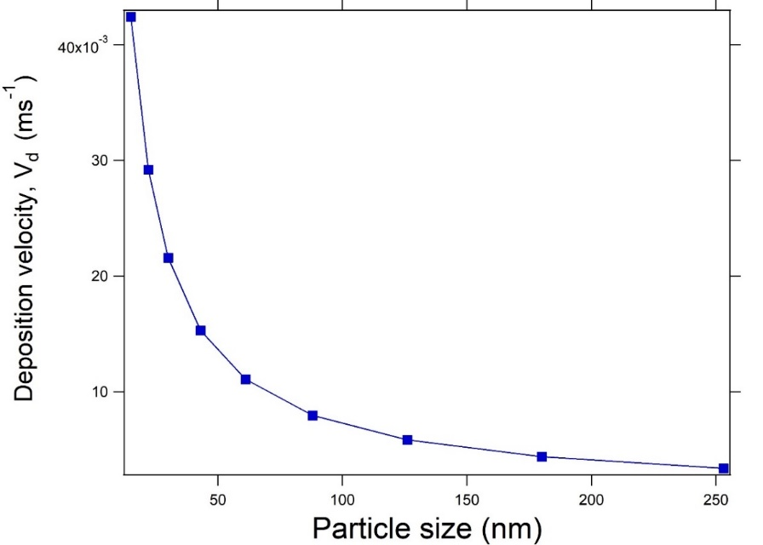
Modeling Framework
Accounting for size-dependent particle deposition
Deposition velocity strongly correlates with mass reduction!
To account for deposition the emission rate A should be modified (Regime I):
$$A=A(1 −W\left(\left(−0.224U+1.68\right)\left(0.057{LAD}^{0.2246}\right)−0.046\right)\log\left(v_{d}\right)+\left(−0.23U+1.69\right)({LAD}^{0.16} −0.41)$$

Slide 17
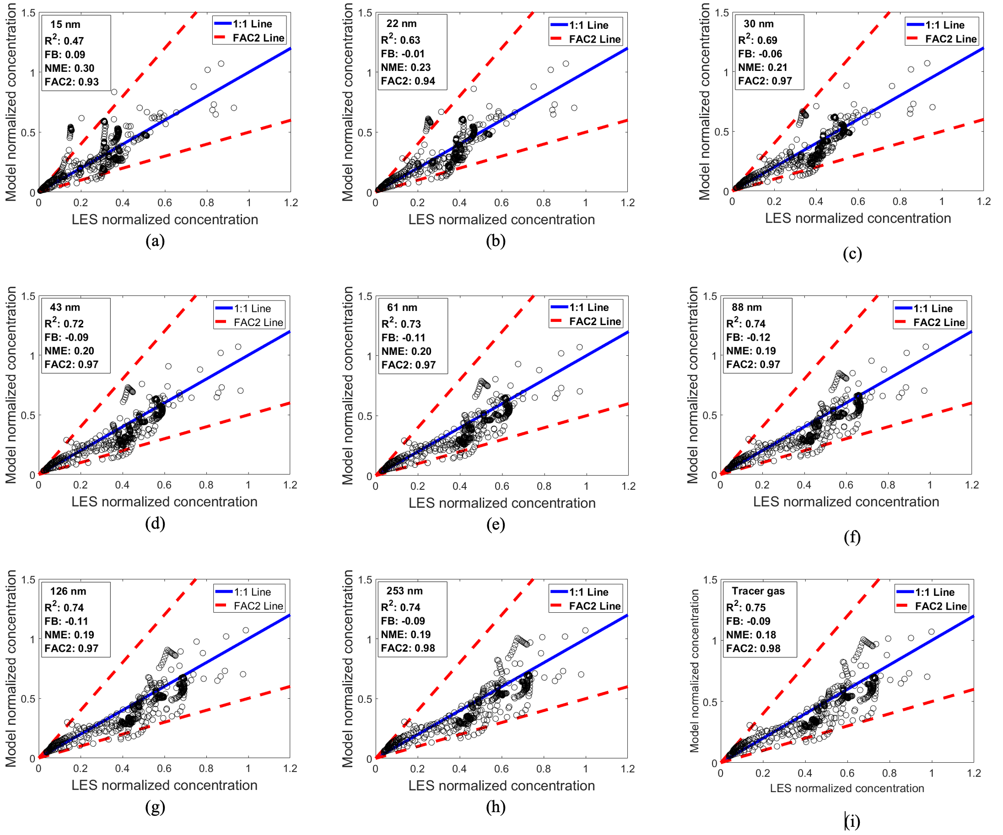
Modeling Framework
CTAG CFD versus the parameterized Gaussian-based model
NME: 0.18 - 0.3
FB: -0.12 - 0.09
FAC2: 0.93 - 0.98
R²: 0.47 - 0.75

Slide 18
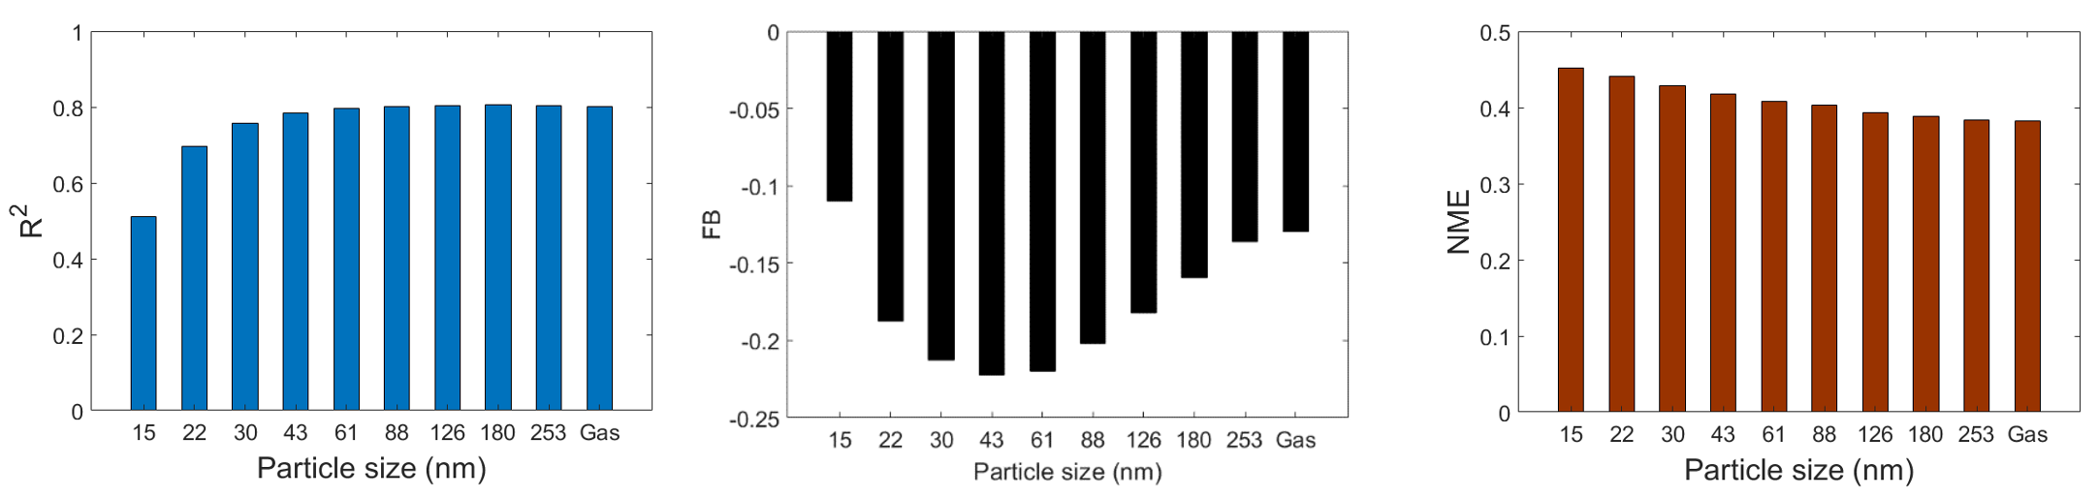
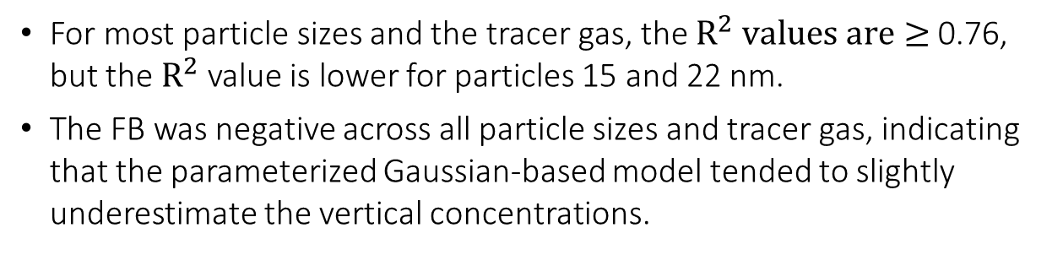
Size-resolved evaluation results
Modeling Framework
For most particle sizes and the tracer gas, the $R^{2} values are≥$0.76, but the $R^{2}$ value is lower for particles 15 and 22 nm.
The FB was negative across all particle sizes and tracer gas, indicating that the parameterized Gaussian-based model tended to slightly underestimate the vertical concentrations.

Slide 19
Urban Vegetation Recommendations
The U.S. EPA developed recommendations for planting and maintaining roadside vegetation
  Used to design and implement planting projects in the U.S. and Europe
  Includes vegetation alone and combined with solid barriers
  Provides designs intended to:
    maximize the potential for air pollution mitigation, and
    avoid unintended consequences and designs that may increase downwind concentrations and exposures
https://www.epa.gov/sites/production/files/2016-08/documents/recommendations_for_constructing_roadside_vegetation_barriers_to_improve_near-road_air_quality.pdf
18

Slide 20
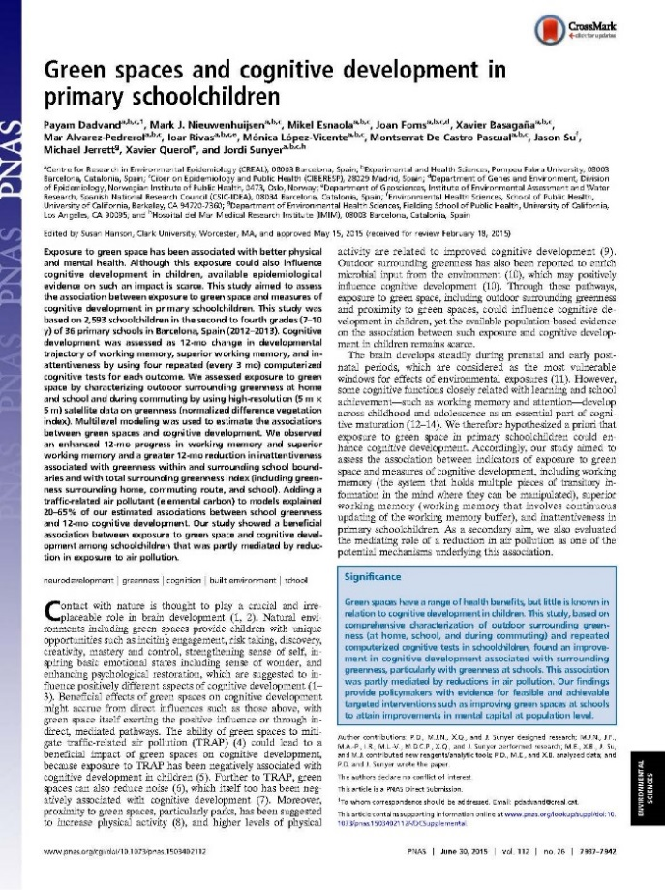
Urban Green Infrastructure Benefits
Urban vegetation, including roadside barriers, can have many other benefits, including:
  Increased CO₂ sequestration
  Methane removal in vegetation soils
  Improved urban cooling
  Reduced stormwater runoff/flooding
  Improved water quality
  Reduced noise levels
  Improved aesthetics/property values
  Enhanced community livability
  Improved general public health
“Exposure to green space has been associated with better physical and mental health”
Dadvand et al. 2015, Proc. Nat Acad Sciences,
112(26), pp.7937-7942

Slide 21
Conclusions
Climate and health concerns from transportation emissions have raised the importance of understanding how urban infrastructure can be used for mitigation.
Urban and roadside green and built infrastructure can provide important air pollution and SLCP reduction benefits when designed properly.
For More Information:
Richard Baldauf, PhD, P.E.
U.S. Environmental Protection Agency
919-541-4386
Baldauf.Richard@epa.gov
Authors: Khaled Hashad, Bo Yang, Jon Steffens, K. Max Zhang (Cornell Univ.), David Heist (EPA), Parik Deshmukh (ERG)
20
This presentation has been subjected to the Agency’s review process and has been approved for publication. These are the views of the authors and do not necessarily reflect official policy of the EPA.
Mention of trade names or commercial products does not constitute endorsement or recommendation for use.
Notes:
20

