Slide 1



Development and Application of Shipping Emissions Estimation Program
Fiona Jiang¹, Beata Czader², Christian Lindhjem¹, Marco Rodriguez¹
¹Ramboll
²Texas Commission on Environmental Quality

Slide 2
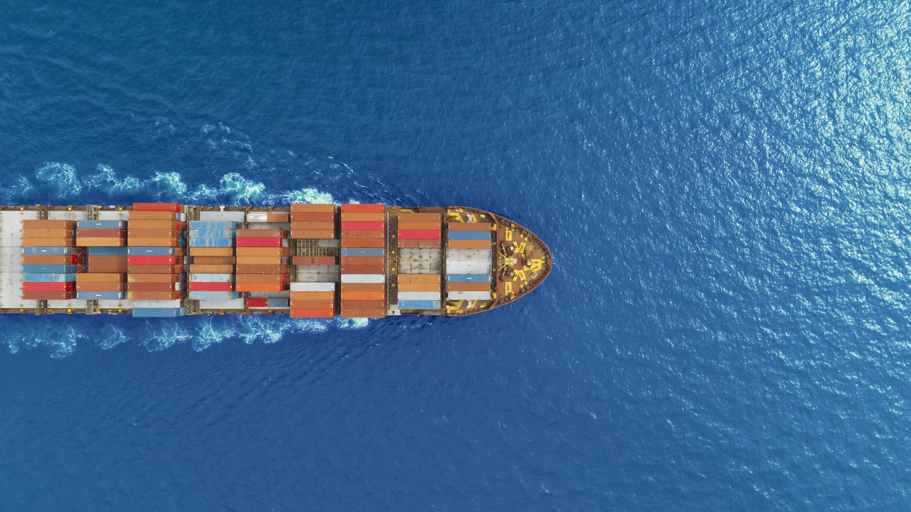
Ramboll’s MARINER tool

Slide 3
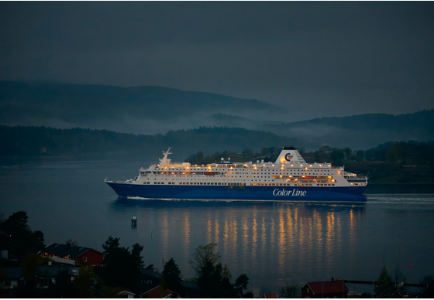
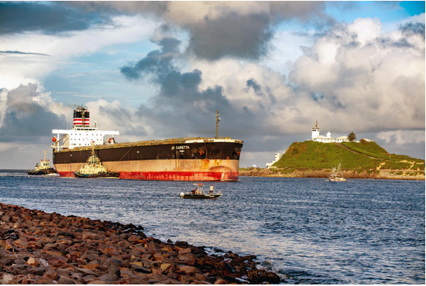
What is MARINER?
A Python tool that automates
  the estimation of commercial marine vessel (CMV) emission inventories
  the generation of air quality modeling inputs
Development started in 2015, and its functionality has been continually expanded
Follows the 2020 EPA Ports Emissions Inventory Guidance explicitly
Photo by Vidar Nordli-Mathisen on Unsplash
Photo by Lynda Hinton on Unsplash

Slide 4
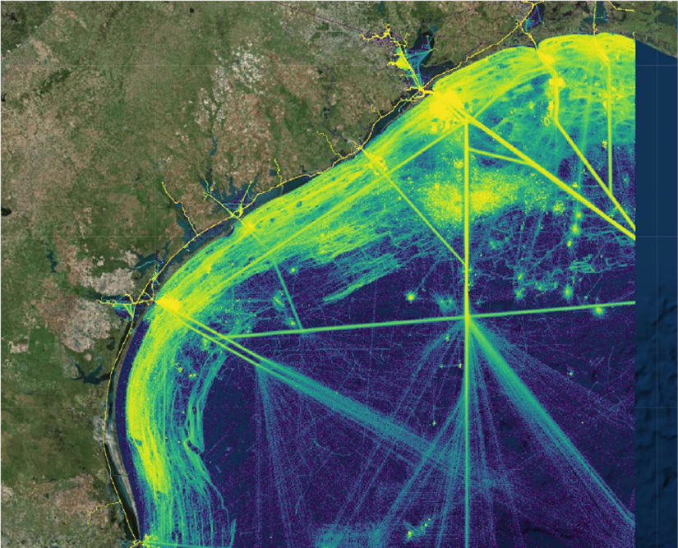
Automatic Identification System (AIS)
Real-time tracking system
Collects vessel traffic data, such as location, time, speed, etc.
Available in U.S. and international waters
Required on all commercially active (small and large) vessels since late 2016
Quality assured data on the Marine Cadastre (a joint U.S. BOEM and NOAA initiative)
Notes:
The AIS records provide a variety of attributes associated with vessel movements, including position, date and time, speed over ground, course over ground, instantaneous draft, vessel identification codes, and vessel type.
Starting in March 2016, all commercially active vessels were required to install AIS transponders; includes tug and other small craft used usually on inland waterways. Though data might not be completed until 2017.
Marine Cadastre is a publicly-available US government database. Quality assured via the Authoritative Vessel Identification System.

Slide 5
Sea-Web IHS Markit Ships Database
Vessel size, age, type of cargo, and total capacity
Main engine, auxiliary engine, and boiler specifications
Fuel and exhaust scrubber types
Over 200,000 vessels characterized
Limited for domestically owned smaller vessels
Notes:
IHS is very limited for domestically owned smaller vessels. IHS is useful primarily for large ocean-going vessel.

Slide 6
MARINER Flowchart
Filter & Process AIS Data
Identify vessel types
Determine trips
Activity calculation
Match with IHS Database
Identify engine tier
Emission & Load Factors
Calculate Emissions
Combine AIS and IHS data to calculate emissions
Spatial Processing
Assign emissions to model grid, county, etc.
Fill missing data
Inputs for MARINER
AIS data
IHS data
User’s input (time period, domain, etc.)
Subset AIS data
Final Products
Emission Inventory for regulatory reporting
EPS3 PRESHP input files for photochemical modeling
Determine engine category
Activity Report
Temporal Profiles

Slide 7
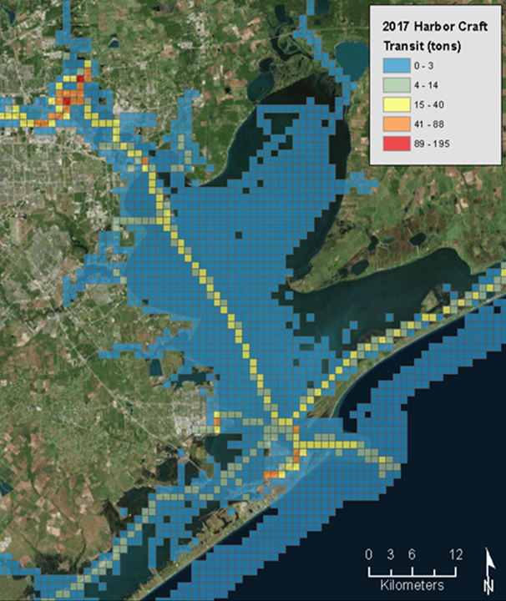
Emissions
Highly resolved by vessel, vessel type, spatial region or temporal period
Can be aggregated over desired resolution by modeling grid scale and temporal event for air quality modeling
Example of calculated emissions for a vessel
Date Time | Latitude | Longitude | MMSI | IMO | AIS Vessel Type | Operating Mode | EPA Ship Type | Vessel Class | Propulsion NOx (g) | Auxiliary NOx (g) | Boiler NOx (g)
7/24/2019 20:11 | 31.78273 | -93.0199 | xxx | xxx | 00 | Transit | Miscellaneous (C3) | C3 | 269 | 4.0 | 3.3
7/24/2019 20:14 | 31.78497 | -93.0226 | xxx | xxx | 00 | Maneuvering | Miscellaneous (C3) | C3 | 160 | 2.5 | 2.2
7/24/2019 20:16 | 31.78702 | -93.0245 | xxx | xxx | 00 | Hotelling | Miscellaneous (C3) | C3 | 127 | 1.8 | 1.7

Slide 8
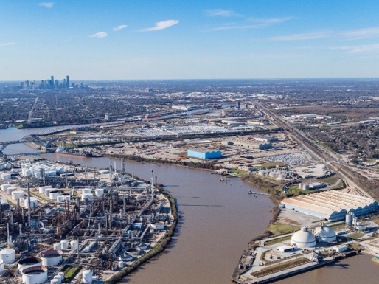
Application to Shipping Emissions in Texas

Slide 9
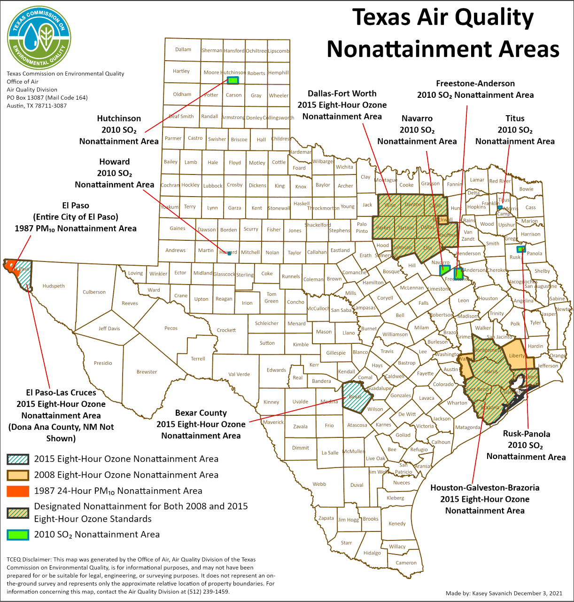
Importance of Shipping Emissions in Texas
Texas and Gulf Coast – home to very active shipping lanes and some of nation's busiest ports
The Houston-Galveston-Brazoria (HGB) ozone nonattainment area impacted by shipping activity
CMV emit NOx and VOC impacting air quality
Data Source: Bureau of Transportation Statistics
Notes:
CMV emit NOx and VOC impacting ozone formation and air quality in the area.
It is essential to understand and quantify CMV emissions to be able to project in future years.
Couple of ports along the Gulf, the Houston port is the largest.
The bar chart shows top US water ports. Port of Houston is the largest. Other ports in the area: Freeport, Texas City, and Galveston add about 30% to the Houston tonnage. All of these port operations impact the HGB air quality.”

Slide 10
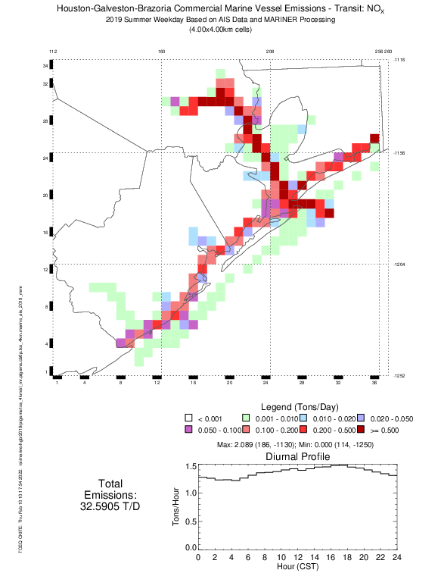
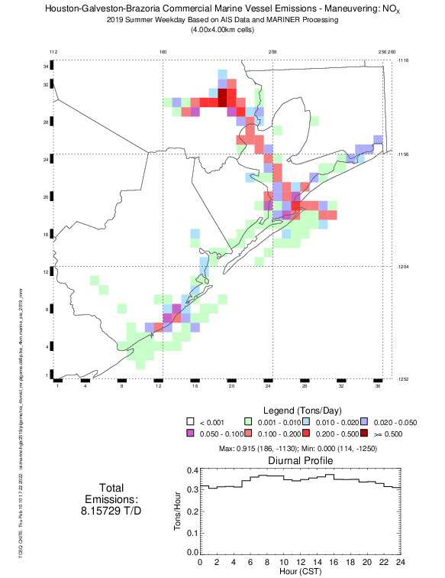
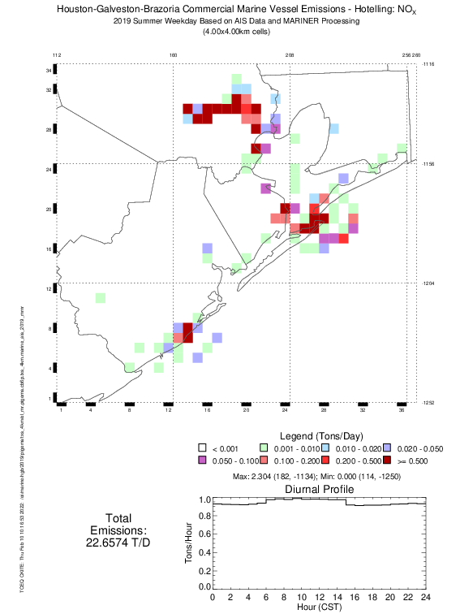
Tracking Emissions by Vessel Activity
Custom SCC codes
distinguish and allow tracking emissions from different vessel activities
Transit Emissions
Maneuvering Emissions
Hoteling Emissions
Notes:
Custom SCC codes allow tracking emissions from different activity types
Spatial pattern of emissions varies with activity type
Transit – Emissions in the Houston Ship Channel and along the coastline
Maneuvering – Emissions mainly in the Houston Ship Channel, lower values along coastline
Hoteling – Emissions at the entrance to the Houston Ship Channel and at the end of it. Also, on the left from the Houston Ship Channel, emissions from port Freeport, located about 60 miles south of Houston, near industrial businesses

Slide 11
Tracking Emissions by Vessel Type
Custom SCC codes
Distinguish and allow tracking emissions from different vessel types
Total 63 custom SCC codes represent
21 vessel types and
3 activity types

Slide 12
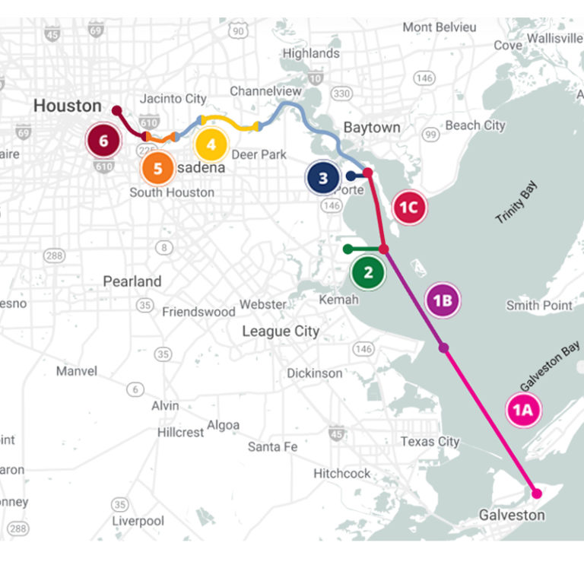
Houston Ship Channel Sensitivity
Houston Ship Channel expected emissions reductions due to its expansion plans
  fewer large ships
  reduced hoteling
MARINER estimated emissions
  2026 future year
  Harris, Chambers, Galveston Counties
  Category 3 vessels: 9 vessel types
  Hoteling only
Image source: www.expandthehoustonshipchannel.com
Period​ | NO_{x}​ | VOC​
Annual Reductions (tpy)​ | 147.20​ | 3.35​
Daily Reductions (tpd)​ | 0.40​ | 0.01​
Daily Unadjusted Emissions (tpd)​ | 16.71​ | 2.18​
Daily Adjusted Emissions​ (tpd) | 16.31 | 2.17
Daily Adjustment Factor​ | 0.9759​ | 0.9958
Notes:
Expected reductions only for 9 categories of ocean-going vehicles, not harbor craft, and only for Hoteling
Current emissions Nox = 19.4 tpd, expected reductions Nox = 0.4 tpd, percent of expected reductions = 2%
Daily unadjusted emissions = current emissions – expected daily reductions

Slide 13
MARINER and EPA 2016v2 Platform Emissions
Emission decreases between 2023 and 2026
NOx emission estimates slightly higher from MARINER
VOC emission estimates slightly lower from MARINER
Notes:
Blue colors – EPA estimates
Orange colors – MARINER estimates

Slide 14
Potential Future Development Ideas
Expand estimates to waters outside Texas
Reduce memory requirement
Minimize mismatched vessels
Prepare CAMx or CMAQ-ready emission files
Notes:
Added CMAQ since it’s a modeling conference; Conduct a formal uncertainty analysis to determine which data strongly influence emission magnitude

Slide 15
Questions?
Contacts:
Fiona Jiang fjiang@ramboll.com
Beata Czader beata.czader@tceq.texas.gov

