Slide 1
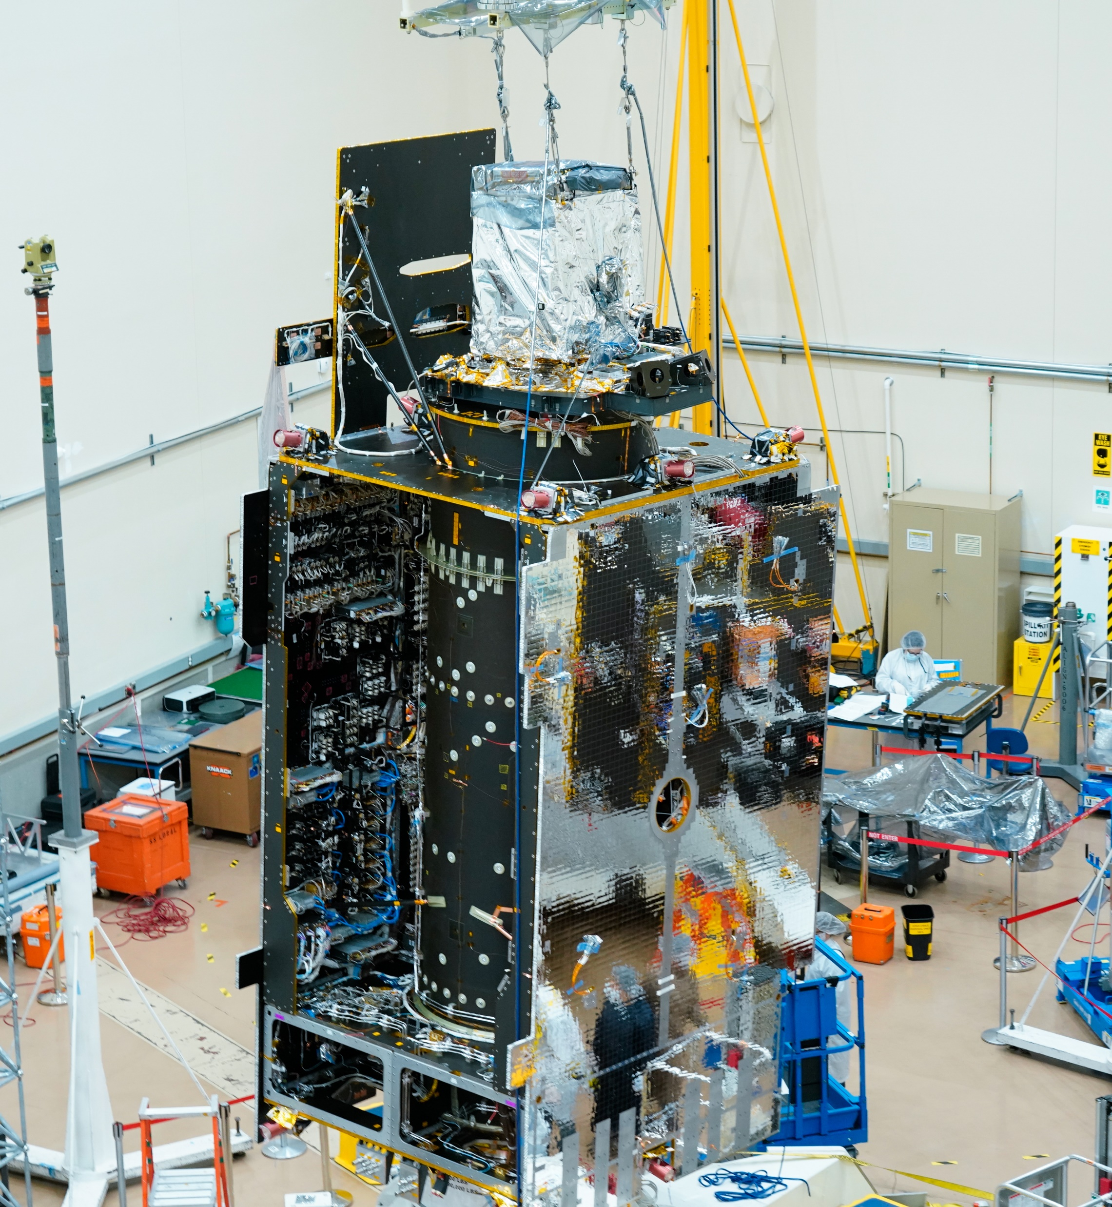
Tropospheric Emissions: Monitoring of Pollution (TEMPO) mission and Level 2 Data Product Validation Plans
21st Annual CMAS Conference
Chapel Hill, NC October 17-19, 2022​
TEMPO Instrument Integration onto Intelsat 40e
Jim Szykman, Lukas Valin, Eric Baumann, and David Williams
Center For Environmental Measurements and Modeling
U.S. EPA Office of Research and Development
w/ contributions from others, including Kelly Chance (TEMPO PI, SAO), Xiong Liu (TEMPO D-PI, SAO), Alexander Cede & Martin Tiefengraber, Luftblick, Laura Judd & Jim Crawford (NASA-LaRC), Tom Hanisco, John Sullivan, & Nader Abuhassan (NASA-GSFC), etc.
Disclaimers: The views expressed in this presentation are those of the authors and do not necessarily represent the views or the policies of the U.S. Environmental Protection Agency.
Any mention of trade names, products, or services does not imply an endorsement by the U.S. Government or the U.S. Environmental Protection Agency. The EPA does not endorse any commercial products, services, or enterprises.

Slide 2
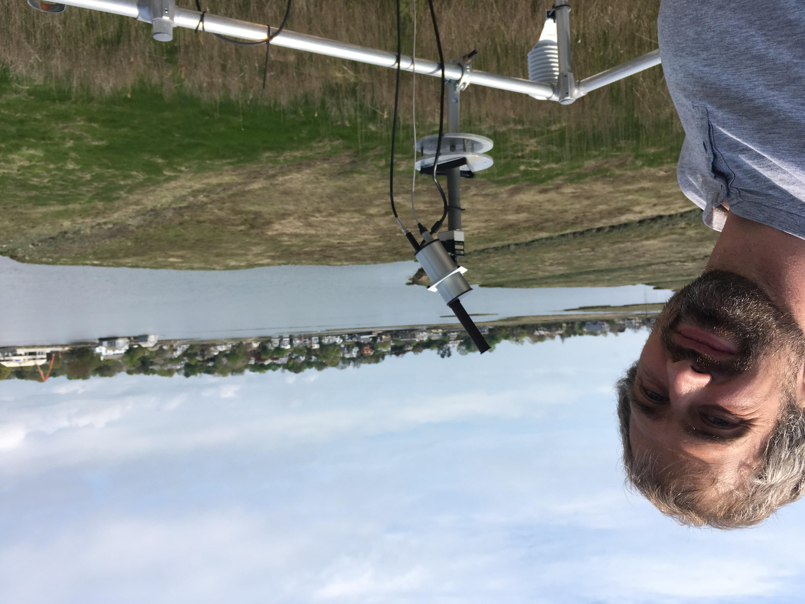
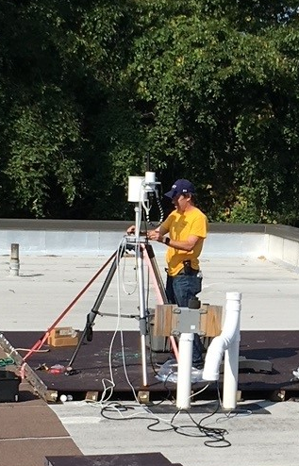
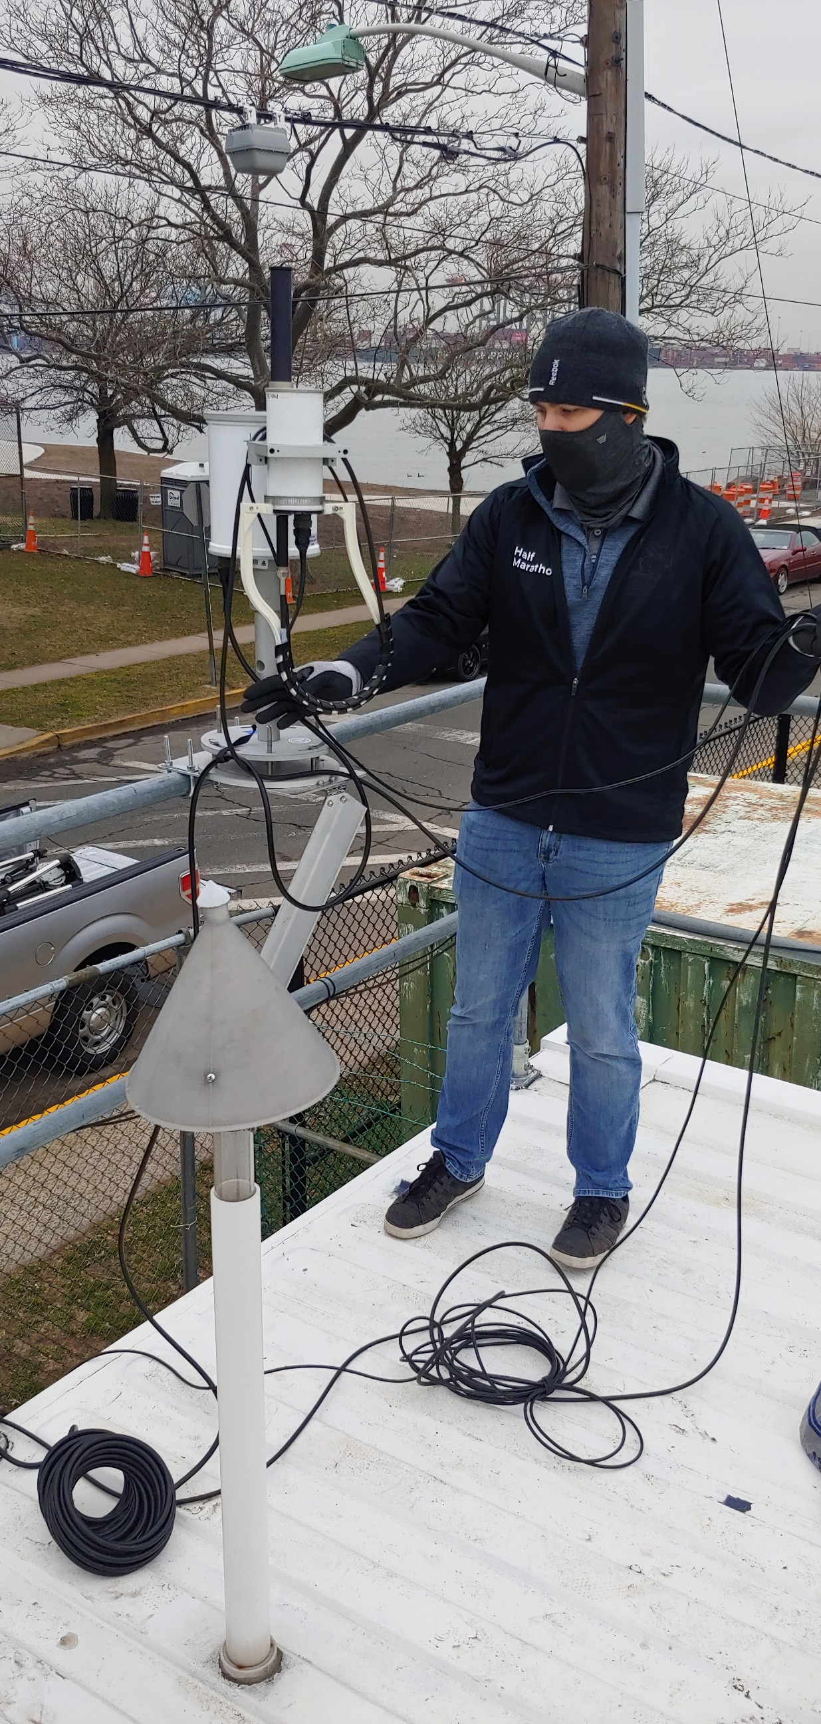
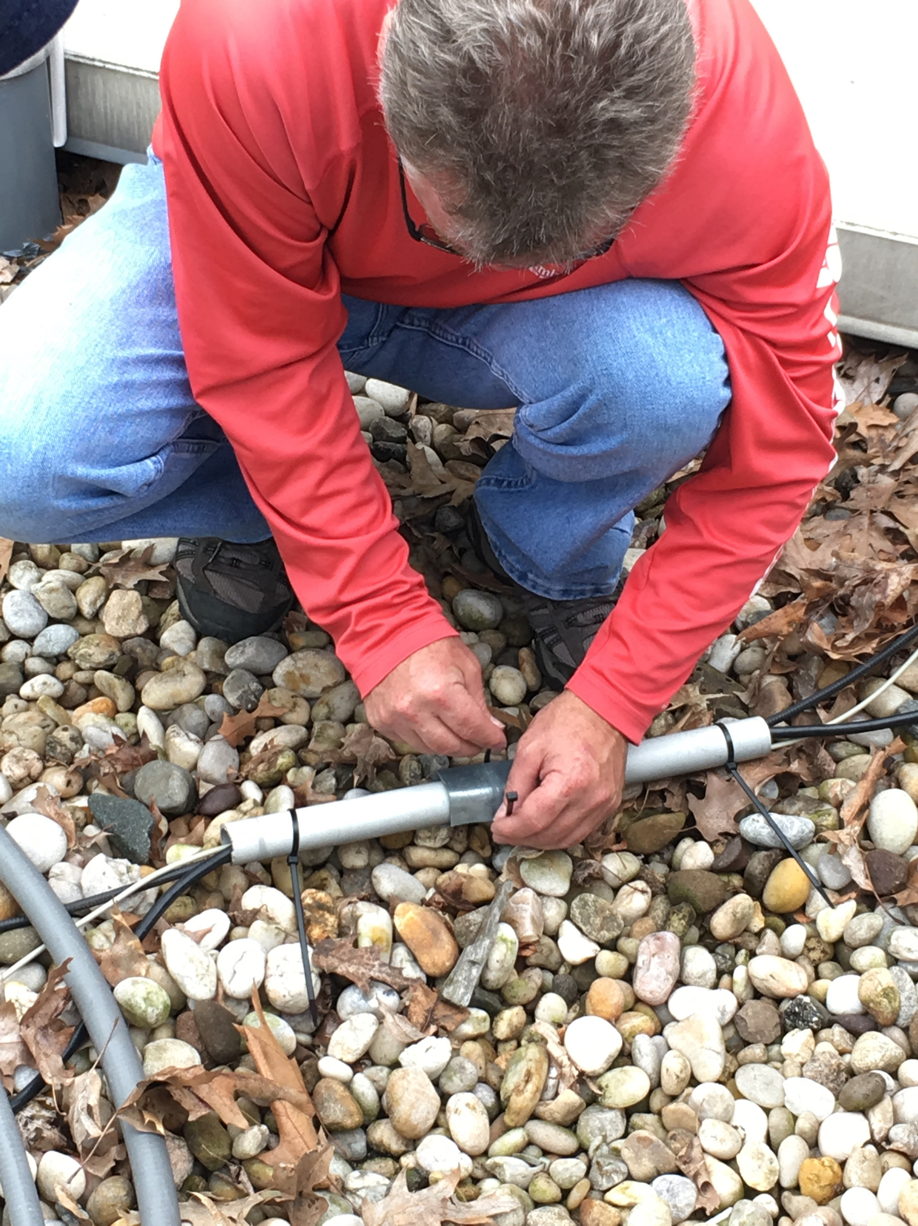
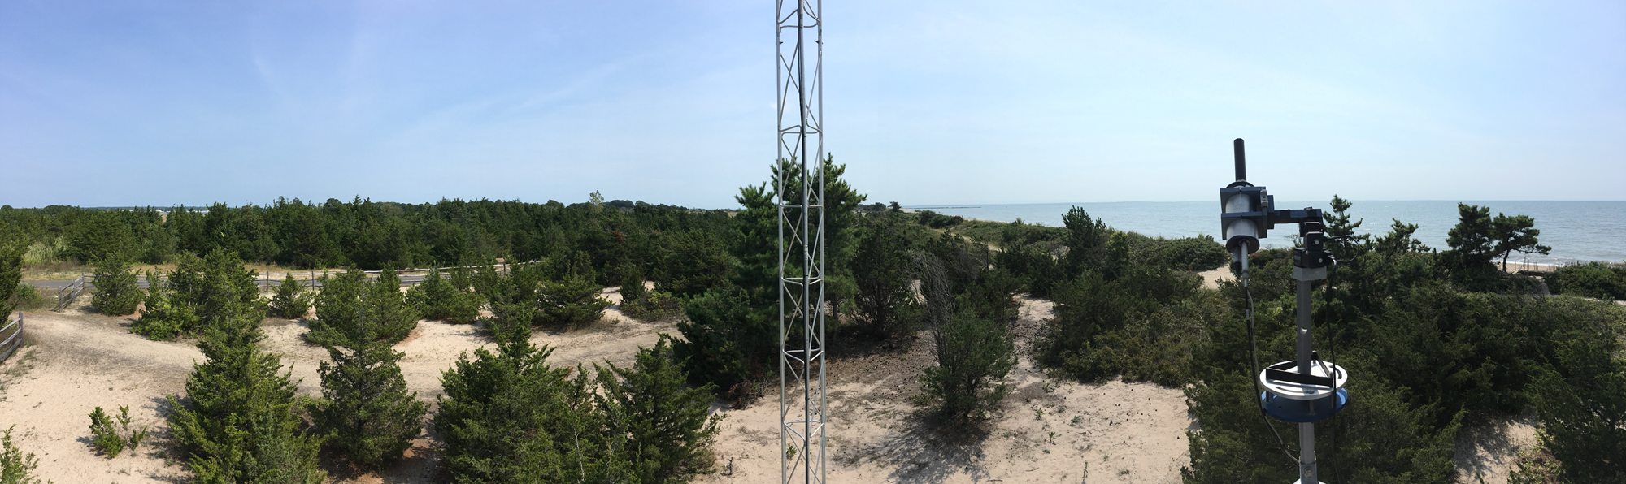
Luke Valin
Integrated AQ assessments
EPA Instrument PGN PI
Westport, CT
home of
Martha Stewart
Dave Williams
Old Field NY
Roof of Stony Brook
Flax Pond Marine Laboratory
Jim Szykman
Rooftop of Pfizer Laboratory
In NY Botanical Gardens, Bronx NY
CTDEEP Madison, CT SLAMS
Eric Baumann
The EPA Pandora Man
Network ops, administration,
Installation. Chapel Hill operator
Bayonne NJ, Port of Newark

Slide 3
Outline
Tropospheric Emissions: Monitoring of Pollution (TEMPO) mission
Emerging Validation Paradigm for TEMPO data products
Ground Remote Sensing Observations – Improving Validation Resources for Routine and Systematic Use
Wrap-up
3

Slide 4
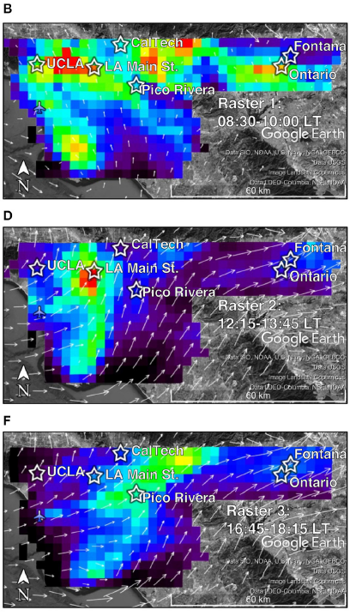
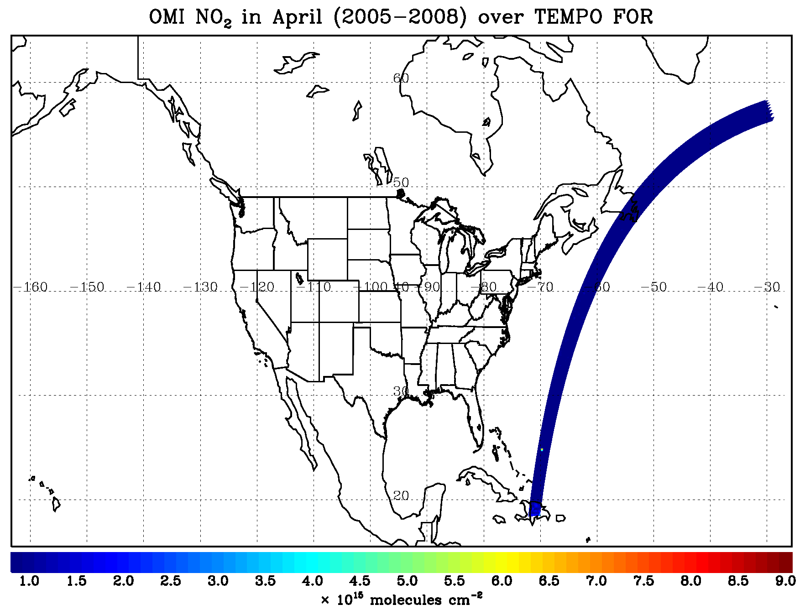
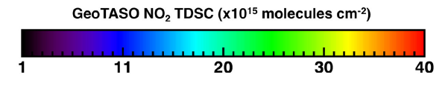
Tropospheric Emissions: Monitoring of Pollution –TEMPO
Moving to Time Resolved Observations at Neighborhood Scales
PI: Kelly Chance, Smithsonian Astrophysical Observatory
Current other Institutions: EPA, NASA LaRC, NASA GSFC, NOAA, NCAR, Harvard, UC Berkeley, St. Louis U, U Alabama Huntsville, U Iowa
International collaboration: Korea, Mexico, Canada, Europe
NO2 Columns from Airborne TEMPO Risk Reduction Mission
CONUS + parts of Canada and Mexico every hour at ~2.1 km
×4.6 km!
Los Angeles
9AM
TEMPO Instrument Integration onto Intelsat 40e
Los Angeles
1 PM
Los Angeles
530 PM

Slide 5
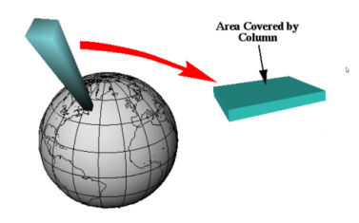
TEMPO Products and Requirements
Species/Products (geophysical product) | Required Precision | AQ relevance (All in surface- 1 km) | Temporal Revisit
0-2 km O₃ (Selected Scenes) Baseline only | 10 ppbv | 10 ppb | 2 hour
Tropospheric O₃ | 10 ppbv | 10 ppb | 1 hour
Total O₃ | 3% |  | 1 hour
Tropospheric NO₂ | 1.0 × 10¹⁵ molecules cm⁻² | 0.4 ppb | 1 hour
Tropospheric H₂CO | 1.0 × 10¹⁶ molecules cm⁻² | 4 ppb | 3 hour
Tropospheric SO₂ | 1.0 × 10¹⁶ molecules cm⁻² | 4 ppb | 3 hour
Tropospheric C₂H₂O₂ | 4.0 × 10¹⁴ molecules cm⁻² | 0.16 ppb | 3 hour
Aerosol Optical Depth | 0.10 |  | 1 hour
TEMPO observes vertical column densities
or number of molecules per cm²
Spatial resolution of ~2 km × 4.75 km; coarse (O3 profile) 8 km x 9.5 km – 12 km x 14.25 km
Up to 25% of observing time can be devoted to non-standard operational scans
  Two types envisioned:
    Events (e.g., eruptions, fires, dust storms, etc.)
    Experiments (non-standard scan patterns to explore phenomena, e.g. lightening NOx, mobile NOx emissions
Aerosols (AOD, SSA, AAI), SO2, C2H2O2 were removed from baseline products during project implementation. Funding via the Federal Satellite Needs Working Group will allow for products to be developed, timing is TBD.
5

Slide 6
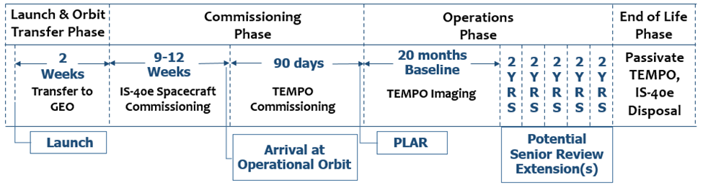
Operational Schedule for TEMPO Mission after launch
Public Data Release Required 6 months after Commissioning Phase ~March 2024
Current Launch Schedule March 2023

Slide 7
TEMPO Validation - Geophysical Data Products
Product Validation Maturity Levels:
Beta: the product is minimally validated but may still contain significant errors; based on product quick looks using the initial calibration parameters. Publication of research based on Beta maturity products is not recommended and highly discouraged.
Provisional: product performance has been demonstrated through a large, but still (seasonally or otherwise) limited number of independent measurements. The analysis is sufficient for limited qualitative determinations of product fitness-for-purpose, and the product is potentially ready for testing by operational users and may be suitable for scientific publication.
Full: product performance has been demonstrated over a large and wide range of representative conditions, with comprehensive documentation of product performance, including known anomalies and their remediation strategies. Products are ready for systematic use and covering the full range of scientific and application use and publication.

Slide 8
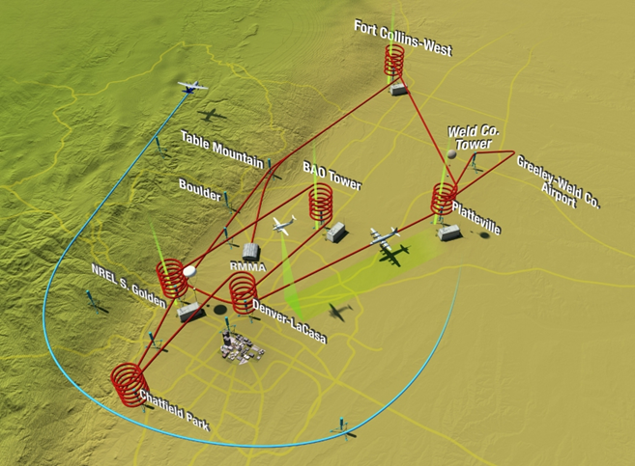
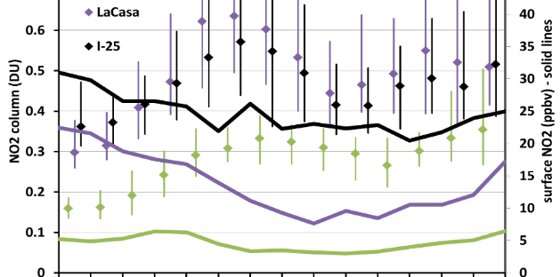
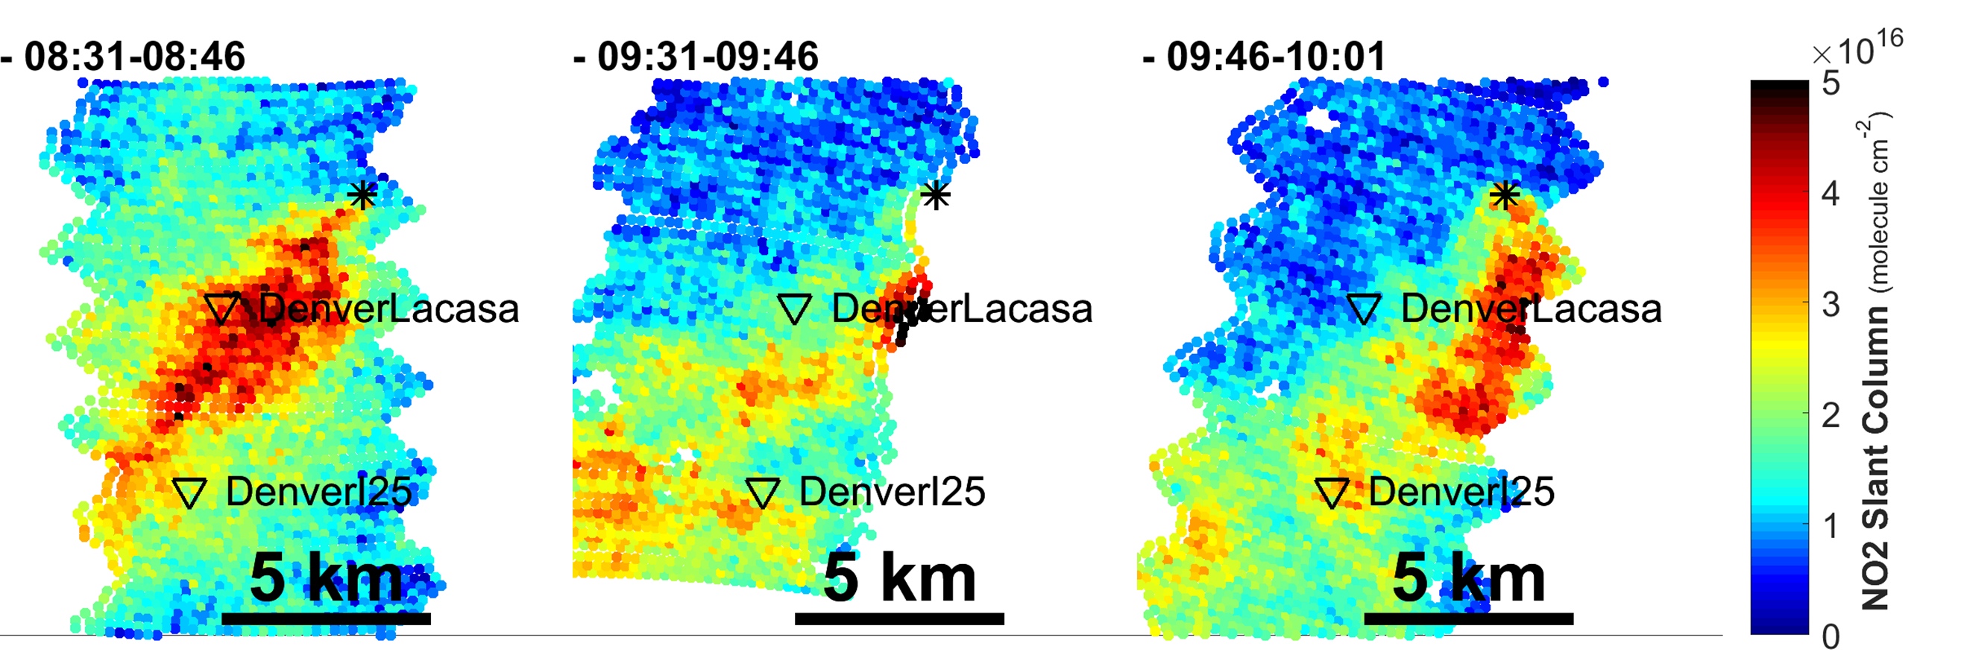
Key Capacity Building Efforts associated (TEMPO) Satellite Validation
Column vs Surface Pollution:
SLAMS +
NASA Airborne +
EPA/NASA/ESA Pandora
NASA DISCOVER-AQ mission 2011-2014 kick-started a new paradigm on measurement strategies to connect satellite and surface observations, along with a decade+ effort to improve on emerging remote sensing technologies.
Field Campaigns such as KORUS-AQ, LMOS, LISTOS, MOOSE, TRACER-AQ have been a key driver in continued maturity of remote sensing measurements and algorithms for the development of independent geophysical measurement for satellite validation:
  Pandora Spectrometer
  NASA airborne spectrometers (GCAS/GEOTASO)
  Tropospheric Ozone Lidar Network
  Associated retrieval algorithms including Planetary Boundary Layer Heights now being used by the Unified Ceilometer Network
EPA-ORD has played a key role in assisting NASA and ESA mature the pandora ground-based spectrometer which now serves as the primary validation instrument for satellite data and adoption as a Fiducial Reference Measurement by EU Copernicus Program.
SLAMS and Pandora
NASA Airborne Mapper

Slide 9
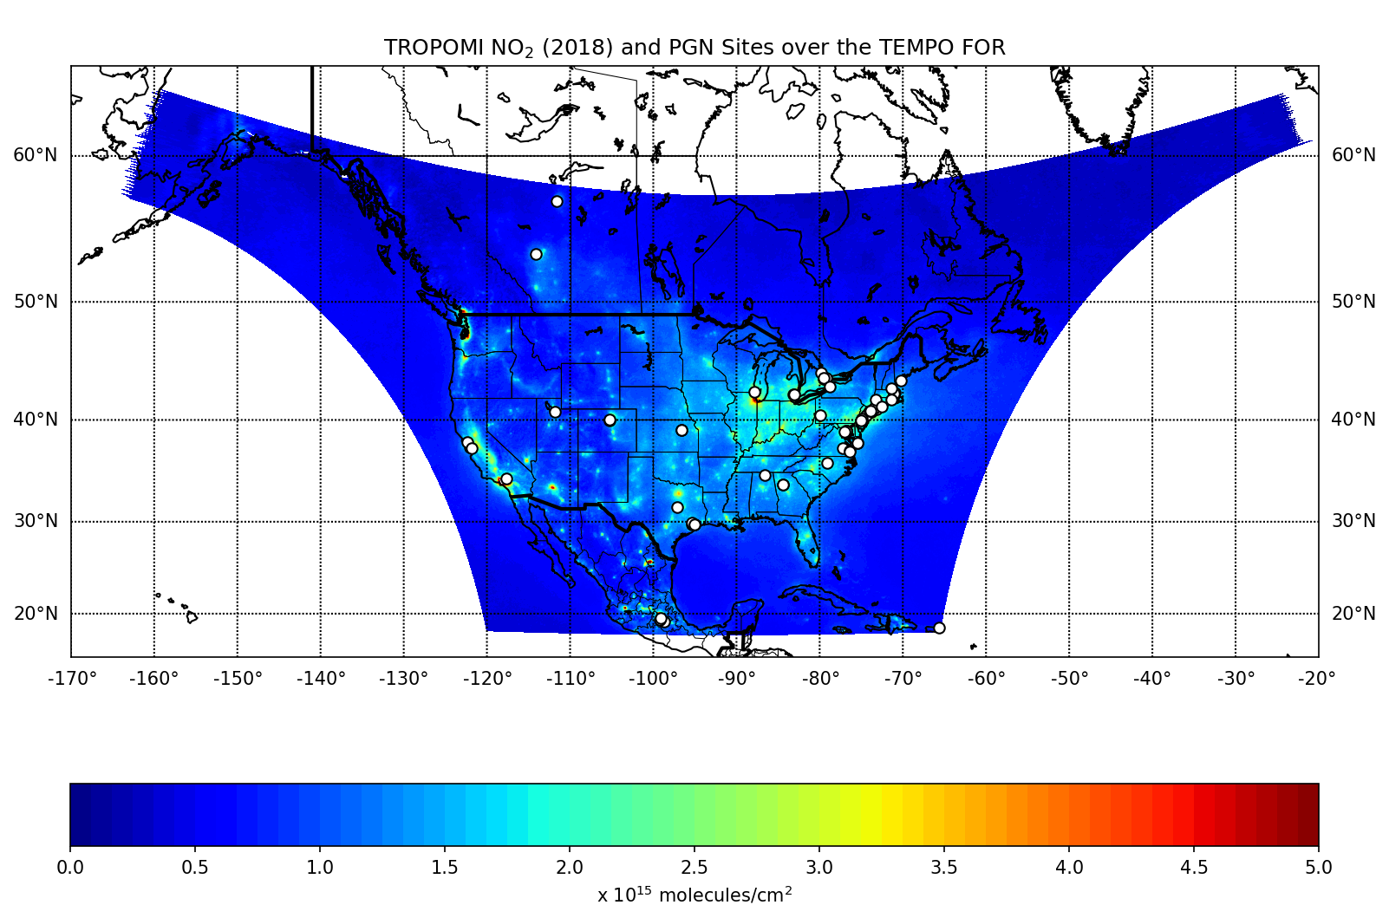
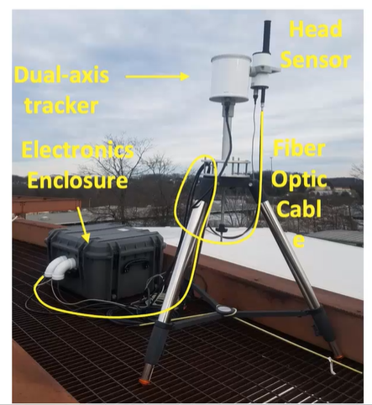
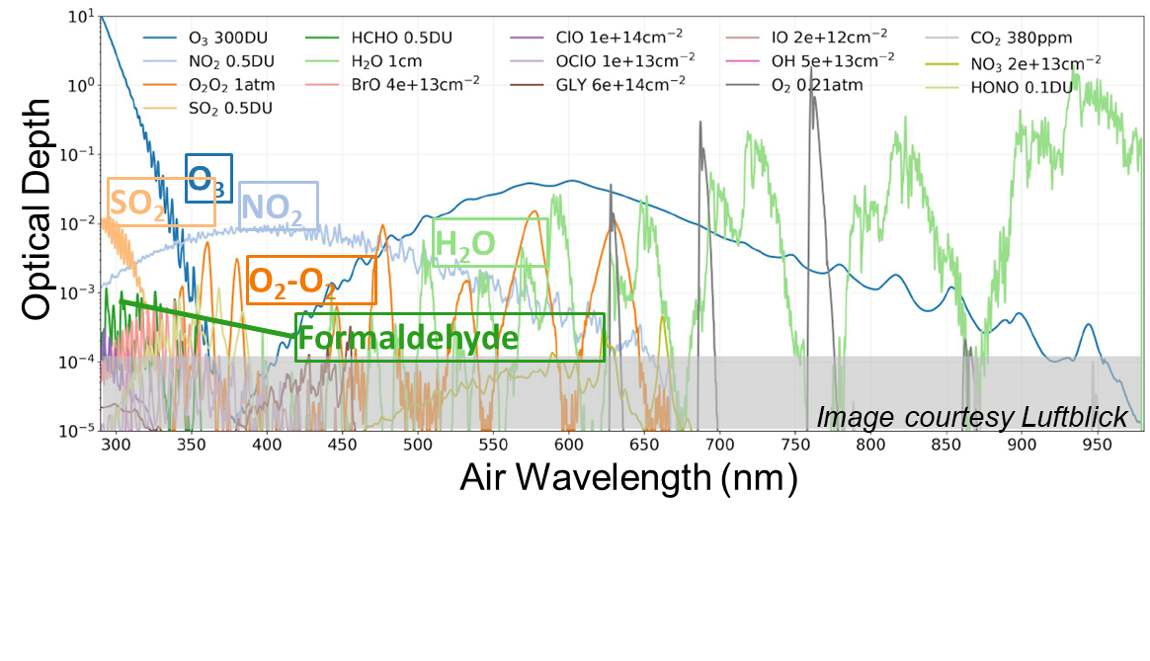
EPA is a key partner with NASA and ESA in transitioning remote sensing research measurements into operational networks in USA for use in TEMPO validation
Owner/Agency | # Units
University/Other | 16
NASA | 17
EPA | 24
ECCC | 9
NOAA | 1
Pandora is a ground-based sun/sky/moon viewing spectrometer system
The sensor head (light collector) is mounted on a 2-axis tracker
Sun/sky/moon-light is directed to the input of a cool spectrometer through a fiber optic cable
Control electronics for semi-autonomous operation in a-weather conditions
Trace gases are derived from spectrally resolved UV/Visible radiances using Direct Sun and/or MAX-DOAS retrievals
In North America both EPA and Environment and Climate Change Canada (ECCC) PGN sites are collocated within the existing AQ Networks to support routine and systematic validation for TEMPO and other satellites on a long-term basis.

Slide 10

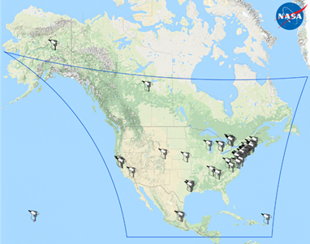

PGN: A key TEMPO validation resource
PGN v1.8 processor version developed during 2020
Tot = Total column amount based on direct sun observations
Prof = Tropospheric column amount, surface concentration and profile information based on sky observations (MAXDOAS type)
Product | Changes compared to v1.7
NO₂ Tot | Improved fitting settings, inclusion of stratospheric climatology, more comprehensive uncertainty, improved field calibration
NO₂ Prof | Added profile information (tropospheric column and surface concentration existed)
O₃ Tot | Improved fitting settings, fitting effective temperature, more comprehensive uncertainty, new field calibration technique
SO₂ Tot | New product
HCHO Tot | New product
HCHO Prof | Added profile information (tropospheric column and surface concentration existed)
Pandonia-global-network.org :
NASA, ESA, EPA, ECCC, academics and more

Slide 11
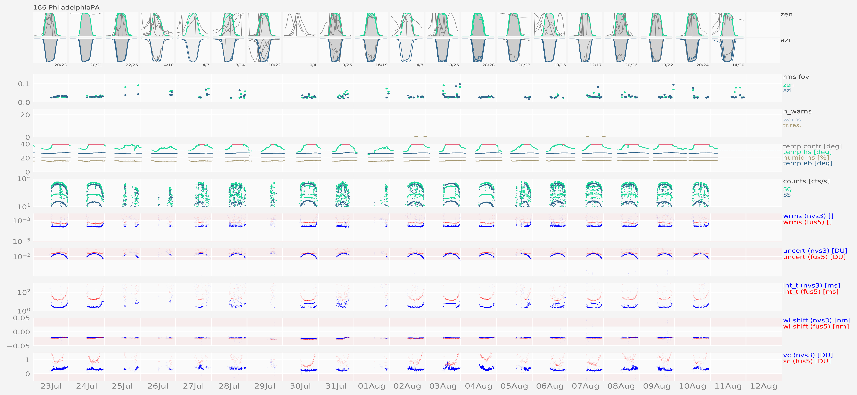
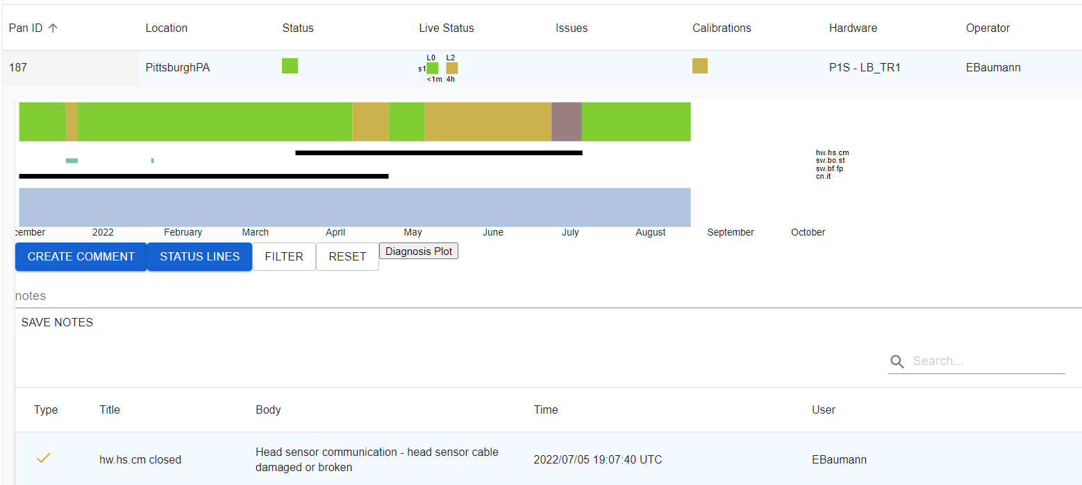
Building QA Routine and Systematic Data Sets for TEMPO Validation (1)
Pandora/PGN Quality Assurance
Ensuring High Quality Data involves Daily Checks. These checks ensure the Pandora is operating at full capacity with zero issues.
Ensures the FOV is unobstructed
Monitors the diagnosis are within tolerable levels
Signifies amount of light reaching spectrometer
Current Status
If a Daily Check sparks any concerns about the data, a detailed check is initiated.
For example, the Red Box in the diagnosis section indicated high Temperature Levels. This requires a more detailed investigation.
Operation History
Status of Issues

Slide 12
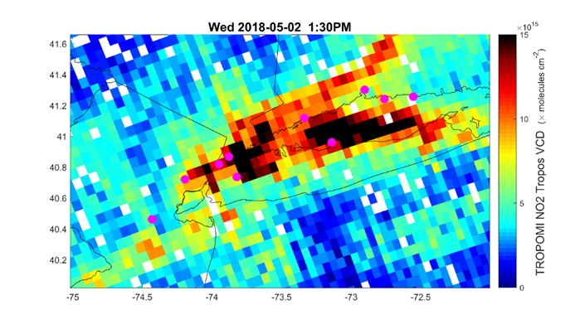
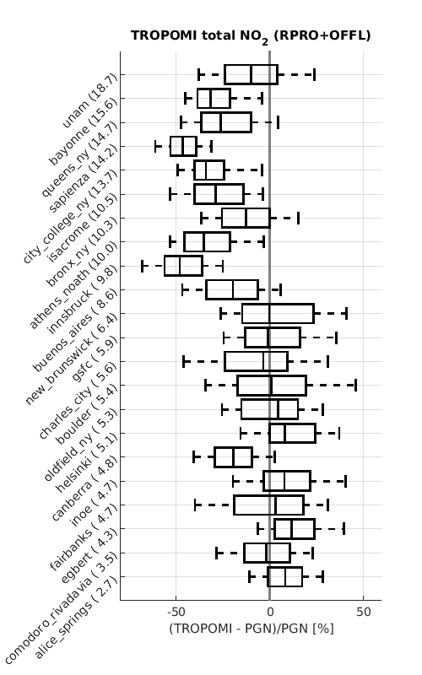
Examples: Pandora Long-Term Deployments provide a more Routine and Systematic Evaluation of Satellite NO₂ data
EPA pandoras hosted by state and local agencies
TROPOMI NO₂ – May 2, 2018
Increasing NO2 column
The PGN provides years-long data sets from around the world to compare with TROPOMI
(Pandoras in the OTR )
These types of comparisons can be used to refine TEMPO retrievals
Judd et al, Evaluating Sentinel-5P TROPOMI tropospheric NO2 column densities with airborne and Pandora spectrometers near New York City and Long Island Sound, AMT, 2020.
Verhoelst et al, : Ground-based validation of the Copernicus Sentinel-5p TROPOMI NO₂ measurements with the NDACC ZSL-DOAS, MAX-DOAS and Pandonia global networks, AMT, 2021.
12
12
12

Slide 13
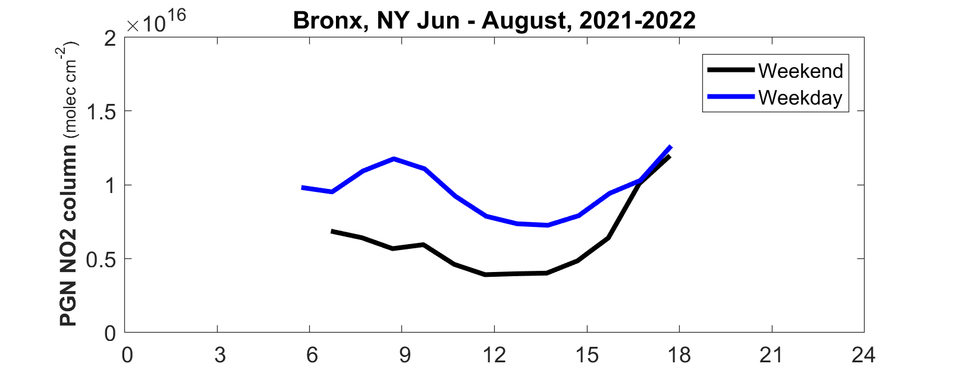
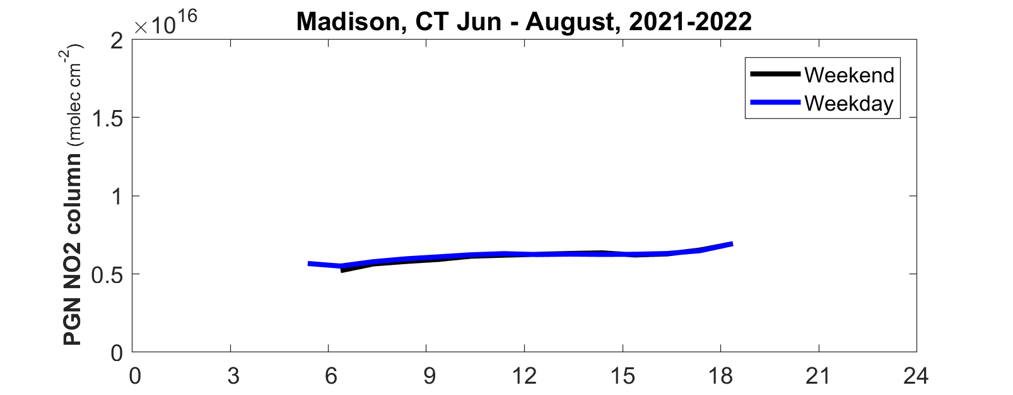
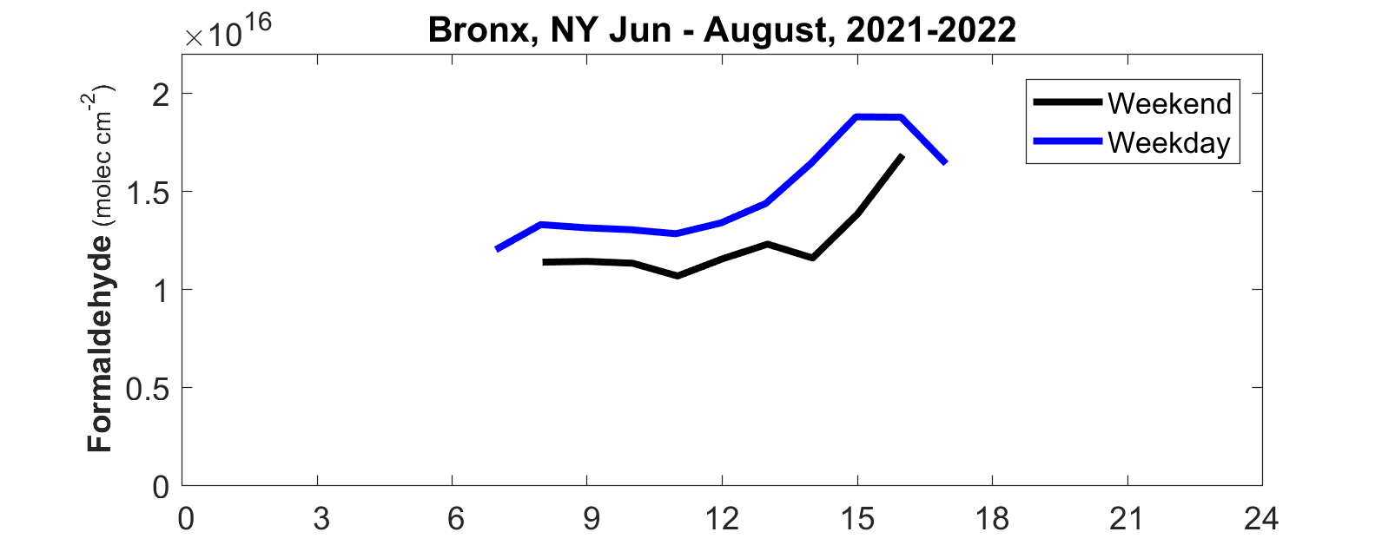
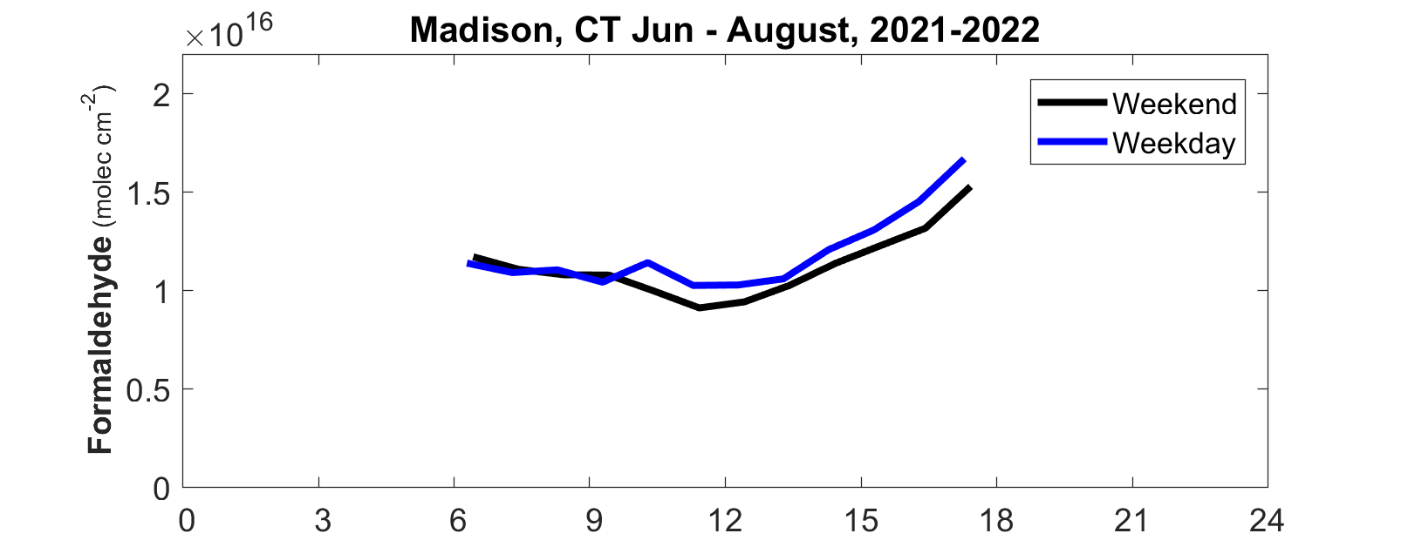
PGN/Pandora: A key TEMPO validation resource
The PGN via Pandora spectrometers are making measurements of a geophysical variable never measured in an operational research network.
Development of appropriate QA metrics is an on-going process.
Preliminary data products are very promising and providing the first reveal of key trace gas columns at high temporal frequencies on long term basis.
Preliminary data

Slide 14
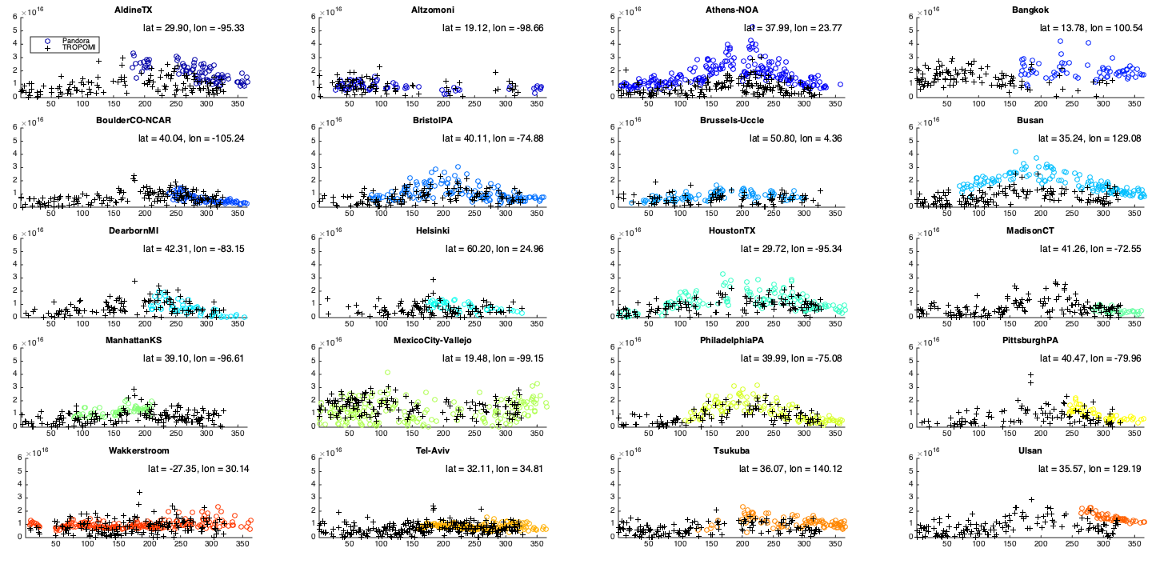

Formaldehyde: TROPOMI (+) and Pandora (o)
HCHO Column
Day of Year 2021
Credit: Jin Liao NASA GSFC

Slide 15
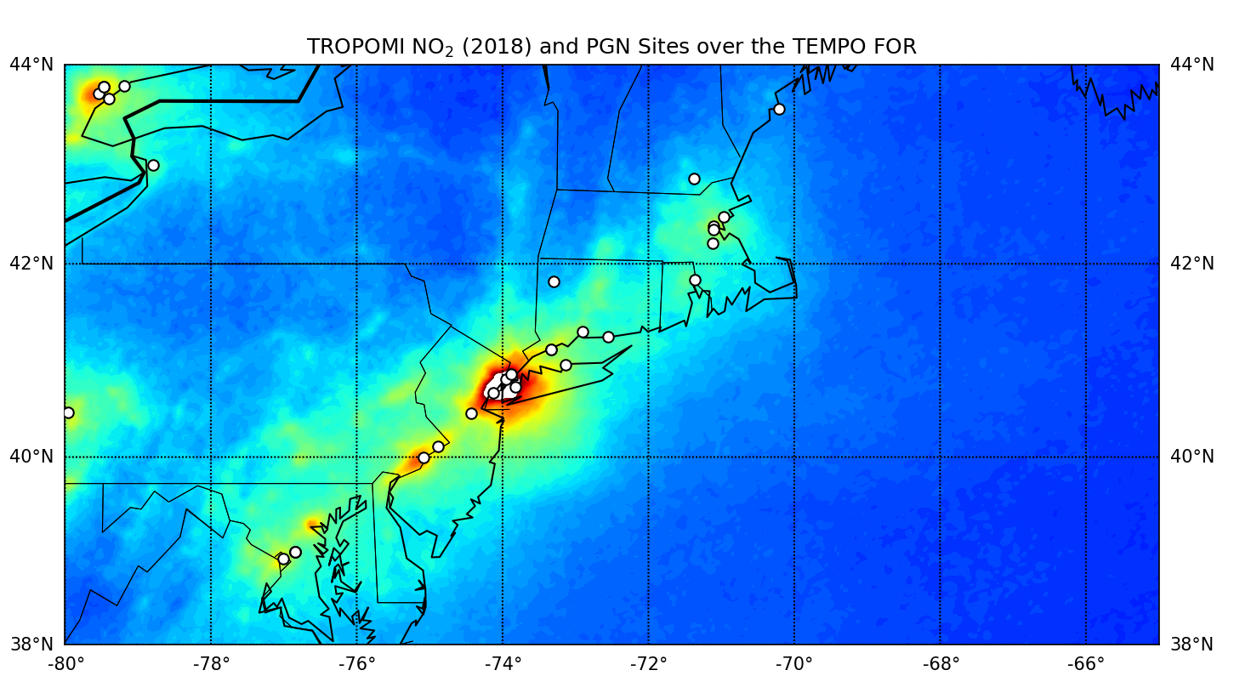
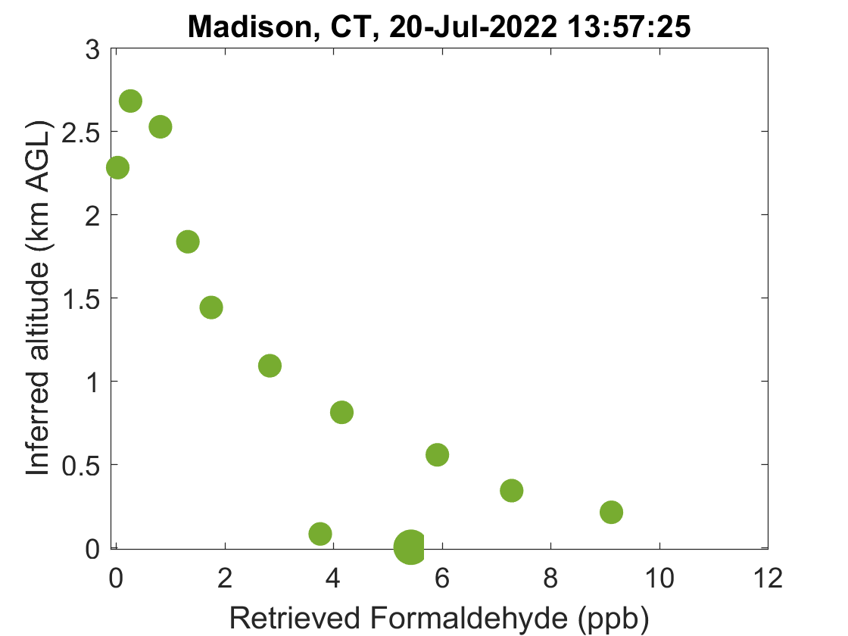
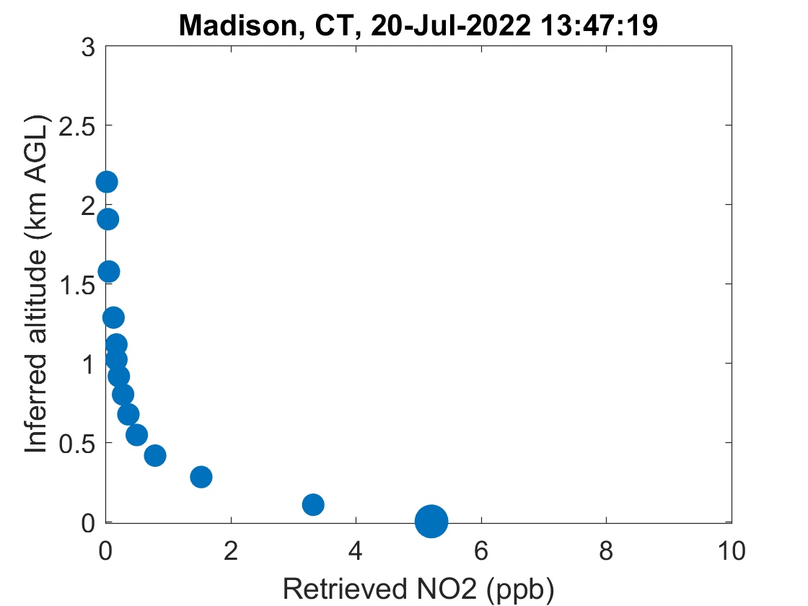
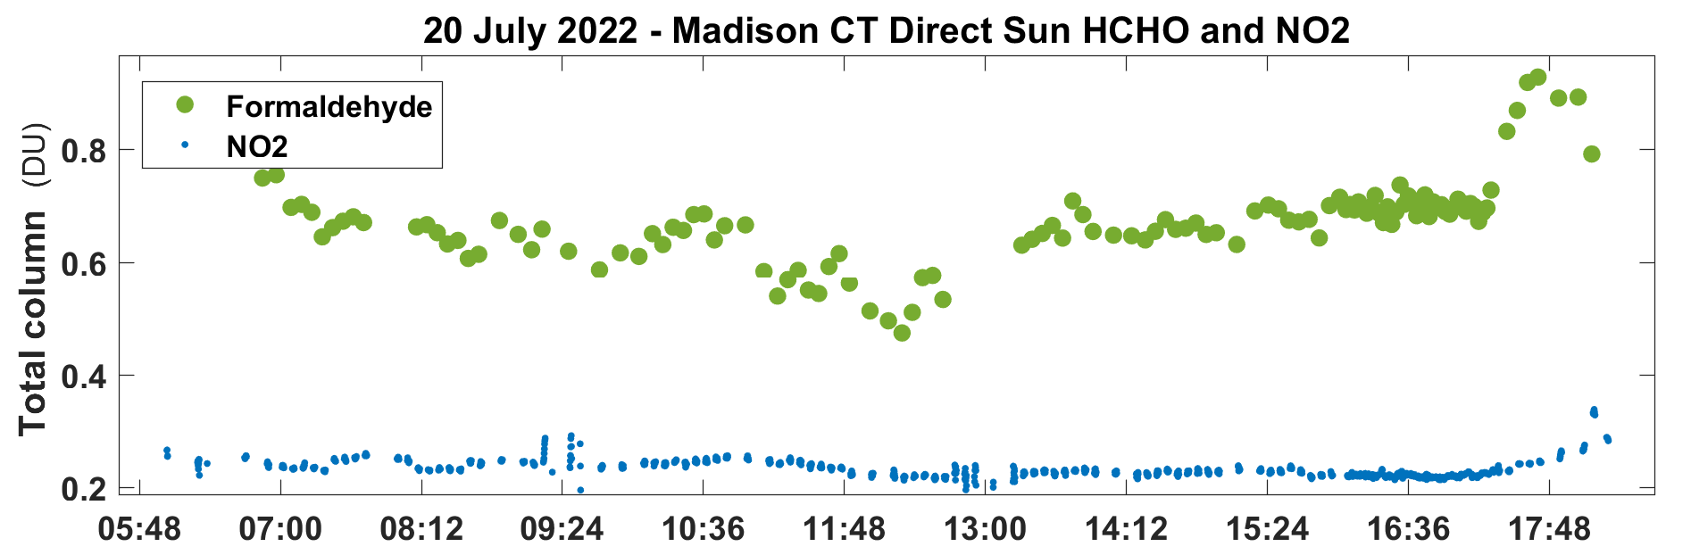
PGN in 2023 Studies
Validation data for GCAS, TEMPO, TROPOMI SO2, HCHO, O3, NO2 data products
Support model evaluation
Use flight profiles and surface in situ monitoring to assess the PGN vertical profile products
Tie study results to long-term records (several dating to 2018)
1 example sky-scan profile of ~40 daily in the default PGN sampling routine
12 PGN site location between Philadelphia and Rhode Island located at AQ stations

Slide 16
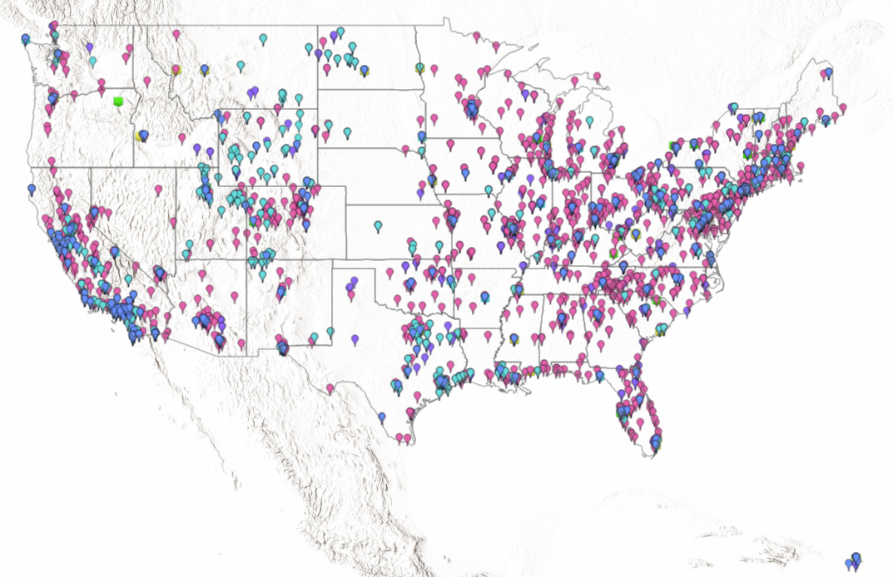
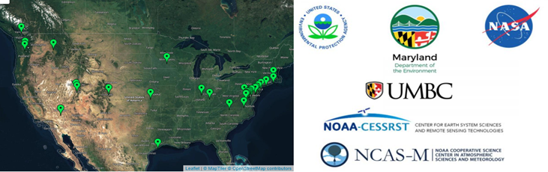
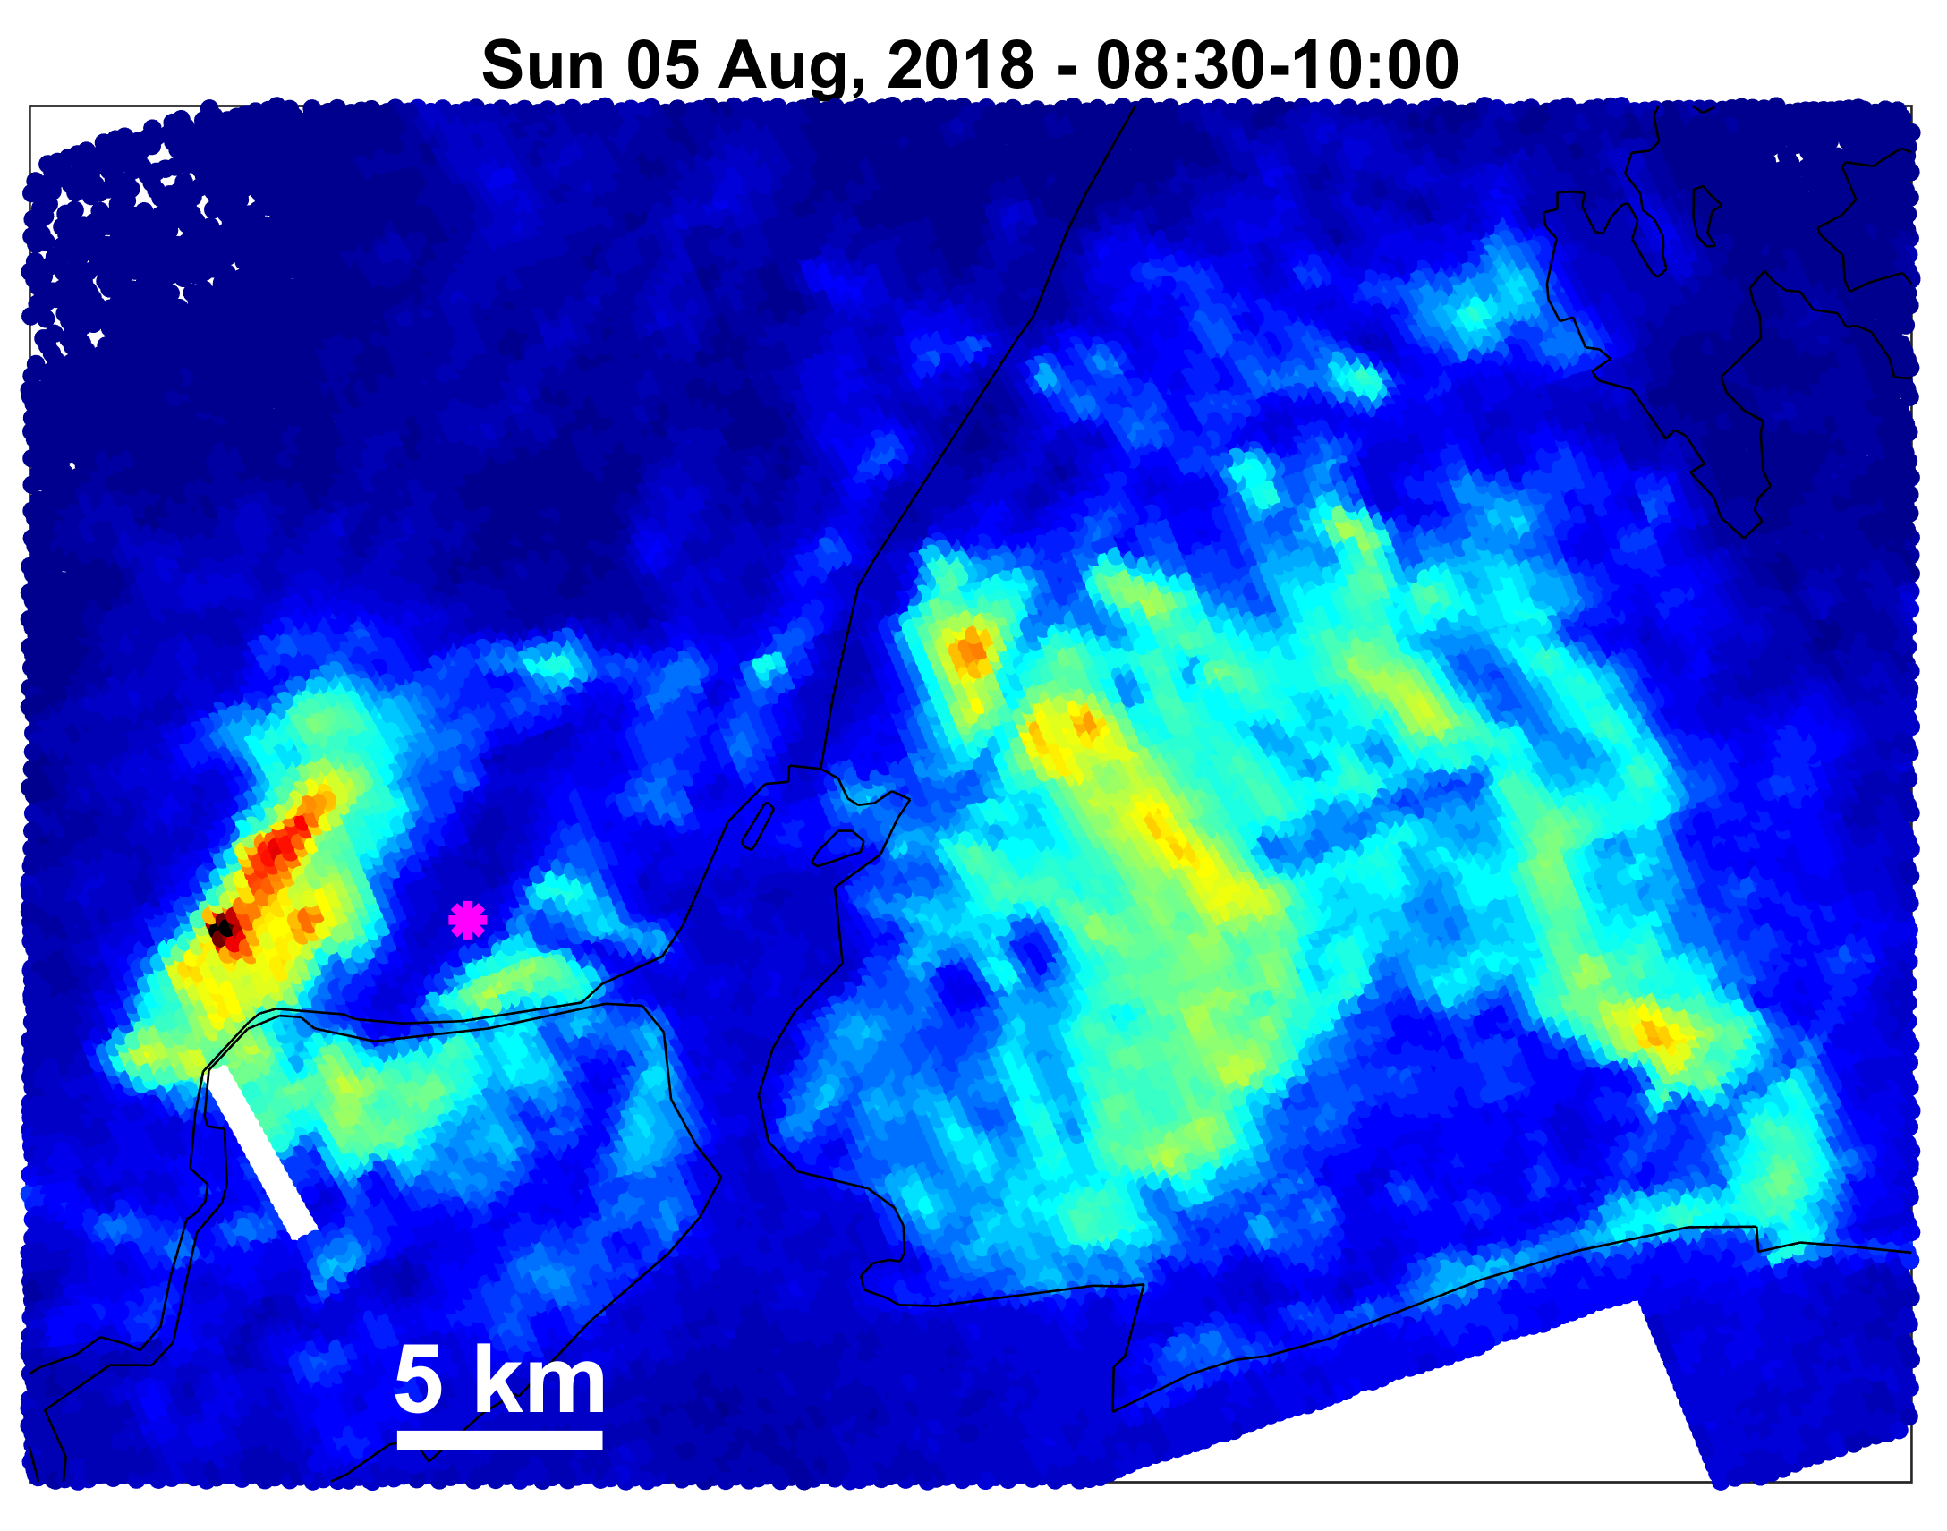
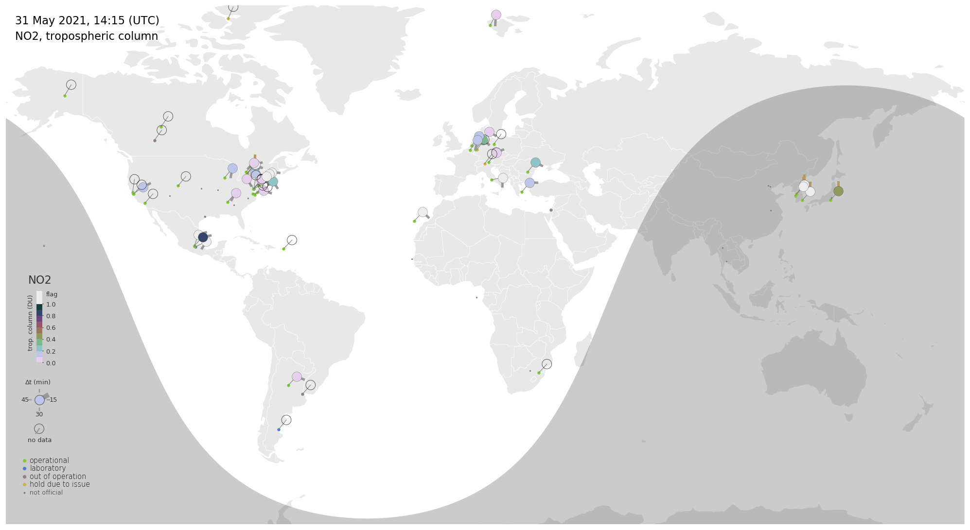
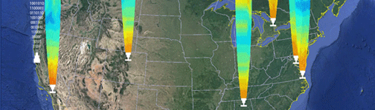

Wrap-Up
A concerted effort is developing for validation of TEMPO data products which is based on leveraging both operational and research air quality monitoring systems.
TEMPO validation efforts will provide routine and systematic (on-going) validation through the PGN and more complex (episodic) validation via planned science campaigns with focus on satellite data and local air quality.
New remote sensing products developed for TEMPO validation also provide a novel and highly valuable tools to better characterize air quality and meteorology within the conventional AQ management framework (e.g., trends analyses, process studies, chemical transport model evaluation).
Field Studies
High-density sensor networks
US EPA and state air quality monitoring networks
Unified Ceilometer Network
Field Studies
Pandonia Global Network
Ports, railyards, highways
Newark Airport

Slide 17

Contacts
Jim Szykman
Senior Research Engineer
Center for Environmental Measurements and Modeling
US EPA Office of Research and Development
Szykman.Jim@epa.gov
Thank You!
28
The views expressed in this presentation are those of the authors and do not necessarily reflect the views or policies of the US EPA. Any mention of trade names, products, or services does not imply an endorsement by the US Government or EPA. EPA does not endorse any commercial products, services, or enterprises.

