Slide 1
Assessment of Vulnerability to Wildfire-induced PM2.5 in the U.S. Using Community Multiscale Air Quality Modeling System
Jihoon Jung, postdoc,
University of North Carolina at Chapel Hill
Department of city and regional planning
Joseph Wilkins, PhD, Howard University
Claire Schollaert, PhD Candidate, University of Washington

Slide 2
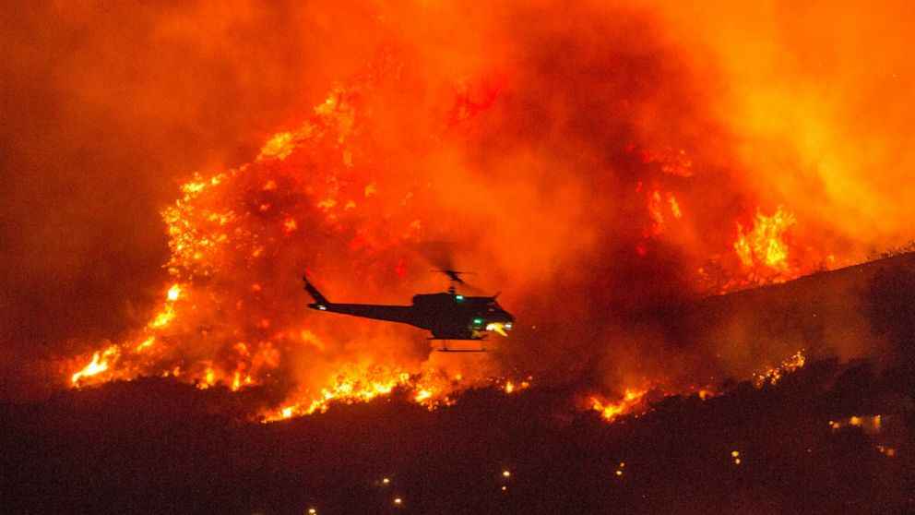
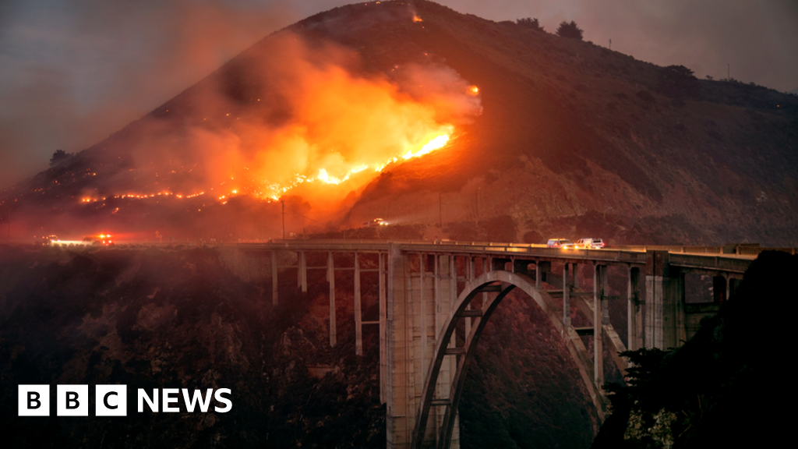
Introduction
Wildfires have become more severe, frequent, longer lasting over the past decades
Notes:
1. demographically vulnerable groups (e.g. the elderly, young children) 2. socioeconomically vulnerable groups (e.g. outdoor workers) 3. those with preexisting diseases (e.g. diabetes, obesity, asthma, COPD, hypertension)

Slide 3
Introduction
Wildfires have become more severe, frequent, longer lasting over the past decades
The impact of wildfires depends not only on biophysical aspects of the events, but also socio-economic aspects of differential societies or population groups
Notes:
1. demographically vulnerable groups (e.g. the elderly, young children) 2. socioeconomically vulnerable groups (e.g. outdoor workers) 3. those with preexisting diseases (e.g. diabetes, obesity, asthma, COPD, hypertension)

Slide 4
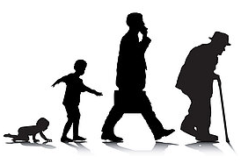
Introduction
Wildfires have become more severe, frequent, longer lasting over the past decades
The impact of wildfires depends not only on biophysical aspects of the events, but also socio-economic aspects of differential societies or population groups
Several communities may experience disproportionately higher smoke exposure than other groups
Notes:
1. demographically vulnerable groups (e.g. the elderly, young children) 2. socioeconomically vulnerable groups (e.g. outdoor workers) 3. those with preexisting diseases (e.g. diabetes, obesity, asthma, COPD, hypertension)

Slide 5
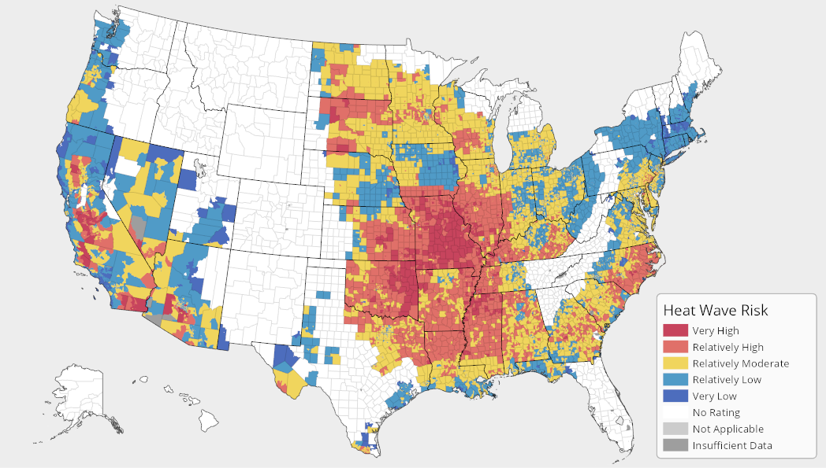
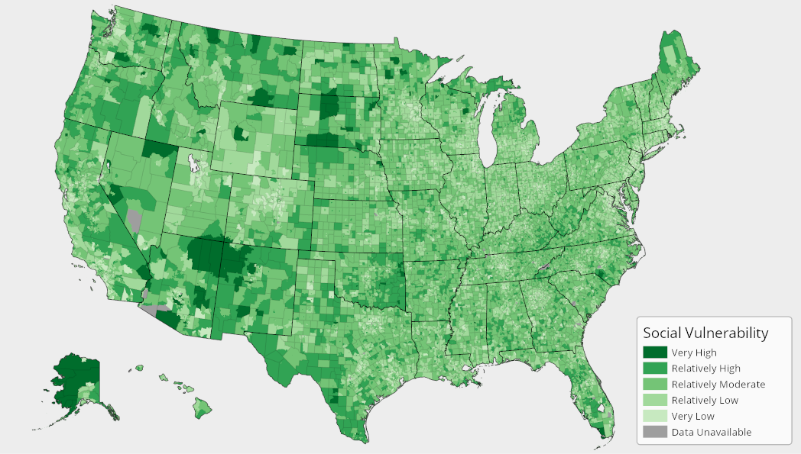
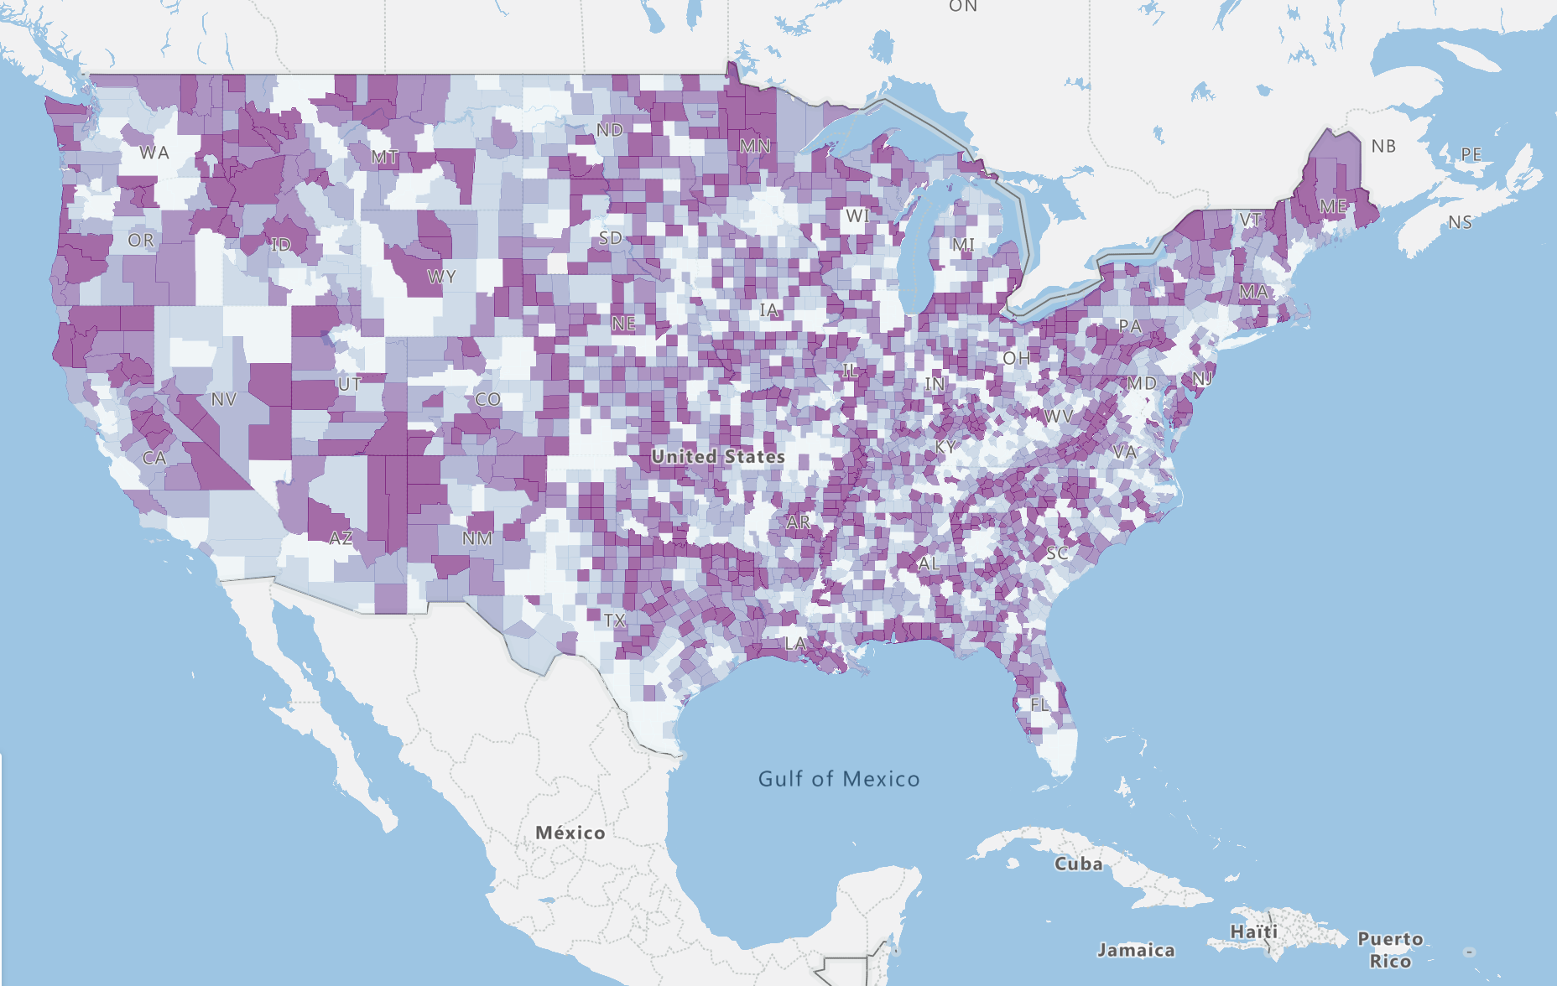
Introduction (Cont.)
Vulnerability assessment may help evaluate the degree of susceptibility of communities to natural hazards
Following the IPCC definition of vulnerability, I used 3 components (exposure, sensitivity, adaptive capacity) to generate one composite vulnerability index
Notes:
This tool has been widely used to decrease population vulnerability, increase adaptive capacity and resilience to cope with disasters, and prepare effective disaster prevention and reduction

Slide 6
Research questions
Investigate counties more or less vulnerable to wildfire induced PM2.5.
Look at what components (exposure, sensitivity, adaptive capacity) lead to lower or higher vulnerability
Examine the relationship between PM2.5 exposure and sensitivity/adaptive capacity.
Calculate population size and number of counties at high risk
Notes:
This tool has been widely used to decrease population vulnerability, increase adaptive capacity and resilience to cope with disasters, and prepare effective disaster prevention and reduction

Slide 7
Method & data

Slide 8
Method & data

Slide 9
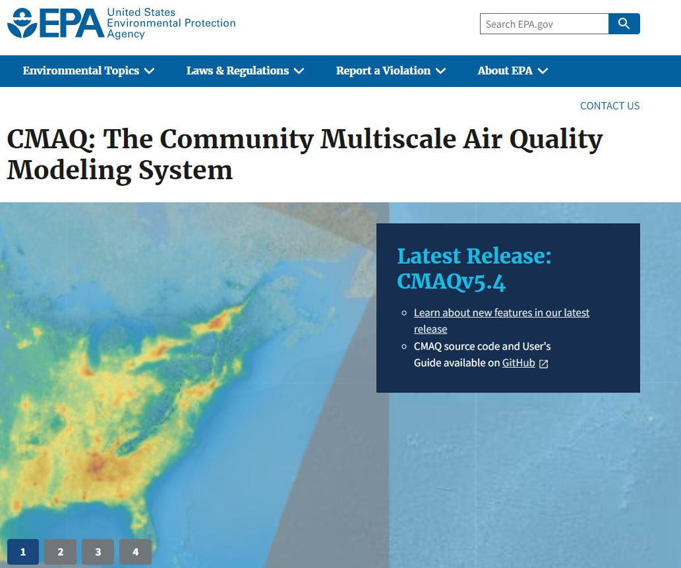
Method & data
2008 to 2018
High exposure -> high vulnerability

Slide 10
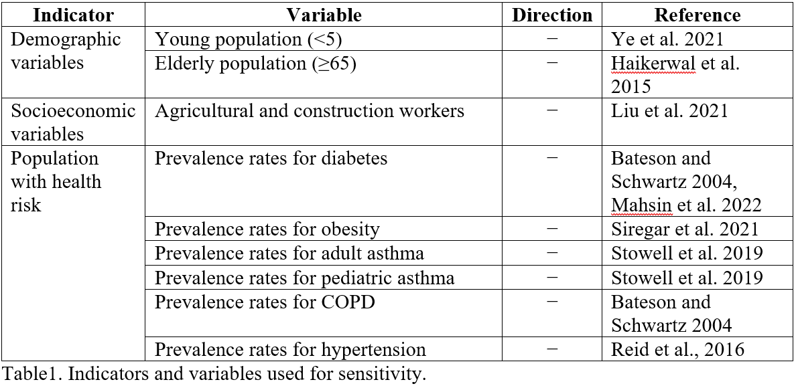
Method & data
High sensitivity -> high vulnerability
Notes:
8 variables

Slide 11
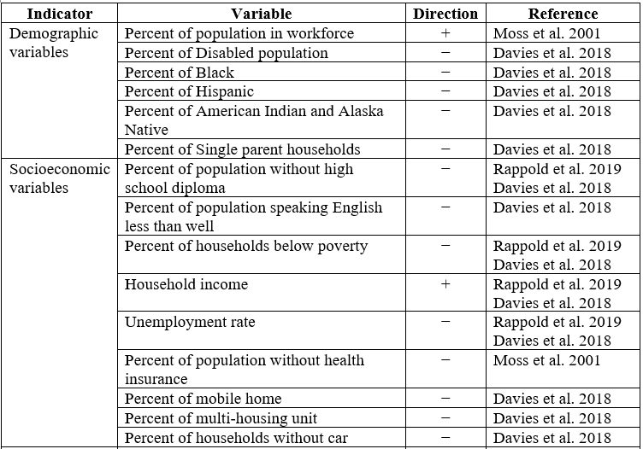
Method & data
Notes:
20 variables

Slide 12
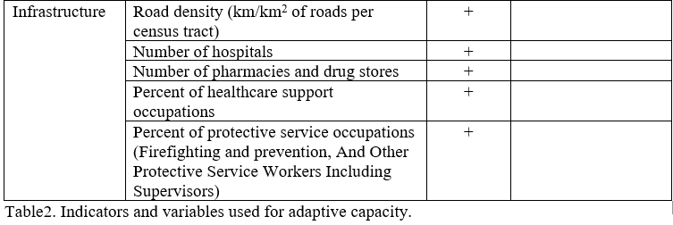
Method & data
Low adaptive capacity -> high vulnerability

Slide 13
Method & data
Normalized each variable to a scale between 0 and 1 because each variable has its own unit and direction.

Slide 14
Method & data
Assumed the same weight between variables
->
Take average of all variables within each component

Slide 15
Method & data
Assumed the same weight between components
->
Vulnerability = Exposure × Sensitivity ×
Adaptive capacity
e.g. If exposure = 0, vulnerability = 0

Slide 16
Result
Adaptive capacity -> Southern (more vulnerable) < Northern
Sensitivity: -> Eastern > Western (more vulnerable)
Exposure: -> Eastern (more vulnerable) > Western

Slide 17
Result
Vulnerability: Eastern (more vulnerable) > Western

Slide 18
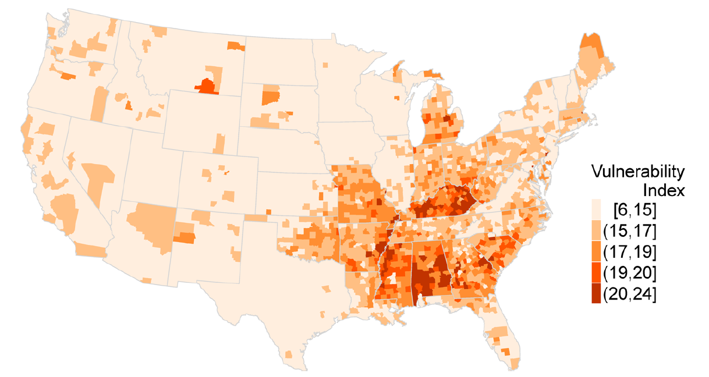
Result
Rappold, A. G., Reyes, J., Pouliot, G., Cascio, W. E., & Diaz-Sanchez, D. (2017). Community vulnerability to health impacts of wildland fire smoke exposure. Environmental Science & Technology, 51(12), 6674-6682.

Slide 19
Associations between sensitivity/adaptive capacity and exposure
Sensitivity
Adaptive capacity
Exposure
Exposure
More sensitive counties tend to be exposed to higher PM2.5 exposure
Higher adaptive capacity counties tend to be exposed to higher PM2.5 exposure

Slide 20
Number of counties at risk summarized by annual average PM2.5 and sensitivity

Slide 21
Number of counties at risk summarized by annual average PM2.5 and sensitivity
More sensitive counties were more likely to have high PM2.5 exposure than less sensitive counties

Slide 22
Number of counties at risk summarized by annual average PM2.5 and sensitivity
More sensitive counties were more likely to have high PM2.5 exposure than less sensitive counties
More than 80% of most sensitive counties were exposed to higher PM2.5 while about 70% of less sensitive counties were exposed to lower PM2.5

Slide 23
Number of counties at risk summarized by annual average PM2.5 and sensitivity
More sensitive counties were more likely to have high PM2.5 exposure than less sensitive counties
More than 80% of most sensitive counties were exposed to higher PM2.5 while about 70% of less sensitive counties were exposed to lower PM2.5
Most sensitive counties tend to have higher percent of the highest PM2.5 exposure

Slide 24
Population size at risk summarized by annual average PM2.5 and sensitivity

Slide 25
Population size at risk summarized by annual average PM2.5 and sensitivity
About 6 million most sensitive people are exposed to higher PM2.5 exposure

Slide 26
In summary
Adaptive capacity-> Southern (more vulnerable) < Northern
Sensitivity: -> Eastern > Western (more vulnerable)
Exposure: -> Eastern (more vulnerable) > Western
Vulnerability: Eastern (more vulnerable) > Western
More sensitive counties are more exposed to PM2.5 exposure
Higher adaptive capacity counties are more exposed to PM2.5 exposure
About 6 million most sensitive people are exposed to higher PM2.5 exposure

Slide 27
Next steps
How to validate the index?
Find the association between vulnerability and landownership (state, federal, private sector) and WUI (wildland urban interface) vs. non-WUI
NASA (funding support – Grants # 80NSSC22K1480 & # 80NSSC22K1684 )

Slide 28
Thank you
Jihoon Jung
climategeo@gmail.com

Slide 29
exposure as “the degree, duration, and extent in which the system is in contact with, or subject to, the perturbation
sensitivity as “the degree to which a system is affected, either adversely or beneficially by natural hazards” (IPCC, 2014)
adaptive capacity as “the ability of a system to adjust to natural hazards to moderate potential damages”

Slide 30
Number of counties at risk summarized by annual average PM2.5 and adaptive capacity
Lower adaptive capacity counties were more likely to have higher PM2.5 exposure than the highest adaptive capacity counties

Slide 31
Number of counties at risk summarized by annual average PM2.5 and adaptive capacity
Lower adaptive capacity counties were more likely to have higher PM2.5 exposure than the highest adaptive capacity counties
Higher percent of most sensitive counties tend to have higher PM2.5 exposure

Slide 32
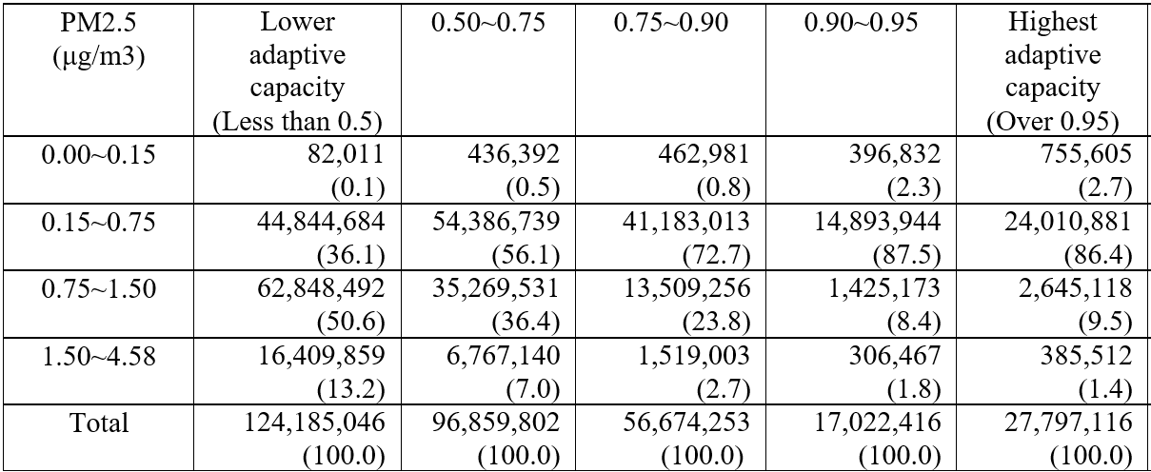
Number of counties at risk summarized by annual average PM2.5 and adaptive capacity

