Slide 1

Development and application of the Community Regional Atmospheric Chemistry Multiphase Mechanism (CRACMM) version 1.0
Havala O. T. Pye¹, Bryan Place¹, Christine Allen², Emma D’Ambro¹, Wyat Appel¹, Jesse Bash,¹ Matt Coggon³, Sara Farrell¹, Kristen Foley¹, Christian Hogrefe¹, Bill Hutzell¹, Faye McNeill⁴, Ben Murphy¹, Ivan Piletic¹, George Pouliot¹, Rebecca Schwantes³, Golam Sarwar¹, Emily Saunders¹, Karl Seltzer¹, Heather Simon¹, William R. Stockwell⁵, Luke Valin¹, Forwood Wiser⁴, Lu Xu³, and the CMAQ Team
¹U.S. EPA, ²General Dynamics Information Technology, ³NOAA/CIRES, ⁴Columbia University, ⁵University of Texas El Paso
The views expressed in this presentation are those of the authors and do not necessarily reflect the views or policies of the U.S. EPA.
Office of Research and Development
Center for Environmental Measurement and Modeling (CEMM), Atmospheric and Environmental Systems Modeling Division
CMAS 2022 Conference
19 October 2022
Notes:
Havala Pye
I’ve been leading a team to develop…

Slide 2
CRACMM
Mechanisms describe how gas-phase emissions connect to secondary species like ozone.
CRACMM1 is a new mechanism in the Community Multiscale Air Quality (CMAQ) modeling system (v5.4).
  508 total reactions (compare to MCM: 17,000; GEOS-Chem: 913; CB6r3: 343).
  229 total chemical species (compare to MCM: 6,700; GEOS-Chem: 287; CB6r3: 194).
Consideration of multiple endpoints:
  Ozone/gas-phase radical chemistry,
  Aerosol including secondary organic aerosol (SOA),
  Cancer/noncancer health risk from toxic species (formaldehyde, benzene, etc),
  Capturing all reactive organic carbon (ROC)¹ emissions to air.
Considering multiple endpoints provides additional system constraints.
¹Safieddine et al., GRL 2017
Notes:
CRACMM is like many mechanisms we have in the community and it’s intent is to describe…
Historically, mechanisms have focused on ozone
CRAMM is mean to be computationally efficient for use in regional scale modeling with CMAQ…
rxn
¾ of species are in the gas phase
CRACMM is designed to consider multiple endpoints…
Considering ….

Slide 3

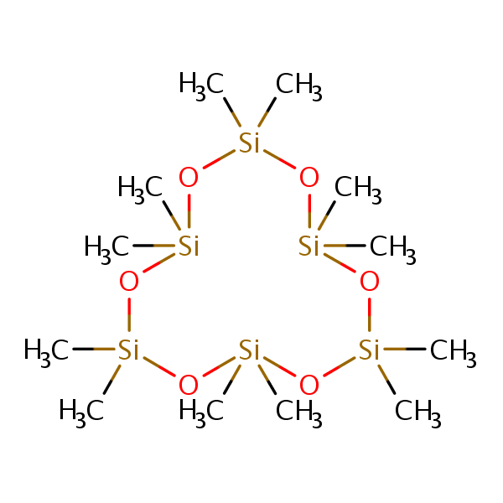

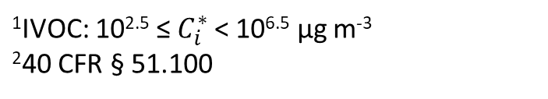
Aerosol and gas-phase lens
Is this species important to include?
What’s its C*? 10⁶ μg m⁻³? That’s an IVOC.¹
IVOCs are important for SOA! We need to keep this species in our model.
¹IVOC: 10^{2.5} ≤ $C_{i}^{∗}$ < 10^{6.5} µg m⁻³
²40 CFR § 51.100
Notes:
Use an example to illustrate how different endpoints affect mechanism decisions…
A focus on one endpoint vs another could lead to different decisions as I’ll illustrate here.
Let’s consider a new compound and trying to decide if it should be in a model and how it should be treated.
I’ve intentionally obscured the compound because this discussion could apply to a number of compounds.
As an aerosol scientist, I’m often very interested in the volatility of species … If I’m applying a traditional VBS-style parameterization, the volatility may be all I care about.

Slide 4

Aerosol and gas-phase lens
Is this species important to include?
What’s its reactivity? Reaction with OH doesn’t seem very favorable.
What’s its C*? 10⁶ μg m⁻³? That’s an IVOC.¹
This species has a long lifetime. Let’s drop it from our model.
IVOCs are important for SOA! We need to keep this species in our model.
Current status of D5:
Exempt from regulatory VOC reporting,²
ignored by mechanism.
Limited SOA formation.³
¹IVOC: 10^{2.5} ≤ $C_{i}^{∗}$ < 10^{6.5} µg m⁻³
²40 CFR § 51.100
³Pennington et al., ACP 2021
Notes:
A gas-phse chemist may be focused on different properties…
…
The compound is D5
The lifetime of D5 would still make it fairly limited for SOA potential, but there could be other reasons to include the species.

Slide 5

Individual species may be important
I’ve seen that all over Boulder and Toronto.¹ You should keep it in the model as a tracer for personal care products!²
¹Coggon et al., ES&T 2018
²Gkatzelis et al., ES&T 2021
Notes:
A species like D5 with low reactivity could be important for other reasons…
…
One of the ways CMAQ is used is for source apportionment so having a tracer species could be a useful diagnostic

Slide 6

Health analyses have additional needs
CMAQ feeds the EPA AirToxScreen assessment of risks for air toxics¹
Many hazardous air pollutants (HAPs) have long lifetimes, so don’t lump purely by OH rate constant.
¹https://www.epa.gov/AirToxScreen
CRACMM emission mapping hierarchy described at CMAS 2021 and available in Pye et al. 2022 ACPD
Notes:
To further emphasize why gas-phase properties alone are insufficient for designing a mechanism, consider that health analyses have additional needs.
CMAQ is used ….
If compounds are lumped purely based on reactivity, species with high and low risk would be mixed together
CRACMM was built with consideration of aerosol, gas-phase, and toxic endpoints in mind and also aims to be developed closely with emerging information on emissions. Now I’ll step through some additional reasons why we’ve integrated chemistry.

Slide 7
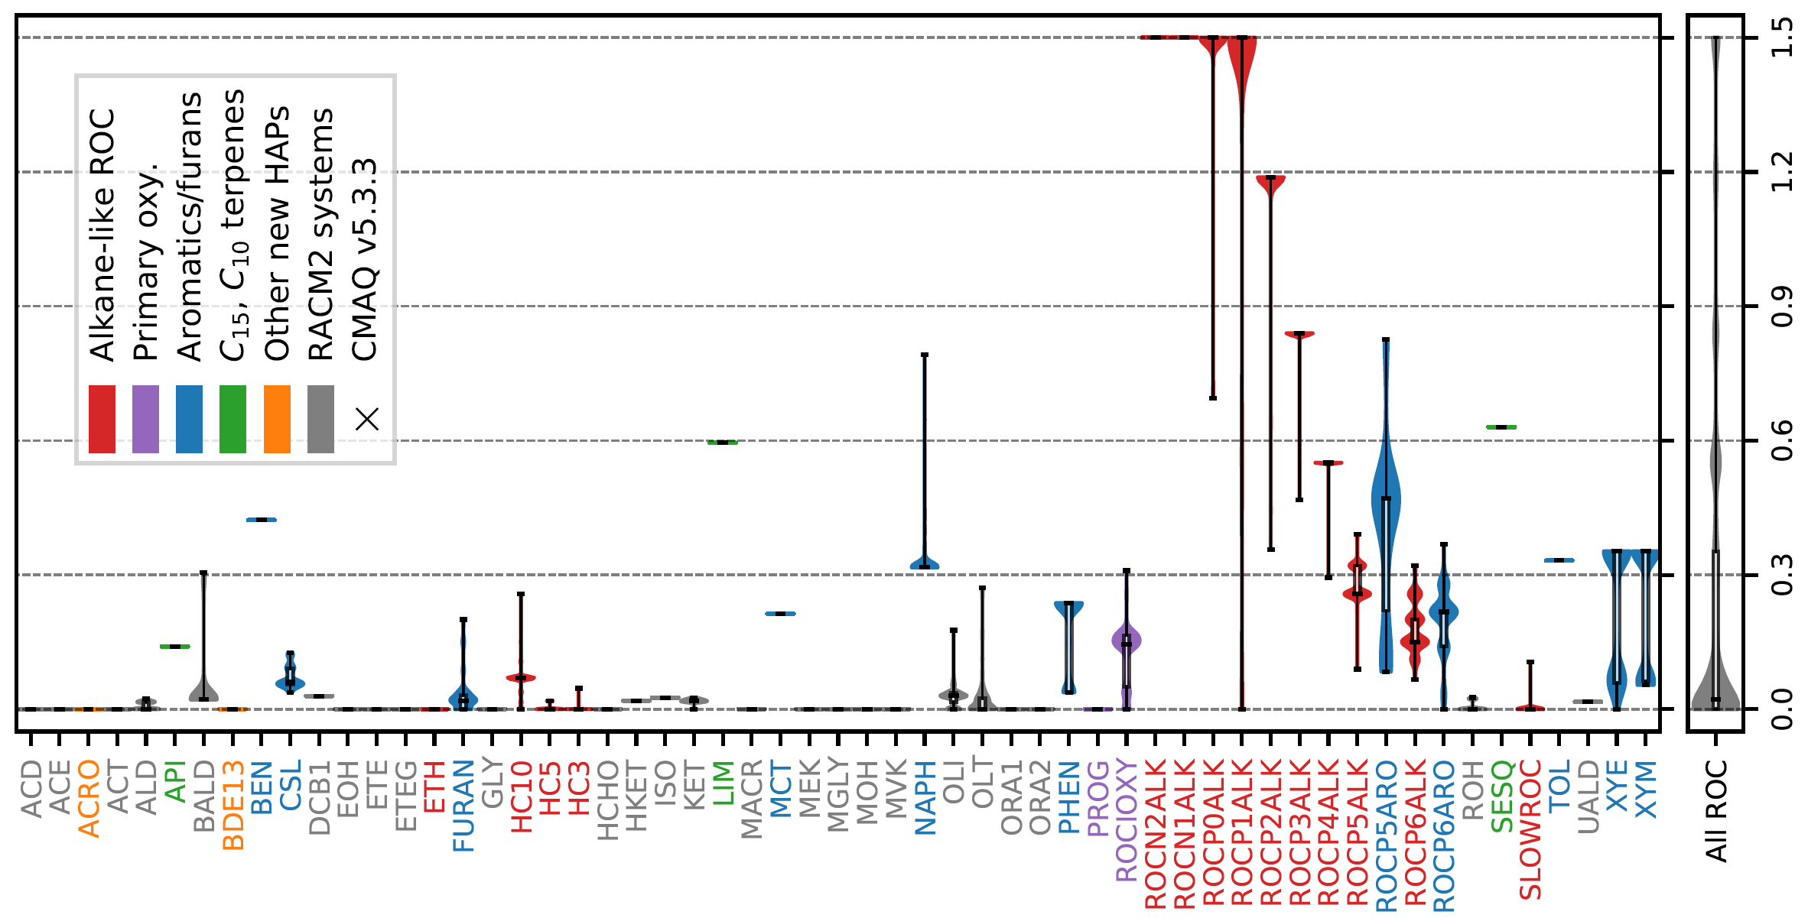

SOA is an important gas-phase product
1.5
Emission-weighted SOA yields (by CRACMM species) can be substantial
1.2
0.9
0.6
benzene
limonene
0.3
0.0
2017 U.S. anthropogenic + biomass burning emissions
colors indicate similar compound functionality; grey from RACM2
Notes:
So now I’ll talk about how we’ve actually integrated the gas and SOA chemistry. And I’ll start by noting that SOA yields are substantial

Slide 8
Mechanisms have room to add products
Current benzene chemistry used in most CMAQ applications:
BEN + OH = 0.53 PHEN + 0.35 RO₂ + 0.12 OPEN + 0.12 OH + 0.53 HO₂
RO₂ + NO = 0.918 NO₂ + 0.082 NTR2 + 0.918 GLY + 0.918 OPEN + 0.918 HO₂
RO₂ + HO₂ =
Same product used for different species:
6 carbon product in Rxn 1 (MCM)
4 carbon product in Rxn 2 (MCM)
NTR2 molecular weight implies loss of 3-4 C
All product mass is lost
SOA yields from benzene RO₂+HO₂ are substantial¹
¹Ng et al., ACP 2007
Notes:
We find that gas-phase mechanisms have plenty of room to add products. Here ….

Slide 9


Connecting to gas-phase enabled more SOA precursors to be treated
18% by mole
Benzene: 2.3 Gmol/yr
SOA: 0.4 Gmol/yr
0% by mole
Phenols: 2.7 Gmol/yr
SOA: 0 Gmol/yr
CMAQ v5.3 model approach: benzene is an SOA precursor
Total SOA: 0.4 Gmol/yr
2017 U.S. annual anthropogenic and biomass burning emissions
Box heights are scaled to the molar flow magnitude
Notes:
By integrating the SOA and radical chemistry, we added new SOA channels

Slide 10
Connecting to gas-phase enabled more SOA precursors to be treated
Benzene emissions: 2.3 Gmol/yr
Non-phenolic products:
1.1 Gmol/yr
47%
21% by mole
+OH
Phenol production:
1.2 Gmol/yr
SOA from benzene emissions: 0.4 Gmol/yr
53%
15% by mole
SOA from phenol emissions: 0.4 Gmol/yr
Phenol emissions:
2.7 Gmol/yr
Total SOA: 0.8 Gmol/yr
2017 U.S. annual anthropogenic and biomass burning emissions
Linking benzene, phenols, and SOA can double the estimated SOA production from this system
Notes:
From python:
BEN to phen to SOA: 0.183 gmol/yr
BEN to furanone to SOA: 0.011 gmol/yr
Ben to ROCN2OXY6 to SOA: 0.21 gmol/yr
Total BEN to SOA: .404 Gmol/yr
Emitted PHEN to SOA: 0.408 Gmol/yr
BEN emission: 177 Gg/yr / 78 g/mol=2.27 Gmol/yr
Phen emission: 283.4 Gg/yr / 105.5 g/mol =2.69 Gmol/yr
Molar yield:
Parent_x Product_x highNOxMolarYield_x lowNOxMolarYield_x check_x Parent_y Product_y highNOxMolarYield_y lowNOxMolarYield_y check_y Parent Product highNOxMolarYield lowNOxMolarYield check TotalMolarSOAYield CRACMM Emission_Gg/yr Effective_Mwt_g/mol TotalSOA2017_Gmol/yr
1 BEN PHEN 0.53 0.53 yes PHEN ASOATJ 0.152 0.152 yes ASOATJ OA 1.0 1.0 yes 0.08056 BEN 177.0056653 78.114 0.1825482806739893
2 BEN FURANONE 0.23453 0.0 yes FURANONE ASOATJ 0.04 0.04 yes ASOATJ OA 1.0 1.0 yes 0.0046906 BEN 177.0056653 78.114 0.01062886004629362
3 BEN VROCN1OXY6 0.000376 0.18701299999999998 yes VROCN1OXY6 OA 0.9900990099009901 0.9900990099009901 yes 0.09276683168316831 BEN 177.0056653 78.114 0.2102088583333631

Slide 11
Role of phenols affects source apportionment
PHEN:
BEN:
Emission sources:

Slide 12
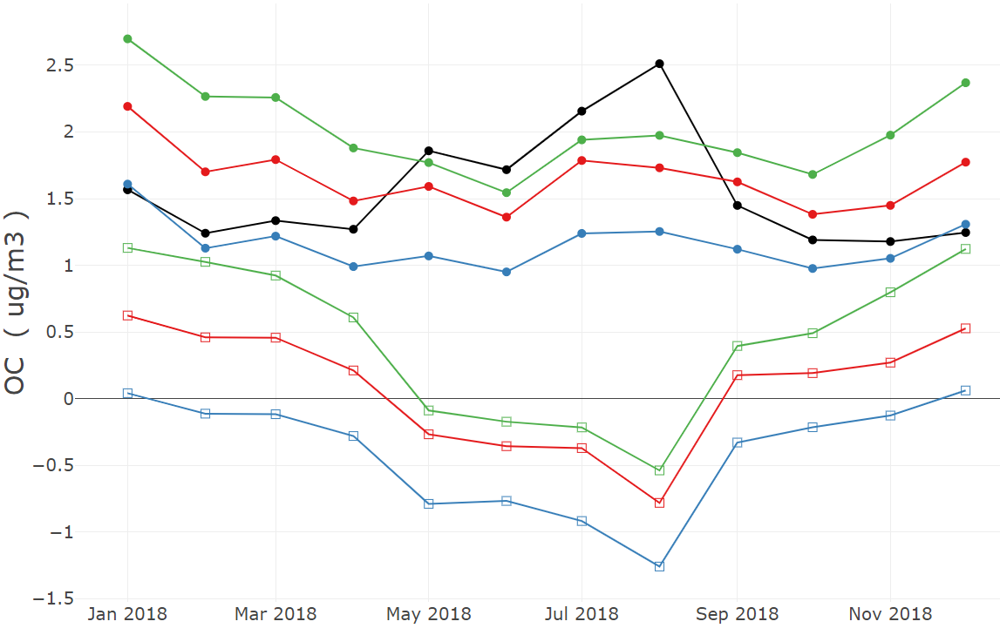
CMAQ v5.4 OC
Observed OC; CB6R5+bottom-up SOA; CB6R5+tuned SOA; CRACMM1
• Monthly Average Concentrations
2018 CONUS annual simulation
CRACMM predicts more SOA than tuned SOA approach
Winter OC overestimated
  Overpredictions in midwest to northeast
  CA and GA winter OC improved in CRACMM
CRACMM summer OC better matches observations
OC (μgC m⁻³)
□ Monthly Average Bias
Tuned SOA = pcSOA (Murphy et al., ACP 2017)

Slide 13
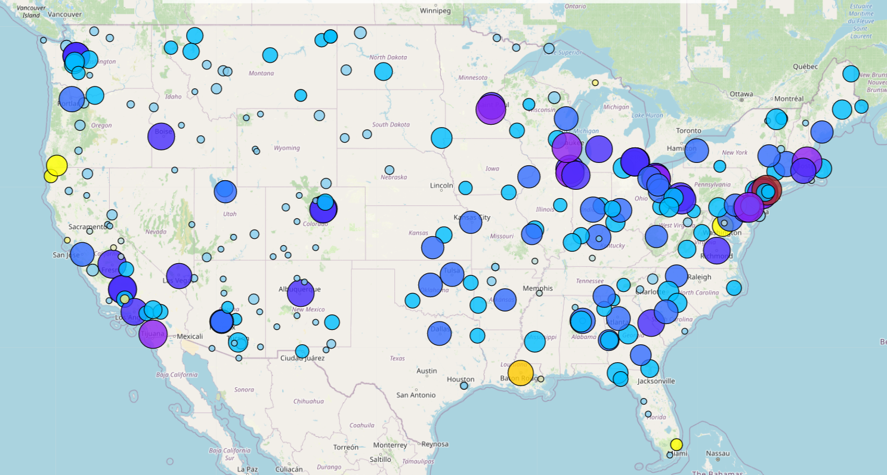
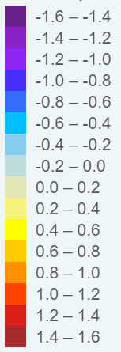
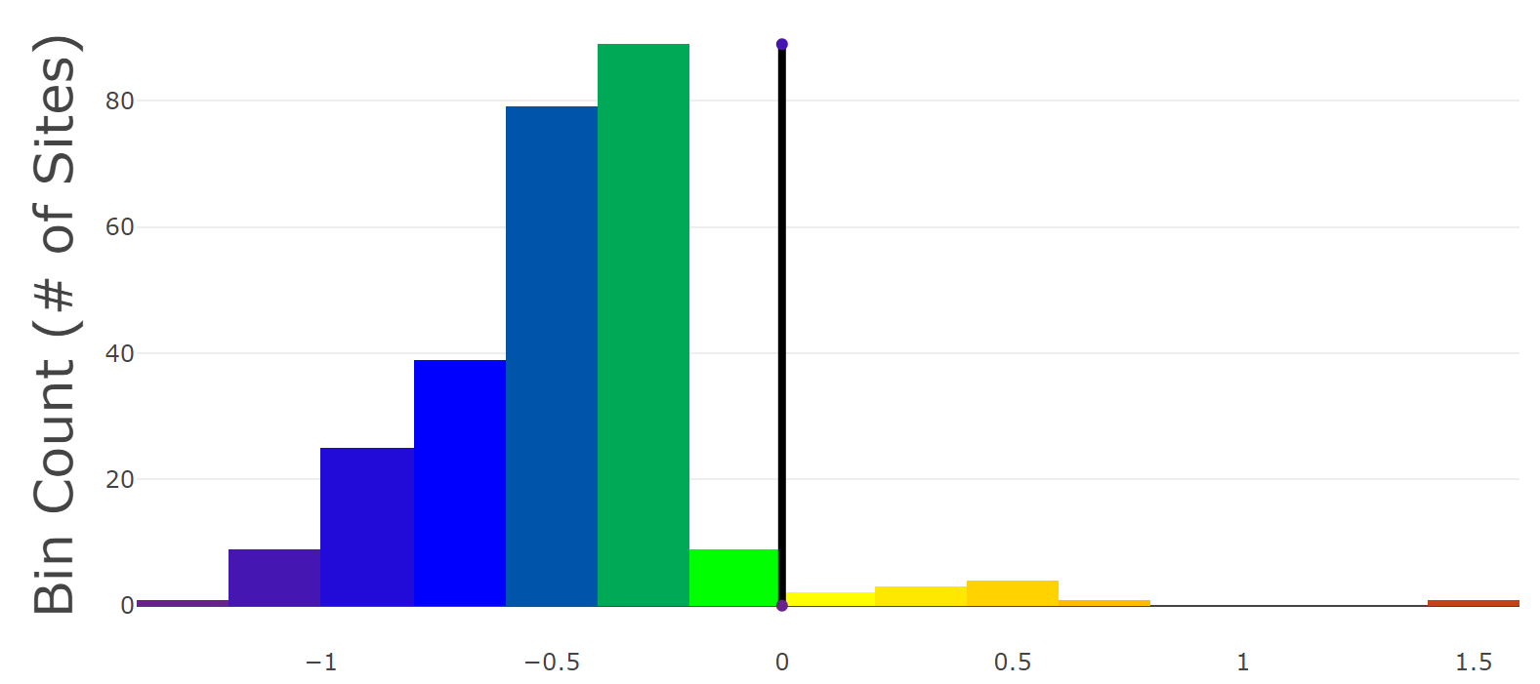
OC improved across U.S. in summer
CRACMM shows improvement at 95.8% of sites over a CB6r5 AE7 simulation with bottom-up SOA (improvement at 84% of sites over CB6r5 AE7 with tuned SOA)
CRACMM significantly improves the representation of summer OC
  Significantly reformulated monoterpene chemistry including autoxidation and SOA from second generation aldehydes and nitrates
  New SOA from phenols, cresols, furanone, S/IVOCs
Absolute Bias Difference in OC (μgC m⁻³), CRACMM1 – CB6R5 w/ bottom-up SOA (June-August 2018)
Reduced bias in CRACMM
Increased bias in CRACMM
size of marker:
absolute change in bias

Slide 14
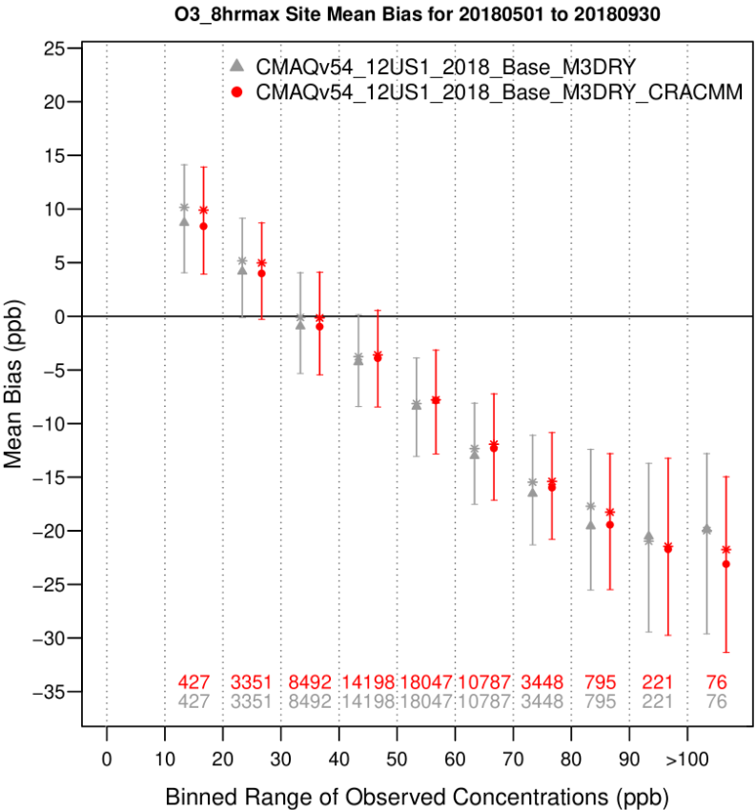
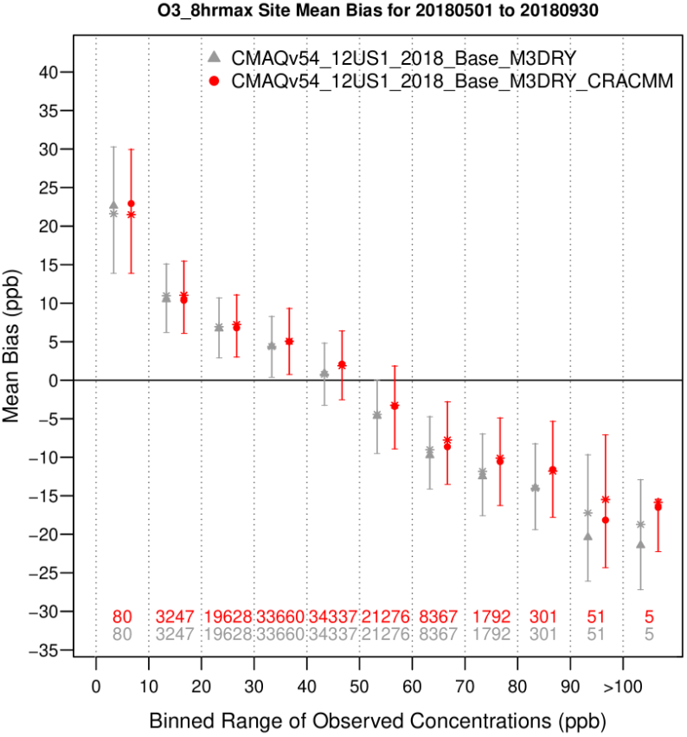
Ozone similar across CB6r5 and CRACMM
Previous RACM2 vs CB showed RACM2 predicted higher O₃ (Sarwar et al., ACP 2013)
CRACMM updates resulted in lower O₃ compared to RACM2 (Place et al., in prep for ACP)
  Inorganic rate constants
  Monoterpene chemistry
CRACMM1 and CB6r5 provide similar O₃ predictions for 2018 CONUS
CRACMM1AMORE expected to have improved performance (Wiser et al., GMDD 2022)
Bias
Bias
CB6r5 AE7; CRACMM1
CB6r5 AE7; CRACMM1
Western U.S.
Eastern U.S.
Notes:
0.28 for HCHO/NO_{y} (lower values – VOC-limited, higher values – NO_{x}-limited)

Slide 15
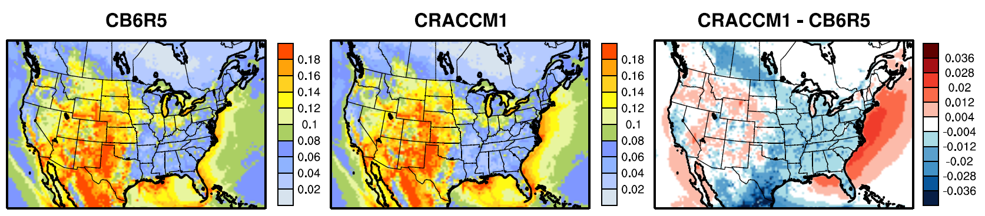
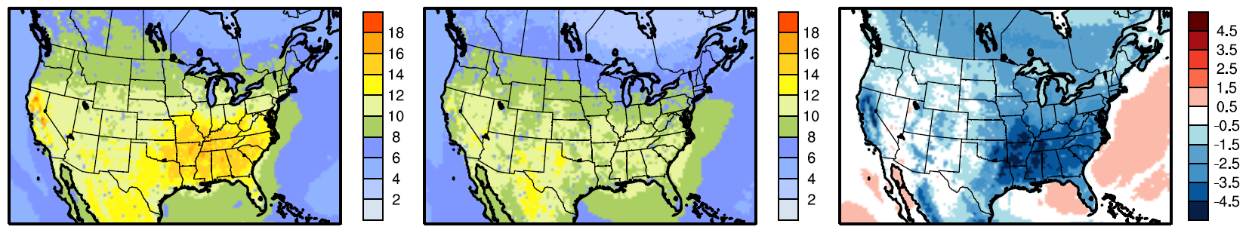
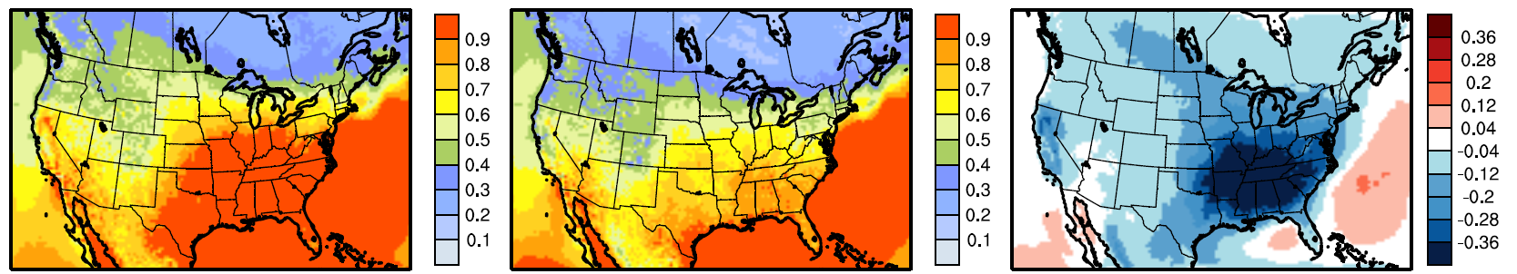
Large differences in summer HO_{X} abundance
CRACMM shows lower H_{X}O_{y} than CB6R5
  Similar to RACM2 vs CB05TUCL for HO₂ and H₂O₂ (Sarwar et al., ACP 2013)
  CRACMM has additional HO_{X} sinks due to SOA formation
Implications for SOA
  Oxidant levels affect CRACMM SOA predictions
  CRACMM more efficient at forming SOA than CB6r5 AE7 due to yields
OH
(ppt)
HO₂
(ppt)
H₂O₂
(ppb)

Slide 16
Summary
The design of mechanism species depends on the endpoints being considered.
Integrating SOA channels can improve our ability to estimate the atmospheric ROC burden by tracking more mass.
Integrating gas and SOA chemistry can improve source apportionment.
CRACMM provides reasonable O₃ and good summertime OC predictions eliminating the need for tuned SOA.
Notes:
The design of mechanism species depends on the endpoints being considered as different properties are relevant for different processes.
Consideration of multiple endpoints can improve mechanisms
Significant gas-phase mass should be sequestered in SOA
This missing loss would improve conservation of mass in chemical mechanisms leading to better estimates of the atmospheric ROC burden
Considering gas-phase chemistry in conjunction with SOA will improve the mechanistic representation of existing SOA pathways and allow for more precursors to be treated.
The chemical pathways to SOA and precursors considered affects source apportionment.

Slide 17
Join the Community!
CRACMM is available in CMAQ v5.4!
  CRACMM1 discussed here (Pye et al. 2022 ACPD, Place et al. in prep)
  CRACMM1AMORE replaces the CRACMM1 isoprene chemistry with the AMORE condensation (Wiser et al., 2022 GMDD)
CRACMM and metadata: https://github.com/USEPA/CRACMM
  Emission support
  Box model input files coming soon
Let us know what works and what doesn’t (emissions and chemistry)!
pye.havala@epa.gov

