Slide 1
Assessing the impact of ScrubberS on shipping emissions in Canada
Mourad Sassi, Calin Zaganescu
Air Quality Policy-Issue Response Section
Canadian Centre for Meteorological and Environmental Prediction
Environment and Climate Change Canada
21st Annual CMAS Conference, October 17-19, 2022

Slide 2
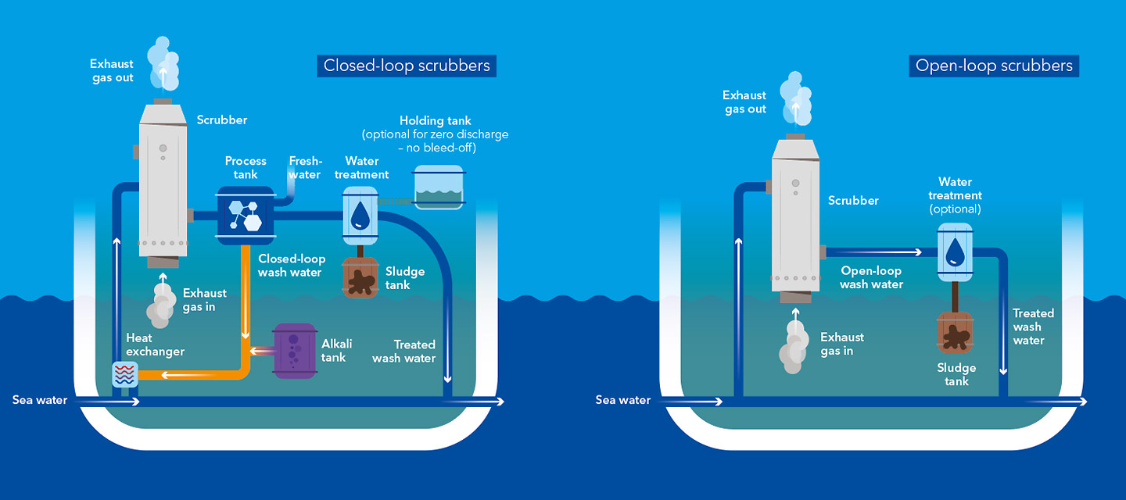
What are scrubbers?
A scrubber is an exhaust gas cleaning system (EGCS) that removes sulfur to comply with fuel standards, allowed by IMO MARPOL Annex VI, Regulation 4
Enable use of heavy fuel oil (HFO) while meeting global (0.5%) or ECA (0.1%) Sulphur levels
  Effective in reducing SOx emissions
  Increased PM_{2.5} and black carbon as compared to <0.1% S distillate fuel
  4% higher GHG emissions at exhaust stack
Scrubbers types
Open-loop scrubbers
  Salt water – all washwater containing CEPA-toxic
  substances is discharged overboard
Closed-loop scrubbers
  Used in freshwater and sensitive ecosystems
  Waste accumulates and must be discharged
  on-shore (hazardous waste)
Notes:
Closed loop scrubbers – typically used in freshwater; caustic agent must be added; continuous bleed-off water high in heavy metals
Open loop scrubbers – used with seawater; typically do not have a sludge tank – all washwater and contaminants discharged overboard
Hybrid systems – operate on open-loop mode in seawater and closed-loop mode in freshwater.

Slide 3
Marine emissions for 2019 over Canadian waters
The Environmental Protection Branch of ECCC has updated its Marine Emissions Inventory Tool (MEIT)
Based on vessel movement data for 2019: all marine vessel classes tracked within Canadian waters
  79 ship types, hourly emissions
  Ship classes include:
    C1 and C2 (no scrubbers): Barge, Coast Guard, Excursion Passenger, Fishing, Merchant Passenger, Special Purpose, Tug, War
    C3 (able to have scrubbers): Cruise, Tanker, Merchant Bulk, Merchant Container and Other Merchant vessels
All vessels with scrubbers are operating in Pacific coast, eastern coast and the Great Lakes & St. Lawrence Seaway

Slide 4
Marine emissions for 2019 over Canadian waters
Four air quality scenarios were performed :
  1 - No scrubber (0%) - all ships use clean fuel with lower sulfur content (control case)
  2 - Current scrubber (30%) - ships able to have scrubbers were assumed to be using them
  3 - All scrubber (100%) - all ships use scrubbers
  4 - No marine - no Canadian marine emissions
We predict an annual growth of 30% in marine scrubber usage from 2019-2023
Scrubber-fitted ships could represent 100% of the global merchant fleet by 2030
The use of scrubbers increases PM_{2.5}, by 50% in ECA regions
Increase black carbon by 130% (depend on engine type)
SO₂ reduced at the same level as in distillate fuel.
 | All scrubber (100%) |  |  |  | Current scrubber (30%)
Relative & absolute differences | PM_{2.5} |  | BC |  | PM_{2.5} |  | BC
 | Tonne | % | Tonne | % | Tonne | % | Tonne | %
TOTAL | 720 | 50 | 176 | 130 | 193 | 13 | 54 | 40
East | 242 | 54 | 58 | 146 | 58 | 13 | 15 | 38
Great Lakes & STL | 151 | 39 | 49 | 118 | 19 | 5 | 9 | 21
Pacific | 326 | 54 | 69 | 128 | 116 | 19 | 30 | 55
Comparison between All Scrubber and Current Scrubber scenario emissions

Slide 5
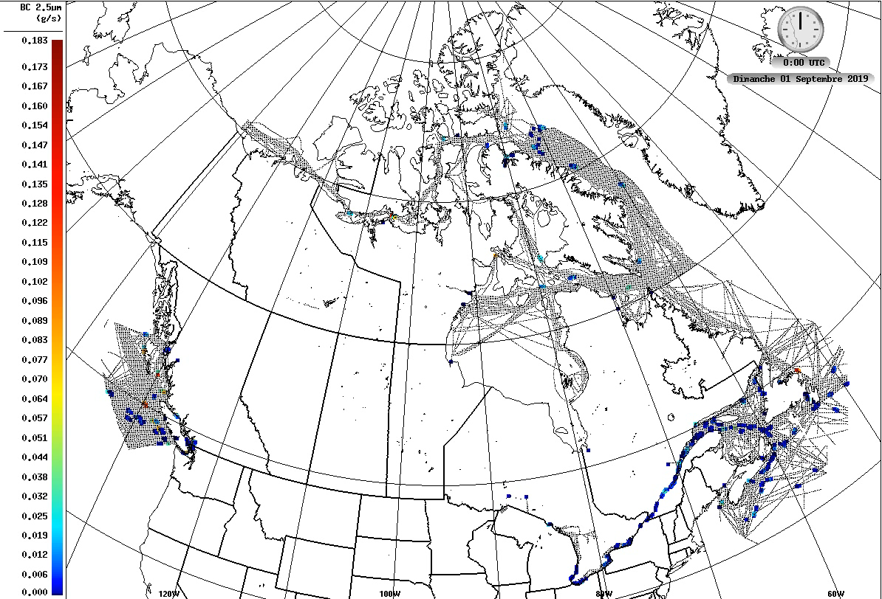
Model and simulation setup
GEM-MACH v2.4.6 (ECCC’s air quality prediction model)
Model domain: North American regional grid,
10-km horizontal resolution and 768x638
Anthropogenic emissions:
  2019 Canadian marine emissions,
  2016 Canadian APEI and 2016 US NEI
On-line biogenic emissions
Simulation period: January – December, 2019

Slide 6
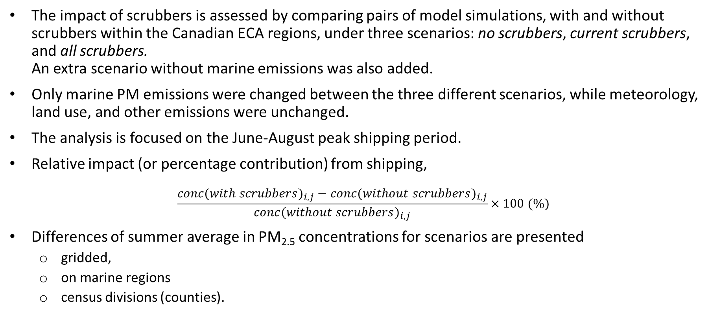
Modeling results
The impact of scrubbers is assessed by comparing pairs of model simulations, with and without scrubbers within the Canadian ECA regions, under three scenarios: no scrubbers, current scrubbers, and all scrubbers.
An extra scenario without marine emissions was also added.
Only marine PM emissions were changed between the three different scenarios, while meteorology, land use, and other emissions were unchanged.
The analysis is focused on the June-August peak shipping period.
Relative impact (or percentage contribution) from shipping,
$$\frac{{conc(with scrubbers)}_{i,j}−{conc(without scrubbers)}_{i,j}}{{conc(without scrubbers)}_{i,j}}×100 (\%)$$
Differences of summer average in PM_{2.5} concentrations for scenarios are presented
  gridded,
  on marine regions
  census divisions (counties).

Slide 7
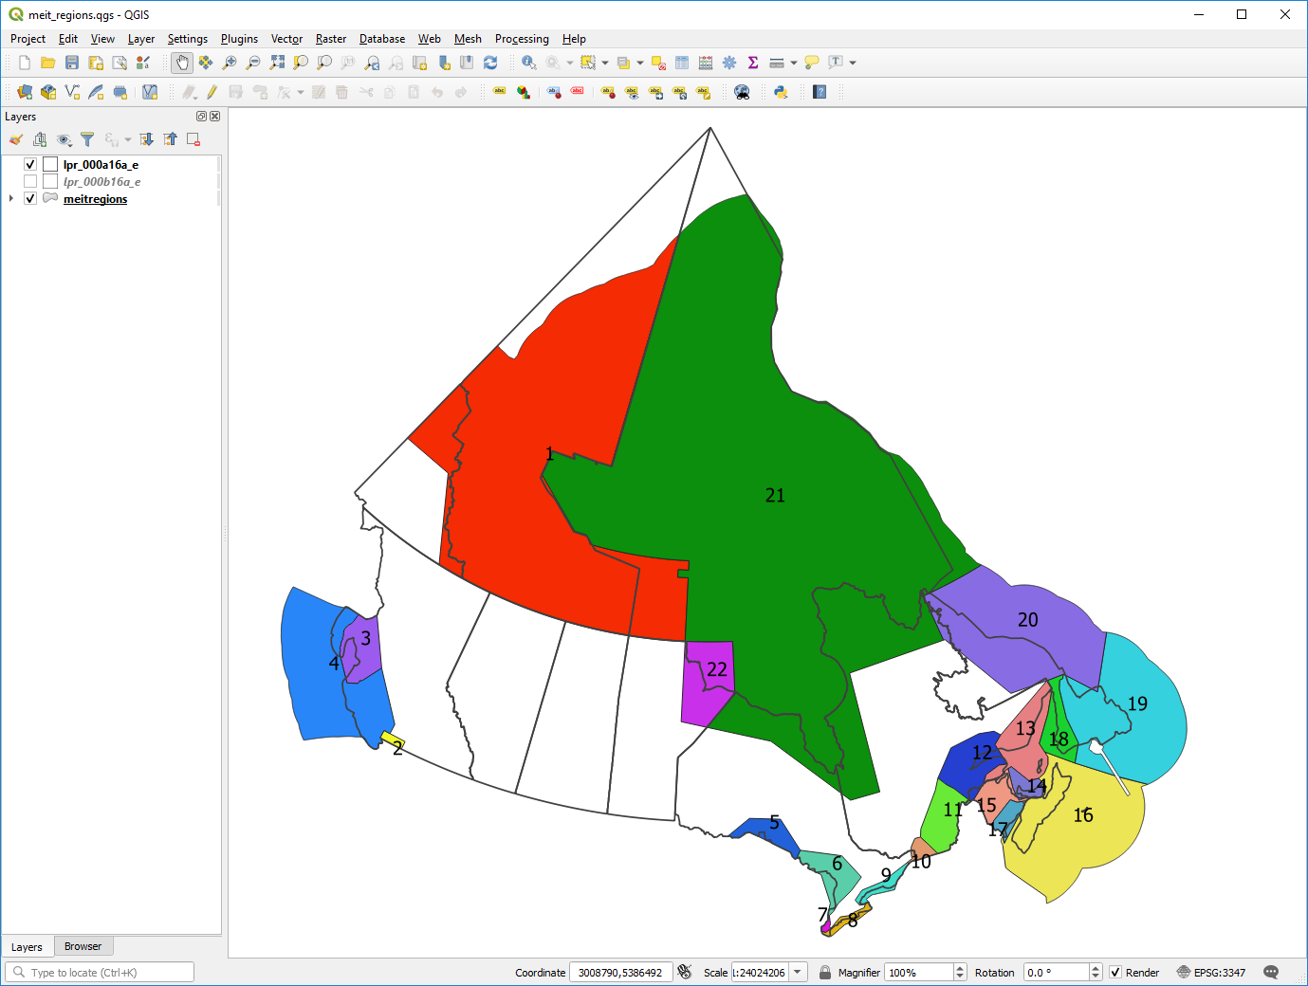
Summer differences of PM_{2.5} concentrations for Pacific and Eastern marine regions
(Geographical assessment – focused on the Canadian ECA regions
Canadian marine regions
Absolute differences mean concentrations (µg/m³)
PM_{2.5} | PACIFIC |  |  | EAST
Regions | 2 | 3 | 4 | 5 | 8 | 10 | 11 | 12 | 13 | 14 | 15 | 17 | 18
Summer Avg
Control case | 5.795 | 0.398 | 0.491 | 1.368 | 4.505 | 4.677 | 2.792 | 1.154 | 0.917 | 1.418 | 1.360 | 1.804 | 0.824
Current 30% | 0.002 | 0.001 | 0.001 | 0.001 |  |  |  |  |  |  |  |  | 0.001
All 100% | 0.006 | 0.002 | 0.001 | 0.001 | 0.001 | 0.001 | 0.000 | 0.001 | 0.001 |  | 0.001 | 0.001 | 0.001
no Marine | -0.299 | -0.018 | -0.014 | 0.000 | -0.021 | -0.010 | -0.022 | -0.023 | -0.013 | -0.012 | -0.006 | -0.012 | -0.011
Relative differences for all regions (%)
PM_{2.5} | PACIFIC |  |  | EAST
Regions | 2 | 3 | 4 | 5 | 8 | 10 | 11 | 12 | 13 | 14 | 15 | 17 | 18
Summer Avg
Current 30% | 0.03% | 0.25% | 0.20% | 0.07% |  |  |  |  |  |  |  |  | 0.12%
All 100% | 0.10% | 0.50% | 0.20% | 0.07% | 0.02% | 0.02% | 0.00% | 0.09% | 0.11% |  | 0.07% | 0.06% | 0.12%
no Marine | -5.16% | -4.52% | -2.85% | 0.00% | -0.47% | -0.21% | -0.79% | -1.99% | -1.42% | -0.85% | -0.44% | -0.67% | -1.33%
Scenarios:
Control case: no scrubber (0%)
current scrubber (30%)
all scrubber (100%)
no marine
Shipping contributions to the averaged ambient concentrations over the ECA regions
An increase of 10 to 40 tonnes of PM_{2.5} in regions 2 & 3 respectively due to the use of scrubbers, would
increase by 0.1% and 0.5% on average the PM_{2.5} ambient concentration in the all scrubbers scenario.
In contrast, the overall shipping contribution to the ambient concentration (no Marine) is ~5% of PM_{2.5} for the Pacific.

Slide 8
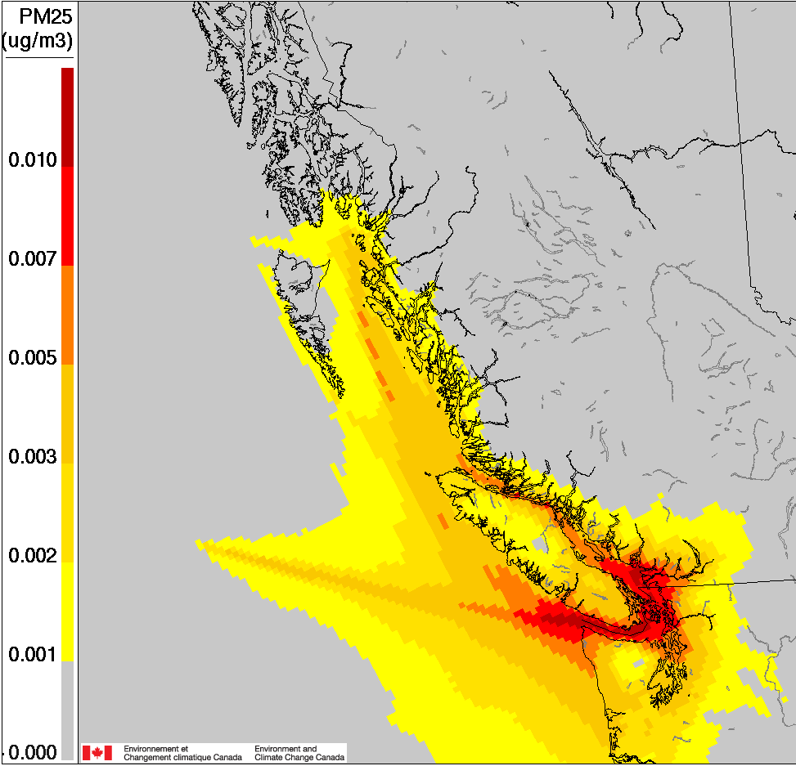
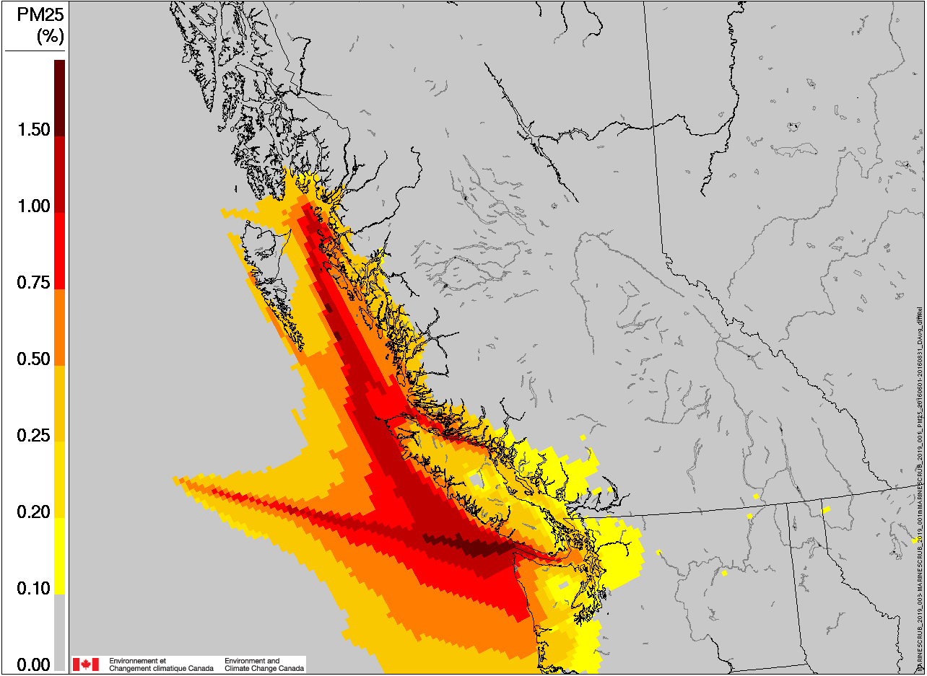
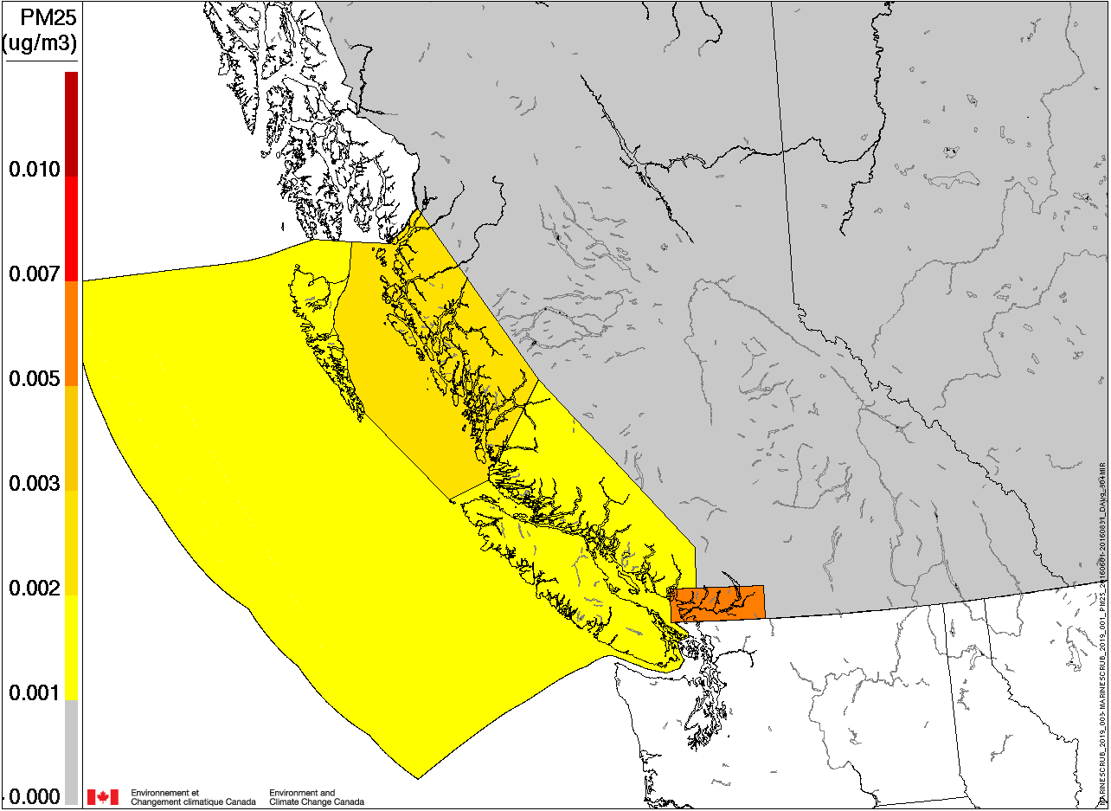
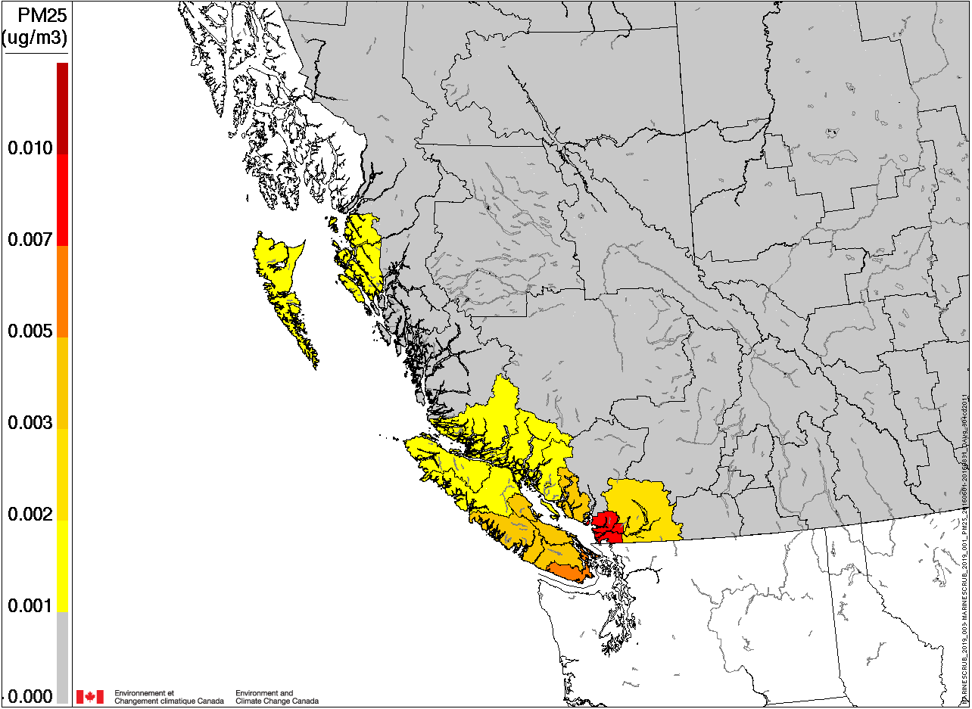
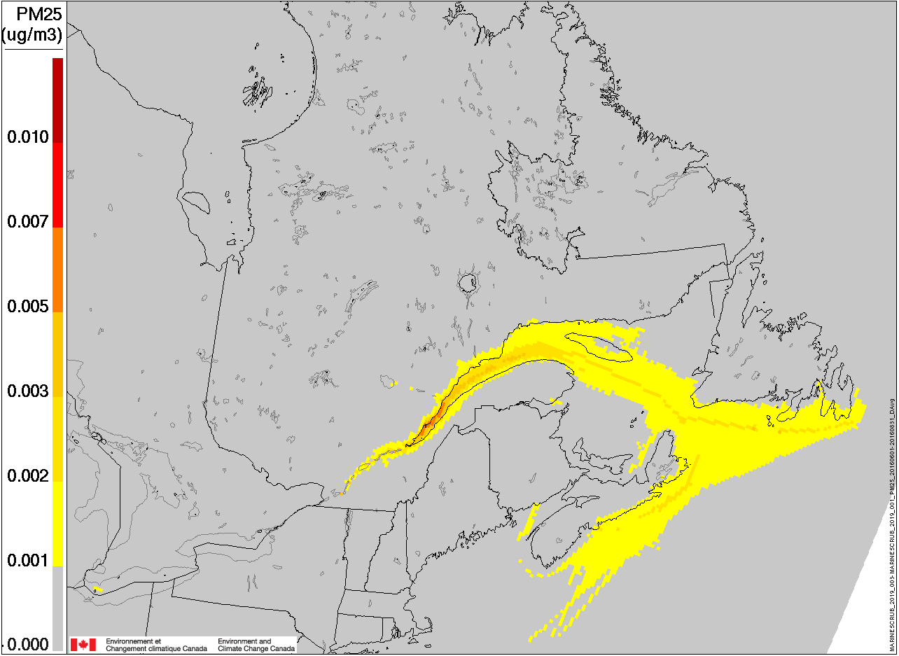
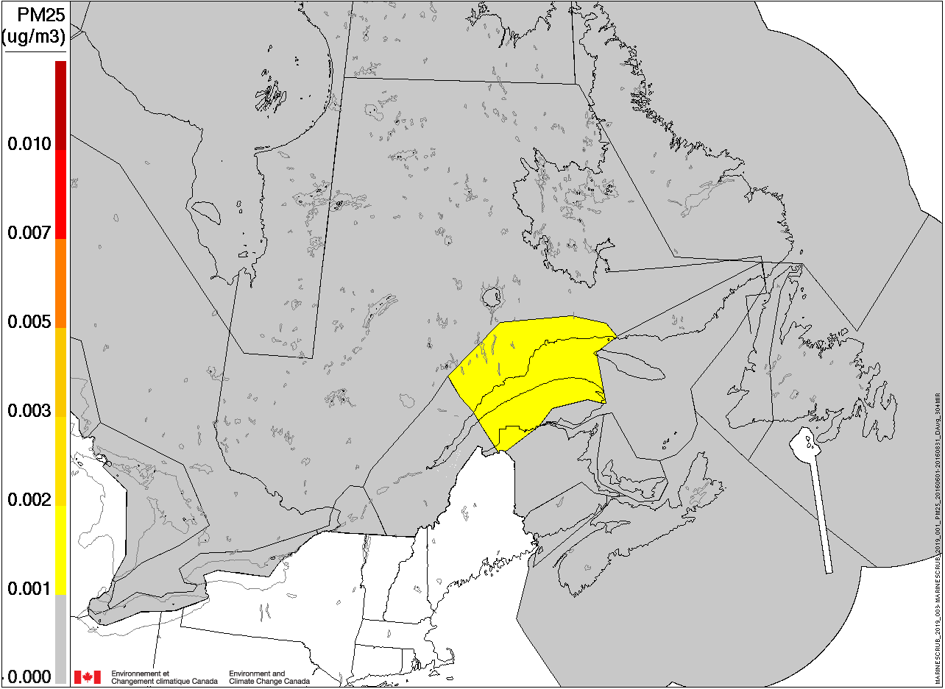
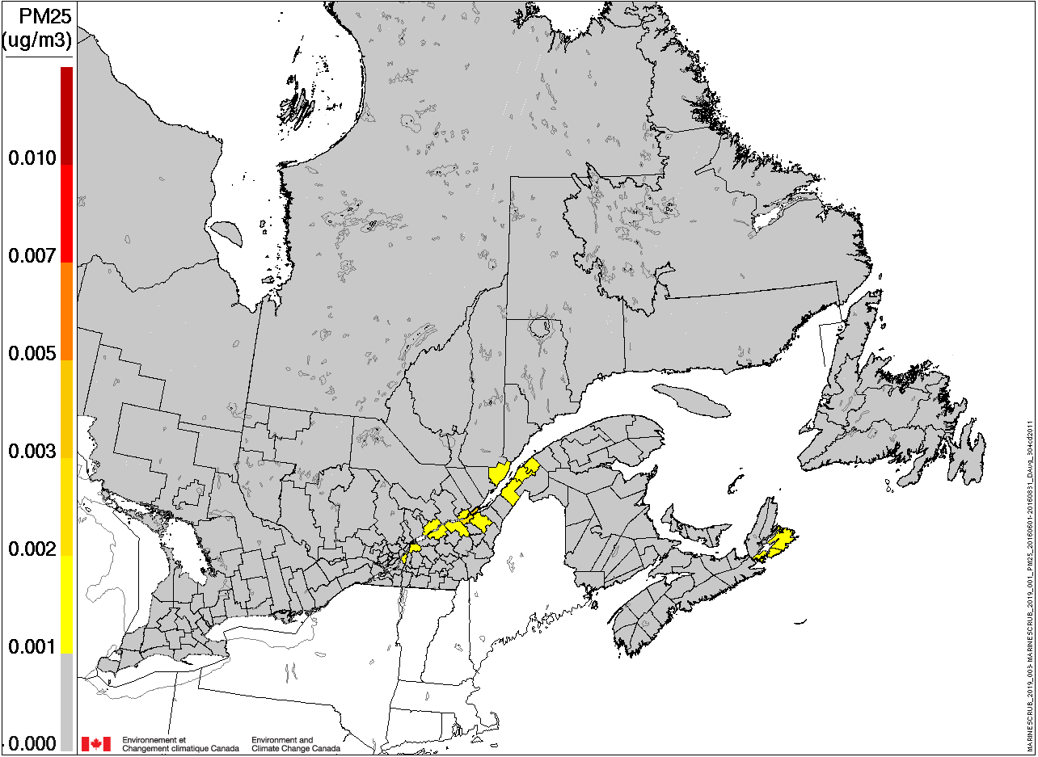
Summer differences of PM_{2.5} average concentrations for All scrubber (100%)
The all scrubber contribution is generally between 0.001 µg/m³ and 0.006 µg/m³ on average over localized areas in the Pacific region for the PM_{2.5} (0.1% to 0.5% increase in PM_{2.5} on average) and 0.01 µg/m³ or ~1.5% in the Strait of Juan de Fuca)
PM_{2.5} relative concentrations
Pacific
The all scrubber contribution is generally below 0.001 µg/m³ on average in the East and the St. Lawrence River regions for the PM_{2.5} (up to 0.12% increase on average)
East

Slide 9
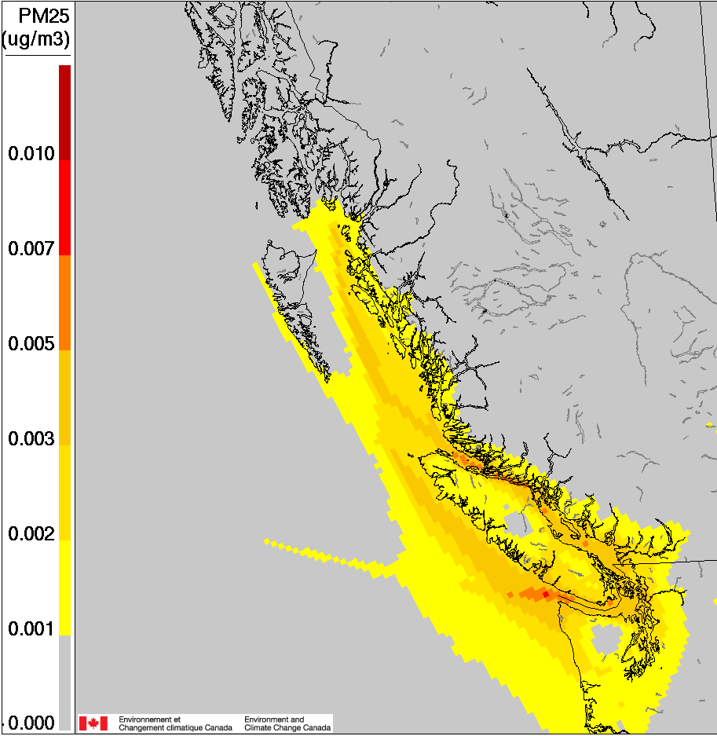
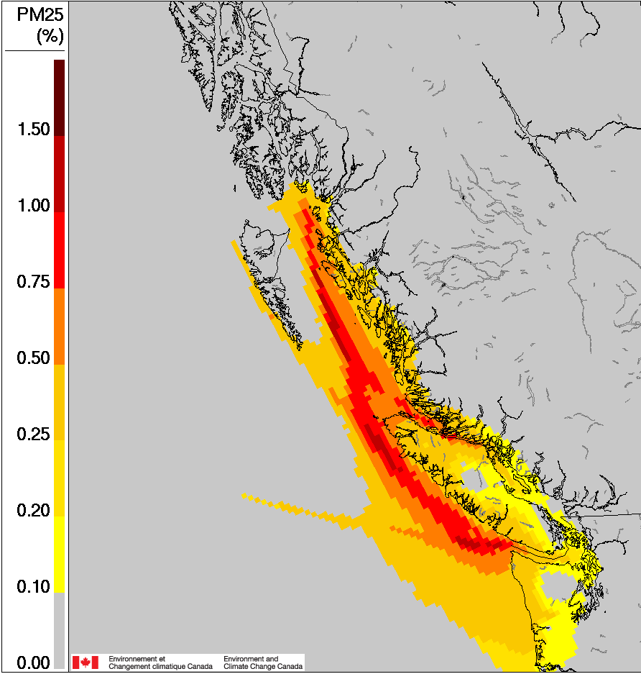
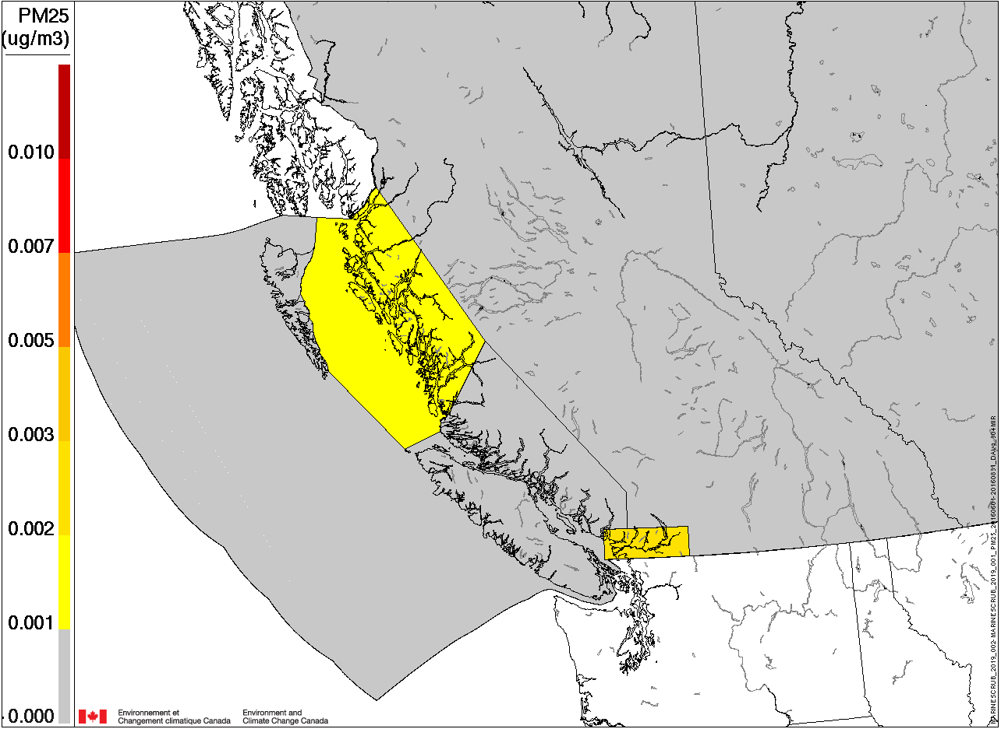
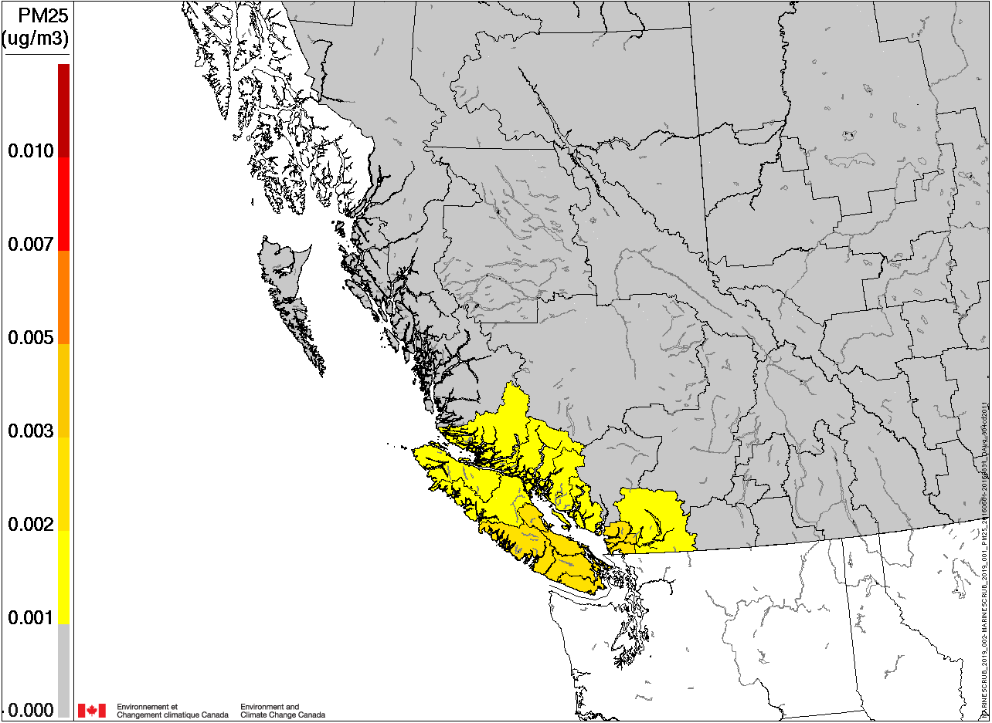
Summer differences of PM_{2.5} average concentrations for Current scrubber (30%)
The current scrubber contribution is generally between 0.001 µg/m³ and 0.002 µg/m³ on average over localized areas in the Pacific region for the PM_{2.5} (0.03% to 0.25% increase in PM_{2.5} on average)
)
PM_{2.5} relative concentrations
Pacific
Although the contribution from the scrubber scenarios over the ECA regions is low and generally below GEM-MACH margin of error, given the large uncertainty in the current estimates, the anticipated increase in PM_{2.5} concentration needs to be carefully assessed.
The PM_{2.5} contribution from the Current scrubber scenario is generally below 0.25% on average over localized areas in the Pacific coast and close to zero for the East coast.
The PM_{2.5} concentration reaches 0.006 µg/m³ or ~0.75% in the Strait of Juan de Fuca

Slide 10
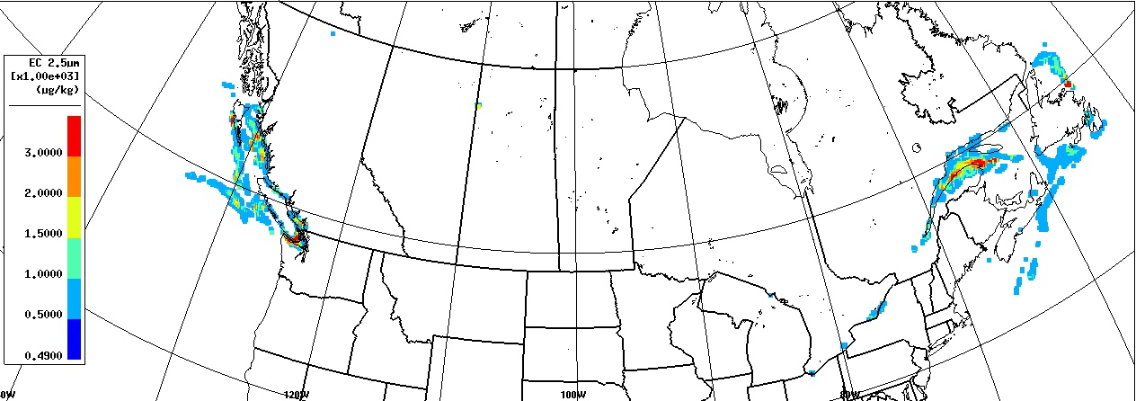
Absolute difference in Elemental Carbon concentration between All scrubber and No scrubber
Sept 1st 2019
Press start to see the video

Slide 11
Conclusion
Results suggest that the use of scrubbers has the following effects on air pollution in the Emission Control Area, at present 2019 emissions levels.
Not effective in reducing PM_{2.5} as compared to <0.1% Sulfur distillate fuel (50% higher PM_{2.5})
Increase black carbon by 130% (depends on engine type)
The use of scrubbers have a local to regional impact on PM_{2.5} concentration and this impact would increase mostly in the Pacific region by 0.1% to 0.5% on average.
While scrubbers contributions to the ambient PM_{2.5} concentrations are generally small at present 2019 levels, these emissions make a proportionally bigger impact on some local environments due to generally pristine ambient conditions.

Slide 12
Future work
Impacts of the NOx Tier III regulations on air quality in the Control Area (ECA).
Investigate impacts of the NOx on secondary PM2.5

Slide 13
MEIT 2019 Annual marine emissions
MEIT 2019 in tonnes | Primary Aerosols |  |  | Gas pollutants
 | BC | PMC | PM_{2.5} | CO | NH3 | NOX | SO₂ | VOC
Classes C1 and C2
No Scrubber | 144 | 31 | 361 | 1,501 | 47 | 30,747 | 14 | 1,201
East | 50 | 10 | 120 | 478 | 16 | 9,748 | 4 | 401
Great Lakes & STL | 27 | 6 | 69 | 282 | 9 | 6,275 | 2 | 226
Pacific | 67 | 15 | 172 | 741 | 23 | 14,723 | 7 | 574
Class C3
No Scrubber | 135 | 126 | 1,444 | 4,609 | 159 | 143,906 | 4,604 | 5,368
East | 40 | 39 | 451 | 1,442 | 50 | 45,322 | 1,163 | 1,702
Great Lakes & STL | 42 | 34 | 390 | 1,266 | 40 | 38,668 | 1,917 | 1,404
Pacific | 54 | 52 | 603 | 1,901 | 69 | 59,917 | 1,524 | 2,262
Current Scrubber | 189 | 155 | 1,637 | 4,654 | 161 | 144,053 | 4,604 | 5,368
East | 55 | 48 | 509 | 1,455 | 51 | 45,365 | 1,163 | 1,702
Great Lakes & STL | 50 | 37 | 409 | 1,271 | 40 | 38,690 | 1,917 | 1,404
Pacific | 83 | 69 | 719 | 1,928 | 70 | 59,998 | 1,524 | 2,262
All Scrubber | 311 | 233 | 2,164 | 4,766 | 164 | 144,551 | 4,604 | 5,368
East | 98 | 75 | 693 | 1,500 | 52 | 45,525 | 1,163 | 1,702
Great Lakes & STL | 91 | 58 | 541 | 1,292 | 41 | 38,841 | 1,917 | 1,404
Pacific | 123 | 100 | 930 | 1,974 | 71 | 60,185 | 1,524 | 2,262
STL: St. Lawrence River region
BC: Black Carbon PMC: Coarse Particulate Matter >2.5 µm and <10 µm

