Slide 1
Using NWS Weather Radars to Constrain Planetary Boundary Layer Height (PBLH) Simulations
John Henderson, Marikate Mountain, and Matthew Alvarado
Verisk Atmospheric and Environmental Research
Lexington, MA, USA
2022 CMAS Conference
19 October 2022
This presentation is based on work supported by the State of Texas through a contract from the Texas Commission on Environmental Quality (TCEQ). The conclusions are the authors’ and do not reflect TCEQ policy.

Slide 2
Importance of the Planetary Boundary Layer
The atmospheric Planetary Boundary Layer (PBL) is a focus of scientific research:
“PBL is of critical importance as it connects the atmosphere to the other components of the Earth system (oceans, land, and ice) and is essential to a number of Earth science priorities”
Dearth of PBL observations at sufficient spatial and temporal scales is a considerable constraint
“A global Planetary Boundary Layer (PBL) observing system is urgently needed to address fundamental PBL science questions and societal applications related to weather, climate and air quality.”
“This PBL observing system should optimally combine new space-based observations of the PBL thermodynamic structure with complementary surface-based and suborbital assets, while taking advantage of, and helping improve, modeling and data assimilation systems.” (Teixeira et al., 2021)

Slide 3
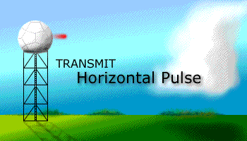
Radar-Based PBLH Estimates
PBL height (PBLH) can be estimated from existing weather surveillance radars
TCEQ funded an exploratory project at AER earlier in 2022
Goal was to provide TCEQ software to estimate PBLH from radar fields

Slide 4
Radar Scanning Strategy

Slide 5
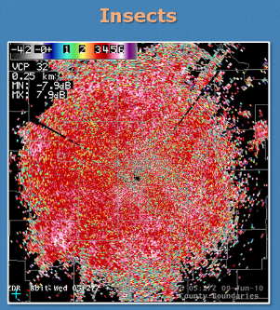
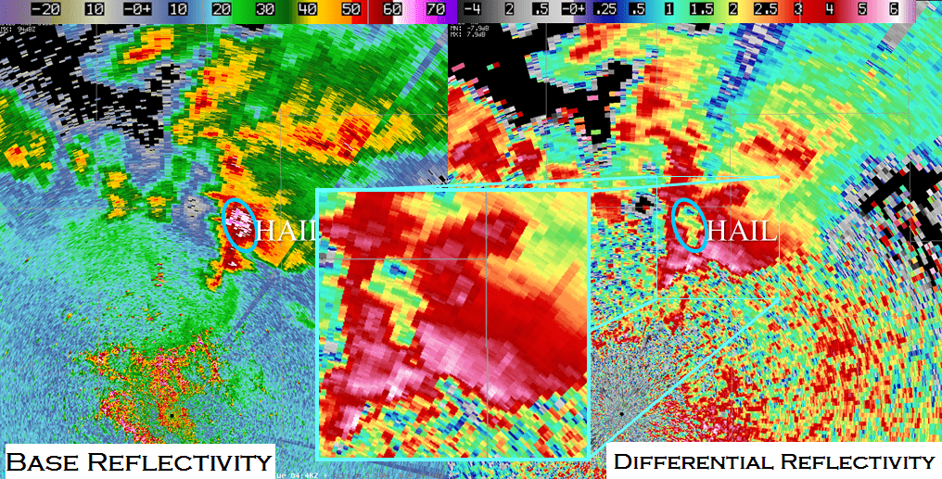
Uses of Differential Reflectivity Field (ZDR)
Most relevant to PBLH estimation:
Differential reflectivity (ZDR) – identifies shape
Can differentiate between rain, hail and insects
Source: Dual Polarization Pre-Deployment Operational Assessment, WDTB ROC
Notes:
-

Slide 6
Bragg Scattering
Bragg scattering underlies radar PBLH approach
Sharp gradients of water vapor and temperature between PBL and free troposphere
Isotropic turbulent mixing causes Bragg scattering at top of convective PBL
Gradients of refractive index on scales ½ wavelength of radar (=5 cm)
At top of PBL
Z field increased, but ZDR field is locally decreased

Slide 7
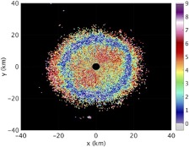
Bragg Scattering Lowers ZDR at top of PBL
Plan position indicator of ring of decreased ZDR
Local minimum in ZDR

Slide 8
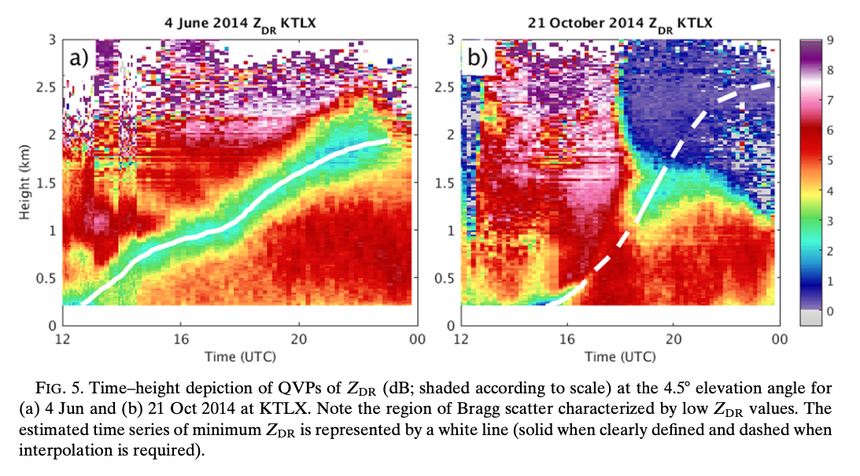
Quasi-Vertical Profiles (QVP) of ZDR
PBLH can be estimated by identifying the local minimum in ZDR atop the convective boundary layer
Banghoff et al. (2018, hereafter BH18) demonstrated the concept of Quasi-Vertical Profiles
Source: BH18

Slide 9
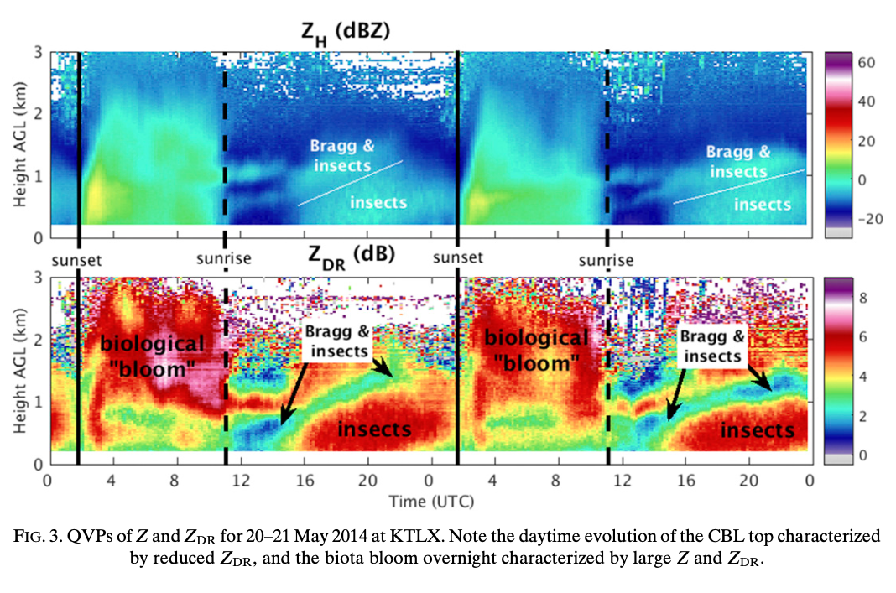
Quasi-Vertical Profiles (QVP) of ZDR
Source: BH18;
Source: BH18

Slide 10
Quality Control: Filtering of Radar Fields
Banghoff et al. (2018) sketched out how they performed quality control and time-averaging on the QVPs
We refined the approach to avoid messy PBLH estimates
Filter precipitation: Z > 0 dBZ and CC > 0.8, typical of precipitation with larger Z than typical of Bragg scatter
Filter ground clutter from side lobes: ZDR < 0 dB (was ZDR < -2 in BH18)
Filter light precipitation: ZDR < 2 dB through column
Remove discontinuities defined by pixels with > 1-dB diff between data points
Remove isolated pixels that have fewer than two adjacent data points

Slide 11
Space/Time Smoothing and Adjustable Parameters
Applying smoothing via application of a running mean over five time and height steps provides a less noisy evolution of QVP ZDR during the daytime
Remove data below min height (200 m)
Estimate PBLH only during the day (12 - 00 UTC)
Find height of minimum differential reflectivity in vertical profile
Limit height of PBLH estimate early in day
If PBLH estimate in past hour - limit growth/collapse of pblh at this time
Find lowest instance or for lowest layer pick middle height
Smooth PBLH estimates with a running mean over 5 times

Slide 12
Effects on PBLH Estimates: Filtering and Space/Time Smoothing

Slide 13
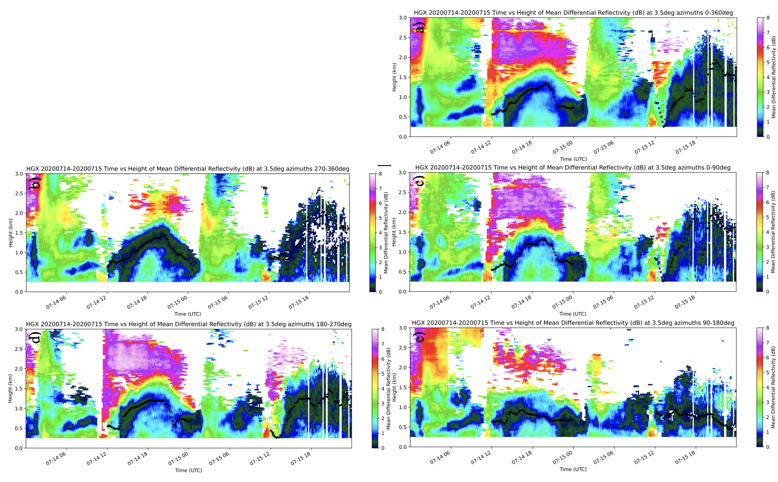
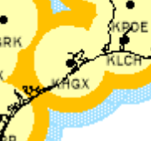
Effects on PBLH Estimates: Azimuthal Restrictions
PBLH estimates for Houston radar
14-15 July 2020: all azimuths

Slide 14
Effects on PBLH of Azimuthal Restrictions
ALL
PBLH estimates for Houston radar
14-15 July 2020:
NW
NE
SW
SE

Slide 15
Code Delivery to TCEQ
Project code was delivered to TCEQ
Ported using Docker
Python scripts
Data ingest:
Python-ARM Radar Toolkit (Py-ART) software
available at arm-doe.github.io/pyart/
documentation at https://arm-doe.github.io/pyart-docs-travis/
Datasets:
Level III 88D radar datasets archived at NCEI (NCDC) https://www.ncdc.noaa.gov/nexradinv
N3Q (reflectivity, 460-km range, 3.4 degrees)
N3X (differential reflectivity, 300-km range, 3.4 degrees)
N3C (correlation coefficient, 300-km range, 3.4 degrees)
entire day of ~10-minute files for differential reflectivity ~1.5 MB of disk space

Slide 16
Future Plans
2023 TCEQ-funded project:
Develop a forward operator to turn WRF PBLH field into pseudo- observations
Validate WRF PBLH field using the QVP-based tool
Find a long-term PBLH database derived from radiosondes to further refine the QVP-based tool

Slide 17
References
Banghoff, J. R., Stensrud, D. J., & Kumjian, M. R. (2018). Convective boundary layer depth estimation from S-band dual-polarization radar. Journal of Atmospheric and Oceanic Technology, 35(8), 1723-1733.
Henderson, J. and M. Mountain, 2022: Using National Weather Service (NWS) Radars to Constrain Planetary Boundary Layer Height (PBLH) Simulations, Task 8: Final Report, 39 p., available from TCEQ.
Teixeira, J., J. R. Piepmeier, A. R. Nehrir, C. O. Ao, S. S. Chen, C. A. Clayson, A. M. Fridlind, M. Lebsock, W. McCarty, H. Salmun, J. A. Santanello, D. D. Turner, Z. Wang, and X. Zeng, 2021: Toward a Global Planetary Boundary Layer Observing System: The NASA PBL Incubation Study Team Report. NASA PBL Incubation Study Team. 134 pp.
Knapp, M. and D. Boyer, 2022: TRACER-AQ: HB Technical Information Meeting,Retrieved 21 September 2022 from https://www.tceq.texas.gov/downloads/air-quality/modeling/meetings/hgb/2022/20220728-traceraq-tceq-knapp.pdf

Slide 18
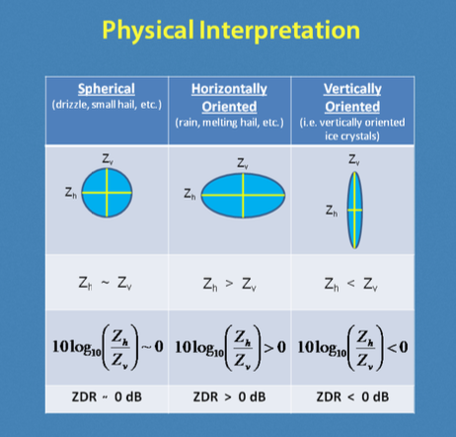
Dual Polarization Enables Science
Legacy fields include:
Reflectivity (Z)
(Radial) Velocity (V)
Dual-polarization upgrade in 2010s added several fields
Most relevant to PBLH estimation:
Differential reflectivity (ZDR)

Slide 19
88D Radar Pedestal and Dome
https://www.facebook.com/NWSHuntsville/

Slide 20
Current NWS 88D Network

